Slide 1
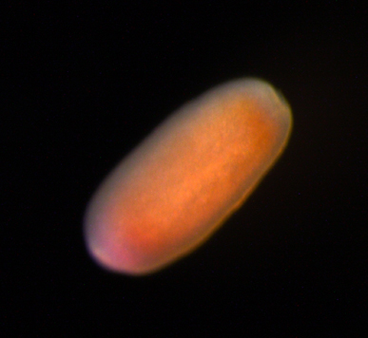
Learning Intention:
recall the life cycle stages of a typical reef-forming hard coral (asexual: fragmentation, polyp detachment; sexual: gametes, zygotes, planulae, polyp/asexual budding)
Success Criteria:
Complete Marine Education worksheet ‘Coral Babies’
A larvae of Acropora tenuis
Notes:
Image: https://www.nibb.ac.jp/en/pressroom/news/2020/10/19.html

Slide 2
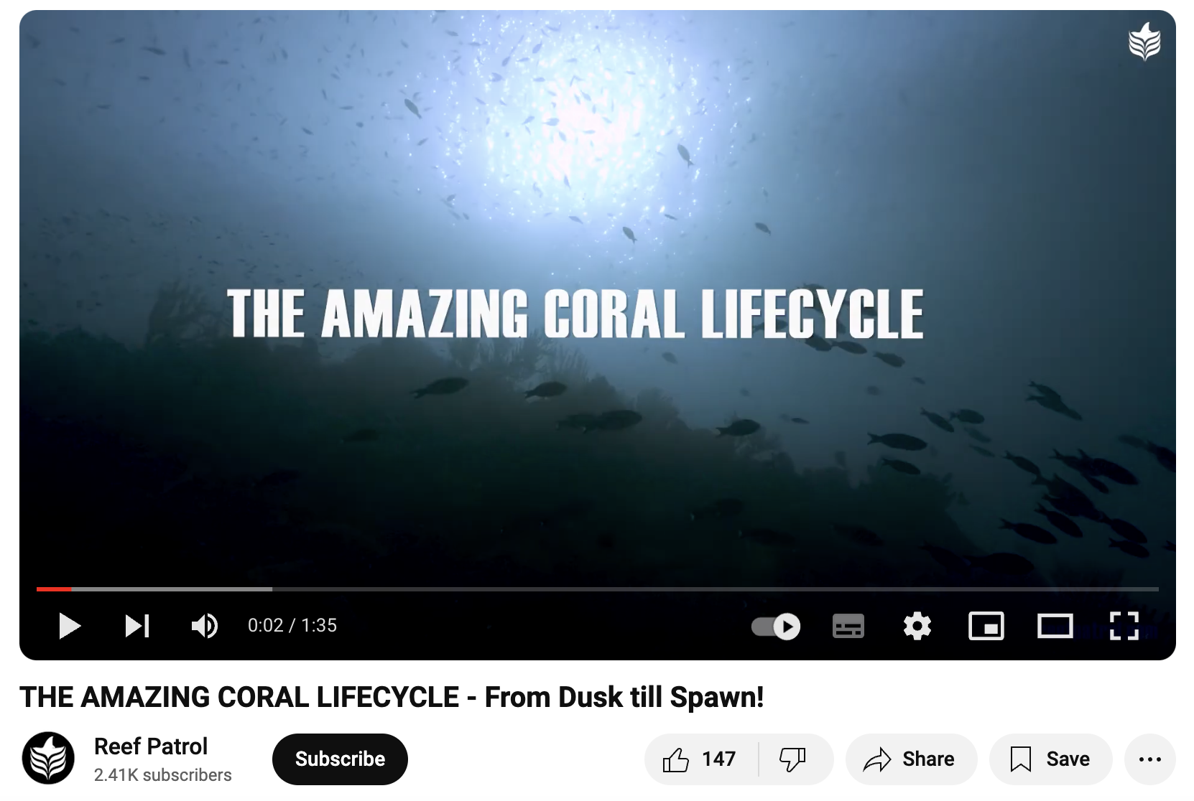
https://www.youtube.com/watch?v=VorXse4HrHs

Slide 3
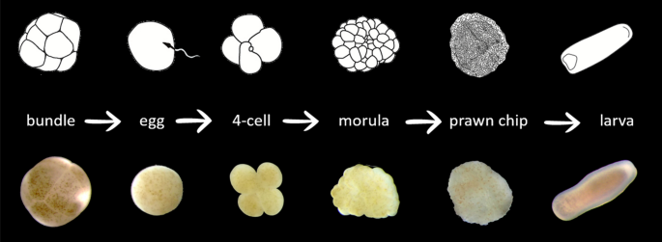
Notes:
Image: https://www.nature.com/articles/s41598-020-69491-0

Slide 4
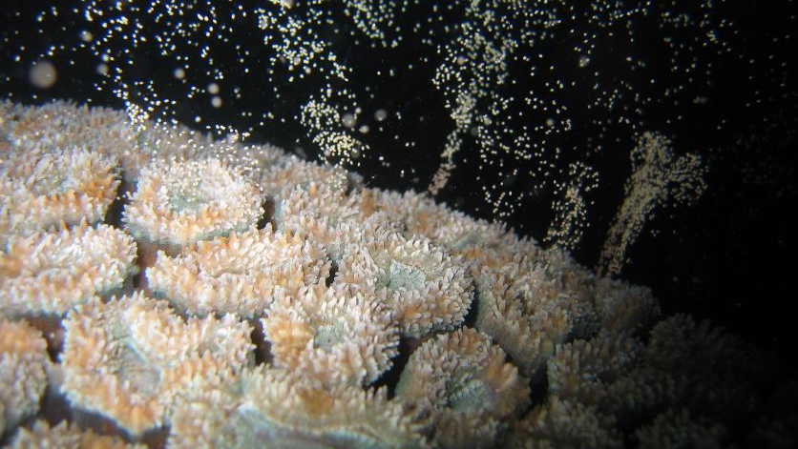
Lobophyllia corymbosa releasing eggs.
Notes:
Image: https://old.xray-mag.com/content/complex-reef-structures-help-coral-larvae-not-stray-far-home

Slide 5
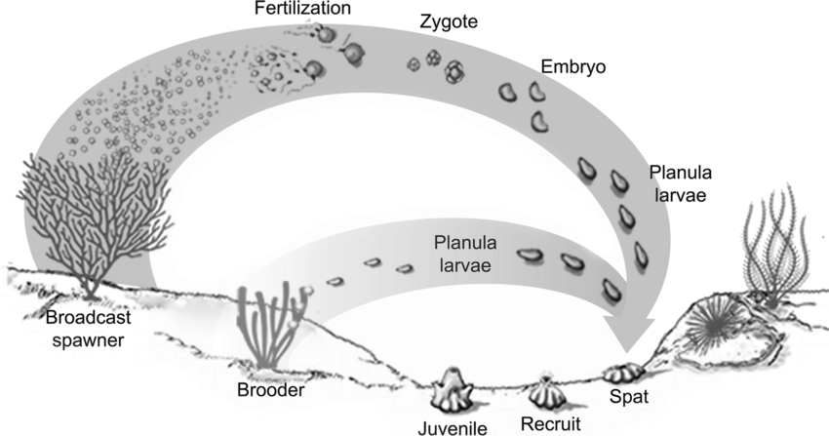
Notes:
Image: Kupfner Johnson, Selena & Hallock, Pamela. (2020). A review of symbiotic gorgonian research in the western Atlantic and Caribbean with recommendations for future work. Coral Reefs. 39. 10.1007/s00338-020-01891-0.
https://www.researchgate.net/figure/Reproductive-cycle-of-brooding-and-broadcast-spawning-gorgonians-original-illustration_fig6_338956275

Slide 6
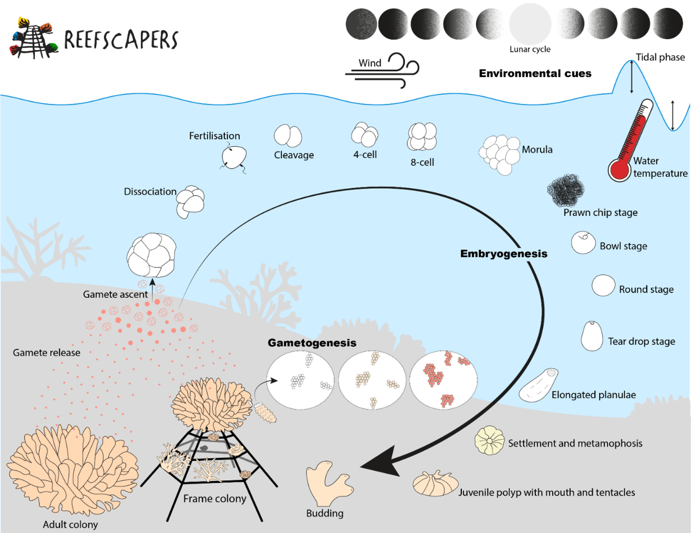
Stages of broadcast spawning
Notes:
Image: Monfared MAA, Sheridan K, Dixon SP, Gledhill M, Le Berre T. 2023. Coral spawning patterns of Acropora across two Maldivian reef ecosystems. PeerJ 11:e16315 https://doi.org/10.7717/peerj.16315
https://reefscapers.com/science/

Slide 7
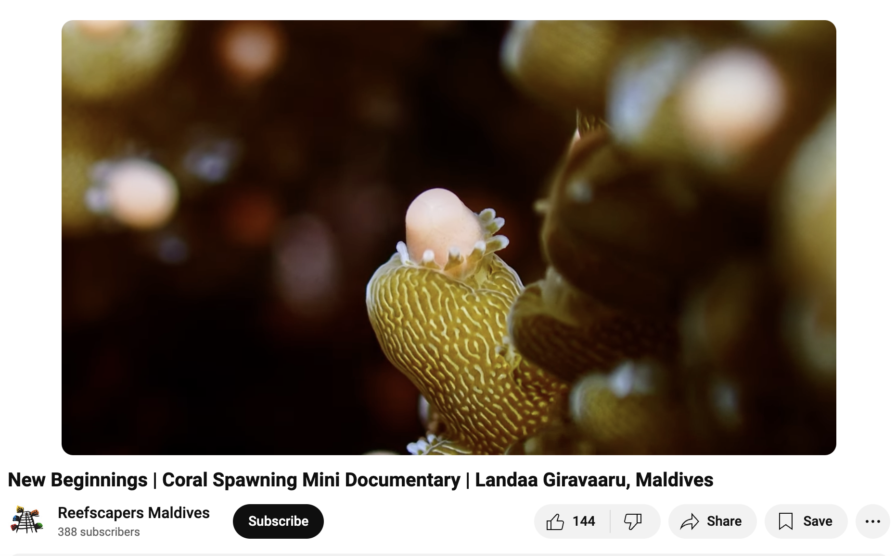
https://www.youtube.com/watch?v=LS1ub_7bTJE&t=1s

Slide 8
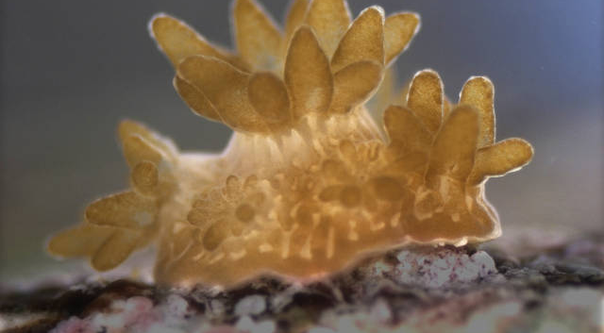
Notes:
Image: https://www.secore.org/site/corals/detail/coral-reproduction.15.html

Slide 9
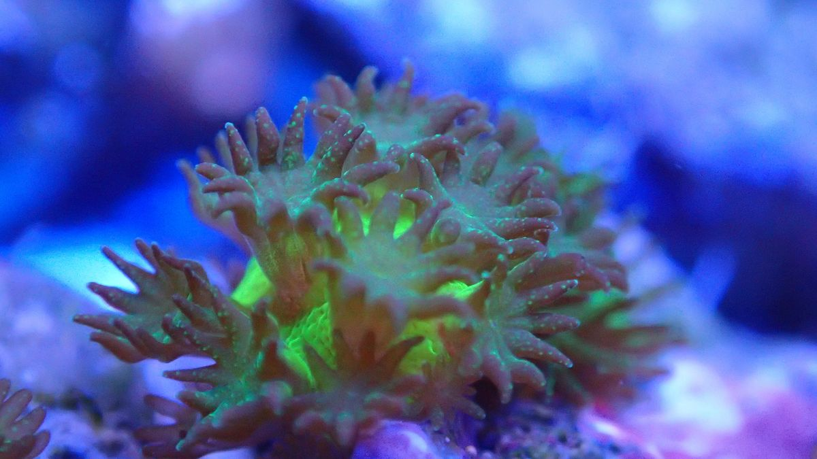
Photo: Samuel Nietzer
Notes:
Image: https://uol.de/en/news/article/scientists-successfully-breed-corals-in-the-lab-4956
Photo: Samuel Nietzer

Slide 10
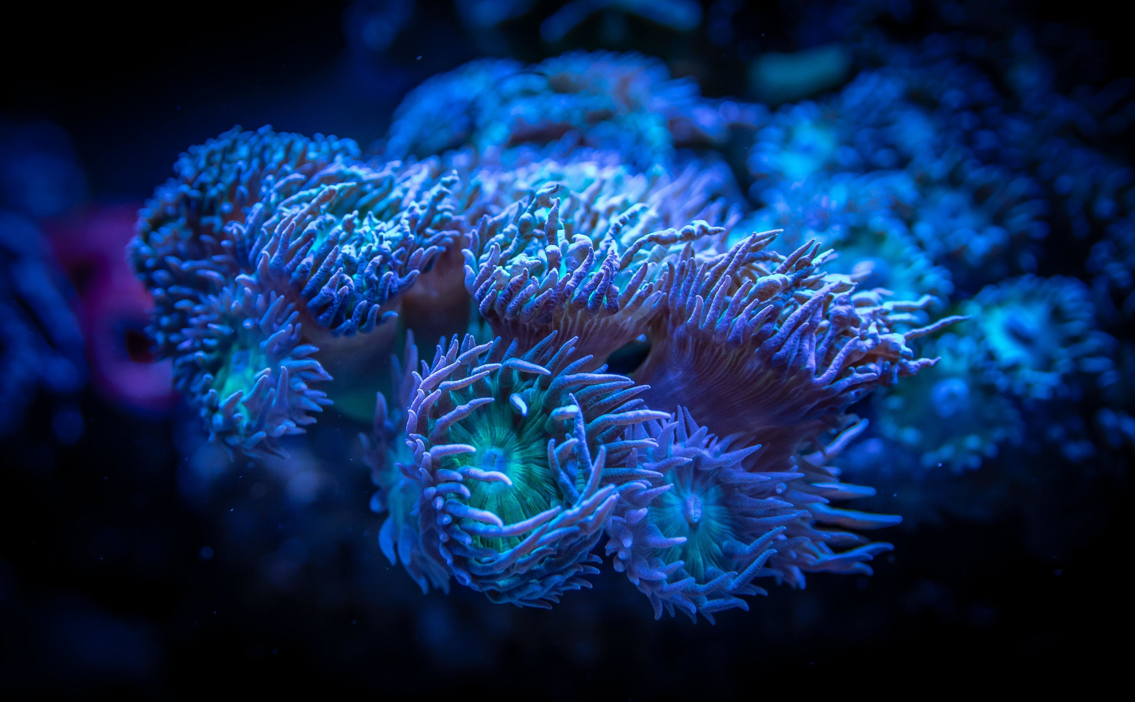
Image: Pexels/Egor Kamelev
Notes:
Image: https://www.weforum.org/agenda/2023/10/12-billion-fund-coral-reef-protection/

Slide 11
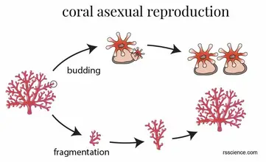
Notes:
Image: https://rsscience.com/coral/

Slide 12
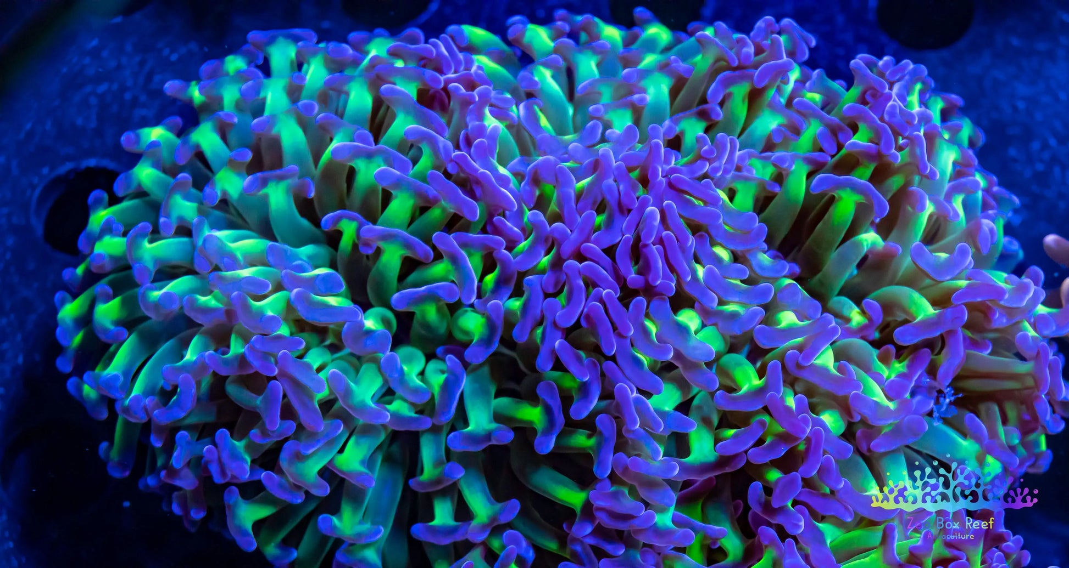
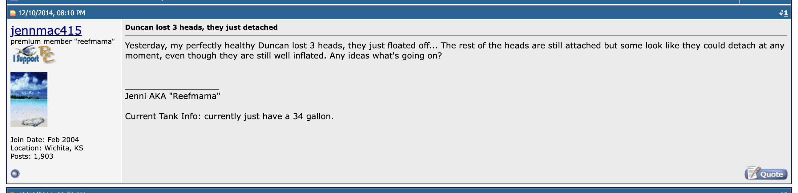

Slide 13
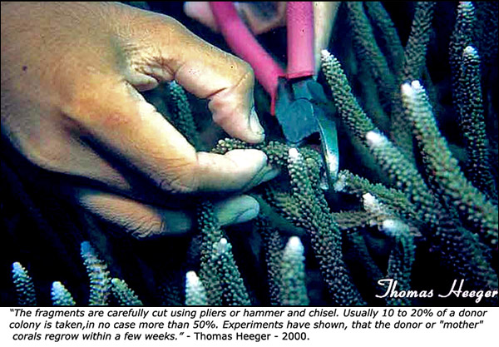
Fragmentation
“Fragging”

Slide 14
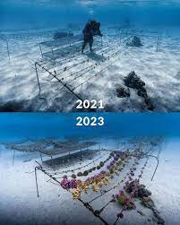
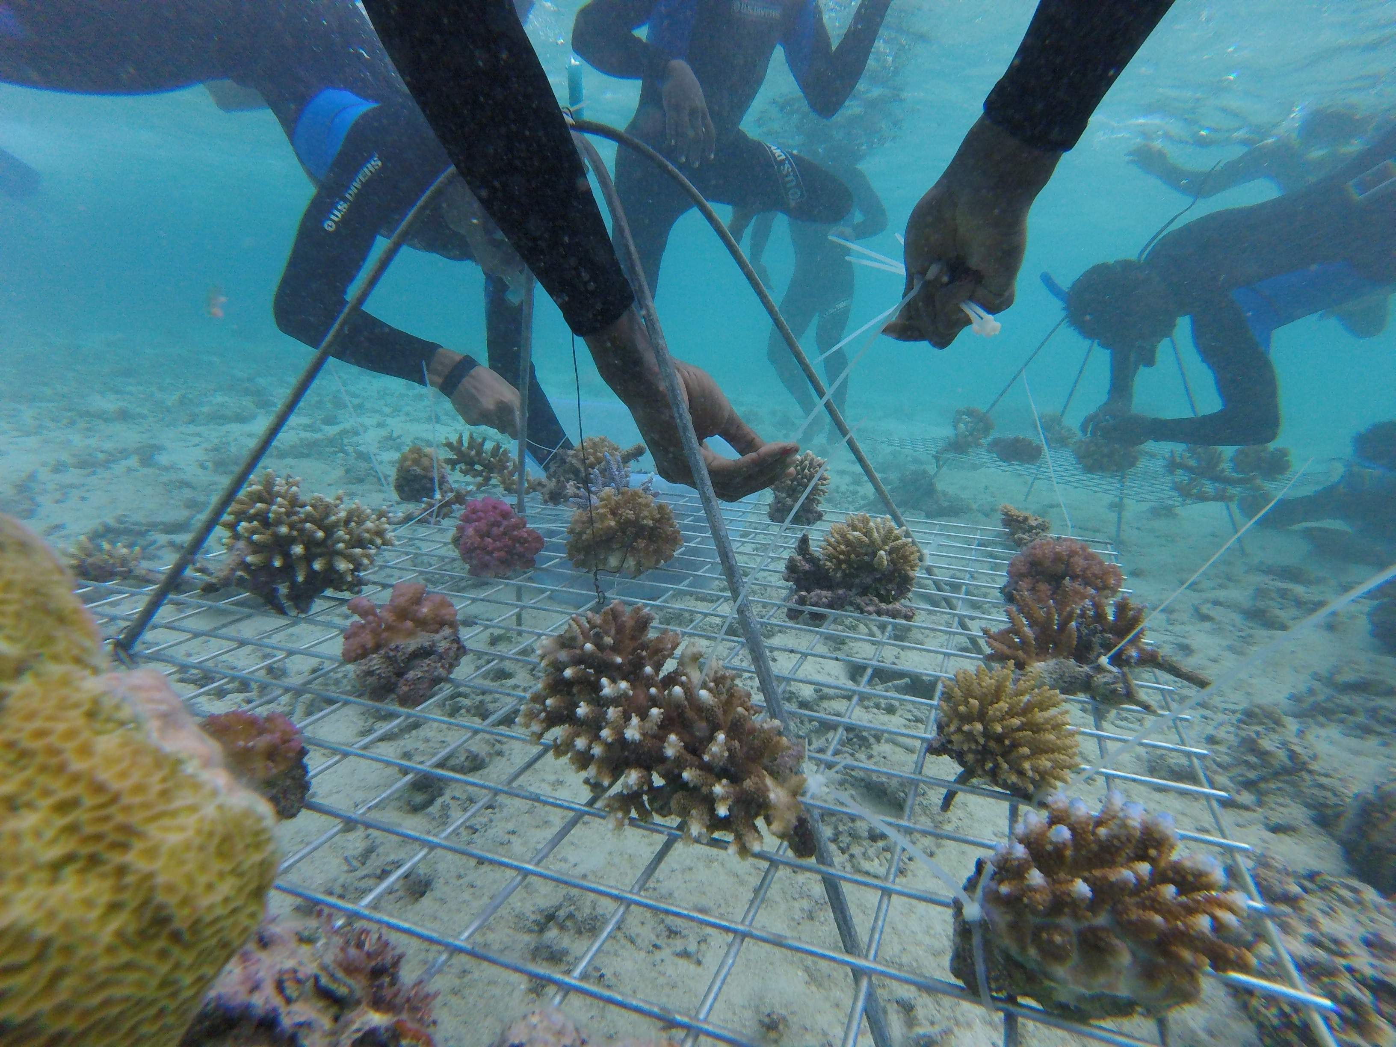
Notes:
Image (left): https://www.instagram.com/coralgardeners/p/CpBuYbQP3B6/

Slide 15
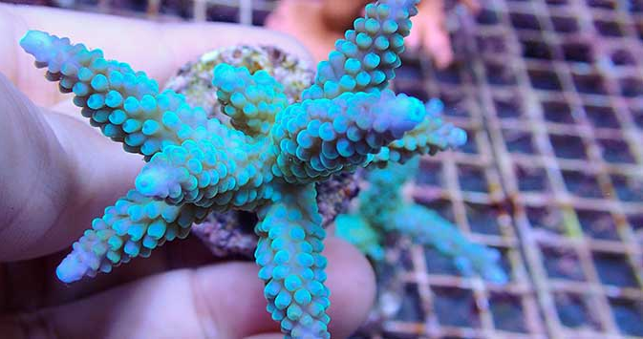
Notes:
Image: https://www.tfhmagazine.com/articles/saltwater/fragging-smallpolyped-stony-corals

Slide 16
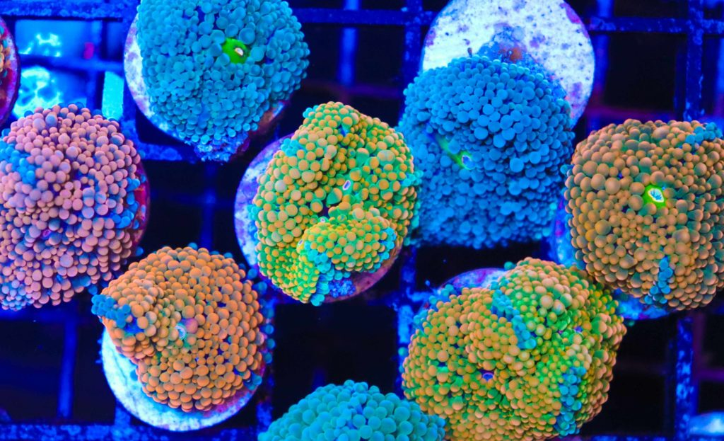
Notes:
Image: https://fragbox.ca/blog/

Slide 17
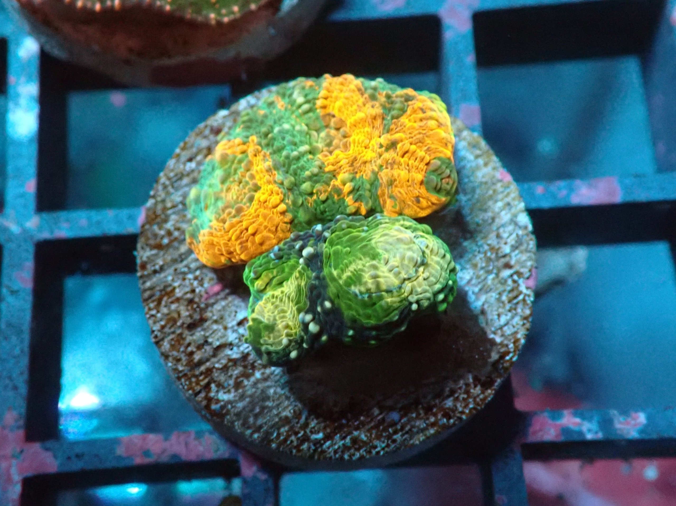
Aragocrete
artificial substrate made of concrete and aragonite sand
“cement cookies”
Notes:
Image: https://www.blackfishmarine.co.uk/tank-set-up/reef-tank-lighting-best-practices-for-coral-health-and-growth/

Slide 18
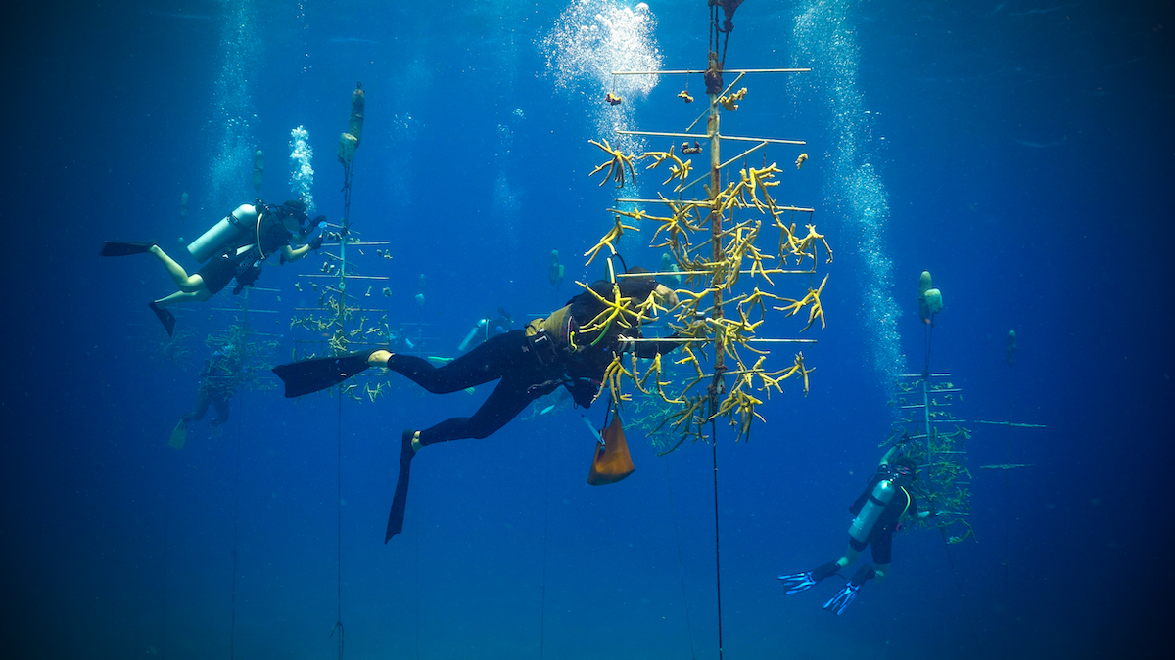
Notes:
Image: https://anthonyskey.com/coral-garden/
The Roatan Institute for Marine Sciences, in collaboration with Anthony’s Key Resort, is dedicated to preserving the precious genetic diversity of staghorn and elkhorn corals on Roatan Island. Through this coral nursery and reef restoration program, the institute and resort work tirelessly to rejuvenate the island’s shallow reefs.

Slide 19
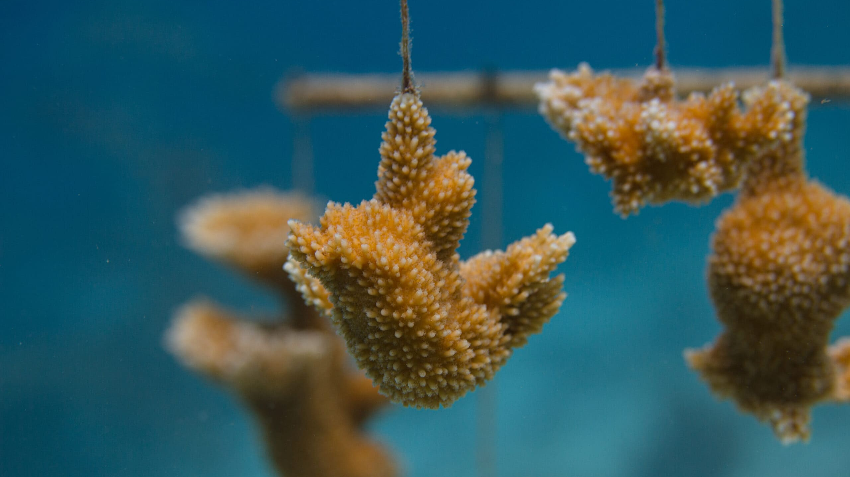
Notes:
Image: https://www.algaebarn.com/blog/beginners/conservation-week-frags/

Slide 20
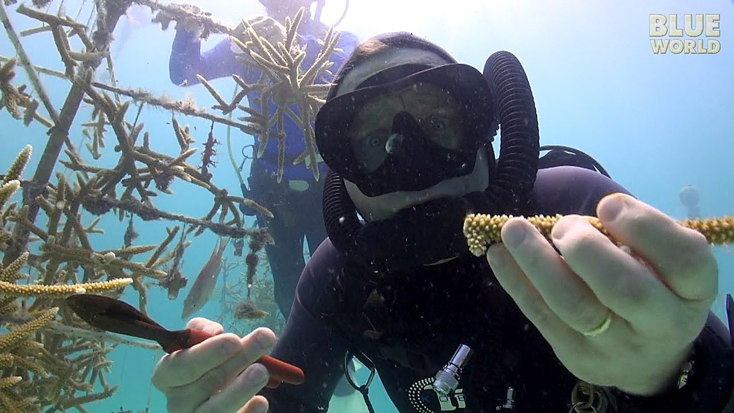
Second generation fragging (for outplanting)
Notes:
Image: https://www.voicetube.com/videos/23322

Slide 21
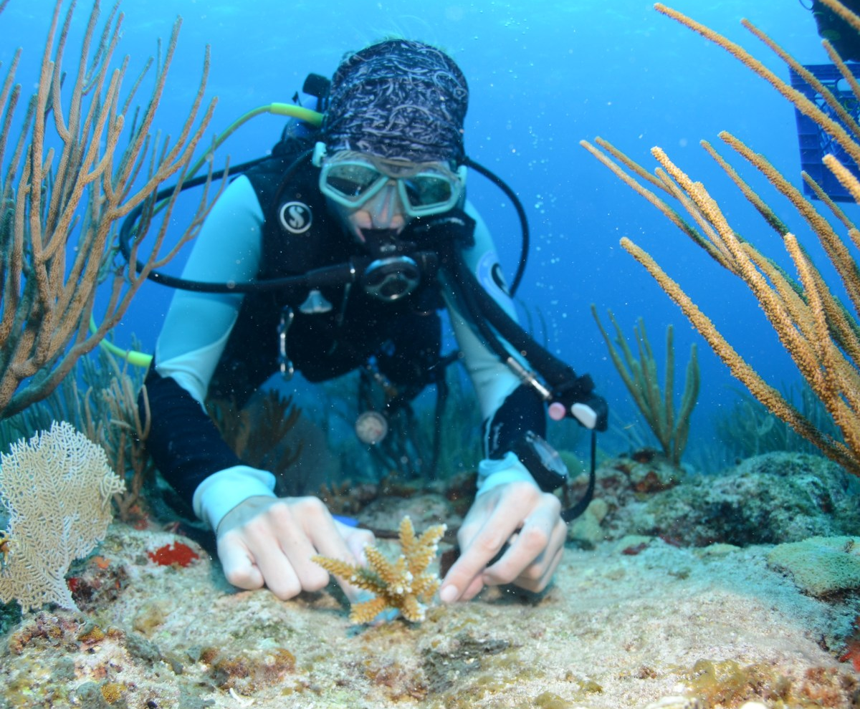
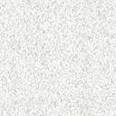
Reef Restoration
Notes:
Image: https://naturefoundationsxm.org/2020/08/26/nature-foundations-outplants-new-coral-colonies-in-the-marine-park-as-part-of-the-coral-restoration-project/

Slide 22
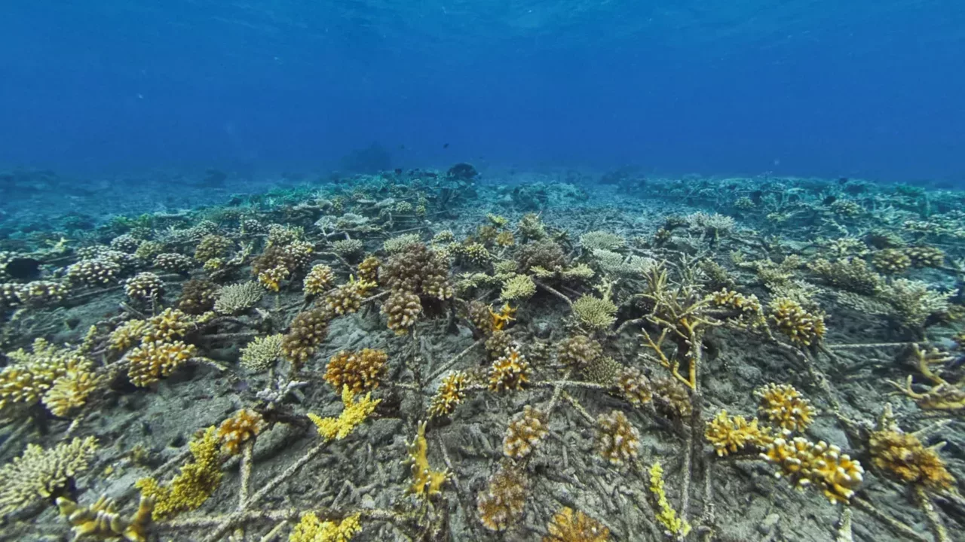
15 months of growth (Indonesia)
Notes:
Image: https://icriforum.org/sheba-announce-hope-reef/
Underwater ‘after’ shot of SHEBA Hope Reef, when coral is at 15 months growth and 45% cover, Salisi’ Besar, Indonesia; October 2020

Slide 23
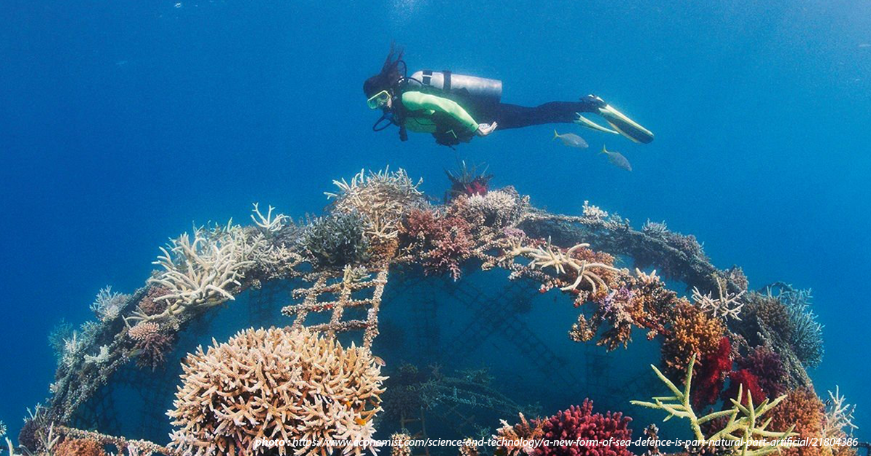
Notes:
Image; https://aisat.edu.ph/altitude_articles/a-hope-for-the-reefs-coral-reef-restoration-projects-in-sea/

Slide 24
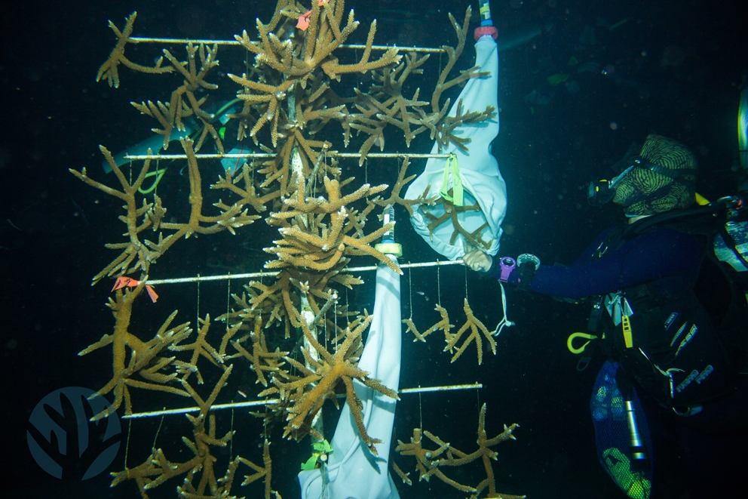
Nurseries spawn!

Slide 25
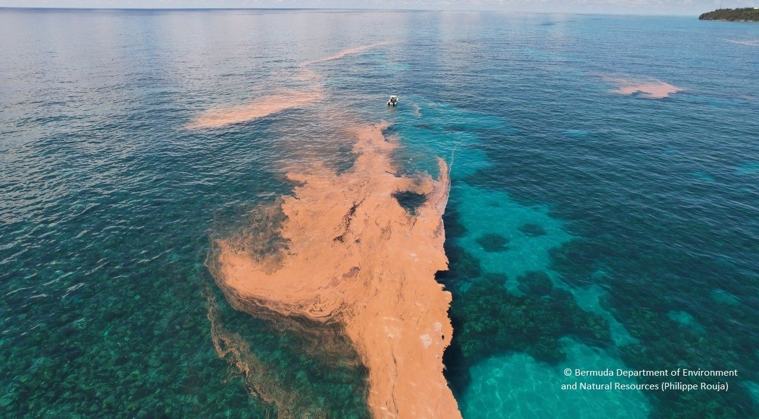
Notes:
Image; https://environment.bm/news-hot-topics//august-coral-spawning

Slide 26
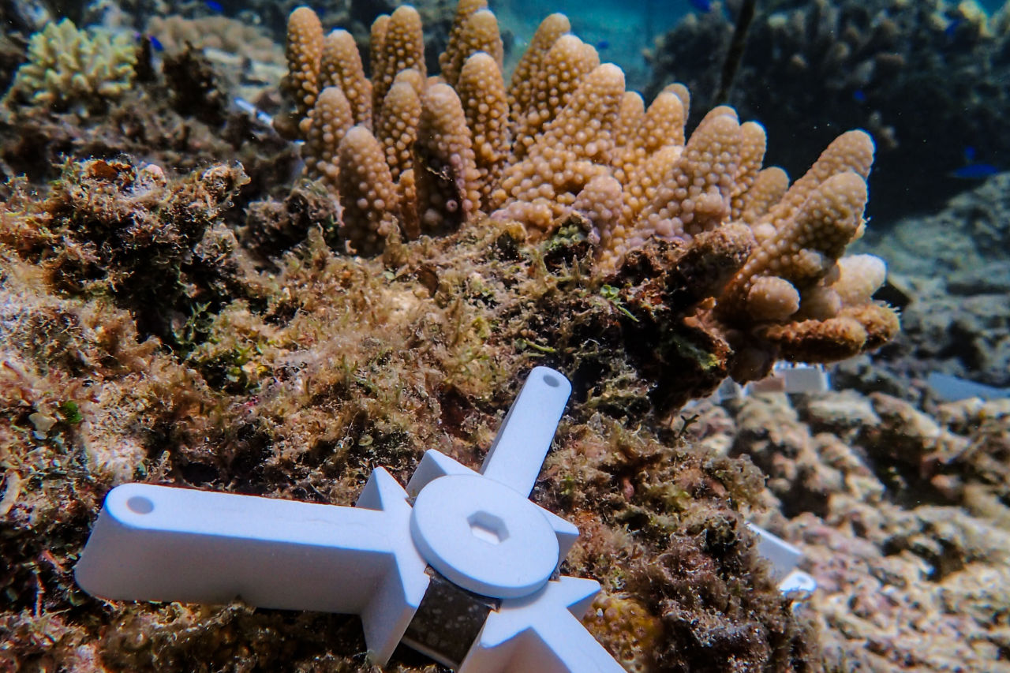
Coral settlement panels

Slide 27
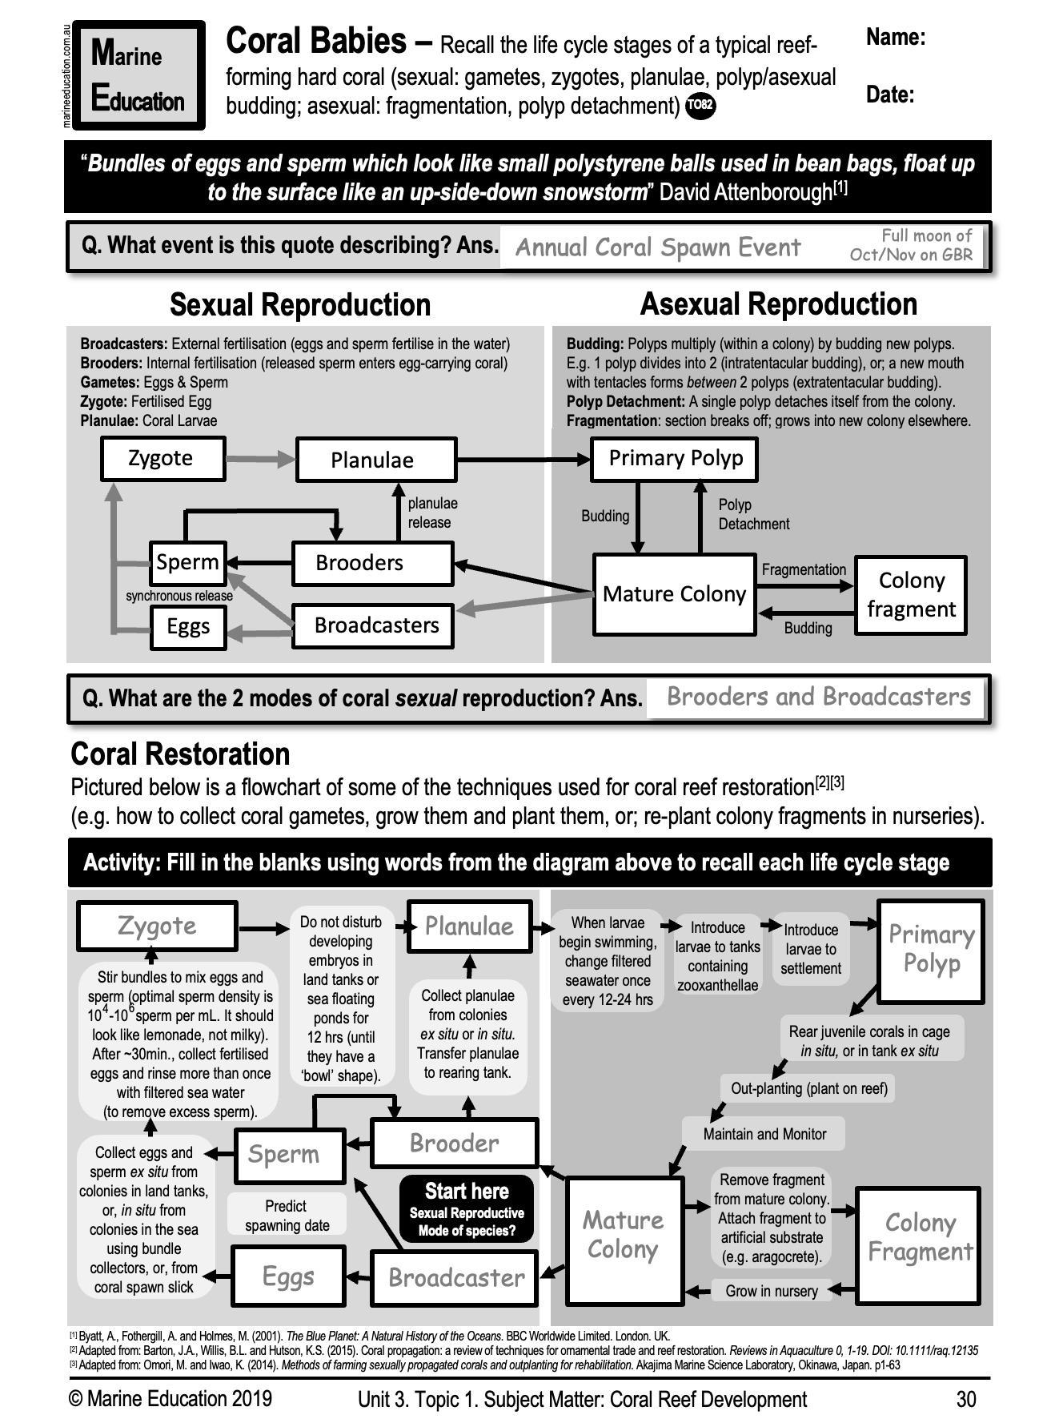
Learning Intention:
recall the life cycle stages of a typical reef-forming hard coral (asexual: fragmentation, polyp detachment; sexual: gametes, zygotes, planulae, polyp/asexual budding)
Success Criteria:
Complete Marine Education worksheet ‘Coral Babies’
Notes:
Image: https://www.nibb.ac.jp/en/pressroom/news/2020/10/19.html

