Slide 1
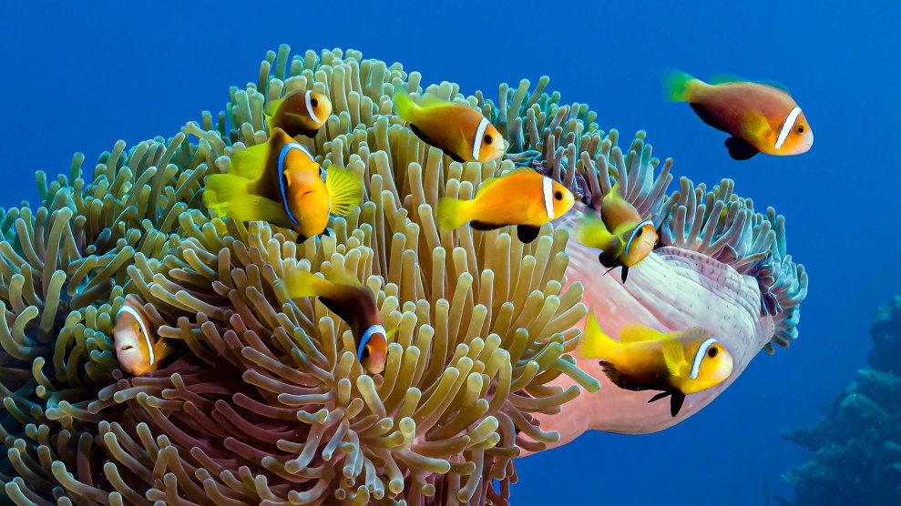
Learning Intention:
Describe the three main types of diversity, i.e. genetic, species and ecosystem.
Success Criteria:
Complete Marine Education worksheet ‘1. Life’s Diversity’

Slide 2
Genetic diversity

Slide 3

Genetic diversity is the diversity of genes in one species.
The greater the diversity, the greater chance of adapting to change and avoiding extinction.

Slide 4
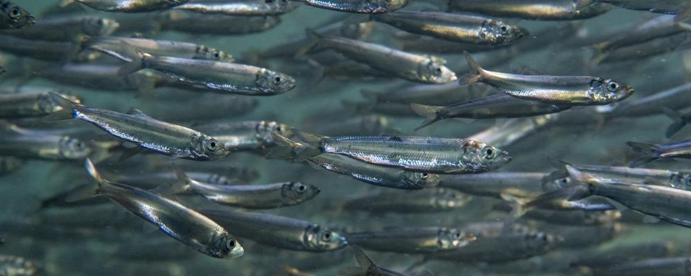
For example….
Low genetic diversity (all the same)

Slide 5
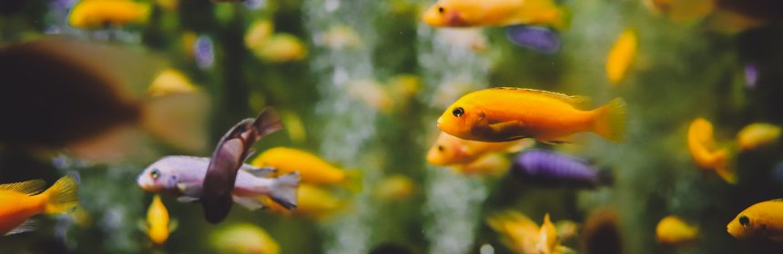
High genetic diversity (all different – but still the same species)

Slide 6
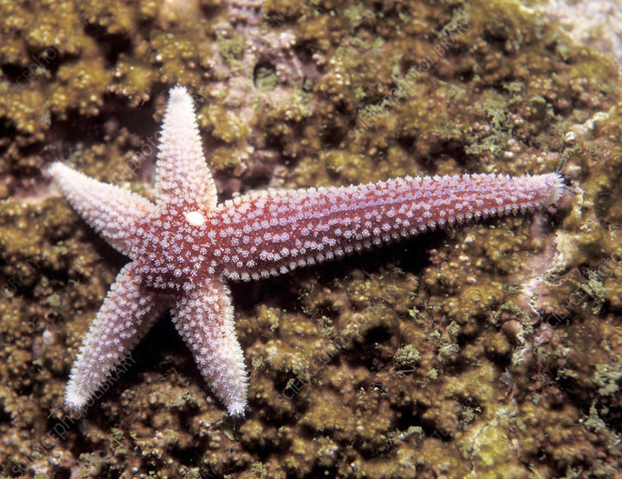
For example:
Asexual reproduction = identical offspring
(all the same)
LOW genetic diversity

Slide 7
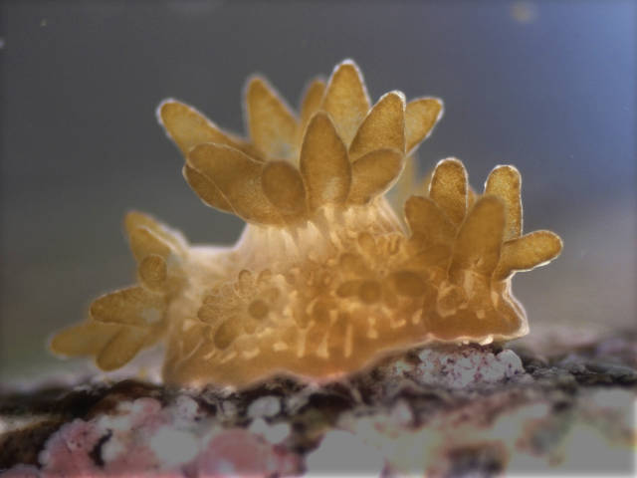
e.g. budding

Slide 8
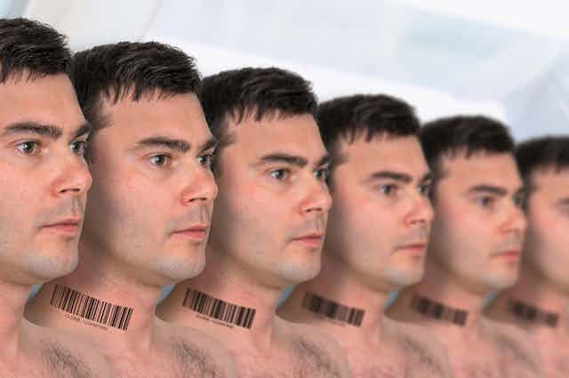
e.g. cloning
Notes:
Image: https://theconversation.com/could-villains-clone-themselves-to-take-over-the-world-101881

Slide 9
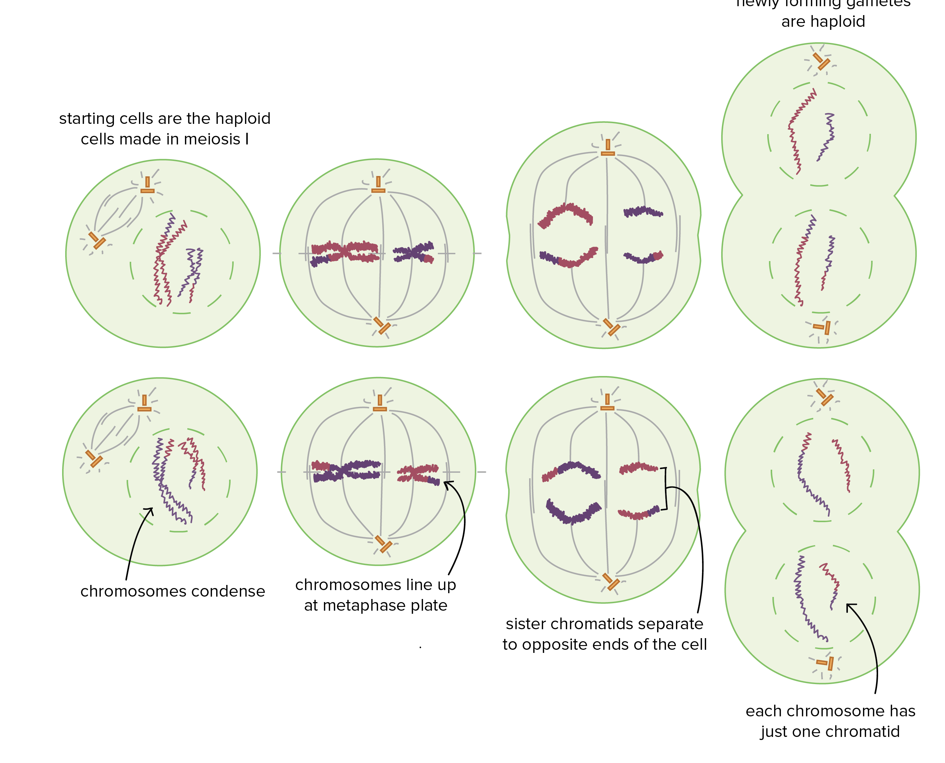
vs. sexual reproduction
(all different)
HIGH genetic diversity
Meiosis: the making of eggs and sperm
Notes:
Image: https://www.darebin.vic.gov.au/Community-and-pets/Multicultural-services-and-diversity

Slide 10
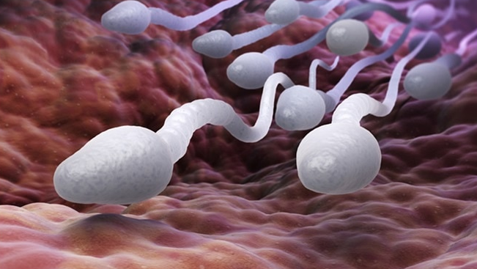
Each sperm has a different set of genes
Notes:
Image: https://www.news-medical.net/health/Do-Stress-and-Anxiety-Affect-Sperm-Quality.aspx

Slide 11
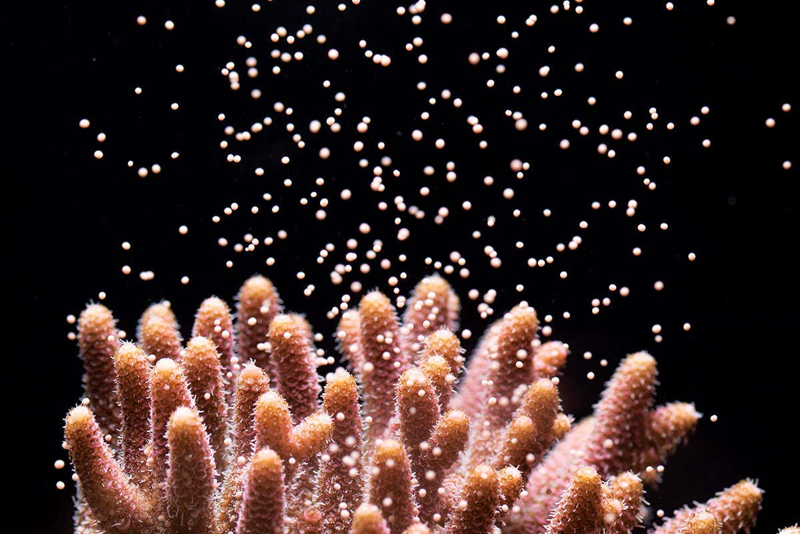
e.g. coral spawning of eggs and sperm
Notes:
Image; https://www.newscientist.com/article/2077033-playing-cupid-to-get-reluctant-corals-in-the-mood-for-love/

Slide 12
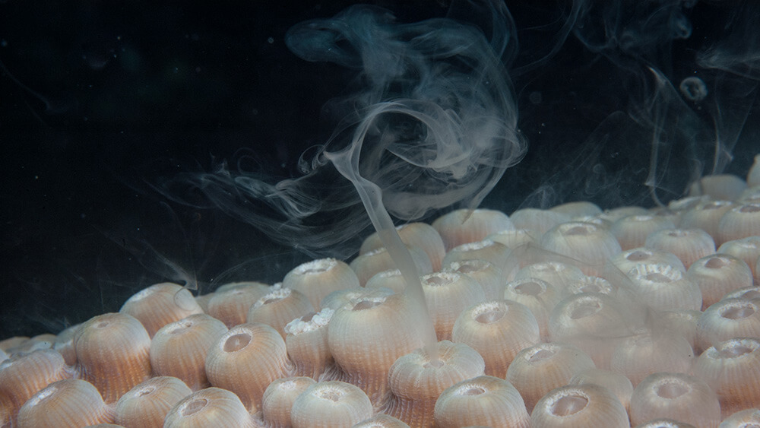
Notes:
Image: https://sanctuaries.noaa.gov/news/may22/explore-spectacular/coral-spawning.html

Slide 13

HIGH genetic diversity
(all different – but still the same species)

Slide 14
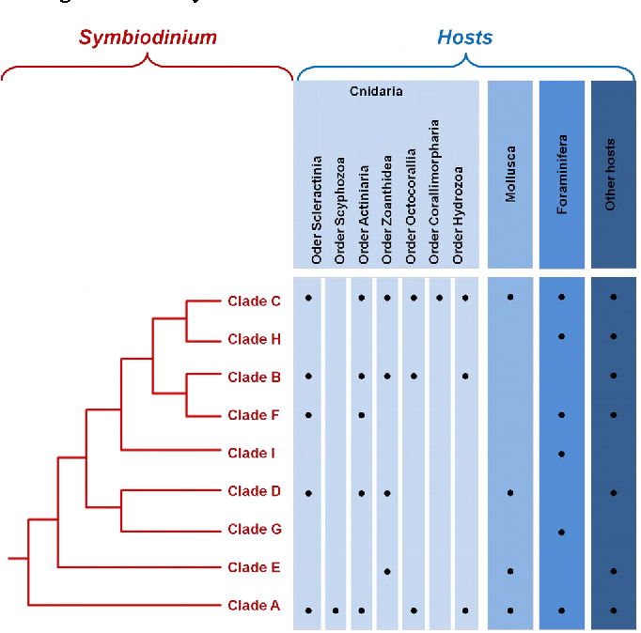
zooxanthellae
e.g. zooxanthellae exist as many different genetic clades
Notes:
Image: https://www.semanticscholar.org/paper/The-story-of-symbiosis-with-zooxanthellae-%2C-or-how-Fournier/75f7f63a1dc6b0f1e42a0d149d6eb237ed8b564a

Slide 15
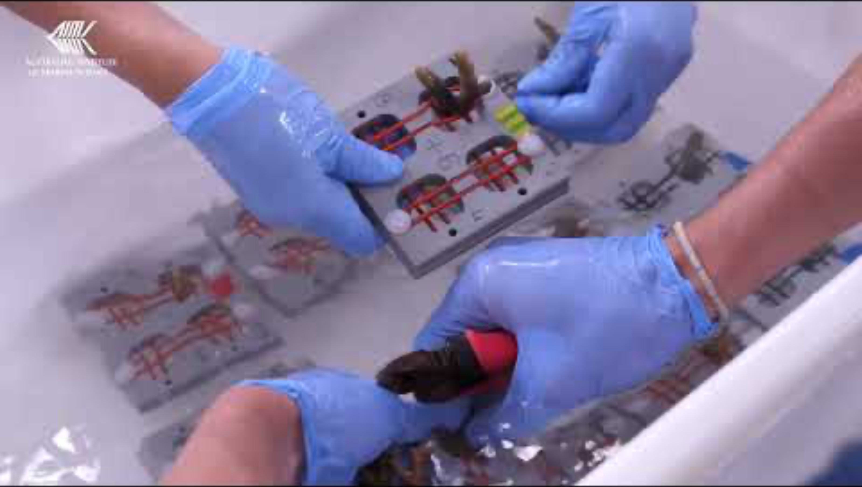
https://www.youtube.com/watch?v=uFCojXVAKyw
Notes:
Youtube video title: The genes of heat tolerant corals on the Great Barrier Reef (AIMS)

Slide 16
Species diversity

Slide 17
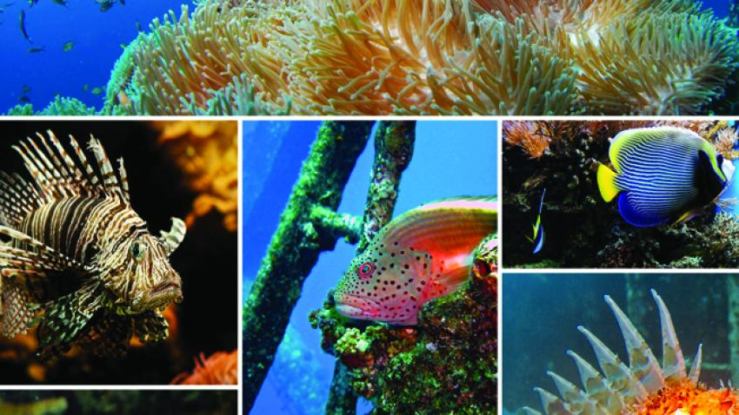
Species diversity is the diversity of species in a given location
The greater the diversity, the healthier and more resilient the ecosystem.

Slide 18
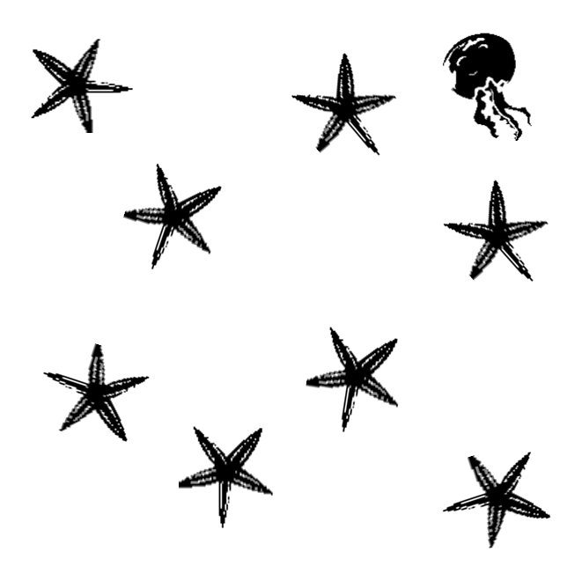
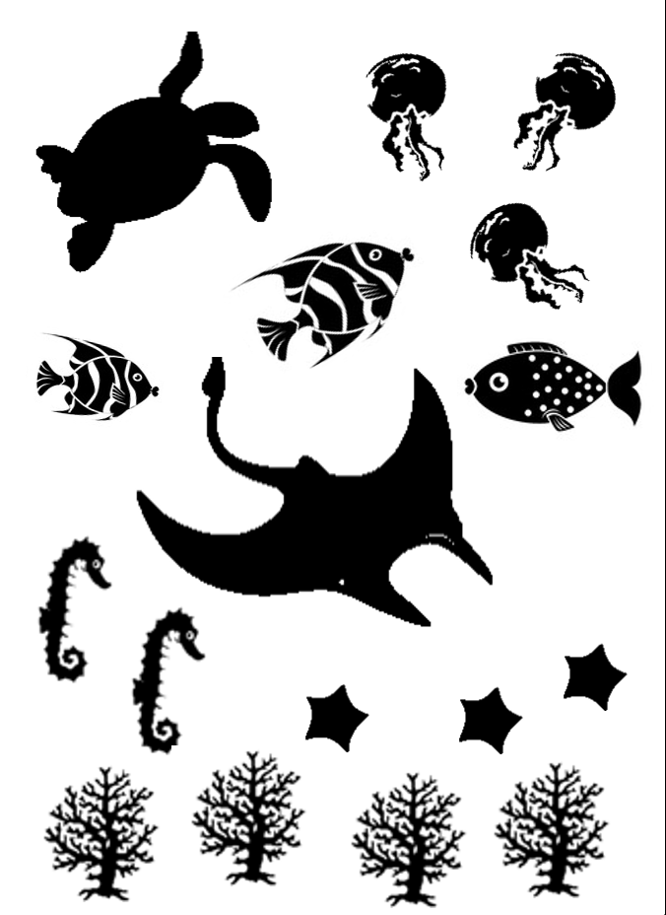
For example….
Low species diversity
(all the same species)
HIGH species diversity
(all different species)

Slide 19
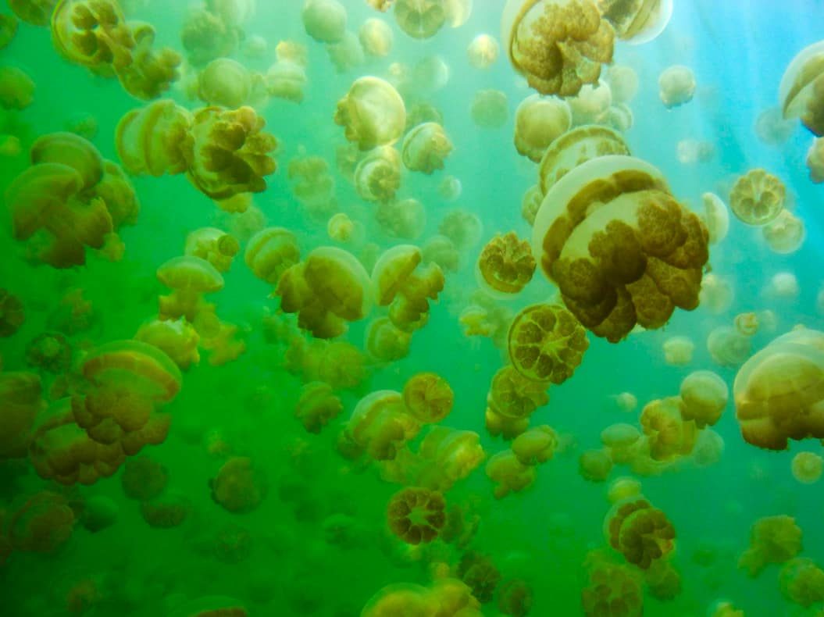
LOW species diversity
(all the same species)
Notes:
Image: https://www.nomadicmatt.com/travel-blogs/unusual-place-of-the-month-jellyfish-lake/

Slide 20
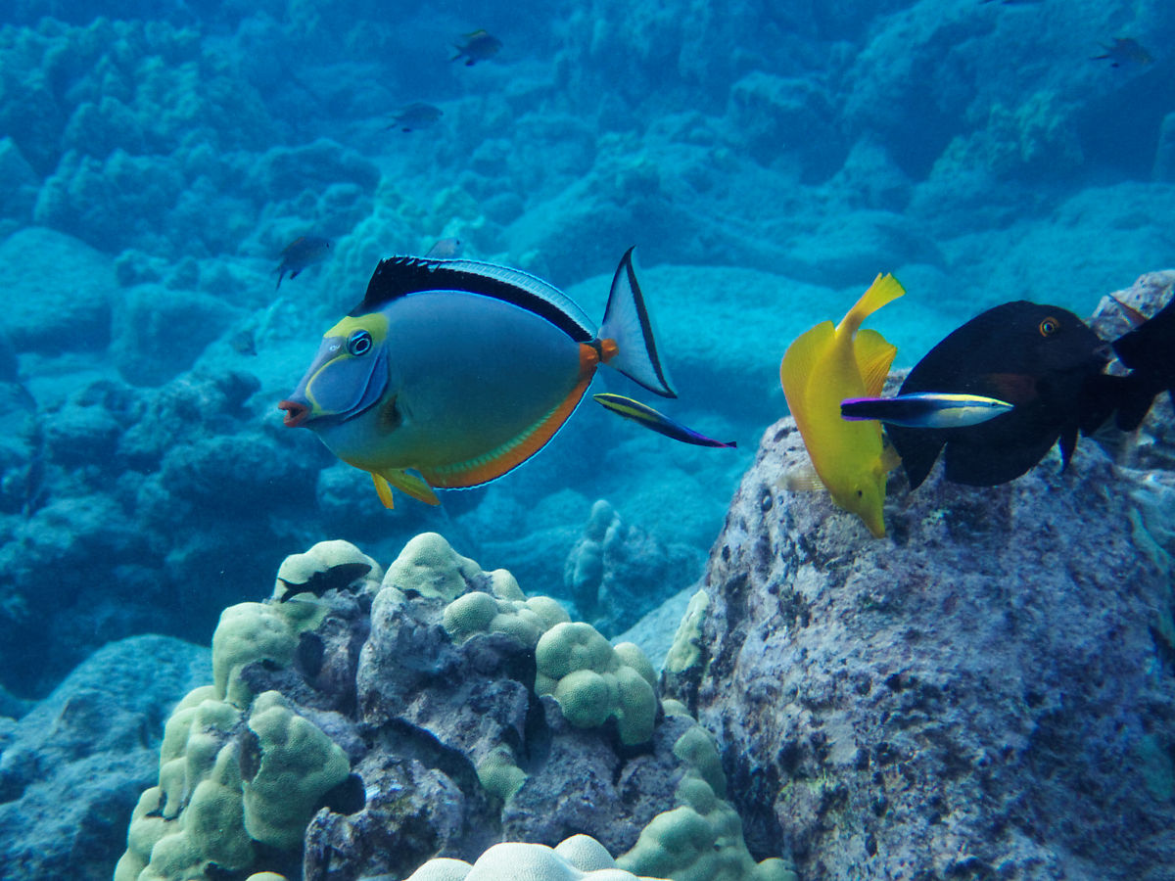
HIGH species diversity
(all different species)

Slide 21
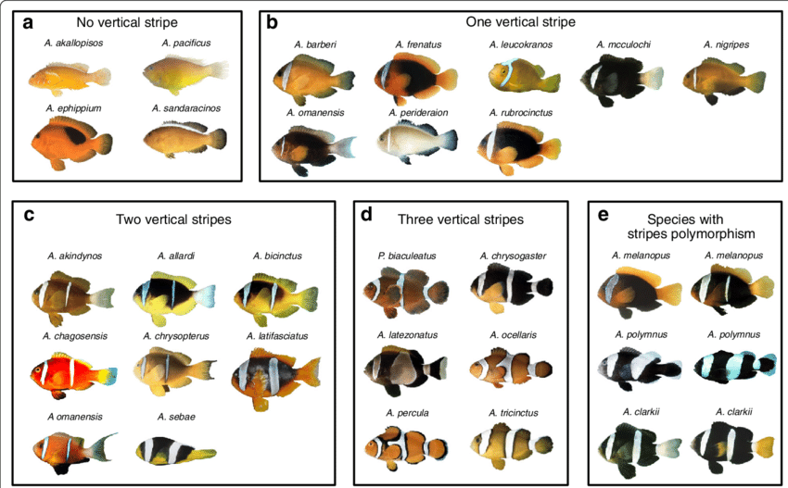
HIGH species diversity
(all different species)

Slide 22
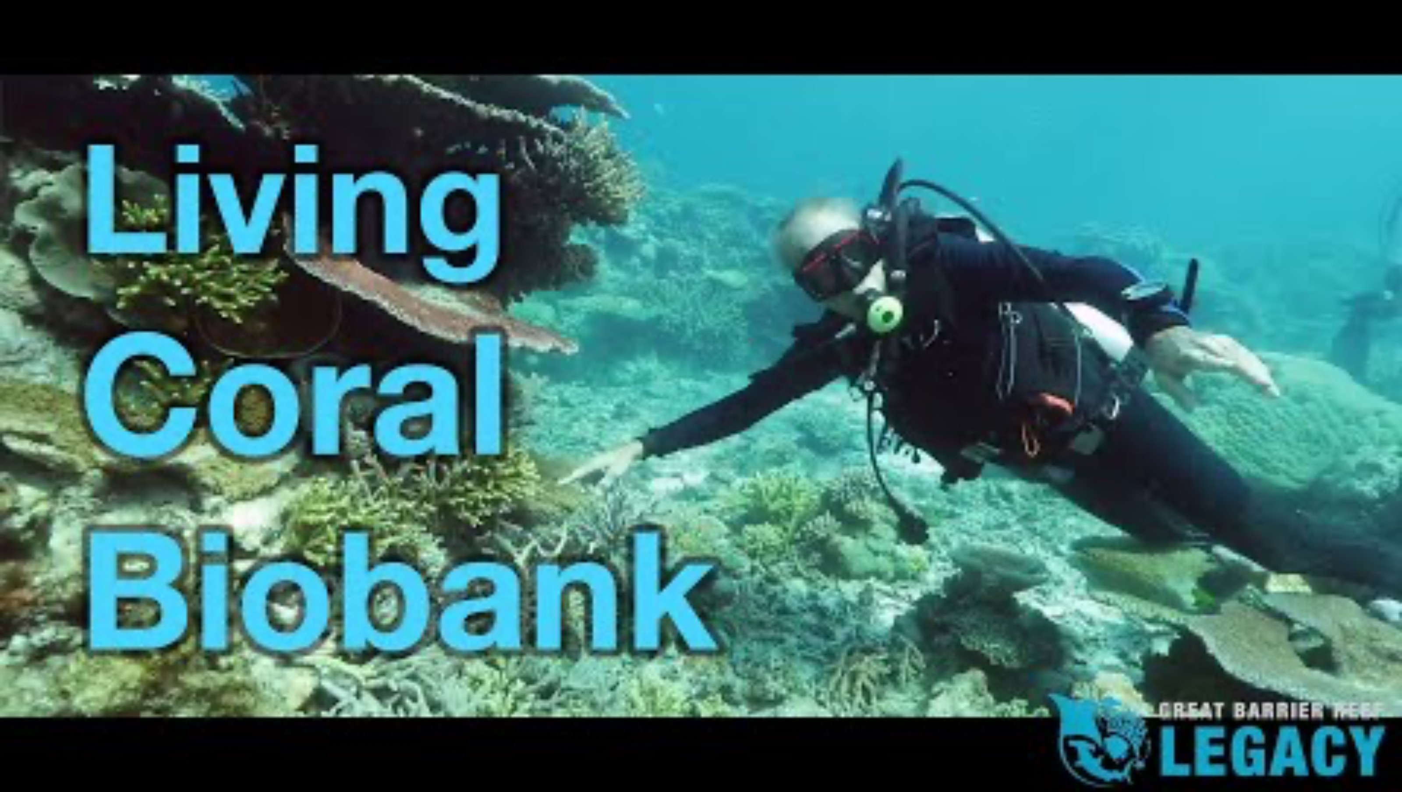
https://www.youtube.com/watch?v=MXsKEs19Jzs
Notes:
Image: https://www.youtube.com/watch?v=MXsKEs19Jzs Living Coral Biobank

Slide 23
Ecosystem diversity

Slide 24
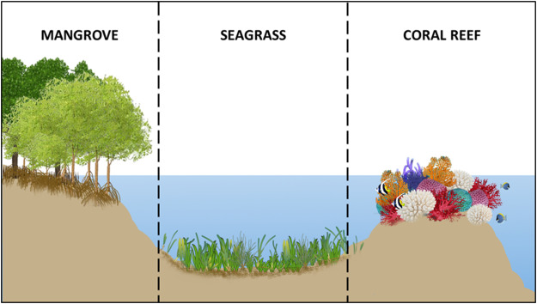
Ecosystem diversity is the diversity of ecosystems.
The greater the diversity, the more habitat diversity for more species to occupy.

Slide 25

For example….
Low ecosystem diversity (all the same ecosystem)

Slide 26
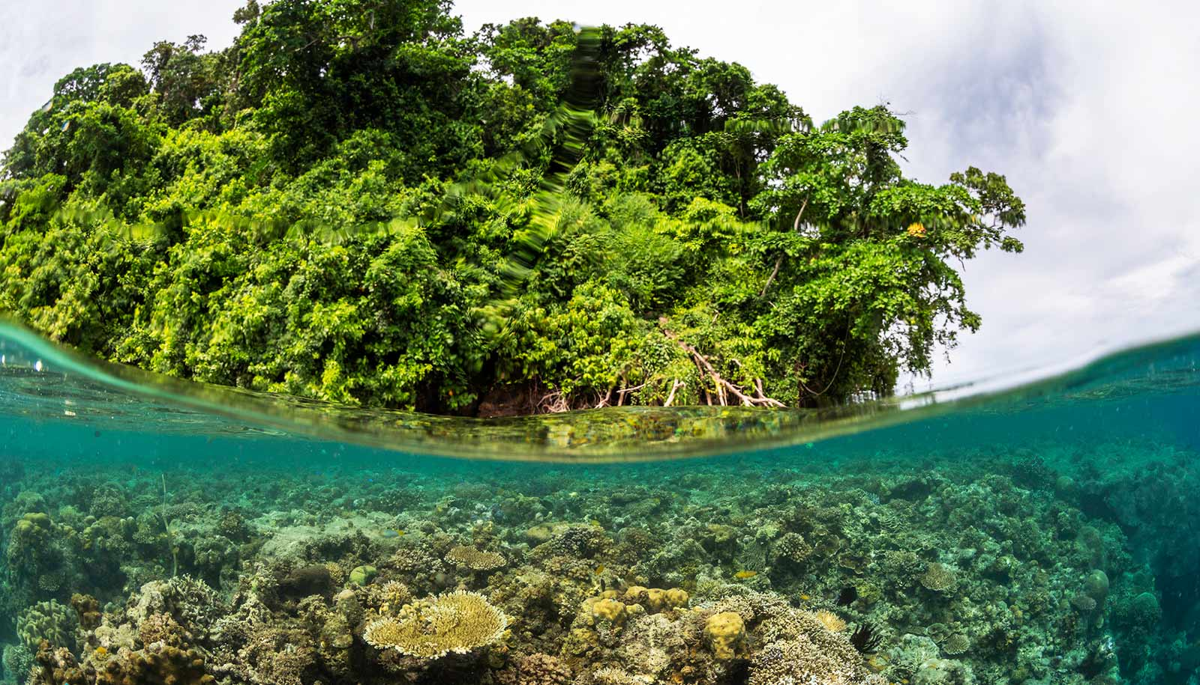
HIGH ecosystem diversity (all different ecosystems)
Notes:
Image: https://www.futurity.org/coral-reefs-mangroves-ecosystems-2569332-2/

Slide 27
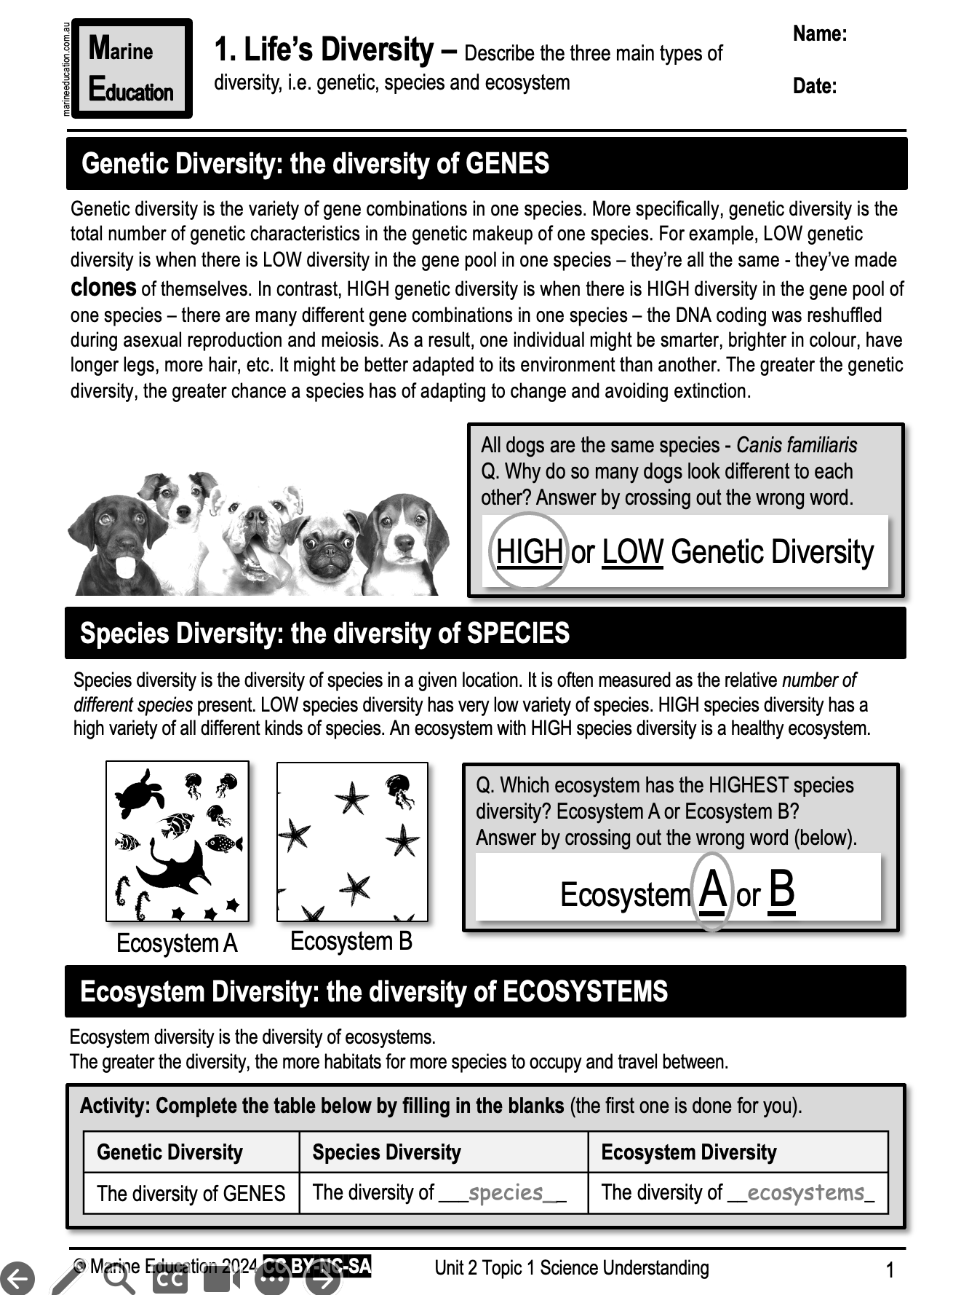
Learning Intention:
Describe the three main types of diversity, i.e. genetic, species and ecosystem.
Success Criteria:
Complete Marine Education worksheet ‘1. Life’s Diversity’

