Slide 1
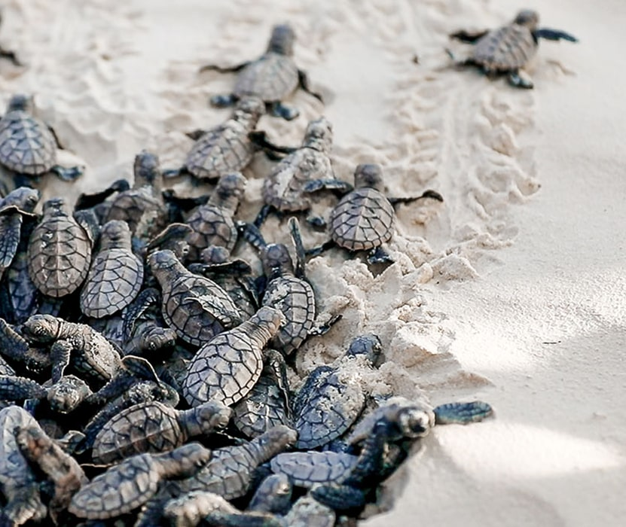
Learning Intention:
Classify the arguments for preserving species and habitats as ecological, economic, social, aesthetic or ethical.
Success Criteria:
Complete Marine Education worksheet ‘1. Nature’s capital’
Notes:
Image: https://www.crownandchamparesorts.com/magazine/press-sea-turtle-hatching-at-kagi-maldives/

Slide 2
The most valuable thing we extract from the ocean is our existence
Sylvia Earle

Slide 3
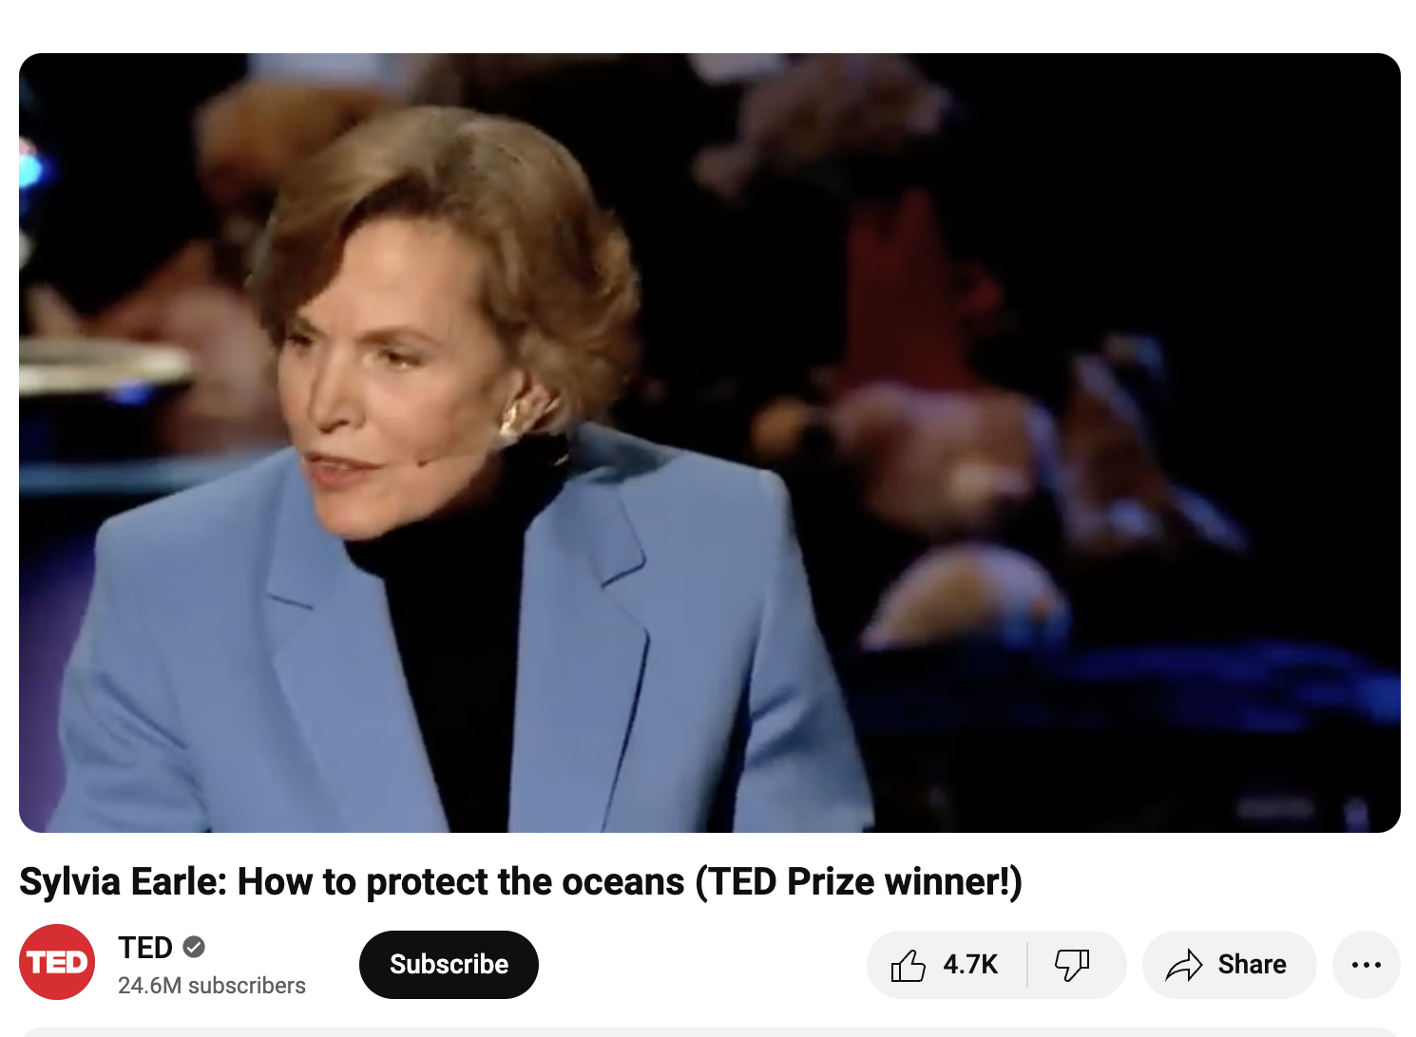
https://www.youtube.com/watch?v=43DuLcBFxoY

Slide 4
The most valuable thing we extract from the ocean is our existence
Sylvia Earle
What does Sylvia Earle mean by this quote?

Slide 5

Ecosystem services
Benefiting by default
We are not always conscious of the links between our surrounding environment and our well-being, and thus we may not always take the true value of ecosystems into account in our decision-making processes (EPA, 2024).
Notes:
EPA Quote: https://www.epa.gov/enviroatlas/ecosystem-services-enviroatlas-1

Slide 6
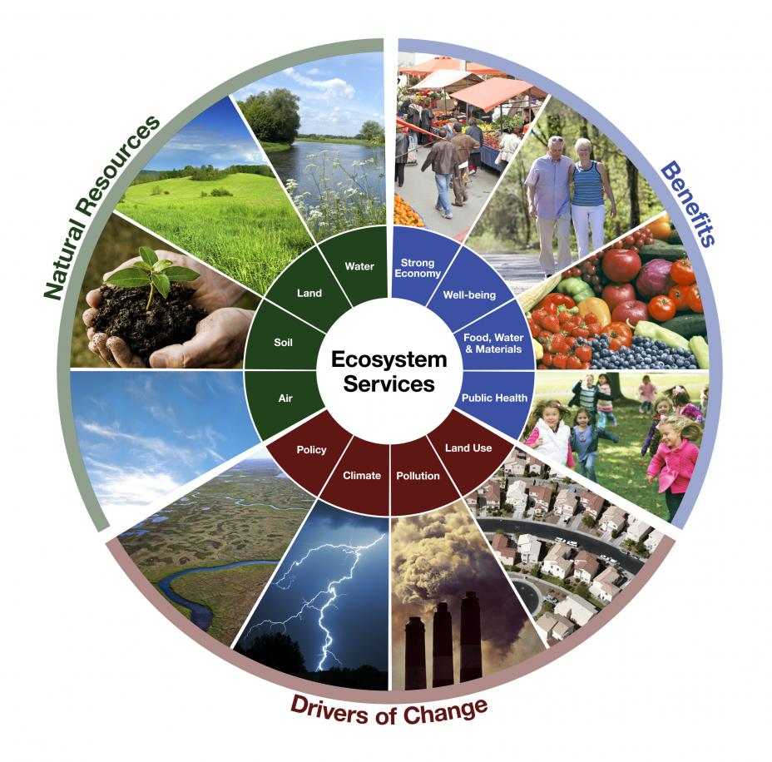
Ecosystem services
Benefiting by default
Notes:
Image: https://www.epa.gov/sites/default/files/2015-04/new_ecowheel.jpg

Slide 7
Why protect nature?

Slide 8
Why protect nature?
Ecological reasons
Economic reasons ($$$$$)
social reasons
Aesthetic reasons
Ethical reasons

Slide 9
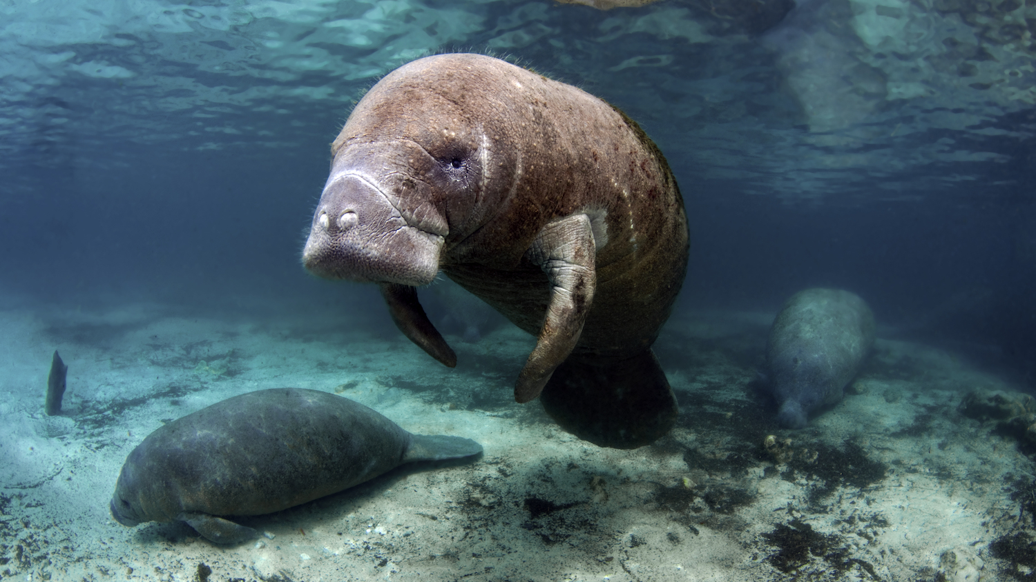
Some seagrass seeds must pass through a dugong or manatee’s digestive system to germinate.
Seagrass meadows are nurseries for commercially important species.
Notes:
Image: https://blog.padi.com/best-marine-life-encounters-around-the-world/

Slide 10
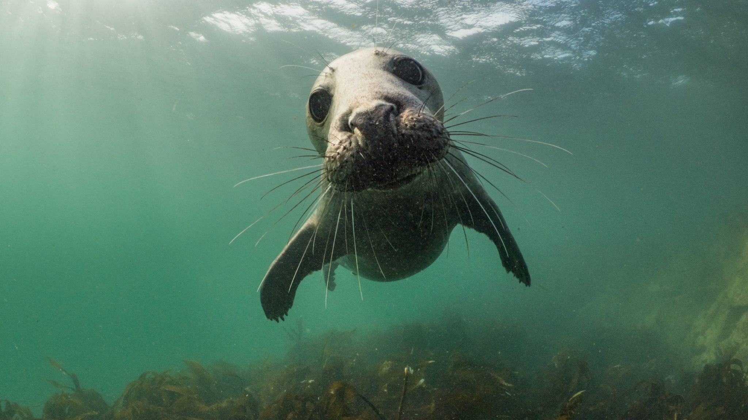
Kelp forests – a keystone habitat - need nutrients to grow.
Seals return nutrients to shallow waters when they poop.
Notes:
Image: https://blog.padi.com/best-marine-life-encounters-around-the-world/

Slide 11
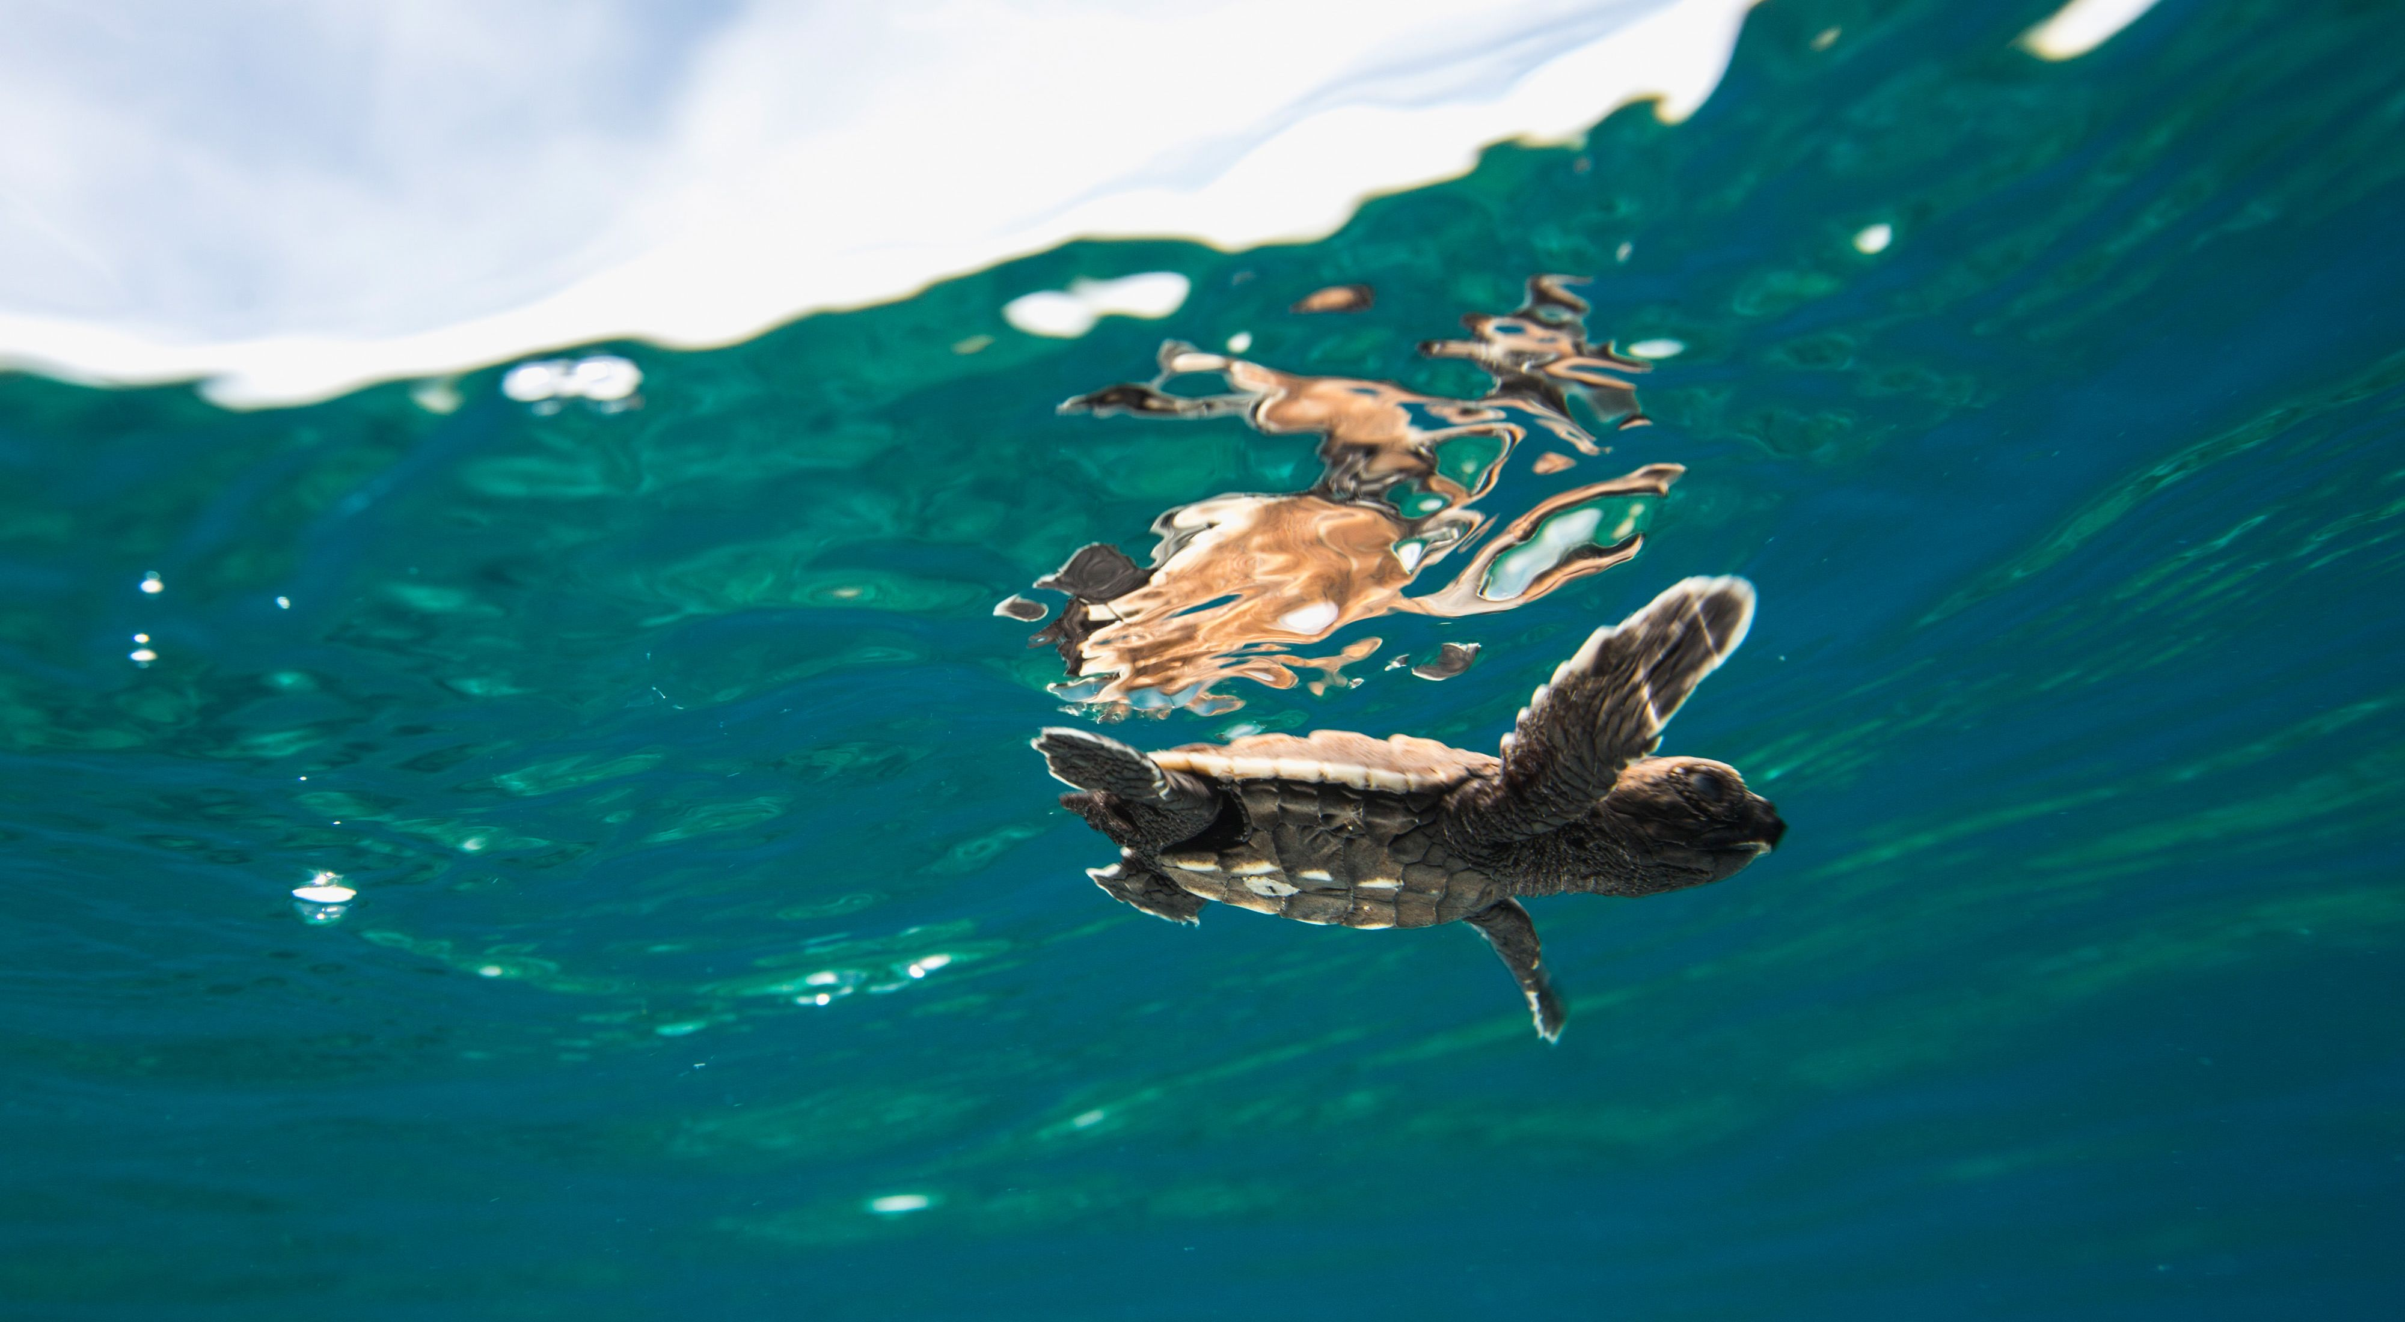
Herbivores eat algae that compete with coral for space.
Herbivores also return nutrients to shallow waters when they poop.
Notes:
Image: https://www.natureaustralia.org.au/what-we-do/our-insights/perspectives/an-audacious-plan-to-save-the-worlds-oceans/

Slide 12
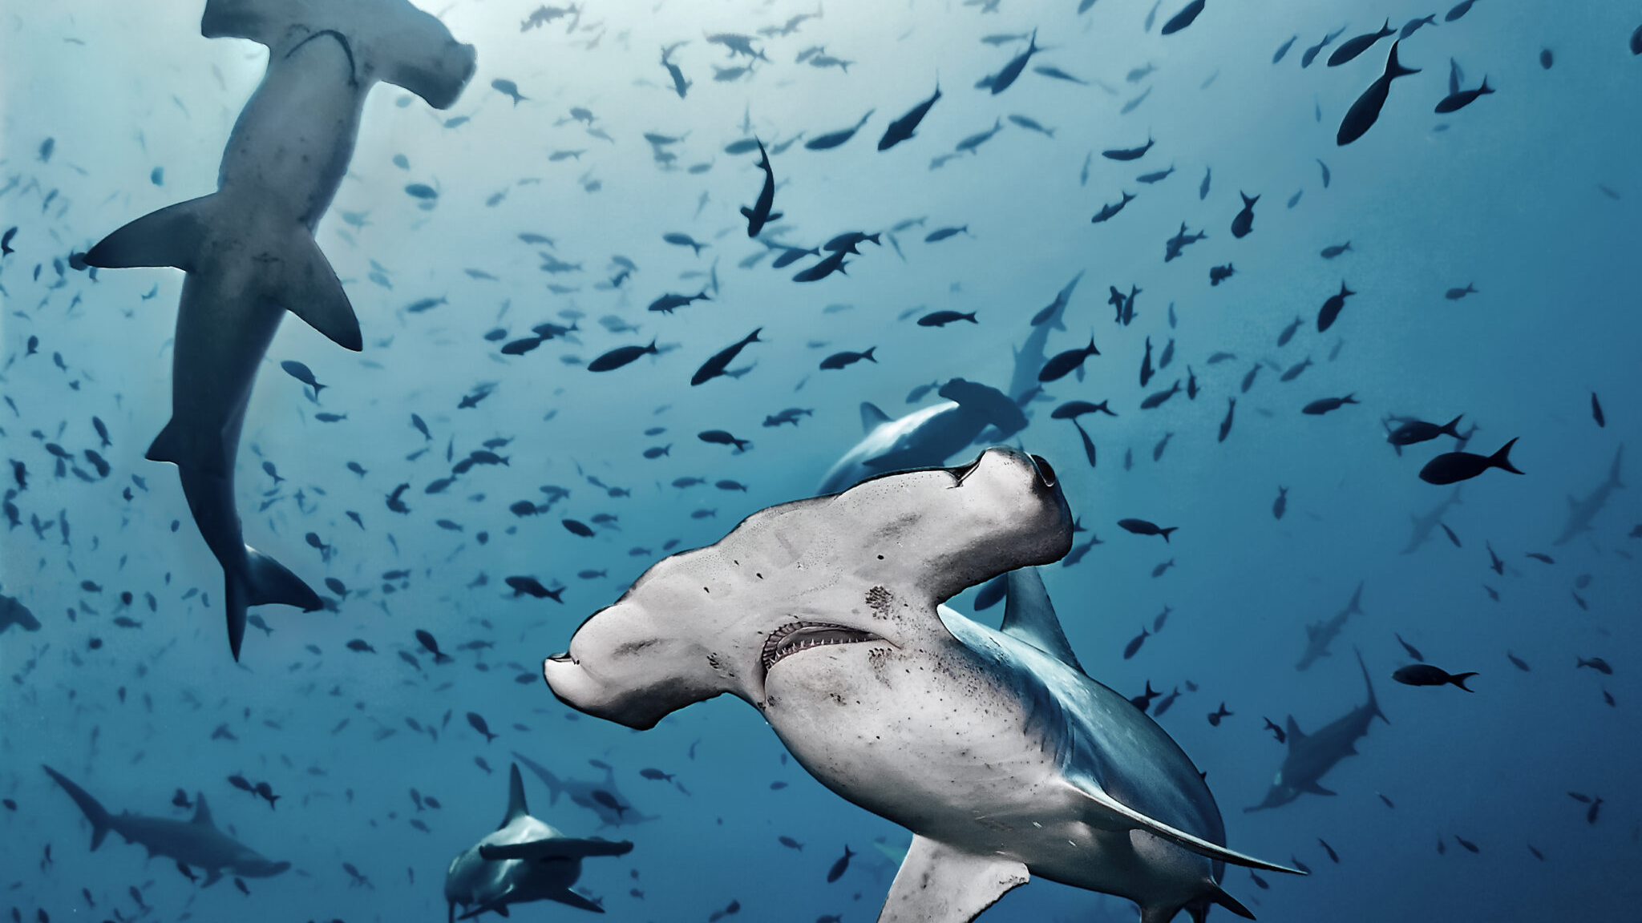
Sharks are apex predators, maintaining balance to food chains.
Notes:
Image: https://blog.padi.com/best-marine-life-encounters-around-the-world/

Slide 13
Why protect nature?
Ecological reasons
Economic reasons ($$$$$)
Social reasons
Aesthetic reasons
Ethical reasons

Slide 14
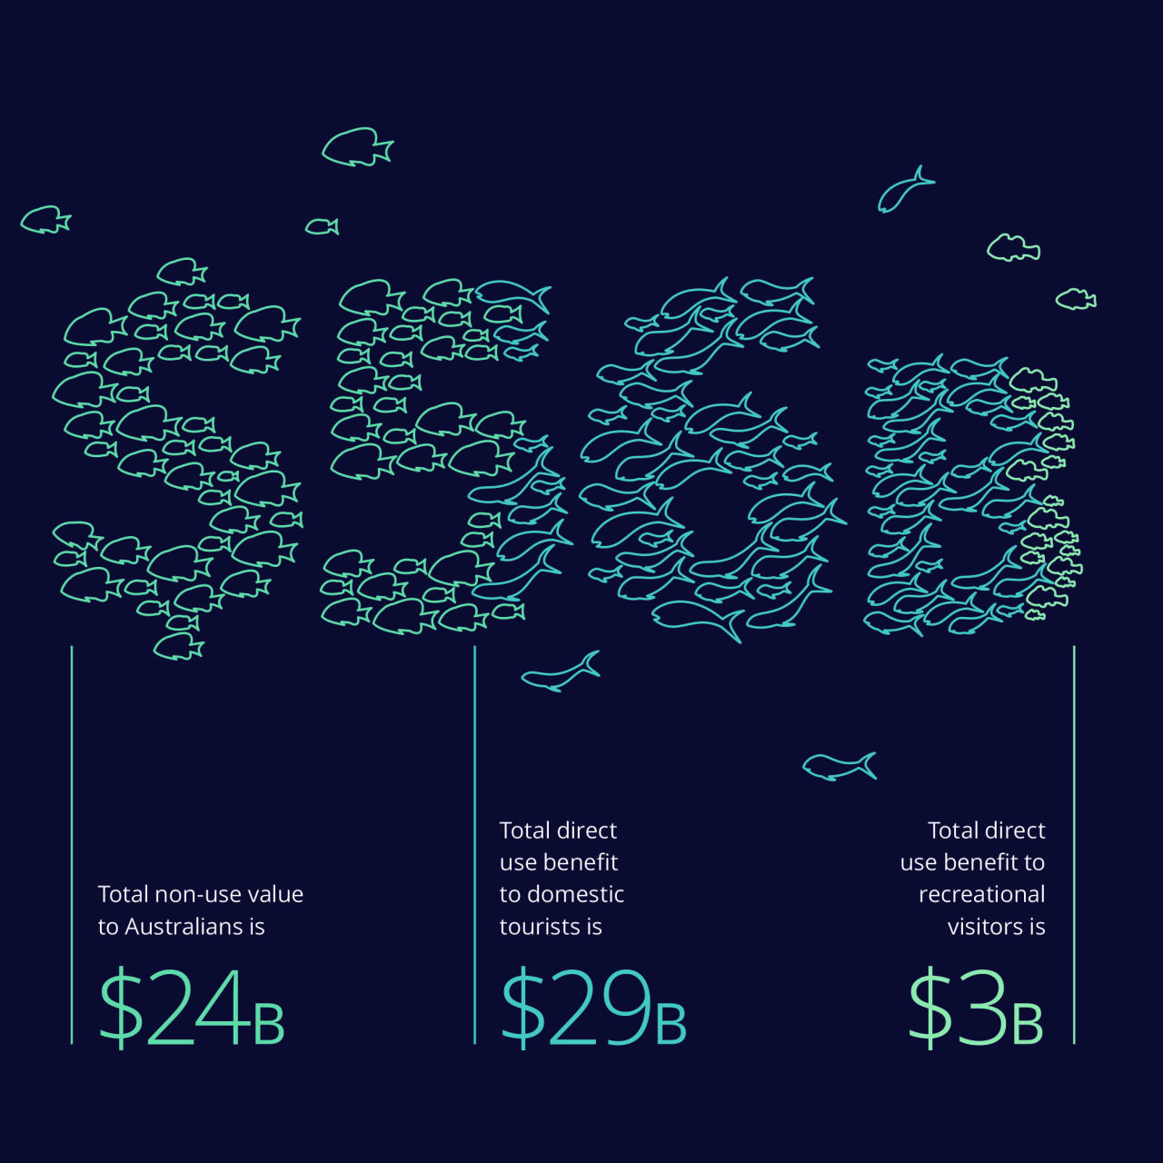
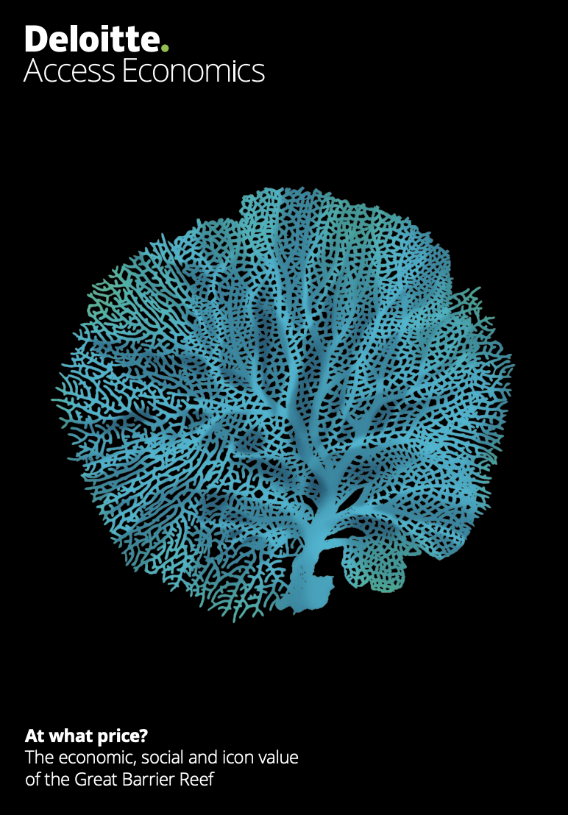
“The Great Barrier Reef has an economic, social and icon asset value of $56 billion. It supports 64,000 jobs and contributes $6.4 billion to the Australian economy”.
Notes:
Image: https://www.barrierreef.org/the-reef/the-value

Slide 15
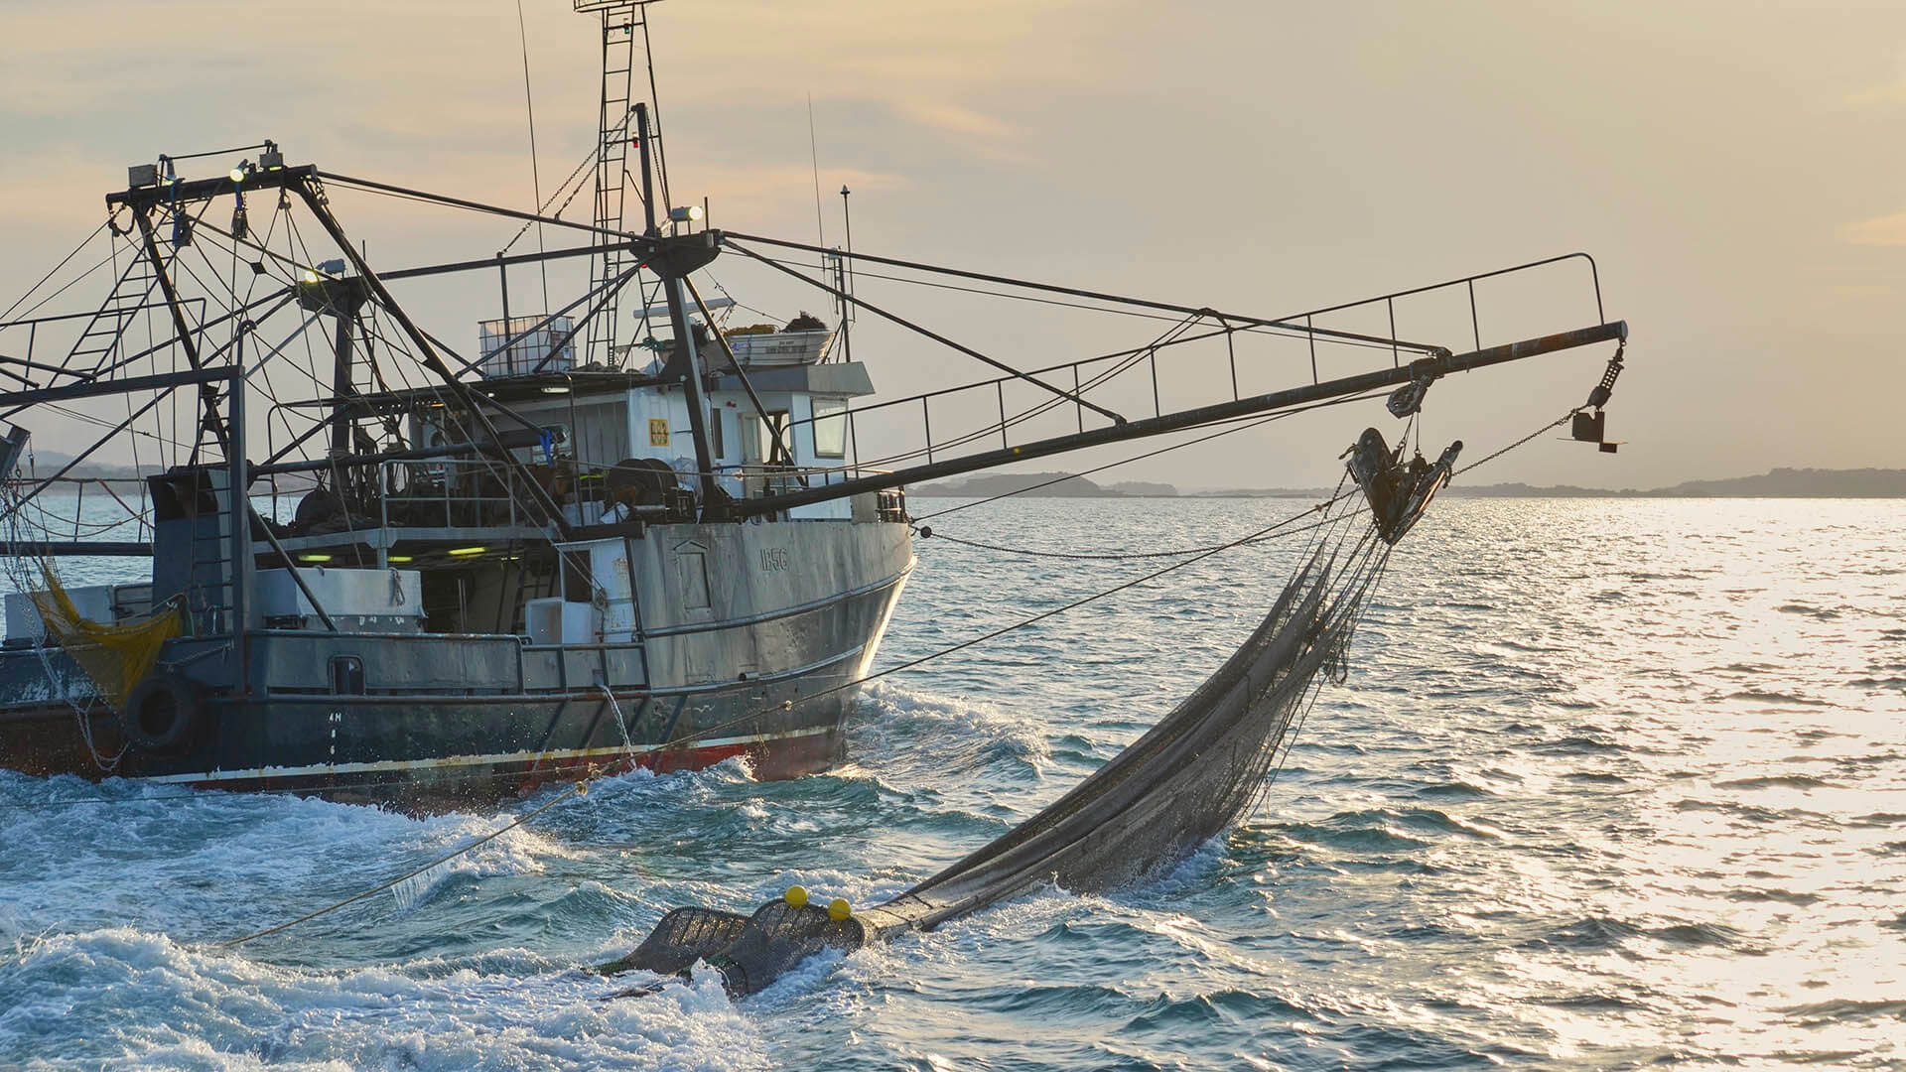
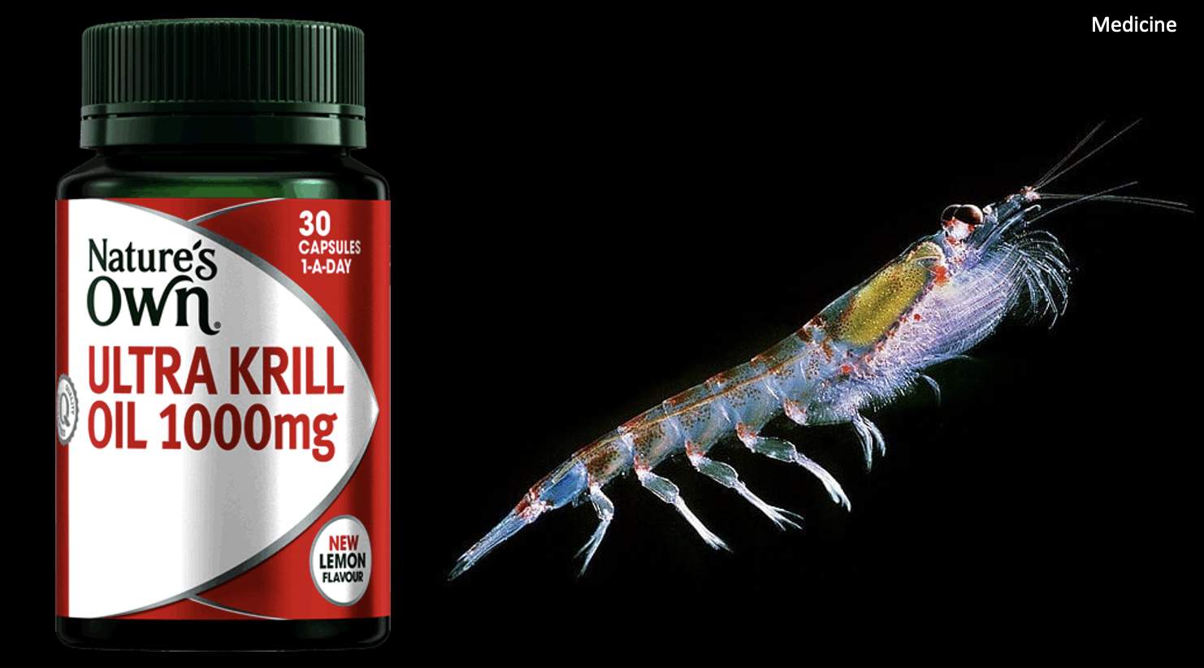
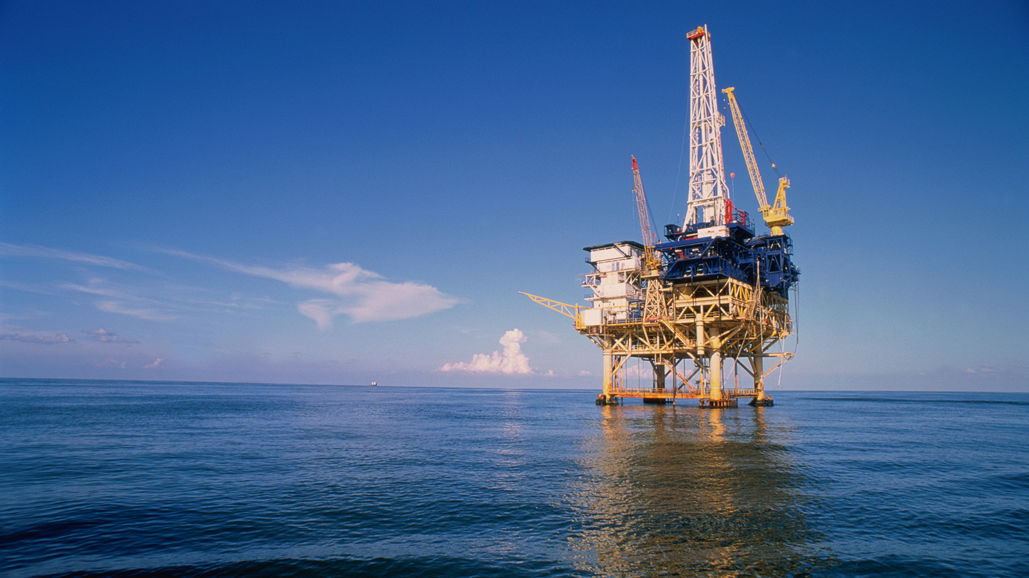
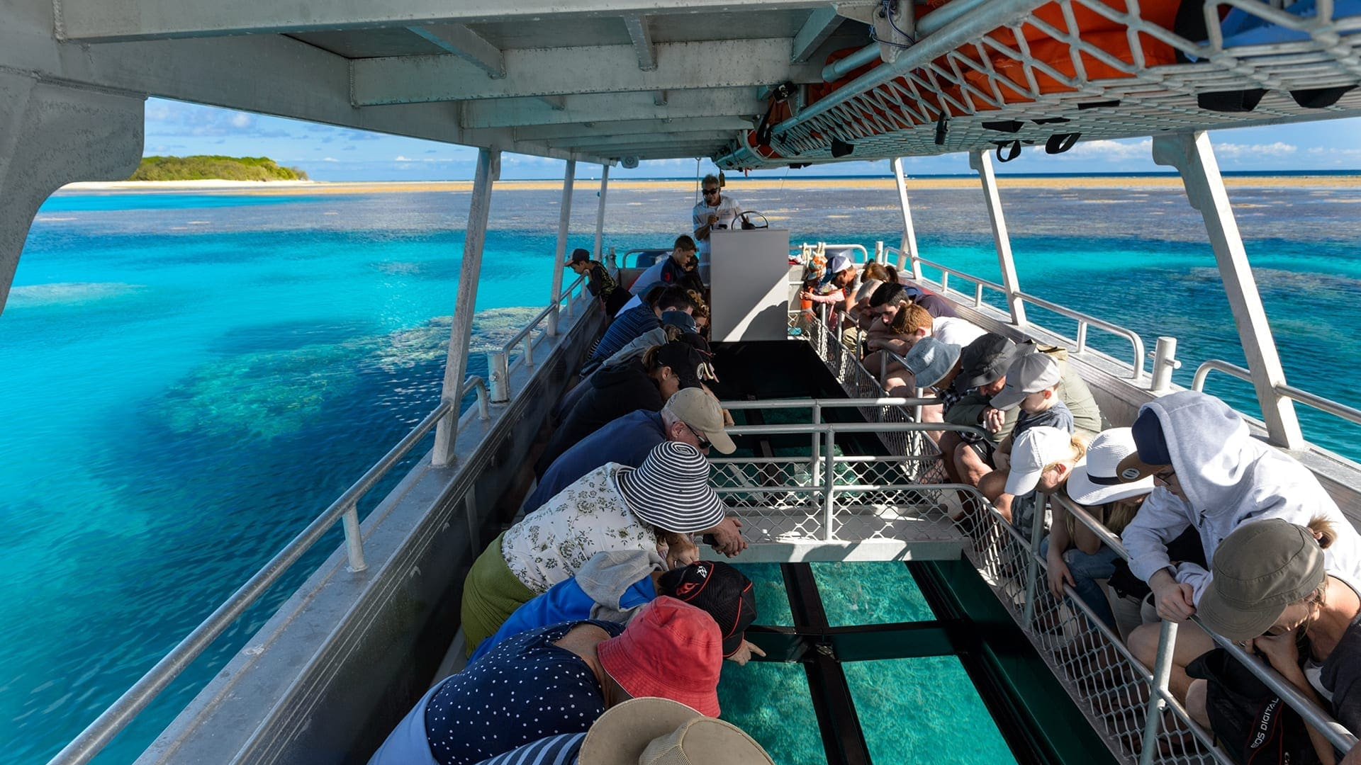
Direct Use Values

Slide 16

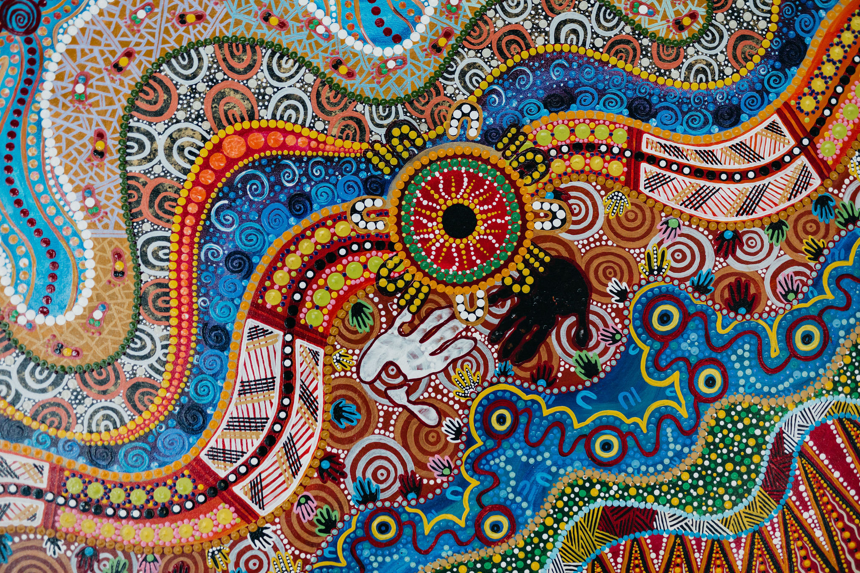
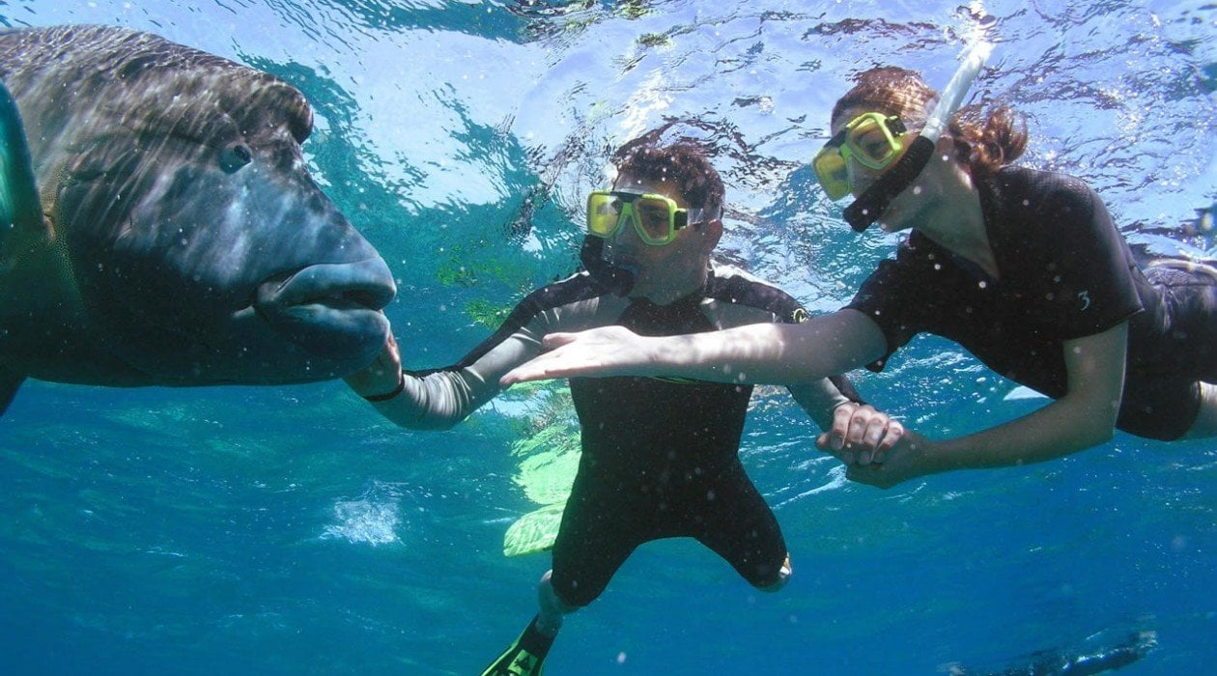
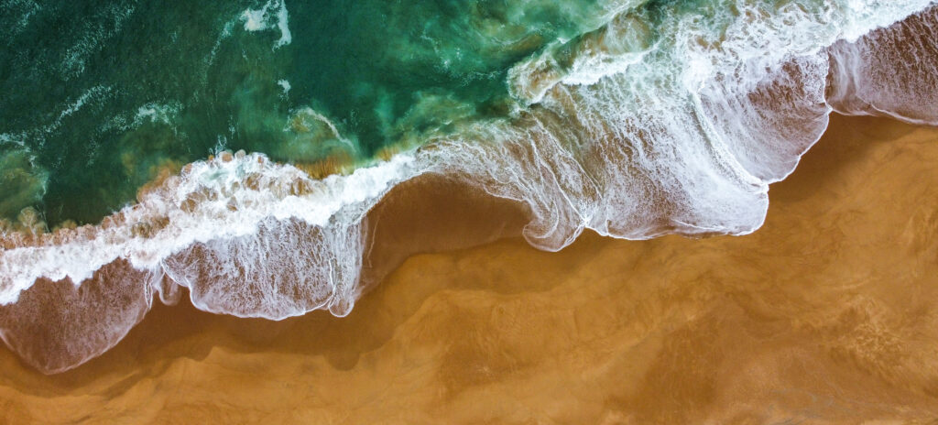
Indirect Use Values
Notes:
Indigenous Painting: https://blog.qm.qld.gov.au/2021/06/11/connections-to-the-land-and-sea/
In 2021, Museum of Tropical Queensland commissioned an artwork from local Townsville Indigenous artist, Jumbo Prior. Go to website to learn more about the painting.
Seascape painting: https://gunaikurnai.org/our-country/sea-country/
Nanjet to Mallacoota
– Sea Country Indigenous Protection Area

Slide 17
Why protect nature?
Ecological reasons
Economic reasons ($$$$$)
Social reasons
Aesthetic reasons
Ethical reasons

Slide 18
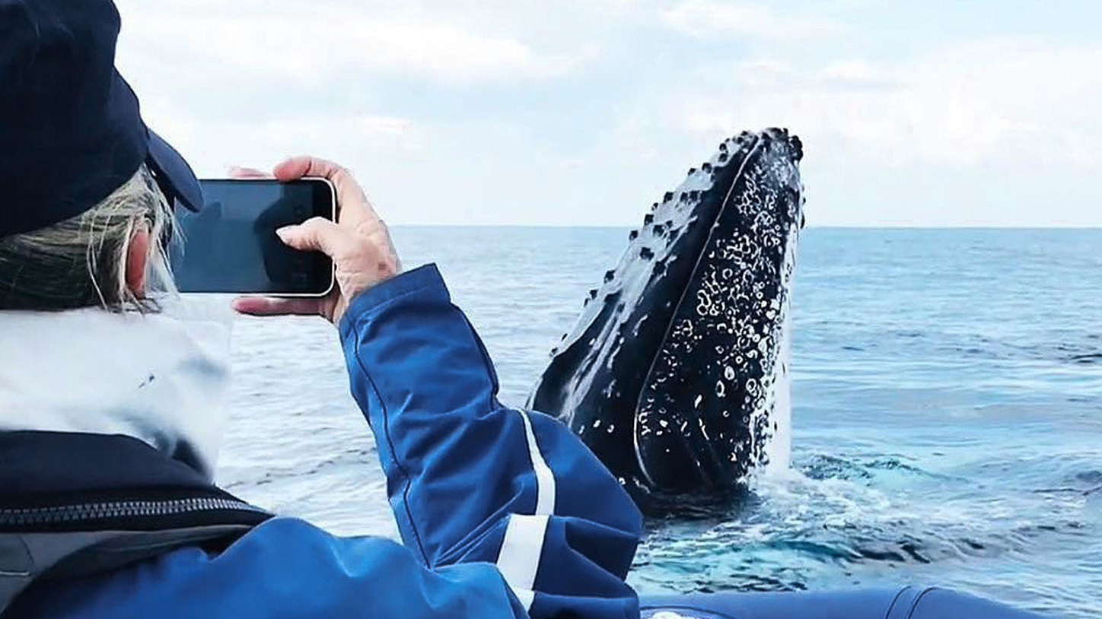
Humpback Whale Watching Hervey Bay
Notes:
Image: https://www.outoftheblueadventures.com/adventures/whale-watching-byron-bay/

Slide 19
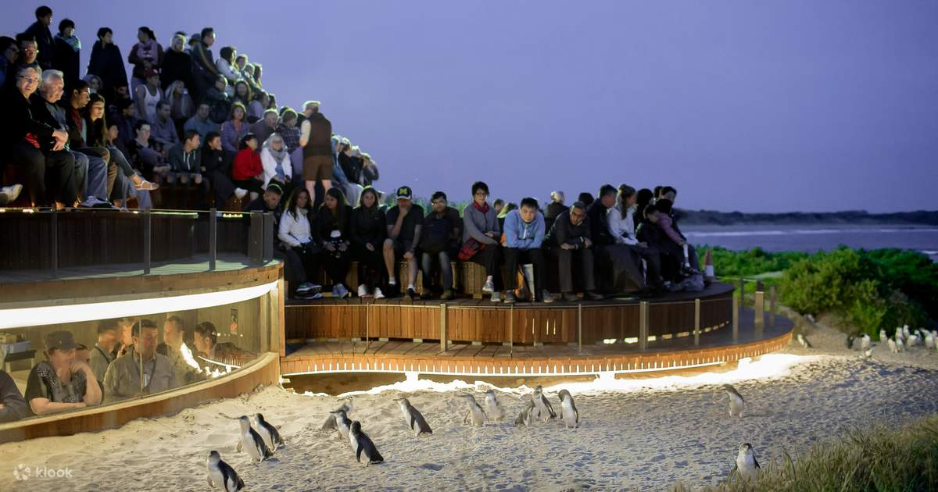
Phillip Island Penguin Parade
Notes:
Image: https://nomadsworld.com/phillip-island-penguin-parade-day-trip/

Slide 20
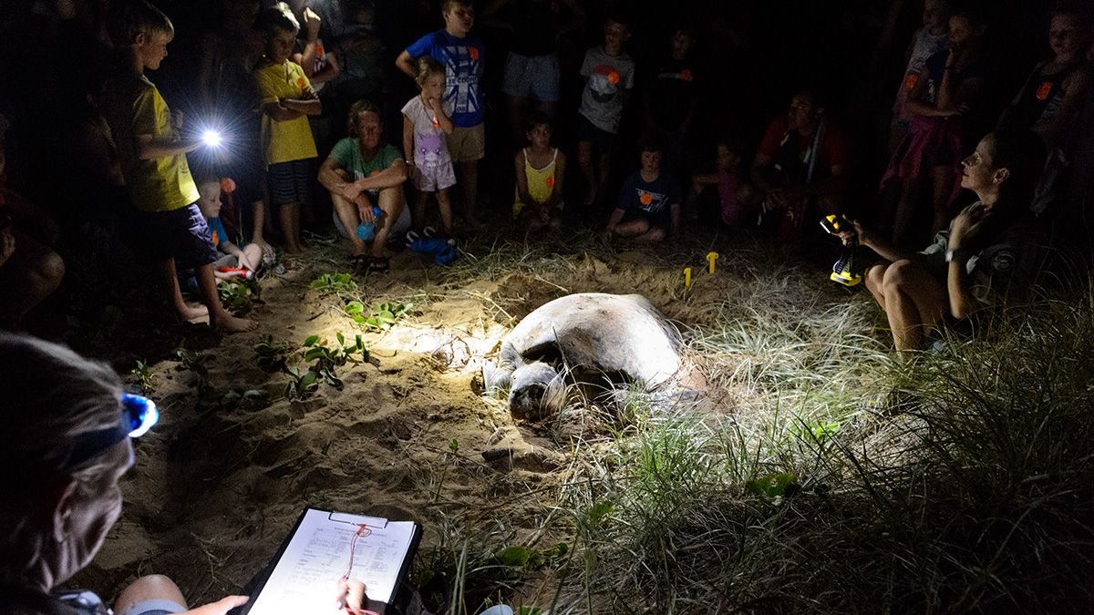
Mon Repos turtle experiences

Slide 21
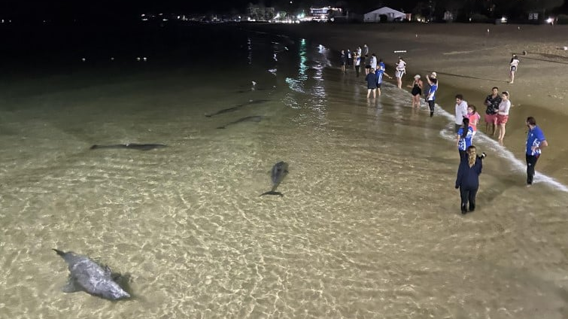
Tangalooma Resort Wild Dolphin Feeding, Moreton Island
Notes:
Image: https://brisbanekids.com.au/dolphin-feeding-at-tangalooma-island-resort-the-review/

Slide 22
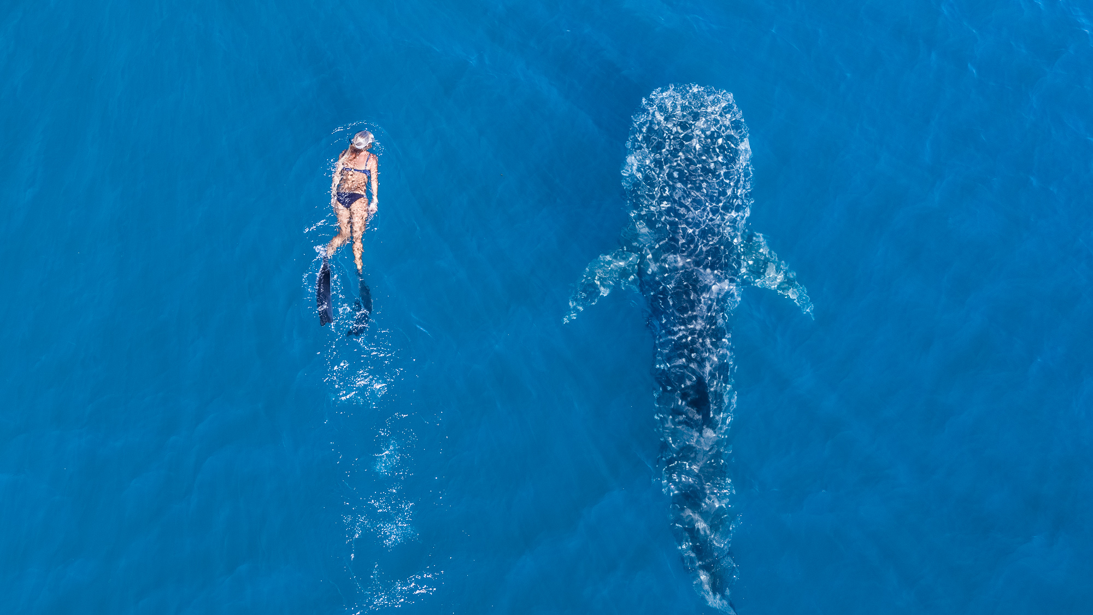
Whale Shark Swims, Ningaloo Reef, WA
Notes:
Image:

Slide 23
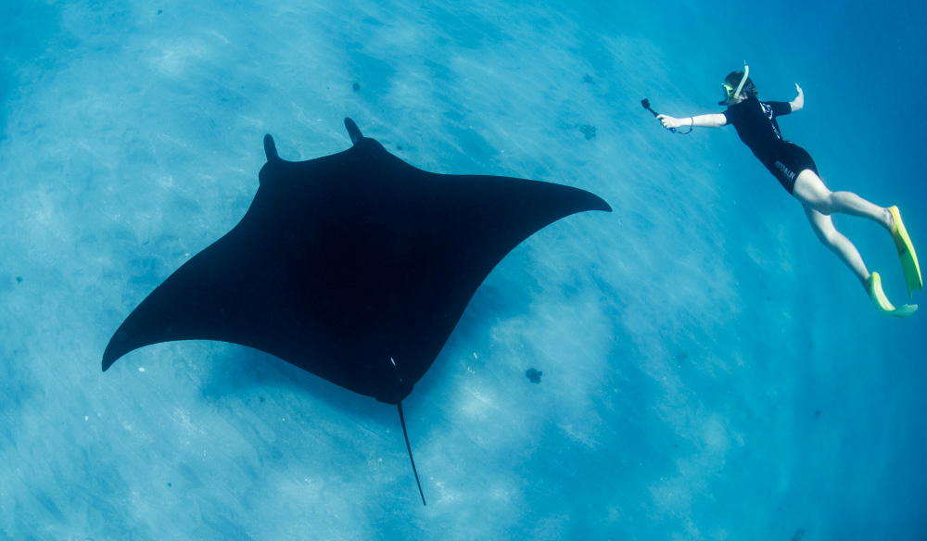
Manta Ray Swims, Lady Elliot Island
Notes:
Image: https://www.australiantraveller.com/australia/17-of-the-best-australian-wildlife-experiences/

Slide 24
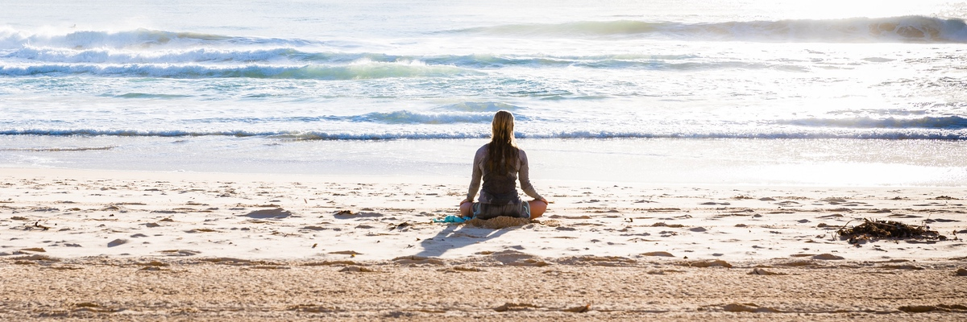
Mental health

Slide 25
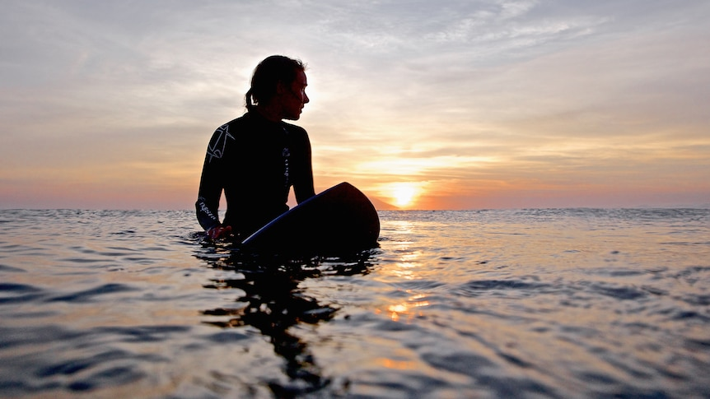

Slide 26
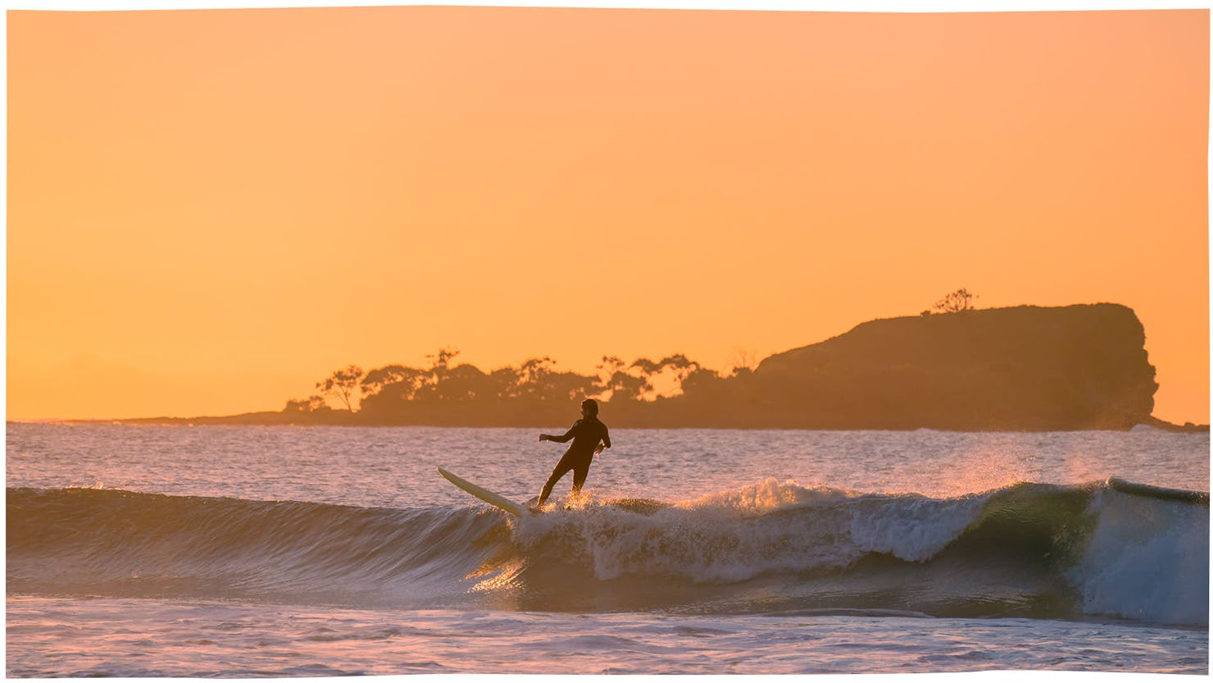
Notes:
Image: https://www.visitsunshinecoast.com/guide/surfs-up-at-these-sunshine-coast-hotspots

Slide 27
Why protect nature?
Ecological reasons
Economic reasons ($$$$$)
Social reasons
Aesthetic reasons
Ethical reasons

Slide 28
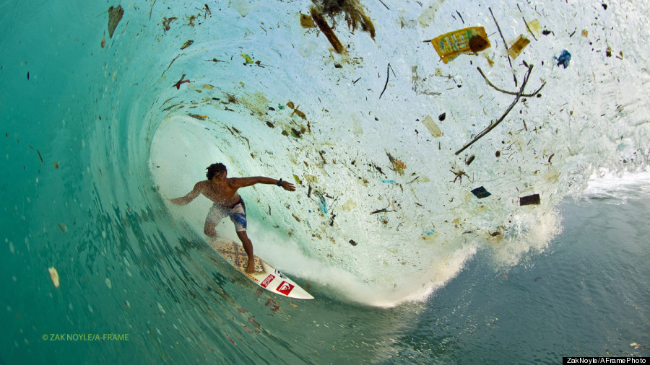
Notes:
Image: https://www.huffpost.com/entry/trash-waves-indonesia_n_3736913

Slide 29
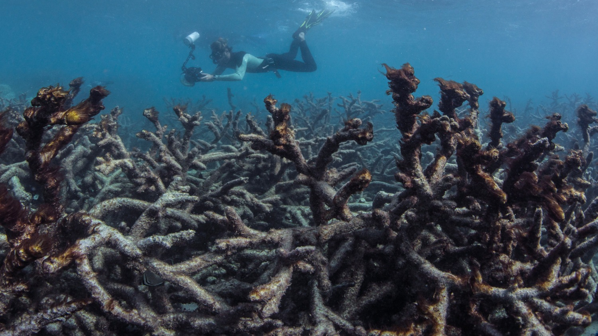
Notes:
Image: https://www.nbcnews.com/news/world/scope-great-barrier-reef-s-massive-coral-bleaching-alarms-scientists-n867521

Slide 30
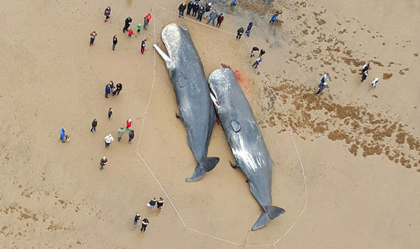
Notes:
Image: https://www.express.co.uk/news/uk/637538/Five-huge-sperm-whales-wash-up-dead-British-coast-one-explodes-autopsy

Slide 31
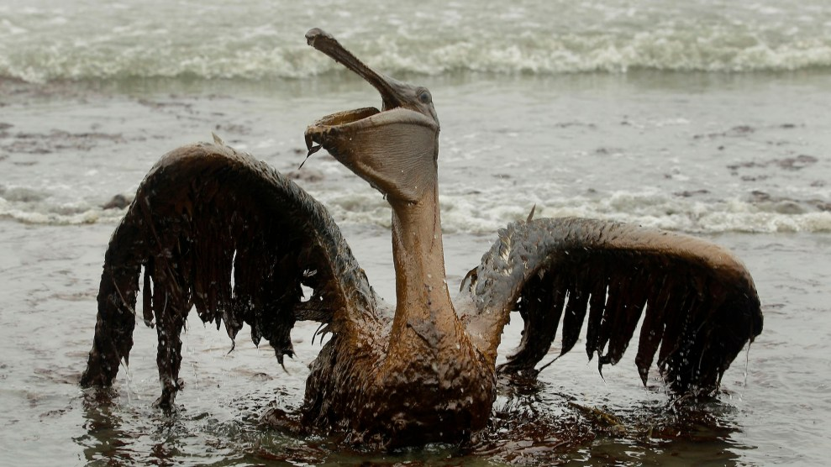
Notes:
Image: https://www.motherjones.com/environment/2019/04/deepwater-horizon-bp-oil-spill/

Slide 32
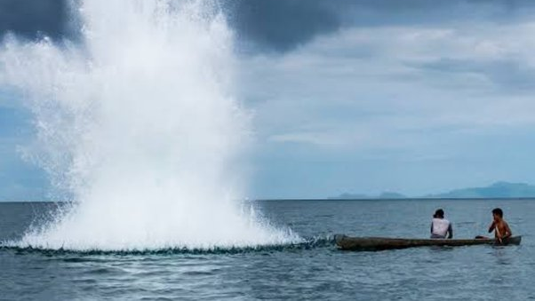
Dynamite fishing
Notes:
Image: https://www.dos-1.ph/?c=what-is-the-cause-and-effect-of-dynamite-fishing-oo-wwb2zDu6

Slide 33
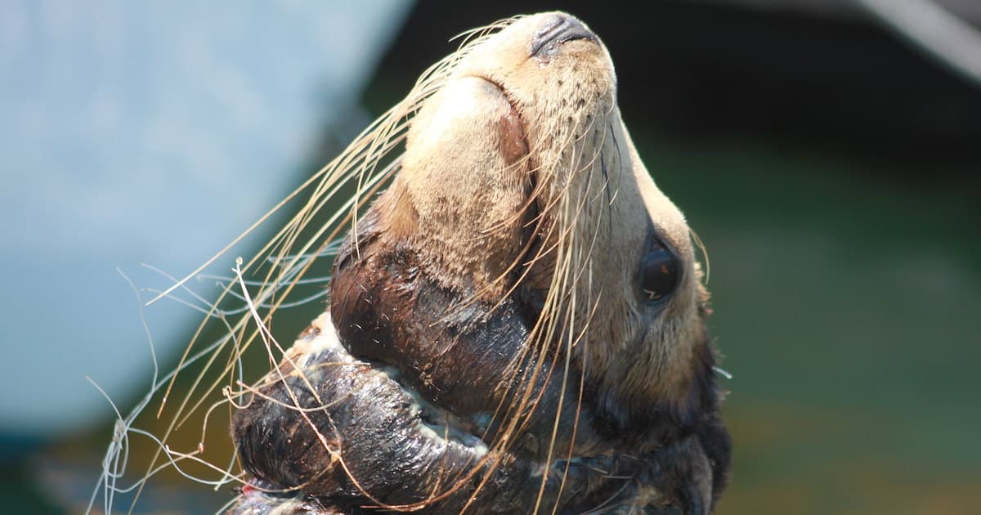
Notes:
Image: https://sentientmedia.org/bycatch/

Slide 34
Why protect nature?
Ecological reasons
Economic reasons ($$$$$)
Social reasons
Aesthetic reasons
Ethical reasons

Slide 35
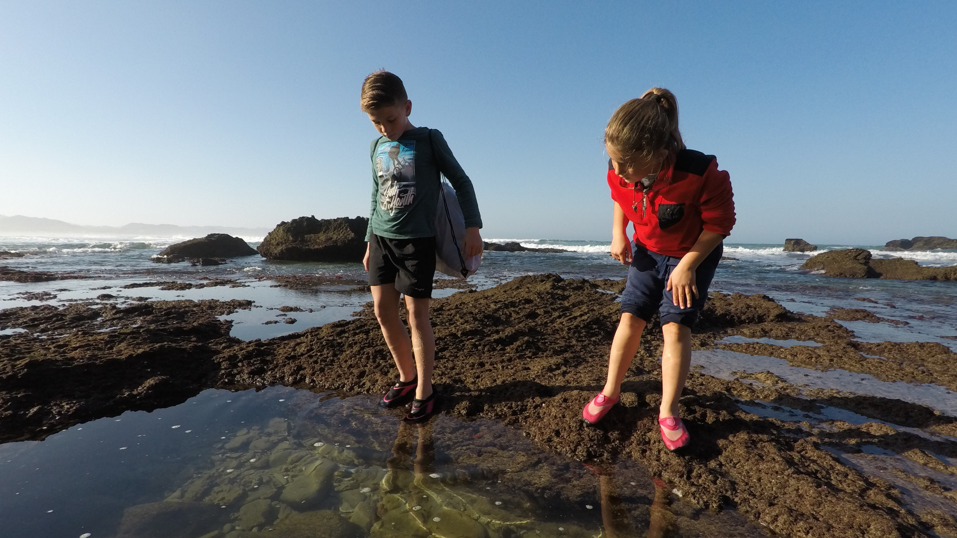
For future generations

Slide 36
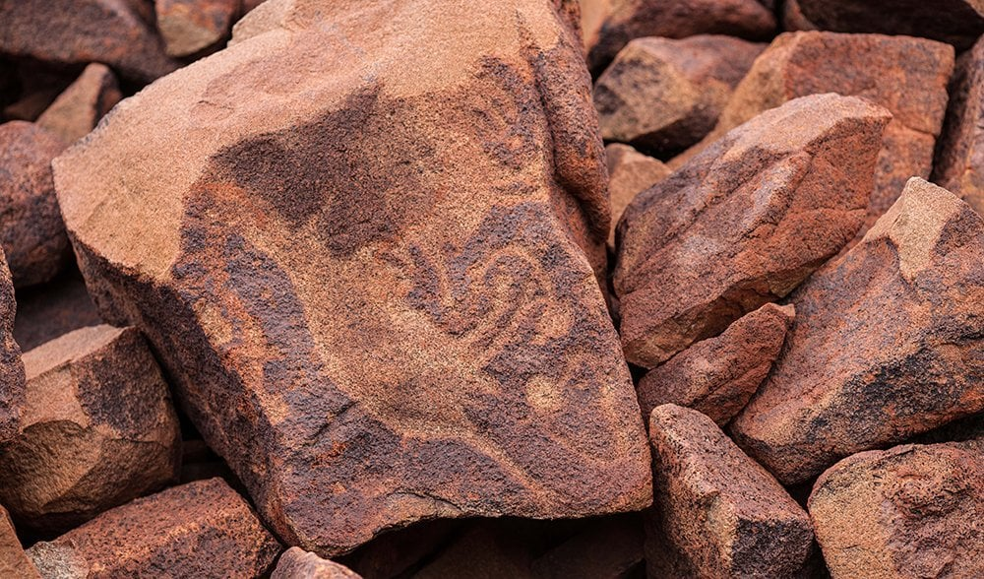
Notes:
Image: https://www.australiangeographic.com.au/travel/travel-destinations/2015/03/pilbaras-karinji-np-culture-etched-in-stone/

Slide 37
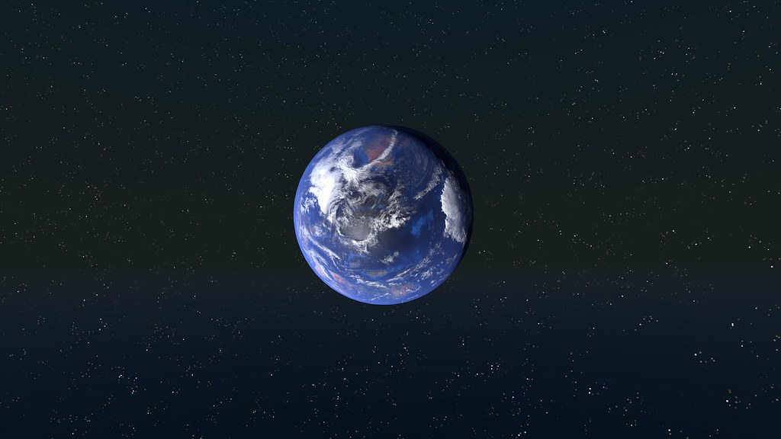
there’s only one earth
Notes:
Image: https://www.iied.org/fifty-years-only-one-earth-rings-true

Slide 38
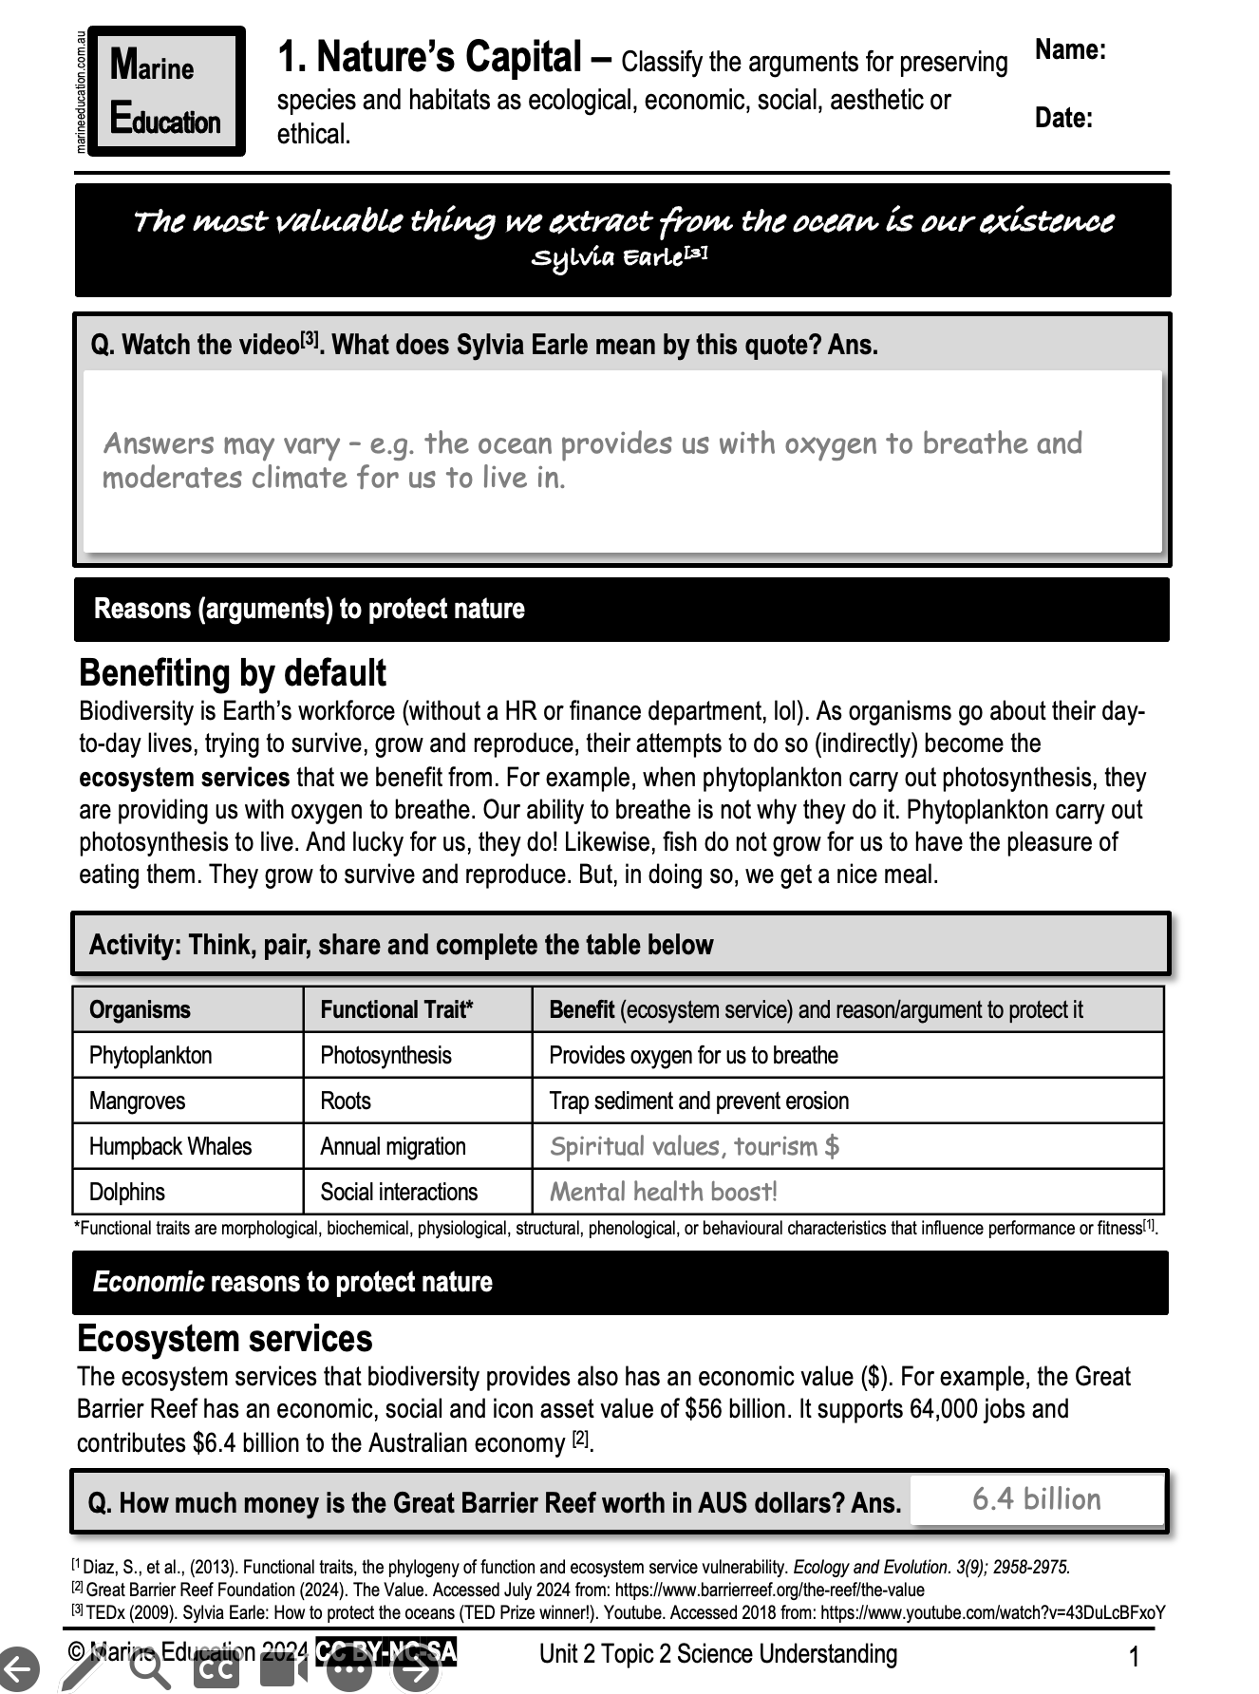
Learning Intention:
Classify the arguments for preserving species and habitats as ecological, economic, social, aesthetic or ethical.
Success Criteria:
Complete Marine Education worksheet ‘1. Nature’s capital’
Notes:
Image: https://www.diveplanit.com/marine-environment/value-of-great-barrier-reef/

Slide 39
Extension Activity
HOW to afford to protect nature

Slide 40
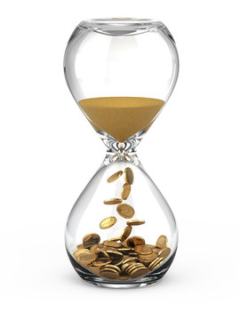
The returns for investing in a marine protected area can sometimes takes decades

Slide 41
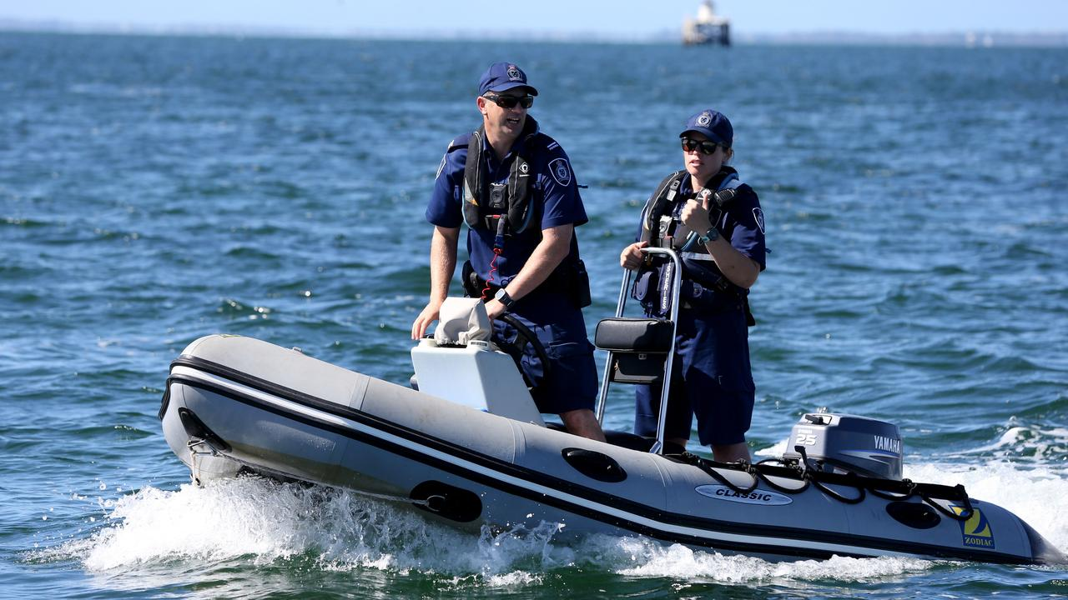
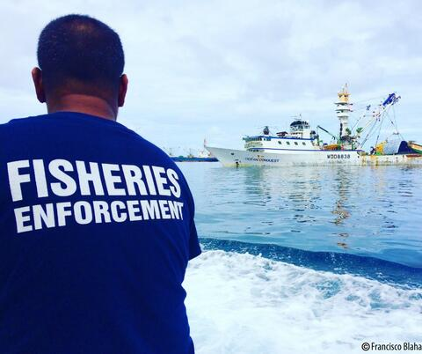
Meanwhile, it costs money to make sure people are following the rules

Slide 42
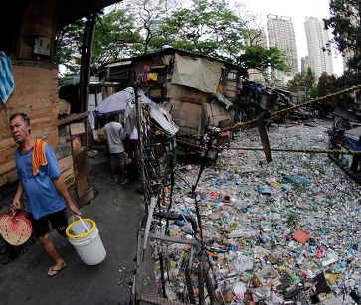
Many poorer countries (where all the good reefs are!) don’t have the funds

Slide 43
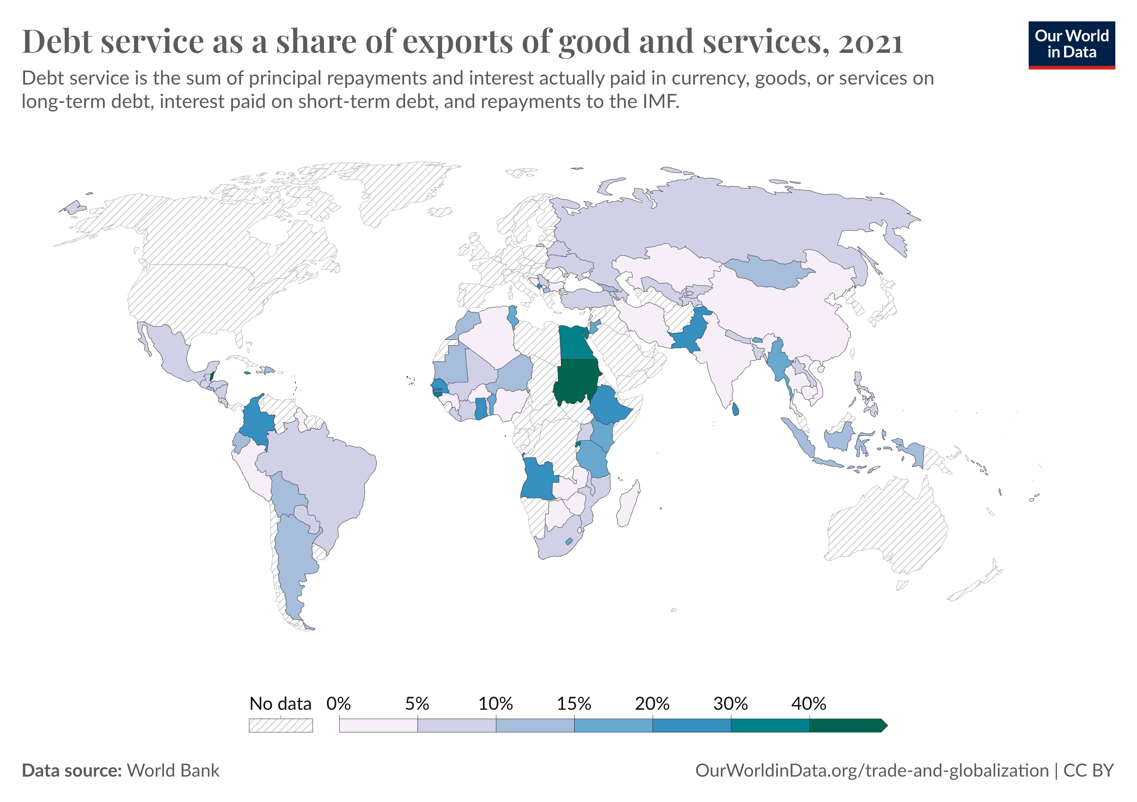
Many poor countries have borrowed money already and have big debts to pay back
Notes:
Image: https://ourworldindata.org/grapher/debt-service-of-exports-of-goods-services?time=latest

Slide 44
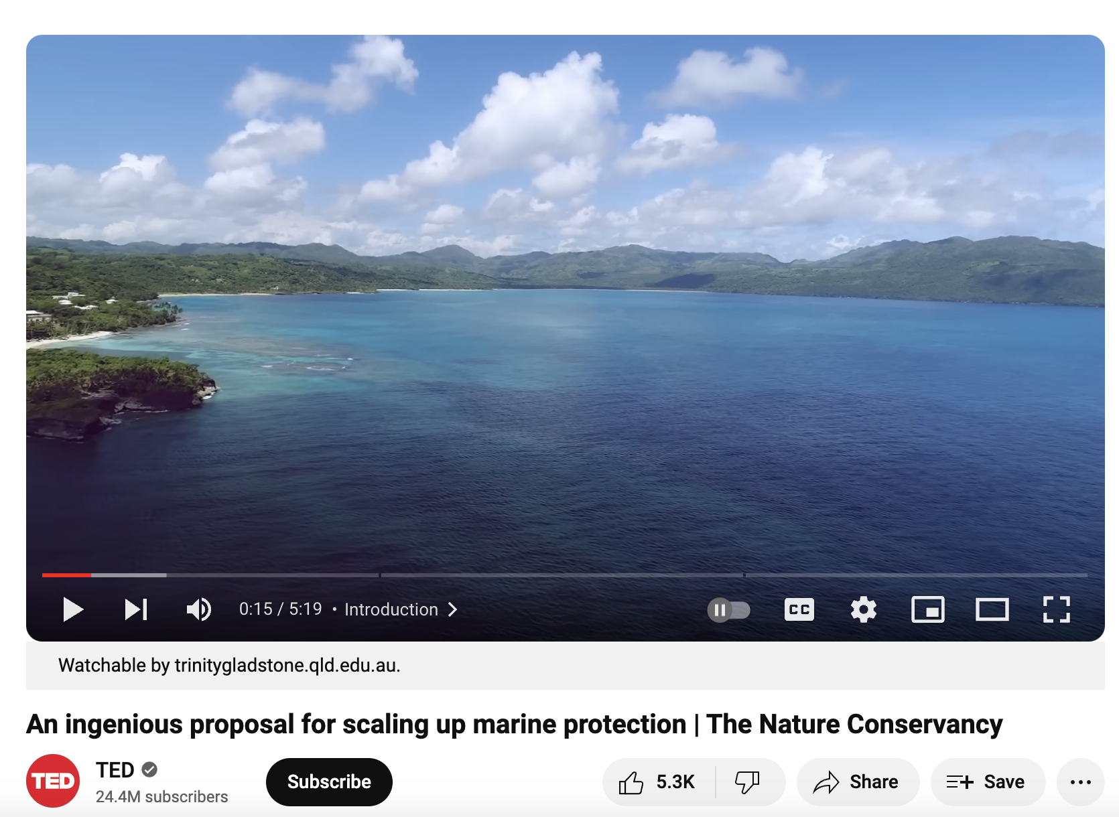
The Nature Conservancy has a solution…
https://www.youtube.com/watch?v=ttcJMNlKif4&t=5s

