Slide 1
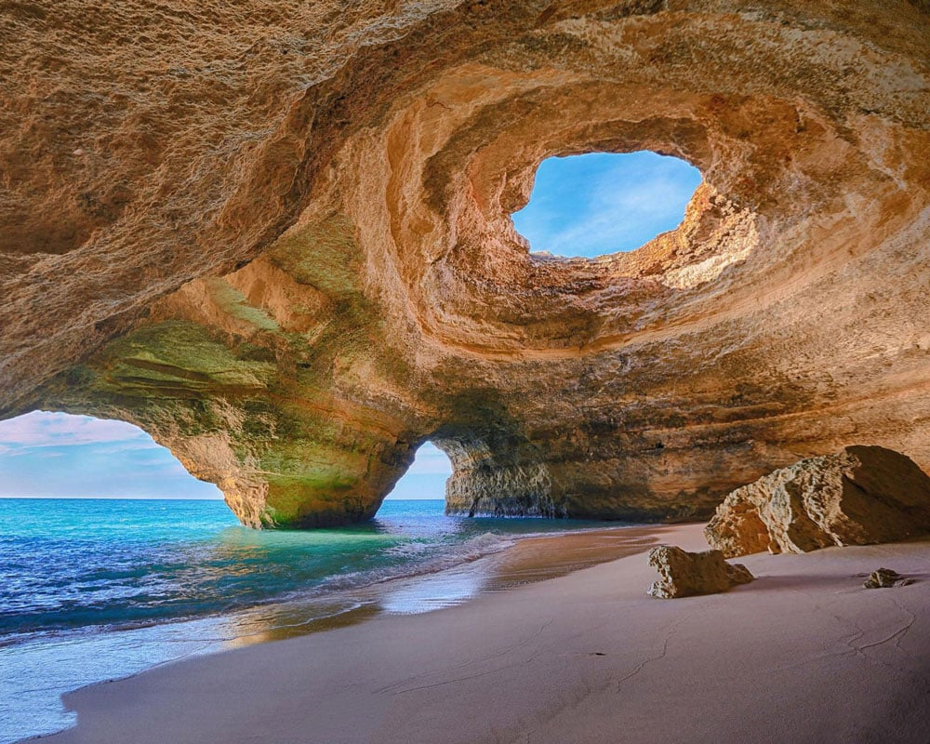
Learning Intention:
Describe how coastlines are shaped by a number of factors, including tectonic plate movements, shifts in climate patterns and sea level change, weather patterns, and movement of sediments and water, e.g. waves, currents.
Success Criteria:
Complete Marine Education worksheet ‘1. The dynamic shore’

Slide 2
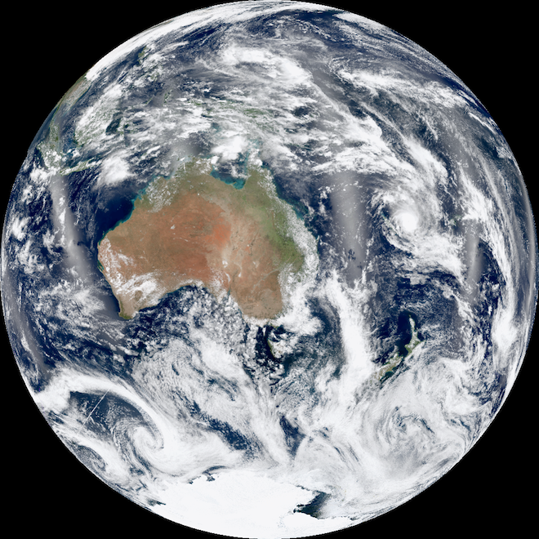

Slide 3
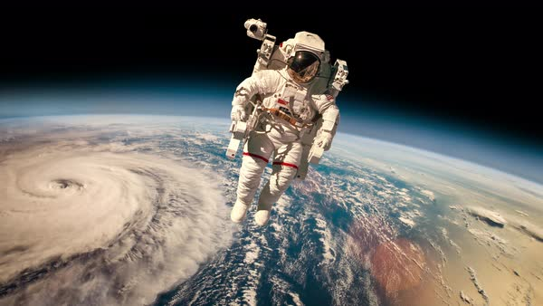

Slide 4
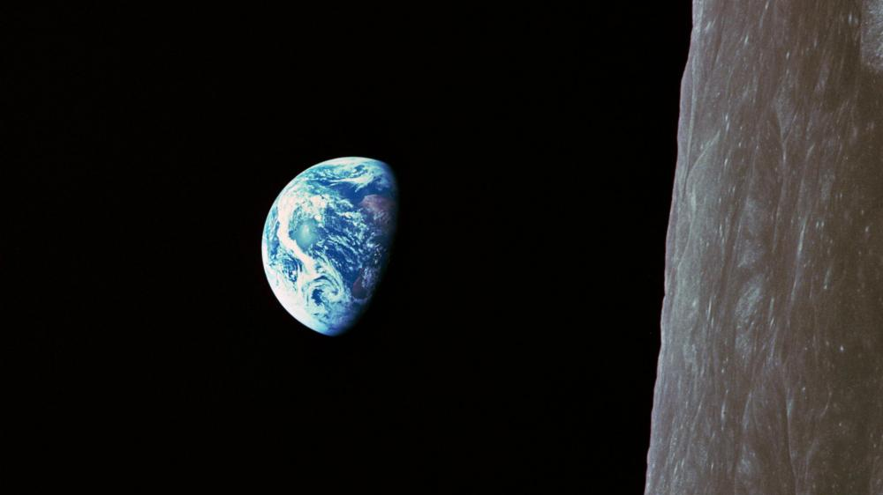

Slide 5
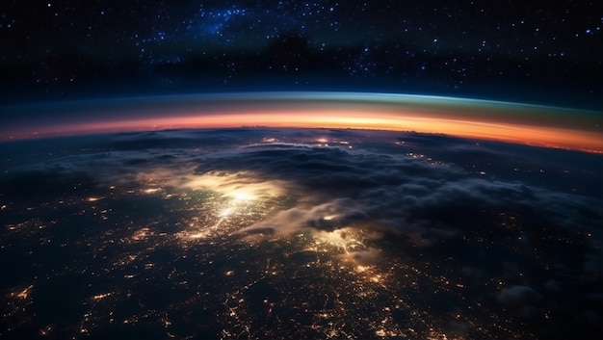

Slide 6
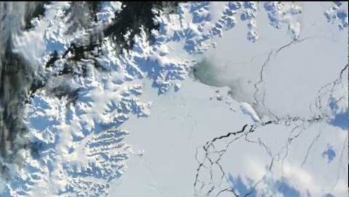
https://www.youtube.com/watch?v=sckOSMf-LpY
Notes:
https://www.youtube.com/watch?v=sckOSMf-LpY
https://www.youtube.com/watch?v=Mx2eTWar0eA

Slide 7
Coastlines are shaped by a number of factors, including
tectonic plate movements…

Slide 8
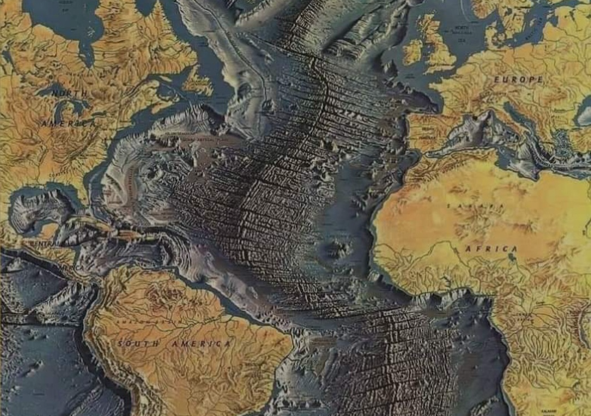
Tectonic plate movements create mountain ranges, islands, headlands and underwater bathymetry

Slide 9
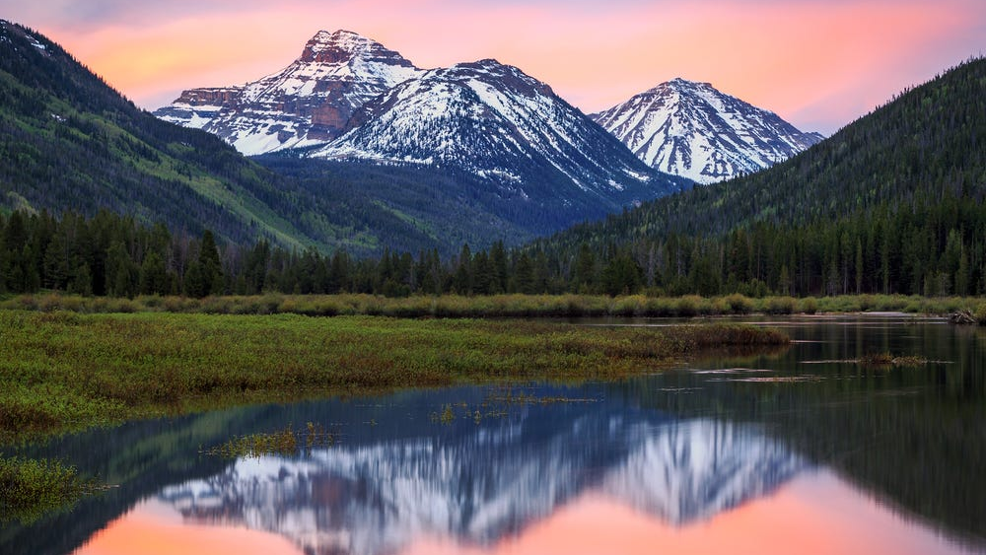

Slide 10
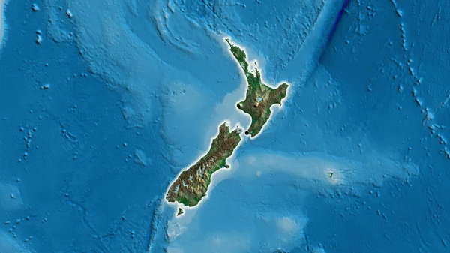

Slide 11
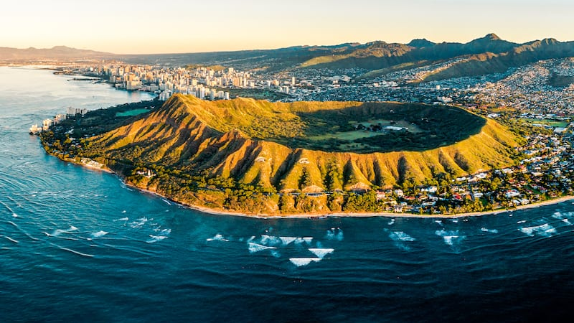

Slide 12
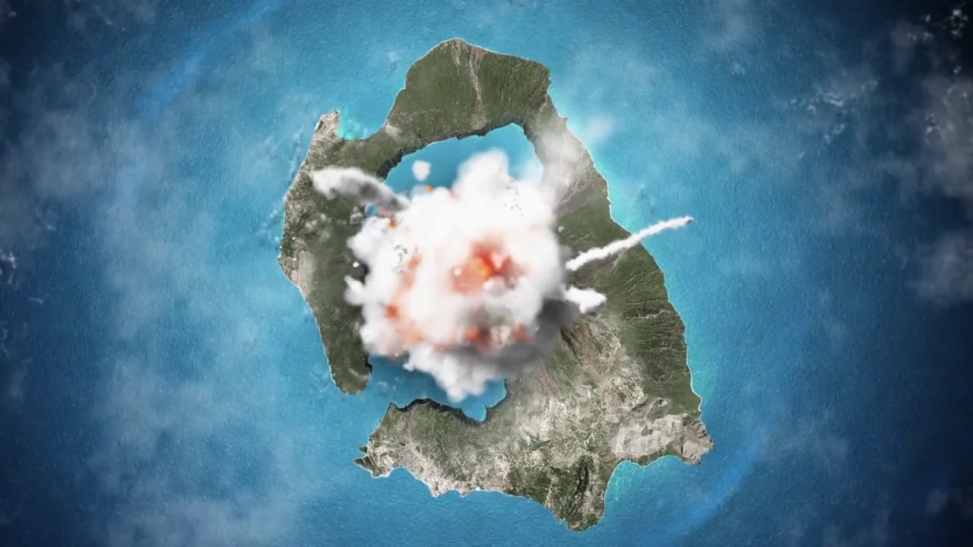

Slide 13
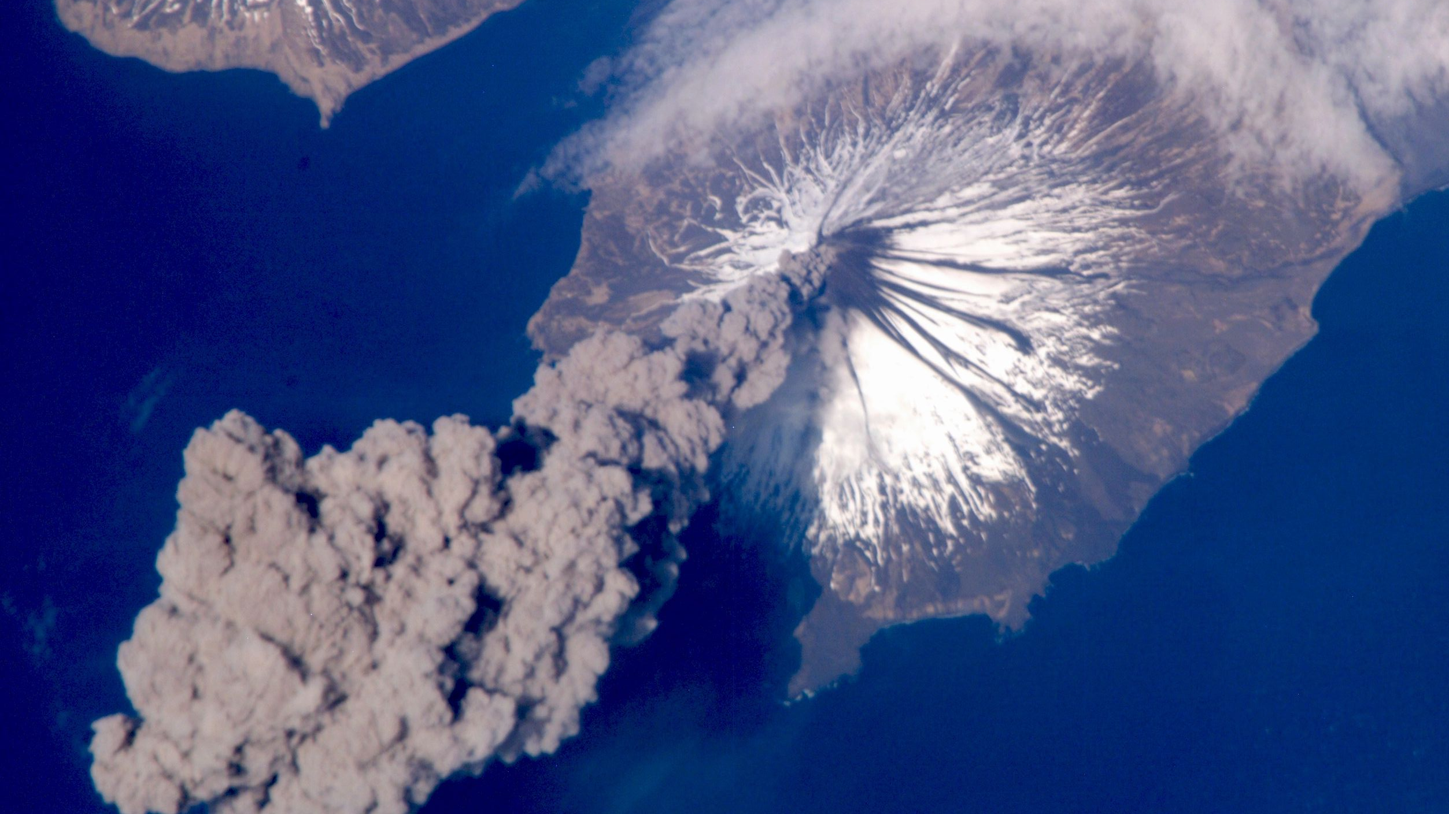

Slide 14
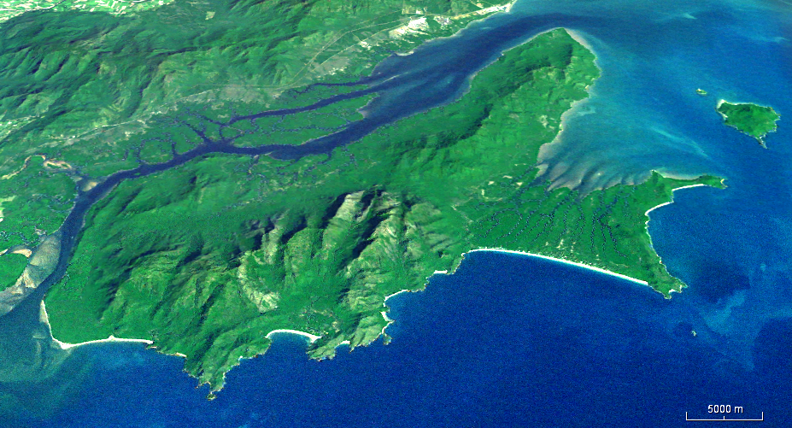
Hinchinbrook Island

Slide 15
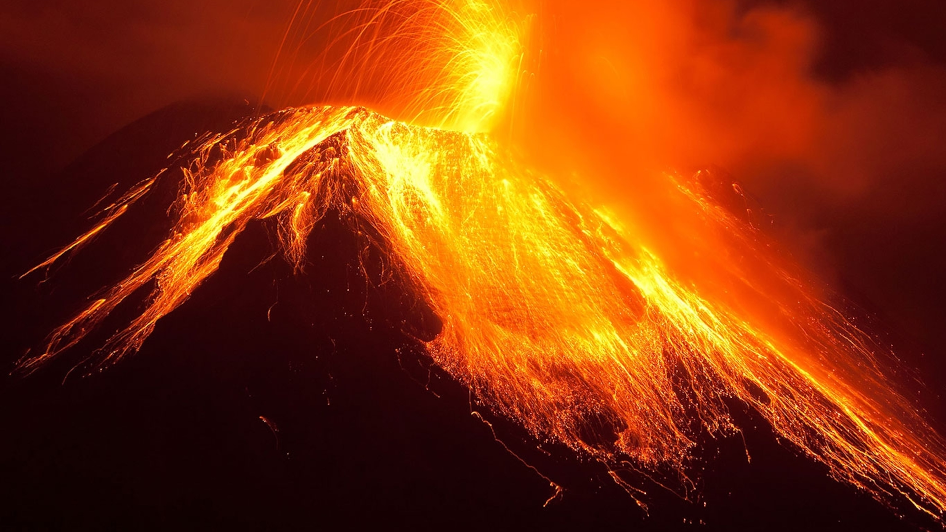

Slide 16
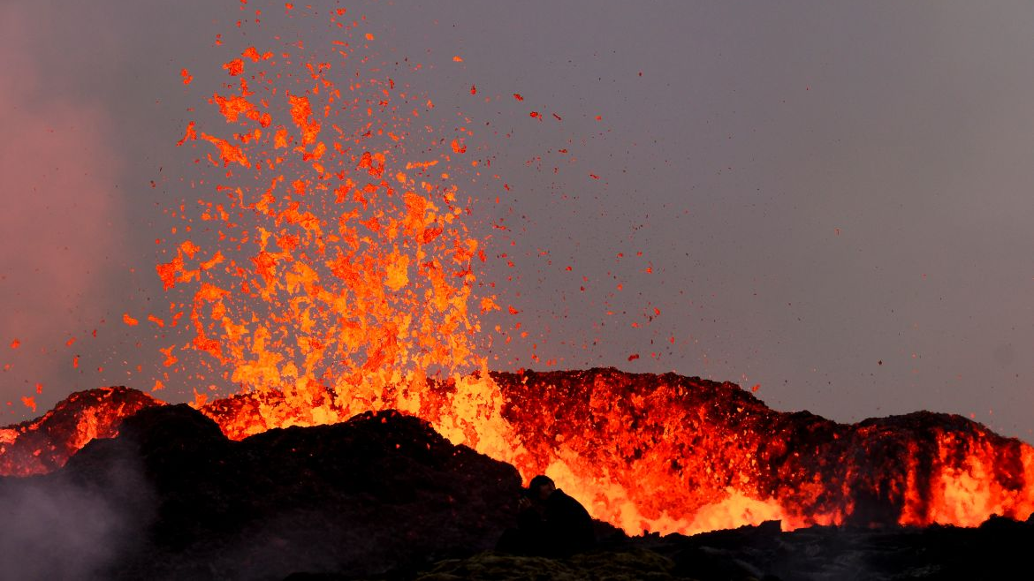

Slide 17
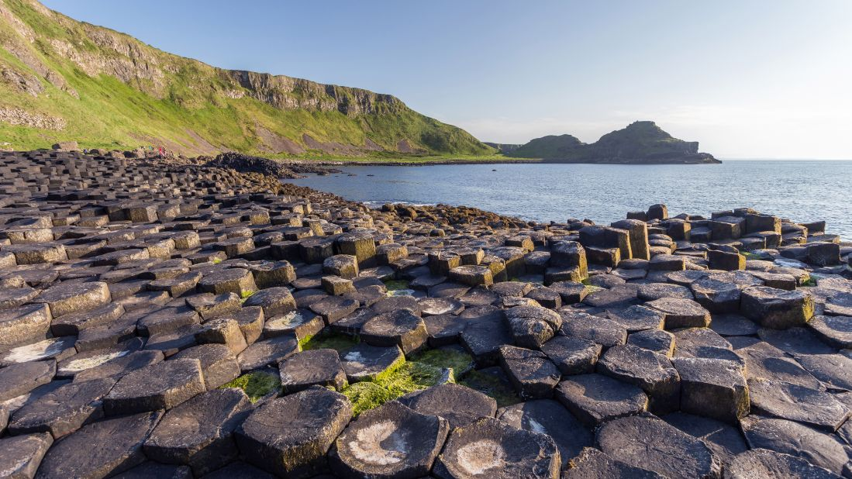

Slide 18
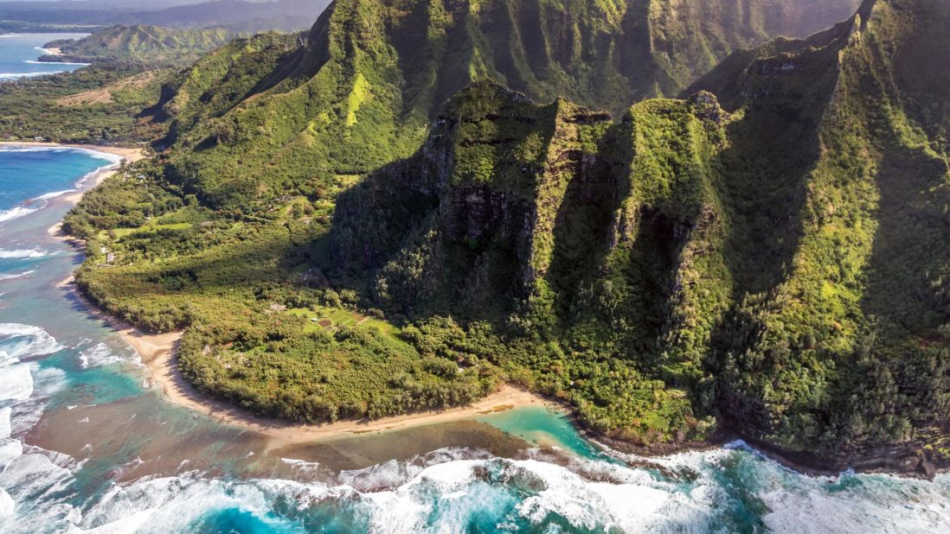

Slide 19
Coastlines are shaped by a number of factors, including
tectonic plate movements,
shifts in climate patterns…

Slide 20
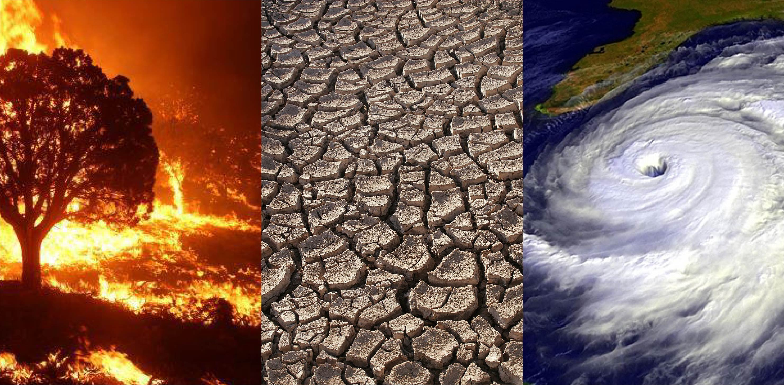
Shifts in climate patterns

Slide 21
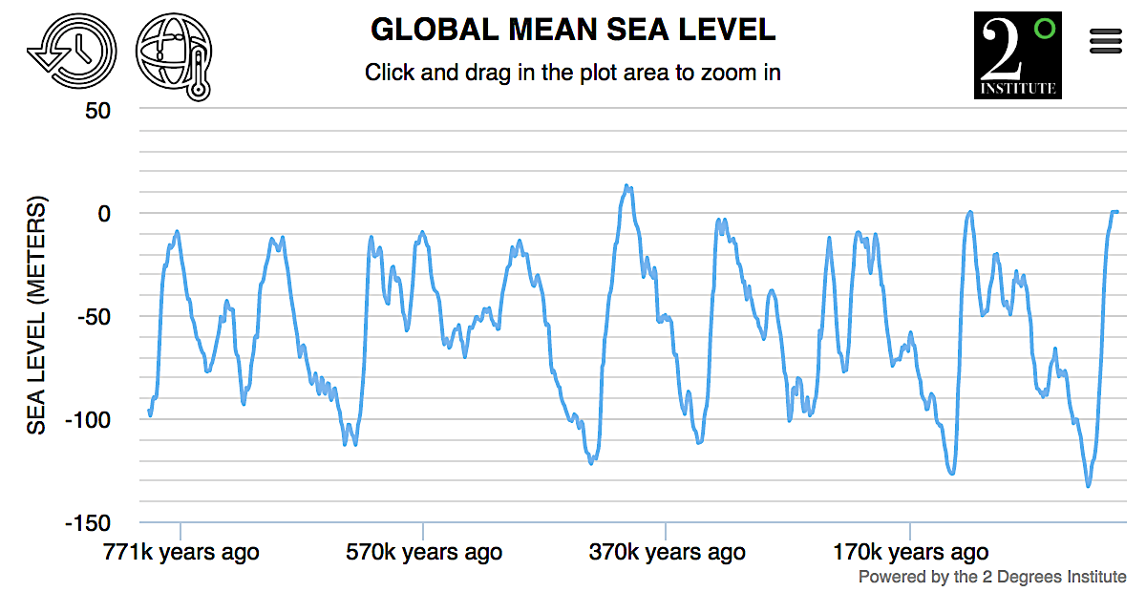
Records show a pattern of sea level rise and fall over time

Slide 22
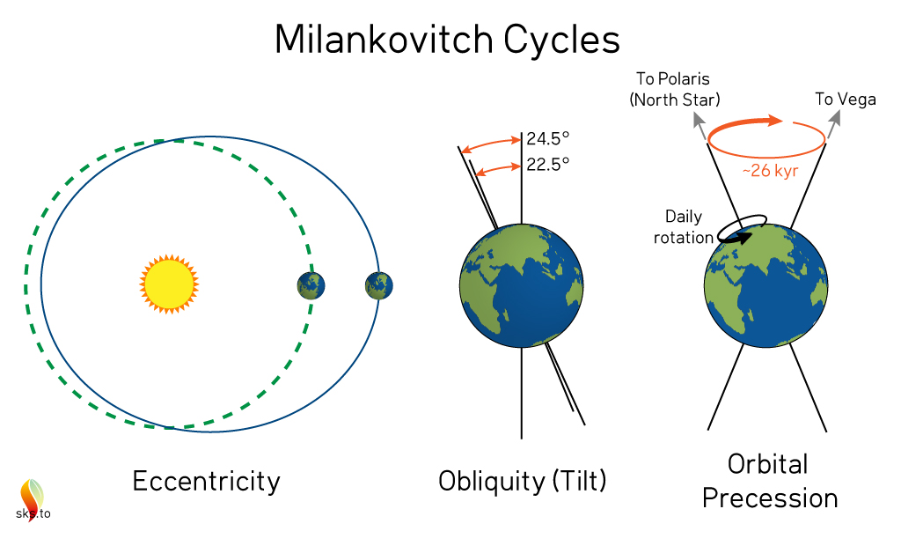
influence climate

Slide 23
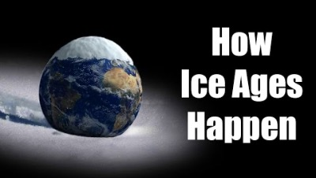
https://www.youtube.com/watch?v=iA788usYNWA
Notes:
https://www.youtube.com/watch?v=iA788usYNWA

Slide 24


Slide 25
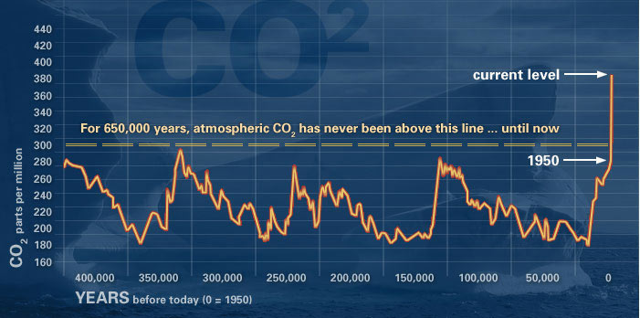
CO₂ is the highest it’s been in thousands of years

Slide 26
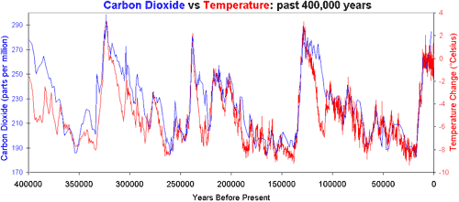
Temperature closely follows trends in CO₂

Slide 27
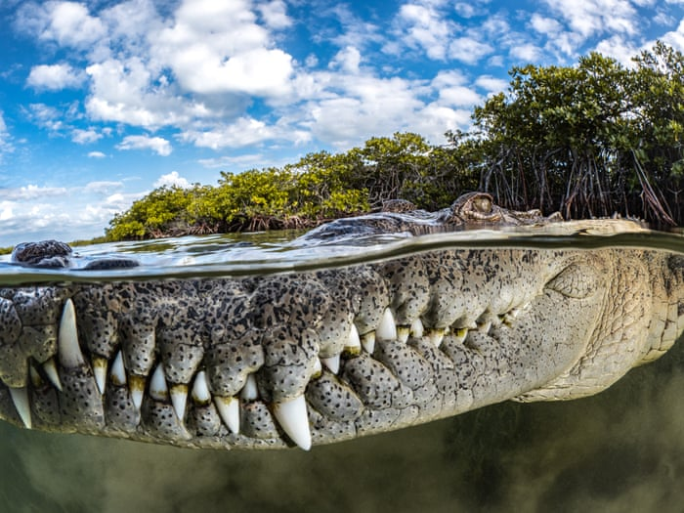
Climate
(average rainfall & temperature)
determines what plants and animals live and thrive best there.

Slide 28
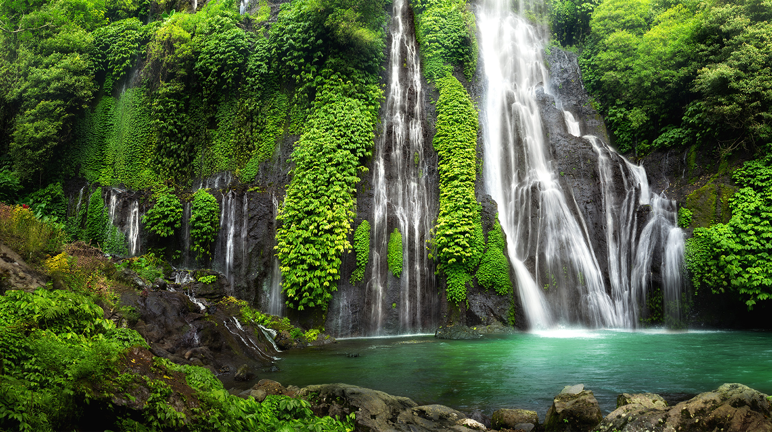

Slide 29


Slide 30
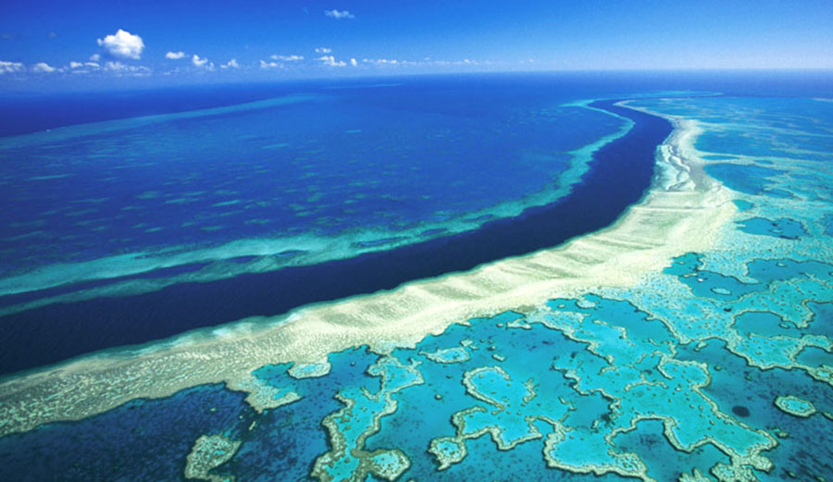

Slide 31
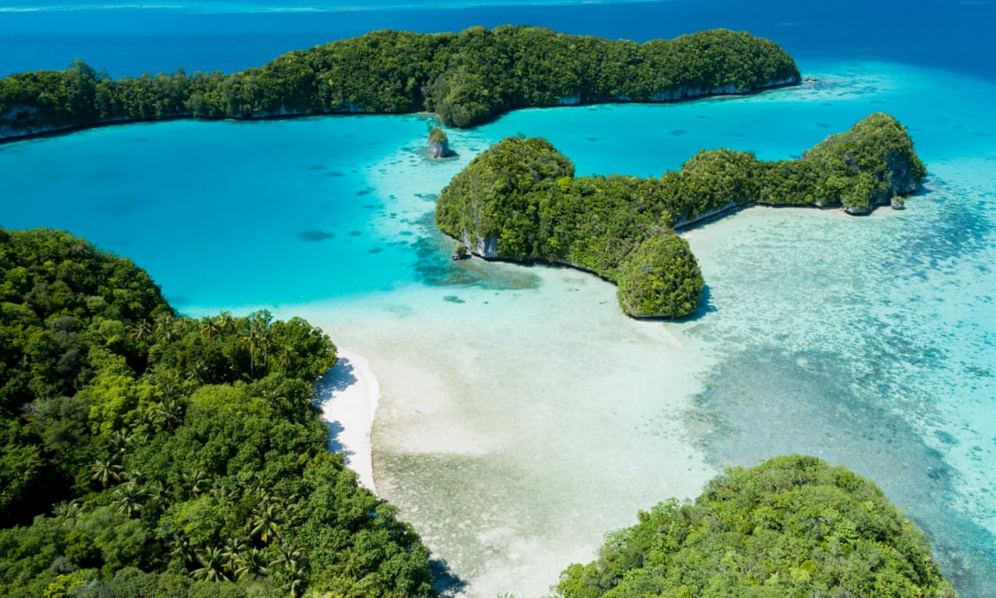

Slide 32
Coastlines are shaped by a number of factors, including
tectonic plate movements, shifts in climate patterns
and sea level change

Slide 33
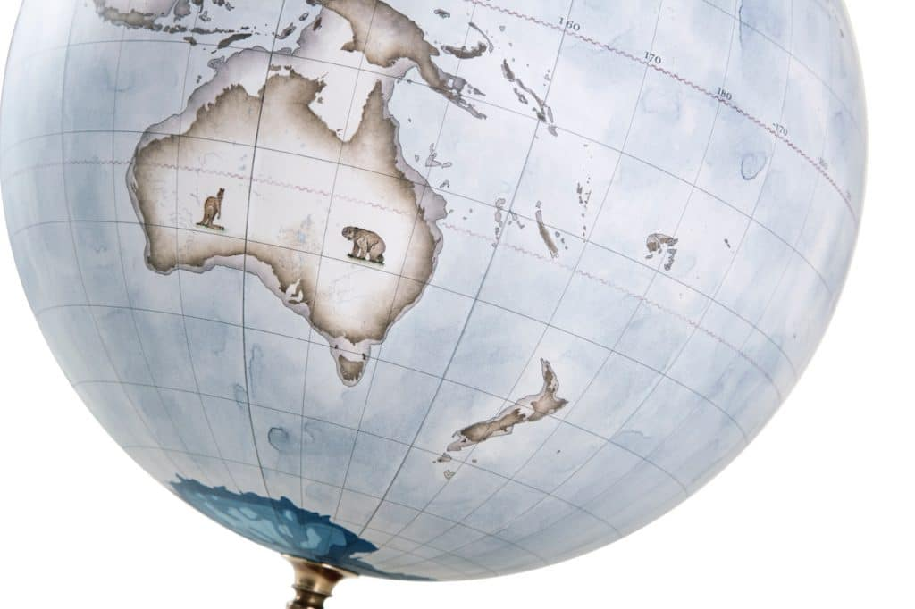
Sea level fall

Slide 34
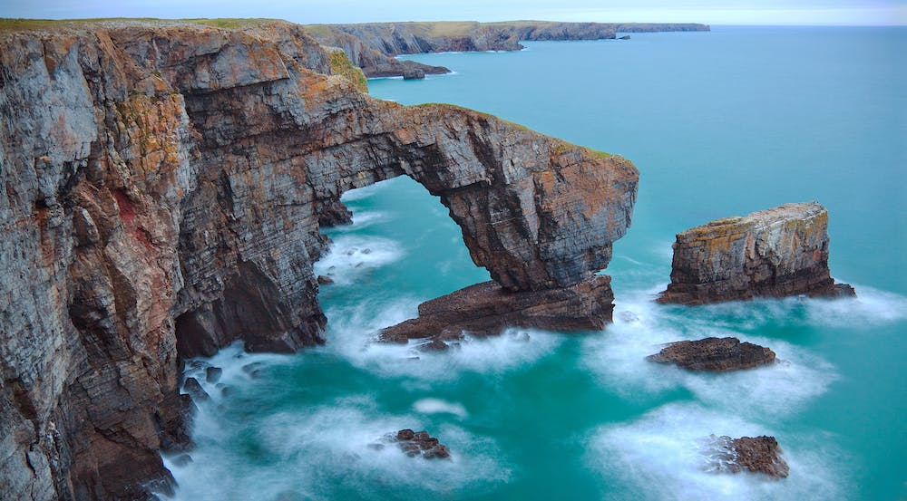

Slide 35
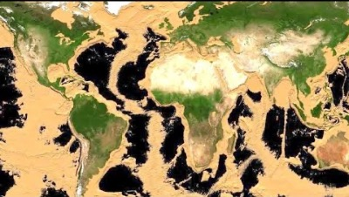
https://www.youtube.com/watch?v=X4pv-7DW-0c
Notes:
https://www.youtube.com/watch?v=X4pv-7DW-0c

Slide 36
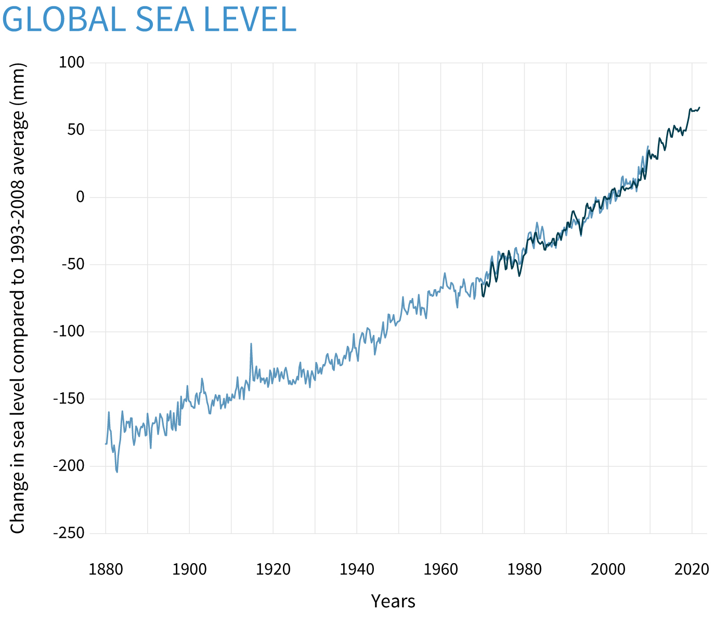
rise
Sea level rise

Slide 37
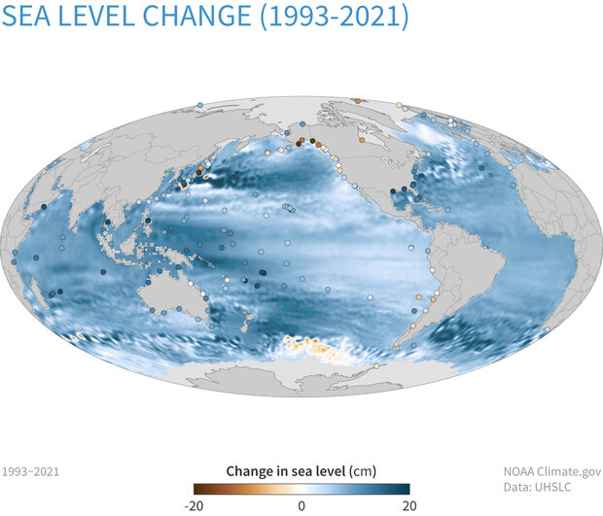
Sea level rise

Slide 38
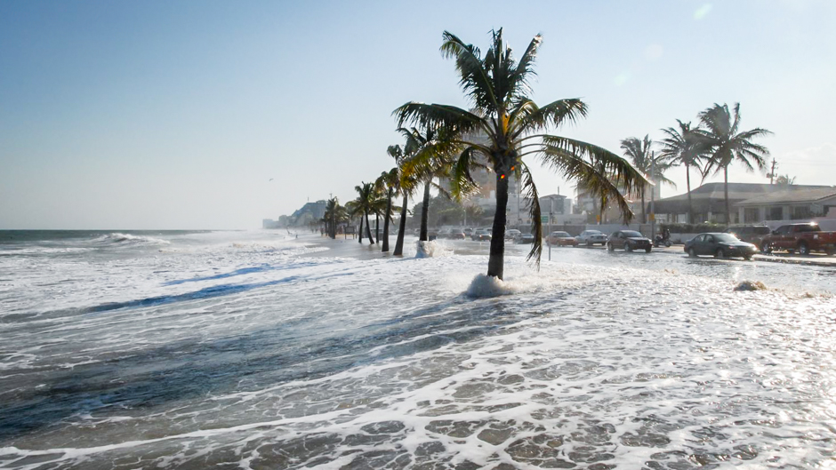
Notes:
https://ourworld.unu.edu/en/sea-level-rise-is-inevitable-but-we-can-still-prevent-catastrophe-for-coastal-regions

Slide 39
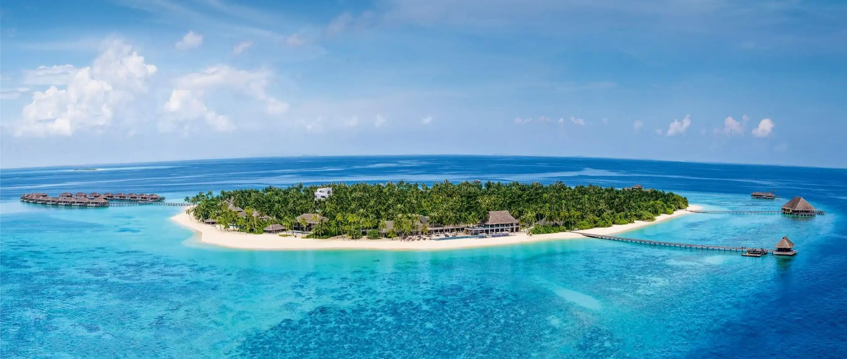
Maldives is only 1m above sea level

Slide 40
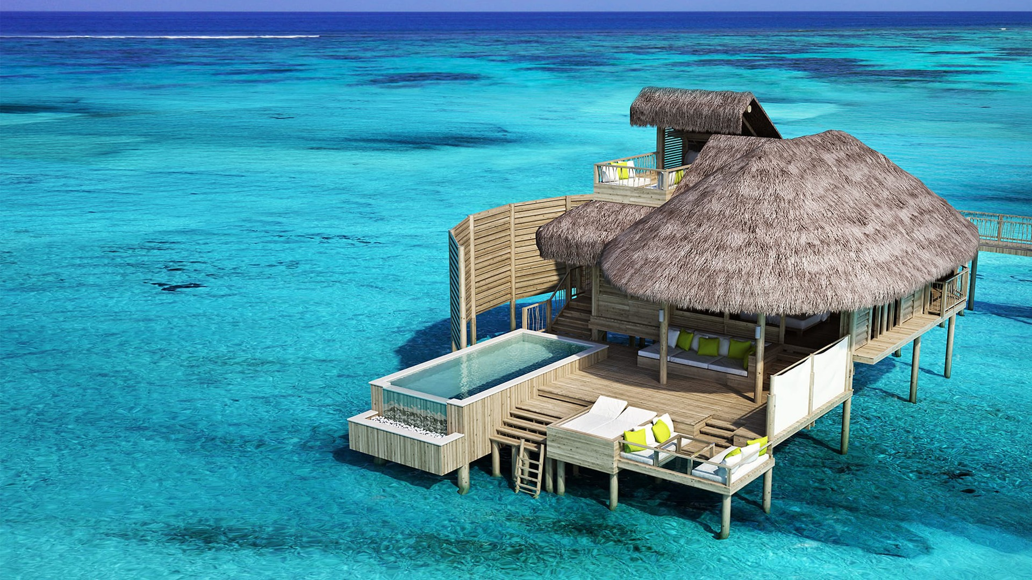

Slide 41
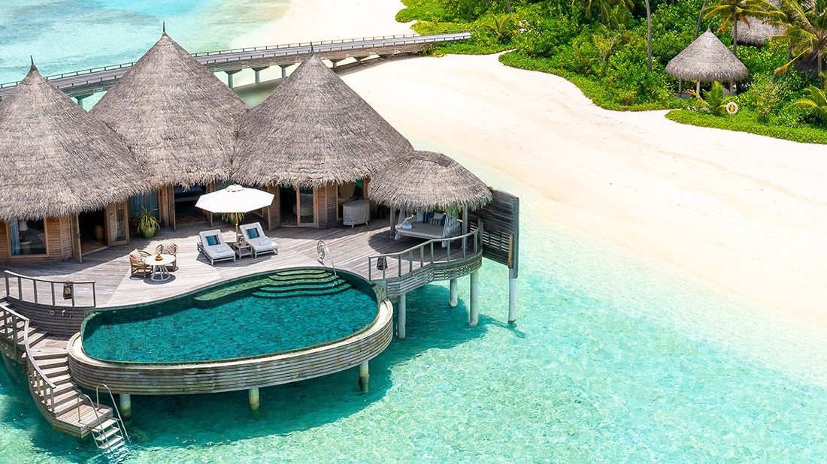

Slide 42
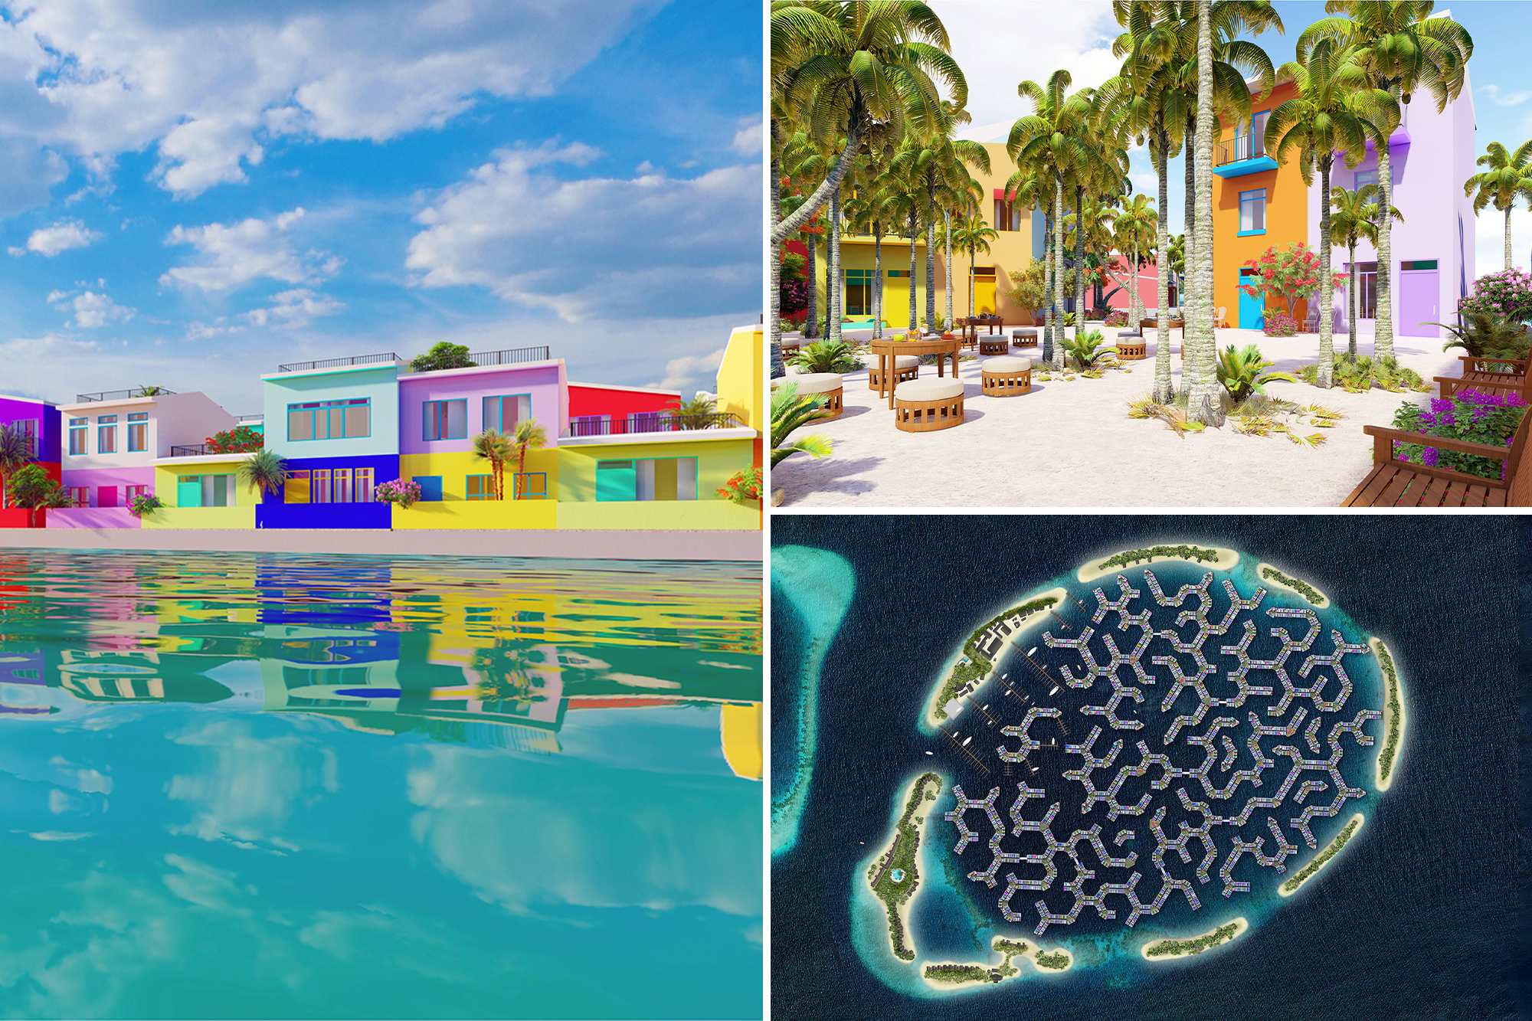
Maldives
plan to overcome
sea level rise is to develop
floating cities

Slide 43
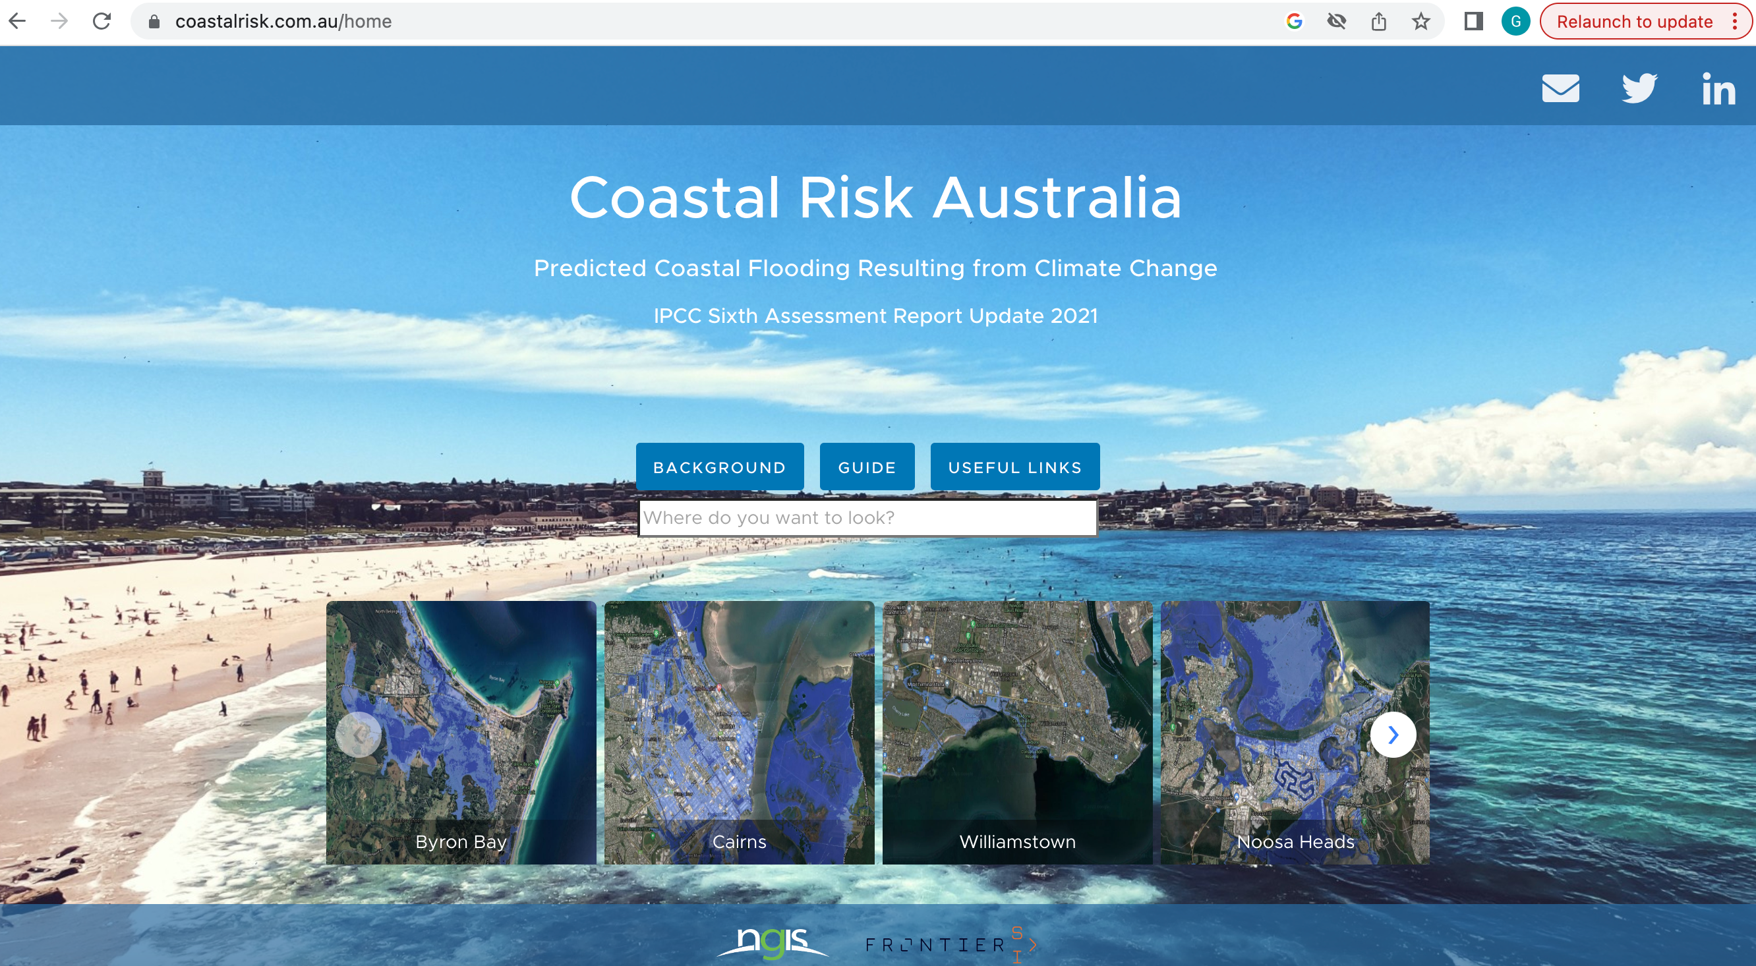
Will your house be underwater in 2100?

Slide 44
Coastlines are shaped by a number of factors, including
tectonic plate movements, shifts in climate patterns and sea level change,
weather patterns…

Slide 45
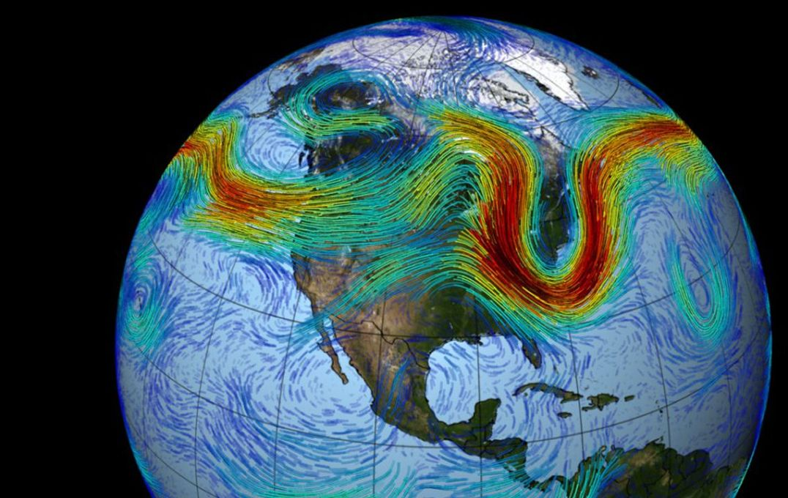
Weather patterns determine the amount of rain that falls, as well as the direction and the energy of the wind.

Slide 46
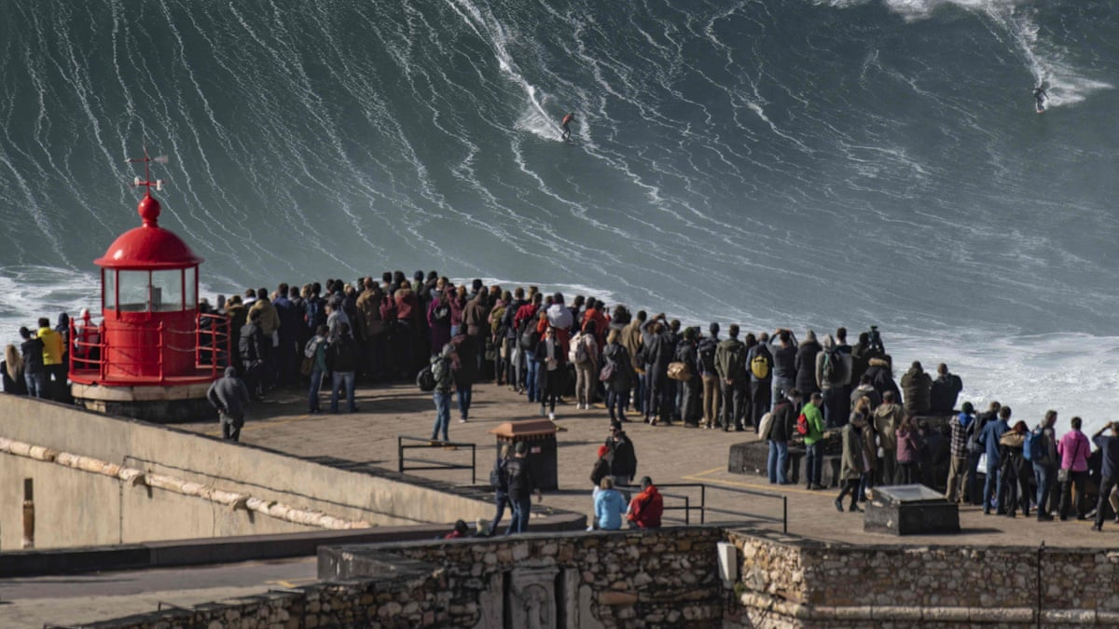

Slide 47
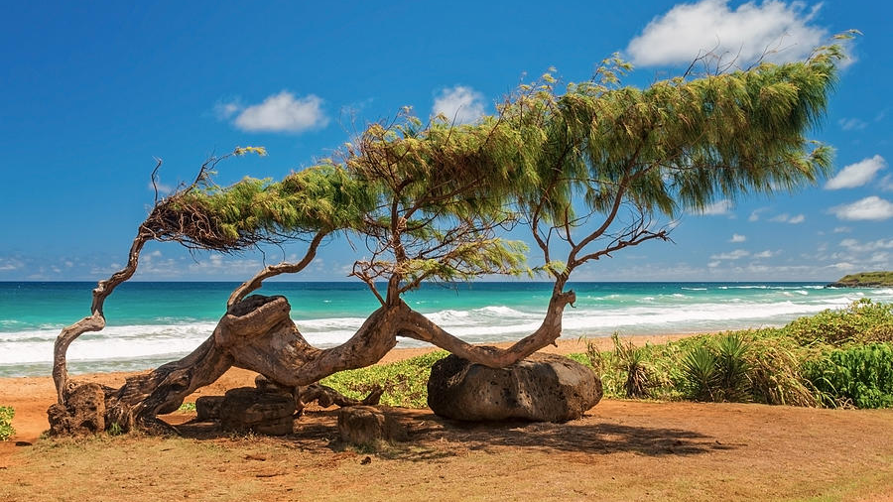

Slide 48
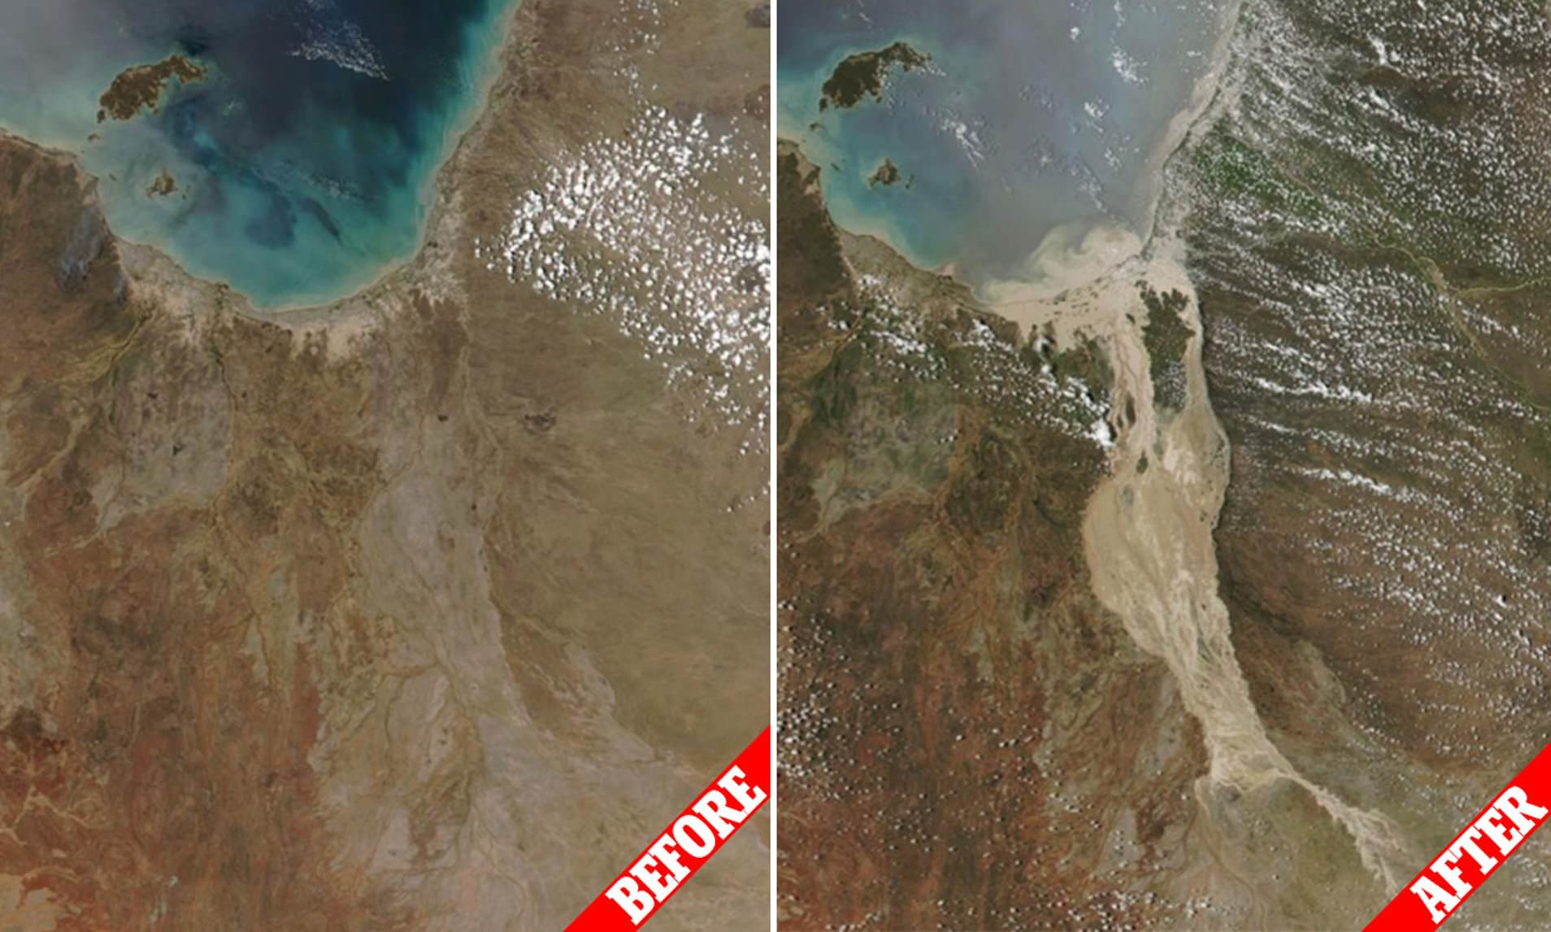
Flinders River

Slide 49
Coastlines are shaped by a number of factors, including
tectonic plate movements, shifts in climate patterns and sea level change, weather patterns and
movement of sediments and water
(e.g. waves, currents).

Slide 50


Slide 51
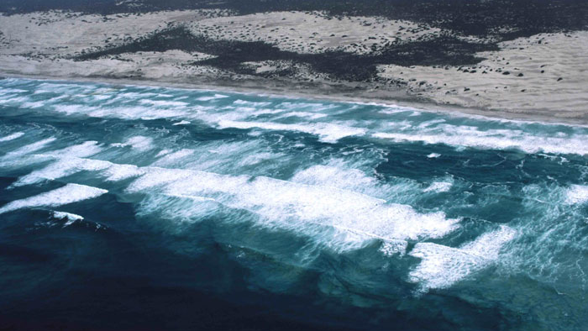

Slide 52
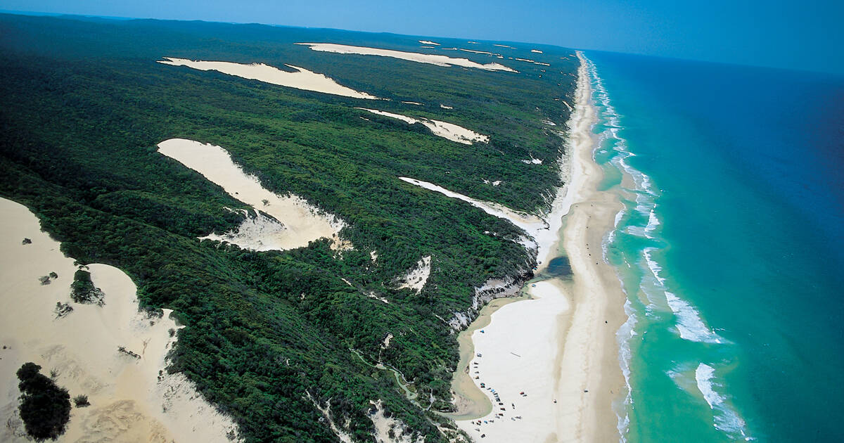

Slide 53


Slide 54
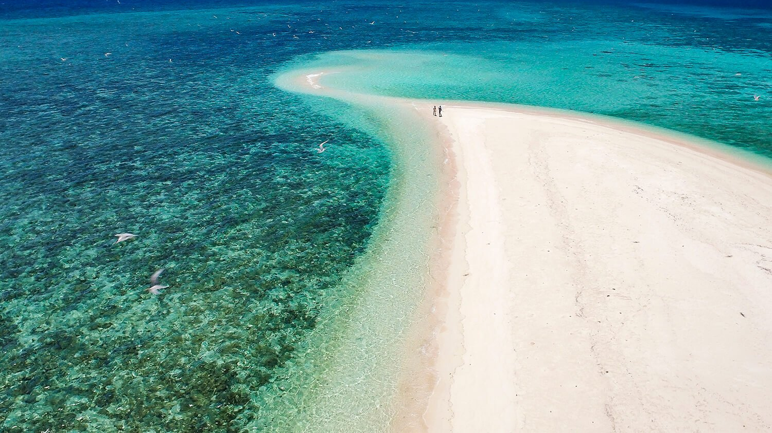

Slide 55
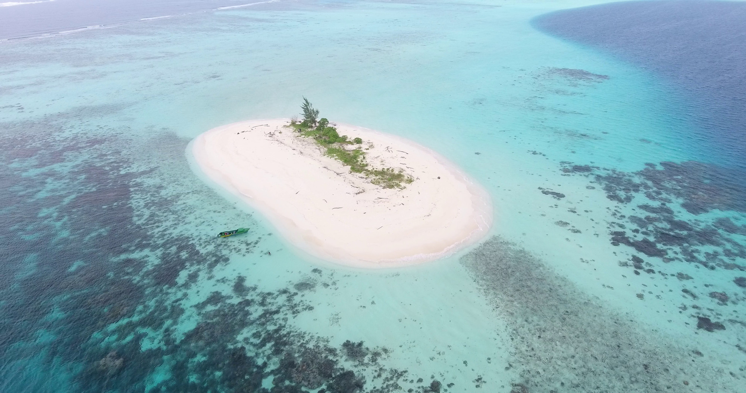

Slide 56
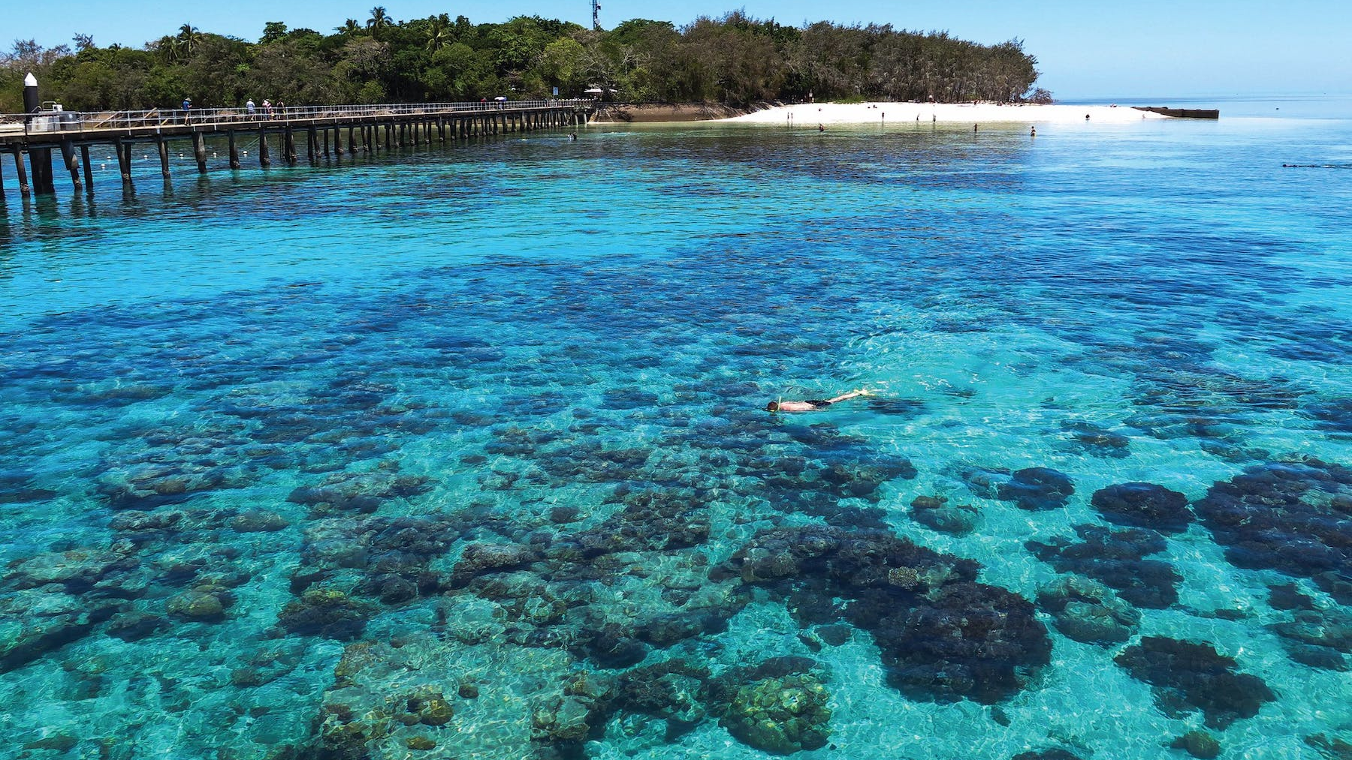

Slide 57
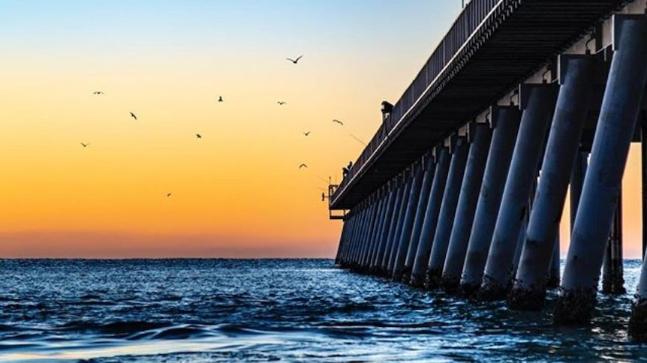
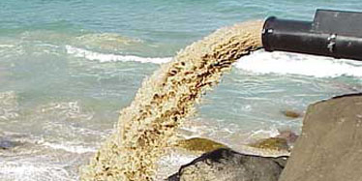
Sand bypass Gold Coast

Slide 58
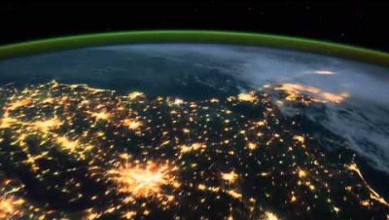
Notes:
https://www.youtube.com/watch?v=ls9yJTphLxg

Slide 59

Learning Intention:
Describe how coastlines are shaped by a number of factors, including tectonic plate movements, shifts in climate patterns and sea level change, weather patterns, and movement of sediments and water, e.g. waves, currents.
Success Criteria:
Complete Marine Education worksheet ‘1. The dynamic shore’

