Slide 1
Marine
Education
Measuring Biodiversity
marineeducation.com.au
Species Richness
and
Species Evenness
© Marine Education 2021
Little Books of Statistics: Diversity Indices

Slide 2
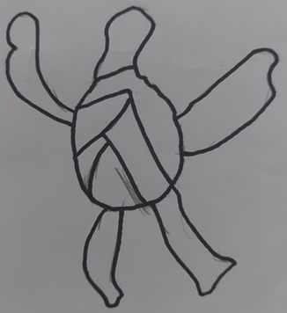
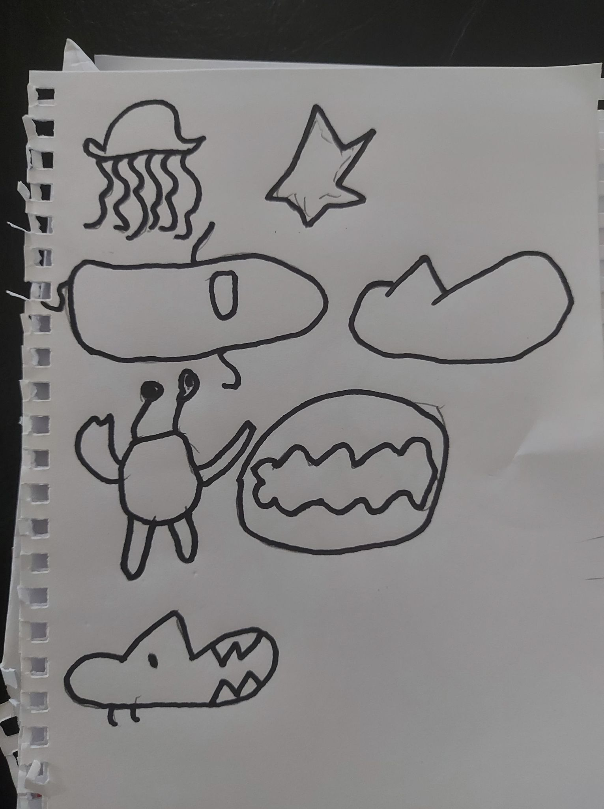
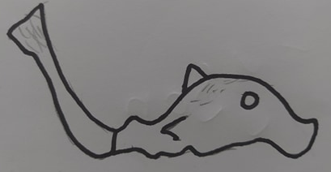
Marine
Education
Measuring Biodiversity
marineeducation.com.au
Biodiversity is
the diversity
of Biological life!
Art by Tyson Farrell (Age 7)
© Marine Education 2021
Little Books of Statistics: Diversity Indices

Slide 3
Marine
Education
Measuring Biodiversity
marineeducation.com.au
Biological LIFE
BIO
DIVERSITY
how diverse it is
© Marine Education 2021
Little Books of Statistics: Diversity Indices

Slide 4
Marine
Education
Measuring Biodiversity
marineeducation.com.au
BIO
BIODIVERSITY
the
in
could be….
© Marine Education 2021
Little Books of Statistics: Diversity Indices

Slide 5
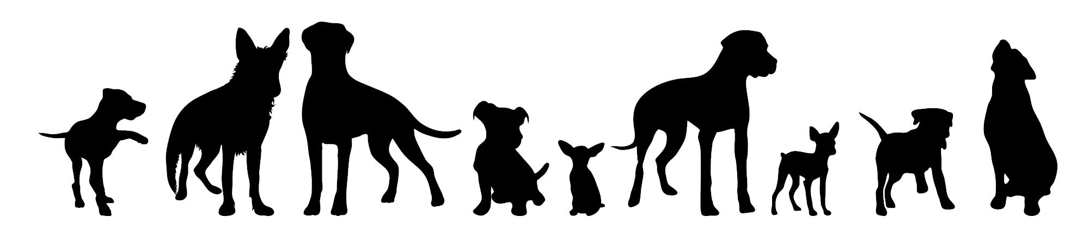
Marine
Education
Measuring Biodiversity
marineeducation.com.au
GENETIC bioDIVERSITY
The diversity of GENES
© Marine Education 2021
Little Books of Statistics: Diversity Indices

Slide 6

Marine
Education
Measuring Biodiversity
marineeducation.com.au
SPECIES bioDIVERSITY
The diversity of SPECIES
© Marine Education 2021
Little Books of Statistics: Diversity Indices

Slide 7

Marine
Education
Measuring Biodiversity
marineeducation.com.au
ECOSYSTEM bioDIVERSITY
The diversity of ECOSYSTEMS
© Marine Education 2021
Little Books of Statistics: Diversity Indices

Slide 8
Marine
Education
Species Richness
marineeducation.com.au
SPECIES RICHNESS
(S)
is the number of different species present
© Marine Education 2021
Little Books of Statistics: Diversity Indices

Slide 9

Marine
Education
Species Richness
marineeducation.com.au
Species Richness
How many different species can you count?
COUNT
© Marine Education 2021
Little Books of Statistics: Diversity Indices

Slide 10
Marine
Education
Species Richness
marineeducation.com.au
If there are
lots of different species……
COUNT
© Marine Education 2021
Little Books of Statistics: Diversity Indices

Slide 11
Marine
Education
Species Richness
marineeducation.com.au
….the ecosystem is healthy ☺
COUNT
© Marine Education 2021
Little Books of Statistics: Diversity Indices

Slide 12
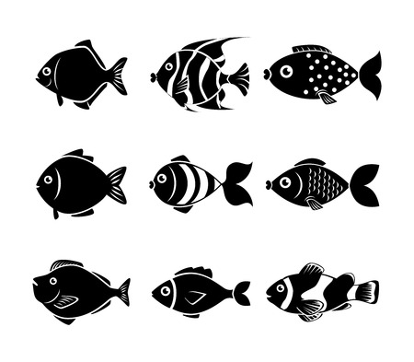
Marine
Education
Species Richness
marineeducation.com.au
© Marine Education 2021
Little Books of Statistics: Diversity Indices

Slide 13
Marine
Education
Species Richness
marineeducation.com.au
1
© Marine Education 2021
Little Books of Statistics: Diversity Indices

Slide 14
Marine
Education
Species Richness
marineeducation.com.au
2
© Marine Education 2021
Little Books of Statistics: Diversity Indices

Slide 15
Marine
Education
Species Richness
marineeducation.com.au
3
© Marine Education 2021
Little Books of Statistics: Diversity Indices

Slide 16
Marine
Education
Species Richness
marineeducation.com.au
4
© Marine Education 2021
Little Books of Statistics: Diversity Indices

Slide 17
Marine
Education
Species Richness
marineeducation.com.au
5
© Marine Education 2021
Little Books of Statistics: Diversity Indices

Slide 18
Marine
Education
Species Richness
marineeducation.com.au
5
© Marine Education 2021
Little Books of Statistics: Diversity Indices

Slide 19
Marine
Education
Species Richness
marineeducation.com.au
There are
5
different species
Species Richness = 5
© Marine Education 2021
Little Books of Statistics: Diversity Indices

Slide 20
Marine
Education
Species Richness
marineeducation.com.au
1
© Marine Education 2021
Little Books of Statistics: Diversity Indices

Slide 21
Marine
Education
Species Richness
marineeducation.com.au
2
© Marine Education 2021
Little Books of Statistics: Diversity Indices

Slide 22
Marine
Education
Species Richness
marineeducation.com.au
2
© Marine Education 2021
Little Books of Statistics: Diversity Indices

Slide 23
Marine
Education
Species Richness
marineeducation.com.au
There are
2
different species
Species Richness = 2
© Marine Education 2021
Little Books of Statistics: Diversity Indices

Slide 24
Marine
Education
Species Richness
marineeducation.com.au
Which ecosystem is healthier?
S=5
or
S=2?
© Marine Education 2021
Little Books of Statistics: Diversity Indices

Slide 25
Marine
Education
Species Richness
marineeducation.com.au
Which ecosystem is healthier?
S=5
or
S=2?
© Marine Education 2021
Little Books of Statistics: Diversity Indices

Slide 26
Marine
Education
Species Evenness
marineeducation.com.au
SPECIES EVENNESS
is the balance
of the number of
each species
present
© Marine Education 2021
Little Books of Statistics: Diversity Indices

Slide 27
Marine
Education
Species Evenness
marineeducation.com.au
Species Evenness
How many
individuals
of each species
can you count?
COUNT
© Marine Education 2021
Little Books of Statistics: Diversity Indices

Slide 28
Marine
Education
Species Evenness
marineeducation.com.au
1
3
2
© Marine Education 2021
Little Books of Statistics: Diversity Indices

Slide 29
Marine
Education
Species Evenness
marineeducation.com.au
1
2
3
© Marine Education 2021
Little Books of Statistics: Diversity Indices

Slide 30
Marine
Education
Species Evenness
marineeducation.com.au
1
2
3
© Marine Education 2021
Little Books of Statistics: Diversity Indices

Slide 31
Marine
Education
Species Evenness
marineeducation.com.au
1
2
3
© Marine Education 2021
Little Books of Statistics: Diversity Indices

Slide 32
Marine
Education
Species Evenness
marineeducation.com.au
1
2
3
© Marine Education 2021
Little Books of Statistics: Diversity Indices

Slide 33
Marine
Education
Species Evenness
marineeducation.com.au
3
of each
© Marine Education 2021
Little Books of Statistics: Diversity Indices

Slide 34
Marine
Education
Species Evenness
marineeducation.com.au
There are
3
of each species
© Marine Education 2021
Little Books of Statistics: Diversity Indices

Slide 35
Marine
Education
Species Evenness
marineeducation.com.au
SPECIES | n
 | 3 | SPECIES EVENNESS
 | 3
 | 3
 | 3
 | 3
(balance of n)
© Marine Education 2021
Little Books of Statistics: Diversity Indices

Slide 36
Marine
Education
Species Evenness
marineeducation.com.au
3
of each
© Marine Education 2021
Little Books of Statistics: Diversity Indices

Slide 37
Marine
Education
Species Evenness
marineeducation.com.au
HIGH
Species EVENness
© Marine Education 2021
Little Books of Statistics: Diversity Indices

Slide 38
Marine
Education
Species Evenness
marineeducation.com.au
The abundance is evenly balanced (3 of each)
EVEN!
Above: Rank Abundance Plot (also called a Whittaker Plot). Species are ranked from most abundant to least abundant on the x-axis.
© Marine Education 2021
Little Books of Statistics: Diversity Indices

Slide 39
Marine
Education
Species Evenness
marineeducation.com.au
compared to….
© Marine Education 2021
Little Books of Statistics: Diversity Indices

Slide 40
Marine
Education
Species Evenness
marineeducation.com.au
© Marine Education 2021
Little Books of Statistics: Diversity Indices

Slide 41
Marine
Education
Species Evenness
marineeducation.com.au
1
© Marine Education 2021
Little Books of Statistics: Diversity Indices

Slide 42
Marine
Education
Species Evenness
marineeducation.com.au
1
© Marine Education 2021
Little Books of Statistics: Diversity Indices

Slide 43
Marine
Education
Species Evenness
marineeducation.com.au
1
© Marine Education 2021
Little Books of Statistics: Diversity Indices

Slide 44
Marine
Education
Species Evenness
marineeducation.com.au
1
© Marine Education 2021
Little Books of Statistics: Diversity Indices

Slide 45
Marine
Education
Species Evenness
marineeducation.com.au
1
2
3
4
5
6
7
8
9
10
11
12
13
© Marine Education 2021
Little Books of Statistics: Diversity Indices

Slide 46
Marine
Education
Species Evenness
marineeducation.com.au
LOW
Species EVENness
dominates
© Marine Education 2021
Little Books of Statistics: Diversity Indices

Slide 47
Marine
Education
Species Evenness
marineeducation.com.au
SPECIES | n
 | 13 | SPECIES EVENNESS
 | 1
 | 1
 | 1
 | 1
(balance of n)
© Marine Education 2021
Little Books of Statistics: Diversity Indices

Slide 48
Marine
Education
Species Evenness
marineeducation.com.au
LOW Species EVENness
UNEVEN!
© Marine Education 2021
Little Books of Statistics: Diversity Indices

Slide 49
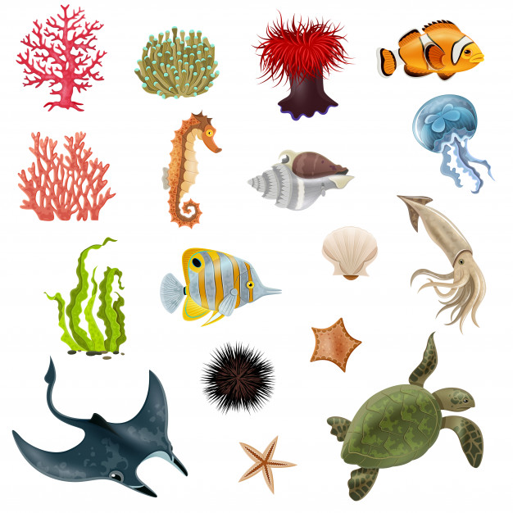
Marine
Education
Measuring Biodiversity
marineeducation.com.au
High Species Richness = High Biodiversity
© Marine Education 2021
Little Books of Statistics: Diversity Indices

Slide 50
Marine
Education
Measuring Biodiversity
marineeducation.com.au
High Species Evenness = High Biodiversity
© Marine Education 2021
Little Books of Statistics: Diversity Indices

Slide 51
Marine
Education
Measuring Biodiversity
marineeducation.com.au
Low Species Richness = Low Biodiversity
© Marine Education 2021
Little Books of Statistics: Diversity Indices

Slide 52
Marine
Education
Measuring Biodiversity
marineeducation.com.au
Low Species Evenness = Low Biodiversity
© Marine Education 2021
Little Books of Statistics: Diversity Indices

Slide 53
Marine
Education
QUESTION…
marineeducation.com.au
Is the following ecosystem healthy or unhealthy?
To find out, we must COUNT!
© Marine Education 2021
Little Books of Statistics: Diversity Indices

Slide 54
Marine
Education
Healthy or Unhealthy?
marineeducation.com.au
© Marine Education 2021
Little Books of Statistics: Diversity Indices

Slide 55





Marine
Education
Identify and Tally
marineeducation.com.au
SPECIES | tally
 | 1
 | 3
 | 2
 | 1
 | 1
 | 2
 | 3
 | 4
© Marine Education 2021
Little Books of Statistics: Diversity Indices

Slide 56
Marine
Education
Species Richness
marineeducation.com.au
SPECIES | tally
 | 1
 | 3
 | 2
 | 1
 | 1
 | 2
 | 3
 | 4
© Marine Education 2021
Little Books of Statistics: Diversity Indices

Slide 57
Marine
Education
Species Richness
marineeducation.com.au
Number of rows
=
species richness
(s)
© Marine Education 2021
Little Books of Statistics: Diversity Indices

Slide 58
Marine
Education
Species Richness
marineeducation.com.au
SPECIES | tally
1 | 1
 | 3
 | 2
 | 1
 | 1
 | 2
 | 3
 | 4
1.
© Marine Education 2021
Little Books of Statistics: Diversity Indices

Slide 59
Marine
Education
Species Richness
marineeducation.com.au
SPECIES | tally
1 | 1
 | 3
 | 2
 | 1
 | 1
 | 2
 | 3
 | 4
1.
2.
© Marine Education 2021
Little Books of Statistics: Diversity Indices

Slide 60
Marine
Education
Species Richness
marineeducation.com.au
SPECIES | tally
1 | 1
 | 3
 | 2
 | 1
 | 1
 | 2
 | 3
 | 4
1.
2.
3.
© Marine Education 2021
Little Books of Statistics: Diversity Indices

Slide 61
Marine
Education
Species Richness
marineeducation.com.au
SPECIES | tally
1 | 1
 | 3
 | 2
 | 1
 | 1
 | 2
 | 3
 | 4
1.
2.
3.
4..
© Marine Education 2021
Little Books of Statistics: Diversity Indices

Slide 62
Marine
Education
Species Richness
marineeducation.com.au
SPECIES | tally
1 | 1
 | 3
 | 2
 | 1
 | 1
 | 2
 | 3
 | 4
1.
2.
3.
4..
5..
6..
7..
8..
© Marine Education 2021
Little Books of Statistics: Diversity Indices

Slide 63
Marine
Education
Species Richness
marineeducation.com.au
8
© Marine Education 2021
Little Books of Statistics: Diversity Indices

Slide 64
Marine
Education
Species Richness
marineeducation.com.au
There are
8
different species
Species Richness = 8
© Marine Education 2021
Little Books of Statistics: Diversity Indices

Slide 65
Marine
Education
Species Richness
marineeducation.com.au
There are
8
rows
Species Richness = 8
© Marine Education 2021
Little Books of Statistics: Diversity Indices

Slide 66
Marine
Education
Healthy or Unhealthy?
marineeducation.com.au
© Marine Education 2021
Little Books of Statistics: Diversity Indices

Slide 67
Marine
Education
Species Evenness
marineeducation.com.au
SPECIES | tally
1 | 1
 | 3
 | 2
 | 1
 | 1
 | 2
 | 3
 | 4
© Marine Education 2021
Little Books of Statistics: Diversity Indices

Slide 68
Marine
Education
Species Evenness
marineeducation.com.au
Does one species dominate?
© Marine Education 2021
Little Books of Statistics: Diversity Indices

Slide 69
Marine
Education
Species Evenness
marineeducation.com.au
© Marine Education 2021
Little Books of Statistics: Diversity Indices

Slide 70
Marine
Education
Species Evenness
marineeducation.com.au
No.
One species does NOT dominate
© Marine Education 2021
Little Books of Statistics: Diversity Indices

Slide 71
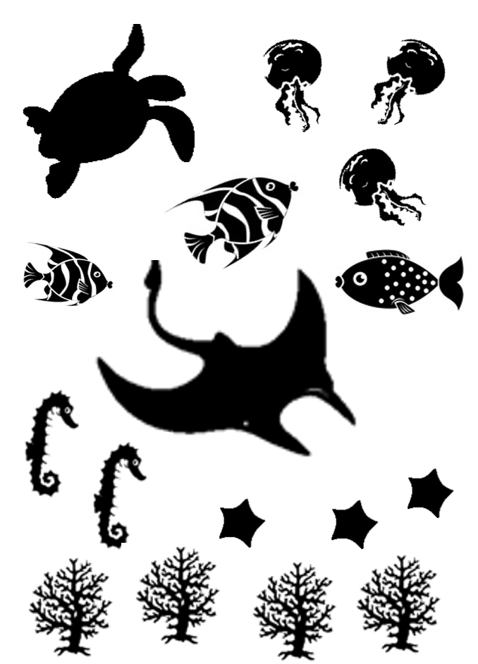
Marine
Education
Healthy or Unhealthy?
marineeducation.com.au
High Species Evenness = High Biodiversity
© Marine Education 2021
Little Books of Statistics: Diversity Indices

Slide 72
Marine
Education
Healthy or Unhealthy?
marineeducation.com.au
High Species Richness = High Biodiversity
© Marine Education 2021
Little Books of Statistics: Diversity Indices

Slide 73
Marine
Education
Healthy!
marineeducation.com.au
High Biodiversity
=
Healthy!
☺
© Marine Education 2021
Little Books of Statistics: Diversity Indices

