Slide 1
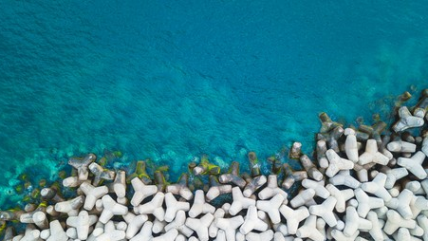
Learning Intention:
Explain how coastal engineering regulates water or sediment flow, affects currents and impacts the coastline, including marine ecosystems
Success Criteria:
Complete Marine Education worksheet ’10. Engineering Marvels or Mayhem?

Slide 2
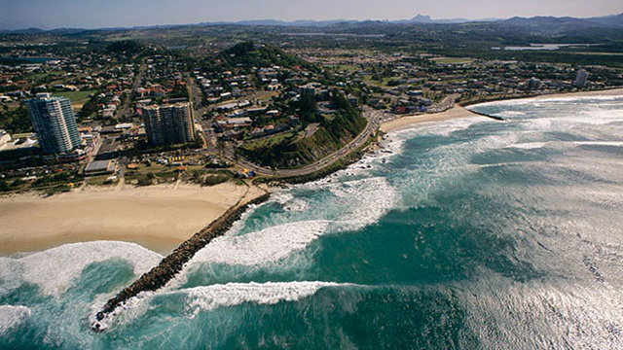
Notes:
Image: https://pantaimoribb.weebly.com/coastal-managment-in-australia.html

Slide 3
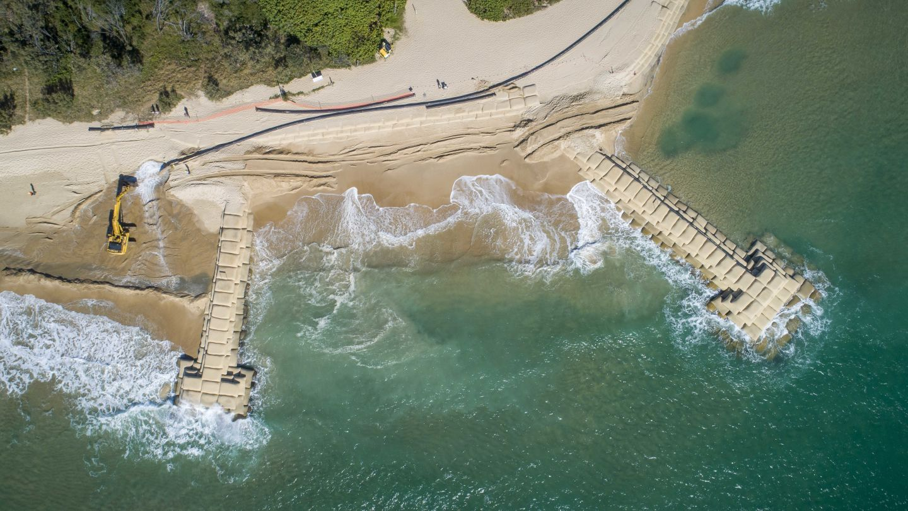
Notes:
Image: https://www.hallcontracting.com.au/projects/government/maroochy-groyne-renewal-project

Slide 4
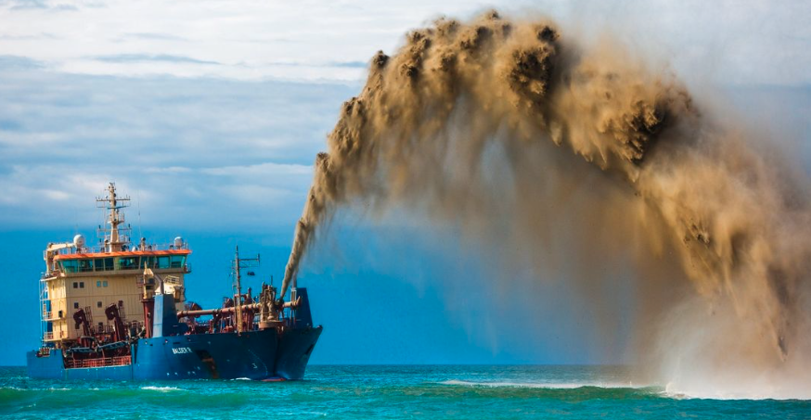
Notes:
Image: https://www.swellnet.com/news/swellnet-dispatch/2022/11/01/sand-nourishment-trial-the-sunshine-coast

Slide 5
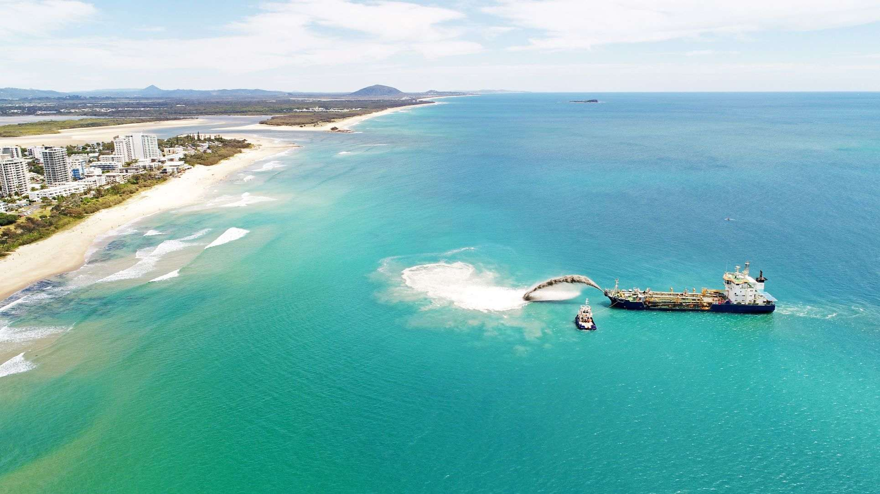
Notes:
Image: https://www.sunshinecoastnews.com.au/2023/06/13/beaches-boost-replenishment-trial-shows-technique-has-merit/

Slide 6
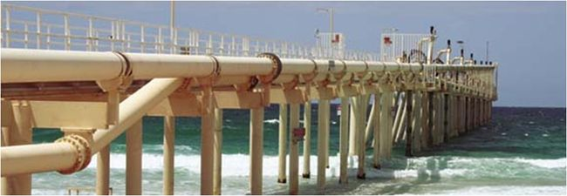
Trestle of Tweed River Sand bypass system (Gold Coast)
Notes:
Image: https://www.coastalwiki.org/wiki/Sand_by-pass_systems

Slide 7
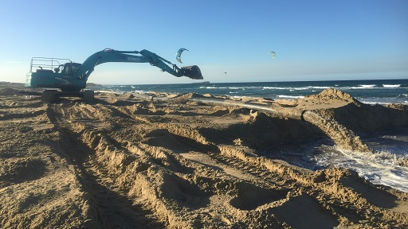
Notes:
Image; https://www.sunshinecoast.qld.gov.au/council/planning-and-projects/infrastructure-projects/maroochydore-sand-renourishment

Slide 8
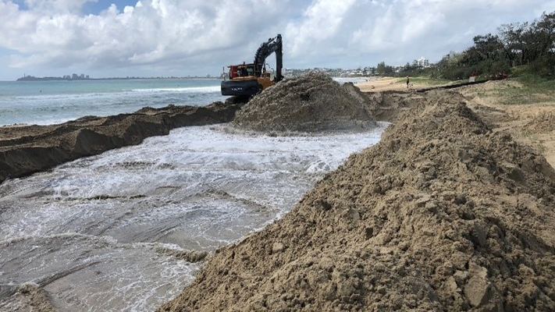
Notes:
Image: https://www.abc.net.au/news/rural/2022-11-24/mooloolaba-harbour-dredging-sandbank-fishing-boating/101691978

Slide 9
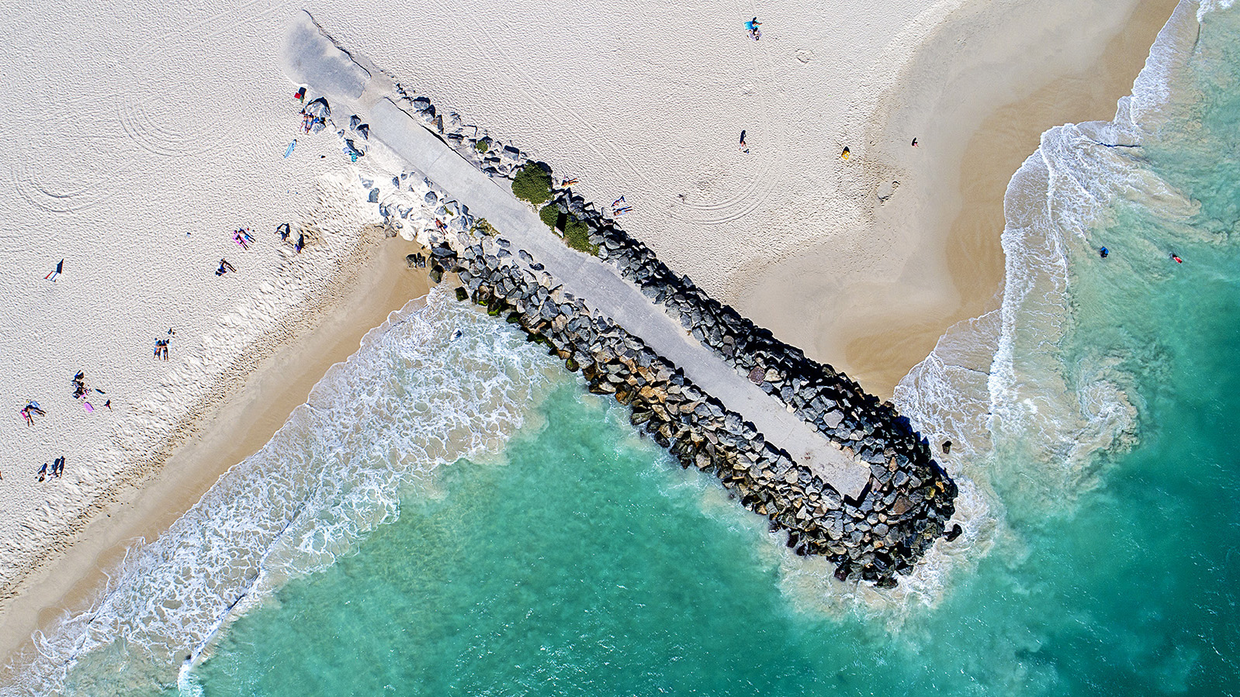
Notes:
Image: https://www.miragegallery.com.au/mirage-shop/jason-mazur/021-city-beach-groyne/

Slide 10
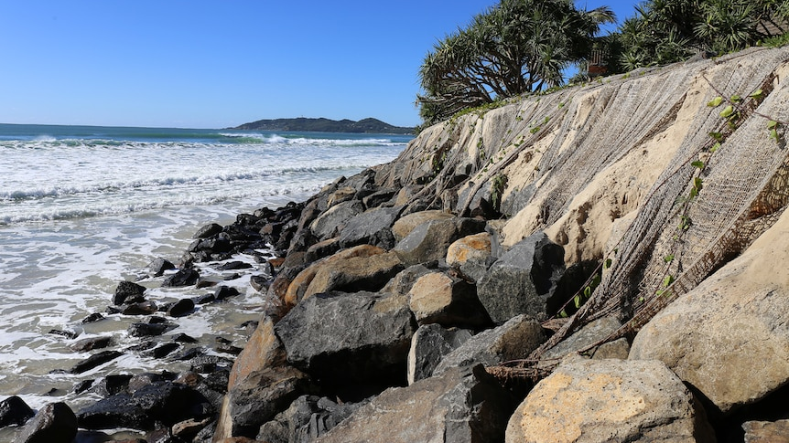
Notes:
Image: https://www.abc.net.au/news/2016-06-07/beach-erosion-has-rock-walls-in-doubt-at-byron-bay/7486514

Slide 11
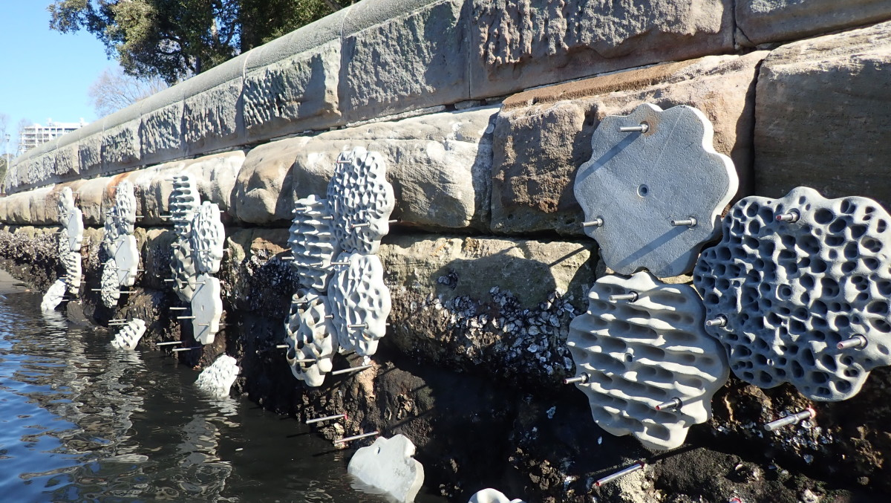
Living seawall
Notes:
Image: https://news.cityofsydney.nsw.gov.au/articles/living-seawalls-bring-new-life-to-our-city-harbour
From snails and seaweed to crabs and limpets, the harbour suburb of Rushcutters Bay is ready to attract more sea plants and creatures with a new living seawall.

Slide 12
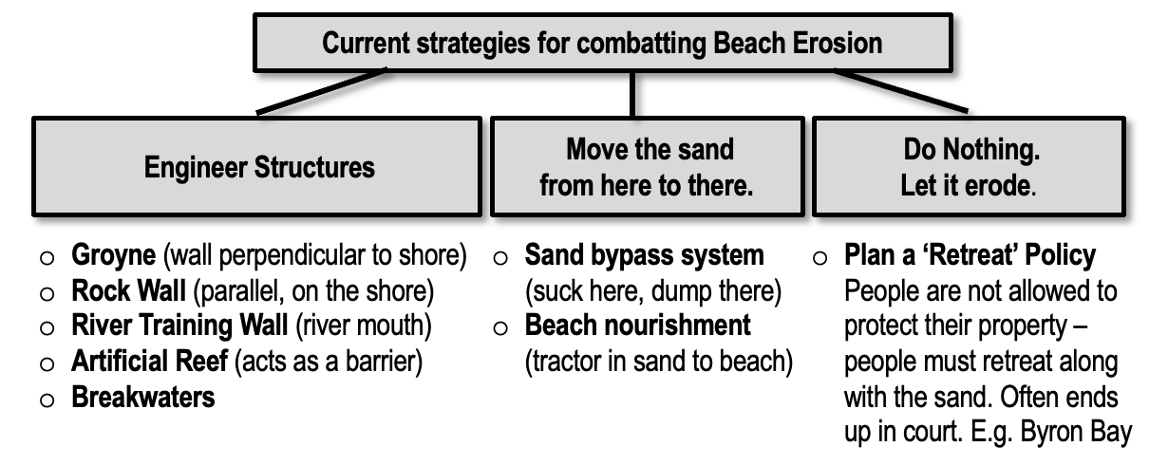
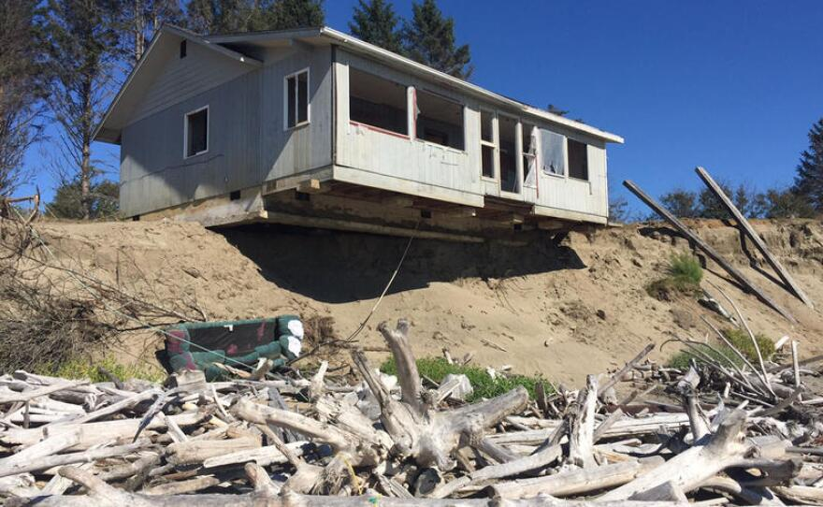
For example…

Slide 13
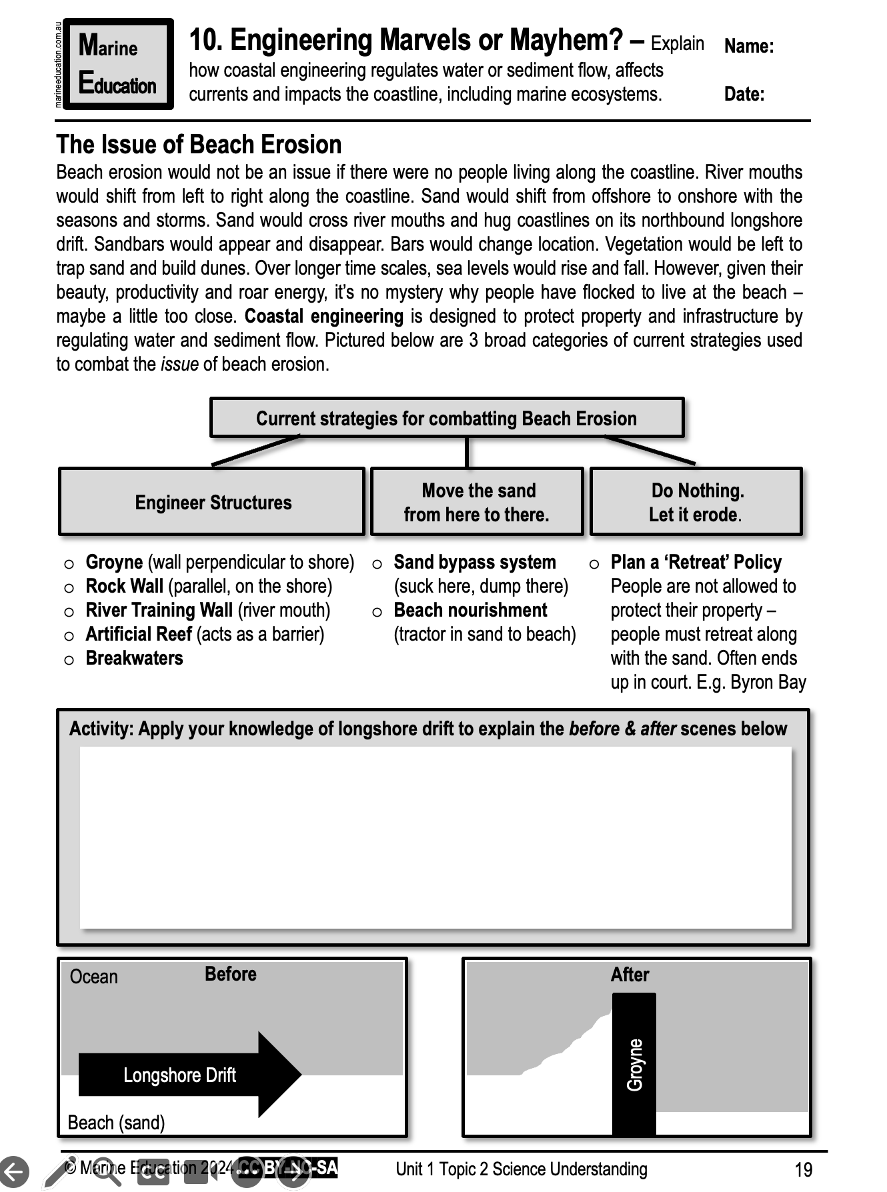
Learning Intention:
Explain how coastal engineering regulates water or sediment flow, affects currents and impacts the coastline, including marine ecosystems
Success Criteria:
Complete Marine Education worksheet ’10. Engineering Marvels or Mayhem?

