Slide 1
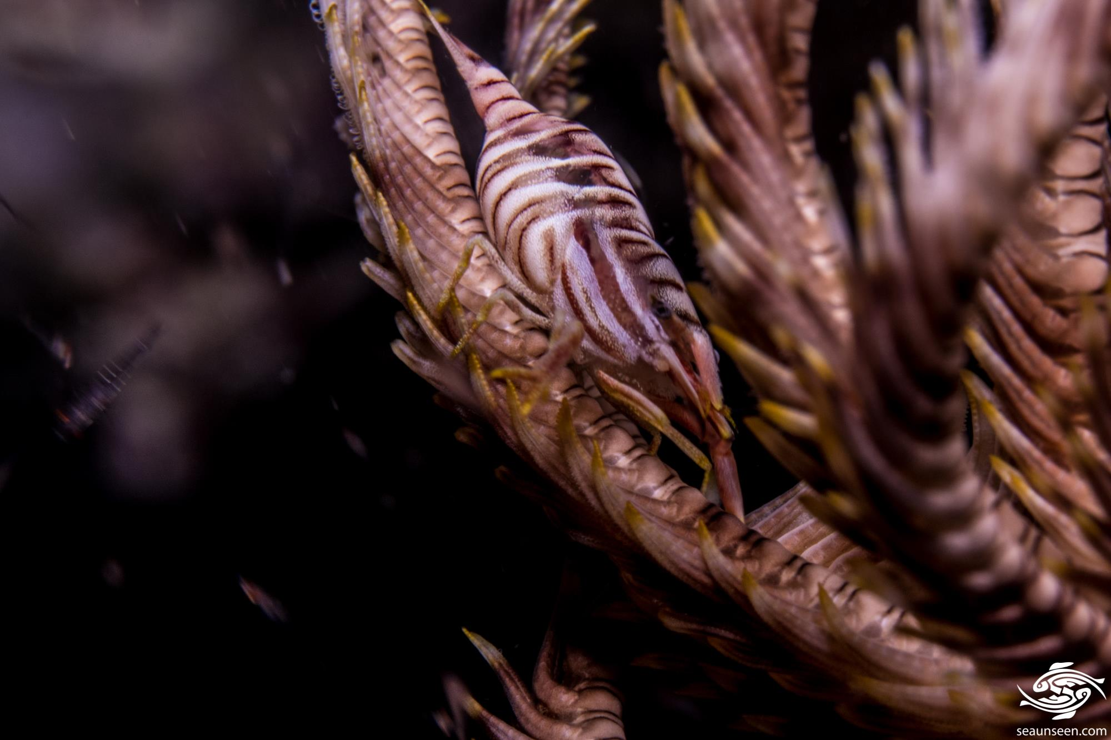
Learning Intention:
Classify biotic interactions based on the following terms:
symbiosis (i.e. parasitism, mutualism, commensalism and amensalism)
competition (i.e. intraspecific and interspecific)
predation.
Success Criteria:
Complete Marine Education worksheet “Social Shenanigans”

Slide 2
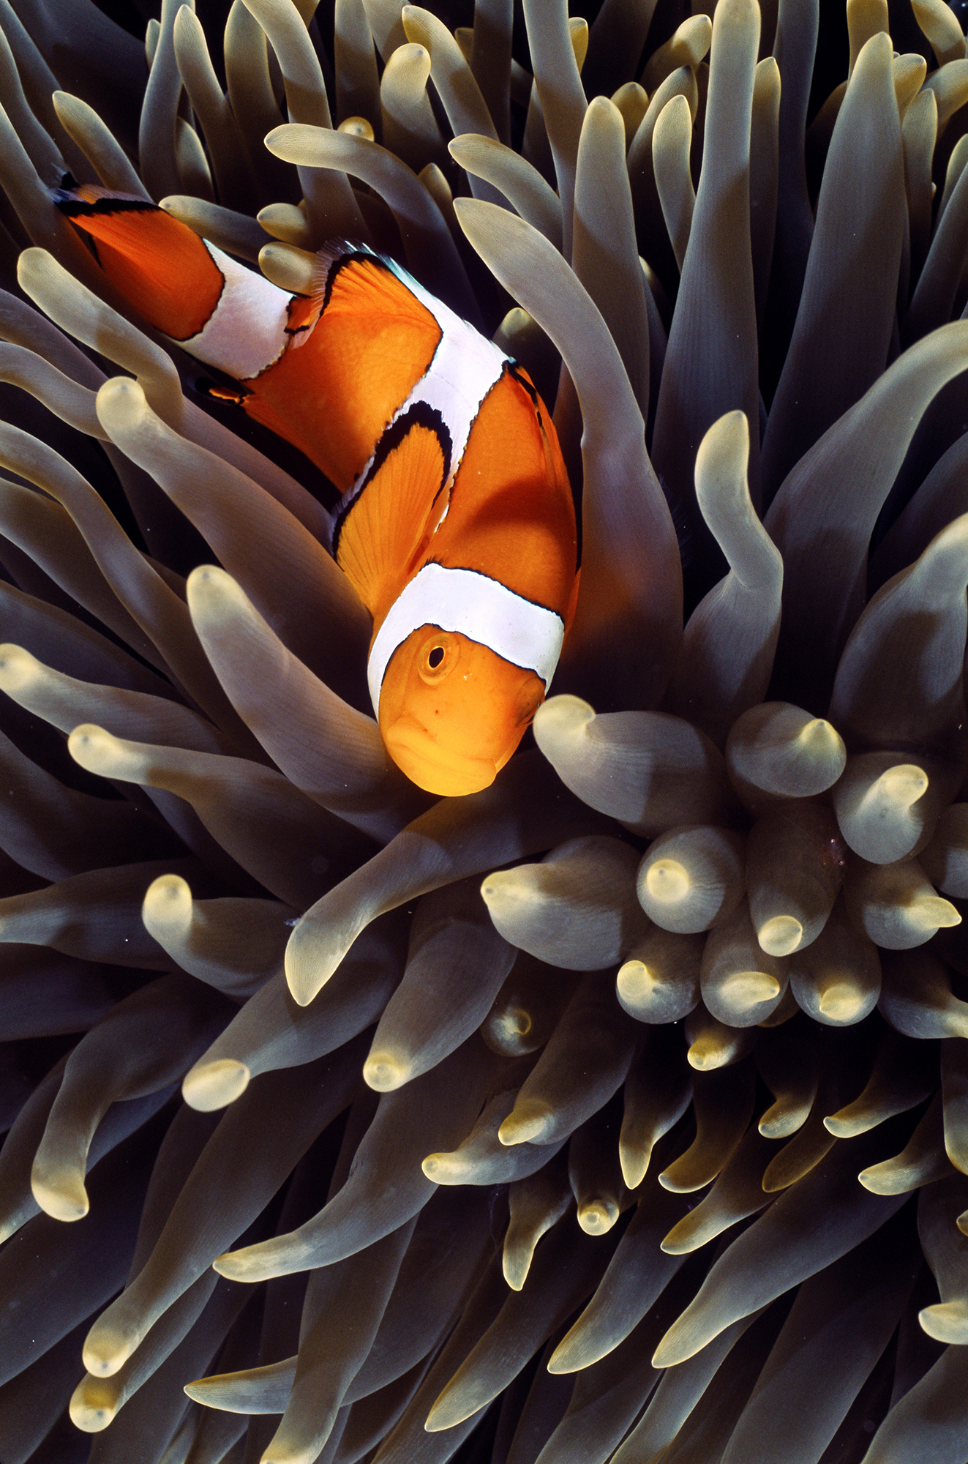
Mechanism of Interaction |  | Effect on “guest” | Effect on “host”
Symbiosis | Parasitism | + | -
 | Mutualism | + | +
 | Commensalism | + | 0
 | Amensalism | 0 | -
Competition |  | - | -
Predation |  | + | -
positive (+) effect
negative (-) effect
no/neutral (0) effect
e.g.

Slide 3
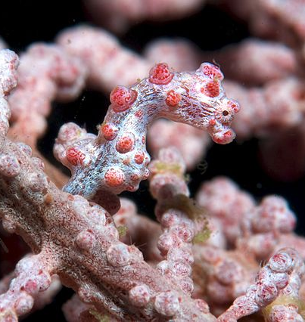
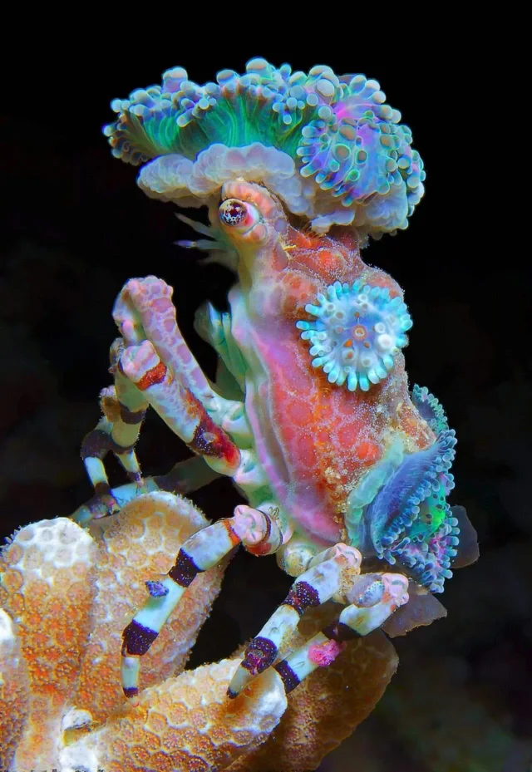
Symbiosis (2 different species living together)

Slide 4
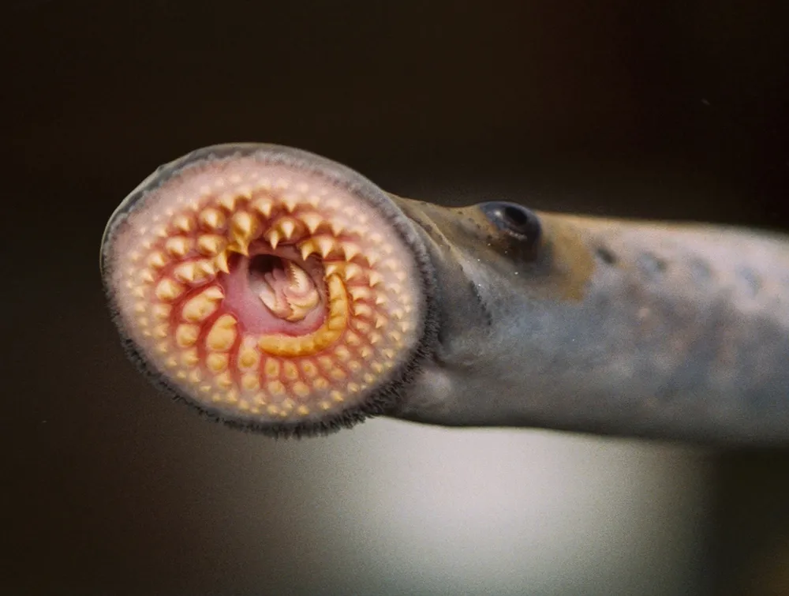
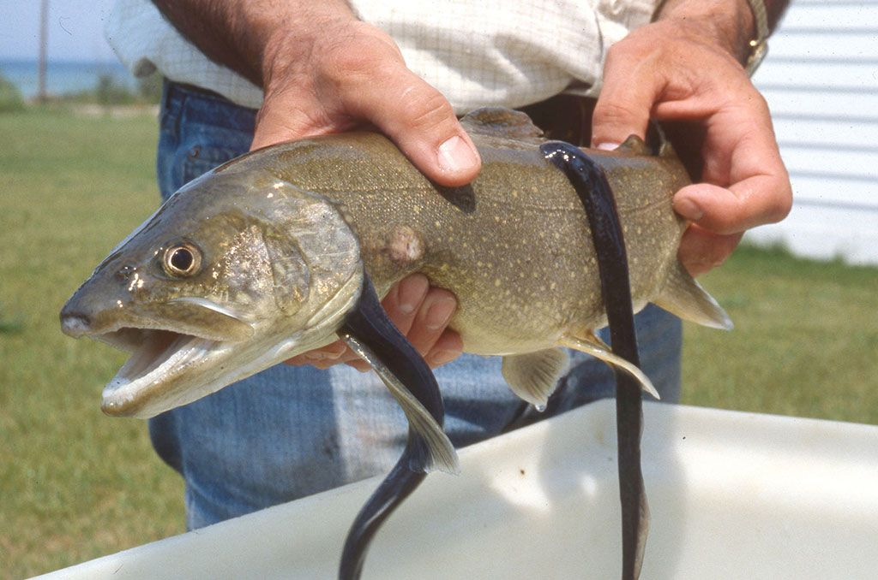
Parasitism
(+, -)
Lamprey
Notes:
Image: https://ocean.si.edu/ocean-life/7-ocean-parasites-worth-celebrating-world-parasite-day

Slide 5
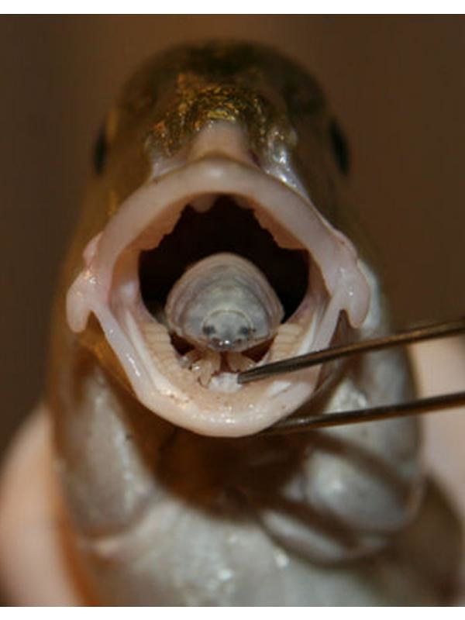
Louse (isopod)
This is a parasitic isopod called a louse
(Cymothoa exigua)
Notes:
Image: https://ar.inspiredpencil.com/pictures-2023/parasitism-examples-in-ocean

Slide 6
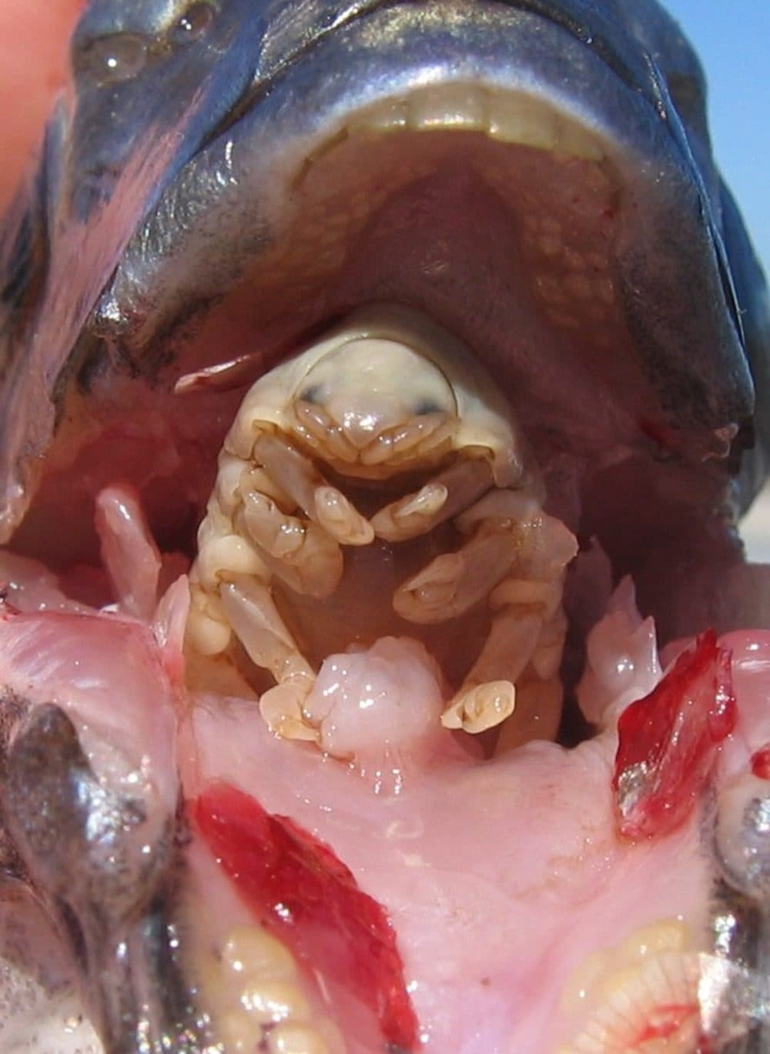
This parasite enters the fish through the gills and then cuts the fish's tongue and
becomes the new tongue and thus takes over every food that the fish gets.

Slide 7
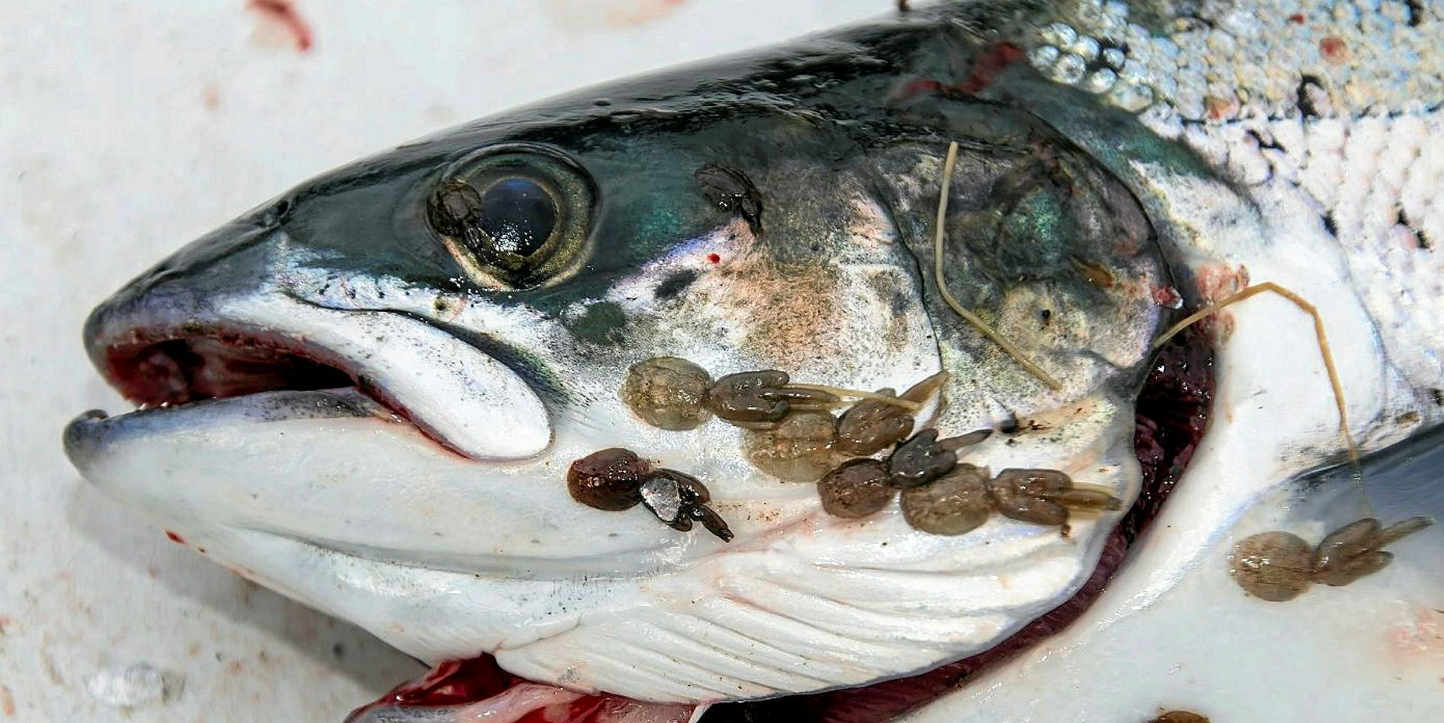
Parasitic sea lice (copepods)
Salmon
Notes:
Image: https://www.intrafish.com/aquaculture/business-intelligence-the-secret-lives-of-sea-lice/2-1-632875?zephr_sso_ott=OcVn7K

Slide 8
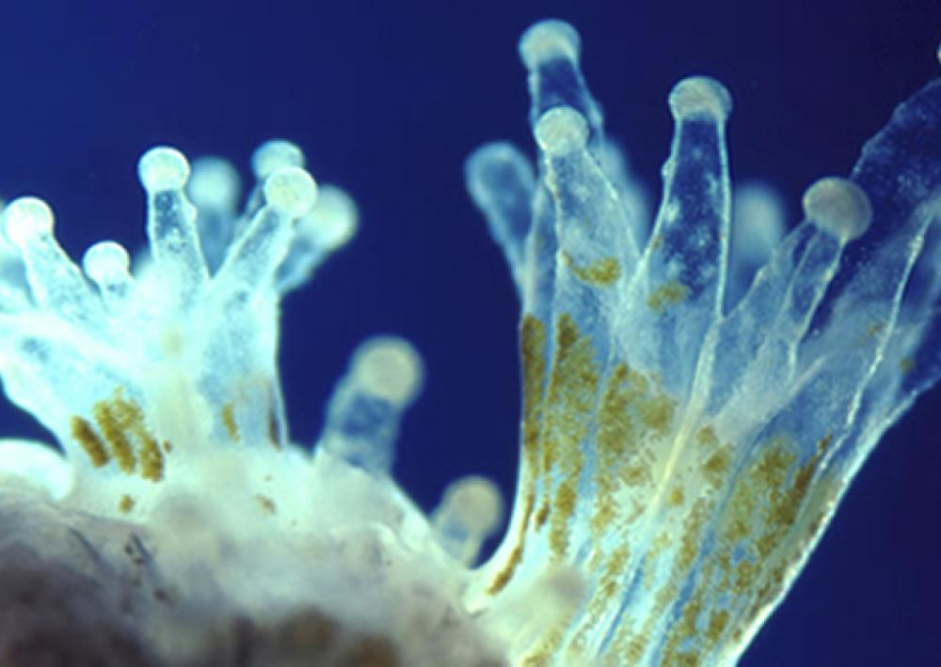
zooxanthellae
Mutualism (+, +)
Notes:
Image: https://www.forbes.com/sites/allenelizabeth/2019/06/30/bleached-corals-compensate-for-stress-by-eating-more-plankton/?sh=172a6ded21ac

Slide 9
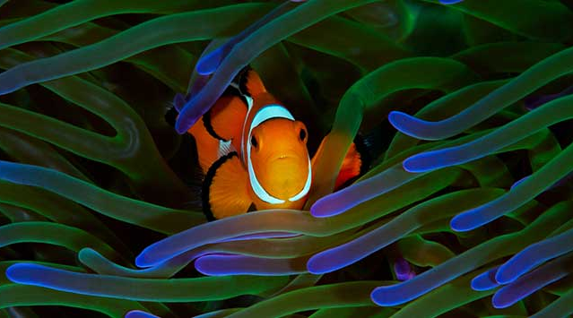
Notes:
Image: https://www.tfhmagazine.com/articles/saltwater/so-happy-together-symbiosis-in-the-marine-aquarium

Slide 10
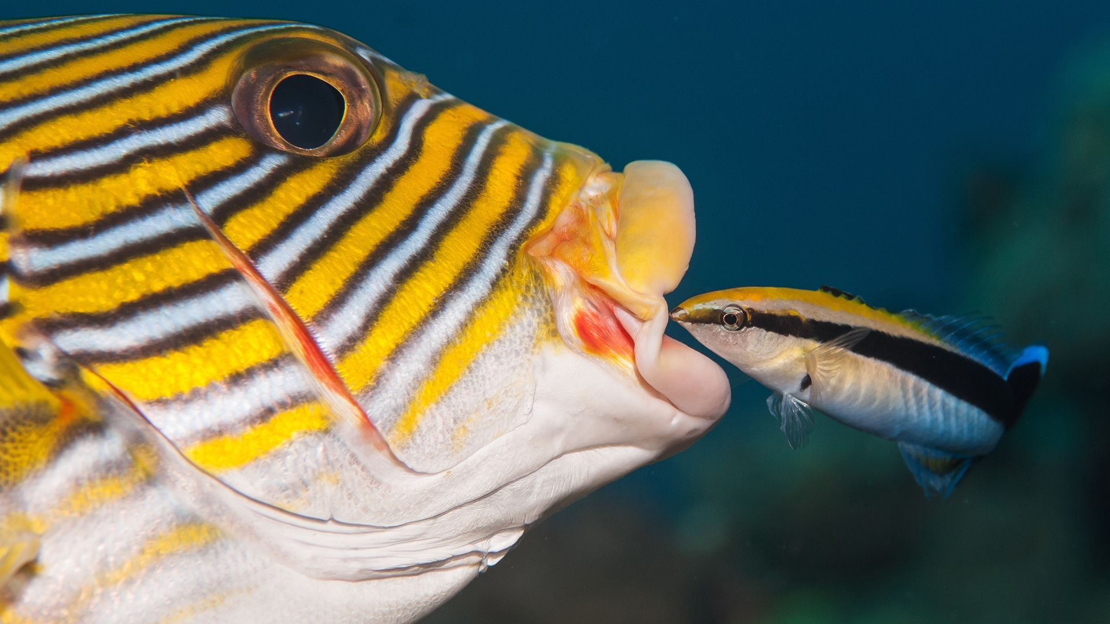

Slide 11
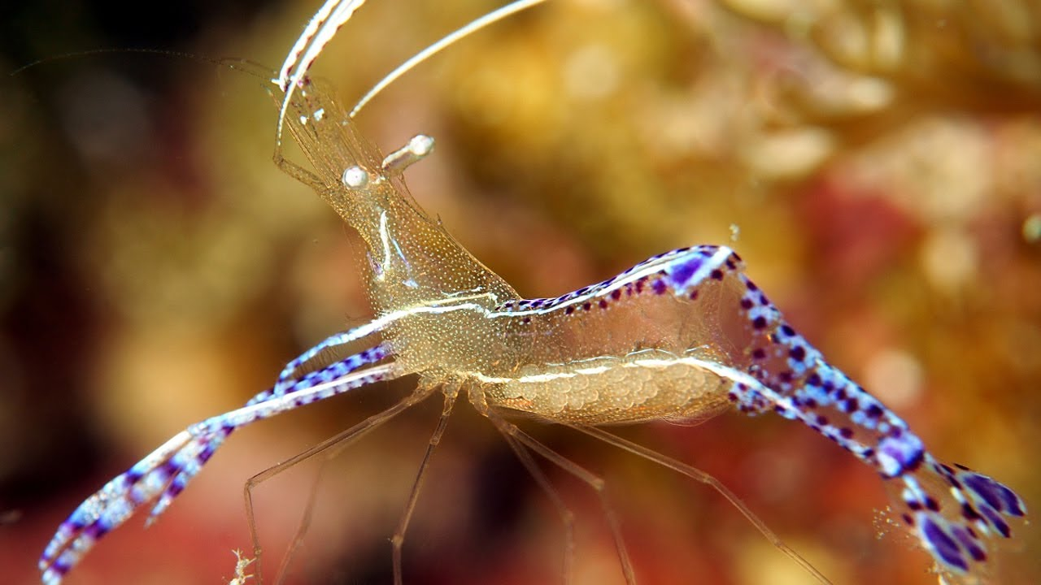
Cleaner shrimp remove parasites

Slide 12
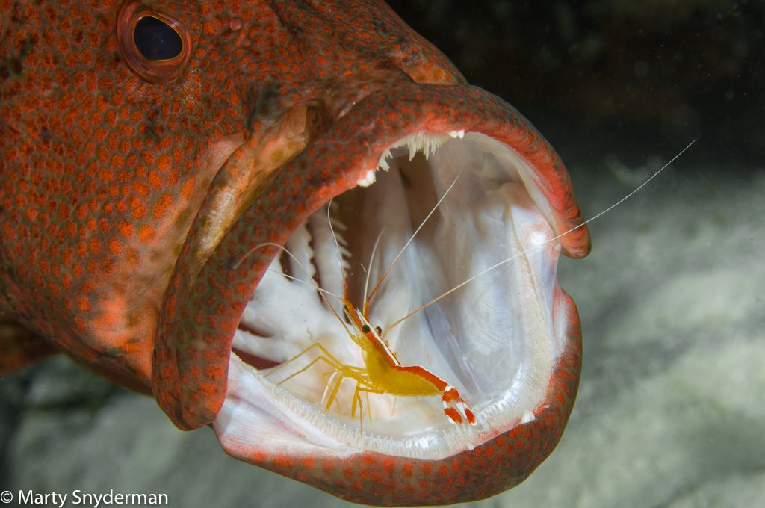
Cleaning station ‘stop over’

Slide 13
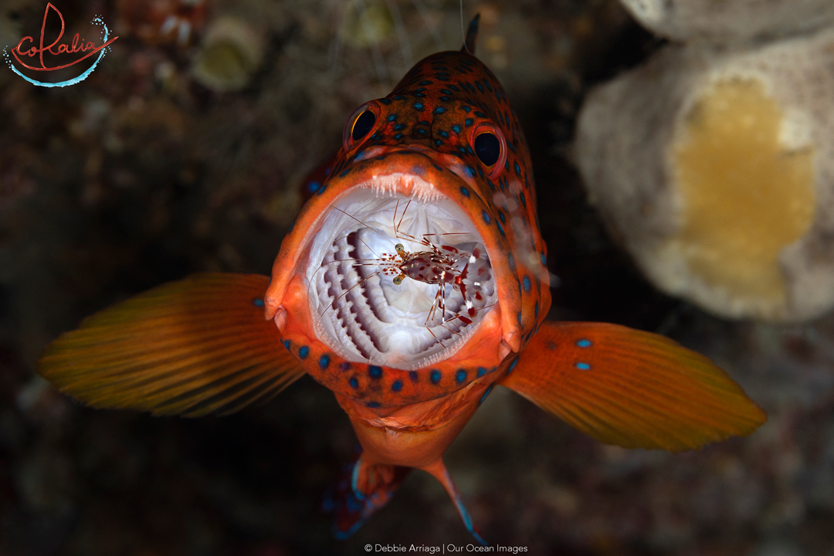

Slide 14
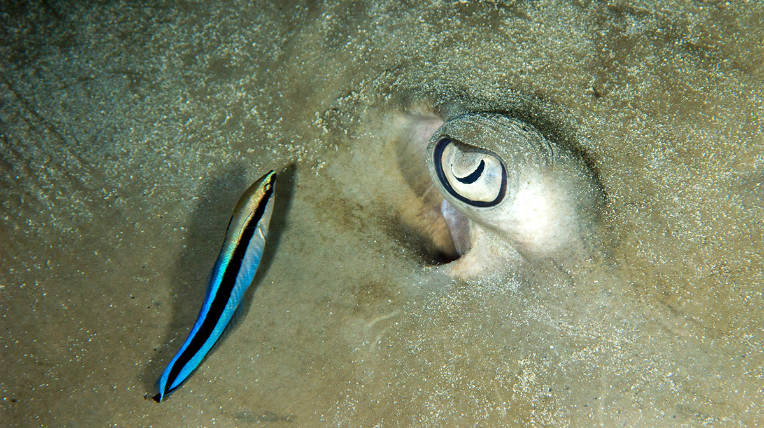
Cleaner wrasse
Notes:
Image: https://india.mongabay.com/2019/07/where-do-fish-go-for-a-spa/

Slide 15
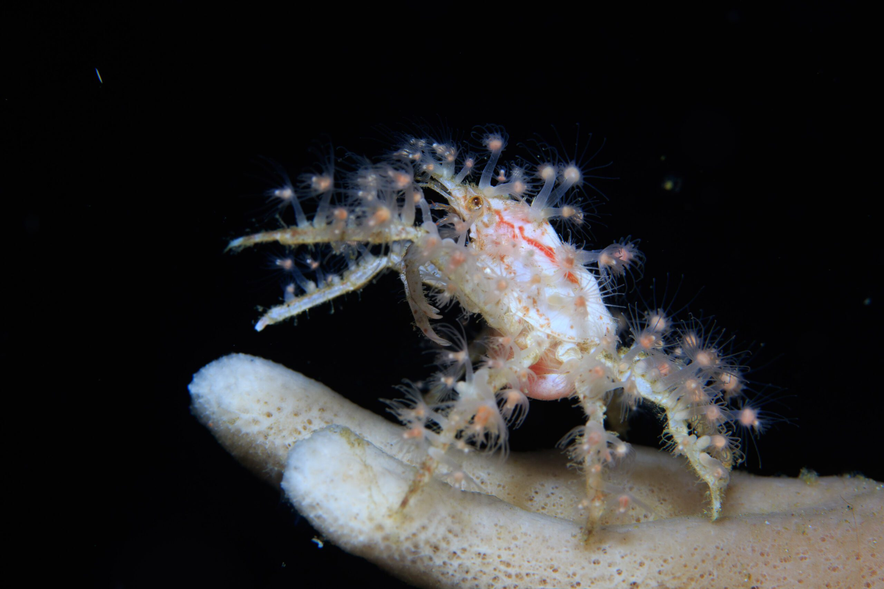
Decorator crab

Slide 16
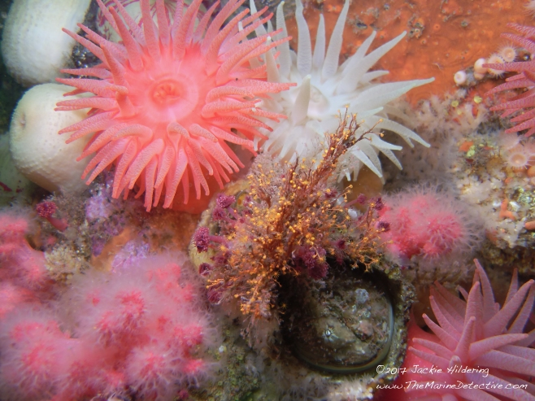
Decorator crab:
the best dressed in the ocean
Notes:
Image: https://themarinedetective.com/2017/04/23/decorator_crabs/

Slide 17
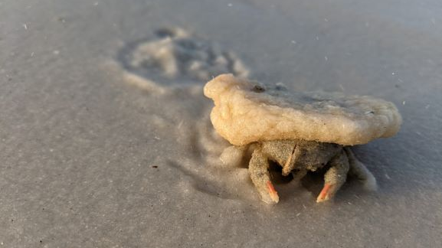
Notes:
Image: https://blogs.ifas.ufl.edu/escambiaco/2021/05/12/weekly-what-is-it-decorator-crab/

Slide 18
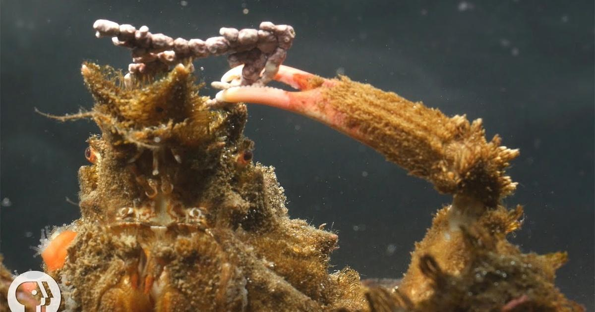

Slide 19
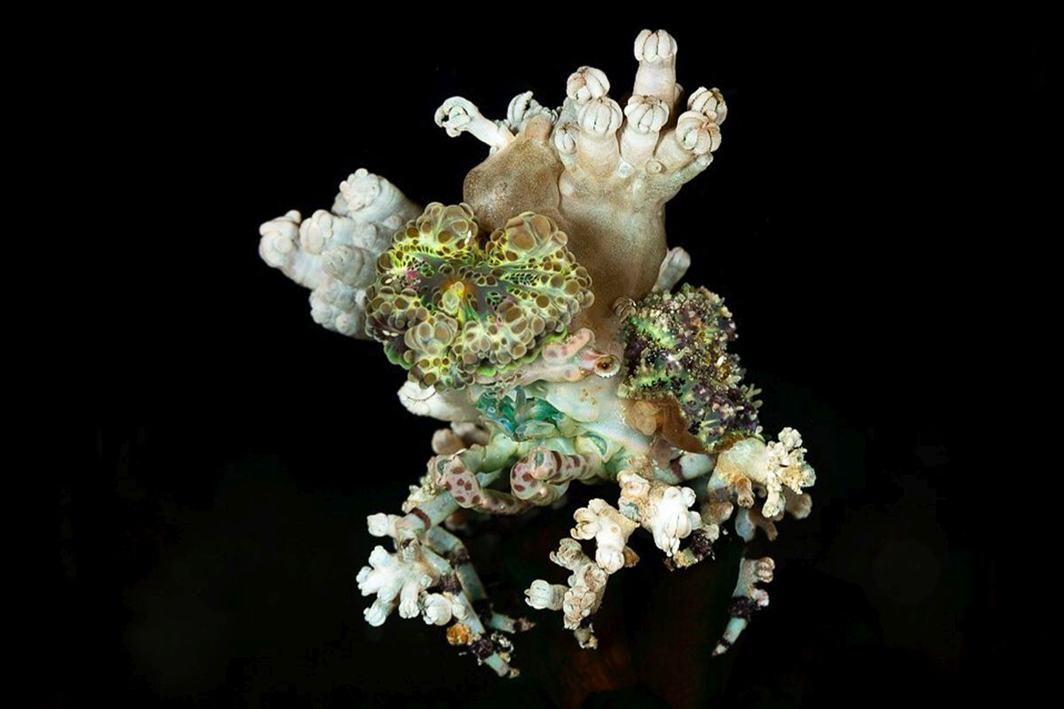
Notes:
Image: https://the-three-p.com/category/critter/romblon-crabs/imitator-crabs-epialtidae/cyclocoeloma-tuberculatum-anemone-decorator-crab/

Slide 20
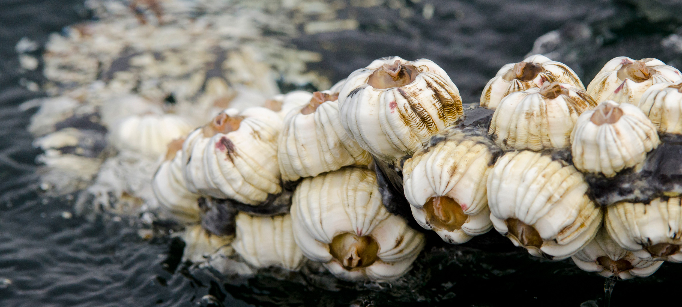
Commensalism (+, 0)
Barnacles attached to whale
Notes:
Image: https://hakaimagazine.com/features/what-whale-barnacles-know/

Slide 21
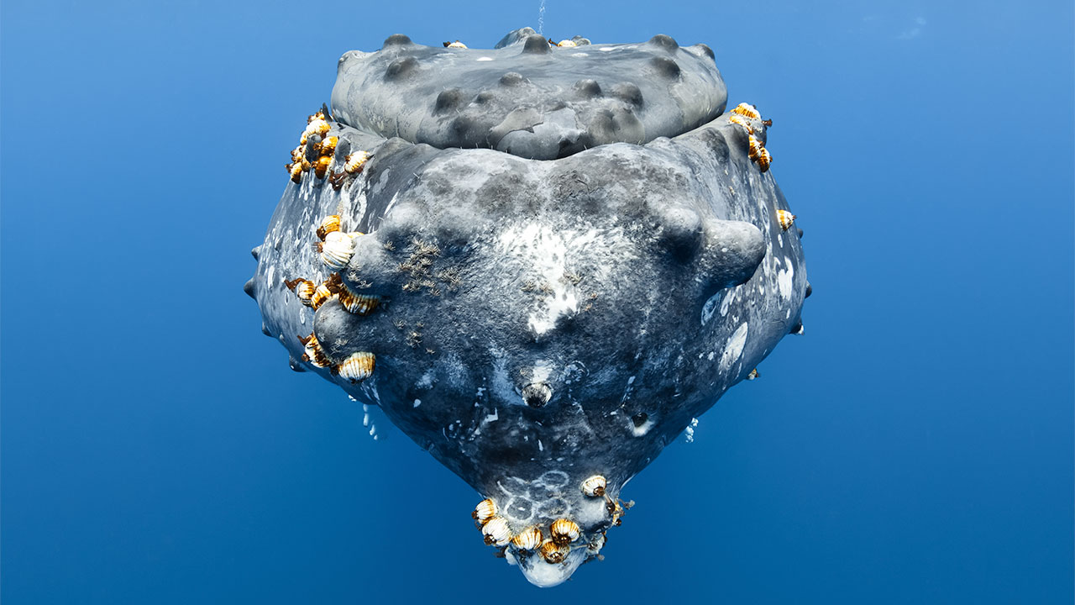
Notes:
Image: https://www.science.org/content/article/hitchhiking-barnacles-could-reveal-migration-routes-ancient-whales

Slide 22
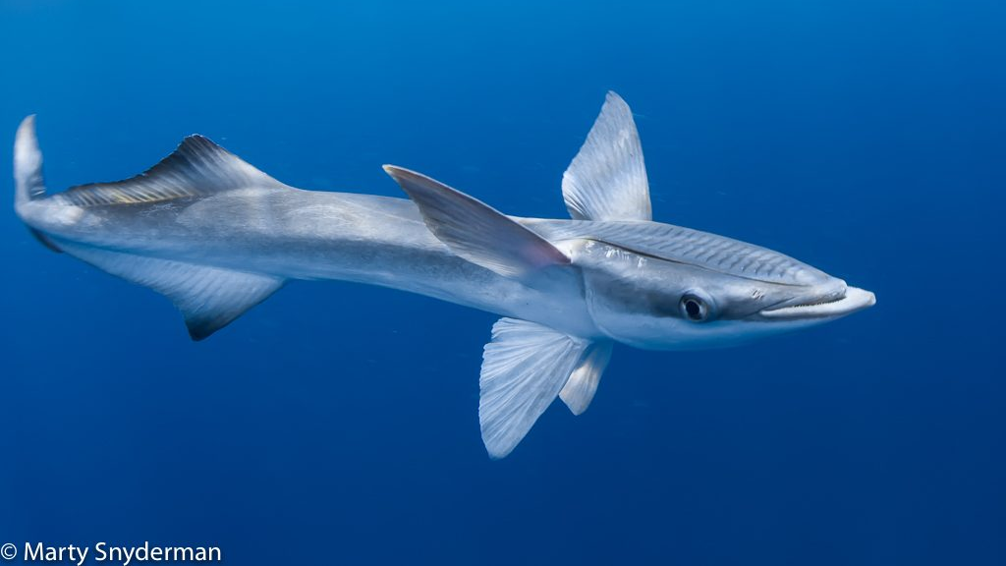
Remora
Notes:
Image: https://depidiomas.unitru.edu.pe/?e=absurd-creature-of-the-week-the-fish-that-wears-ll-gMqxwvFo

Slide 23
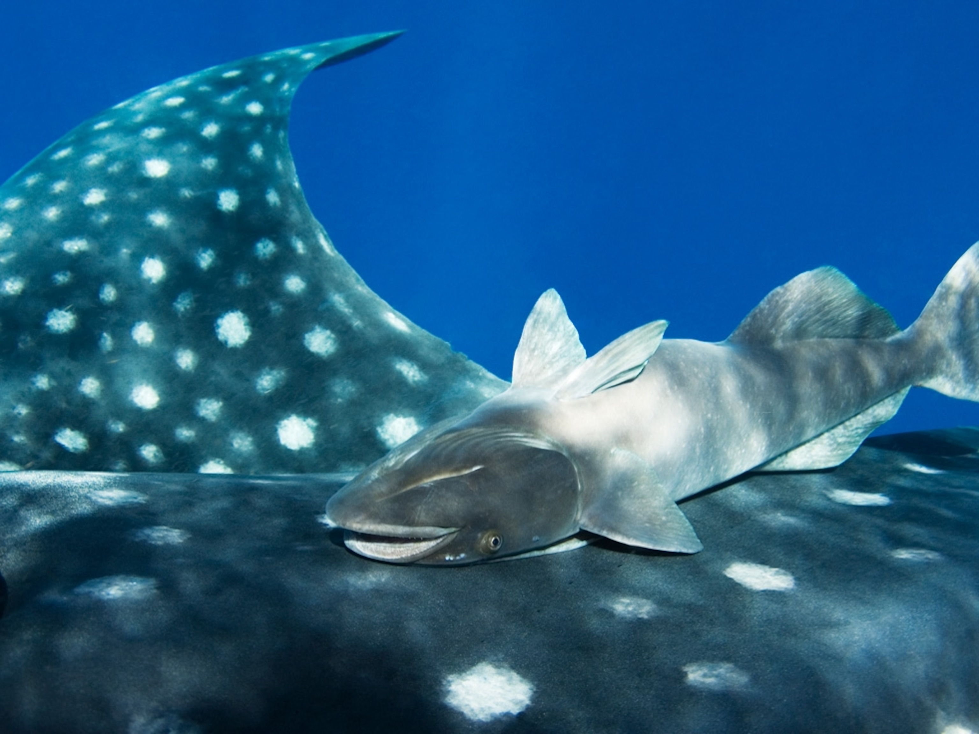
Remora get a ‘free ride’ & ‘free food’
Notes:
Image: https://www.nationalgeographic.com/science/article/what-good-is-half-a-sucker

Slide 24
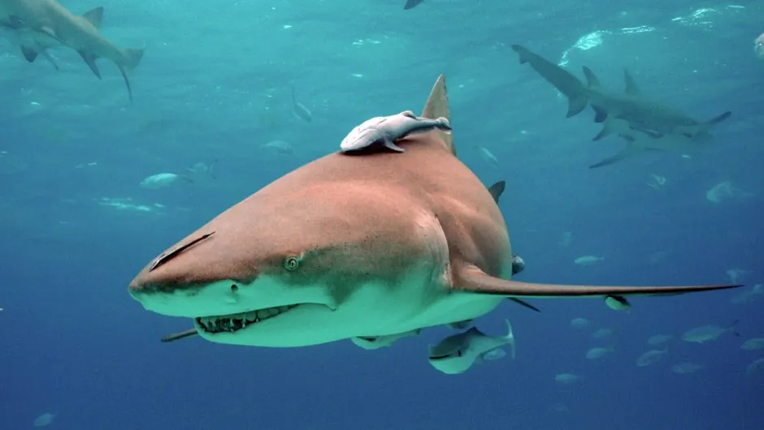

Slide 25
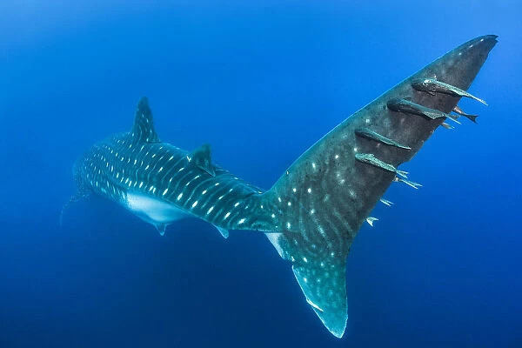
Remora on whale shark

Slide 26
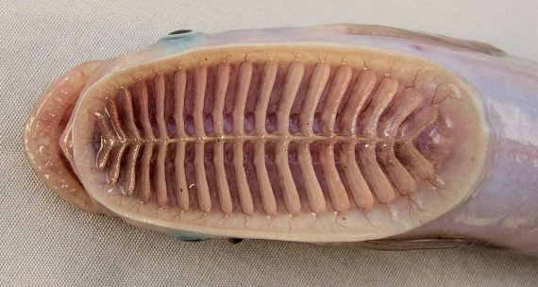
Remora’s head

Slide 27
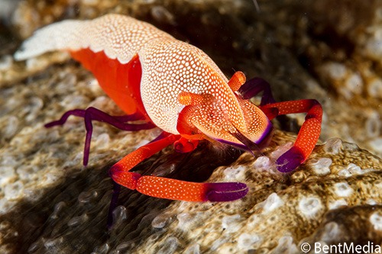
Emperor shrimp on sea cucumber host
Notes:
Image: https://www.nad-lembeh.com/blog/uncategorized/symbiosis-and-commensalism/

Slide 28
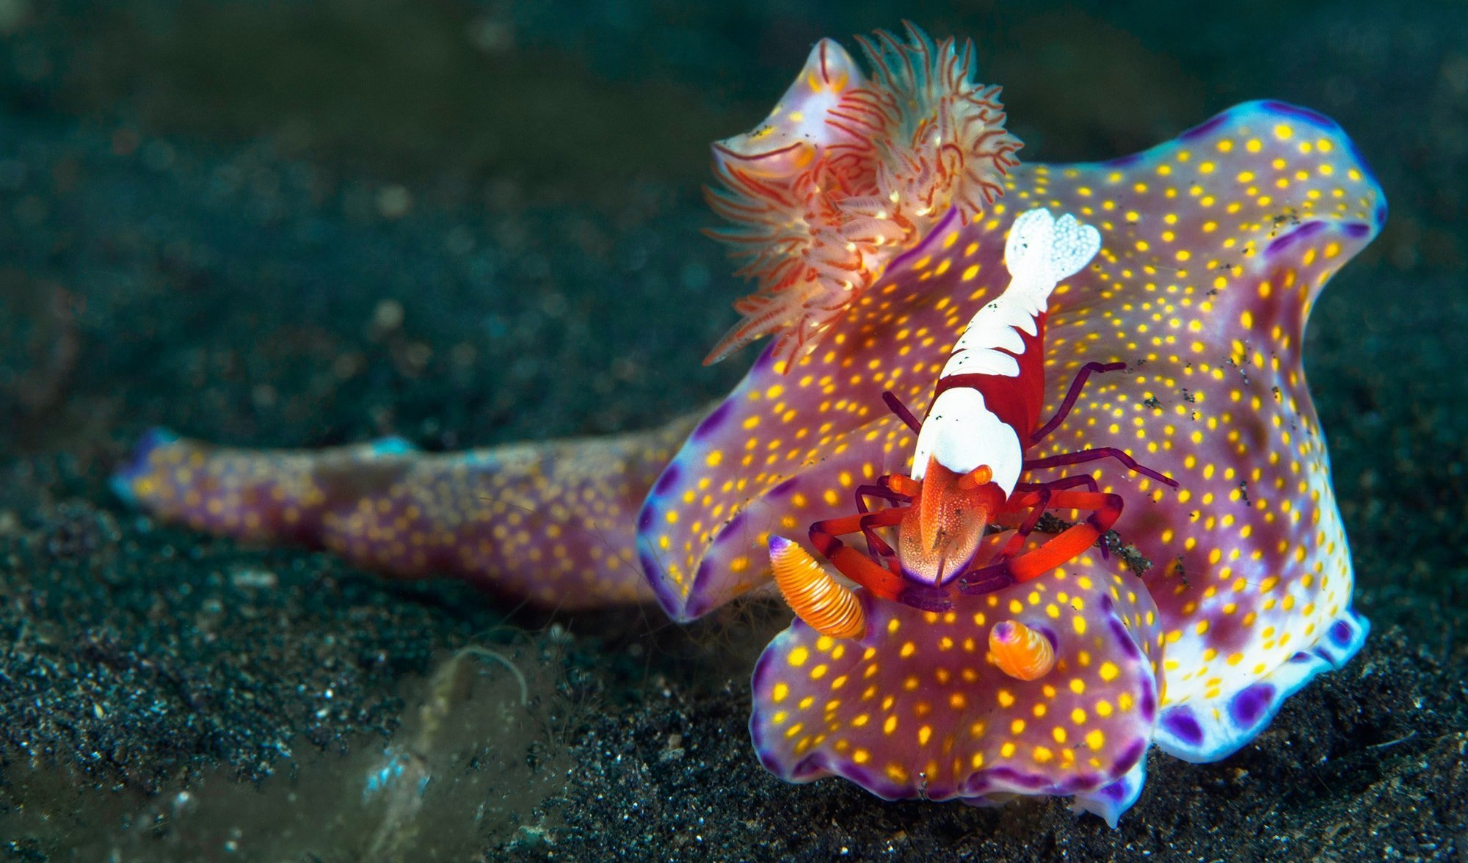
Emperor shrimp on a nudibranch
Notes:
Image: https://www.australiangeographic.com.au/topics/wildlife/2019/07/meet-the-smart-little-shrimp-that-rides-on-the-back-of-nudibranchs/

Slide 29
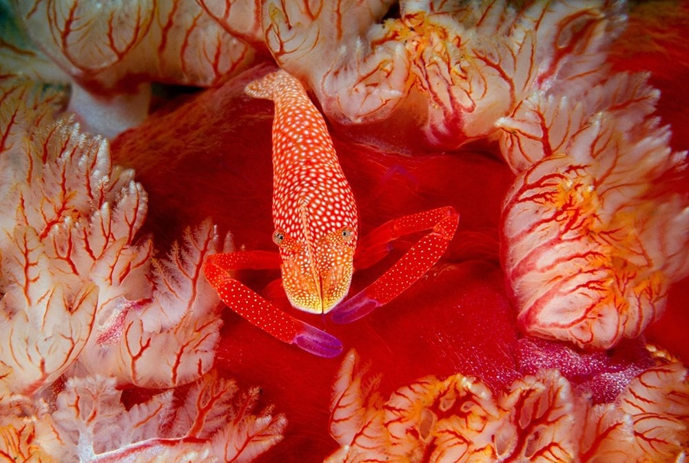
Emperor shrimp on Spanish dancer nudibranch
Notes:
Image: https://www.australiangeographic.com.au/blogs/creatura-blog/2021/02/the-spanish-dancer-is-lovely-and-almost-ludicrously-large/

Slide 30
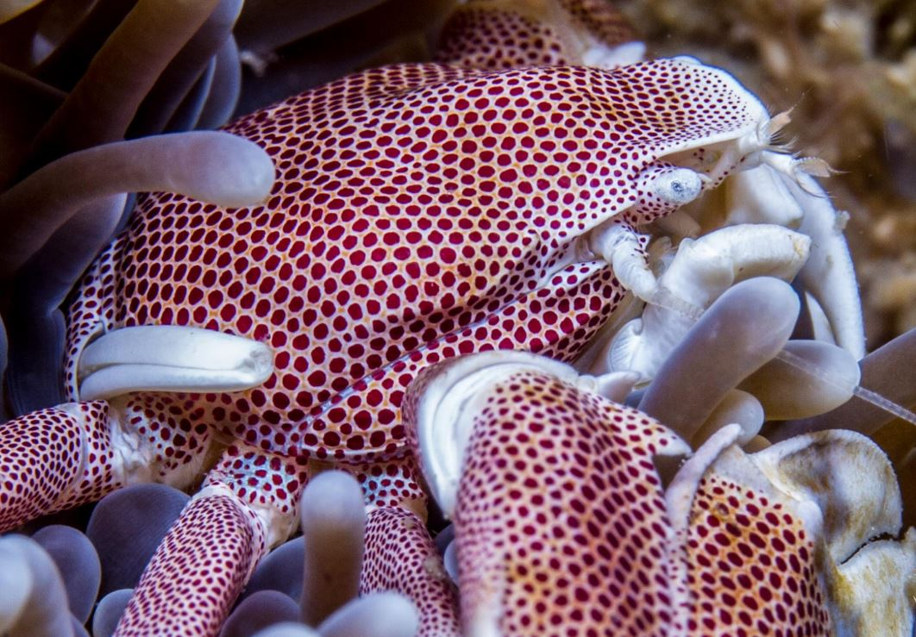
Porcelain crab in anemone
Notes:
Image: https://www.aquariumgallery.com.au/products/copy-of-hermit-crab

Slide 31
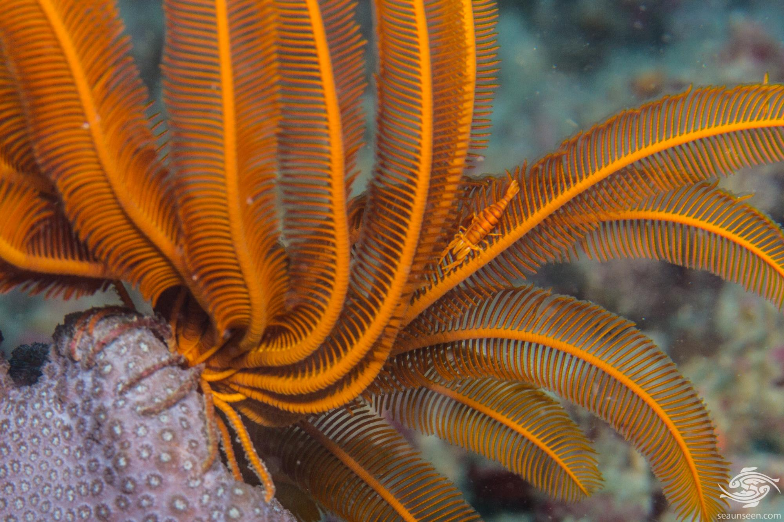
Spot the shrimp
Notes:
Image: https://seaunseen.com/crinoid-shrimp/

Slide 32
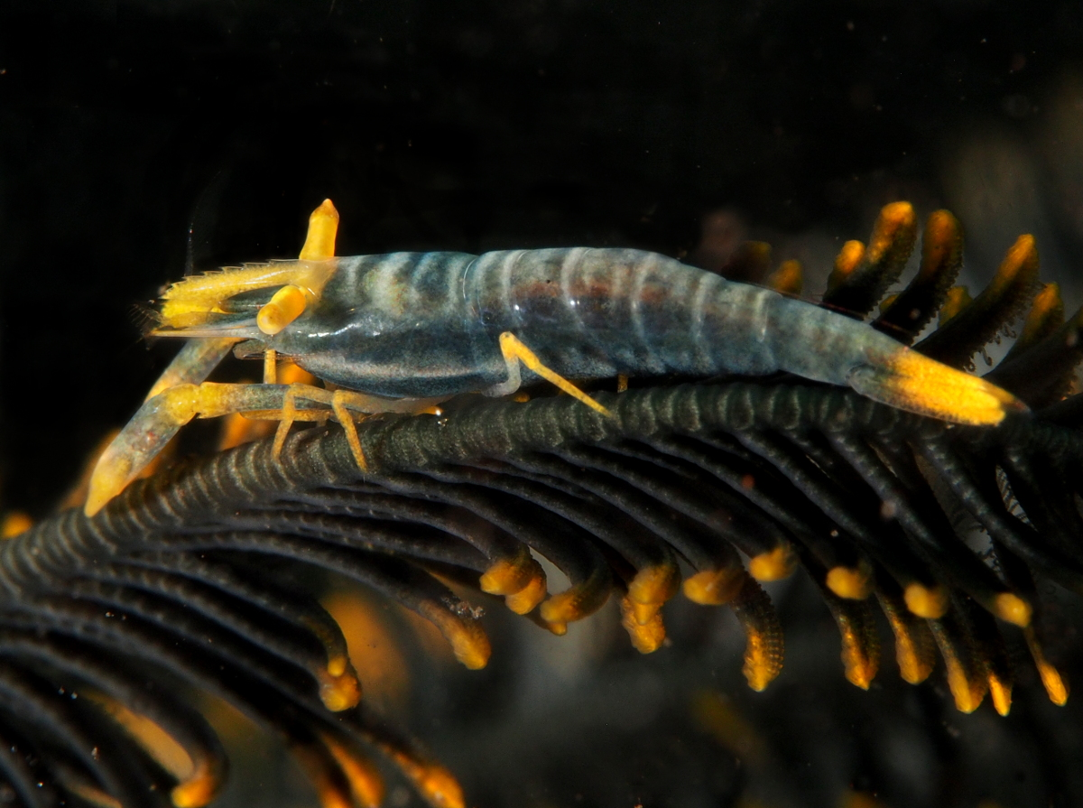
Ambon crinoid (feather star) shrimp
Notes:
Image: https://reefguide.org/laomenesamboinensis.html

Slide 33
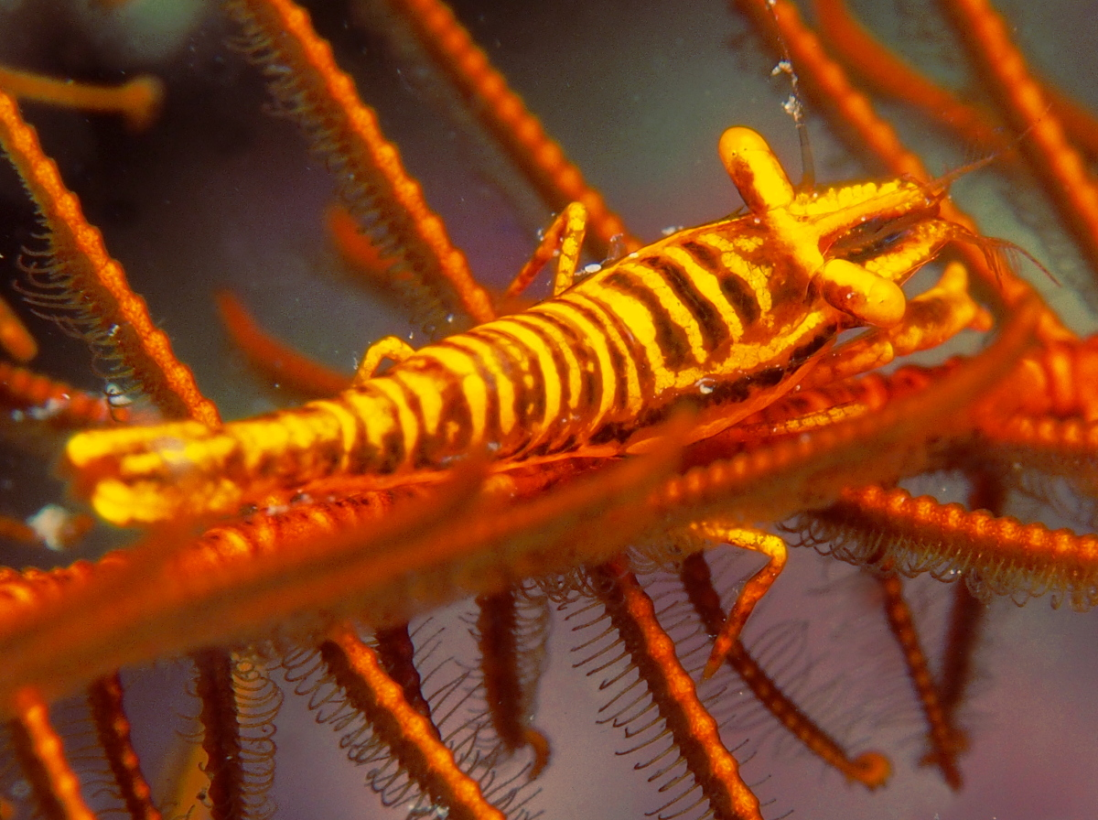
Tiger crinoid shrimp
Notes:
Image: https://reefguide.org/laomenestigris.html

Slide 34
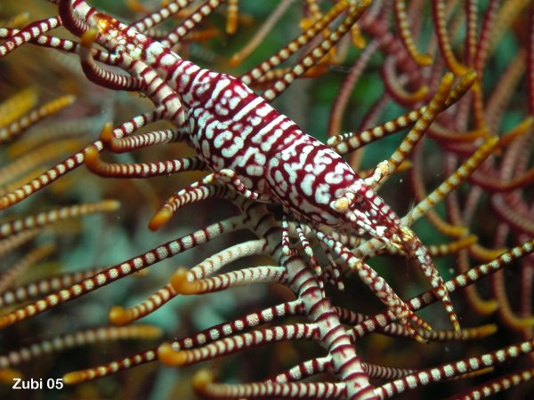
Zubi crinoid shrimp
Notes:
Image: https://www.starfish.ch/invertebrates-Wirbellose/crustaceans-Gliederfuesser/Laomenes-pardus.html

Slide 35
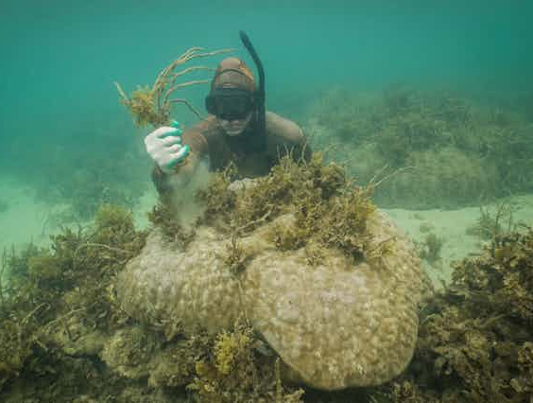
Amensalism (0, -)
Notes:
Info: https://www.researchgate.net/publication/325174117_Allelopathy_Principles_and_Basic_Aspects_for_Agroecosystem_Control
“Allelopathy is a form of amensalism, an association between organisms in which one is inhibited or destroyed and the other is unaffected through the release into the environment of secondary metabolites called allelochemicals. ”
Image: https://theconversation.com/seaweed-is-taking-over-coral-reefs-but-theres-a-gardening-solution-sea-weeding-212460

Slide 36
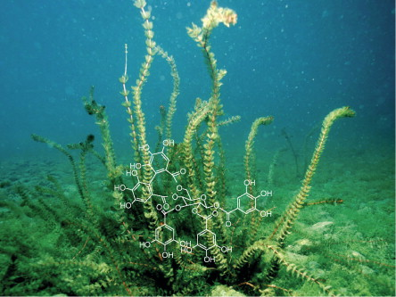
E.g. seaweed allelopathy
whereby
seaweeds release chemicals
(secondary metabolites) that harm corals
Notes:
Image: https://www.sciencedirect.com/topics/earth-and-planetary-sciences/allelopathy

Slide 37
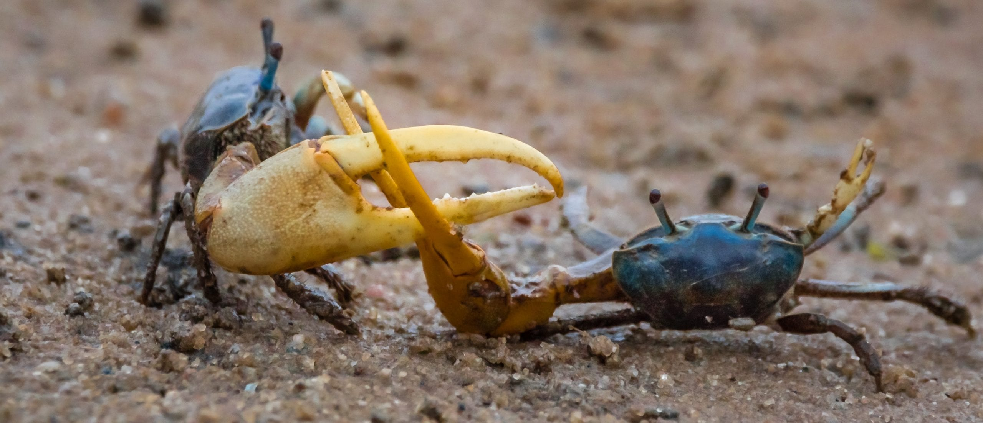
Competition
Notes:
Image: https://tbrnewsmedia.com/your-turn-a-fiddlers-convention/

Slide 38
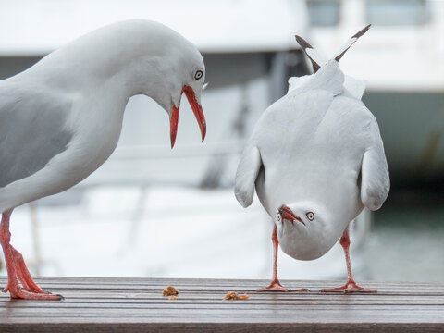
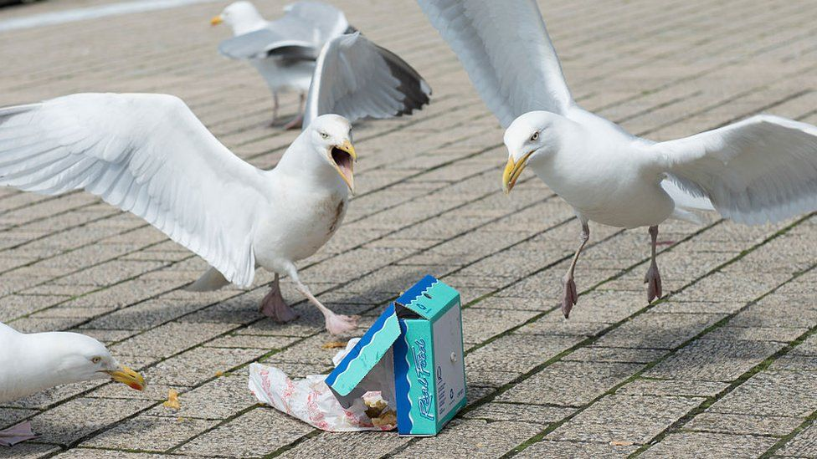
InTRAspecific competition
same species competing
Notes:
Image:

Slide 39
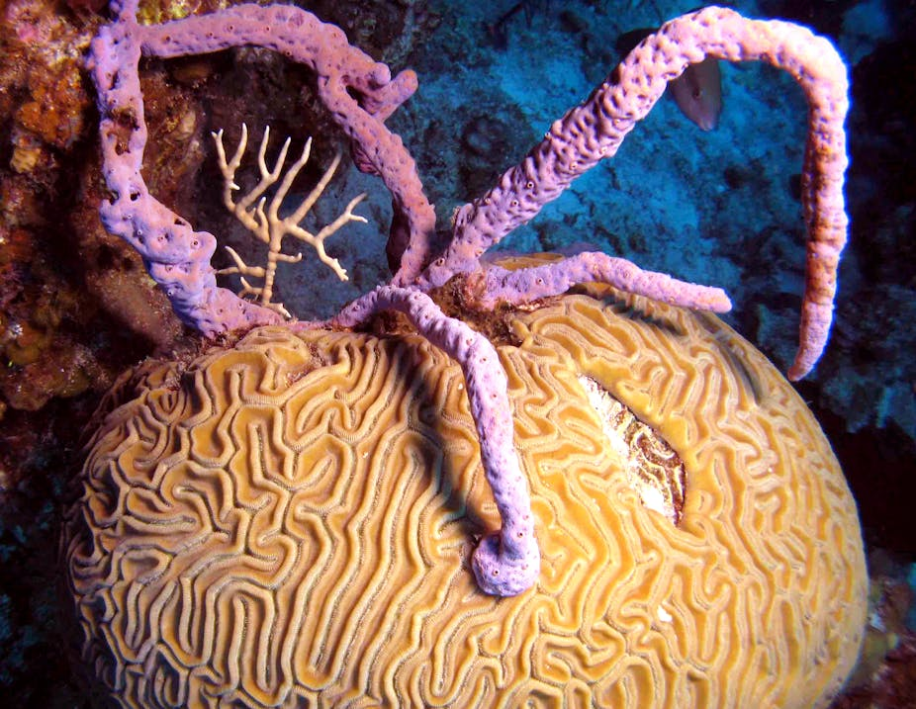
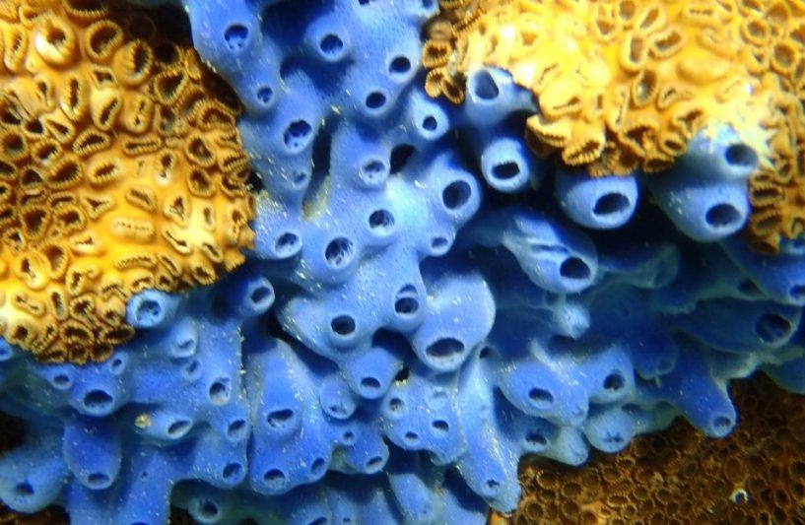
InTERspecific competition
different species competing
Notes:
Image:

Slide 40
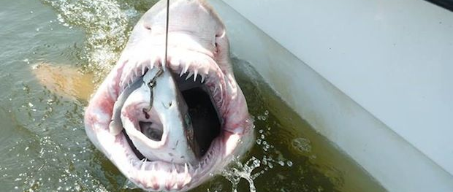
Predation
Notes:
Image: https://www.livescience.com/38976-large-shark-eat-shark.html
A small shark (a smooth dogfish) was swallowed whole by a very hungry sand tiger shark in Delaware Bay in August 2013. (Image credit: University of Delaware ORB Lab)

Slide 41
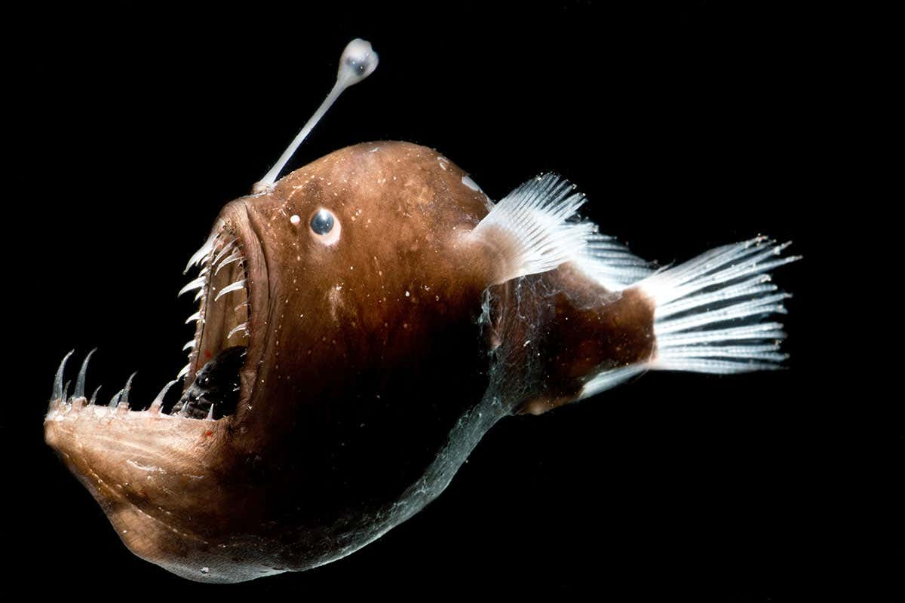
Anglerfish
Notes:
Image: https://www.newscientist.com/article/2219425-deep-sea-anglerfish-may-shed-luminous-bacteria-into-the-ocean-water/

Slide 42
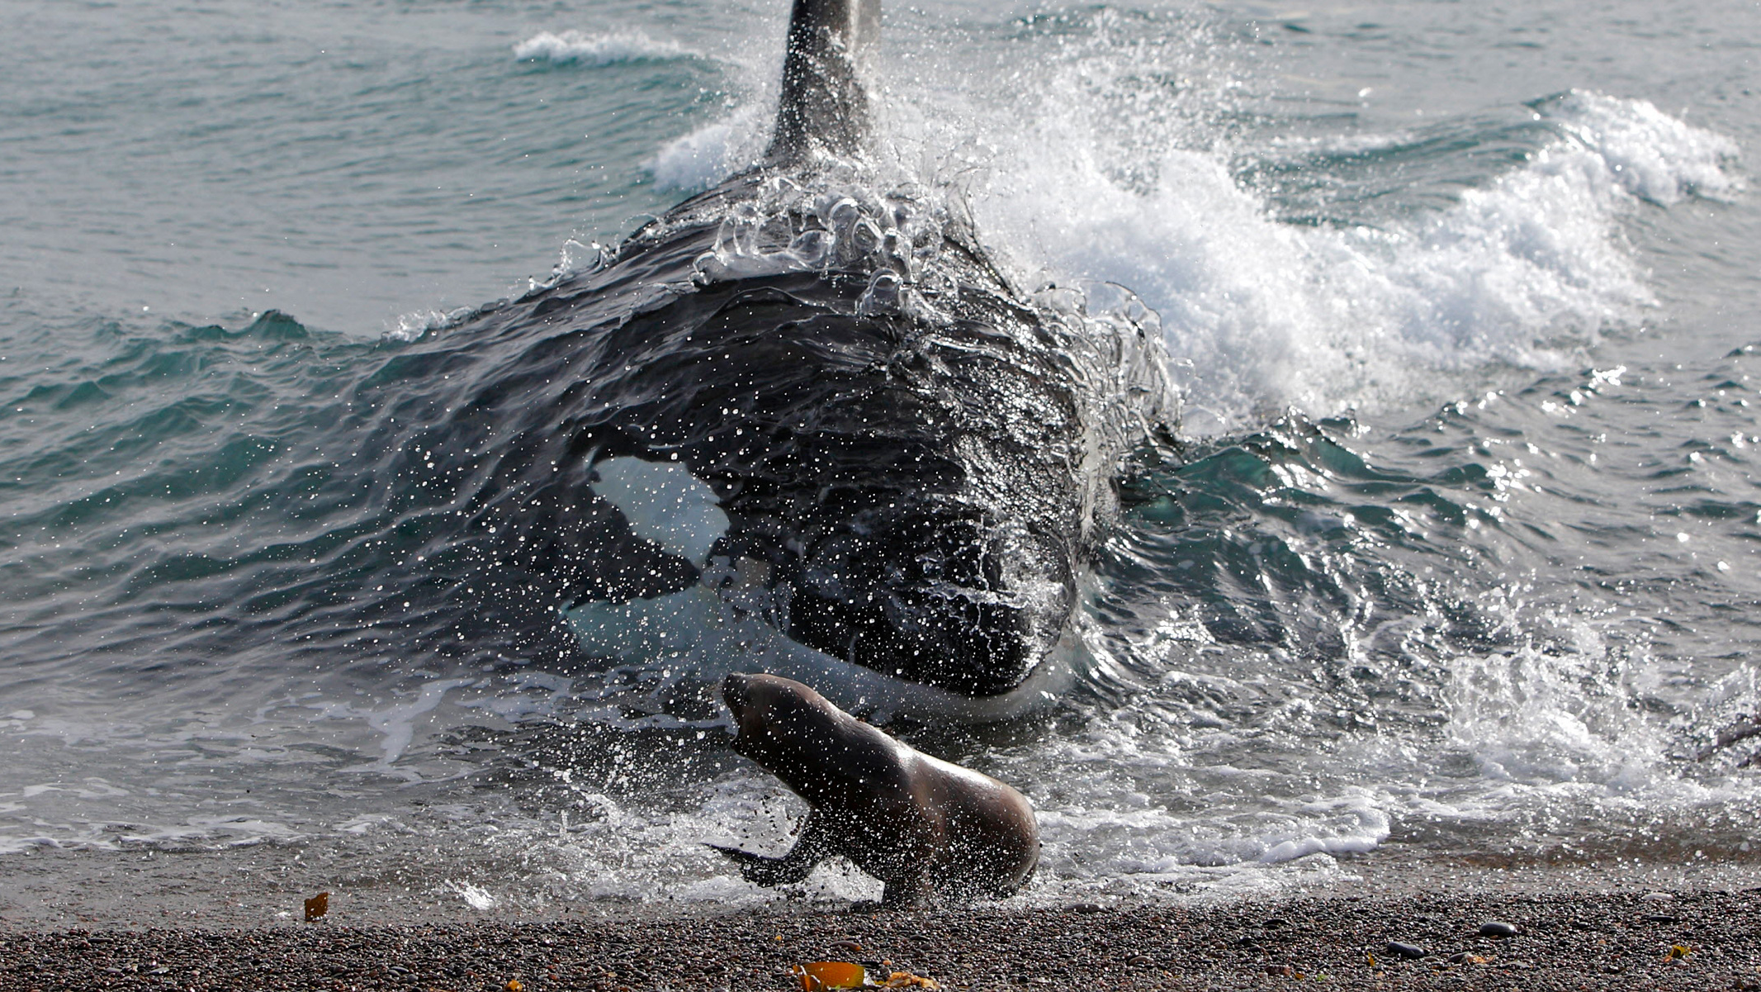
Notes:
Image: https://hakaimagazine.com/news/salish-sea-killer-whales-have-a-surprising-new-way-of-hunting/
A killer whale in Argentina charges a sea lion. This behavior, dubbed intentional stranding, has now been seen in killer whales in the northern hemisphere. Photo by Sylvain Cordier/NPL/Minden Pictures

Slide 43
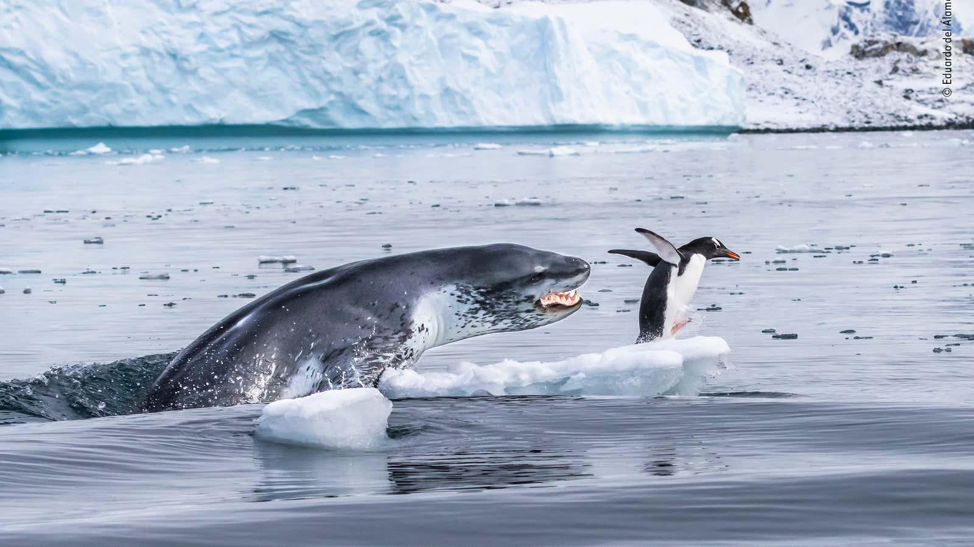

Slide 44
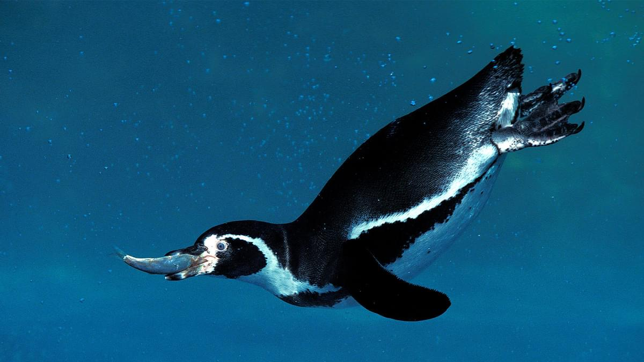
Notes:
Image: https://birdfact.com/articles/what-do-penguins-eat

Slide 45
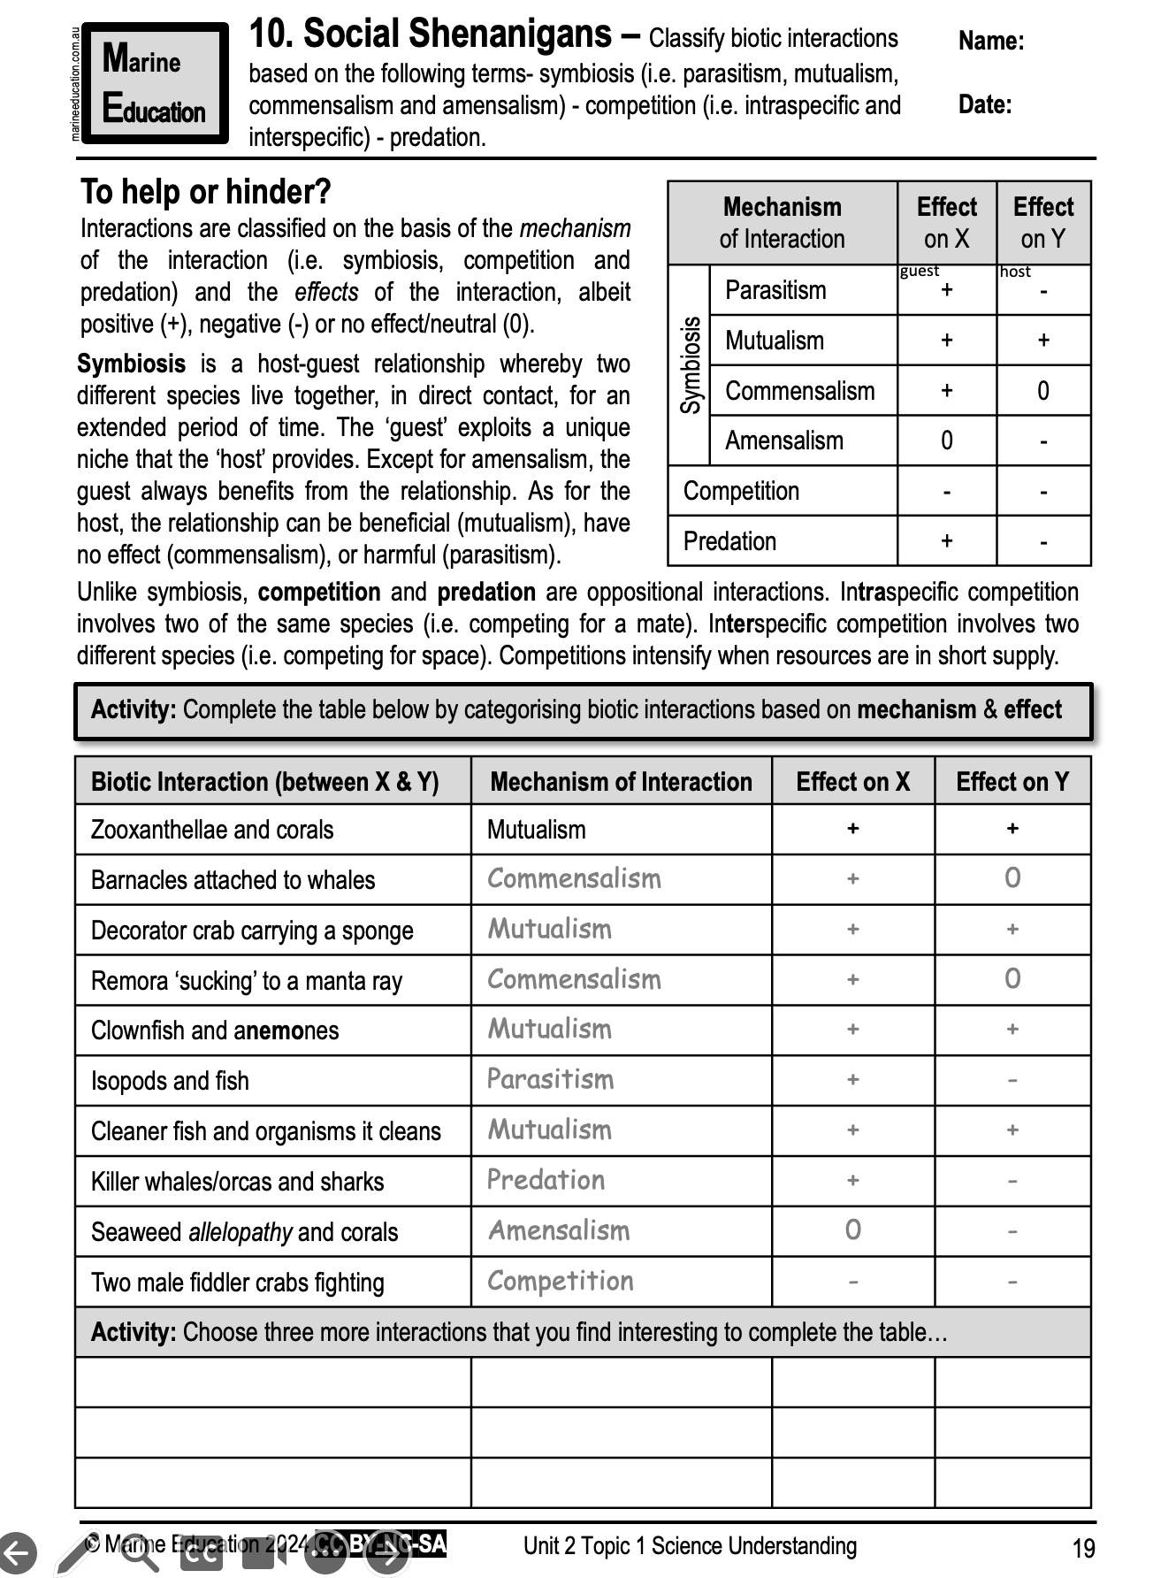
Learning Intention:
Classify biotic interactions based on the following terms:
symbiosis (i.e. parasitism, mutualism, commensalism and amensalism)
competition (i.e. intraspecific and interspecific)
predation.
Success Criteria:
Complete Marine Education worksheet “Social Shenanigans”

