Slide 1
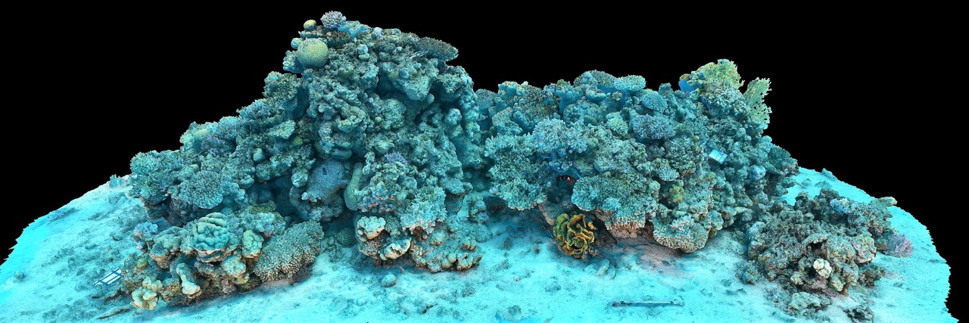
Learning Intention:
Analyse evidence from longitudinal studies showing changes that occur in marine environments, e.g. satellite imagery, aerial photography, field research
Success Criteria:
Complete Marine Education
worksheet ’11. Information in
Imagery’
Notes:
Image: https://sketchfab.com/blogs/community/underwater-imaging-for-coral-reef-3d-mapping/

Slide 2
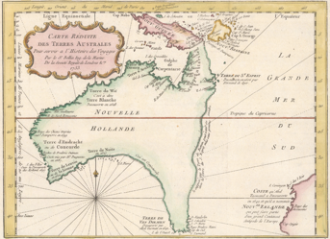

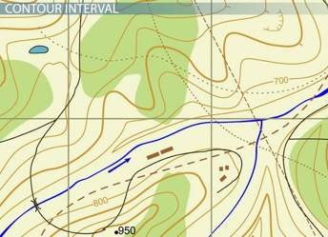
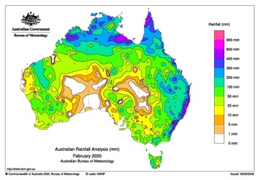
Topographic map
1753
Question – Why do you use a map?
Question – Why might an environmental scientist use a map?

Slide 3
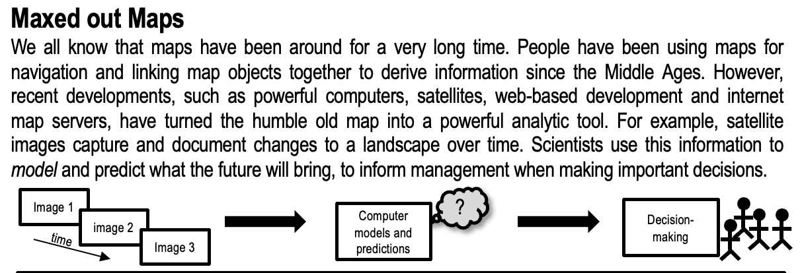
“If you can’t map it, you can’t manage it”

Slide 4
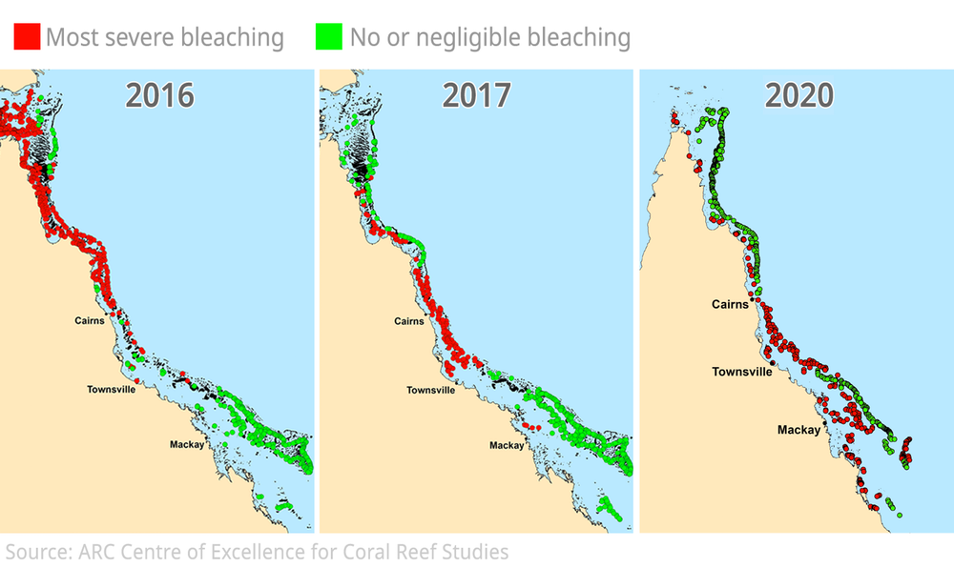
Spatial
AND
temporal information
Spatial = location
Temporal = time
Notes:
Image: https://arstechnica.com/science/2020/04/great-barrier-reef-survey-what-we-saw-was-an-utter-tragedy/

Slide 5
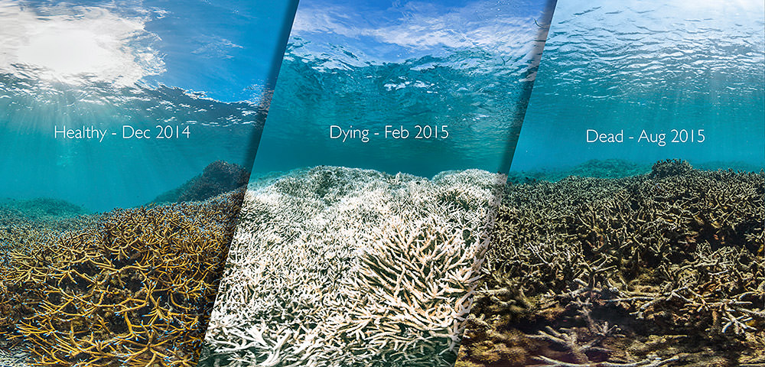
Before it hit Australia, mass bleaching was recorded in coral reefs of American Samoa between 2014 and 2015. Photo: XL Catlin Seaview Survey
Notes:
Image: https://sanctuaries.noaa.gov/news/jun16/how-is-coral-bleaching-affecting-sanctuaries.html

Slide 6
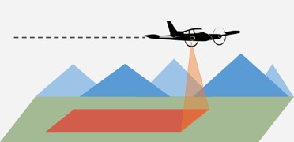
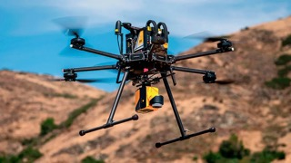
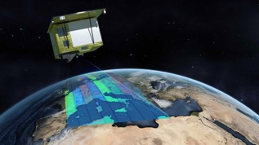
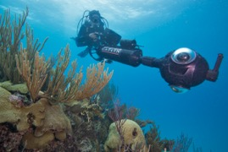
Question – How do we obtain the information to make a map?

Slide 7
Aerial photography
e.g. LIDAR

Slide 8
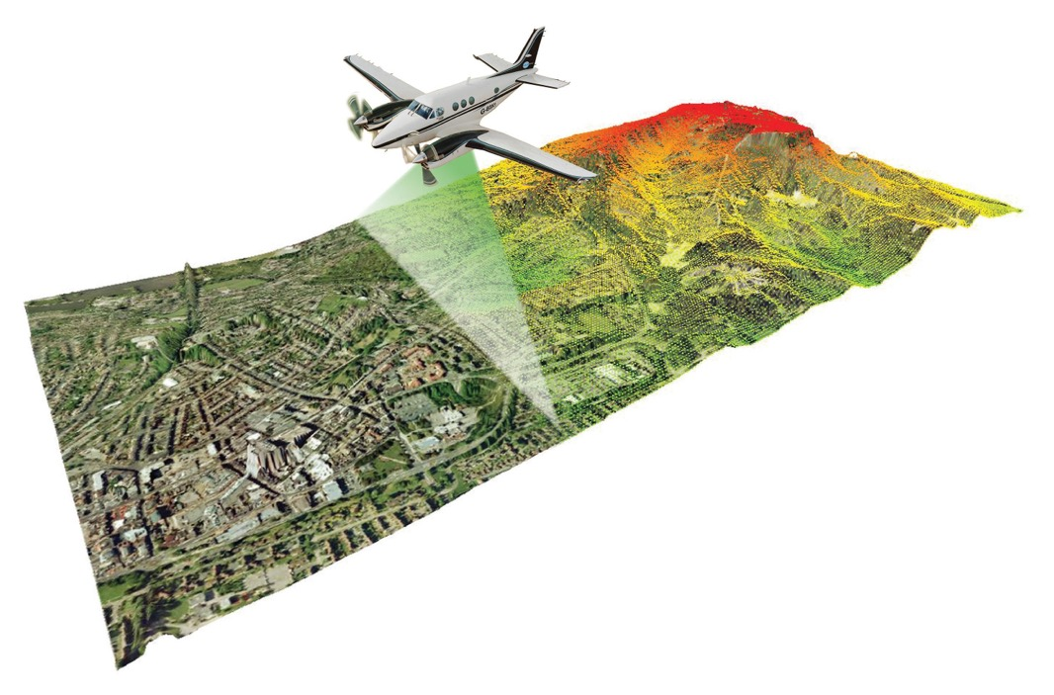

LIDAR
a remote sensing method
used to examine the surface
of the Earth.
Light Detection and Ranging
a.k.a. laser scanning
uses reflected light off objects as a kind of visual sonar
Notes:
Image: https://www.reddit.com/r/flightsim/comments/h8om3d/i_think_the_future_of_mfs2020_scenery_is_lidar/?rdt=65531

Slide 9
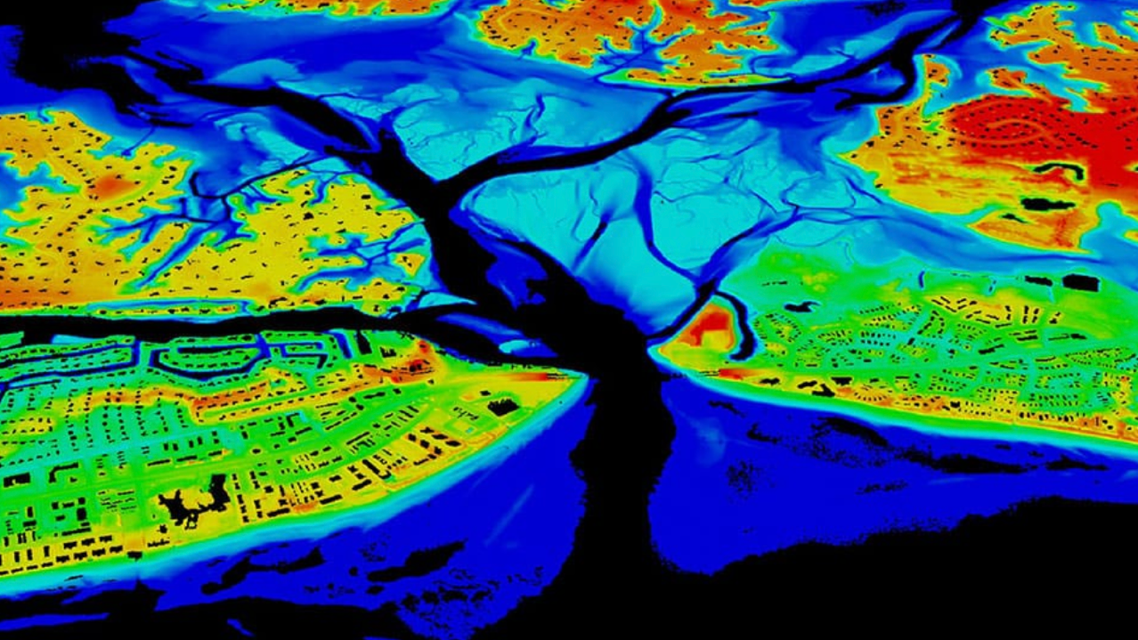
Notes:
Image: https://oceanservice.noaa.gov/facts/lidar.html

Slide 10
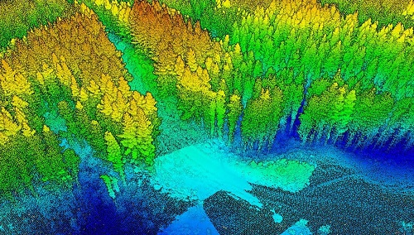
LIDAR forest data
Notes:
Image: https://gogeomatics.ca/a-japanese-perspective-lidar-forest-data-for-resource-analysis-in-japan/

Slide 11
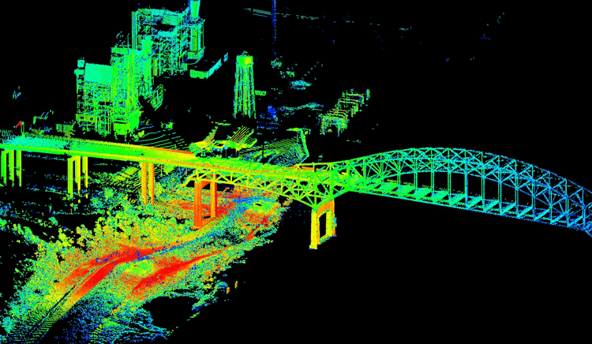
Notes:
https://www.geographyrealm.com/lidar/

Slide 12
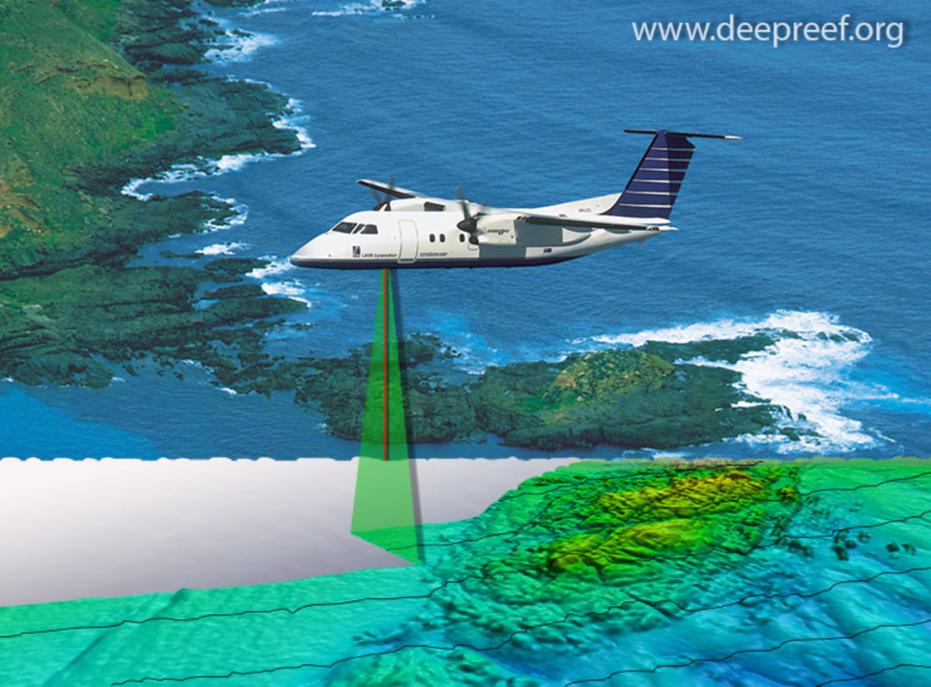
The LIDAR sensor uses the time it takes for each pulse to return to the sensor to calculate the distance it travelled (and hence depth or altitude)

Slide 13
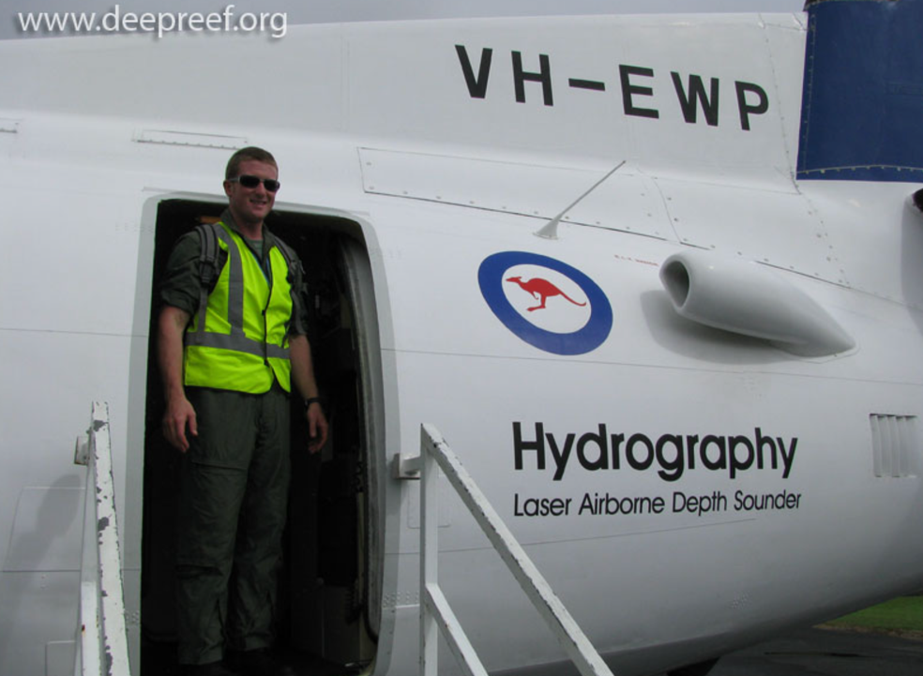
This aircraft is a Fokker F27.
It has been used many years by the Royal Australian Navy LADS Flight team to conduct LIDAR hydrographic surveying

Slide 14
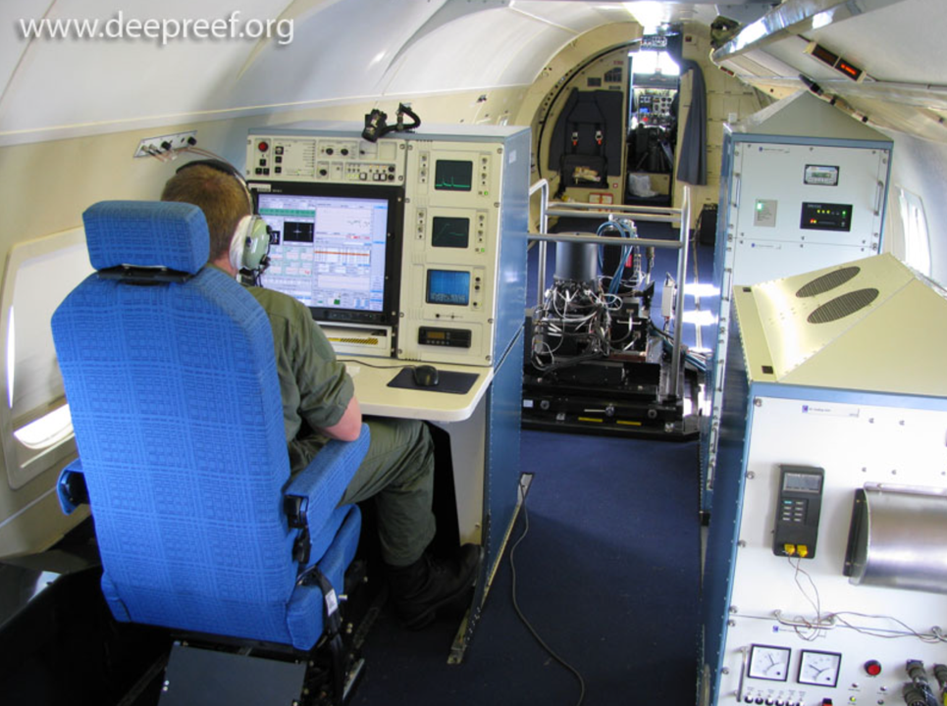
Many of the navigational charts in use for the Great Barrier Reef were surveyed using this aircraft.
Note: In late 2009,
a newer Dash 8 aircraft replaced the
Fokker F27.
Notes:
Image: https://www.deepreef.org/2009/10/01/lidar/

Slide 15
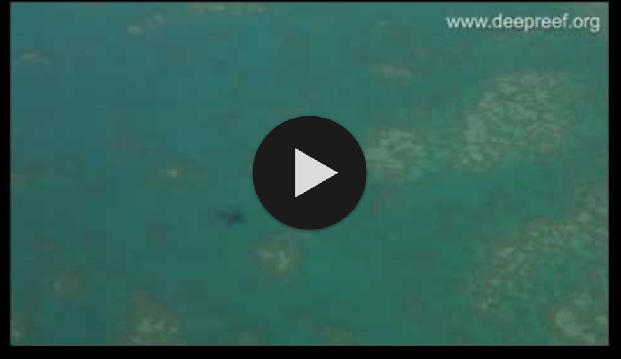
Lidar mapping on the Great Barrier Reef
Play video: https://www.youtube.com/watch?v=5Knp_mg5Cw0&t=2s
Notes:
https://www.youtube.com/watch?v=5Knp_mg5Cw0&t=2s

Slide 16
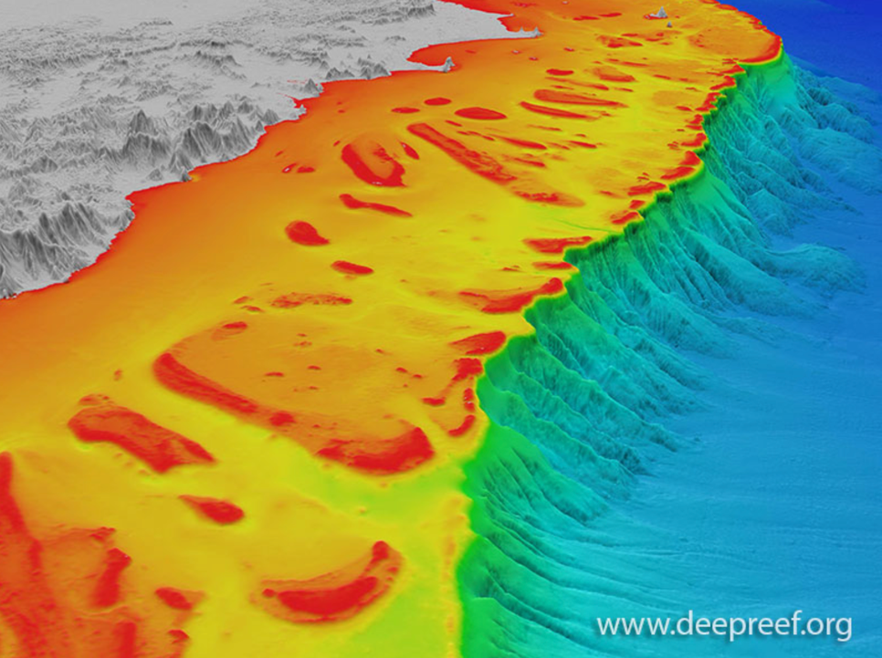
LIDAR has been used to successfully map large areas of continental shelf where vessel surveys would be impracticable (or too expensive)
GBR shelf

Slide 17
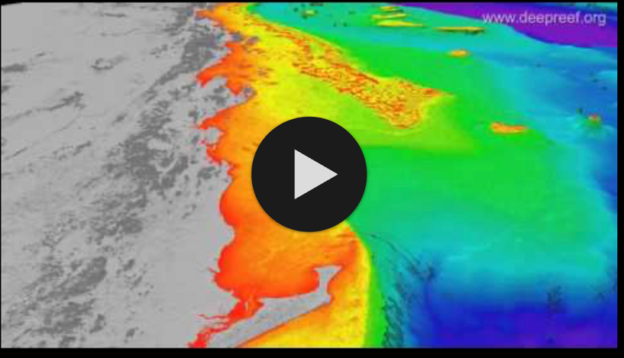
3D view of the Great Barrier Reef, Coral Sea
Play video: https://www.youtube.com/watch?v=BOvrNXGJhTA&t=23s
Notes:
Video: https://www.youtube.com/watch?v=BOvrNXGJhTA&t=23s

Slide 18
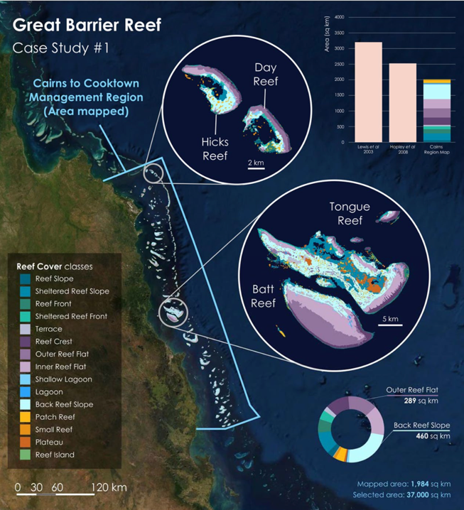
e.g. LIDAR was used to map 1,900 km² of reef habitat across the Cairns Management Area (37,000 km²) to support national management.
Notes:
Image: https://www.nature.com/articles/s41597-021-00958-z
Paper Title: Reef Cover, a coral reef classification for global habitat mapping from remote sensing

Slide 19
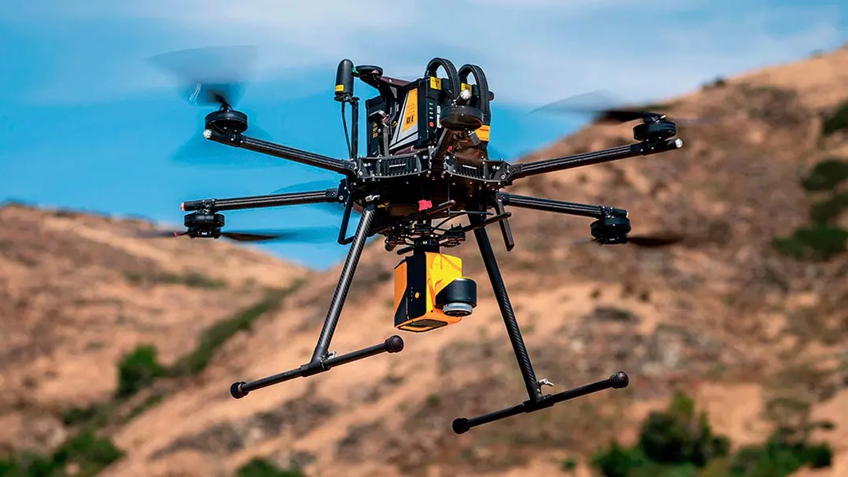
LIDAR on a drone
Notes:
Image: https://www.yellowscan.com/knowledge/lidar-drone/

Slide 20
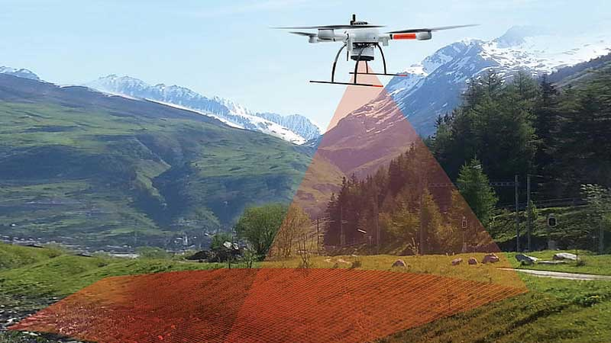
Notes:
Image: https://dronebelow.com/2018/06/12/what-is-lidar-and-why-is-it-important-for-drones/
Video with more information: https://www.youtube.com/watch?v=6K36y-I2i0g

Slide 21
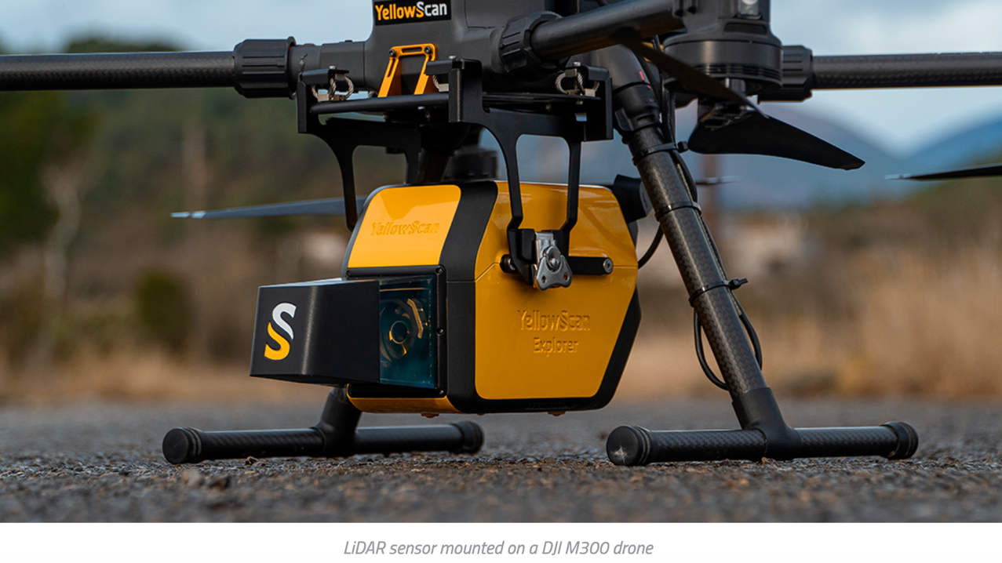
Notes:
Image: https://www.yellowscan.com/knowledge/lidar-drone/

Slide 22
satellite imagery

Slide 23

Notes:
Image: https://www.spacequip.eu/2022/03/30/german-enmap-satellite-ready-for-launch-environmental-data-for-researchers-worldwide/

Slide 24

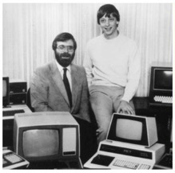
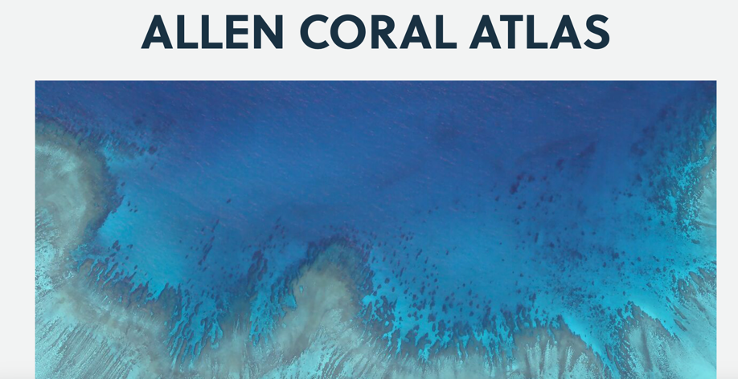
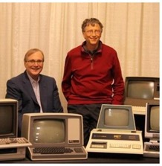
Paul Allen had a vision to map all the reefs of the world!
Paul Allen and Bill Gates re-enact an iconic Microsoft photo. (Photos: Microsoft and Vulcan)

Slide 25
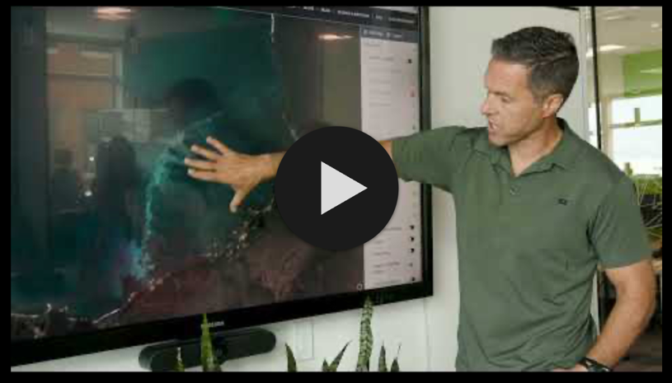
The Allen Coral Atlas Completes the World's First Global Coral Habitat Maps and Monitoring System
Play video: https://www.youtube.com/watch?v=TJ-3IglKbZ4
Notes:
https://www.youtube.com/watch?v=TJ-3IglKbZ4

Slide 26
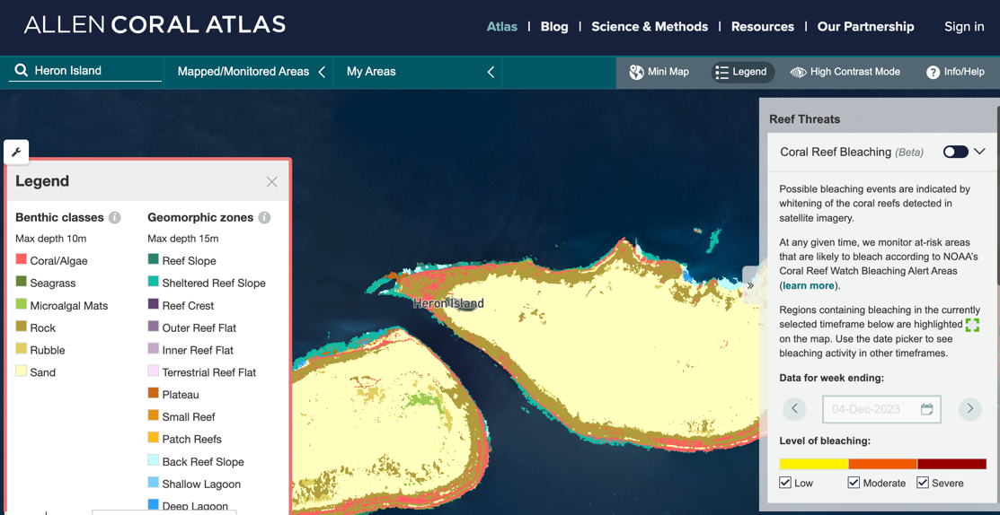

Slide 27
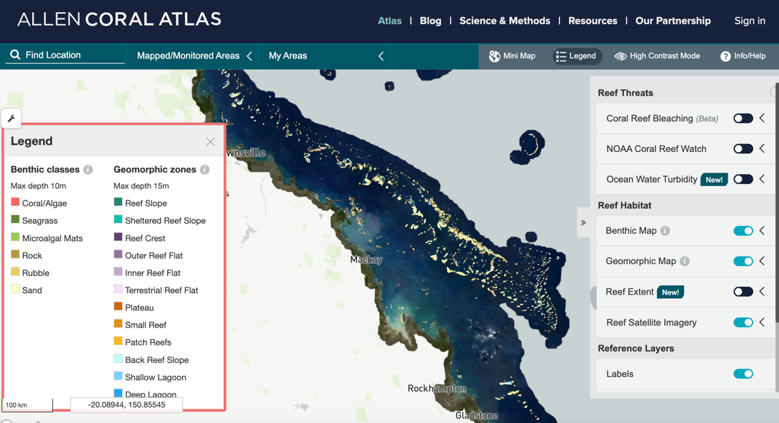
Go on and take a look!

Slide 28
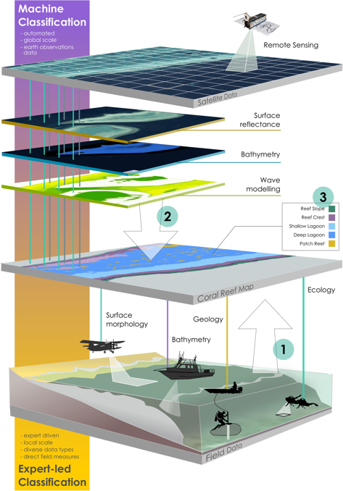
Allen Coral Atlas combines satellite data with direct field measurements (field research) to observe changes occurring in marine environments.
Other coral reef habitat maps that use this technology include: NOAA’s Biogeography of Coral Reef maps, Living Oceans Foundation and Millennium Coral Reef Mapping Project.

Slide 29
Field research

Slide 30
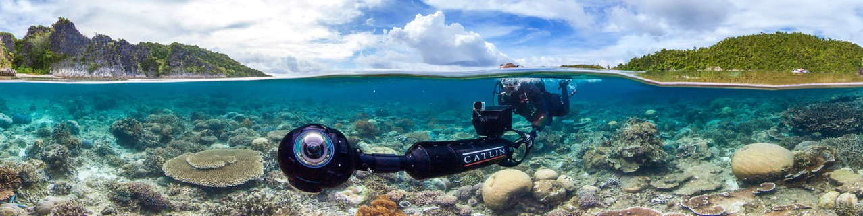

OUR MISSION WAS TO SCIENTIFICALLY RECORD THE WORLD’S CORAL REEFS AND REVEAL THEM TO ALL IN HIGH RESOLUTION, 360-DEGREE PANORAMIC VISION
XL CATLIN SEAVIEW SURVEY

Slide 31
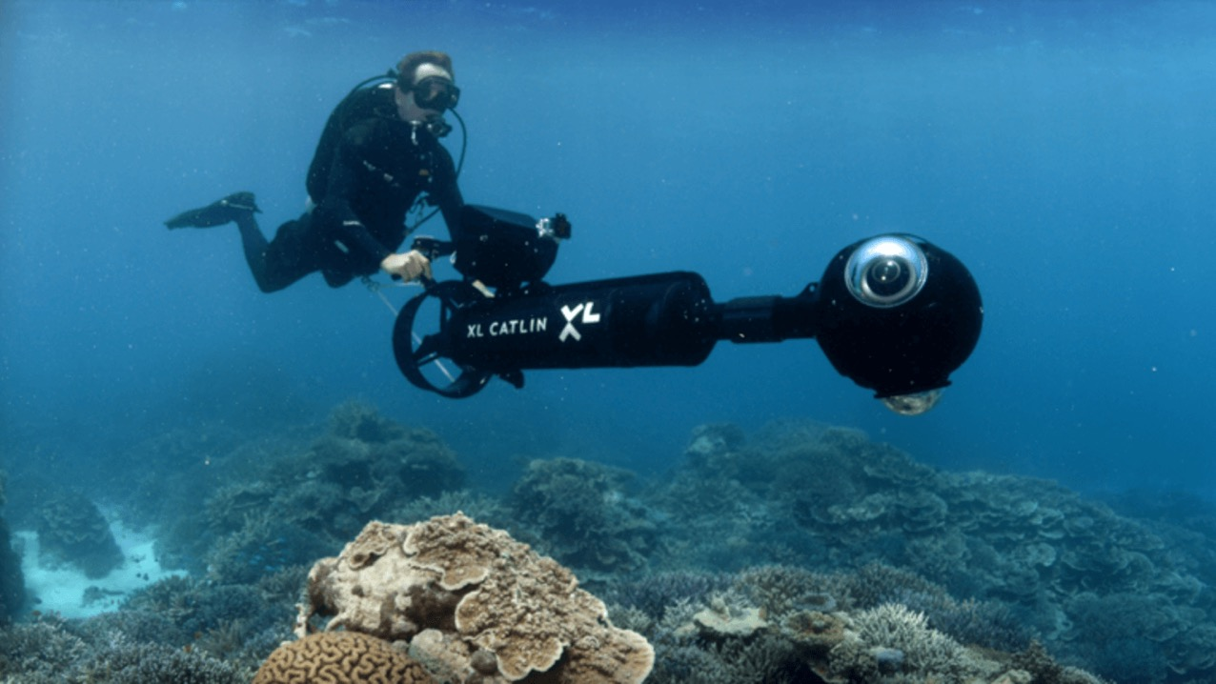
There are cameras for shallow water surveys….

Slide 32
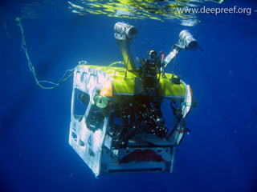
…and there are cameras for deep water surveys

Slide 33
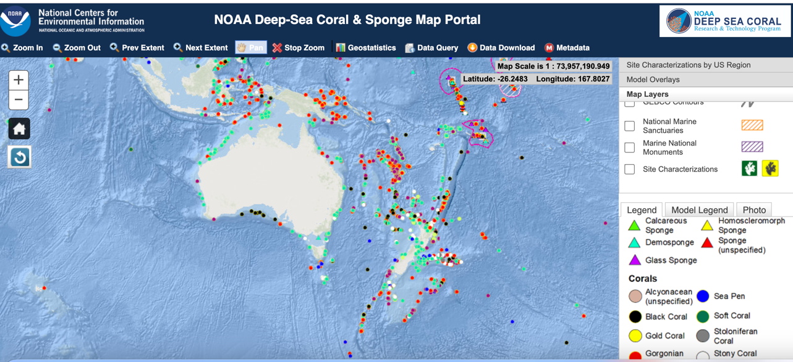
Maps of deep sea corals and sponges!
Notes:
Image: https://www.ncei.noaa.gov/maps/deep-sea-corals/mapSites.htm

Slide 34
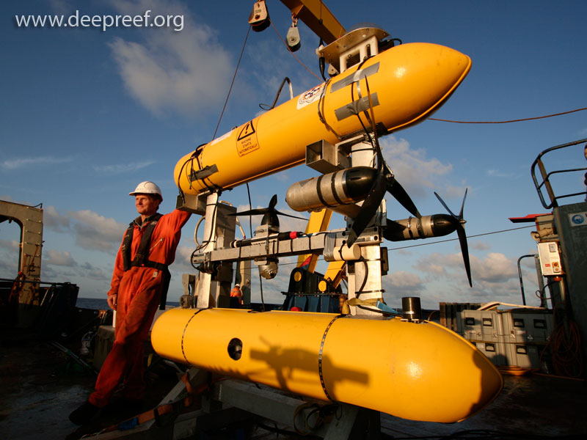
AUV – Autonomous Underwater Vehicle (unmanned)

Slide 35
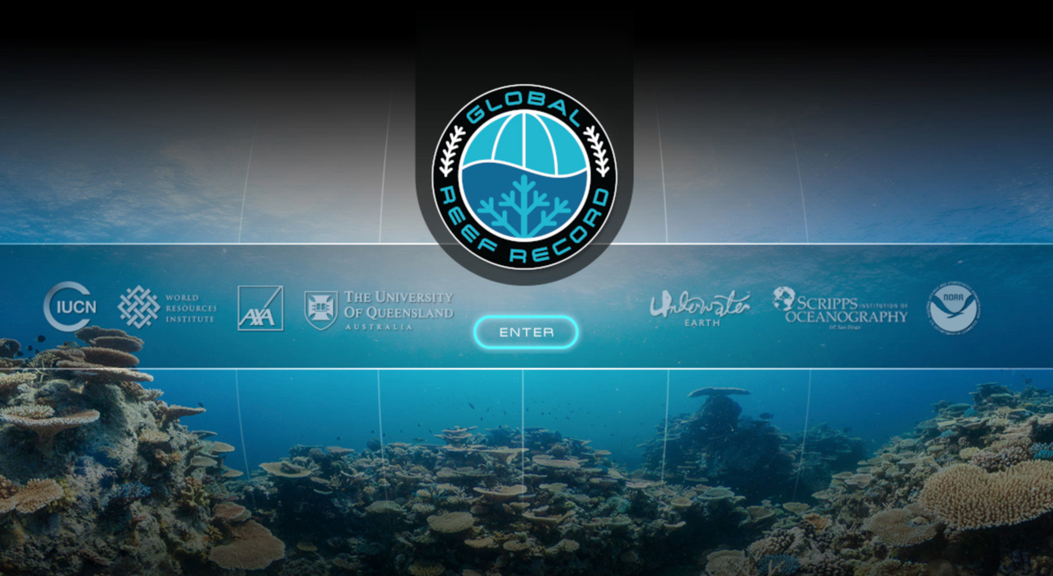
All Catlin Seaview data is now publicly available on the Global Reef Record.

Slide 36
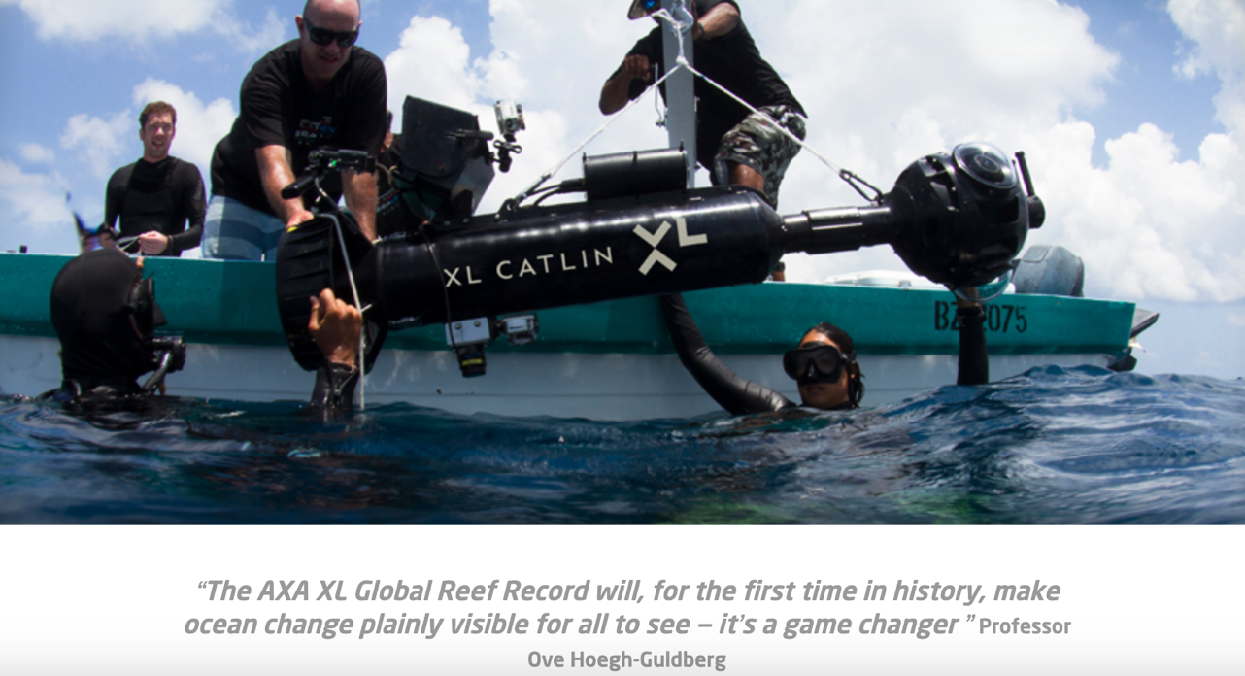

Slide 37
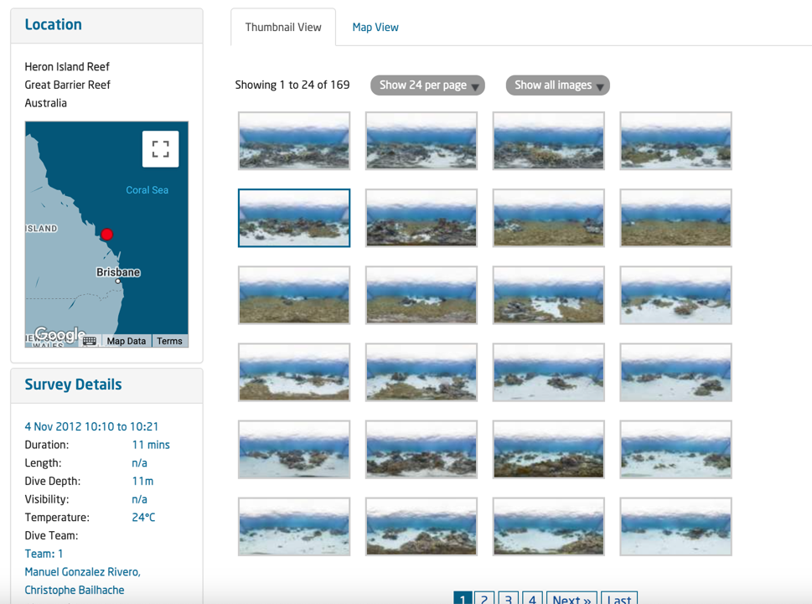
Click on the ‘data’ tab

Slide 38
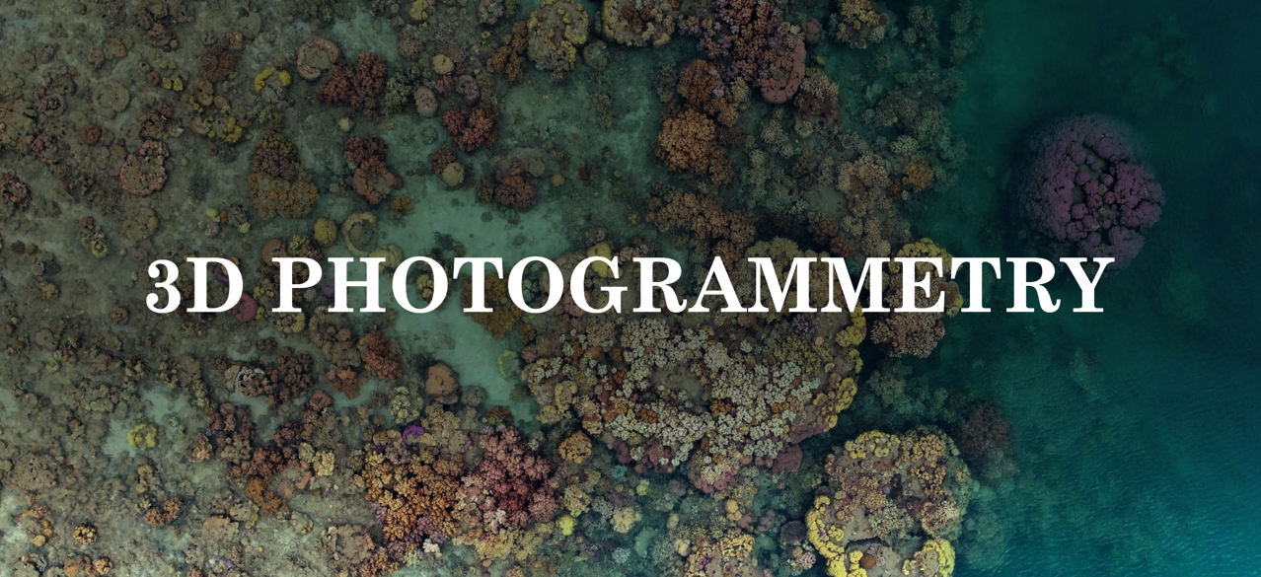
Photogrammetry is the art and science of extracting 3D information from photographs.
Notes:
Image: https://www.reef.support/tools/3d

Slide 39
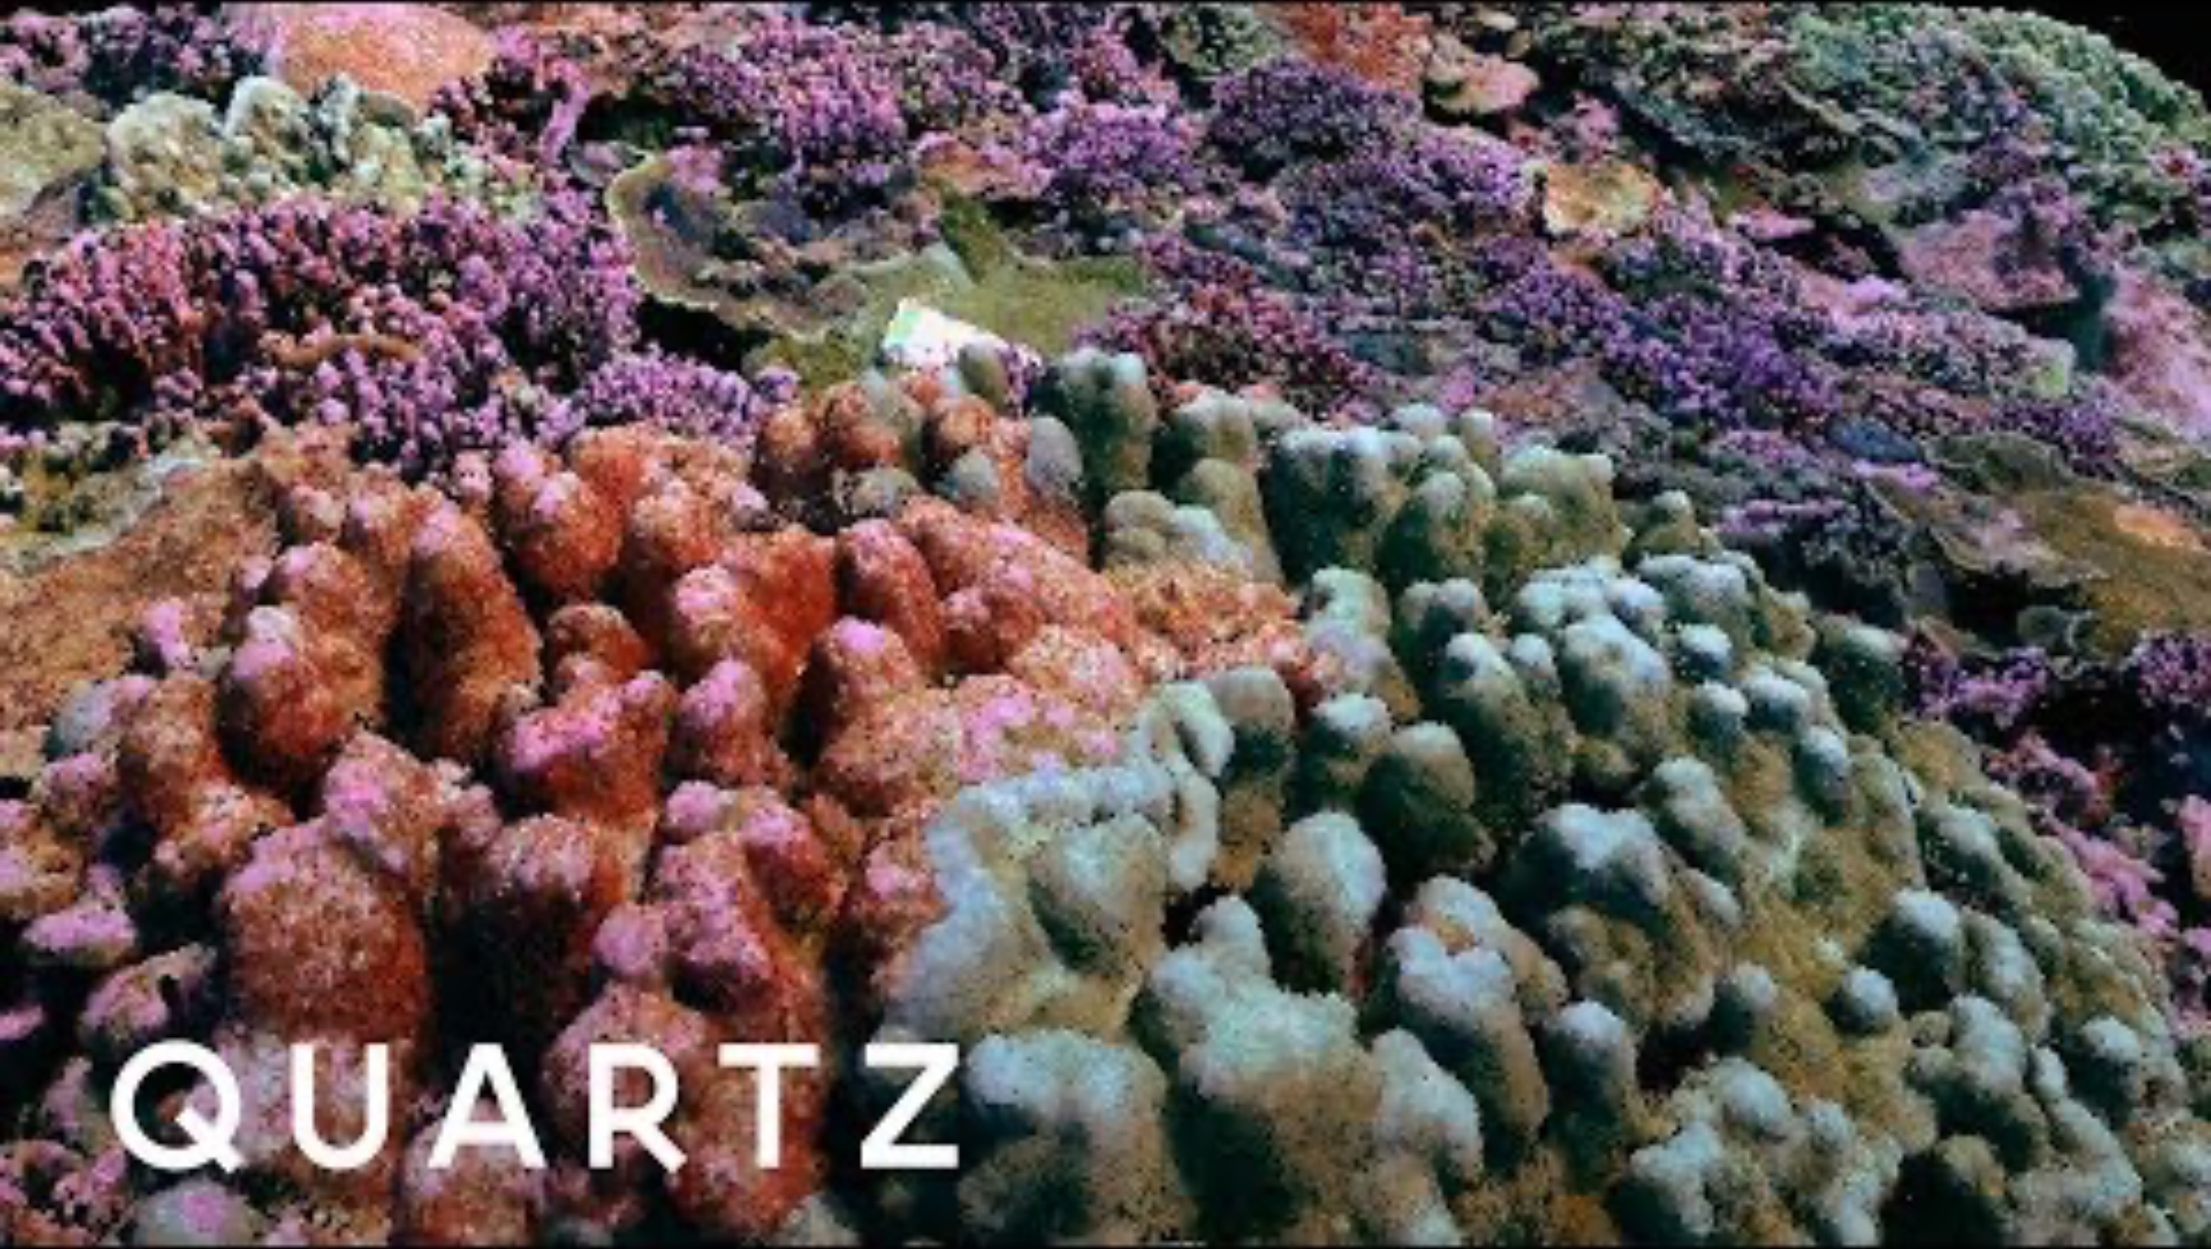
3D photogrammetry maps of coral reefs
Play video: https://www.youtube.com/watch?v=sE5bcnPaSLk
Notes:
https://www.youtube.com/watch?v=sE5bcnPaSLk

Slide 40
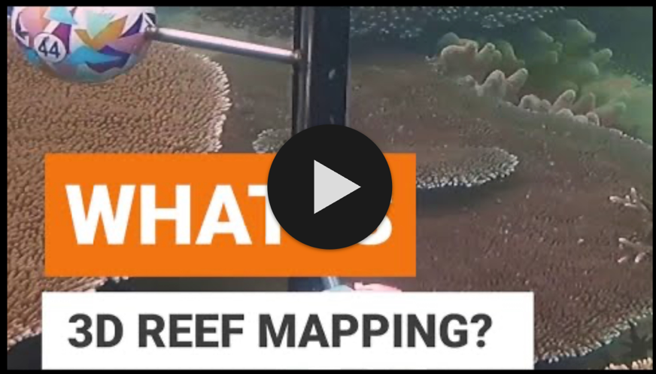
What is 3D reef mapping?
Play video: https://www.youtube.com/watch?v=fwwDWln7Ivk
Notes:
https://www.youtube.com/watch?v=fwwDWln7Ivk

Slide 41
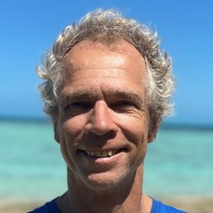
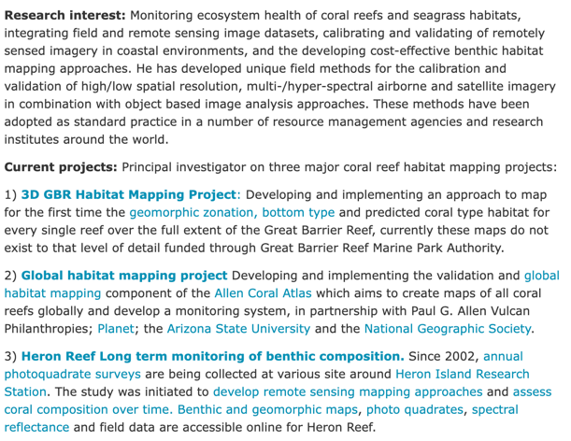
Chris has been working on the Allen Coral Atlas, as well as many other mapping projects. He has kindly shared his photographs!
About Chris (also an awesome guy!)
Associate Professor Chris Roelfsema
School of the Environment
Faculty of Science
University of Queensland

Slide 42
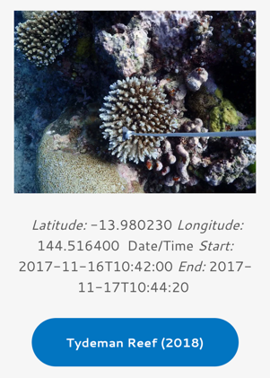
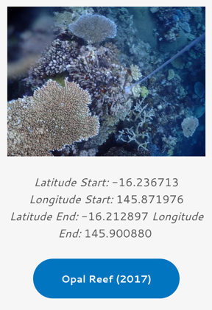
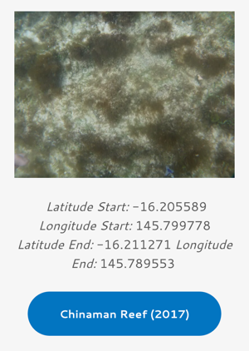
https://www.pangaea.de/helpers/Benthos.php?B=Great_Barrier_Reef&C=FNR&S=Tydeman&ID=891496&Page=0
https://www.pangaea.de/helpers/Benthos.php?B=Great_Barrier_Reef&C=CCMR&S=Opal_Reef_2017-01&ID=877563&Page=0
https://www.pangaea.de/helpers/Benthos.php?B=Great_Barrier_Reef&C=CCMR&S=Chinaman_Reef_2017-05&ID=877554

Slide 43
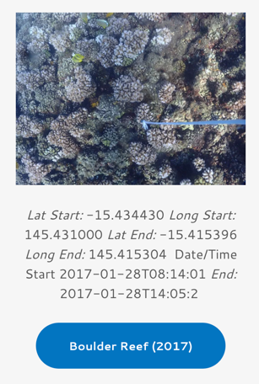
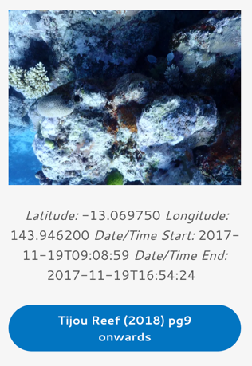

https://www.pangaea.de/helpers/Benthos.php?B=Great_Barrier_Reef&C=CCMR&S=Boulder_Reef_2017-01&ID=877552
https://www.pangaea.de/helpers/Benthos.php?B=Great_Barrier_Reef&C=FNR&S=Tijou&ID=891495&Page=9
https://www.pangaea.de/helpers/Benthos.php?B=Heron_Reef&C=2009&ID=895570

Slide 44

GIS
Geographic Information
System
brings it altogether!

Slide 45


Slide 46


AUGUST 2023
Coral bleaching alerts
DEC. 2023
What do you predict will happen in 2024?
Notes:
Images: https://coralreefwatch.noaa.gov/product/5km/index_5km_baa-max-7d.php

Slide 47


10 March 2024
This is what happened
21 March 2024

Slide 48

Learning Intention:
Analyse evidence from longitudinal studies showing changes that occur in marine environments, e.g. satellite imagery, aerial photography, field research
Success Criteria:
Complete Marine Education
worksheet ’11. Information in
Imagery’
Notes:
Image: https://sketchfab.com/blogs/community/underwater-imaging-for-coral-reef-3d-mapping/

