Slide 1
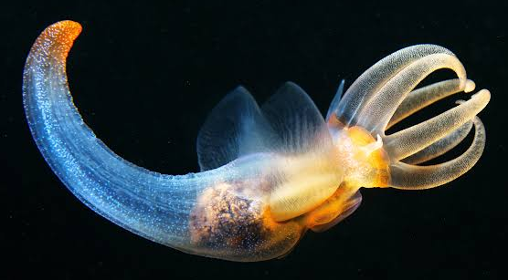
Learning Intention:
Identify and describe marine species, using field guides and identification keys.
Success Criteria:
Complete Marine Education worksheet ‘11. Pick a name’
Pteropod

Slide 2
Think-Pair-Share
Do you recognise this animal?
If so, what is its common name?
Where might you see this animal?
What do you already know about this animal?

Slide 3
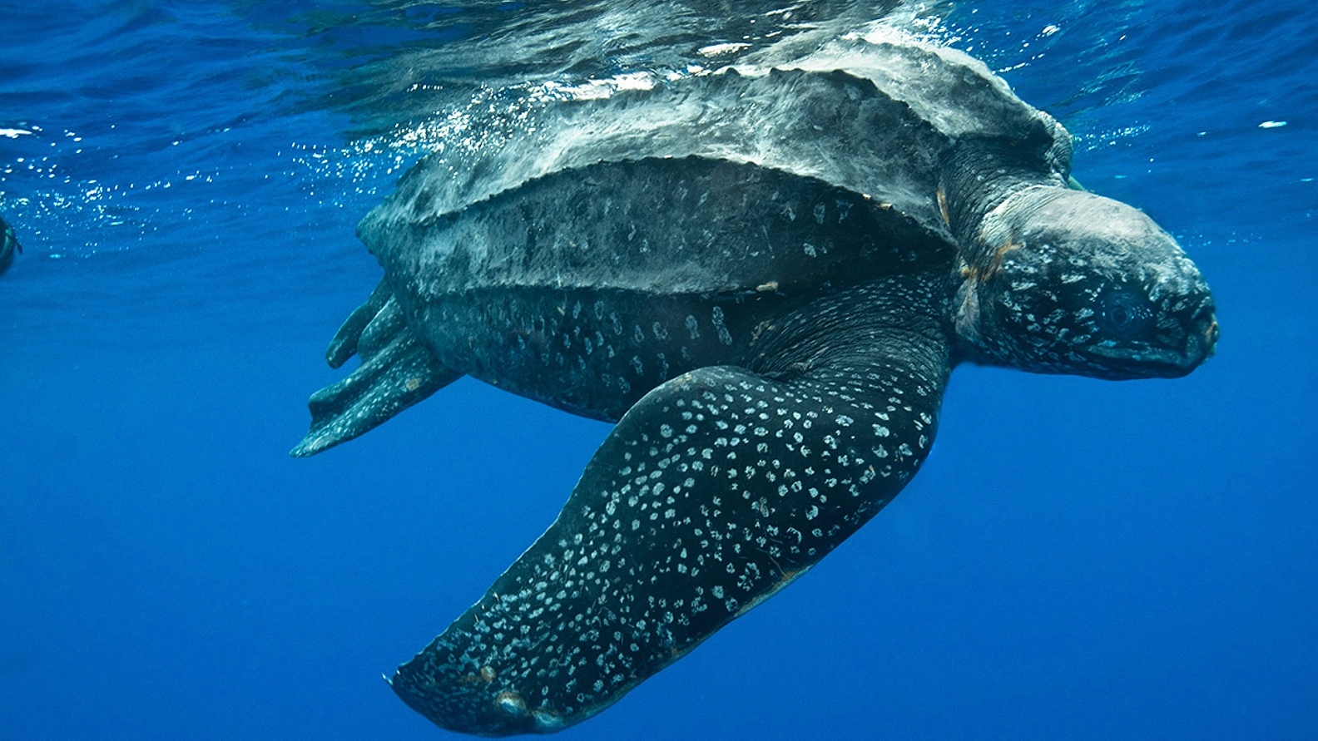
Do you recognise this animal?
If so, what is its common name?
Where might you see this animal?
What do you already know about this animal?
Notes:
Leatherback turtle

Slide 4
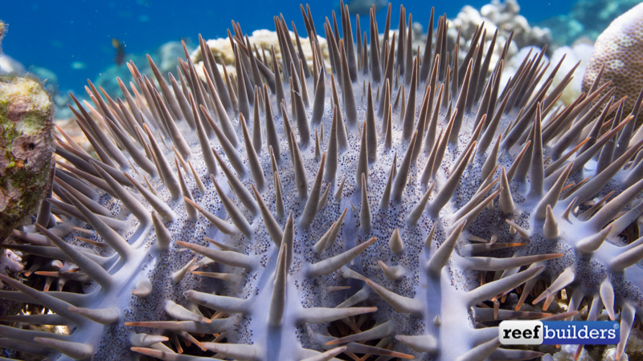
Do you recognise this animal?
If so, what is its common name?
Where might you see this animal?
What do you already know about this animal?

Slide 5
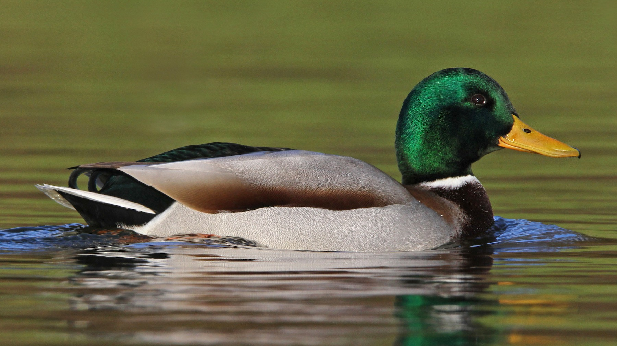
Do you recognise this animal?
If so, what is its common name?
Where might you see this animal?
What do you already know about this animal?

Slide 6
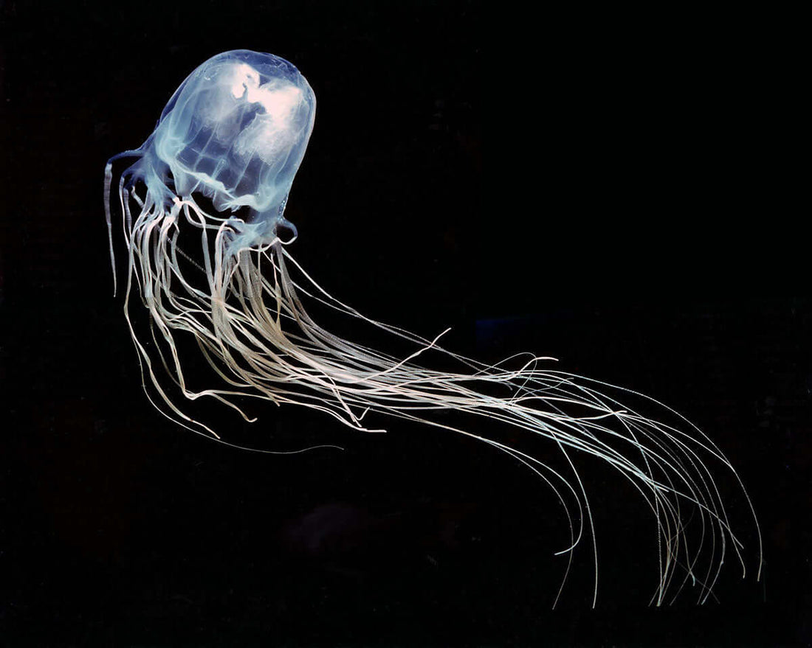
Do you recognise this animal?
If so, what is its common name?
Where might you see this animal?
What do you already know about this animal?

Slide 7
Common names can change with location and cultural norms.
The only sure way to know if you’re talking about the same species is to use the
Genus species (binomial) name.

Slide 8
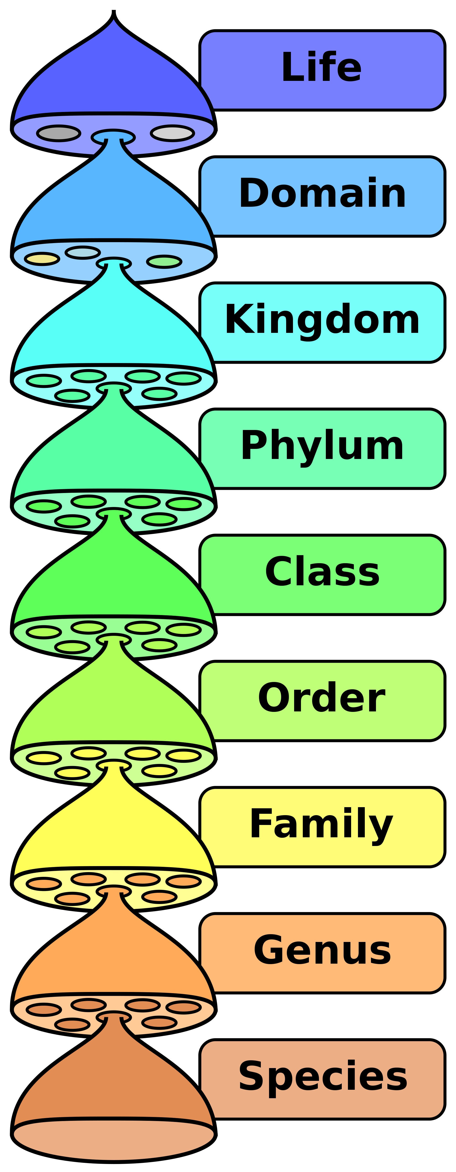
Many Binomial names have Greek or Latin roots
Greek | dermo | skin
 | ptera | wing
 | chiro | hand
 | nex | murder
 | hexa | six
 | melan | black
Latin | anas | duck
 | acantha | thorn
 | ciliosa | fine hair
Binomial is the Genus species name

Slide 9
Activity: Think-Pair-Share
Match the animal to the binomial name
Acanthaster planci
Dermochelys coriacea
Chironex fleckeri
Anas platyrhynchos

Slide 10
Answers
Acanthaster planci
Dermochelys coriacea
Chironex fleckeri
Anas platyrhynchos
Dermochelys coriacea
Acanthaster planci
Anas platyrhynchos
Chironex fleckeri

Slide 11
Can you see why they match?
Greek | dermo | skin
 | ptera | wing
 | chiro | hand
 | nex | murder
 | hexa | six
 | melan | black
Latin | anas | duck
 | acantha | thorn
 | ciliosa | fine hair
Dermochelys coriacea
Acanthaster planci
Anas platyrhynchos
Chironex fleckeri
Notes:
Chironex fleckeri has the distinction of being extremely venomous – even its name suggests the hand of death: derived from the Greek `cheiro' meaning `hand', and the Latin `nex' meaning `murderer'

Slide 12
Can you see why they match?
Greek | dermo | skin
 | ptera | wing
 | chiro | hand
 | nex | murder
 | hexa | six
 | melan | black
Latin | anas | duck
 | acantha | thorn
 | ciliosa | fine hair
Dermochelys coriacea
Acanthaster planci
Anas platyrhynchos
Chironex fleckeri
Notes:
Chironex fleckeri has the distinction of being extremely venomous – even its name suggests the hand of death: derived from the Greek `cheiro' meaning `hand', and the Latin `nex' meaning `murderer'

Slide 13
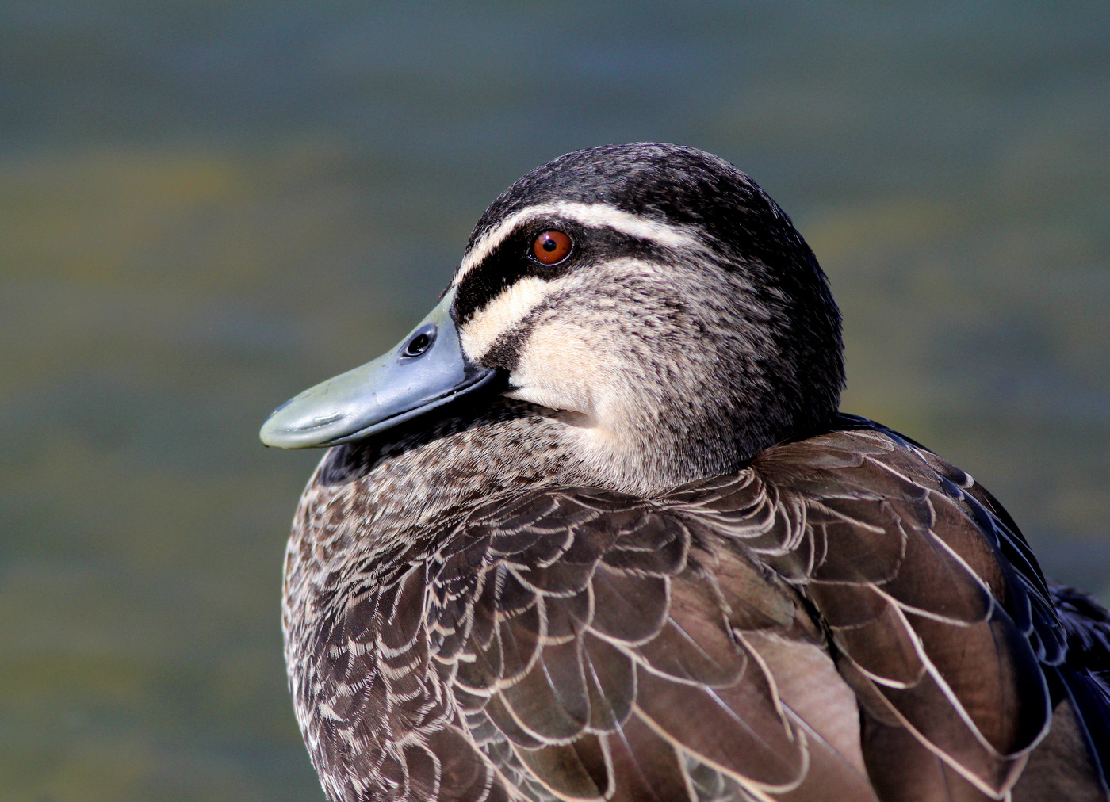
Name this animal
(make it up using Greek and Latin words)
Greek | dermo | skin
 | ptera | wing
 | chiro | hand
 | nex | murder
 | hexa | six
 | melan | black
Latin | anas | duck
 | acantha | thorn
 | ciliosa | fine hair

Slide 14
It’s actual binomial name is Anas superciliosa
(the Pacific Black Duck)
Greek | dermo | skin
 | ptera | wing
 | chiro | hand
 | nex | murder
 | hexa | six
 | melan | black
Latin | anas | duck
 | acantha | thorn
 | ciliosa | fine hair

Slide 15
Many Phylum names have Greek or Latin roots too.
Greek | cnidos | stinging nettle
 | ptera | wing
 | poda | foot
 | hexa | six
 | deca | ten
 | chord | string
Latin | arthro | jointed
 | octo | eight
 | porus | pore

Slide 16
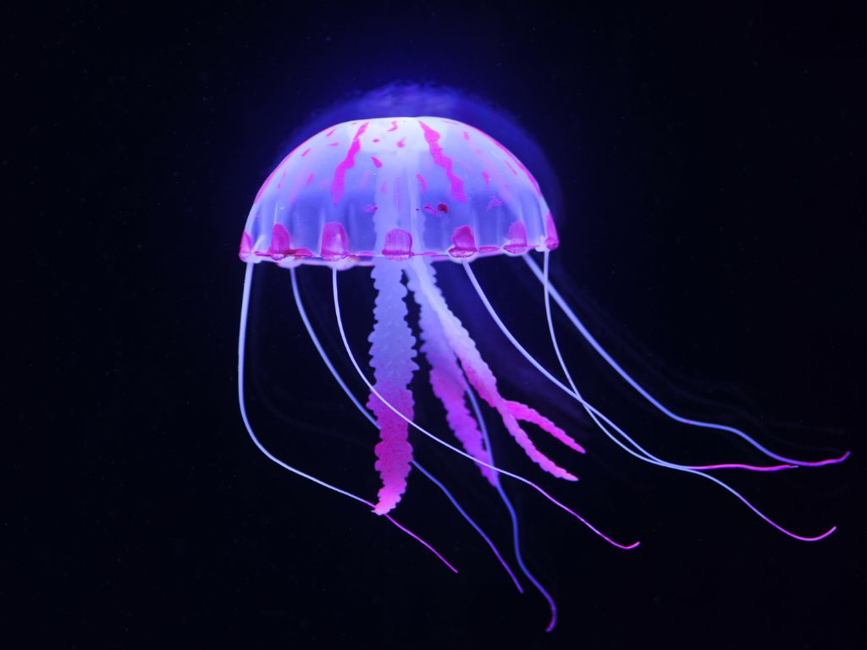
Activity: Match the animal to the Phylum name
Greek | cnidos | stinging nettle
 | ptera | wing
 | poda | foot
 | hexa | six
 | deca | ten
 | chord | string
Latin | arthro | jointed
 | octo | eight
 | porus | pore
Phylum names (to choose from)
Cnidaria
Chordata
Porifera
Arthropoda

Slide 17
Answer
Greek | cnidos | stinging nettle
 | ptera | wing
 | poda | foot
 | hexa | six
 | deca | ten
 | chord | string
Latin | arthro | jointed
 | octo | eight
 | porus | pore
Phylum names (to choose from)
Cnidaria
Chordata
Porifera
Arthropoda

Slide 18
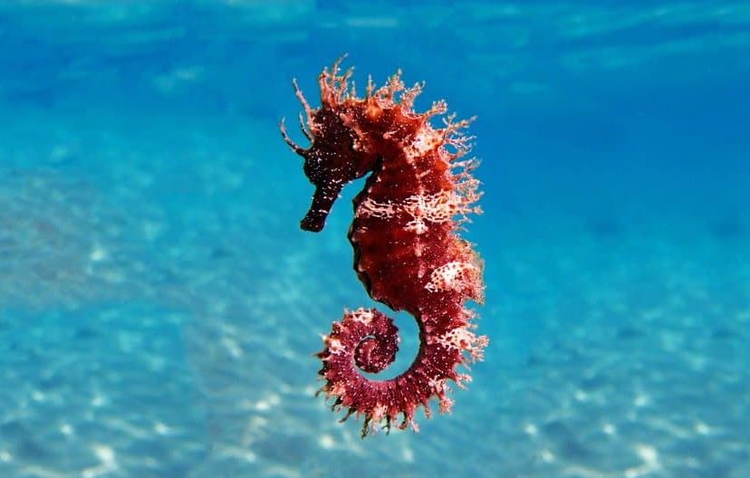
Activity: Match the animal to the Phylum name
Greek | cnidos | stinging nettle
 | ptera | wing
 | poda | foot
 | hexa | six
 | deca | ten
 | chord | string
Latin | arthro | jointed
 | octo | eight
 | porus | pore
Phylum names (to choose from)
Cnidaria
Chordata
Porifera
Arthropoda

Slide 19
Answer
Greek | cnidos | stinging nettle
 | ptera | wing
 | poda | foot
 | hexa | six
 | deca | ten
 | chord | string
Latin | arthro | jointed
 | octo | eight
 | porus | pore
Phylum names (to choose from)
Cnidaria
Chordata
Porifera
Arthropoda

Slide 20
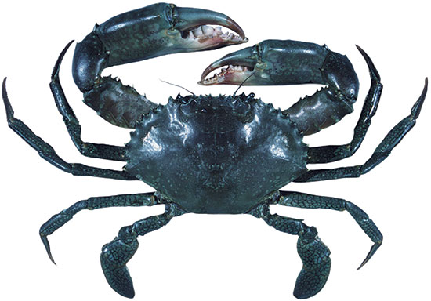
Activity: Match the animal to the Phylum name
Greek | cnidos | stinging nettle
 | ptera | wing
 | poda | foot
 | hexa | six
 | deca | ten
 | chord | string
Latin | arthro | jointed
 | octo | eight
 | porus | pore
Phylum names (to choose from)
Cnidaria
Chordata
Porifera
Arthropoda

Slide 21
Answer
Greek | cnidos | stinging nettle
 | ptera | wing
 | poda | foot
 | hexa | six
 | deca | ten
 | chord | string
Latin | arthro | jointed
 | octo | eight
 | porus | pore
Phylum names (to choose from)
Cnidaria
Chordata
Porifera
Arthropoda

Slide 22
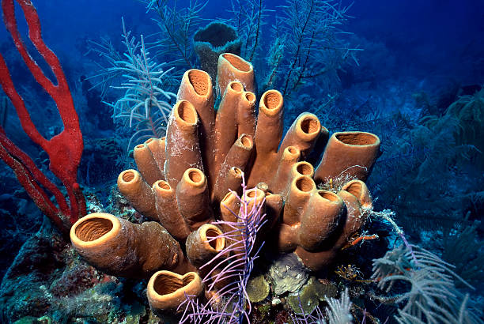
Activity: Match the animal to the Phylum name
Greek | cnidos | stinging nettle
 | ptera | wing
 | poda | foot
 | hexa | six
 | deca | ten
 | chord | string
Latin | arthro | jointed
 | octo | eight
 | porus | pore
Phylum names (to choose from)
Cnidaria
Chordata
Porifera
Arthropoda

Slide 23
Answer
Greek | cnidos | stinging nettle
 | ptera | wing
 | poda | foot
 | hexa | six
 | deca | ten
 | chord | string
Latin | arthro | jointed
 | octo | eight
 | porus | pore
Phylum names (to choose from)
Cnidaria
Chordata
Porifera
Arthropoda

Slide 24
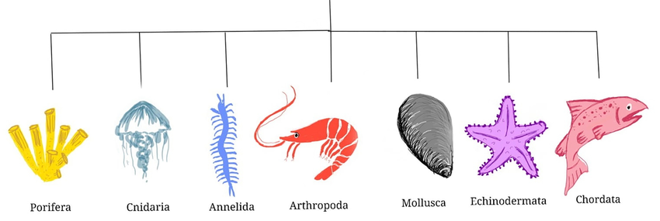
Common marine PHYLUM
and their Greek name meanings
Pore-bearing
stinging nettle
Small ring (segmented worms)
Jointed legs
string (notochord)
soft
spiny skin
Notes:
Image: https://www.researchgate.net/publication/369830543_Marine_Antimicrobial_Peptides_An_Emerging_Nightmare_to_the_Life-Threatening_Pathogens

Slide 25
Many Order names also have Greek or Latin roots
Greek | cnidos | stinging nettle
 | ptera | wing
 | poda | foot
 | hexa | six
 | deca | ten
 | chord | string
Latin | arthro | jointed
 | octo | eight
 | porus | pore

Slide 26
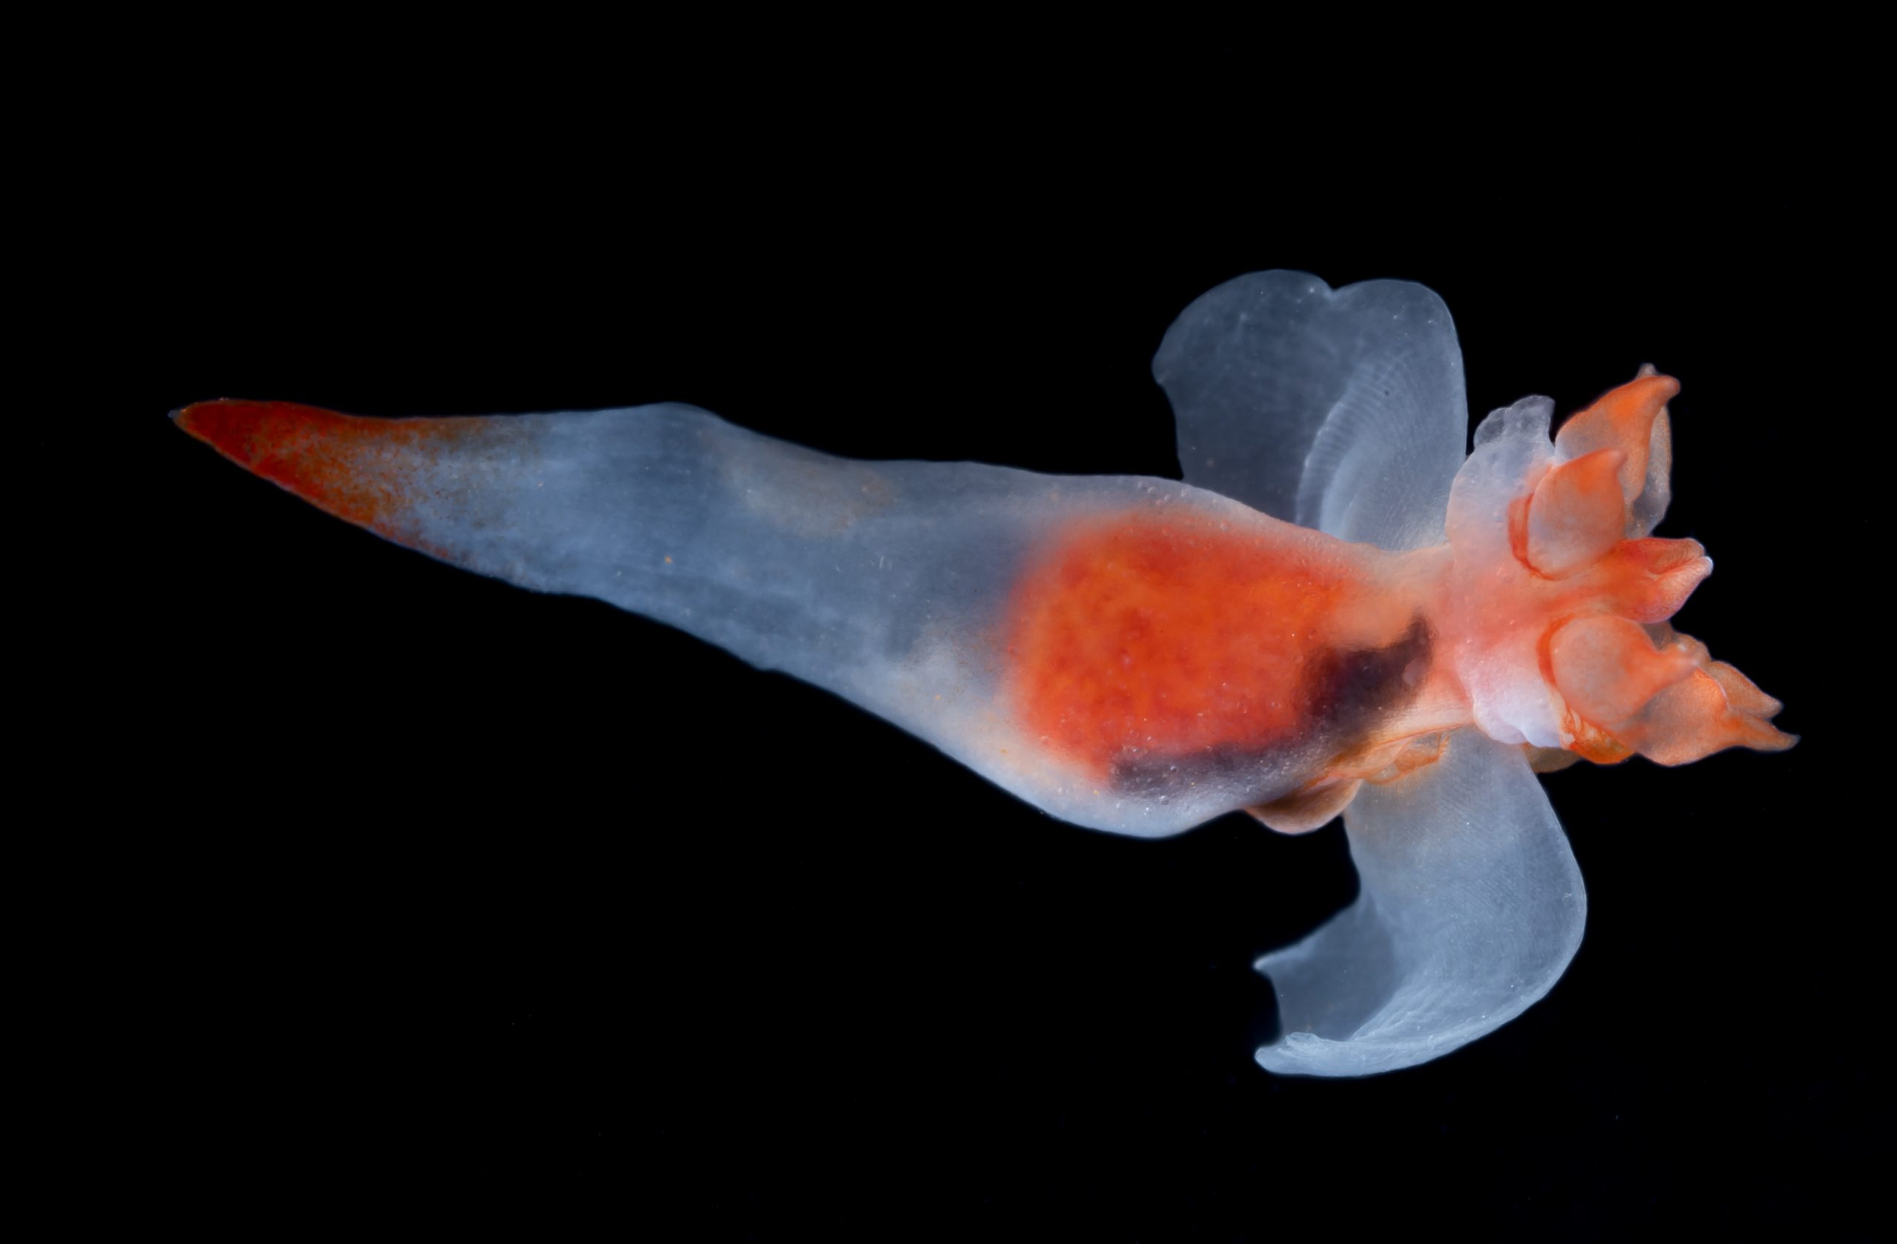
Activity: Match the animal to the Order name
Greek | cnidos | stinging nettle
 | ptera | wing
 | poda | foot
 | hexa | six
 | deca | ten
 | chord | string
Latin | arthro | jointed
 | octo | eight
 | porus | pore
Order names (to choose from)
Pteropoda
Decapoda

Slide 27
Answer
Greek | cnidos | stinging nettle
 | ptera | wing
 | poda | foot
 | hexa | six
 | deca | ten
 | chord | string
Latin | arthro | jointed
 | octo | eight
 | porus | pore
Order names (to choose from)
Pteropoda
Decapoda

Slide 28
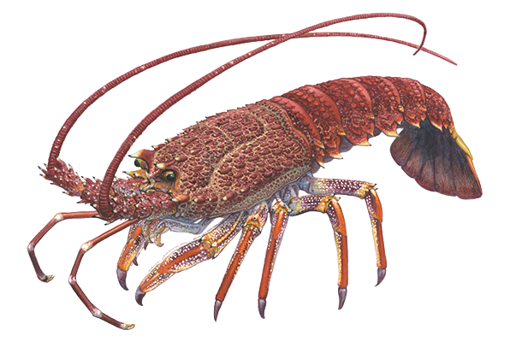
Activity: Match the animal to the Order name
Greek | cnidos | stinging nettle
 | ptera | wing
 | poda | foot
 | hexa | six
 | deca | ten
 | chord | string
Latin | arthro | jointed
 | octo | eight
 | porus | pore
Order names (to choose from)
Pteropoda
Decapoda

Slide 29
Answer
Greek | cnidos | stinging nettle
 | ptera | wing
 | poda | foot
 | hexa | six
 | deca | ten
 | chord | string
Latin | arthro | jointed
 | octo | eight
 | porus | pore
Order names (to choose from)
Pteropoda
Decapoda

Slide 30
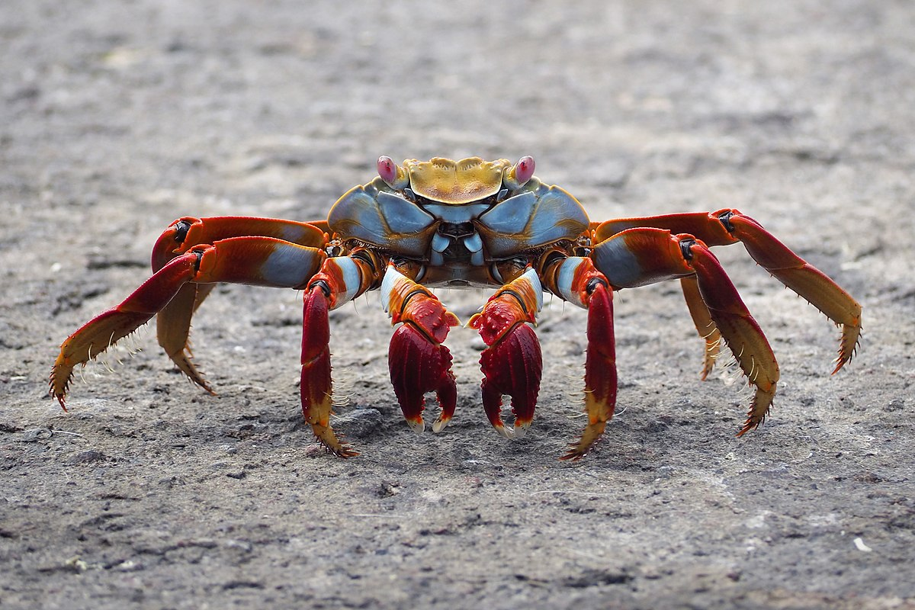
Activity: Match the animal to the Order name
Greek | cnidos | stinging nettle
 | ptera | wing
 | poda | foot
 | hexa | six
 | deca | ten
 | chord | string
Latin | arthro | jointed
 | octo | eight
 | porus | pore
Order names (to choose from)
Pteropoda
Decapoda

Slide 31
Answer
Greek | cnidos | stinging nettle
 | ptera | wing
 | poda | foot
 | hexa | six
 | deca | ten
 | chord | string
Latin | arthro | jointed
 | octo | eight
 | porus | pore
Order names (to choose from)
Pteropoda
Decapoda

Slide 32
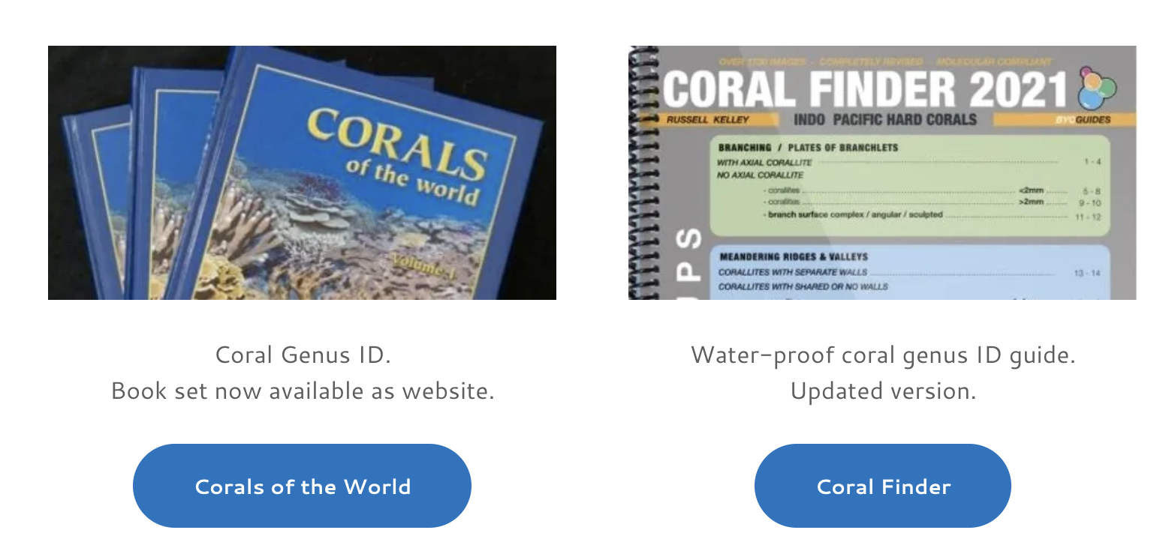
Field Guides and ID keys for Coral ID
http://www.coralsoftheworld.org/page/home/
https://byoguides.com/products/coral-finder

Slide 33
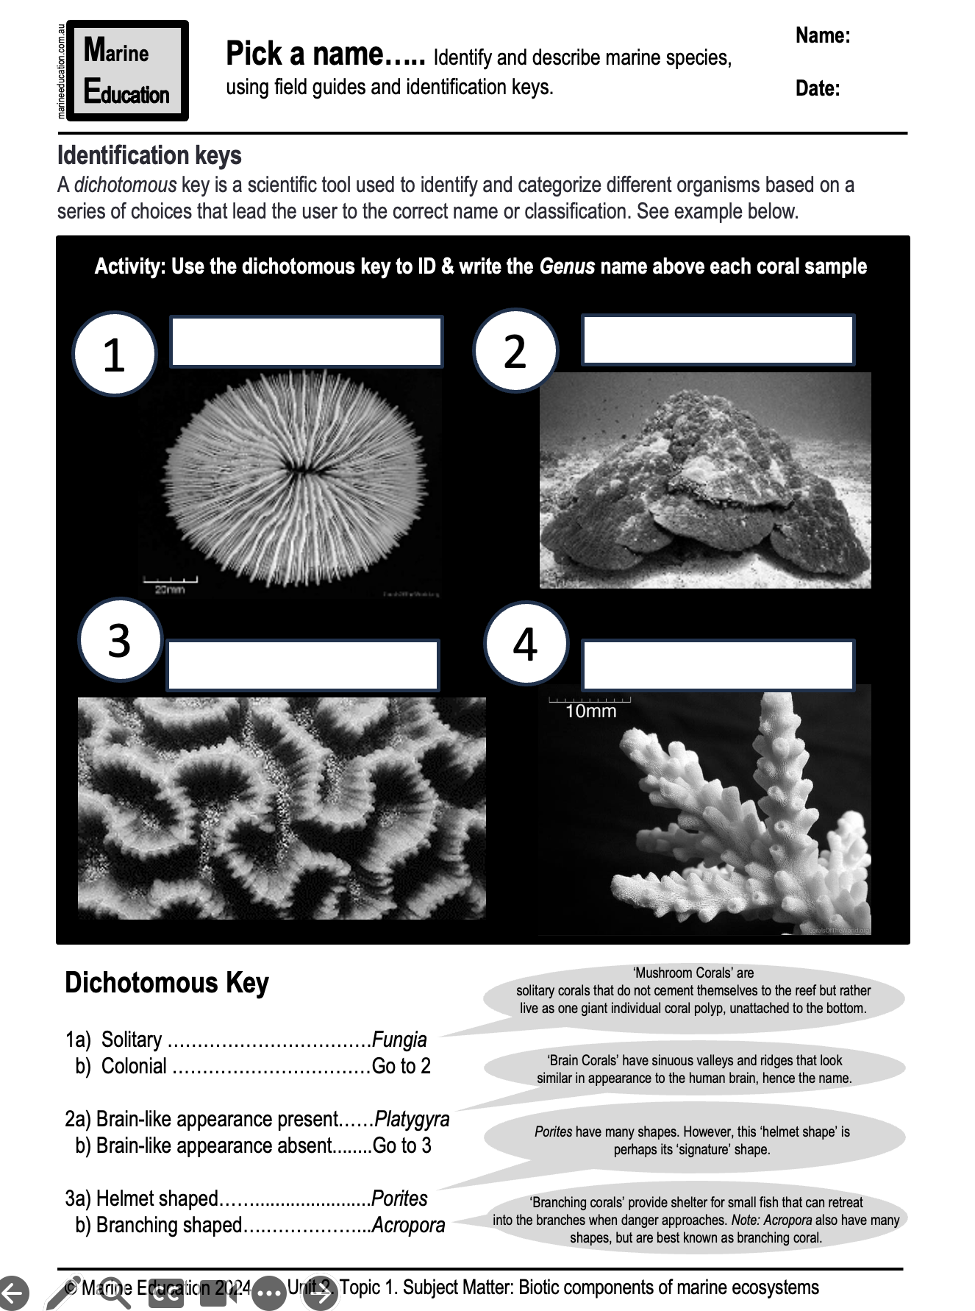
Activity: Identify the following animals using the identification key on your worksheet (& below)

Slide 34
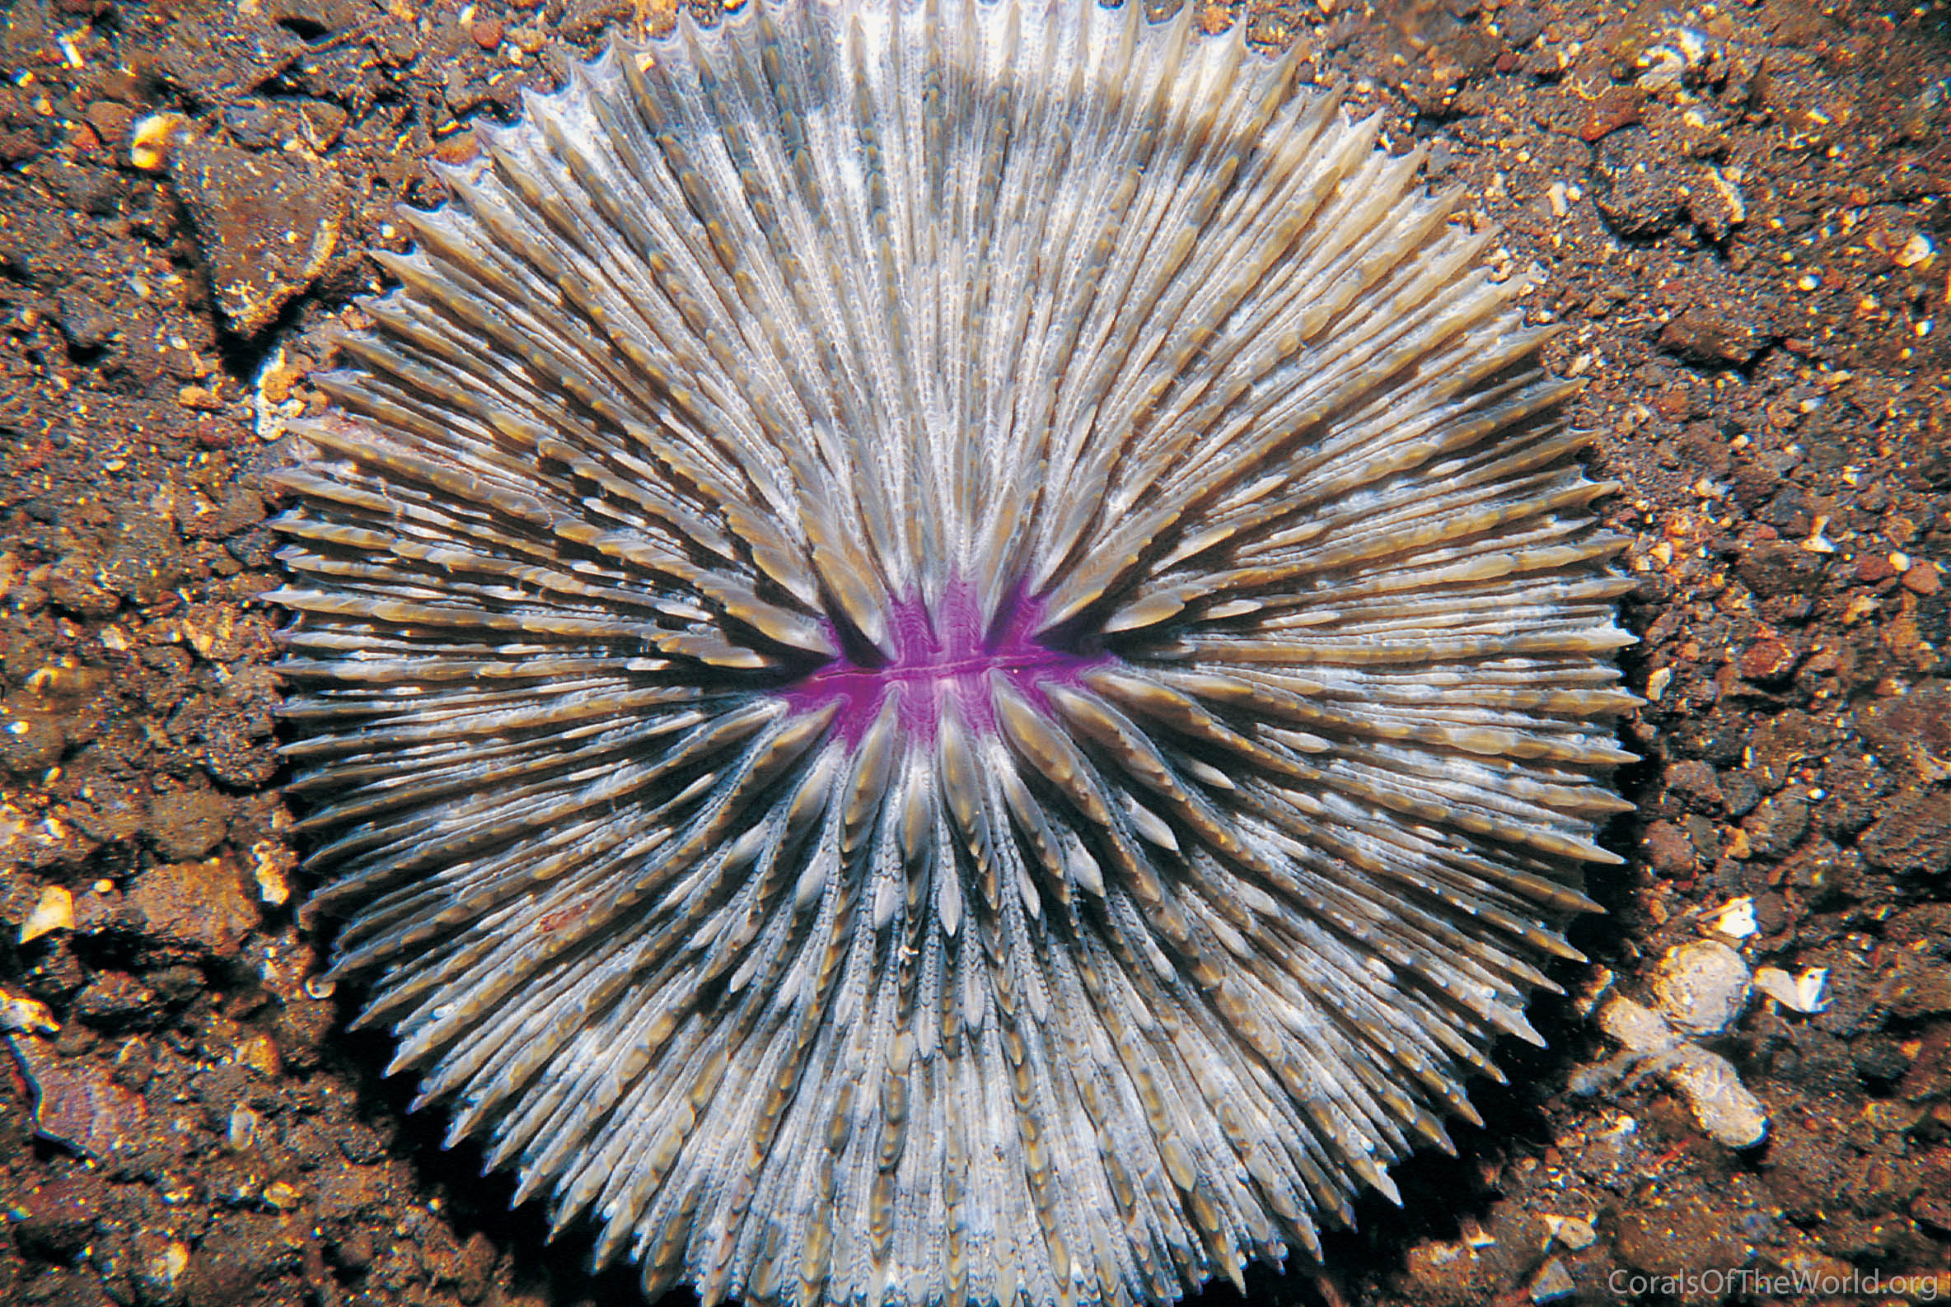
solitary
Photograph: Neville Coleman; Corals of the World
Notes:
Image: http://www.coralsoftheworld.org/species_factsheets/species_factsheet_summary/fungia-danai/

Slide 35
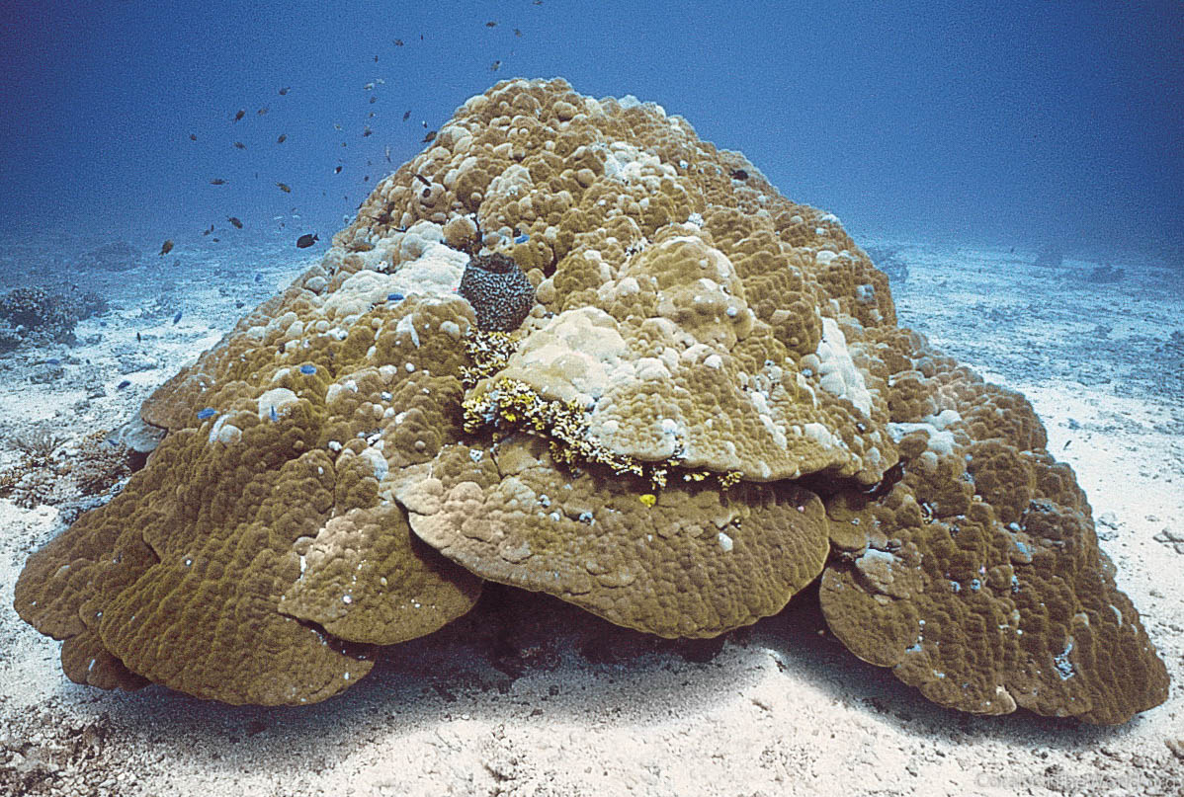
Photograph: Charlie Veron; Corals of the World
Helmet shaped
Notes:
Image: http://www.coralsoftheworld.org/species_factsheets/species_factsheet_summary/porites-lutea/

Slide 36
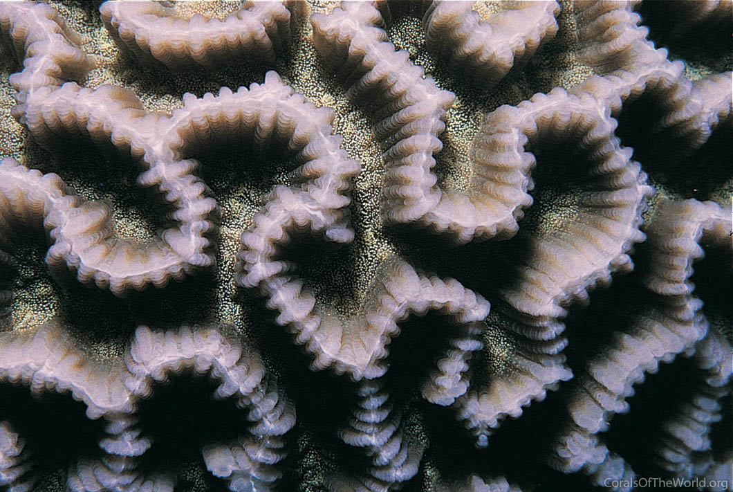
Brain-like
Photograph: Charlie Veron; Corals of the World
Notes:
Image: http://www.coralsoftheworld.org/species_factsheets/species_factsheet_summary/platygyra-acuta/

Slide 37
Branching
Photograph: Charlie Veron; Corals of the World
Notes:
Image: http://www.coralsoftheworld.org/species_factsheets/

Slide 38
How did you go?
Fungia
Platygyra
Porites
Acropora

Slide 39


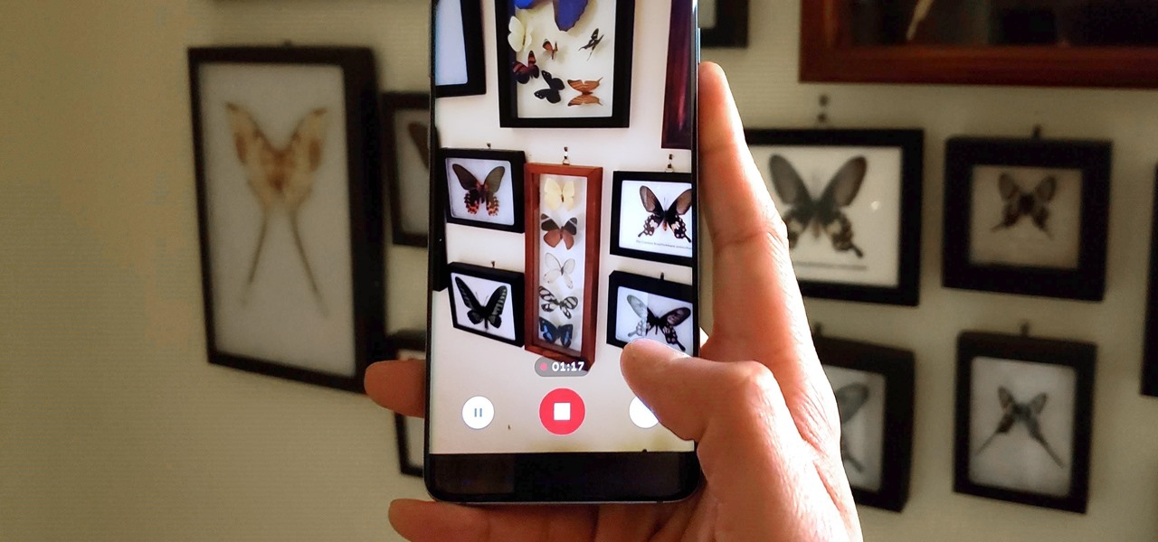
Use google images on your device to help ID
1.
2.
3.

Slide 40
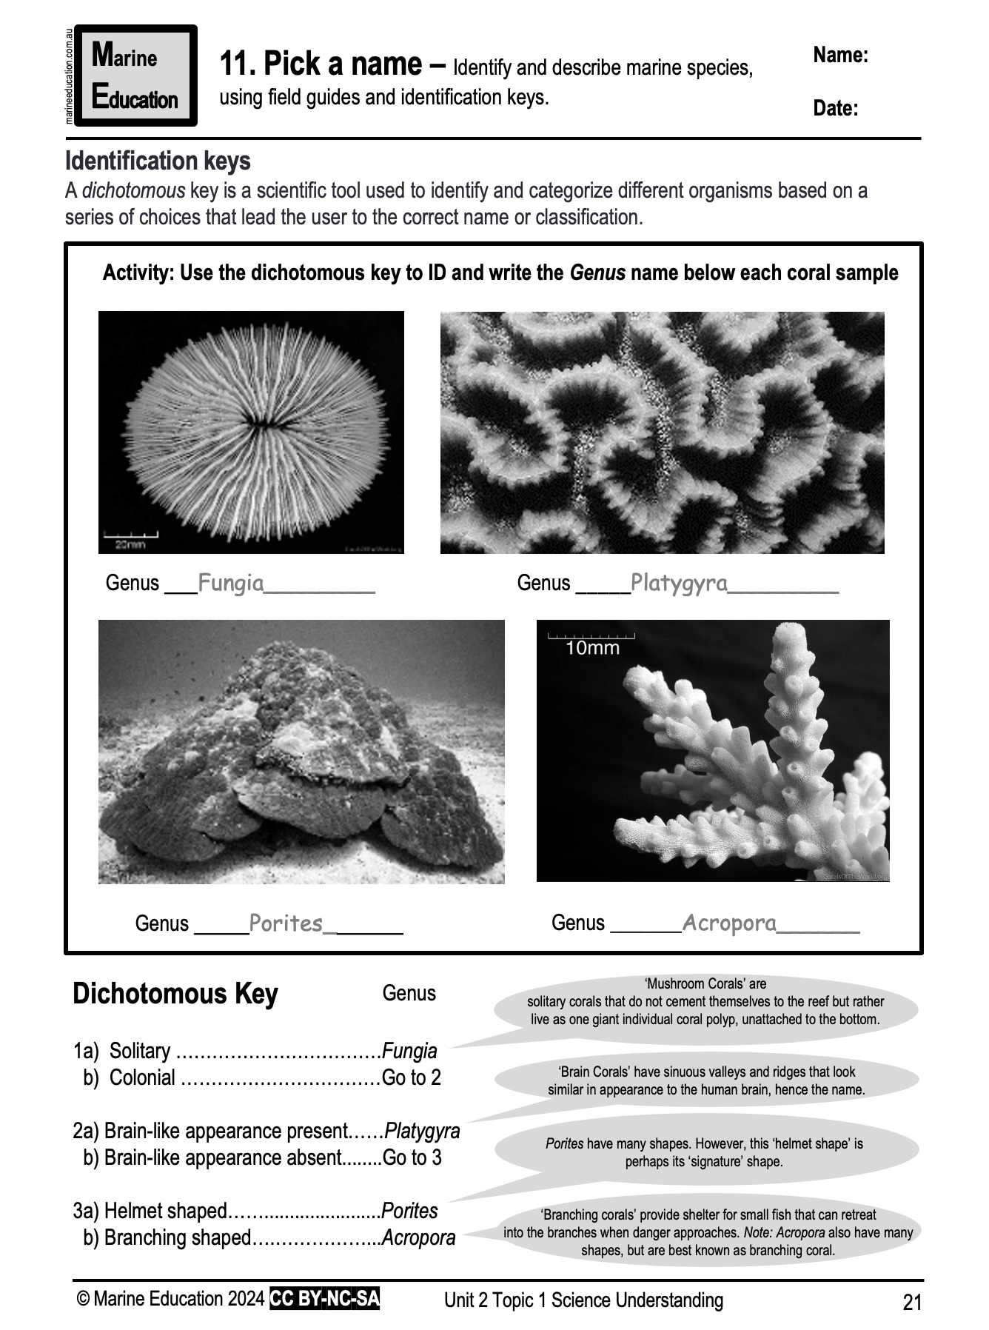
Learning Intention:
Identify and describe marine species, using field guides and identification keys.
Success Criteria:
Complete Marine Education worksheet ‘11. Pick a name”

