Slide 1
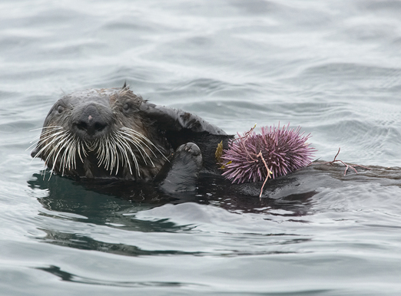
Learning Intention:
Identify how organisms populate areas following changes in habitats, e.g. succession.
Success Criteria:
Complete Marine Education worksheet ’12. Success-ion’

Slide 2
The order in which species occupy a given space, in time, is called ‘succession’.

Slide 3
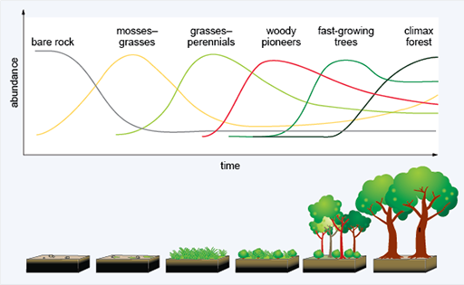
The most competitively superior species, at the time, wins the space.
Notes:
Image: https://www.open.edu/openlearn/science-maths-technology/fire-ecology/content-section-4.1

Slide 4
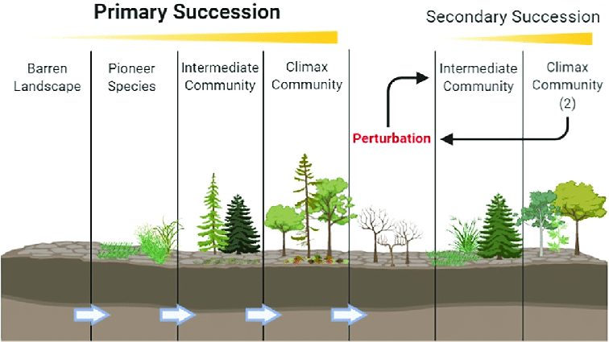
(disturbance event)
Notes:
Image: https://www.researchgate.net/figure/Model-of-ecological-succession-describing-the-stages-of-primary-succession-left-that_fig1_347413667

Slide 5
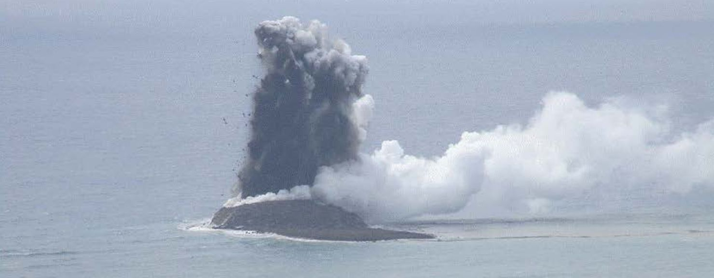
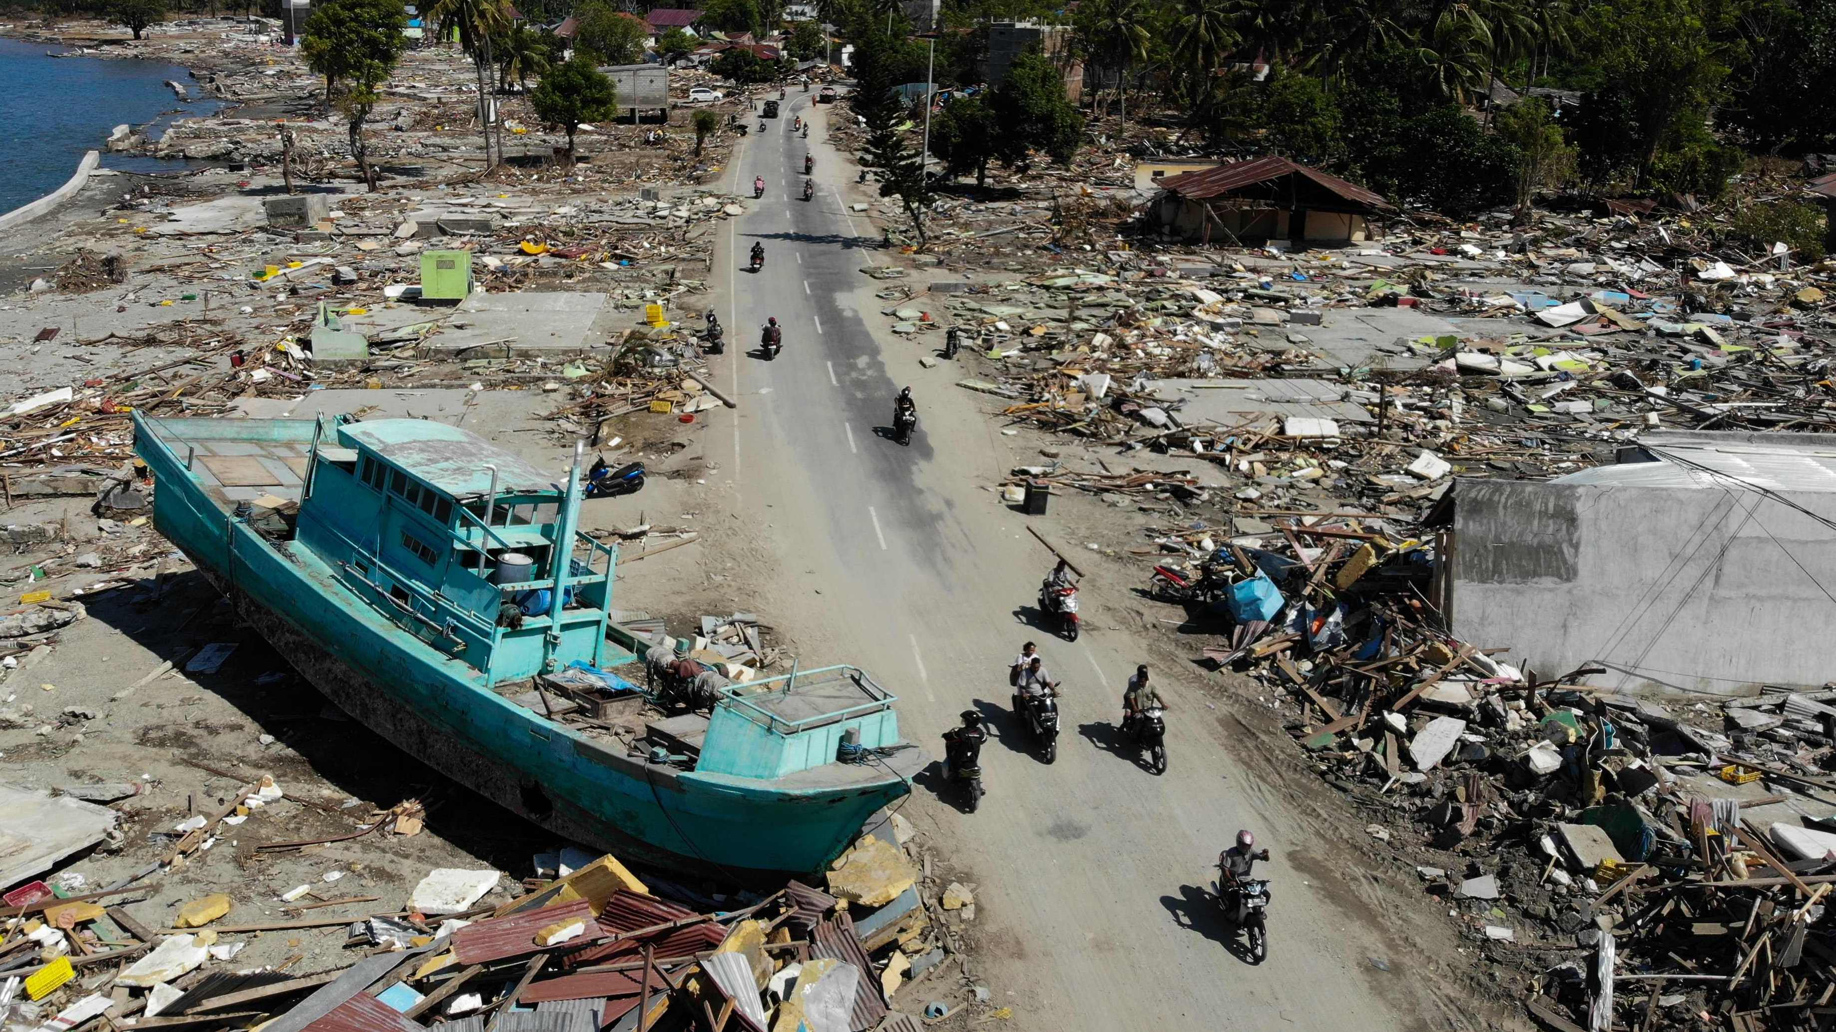
Primary succession starts from scratch.
A new island in Japan was formed by an undersea volcanic eruption on October 30th 2023.
Secondary succession follows a DISTURBANCE event.
Tsunami aftermath, Indonesia

Slide 6
DISTURBANCE event:
an event of intense environmental stress, forcing change upon an ecosystem.

Slide 7
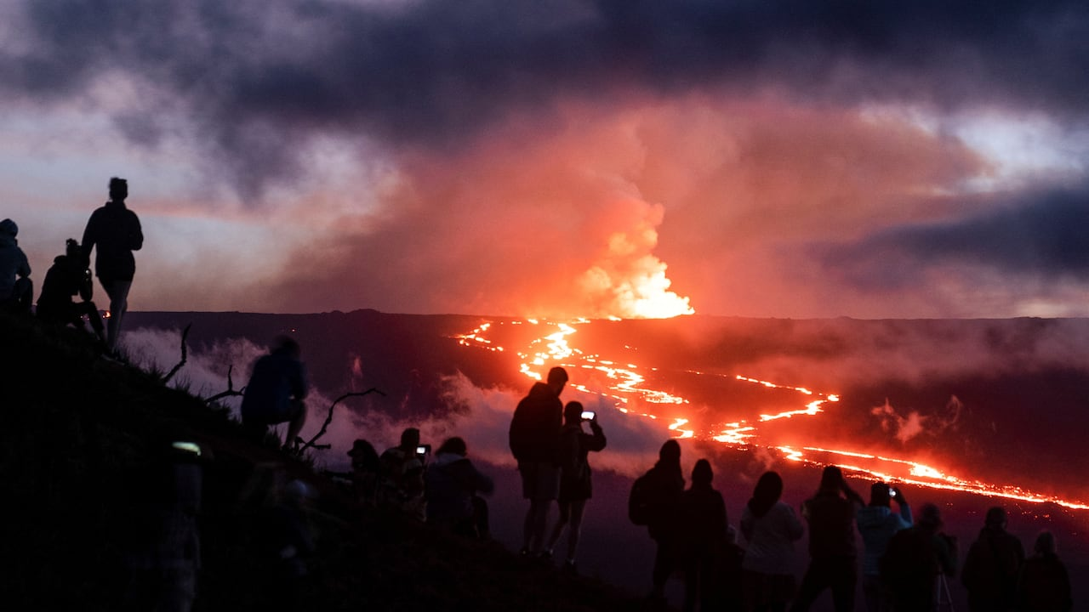
People gather to observe the eruption of the Mauna Loa volcano in Hawaii on Dec. 1, 2022. (Go Nakamura/Reuters)
Notes:
Image: https://www.cbc.ca/radio/quirks/hawaii-volcano-plate-tectonic-theory-1.6672128

Slide 8
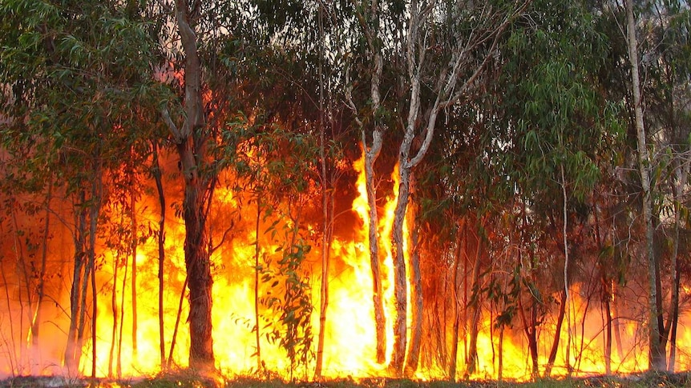
Notes:
Image: https://www.abc.net.au/news/science/2017-01-06/the-science-of-bushfires/8124050

Slide 9
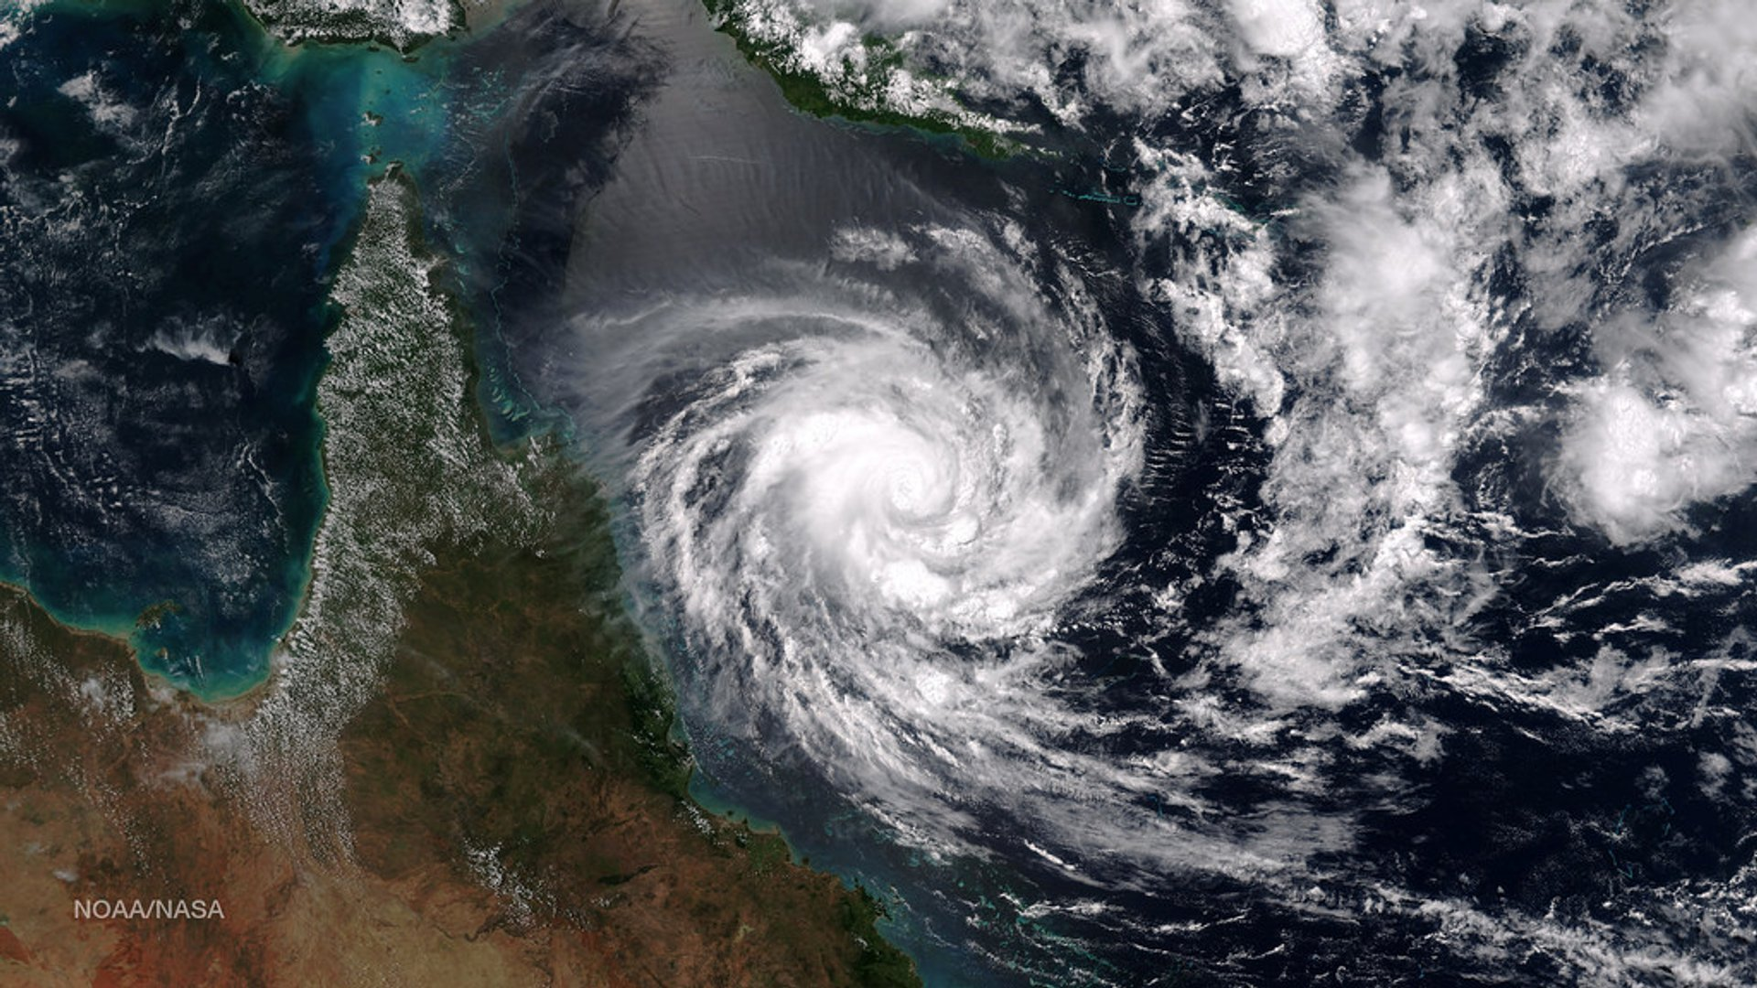
Notes:
Image: https://rove.me/to/great-barrier-reef/tropical-cyclones

Slide 10
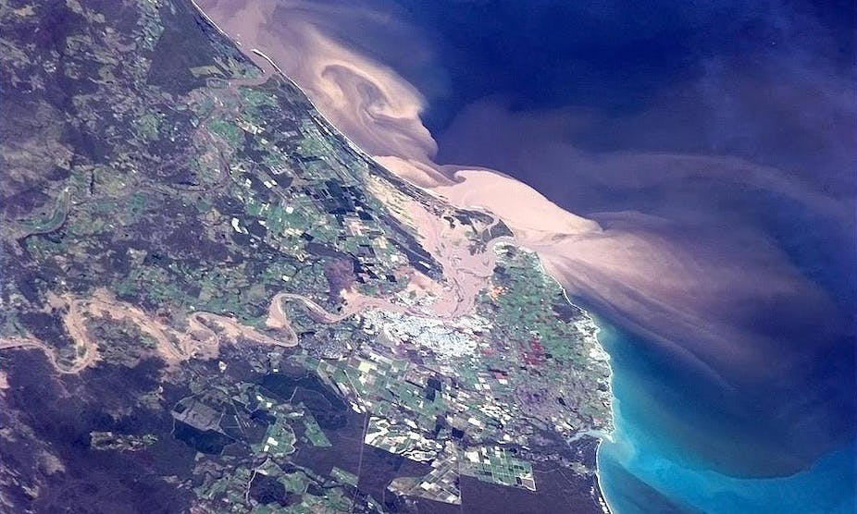

Slide 11
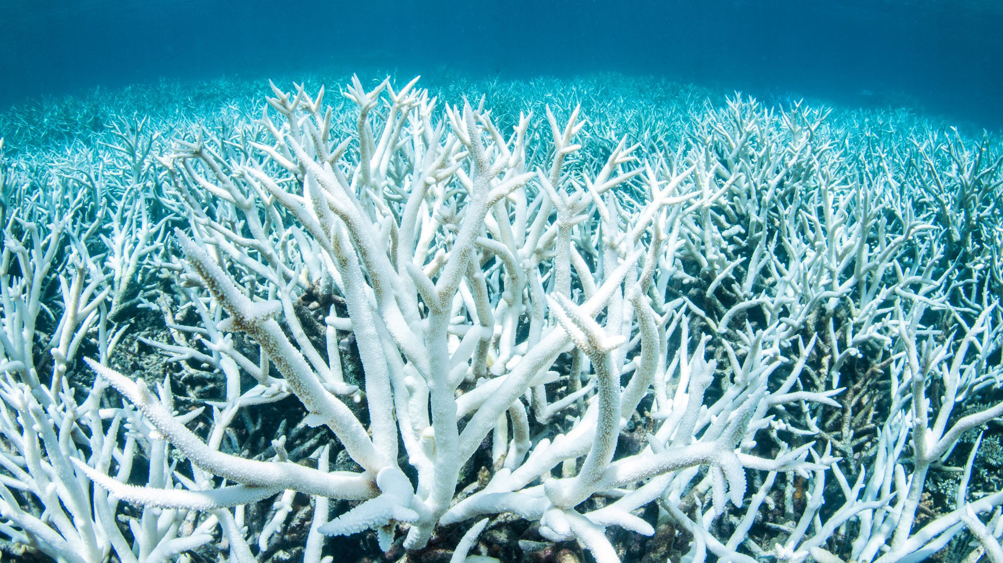

Slide 12
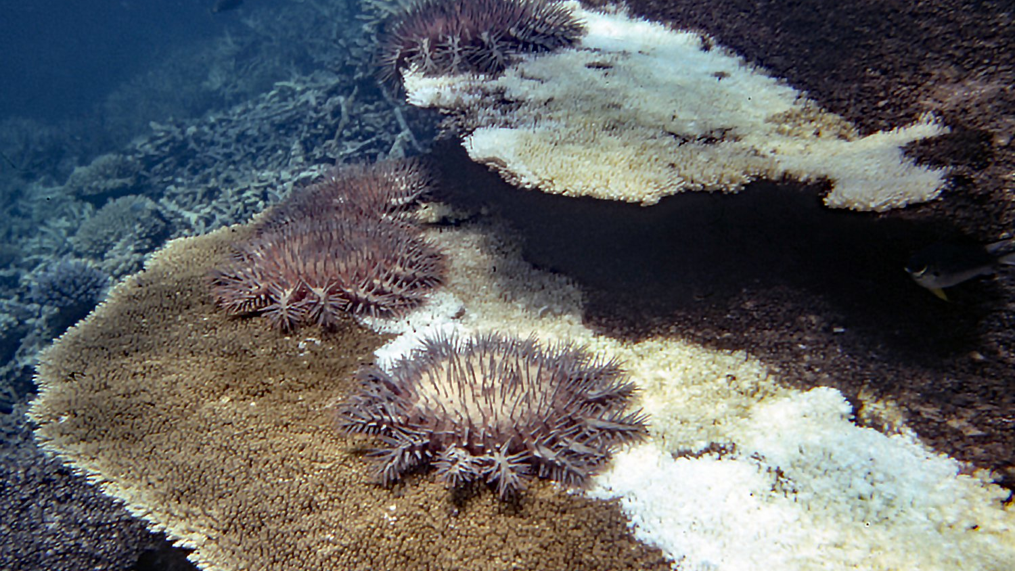

Slide 13
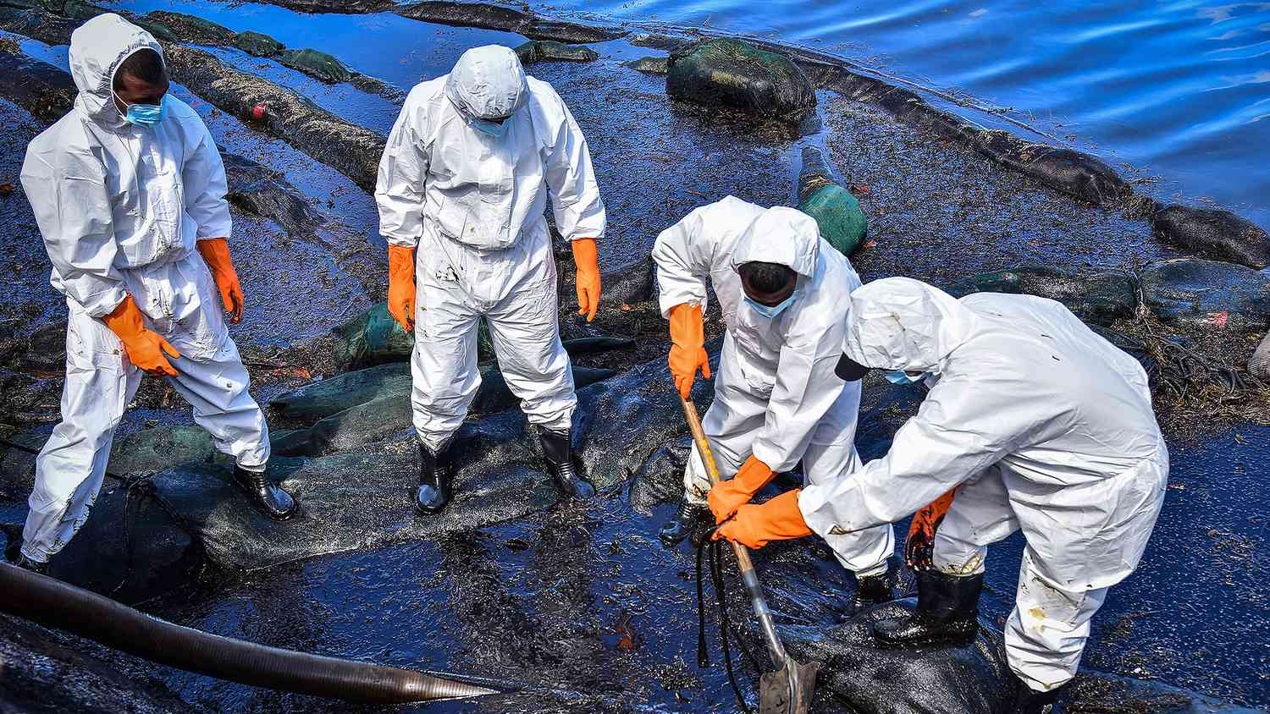

Slide 14
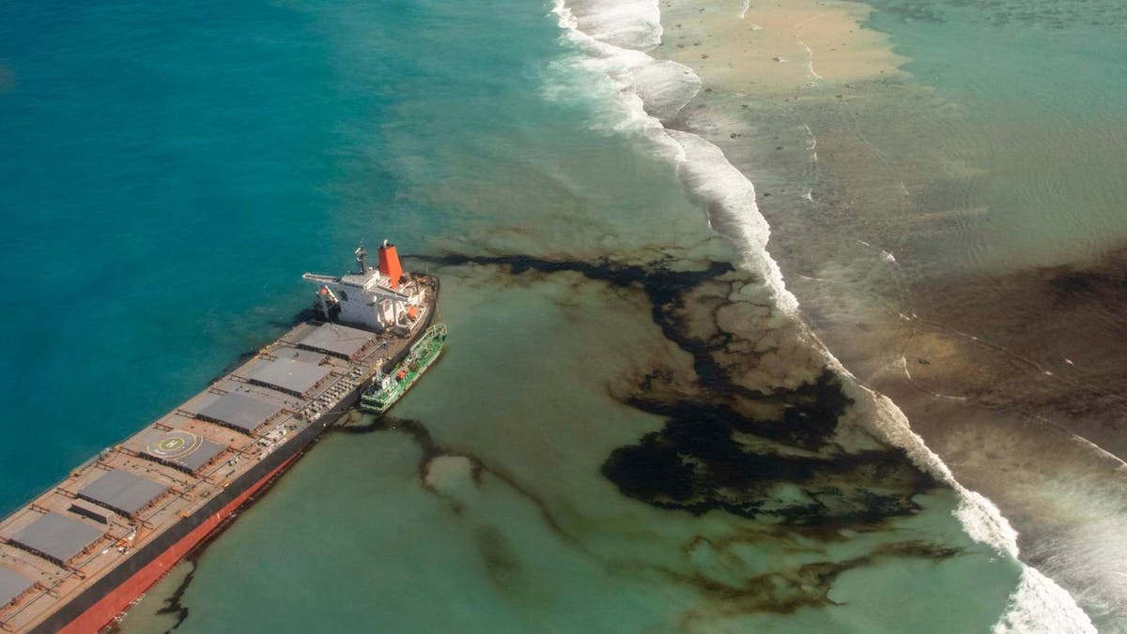

Slide 15
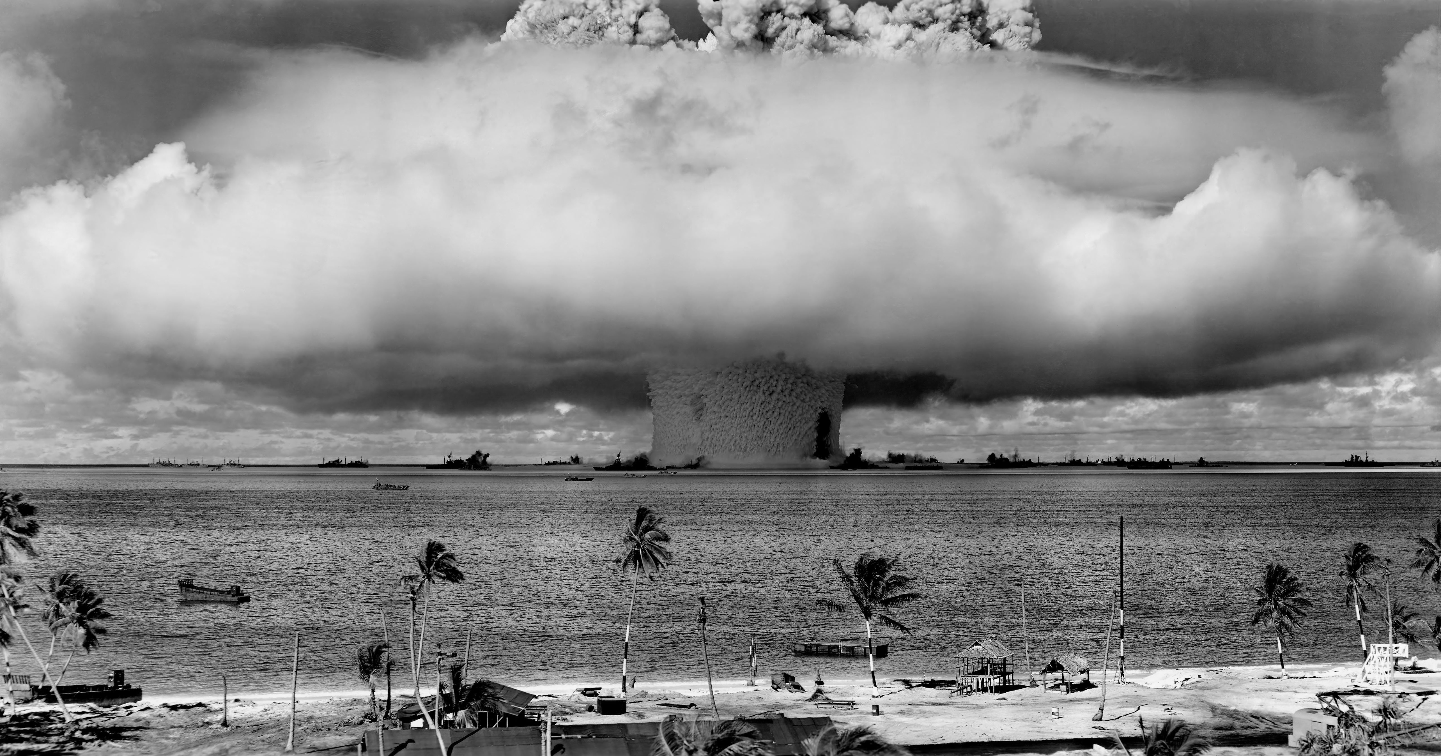
The United States began using the Marshall Islands as a nuclear testing site beginning in 1946.

Slide 16
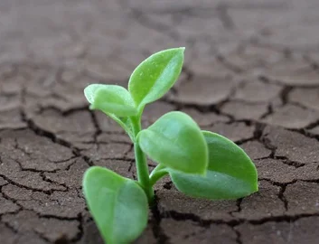
Fast growing
species occupy the free space first

Slide 17
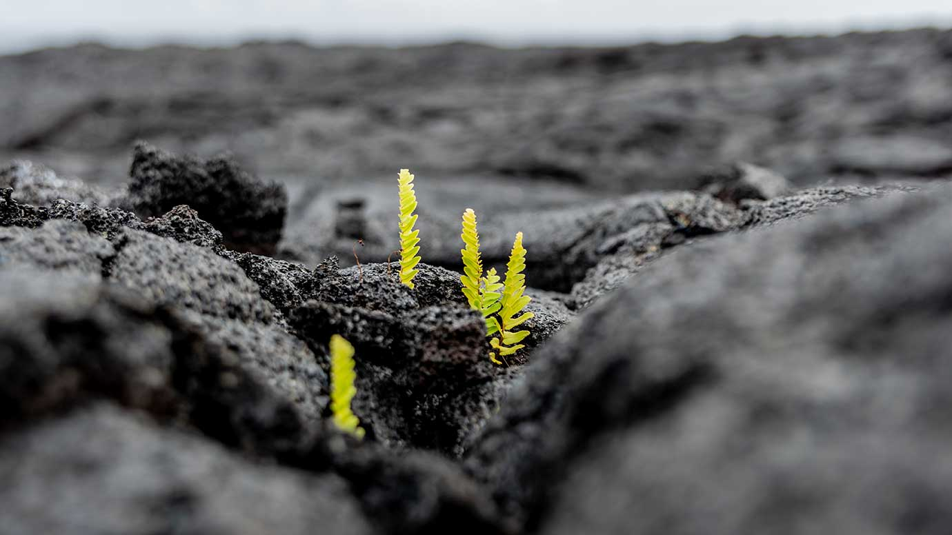
Notes:
Image: https://news.uchicago.edu/explainer/what-is-ecological-succession

Slide 18
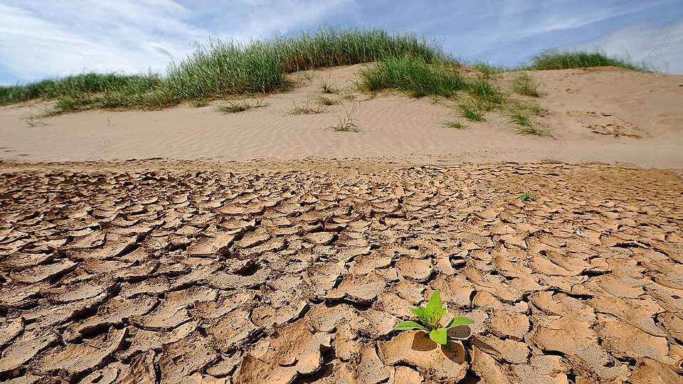

Slide 19
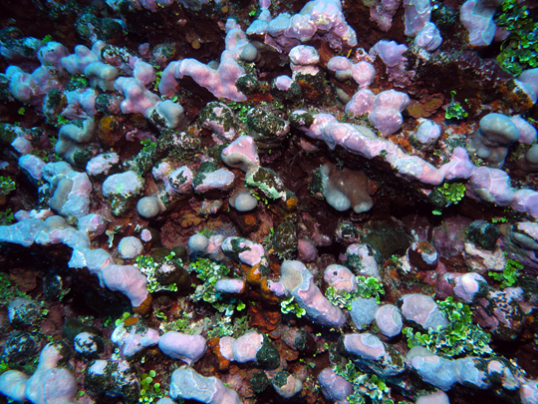
E.g. pinkish-red crustose coralline algae (CCA) acts as the ‘cement’ or ‘glue’ that aids reef recovery after a disturbance event.
Coral larvae (particularly Acropora) like to settle on the pink crustose coralline algae (CCA).
Notes:
Image: https://www.livingoceansfoundation.org/investigating-the-reef-slope/

Slide 20
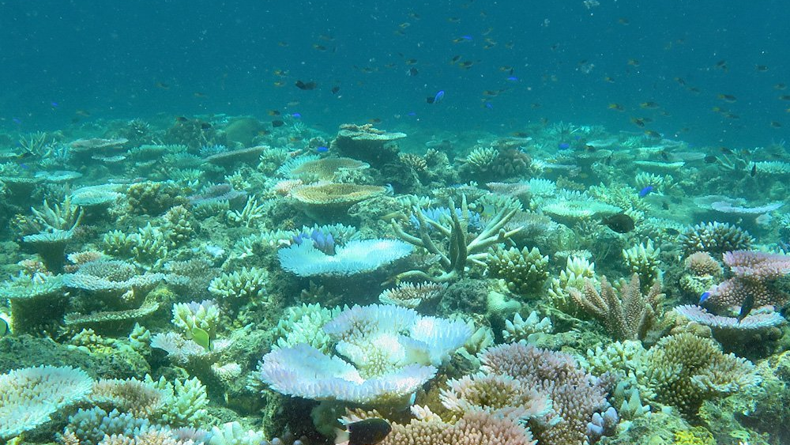
E.g. corals from the Genus Pocillopora function as fast-growing and weedy pioneer species. Photo: Lizard Island in recovery post disturbance events.

Slide 21
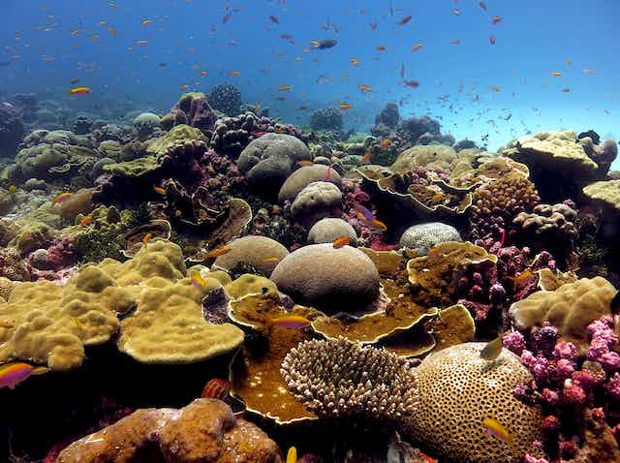
More species then join the party / competition
Notes:
https://theconversation.com/coral-reefs-how-climate-change-threatens-the-hidden-diversity-of-marine-ecosystems-211007

Slide 22
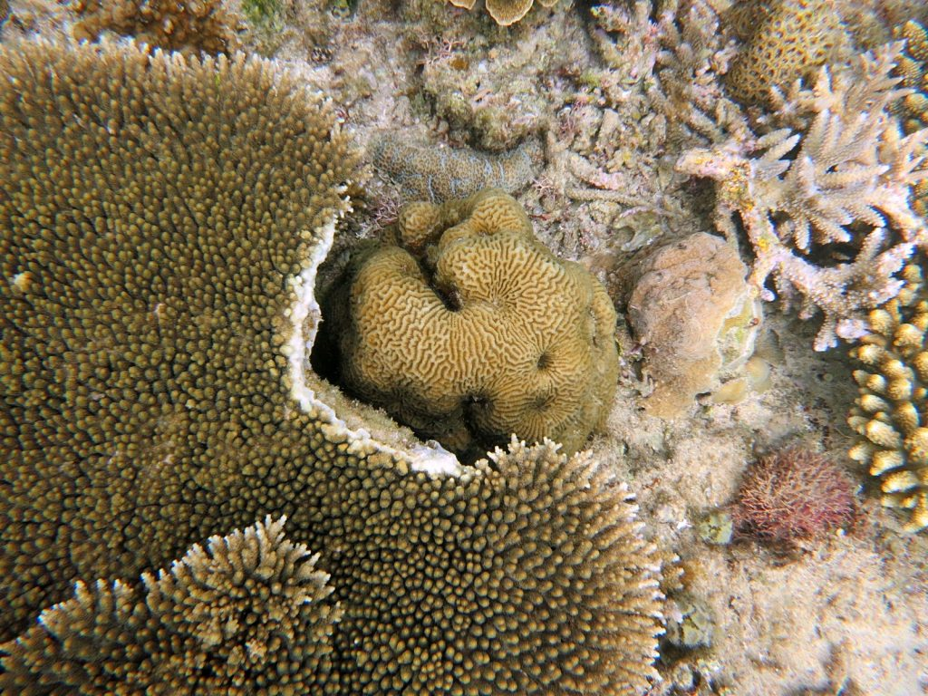
all competing for space

Slide 23
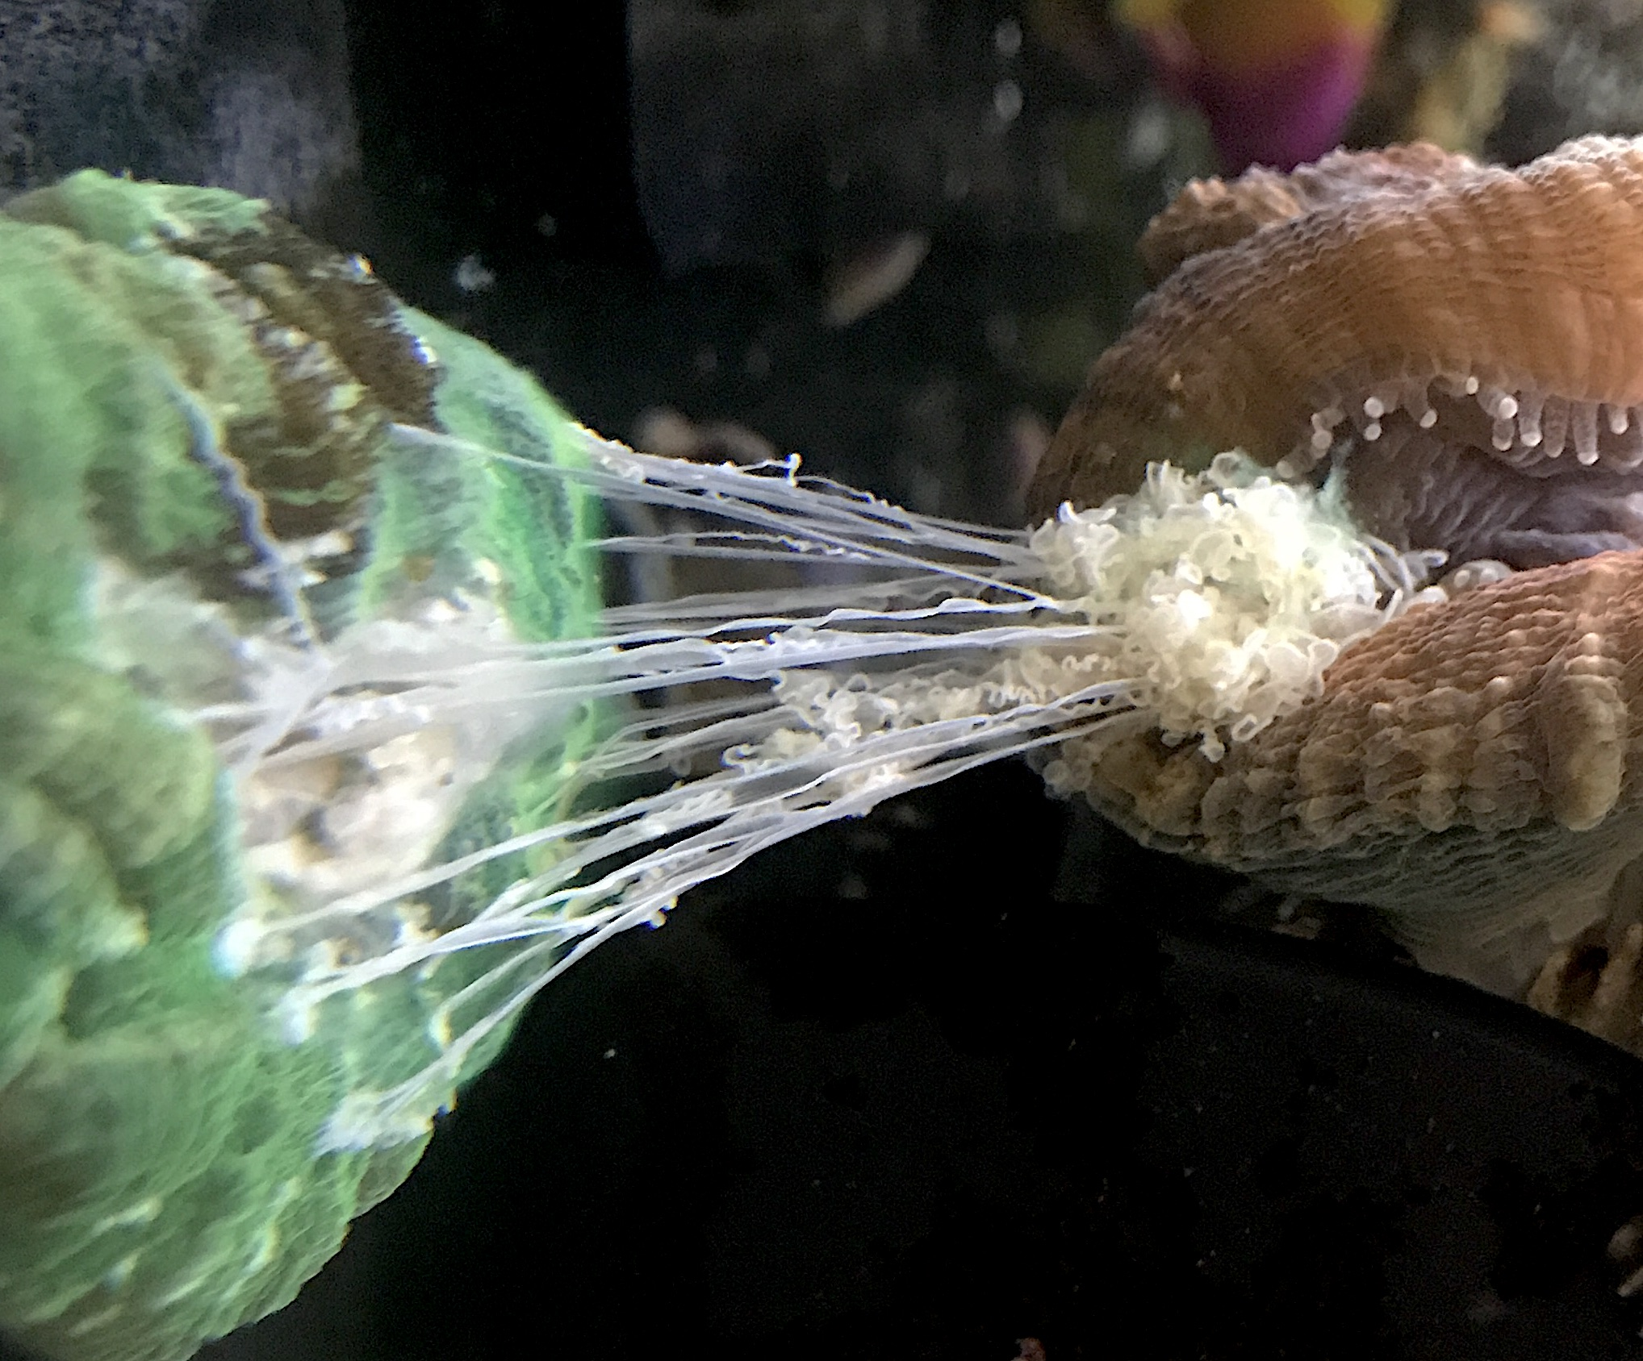
Some quite aggressively

Slide 24
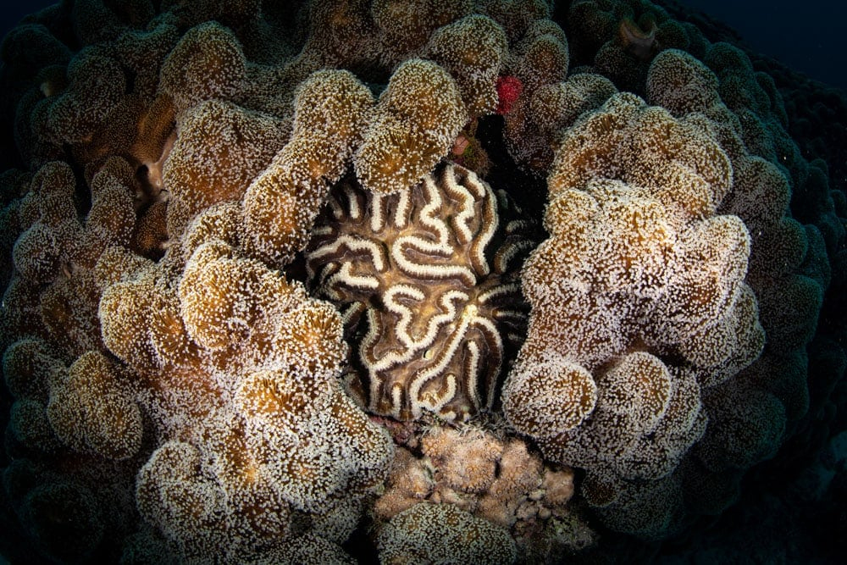
Notes:
Image: https://ladyelliot.com.au/great-barrier-reef/

Slide 25
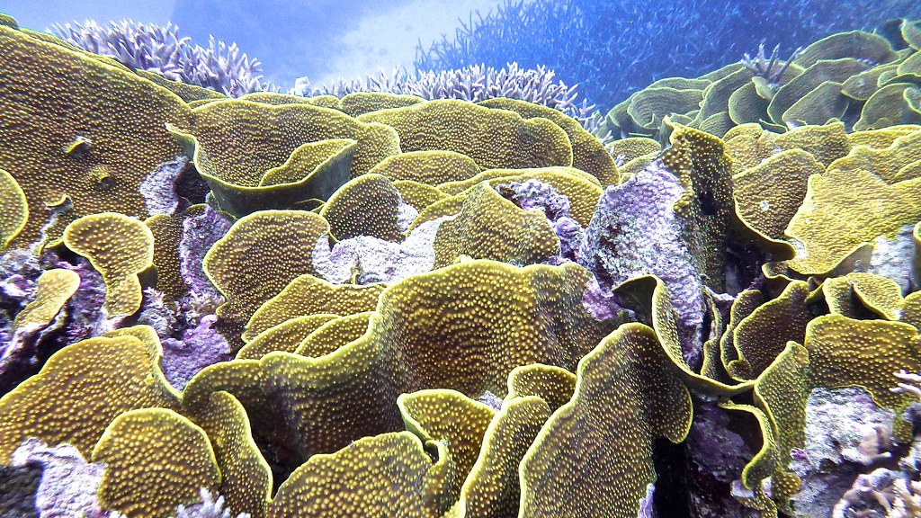
Notes:
Image: https://www.flickr.com/photos/pmforster/9341029235

Slide 26
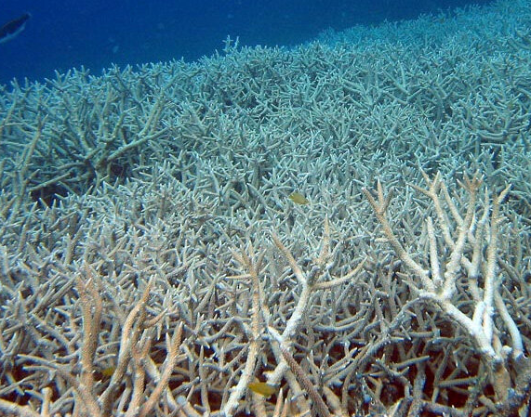
The competitively superior
species dominate in the end

Slide 27
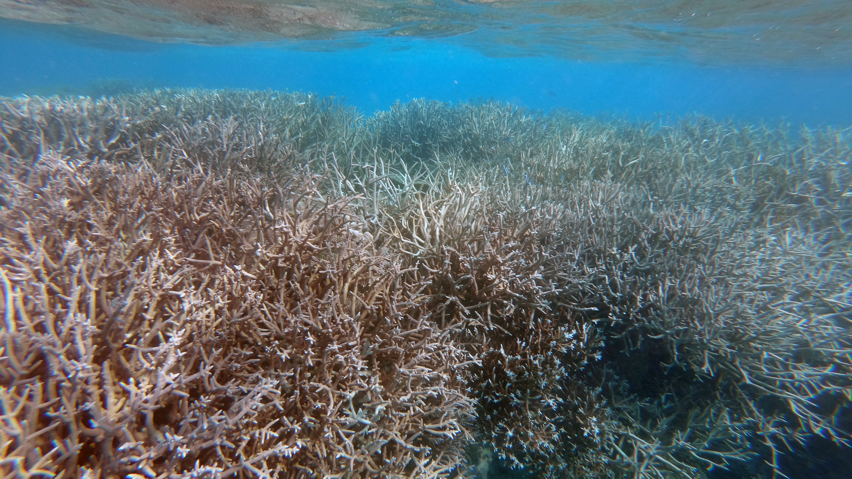
Climax community of Branching corals

Slide 28
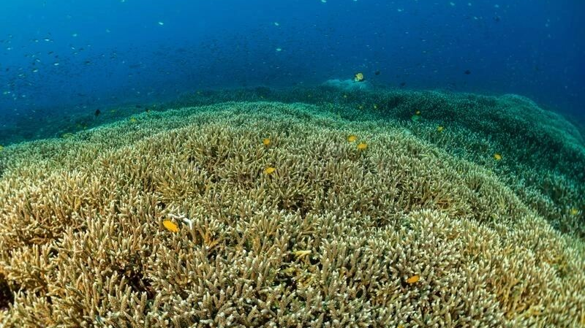
Climax community of Branching corals

Slide 29
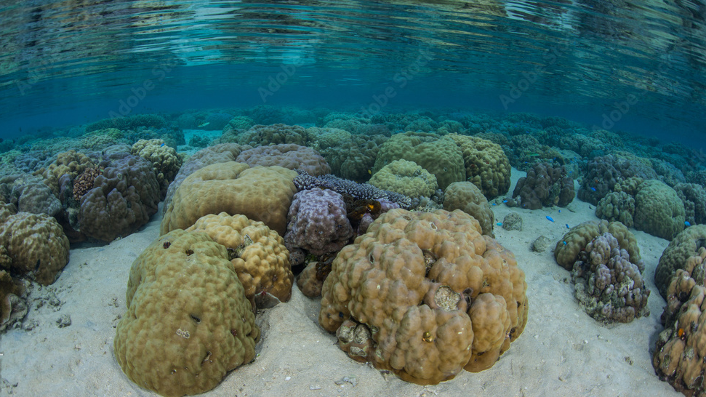
Climax community of Boulder corals (Genus: Porites)
Notes:
Image: https://stock.adobe.com/ar/images/healthy-boulder-corals-porites-sp-grow-in-shallow-water-near-the-island-of-ambon-indonesia-this-remote-tropical-area-is-part-of-the-coral-triangle-and-harbors-extraordinary-marine-biodiversity/276735705

Slide 30
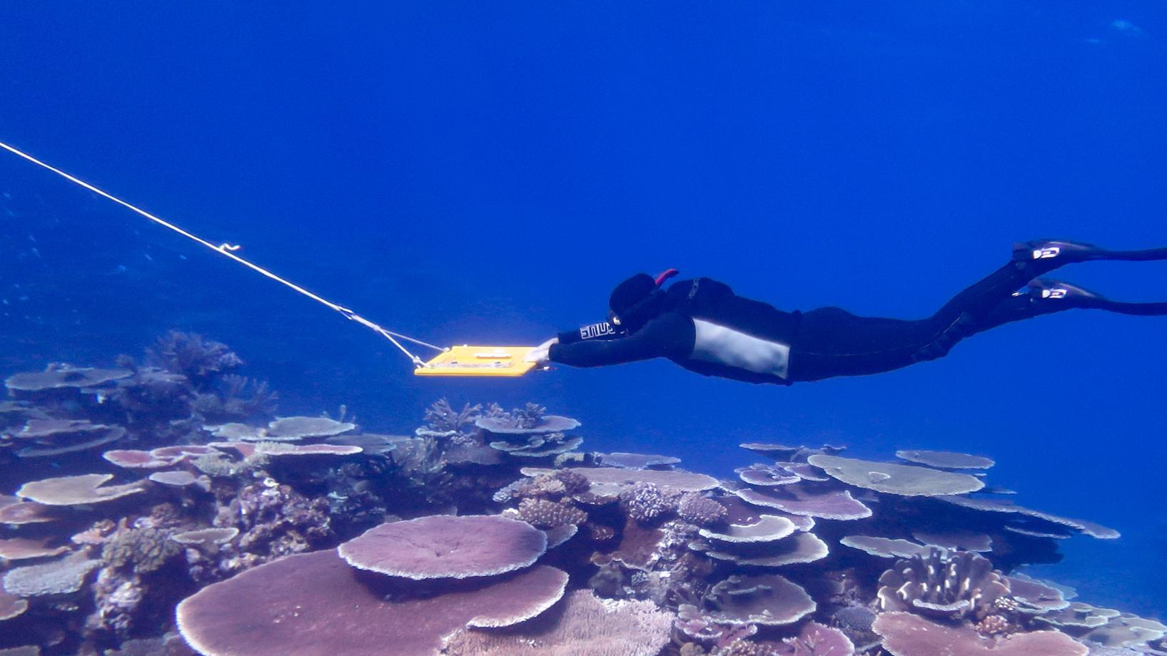
Climax community of Plate corals
Notes:
Image: https://www.aims.gov.au/monitoring-great-barrier-reef/gbr-condition-summary-2021-22

Slide 31
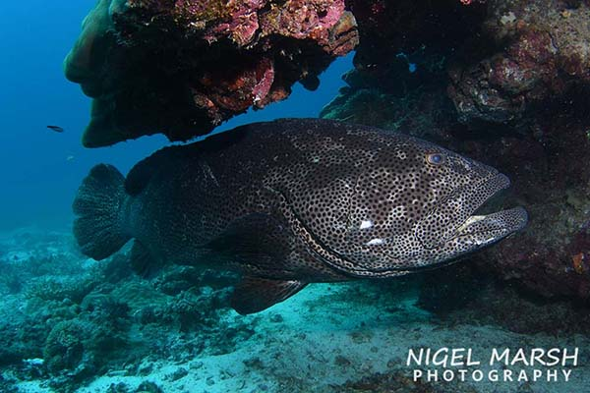
These species become the ‘habitat formers’
whereby, many other species rely on them for habitat
Notes:
Image: https://www.nigelmarshphotography.com/blog-posts/lady-elliot-island-scuba-diver

Slide 32
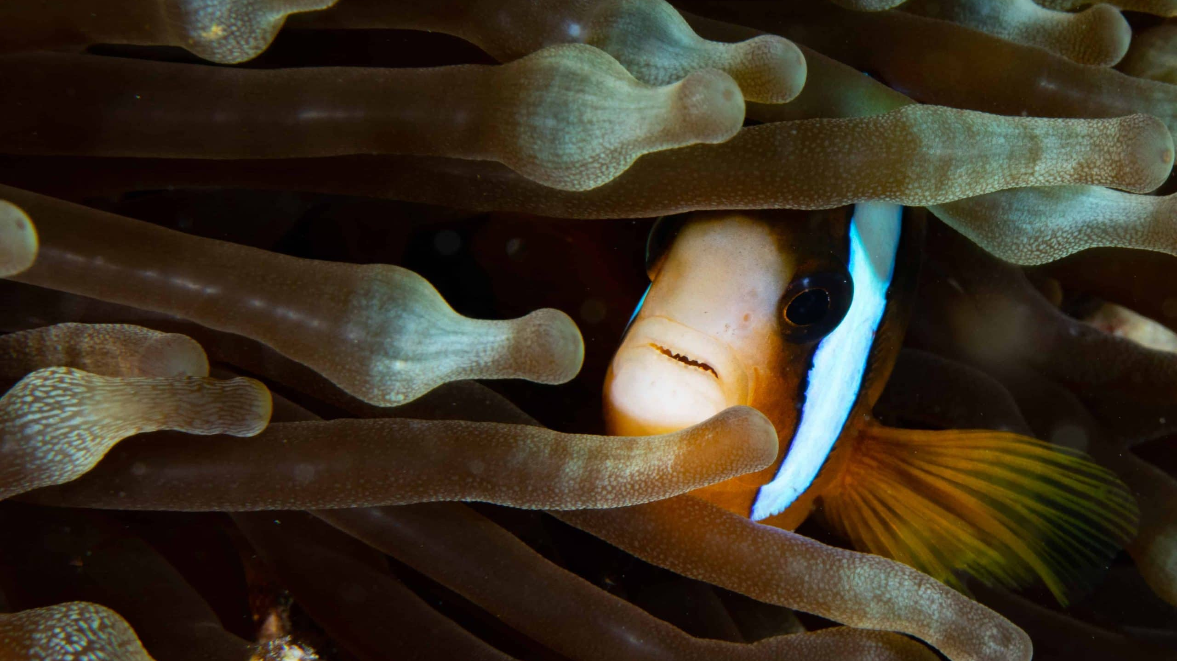
Notes:
Image: https://ladyelliot.com.au/great-barrier-reef/

Slide 33
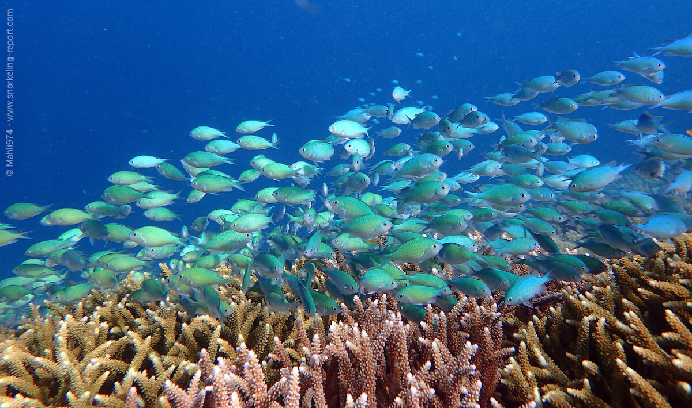
Notes:
Image: https://www.snorkeling-report.com/damselfish-sergeant-major-species-identification/

Slide 34
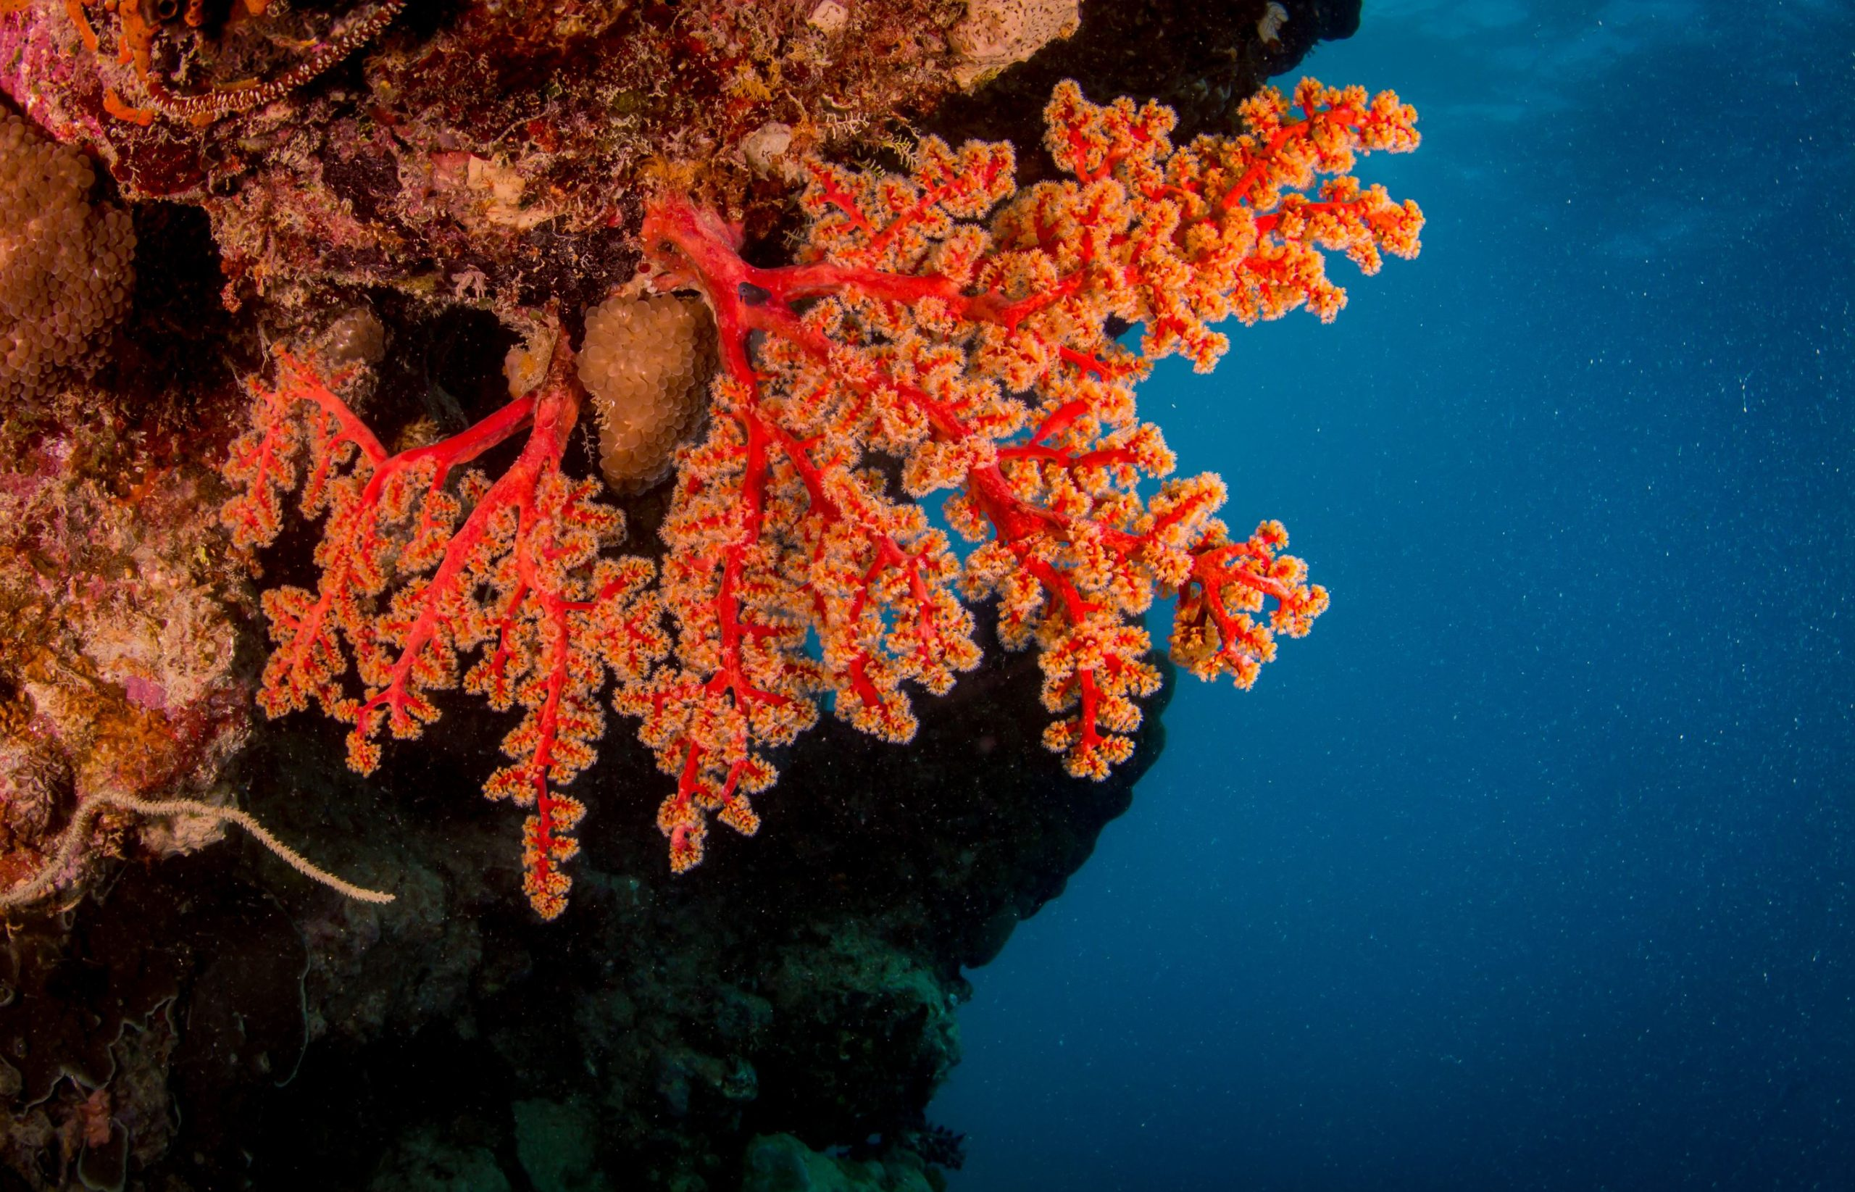
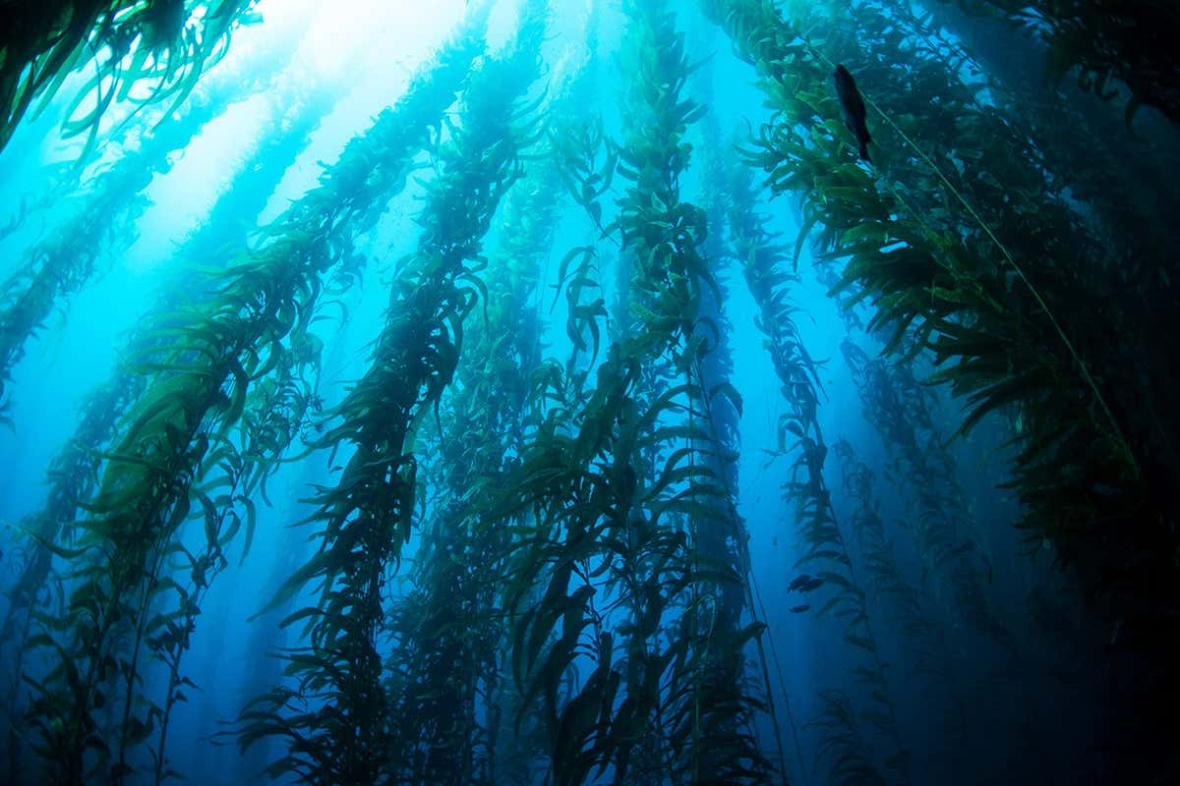
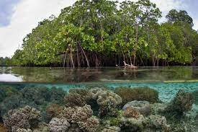
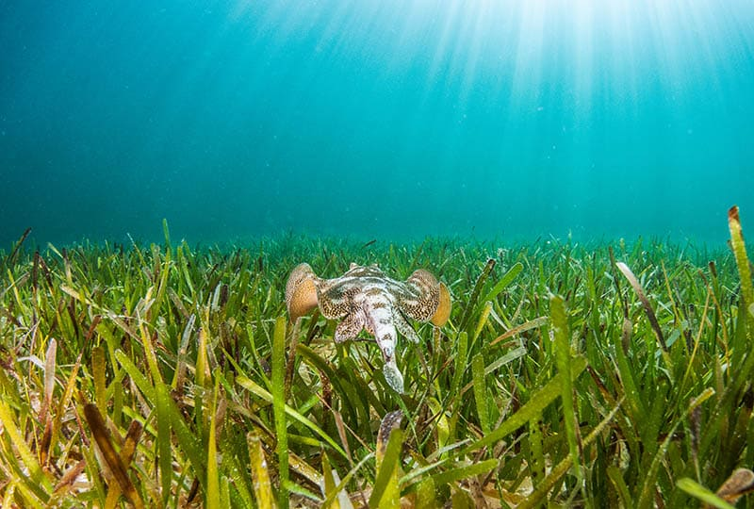
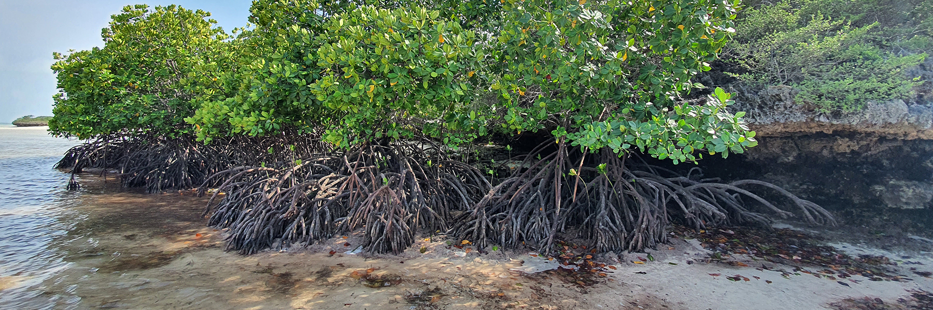
e.g.
a coral reef
a kelp forest
A mangrove forest
A seagrass meadow

Slide 35
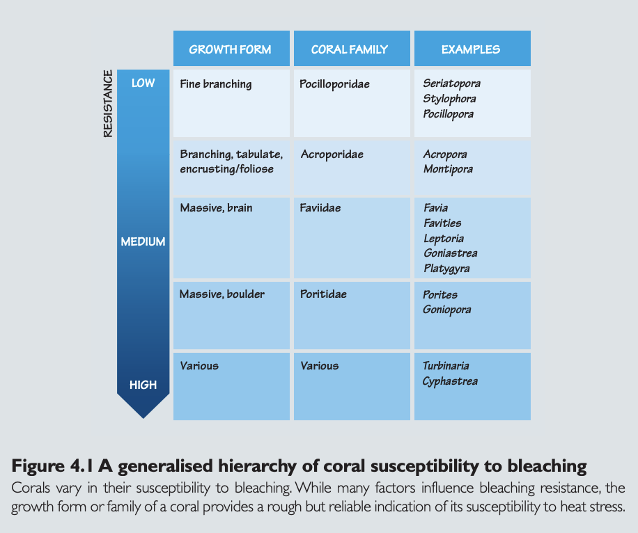
These communities dominate until a disturbance restarts the succession process.
Notes:
Image: https://www.coris.noaa.gov/activities/reef_managers_guide/reef_managers_guide_ch4.pdf

Slide 36
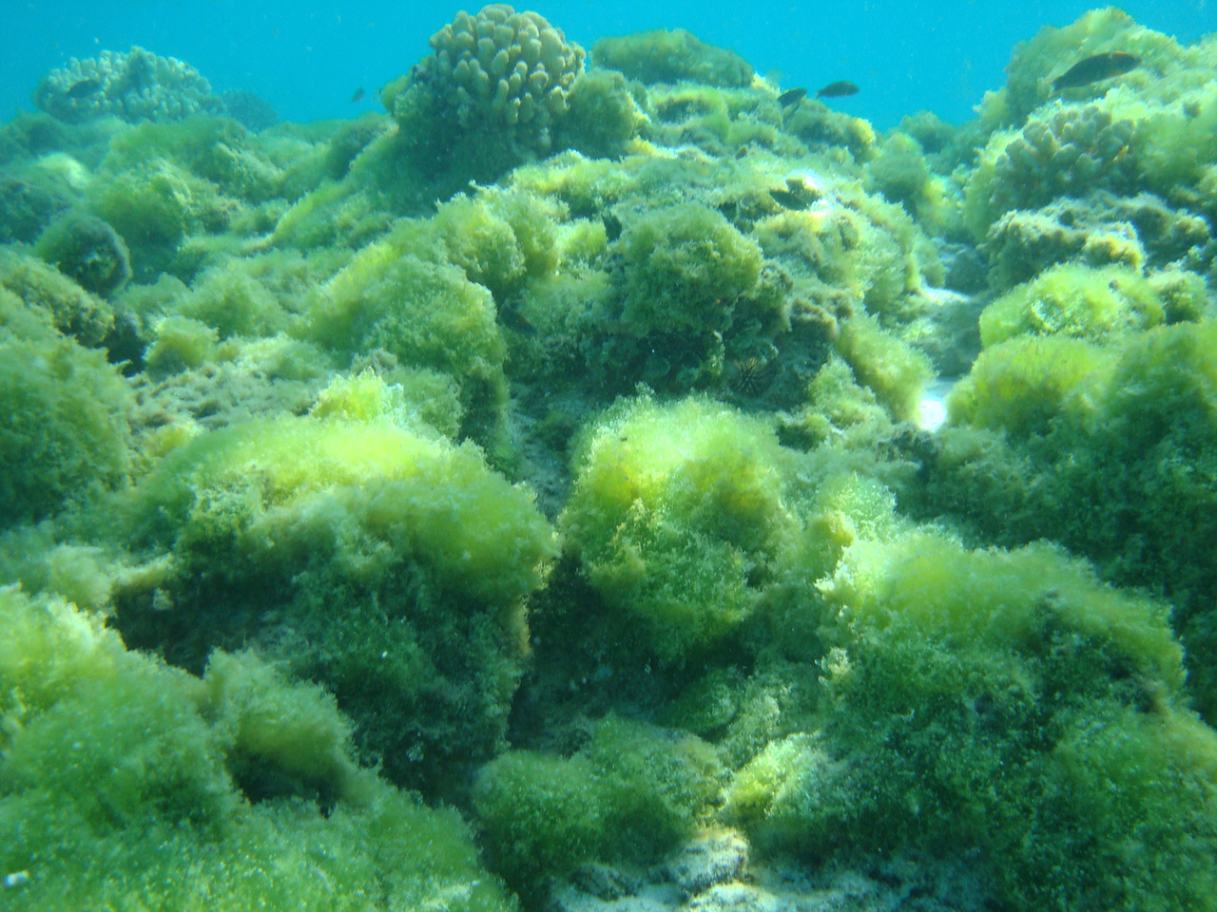
Fast growing species
(e.g. turf algae) quickly invade the free space
Notes:
Image: https://www.fisheries.noaa.gov/pacific-islands/ecosystems/coral-health-and-threats-pacific-islands

Slide 37
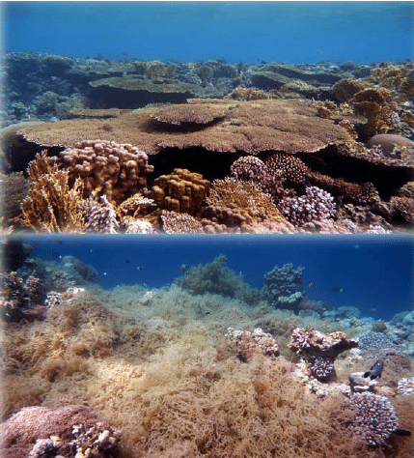
What happens next is a game of survivor
Notes:
Image: https://www.fisheries.noaa.gov/pacific-islands/ecosystems/coral-health-and-threats-pacific-islands

Slide 38
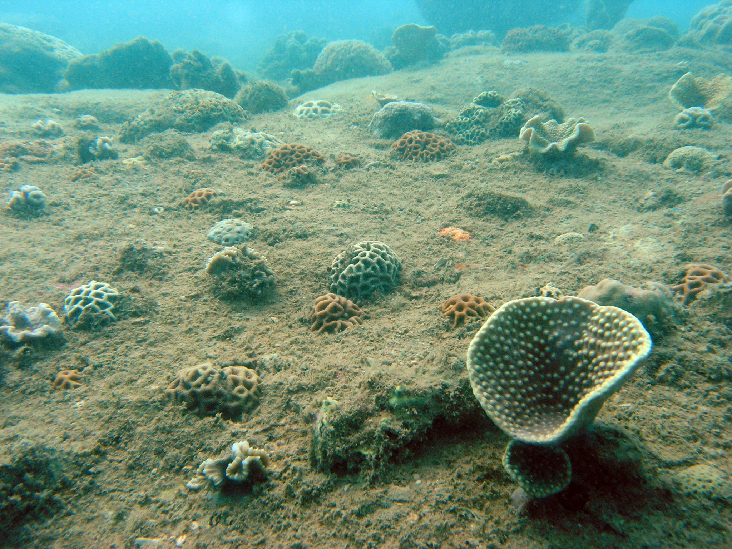
Image: Slow growing boulder corals trying to regain a foot hold
Notes:
Image: https://www.mscience.net.au/marine_services/coral-benthos-monitoring/

Slide 39
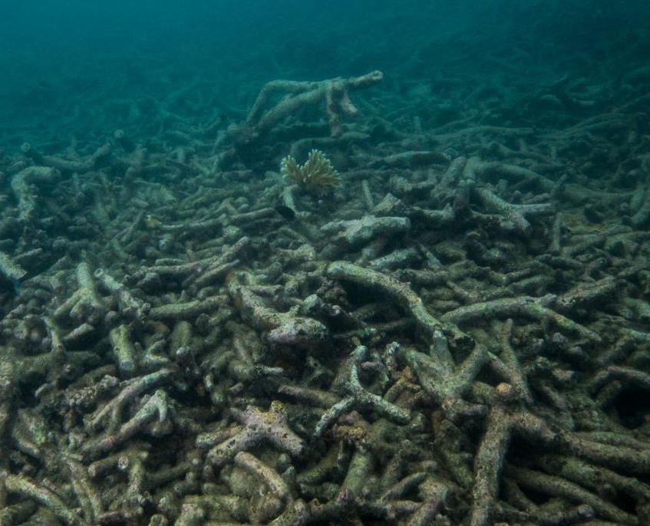
If the disturbance event is big enough to kill most of the climax community…
or competing species get the upper hand ……

Slide 40
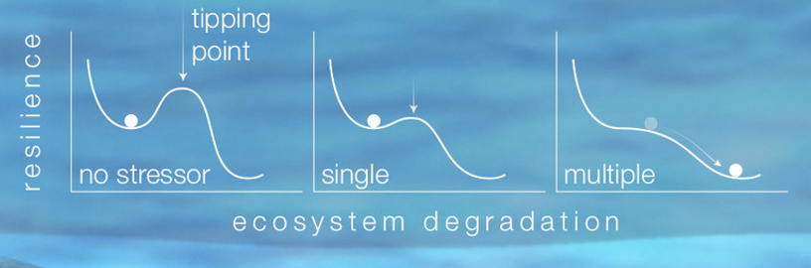
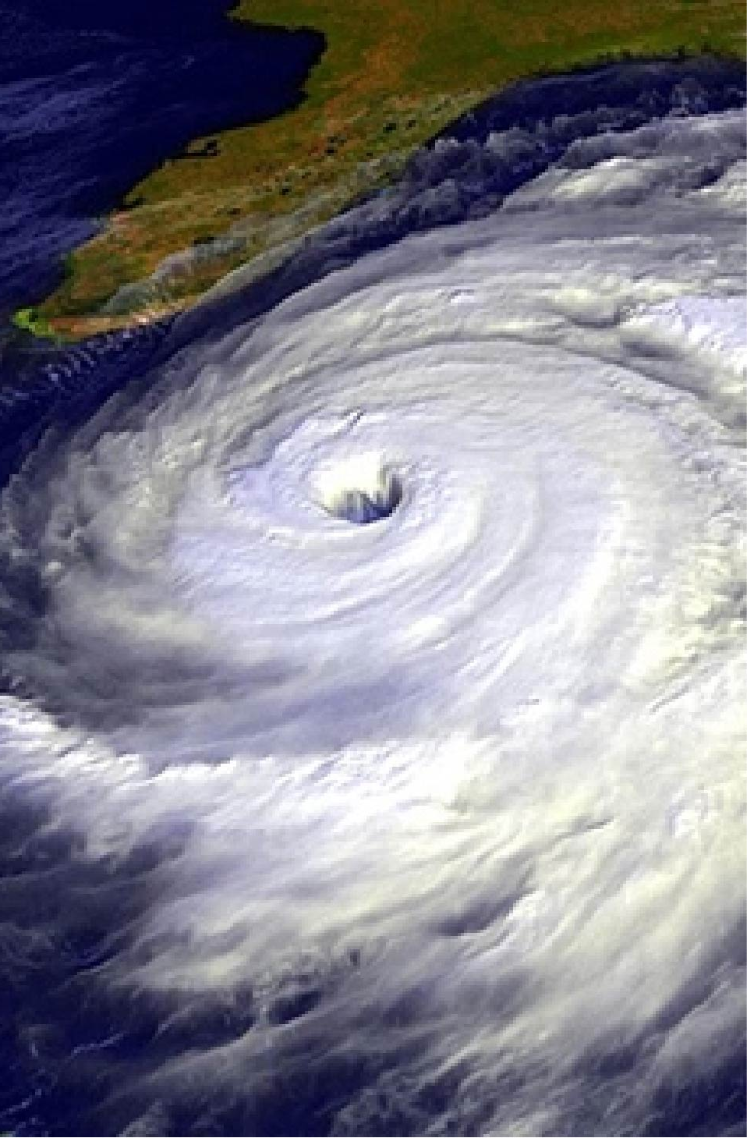
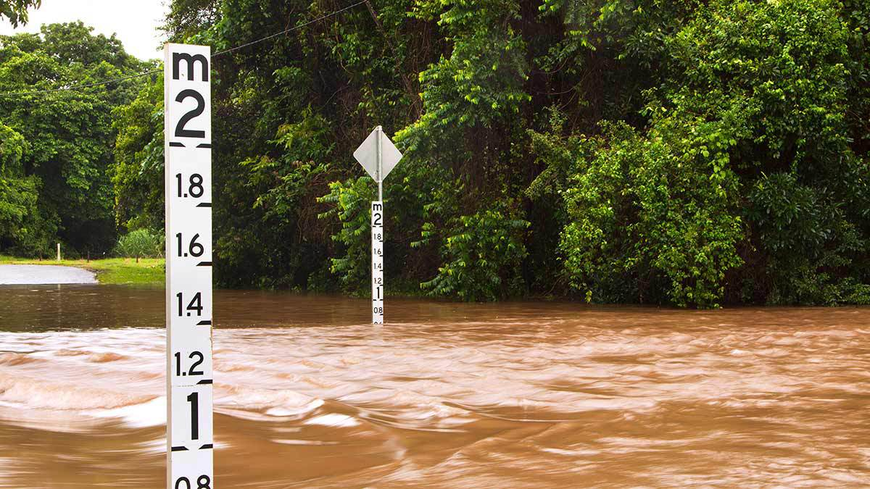
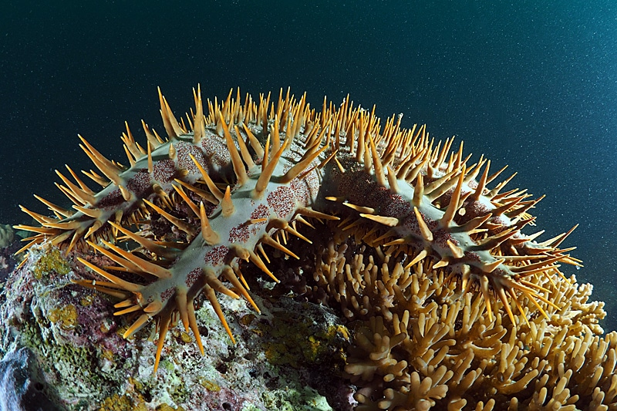
or multiple disturbances hit all at once…

Slide 41
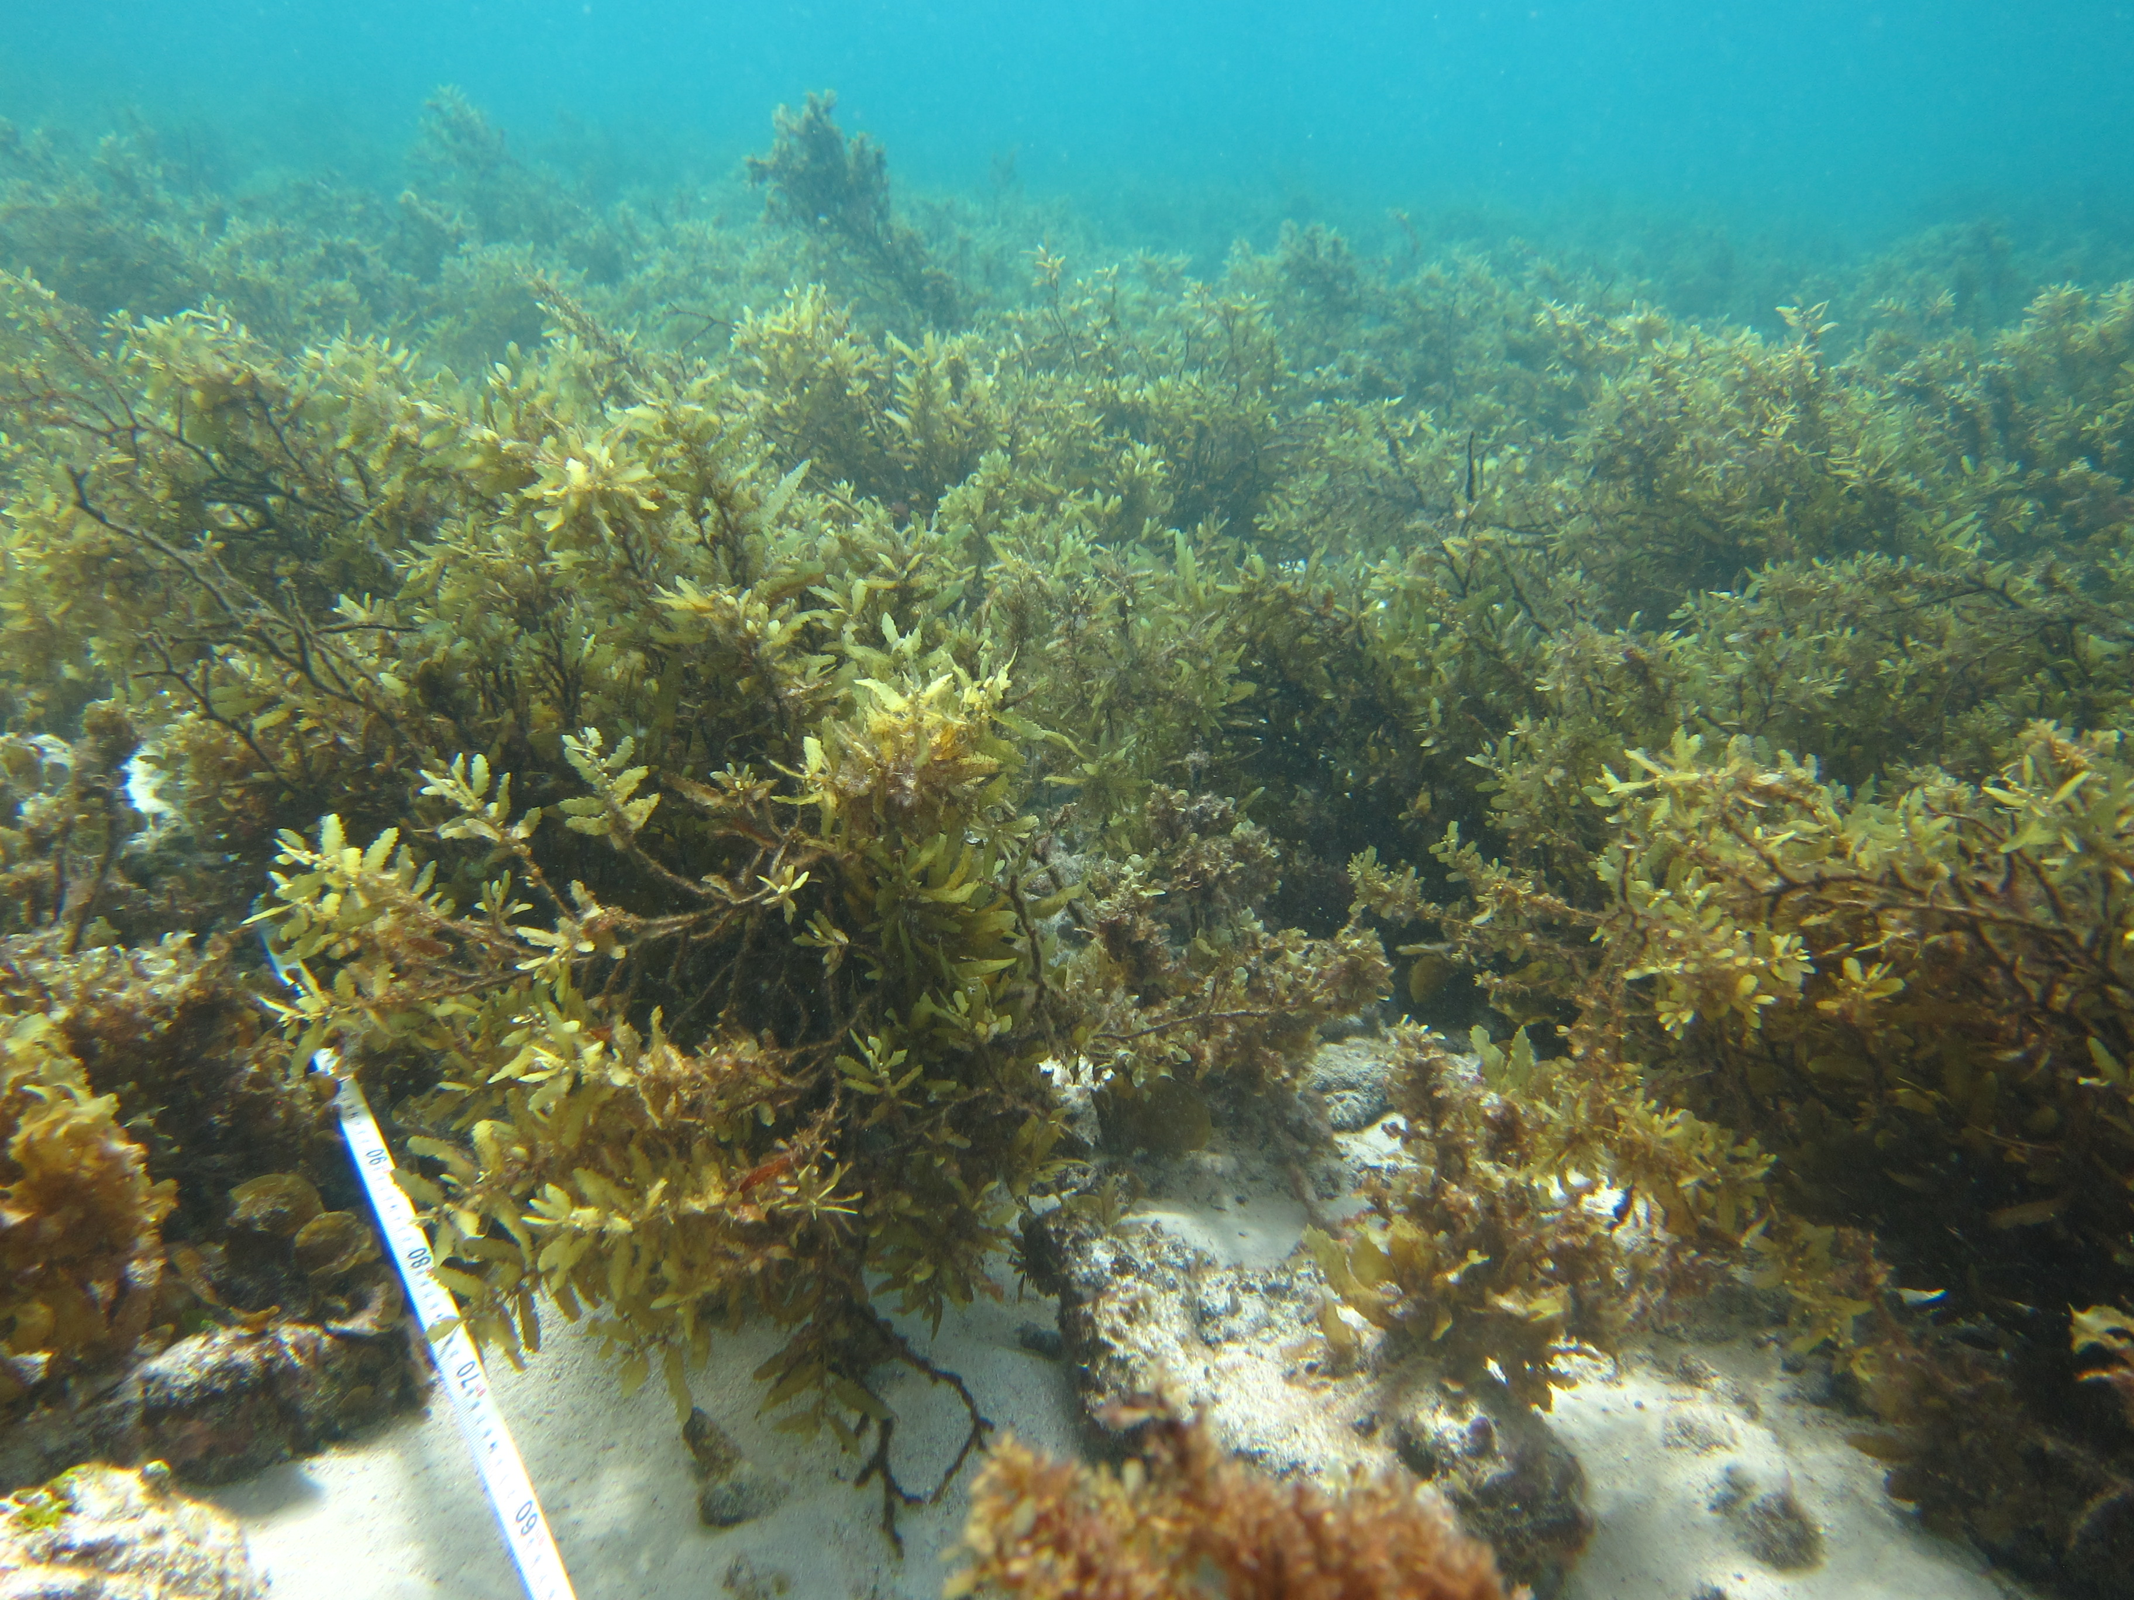
the entire habitat can change…
(called a ‘phase shift’)

Slide 42
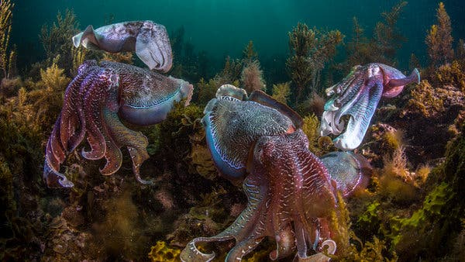
…so the occupants of the habitat change too
Notes:
Image: https://www.nytimes.com/2016/05/25/science/squid-are-thriving-while-fish-decline.html

Slide 43
For example…

Slide 44
Kelp Forest,
California
Notes:
Image: https://www.newscientist.com/article/2369412-kelp-forests-capture-nearly-5-million-tonnes-of-co2-annually/

Slide 45
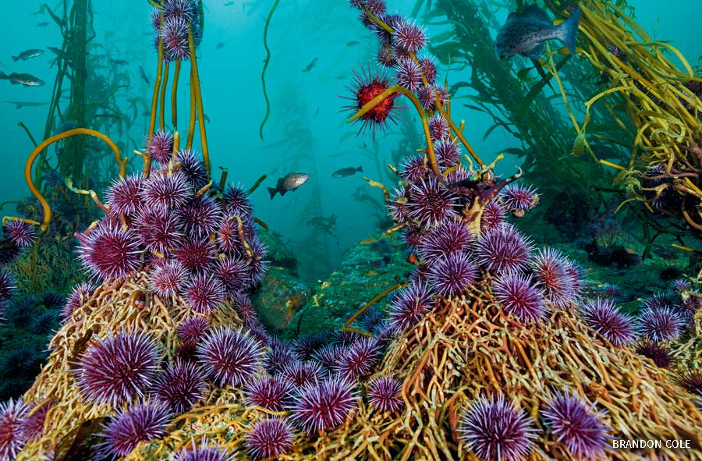
Now a sea urchin barren
Notes:
Image: https://www.nwf.org/Home/Magazines/National-Wildlife/2021/Feb-Mar/PhotoZone/Natures-Witness

Slide 46
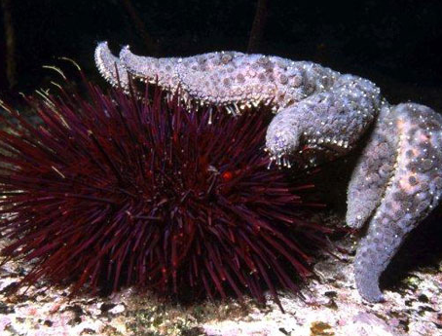
In 2013, many sea stars died from disease leaving nothing to eat the sea urchins, which consequently ate the kelp holdfasts
Notes:
Image: https://seastarsofthepacificnorthwest.info/sunflower-star.html

Slide 47

PRE-IMPACT
POST-IMPACT
canopy
Multiple other stressors, including a marine heat wave, tipped the bull kelp forest into a sea urchin barren
Sub-canopy
benthose
Notes:
Image: https://www.researchgate.net/figure/Ecosystem-shifts-observed-for-kelp-forest-canopy-top-subcanopy-middle-and-benthose_fig2_336716207

Slide 48

Can it go back to this?
Notes:
Image: https://onetreeplanted.org/blogs/stories/kelp-forest-facts
Source: Smithsonian Photographed by Kyle McBurnie

Slide 49


Question – can it change back?
Or, will a new climax community eventually dominate?

Slide 50

Once an alternative state has itself become a stable climax community, it’s very difficult to change back (due to feedback loops).
(a new climax community)
Notes:
Image (adapted by Marine Education: https://www.researchgate.net/figure/Schematic-representation-of-the-outlined-future-research-directions-The-microbial_fig2_315595669

Slide 51

Coral-dominated reef
Fishing
Climate change (heat stress)
Nutrient & sediment inputs
Introduced species
Algae-dominated reef
Fig. 1: General process of coral reef modification. These shifts can become permanent due to several stabilizing feedback loops and even accelerate to more degraded systems by extinctions vortices.
Notes:
Image: https://www.researchgate.net/figure/General-process-of-coral-reef-modification-Coral-reefs-are-typified-by-high-biological_fig1_305036882
Paper: Ecological limitations to the resilience of coral reefs. https://www.researchgate.net/publication/305036882_Ecological_limitations_to_the_resilience_of_coral_reefs

Slide 52

Could this help?
Photo: Liv Williamson.
Notes:
Image: https://www.themarinediaries.com/tmd-blog/creating-a-more-resilient-coral

Slide 53

Learning Intention:
Identify how organisms populate areas following changes in habitats, e.g. succession.
Success Criteria:
Complete Marine Education worksheet ’12. Success-ion’

