Slide 1
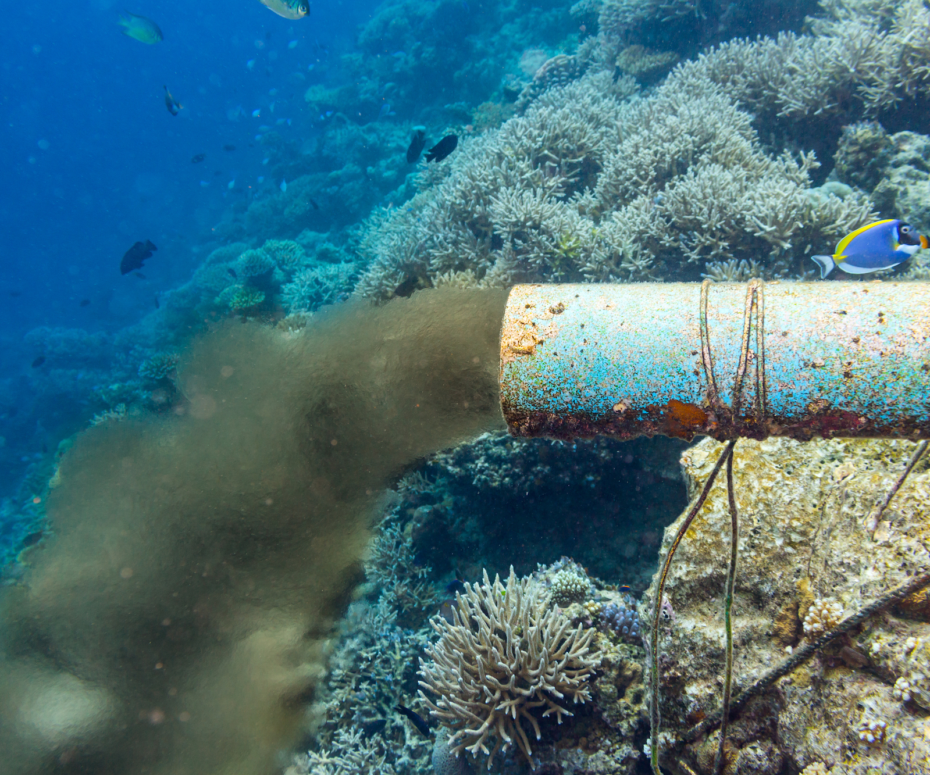
Learning Intention:
Identify types of pollution of coastal zones, including organic wastes, thermal, toxic compounds, heavy metals, oil, nutrients and pesticides.
Success Criteria:
Complete Marine Education worksheet ‘13. Pollution Playlist’
Notes:
Image: https://education.nationalgeographic.org/resource/marine-pollution/

Slide 2
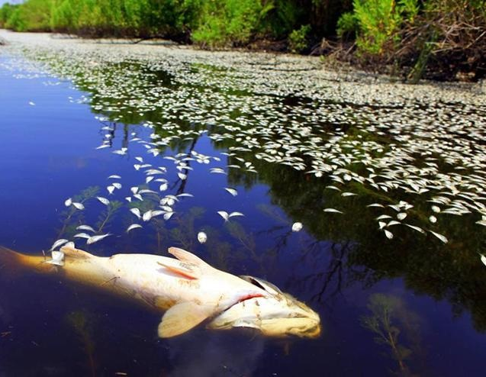
Organic Waste
When plants and animals die or defecate, the decay process uses up lots of oxygen. Large amounts of decay make oxygen levels dangerously low. Not good news for oxygen breathing animals!
Notes:
Image: https://www.westernbass.com/article/potential-fish-kills-due-cold

Slide 3
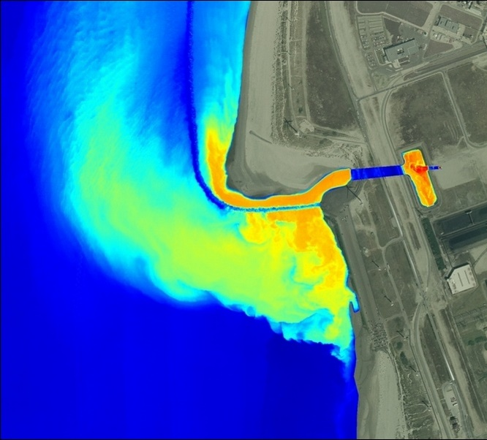
Thermal Pollution
Thermal means temperature. Thermal pollution changes the temperature of waterways. Sources include industrial factories releasing hot water (that was used to remove heat from machinery) & the release of water from
a dam.
Notes:
Image: https://giveme-5.org/thermal-pollution-in-water/

Slide 4
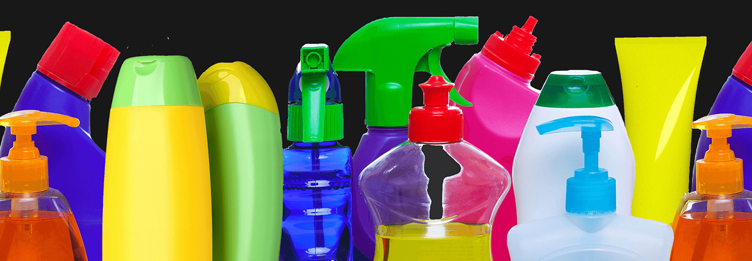
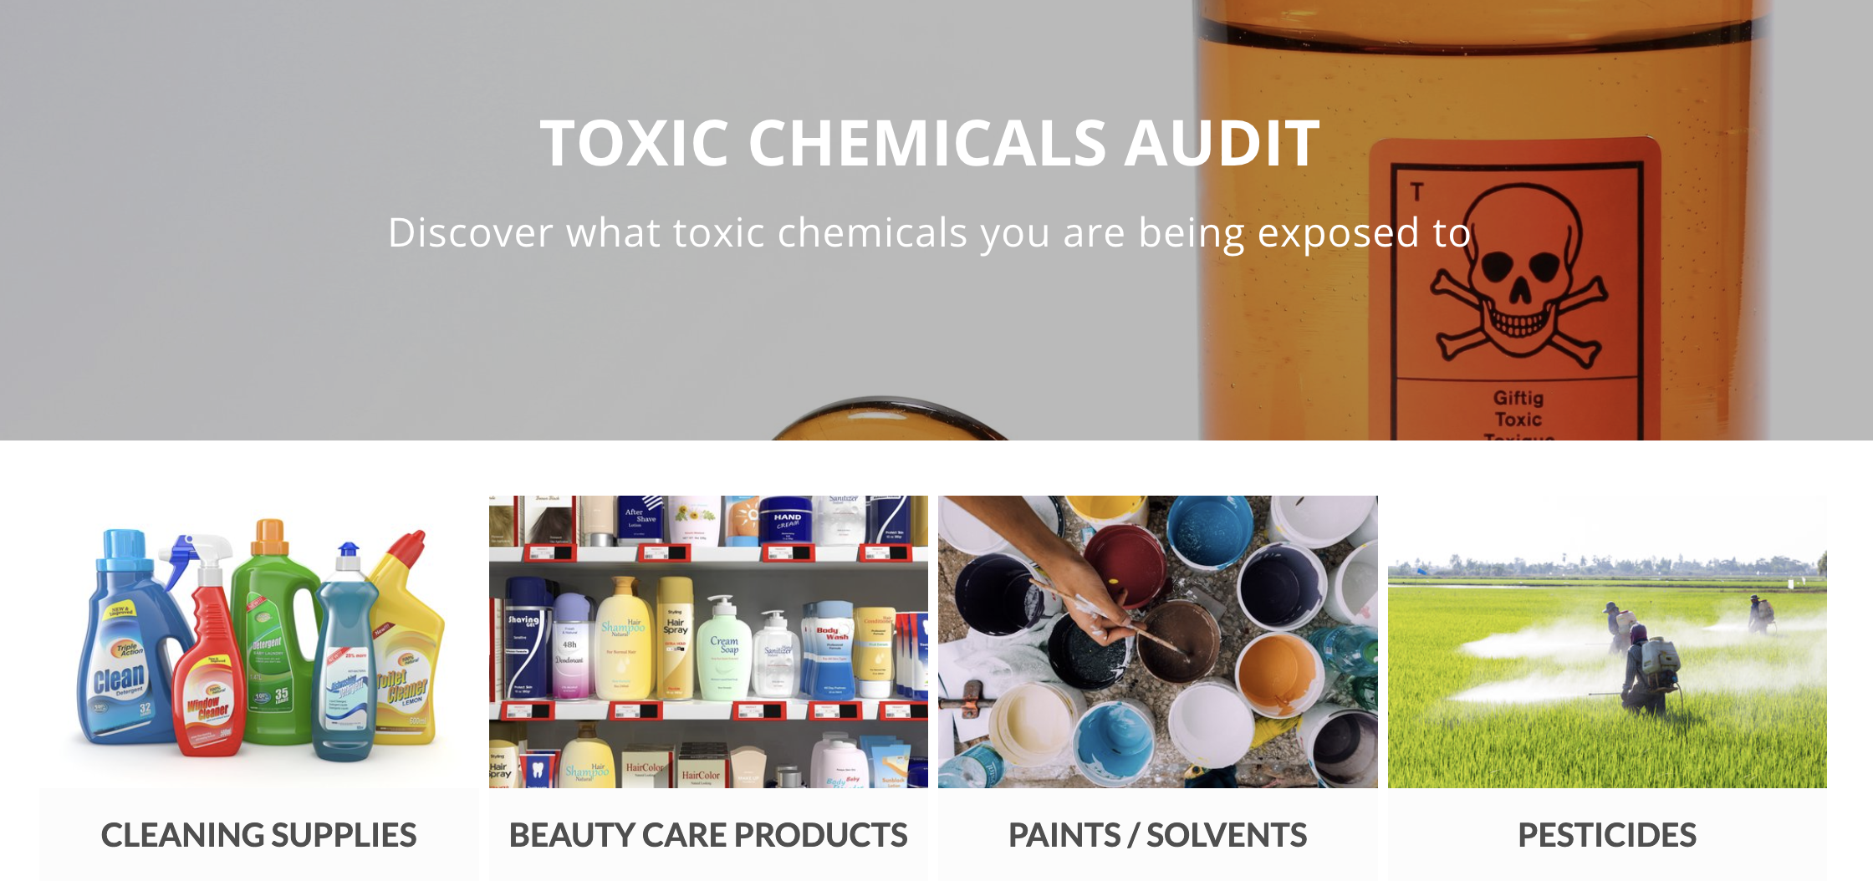
Toxic Compounds
Toxic chemicals are those that cause harm when inhaled, ingested or absorbed. Their toxicity depends on the concentration and degree in which it harms the organism. Examples include chemical, biological, physical or nuclear compounds.
Notes:
Image (top): https://www.theguardian.com/us-news/2019/may/22/toxic-chemicals-everyday-items-us-pesticides-bpa
Image (bottom): https://www.testmyhome.com/toxic-chemicals-testing

Slide 5
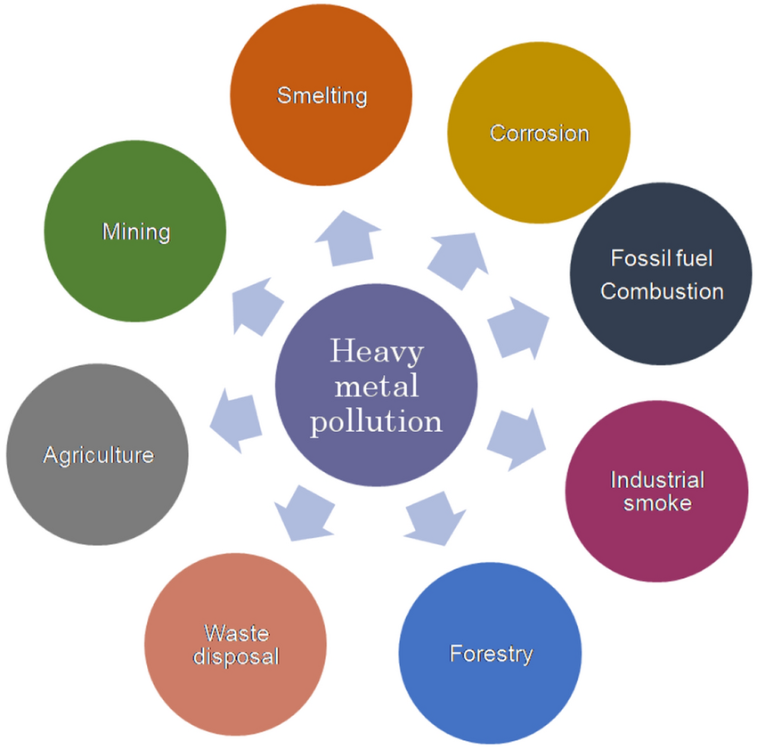
Heavy Metals
A heavy metal is an element on the Periodic Table noted for its potential toxicity such as lead, mercury, copper, zinc & arsenic. Mining and industrial wastes are likely sources. They do not biodegrade and effects are horrendous.
Notes:
Image: https://www.researchgate.net/figure/Major-sources-of-heavy-metal-pollution-in-the-eco-system_fig1_366006306

Slide 6
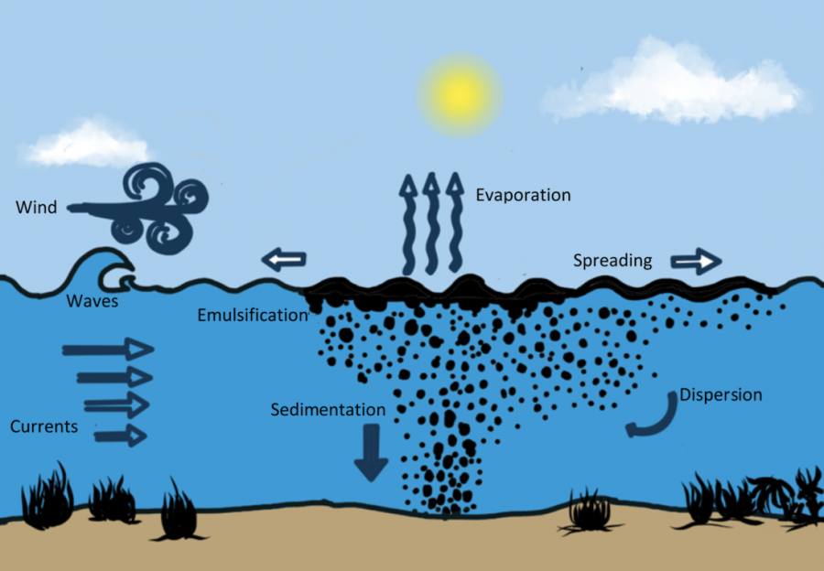
Oil Pollution
Oil (including fuel) does not dissolve in water. When spilled, oil forms a thick sludge that suffocates and smothers. Major oil spills are catastrophic, but rare. Other sources include industrial discharge, urban runoff and oil leaking from boats.
Notes:
Image: https://www.savethewaves.org/the-repsol-oil-spill-in-peru-its-ongoing-impact-and-how-you-can-help/

Slide 7
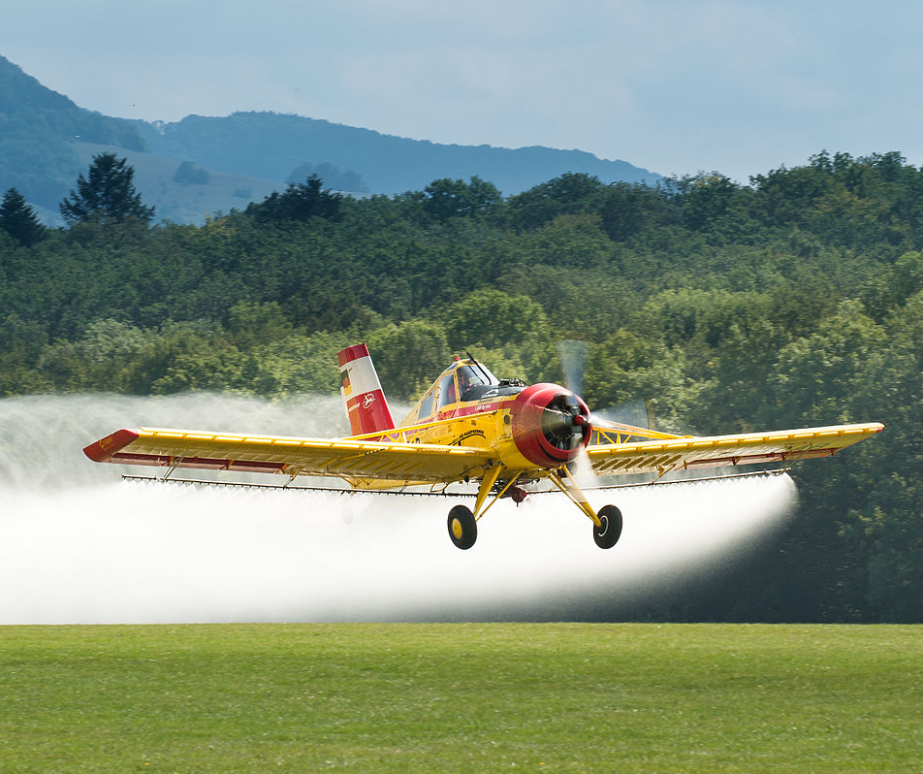
Nutrients and Pesticides
Nutrients and pesticides are sprayed on food crops to enhance growth and control pests. They enter waterways via rainfall runoff (when it rains, the chemicals wash into the waterways) and groundwater contamination.

Slide 8
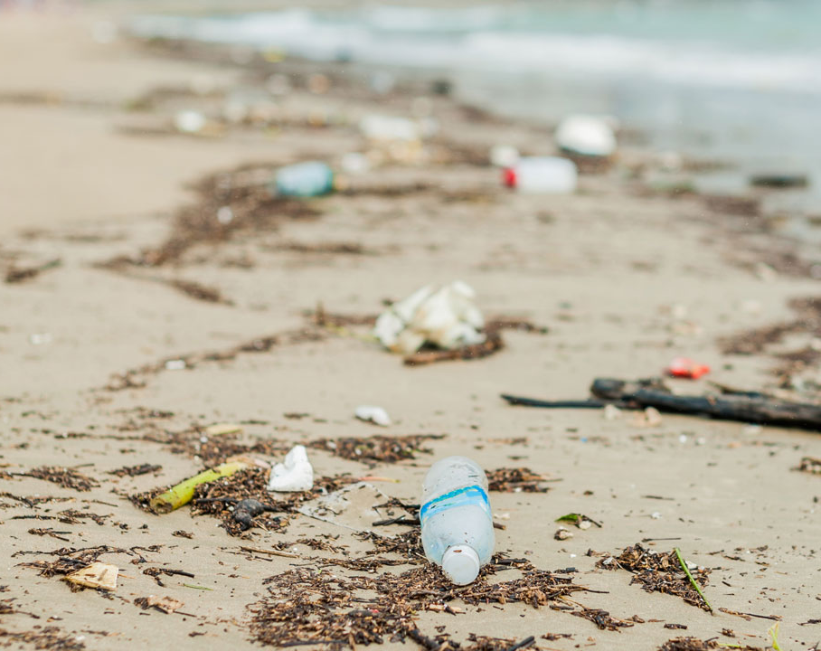
Plastics and Marine Debris
Plastics became popular over half a century ago for their durability and affordability.
Marine life now get tangled in it and ingest plastic by mistake. Even our seafood contains traces of plastic.

Slide 9
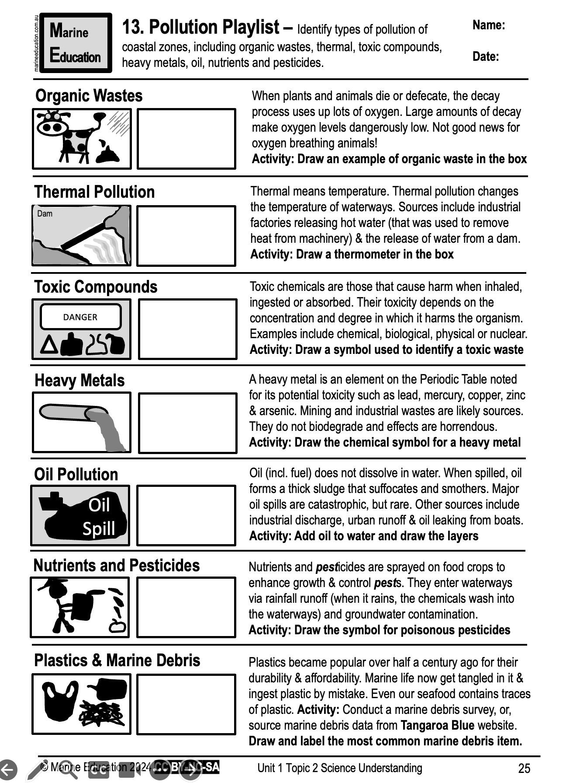
Learning Intention:
Identify types of pollution of coastal zones, including organic wastes, thermal, toxic compounds, heavy metals, oil, nutrients and pesticides.
Success Criteria:
Complete Marine Education worksheet ‘13. Pollution Playlist’
Notes:
Image: https://education.nationalgeographic.org/resource/marine-pollution/

