Slide 1
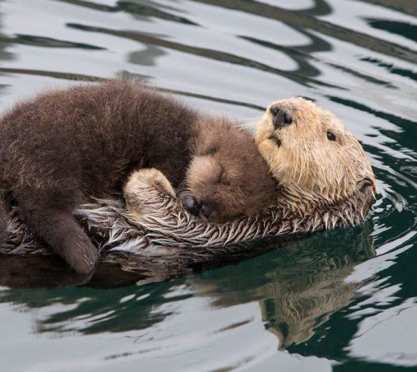
Learning Intention:
Describe the concept of population dynamics using the terms population size, density, abundance, distribution (i.e. clumped, uniform, random), carrying capacity, niche, K-strategists and r-strategists, keystone species.
Success Criteria:
Complete Marine Education worksheet
‘14. Population Dynamics’
Notes:
Image: https://www.boredpanda.com/cute-baby-sea-otters/

Slide 2
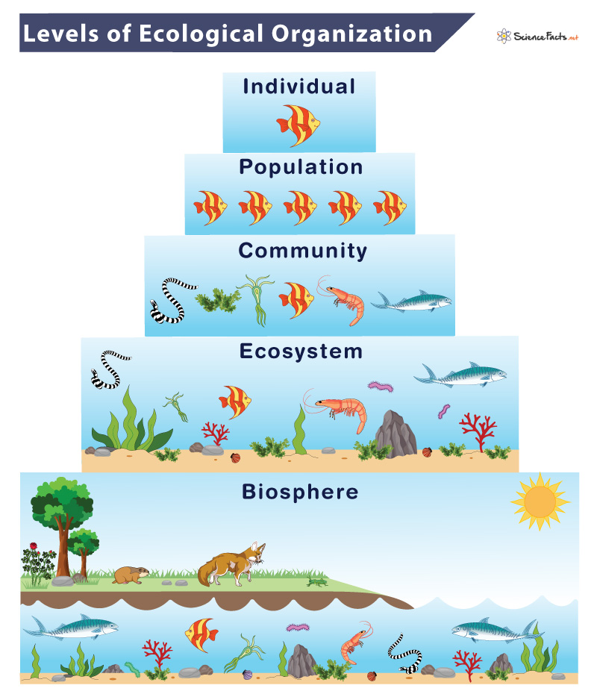
A population is
a group of organisms of the same species in the same space at
the same time
Notes:
Image: https://www.sciencefacts.net/levels-of-ecological-organization.html

Slide 3
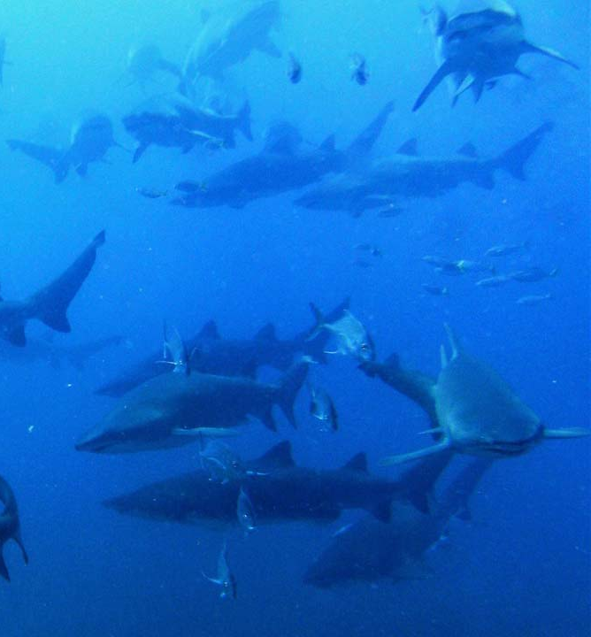
population size is how many
in the population (N).
Another word for
how many is
“abundance”
E.g. 50 species
Grey Nurse Shark breeding season, Wolf Rock, Qld.
Notes:
Image: https://www.diveplanit.com/dive-destination/wolf-rock/

Slide 4
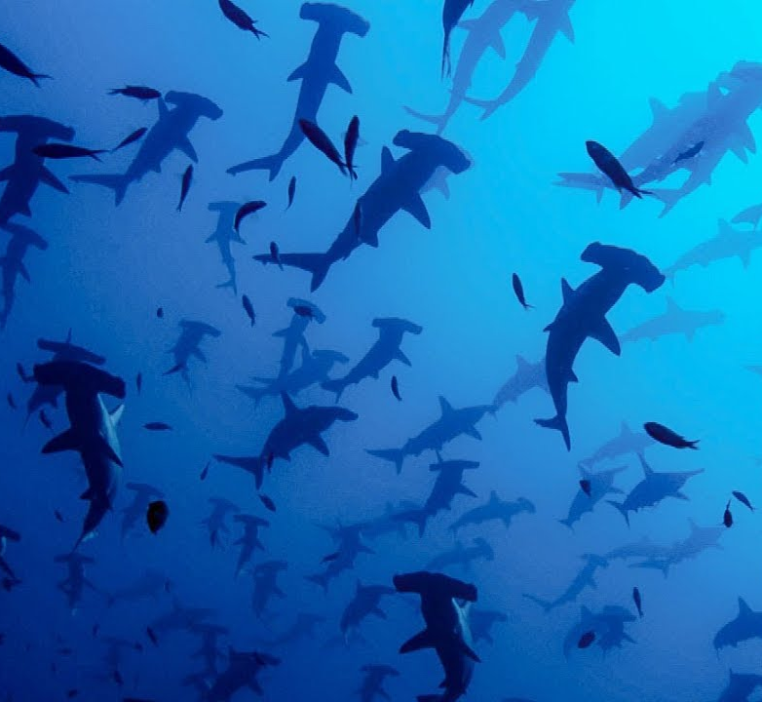
population density is simply
population size
per unit of area
E.g. 50 species/km²
add area
Scalloped Hammerhead Sharks, Galapagos Islands.
Notes:
Image; https://www.google.com/url?sa=i&url=https%3A%2F%2Fm.youtube.com%2Fwatch%3Fv%3DKsWuJtQpgsw&psig=AOvVaw2-S_qMth1NF26q-BpnrlQr&ust=1710075317357000&source=images&cd=vfe&opi=89978449&ved=0CBMQjhxqFwoTCMjqk5Gd54QDFQAAAAAdAAAAABAD

Slide 5
Population
Distribution (dispersion)
Patterns

Slide 6
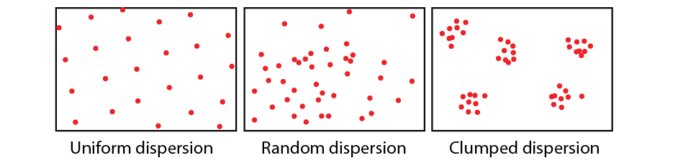
uniform
population distribution is
where
individuals position themselves within the population
(also called ‘dispersion’)
random
clumped

Slide 7
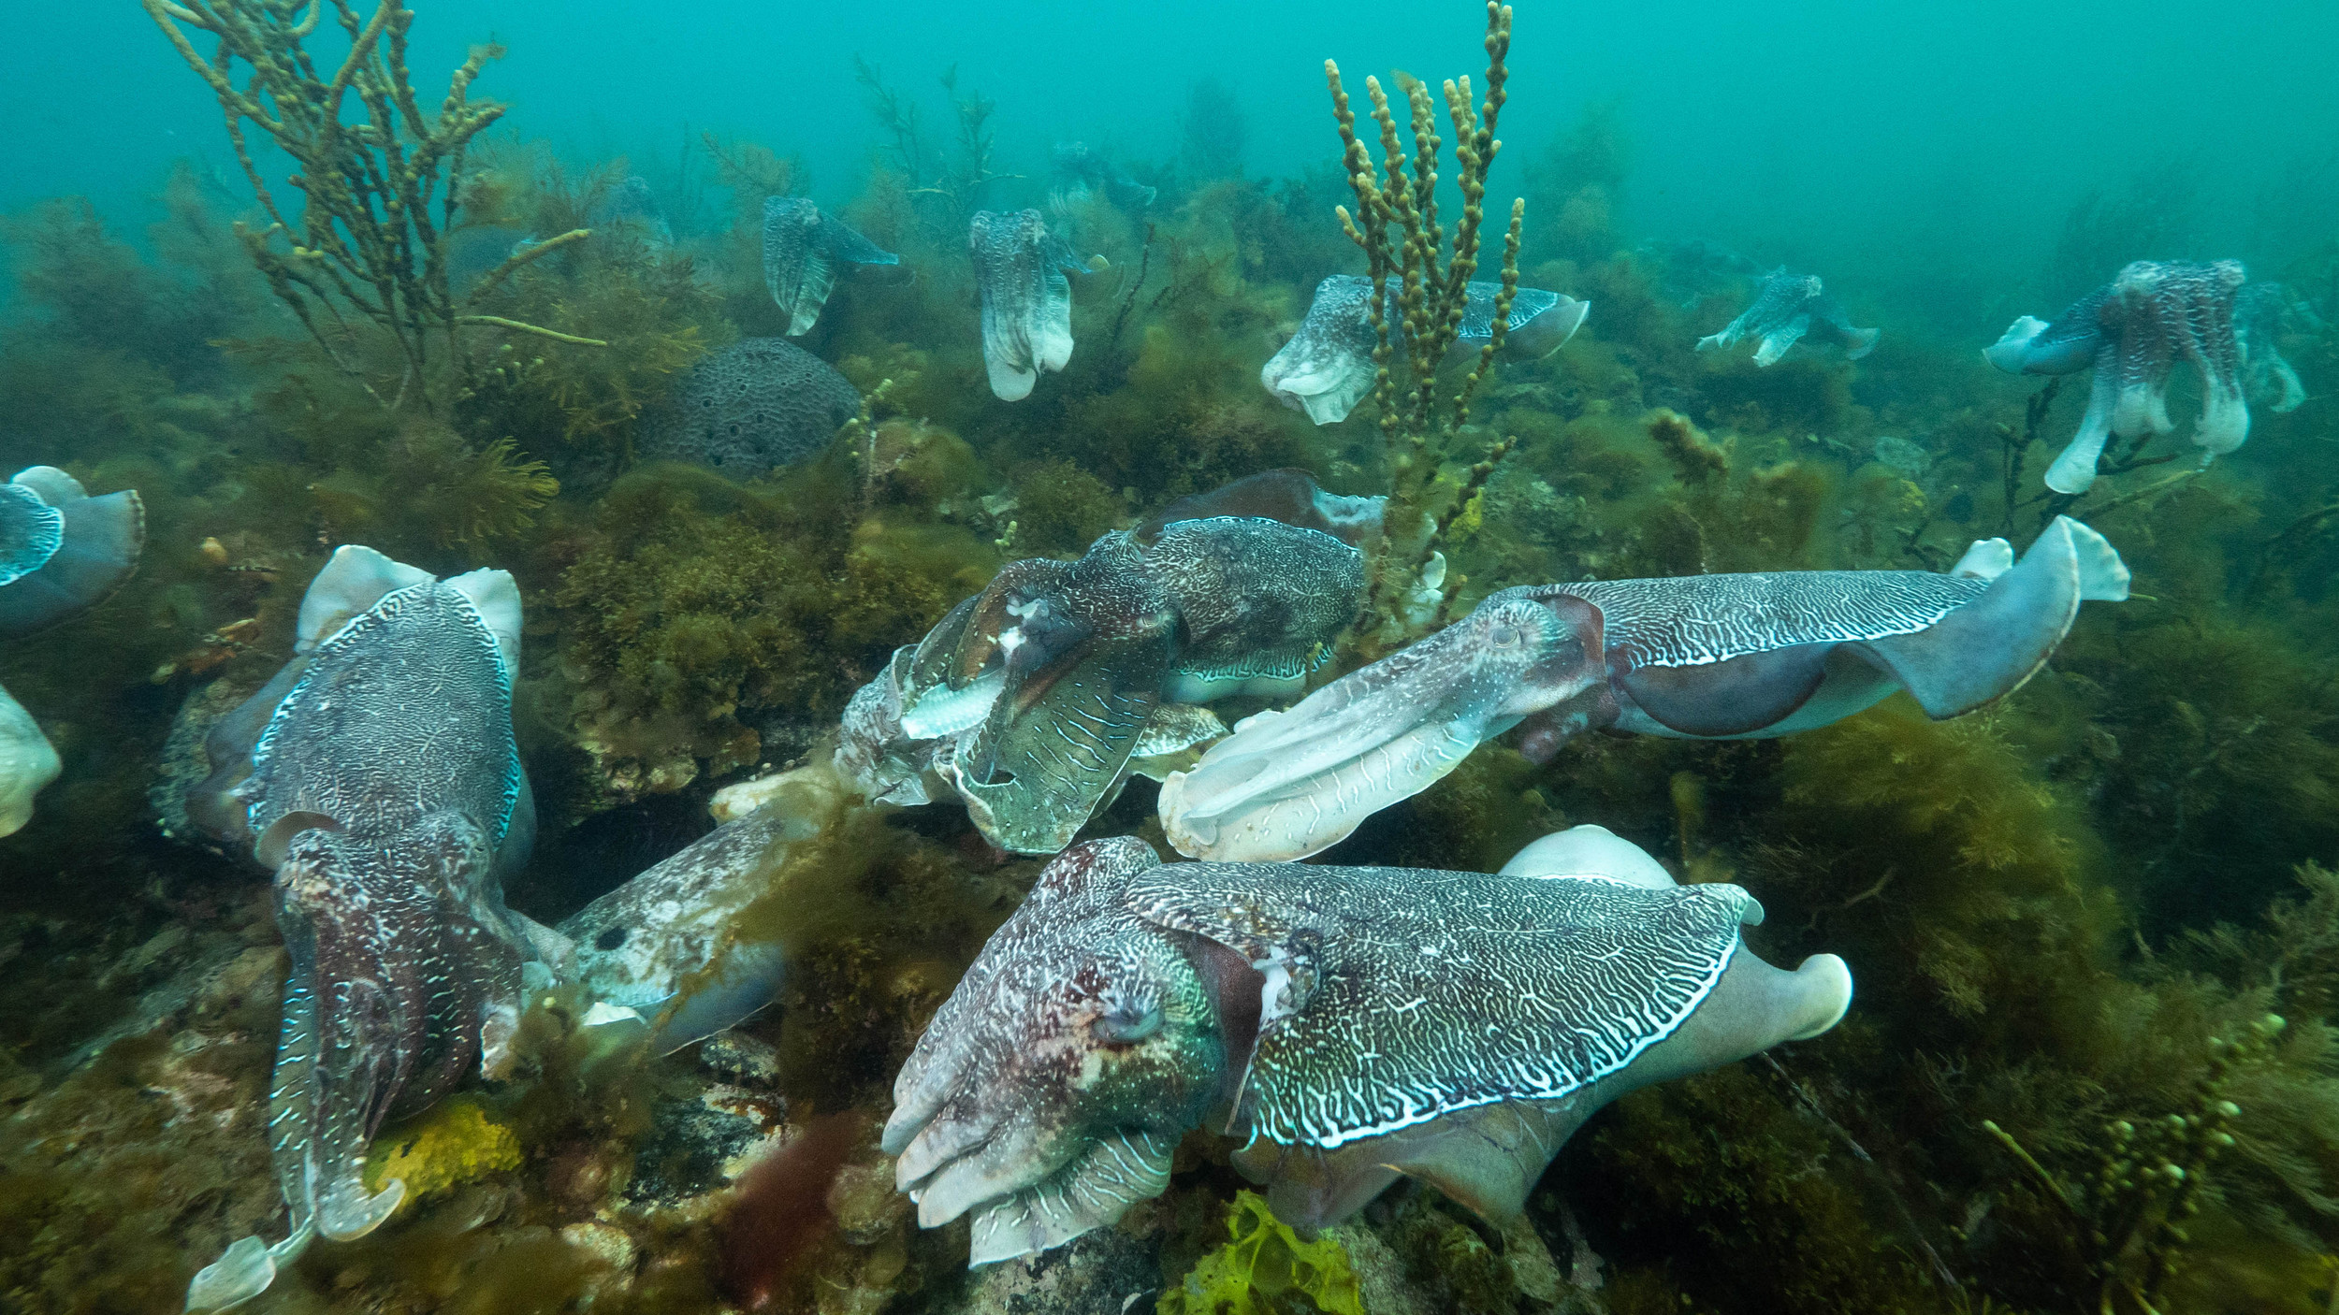
Cuttlefish breeding season, Whyalla, S.A.
Uniform, random or clumped?
Notes:
Image: https://www.theocean.com.au/giant-cuttlefish

Slide 8
Population Dynamics
The study of how a population changes over time

Slide 9
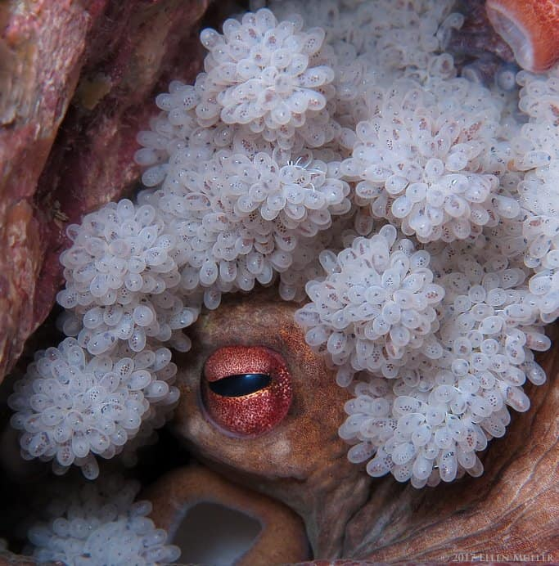
Once the size of the population is known, then ecologists can measure any changes to the size of a population over time.
This is called population dynamics.
means ‘changes’
The mother octopus starves to death to look after her eggs
Notes:
Image: https://octonation.com/how-do-octopus-give-birth/

Slide 10
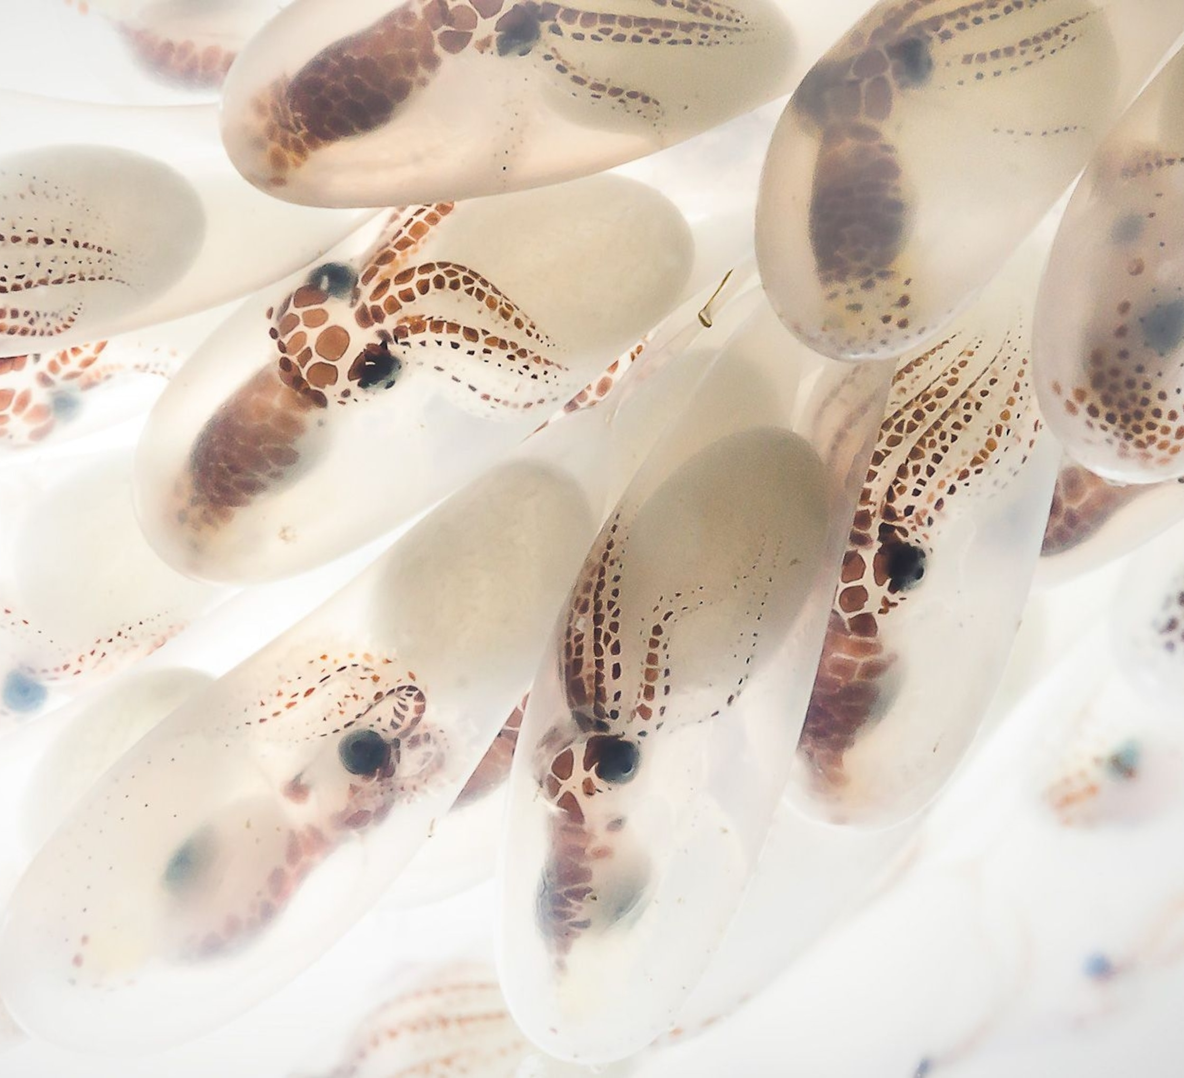
Population dynamics compares the number of species entering a population
(birth rate and immigration) with the number of species leaving a population
(death rate and emigration) over time.
Baby octopus
Notes:
Image: https://www.nationalgeographic.com/photo-of-the-day/photo/octopus-eggs-macro

Slide 11
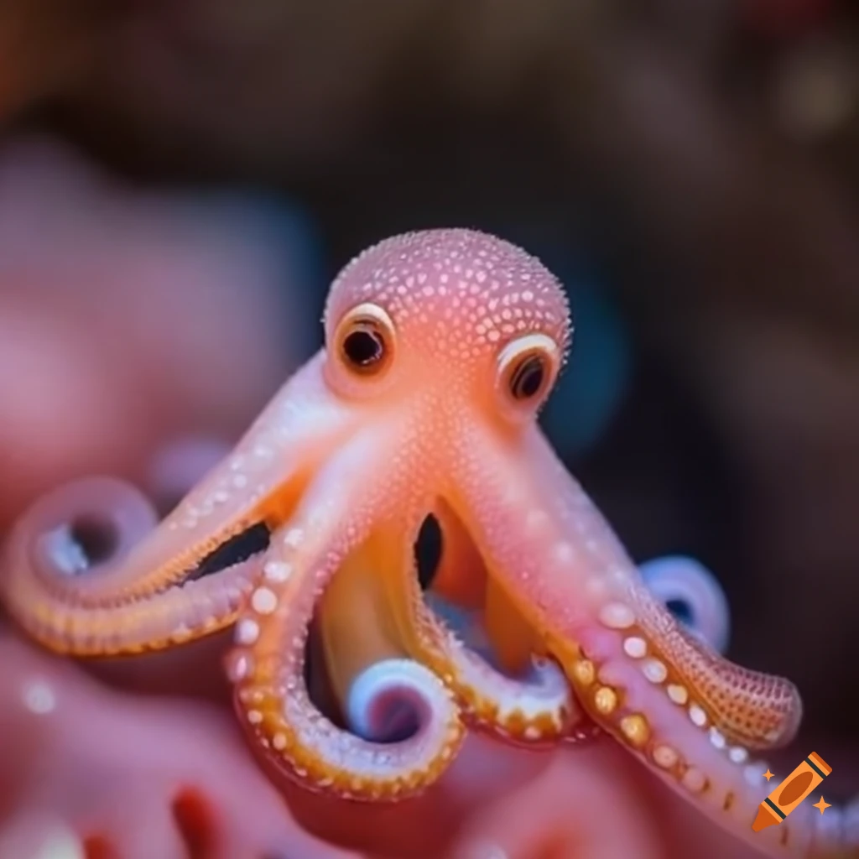
Births add to the population
Notes:
Image: https://www.craiyon.com/image/yPdFvzaHQbascDlcKuZ5pQ

Slide 12
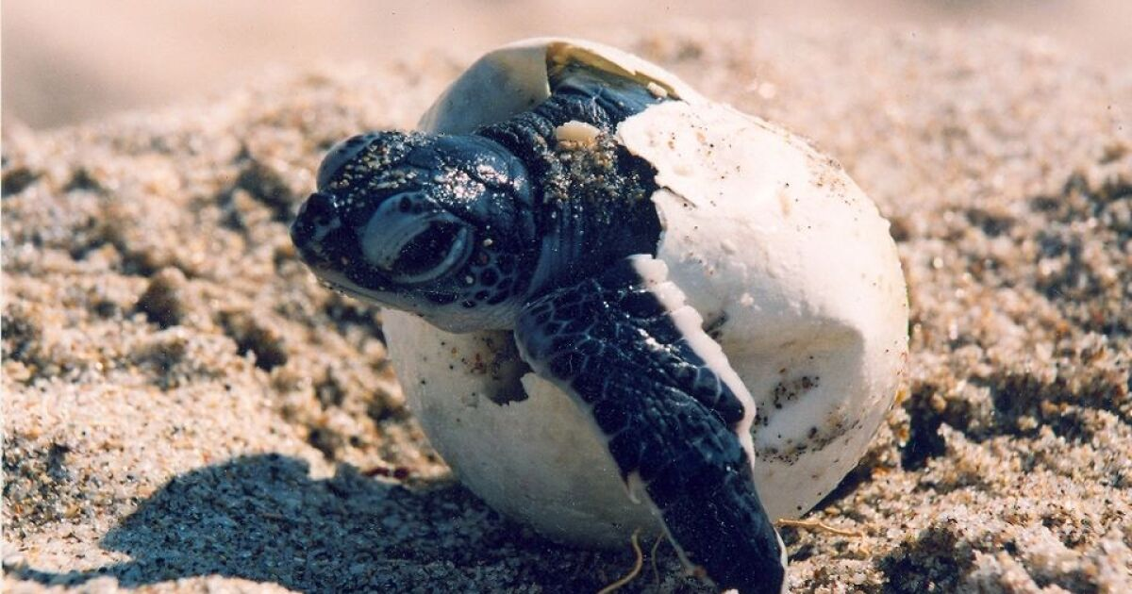
Notes:
Image: https://www.wusf.org/environment/2019-05-01/its-sea-turtle-nesting-season-for-floridas-gulf-coast

Slide 13
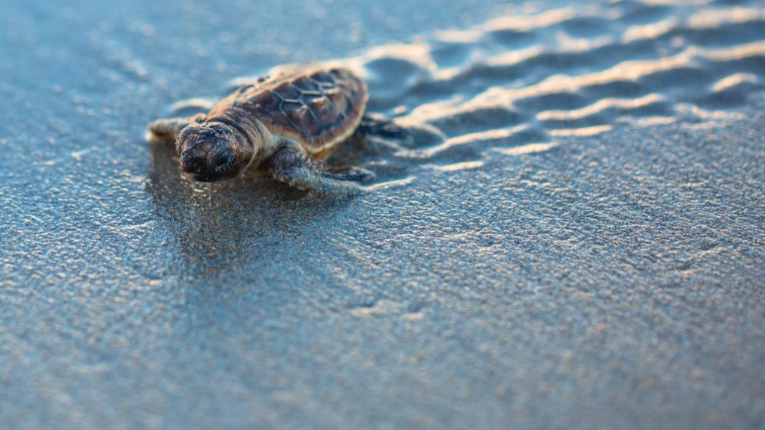
Notes:
Image: https://www.ox.ac.uk/news/features/tracking-endangered-sea-turtles-hardware-size-pound-coin

Slide 14
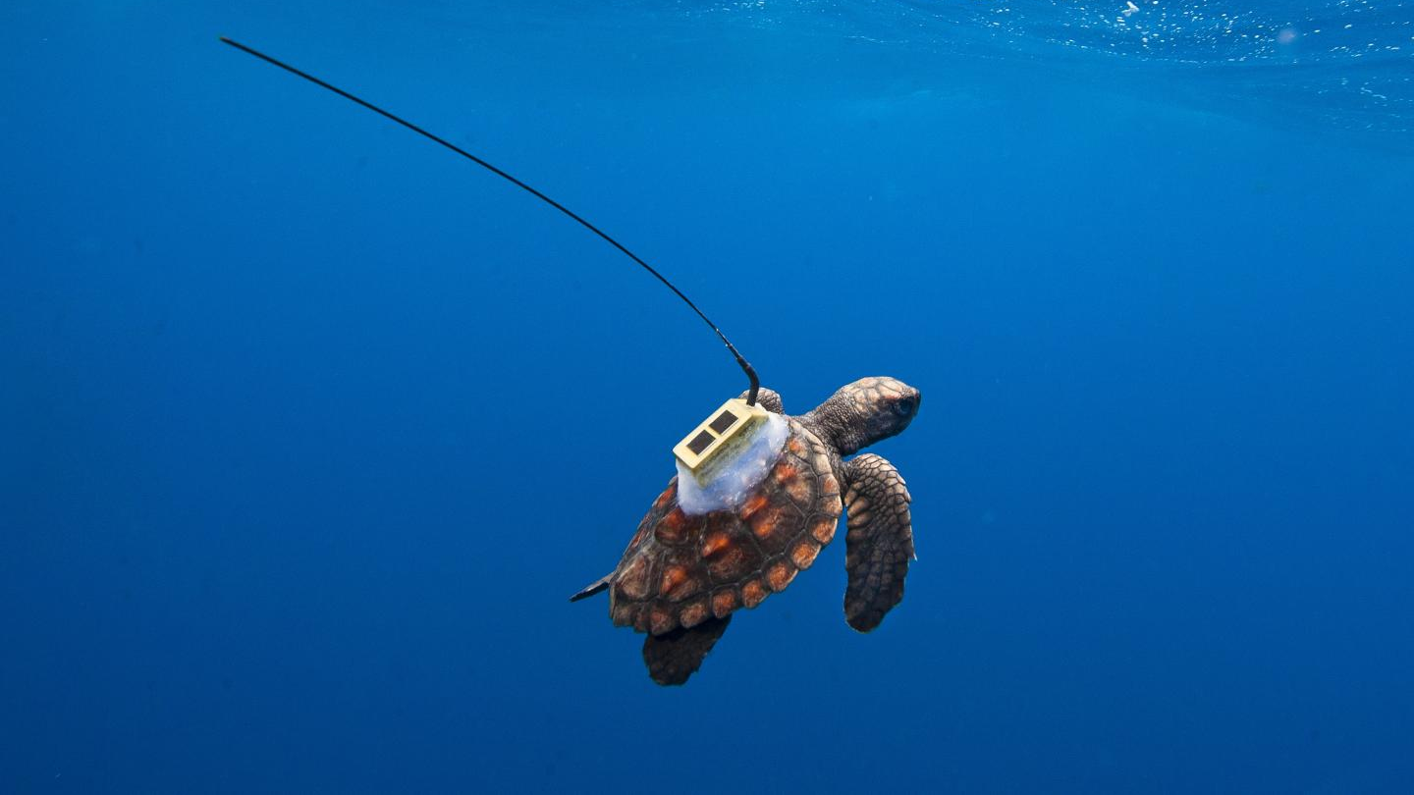

Slide 15
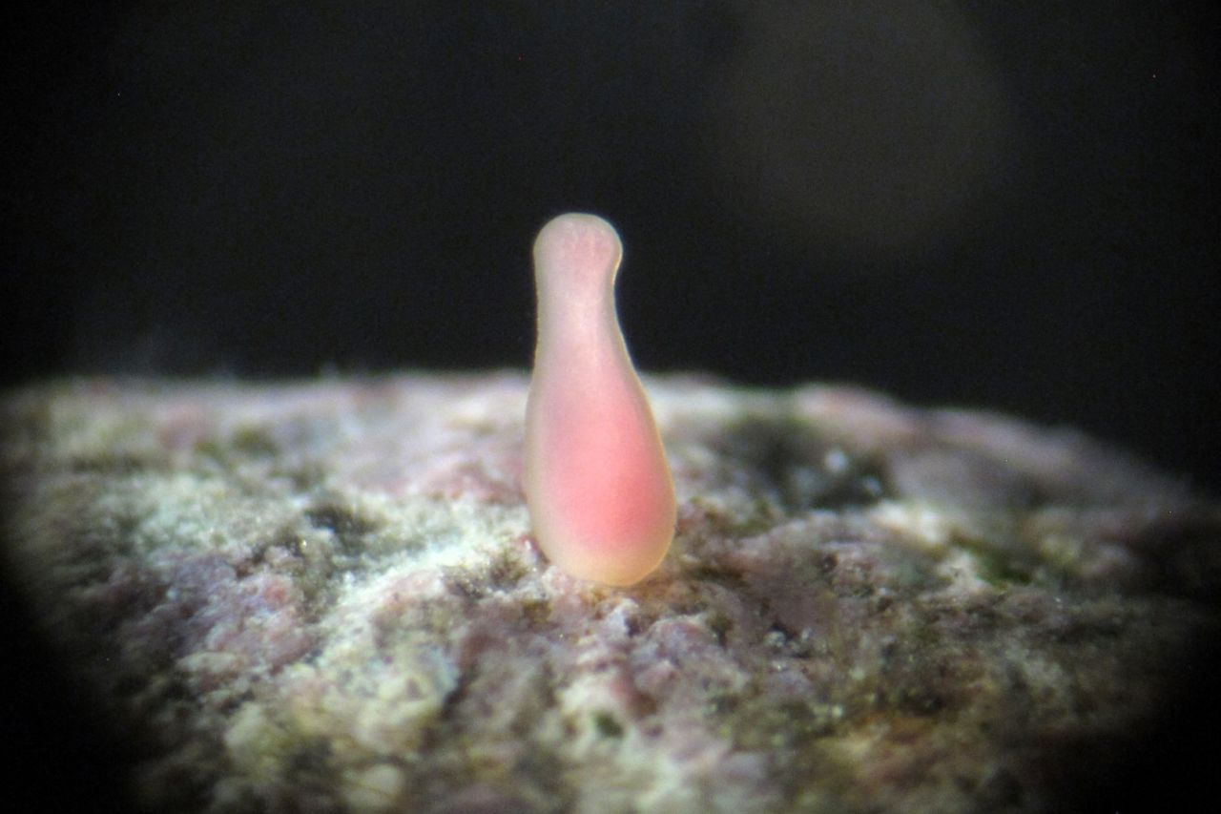
FREE-SWIMMING LARVAE SETTLES ON A SUITABLE ROCK SURFACE. CREDIT: PETER HARRISON.
Immigrants add to the population
Notes:
https://www.barrierreef.org/news/explainers/coral-spawning-breeds-a-new-generation-for-our-reefFREE-SWIMMING LARVAE SETTLES ON A SUITABLE ROCK SURFACE. CREDIT: PETER HARRISON.

Slide 16
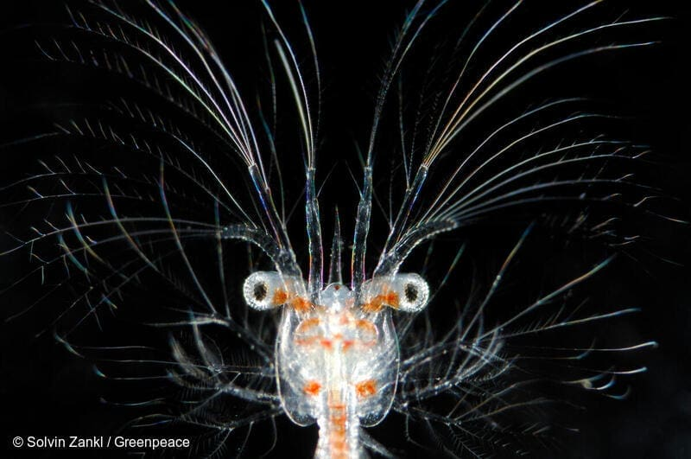
Plankton
Notes:
https://lautsehat.id/flora-fauna/literasivisual/yuk-kita-kenalan-dengan-plankton-si-pahlawan-bumi/

Slide 17
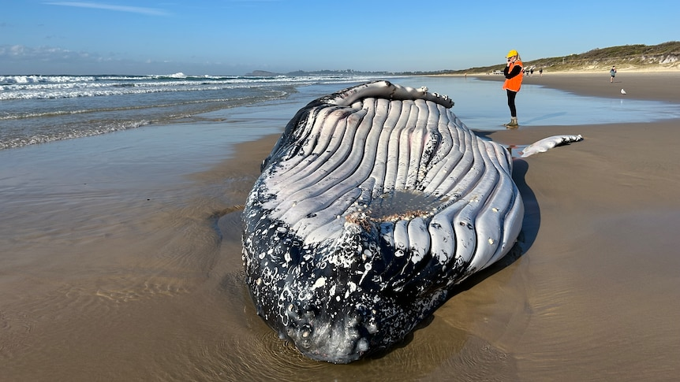
Deaths subtract from the population
a beached whale at Lennox Head (ABC North Coast: Hannah Ross)
Notes:
https://www.abc.net.au/news/2023-07-02/humpback-whale-carcass-to-be-buried-nsw-beach/102551942

Slide 18
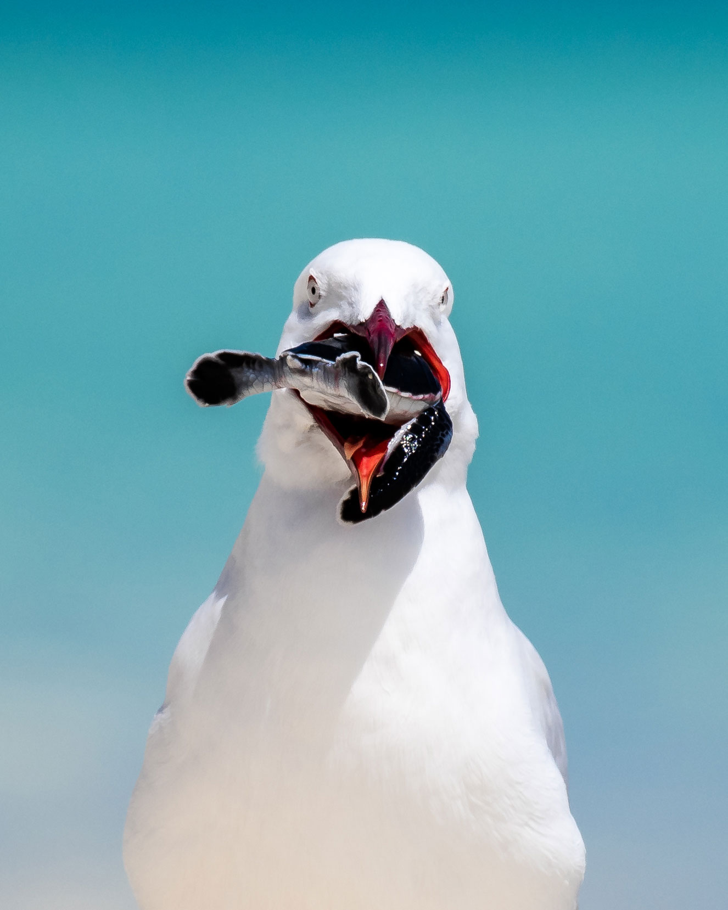
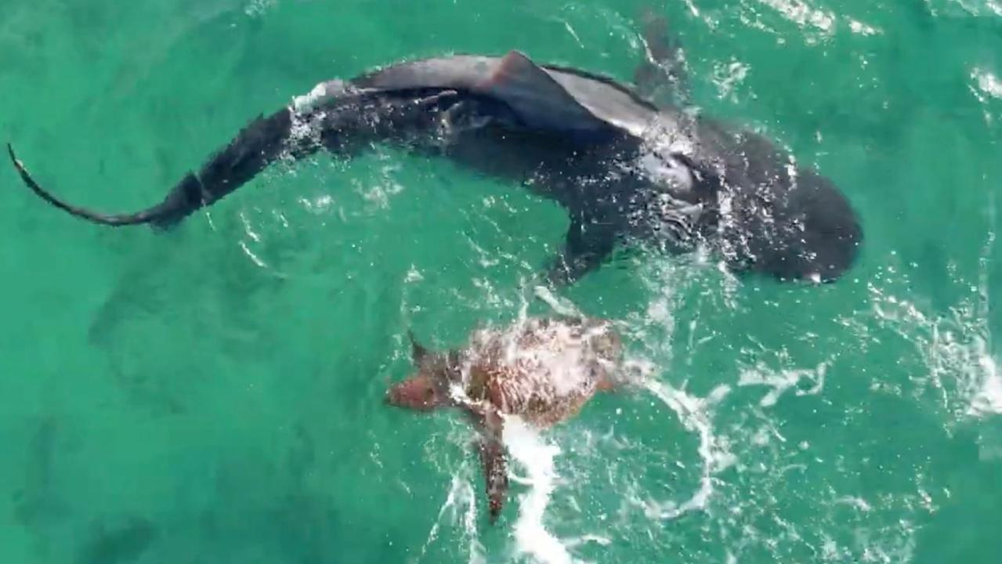
Loggerhead vs Tiger Shark, W.A.
Notes:
Image: https://www.dailytelegraph.com.au/technology/science/turtle-fights-off-shark-during-ocean-battle-in-western-australia/news-story/de0f6e393cacefce7a0cd9b9d43b6a97

Slide 19
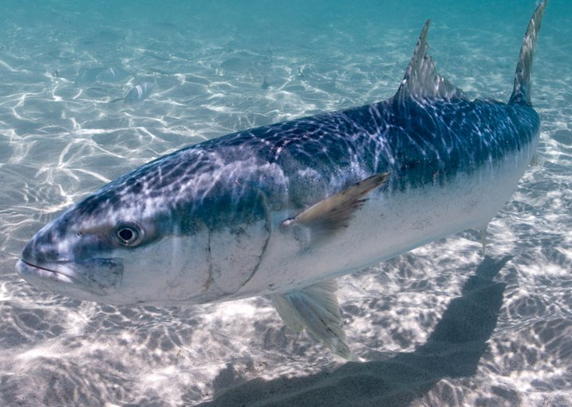
Emigrants subtract from the population
Notes:
Image: https://australian.museum/learn/animals/fishes/yellowtail-kingfish-seriola-lalandi/

Slide 20
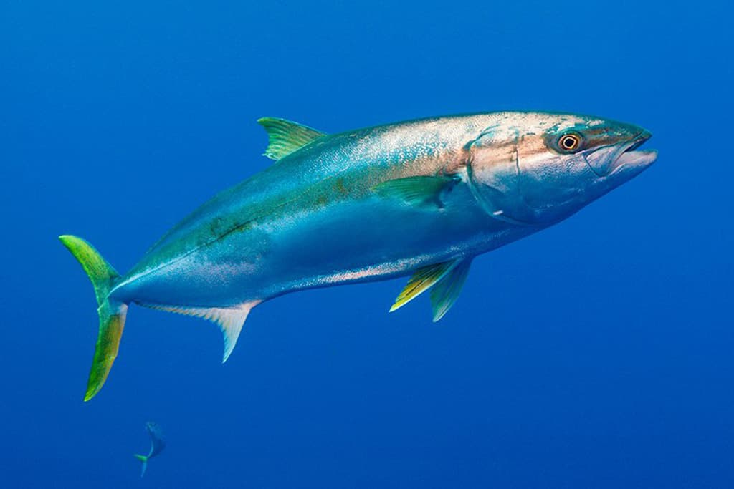
International research published in 2013 found that fish species were being pushed towards the poles at a rate of 7kms every year as they chase the climates they can survive in.
E.g. Yellowtail kingfish are moving from SA to Tas.
Notes:
Info: https://www.theguardian.com/environment/2015/jan/29/australian-fish-moving-south-as-climate-changes-say-researchers
Image: https://www.goldcoastfishingcharters.com.au/yellowtail-kingfish-gold-coast/

Slide 21
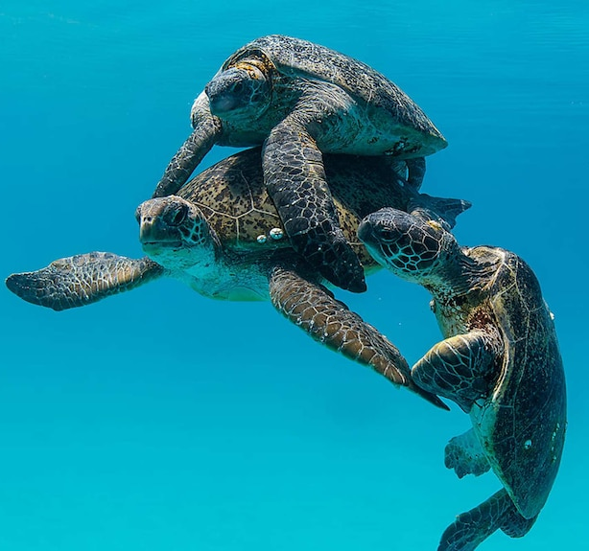
If the number leaving equals the number arriving, the population size remains the same.
Notes:
Image: https://hakaimagazine.com/videos-visuals/one-great-shot-when-dinner-will-not-go-gently/

Slide 22
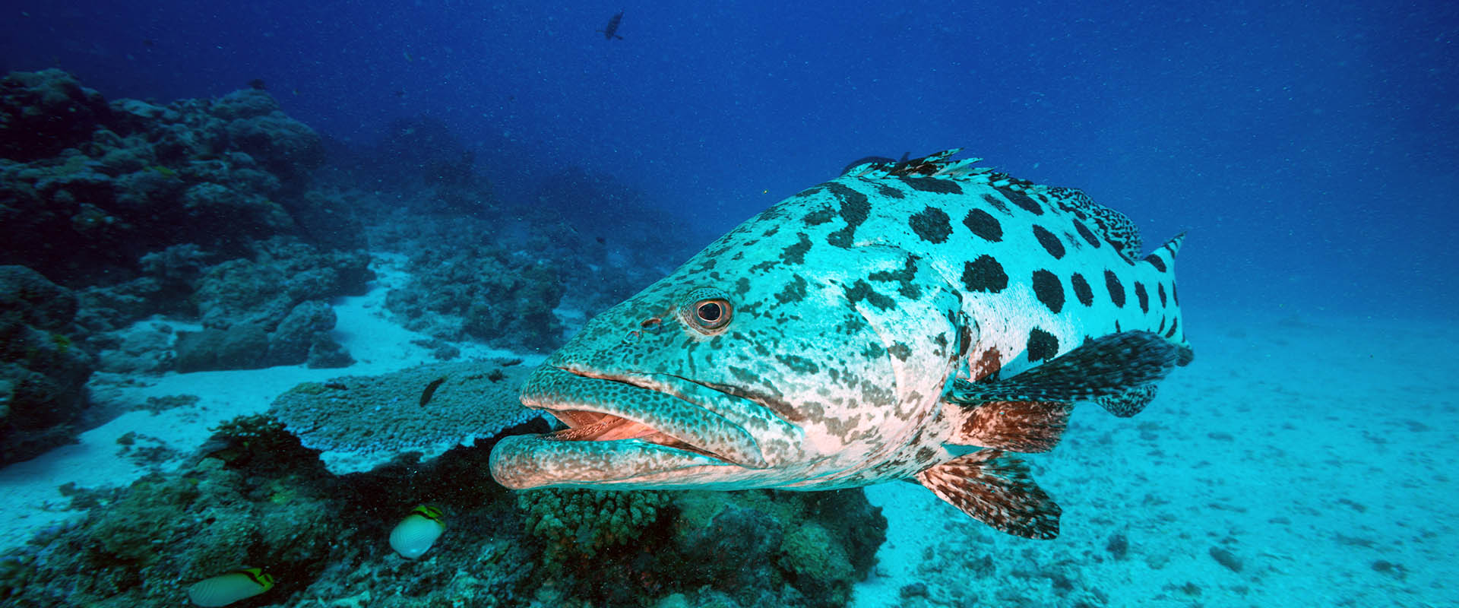
If heaps of them leave….but very few arrive to take their place
the population shrinks in size.
Potato Cod at Cod Hole - a famous dive site near Lizard Island.
There used to be hundreds here. Now there’s only 4 left.
Notes:
Image: https://www.liveaboard.com/diving/australia/cod-hole
Info: https://www.dpi.nsw.gov.au/__data/assets/pdf_file/0008/568691/BW108-Kingfish-and-satellite-tagged-tiger.pdf
Stats info: https://www.brisbanetimes.com.au/national/queensland/great-barrier-reef-potato-cod-at-risk-from-own-friendliness-20141217-129bfv.html

Slide 23
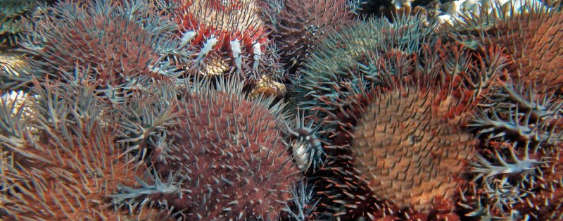
If hardly any leave….but more and more keep arriving
the population grows bigger in size.
Crown-of-thorns outbreak
Notes:
Image: https://www.brisbanetimes.com.au/national/queensland/researchers-use-weather-to-predict-crown-of-thorns-starfish-on-barrier-reef-20151024-gkhp72.html

Slide 24
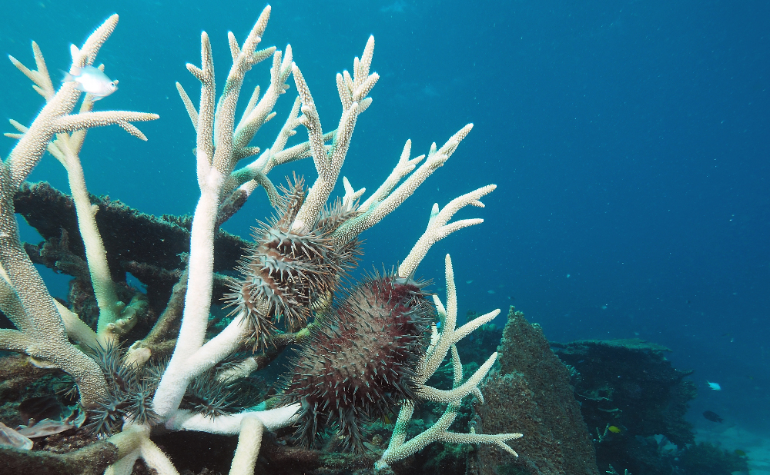
The population keeps growing
until
it reaches the
carrying capacity of its environment (K)
(assuming nothing wipes it
out beforehand)
Notes:
Image: https://www.csiro.au/en/research/natural-environment/oceans/CoTS

Slide 25
Carrying Capacity (K)
the maximum population size that a given area can sustain

Slide 26
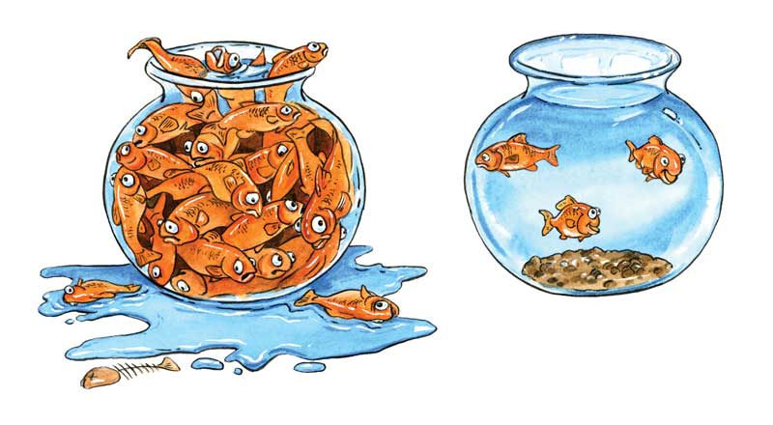
A population stops growing in size when at carrying capacity (K)

Slide 27
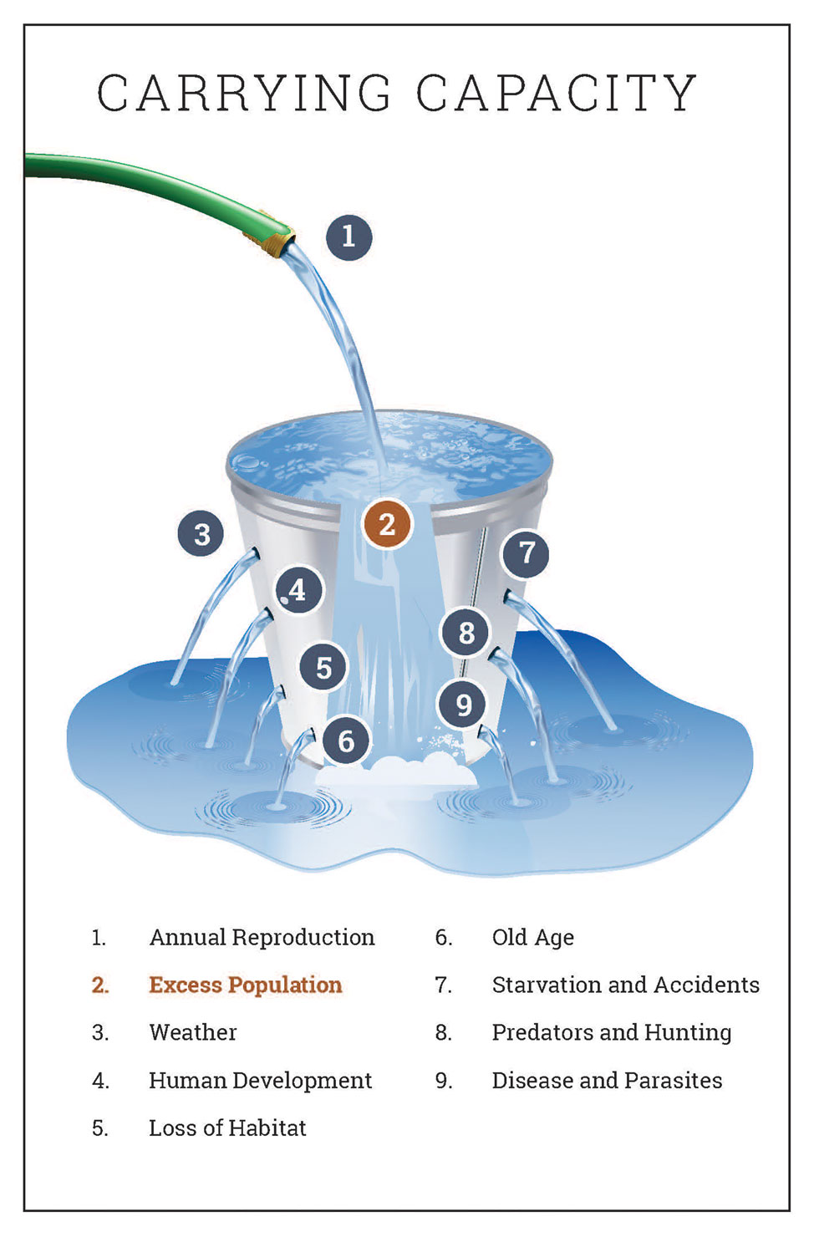
For example:
The top edge of the bucket is the
carrying capacity (K).
When the bucket is full – at carrying capacity –
the population can’t grow any bigger.
Notes:
Image: https://www.hunter-ed.com/ethically-hunting-arizona/studyGuide/Carrying-Capacity-cont./203004_185633/

Slide 28
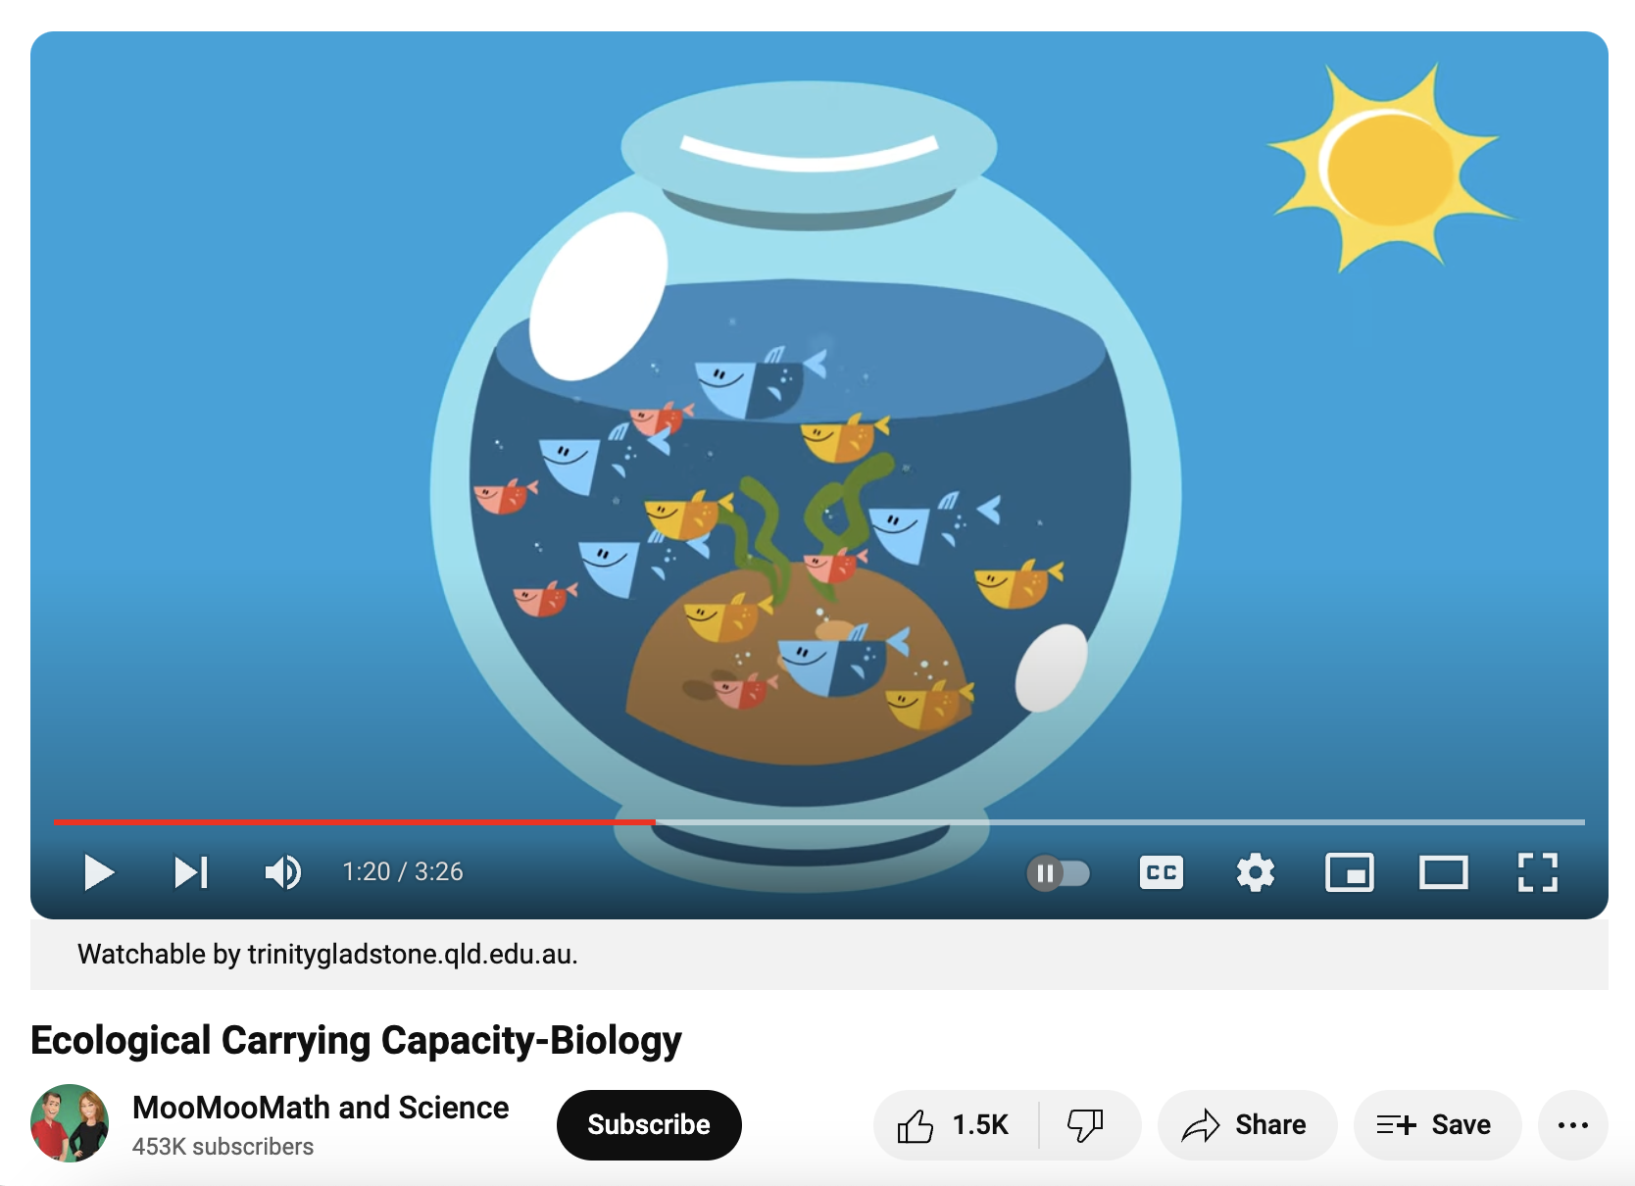
https://www.youtube.com/watch?v=ozW7y-y6Ymw

Slide 29
K-strategists and r-strategists

Slide 30
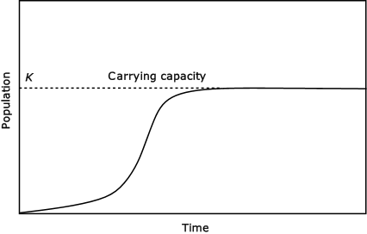
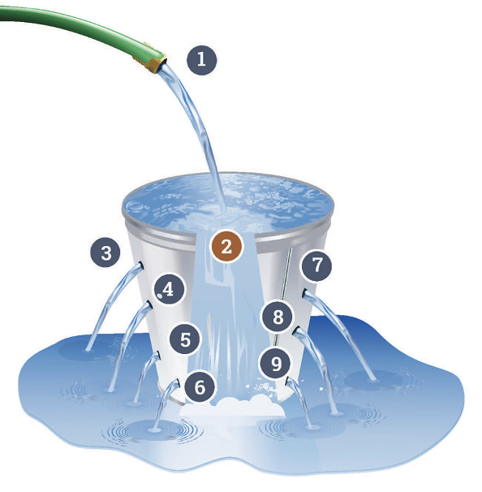
K-strategists is a term given to populations whose population size is density-dependent and therefore stops growing at carrying capacity (K).
Population size

Slide 31
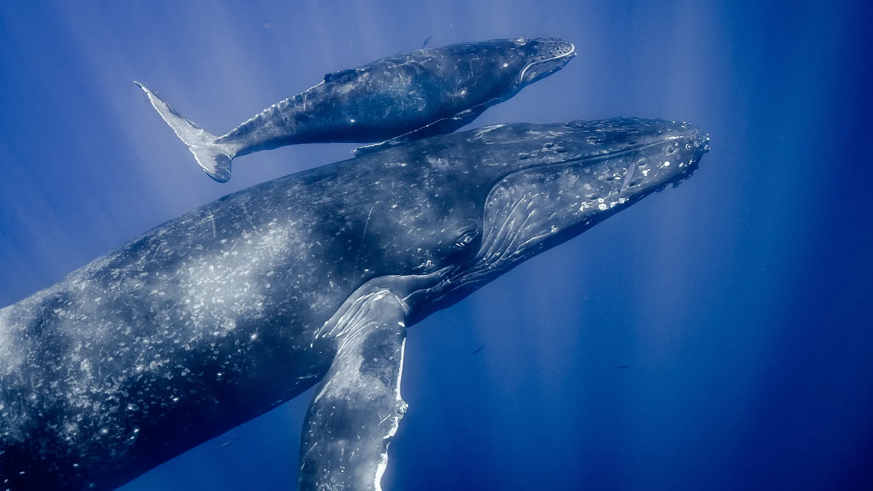
Their mortality is controlled by whatever the carrying capacity (K) is.

Slide 32
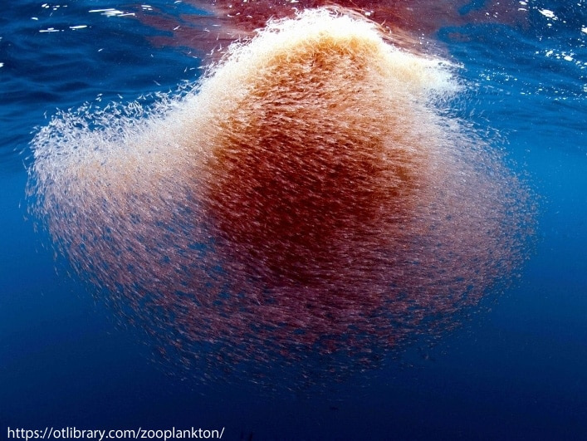
E.g. the size of a humpback whale population is largely dependent on what resources are available to them, such as their favourite food, krill.
Notes:
Image: https://www.consciousbreathadventures.com/blogs/what-do-humpback-whales-eat-part-5-krill/

Slide 33
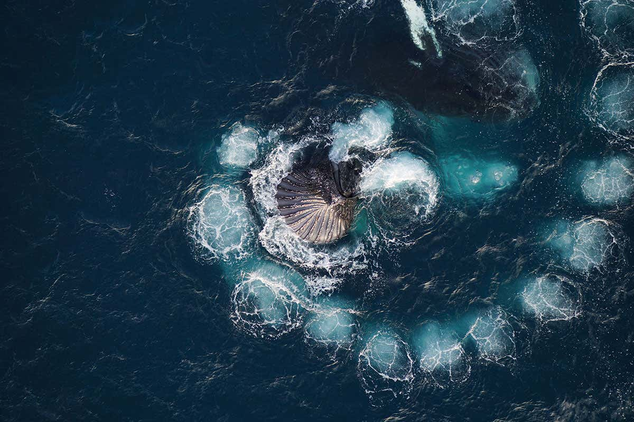
Humpback whales ‘bubble-netting’ krill
Notes:
Image: https://www.newscientist.com/article/mg23731650-100-drone-captures-humpback-whales-catching-krill-with-bubbles/

Slide 34
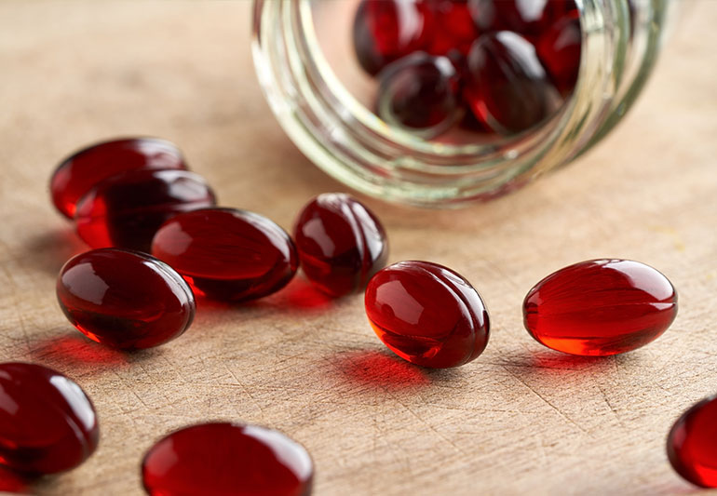
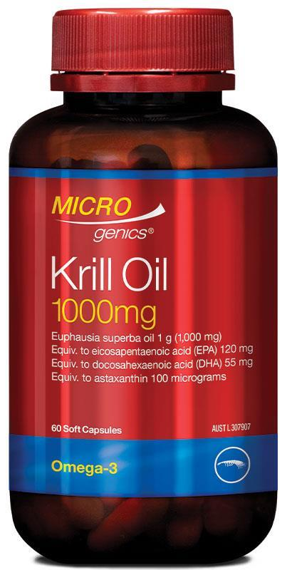
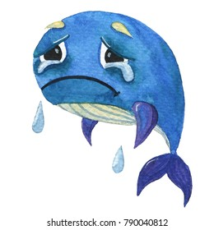

Slide 35

The life strategy of a K-strategist is to grow slowly, but to live a long life.
Their moto is ‘slow and steady wins the race’.
Humans are K-strategists.

Slide 36
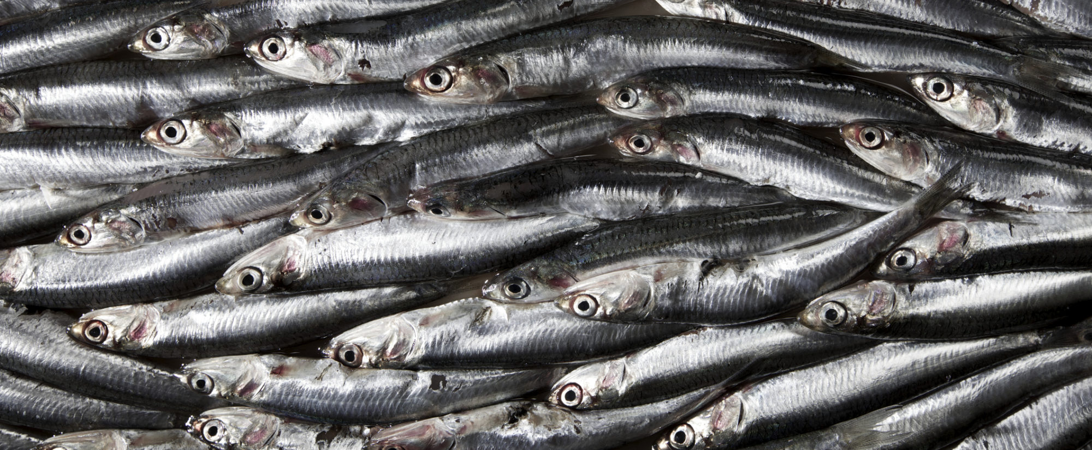
r-strategists are populations whose size is density-independent.
Their mortality is controlled by whatever the catastrophe is (not by K).
Notes:
Image: https://www.sunset.com/food-wine/restaurants/anchovy-wine-bar-san-francisco

Slide 37
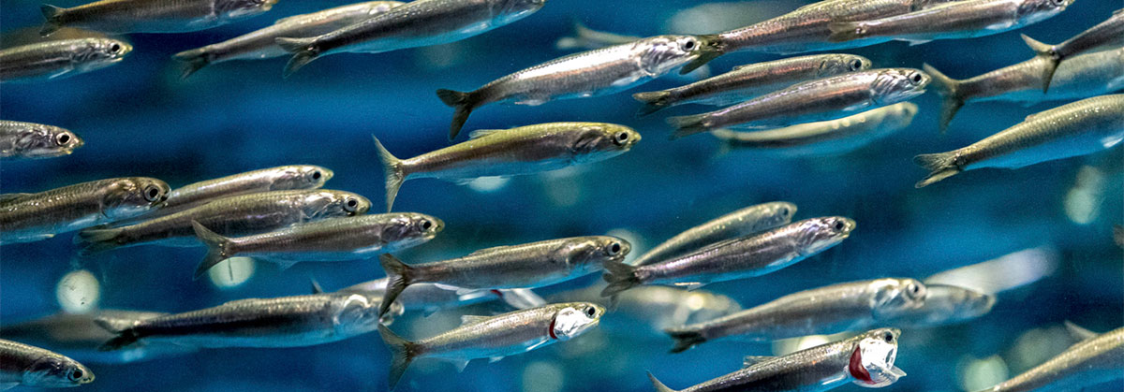
r-strategists live by a more reckless ‘boom and bust’ lifestyle.
Their moto would be ‘make hay while the sun shines’.
r-strategists have many offspring, short gestation, less parental care, and a short time until sexual maturity.
anchovies
Notes:
Image: https://www.ecomagazine.com/news/fisheries-aquaculture/anchovies-in-the-bay-of-biscay-are-smaller-than-30-years-ago

Slide 38
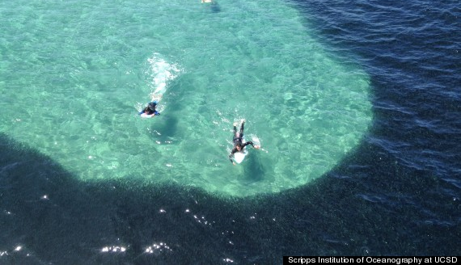
The r stands for ‘rate of increase’.
Their life strategy is to grow and reproduce as fast as they can between catastrophes.

Slide 39
(ecological) niche
The role or function of an organism in an ecosystem (‘job description’).
Where it lives and what it does.

Slide 40
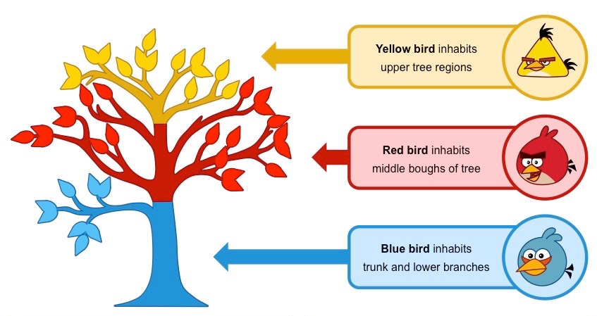
Sometimes an organism will occupy a very specific niche
Notes:
Image: https://old-ib.bioninja.com.au/standard-level/topic-4-ecology/41-species-communities-and/niches.html

Slide 41
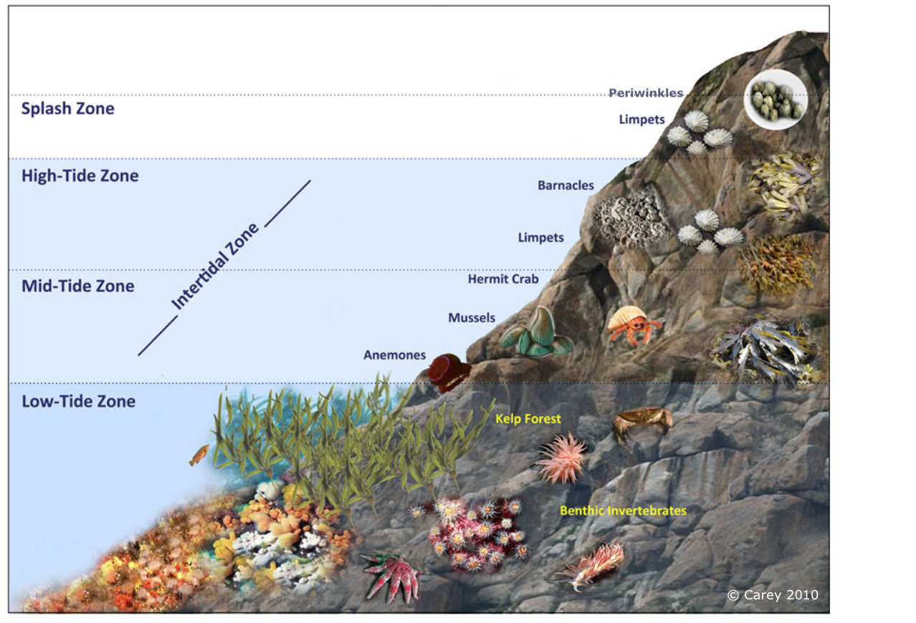
e.g.
the zone where it lives
Notes:
Image: https://www.sciencelearn.org.nz/images/4673-rocky-shore-zonation

Slide 42
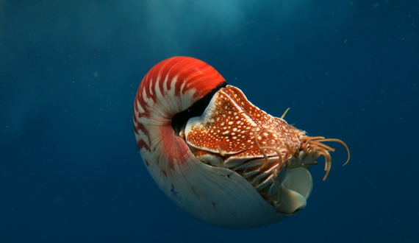
what it does (e.g. activity patterns)
Nautilus rise up to 130m at night and descend back down to 700 m during the day.
Notes:
Image: https://www.biologicaldiversity.org/species/invertebrates/chambered_nautilus/
Info: https://journals.plos.org/plosone/article?id=10.1371/journal.pone.0016311#:~:text=Dawn%20(0400%E2%80%930800%20hrs)%20was%20the%20period%20of%20deepest,%2C%2070%20and%2071%20(Fig.

Slide 43
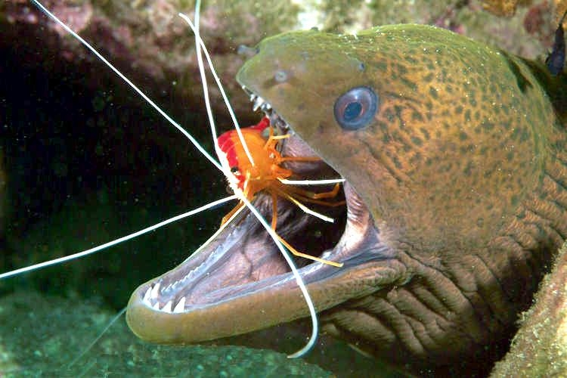
How it interacts with its environment
(e.g. symbiosis, competition and predator-prey relationships)
Cleaner shrimp cleaning moray eel
Notes:
Image: https://otlibrary.com/wp-content/gallery/cleaner-shrimp/

Slide 44
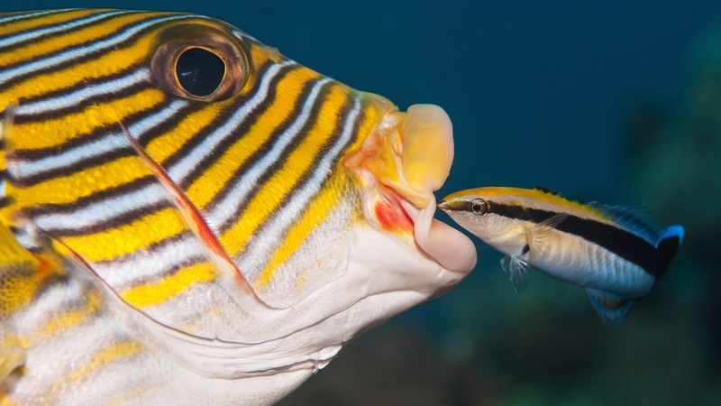
Cleaner wrasse
Notes:
Image: https://www.britannica.com/animal/remora

Slide 45
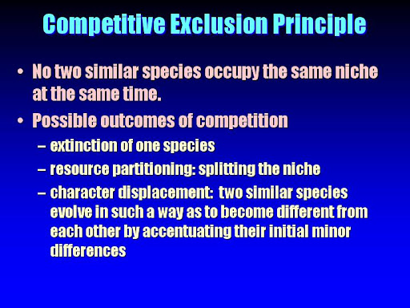
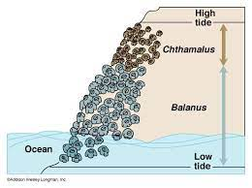
The competitive exclusion principle tells us that two species can't have exactly the same niche in a habitat and stably coexist.
That's because species with identical niches also have identical needs,
which means they would compete for precisely the same resources.
barnacles
Notes:
Info: https://www.khanacademy.org/science/ap-biology/ecology-ap/community-ecology/a/niches-competition#:~:text=The%20competitive%20exclusion%20principle%20tells,for%20precisely%20the%20same%20resources.
Slide: krupp.wcc.Hawaii.edu

Slide 46
Keystone species

Slide 47
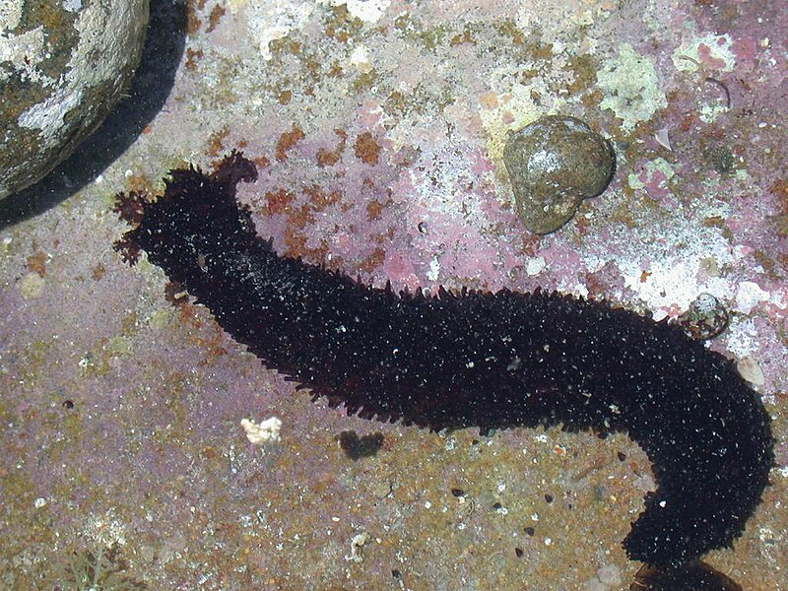
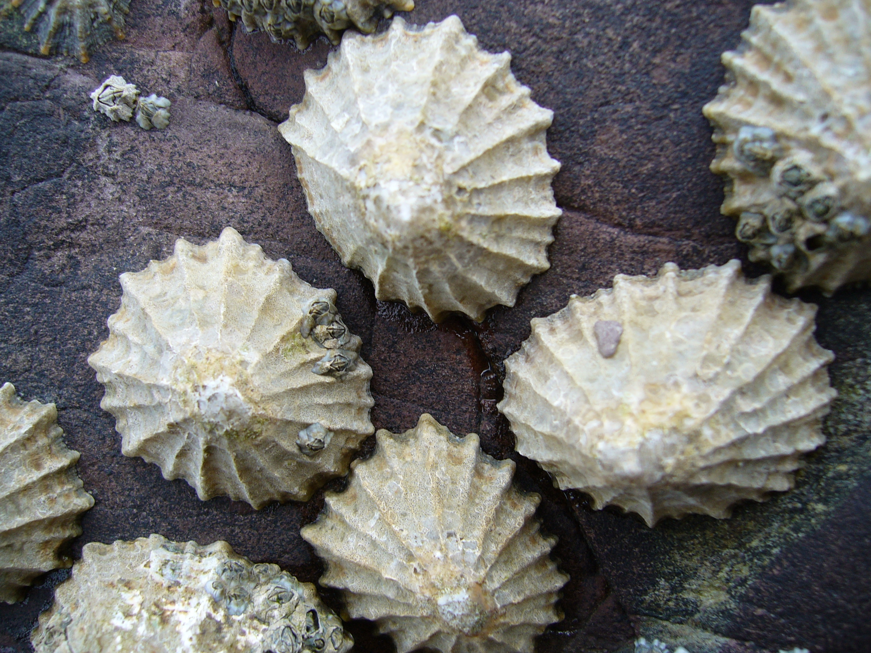
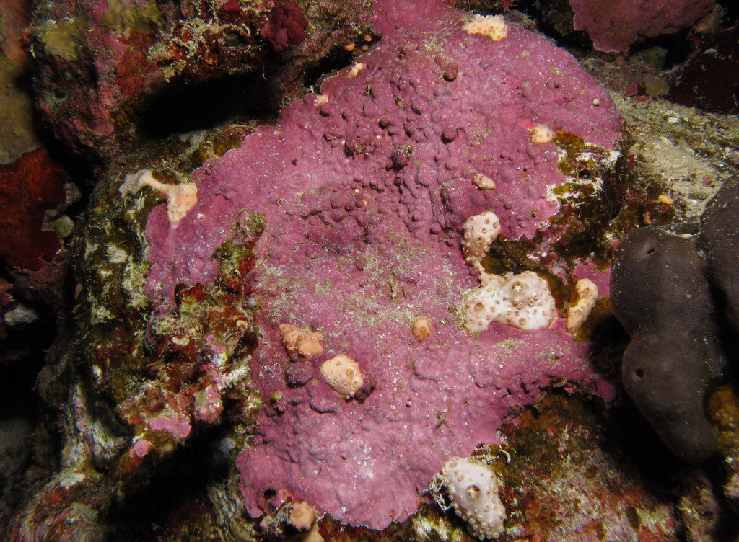
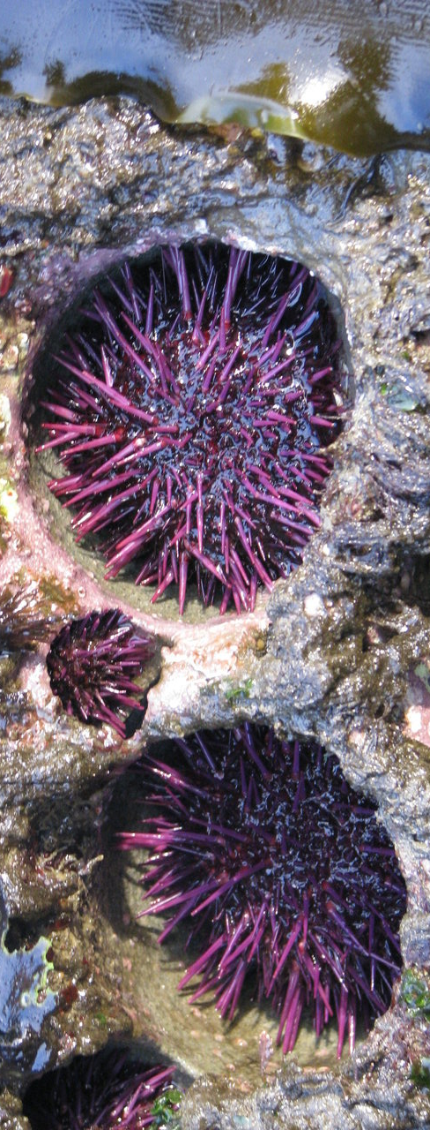
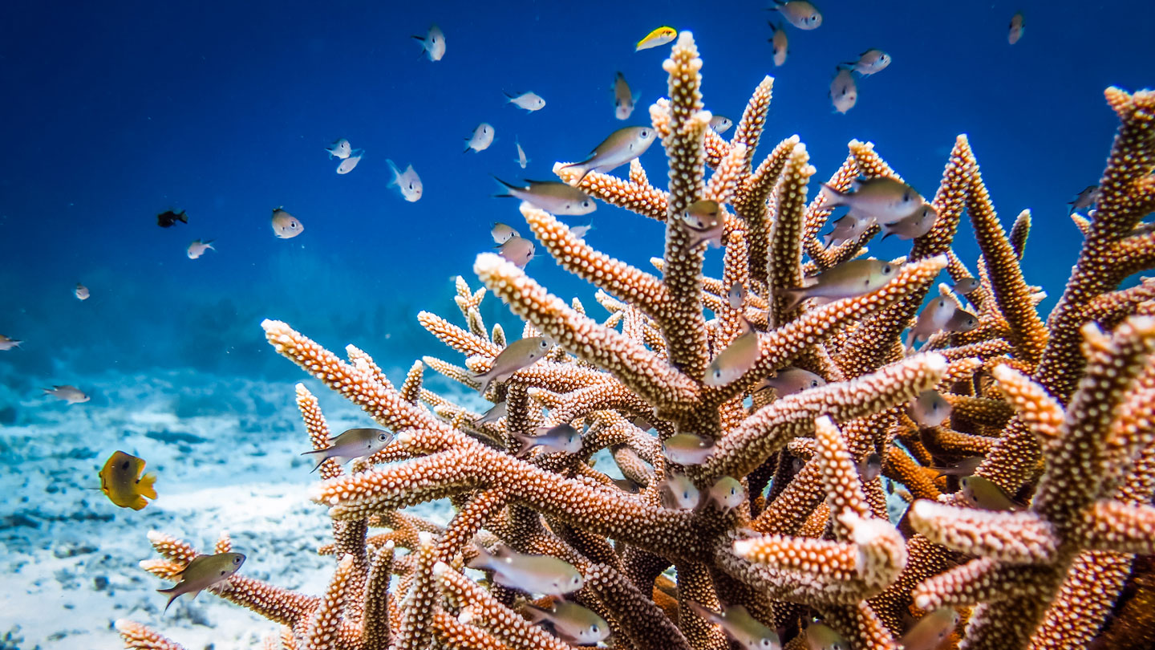
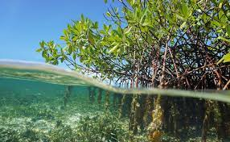

Keystone species
have a disproportionately large influence on their environment
(if removed, it’s noticeable!)
Notes:
Info: How Tiny Limpets Do the Heavy Lifting of Climate Resilience
https://hakaimagazine.com/news/how-tiny-limpets-do-the-heavy-lifting-of-climate-resilience/

Slide 48

The keystone metaphor: The keystone is the component of a structure that is irreplaceable. Without the keystone, a structure could be reassembled, but could never be the same as if the keystone were present and functioning in its role.
Notes:
Image and info: https://www.researchgate.net/publication/327660237_The_Social-Ecological_Keystone_Concept_A_Quantifiable_Metaphor_for_Understanding_the_Structure_Function_and_Resilience_of_a_Biocultural_System
The Social-Ecological Keystone Concept: A Quantifiable Metaphor for Understanding the Structure, Function, and Resilience of a Biocultural System. September 2018. Sustainability 10(9):3294 DOI:10.3390/su10093294

Slide 49

Keystone Predators

Slide 50

Notes:
Image: https://www.esa.org/blog/tag/keystone-species/

Slide 51

Sea otters are keystone species, exerting top-down pressure via predation on sea urchins, which graze on kelp. When sea otters eat the urchins, they reduce the urchin grazing pressure on kelp and, as a result, kelp forests flourish in the presence of sea otters.
Notes:
Image: https://media.hhmi.org/biointeractive/click/keystone/sea-otter.html
Info: https://www.nps.gov/glba/blogs/a-keystone-species-the-sea-otter-colonizes-glacier-bay.htm#:~:text=Sea%20otters%20are%20a%20%22keystone,the%20presence%20of%20sea%20otters.

Slide 52

Fiddler crabs are keystone species because they are deposit feeders and significantly influence the transfer of nutrients and energy.
Keystone Ecosystem Engineers/Modifiers: modify the environment and affect the availability of resources to other organisms
Notes:
Info: https://www.sciencedirect.com/science/article/abs/pii/S0022098119304253#:~:text=Fiddler%20crabs%20are%20a%20key,al.%2C%201994%3B%20Reinsel%2C Battle of the borders: Is a range-extending fiddler crab affecting the spatial niche of a congener species?
Image: https://www.thesprucepets.com/fiddler-crabs-1237222

Slide 53

Beavers build dams
Notes:
Image: https://www.nrdc.org/resources/beavers-natures-wetland-ecosystem-engineers

Slide 54

Corals build reefs

Slide 55

Keystone Mutualists
Coral and zooxanthellae

Slide 56

Keystone Hosts
Kelp forest
Notes:
Image: https://www.nature.org/en-us/magazine/magazine-articles/kelp-forest/

Slide 57

Keystone Prey
Krill – a vital link in the food chain
Notes:
Image: https://www.antarctica.gov.au/about-antarctica/animals/krill/

Slide 58

Learning Intention:
Describe the concept of population dynamics using the terms population size, density, abundance, distribution (i.e. clumped, uniform, random), carrying capacity, niche, K-strategists and r-strategists, keystone species.
Success Criteria:
Complete Marine Education worksheet
‘14. Population Dynamics’
Notes:
Image: https://www.boredpanda.com/cute-baby-sea-otters/

