Slide 1
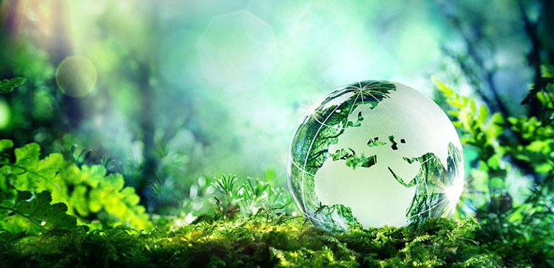
Learning Intention:
Describe the concept of sustainable management practices.
Success Criteria:
Complete worksheet
’14. The Ability to Sustain’

Slide 2
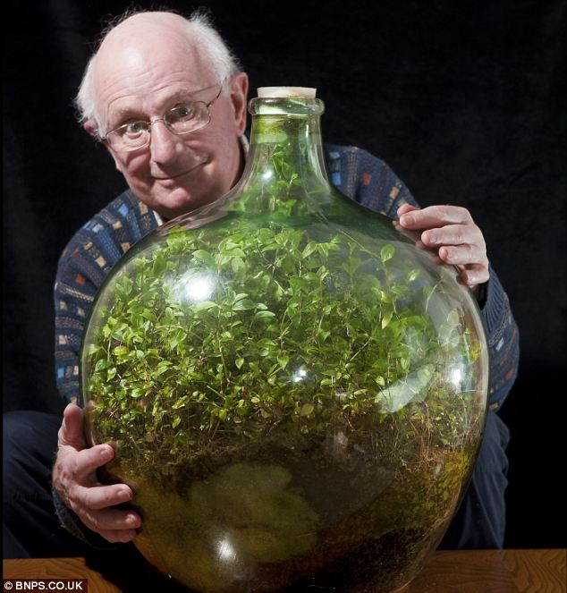
Still going strong: Pensioner David Latimer from Cranleigh, Surrey, with his bottle garden that was first planted 53 years ago and has not been watered since 1972 - yet continues to thrive in its sealed environment.
Notes:
Image: https://www.dailymail.co.uk/sciencetech/article-2267504/The-sealed-bottle-garden-thriving-40-years-fresh-air-water.html

Slide 3
What is sustainability?

Slide 4
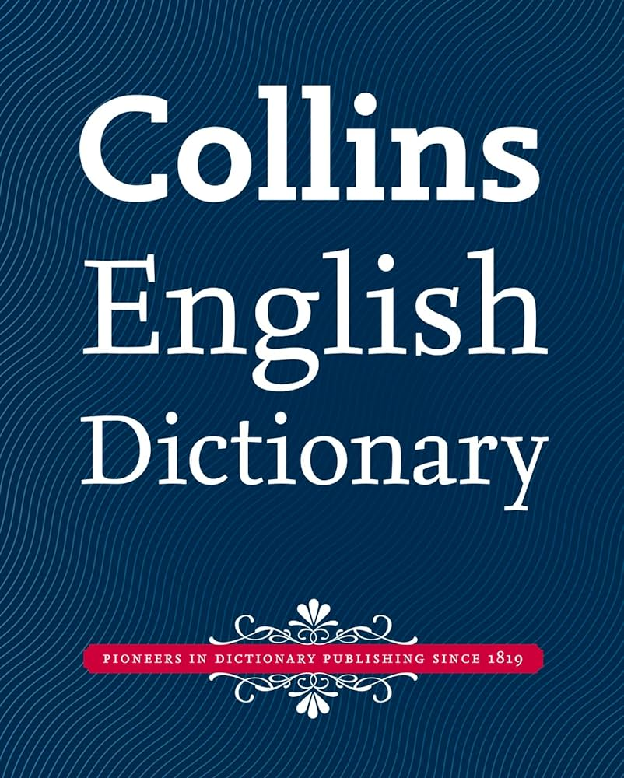
According to Collins English Dictionary, if you sustain something, you continue it, or maintain it for a period of time.

Slide 5
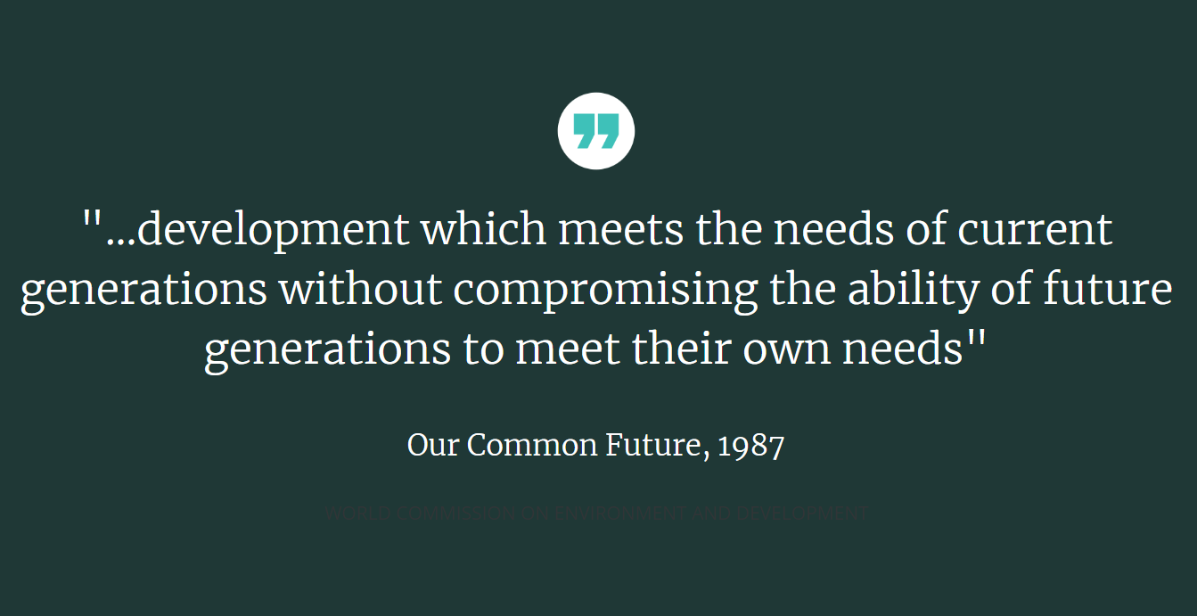

Slide 6
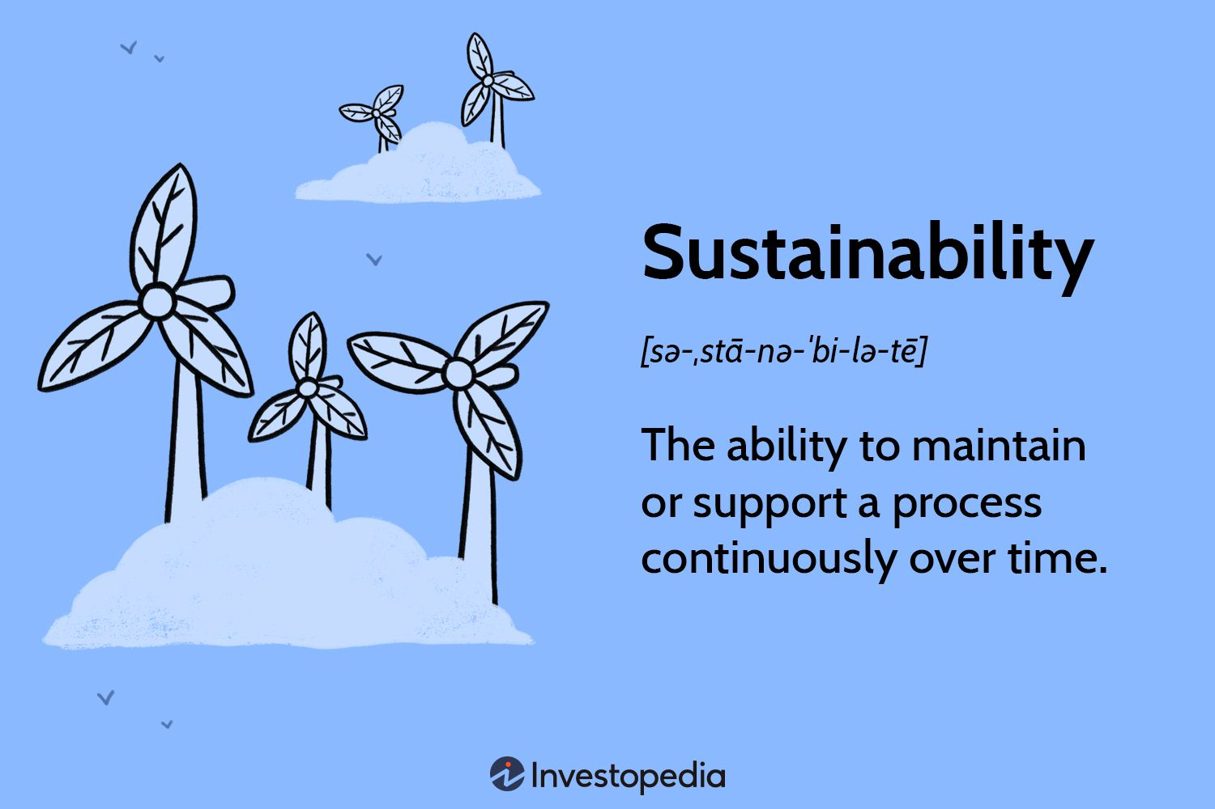

Slide 7
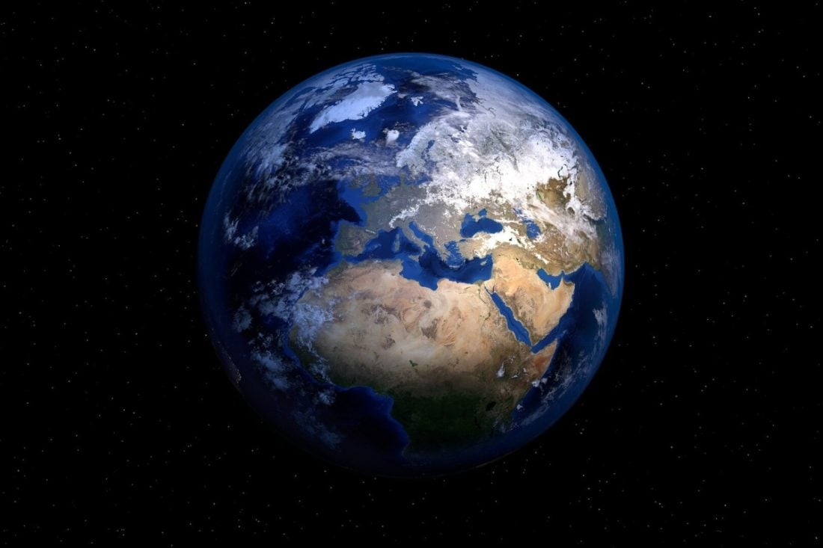
Sustainability presumes that resources are finite, and should be used conservatively and wisely with a view to long-term priorities and consequences of the ways in which resources are used.
Our Planet
Our Future

Slide 8
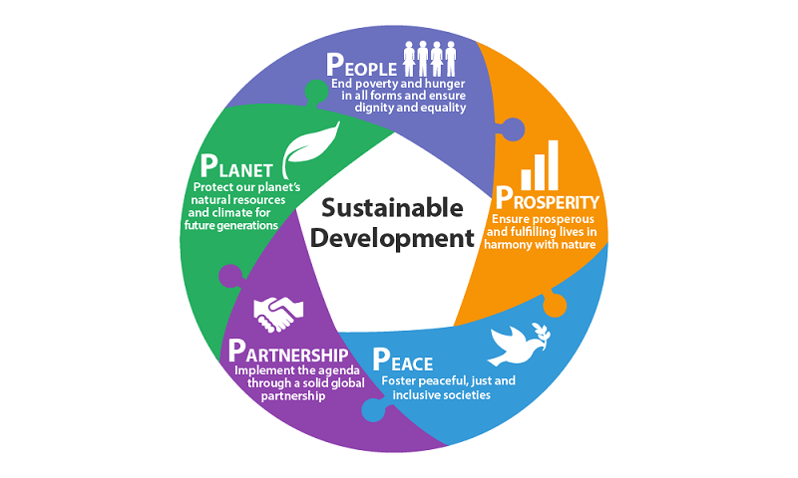
Sustainable management practices are practices (things we do) that are informed by the concept of sustainability
Notes:
Image: https://www.iynf.org/2018/08/a-guide-to-sustainable-development-and-its-challenges-in-developing-countries/

Slide 9
Example of a sustainable management practice – Life Cycle Analysis (LCA)
(also called a Life Cycle Assessment)

Slide 10
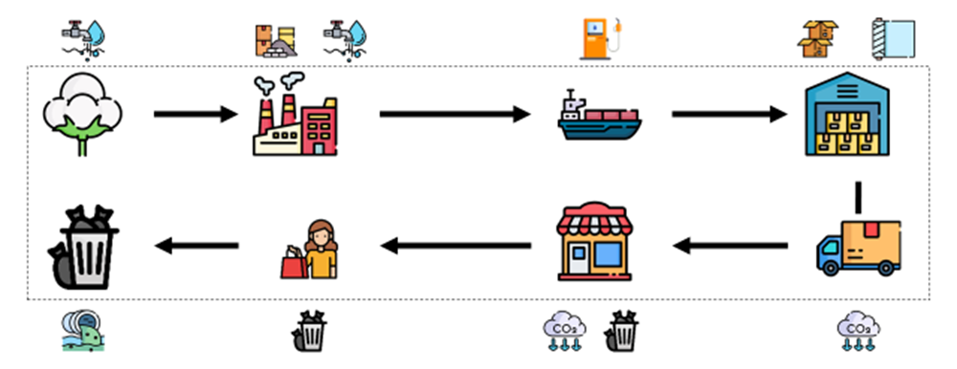
A life cycle analysis (LSA) measures the environmental impacts of a product or service
– from production to disposal.
Notes:
Image: https://towardsdatascience.com/what-is-a-life-cycle-assessment-lca-e32a5078483a

Slide 11
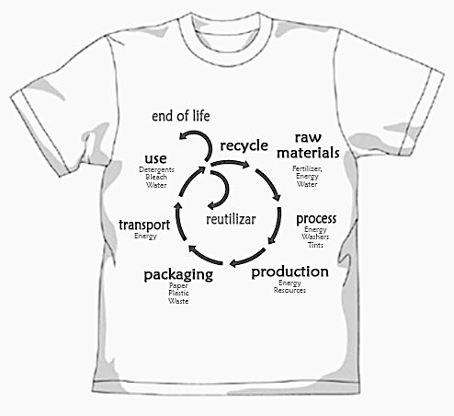
E.g. LCA of a t-shirt
reuse
Notes:
Image: https://towardsdatascience.com/what-is-a-life-cycle-assessment-lca-e32a5078483a

Slide 12
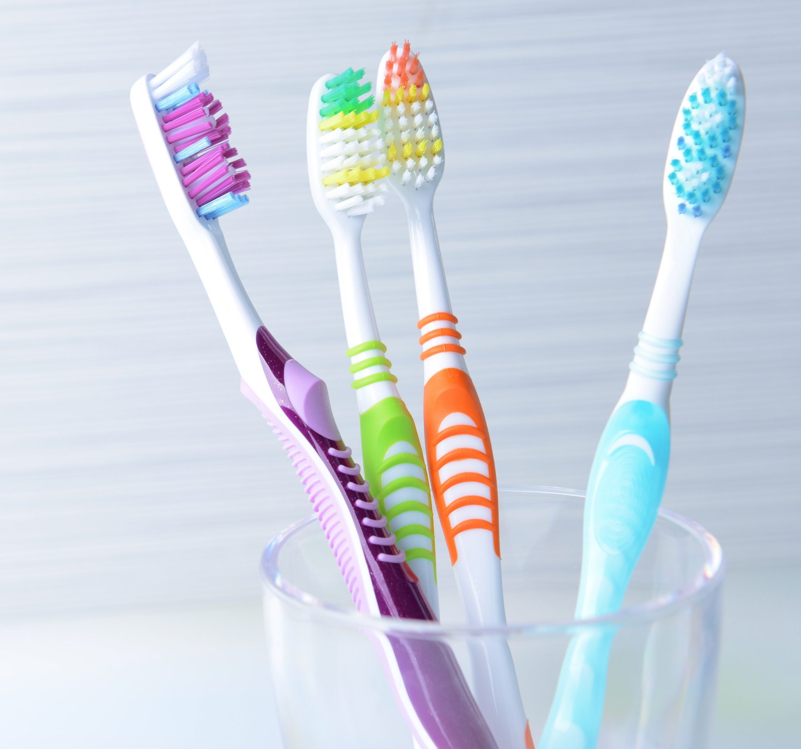
E.g. LCA of a
plastic toothbrush
Our toothbrushes first start their journey as oil.
The oil is then sent to a refinery which separates the oil into plastic pellets.
To make the handle, plastic pellets are melted down and shaped with a mould.
The toothbrush bristles are made of nylon. They are stapled in place and attached to the toothbrush’s core.
The bristles are trimmed with a machine that can precisely trim the bristles to the proper length and form.
The brushes are packed into boxes that are again made up of a combination of plastics and cardboard.
According to the Center for Disease Control and Prevention (CDC), we should change our toothbrushes every 3 to 4 months. After that, the bristles will start to wear off and the brush won’t be as effective as it should be.
Once discarded, toothbrushes spend rest of their life in landfills.
Because plastic is practically indestructible, nearly every toothbrush produced since the 1930s is still alive and well somewhere in the world as a piece of trash.
Notes:
Info: https://community.missionsustainability.org/blog/life-cycle-of-a-plastic-toothbrush/

Slide 13
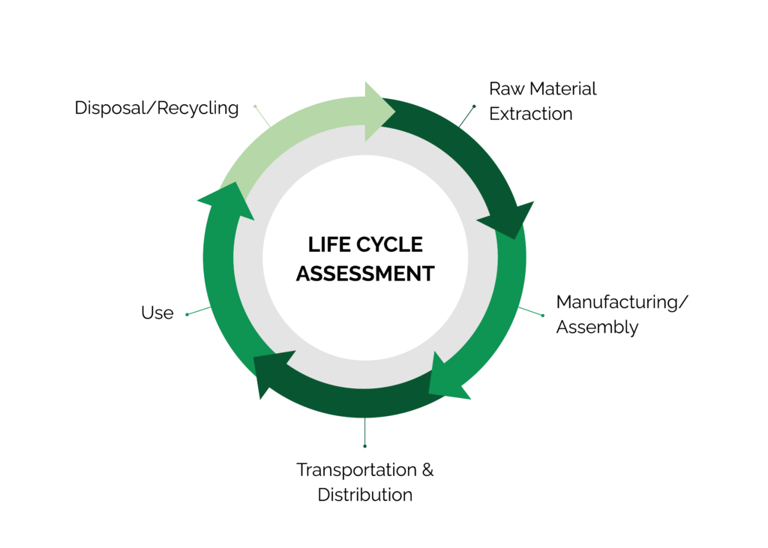
Notes:
Image: https://stich.culturalheritage.org/life-cycle-assessment-explained/

Slide 14
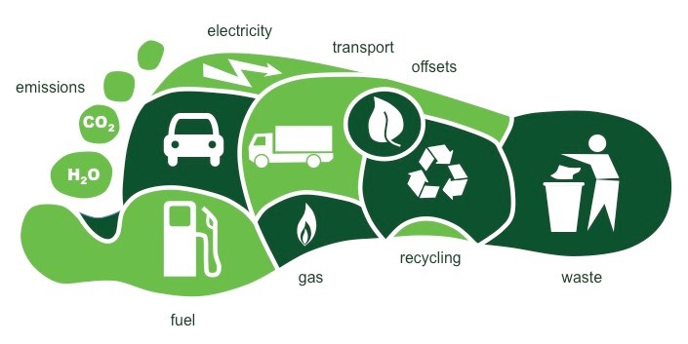
What is your ecological footprint?
how much nature is there vs. how much do you use?
Notes:
Imaage: https://wp.wwu.edu/marketing474gill/2018/04/10/ecological-footprint/comment-page-1/

Slide 15
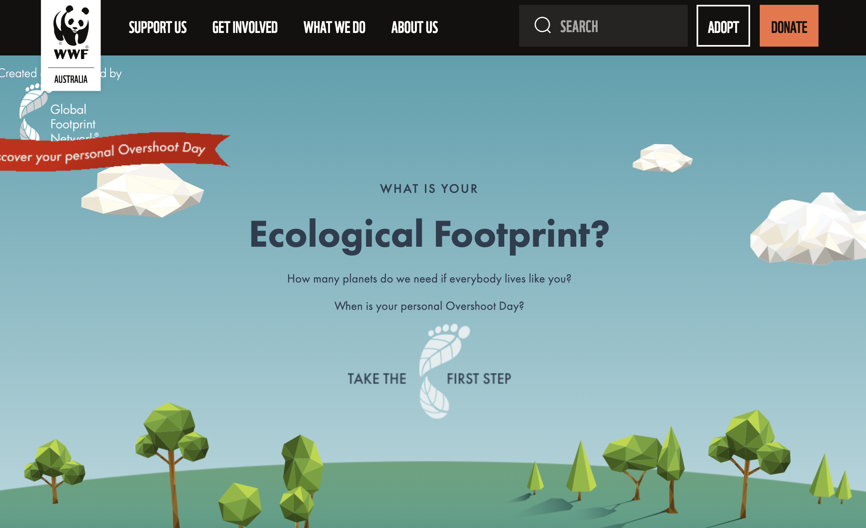
https://wwf.org.au/get-involved/ecological-footprint-calculator/
Notes:
https://wwf.org.au/get-involved/ecological-footprint-calculator/

Slide 16
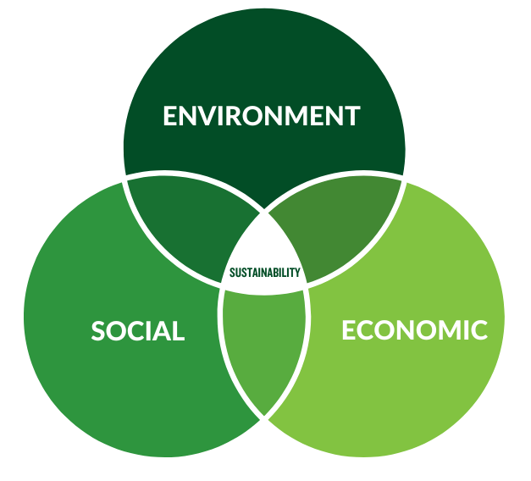
Is this possible?
bearable
viable
equitable
Notes:
Image: https://agnext.colostate.edu/2023/01/10/what-is-sustainability/

Slide 17
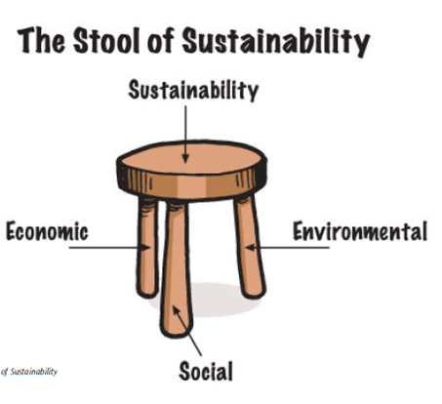
If the legs of the stool are uneven, the stool falls over and the practice is unsustainable.
Remember, the environment has limited resources. Therefore, there must also be some kind of limit to how much our economy and society can expand.
Notes:
Image: http://cbecosprey.weebly.com/what-is-sustainability.html

Slide 18
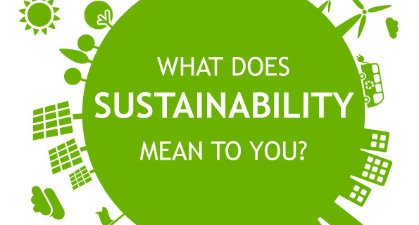

Slide 19
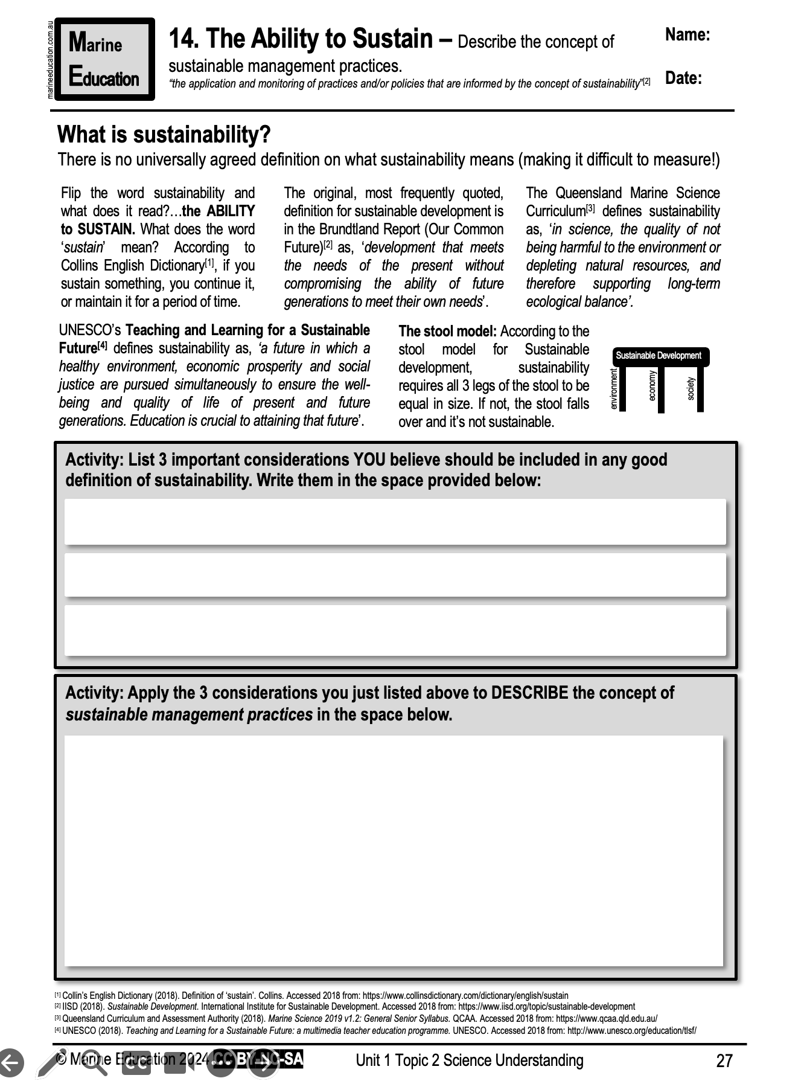
Learning Intention:
Describe the concept of sustainable management practices.
Success Criteria:
Complete worksheet
’14. The Ability to Sustain’

