Slide 1

Learning Intention:
Interpret population data to determine population size, density, abundance, distribution, carrying capacity.
Success Criteria:
Complete Marine Education worksheet ‘15. Measuring Populations’
Notes:
Image: https://www.markgray.com.au/gallery/limited-edition-prints/mooloolaba-beach-sunrise.php

Slide 2
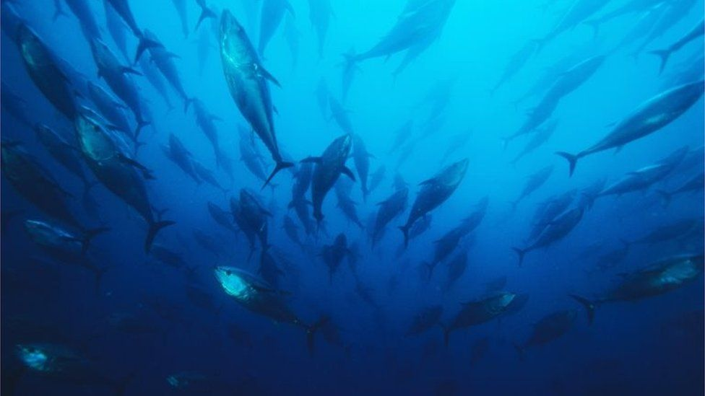
Its often too difficult to count ALL the animals in a population.
Notes:
Image: https://www.bbc.com/news/science-environment-34265672

Slide 3
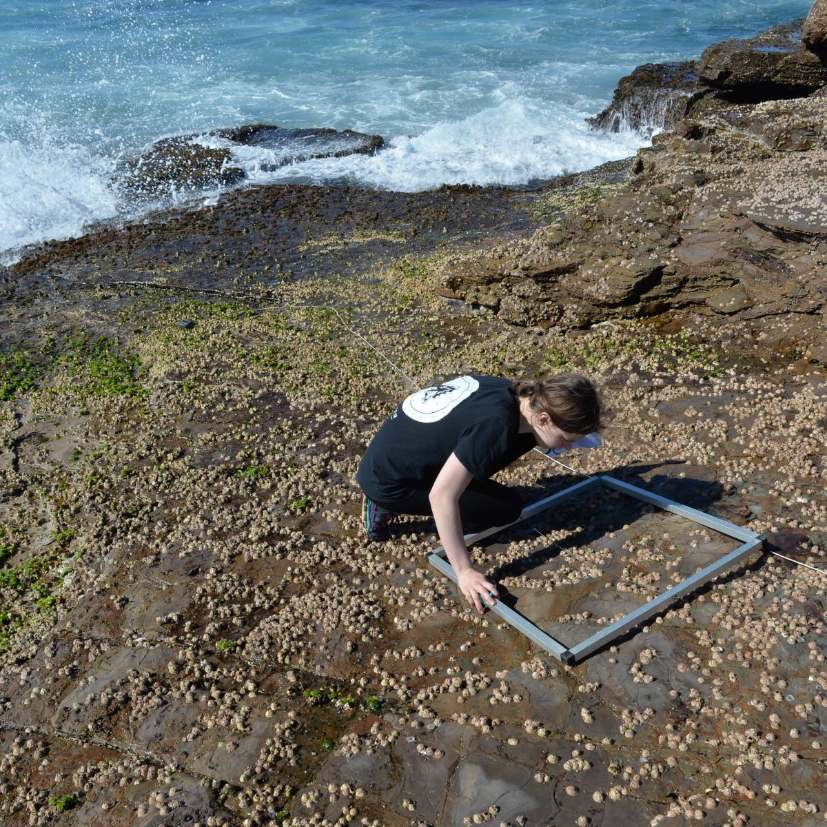
Instead,
we estimate the population size,
by taking
samples
Notes:
Image: https://www.auseco.com.au/index.asp?pagename=Independent+Research+Project

Slide 4
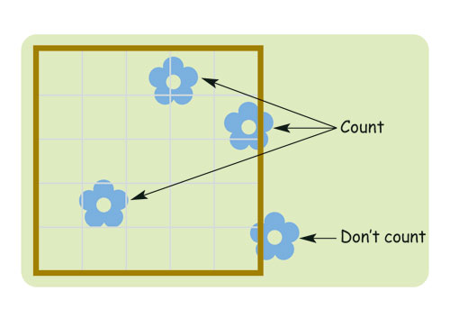
Estimating Population Size
using Quadrat samples

Slide 5
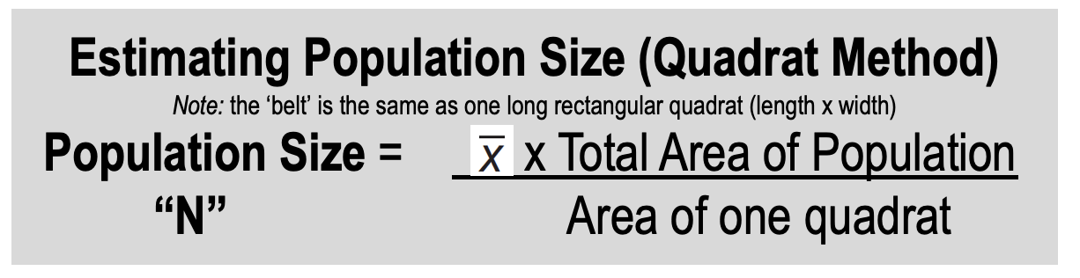
sample mean (average)

Slide 6

The population we will estimate is made of sea stars!

Slide 7
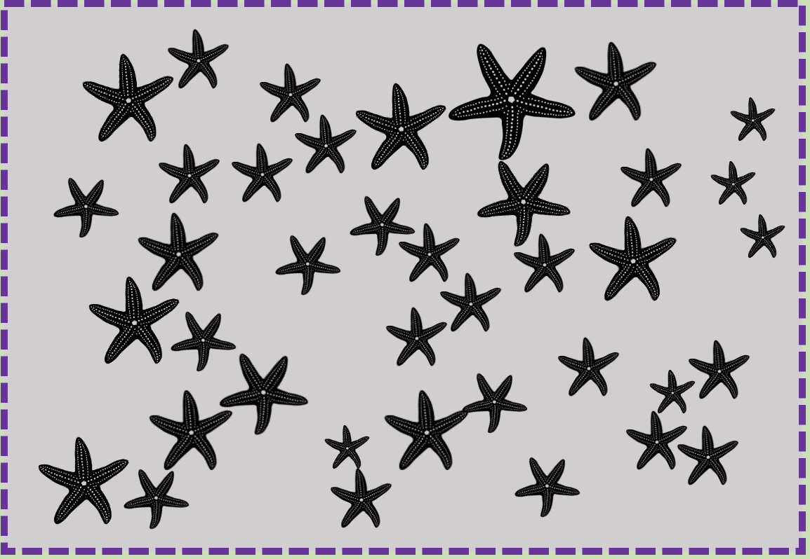
2.5m
2.5 x 2.5 =
6.25m²
The total area of the population is 6.25m²
2.5m

Slide 8
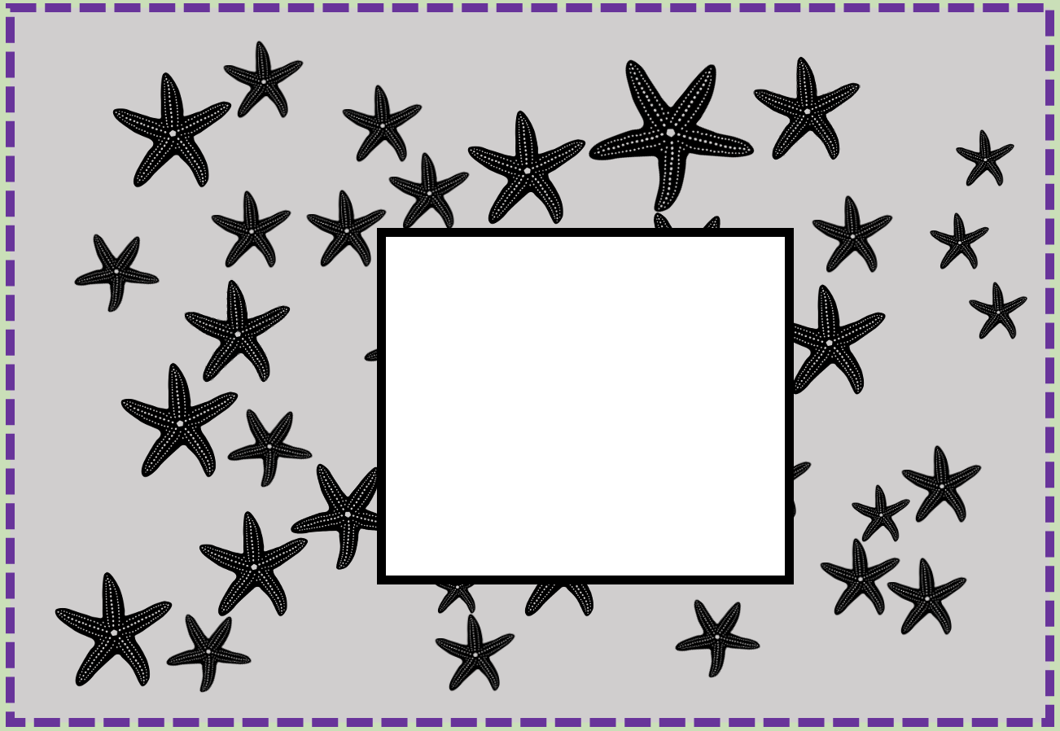
The area of one quadrat is 1m²
1m
1m
1m²

Slide 9
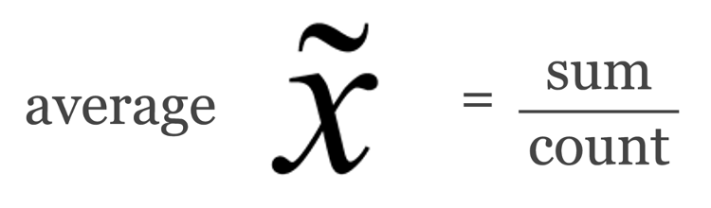
x
6.25m²
1m²
All we need now is the sample mean (average)

Slide 10
Your turn to count!
Sample size:
Do not count sea stars touching the edges of the quadrat.
?

Slide 11
2
1
3
Sample size:
5
4
6
6

Slide 12
One sample (quadrat) is not enough
Let’s go again!
Note: quadrats are being placed at random

Slide 13
Count again!
Sample size:
?

Slide 14
1
2
Sample size:
3
4
5
7
6
7

Slide 15
You should always have a minimum of
3 samples
(even more is better)
So let’s keep going…

Slide 16
Count again!
Sample size:
?

Slide 17
Sample size:
5
1
2
4
3
5

Slide 18
6
7
5
?

Slide 19
Calculate the sample mean (average)

Slide 20
manually
6
+
7
+
5
6
=
3

Slide 21
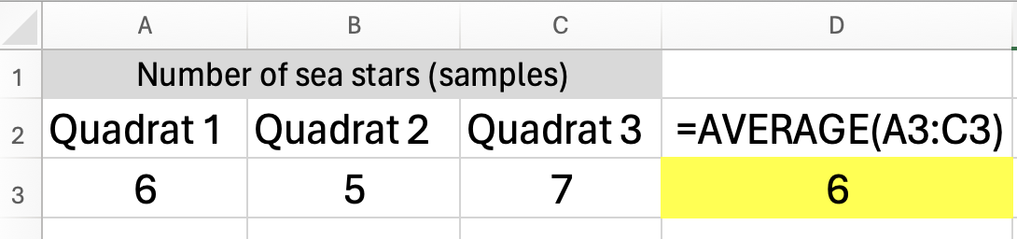
on Excel
= AVERAGE ( : )

Slide 22
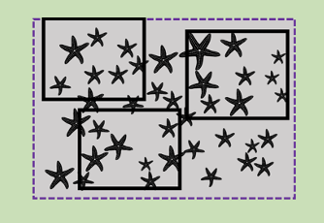
Thus, the sample mean is 6 sea stars
=
6

Slide 23
Population size?
(N=?)
?

Slide 25
6
x
6.25m²
1m²
38

Slide 26
How close was our estimate?
38

Slide 27
5
6
1
3
4
2
7
9
14
8
Spot on!
13
15
11
12
10
20
17
22
23
19
18
21
38
16
36
24
25
26
28
37
27
33
30
32
38
29
31
35
34

Slide 28
Population
Distribution (dispersion)
Patterns

Slide 29
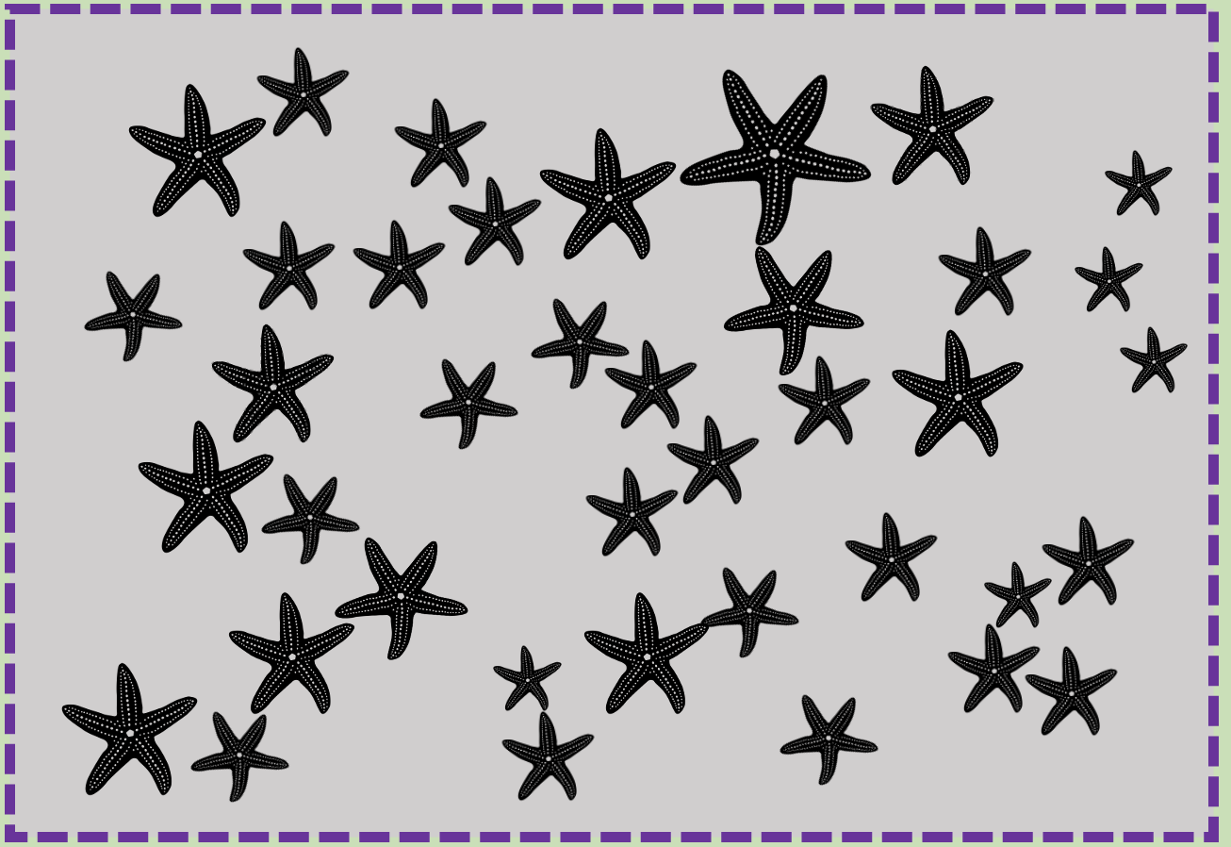
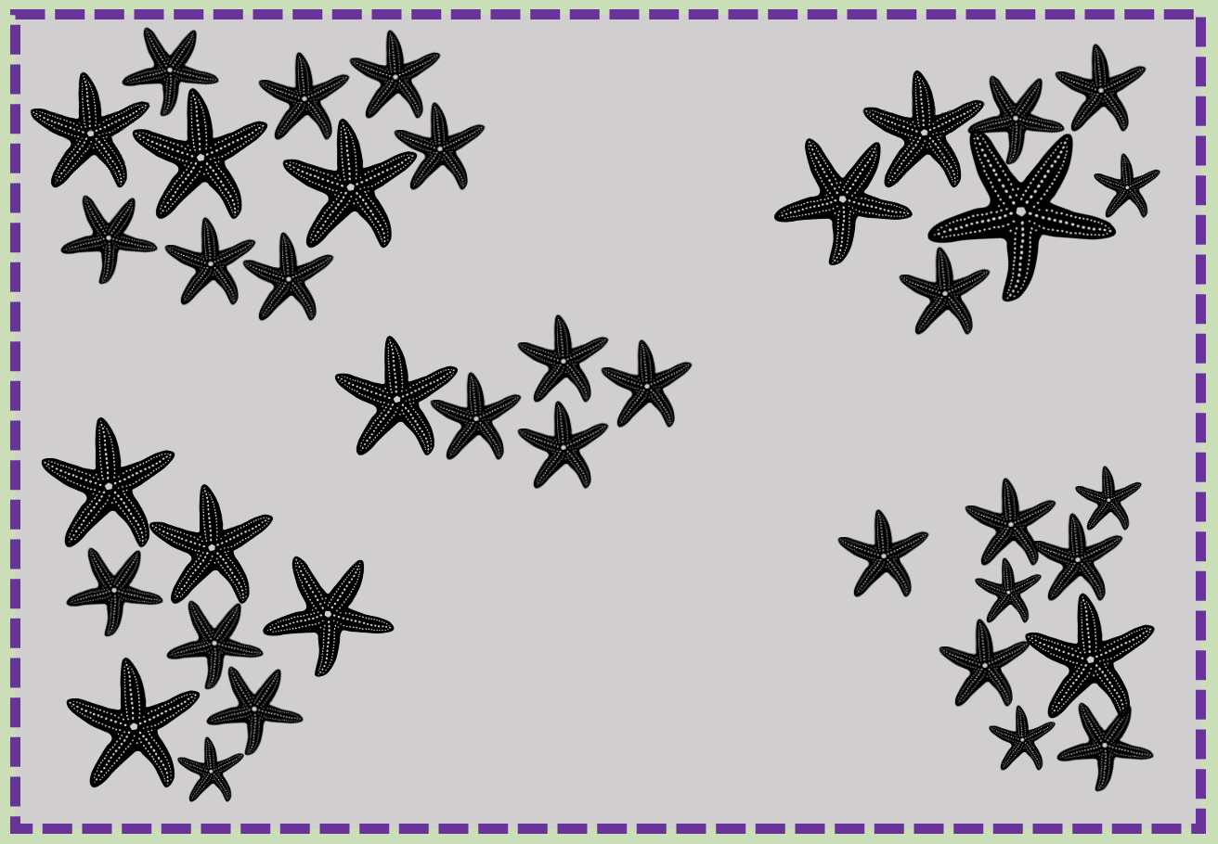
vs
What if they weren’t so evenly spread apart?
Would your estimate of the total population size (N=38) still be so accurate?

Slide 30
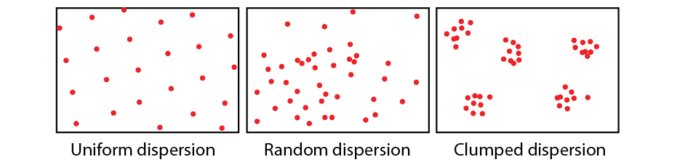
uniform
population distribution is
where
individuals position themselves within the population
(also called ‘dispersion’)
random
clumped

Slide 31
When a population is clumped,
it’s very easy to overestimate or underestimate
its total size
(depending on where the quadrats are placed).

Slide 32
28
For example:
Consider this…..
what if we placed down
3 quadrats again and counted how many sea stars were in each…
0
1

Slide 33
28
0
…and the sample mean was 10
=
10
1

Slide 34
10
x
6.25m²
1m²
63

Slide 35
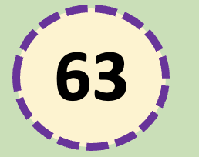
is a gross overestimate
(we know it’s 38)

Slide 36
0
Consider this…..
what if we placed down
3 quadrats again, but this time in different spots
0
9

Slide 37
28
0
…and the sample mean was
3
=
3
1

Slide 38
3
x
6.25m²
1m²
19

Slide 39
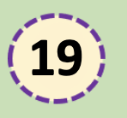
is a gross underestimate
(we know it’s 38)

Slide 40
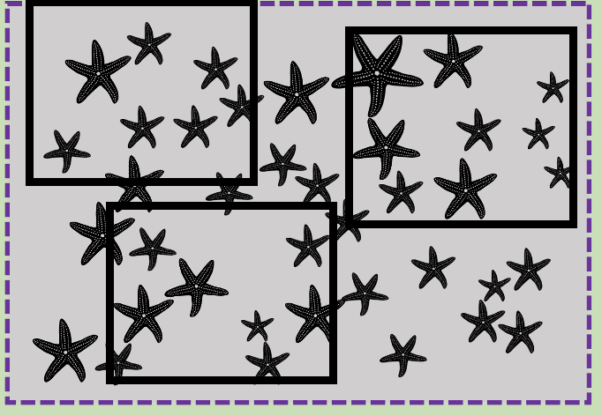
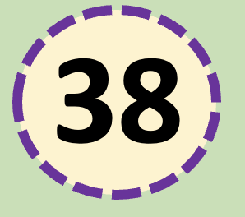
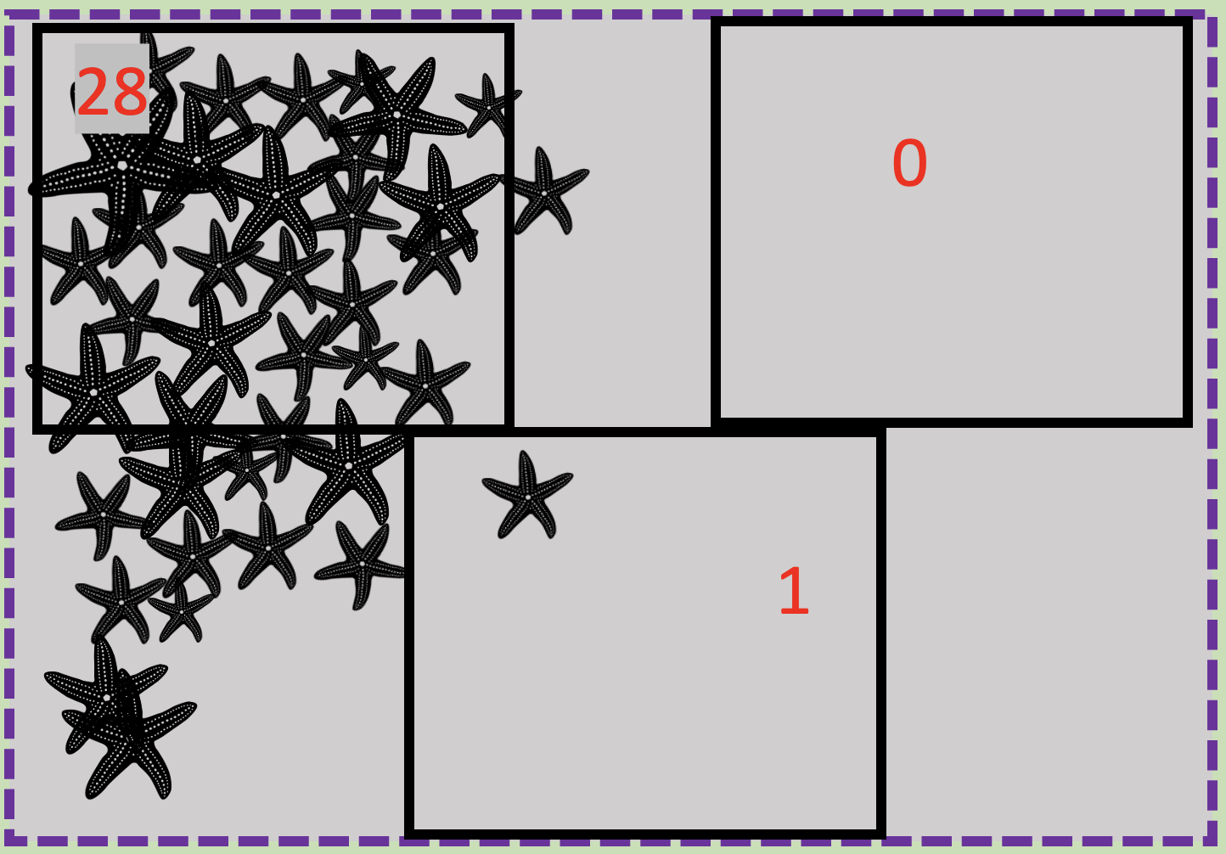
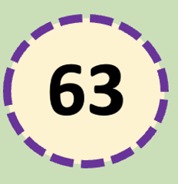
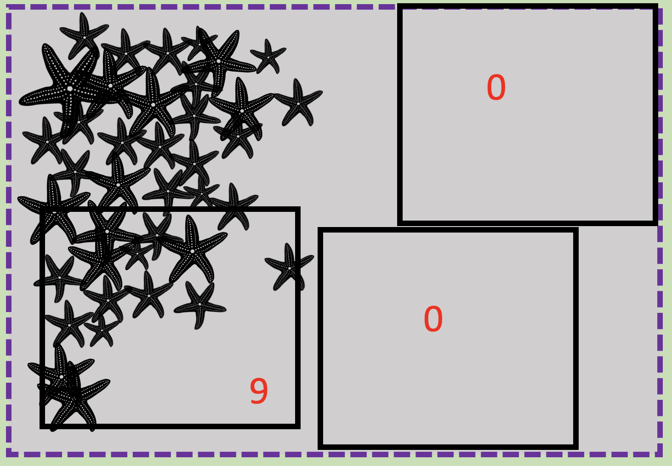
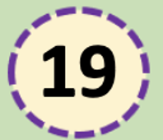
You can tell how accurate your estimate is going to be (or not be) by looking at the range of your quadrat counts.
Range = maximum value – minimum value
6, 7, 5
Range=2
Low range.
Low margin of error (accurate)
28, 0, 1
VERY large range. VERY Large margin of error (inaccurate)
Range=27
9, 0, 0
Range=9
Large range.
Large margin of error (inaccurate)

Slide 41
You can tell how accurate your estimate is going to be (or not be) by looking at the range of your quadrat counts.
Range = maximum value – minimum value
6, 7, 5
Range=2
Small
error bar
28, 0, 1
Range=27
VERY Large error bar
9, 0, 0
Range=9
Large
error bar

Slide 42
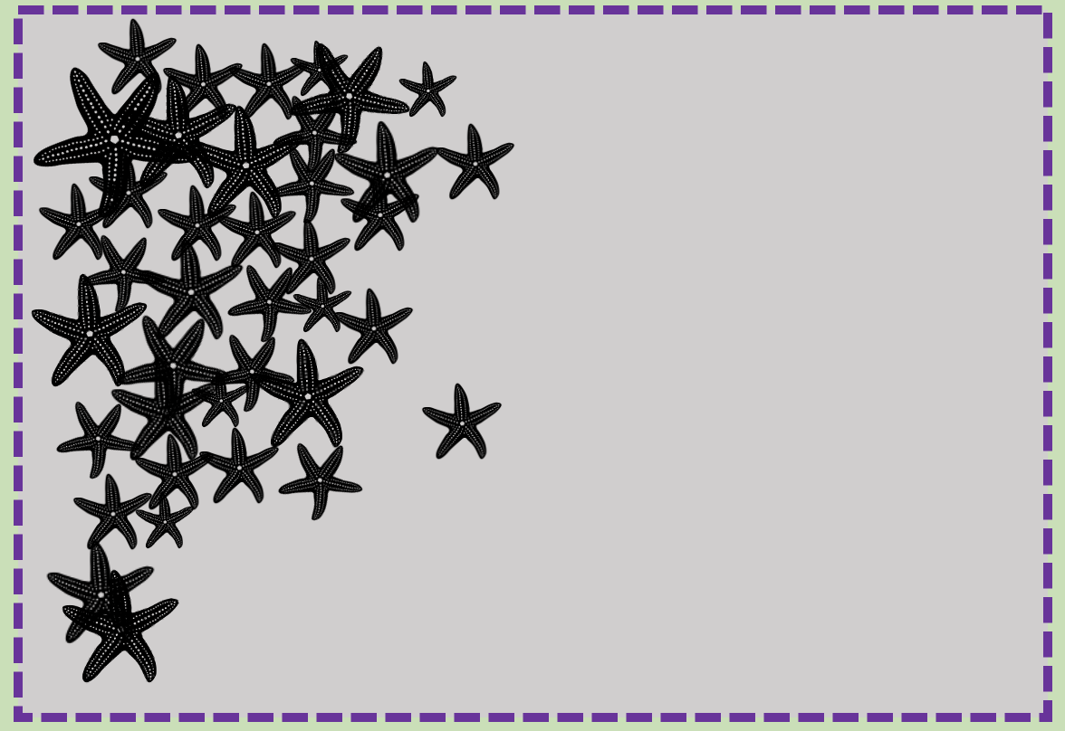

Limitations when estimating
total population size (N) using quadrats
When individuals in a population are CLUMPED
When they can move in and out of the quadrat before counting is finished

Slide 43
Estimating Population Density

Slide 44
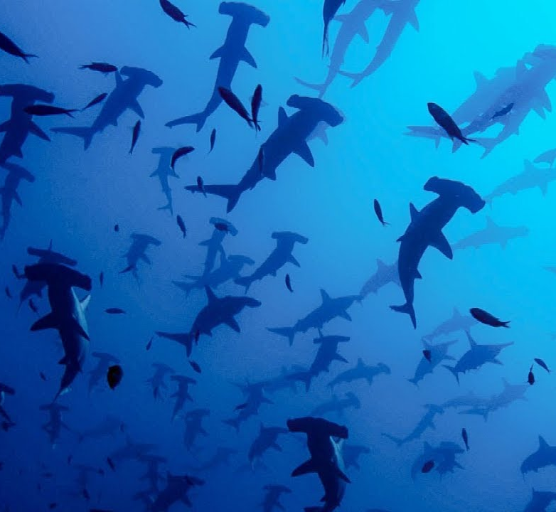
population density is simply
population size
per unit of area
E.g. 50 species/km²
add area
Scalloped Hammerhead Sharks, Galapagos Islands.
Notes:
Image; https://www.google.com/url?sa=i&url=https%3A%2F%2Fm.youtube.com%2Fwatch%3Fv%3DKsWuJtQpgsw&psig=AOvVaw2-S_qMth1NF26q-BpnrlQr&ust=1710075317357000&source=images&cd=vfe&opi=89978449&ved=0CBMQjhxqFwoTCMjqk5Gd54QDFQAAAAAdAAAAABAD

Slide 45
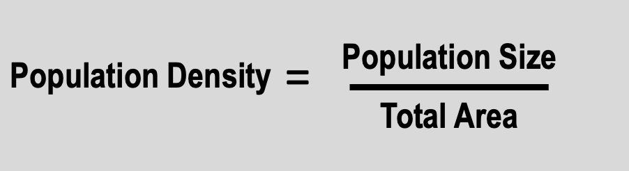

Slide 46
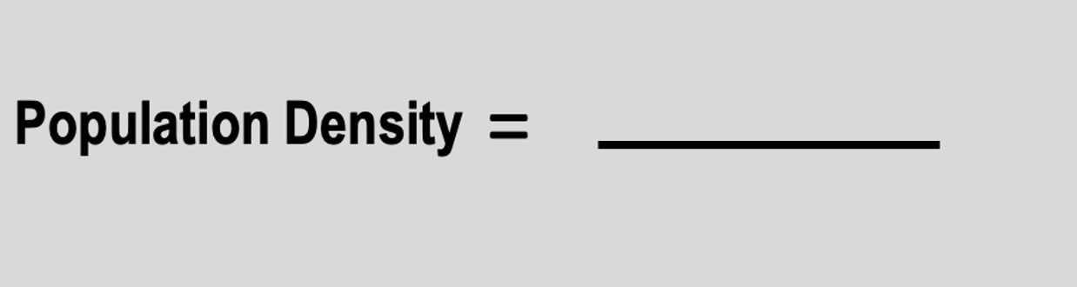
38
6.25m²

Slide 47
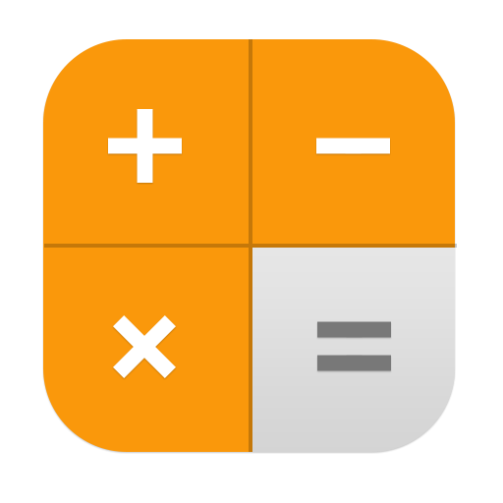
This is a divide by sign!
38
6.25m²

Slide 48
This is a divide by sign!
38
6.25m²
= 6/m²

Slide 49
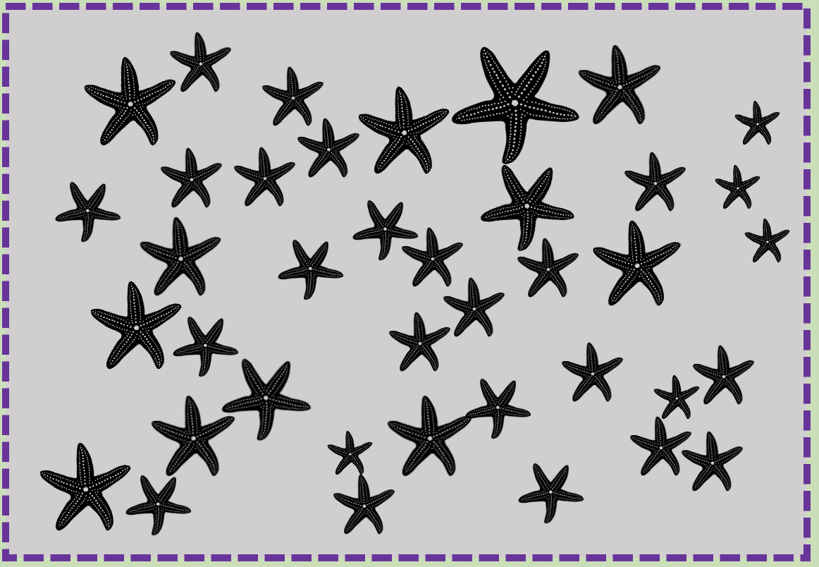
population density:
6/m²
6/m²

Slide 50
Carrying Capacity (K)
the maximum population size that a given area can sustain

Slide 51
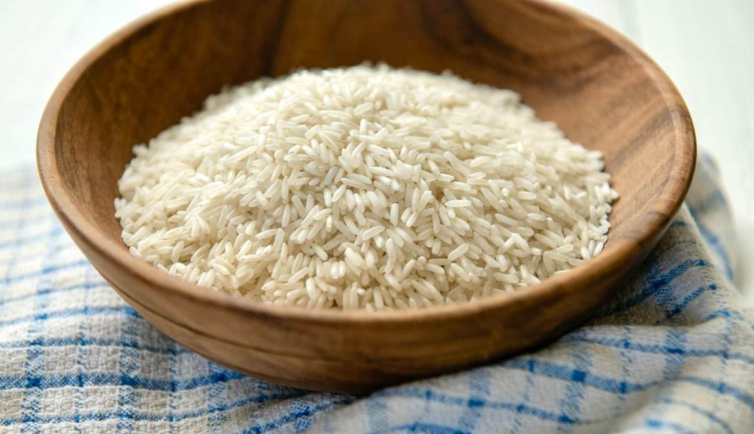
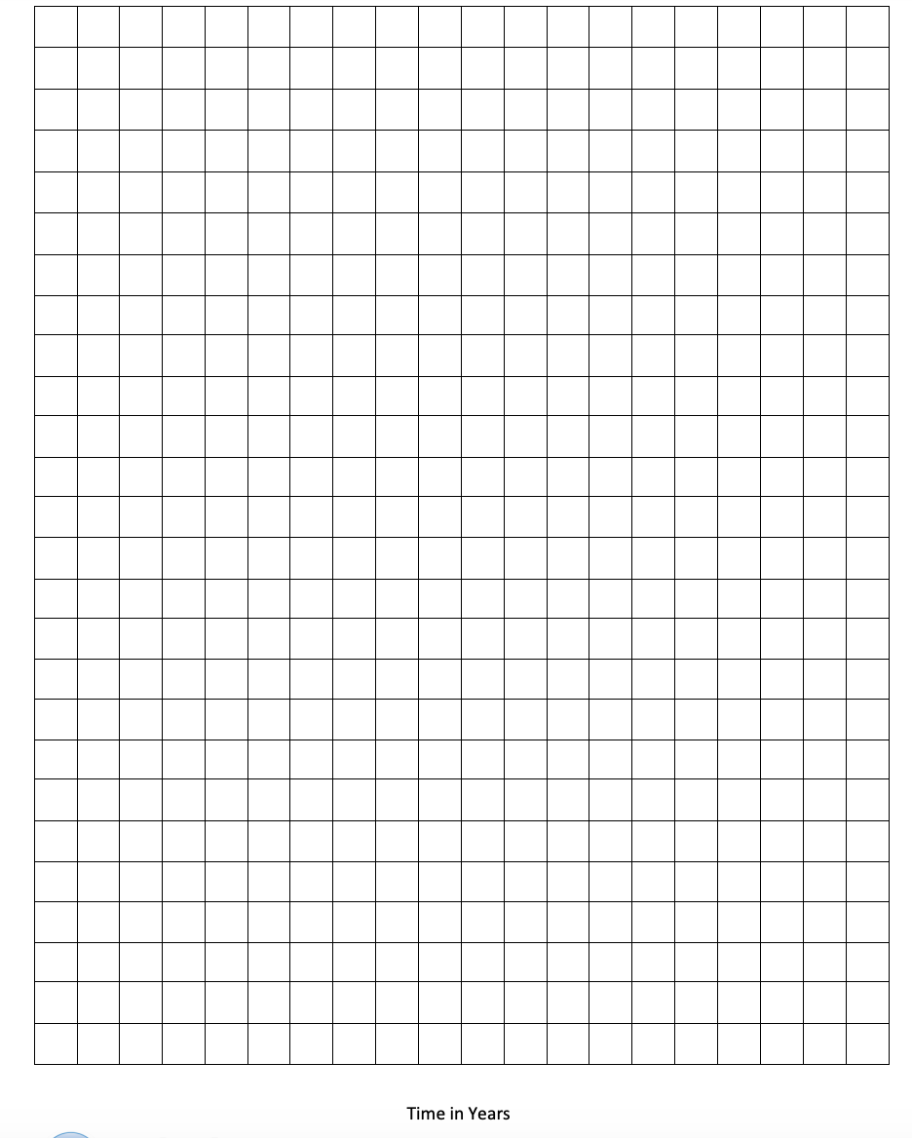
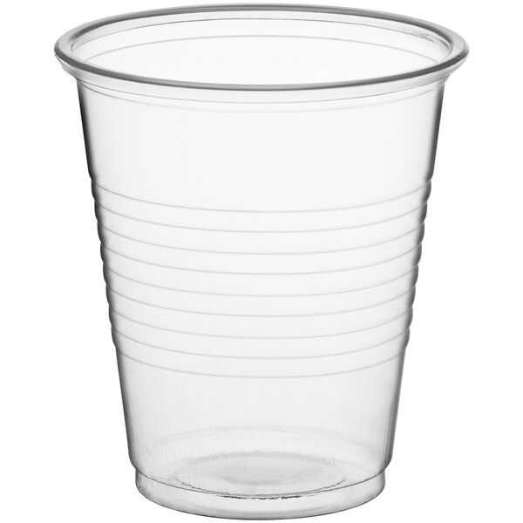
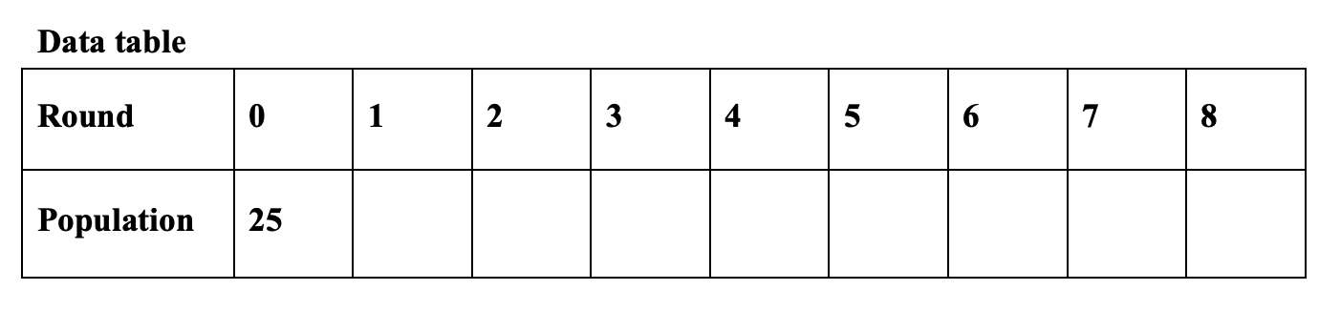
Activity: Estimate carrying capacity
What you need…
25 grains of rice
Grid Paper
25
Cup
Population size
Time (years)
Notes:
Source: https://entnemdept.ufl.edu/hodges/ProtectUs/lp_webfolder/7th_grade/Student_Handout_2_for_7_grade.pdf

Slide 52
Instructions:
Count out 25 pieces of rice (which represent fish in a population) and place them in the cup.
Randomly dump the “fish” onto the grid from a height of about a ruler length (30cm).
If five or more fish occupy a square, remove all of them from that square. This represents overpopulation of the environment (there were not enough resources to support them all) and that means that the fish have died.
If 2, 3 or 4 fish occupy a square, add 1 piece of rice to that square for each one there (for example, if there are 2 fish in a square, add two more rice, if there are three, add three more, if there are four, add four more). This represents reproduction. The overpopulation and death rule doesn’t apply to these yet (they are babies and won’t eat much or take up too much space).
If there is only one fish in a square, they survive to the next round but don’t reproduce because this fish can’t reproduce without a mate.
Now count the number of fish left on the grid and record the population for the next round in the data table.
Gather up all of the rice on the grid (the population number you recorded in step 6), place them into the empty cup, and start over with step 2.
Repeat the above process for eight rounds. Each of these rounds represents a year. Record the total population present at the end of each round.
On the graph paper provided, graph the results from your data table with Population of fish on the y-axis and Time on the x-axis (let each round represent one year).
Estimate the carrying capacity of your population and indicate it on your graph.
Notes:
Source: https://entnemdept.ufl.edu/hodges/ProtectUs/lp_webfolder/7th_grade/Student_Handout_2_for_7_grade.pdf

Slide 53
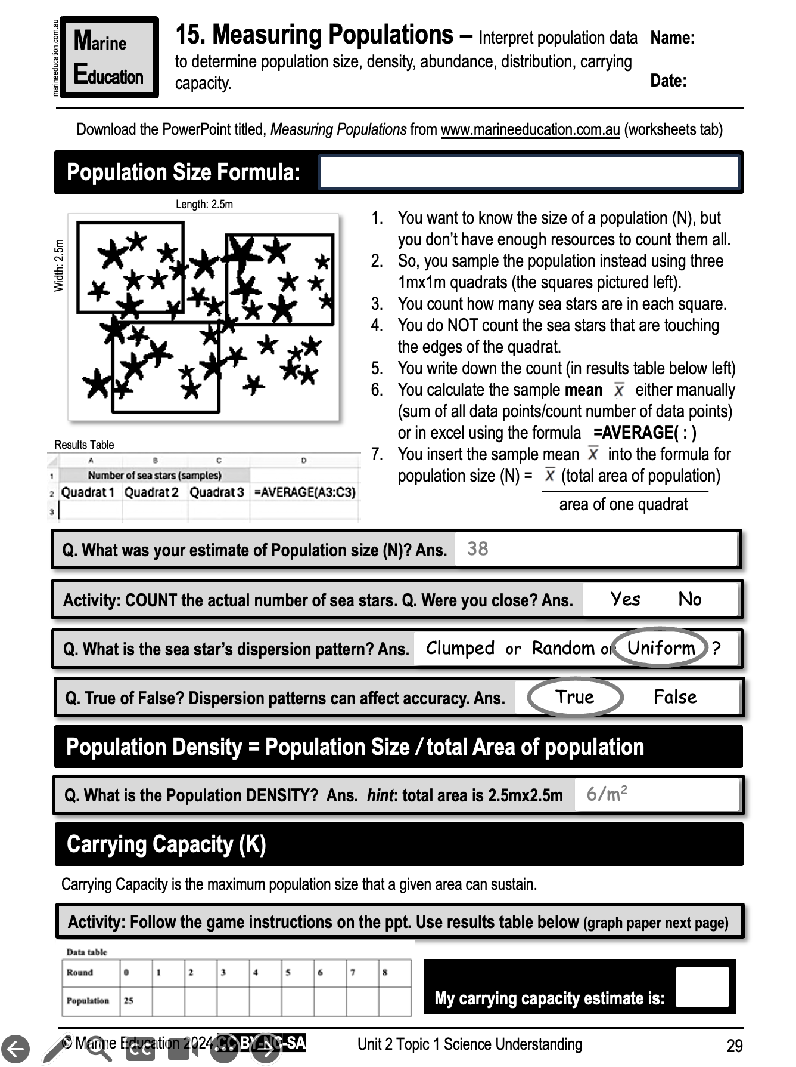
Learning Intention:
Interpret population data to determine population size, density, abundance, distribution, carrying capacity.
Success Criteria:
Complete Marine Education worksheet ‘15. Measuring Populations’

