Slide 1
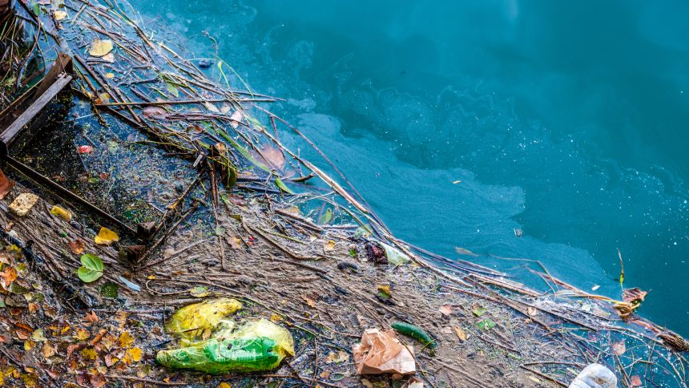
Learning Intention:
Compare point source and non-point source forms of pollution
Success Criteria:
Complete Marine Education worksheet ’15. Pin-pointing Pollution’
Notes:
Image:

Slide 2
The term point source means the source of the pollution has one specific discharge point (pipe, ditch..).
The term non-point source means the source of pollution comes from multiple points, spread out (runoff).

Slide 3
Is the source of pollution from a
point source
or
non-point source?

Slide 4
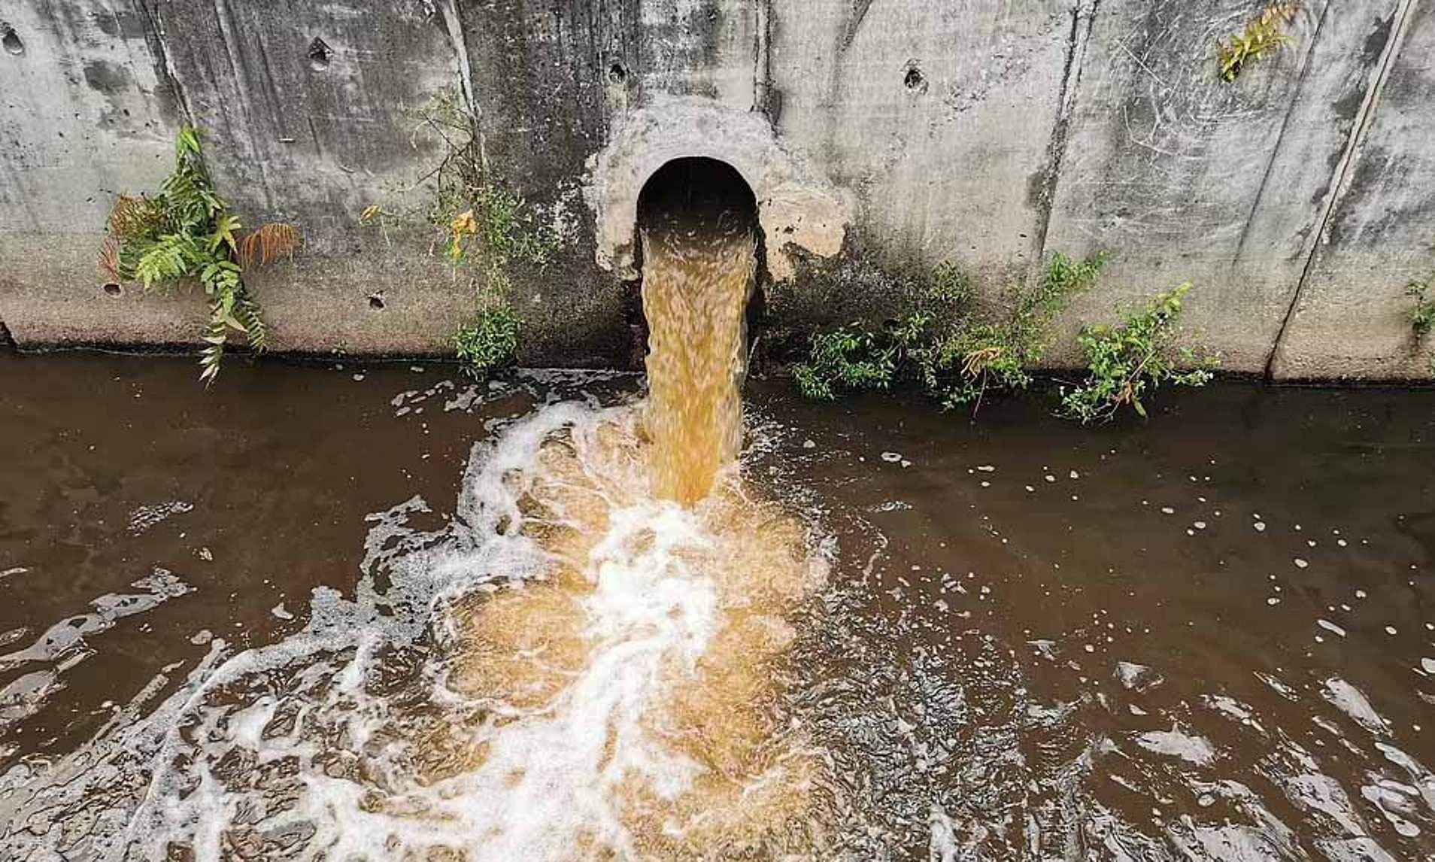

Slide 5
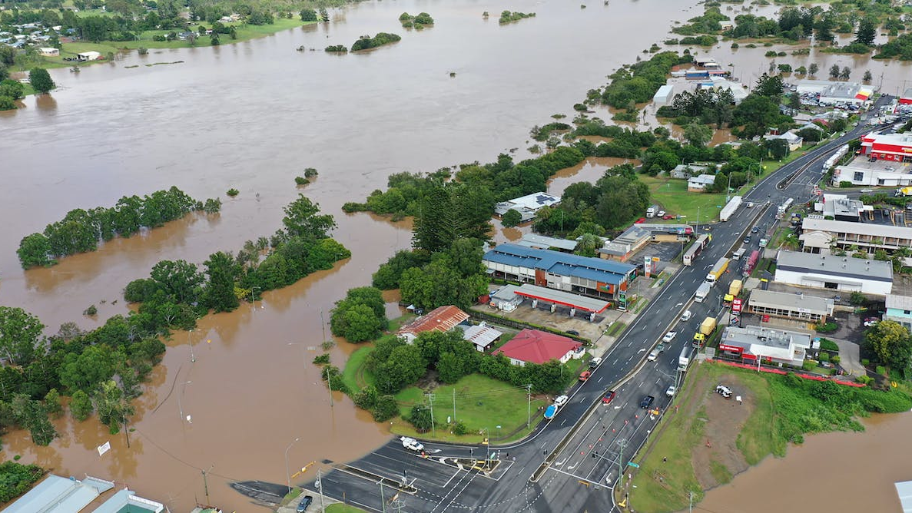
Notes:
Image: https://theconversation.com/like-rivers-in-the-sky-the-weather-system-bringing-floods-to-queensland-will-become-more-likely-under-climate-change-176711

Slide 6
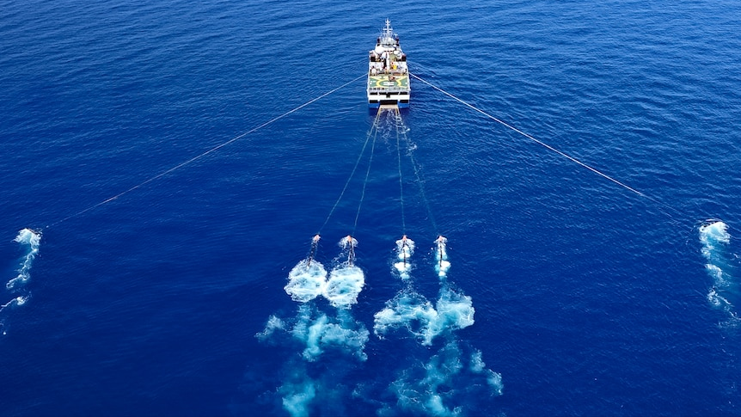

Slide 7
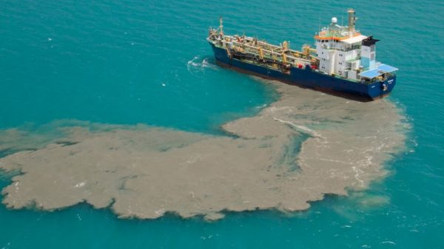
Notes:
Image: https://bvinews.com/stop-boats-from-pumping-human-waste-in-bays-lawmakers-told/

Slide 8
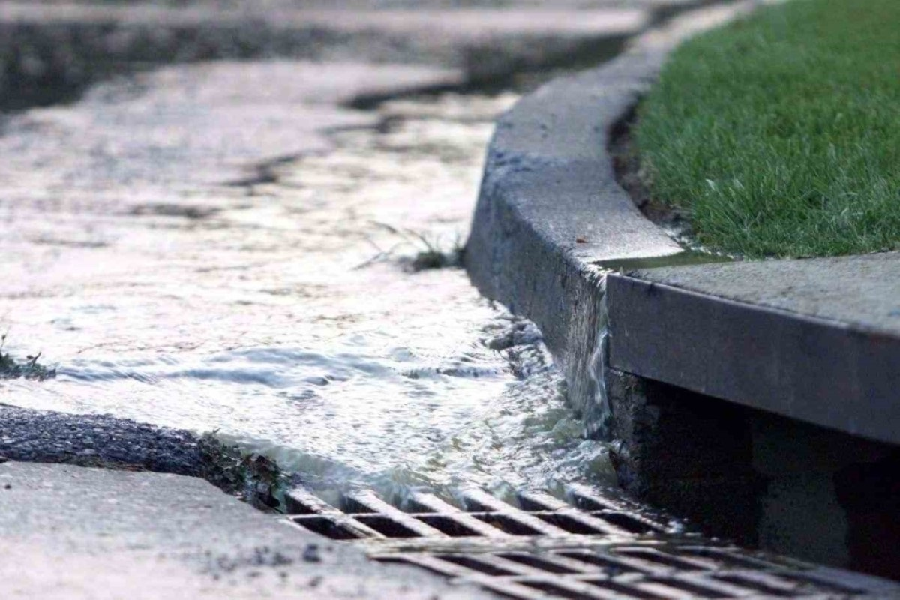
Notes:
Image: https://www.nillumbik.vic.gov.au/Residents/Roads-drains-and-paths/Drainage-and-stormwater

Slide 9
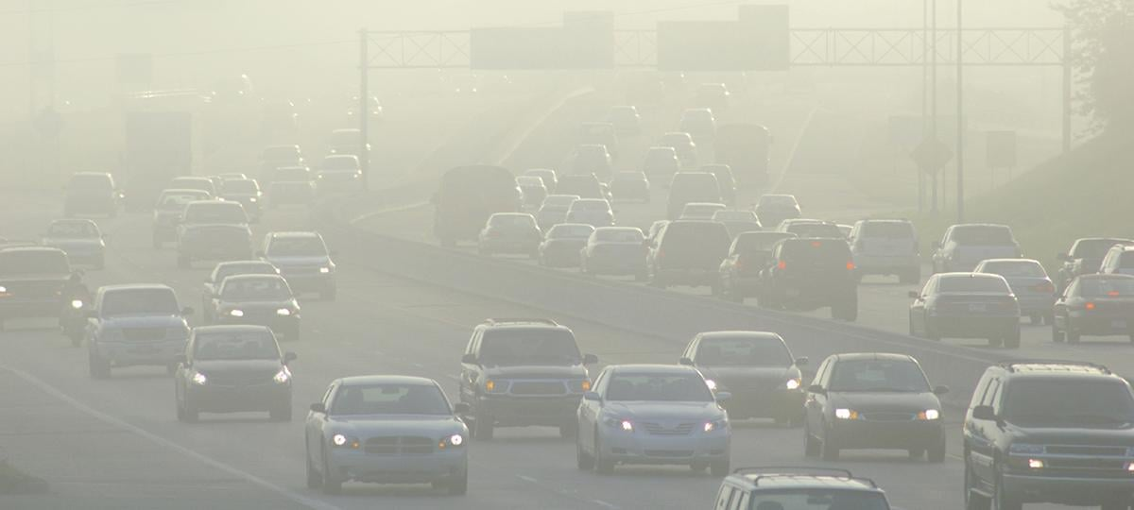
Notes:
Image: https://www.ucsusa.org/resources/vehicles-air-pollution-human-health

Slide 10
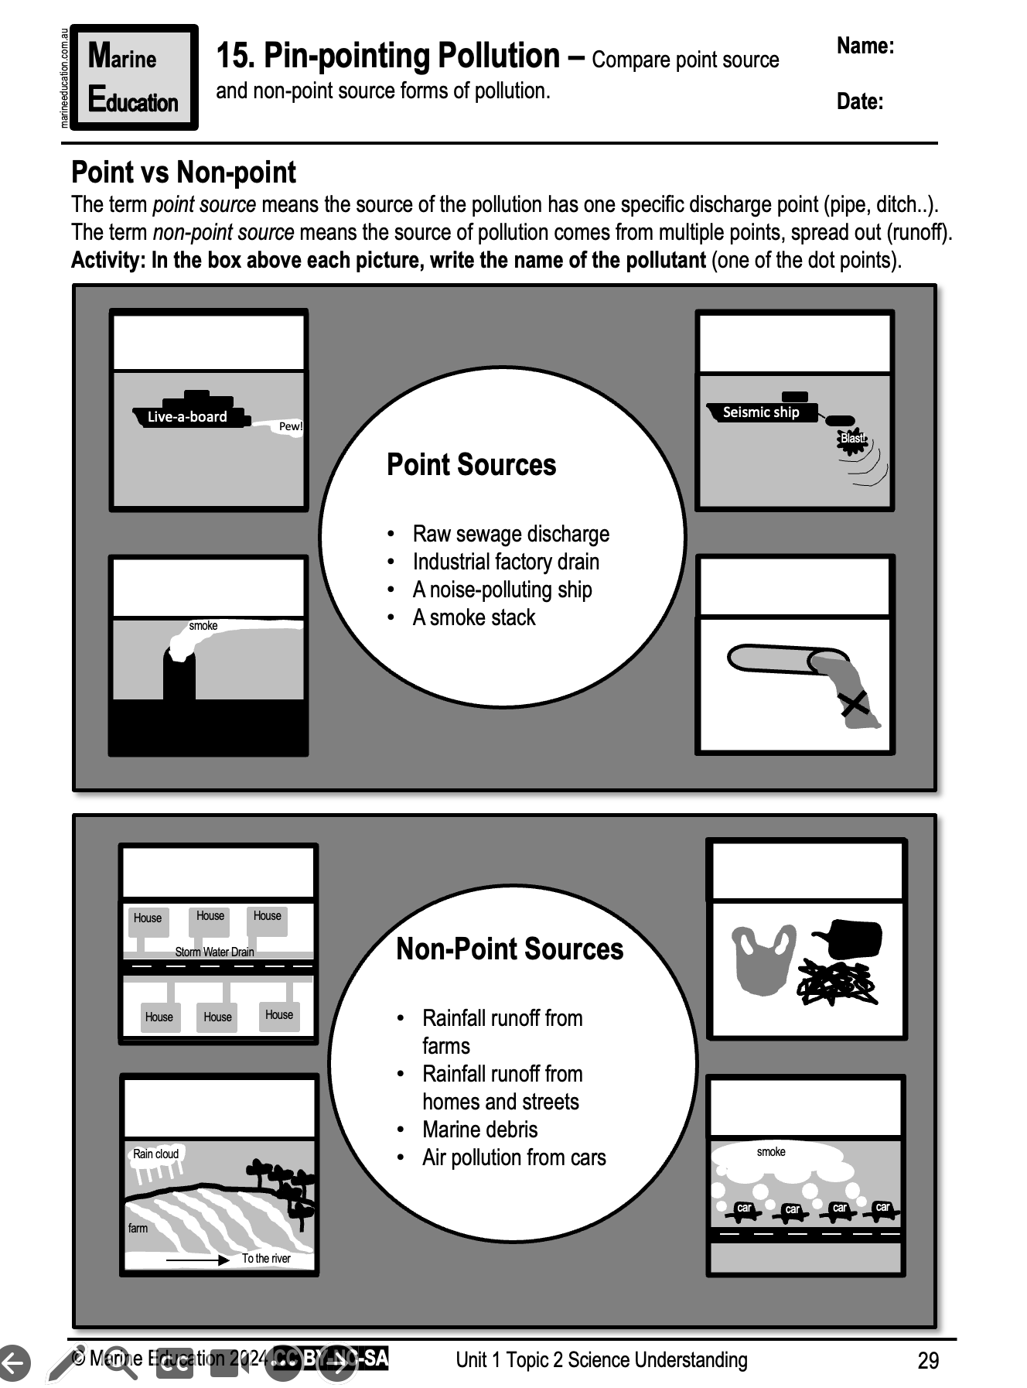
Learning Intention:
Compare point source and non-point source forms of pollution
Success Criteria:
Complete Marine Education worksheet ’15. Pin-pointing Pollution’
Notes:
Image:

