Slide 1

Learning Intention:
Calculate the rate of change of a population using 𝑅 = (𝐵 + 𝐼) − (𝐷 + 𝐸) where
R = the rate of change of a population,
B = birth rate
D = death rate
I = immigration and
E = emigration.
Success Criteria:
Complete Marine Education ‘16. BIDE model’
Notes:
Image: https://www.istockphoto.com/photos/dog-with-calculator

Slide 2
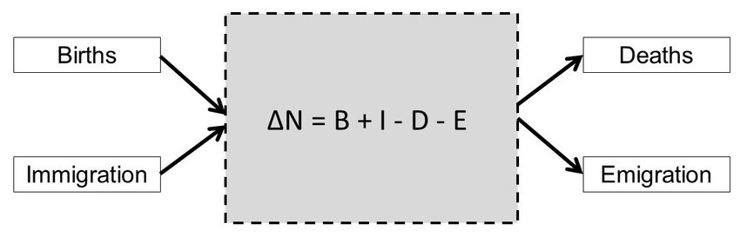
BIDE model
R
Notes:
Image: https://www.researchgate.net/publication/291973245_Estimation_of_Parameters_for_Animal_Populations_a_primer_for_the_rest_of_us
Estimation of Parameters for Animal Populations: a primer for the rest of us

Slide 3
Add individuals
Births
Immigration
Subtract Individuals
Death
Emigration
B
B
R = (𝐵 + 𝐼) − (𝐷 + 𝐸)
D
I
R
I
E
D
E

Slide 4
Add individuals
Births
Immigration
Subtract Individuals
Death
Emigration
Are you ready?
Calculate this!!!!
B
20
R=(20+2)-(20+2)
20
I
R= __
2
2
D
E

Slide 5
Add individuals
Births
Immigration
Subtract Individuals
Death
Emigration
B
ANSWER
20
R=(20+2)-(20+2)
20
I
R=0
2
2
D
True or False?
The population is NOT INCREASING OR DECREASING
E

Slide 6
Add individuals
Births
Immigration
Subtract Individuals
Death
Emigration
B
ANSWER
20
R=(20+2)-(20+2)
20
I
R=0
2
2
D
True or False?
The population is NOT INCREASING OR DECREASING
E

Slide 7
Add individuals
Births
Immigration
Subtract Individuals
Death
Emigration
Are you ready?
Calculate this!!!!
B
50
20
I
R= __
10
0
D
E

Slide 8
Add individuals
Births
Immigration
Subtract Individuals
Death
Emigration
B
ANSWER
50
R=(50+10)-(20+0)
20
I
R= 40
10
0
D
True or False?
The population is INCREASING
E

Slide 9
Add individuals
Births
Immigration
Subtract Individuals
Death
Emigration
B
ANSWER
50
R=(50+10)-(20+0)
20
I
R= 40
10
0
D
True or False?
The population is INCREASING
E

Slide 10
Add individuals
Births
Immigration
Subtract Individuals
Death
Emigration
Are you ready?
Calculate this!!!!
B
10
50
I
R= __
0
10
D
E

Slide 11
Add individuals
Births
Immigration
Subtract Individuals
Death
Emigration
B
ANSWER
10
R=(10+0)-(50+10)
50
I
R = -50
0
10
D
True or False?
The population is DECREASING
E

Slide 12
Add individuals
Births
Immigration
Subtract Individuals
Death
Emigration
B
ANSWER
10
R=(10+0)-(50+10)
50
I
R = -50
0
10
D
True or False?
The population is DECREASING
E

Slide 13
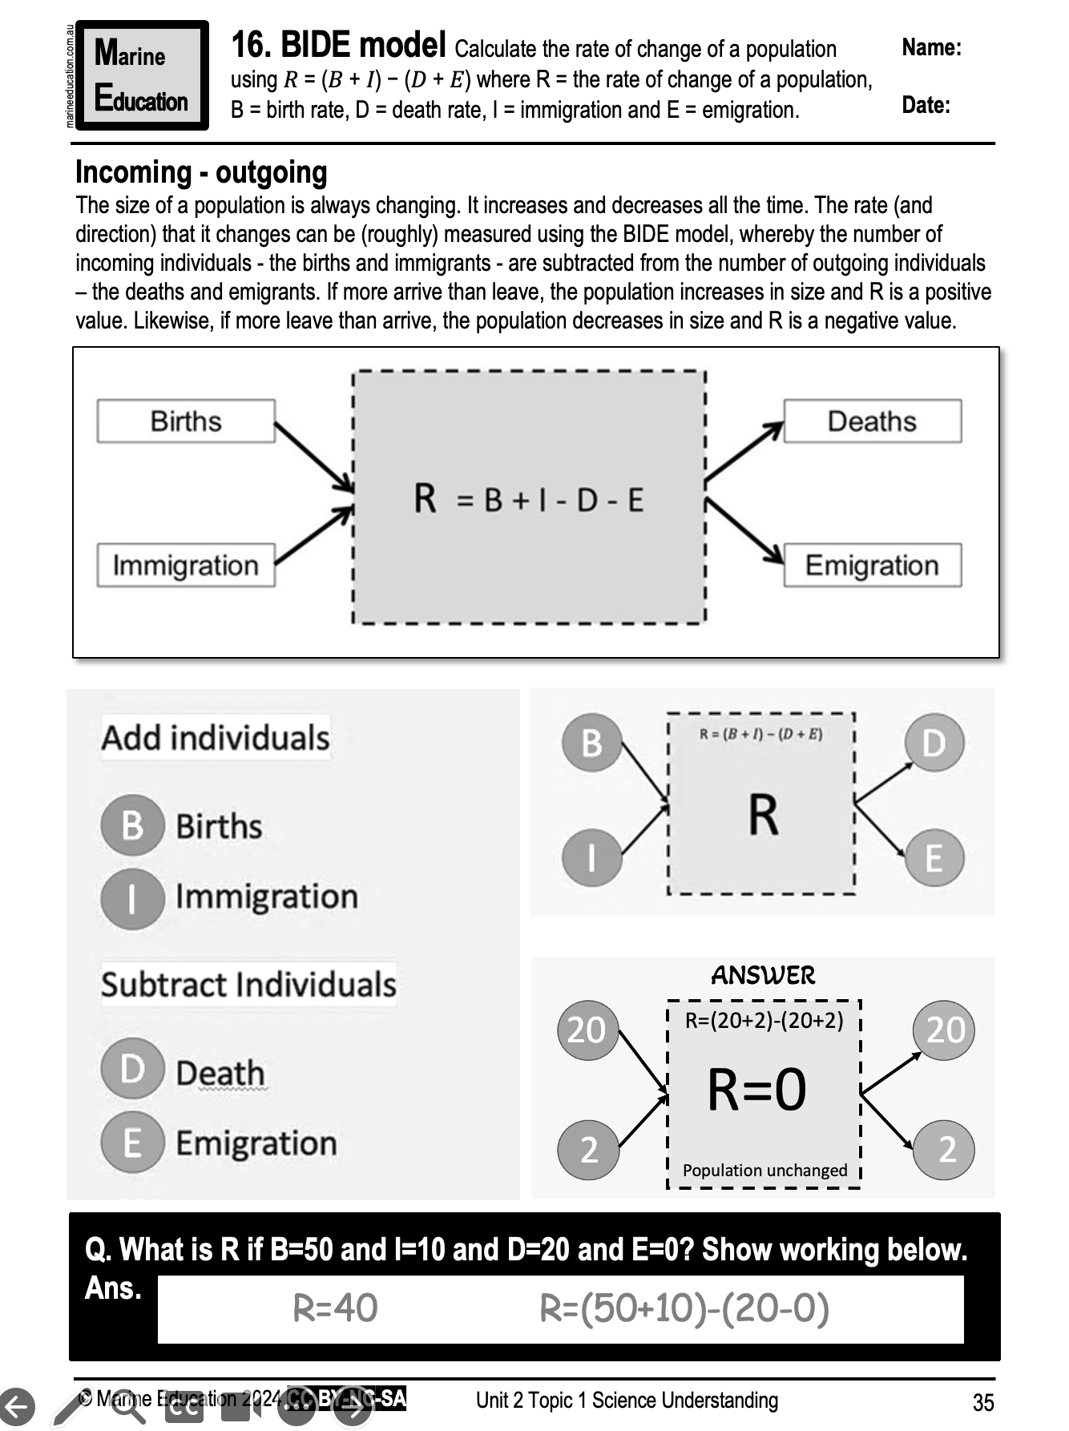
Learning Intention:
Calculate the rate of change of a population using 𝑅 = (𝐵 + 𝐼) − (𝐷 + 𝐸) where
R = the rate of change of a population,
B = birth rate
D = death rate
I = immigration and
E = emigration.
Success Criteria:
Complete Marine Education ‘16. BIDE model’
Notes:
Image: https://www.istockphoto.com/photos/dog-with-calculator

