Slide 1
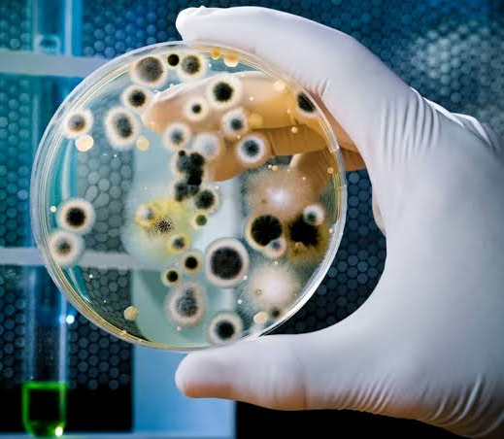
Learning Intention:
Describe two direct methods of monitoring water pollution levels using an abiotic test (e.g. nitrate, phosphate, heavy metals) or a biotic test (e.g. faecal coliform).
Success Criteria:
Complete Marine Education worksheet ’16. Testing the Waters’
Notes:
Image:

Slide 2
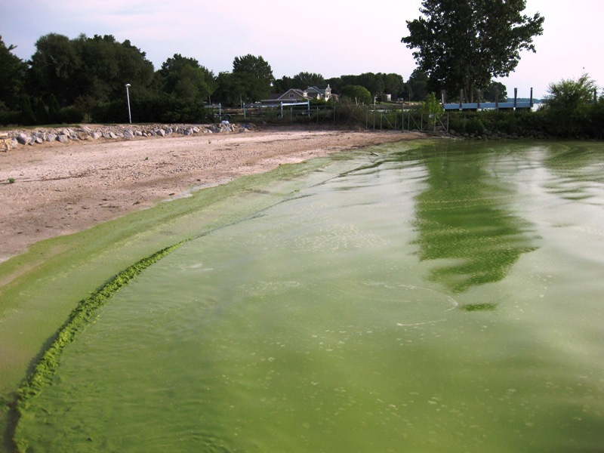
Testing for nitrates and phosphates
To avoid this!

Slide 3
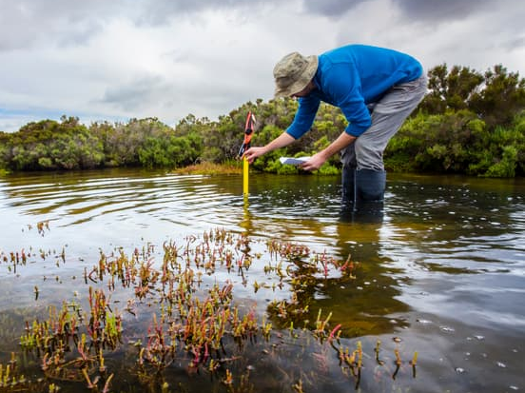
Method
(probe or test kit)

Slide 4

A huge proportion of the Nahua tribe in Peru have been affected by mercury poisoning, which causes anemia and acute kidney problems © Johan Wildhagen
Testing for heavy metals
To avoid this!
Notes:
Image: https://www.survivalinternational.org/news/11167

Slide 5
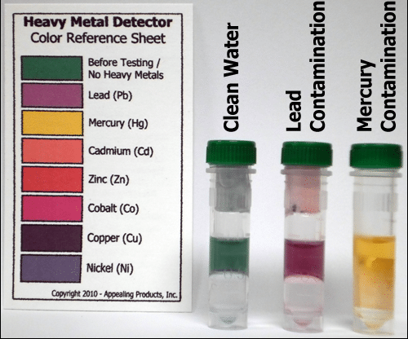
Method
(test kit)

Slide 6

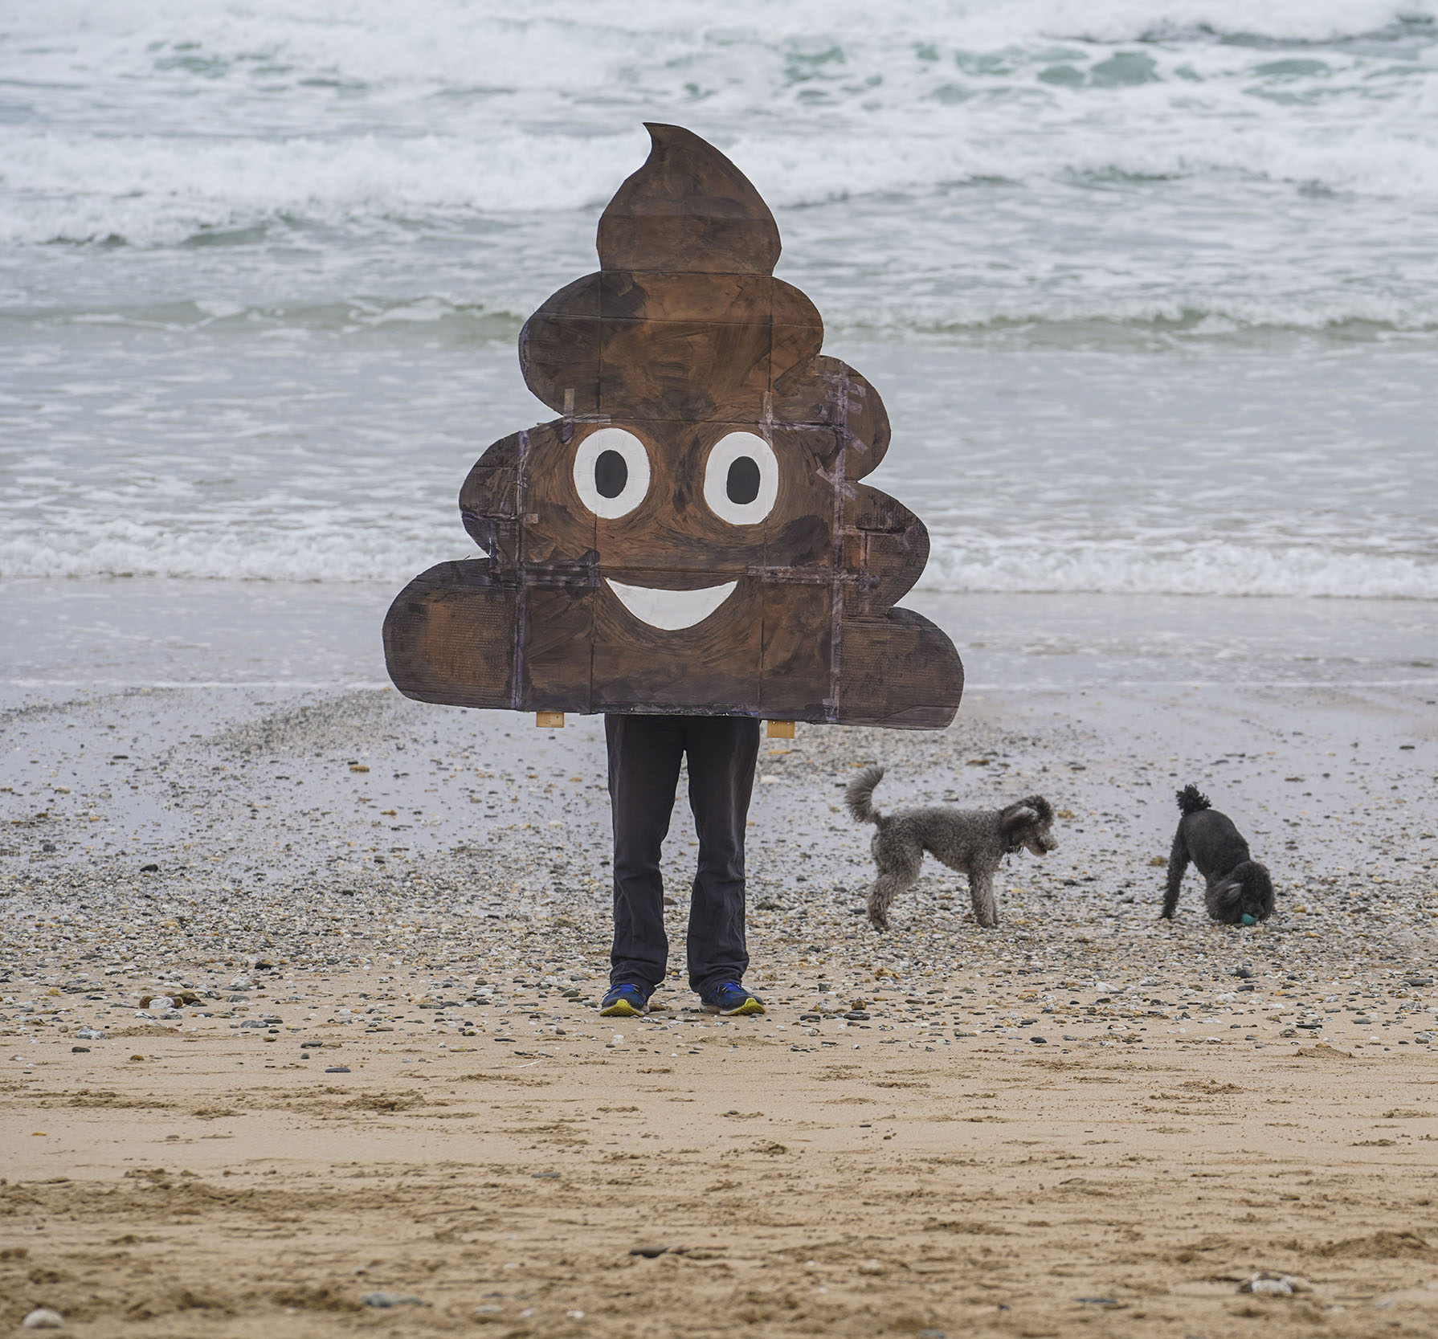
Testing for faecal coliforms
To avoid this!

Slide 7
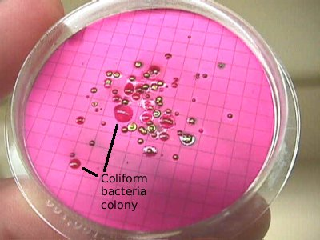
Method
(test kit)

Slide 8
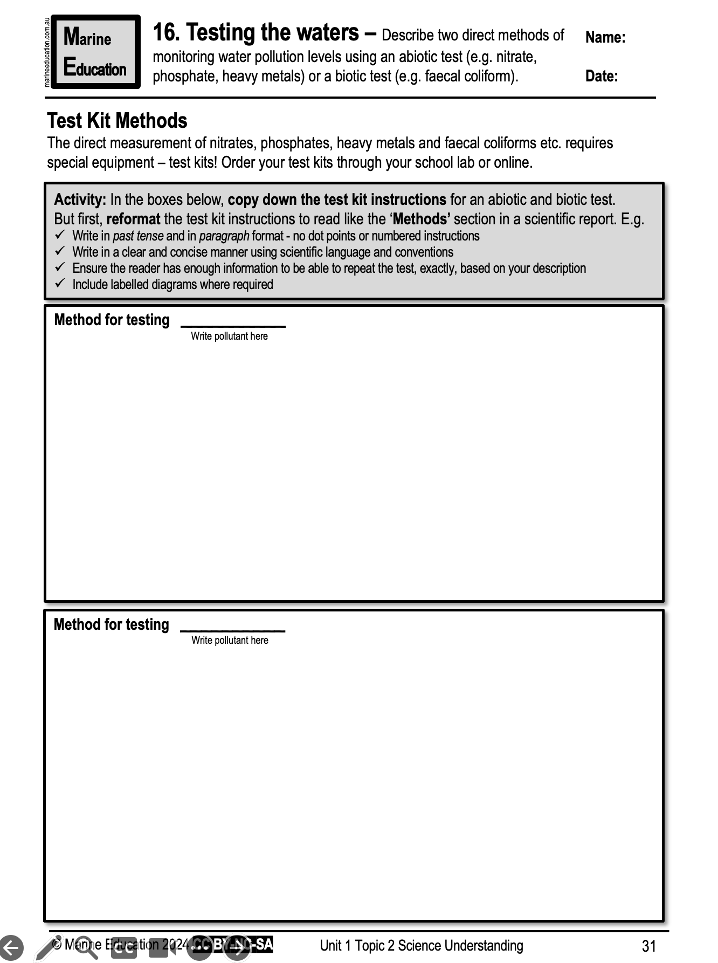
Learning Intention:
Describe two direct methods of monitoring water pollution levels using an abiotic test (e.g. nitrate, phosphate, heavy metals) or a biotic test (e.g. faecal coliform).
Success Criteria:
Complete Marine Education worksheet ’16. Testing the Waters’
Notes:
Image:

