Slide 1
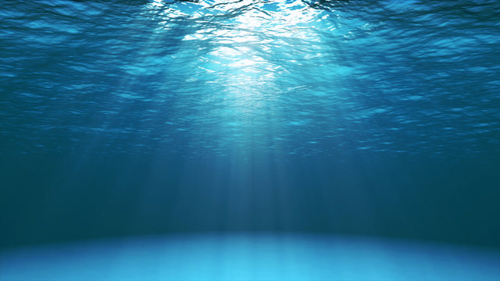
Learning Intention:
Describe abiotic components of marine ecosystems: light availability, depth, stratification, temperature, currents (water and wind), tides, sediment type and nutrient availability
Success Criteria:
Complete Marine Education worksheet
‘17. Abiotic Antics’

Slide 2
Light availability

Slide 3
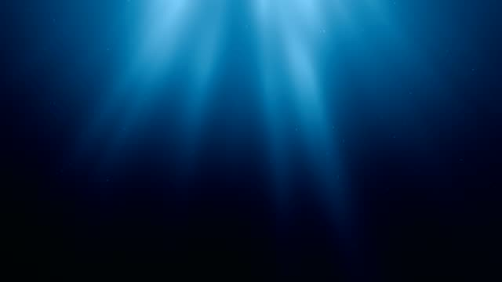
Light availability decreases with depth

Slide 4
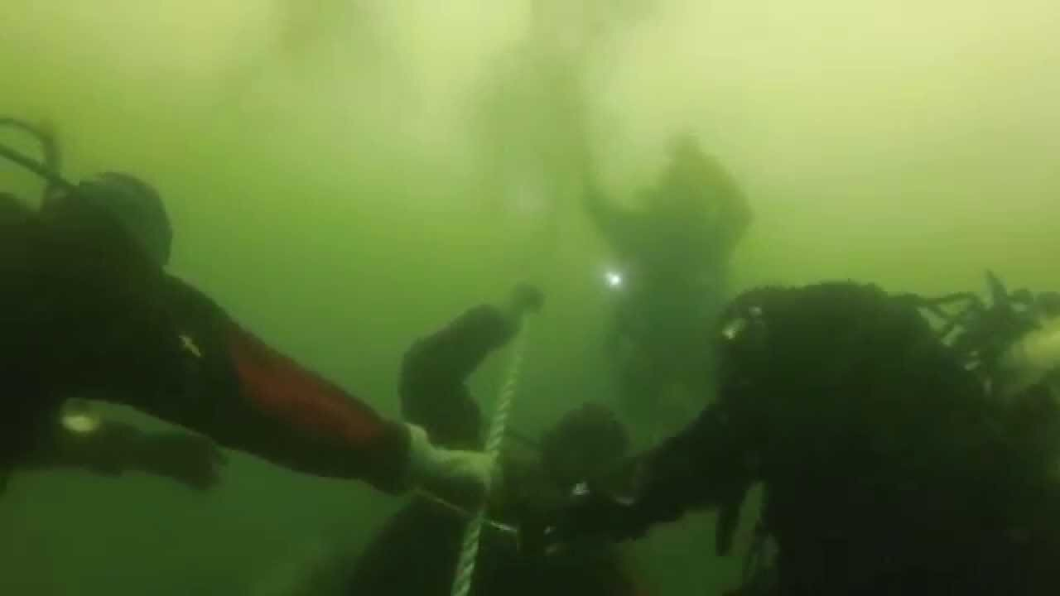
Light availability also decreases with increasing amounts of suspended particles in the water
Notes:
Image: https://www.rowandsreef.com/blog/2017/6/20/what-causes-bad-visibility-in-the-summer

Slide 5
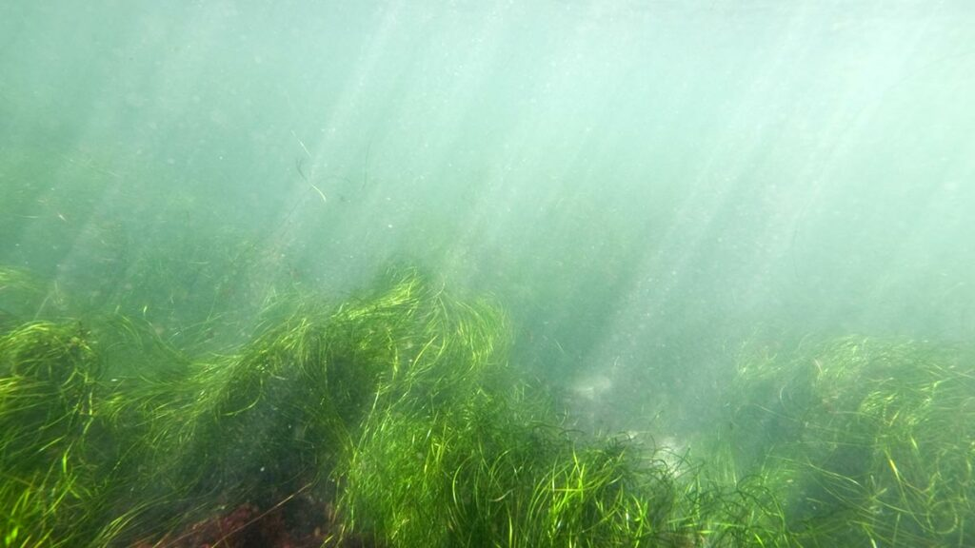
Organisms that need sunlight to grow includes seagrass…

Slide 6
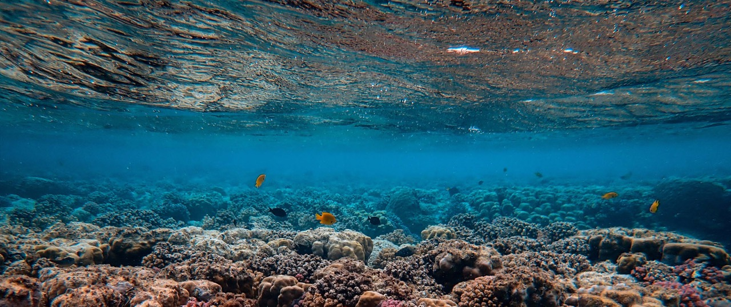
and zooxanthellae (algae) symbionts in coral.

Slide 7
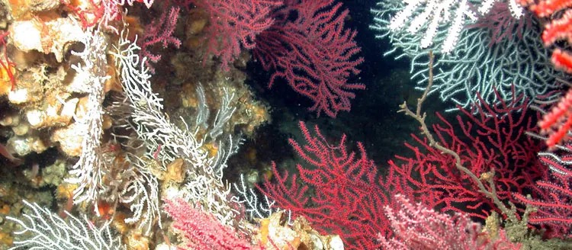
Organisms that do NOT need sunlight include deep sea corals (no zooxanthellae)...
Notes:
Image: https://ocean.si.edu/ecosystems/coral-reefs/deep-sea-corals

Slide 8
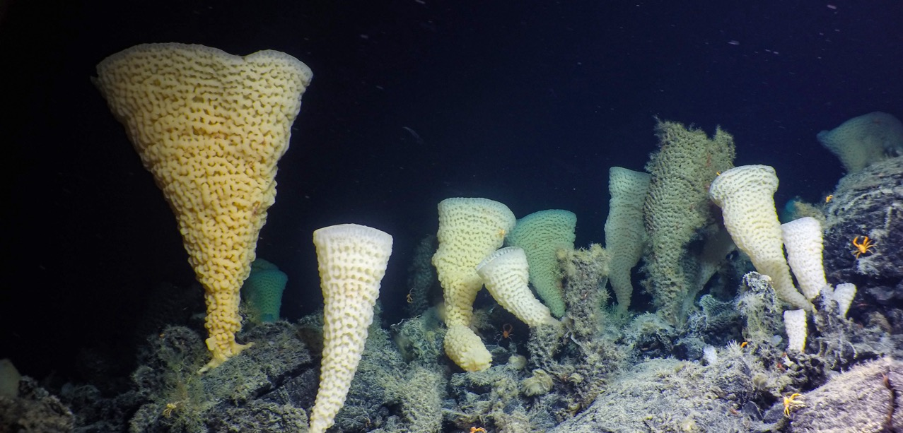
…and deep sea sponges.
Notes:
Image: https://hakaimagazine.com/news/british-columbias-seamounts-are-becoming-uninhabitable/

Slide 9
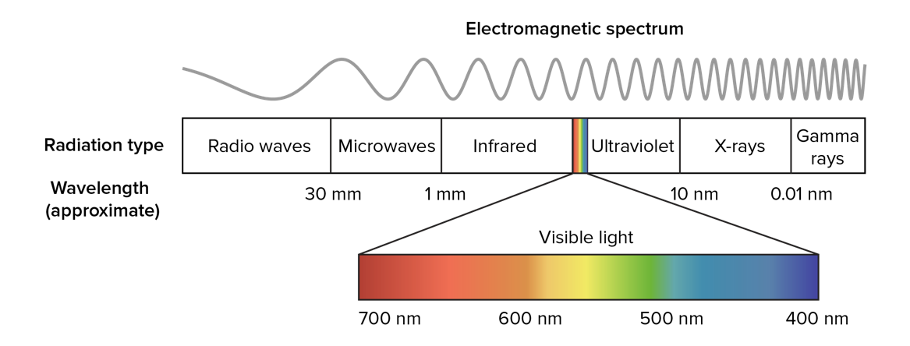
Your brain interprets visible light as a range of colours.

Slide 10
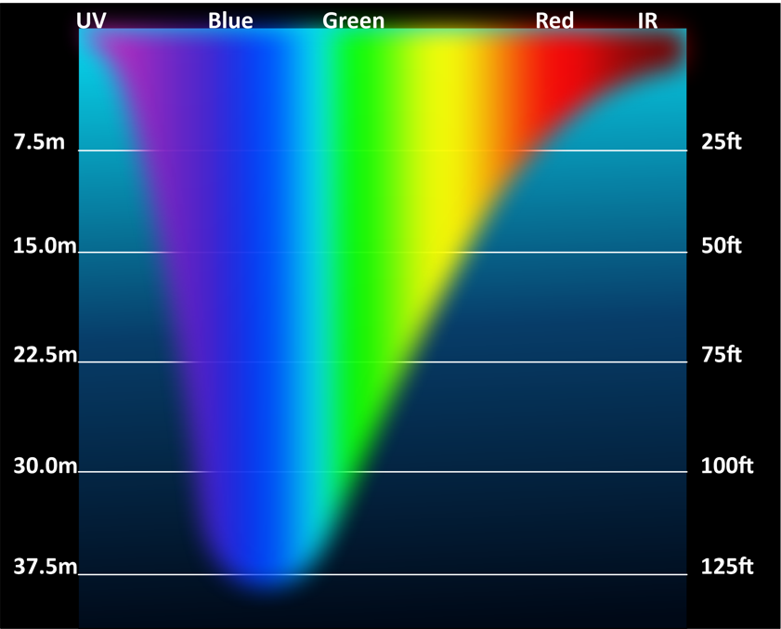
Different colours disappear (are absorbed) at different depths
Notes:
Image: https://pt.m.wikipedia.org/wiki/Ficheiro:Light_Penetration_Spectrum_in_Water_01.png

Slide 11
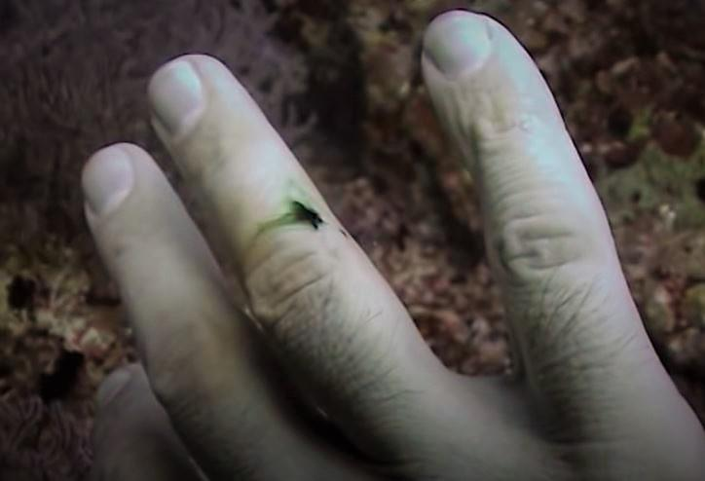
red blood looks green
below 8m

Slide 12
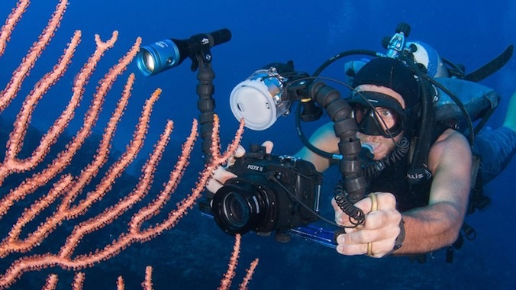
Artificial light (torches, strobes) are needed to capture colours

Slide 13
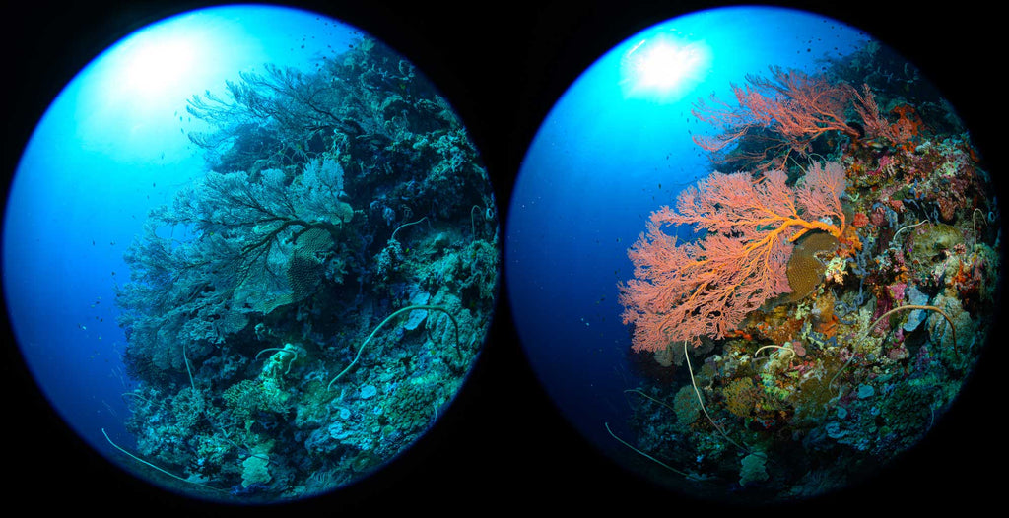
NO artificial light
Artificial light
Notes:
Image: https://www.ikelite.com/blogs/buying-guides/why-you-need-strobes-underwater

Slide 14
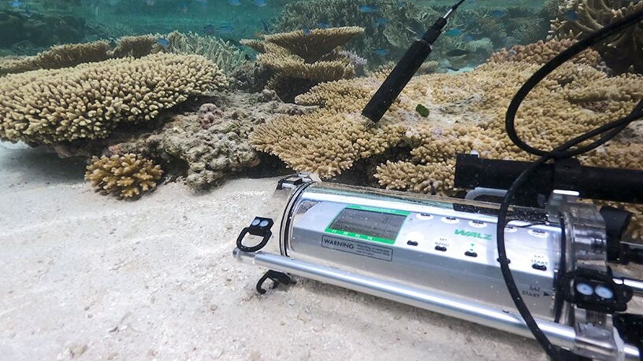
Light availability is measured using various meters and sensors
Notes:
Image: https://www.walz.com/products/chl_p700/diving-pam-II/introduction.html

Slide 15
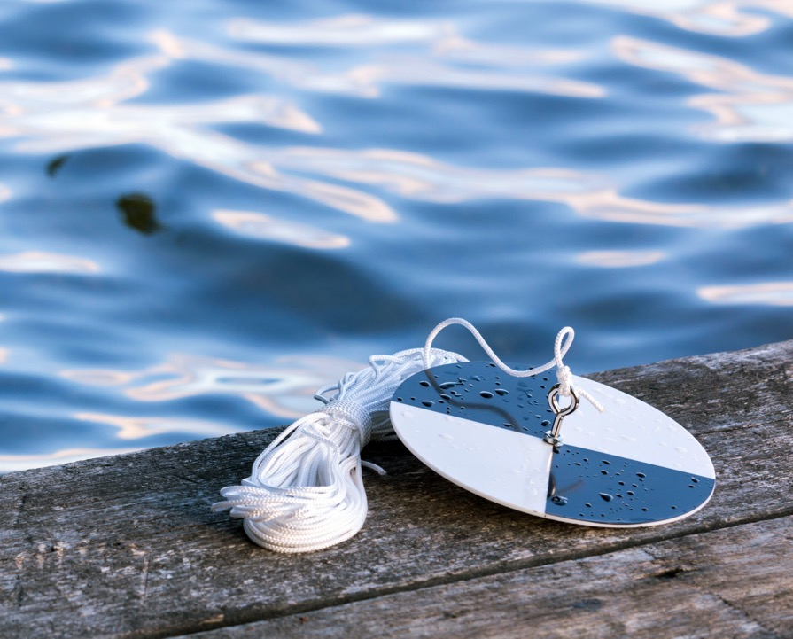
Light availability is also measured using
water clarity measurements such as a
secchi disk
Notes:
Image: http://www.themanyfacesofwater.eu/index.php/2017/05/19/measuring-water-clarity-with-secchi/

Slide 16
Depth

Slide 17
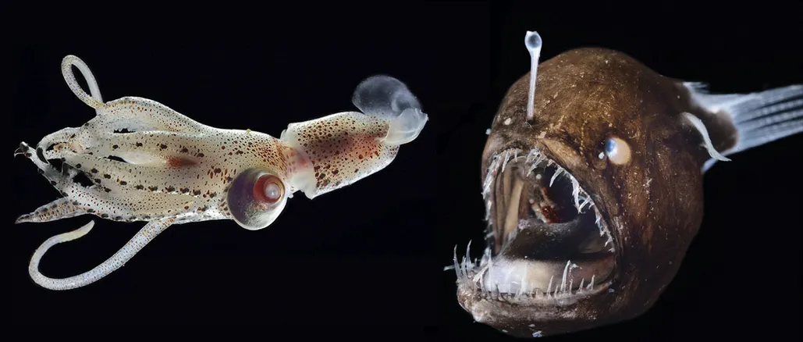
Depth has a significant effect on species abundance, distribution and community composition.

Slide 18
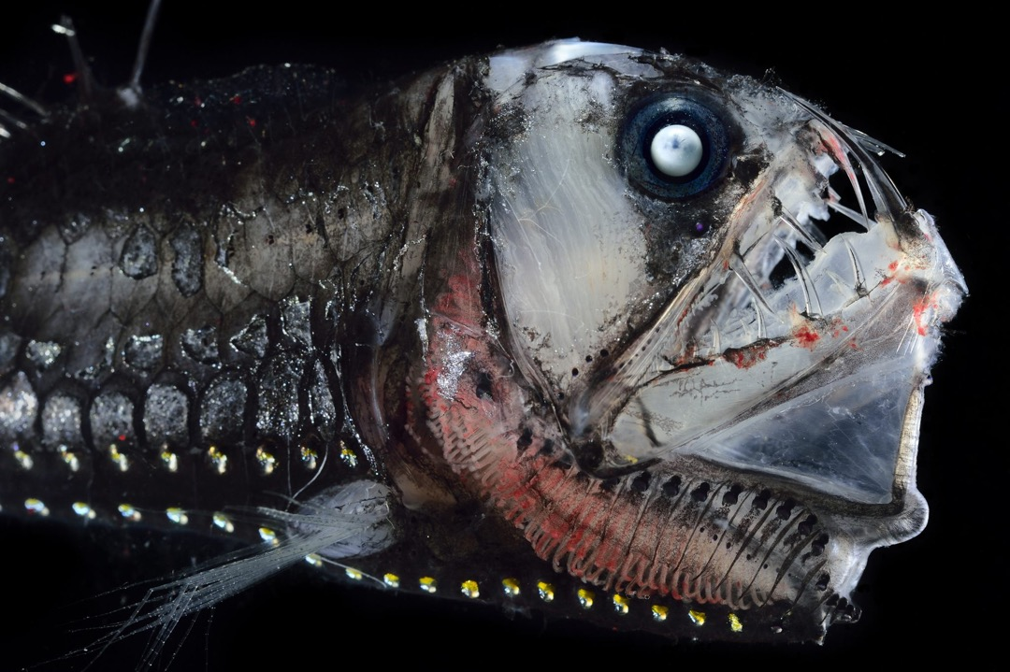
Sloan’s viperfish (Chauliodus sloani)
Notes:
Image: https://www.atlasobscura.com/articles/see-the-weird-and-fascinating-deepsea-creatures-that-live-in-constant-darkness

Slide 19
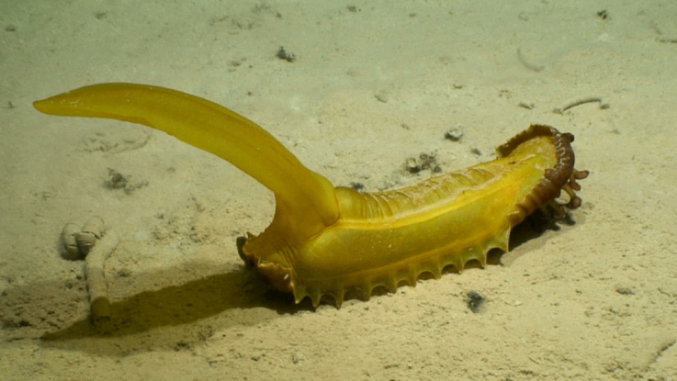
Deep Sea Cucumber. Photo: NOAA Ocean Explorer (Deep CCZ expedition)
Notes:
Image: https://ocean.si.edu/ocean-life/microbes/deep-sea-cucumber

Slide 20
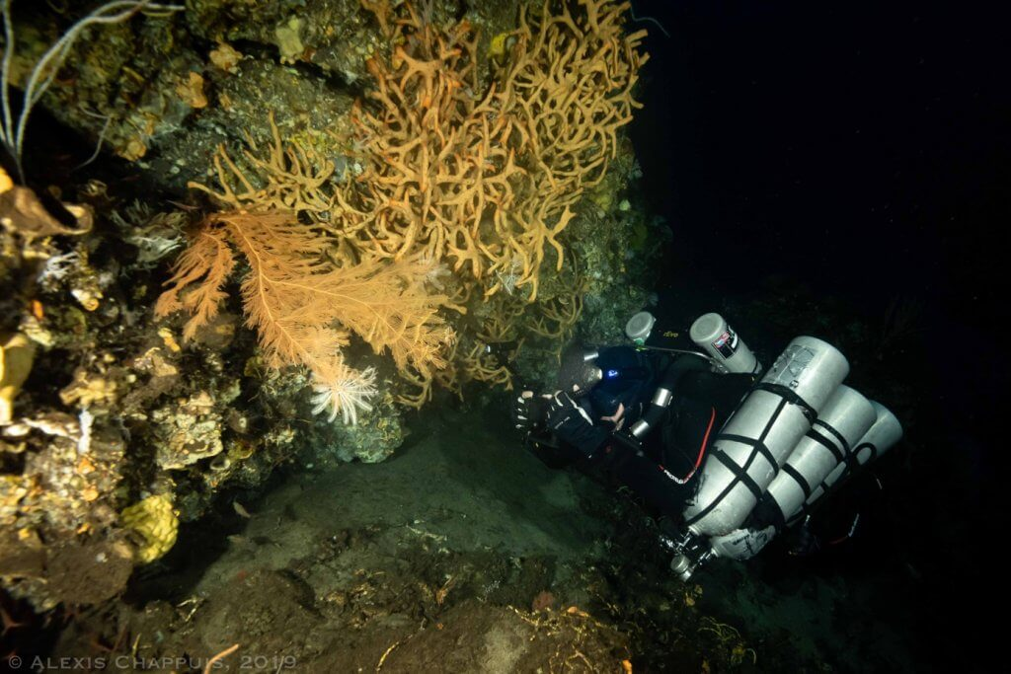
Marc Crane filming the life developing inside and around sponges and cnidarians, at 102 m. Photo: Alexis Chappuis
Notes:
Image: https://www.shearwater.com/monthly-blog-posts/mces-in-indonesia/
Written by Alexis Chappuis
Alexis Chappuis is a French marine biologist, technical scientific diver and amateur photographer. He has conducted various marine ecological studies worldwide during his young career, logging hours on and under the sea.

Slide 21
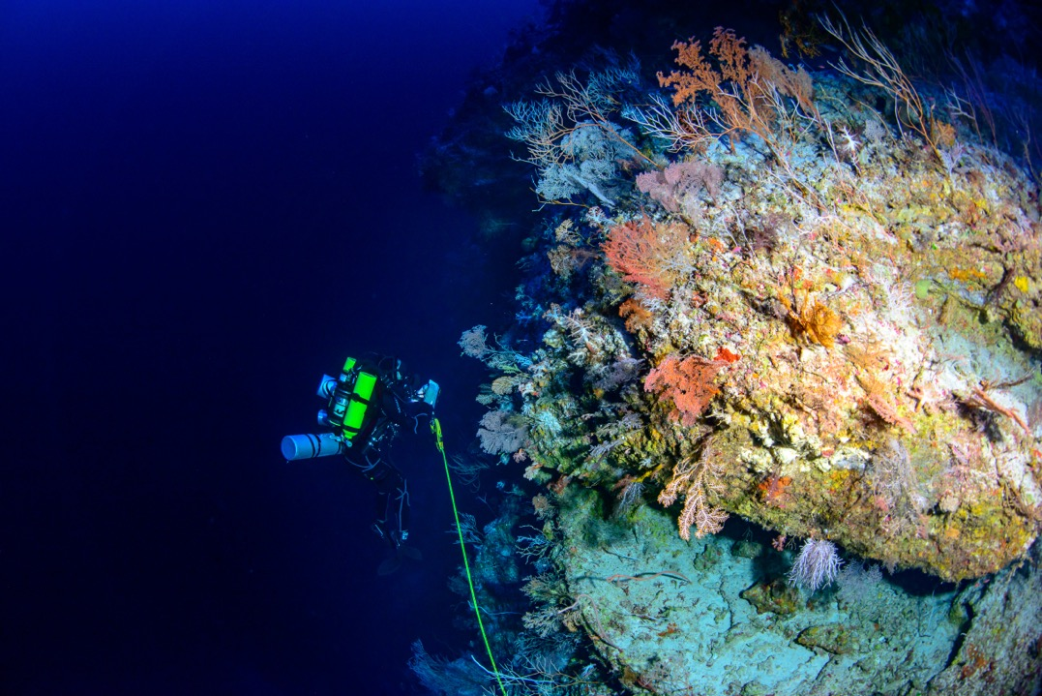
Mesophotic reef ecosystems. Photo: Hudson T. Pinheiro

Slide 22
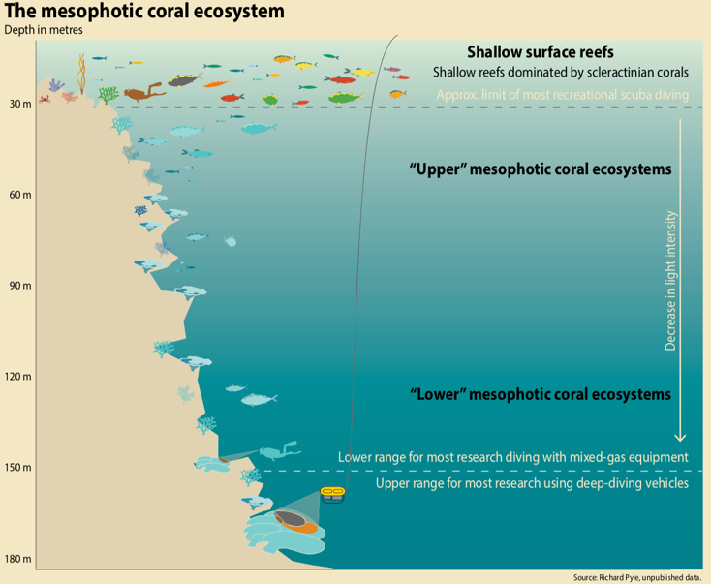
The mesophotic zone is between 30m and 150m. Special dive equipment and training is needed to go there on SCUBA.
Notes:
Image: https://www.shearwater.com/monthly-blog-posts/mces-in-indonesia/

Slide 23
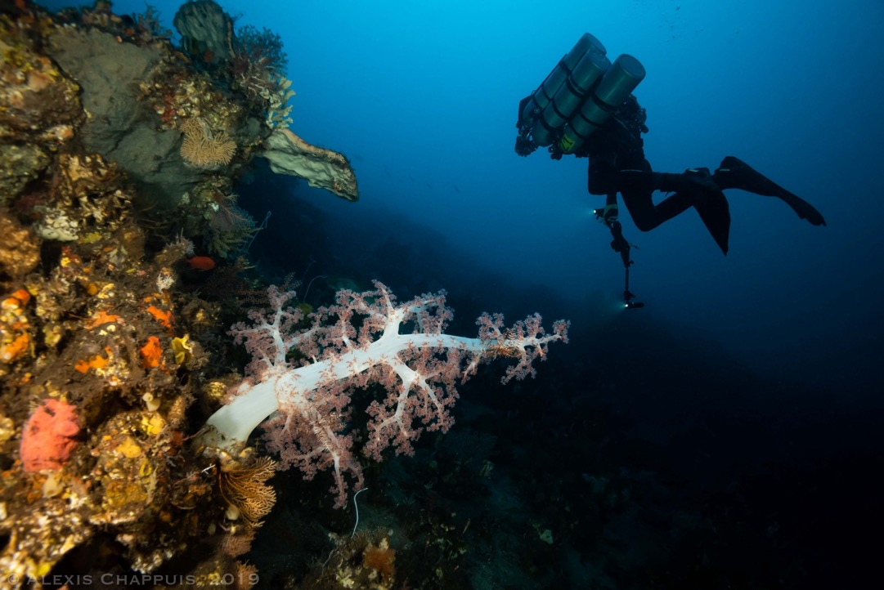
66m
Notes:
Image: https://www.shearwater.com/monthly-blog-posts/mces-in-indonesia/

Slide 24
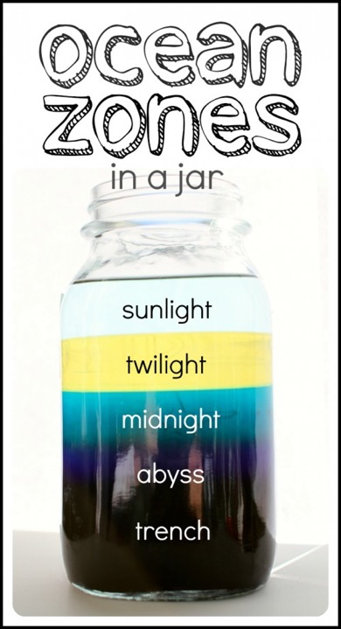
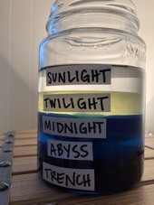
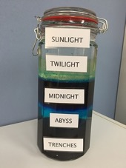
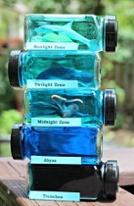
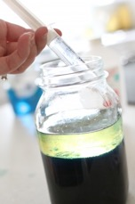
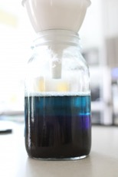
Sunlight (photic) zone: rubbing alcohol (light blue food colouring)
Twilight (mesophotic) zone: oil (dark blue food colouring)
Midnight (aphotic) zone: water (dark green food colouring)
The abyss: dish soap (purple food colouring)
The trench: corn syrup (black food colouring)
Use syringe for sunlit zone
Use funnel for abyss etc.
Notes:
Image: https://www.icanteachmychild.com/make-ocean-zones-jar/

Slide 25
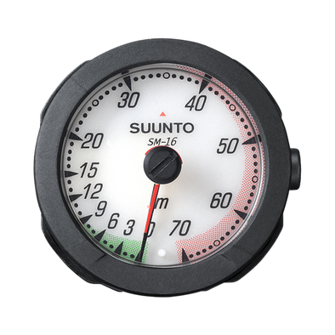

Depth is measured using
depth gauges

Slide 26
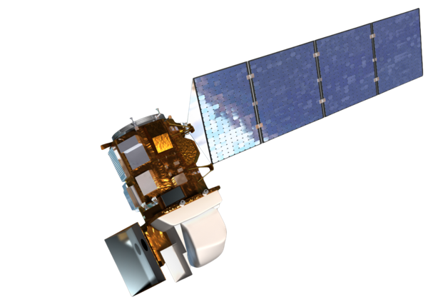
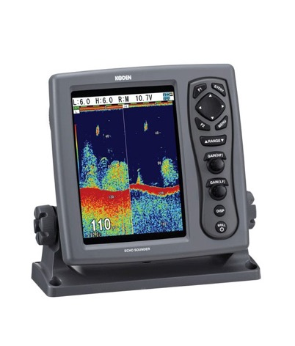
Depth is also measured using
depth sounders
and even satellites
Notes:
Image: http://www.themanyfacesofwater.eu/index.php/2017/05/19/measuring-water-clarity-with-secchi/

Slide 27
Stratification

Slide 28
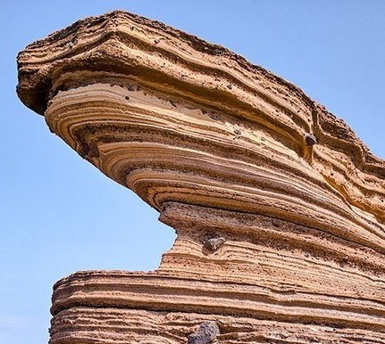
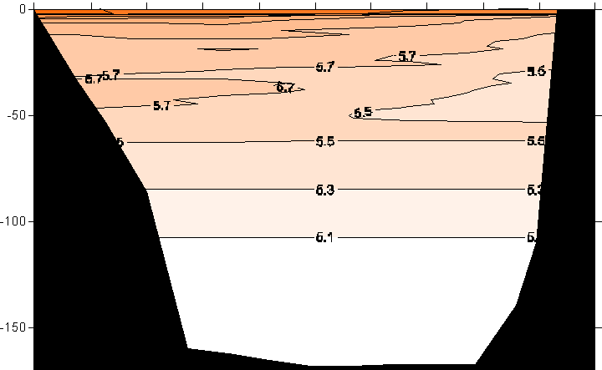
A lot of the ocean is separated into layers
Notes:
Image (left): https://quizizz.com/admin/quiz/6020959e136881001cb3f4b7/stratified-rocks
Image (right): https://courses.washington.edu/uwtoce05/webg1/results.html

Slide 29
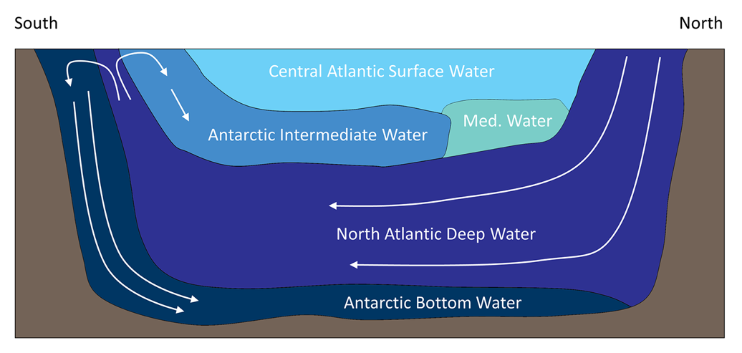
Each layer has a specific density.
The heaviest, most dense, sits on the bottom.

Slide 30
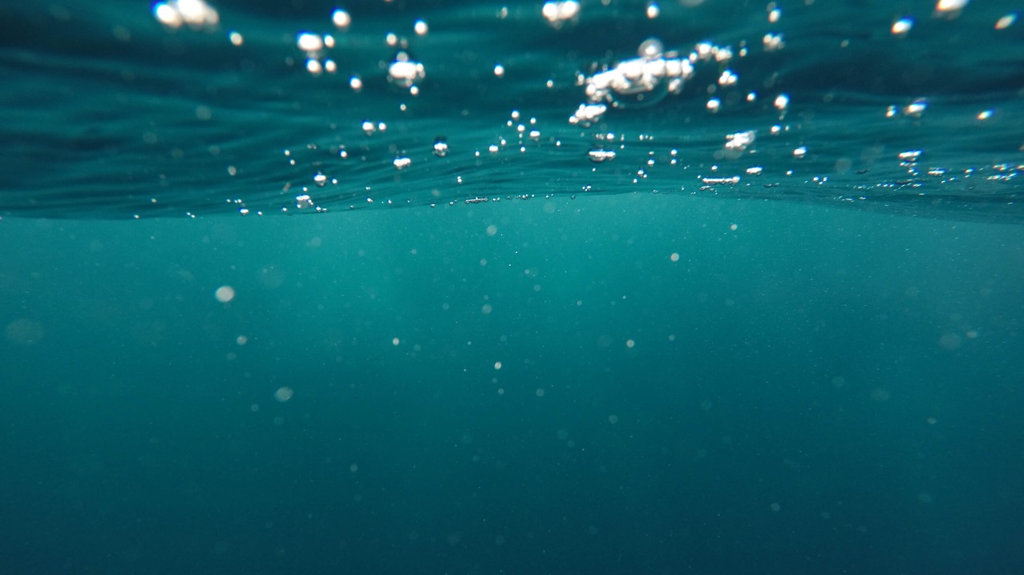
Stratification is the layering of the ocean

Slide 31
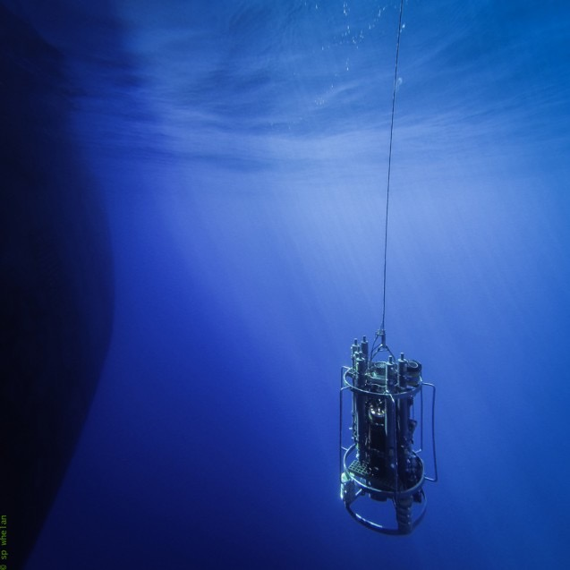
Stratification is measured using temperature and salinity readings
(converted to density)
CTD

Slide 32
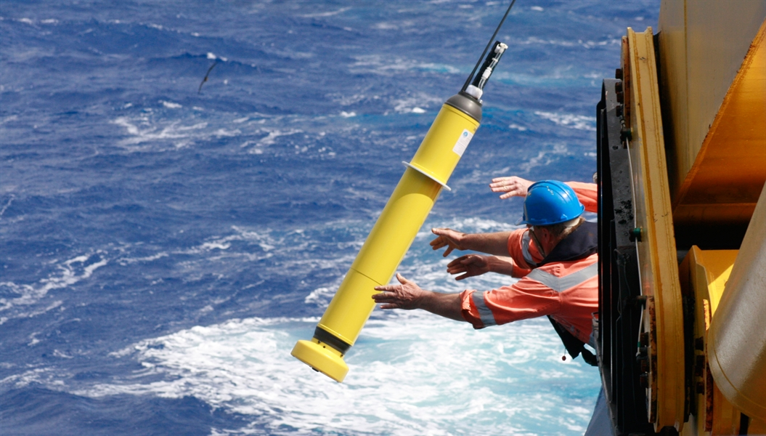
Argo float
Notes:
Image: https://research.noaa.gov/2018/12/10/argo-program-achieves-milestone-with-two-million-ocean-measurements/

Slide 33
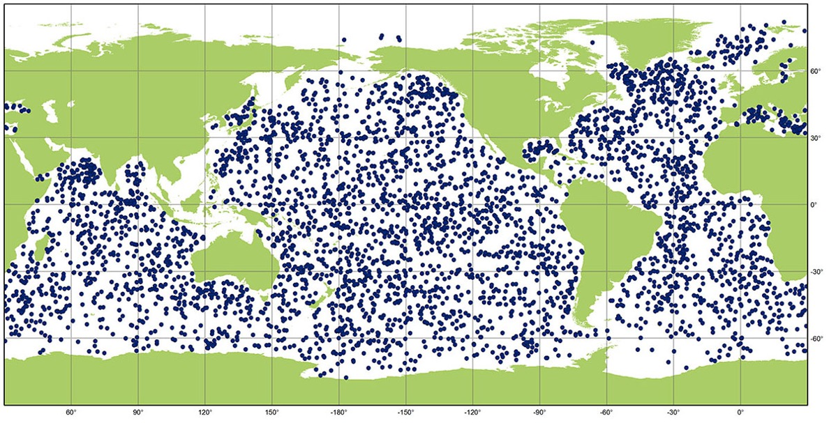
Argo Floats measure temperature and salinity
Notes:
Image: https://argo.ucsd.edu/

Slide 34
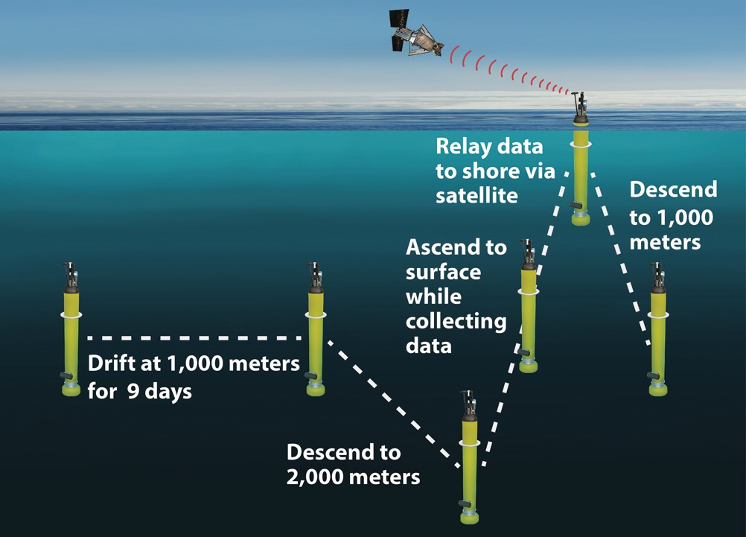
Argo float
Notes:
Image: https://www.whoi.edu/press-room/news-release/go-bgc-array/

Slide 35
Temperature

Slide 36
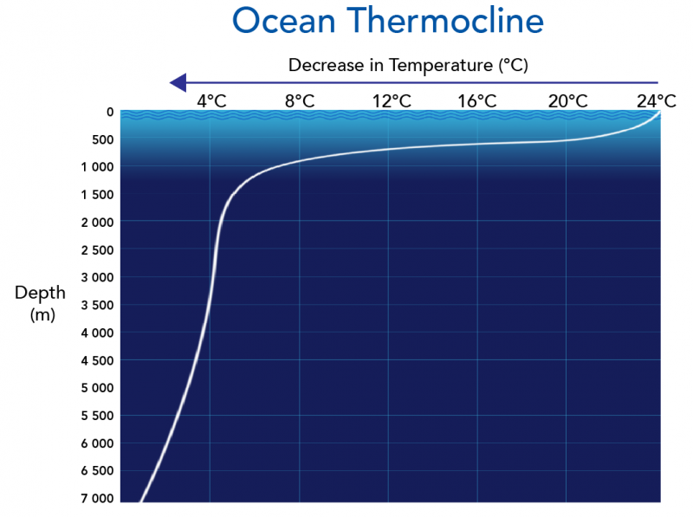
Cold water is more dense than warm water
Notes:
Image: https://letstalkscience.ca/educational-resources/backgrounders/ocean-zones

Slide 37
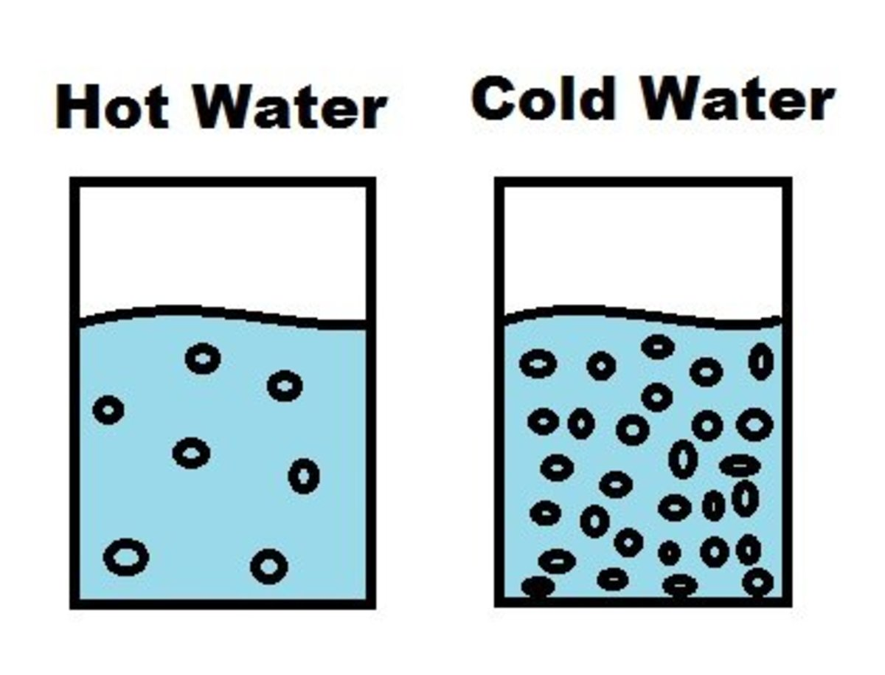

Slide 38
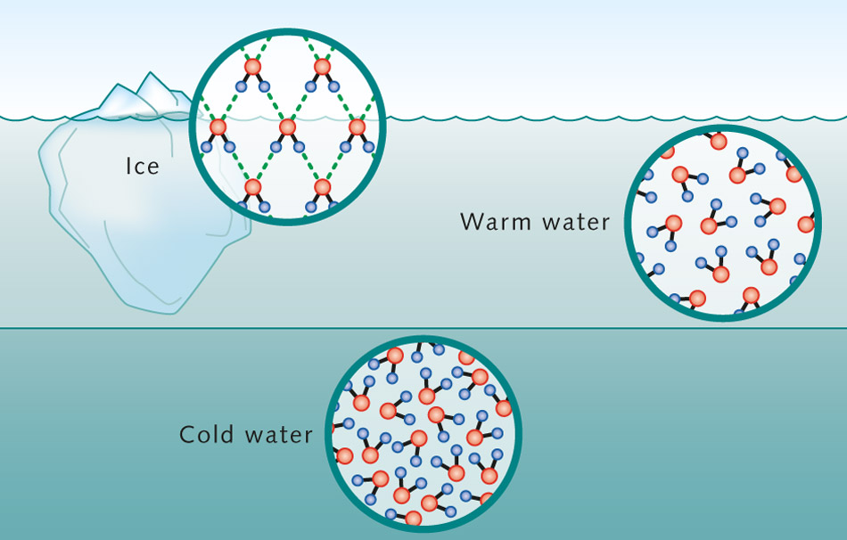
Cold water sinks

Slide 39
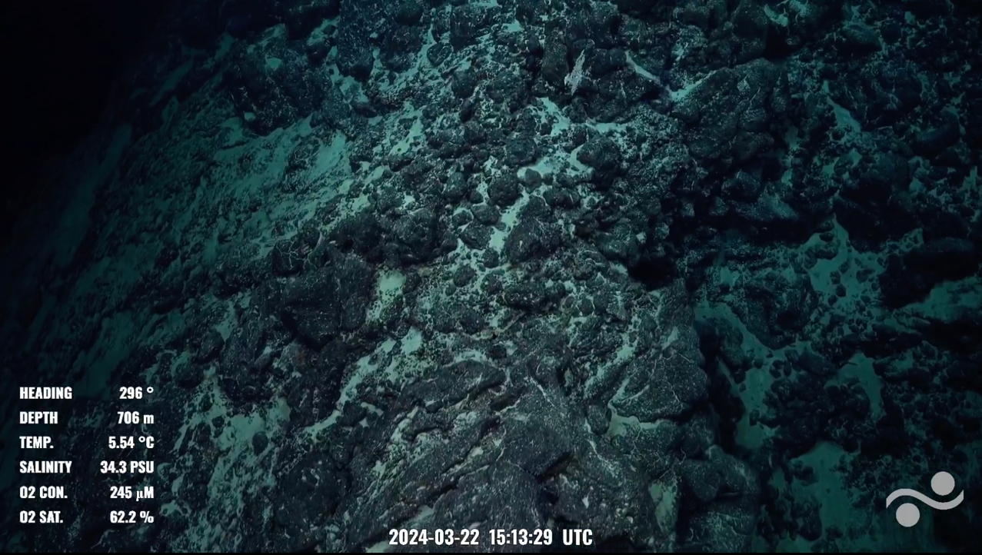

5.54 degrees C
Notes:
Image: Schmidt Ocean Institute facebook page post

Slide 40
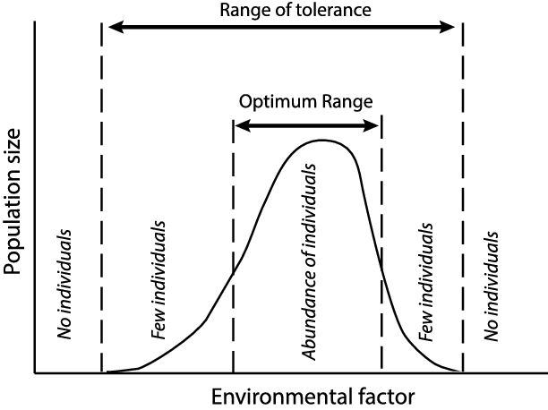
Temperature has a strong influence on species abundance and distribution.
Species operate within a specific temperature range (Shelford’s Law).
TOO COLD
TOO HOT

Slide 41
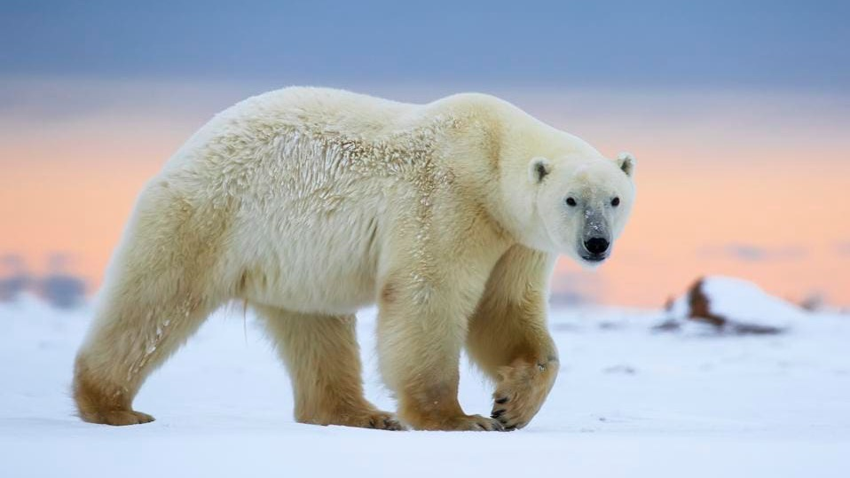
Notes:
Image: https://www.forbes.com/sites/jimdobson/2020/01/07/walking-with-wild-polar-bears-how-a-dramatic-arctic-safari-will-change-your-life-forever/?sh=67f396c13b29

Slide 42
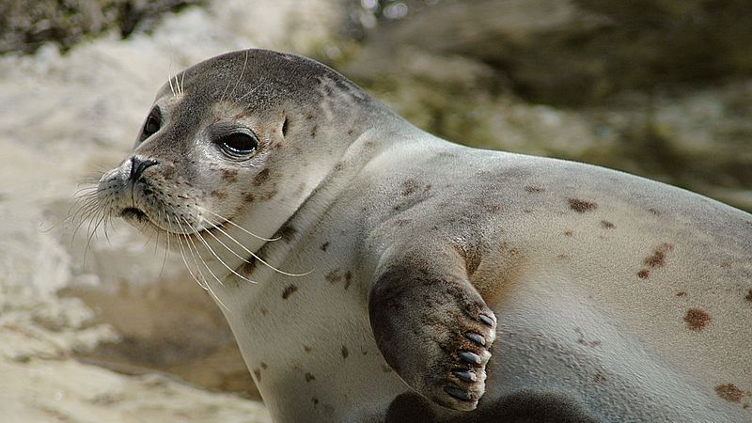
Notes:
Image: https://www.differencebetween.com/difference-between-eurythermal-and-vs-stenothermal-animals/

Slide 43
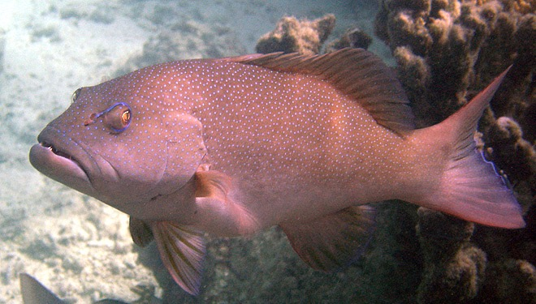
Coral trout
Notes:
Image: https://www.thalabeach.com.au/coral-trout/

Slide 44
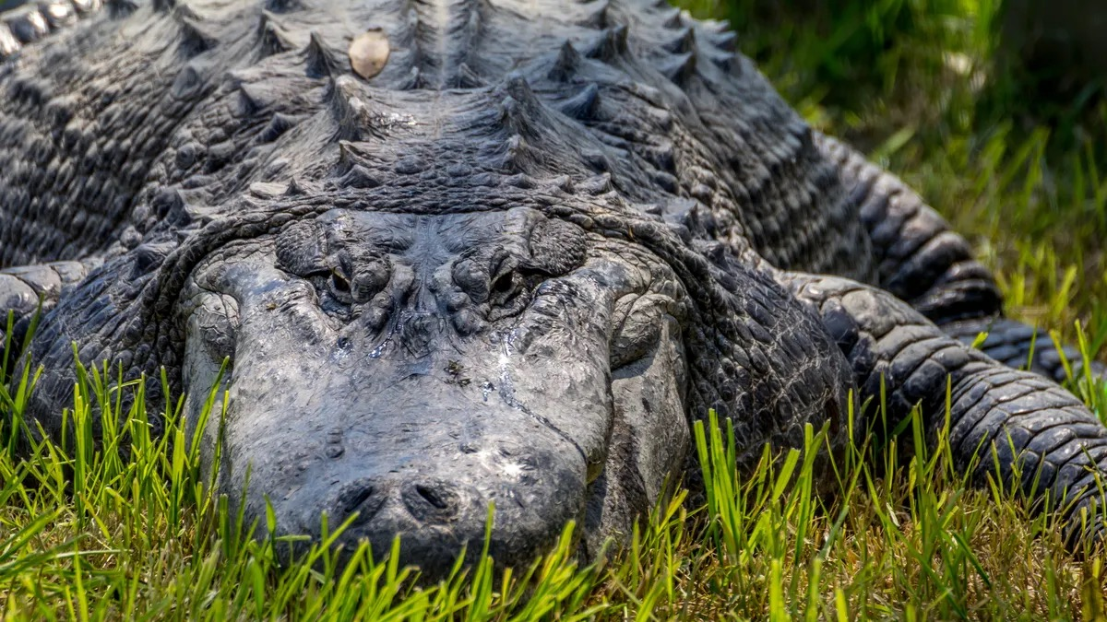
Notes:
Image: https://www.discoverwildlife.com/animal-facts/reptiles/facts-about-saltwater-crocodile

Slide 45
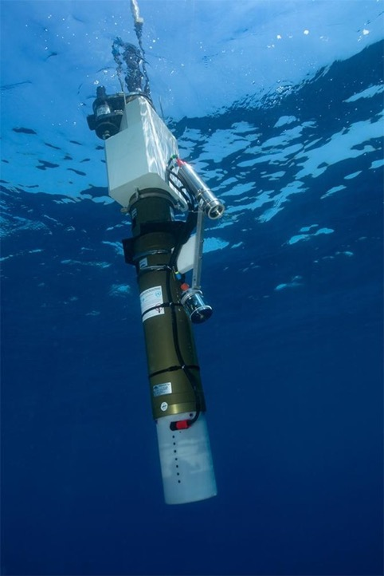
Temperature is measured
at depth
using
thermometers
on argo floats and mounted on CTDs
Notes:
Image: https://www.imas.utas.edu.au/news/news-items/picture-this-robotic-floats-uncover-carbon-storage-pathways-in-the-southern-ocean

Slide 46
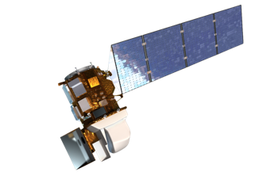
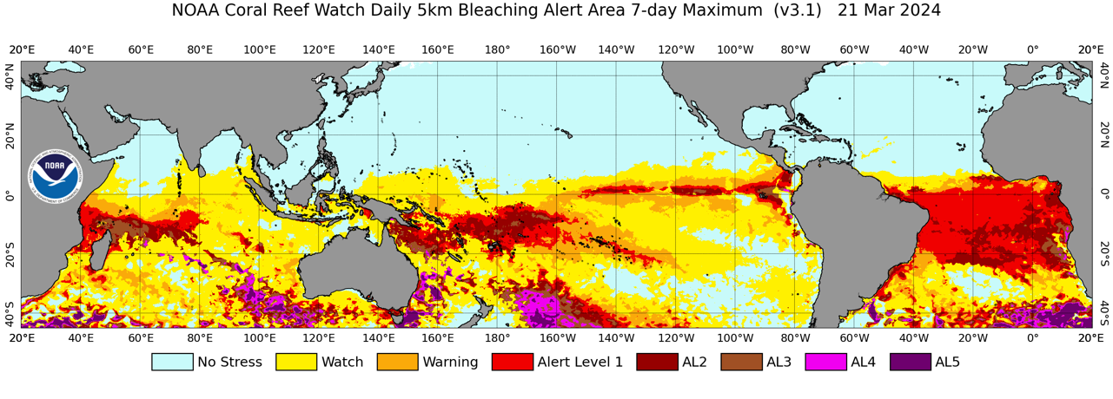
Sea surface temperatures (SSTs) are measured using
buoys and satellites

Slide 47
Currents (water and wind)

Slide 48

Currents are Earth’s transport system.
They deliver heat, food, nutrients, oxygen, larvae and plankton.

Slide 49


Slide 50

Notes:
Image: https://greatbarrierreeftours.com/great-barrier-reef/coral-reef/coral-spawning/

Slide 51

The spawn of Bohar snappers. Photo: Richard Barnden
Notes:
Image: https://masterliveaboards.com/spawning-dives-what-are-they-all-about/
The spawn of Bohar snappers. Photo: Richard Barnden

Slide 52

E.g. thermohaline circulation or THC (a.k.a. the ‘global conveyor belt’)

Slide 53

The THC is ‘pushed’ along by dense water sinking
Where do you think the water might sink (downwelling)?
Notes:
Image: https://rwu.pressbooks.pub/webboceanography/chapter/6-3-density/

Slide 54

Whereas, surface currents are ‘pushed’ by the wind
Notes:
Image: http://www.bom.gov.au/australia/charts/viewer/index.shtml?type=mslp-precip&tz=AEDT&area=G&model=G&chartSubmit=Refresh+View

Slide 55

Notes:
Image: https://oceanservice.noaa.gov/facts/roaring-forties.html

Slide 56

Surface currents are measured using drifters.
They float on the surface and GPS tracks their positions.
CTD
Notes:
Image: https://www.usgs.gov/media/images/gps-equipped-ocean-current-drifters
Good read: - https://flypaper.soundfly.com/discover/what-is-the-sofar-channel-probably-not-what-you-think/

Slide 57


Slide 58

Drifters paint a picture of current speed and direction. Drifters also measure other parameters like sea surface temperature, salinity, barometric pressure, and wave height.
Notes:
Image: https://www.aoml.noaa.gov/global-drifter-program/

Slide 59

Ocean currents are influenced by Earth’s rotation
(and the Coriolis effect)

Slide 60

…as well as other laws of physics
(e.g. Ekman spiral)

Slide 61
Tides

Slide 62


Tidal currents are ‘pulled’ by the moon and sun
Spring tide
Notes:
Image: https://www.skyatnightmagazine.com/space-science/two-high-low-tides-day (adapted)

Slide 63

High tide
Low tide
The Bay of Fundy in Canada has 15m tides
Notes:
Image: https://scijinks.gov/tides/

Slide 64

Average tidal range at spring tides around Australia
(dark red = up to 10m)
Notes:
Image: https://media.bom.gov.au/social/blog/1677/explainer-tidal-rangethe-difference-between-high-and-low-tide-around-australia/

Slide 65

Cotidal lines
join locations that experience high tide at the same time
Notes:
Image: https://commons.wikimedia.org/wiki/File:Cotidal-lines-tide-height.jpg

Slide 66

Tides are measured from the CHART DATUM
(lowest astronomical tide or LAT)
CTD

Slide 67
Sediment type

Slide 68

Sediment types influence where organisms live
Notes:
Image: https://www.digitalatlasofancientlife.org/learn/paleoecology/paleoenvironmental-reconstruction/

Slide 69

Ghost crabs like sand

Slide 70

Beach worms

Slide 71

pipi

Slide 72

Lug worm poo

Slide 73



Porites astreoides at eight months
Montastraea cavernosa recruit at about 3 weeks old. Photo by National Coral Reef Institute
Porites astreoides. Photo by NCRI
Notes:
Image: https://www.solutions-site.org/node/308

Slide 74

Restoration requires knowing what they like
Notes:
Image: https://news.un.org/en/gallery/1128967

Slide 75


I like mud

Slide 76


Notes:
Image: https://en.wikipedia.org/wiki/Mangrove_restoration

Slide 77

Sediment size is commonly measured
using the Wentworth scale
CTD

Slide 78
Nutrient availability

Slide 79

Algae bloom (algae LOVE nutrients)

Slide 80







Nutrients are measured using nutrient or Chl a analysis
Spectrometer
Test Kits
satellite
Test Strips
Fluorometer
Lab analysis

Slide 81

Learning Intention:
Describe abiotic components of marine ecosystems: light availability, depth, stratification, temperature, currents (water and wind), tides, sediment type and nutrient availability
Success Criteria:
Complete Marine Education worksheet
‘17. Abiotic Antics’

