Slide 1
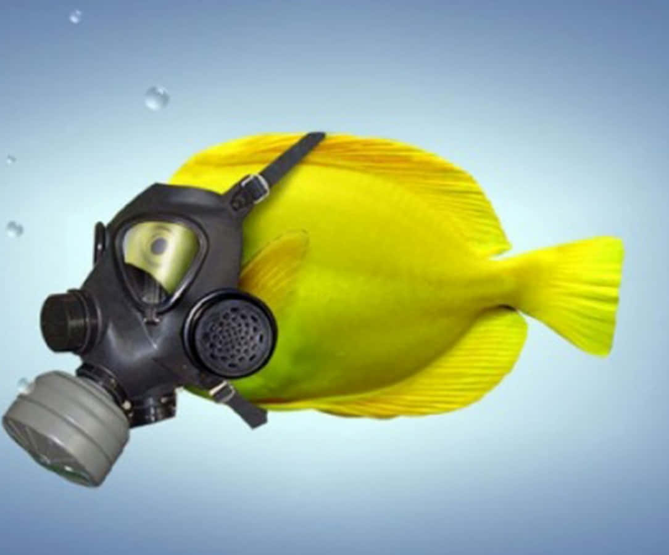
Learning Intention:
Describe how biochemical oxygen demand (BOD) is used to indirectly assess water pollution levels
(worksheet #1)
Success Criteria:
Complete Marine Education worksheet ’17. I demand Oxygen!’
Notes:
Image: https://wallpapers.com/picture/funny-fish-wearing-oxygen-mask-picture-gs28vhhv1dzgfoyk.html

Slide 2
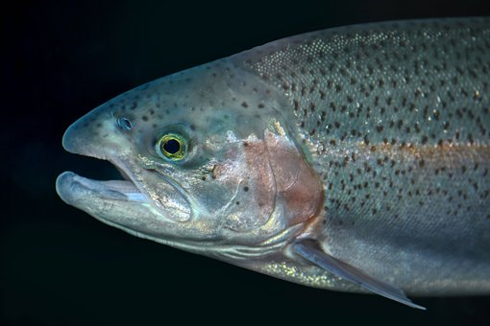
Animals need oxygen to breathe
Oxygen is dissolved in water (called DO or dissolved oxygen).
Notes:
Image: https://pixabay.com/images/search/gill/?date=1y

Slide 3
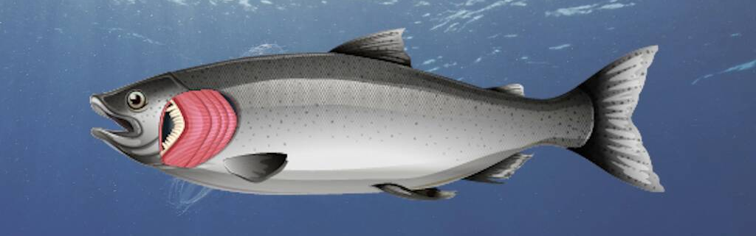
Most marine animals have gills to breathe in dissolved oxygen
Animals die without oxygen.
Notes:
Image: https://study.com/learn/lesson/gills-concept-function.html

Slide 4
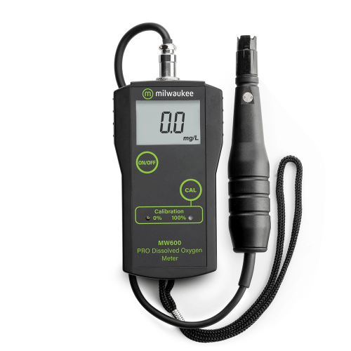
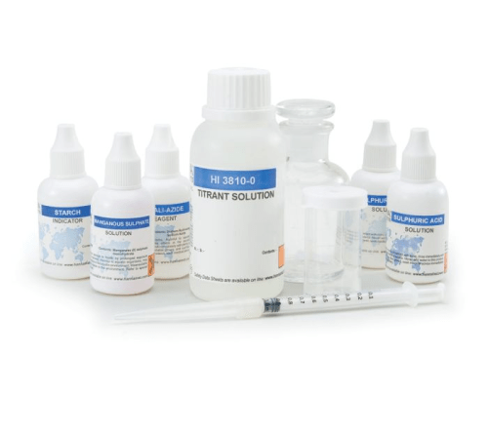
DO is measured using a probe or with micro-titration kits.
approx. $500
approx. $150
Notes:
Probe image: https://www.instrumentchoice.com.au/simple-to-use-low-cost-dissolved-oxygen-meter-ic-mw-600?campaign=17931366640&content=614385857015&keyword=&gad_source=1&gclid=Cj0KCQiAj_CrBhD-ARIsAIiMxT-DF7P-AUfyn-k_NJ1_6R1mBPAgBuZ6FzgVPTBLJBReuLwVl0g5bWYaAldlEALw_wcB

Slide 5
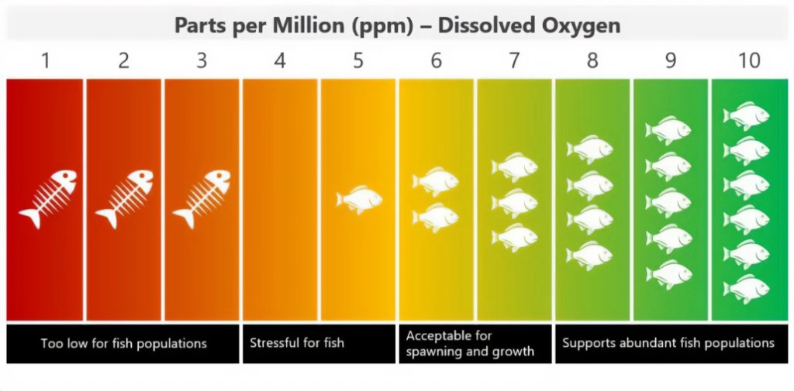
If DO levels significantly drop in concentration over time
(to anything below 3ppm) there is serious cause for concern.
Notes:
Image: https://atlas-scientific.com/blog/what-affects-dissolved-oxygen-levels-in-water/

Slide 6
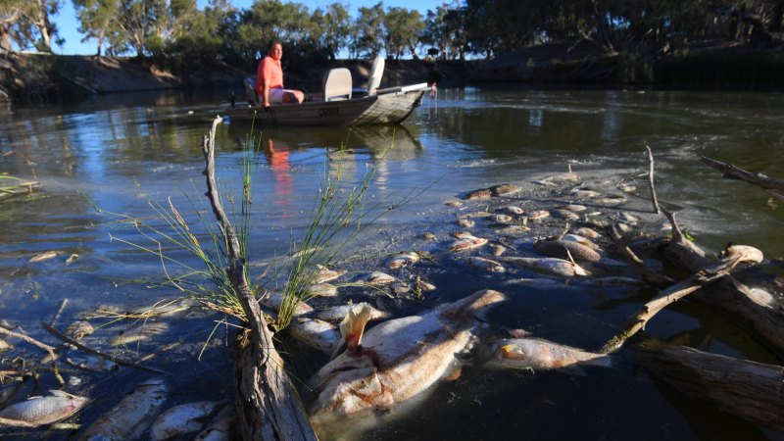
Graeme McCrabb, a Menindee resident, sits in his boat amidst some of the thousands of dead fish killed in Jan. 2019 resulting from an algae bloom in the Menindee Weir Pool, NSW. CREDIT:NICK MOIR
Notes:
Image; https://www.smh.com.au/environment/conservation/nsw-labor-demands-water-management-inquiry-after-massive-fish-kill-20190110-p50qlb.html

Slide 7
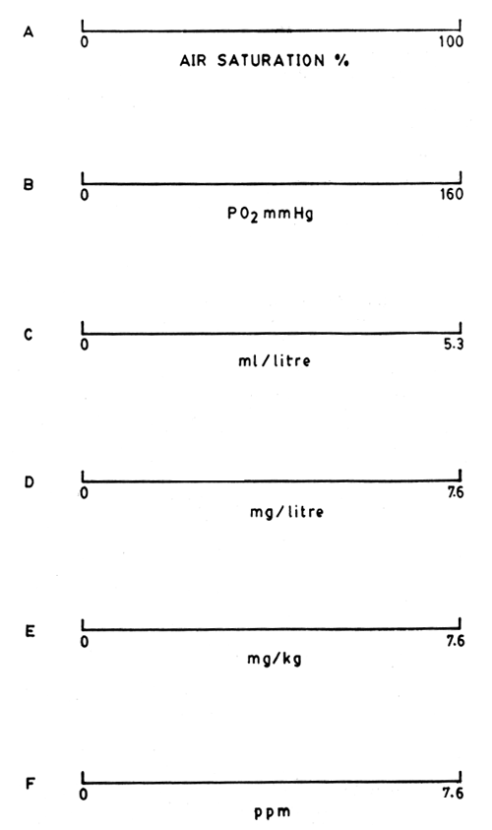
Note: there are many different units of measurement used to report the DO concentration
Notes:
Image: https://www.fao.org/3/AC183E/AC183E04.htm#:~:text=Oxygen%20is%20absorbed%20in%20water,6%20meters%20in%20quiet%20water.

Slide 8
Natural factors that affect DO levels

Slide 9
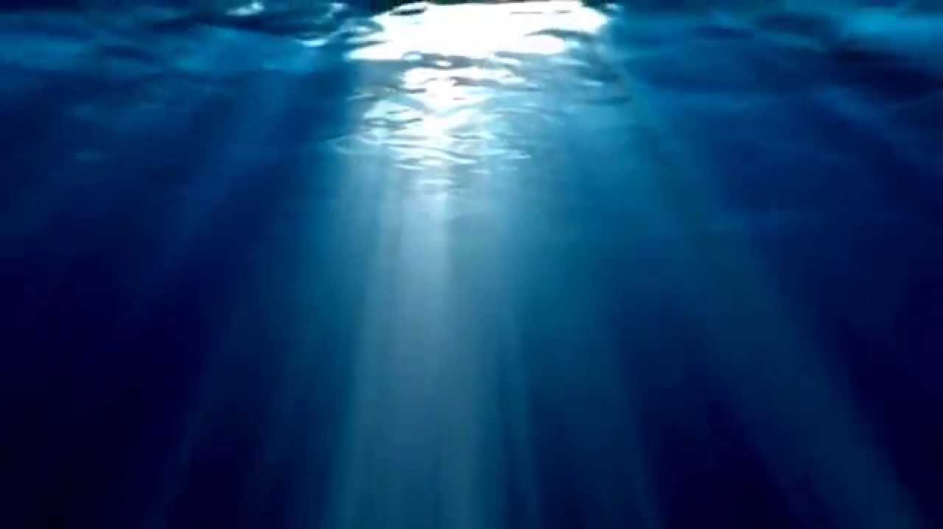
DO increases with photosynthesis
Notes:
Image: https://www.youtube.com/watch?v=ePYcUyEE6Bo

Slide 10
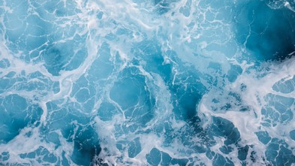
DO increases with DIFFUSION and AERATION
Turbulent water contains more oxygen than calm water

Slide 11
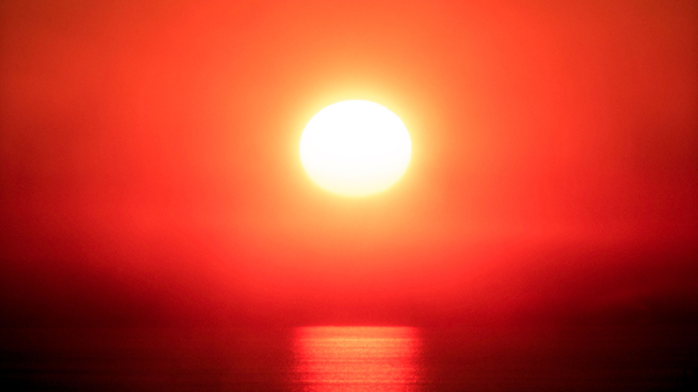
DO decreases when the water warms up

Slide 12
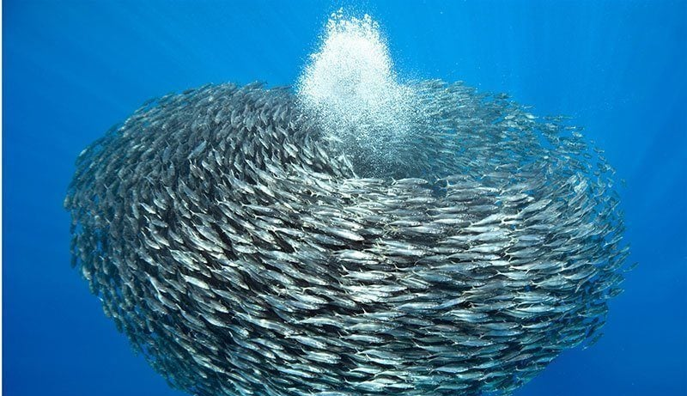
DO decreases with respiration
Notes:
Image: https://allthatsinteresting.com/schooling-fish

Slide 13
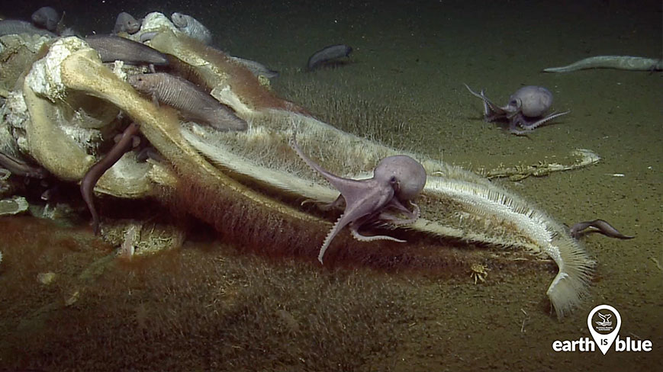
DO decreases with DECOMPOSITION
Notes:
Image: https://oceanservice.noaa.gov/facts/whale-fall.html

Slide 14
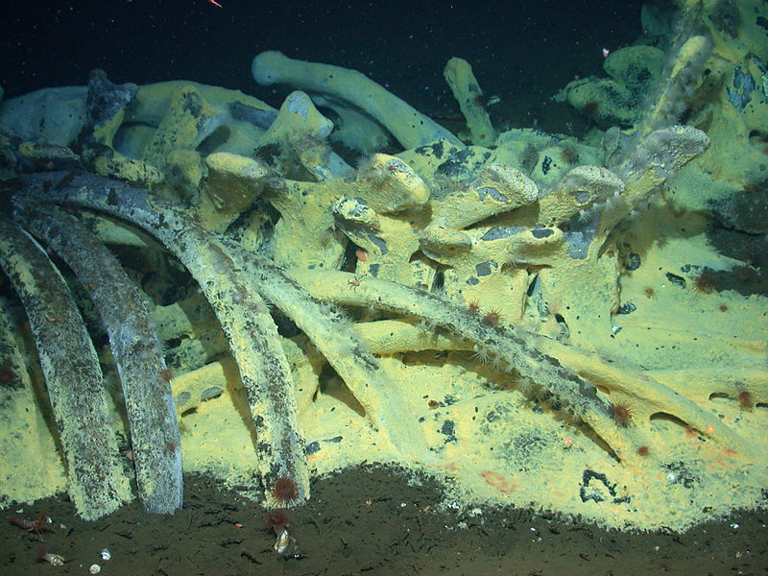
The decomposition of organic matter
(by aerobic bacteria)
uses up
valuable oxygen
Notes:
Image: https://en.wikipedia.org/wiki/Whale_fall

Slide 15
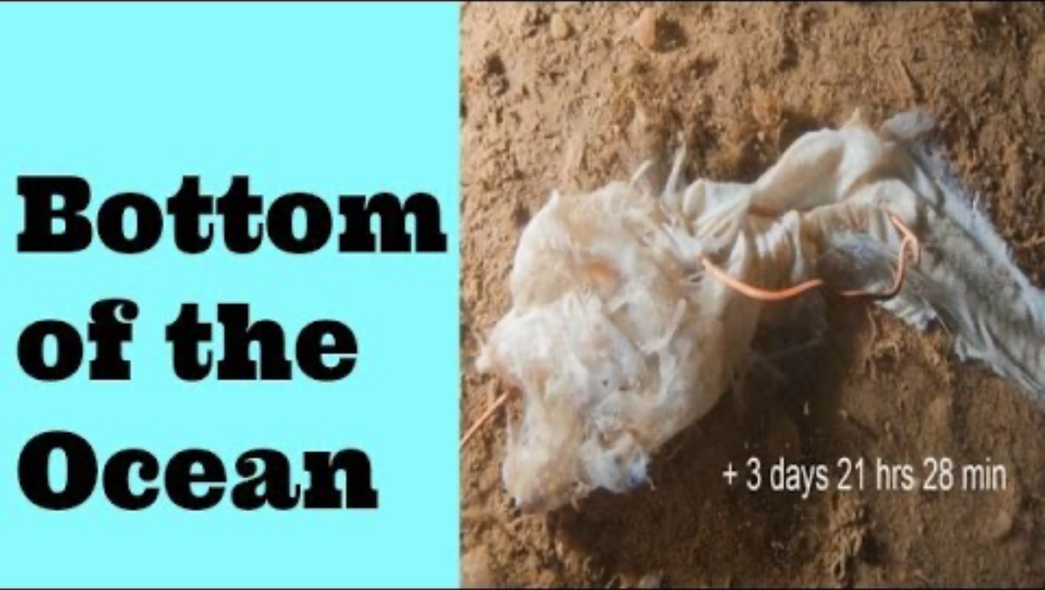
https://www.youtube.com/watch?v=XOMHuZX582E
Notes:
Youtube: https://www.youtube.com/watch?v=XOMHuZX582E

Slide 16
Anthropogenic (human) factors that reduce DO levels (by increasing decomposition)

Slide 17
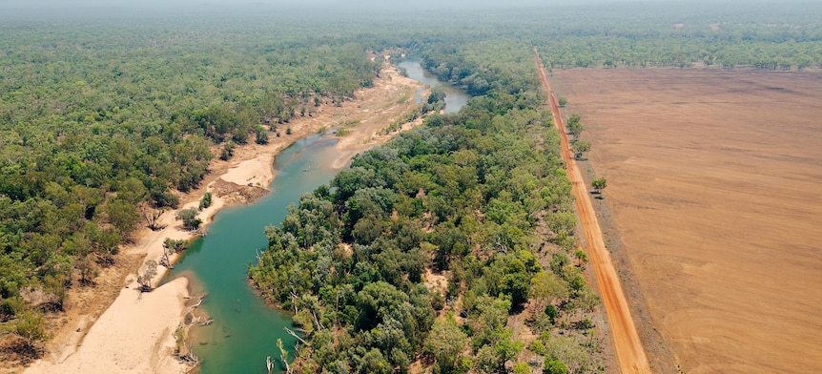
Land Clearing
adds more organic matter to water when it rains (nothing to stop the runoff).
Notes:
Image: https://www.abc.net.au/news/2023-02-03/criticisms-mount-over-unregulated-land-clearing-in-the-nt/101897606

Slide 18
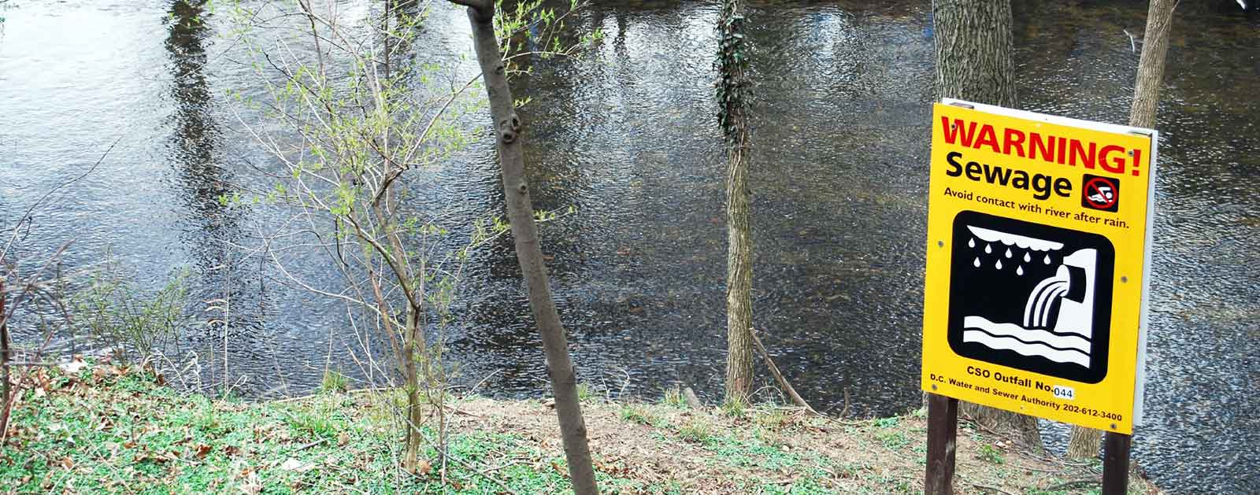
Sewage Waste
adds more organic matter (& nutrients) to water when it rains & overflows
Notes:
Image: https://www.americanrivers.org/threats-solutions/clean-water/sewage-pollution/

Slide 19
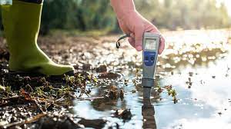
More organic matter = more decomposition = less oxygen
Notes:
Image: https://sinay.ai/en/what-are-the-main-indicators-of-water-quality/

Slide 20
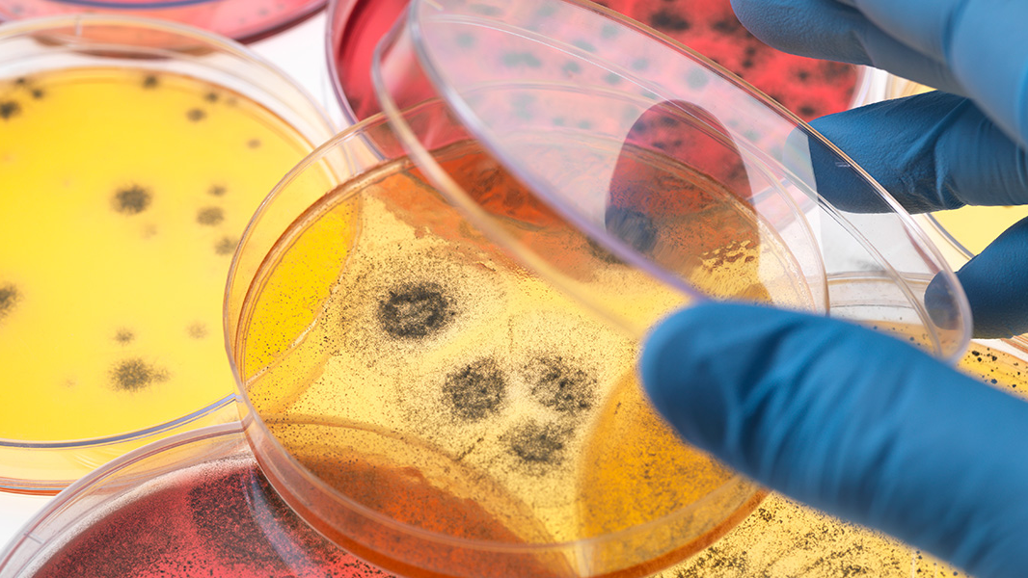
Decomposers - Bacteria

Slide 21
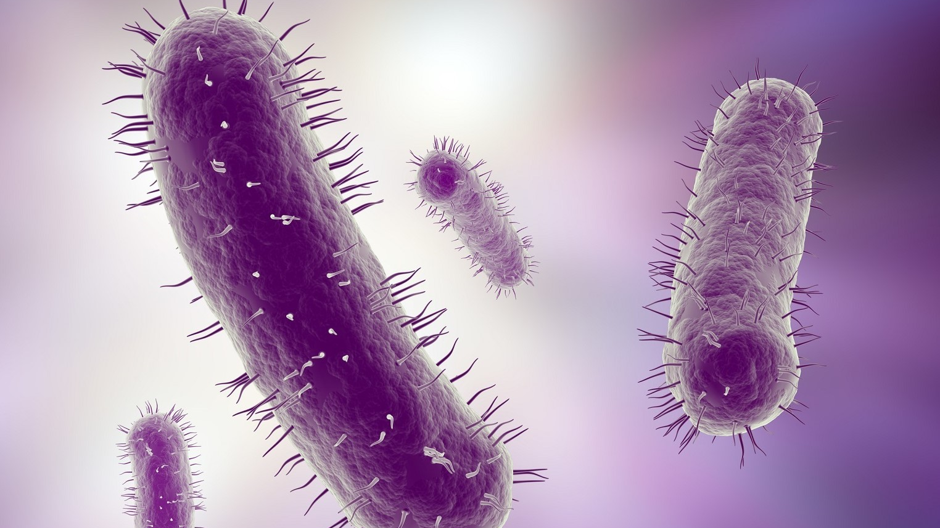
Decomposers - Bacteria

Slide 22
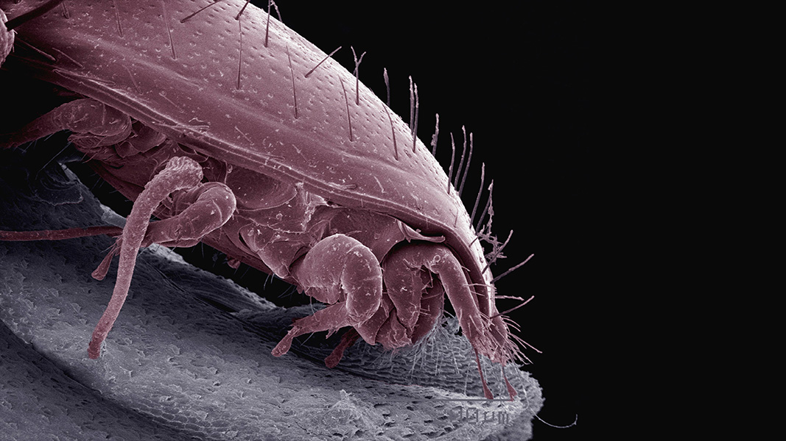
Decomposers - Mites
Notes:
Image: https://bokashiorganko.com/bokashi-library/what-organisms-are-involved

Slide 23
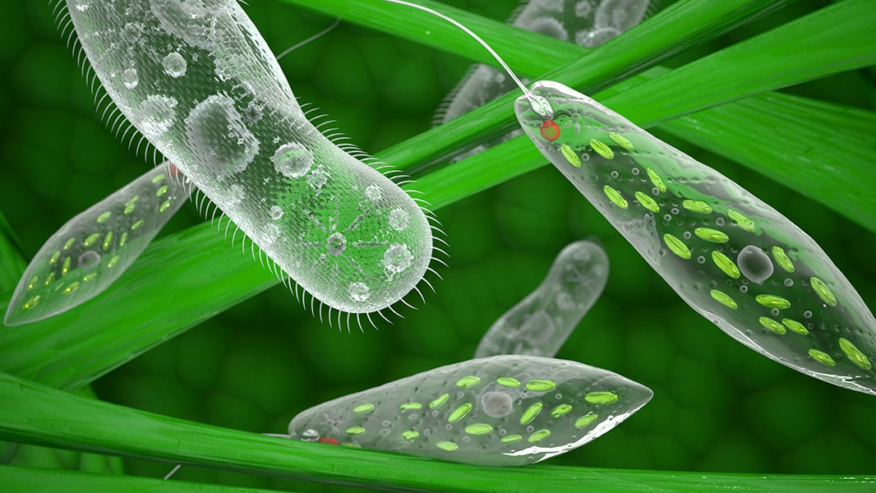
Decomposers - Protozoans
Notes:
Image: https://bokashiorganko.com/bokashi-library/what-organisms-are-involved

Slide 24
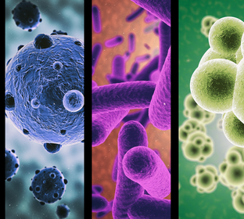
Populations of these microorganisms increase when the amount of dead organic matter (their food source) increases.

Slide 25
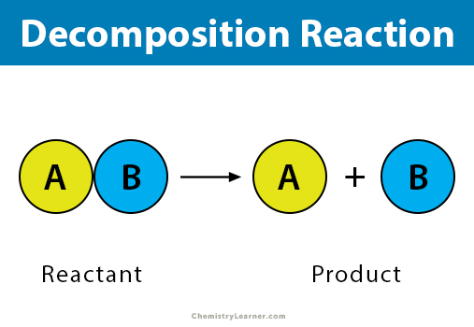
Decomposition
is the breaking down of organic matter
Decomposers (e.g. bacteria)

Slide 26
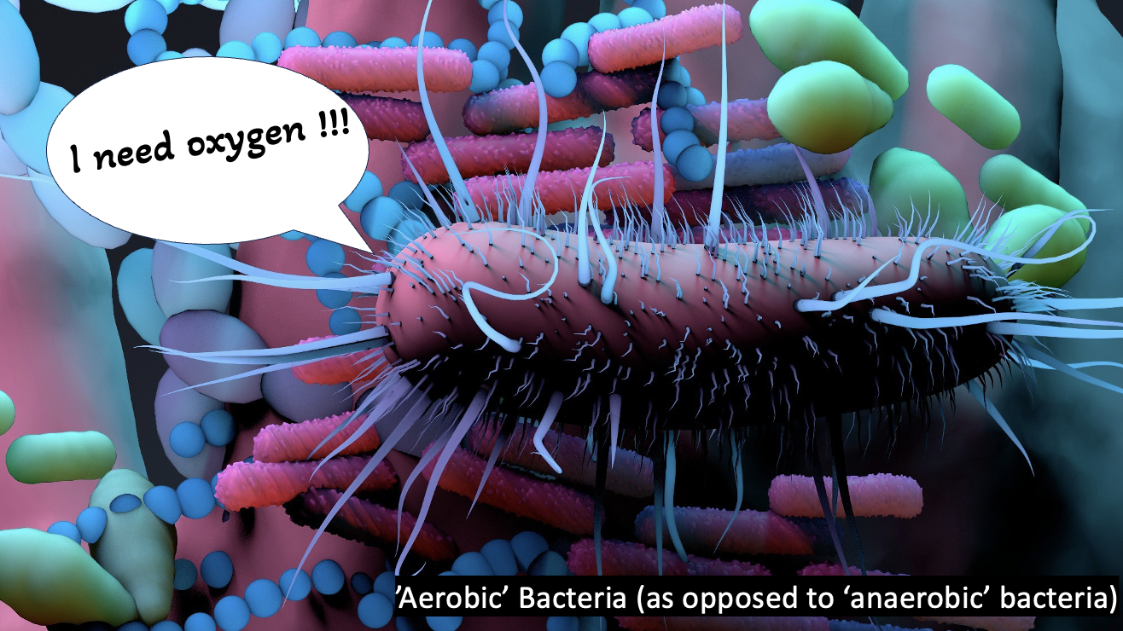
Aerobic bacteria are decomposers that require oxygen to do the job of breaking down the organic matter

Slide 27



Aerobic bacteria
need oxygen to decompose organic matter.
Anaerobic bacteria do not.
Aerobic water (has oxygen in it)
Organic matter + oxygen + → CO₂ + H₂O + energy
Ammonia (e.g. in urine) + oxygen + → nitrite + energy
Nitrite + oxygen + → nitrate + energy
vs. Anaerobic water (no oxygen in it)
Organic matter + → intermediates (many that smell bad) + CO₂ + H₂O + energy
Notes:
Image:

Slide 28
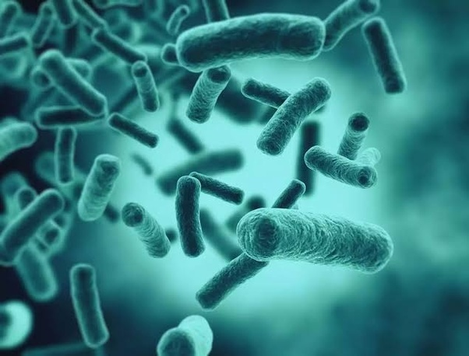
Aerobic bacteria deplete oxygen supplies when consuming the organic matter (& nutrients)
Notes:
Image: https://www.quora.com/Why-is-it-important-that-decomposers-such-as-bacteria-release-nutrients

Slide 29
Biochemical oxygen demand (BOD)
is a measure of the amount of dissolved oxygen consumed by aerobic bacteria during the decomposition of organic material, in a given volume of water.
Hence the name.

Slide 30
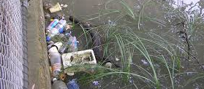
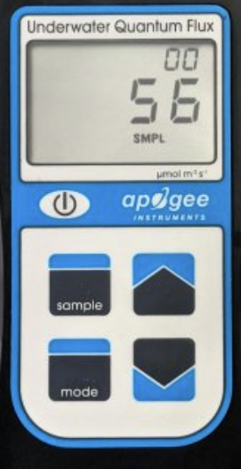
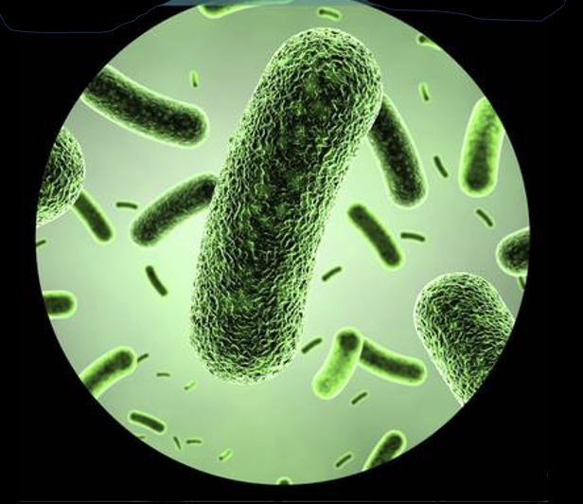
In other words, BOD is the demand for oxygen from the aerobic bacteria
when they’re decomposing organic material.
DO meter
5.0ppm
I DEMAND oxygen !!

Slide 31
Therefore, when the amount of organic material increases (via pollution), so does the amount of decomposition, the demand for DO, and BOD.
Then, the fish might have trouble breathing ☹
DO meter
3.5

Slide 32
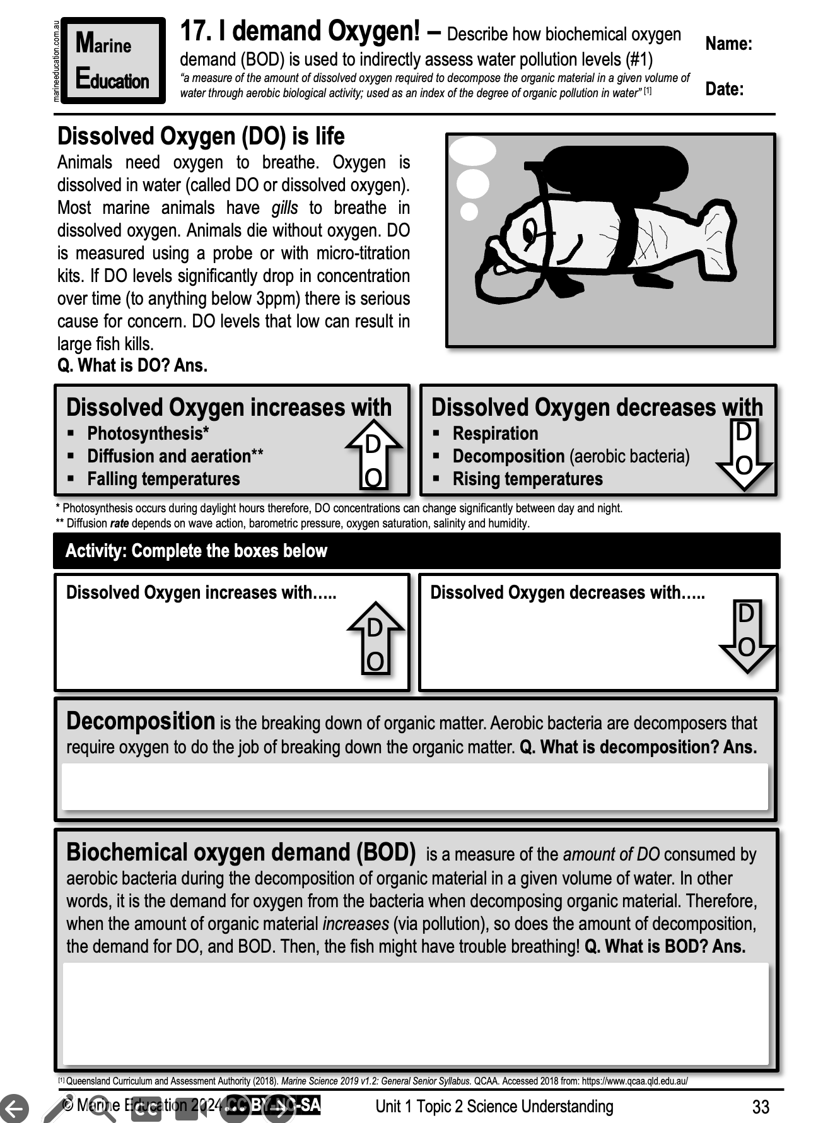
Learning Intention:
Describe how biochemical oxygen demand (BOD) is used to indirectly assess water pollution levels
(worksheet #1)
Success Criteria:
Complete Marine Education worksheet ’17. I demand Oxygen!’
Notes:
Image: https://wallpapers.com/picture/funny-fish-wearing-oxygen-mask-picture-gs28vhhv1dzgfoyk.html

