Slide 1
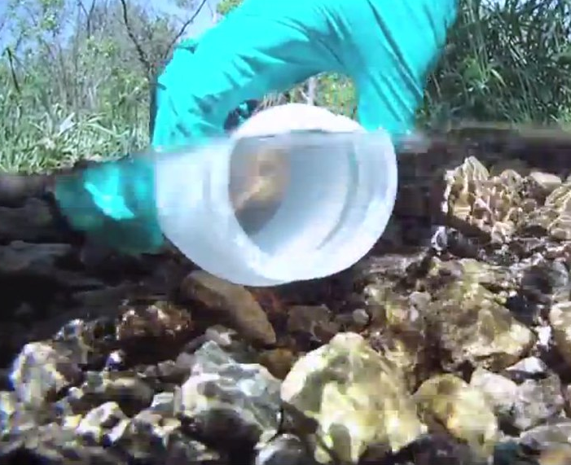
Learning Intention:
Describe how BOD is used to indirectly assess water pollution levels
(worksheet #2)
Success Criteria:
Complete Marine Education worksheet
’18. Cracking
the case’
Notes:
Image: https://publiclab.org/notes/stevie/01-17-2020/how-to-collect-a-water-sample

Slide 2
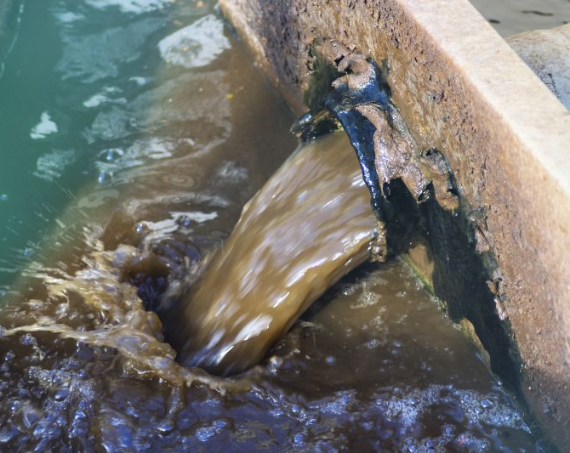
A Biochemical Oxygen Demand (BOD) test
is used when organic waste is suspected to be polluting the water
Notes:
Image: https://watermission.org/news/treating-testing-engineers-take-water-quality/

Slide 3
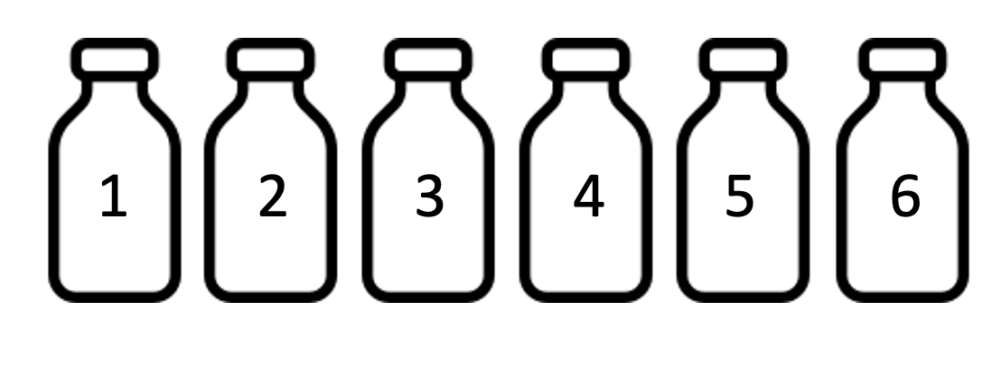
Step 1: Collect 6 water samples (5 repeats and one control)
Fill to the top and screw on the lid before removing from the water
Fill to the top and screw on the lid before removing from the water.
This ensures the only oxygen in the bottle is in the water.

Slide 4
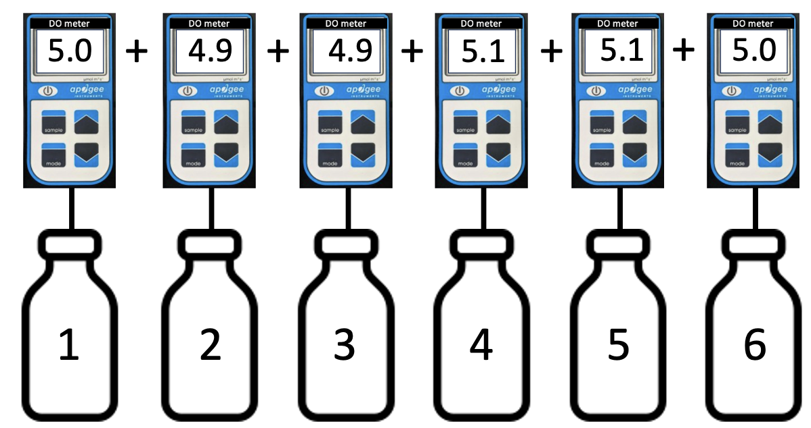
Step 2: Measure Dissolved Oxygen (DO). Calculate the mean (average).
For example,
= 30
6 bottles
equals….
5ppm

Slide 5
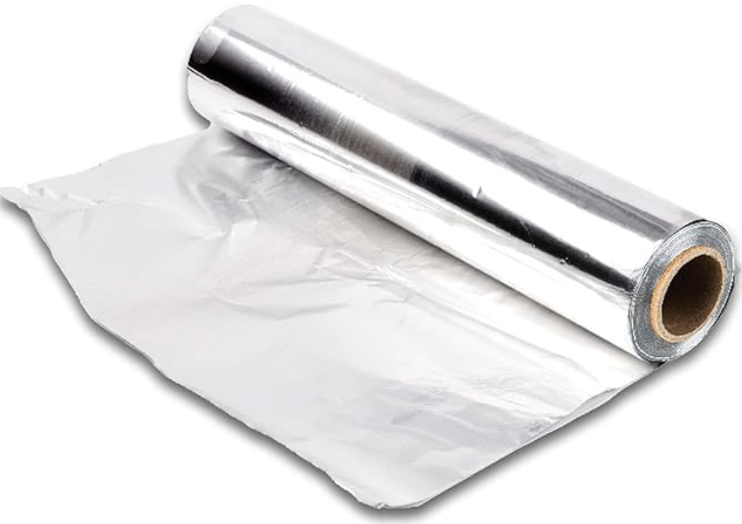
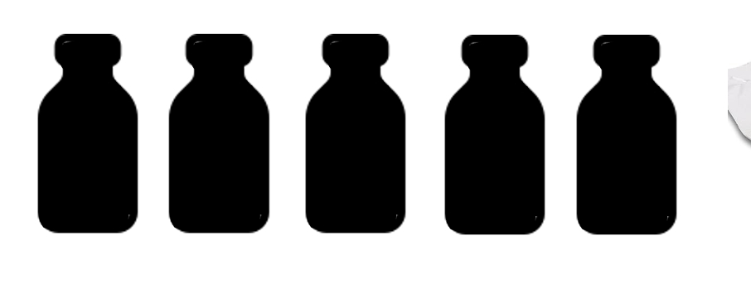

Step 3: Cover. Store at constant temperature.
Cover the sample bottles to block out the light and therefore eliminate photosynthesis adding oxygen to the bottle. Leave one bottle uncovered, to be the control.
Store at constant temperature because a change in temperature causes a change in DO.

Slide 6
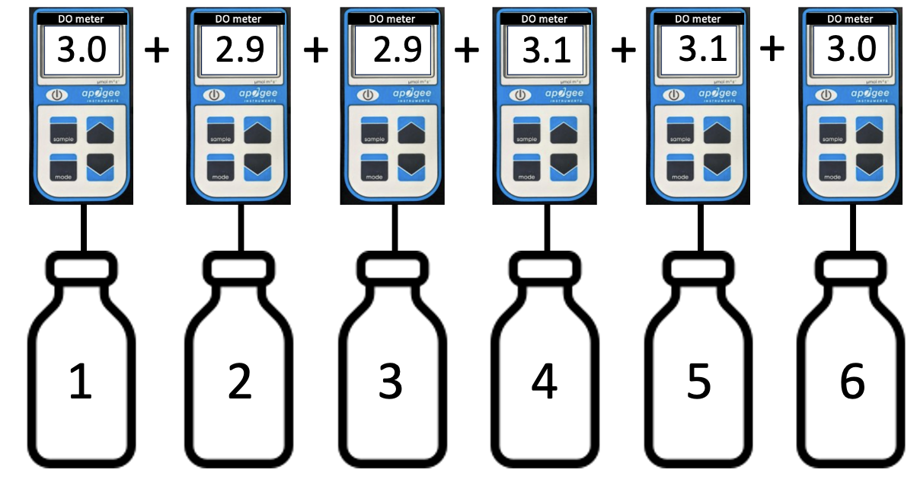
Step 4: 5 days later measure mean DO again.
For example,
= 18
6 bottles
equals….
3ppm

Slide 7
Step 5: Day 1 mean DO minus Day 5 mean DO equals BOD!
5ppm
3ppm
= 2ppm
Day 1
Day 5

Slide 8
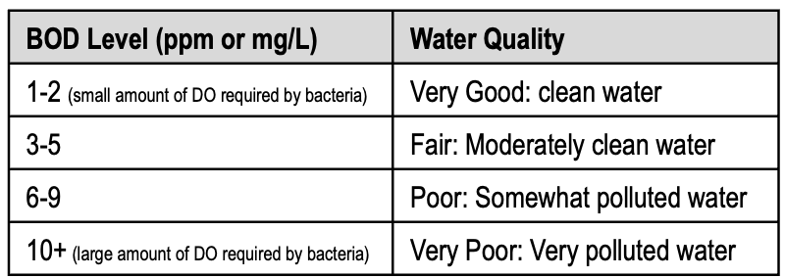
Step 6: Use the table below to determine water quality

Slide 9
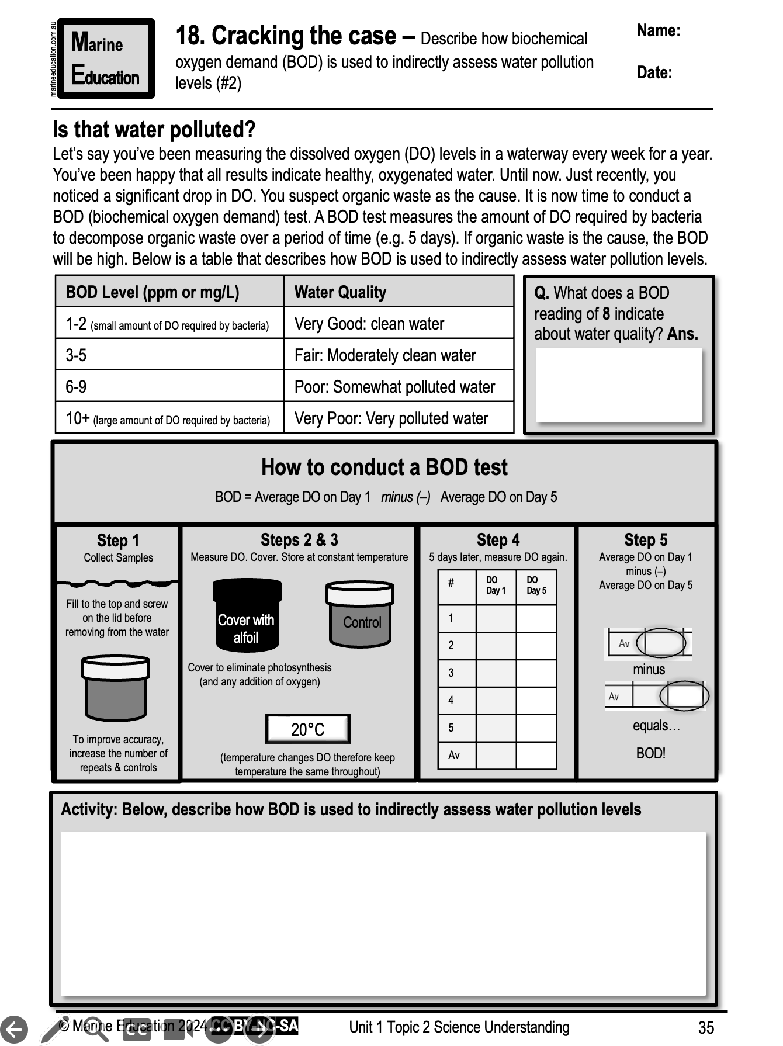
Learning Intention:
Describe how BOD is used to indirectly assess water pollution levels
(worksheet #2)
Success Criteria:
Complete Marine Education worksheet ‘Cracking the case’
Notes:
Image: https://publiclab.org/notes/stevie/01-17-2020/how-to-collect-a-water-sample

