Slide 1

Learning Intention:
Explain how marine ecosystems are influenced and limited by abiotic factors differently than terrestrial ecosystems due to the different physical and chemical properties of water , e.g. light availability, buoyancy, pressure, temperature, viscosity, sound, salinity and sediment loading.
Success Criteria:
Complete Marine Education worksheet
‘18. Wrapped in Water’
Lands meets Sea (artwork © Chloe Wigg)
Notes:
Image: https://artloversaustralia.com.au/product/land-meets-sea/

Slide 2
Water
vs
Land

Slide 3

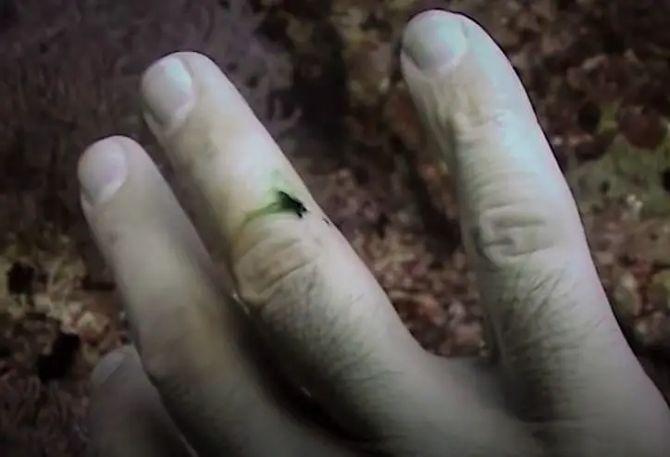
Light availability
Light availability

Slide 4
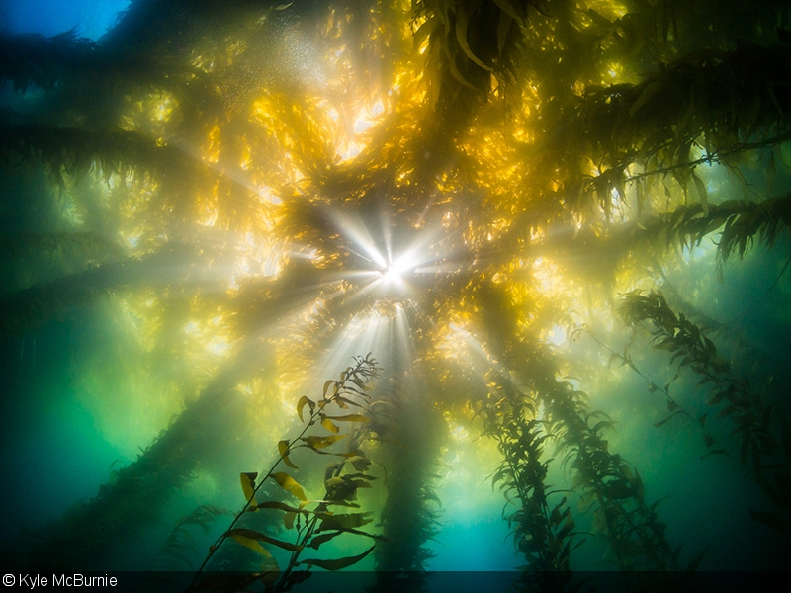
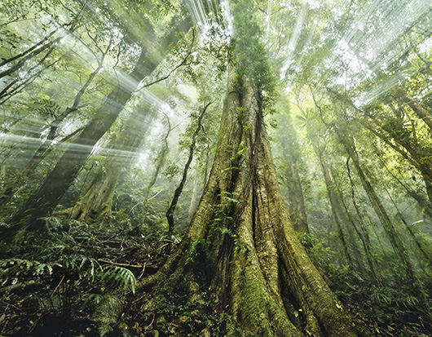
Light availability
Light availability
Kelp forest
Rainforest
Notes:
Image (left): https://www.divephotoguide.com/underwater-photography-techniques/article/underwater-photography-kelp-forests/
Image (right): https://www.australianphotography.com/news/10-essential-rainforest-photography-tips

Slide 5
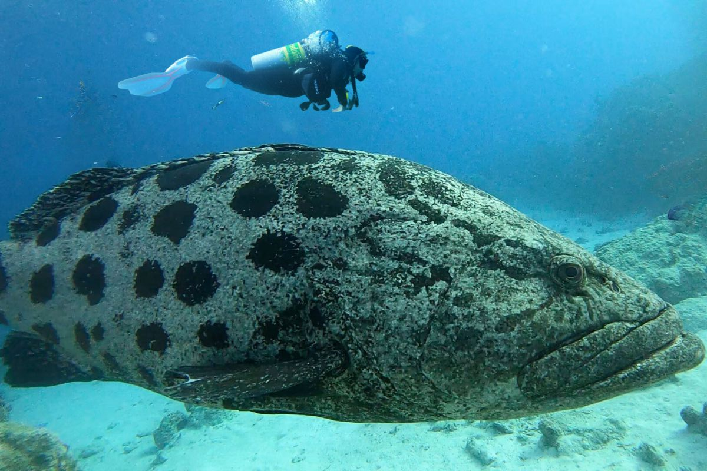
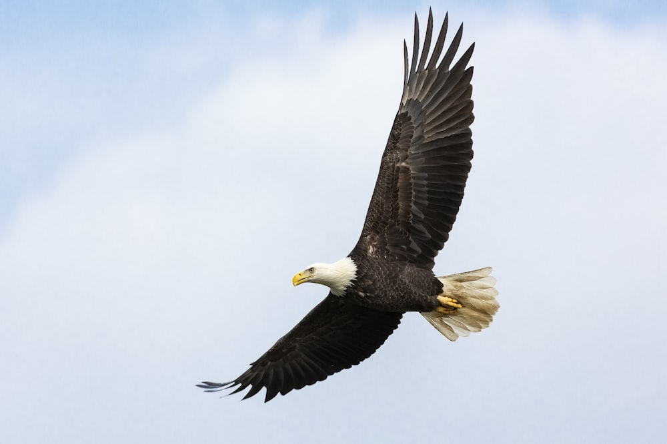
Buoyancy
Buoyancy
Diver needs a BCD (buoyancy control device) whereas most fish have a swim bladder to control their buoyancy

Slide 6
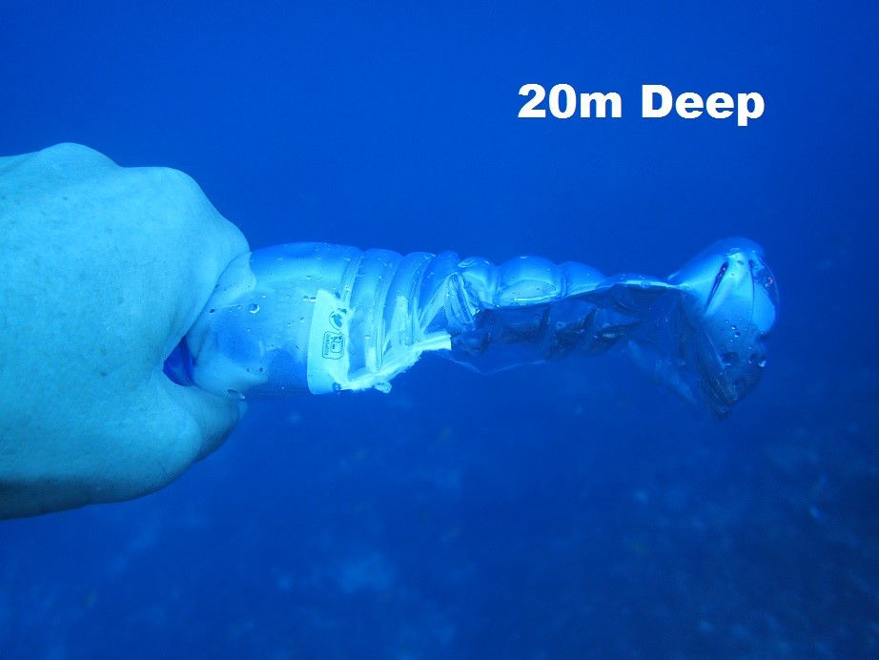
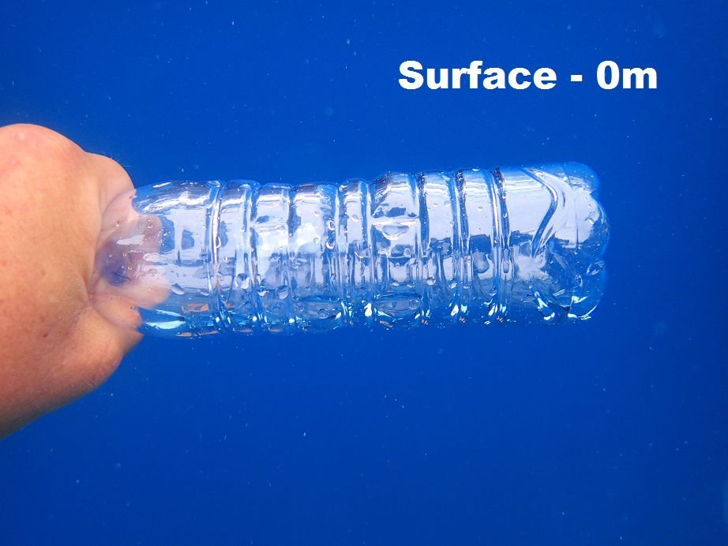
Pressure
Pressure
Pressure increases by 1 atmosphere every 10m
Notes:
Images:https://www.tratenor.es/?k=effect-of-pressure-on-scuba-divers-at-varying-depths-kk-vQPA2euN

Slide 7
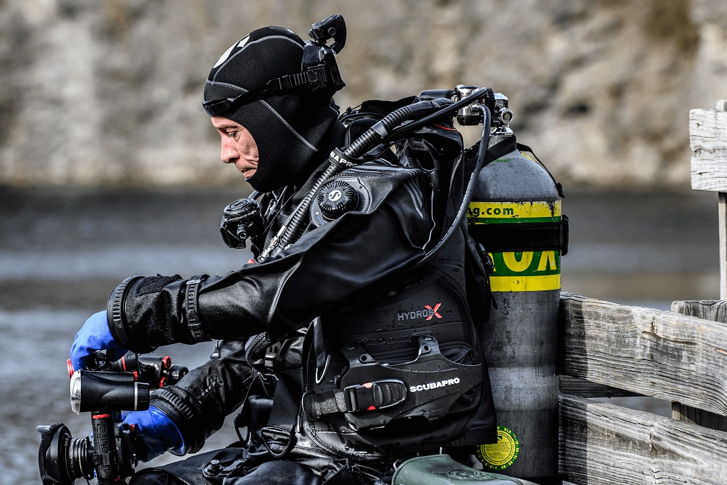

Temperature
Temperature
10 degrees C – you get colder faster in water than in air
10 degrees C

Slide 8
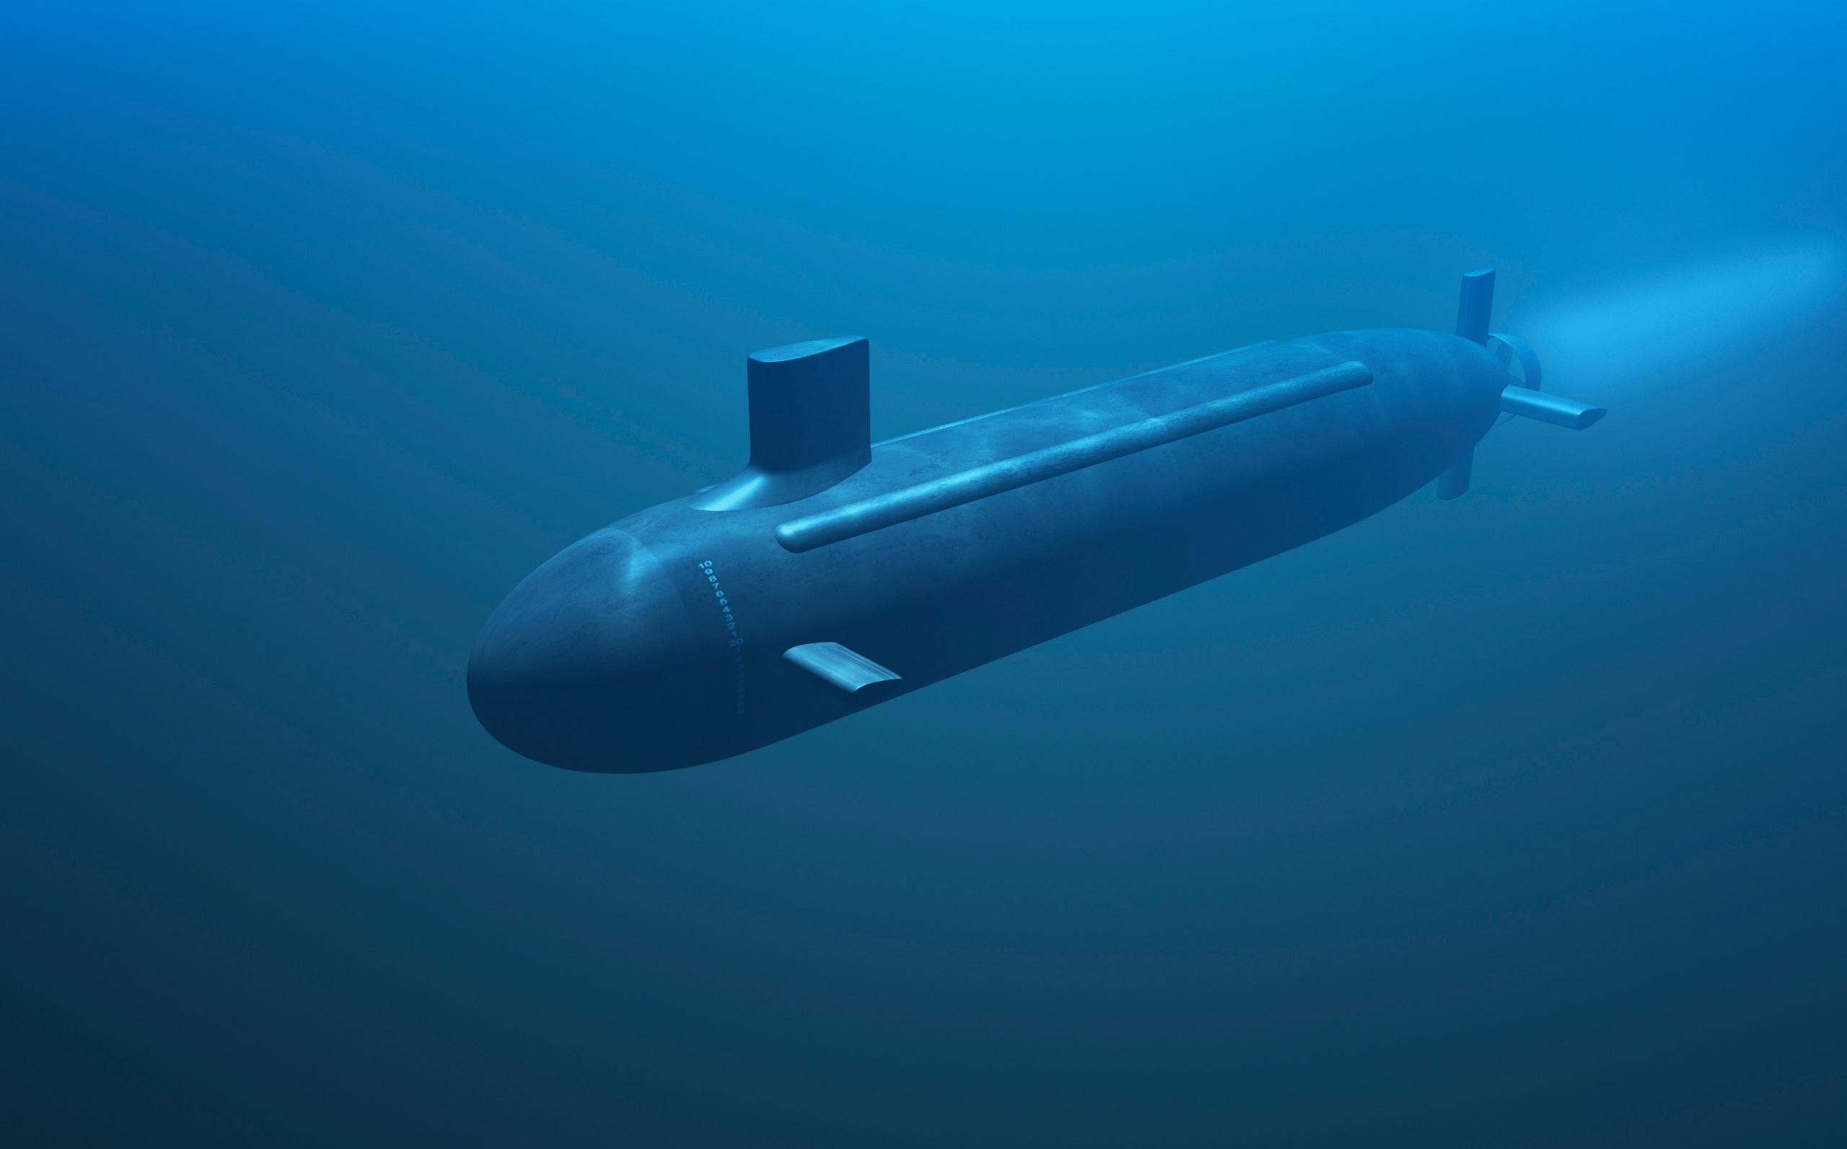

Viscosity
Viscosity
Viscosity is greater in water

Slide 9
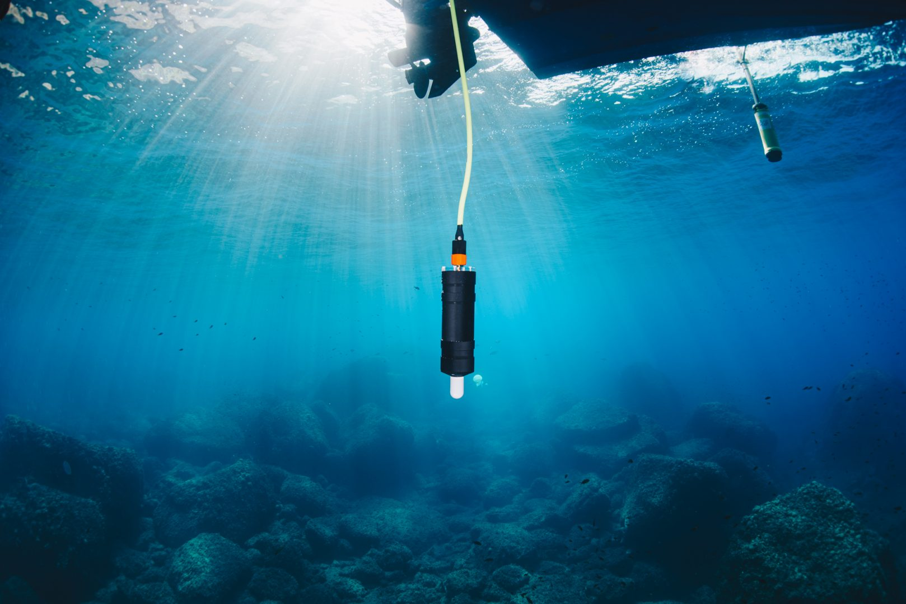
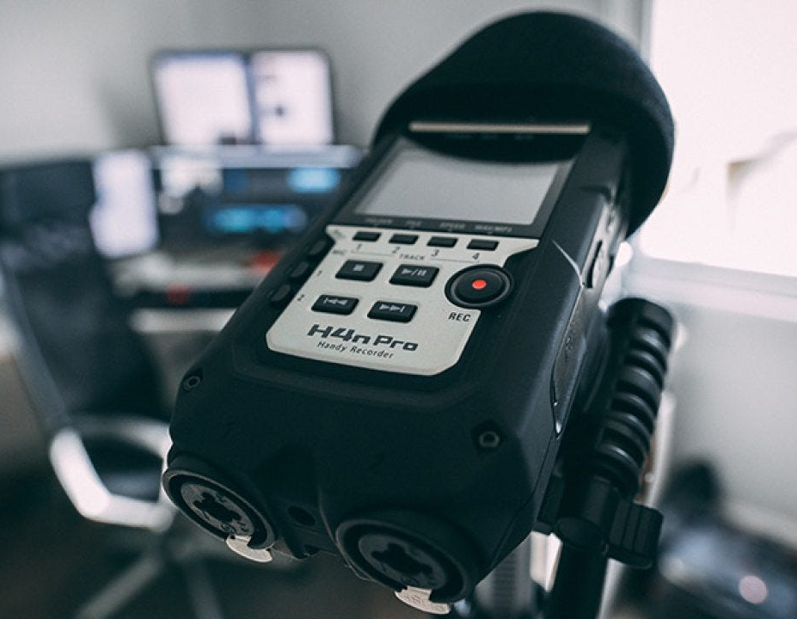
Sound
Sound
sound travels 4x faster in water

Slide 10
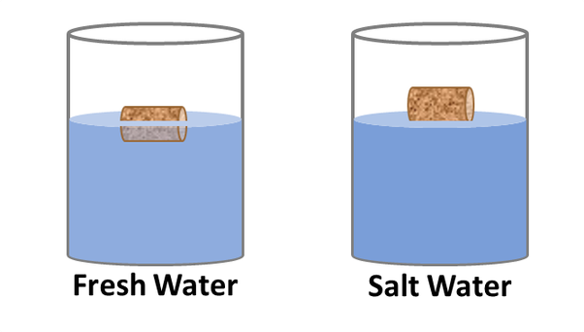
Salinity
Salinity
Items are more buoyant in salt water

Slide 11


Salinity
Salinity
gains salt
I’m so thirsty!
freshwater fish
saltwater fish
loses salt
Osmosis causes salt to enter the salt-water fish
Osmosis causes salt to exit the fresh-water fish

Slide 12
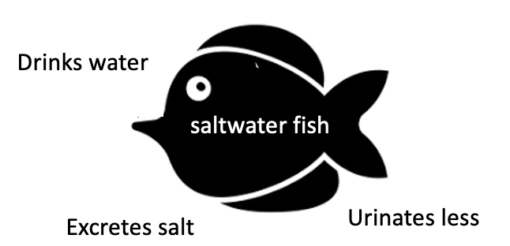

Salinity
Salinity
Drinks less
freshwater fish
Absorbs salt
Urinates more
loses salt
Salt-water fish drink lots of sea water, urinate less, and excrete salt ions out from their gills.
Fresh-water fish by not drink water, urinate more, and absorb salt ions in through their gills.
Notes:
Note: when they ‘drink’ the water, instead of swallowing it, they push it out over the gills.

Slide 13
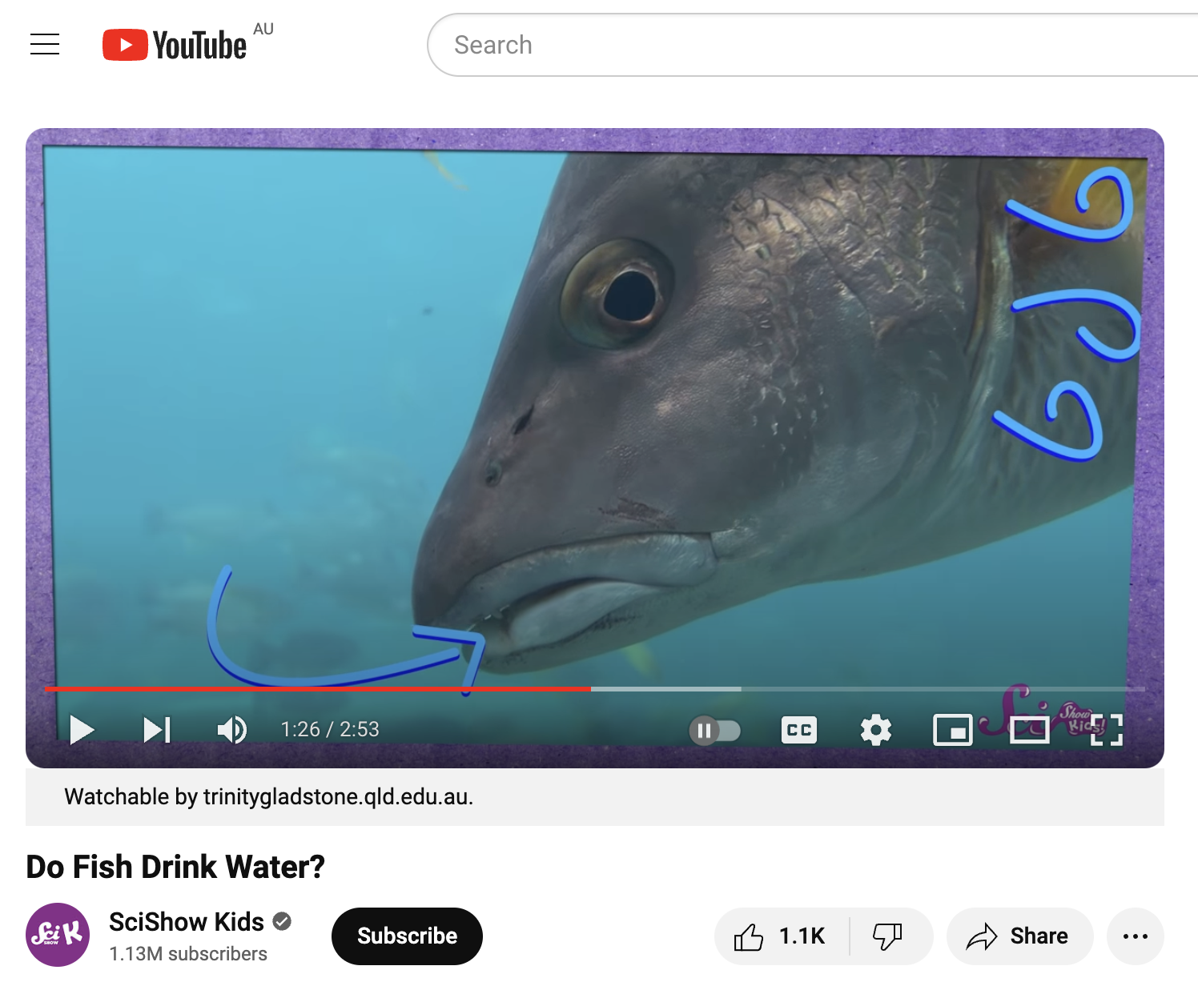
https://www.youtube.com/watch?v=LS8moIbGdnc&t=153s

Slide 14
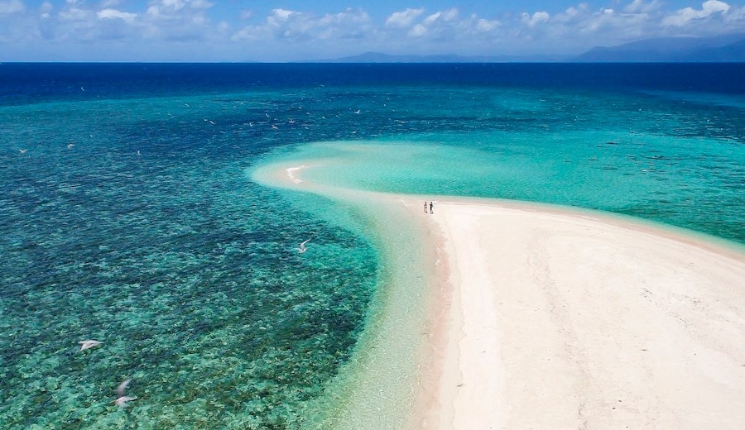
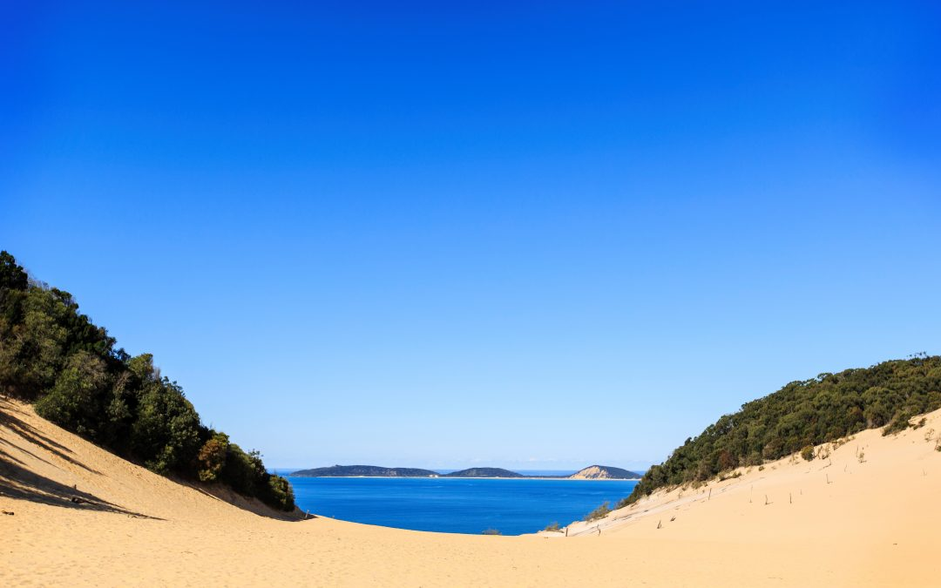
Sediment loading
Sediment loading

Slide 15
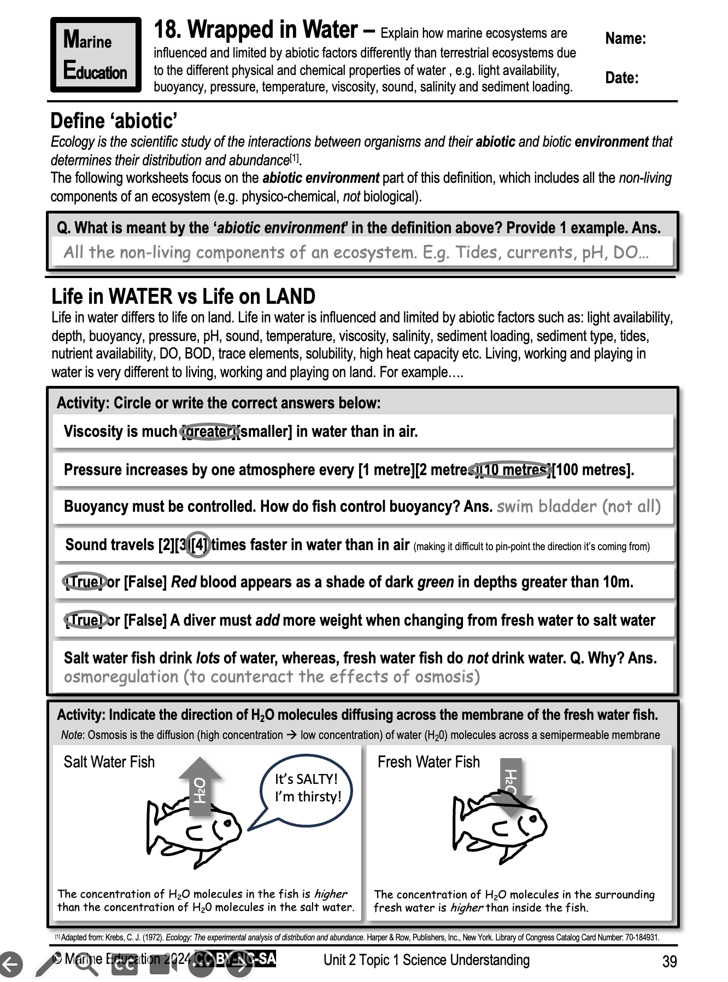
Learning Intention:
Explain how marine ecosystems are influenced and limited by abiotic factors differently than terrestrial ecosystems due to the different physical and chemical properties of water , e.g. light availability, buoyancy, pressure, temperature, viscosity, sound, salinity and sediment loading.
Success Criteria:
Complete Marine Education worksheet
‘18. Wrapped in Water’

