Slide 1
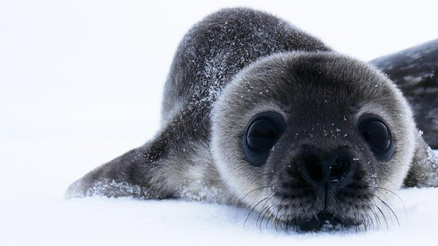
Learning Intention:
Explain the concepts of limiting factors and tolerance limits and their importance in population distributions.
Success Criteria:
Complete Marine
Education
worksheet
‘19. Shelford
and
Leibig’
Notes:
Image: https://www.pbs.org/wgbh/nova/video/antarctic-extremes-weddell-seals/

Slide 2
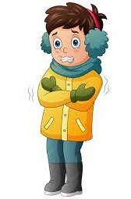
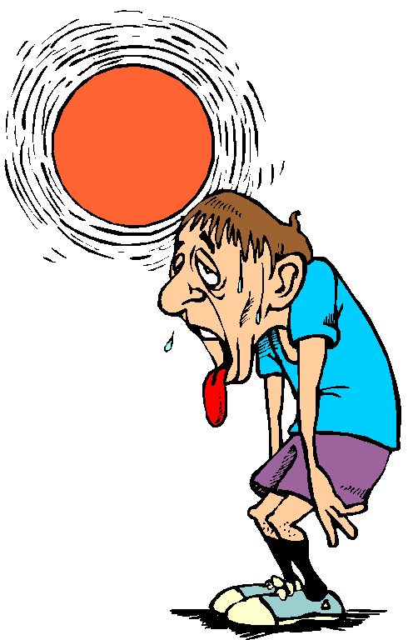
Populations have an upper limit and a lower limit to what conditions they can tolerate
Too cold
Too hot
Notes:
Image: https://www.antarctica.gov.au/about-antarctica/animals/seals/weddell-seal/
Weddell seal near Mawson station Photo: Glenn Browning

Slide 3

Hence, populations grow in size where conditions are just right (for them specifically)
Just right
Notes:
Image: https://www.antarctica.gov.au/about-antarctica/animals/seals/weddell-seal/
Weddell seal near Mawson station Photo: Glenn Browning

Slide 4
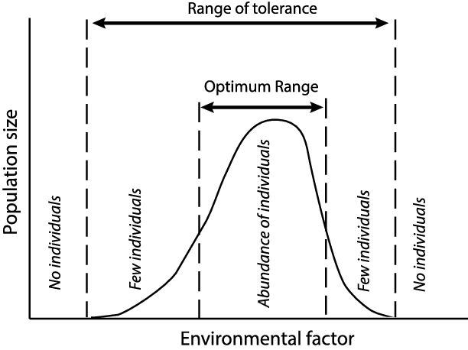
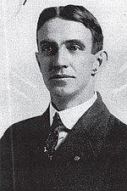
This is known as, “Shelford’s range of tolerance”
Victor E. Shelford
1877-1968
Notes:
Shelford Image: https://en.wikipedia.org/wiki/Victor_Ernest_Shelford

Slide 5
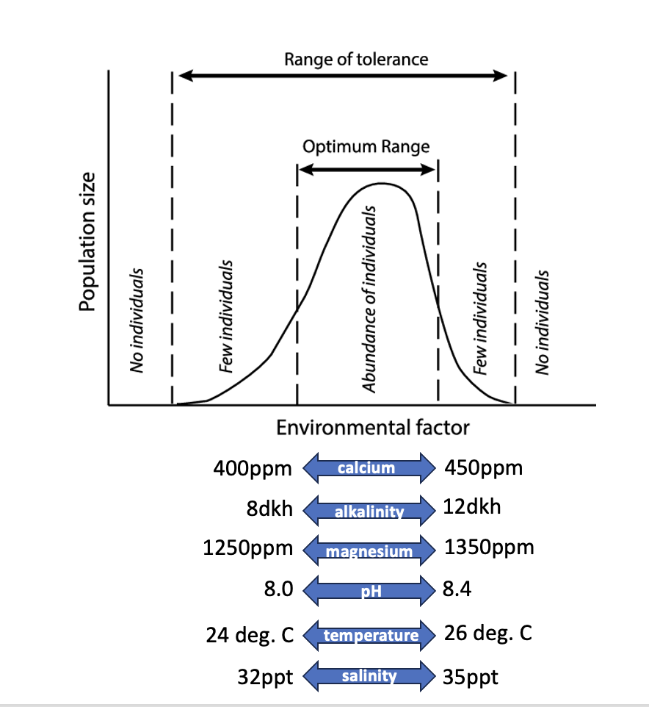
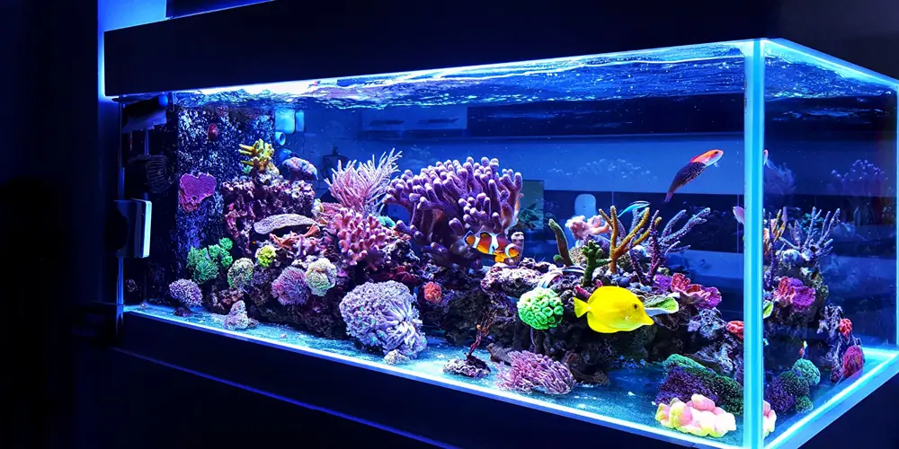
For example,
when growing coral in a tank….
for best results, you need water that has….
Calcium: 400-450ppm
Alkalinity: 8-12dkh
Magnesium: 1250-1350ppm
pH: 8-8.4
Temperature: 24-26 degrees C
Salinity: 32-35ppt
Phosphate: 0.02-0.05ppm
Ammonia: ZERO!
Nitrite: ZERO!
Nitrate: 0.025-5ppm

Slide 6
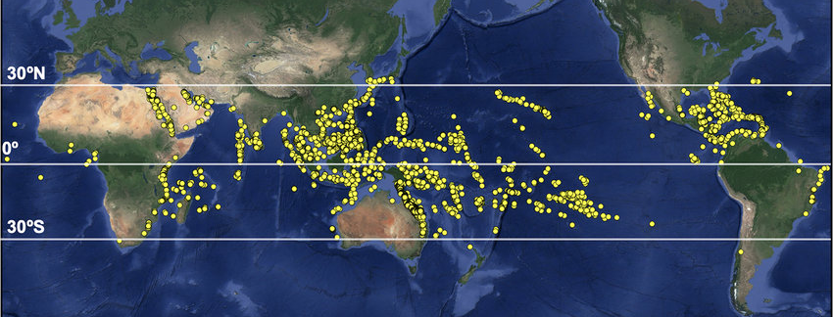
Where in the world is the water like this?
Where most corals are found of course!
Notes:
Image:

Slide 7
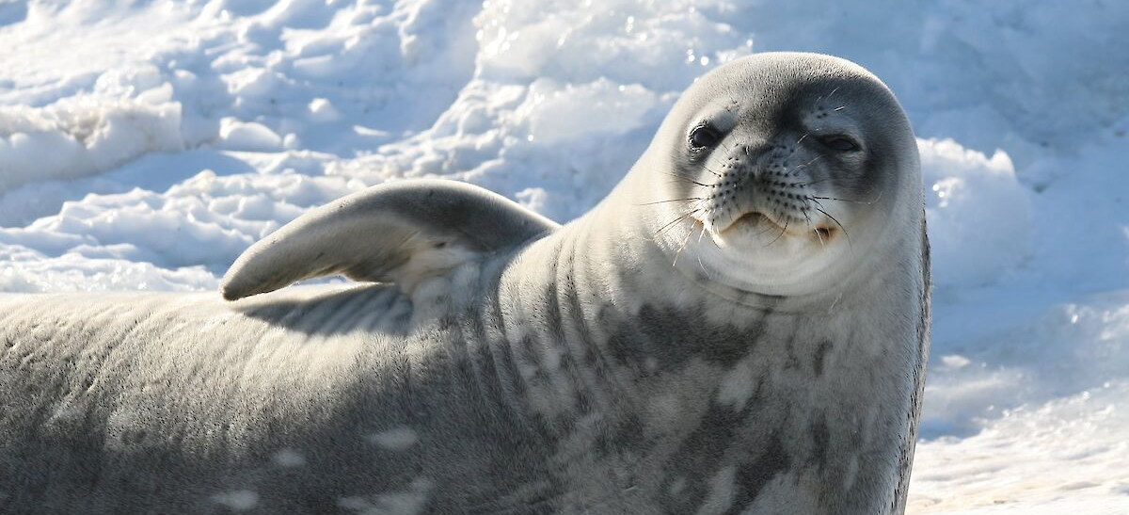
Individuals live where environmental conditions are within their optimum range of tolerance
E.g. Seals live where it’s cold
Notes:
Image: https://www.antarctica.gov.au/about-antarctica/animals/seals/weddell-seal/
Weddell seal near Mawson station Photo: Glenn Browning

Slide 8
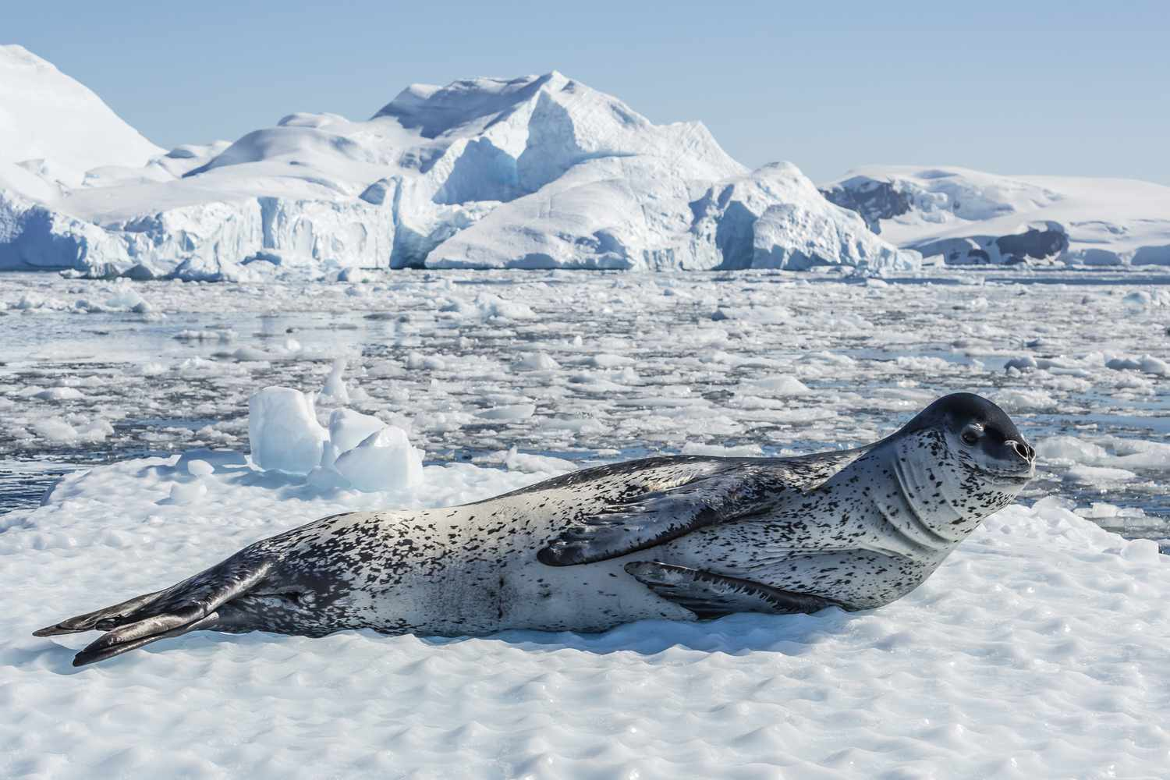
Which is why you don’t see many seals in Qld!
Adult leopard seal (Hydrurga leptonyx) on ice in Cierva Cove, Antarctic Peninsula, Antarctica, Southern Ocean, Polar Regions. Michael Nolan / robertharding / Getty Images
Notes:
Image: https://www.thoughtco.com/leopard-seal-facts-4155875

Slide 9
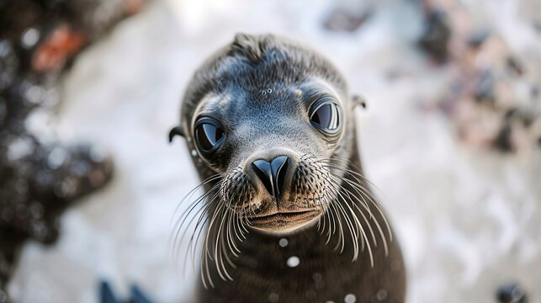
Notes:
Image: https://stock.adobe.com/search/images?k=antarctica+seal

Slide 10
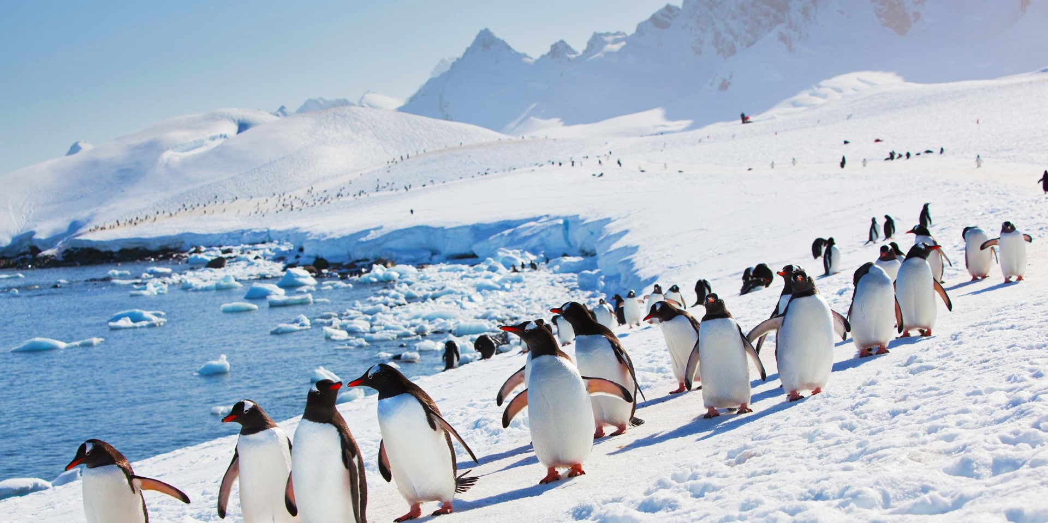
Another word to describe where populations live is their ‘distribution’.
Notes:
Image: https://www.hurtigruten.com/en-au/expeditions/stories/meet-the-penguins-of-antarctica/

Slide 11
Populations are greatest in size in places that are within their optimum range of tolerance

Slide 12
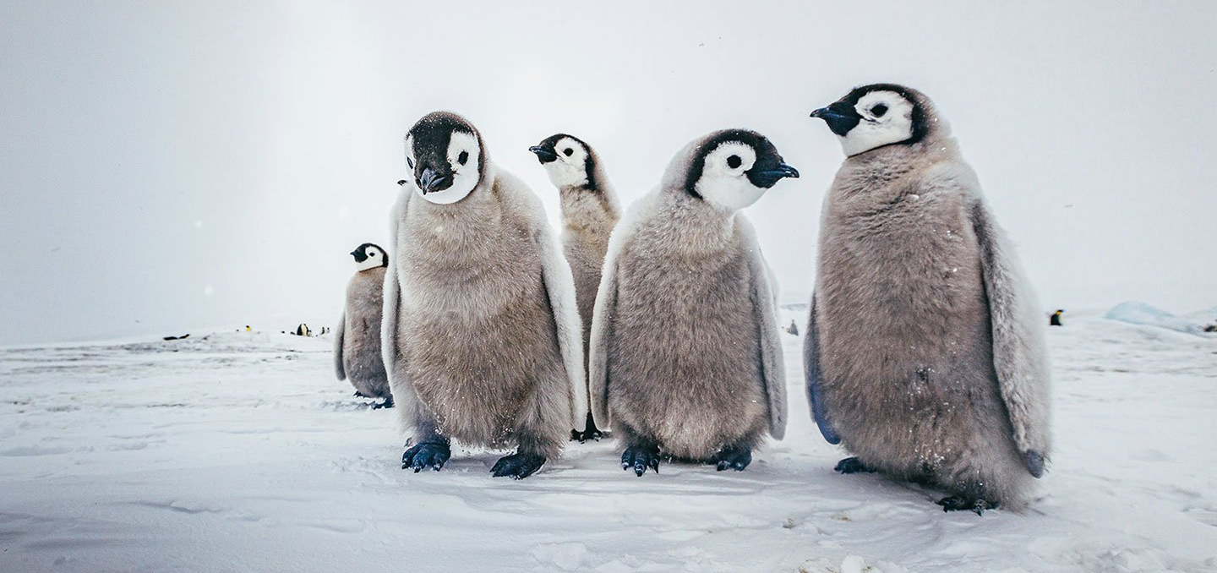
Wherever that is!
Notes:
Image:

Slide 13
When an environmental factor goes beyond their optimum range of tolerance,
individuals start dying (or leaving – if they can) and the population size shrinks.

Slide 14
When an environmental factor goes beyond their range of tolerance altogether,
they die (or were never there in the first place)

Slide 15
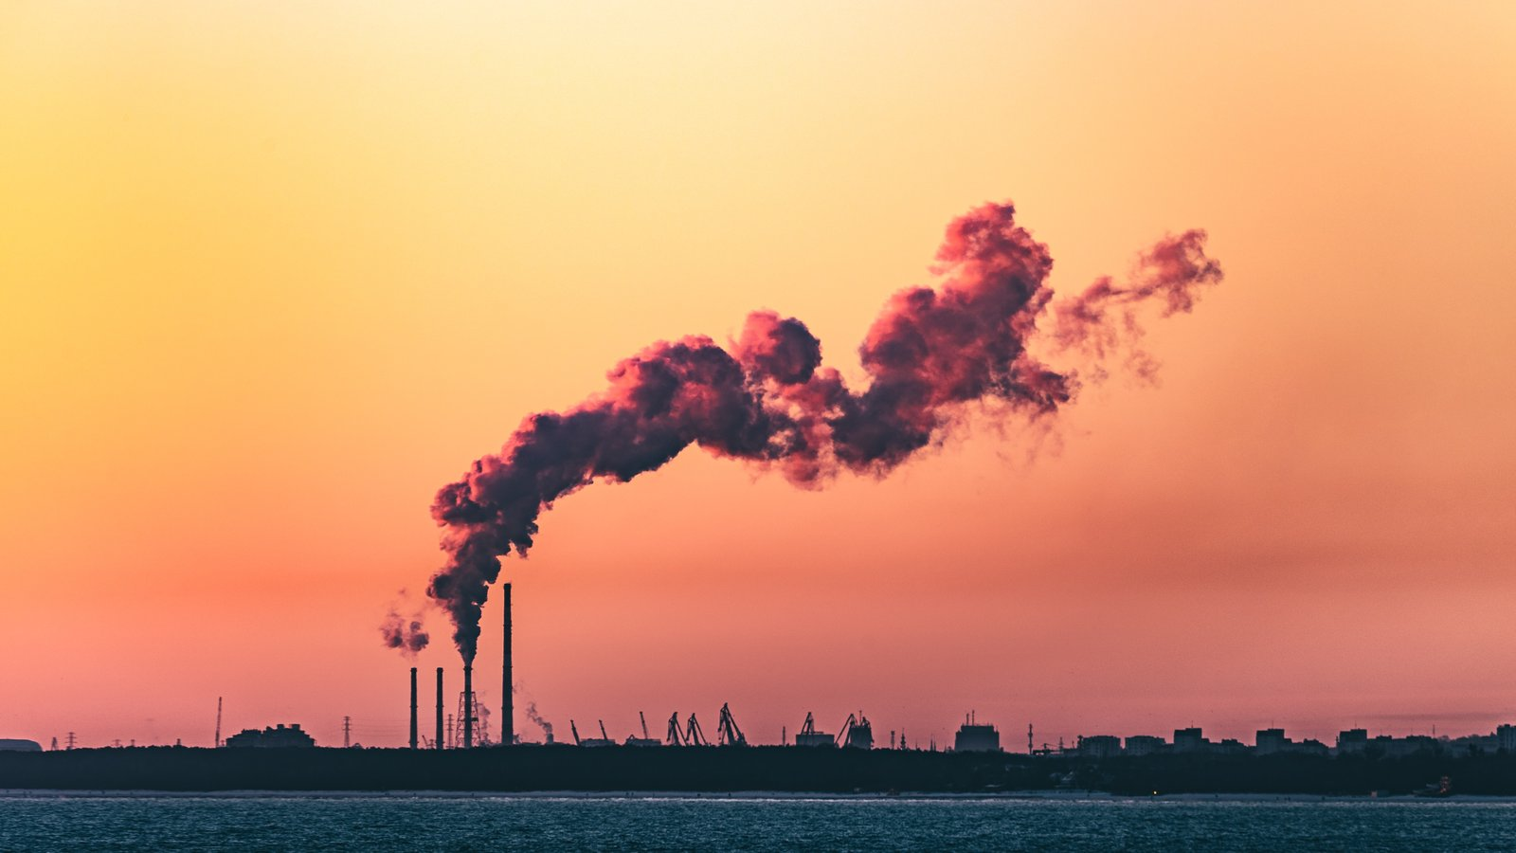
The climate is changing
Notes:
Image: https://www.globalcitizen.org/en/content/global-warming-everything-you-need-to-know/

Slide 16
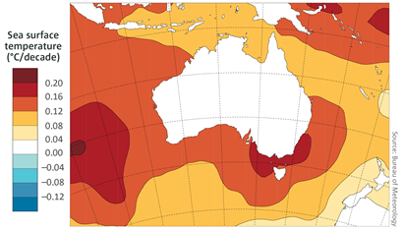
The water is warming
Trends in sea surface temperatures in the Australian region from 1950 to 2017 (data source: ERSST v5)

Slide 17
Species are finding themselves in conditions that are much warmer than what they’re used to

Slide 18
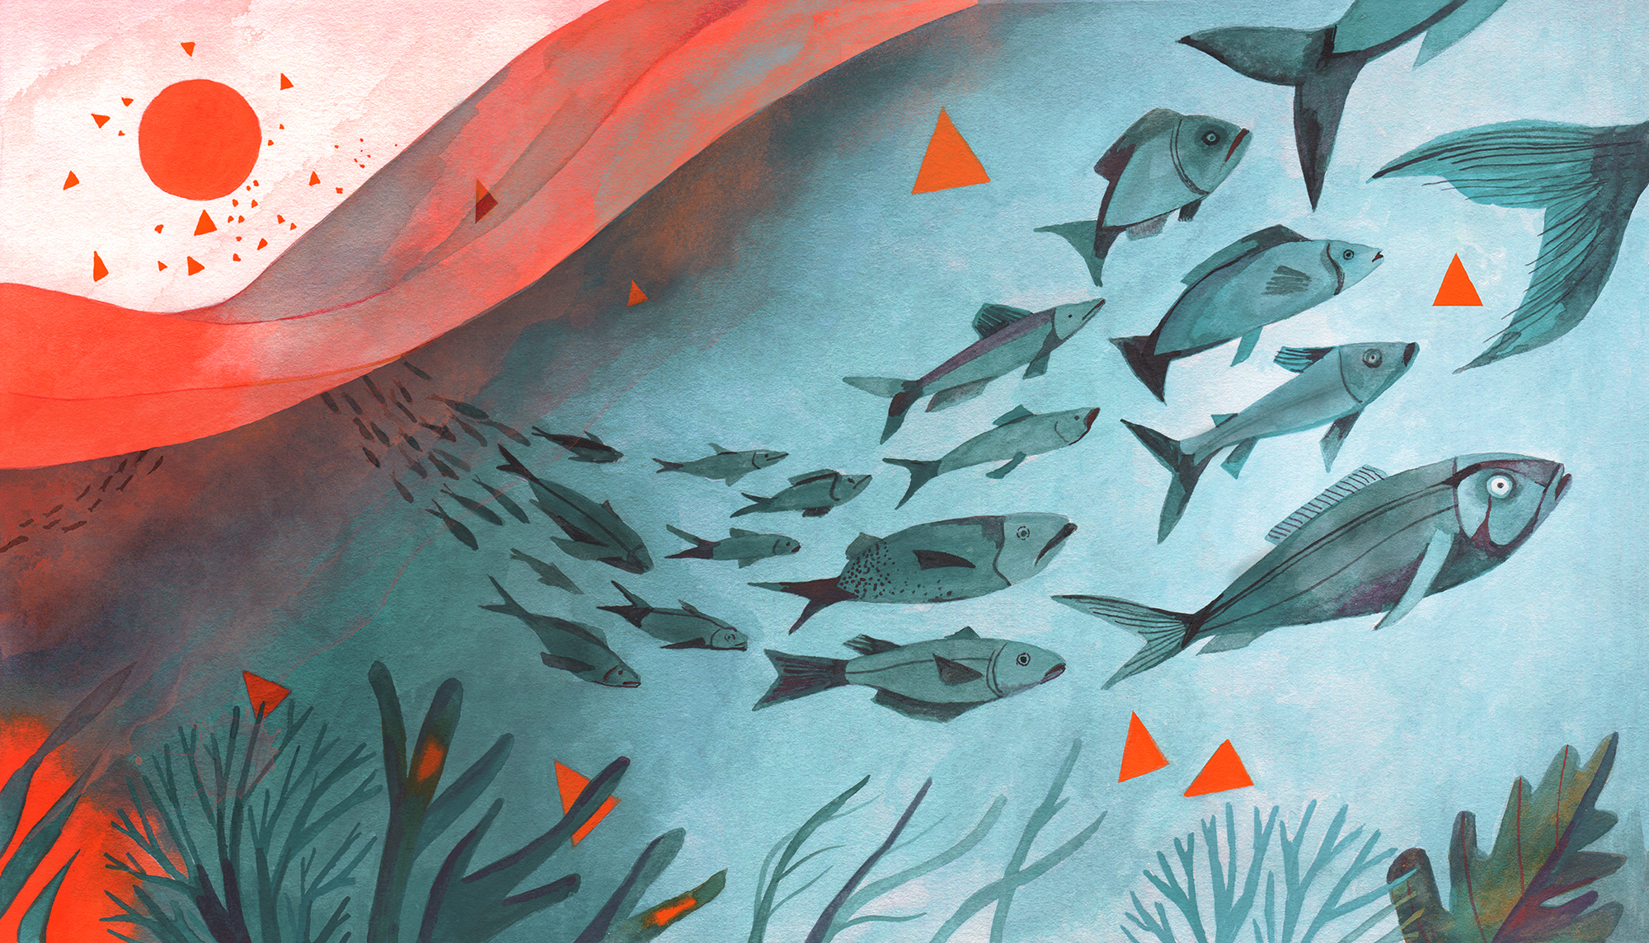
Those that still can, are leaving town
Illustration by Luisa Rivera/Yale E360
Notes:
Image: https://e360.yale.edu/features/feeling-the-heat-warming-oceans-drive-fish-into-cooler-waters
ILLUSTRATION BY LUISA RIVERA/YALE E360

Slide 19
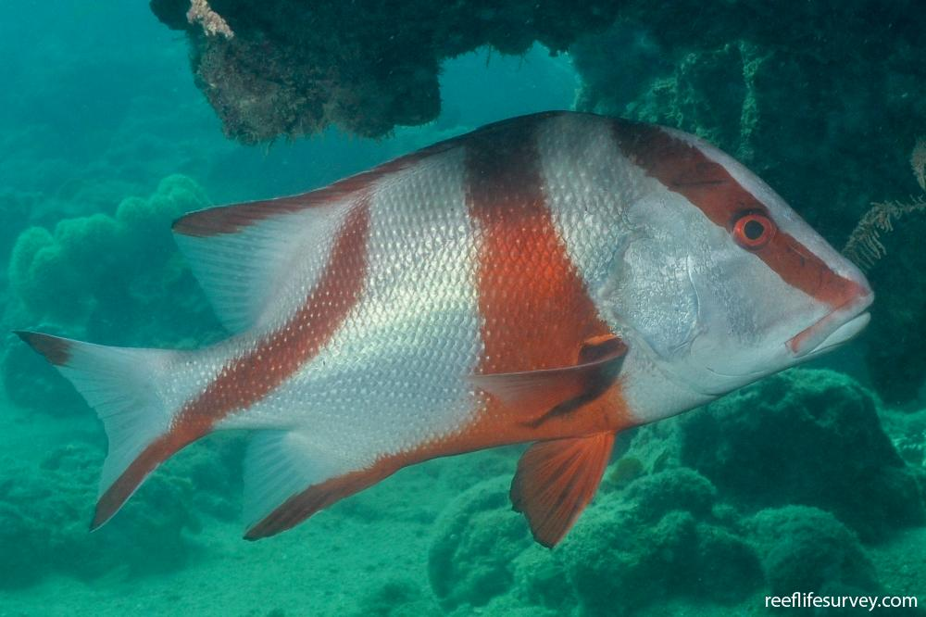
Examples of species that are on the move…
Red Emperer Lutjanus sebae
Notes:
Image and map: https://reeflifesurvey.com/species/lutjanus-sebae/
Info: https://www.redmap.org.au/media/uploads/2022/08/22/redmap_aus-report-poster_Q3rp3Ee.pdf

Slide 20
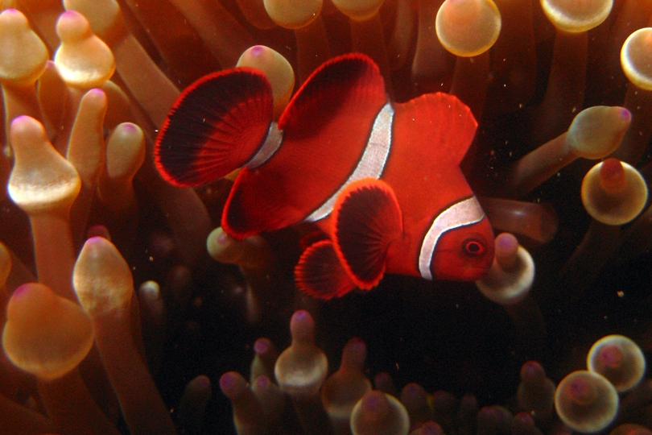
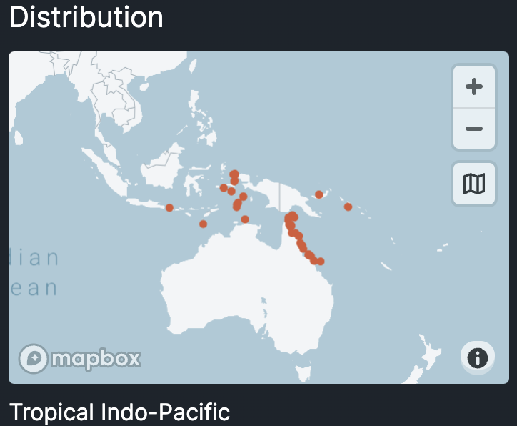
The spine-cheek clownfish
(Amphiprion biaculeatus) was spotted in southern Qld!
(source: redmap).
Notes:
Info: https://www.redmap.org.au/media/uploads/2022/08/22/redmap_aus-report-poster_Q3rp3Ee.pdf
Distribution map: https://reeflifesurvey.com/species/premnas-biaculeatus/

Slide 21
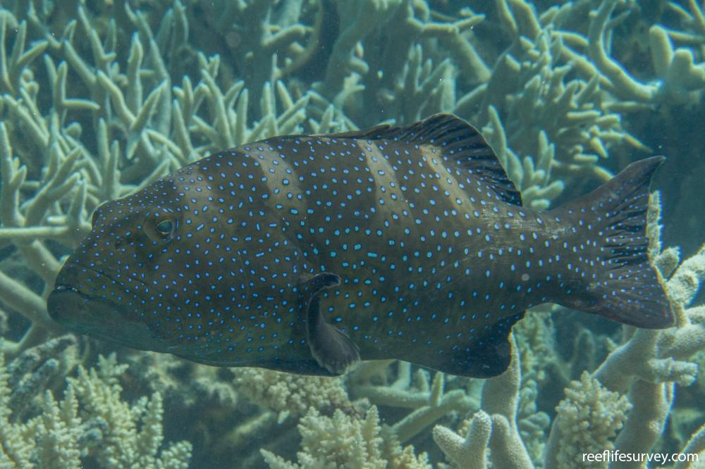
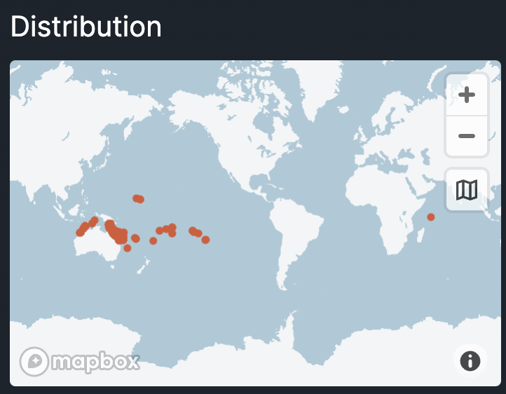
The Bluespotted
Coral Trout (Plectropomus laevis)
was spotted as far south as Victoria
(source: redmap).
Notes:
Info: https://www.redmap.org.au/media/uploads/2022/08/22/redmap_aus-report-poster_Q3rp3Ee.pdf
Image: https://reeflifesurvey.com/species/plectropomus-laevis/

Slide 22
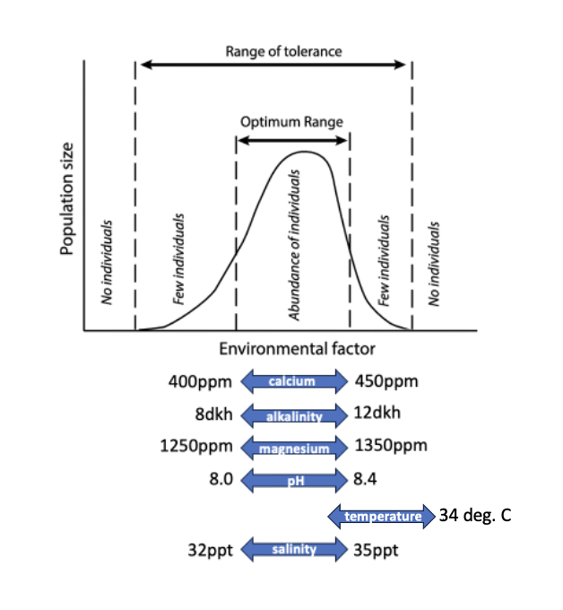
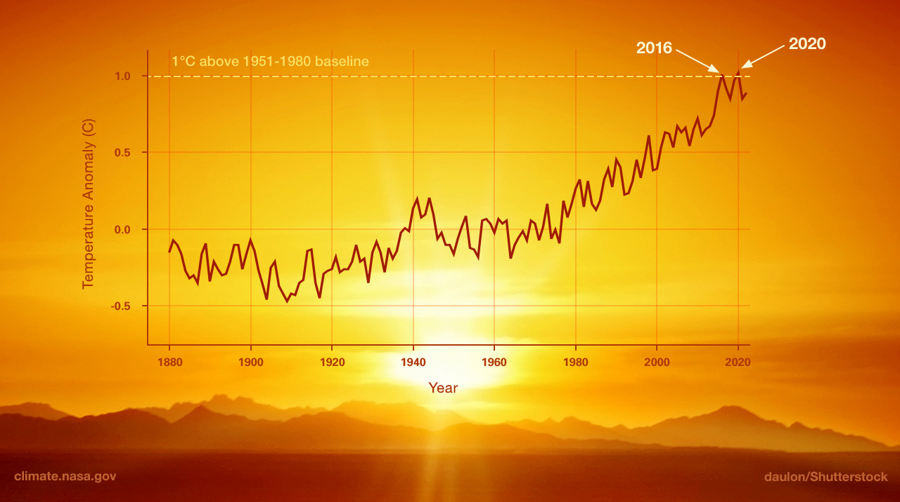
It only takes one factor to be outside a species range of tolerance for the population to be limited in its ability to survive, grow and reproduce there
(regardless of the quantity of other factors within its range of tolerance)
Notes:
Image: https://science.nasa.gov/climate-change/what-is-climate-change/

Slide 23
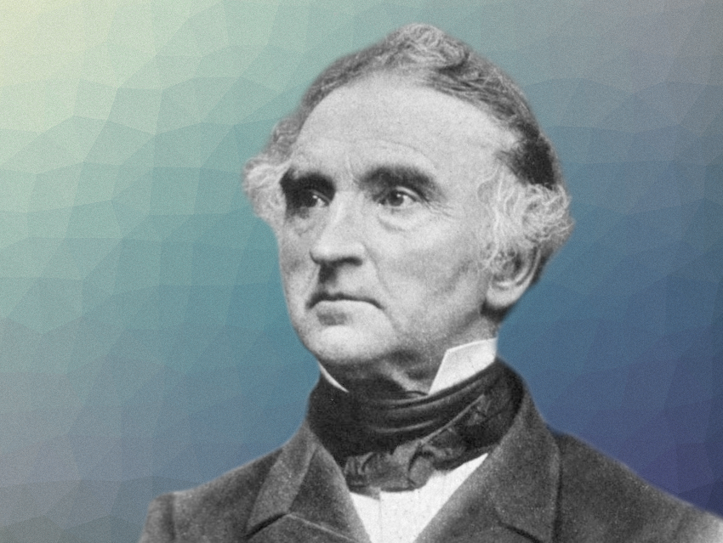
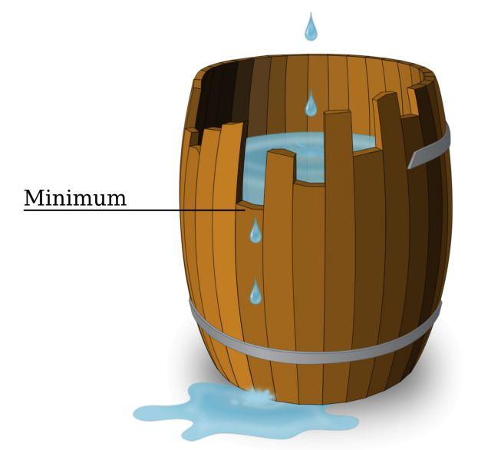
This is known as, ”Leibig’s Law of the Minimum”
Justus von Leibig (1803-1873)

Slide 24
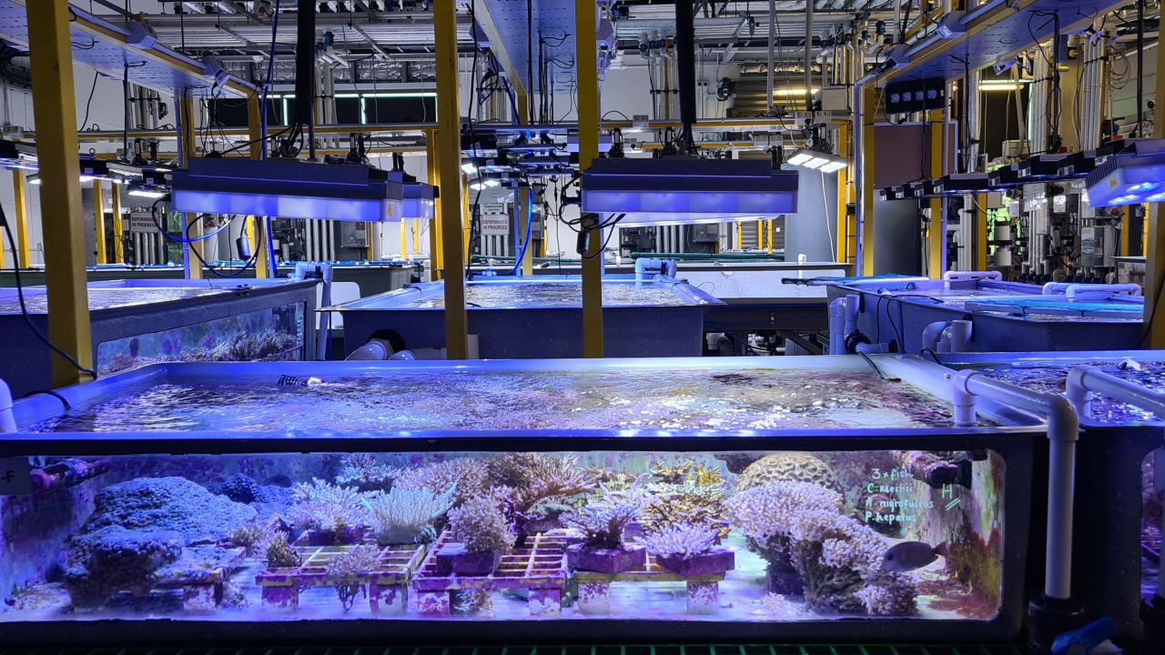
For example, if any one of these parameters is too low or too high, your corals will bleach
Calcium: 400-450ppm
Alkalinity: 8-12dkh
Magnesium: 1250-1350ppm
pH: 8-8.4
X Temperature: 34 degrees C
Salinity: 32-35ppt
Phosphate: 0.02-0.05ppm
Ammonia: ZERO!
Nitrite: ZERO!
Nitrate: 0.025-5ppm
Notes:
Image: https://atinorthamerica.com/blog/water-quality-for-reef-tanks-part-1-the-most-important-parameters/

Slide 25
Similarly, if that ONE parameter is brought back, so that ALL parameters are now within the coral’s optimum range of tolerance, the corals will start to grow again ☺
Calcium: 400-450ppm
Alkalinity: 8-12dkh
Magnesium: 1250-1350ppm
pH: 8-8.4
Temperature: 24-26 degrees C
Salinity: 32-35ppt
Phosphate: 0.02-0.05ppm
Ammonia: ZERO!
Nitrite: ZERO!
Nitrate: 0.025-5ppm
☺
Notes:
Image: https://atinorthamerica.com/blog/water-quality-for-reef-tanks-part-1-the-most-important-parameters/

Slide 26
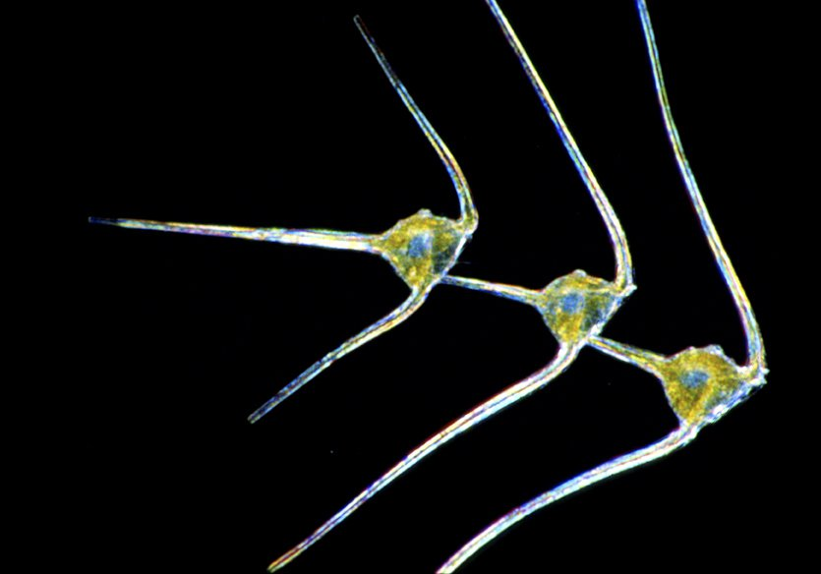
Here is another example….
Unlike coral
phytoplankton
love
nutrients
Notes:
Image: https://australian.museum/learn/animals/plankton/phytoplankton/

Slide 27
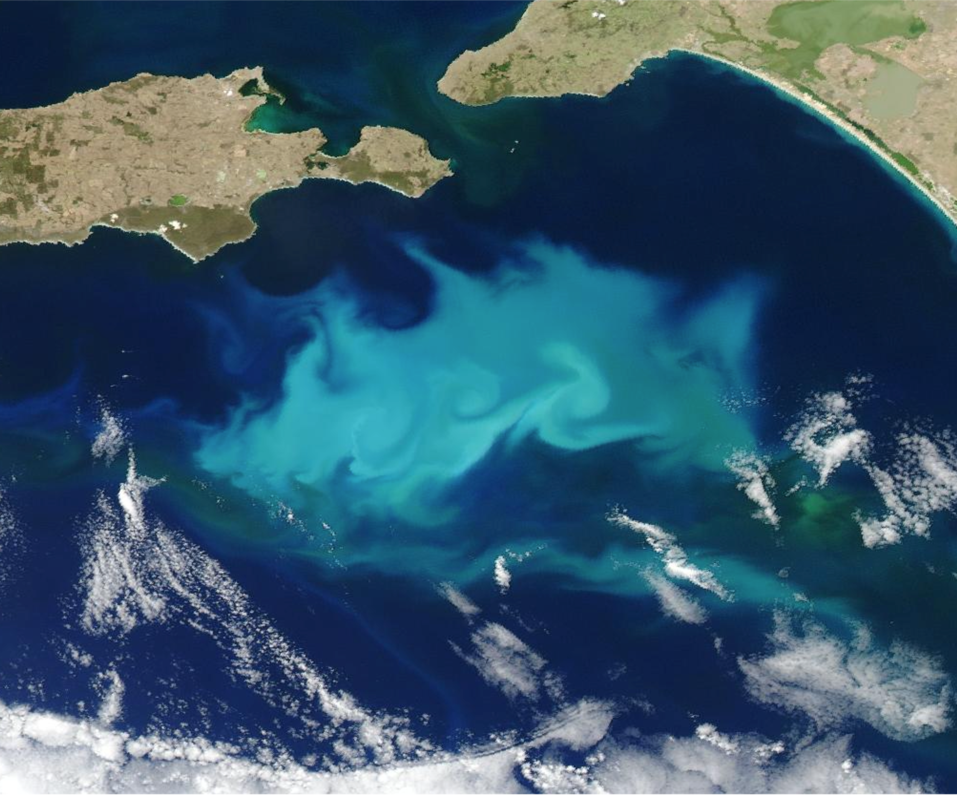
South Australia
Only where there’s nutrients
(i.e. upwellings)
do phytoplankton bloom.
Nutrients are often the limiting factor for phytoplankton.
Kangaroo Island
Phytoplankton bloom
nutrients
Notes:
Image: https://oceancurrent.aodn.org.au/news.php

Slide 28

Phytoplankton also
need
sunlight
Notes:
Image: https://australian.museum/learn/animals/plankton/phytoplankton/

Slide 29
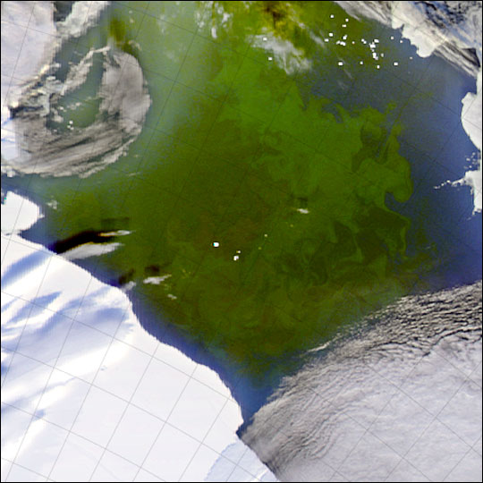
In Antarctica
in winter
(when it’s always dark)
sunlight is the limiting factor for phytoplankton.
(Lots of nutrients are already there)
Only when there’s sunlight in Antarctica, do phytoplankton
bloom.
Phytoplankton bloom
sun
Antarctica
Notes:
Image: https://earthobservatory.nasa.gov/images/5065/phytoplankton-bloom-in-the-ross-sea

Slide 30

E.g. the limiting factor is the paperclip

Slide 31
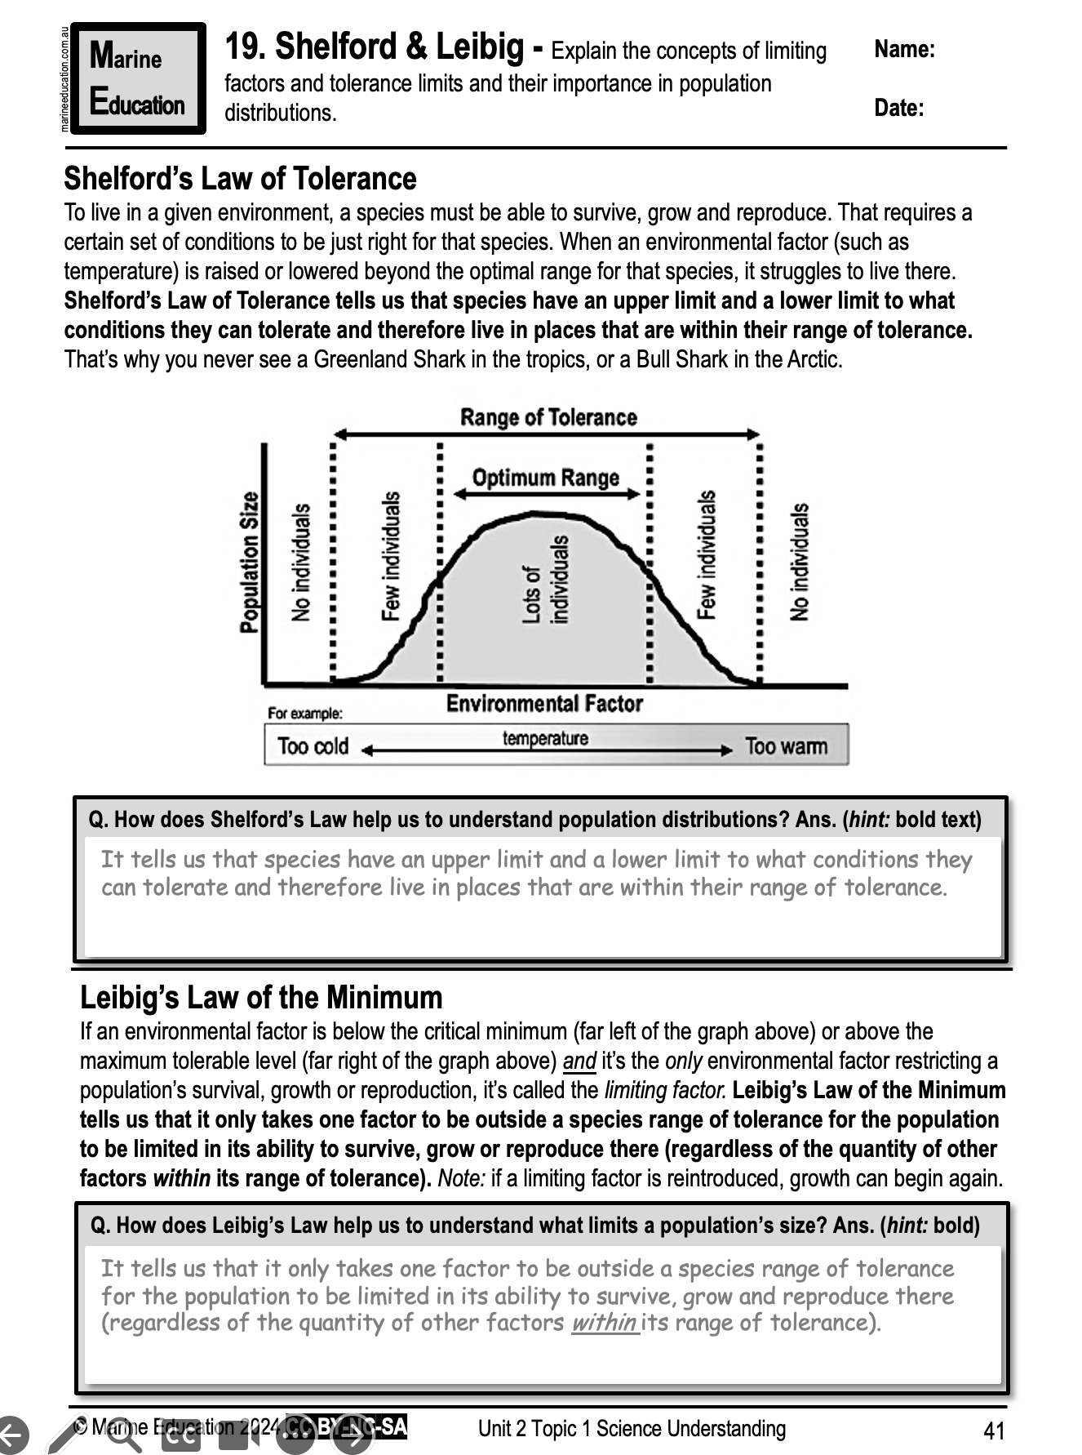
Learning Intention:
Explain the concepts of limiting factors and tolerance limits and their importance in population distributions.
Success Criteria:
Complete Marine
Education
worksheet
‘19. Shelford
and
Leibig’
Notes:
Image: https://www.pbs.org/wgbh/nova/video/antarctic-extremes-weddell-seals/

