Slide 1
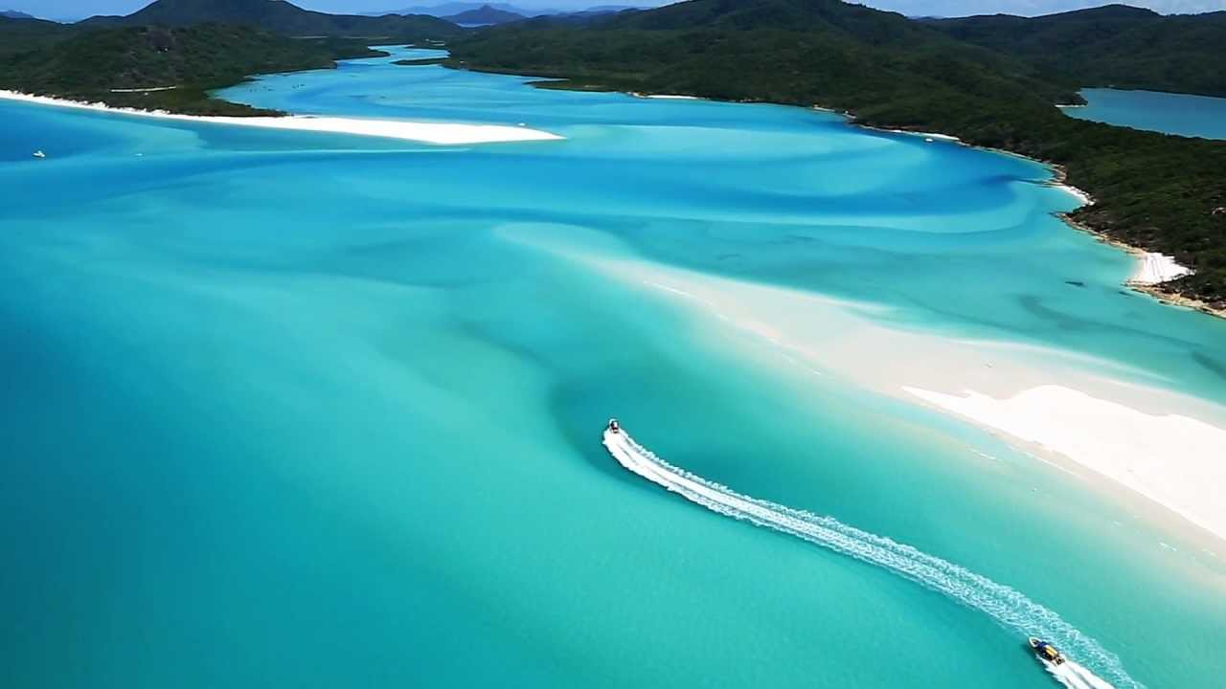
Learning Intention:
Apply models to understand the geological features of the Earth (e.g. sea floor modelling, tectonic plate movements, coastal landforms, stratigraphy)
Success Criteria:
Complete Marine Education worksheet ‘’2. Geology Rocks!’
Notes:
Image: https://medium.com/@amykwilson/weird-and-wonderful-creatures-of-the-deep-sea-66826a3ae5e4

Slide 2
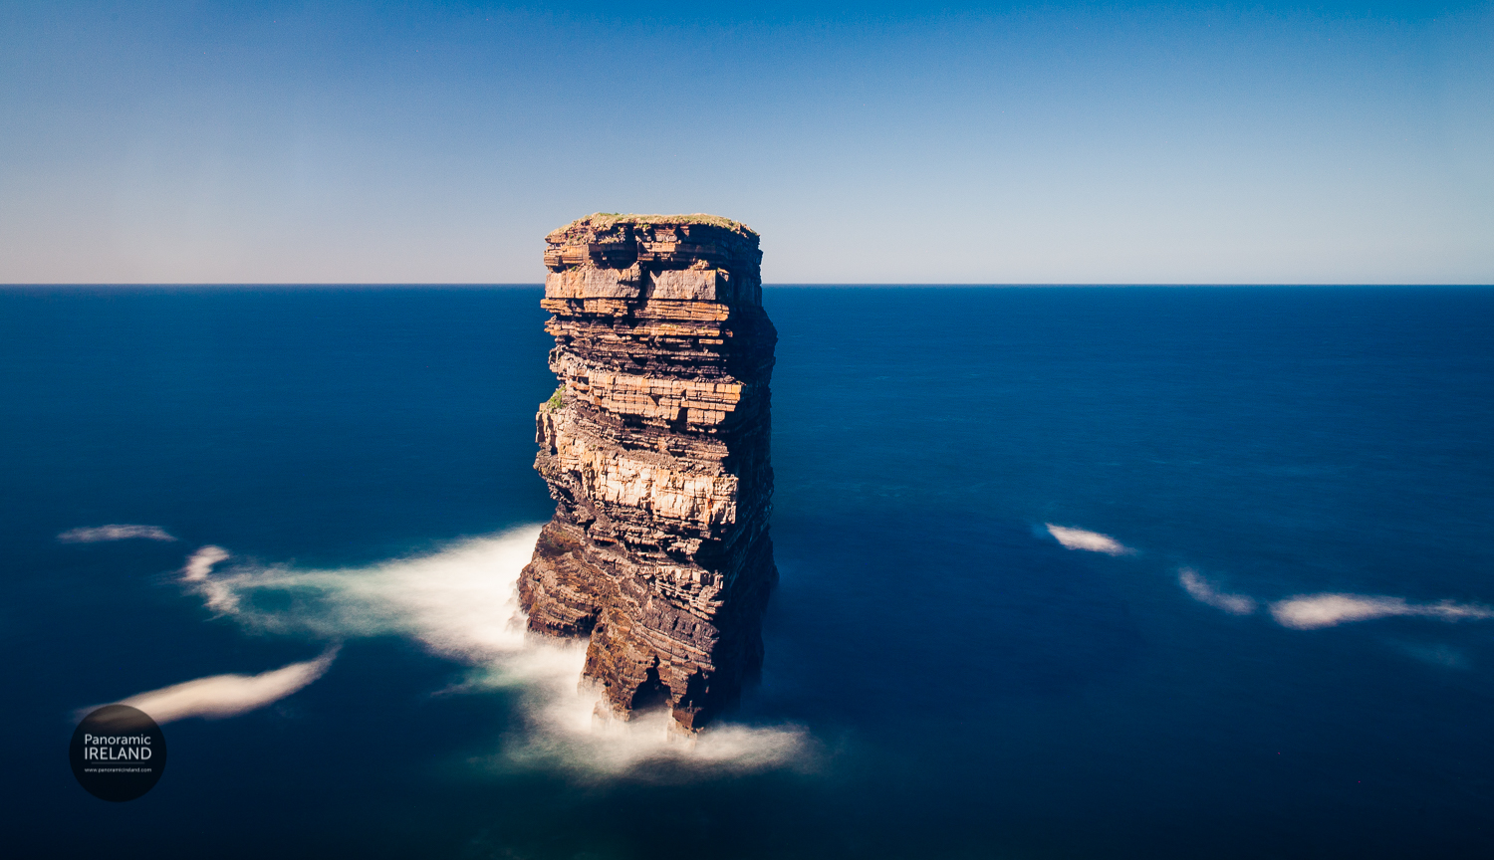
For every picture you see… try to work out how it was formed….
‘the broken fort’, Ireland

Slide 3
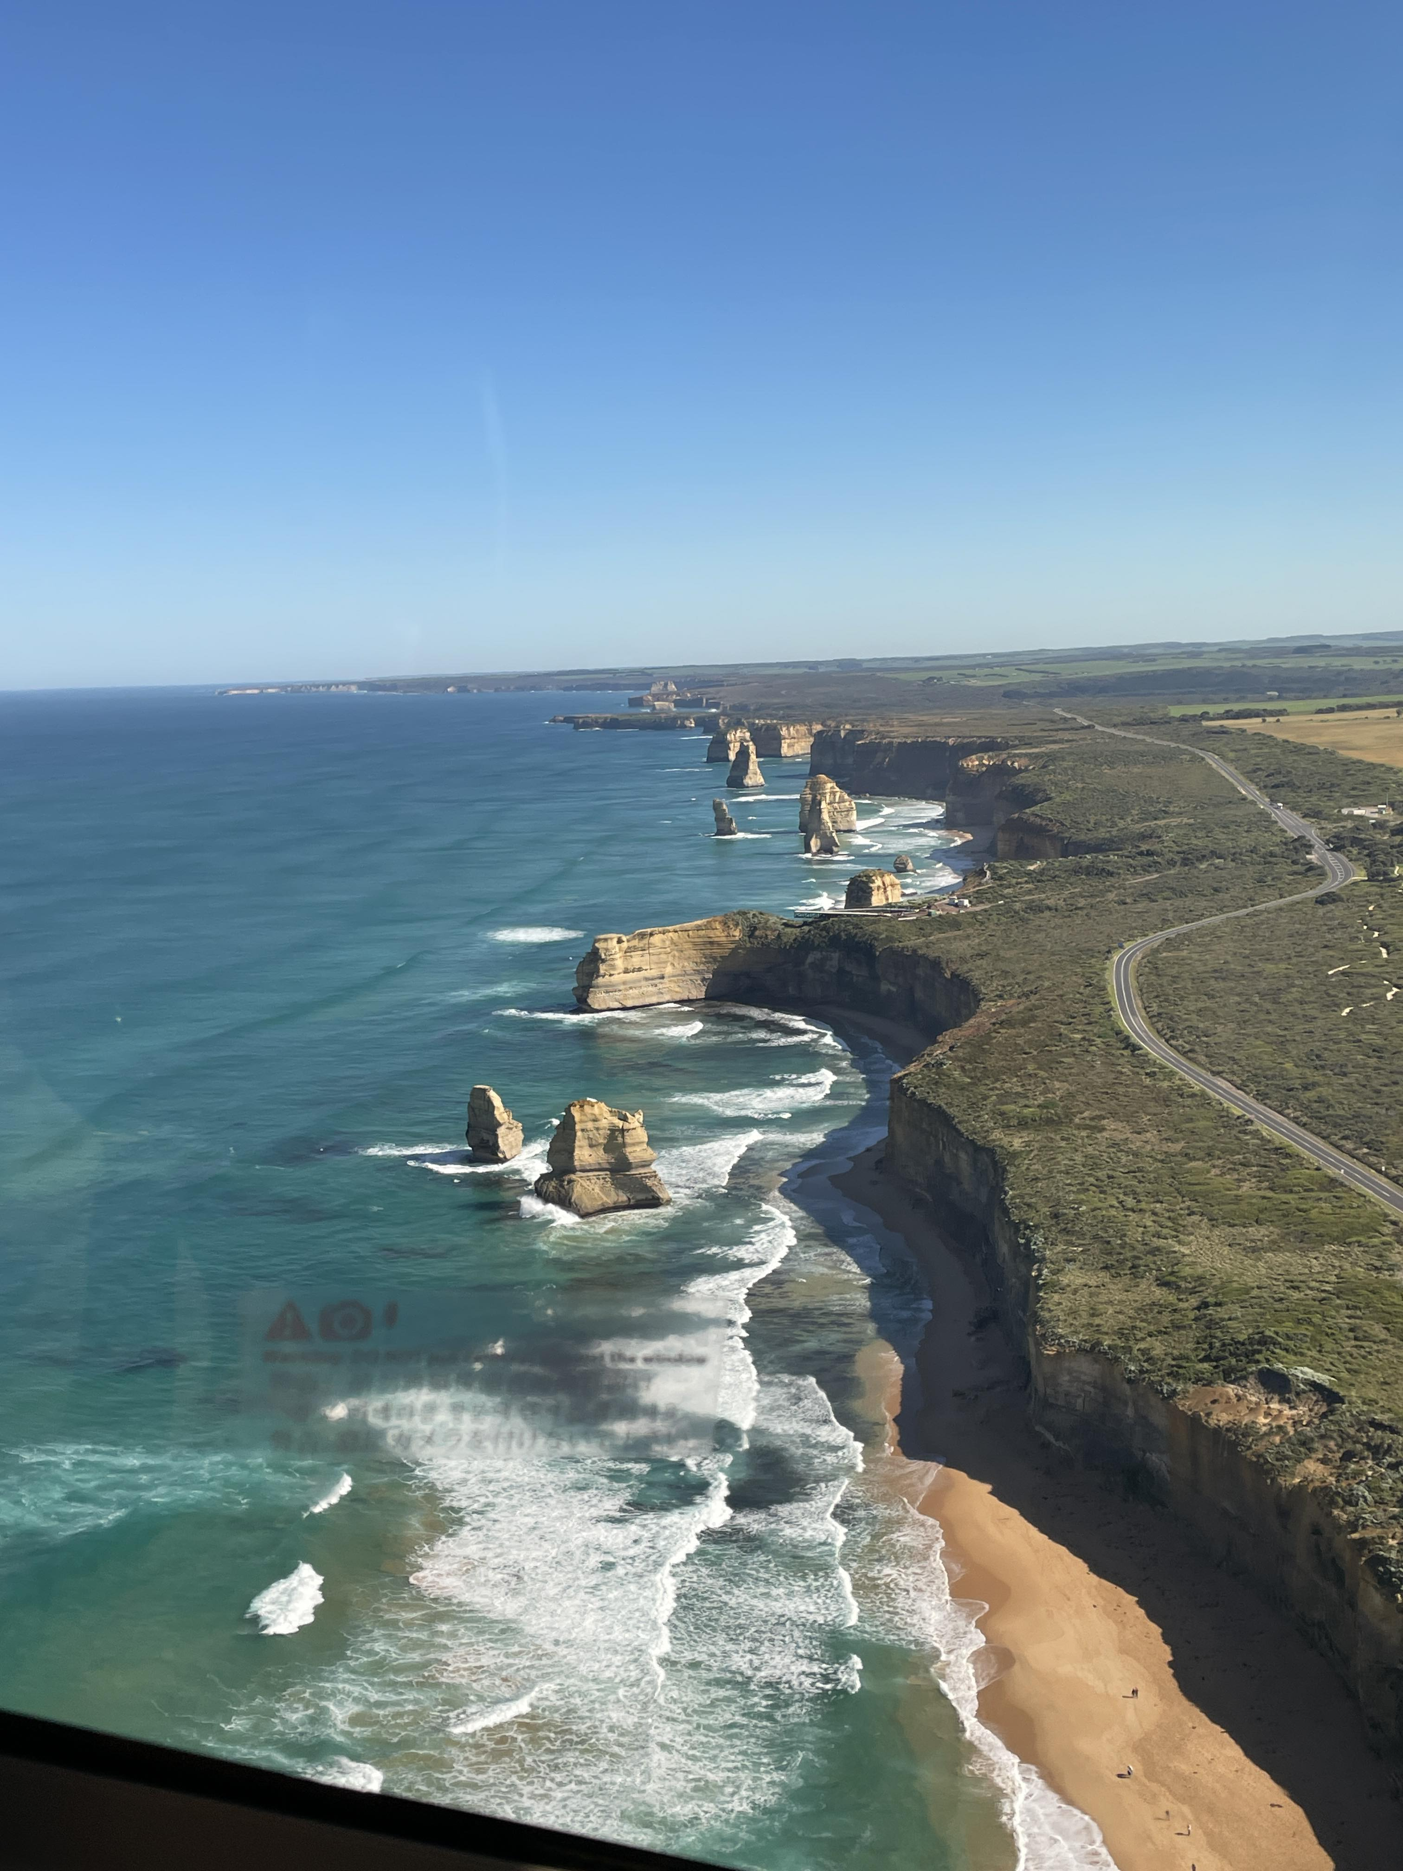
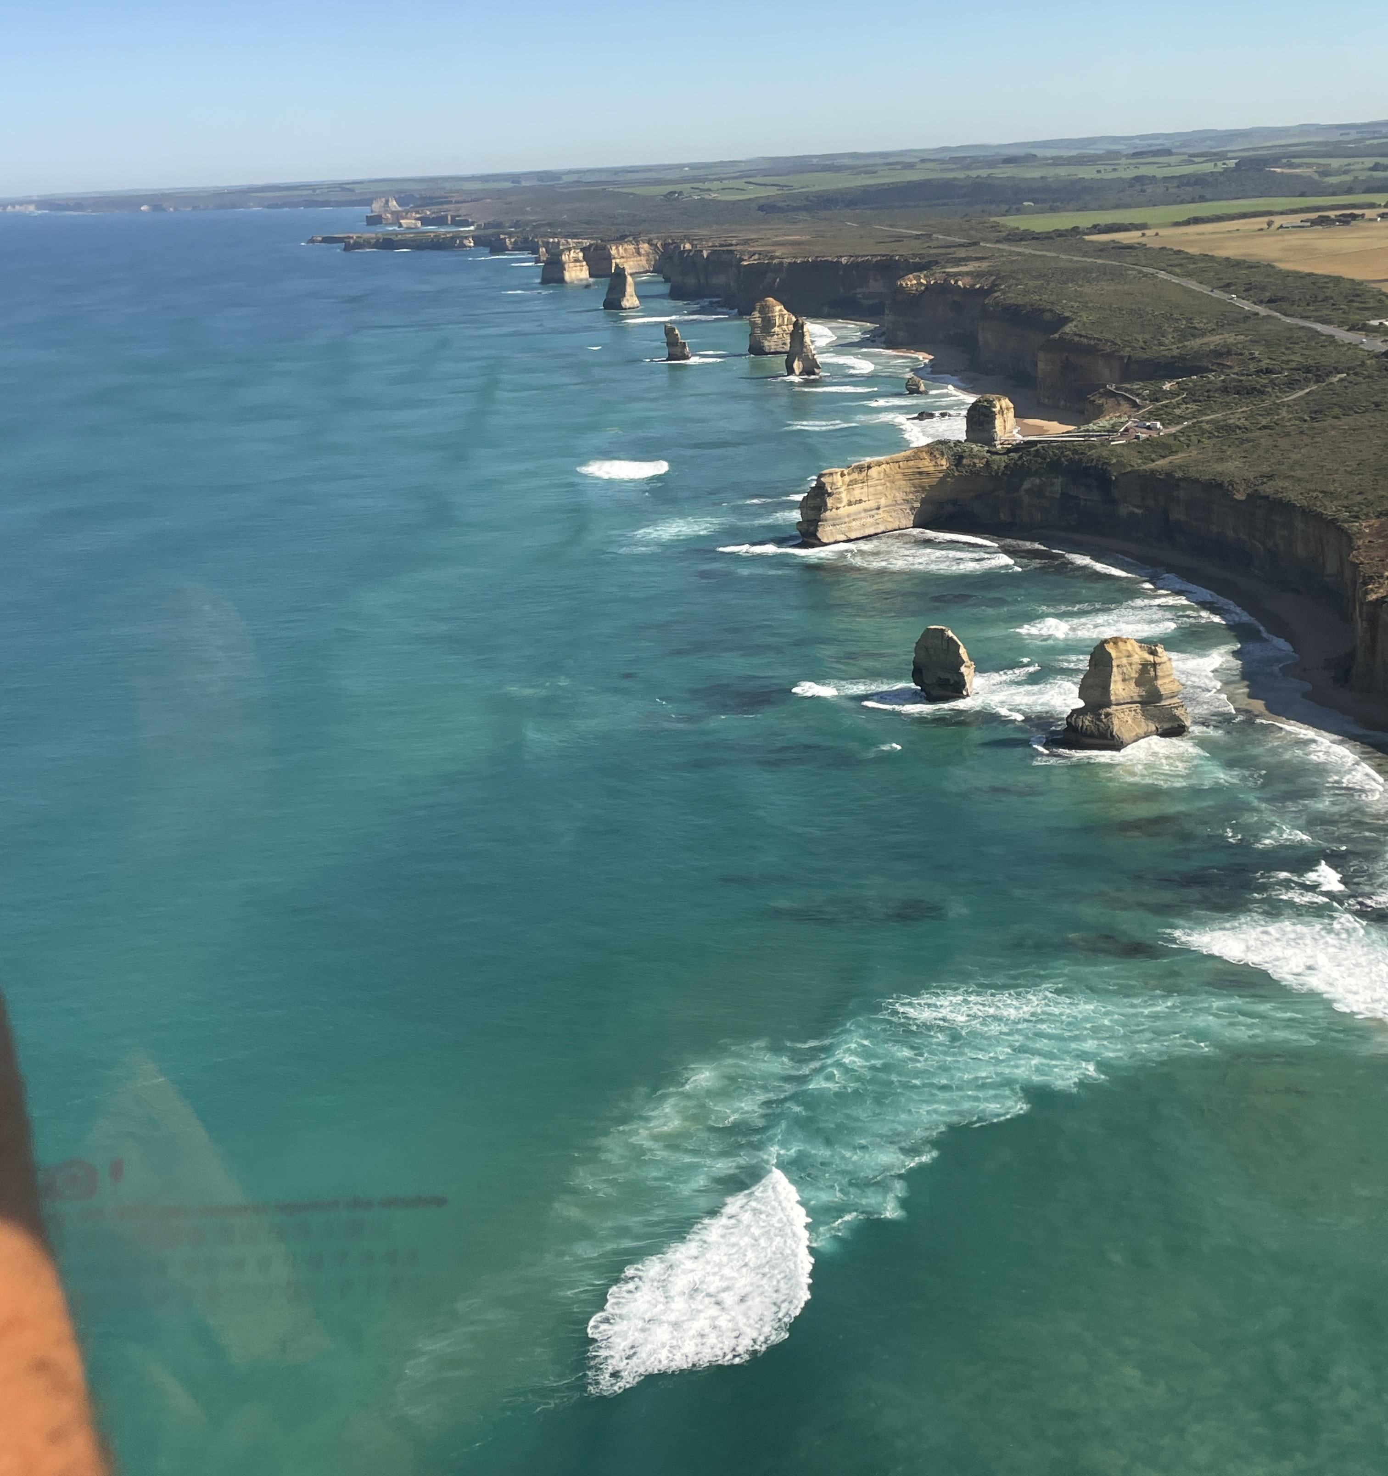
‘Great Ocean Road’, Victoria (Photo © Mrs. Kate Hodge, Trinity College)

Slide 4
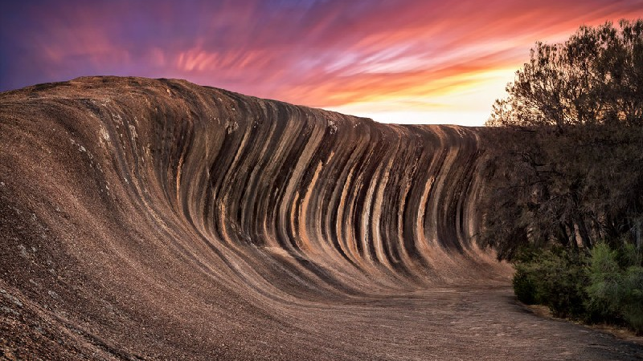
‘Wave rock’, Western Australia

Slide 5
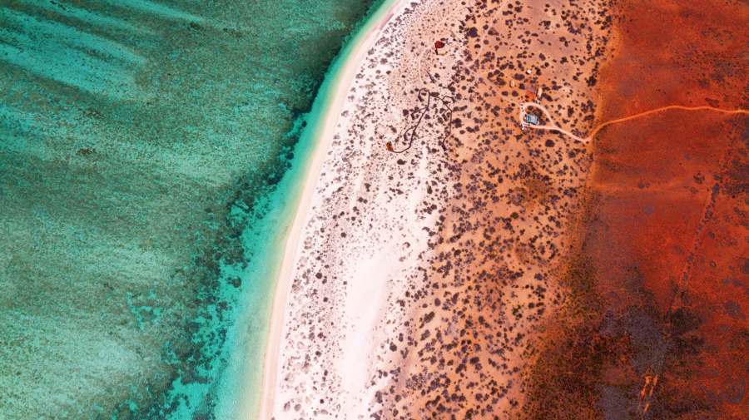
The contrasting colours of‘Shark Bay, Western Australia

Slide 6
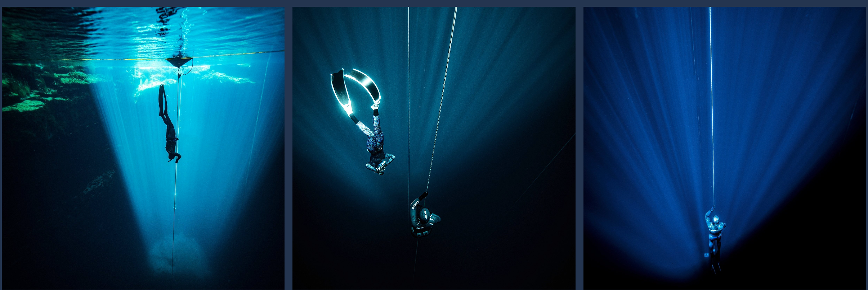
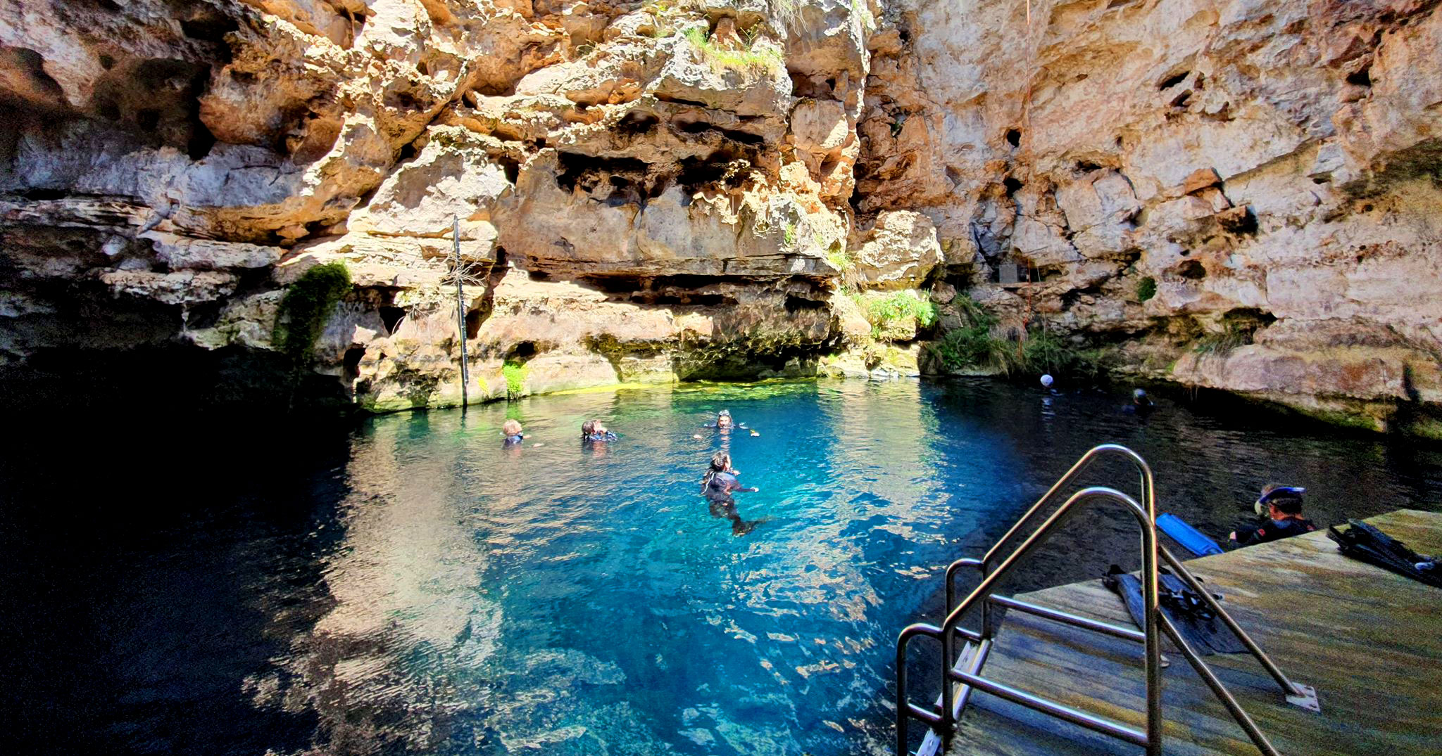
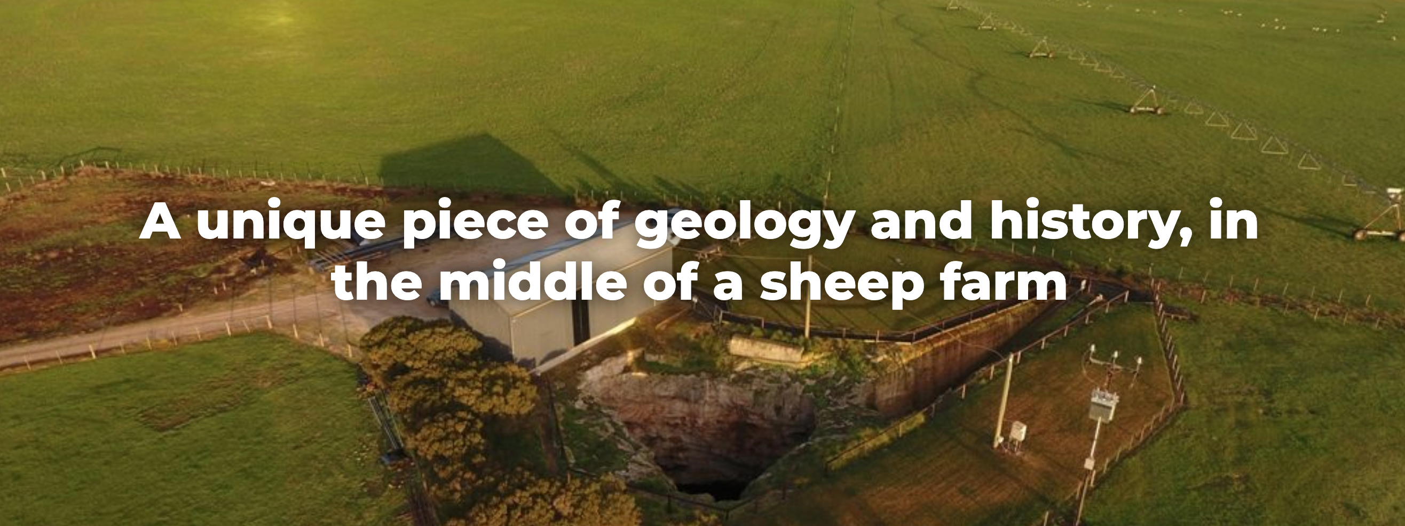
‘Kilsby Sinkhole’, South Australia
Notes:
Image: https://www.kilsbysinkhole.com/about-the-sinkhole/

Slide 7
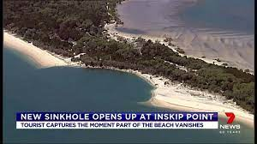
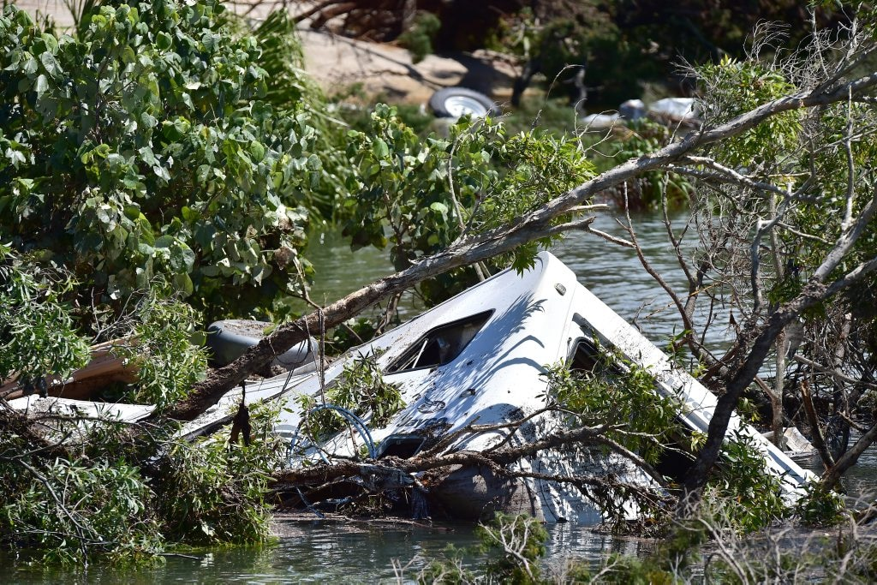
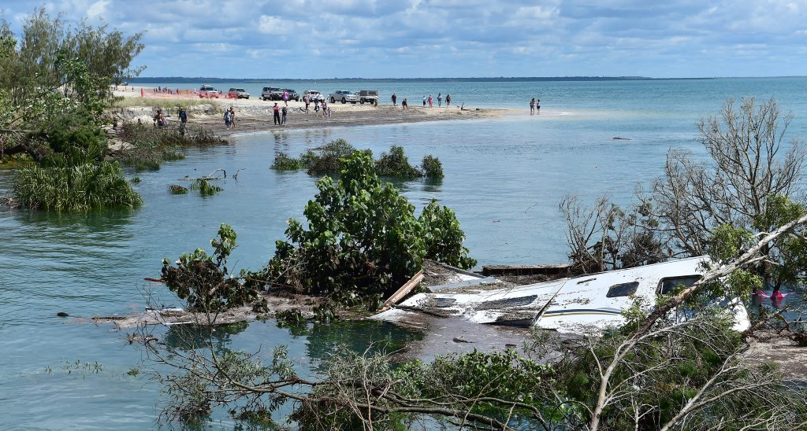
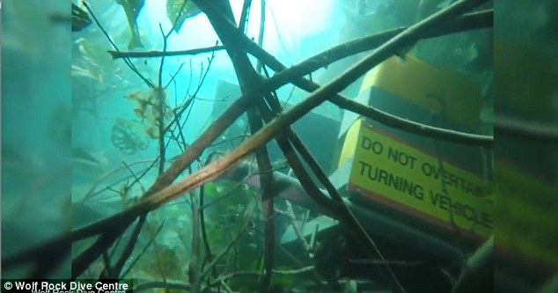

Slide 8
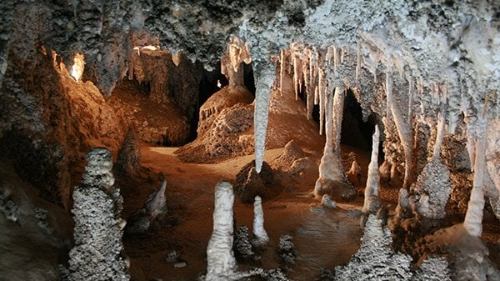
‘Limestone Caves’, Blue Mountains NSW

Slide 9
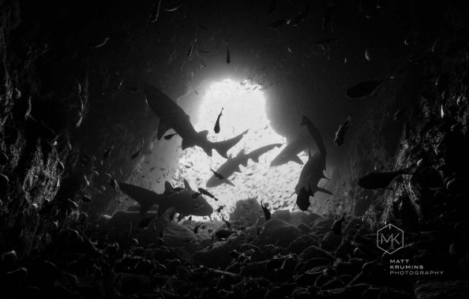
‘Fish Rock Cave’, NSW
Notes:
Image: Sharks circling the cave opening (c) Matt Krumins Photography

Slide 10
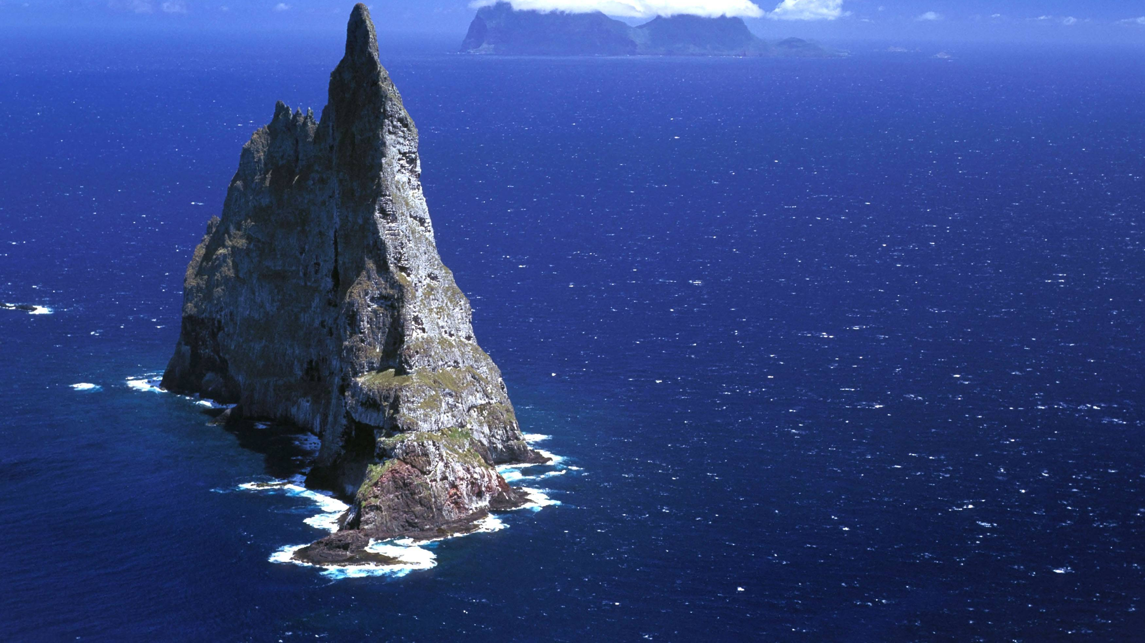
‘Balls pyramid’ and Lord Howe Island (in background), NSW

Slide 11
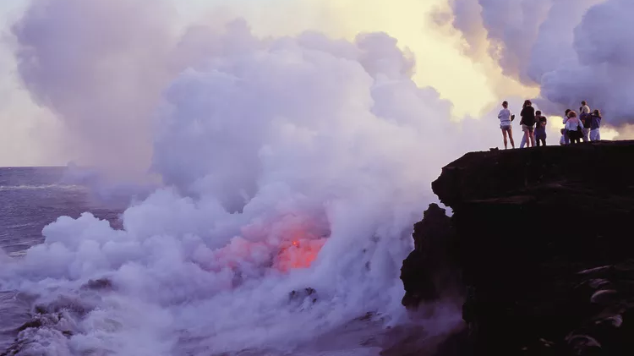
Hawaii, USA (middle of a tectonic plate)
Notes:
Image: Greg Vaughn/Getty Images…https://www.thoughtco.com/islands-of-hawaii-1435751

Slide 12
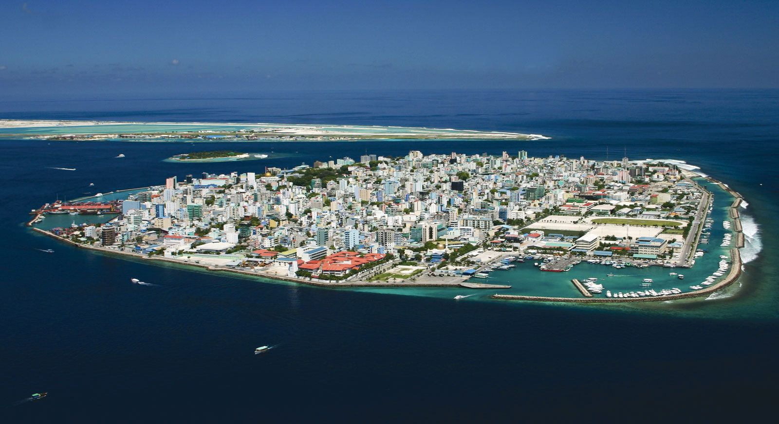
Coral Atoll, Male, Maldives

Slide 13
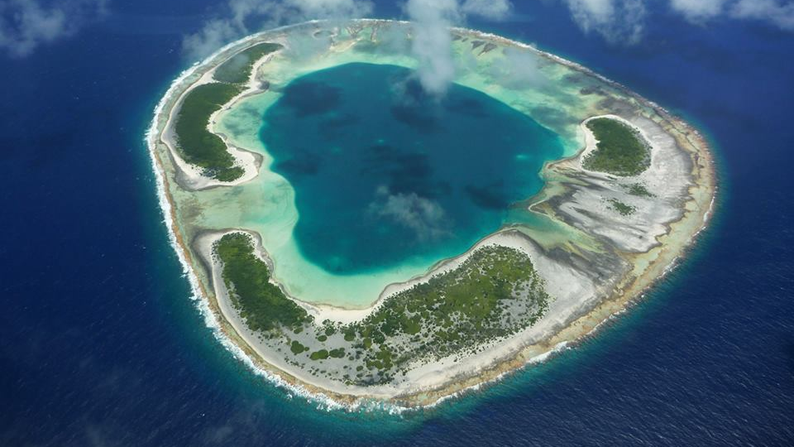
The atoll of Anuanurunga, part of the Tuamotu Archipelago in French Polynesia (currently for sale)

Slide 14
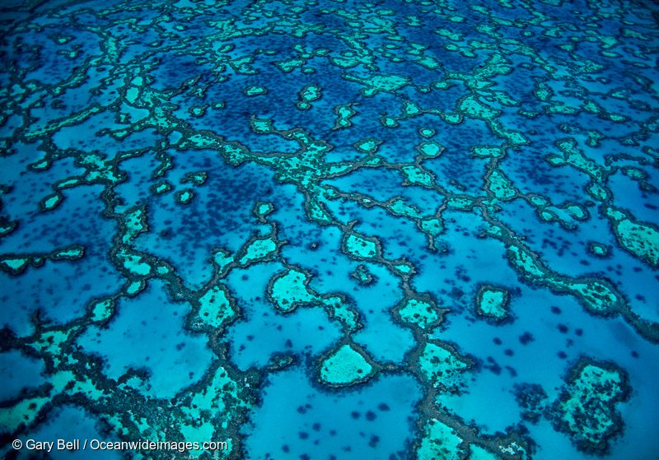
”Wistari Reef’ Capricorn Bunker Group, Gladstone Qld

Slide 15
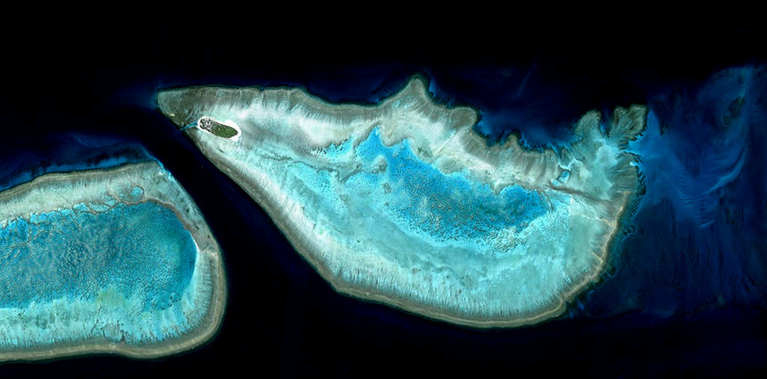
Wistari Reef and Heron Island, Capricorn Bunker Group, Gladstone Qld

Slide 16
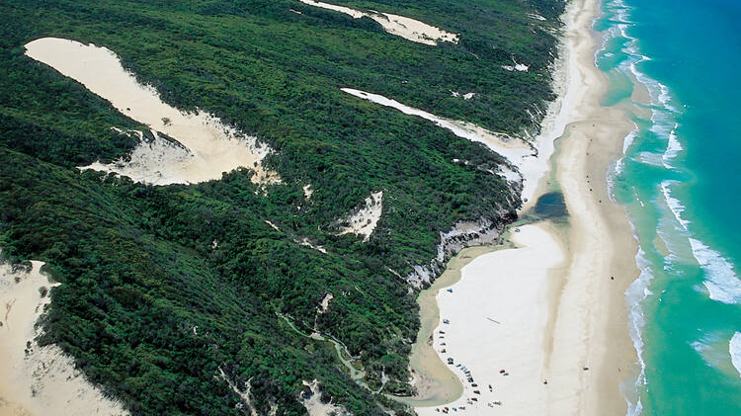
K’gari (Fraser Island), Queensland (largest sand island in the world)

Slide 17
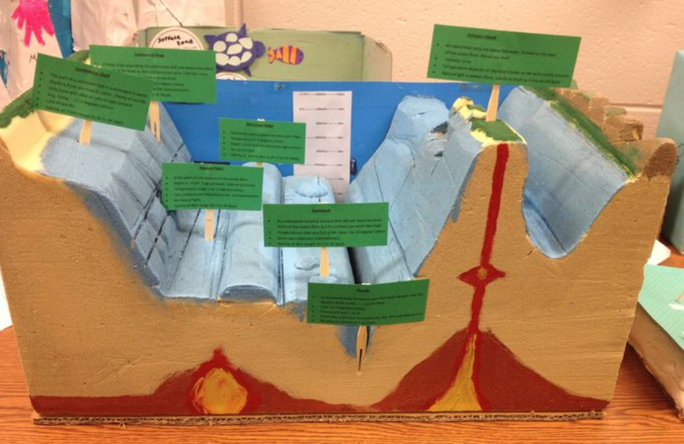
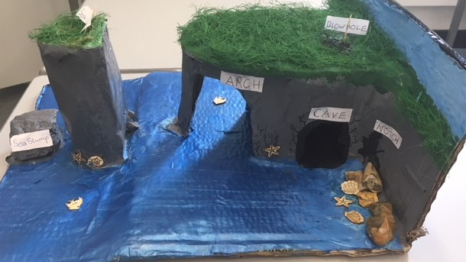
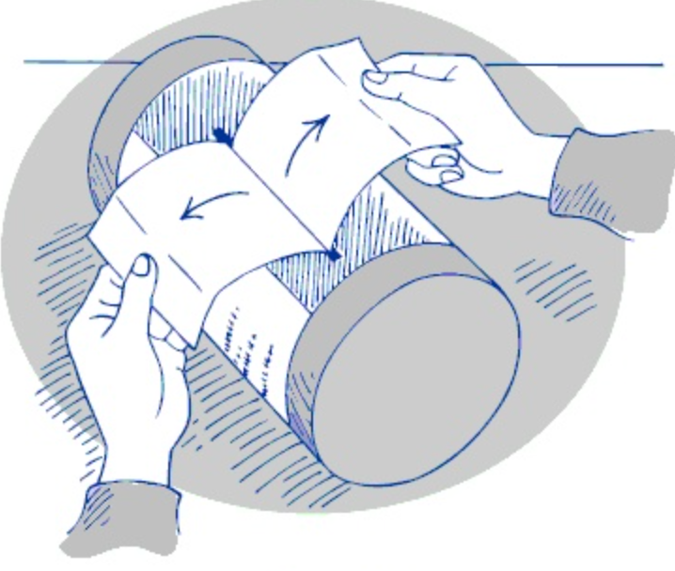
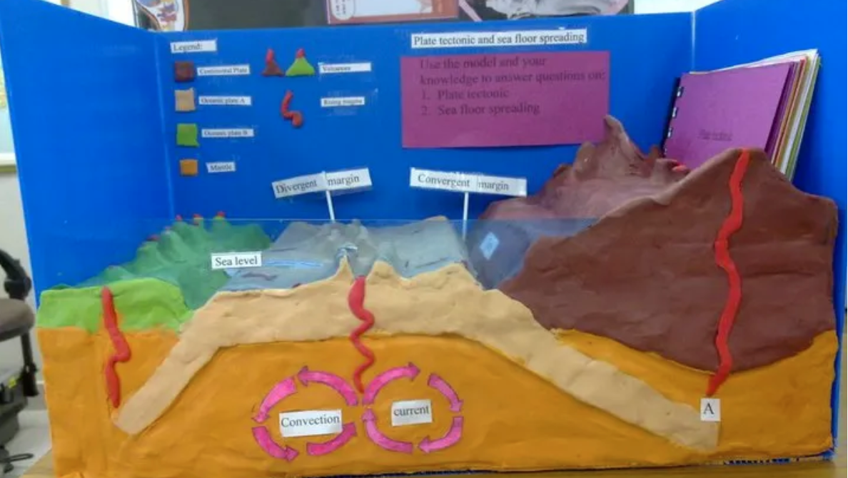
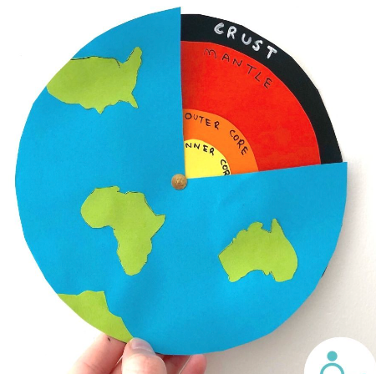
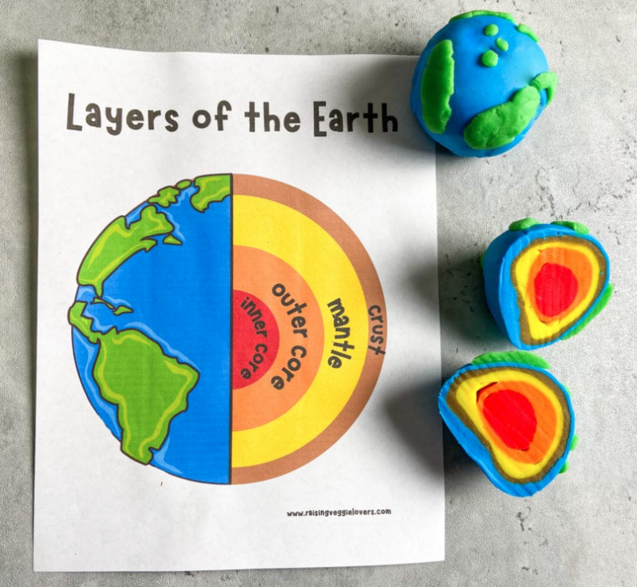
Models
A model is a simple representation of reality that helps us to understand how something works.
The geological features of the Earth, particularly those underwater, such as trenches, mid-ocean ridges and seamounts, are difficult for you and me to access, see and therefore understand.
Models help us to visualise what they look like and why.
Models also help us to simulate Earth processes, to understand what happened in the past, and predict what will happen in the future.
How did you go when trying to explain the geological structures in the pictures? Would a model help?
Here are some examples of models explaining how some were (thought to be) formed.

Slide 18
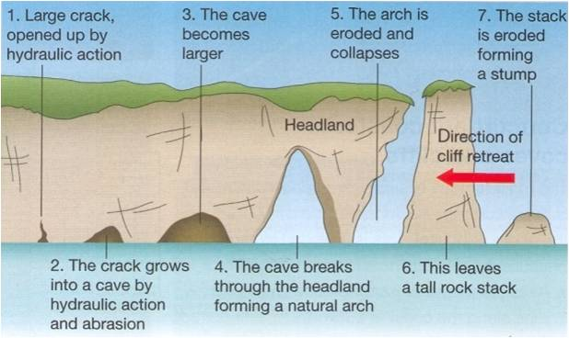

Slide 19
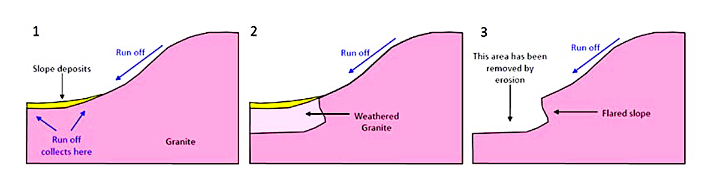
This granite cliff resembling a wave about to break is on the northern face of a large erosional remnant called Hyden Rock. This curved cliff face has been rounded by weathering and erosion, undercutting its base and leaving a
rounded overhang.

Slide 20
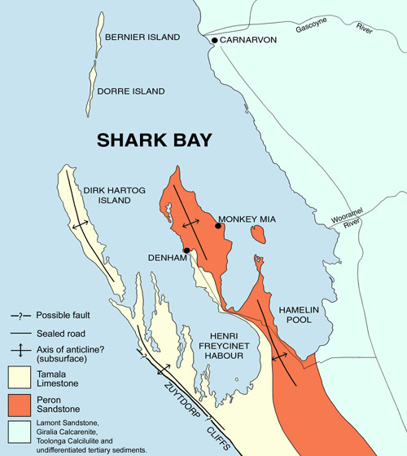
Colours: The red colour of the Peron Sandstone is due to a thin iron oxide coating around the sand grains.
The white sand is known as Tamala Limestone. It is made from broken shells, corals and skeletons of marine organisms.

Slide 21
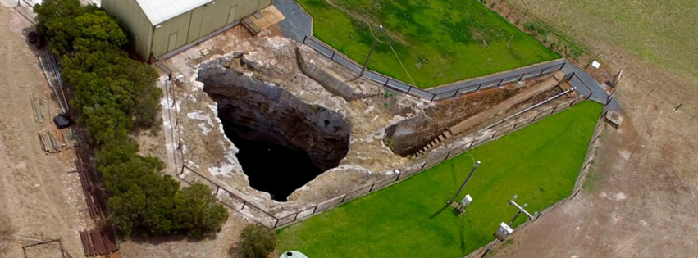
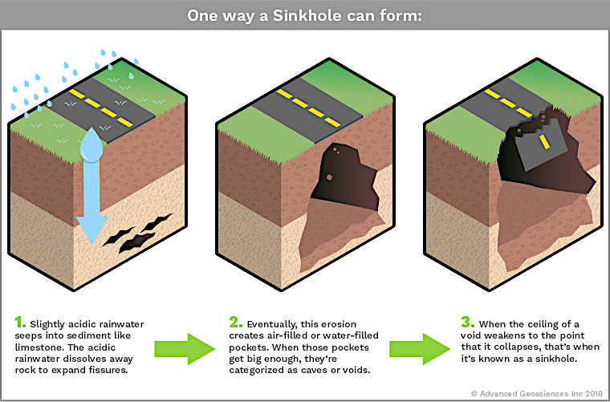
How do sinkholes form?
Where the bedrock is limestone, or other soluble rock, water dissolves the rock to create a hole.
A sink hole results when the surface rock falls down
through the hole.

Slide 22
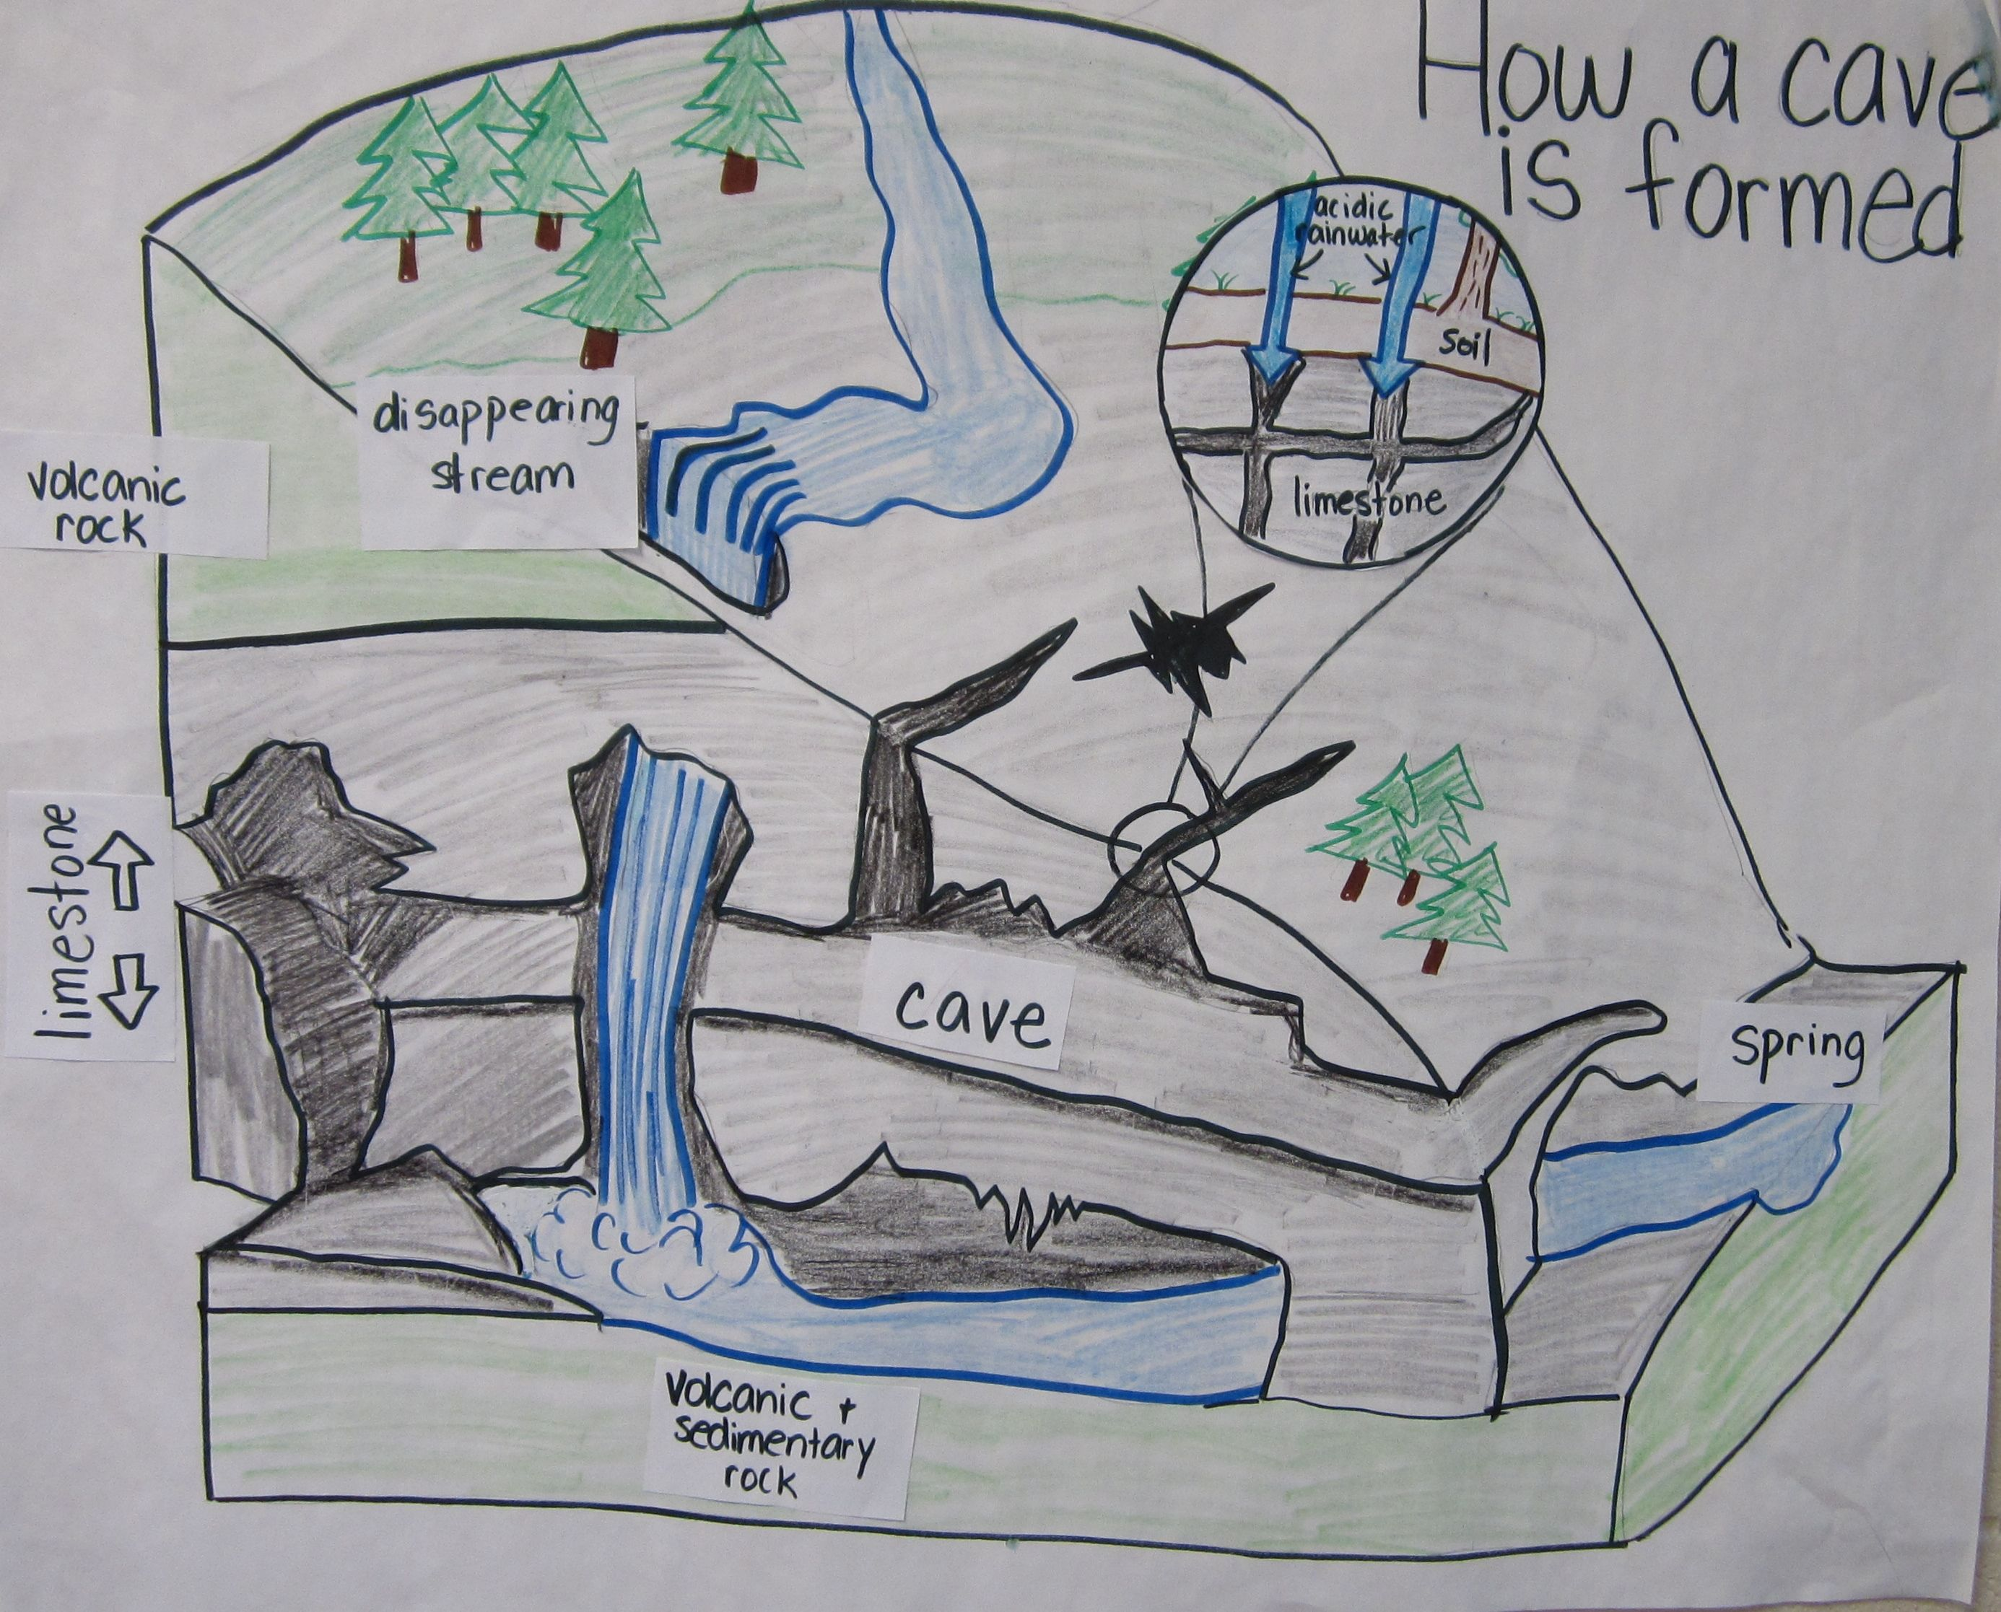
How do Limestone Caves form?
Limestone rocks are purely made from the skeletons of marine organisms such as hard corals.
All limestone cliffs used to be coral reefs!
Limestone is calcium carbonate (CaCO₂)
what coral skeletons are made of.
It dissolves faster than other types of rock.
Thus, limestone caves are the result of when slightly acidic groundwater seeps through limestone rock and dissolves a hole in the rock to make a cave.

Slide 23
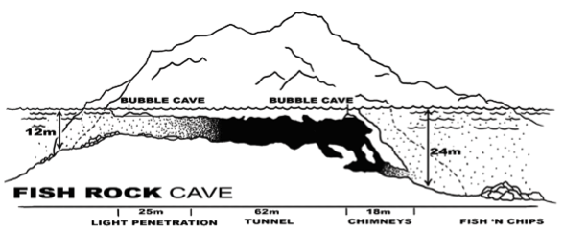
Notes:
Image: https://swrdive.com.au/pages/dive-sites
Image: Sharks circling the cave opening (c) Matt Krumins Photography

Slide 24
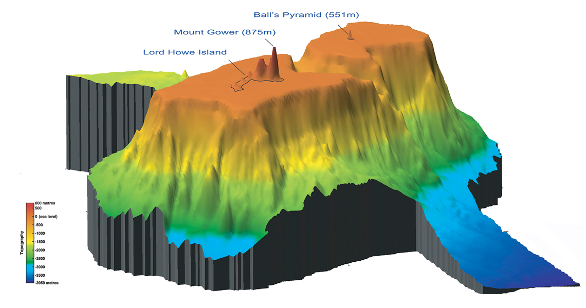
“Lord Howe Island and Ball’s Pyramid are eroded volcanic peaks.”
Notes:
Image: https://lhimuseum.com/learn/geology/

Slide 25
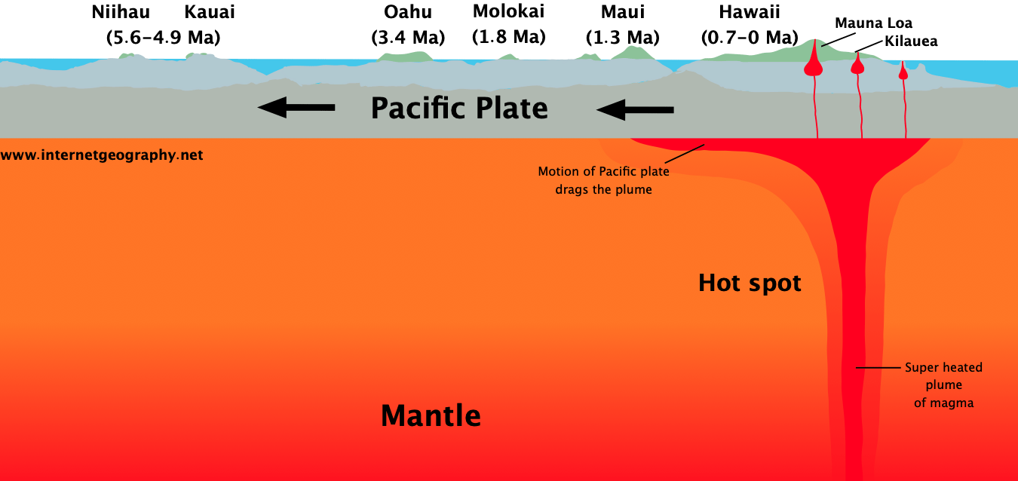
“While the hot spot itself is fixed, the plate is moving”.

Slide 26
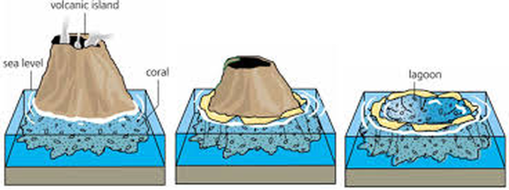
How do atolls form?
An atoll is the remains of the top of a volcano that once rose above the water’s surface but has since become submerged.
Long after the volcano receded into the ocean,
the atoll still remains.

Slide 27
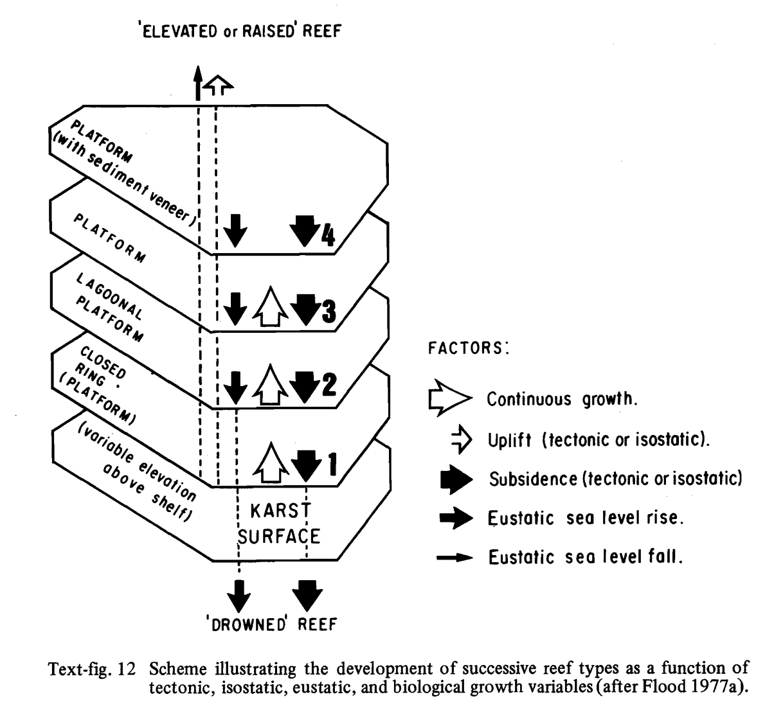
Heron Island and other reefs in the Capricorn Bunker Group are platform (or patch) reefs that grow up from the shallow continental shelf. Those that reach the surface form islands called coral cays (e.g. Heron Island). Others aren’t quite there yet (Wistari Reef). Whether they form an island or not depends on whether reef growth (and uplift) is faster than subsistence (sinking) and sea level rise (Fig. 12). Notably, those that are already coral cays, such as Heron Island, were shallower to begin with, thus got a head start.
Notes:
Image: https://espace.library.uq.edu.au/data/UQ_10881/dgp_1978_8_3.pdf?Expires=1695620567&Key-Pair-Id=APKAJKNBJ4MJBJNC6NLQ&Signature=PXvOrH1Nz8Rcmb8aVmXHFu2rPtssEjcYkHhDEx5YwX7DwmyGMxdB87OQzfcEh5t12~bbW8cNKisjLf7ZOdMh-F5YJ1uvWUvVVyqrGt-YsjUr2bPMNj2E1QQpboKtgguWIqeR605GEuEGp6Ah7EEMgMEp8RTuV593M-hNIPBXeh569gKxHg0-TwokCPn3hB2ak3jpWTjhaC5Df6imibqfUDvC6mBrKX-acYbDOIyVI9ZlRhtj98V6MT3n7uF29Qm7BNSkiMKQt656sljdXZgr34EREDXfl2BwQXjIZY0wUABouJNmiB1owT4lHLFebCT6fvOHRmMbZ73FUZAxsAByEw__

Slide 28
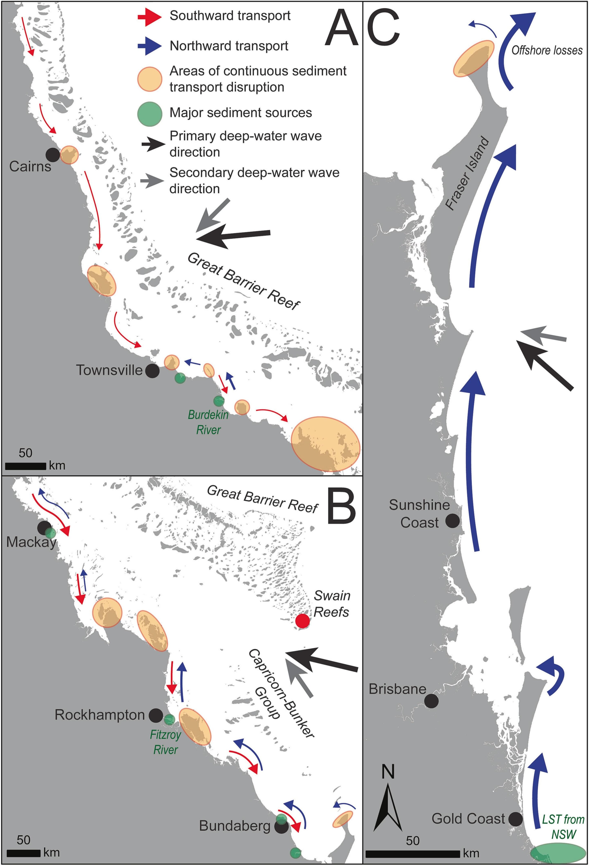
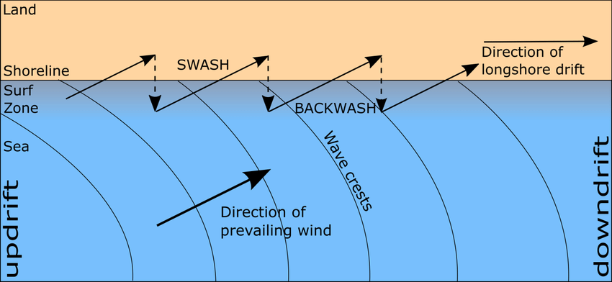
Islands made of SAND
Far left: Diagrammatic representation of the transport of sediment (sand) along the north (a), central (b) and south (c) coastlines of Queensland.
Below: Longshore Drift
Longshore Drift
Notes:
Image (left): https://phys.org/news/2023-08-great-barrier-reef-decline-impact.html
Dylan Cowley, Daniel L. Harris, Wave-driven sediment transport potential on a tropical coast: Implications for the northeastern Australian sediment budget, Marine Geology, Volume 463, 2023, 107104, ISSN 0025-3227, https://doi.org/10.1016/j.margeo.2023.107104.

Slide 29
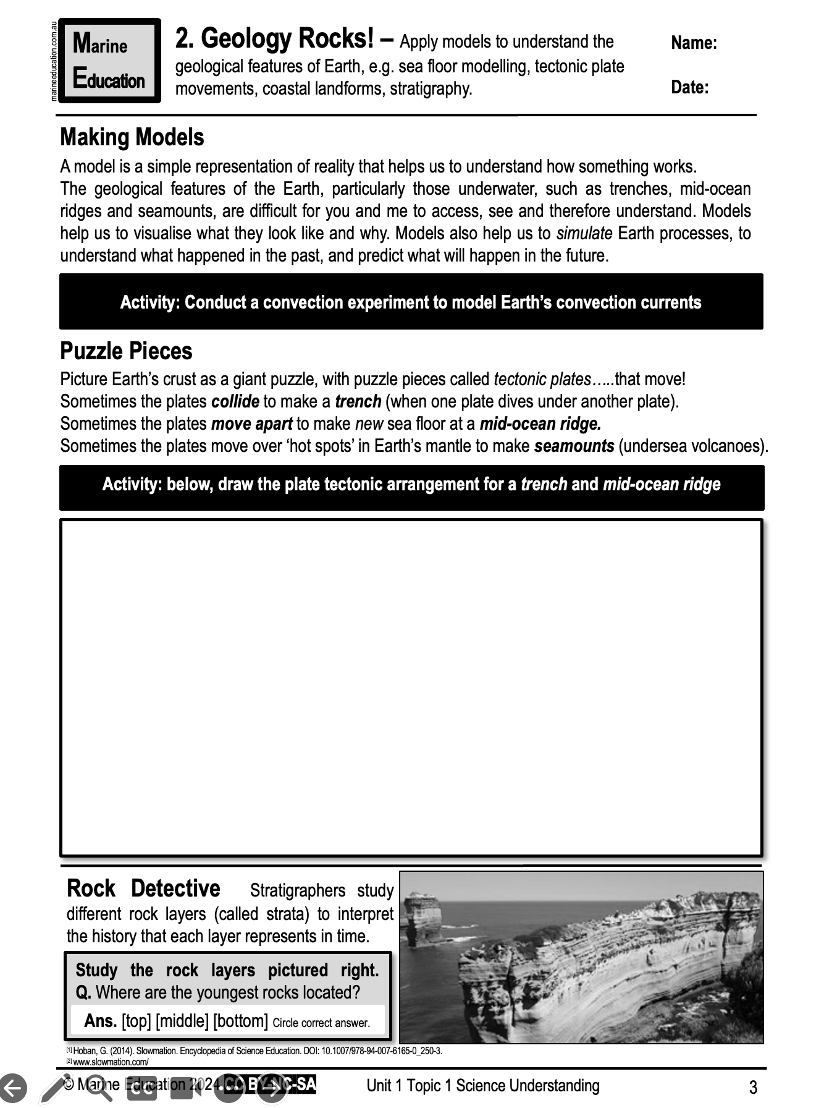
Learning Intention:
Apply models to understand the geological features of the Earth (e.g. sea floor modelling, tectonic plate movements, coastal landforms, stratigraphy)
Success Criteria:
Complete Marine Education worksheet ‘’2. Geology Rocks!’
Notes:
Image: https://medium.com/@amykwilson/weird-and-wonderful-creatures-of-the-deep-sea-66826a3ae5e4

