Slide 1
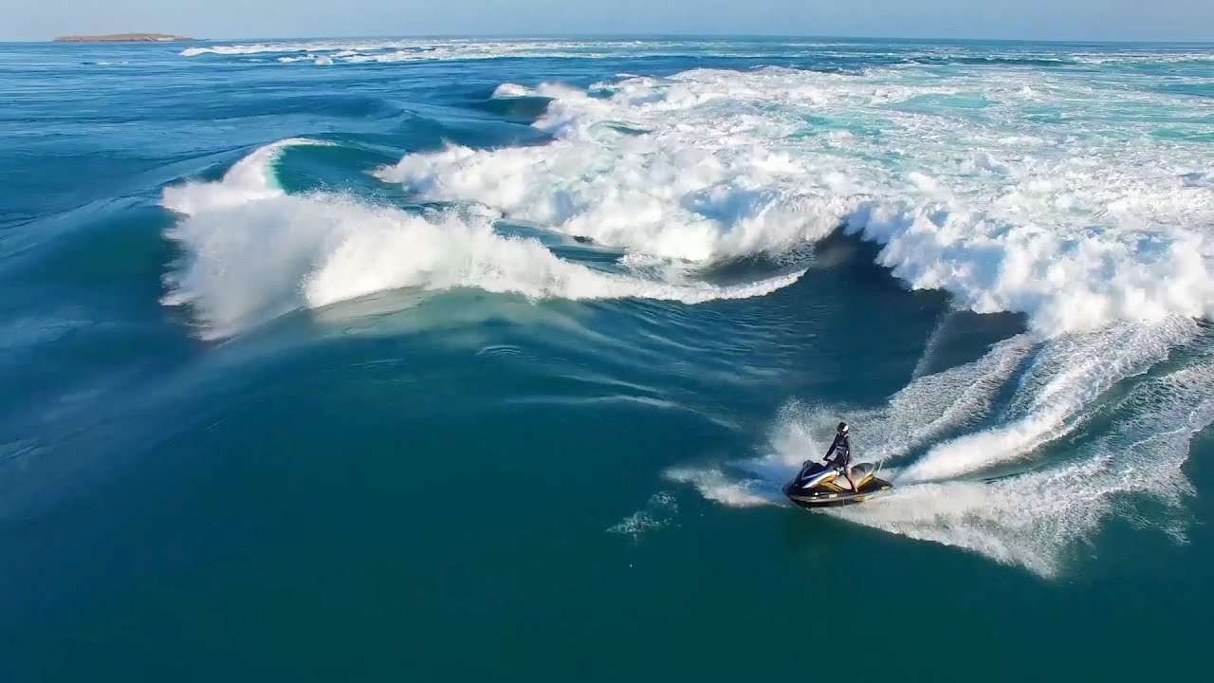
Learning Intention:
Explain how gravitational pull, current strength and wave action cause tidal movement.
Success Criteria:
Complete Marine Education worksheet ‘2. Tide trickery’
Notes:
https://www.youtube.com/watch?app=desktop&v=loRr97fOWdg

Slide 2
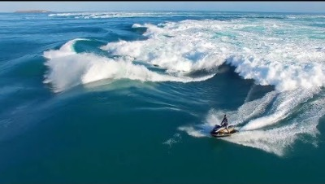
https://www.youtube.com/watch?app=desktop&v=loRr97fOWdg
Notes:
https://www.youtube.com/watch?app=desktop&v=loRr97fOWdg

Slide 3
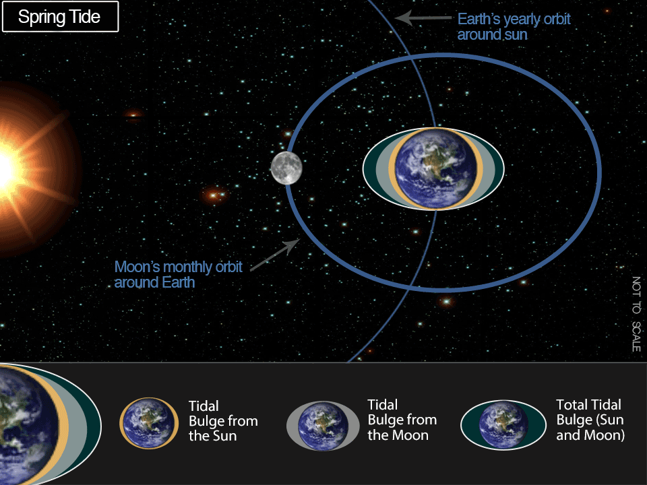
Time of the month?
Spring tide
Full moon
New moon
large tidal range
stronger currents
Neap tide
Half moon
small tidal range
weaker currents

Slide 4
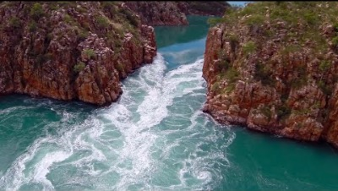
https://www.youtube.com/watch?v=3dIhCmo3g0c
Notes:
https://www.youtube.com/watch?v=3dIhCmo3g0c

Slide 5
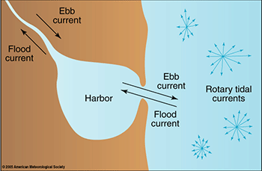
Terminology
Ebb tide= going OUT
Flood tide= coming IN

Slide 6
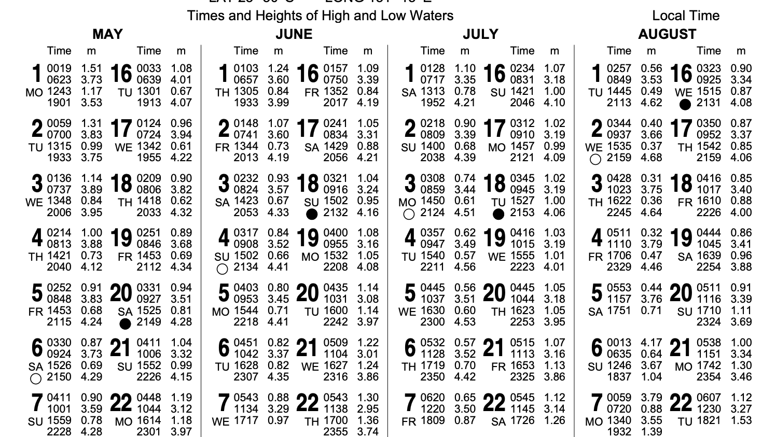

Slide 7
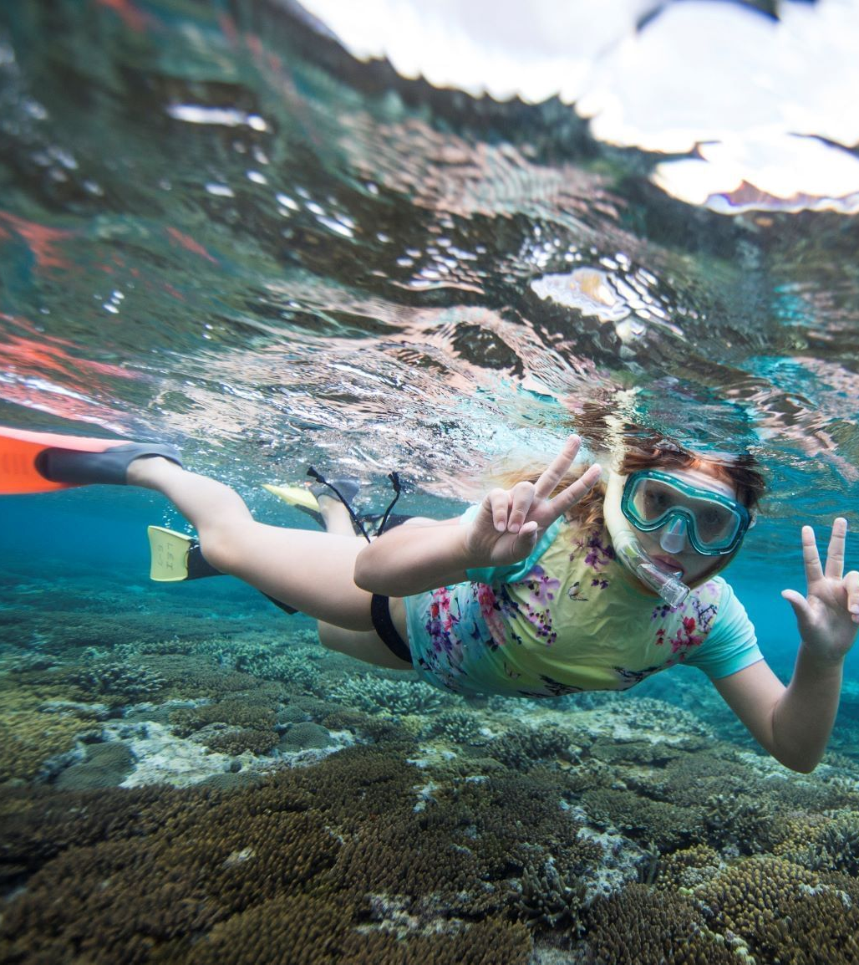
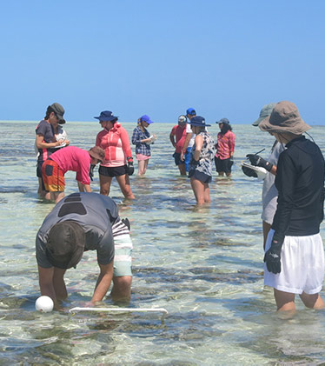
High tide vs Low tide
activities
(Heron Island)

Slide 8
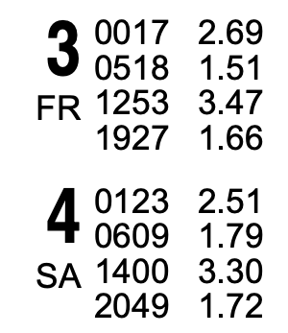
If I want to snorkel the same tide height tomorrow, how much later in the day will it be?
High tide on Friday was at 12.53pm (1253)
On Saturday, high tide is at 2pm (1400).
That is 1hour 7minutes later in the day.

Slide 9
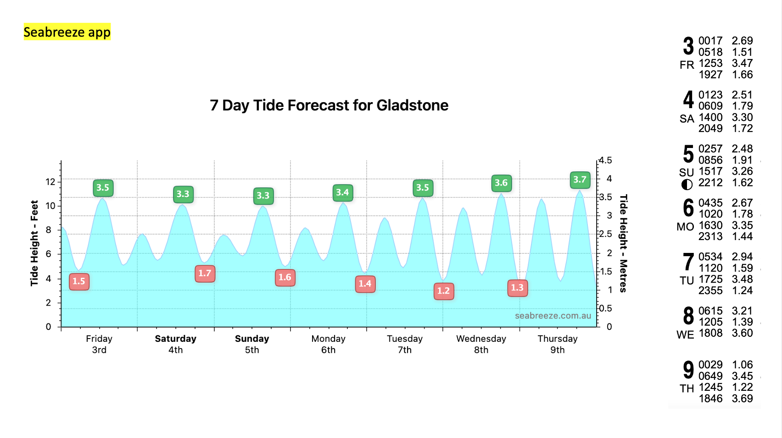

Slide 10
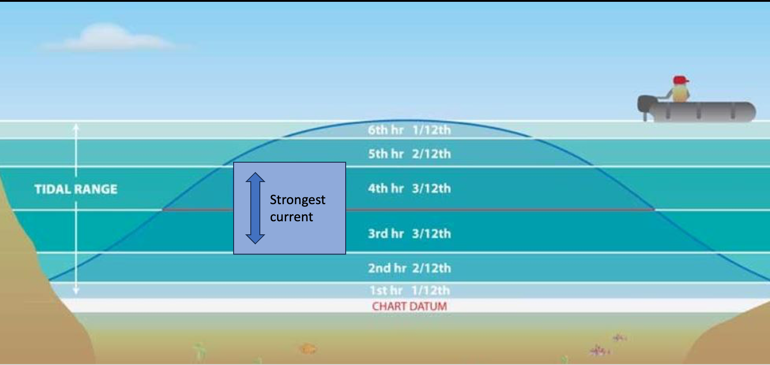
Rule of twelfths (strongest current mid-tide)
Strongest current

Slide 11
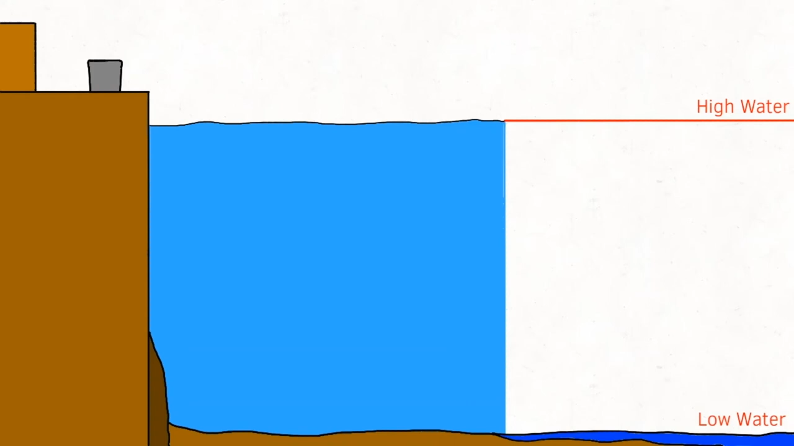
Rule of twelfths explained

Slide 12
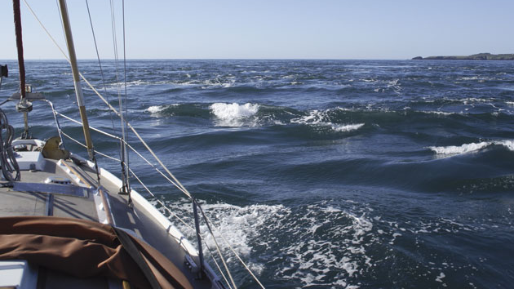
Wind against tide

Slide 13
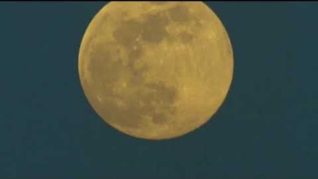
https://www.youtube.com/watch?v=a5E2p1lF10E
Notes:
https://www.youtube.com/watch?v=a5E2p1lF10E

Slide 14
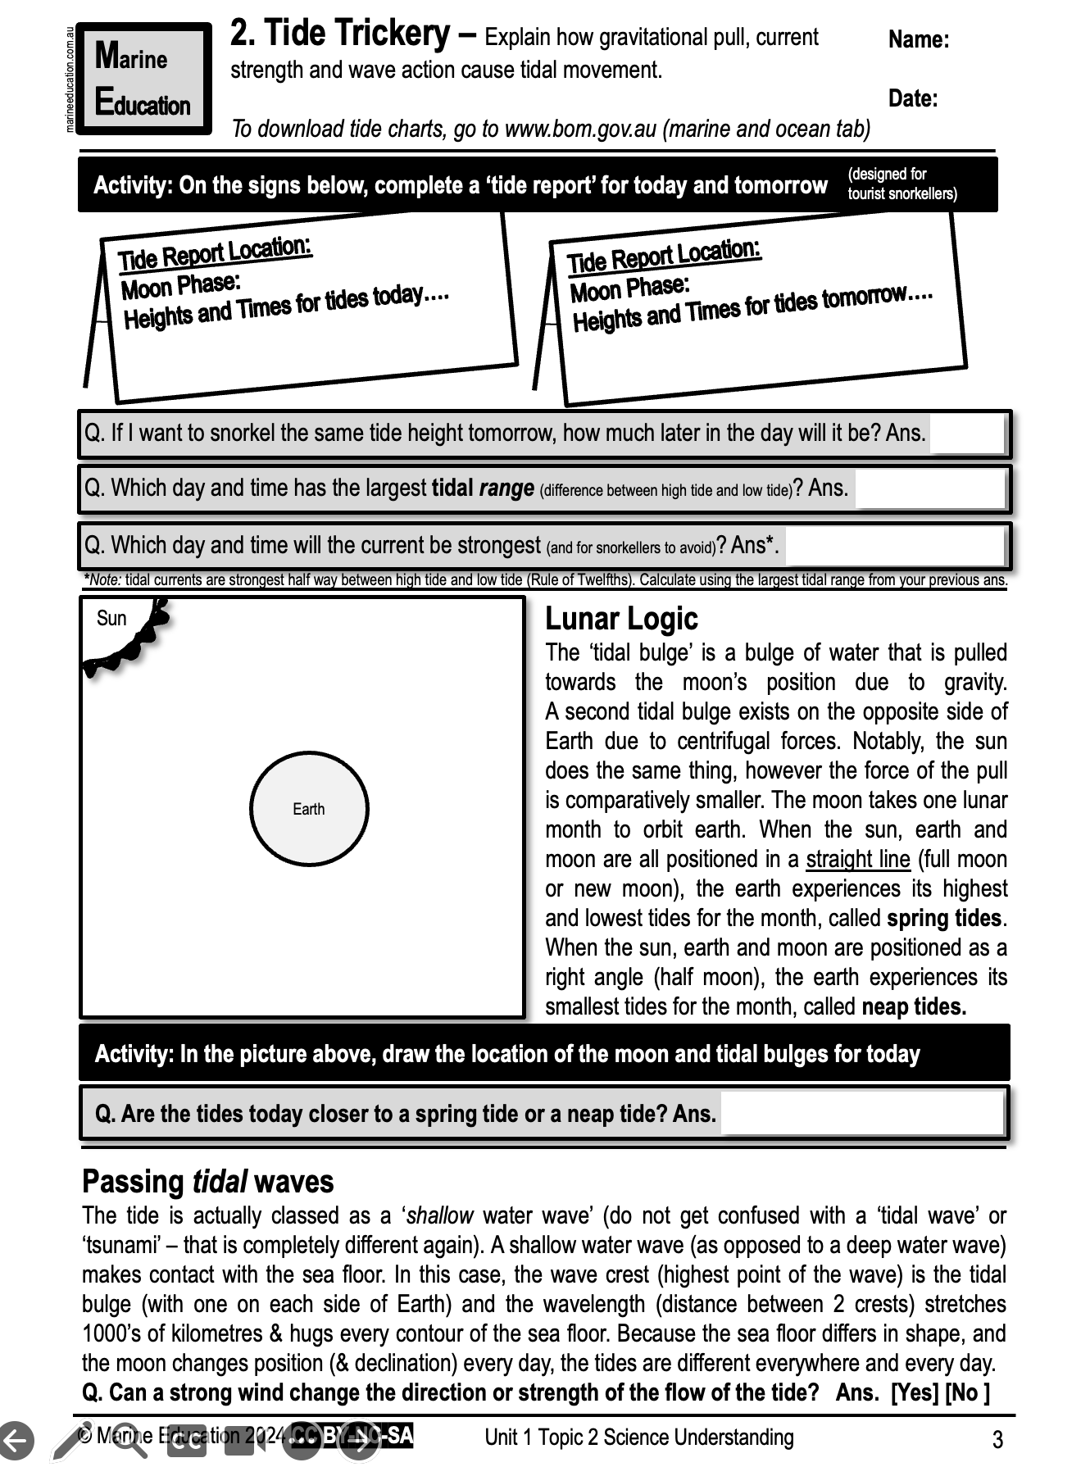
Learning Intention:
Explain how gravitational pull, current strength and wave action cause tidal movement.
Success Criteria:
Complete Marine Education worksheet ‘2. Tide trickery’
Notes:
https://www.youtube.com/watch?app=desktop&v=loRr97fOWdg

