Slide 1
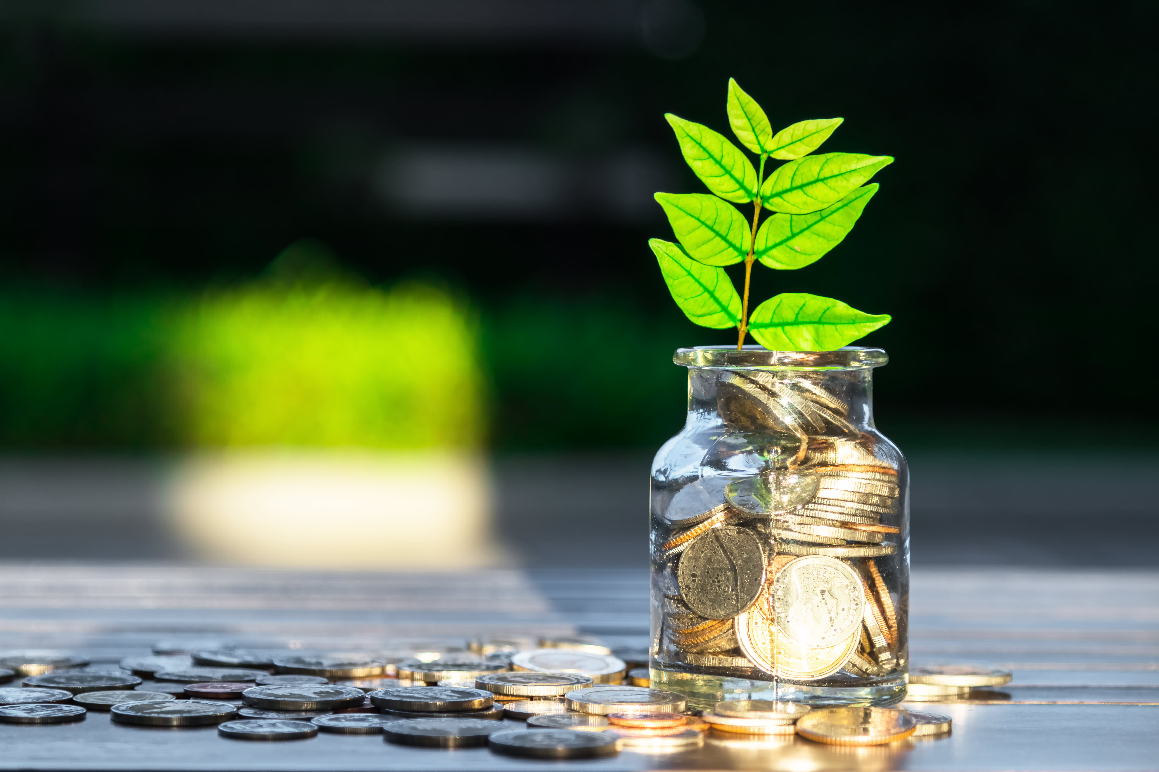
Learning Intention:
Describe the direct and indirect values of marine ecosystems of Australia.
Success Criteria:
Complete Marine Education worksheet ‘2. Valuing Nature’
Notes:
Image: https://www.cnbc.com/2020/01/14/esg-funds-see-record-inflows-in-2019.html

Slide 2
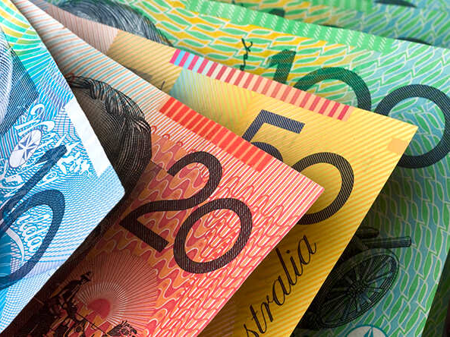
We live in a world where money and economics influences so many of our decisions and behaviours.
Thus, ecosystem services are often assigned economic values ($) to assist decision-making.

Slide 3
These values ($$)
are categorised as either DIRECT or INDIRECT

Slide 4
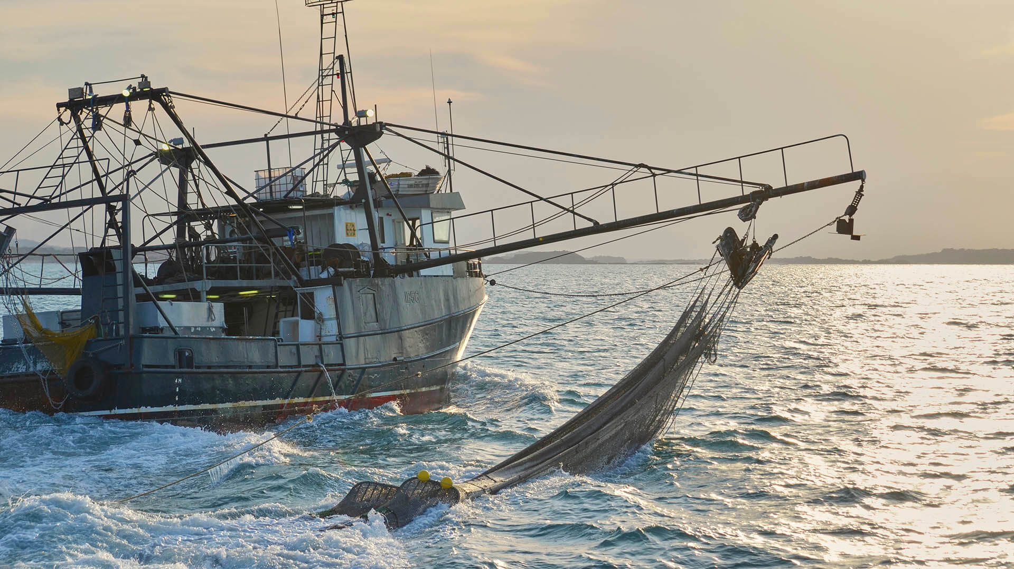
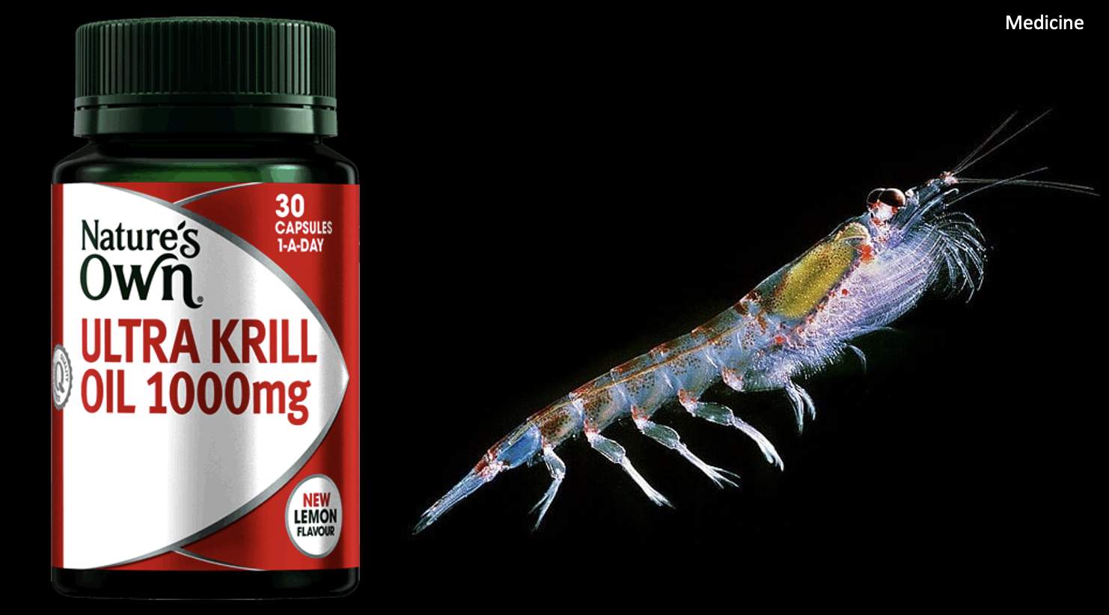
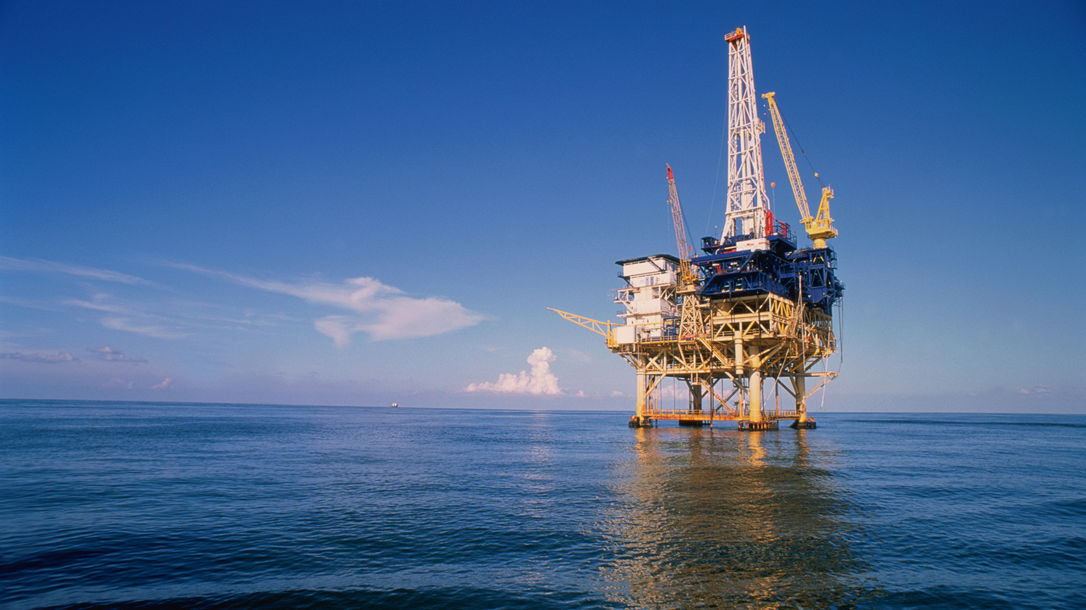
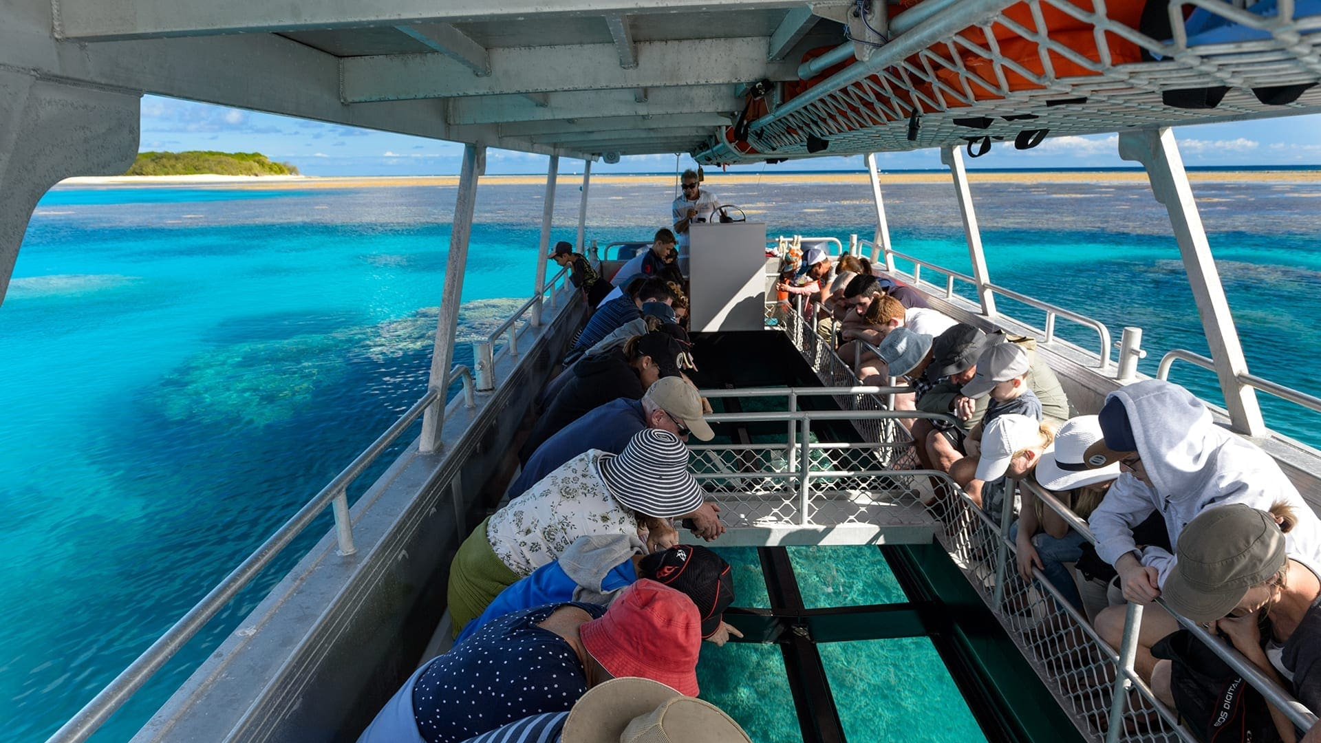
Direct Use Values

Slide 5

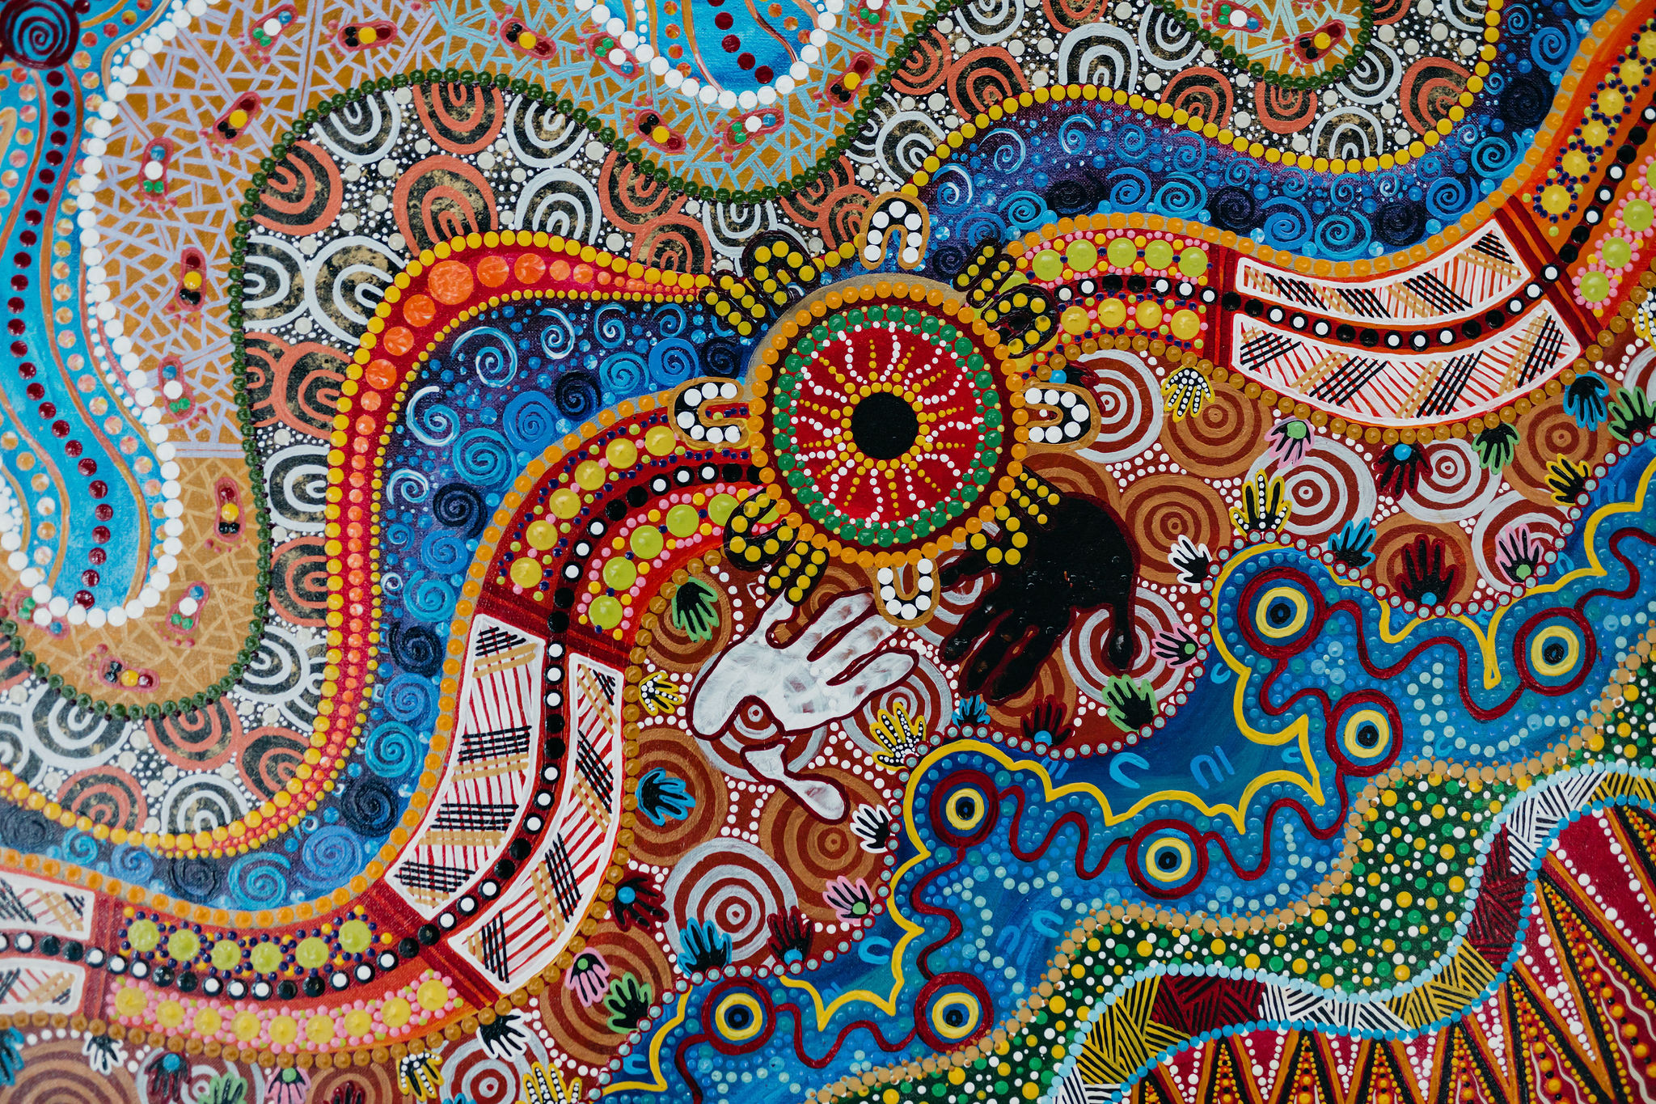
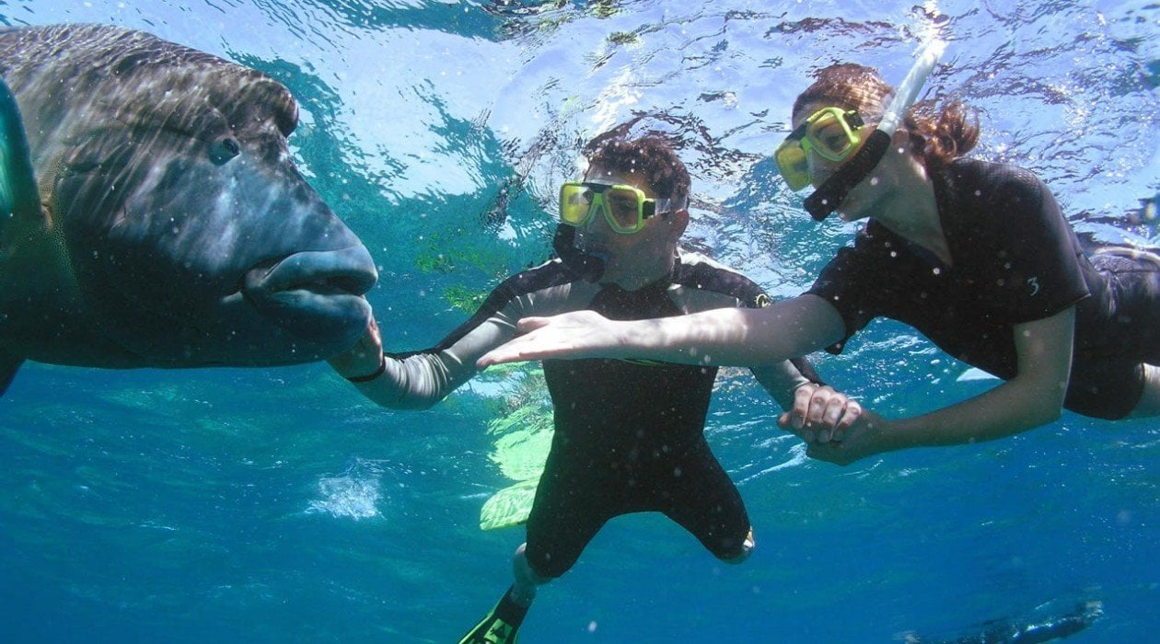
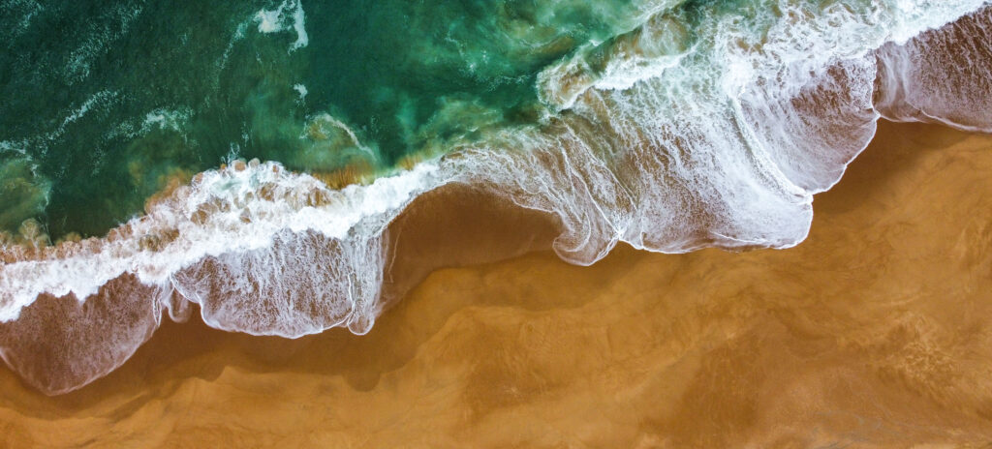
Indirect Use Values
Notes:
Indigenous Painting: https://blog.qm.qld.gov.au/2021/06/11/connections-to-the-land-and-sea/
In 2021, Museum of Tropical Queensland commissioned an artwork from local Townsville Indigenous artist, Jumbo Prior. Go to website to learn more about the painting.
Seascape painting: https://gunaikurnai.org/our-country/sea-country/
Nanjet to Mallacoota – Sea Country Indigenous Protection Area

Slide 6
The terms direct and indirect use values are economics terms.
Increasing difficulty of valuation

Slide 7
Direct use values
A direct use value is the product value of nature, when you remove or exploit something from it for money.

Slide 8
Food
Notes:
Image: https://www.msc.org/en-au/what-we-are-doing/our-collective-impact/what-is-a-fishery

Slide 9
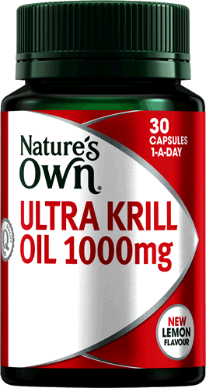
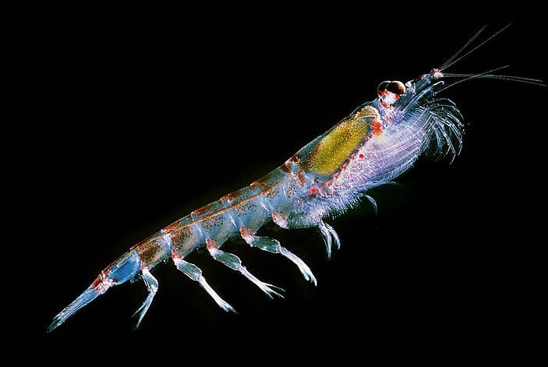
Medicine

Slide 10
Oil and Gas
Notes:
Image: https://science.howstuffworks.com/environmental/energy/offshore-drilling.htm

Slide 11
Tourism

Slide 12
Indirect use values
An indirect use value is the social and functional value of nature, when you still use it (indirectly) and benefit from it, but you don’t take anything from it, nor profit from it.

Slide 13
Relaxation
Notes:
Image: https://www.uminabeachyoga.com/classes/yoga-meditation/

Slide 14
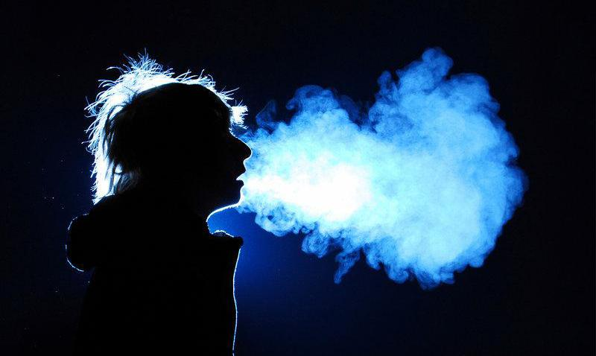
Breathing (diatoms make oxygen)

Slide 15
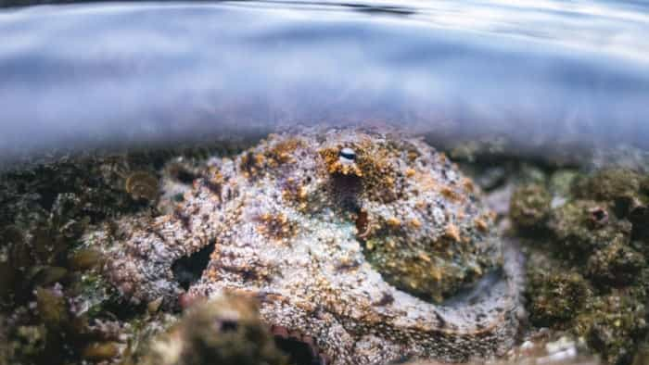
Wildlife encounters

Slide 16
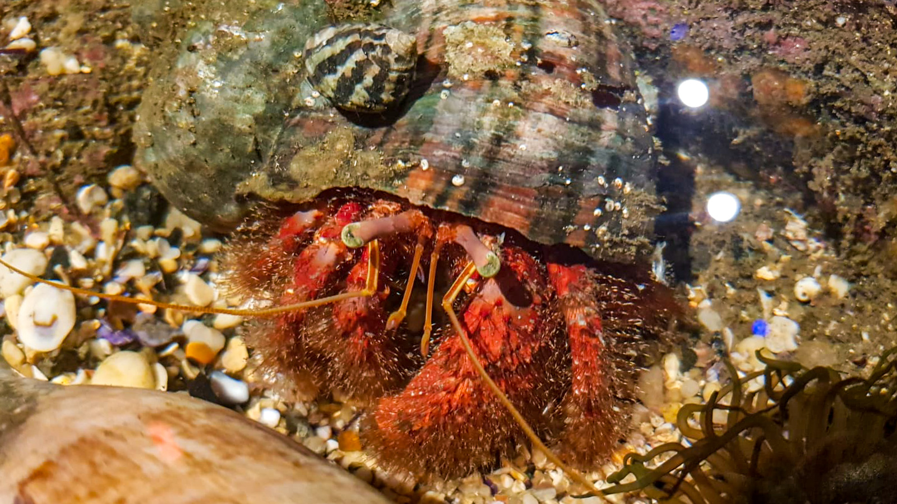
Wildlife encounters
Notes:
Image: https://www.visitsealife.com/sydney/whats-inside/animals/rock-pool-species/

Slide 17
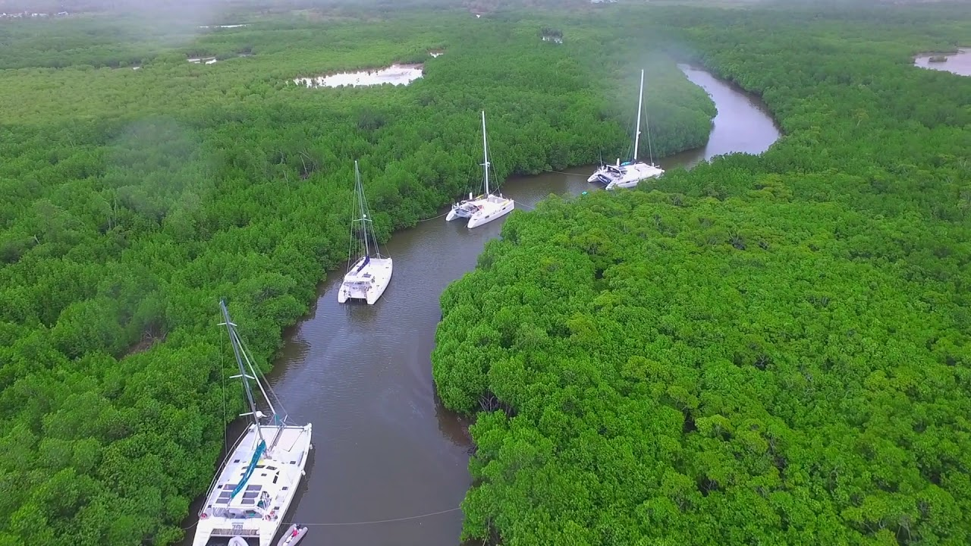
Storm protection
Notes:
Image: https://www.youtube.com/watch?app=desktop&v=o32nvI3bIC8

Slide 18
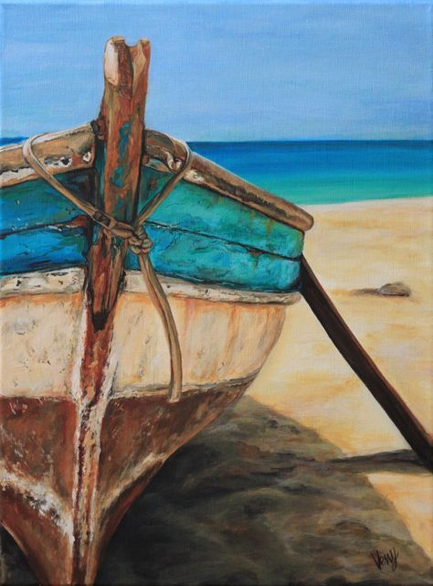
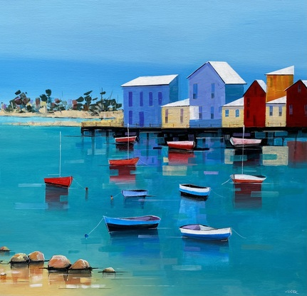
Art
Notes:
Image (left): https://www.pinterest.com.au/pin/150941024987207037/
Image (right): https://bluethumb.com.au/peter-clark/Artwork/boats-in-the-harbour-623501

Slide 19
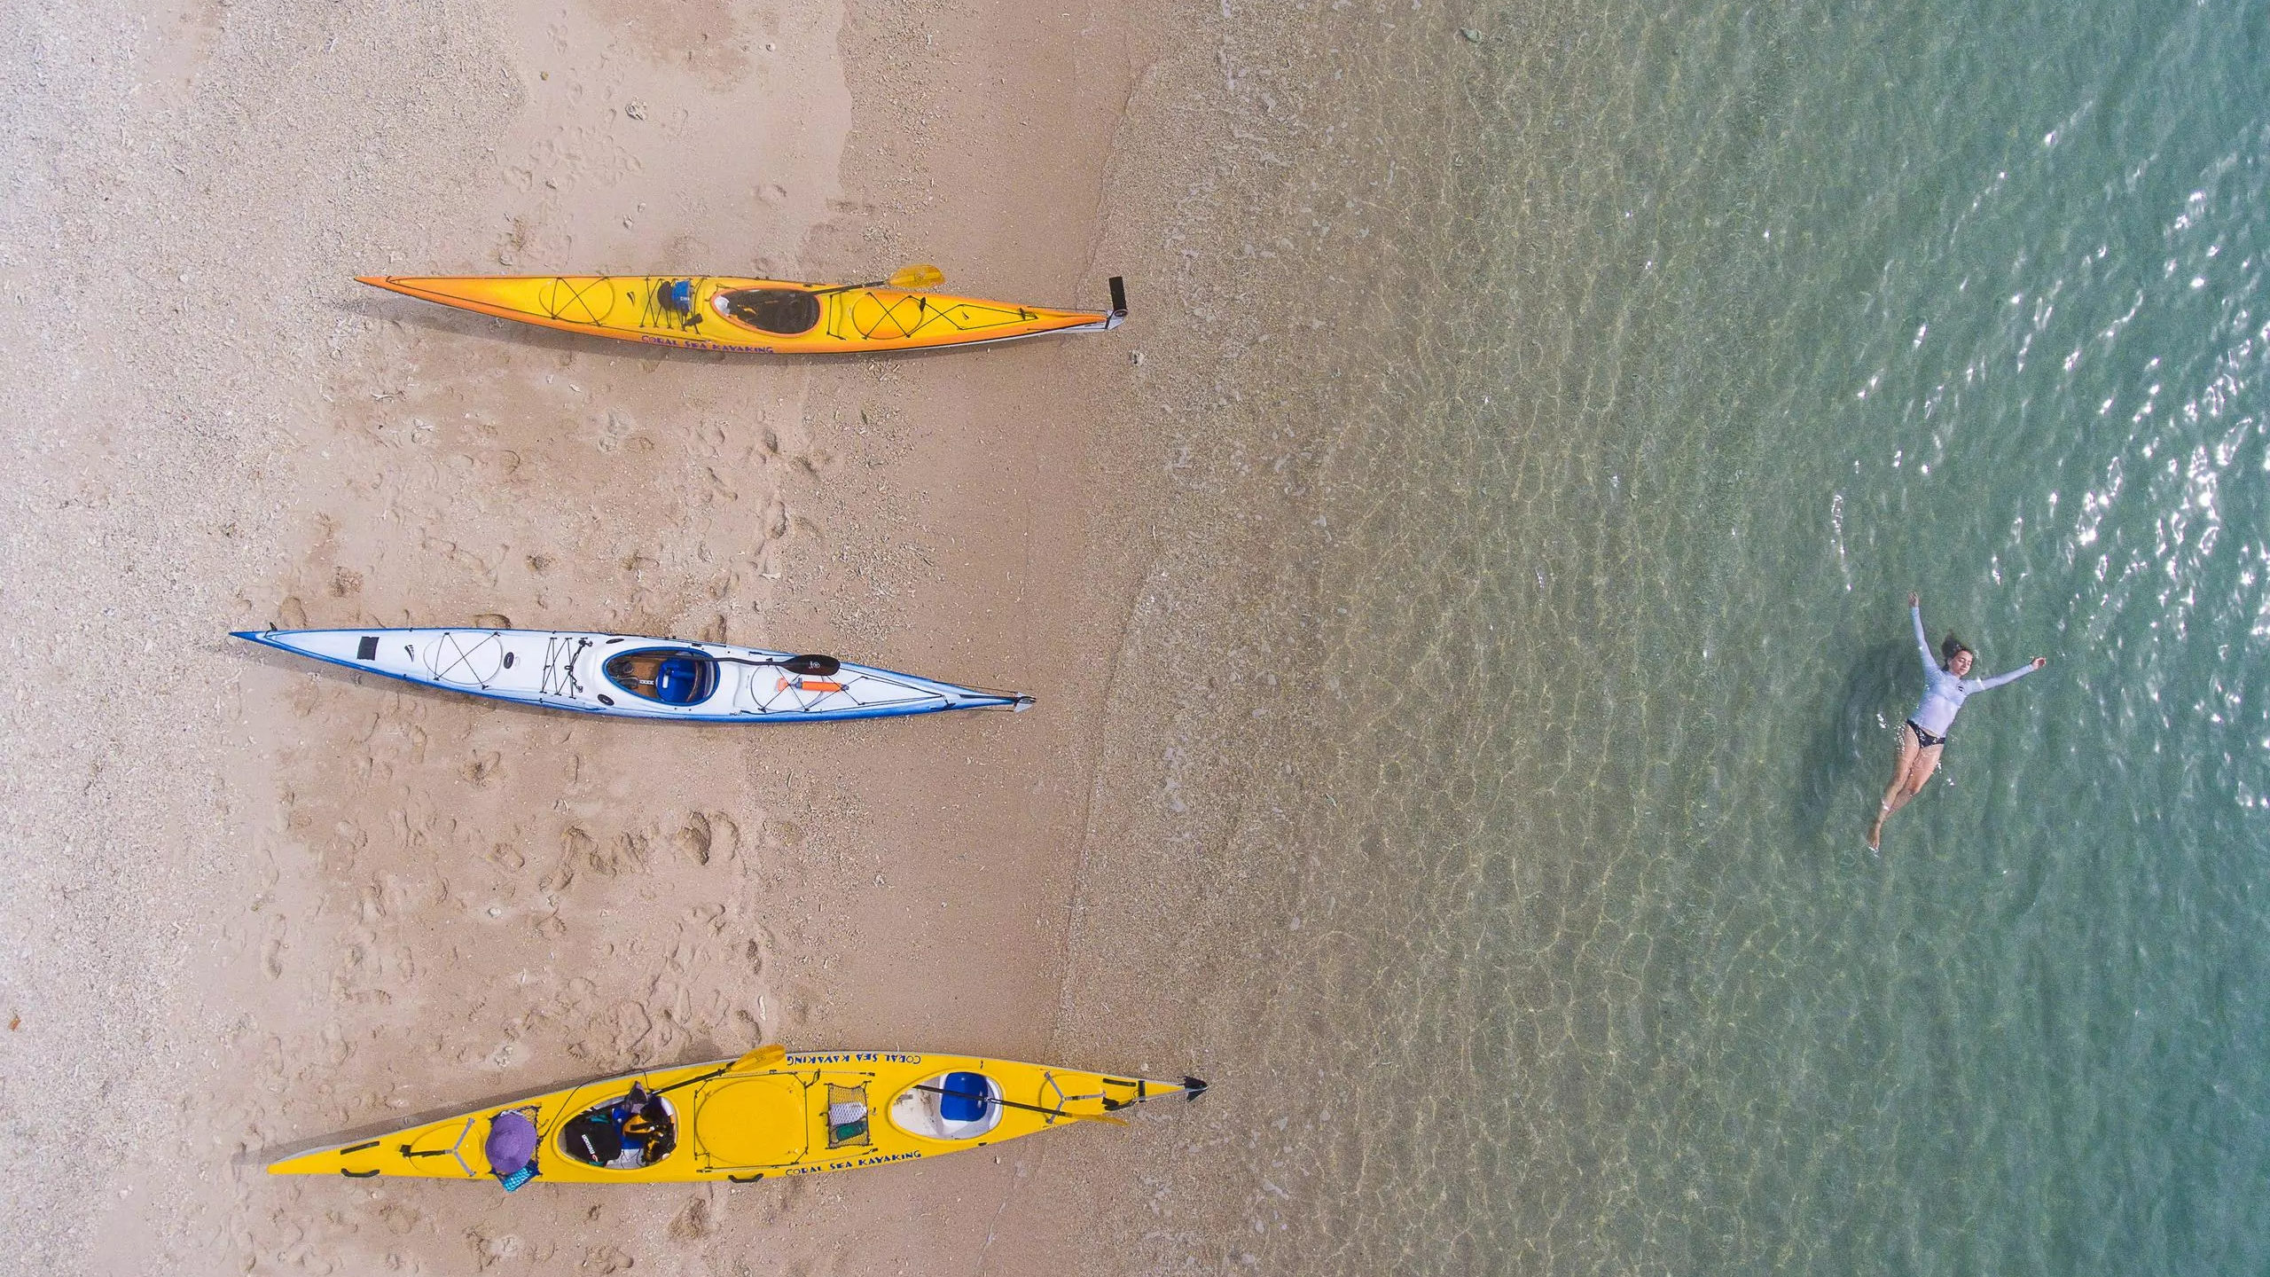
Recreation
Notes:
Image: https://islandsandicetravel.com/tours/hinchinbrook-island-adventure

Slide 20
experiences

Slide 21
Artist: Jumbo Prior
Notes:
Indigenous Painting: https://blog.qm.qld.gov.au/2021/06/11/connections-to-the-land-and-sea/
In 2021, Museum of Tropical Queensland commissioned an artwork from local Townsville Indigenous artist, Jumbo Prior. Go to website to learn more about the painting.

Slide 22
How much are you willing to pay?

Slide 23
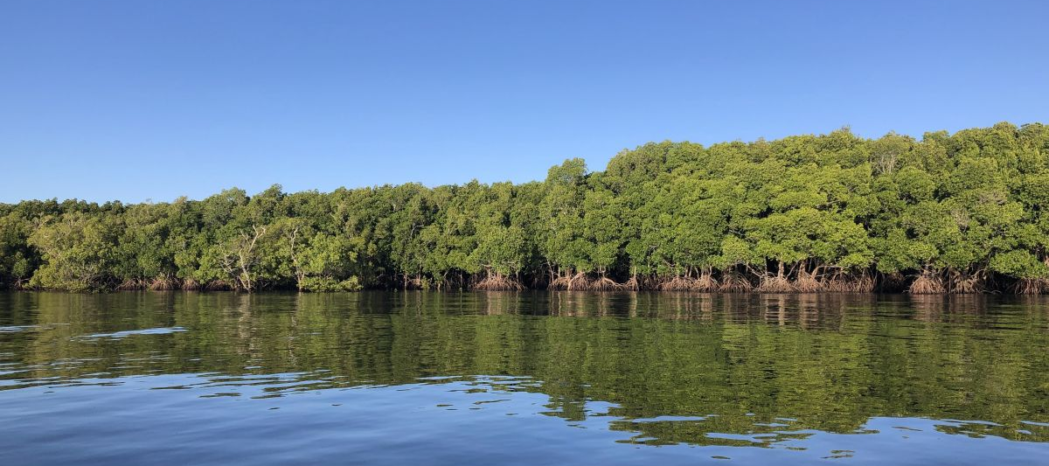
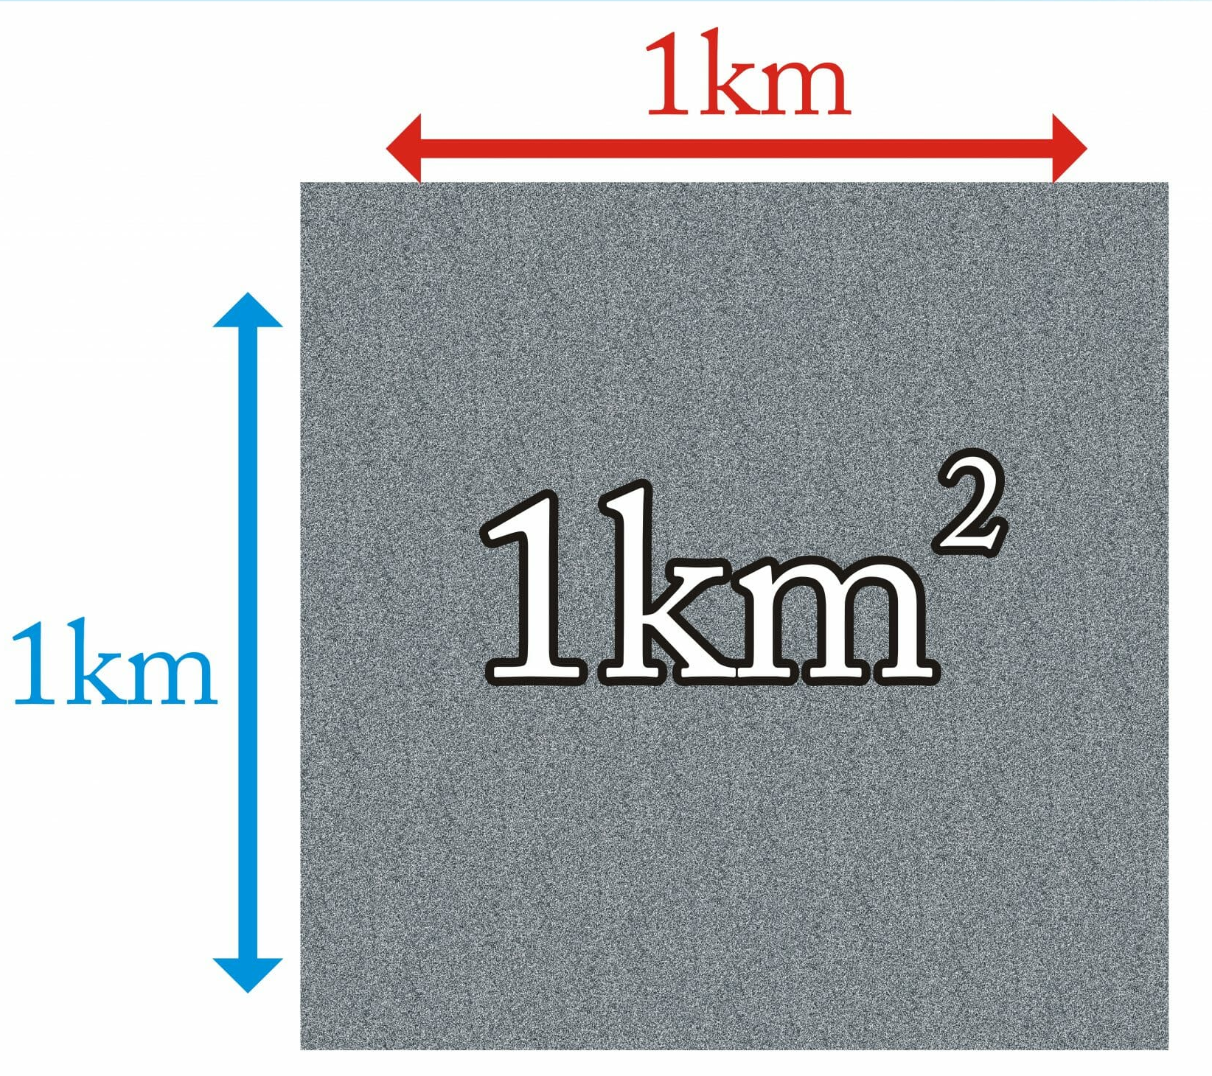
A United Nations Environment report estimated the TEV of mangroves to be worth USD$900 000 per km² (AUD$1.35millon)
Notes:
Info (TEV of mangroves): https://parks.desi.qld.gov.au/parks/moreton-bay/zoning/information-sheets/mangroves#:~:text=A%20United%20Nations%20Environment%20report,000%20per%20square%20kilometre%202.
Image: https://www.barrierreef.org/news/project-news/empowered-communities-care-for-mangroves-in-queensland

Slide 24
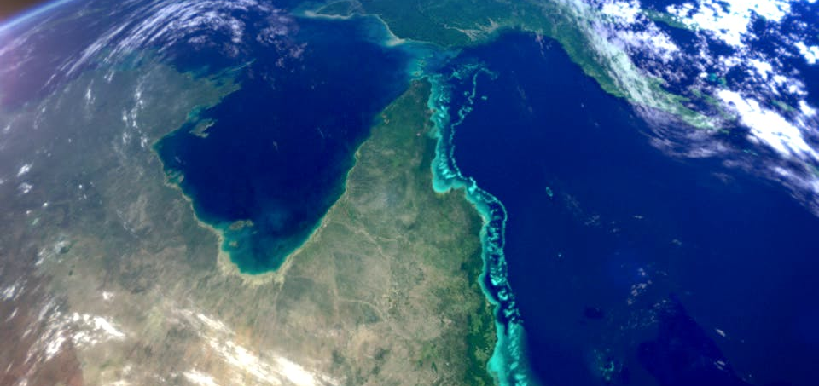
The Great Barrier Reef was valued at $56 billion
as an Australian economic, social and iconic asset
Notes:
Info (GBR @56 Billion): https://www.barrierreef.org/the-reef/the-value#:~:text=More%20than%20the%20jobs%20it,of%20building%20Australia's%20new%20submarines.
Info (coal): https://www.statista.com/statistics/697085/australia-total-income-coal-mining-industry/#:~:text=In%20financial%20year%202022%2C%20the,recorded%20during%20the%20reported%20period.
Image: https://www.ozsail.com.au/blog/the-great-barrier-reef/

Slide 25
What do you think of the idea of putting a price
(a dollar value) on the environment?

Slide 26
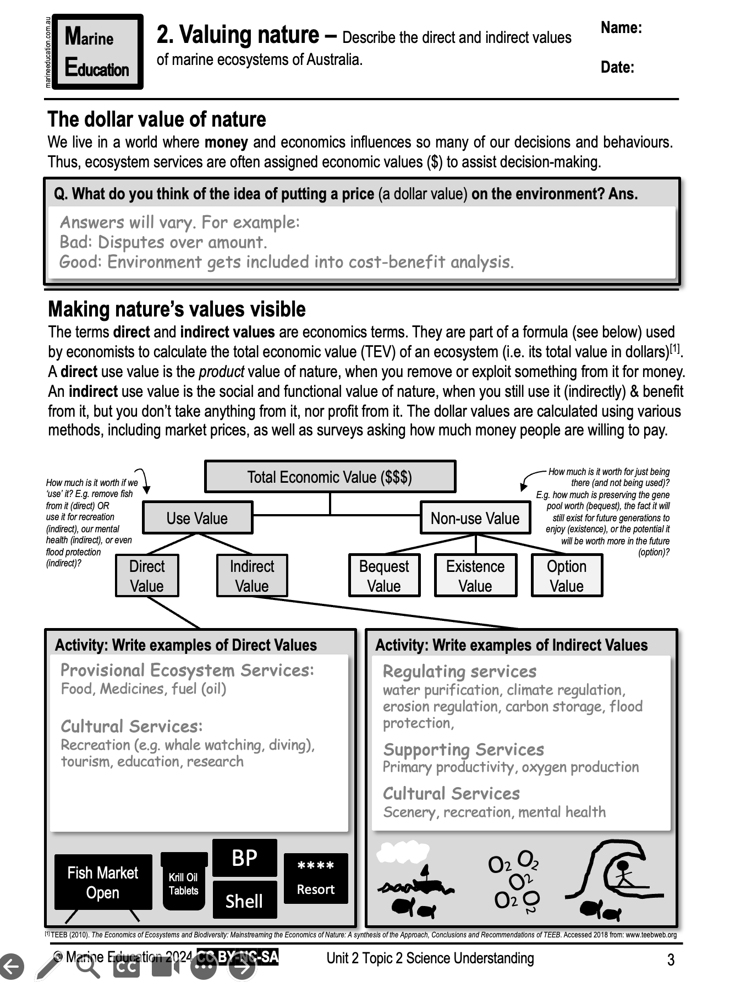
Learning Intention:
Describe the direct and indirect values of marine ecosystems of Australia.
Success Criteria:
Complete Marine Education worksheet ‘2. Valuing Nature’
Notes:
Image: https://www.cnbc.com/2020/01/14/esg-funds-see-record-inflows-in-2019.html

