Slide 1
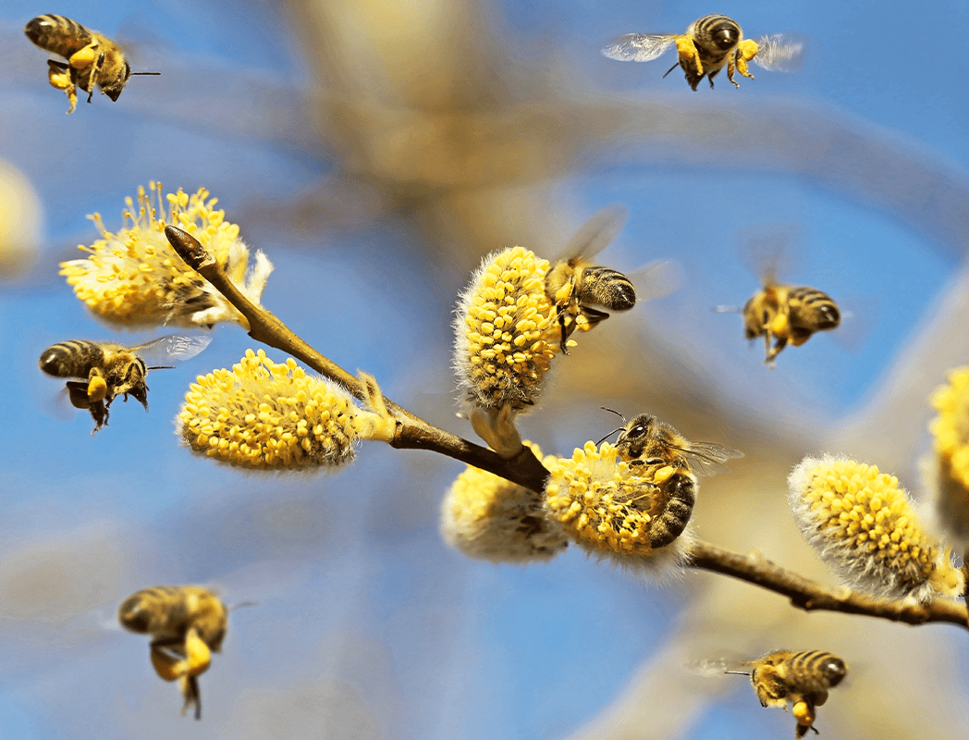
Learning Intention:
Describe land management practices that contribute to the health of marine ecosystems, including siltation, algal blooms and agricultural practices
Success Criteria:
Complete Marine Education worksheet ’20. Saving our soils and seas’
Notes:
Image: https://www.green.earth/blog/what-is-sustainable-land-management#:~:text=Sustainable%20land%2Dmanagement%20practices%20such,infiltration%2C%20and%20reduce%20soil%20degradation.

Slide 2
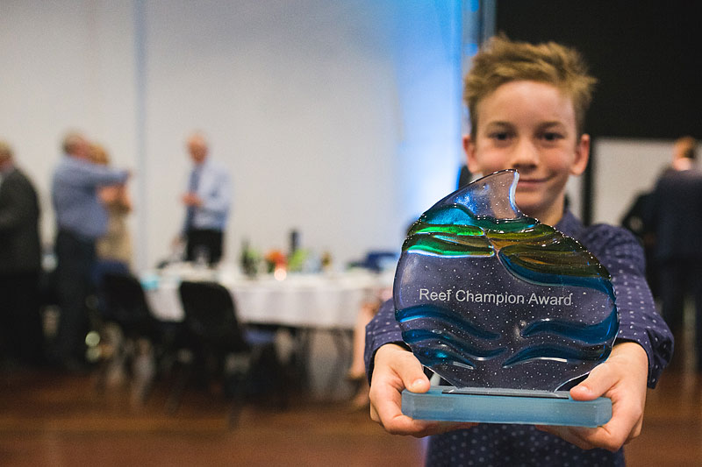
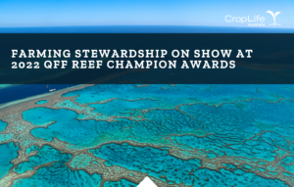
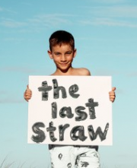
Reef Champion Awards - celebrating landholders, individuals and community groups working to improve water quality draining into the Great Barrier Reef.
10 year old
Sid Crawshaw was awarded the winner of the 2018 Reef Youth Champion Under 15 Award for reducing
single-use plastic straws in his coastal
home-town of Tannum Sands.
Notes:
Images: https://fba.org.au/yeppoon-at-the-centrestage-for-2018-reef-champion-awards/
Sid’s award: https://www.qff.org.au/projects/reef-champion-awards/awards/

Slide 3

Reef Champion Award Winner Matt Hinz of Hillview, who reduces sediment running off his property by an estimated 5.71 tonnes every year.

Slide 4

Reef Champion Award Winner Yeppoon Inlet Association who have volunteered their time to remove sunken and abandoned vessels and associated debris from the Figtree Creek inlet – in one year removing 57 tonnes.

Slide 5
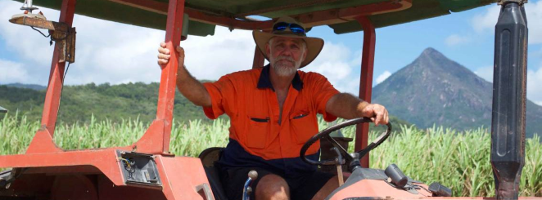
Prince’s Trust Australia Environmental Leadership – Reef Sustainability Award
Tony Rossi, Aloomba, for using his scientific skills on the farm; Tony was always interested in soil health, soil testing, developing precision agricultural techniques & regional environmental issues, & has become an advocate for demonstrating on-farm sustainable environmental practices to other farmers and industry.
"I see a real connection between farmers and First Nations people - I am so proud to work with our clan people, we all touch the earth.” Tony Rossi (Nth Qld)
Notes:
Image: https://www.princes-trust.org.au/post/2022-reef-champion-award-winners

Slide 6
Industry Best Management Programs (Qld)

Slide 7
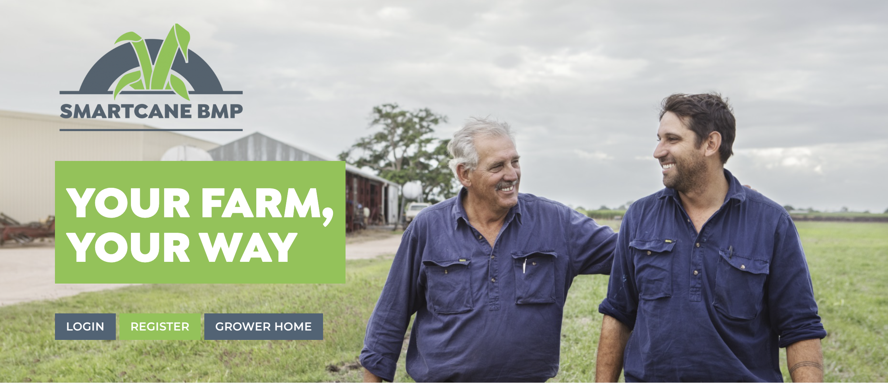
Sugarcane
https://smartcane.com.au/

Slide 8

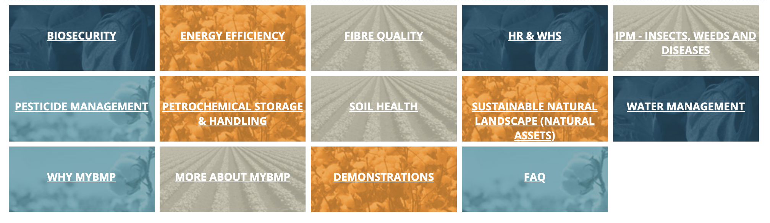
Cotton
https://www.mybmp.com.au/home.aspx

Slide 9

Horticulture
https://www.hort360.com.au/

Slide 10
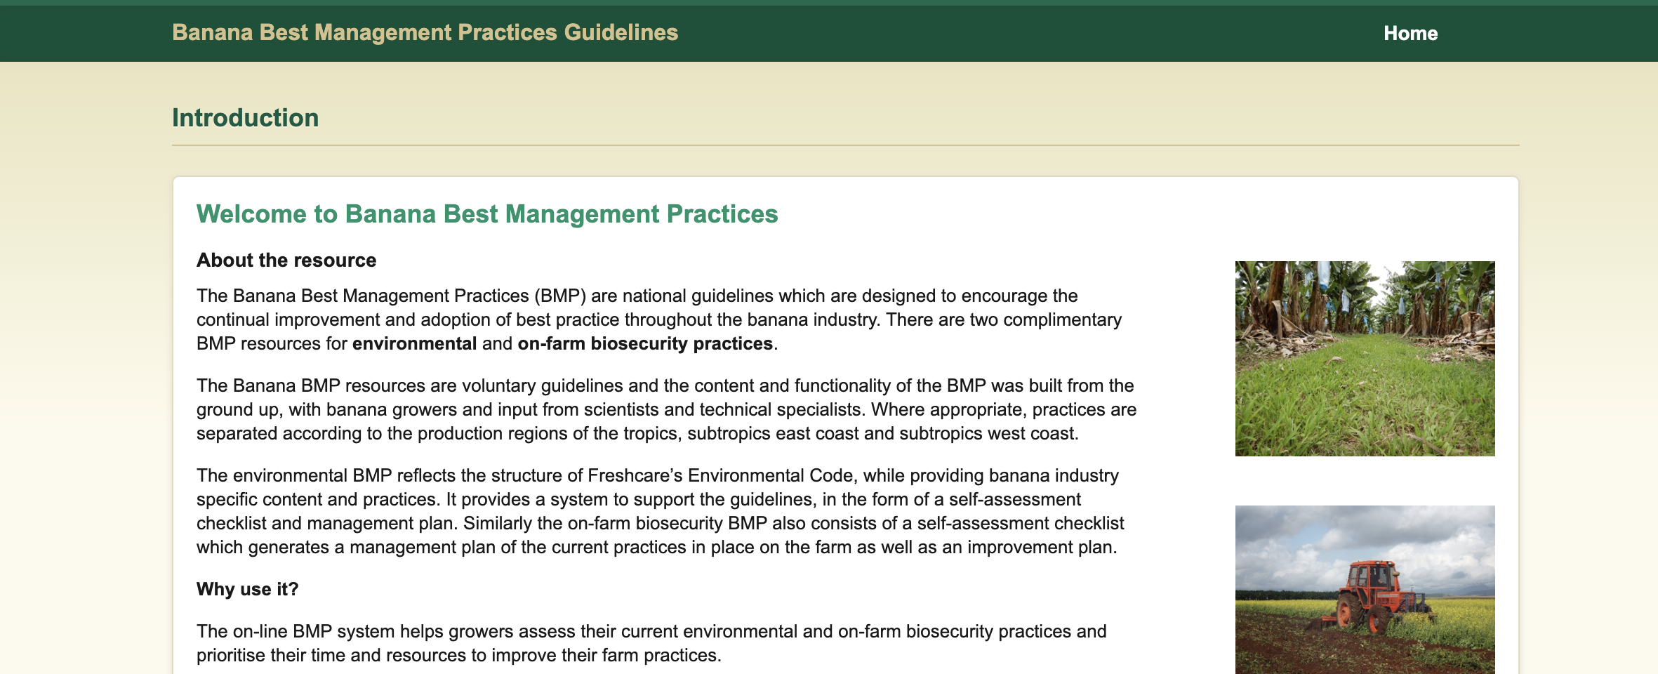
Banana
https://bmp.abgc.org.au/

Slide 11


Nursery
https://www.greenlifeindustry.com.au/

Slide 12
Examples of Best Land Management Practices

Slide 13
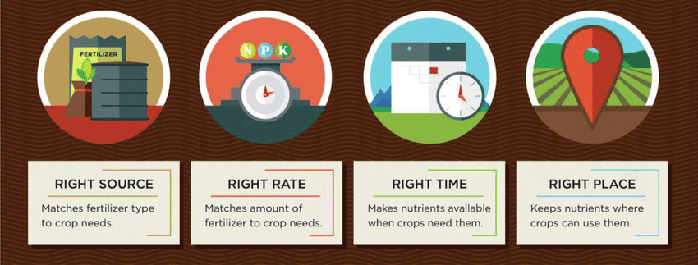
Nutrient management
(4R approach)
e.g. timing, application and matching fertilisers to crop requirements
Notes:
Image: https://www.researchgate.net/figure/Four-R-nutrient-stewardship-model-for-best-management-practices-BMP_fig2_335919415

Slide 14
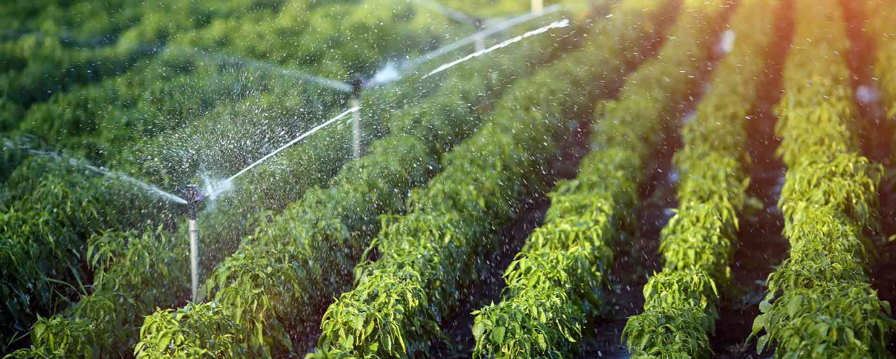
Water use efficiency
e.g. irrigation method and timing and water reuse where possible

Slide 15
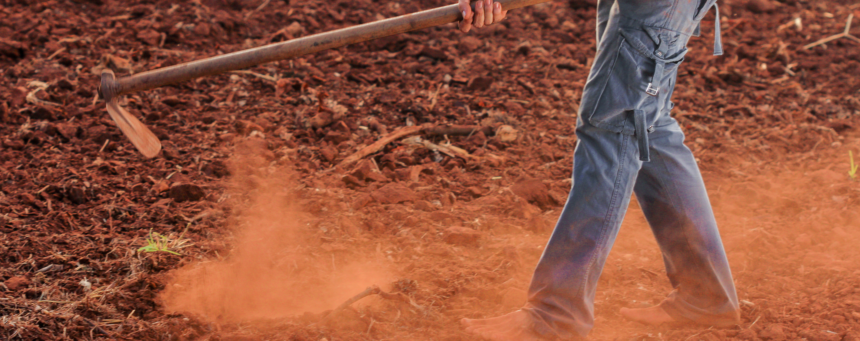
Soil and sediment management
e.g. minimum tillage, soil conservation, vegetated buffers, swales, and drains
Notes:
Image: https://wikifarmer.com/tillage-can-sometimes-help-but-usually-harm-soil-and-water-conservation/

Slide 16
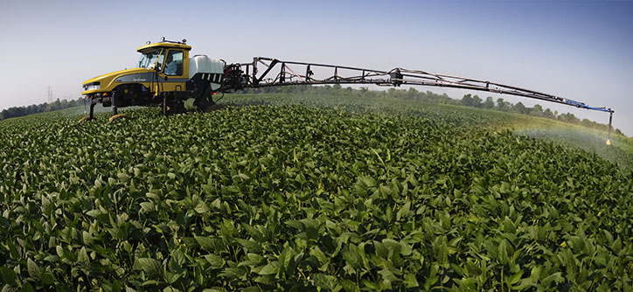
weed and chemical management
e.g. integrated weed management, spray drift management

Slide 17
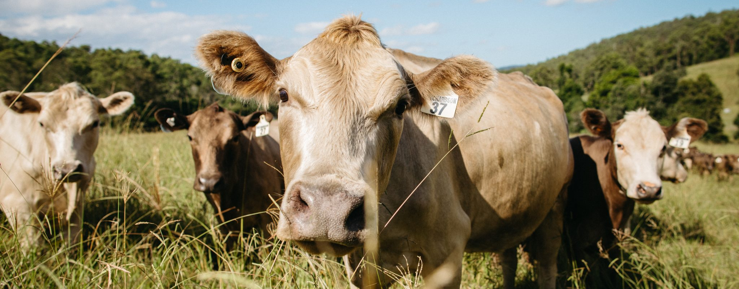
Grazing land and herd management
e.g. stocking rates, spelling, controlling access to wetlands and waterways
Notes:
Image: https://coastbeat.com.au/uncategorized/chef2farmer-ethical-produce-from-paddock-to-plate

Slide 18
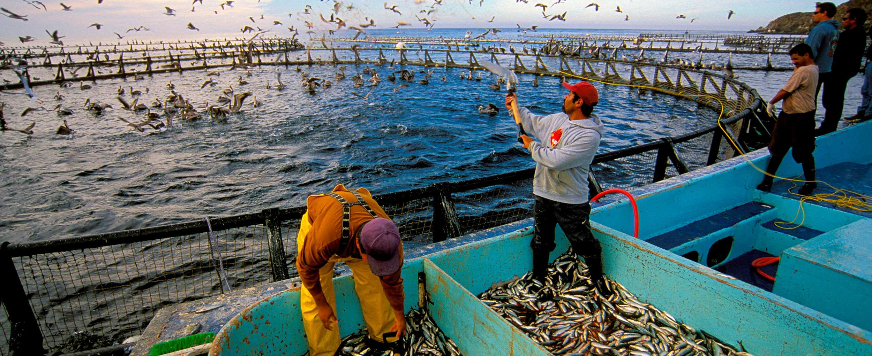
Sustainable aquaculture management
e.g. matching feed to production requirements, feed stock source is sustainable
Notes:
Image: https://hakaimagazine.com/features/taking-the-fish-out-of-fish-feed/

Slide 19

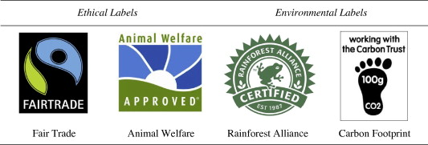
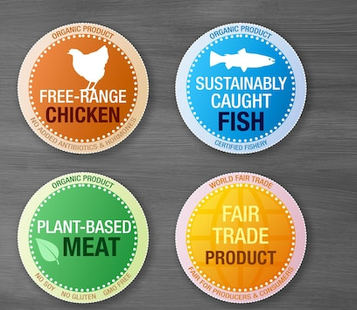
Is it sustainable? Look for the badge. Make an informed choice.
Notes:
Image: https://www.seafoodnutrition.org/seafood-research-oldpage2023/seafood-sustainability/

Slide 20
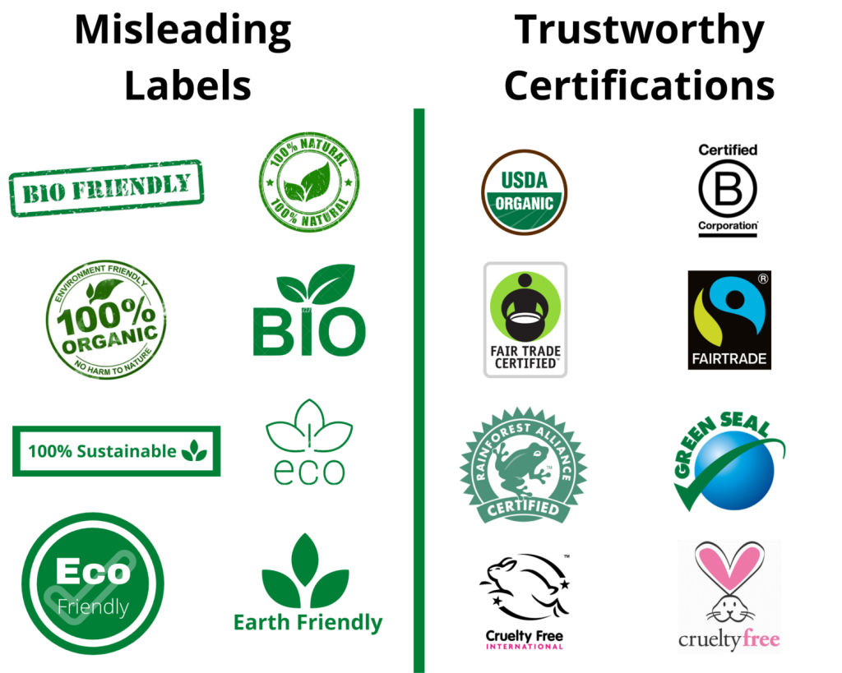
Greenwashing
Beware!
Notes:
Image: https://blog.strive2thrive.earth/eco-friendly-labels-genuine-or-misleading/

Slide 21
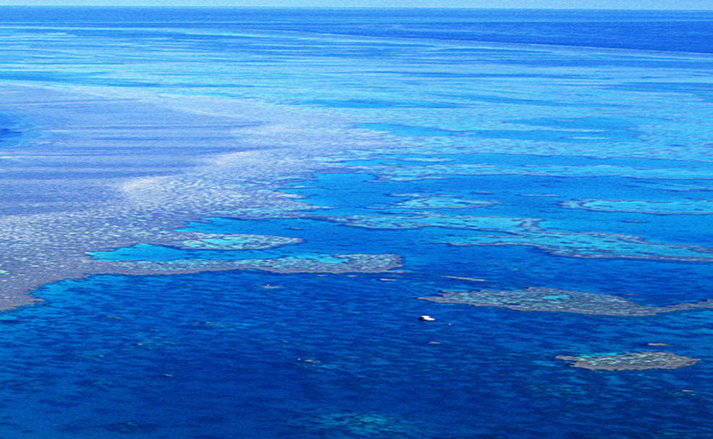
T033 Land management and pollution
Next - view this ppt made by Bob Moffatt at Wet Paper
Bob Moffatt

Slide 22
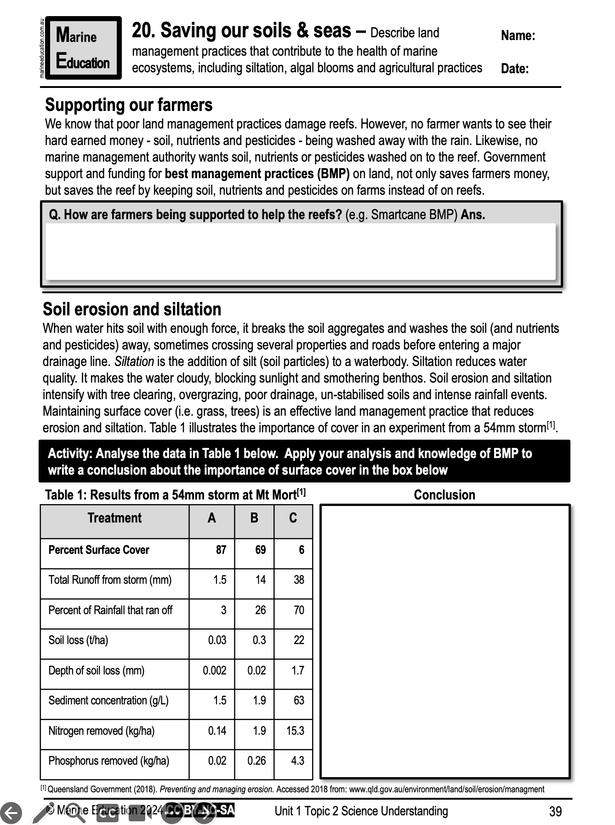
Learning Intention:
Describe land management practices that contribute to the health of marine ecosystems, including siltation, algal blooms and agricultural practices
Success Criteria:
Complete Marine Education worksheet ’20. Saving our soils and seas’
Notes:
Image: https://www.green.earth/blog/what-is-sustainable-land-management#:~:text=Sustainable%20land%2Dmanagement%20practices%20such,infiltration%2C%20and%20reduce%20soil%20degradation.

