Slide 1
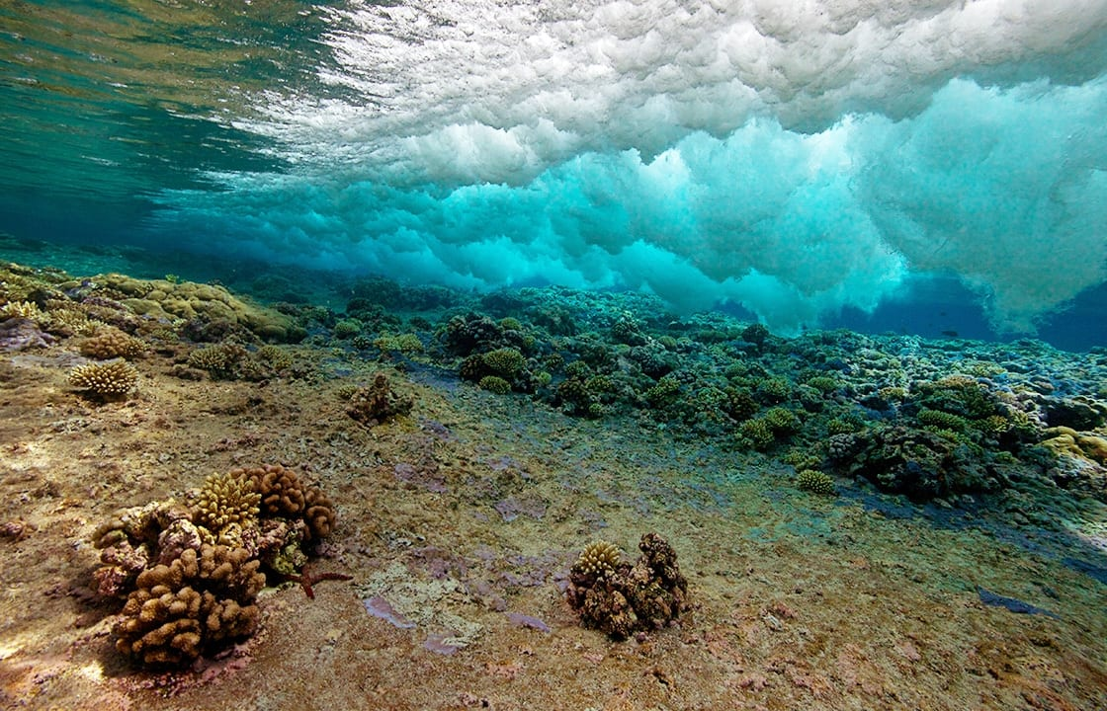
Learning Intention:
Interpret data to identify an organism’s tolerance limit, e.g. of intertidal organisms or mangrove zonation.
Success Criteria:
Complete Marine Education worksheet ‘20. Testing Tolerance”
Notes:
Image: https://www.whoi.edu/know-your-ocean/ocean-topics/how-the-ocean-works/ocean-zones/sunlit-zone/

Slide 2
Zonation
Patterns of species abundance and distribution

Slide 3
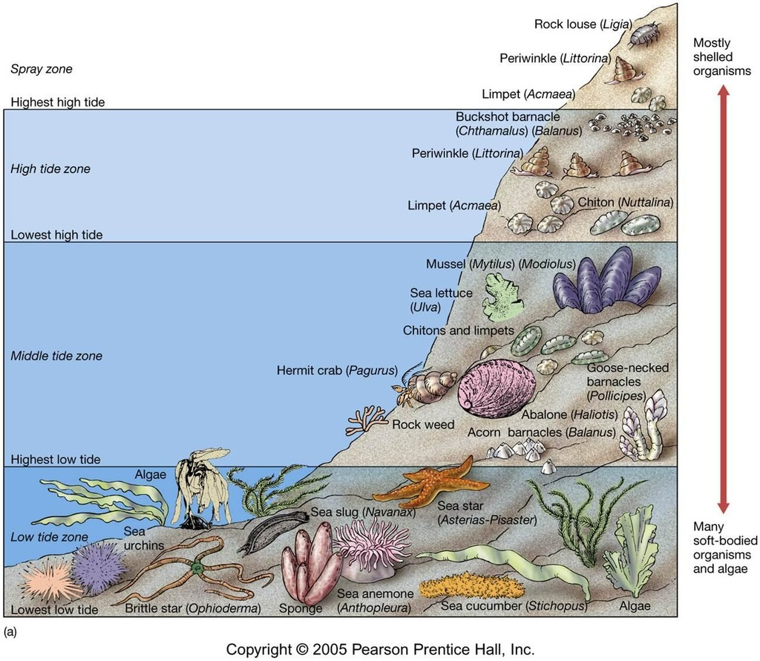
Zones in an intertidal
(rocky shore) ecosystem
Notes:
Image: https://quizlet.com/233881335/chapter-11-intertidal-diagram/

Slide 4
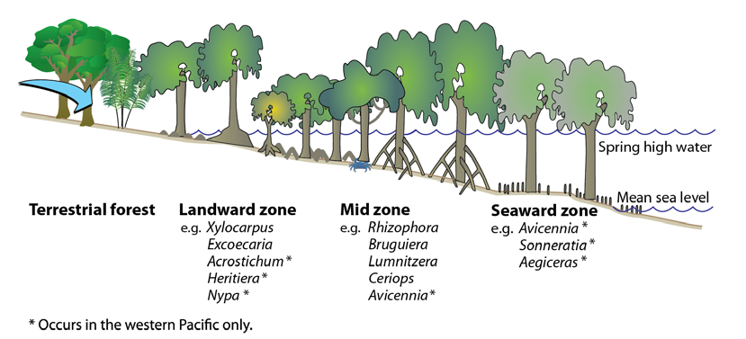
Zones in a mangrove ecosystem
Notes:
Image: https://www.researchgate.net/publication/259649359_Vulnerability_of_mangroves_seagrasses_and_intertidal_flats_in_the_tropical_Pacific_to_climate_change
Vulnerability of mangroves, seagrasses and intertidal flats in the tropical Pacific to climate change
January 2011
In book: Vulnerability of fisheries and aquaculture in the Pacific to climate change. (pp.97-168)
Chapter: 6
Publisher: Secretariat of the Pacific Community, Noumea, New Caledonia.
Editors: J Bell, J Johnson

Slide 5
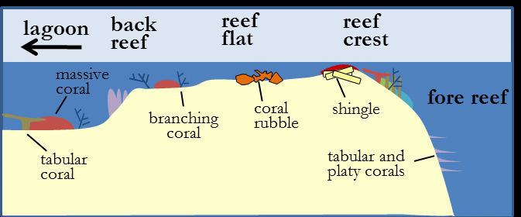
Zones on a coral reef
Notes:
Image: https://www.researchgate.net/figure/Coral-reef-zonation_fig15_260855277
New Edition of the UNESCO-IOC International Tsunami Survey Team (ITST) Post-Tsunami Survey Field Guide

Slide 6
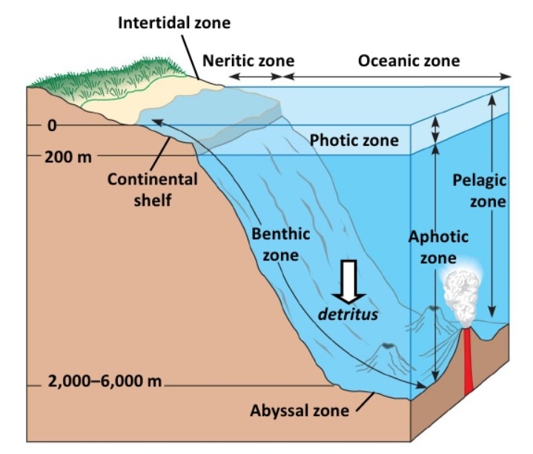
Zones in the ocean
Notes:
Image: https://www.ritubiology.com/2016/07/16/aquatic-microbiology-viii-horizontal-zonation-ocean-stratification-benthic-population/

Slide 7
Mechanisms underlying these patterns

Slide 8
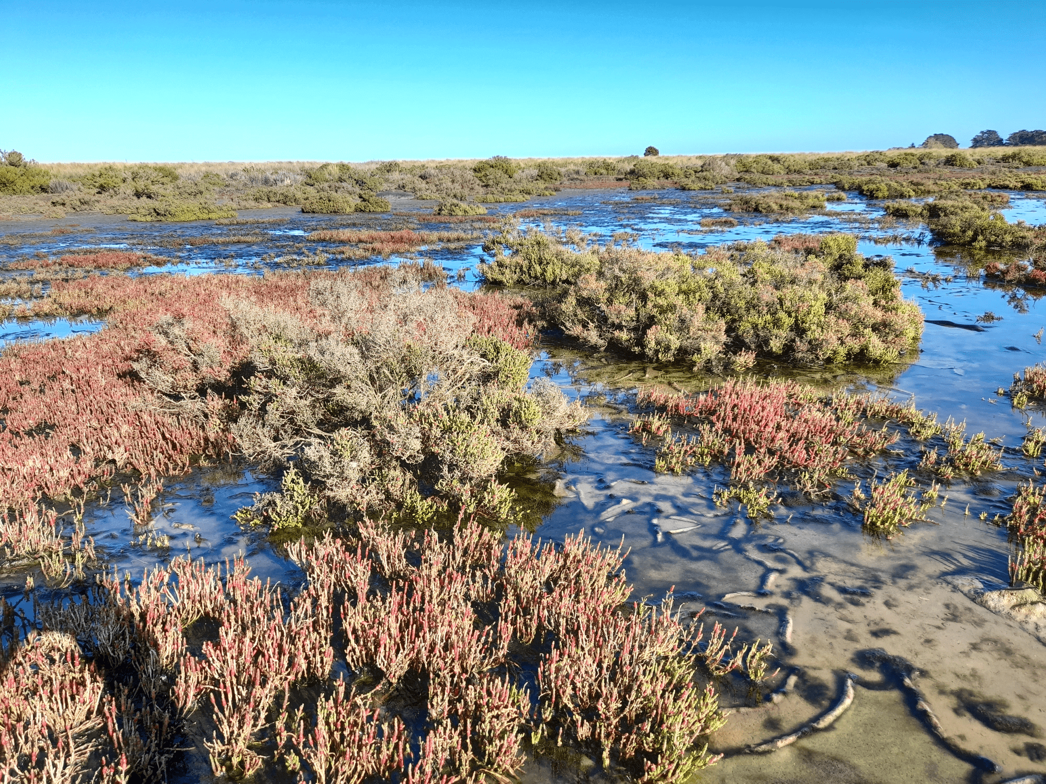
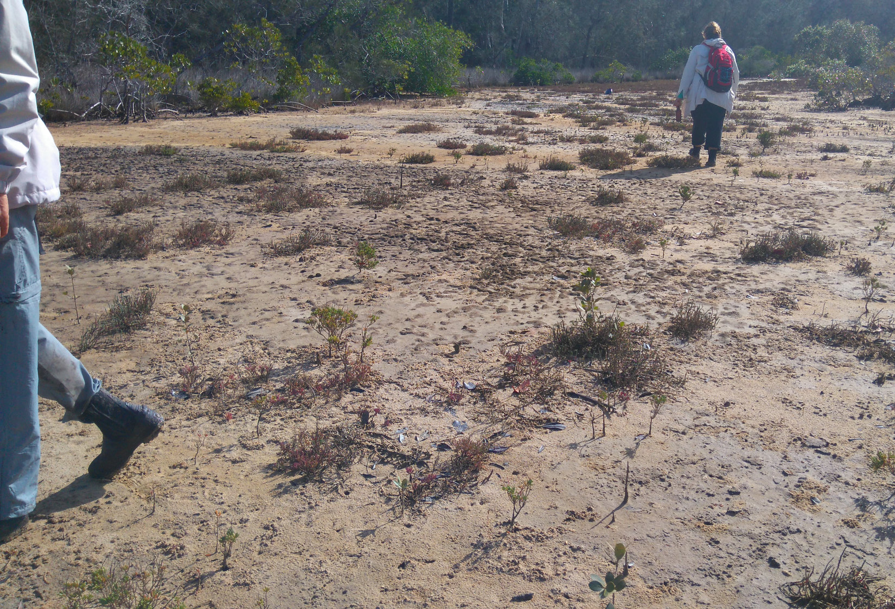
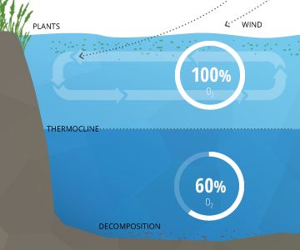
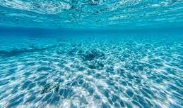
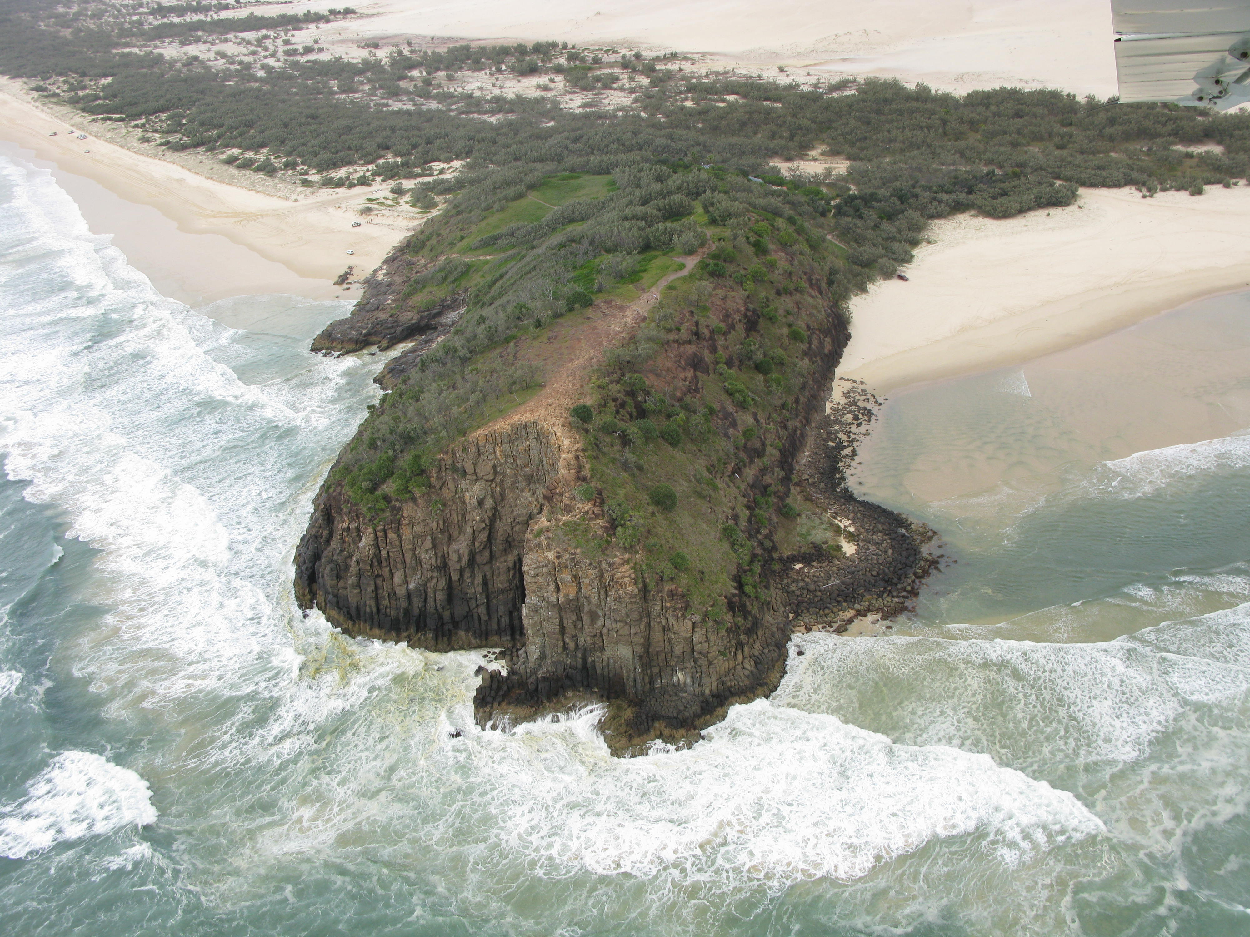
For example…
Abiotic factors
Salinity
Tidal inundation
Dissolved O₂
Waves
Light availability
Substrate

Slide 9
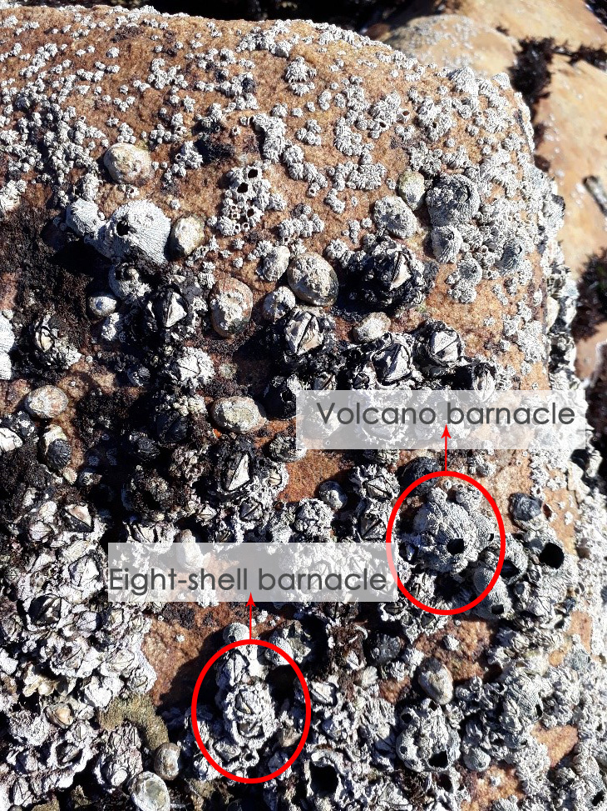
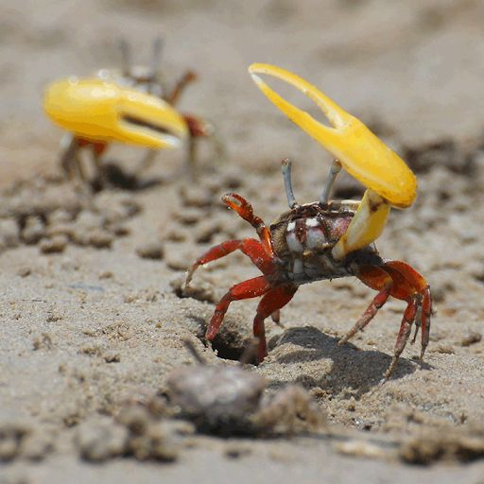
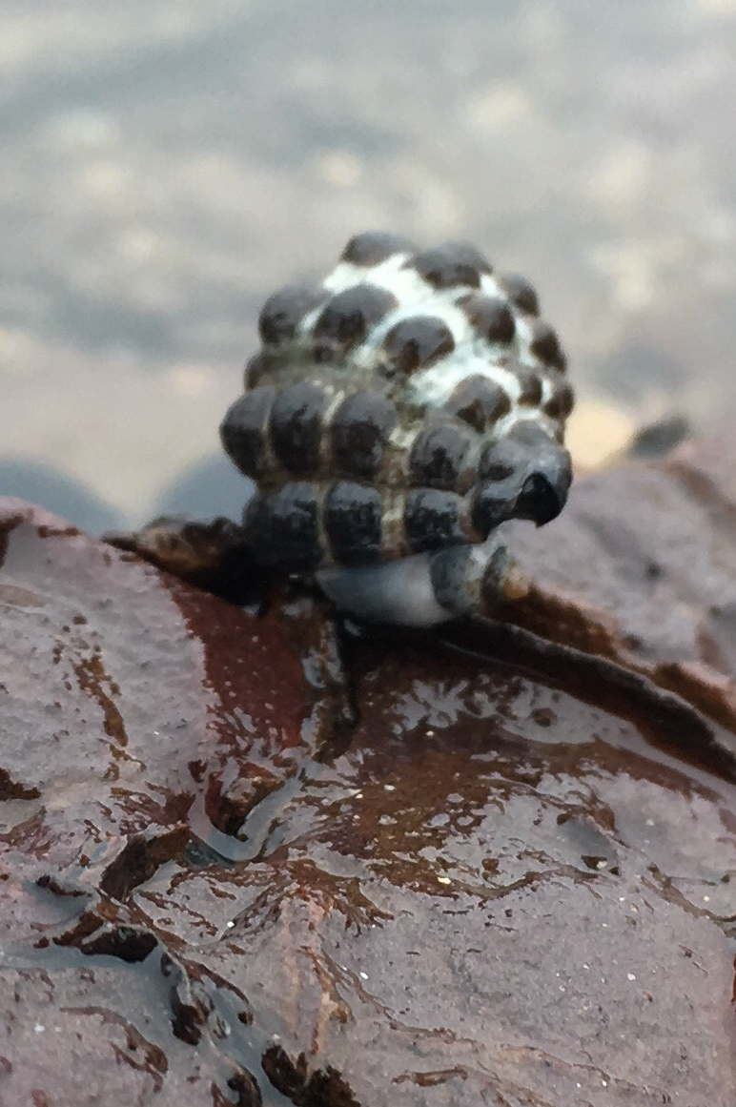
For example…
Biotic factors
Intraspecific competition
Reproduction
Predation
Notes:
Image (left): https://stfranciskrommetrust.co.za/coastal-treasure/rocky-shores/

Slide 10
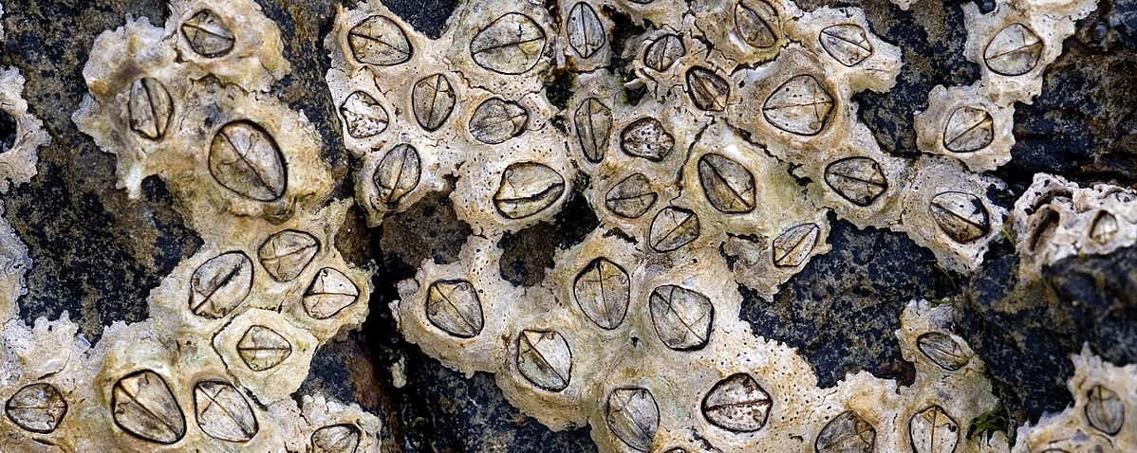
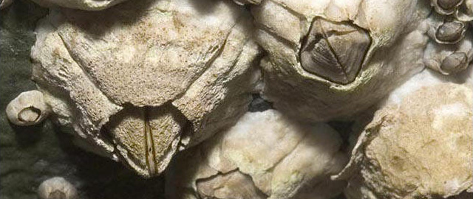
For example,
The tolerance limit of the six-plated barnacle
(Chthamalus sp.)
becomes evident when its competition - the northern acorn barnacle
(Semibalanus sp.)
is removed.
Chthamalus sp
Semibalanus sp
Notes:
Image: https://en.wikipedia.org/wiki/Chthamalus

Slide 11
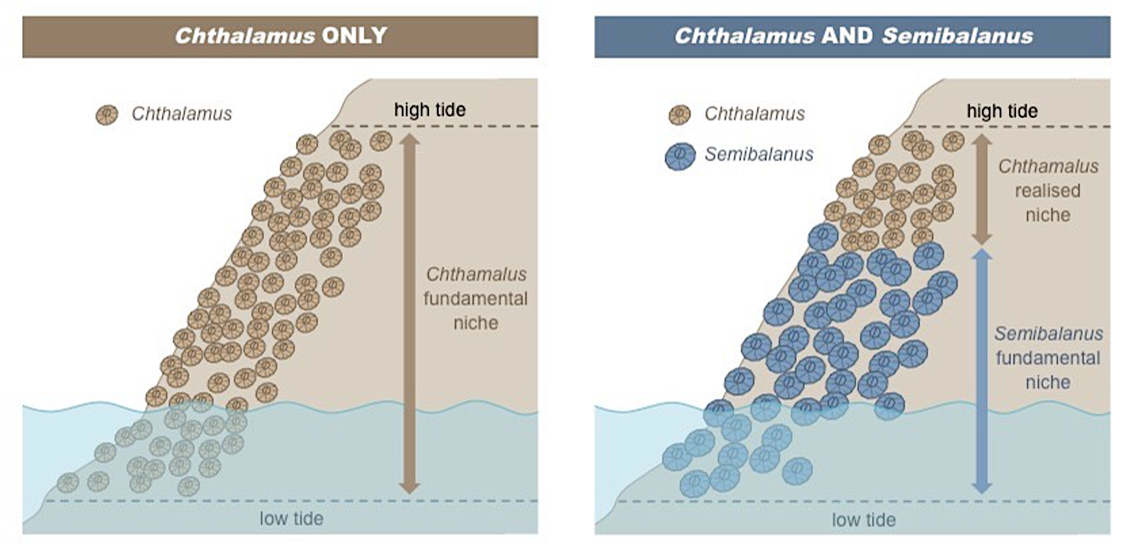
When the acorn barnacle is removed,
the six plated barnacle Chthalamus occupies the entire
tidal zone
(no competition)
Notes:
Image: https://old-ib.bioninja.com.au/options/option-c-ecology-and-conser/c1-species-and-communities/ecological-niche.html

Slide 12
When the acorn barnacle returns,
the six plated barnacle Chthalamus
is only found in the
high tide zone
Notes:
Image: https://old-ib.bioninja.com.au/options/option-c-ecology-and-conser/c1-species-and-communities/ecological-niche.html

Slide 13
WARNING:
CONSIDER ETHICS IF AND WHEN TESTING AN ORGANISM’S TOLERANCE LIMIT
PAPERWORK MUST BE SUBMITTED AND PERMISSIONS MUST BE GRANTED BEFORE DOING ANY TOLERANCE LIMIT EXPERIMENTS

Slide 14
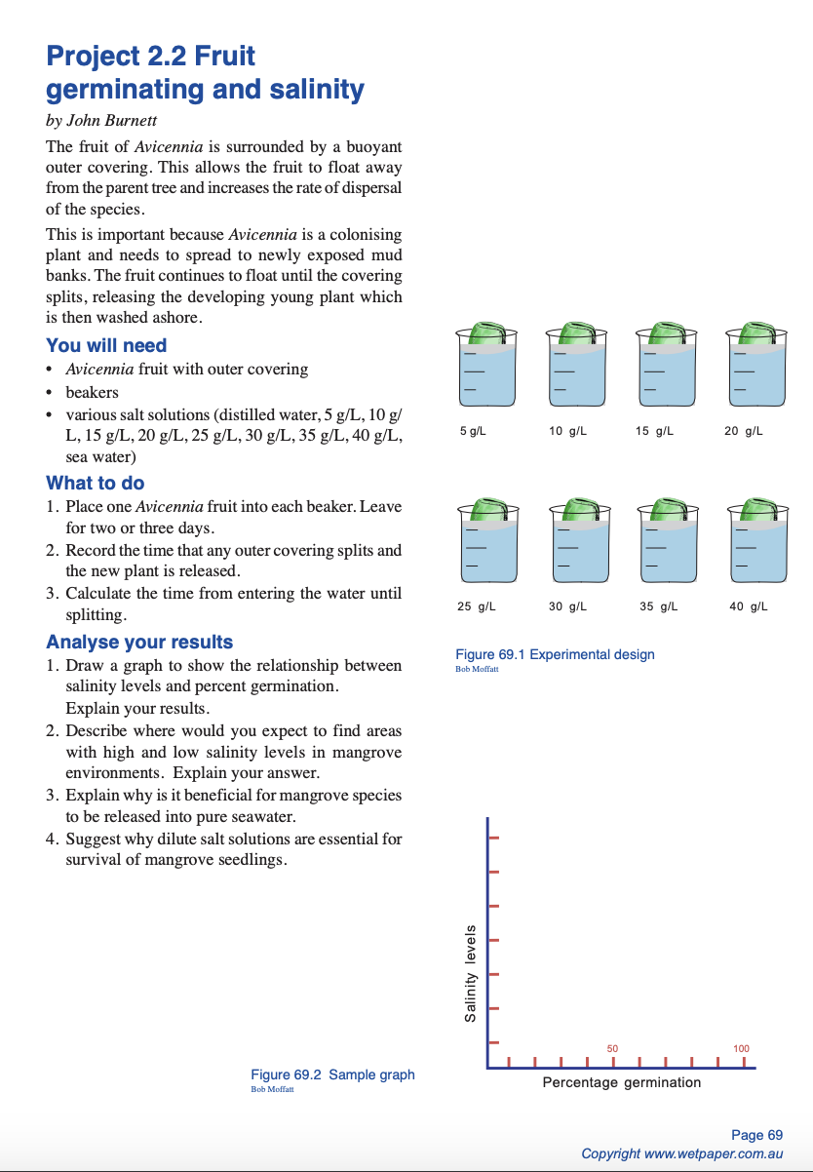
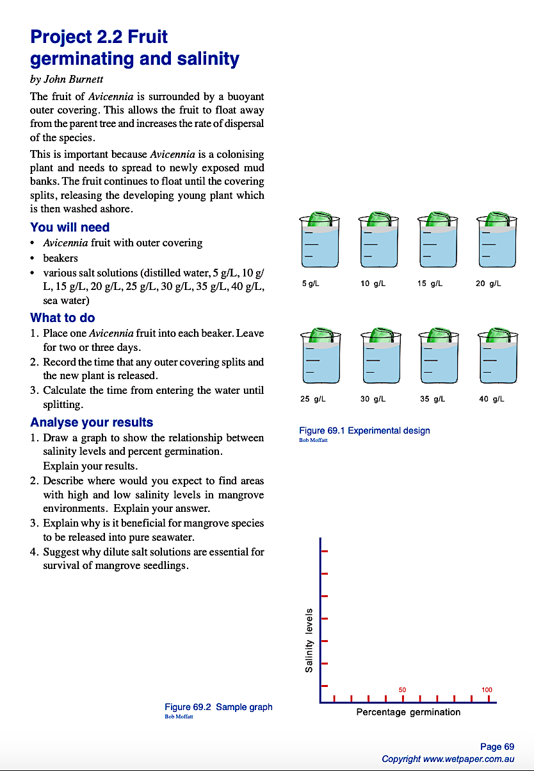
Source: Wet Paper Publications
Notes:
Image: Wet Paper Publications © Bob Moffatt

Slide 15
Source: Wet Paper Publications
What is the optimum range of tolerance of salinity for the germination of a mangrove seed?
Notes:
Image: Wet Paper Publications © Bob Moffatt

Slide 16
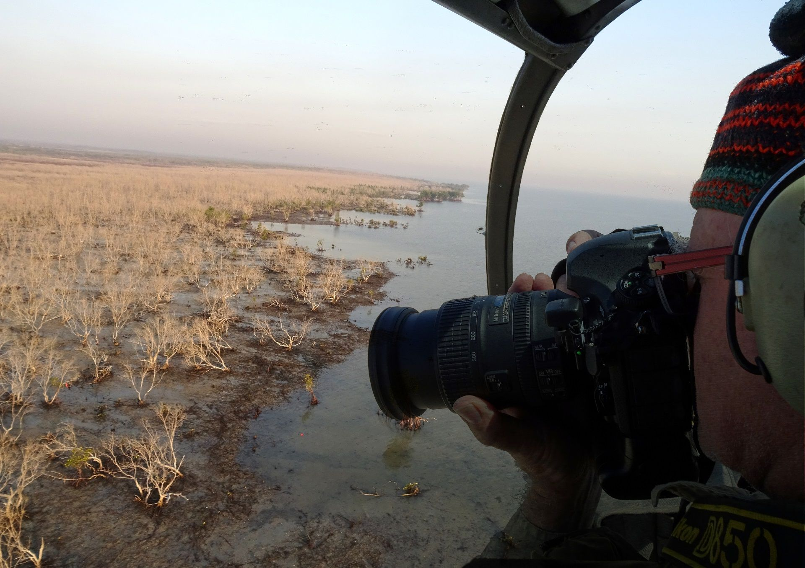
Gulf of Carpentaria Mangrove die-back
2016
‘they died of thirst’
Limiting factor: WATER!
Notes:
Image: https://www.jcu.edu.au/news/releases/2022/july/gulf-mangrove-dieback-discovery

Slide 17
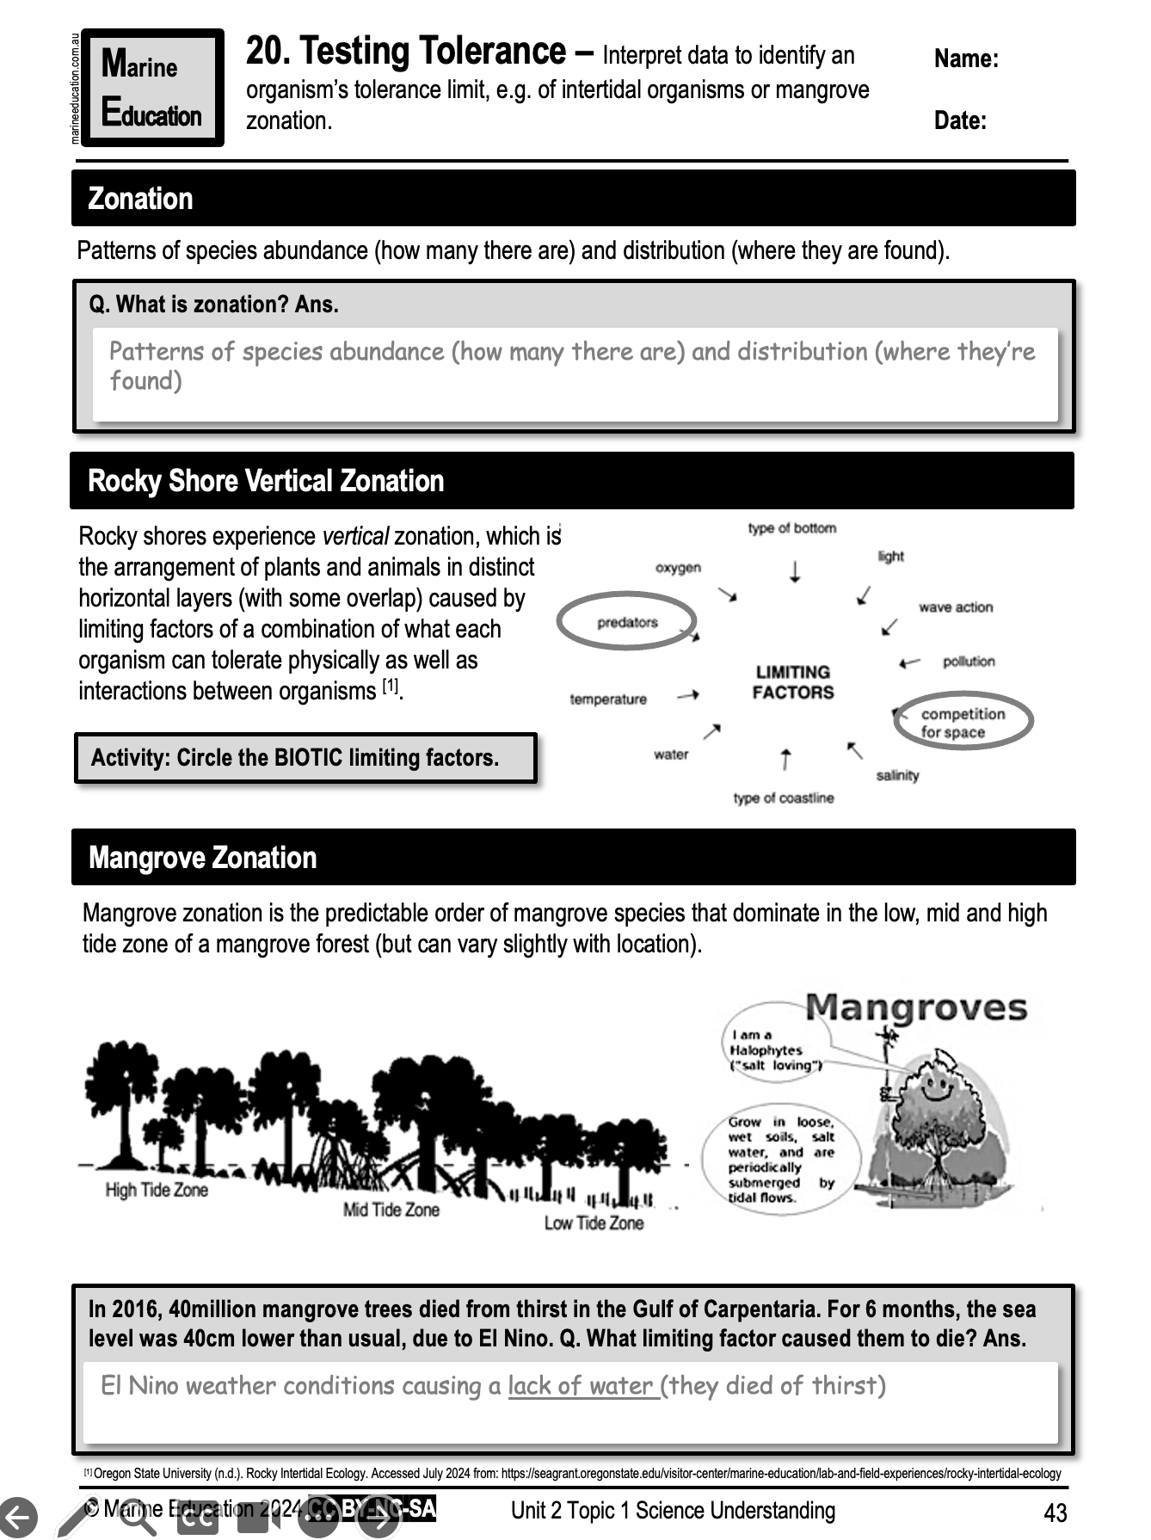
Learning Intention:
Interpret data to identify an organism’s tolerance limit, e.g. of intertidal organisms or mangrove zonation.
Success Criteria:
Complete Marine Education worksheet ‘20. Testing Tolerance”
Notes:
Image: https://www.whoi.edu/know-your-ocean/ocean-topics/how-the-ocean-works/ocean-zones/sunlit-zone/

