Slide 1
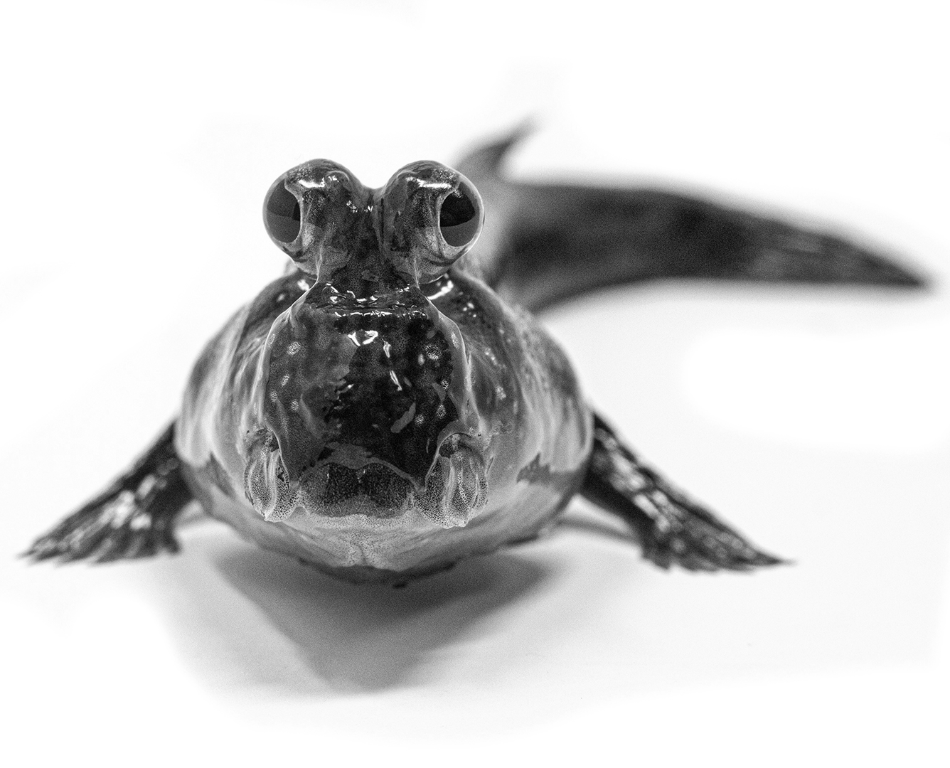
Learning Intention:
Explain an indirect method of measuring pollution levels using a biotic index
Success Criteria:
Complete Marine Education worksheet ’21. Bug life’
Notes:
Image: Hutchings Museum, 55 N Center Street, Lehi, UT 84043. Accessed from: https://johnhutchingsmuseum.org/atlantic-mudskipper

Slide 2
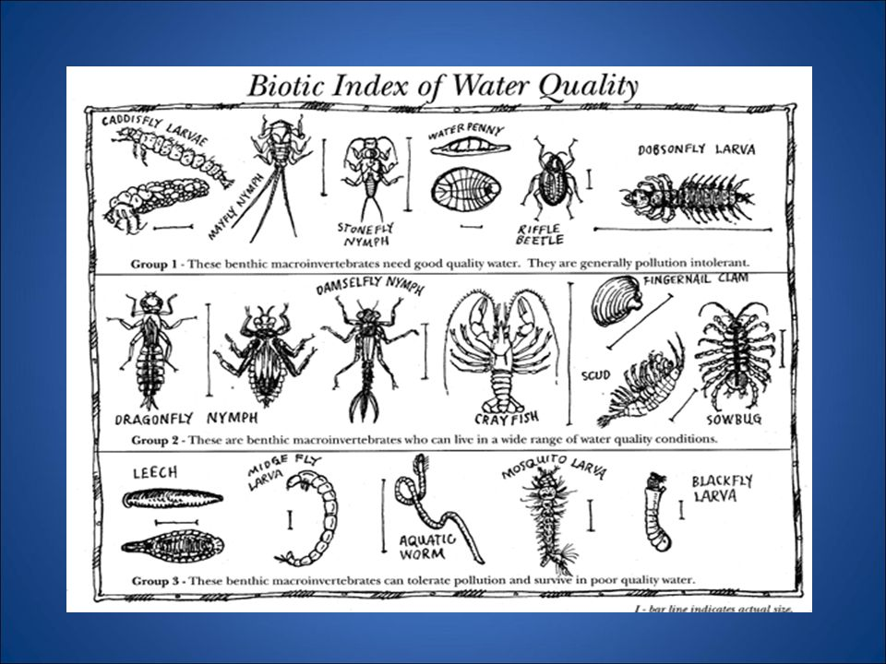
Tolerance levels to pollution are not the same for all organisms.
Some organisms survive in polluted waters, others don’t.
If a waterbody is polluted, only tolerant species will be present.
Notes:
Image: https://www.ableweb.org/biologylabs/wp-content/uploads/volumes/vol-5/6-zimmerman.pdf
The Use of the Biotic Index as an Indication of Water Quality Melvin C. Zimmerman
Image: https://slideplayer.com/slide/9963001/

Slide 3
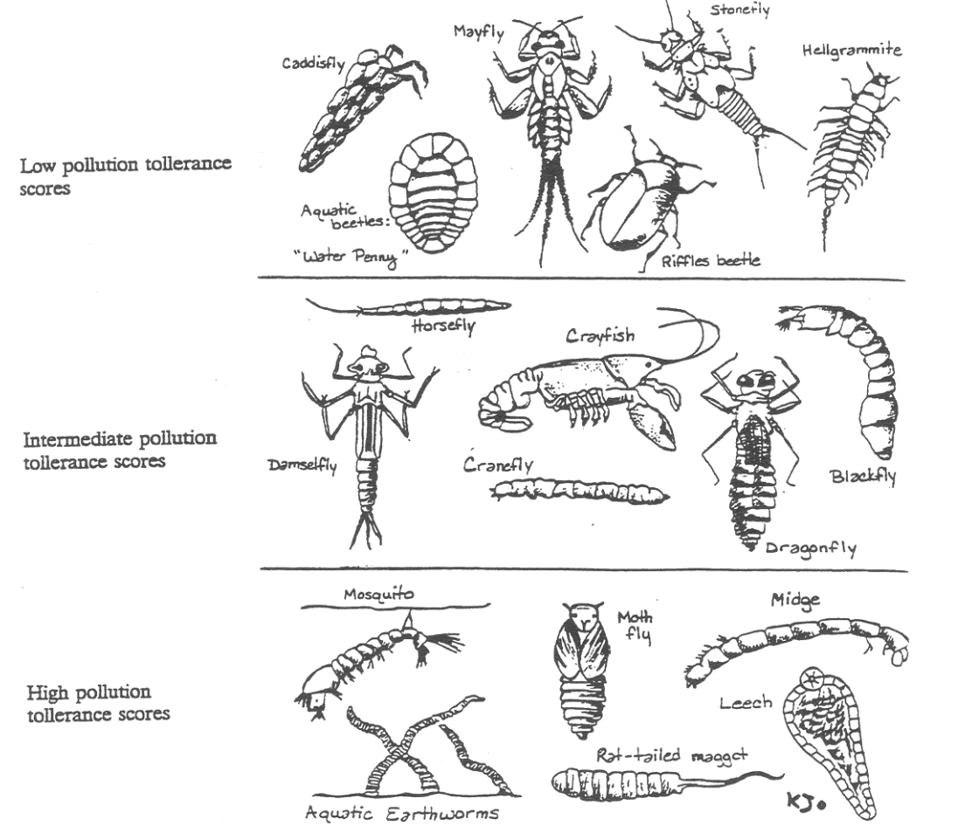
A biotic index is a rapid assessment technique for stream pollution and water quality, based on the tolerance levels of species present.

Slide 4
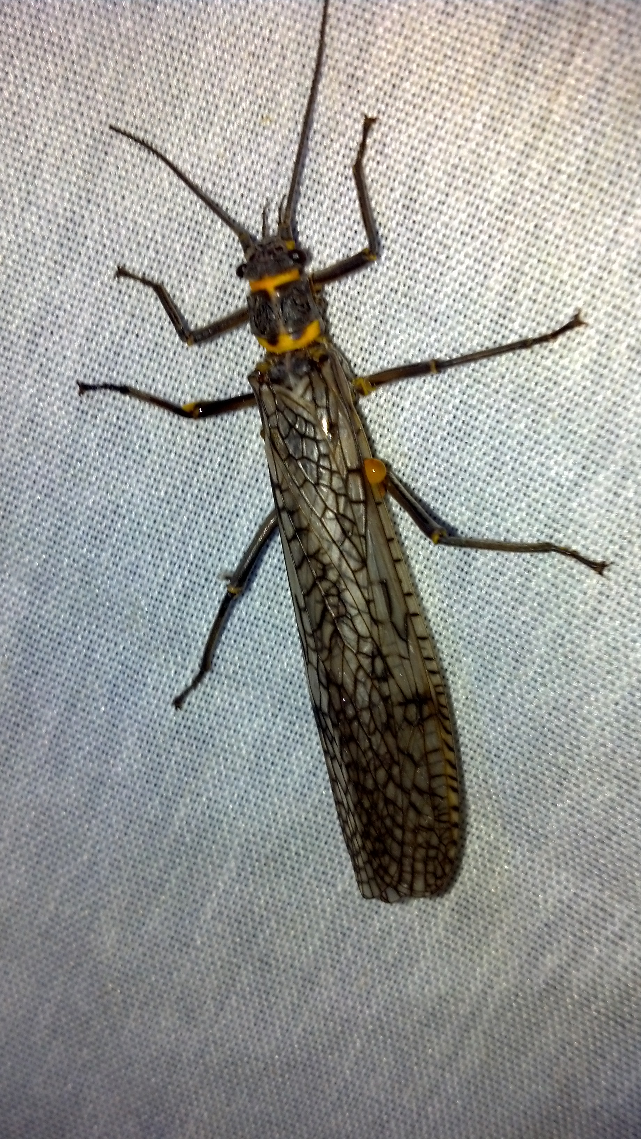
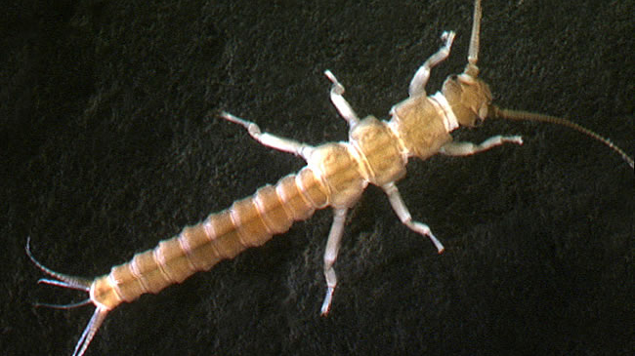
You see a stonefly nymph, and you know the water is clean!
nymph
adult

Slide 5
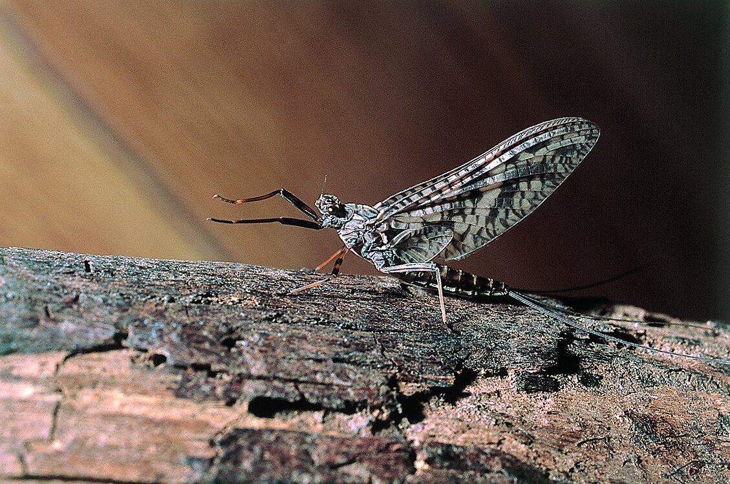
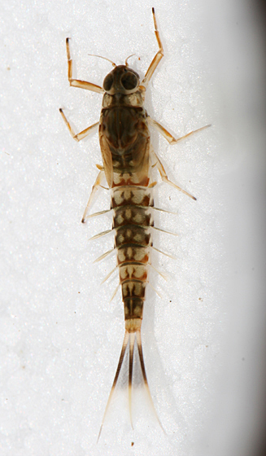
You see a mayfly nymph, and you also know the water is clean!
nymph
adult
Notes:
Image: https://collections.museumsvictoria.com.au/species/8471

Slide 6
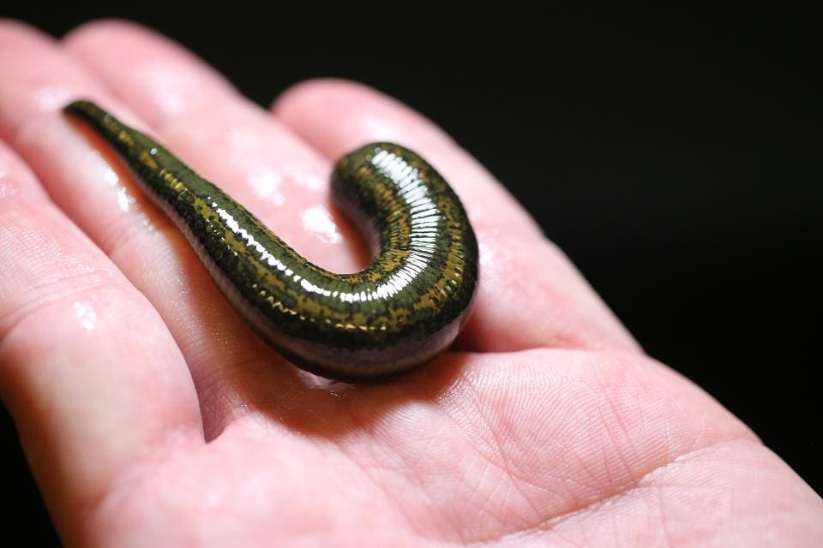
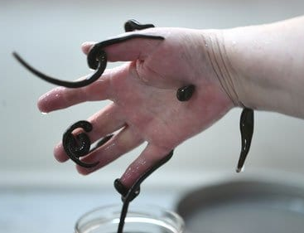
Leeches, on the other hand, can tolerate very polluted water
Notes:
Image: https://www.smithsonianmag.com/science-nature/why-world-needs-bloodsucking-creatures-180973670/

Slide 7
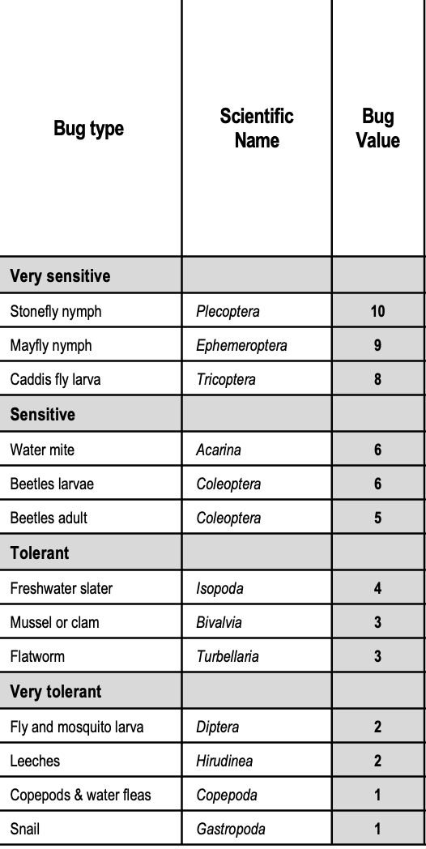
The tolerance levels (bug values) are predetermined.
All you have to do is sample the water by catching as many species as you can in a given time period, identify what you find and count how many there are.
Then do some maths to get a biotic index value.

Slide 8
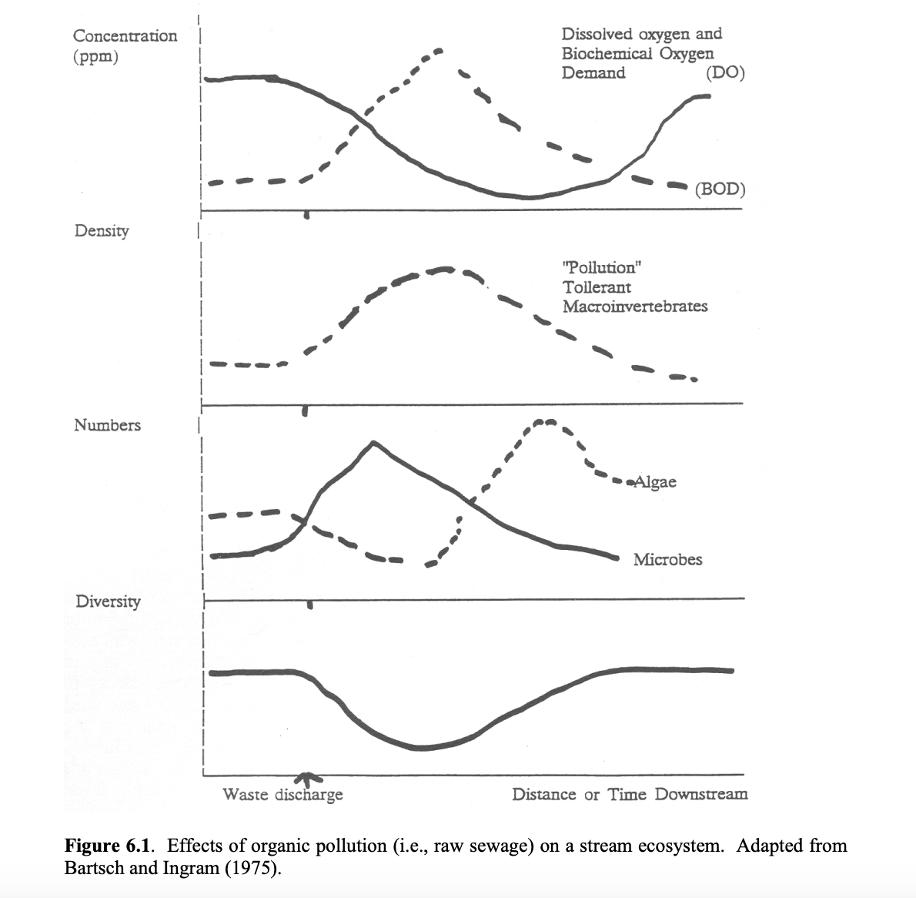
The pollution tolerant species will not only be there, but they will be there in greater abundance as well.
Notes:
Image: https://www.ableweb.org/biologylabs/wp-content/uploads/volumes/vol-5/6-zimmerman.pdf
The Use of the Biotic Index as an Indication of Water Quality Melvin C. Zimmerman

Slide 9
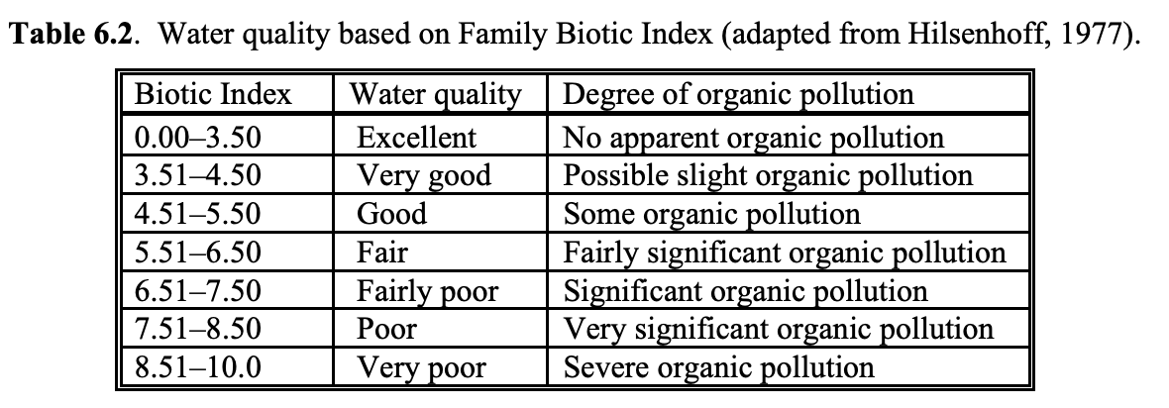
If polluted, the biotic index will be high.
Notes:
Image: https://www.ableweb.org/biologylabs/wp-content/uploads/volumes/vol-5/6-zimmerman.pdf

Slide 10
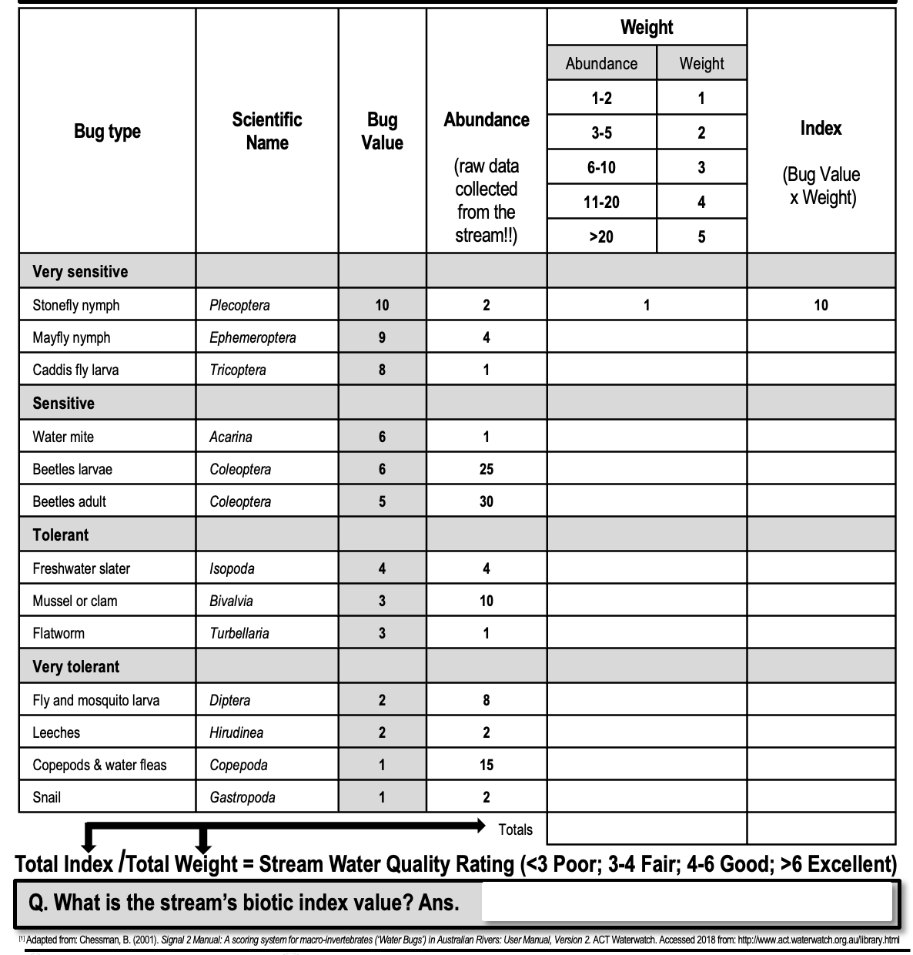
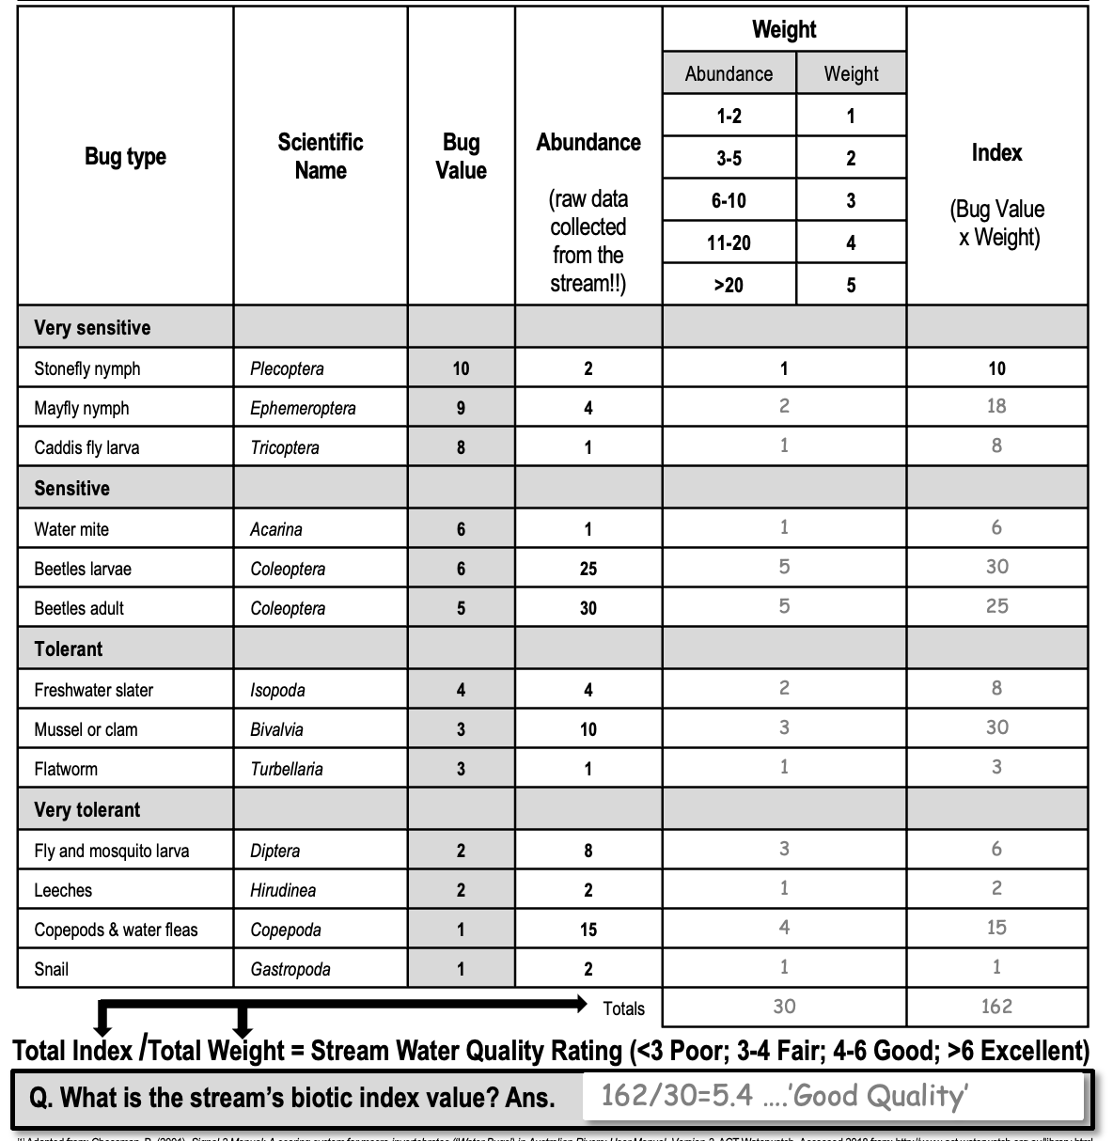
Table 1 below is an example using bug abundance data collected from a local stream.
Table 2 below is the maths used to calculate the final biotic index value.

Slide 11
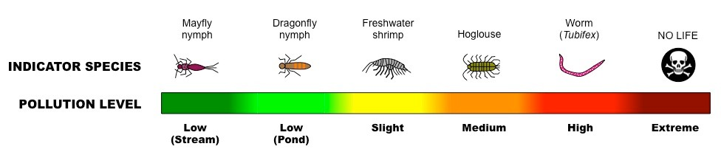
Biotic indices are useful when you don’t have the $ to test every abiotic factor.
Instead, biological indicators provide an overall picture of ecosystem health.
Notes:
Image: https://www.sciencedirect.com/science/article/abs/pii/S1470160X19307265

Slide 12
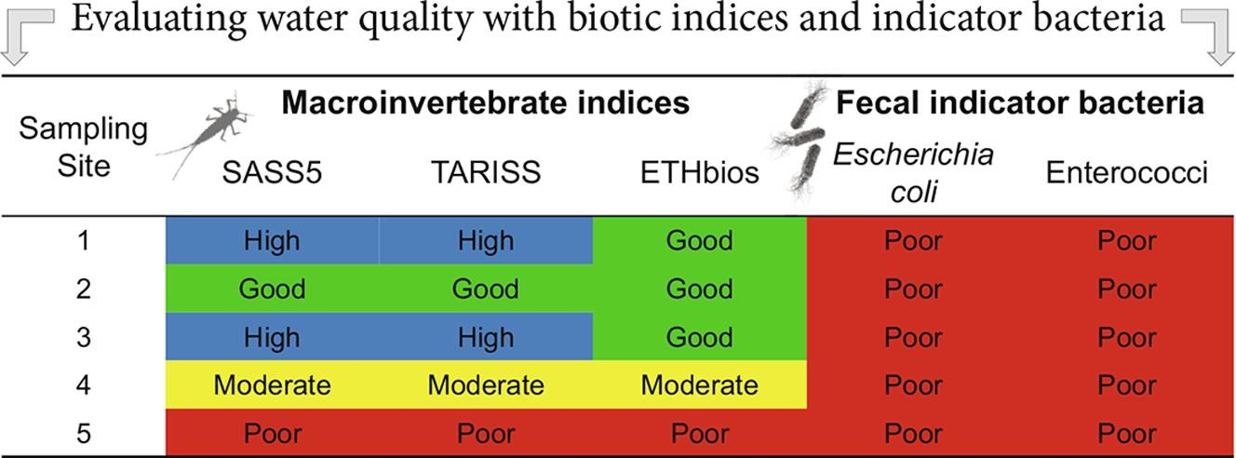
Note: there are several different biotic indices, each with their own math formulas.
Notes:
Image: https://www.sciencedirect.com/science/article/abs/pii/S1470160X19307265

Slide 13
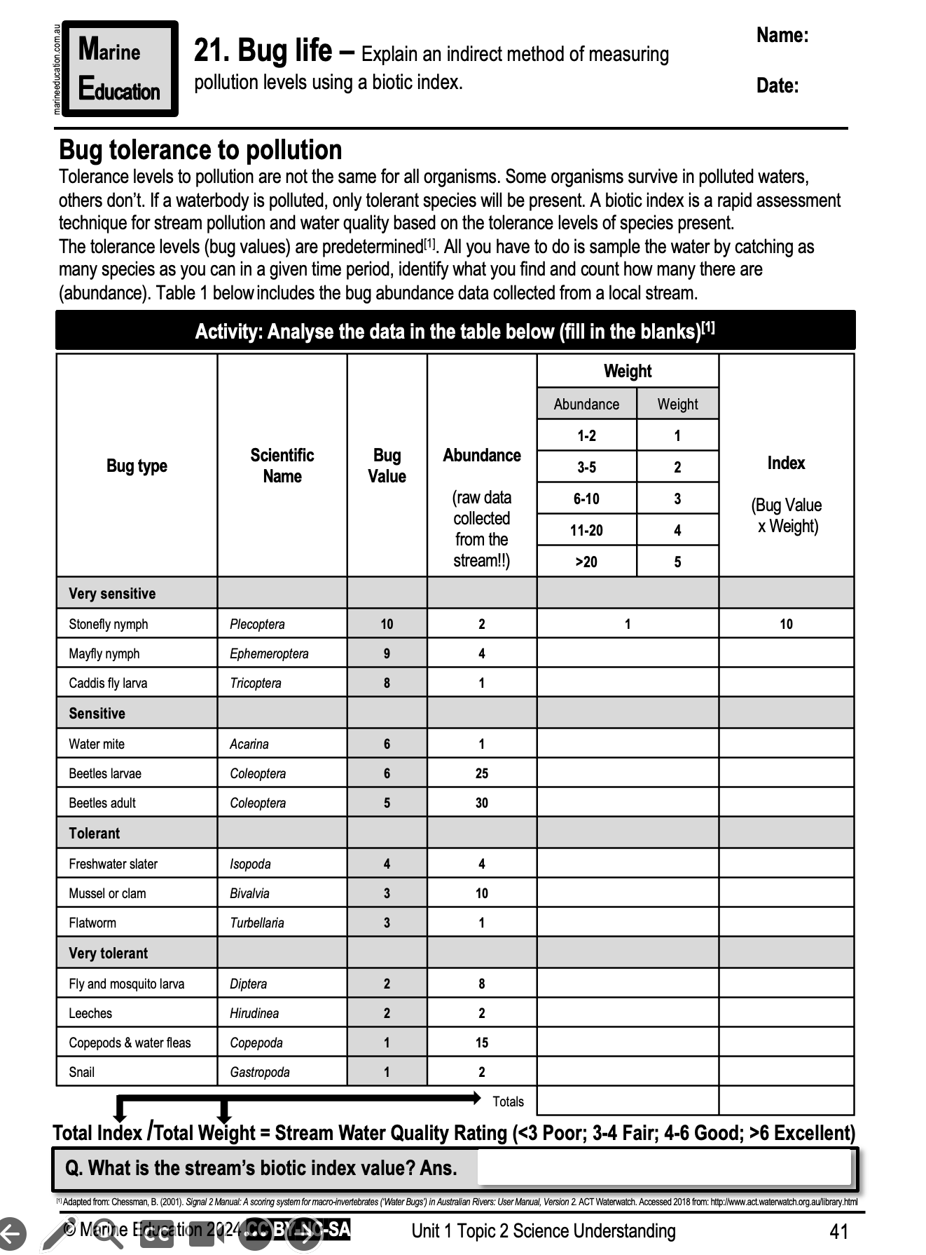
Learning Intention:
Explain an indirect method of measuring pollution levels using a biotic index
Success Criteria:
Complete Marine Education worksheet ’21. Bug life’
Notes:
Image: Hutchings Museum, 55 N Center Street, Lehi, UT 84043. Accessed from: https://johnhutchingsmuseum.org/atlantic-mudskipper

