Slide 1
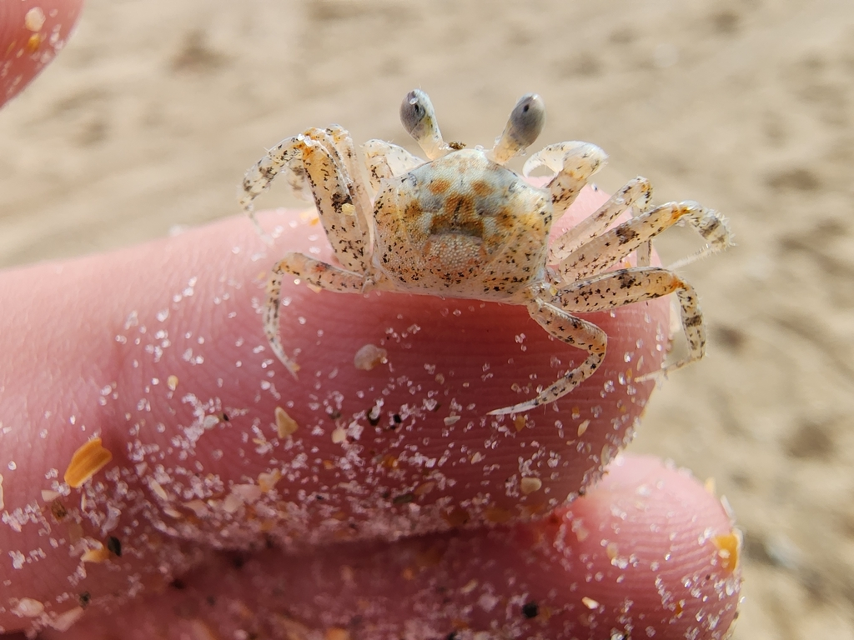
Learning Intention:
Interpret field data from a local ecosystem.
Success Criteria:
Complete the worksheet ‘22. Beach Excursion’
Notes:
Image: iNaturalist

Slide 2
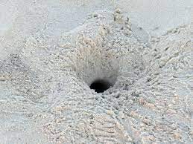

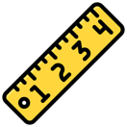
RQ: Is there a linear relationship between
[ghost crab size] and [distance from low tide (m)]?
Ghost crabs are indicator species of beach health!
Hole diameter indicates crab SIZE
Distance from low tide (m) | Ghost crab size (hole diameter) in centimeters
Measure the distance of crab hole from low tide (m)

Slide 3
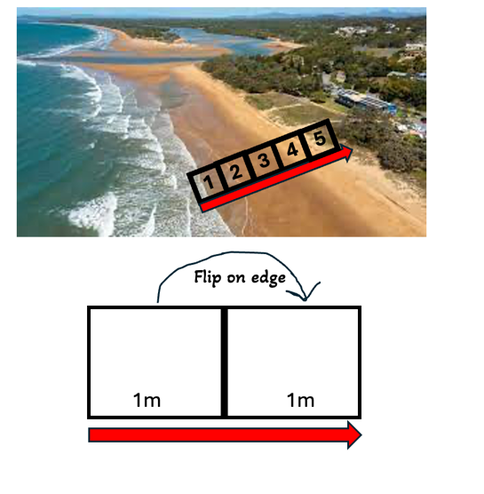
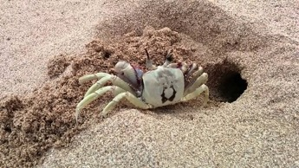
RQ: Is there a linear relationship between
[ghost crab abundance] and [distance from low tide (m)]?
Ghost crabs are indicator species of beach health!
Distance from low tide (quadrat #) | Ghost crab abundance (tally)
1
2
3
4
5
6
7
8
9
10

Slide 4
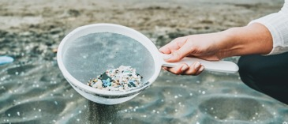
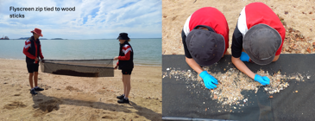

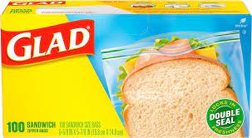
RQ: Is there a linear relationship between
[number of microplastics] and [distance from low tide (m)]?
Distance from low tide (quadrat #) | Number of microplastics (<5mm)
1
2
3
4
5
6
7
8
9
10
If time poor, take samples in glad snap-lock bags (label them) to analyse back at school

Slide 5
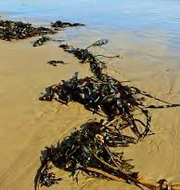
RQ: Is there a linear relationship between
[beach wrack percentage cover] and [distance from low tide (m)]?
Beach wrack is the organic material washed up onto the beach by tides, wind and waves. It eventually breaks down and is recycled back into the system as a food source.
Distance from low tide (quadrat #) | % cover of marine wrack
1
2
3
4
5
6
7
8
9
10

Slide 6
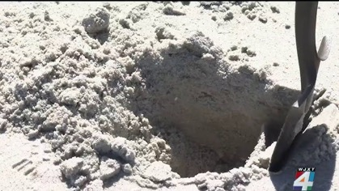
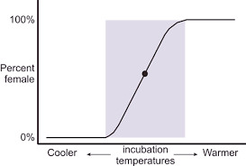
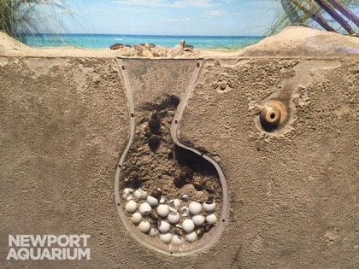
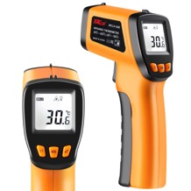
RQ: Is there a linear relationship between
[temperature] and [depth of sand]?
Depth of sand (cm) | Temperature (degrees C)
0
10
20
30
40
50
60
70
80
90
100
110
120
The temperature of the sand determines the gender of the turtle hatchlings.

Slide 7
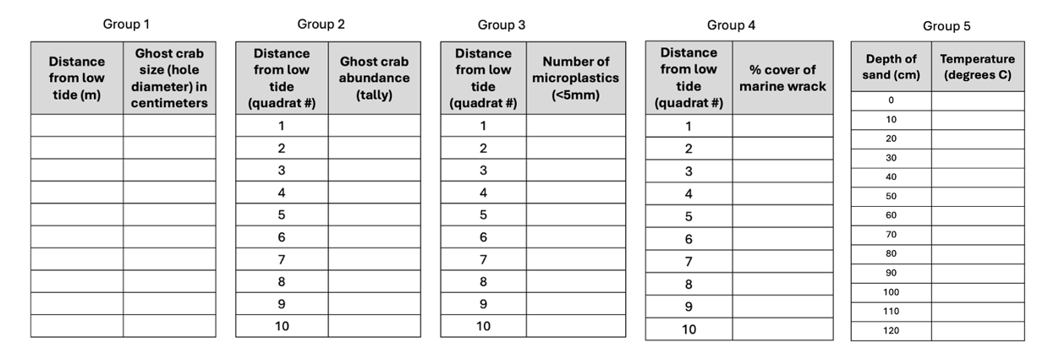





Results tables and equipment ready?
quadrat
quadrat
quadrat

Slide 8
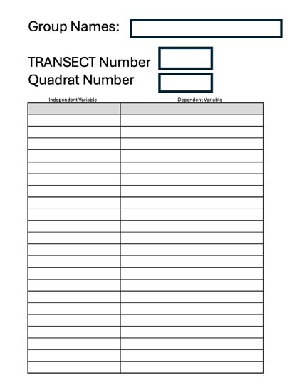
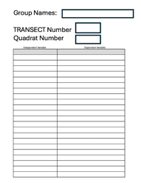
Or, use a generic results table to duplicate for repeats

Slide 9
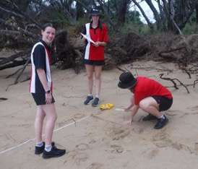
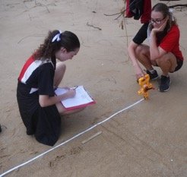
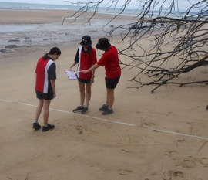
Results Group 1 (ghost crab size)
Trinity College, Gladstone
Feedback: whilst each transect was approx. 7m apart, we combined them to add more dots on the scatterplot graph. The crab holes were so small, it is difficult to know if they were even ghost crab holes at all? When presenting the data, the x-axis was formatted to start at 15m due to there being no holes any closer to the low tide zone.
R² = 0.1146

Slide 10
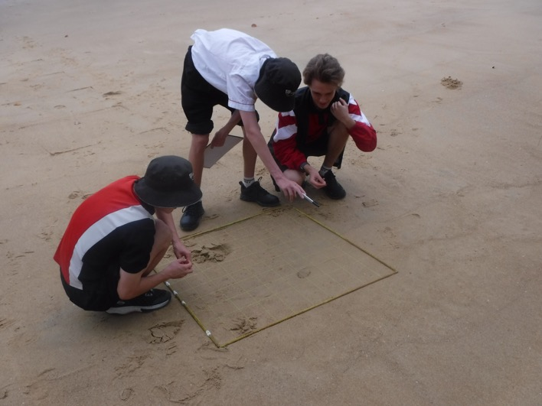
Results Group 2 (ghost crab abundance)
Trinity College, Gladstone
There was enough time for 1.5 transects, with a lot of zero counts in the low and mid tide zone. Most of the crab holes were up under the trees and logs high up on the beach near the dunes. There is suspicion they were not ghost crab holes (very small in size) and instead holes from another organism. They were so small, sometimes it was difficult to tell if it was even a crab hole or not.
R² was 0.3511 (no linear relationship).

Slide 11
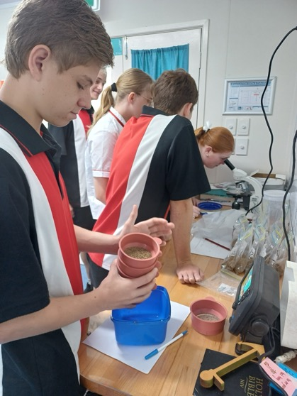
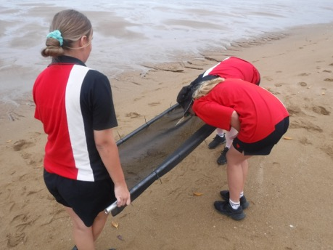
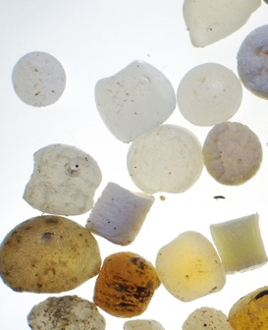
Results Group 3 (microplastics)
Trinity College, Gladstone
Feedback: the sand was wet, therefore the group didn’t have enough time to sieve all samples in situ. Collecting sand in gladbags was a good idea. Dried the samples and identified pieces of microplastic under the microscope. Put through a sieve first to make it easier to select samples for the microscope dish. However, it takes a VERY long time to look at every individual grain of sand under the microscope to see if it’s a piece of plastic or not – which was also questionable sometimes. E.g. it took one student, with one microscope, 2 hours to identify pieces of microplastic from a pile of sand that would fit in the palm of your hand. There is no graph yet, because they’re still going!

Slide 12
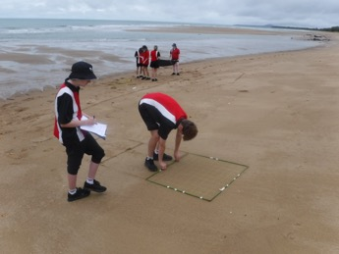
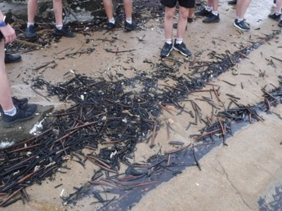
Results Group 4 (% cover marine wrack)
Trinity College, Gladstone
R² = 0.3614
Feedback: the group measuring % cover marine wrack were able to gather data from 4 transects. Therefore, we were able to calculate the average (mean) % cover. The students decided marine wrack included anything organic that a crab or other beach organism would like to eat. Shells did not count. After measuring was finished, we walked the beach and found a lot of marine wrack washed up against some rocks in a great big pile. This was not included in the analysis.
Flip method worked well.
found later…

Slide 13
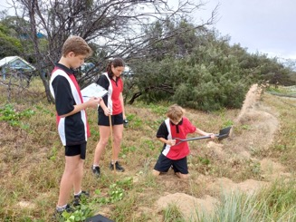
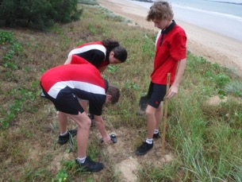
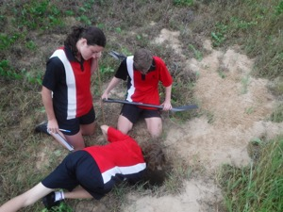
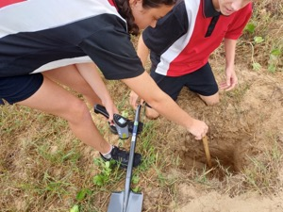
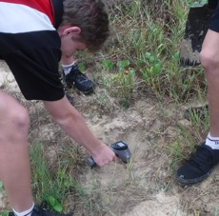
Results Group 5 (depth and temperature)
Trinity College, Gladstone
Depth (m) | Temperature (deg. C)
10 | 30.6
20 | 30.1
30 | 29.3
40 | 28.2
50 | 28
60 | 27
70 | 27.3
80 | 27.4
90 | 26.4
100 | 26.1
R² = 0.9185
Feedback: anything deeper than 100cm, and it started to cave in. Only 1 hole (took approximately 20min to dig). Recommendation: keep sand in a pile next to the hole, to later refill the hole easily.

Slide 14
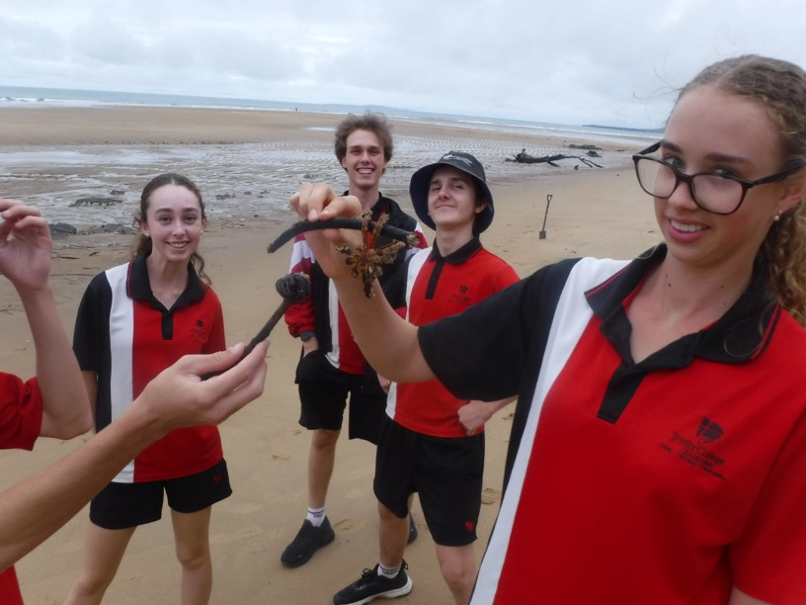
Thank you to yr11 Marine Science students (2024).
Trinity College, Gladstone.
Photo: Tannum Sands Beach (out front of life saving club) March 25th 2024 © Ms Riches

Slide 15
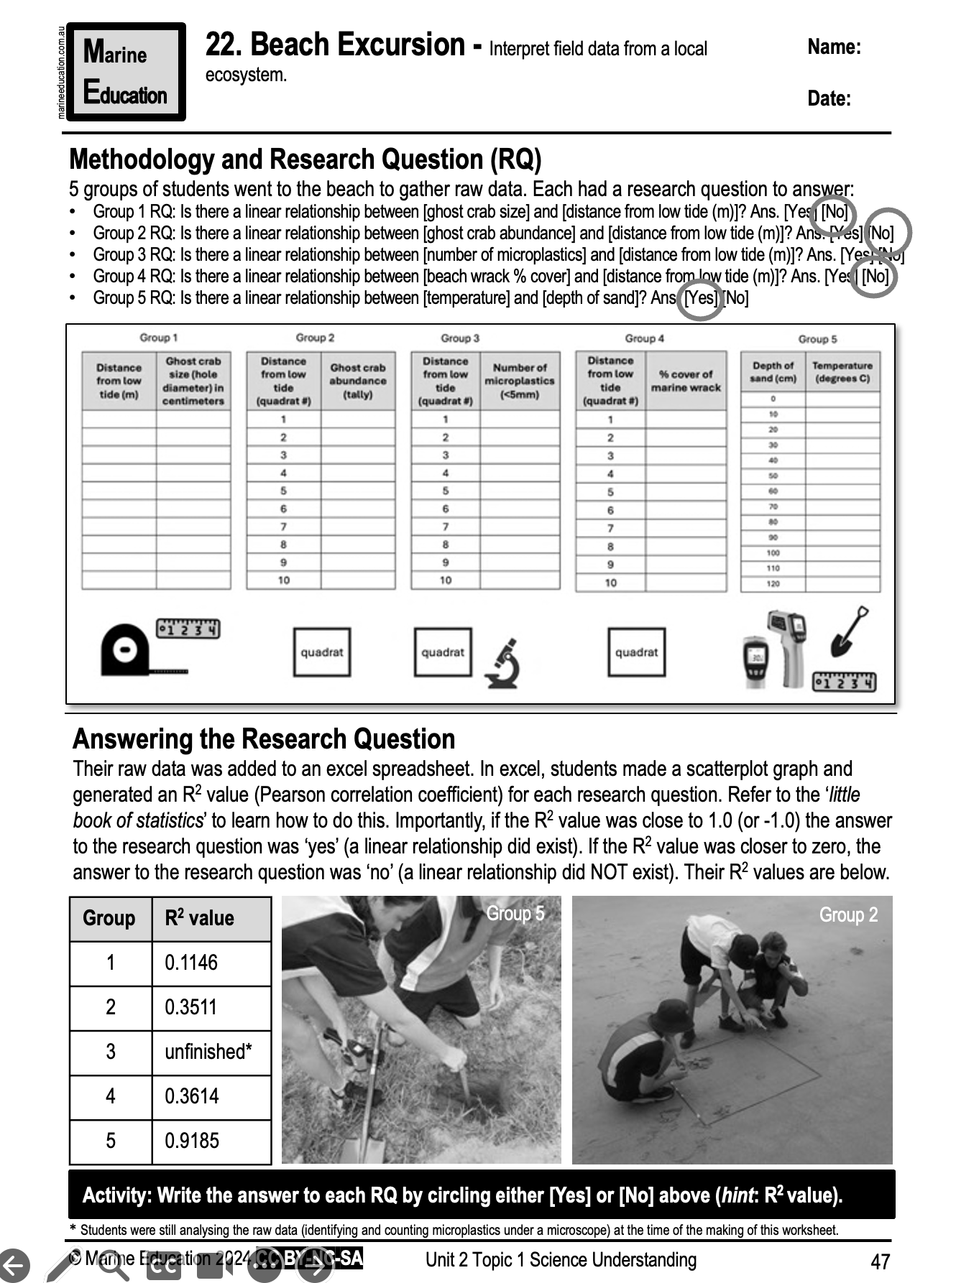
Learning Intention:
Interpret field data from a local ecosystem.
Success Criteria:
Complete the worksheet ‘22. Beach Excursion’
Notes:
Image: iNaturalist

