Slide 1
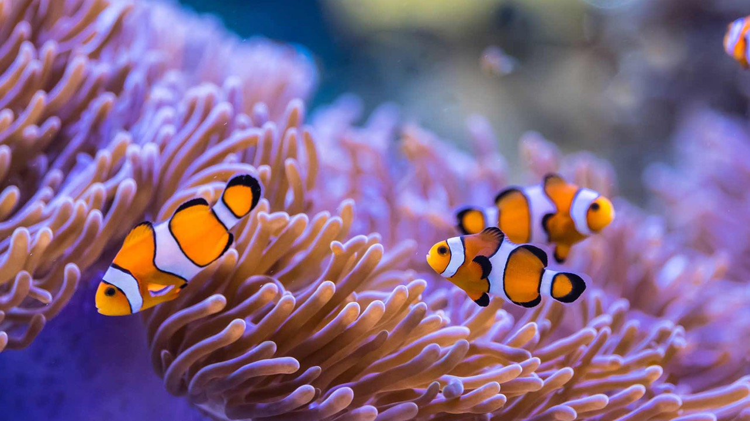
Learning Intention:
Classify different groups of animals using structural characteristics.
Success Criteria:
Complete Marine Education worksheet
‘23. Marine Matchup’
Note: this ppt will take at least 3-4 lessons to deliver
Notes:
Image: https://www.scuba.com/blog/sea-anemones-flowers-of-the-ocean/

Slide 2
Echinoderms
(Greek root word echino- meaning spiny; Latin root word -derm meaning skin)

Slide 3
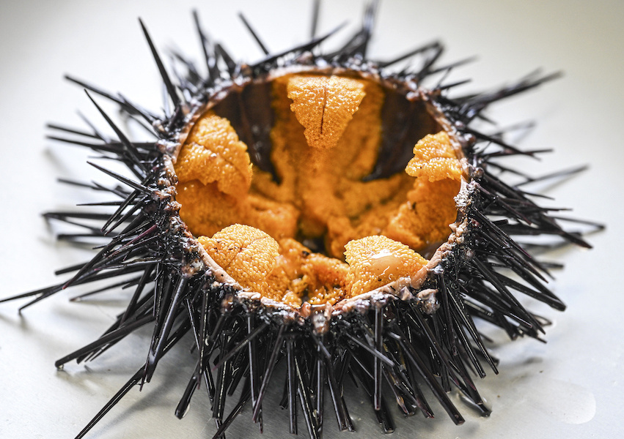
Sea urchin
(in half, plump with roe/eggs)
Echinoderm
Spiny skin
Notes:
Image: https://www.japan.go.jp/kizuna/2023/10/delicious_sea_urchins.html

Slide 4
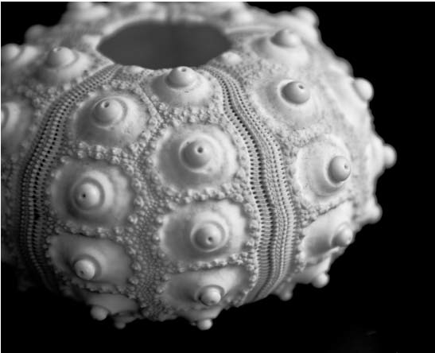
Echinoderm
Calcareous skeleton
Sea urchin

Slide 5
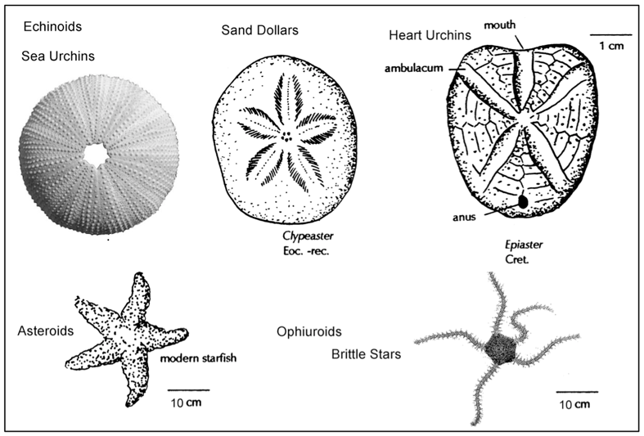
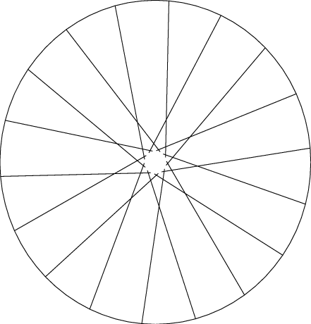
Echinoderm
Radial Symmetry (like the spokes of a wheel)
Notes:
Image: https://pressbooks.bccampus.ca/earthhistorylab/chapter/phylum-echinodermata/

Slide 6
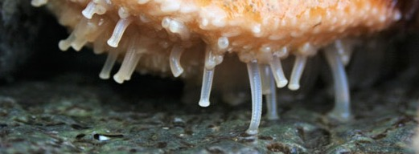
Echinoderm
No heart, but do have a water vascular system (including tube feet)
Notes:
Image: https://www.sciencenews.org/article/sea-stars-ancient-echinoderms-nibbled-tiny-tube-feet

Slide 7
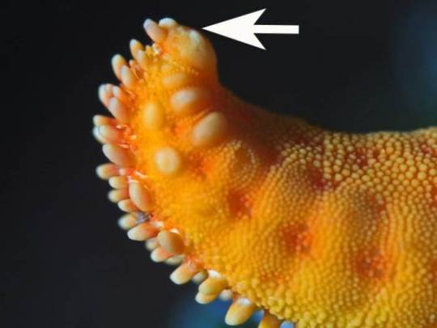
Eye spot (ocellus), to detect light and dark
No brain, but do have a complex central nervous system
Notes:
Image: https://alphynix.tumblr.com/post/175648749770/hi-bog-i-appreciate-your-commitment-to-pointing
Interesting article: https://www.ncbi.nlm.nih.gov/pmc/articles/PMC3896028/

Slide 8
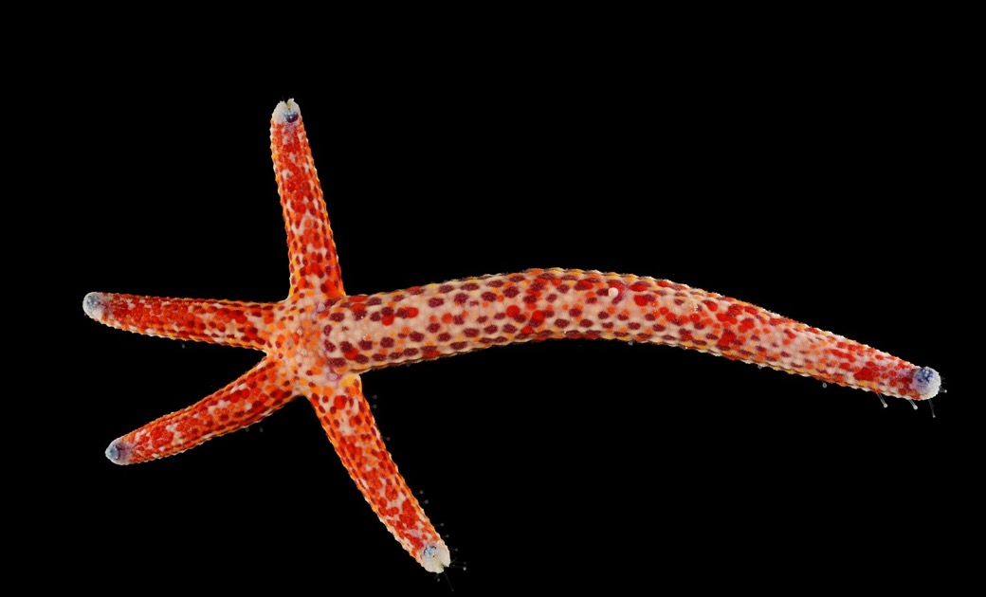
Echinoderm
Powers of regeneration
Notes:
Image: https://francoismichonneau.net/2012/11/from-the-field-in-the-sea-comets-become-stars/

Slide 9
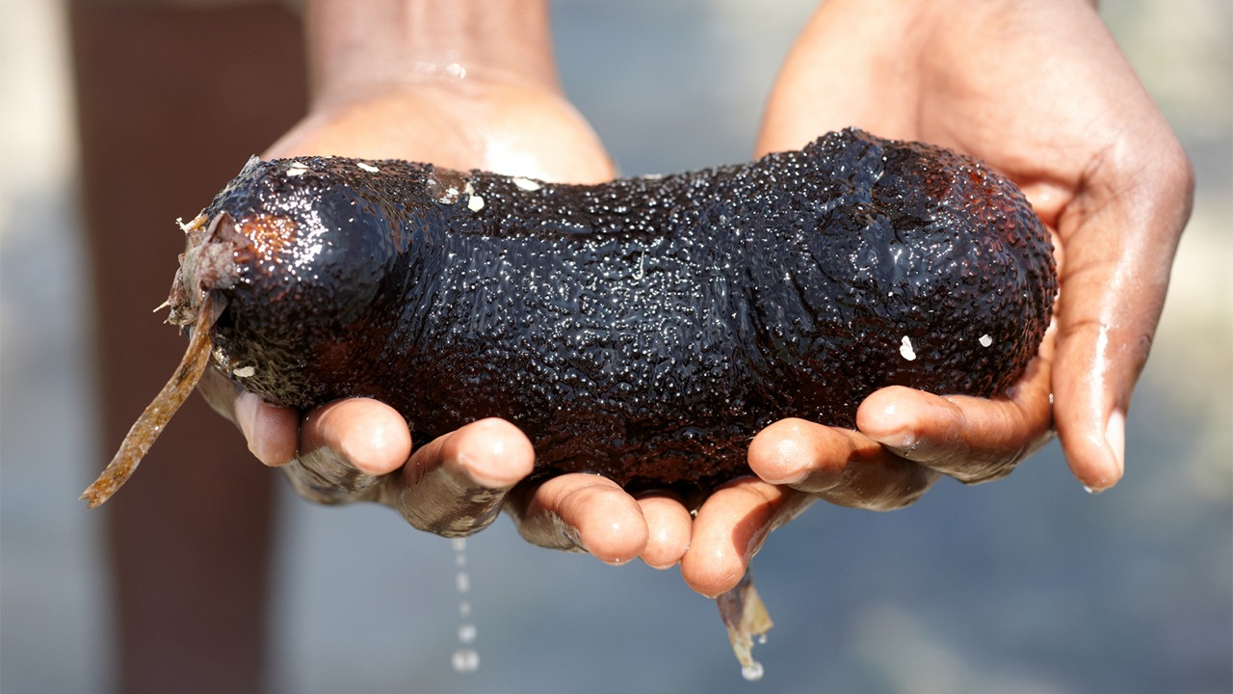
Sea cucumber
Echinoderm

Slide 10
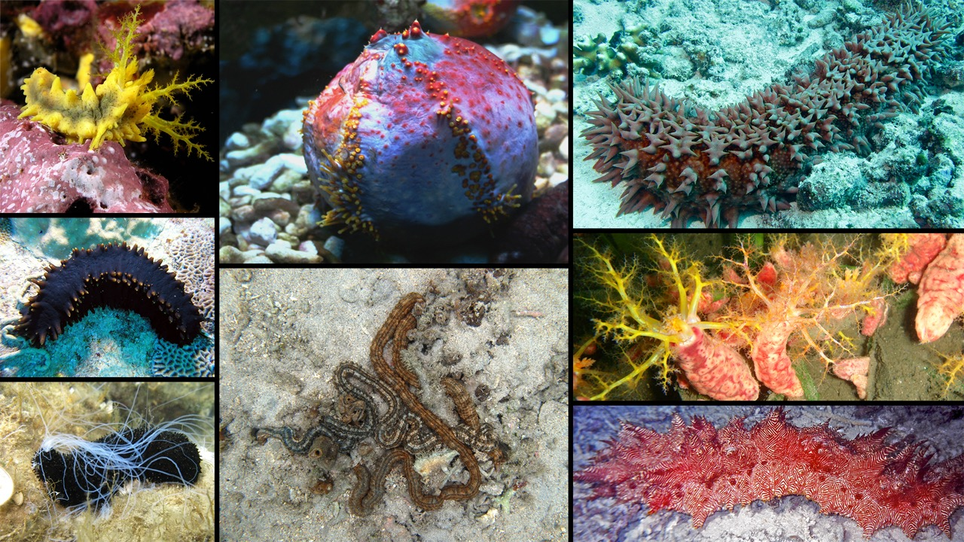
Sea cucumbers
Echinoderm
Notes:
Image: https://www.digitalatlasofancientlife.org/learn/echinodermata/holothuroidea/

Slide 11
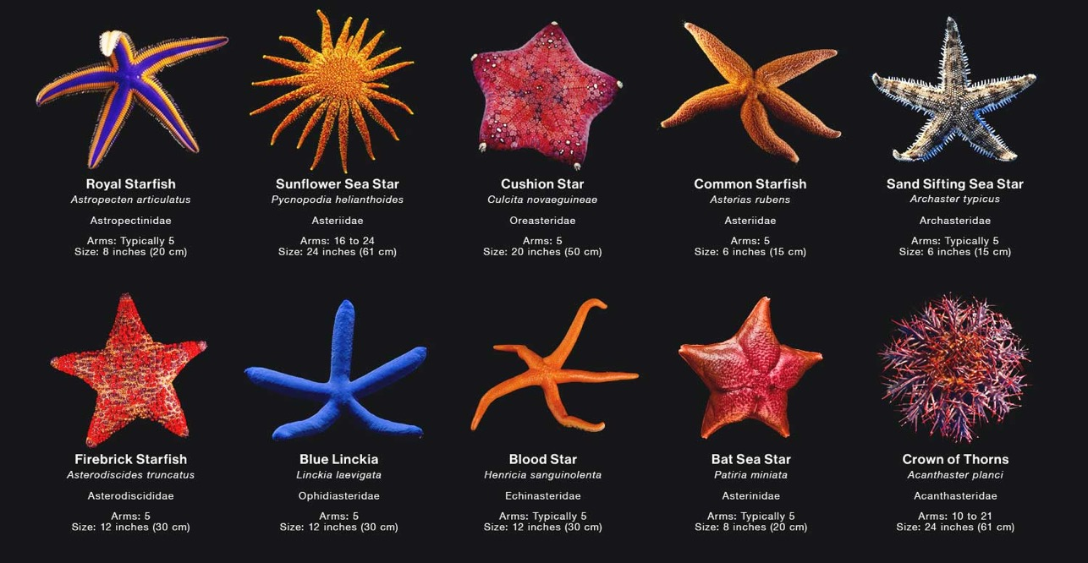
Sea stars
Echinoderm
Notes:
Image: https://www.citrusreef.com/blogs/news/different-types-of-starfish

Slide 12
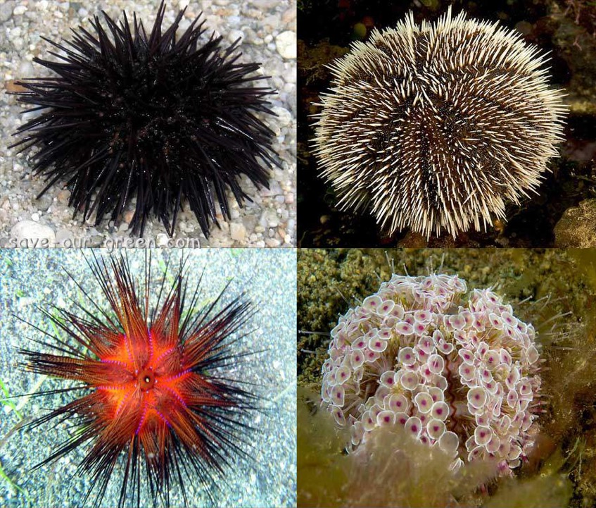
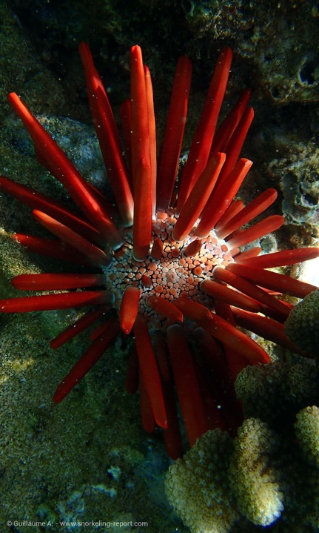
Echinoderm
Sea urchins
Notes:
Image (left): https://mosaic-lille.fr/?o=sea-urchin-save-our-green-rr-gl49V3hj
Image (right): https://www.snorkeling-report.com/sea-urchins-species-identification/

Slide 13
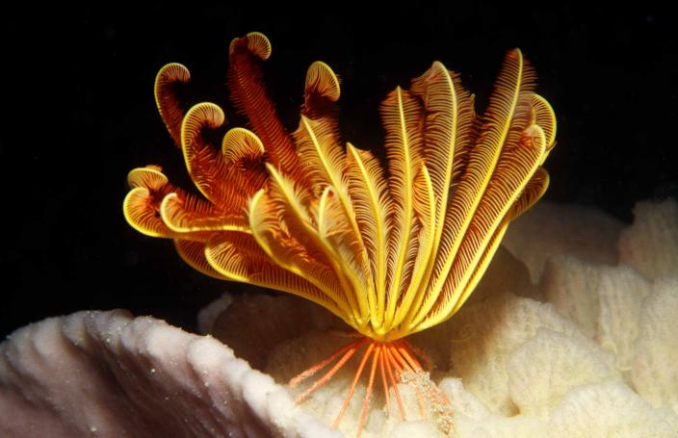
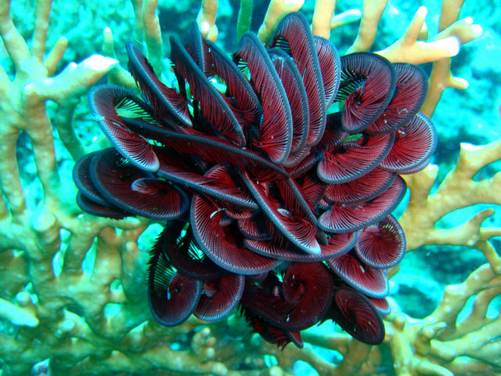
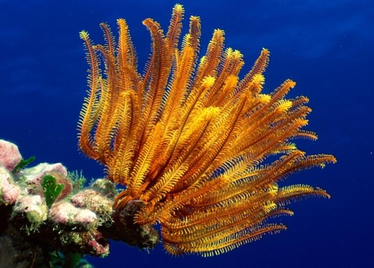
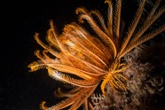
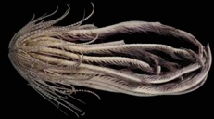
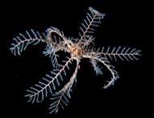
Feather stars
Echinoderm
Notes:
Image (top left): https://museum.wa.gov.au/research/collections/aquatic-zoology/marine-invertebrates-section/echinodermata-echinoderms-class-cr
Image (far bottom left): https://www.greenmatters.com/community/jimbacrinus-crinoid-swimming-feather-star
Image (top right): https://www.gaiaguide.info/Group.html?groupId=QPfB4GLN
Image (bottom left): https://www.earth.com/news/sea-monster-with-20-arms-found-in-the-dark-antarctic-waters/
Image (bottom middle): https://www.wildwondersofchina.com/image/I0000kYfmYzG50s8
Image (bottom right): https://www.istockphoto.com/photos/feather-star-in-sipadan-malaysia

Slide 14
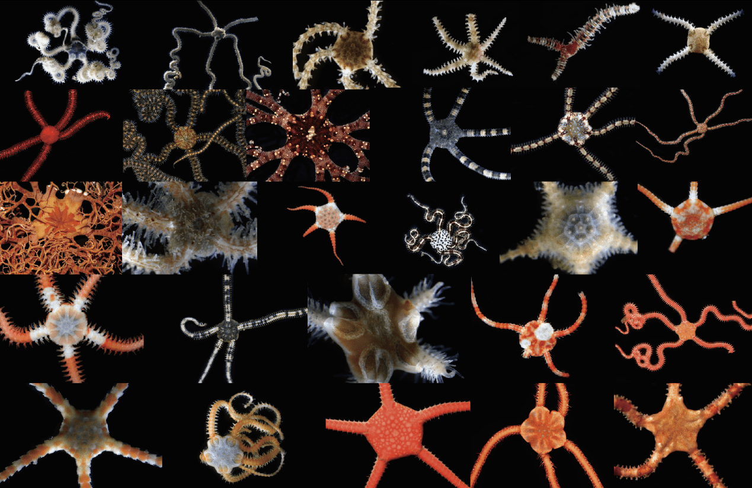
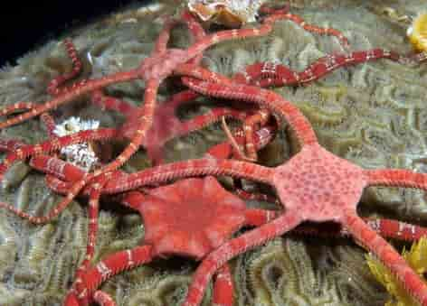
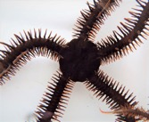
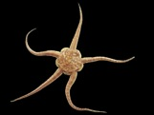
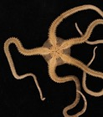
Echinoderm
brittle stars
Notes:
Image: https://statisticsofantarctica.com/api/users?token=L2hpNTJzdDJjcnI_a2V5PTBmMjJjMWZkNjA5ZjEzY2I3OTQ3YzhjYWJmZTFhOTBkJnN1Ym1ldHJpYz0xNDk2MTYxNA

Slide 15
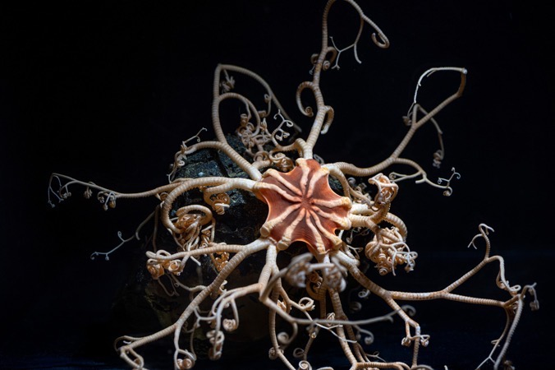
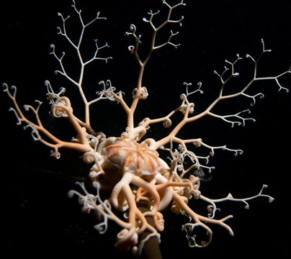
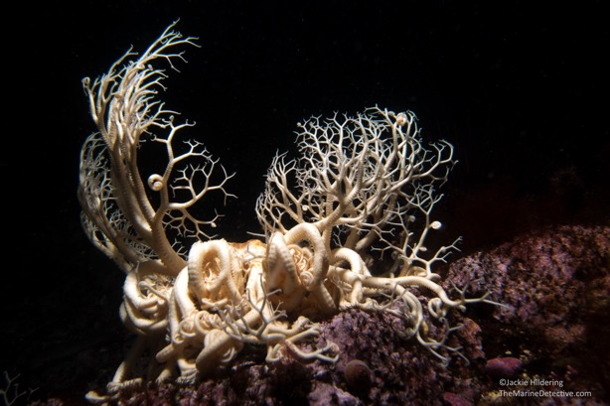
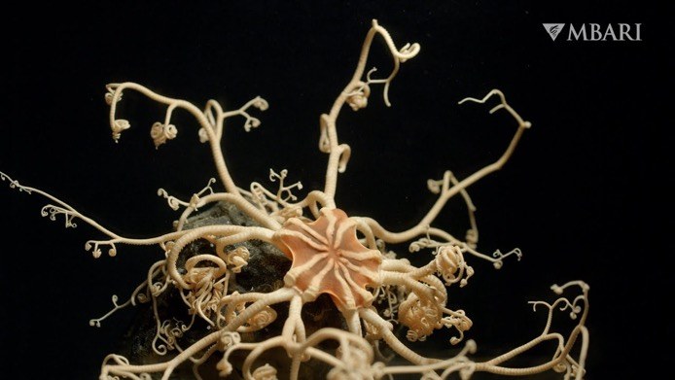
Echinoderm
basket stars

Slide 16
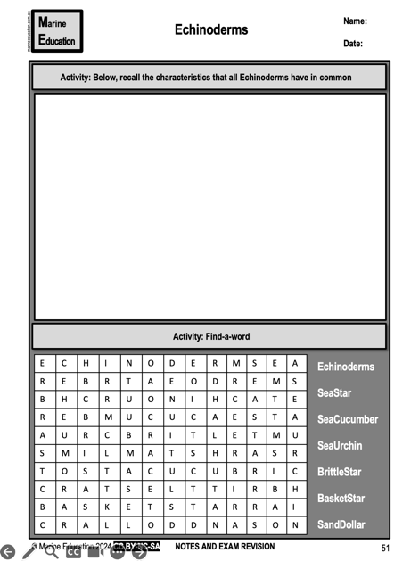
Learning Intention:
Classify different groups of animals using structural characteristics.
Success Criteria:
Complete Marine Education worksheet
‘Echinoderms’
Notes:
Image: https://www.scuba.com/blog/sea-anemones-flowers-of-the-ocean/

Slide 17
Crustaceans
(Crusta = ‘shell’)

Slide 18
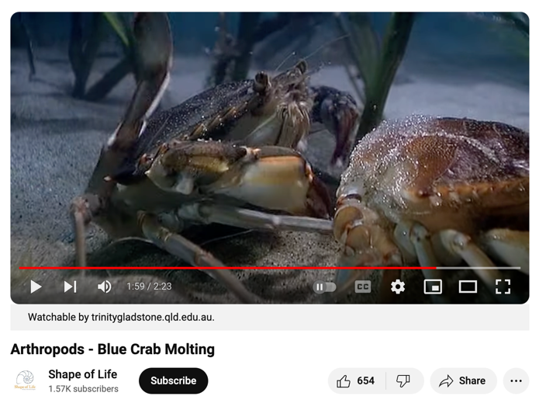
Crustacean
Hard exoskeleton
https://www.youtube.com/watch?v=8pEsPi1VKe4

Slide 19
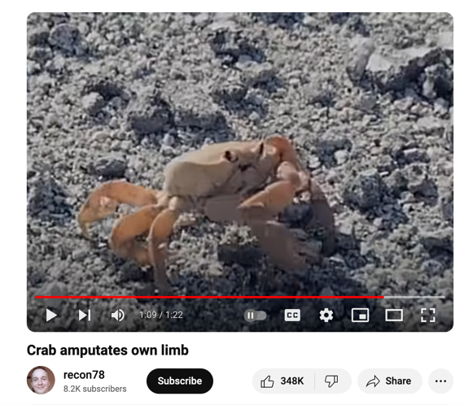
Crustacean
Limbs can be amputated and grow back
https://www.youtube.com/watch?v=v241TF-cSzU

Slide 20
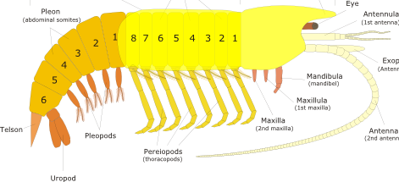
Crustacean
Head, thorax, abdomen and tail region
thorax
head
abdomen
Tail
Notes:
Image adapted from: https://www.quantum-immortal.net/other/crustacea.php

Slide 21
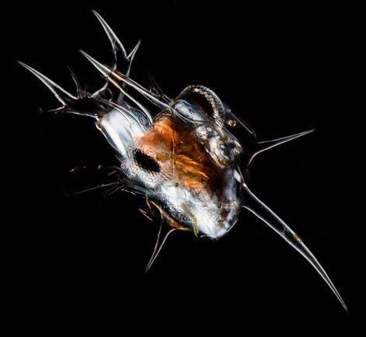
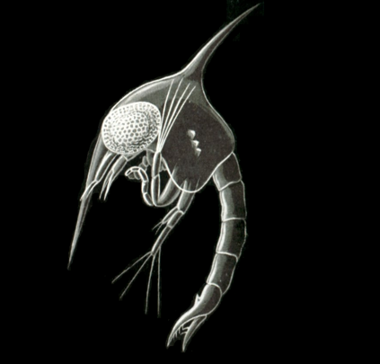
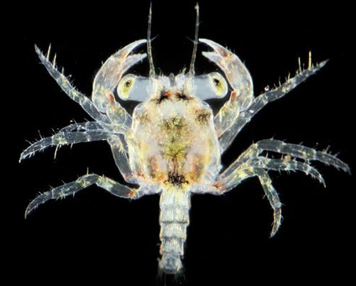
Crustacean
Nauplius
larvae stage
2. Zoea
larvae stage
3. Megalopa
larvae stage
crab
Notes:
Image (crab nauplius): https://www.photomacrography.net/forum/viewtopic.php?t=31667

Slide 22
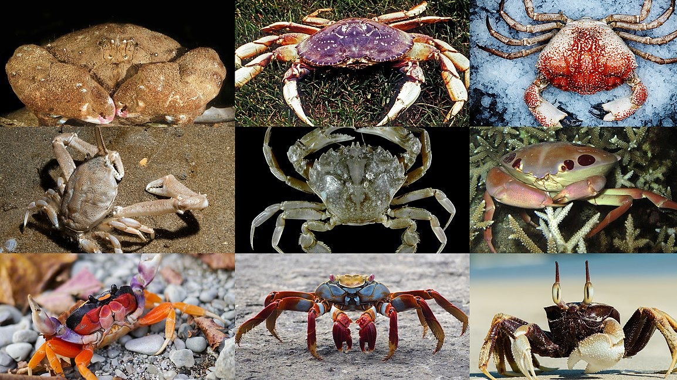
crabs
Crustacean

Slide 23
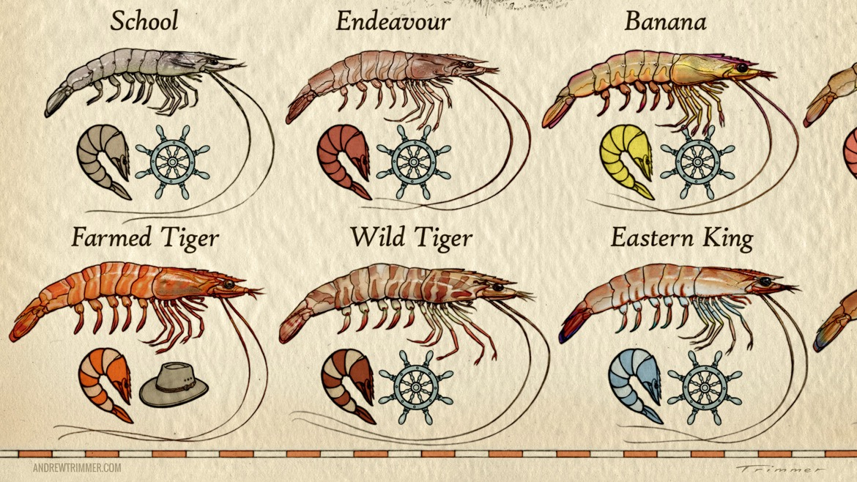
prawns
Crustacean

Slide 24
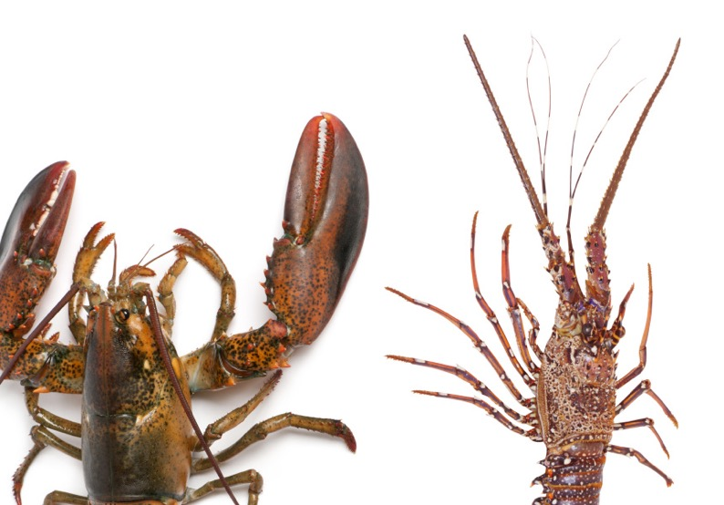
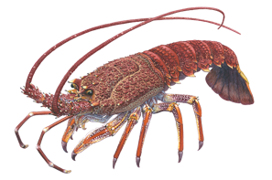
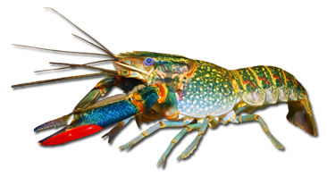
Crustacean
Lobsters /crayfish
Lobsters typically have two large front claws. However, the common names lobster and crayfish can swap interchangeably depending on cultural interpretations.
Southern rock lobster
Red claw crayfish
Notes:
Images (right): https://link.springer.com/chapter/10.1007/978-981-32-9094-5_2
Image (left): https://www.broadsheet.com.au/national/food-and-drink/article/lobster-versus-crayfish

Slide 25
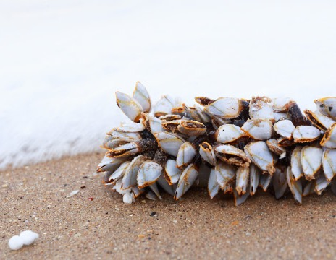
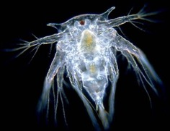
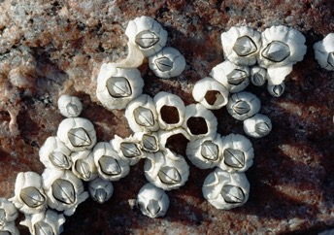
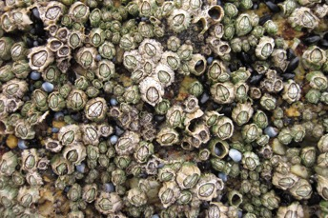
Barnacles (classified as crustacean due to having a nauplius larvae stage)
Crustacean
Barnacle nuaplius
Acorn barnacle – look like volcanoes (Chthamalus antennatus)
Six plated barnacle (Chthamalus antennatus)
Gooseneck barnacles (Lepas anserifera)
Notes:
Image (barnacle nauplius): https://courses.washington.edu/mareco07/students/nina/barnacleshome.html

Slide 26
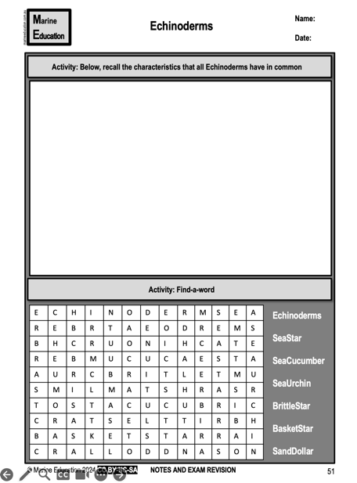
Learning Intention:
Classify different groups of animals using structural characteristics.
Success Criteria:
Complete Marine Education worksheet
‘Crustaceans’
Notes:
Image: https://www.scuba.com/blog/sea-anemones-flowers-of-the-ocean/

Slide 27
Molluscs

Slide 28
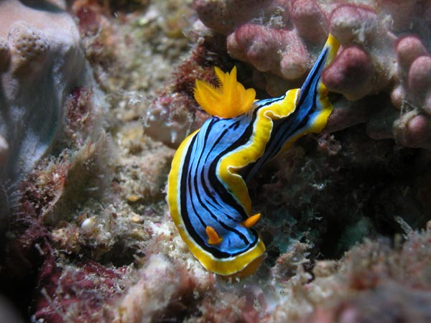
Mollusc
Soft Body
Nudibranch (Chromodoris elisabethina). Photo: Gary Cobb (nudibranch.com.au)
Notes:
Image: https://nudibranch.com.au/

Slide 29
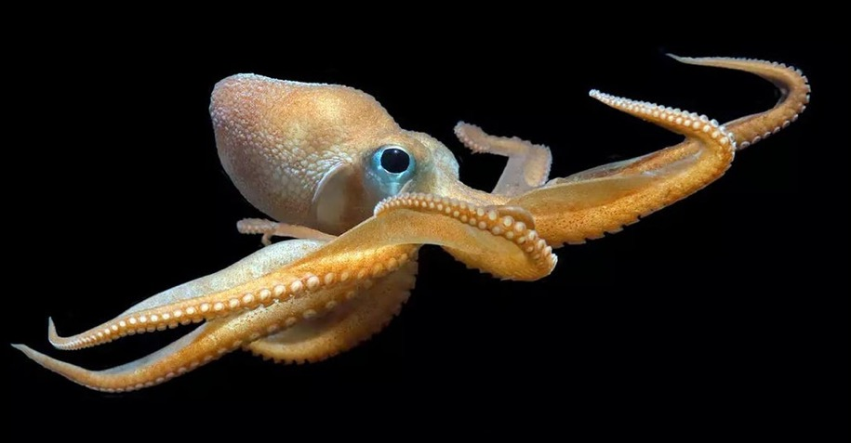
Mollusc
Soft Body
A North Pacific bigeye octopus. Monterey Bay Aquarium
Notes:
Image: https://slate.com/technology/2022/12/octopus-californicus-rescue-babies-eggs-raised.html

Slide 30
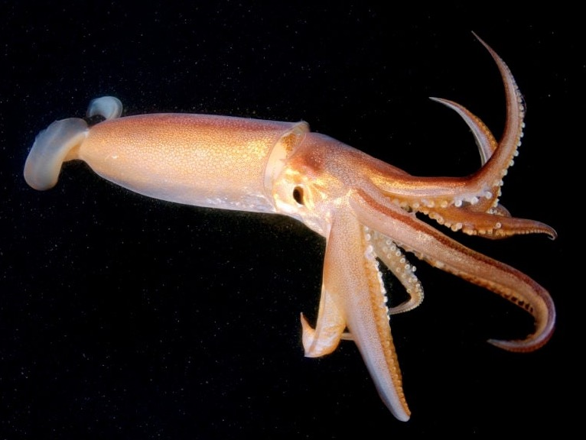
Mollusc
Soft Body
Squid
Notes:
Image: https://www.medicalnewstoday.com/articles/are-squids-as-smart-as-dogs

Slide 31
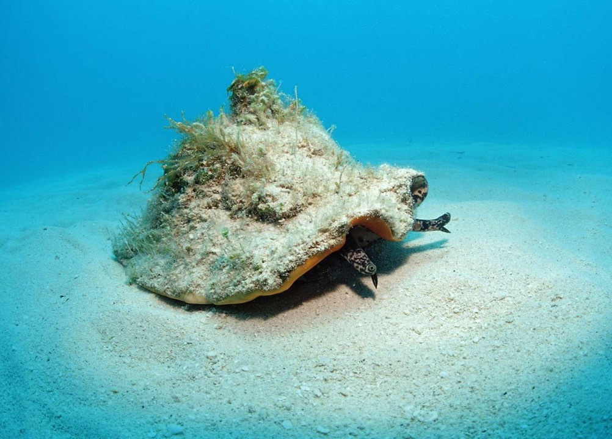
Mollusc
some with an external shell
Queen conch Photo: Reinhard Dirscherl / WaterFrame/ Getty Images
Notes:
Image: https://www.thoughtco.com/types-of-gastropods-2291933 AND/OR https://www.wired.com/story/the-queen-conchs-gambit/

Slide 32
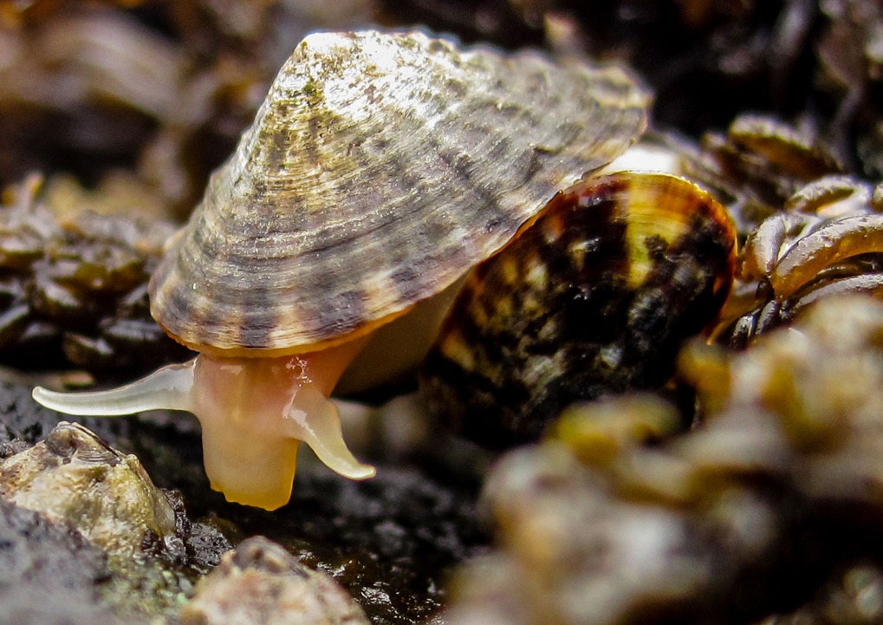
Mollusc
some with an external shell
Limpet. Photo: Rebecca Kordas/UBC
Notes:
Image: https://hakaimagazine.com/news/how-tiny-limpets-do-the-heavy-lifting-of-climate-resilience/

Slide 33

Mollusc
some with an external shell

Slide 34

Mollusc
some with an external shell
Giant clam
Notes:
Image; https://greatbarrierreeftours.com/great-barrier-reef/great-barrier-reef-animals/giant-clam/

Slide 35



Cuttlefish
Mollusc
some with an INTERNAL shell
Notes:
Image;

Slide 36


Mollusc
Spirula spirula (deep sea squid)
some with an INTERNAL shell
Notes:
Image: https://www.google.com/search?q=spirula+spirula&source=lmns&bih=669&biw=1185&prmd=isvmnbtz&hl=en&sa=X&ved=2ahUKEwjmn67OmKCFAxVRzDgGHZ6iAjAQ0pQJKAB6BAgBEAI#vhid=-NbEYrgjJdqgTM&vssid=l

Slide 37

Mollusc
Mantle
Egg cowrie (there’s always TWO)
Notes:
Image;

Slide 38

Mollusc
Giant clam
The mantle is the organ that makes the shell
Notes:
Image: https://spie.org/news/photonics-focus/septoct-2021/photonics-research-inspired-by-animal-plant-symbiosis-#_=_

Slide 39

Mollusc
Notes:
Image: https://klumcollection.com/produkt/giant-clam-iv/

Slide 40

Mollusc
Mantle of a scallop (blue parts are eyes)
Notes:
Image; https://www.popularmechanics.com/science/animals/a13987338/the-humble-scallop-has-eyes-like-an-advanced-telescope/
Matthew Krummins via Wikimedia Commons

Slide 41

Mollusc
Sometimes the mantle covers the shell entirely
Polka dot egg cowrie
Notes:
Image; https://www.reddit.com/r/DiscoverEarth/comments/tdrjph/a_polka_dot_egg_cowrie_a_type_of_sea_snail_found/

Slide 42

Mollusc
Visceral Mass (internal organs)
Notes:
Image: https://www.reddit.com/r/Awwducational/comments/4hus0r/snails_anuses_are_above_their_heads_this_is_due/

Slide 43

Mollusc
The visceral mass includes the digestive, nervous, excretory, reproductive, and respiratory systems
Notes:
Image: https://flexbooks.ck12.org/cbook/ck-12-advanced-biology/section/15.22/primary/lesson/mollusk-body-plans-advanced-bio-adv/

Slide 44

Mollusc
Notes:
Image: https://molluscsf.blogspot.com/2007/03/what-is-mollusk.html

Slide 45




Mollusc
Cephalopods

Slide 46



Mollusc
Gastropods
Textile cone shell (very dangerous)
Notes:
Image (textile coneshells): https://www.sawanonlinebookstore.com/textile-cone-snail/ and wikapedia
Image: https://ucmp.berkeley.edu/taxa/inverts/mollusca/gastropoda.php
Variation in shell morphology in some marine gastropods: Clockwise from top left, Calliostoma antonii from off the Pacific coast of Panama; the dovesnail Columbella strombiformis from offshore near San Carlos, Mexico; the moonsnail Natica elenae from the Gulf of Panama; Oliva peruviana from shallow water near Iquique, Chile; the turbinid Guildfordia triumphans from Wakayama, Japan; the muricid Vokesimurex elenensis from the Pacific coast of Mexico; a wentletrap, Epitonium scalare, from the Phillippines; and another muricid, Pteropurpura trialata, from offshore near Los Angeles, California.

Slide 47

Mollusc
Bivalves
(‘2 valves’)
e.g. clams, pipi, mussel, oyster, scallop, etc.
Notes:
Image; https://en.wikipedia.org/wiki/Bivalvia

Slide 48

Mollusc
Chitons (pronounced ‘kye-tonne’)
Notes:
Image: https://seashellsofnsw.org.au/Chitonidae/Pages/Chiton_jugosus.htm

Slide 49


Mollusc
Nudibranchs
(nudi=naked; branch = gill)
Blue dragon or Blue glaucus (Glaucus atlanticus)
Notes:
Image (left): https://www.australiangeographic.com.au/fact-file/blue-dragon/
Image (right): https://www.pinterest.com.au/pin/550635491912151699/

Slide 50

Learning Intention:
Classify different groups of animals using structural characteristics.
Success Criteria:
Complete Marine Education worksheet
‘Molluscs’
Notes:
Image: https://www.scuba.com/blog/sea-anemones-flowers-of-the-ocean/

Slide 51
Vertebrates
(vertebrae – backbone)

Slide 52

Spinal chord (notochord)
Vertebrate
Reptiles
Notes:
Image: https://www.australiangeographic.com.au/topics/wildlife/2022/07/yes-crocodiles-can-be-cute/

Slide 53

Vertebrate
Reptiles
Notes:
Image: https://www.britannica.com/animal/turtle-reptile

Slide 54

Vertebrate
Reptiles
Notes:
Image: https://www.forbes.com/sites/priyashukla/2018/10/07/why-fatal-sea-snake-bites-are-unusual/?sh=451907fb3415

Slide 55

Vertebrate
ALL fish
Notes:
Image: https://www.discoverwildlife.com/animal-facts/fish/can-fish-drown

Slide 56

Vertebrate
Cetaceans (dolphins & whales)
Notes:
Image: https://www.usatoday.com/videos/news/have-you-seen/2022/07/08/dolphins-take-playful-joy-ride-off-bow-whale/10017335002/

Slide 57

Vertebrate
All sharks
Great White Shark
Notes:
Image: https://kids.nationalgeographic.com/animals/fish/article/surprising-sharks

Slide 58

All birds
Vertebrate
Booby Bird
Notes:
Image: https://www.nytimes.com/2017/03/06/science/galapagos-blue-footed-boobies.html

Slide 59

Amphibians
Vertebrate
Axolotl
Notes:
Image: https://www.worldwildlife.org/magazine/issues/summer-2021/articles/meet-the-peter-pan-of-salamanders-the-axolotl

Slide 60

Amphibians
Vertebrate
Green tree frog
Notes:
Image: https://www.mentoneaquarium.com.au/post/how-to-best-care-for-your-green-tree-frog

Slide 61

Learning Intention:
Classify different groups of animals using structural characteristics.
Success Criteria:
Complete Marine Education worksheet
‘Vertebrates’
Notes:
Image: https://www.scuba.com/blog/sea-anemones-flowers-of-the-ocean/

Slide 62
Annelids (segmented worms)

Slide 63

Annelid worm
Annelid
Notes:
Image: https://www.earth.com/earthpedia-articles/annelids/

Slide 64

Annelid worms (often used for bait)
Annelid
Notes:
Image; https://www.earth.com/earthpedia-articles/annelids/

Slide 65

Annelid Polychaete worm
Annelid
Christmas tree worm

Slide 66


Annelid Polychaete worm
Annelid
Bristle worm
Notes:
Image (left): https://www.telegraph.co.uk/news/earth/earthpicturegalleries/9093312/Creatures-of-the-deep-terrifying-macro-pictures-of-polychaetes-or-bristle-worms.html
Image (right): https://www.chesapeakebay.net/discover/field-guide/entry/bristle-worms

Slide 67

Annelid Polychaete worm
Annelid
Bristle worm
Notes:
Image: https://www.chesapeakebay.net/discover/field-guide/entry/bristle-worms

Slide 68

Annelid Polychaete worm
Annelid
Beach worm
Notes:
Image: https://www.youtube.com/watch?v=zewFg1vXeFk

Slide 69
Nematodes (round worms)

Slide 70

Nematode
Parasitic nematode worm

Slide 71

Learning Intention:
Classify different groups of animals using structural characteristics.
Success Criteria:
Complete Marine Education worksheet
‘Annelids and Nematodes’
Notes:
Image: https://www.scuba.com/blog/sea-anemones-flowers-of-the-ocean/

Slide 72
Cnidarians
(cnid = nettle or stinging cell)

Slide 73

Cnidarian
Stinging cells (nematocysts)
on the tentacles only
Notes:
Image: https://cnidologytonight.wordpress.com/2021/03/01/how-do-jellyfish-sting/
Cnidocyte of the blubber jelly, Catostylus mosaicus as seen under an electronic microscope. Credit, Meredith Peach. this image is from Jellypedia

Slide 74

Cnidarian
https://www.youtube.com/watch?v=7WJCnC5ebf4

Slide 75

Deadly jellyfish
Cnidarian
Medusa body plan
Shaped like an umbrella with tentacles
Free swimming
Notes:
Image: https://www.britannica.com/animal/cnidarian

Slide 76

Sunflower coral
Cnidarian
and/or Polyp
body plan
Upside-down medusa, attached to something
Not free-swimming
Notes:
Image: https://www.kidcyber.com.au/coral-polyps

Slide 77

Cnidarian
One opening for mouth and anus
Coral polyps in a colony
Notes:
Image: https://www.livingoceansfoundation.org/education/portal/course/coral-anatomy/

Slide 78

Cnidarians
Notes:
Image adapted from: https://en.wikipedia.org/wiki/Cnidaria#/media/File:Radiata_diversity.jpg

Slide 79









Cnidarian
Scyphozoa Jellyfish
Moon jelly
Jellyfish lake Palau

Slide 80

Cnidarian
Cubozoa (box) jellyfish
Lethal if lots of tentacles touch the skin

Slide 81






Cnidarian
Irukandji
Lethal if heart can’t cope.
Pain is gone within 24hrs.
First symptom is lower back pain.
Can fit through stinger net.
Irukandji
Notes:
Image: https://beachsafe.org.au/surf-safety/irukandji

Slide 82





Cnidarian
Blue bottle
Hydrozoans
Feels like a sting. First aid: apply ice
Fire coral
Stinging hydroids
By the wind sailor (Velella velella)

Slide 83


Cnidarian
Anthozoa
Sea anemone
Notes:
Image: https://www.grida.no/resources/3524

Slide 84

Cnidarian
Branching Coral
Acropora copiosa Colony composed of compact sturdy branches. Indonesia
Photograph: Charlie Veron. Corals of the World.

Slide 85

Cnidarian
Boulder (massive) Coral
Favia lizardensis Small massive colony. BruneI Photograph: Emre Turak and Lyndon DeVantier
Corals of the World

Slide 86

Cnidarian
Plate Coral
Acropora clathrata Large plate. Brunei. Photograph: Emre Turak and Lyndon DeVantier
Corals of the World

Slide 87

Cnidarian
Encrusting Coral
Notes:
Image: https://oceanservice.noaa.gov/education/tutorial_corals/media/supp_coral03g.html

Slide 88

Cnidarian
Solitary Coral (one coral polyp)
Notes:
Image: https://www.reddit.com/r/coralsoftheworld/comments/hlv51f/fungia_fungites_of_the_family_fungiidae_is_a/

Slide 89

Cnidarian
Soft Coral
Notes:
Image: https://fishtankaustralia.com.au/products/assorted-leather-corals

Slide 90

Cnidarian
Gorgonian Sea Fans
Notes:
Image: https://www.dresseldivers.com/blog/gorgonian-corals/

Slide 91

Cnidarian
Black Coral (even though its’ white)
Notes:
Image: https://www.nbcnews.com/id/wbna30250258

Slide 92

Cnidarian
Anemones
Notes:
Image: https://www.aquariumofpacific.org/onlinelearningcenter/species/aggregating_anemone

Slide 93

Learning Intention:
Classify different groups of animals using structural characteristics.
Success Criteria:
Complete Marine Education worksheet
‘Cnidarians’
pronounced NIDE AIR EE ANS
Notes:
Image: https://www.scuba.com/blog/sea-anemones-flowers-of-the-ocean/

Slide 94
Porifera (sponges)

Slide 95

Porifera
Porous - small pores (ostia) and large openings (oscules)
Notes:
Image; https://pngtree.com/freebackground/marine-vase-sponge-sea-life-aquarium-marine-sponge-photo_3813316.html

Slide 96

Porifera
Filter feeders (with beating flagellum that work like a pump)
Notes:
Image: https://experiment.com/u/tiDWCA

Slide 97

Porifera
Lots of different shapes and colours

Slide 98

Learning Intention:
Classify different groups of animals using structural characteristics.
Success Criteria:
Complete Marine Education worksheet
‘Porifera’
Notes:
Image: https://www.scuba.com/blog/sea-anemones-flowers-of-the-ocean/

Slide 99

Test your memory!
Can you remember which one it is?
(write answers on mini-whiteboard or play kahoot?)
Echinoderm
Crustacean
Mollusc
Vertebrate
Annelids & Nematodes (worms)
Cnidarians
Porifera (sponges)
← Choices will be from this list…

Slide 100

Brittle star
Hint: radial symmetry, calcareous skeleton….
What is it?
Echinoderm
Crustacean
Mollusc
Vertebrate
Annelids & Nematodes (worms)
Cnidarians
Porifera (sponges)
Notes:
Image: https://www.swifft.net.au/cb_pages/sp_brittle_star_amphiura_triscacantha_and_ophiocomina_australis.php

Slide 101

Feather star
Hint: radial symmetry, calcareous skeleton….
Echinoderm
Crustacean
Mollusc
Vertebrate
Annelids & Nematodes (worms)
Cnidarians
Porifera (sponges)
Notes:
Image: https://www.australiangeographic.com.au/blogs/creatura-blog/2017/08/feather-stars/

Slide 102

Basket star
Hint: radial symmetry, calcareous skeleton….
Echinoderm
Crustacean
Mollusc
Vertebrate
Annelids & Nematodes (worms)
Cnidarians
Porifera (sponges)
Notes:
Image: https://www.mediastorehouse.com.au/nature-picture-library/2013-highlights/close-deepsea-basket-star-gorgonocephalus-sp-15264127.html

Slide 103

Sea urchin
Hint: radial symmetry, calcareous skeleton….
Echinoderm
Crustacean
Mollusc
Vertebrate
Annelids & Nematodes (worms)
Cnidarians
Porifera (sponges)
Notes:
Image: https://www.aquariumdomain.com/SpeciesProfiles/MarineInverts/RedSlatePencilUrchin.shtml

Slide 104

Sea cucumber
Echinoderm
Crustacean
Mollusc
Vertebrate
Annelids & Nematodes (worms)
Cnidarians
Porifera (sponges)
Hint: radial symmetry, calcareous skeleton, tube feet….
Notes:
Image: https://ladymusgraveexperience.com.au/bundaberg-tourism/sea-cucumber/

Slide 105

Crinoid (feather star) shrimp
Echinoderm
Crustacean
Mollusc
Vertebrate
Annelids & Nematodes (worms)
Cnidarians
Porifera (sponges)
Notes:
Image: https://pixels.com/featured/crinoid-shrimp-cebu-philippines-bruce-shafer.html

Slide 106

Japanese spider crab
Echinoderm
Crustacean
Mollusc
Vertebrate
Annelids & Nematodes (worms)
Cnidarians
Porifera (sponges)
Notes:
Image: https://en.wikipedia.org/wiki/Japanese_spider_crab

Slide 107


Mantis shrimp
Echinoderm
Crustacean
Mollusc
Vertebrate
Annelids & Nematodes (worms)
Cnidarians
Porifera (sponges)

Slide 108

Leaf sheep nudibranch (Costasiella kuroshimae)
Hint: soft body
Echinoderm
Crustacean
Mollusc
Vertebrate
Annelids & Nematodes (worms)
Cnidarians
Porifera (sponges)
Notes:
Image: https://www.citrusreef.com/blogs/news/strangest-types-of-nudibranch

Slide 109

Spanish dancer nudibranch (Hexabranchus sanguineus)
Hint: soft body
Echinoderm
Crustacean
Mollusc
Vertebrate
Annelids & Nematodes (worms)
Cnidarians
Porifera (sponges)

Slide 110

Cuttlefish
Hint: soft body
Echinoderm
Crustacean
Mollusc
Vertebrate
Annelids & Nematodes (worms)
Cnidarians
Porifera (sponges)
Notes:
Image: https://www.sciencefocus.com/nature/everything-you-wanted-to-know-about-cuttlefish

Slide 111

Pearl shell
Hint: has a shell
Echinoderm
Crustacean
Mollusc
Vertebrate
Annelids & Nematodes (worms)
Cnidarians
Porifera (sponges)

Slide 112

Nautilus
Hint: has a shell
Echinoderm
Crustacean
Mollusc
Vertebrate
Annelids & Nematodes (worms)
Cnidarians
Porifera (sponges)

Slide 113

Triton shell
(eating a sea star)
Hint: has a shell
Echinoderm
Crustacean
Mollusc
Vertebrate
Annelids & Nematodes (worms)
Cnidarians
Porifera (sponges)
Notes:
Image: https://www.wildlifeadventurer.com.au/triton-shell/

Slide 114

Chiton
Hint: has a shell
Echinoderm
Crustacean
Mollusc
Vertebrate
Annelids & Nematodes (worms)
Cnidarians
Porifera (sponges)

Slide 115

Humpback Whale
Hint: has a backbone
Echinoderm
Crustacean
Mollusc
Vertebrate
Annelids & Nematodes (worms)
Cnidarians
Porifera (sponges)
Notes:
Image: https://www.northernbeaches.nsw.gov.au/environment/species/humpback-whales

Slide 116

Green paddle worm (segmented)
Echinoderm
Crustacean
Mollusc
Vertebrate
Annelids & Nematodes (worms)
Cnidarians
Porifera (sponges)
Notes:
Image: https://www.reddit.com/r/AIDKE/comments/iho1q7/the_green_paddle_worm_phyllodoce_novaehollandia/

Slide 117

Hint: polyp body plan
Mushroom coral (Lithophyllon undulatum)
Echinoderm
Crustacean
Mollusc
Vertebrate
Annelids & Nematodes (worms)
Cnidarians
Porifera (sponges)
Notes:
Image: https://tidalgardens.com/stock-blue-eye-lithophyllon-plate-chalice.html

Slide 118

Box jellyfish
Hint: medusa body plan
Echinoderm
Crustacean
Mollusc
Vertebrate
Annelids & Nematodes (worms)
Cnidarians
Porifera (sponges)
Notes:
Image: https://animalecologyinfocus.com/2021/12/08/how-and-what-do-jellyfish-see/
Image shows Tripedalia cystophora from: Jan Bielecki; Alexander K. Zaharoff, Nicole Y. Leung, Anders Garm, Todd H. Oakley (June 2014). “Ocular and Extraocular Expression of Opsins in the Rhopalium of Tripedalia cystophora (Cnidaria: Cubozoa)”. PLOS ONE 9 (6). DOI:10.1371/journal.pone.0098870

Slide 119

Hint: polyp body plan
Anemone, Epiactis sp.,
Photo: David Staples
Echinoderm
Crustacean
Mollusc
Vertebrate
Annelids & Nematodes (worms)
Cnidarians
Porifera (sponges)
Notes:
Image: https://collections.museumsvictoria.com.au/species/8616

Slide 120

Hint: polyp body plan
gorgonian sea fan
(with brittle star)
Echinoderm
Crustacean
Mollusc
Vertebrate
Annelids & Nematodes (worms)
Cnidarians
Porifera (sponges)

Slide 121

Hint: porous filter feeder
Sponge
Echinoderm
Crustacean
Mollusc
Vertebrate
Annelids & Nematodes (worms)
Cnidarians
Porifera (sponges)

Slide 122

Learning Intention:
Classify different groups of animals using structural characteristics.
Success Criteria:
Complete Marine Education worksheet
‘Cross Word – Marine Classification’
Notes:
Image: https://www.scuba.com/blog/sea-anemones-flowers-of-the-ocean/

Slide 123

Learning Intention:
Classify different groups of animals using structural characteristics.
Success Criteria:
Complete Marine Education worksheet
‘23. Marine Matchup’
Notes:
Image: https://www.scuba.com/blog/sea-anemones-flowers-of-the-ocean/

