Slide 1
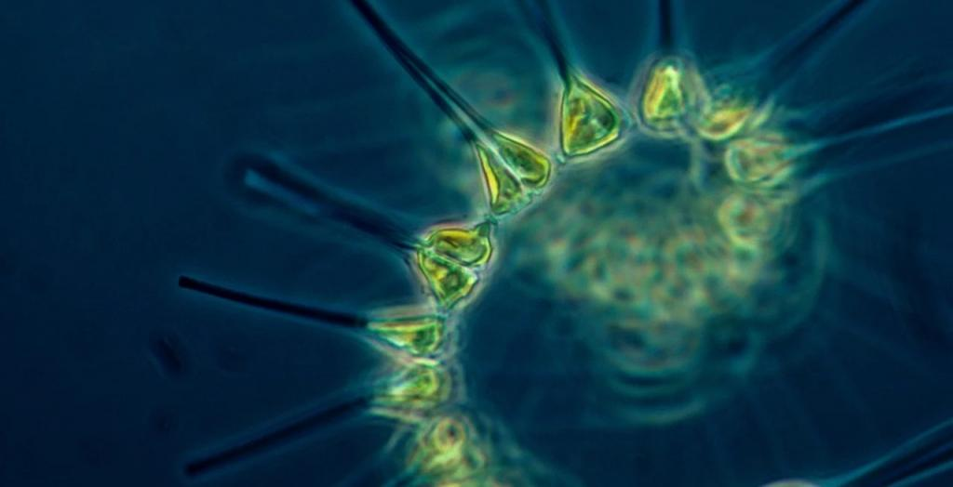
Learning Intention:
Interpret data from biotic and abiotic tests on a water sample to determine water quality.
Success Criteria:
Complete Marine Education Workbook titled, ’23. Muddy Waters’
Notes:
Image:

Slide 2
Biotic tests
WARNING: QCAA does NOT endorse any experiments that involve harming marine life. Consider a simulation first.
Notes:
Image: https://www.downtoearth.org.in/news/wildlife-biodiversity/new-study-helps-monitor-trends-in-phytoplankton-biomass-in-bay-of-bengal-73377

Slide 3
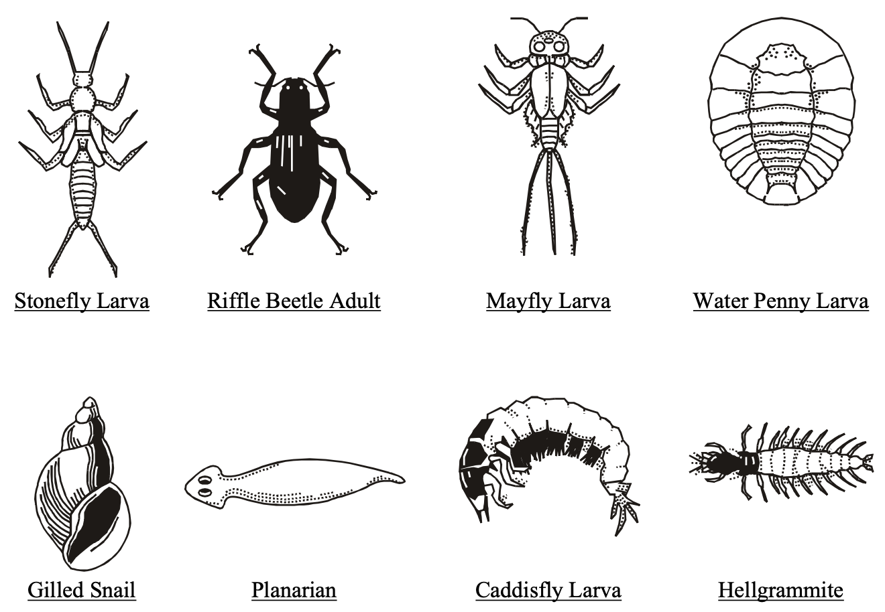
Measuring macroinvertebrates
Macroinvertebrates sensitive to pollution →

Slide 4
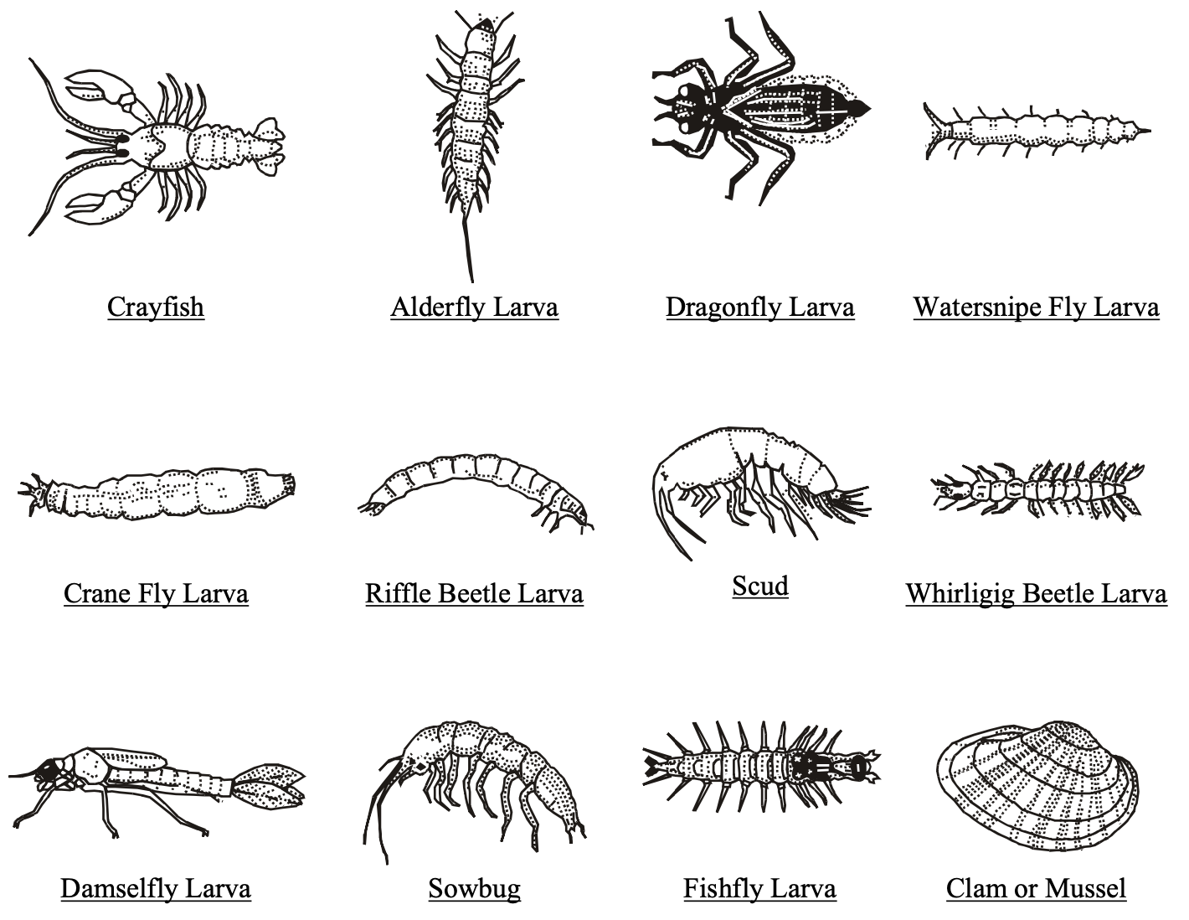
Measuring macroinvertebrates
Macroinvertebrates somewhat sensitive
to pollution →

Slide 5
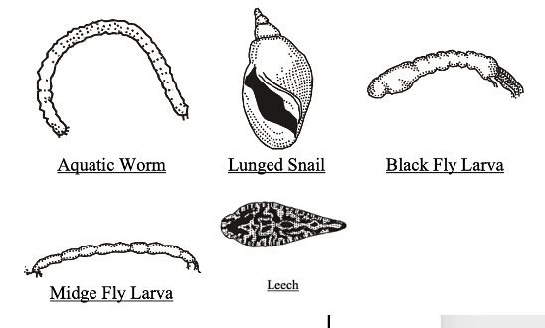
Measuring macroinvertebrates
Macroinvertebrates tolerant
to pollution →

Slide 6
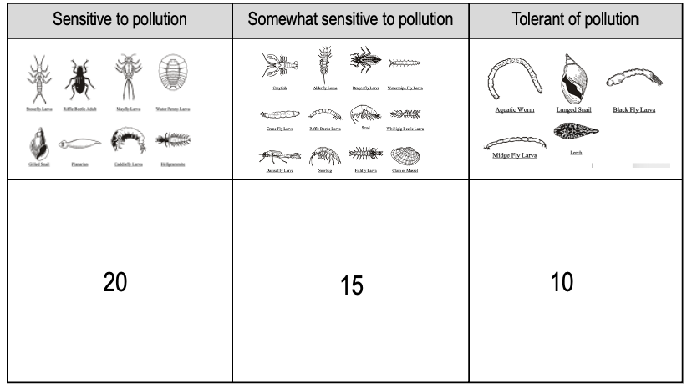
Measuring macroinvertebrates
Healthy

Slide 7
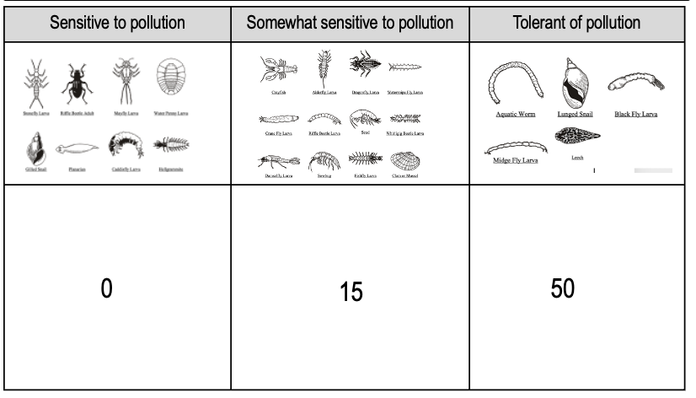
Measuring macroinvertebrates
vs. unhealthy

Slide 8
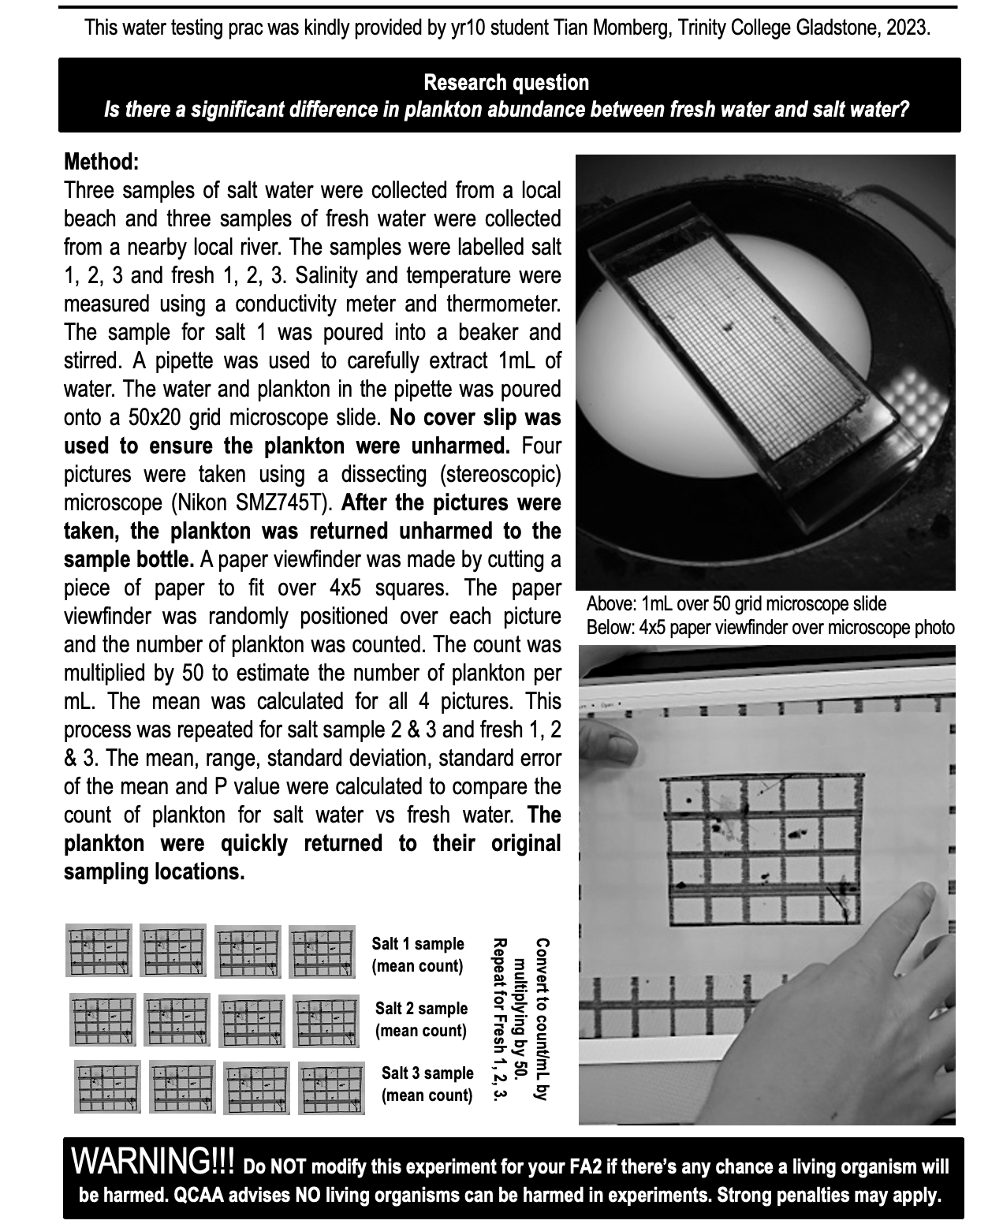
Measuring plankton abundance
Interpret the data
(next page)

Slide 9
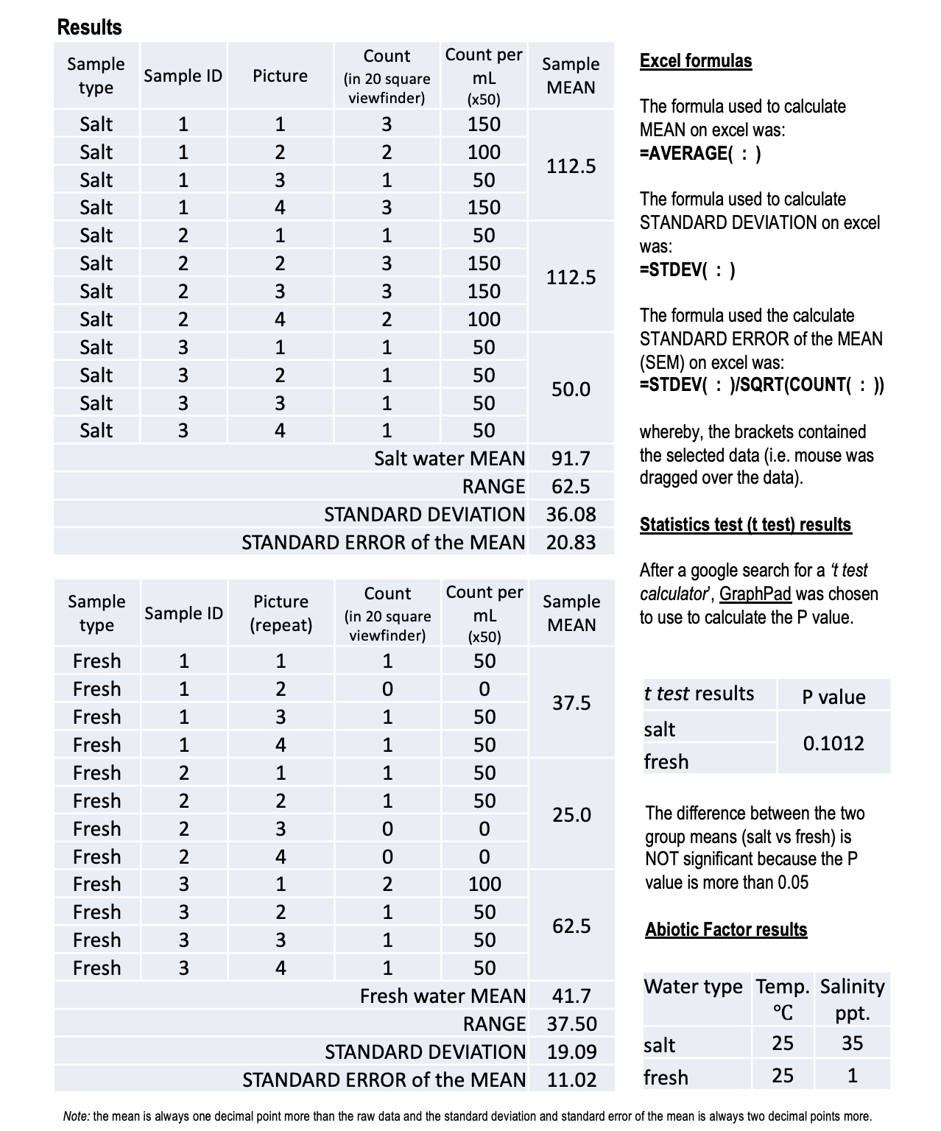
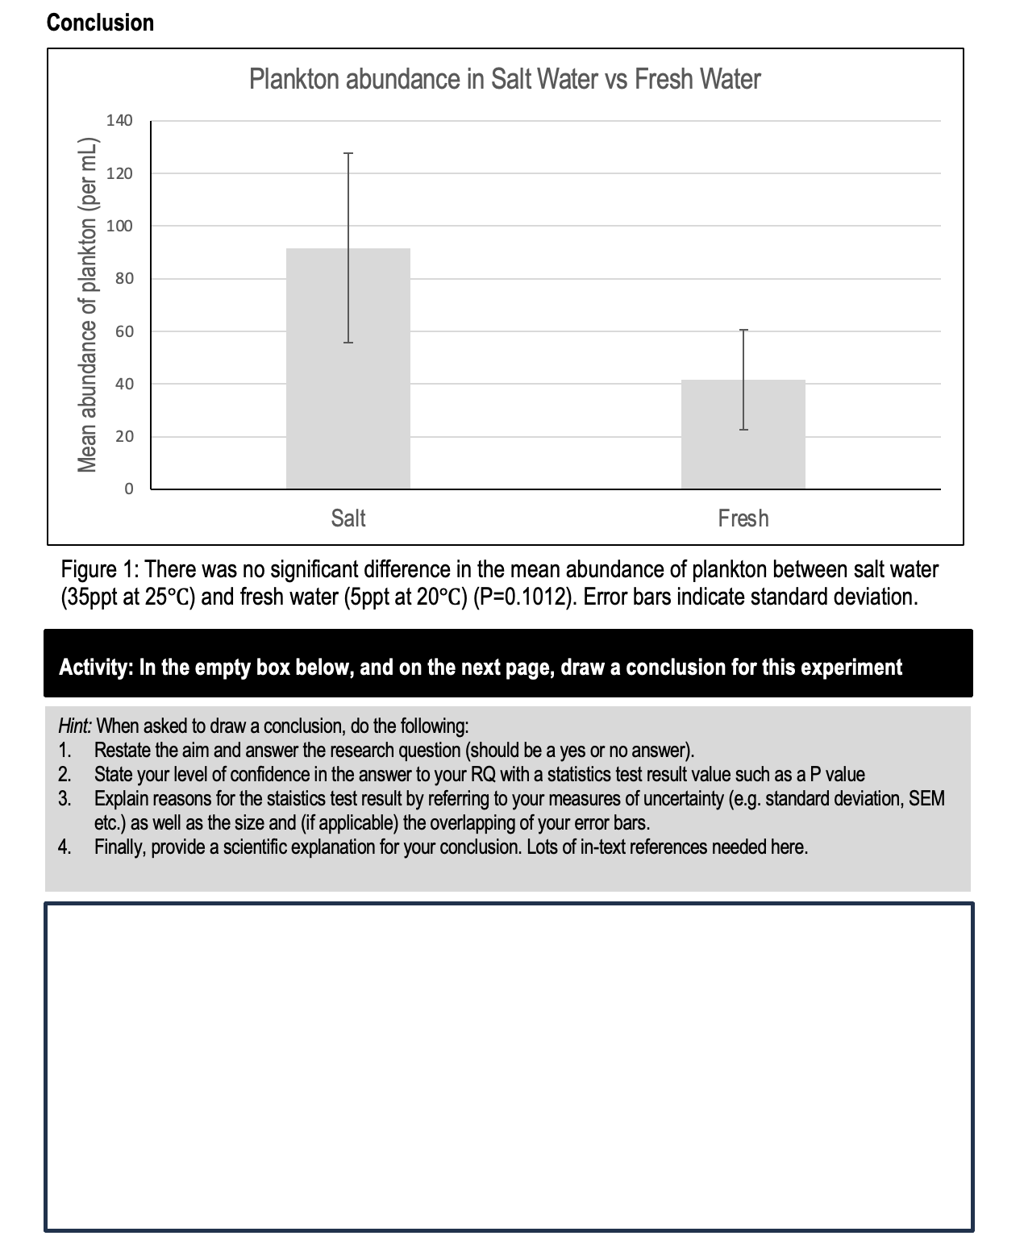

Slide 10
Abiotic tests

Slide 11
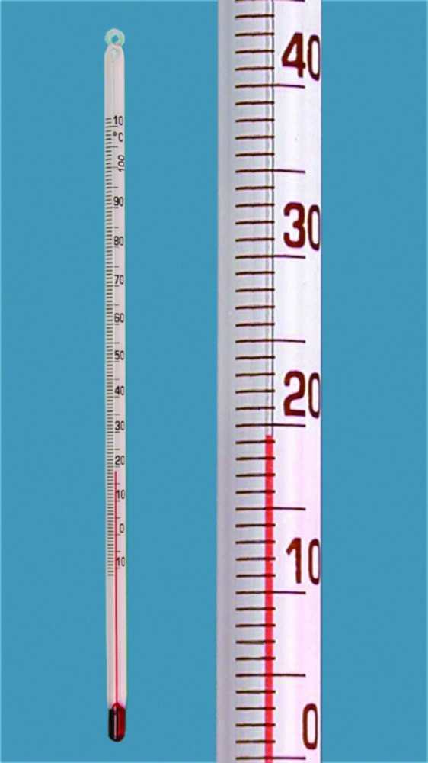
Temperature °C
Temperature influences many biological responses. For example: hatching success, feeding rates and growth rates, as well as survival rates and migration patterns. Each species requires a specific temperature range for optimal performance.
.
Temperature changes with depth.
Therefore, when you record the temperature, also record the depth of the temperature probe.
Cold water holds more dissolved oxygen (DO) than warm water. For this reason, measure temperature and dissolved oxygen (DO) together.

Slide 12
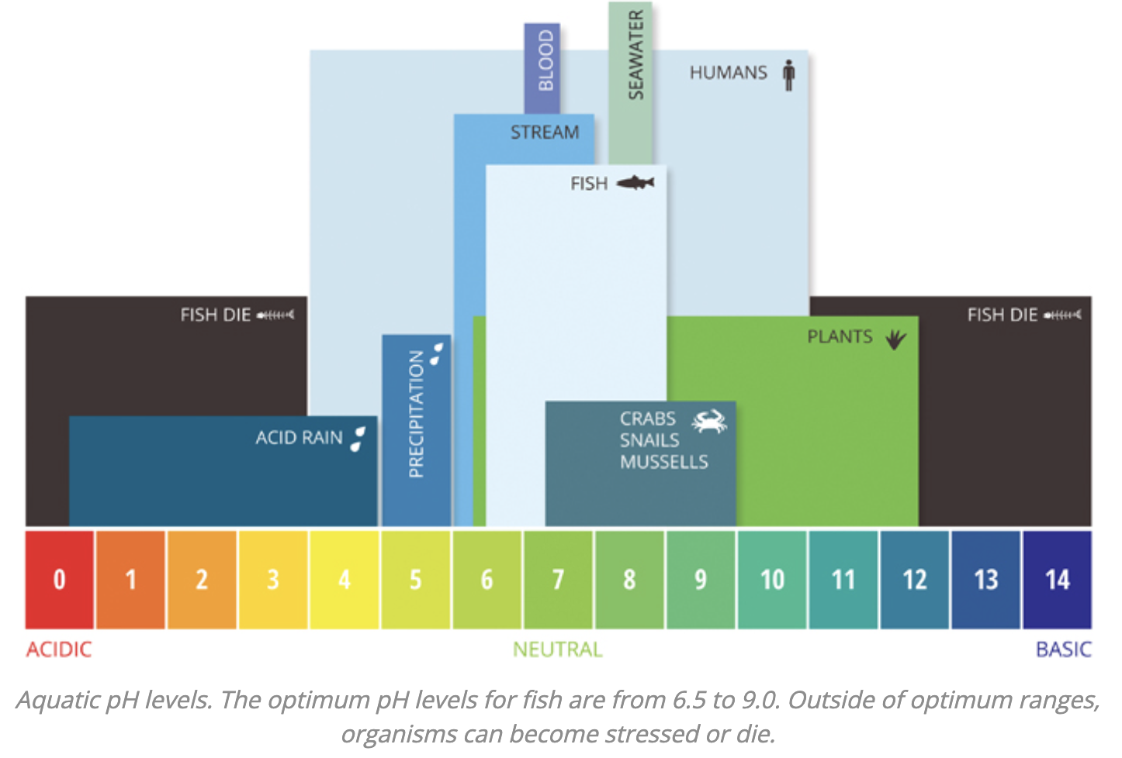
pH levels
Too low (acidic) or too high (basic) are both lethal.
Notes:
Image; https://www.fondriest.com/environmental-measurements/parameters/water-quality/ph/#:~:text=Pollution%20in%20the%20air%2C%20soil,known%20as%20acid%20rain%20%C2%B2%C2%B9.

Slide 13
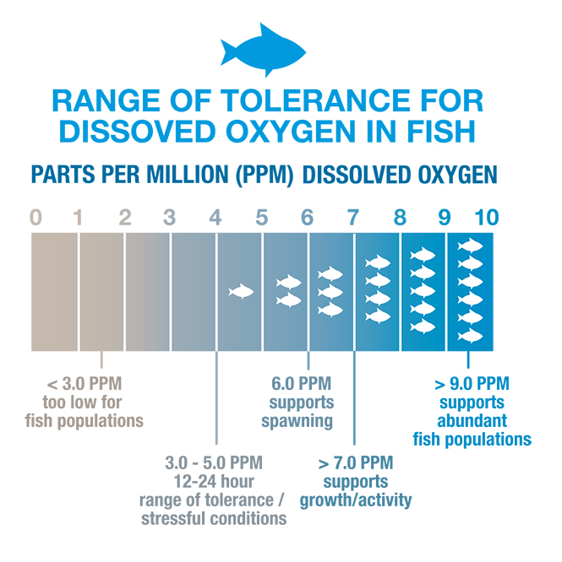
Dissolved Oxygen
Aquatic animals rely on oxygen that is dissolved in the water to survive.
Anything below 5ppm is too low.
Notes:
Image: https://www.knowyourh2o.com/outdoor-4/dissolved-oxygen-in-water

Slide 14

Salinity
(salt concentration)
Different plants and animals have different tolerances to fresh and salt water.
e.g. Lots of fresh water from flooding rains or pollution can be damaging to marine organisms with a low tolerance for fresh water.
Notes:
Image: https://geographical.co.uk/science-environment/the-future-of-desalination

Slide 15
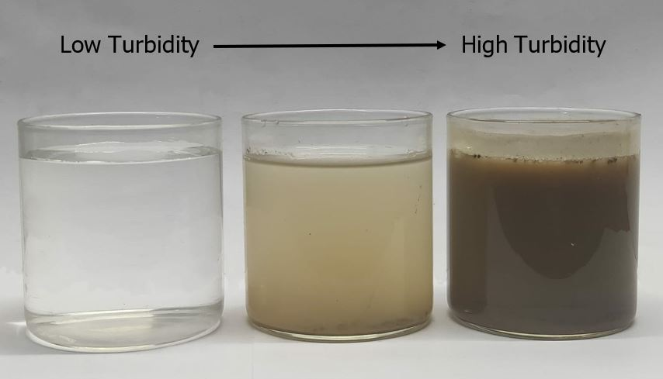
Turbidity
is the cloudiness or haziness of the water caused by suspended solids.
Turbidity is not a direct measurement of the total suspended solids in water; it just indicates that something is there.
Turbidity units have no inherent value.
E.g. clear water is not always healthy, and likewise turbid water does not necessarily indicate an issue.
Turbidity data must always be taken in context!

Slide 16
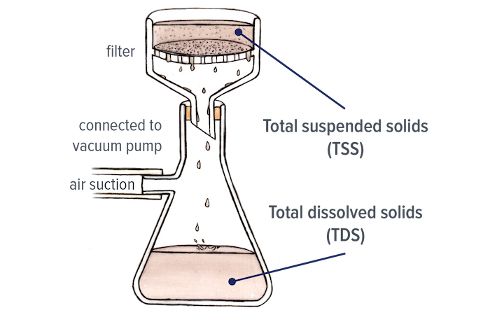
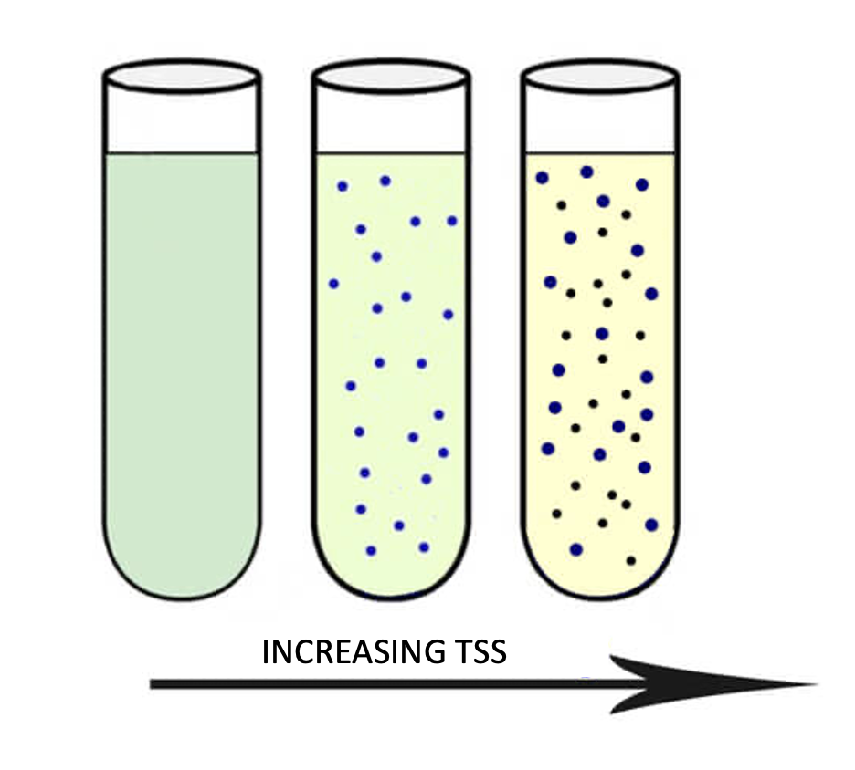
Total Suspended Solids (TSS)
is the total concentration of suspended solids (particles) bigger than 2µm.
Clean water has low TSS
Murky water has high TSS

Slide 17
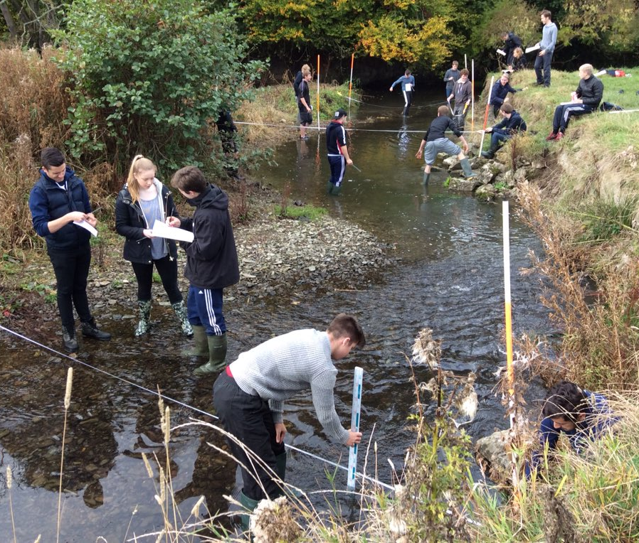
Depth
Abiotic factors change with depth.
Measure depth for context.

Slide 18
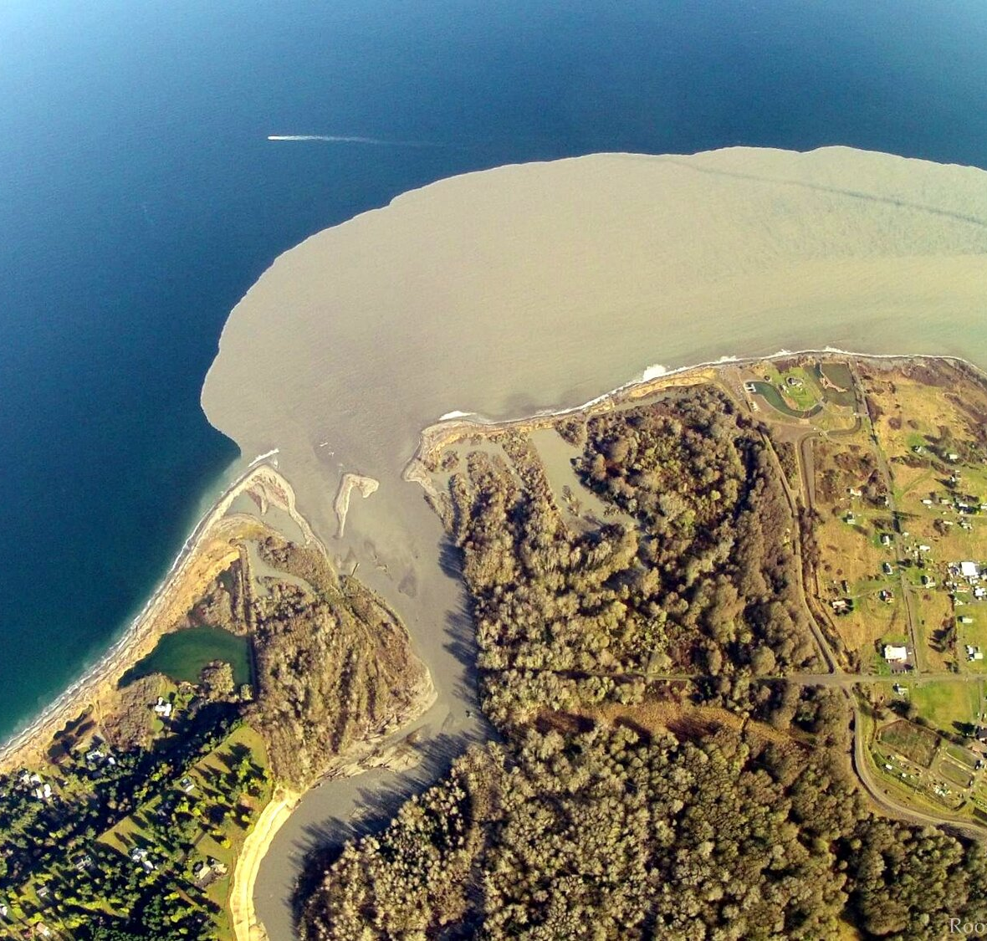
Water source
Where does the water come from and what is the level of contamination?
E.g. rainfall runoff, groundwater, tidal waters, irrigation, return flows?
Is it a point source or non-point source?
Notes:
Image: https://www.hydronia.com/riverflow2d-st-model

Slide 19

Tooway Lake, Sunshine Coast, opened to ocean
Flow
Flow = volume (m³)
time (sec)
As flows increase or decrease, abiotic factors change.
Flow regimes include the magnitude (size), timing, frequency and duration of flows.
Notes:
Image: https://www.sunshinecoastnews.com.au/2023/07/07/see-the-video-rare-surfing-event-always-draws-a-crowd/
A rare event has occurred again this week at Tooway Lake at Caloundra's Moffat Beach. Picture: Brett Tollis

Slide 20
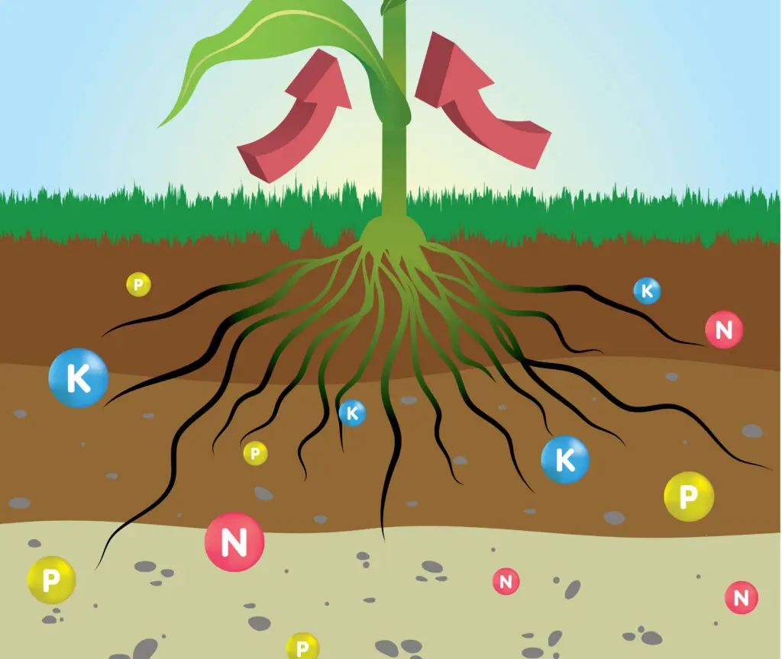
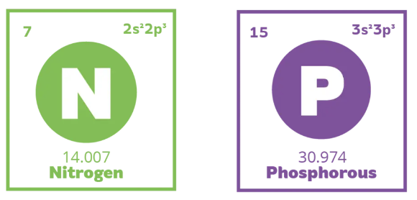
Nutrients
N and P can be measured many ways.
What you measure depends on what you want to know. E.g. Dissolved inorganic nitrogen (DIN) and dissolved inorganic phosphorus (DIP) often control the formation of algae blooms due to their bioavailability. Thus, if wanting to monitor potential algae blooms, measure DIN & DIP (usually expressed as µg/L or parts per billion). Both should be single digit values to avoid algae bloom conditions (bad if it’s a lake).
Notes:
Image: https://greenplanetnutrients.com/blog/tips-advice/understanding-plant-nutrition/

Slide 21
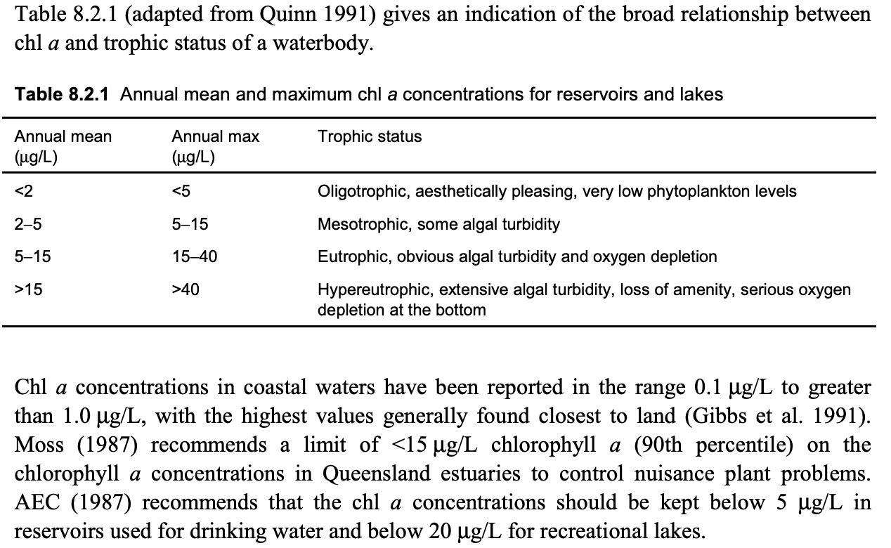
Chlorophyll a (chl a)
Signals an algae bloom (easier than measuring phytoplankton under a microscope)
Qld water quality guidelines (des.qld.gov.au)
Notes:
Image: https://www.waterquality.gov.au/sites/default/files/documents/anzecc-armcanz-2000-guidelines-vol2.pdf

Slide 22
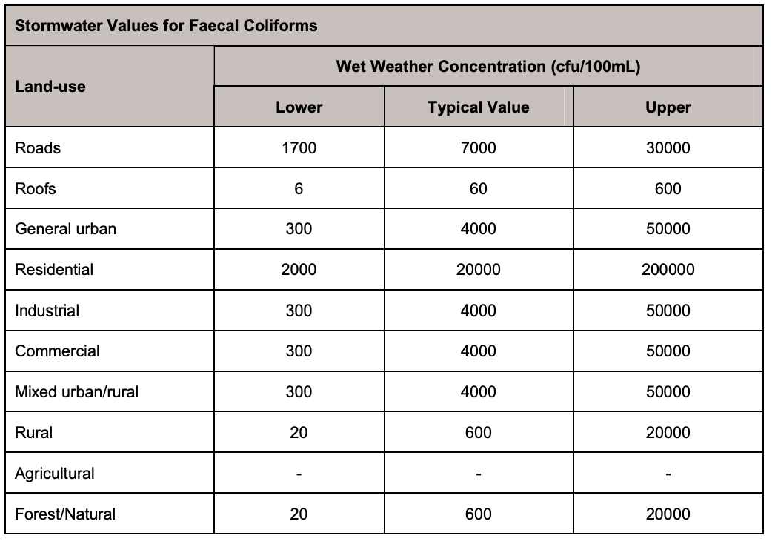
Faecal Bacteria
indicate the presence of feacal matter (poop).
It is used as an indicator species for the presence of more harmful pathogens.
Obviously, you want none in drinking water!
Qld water quality guidelines (des.qld.gov.au)
Notes:
Image: https://environment.des.qld.gov.au/__data/assets/pdf_file/0020/95150/water-quality-guidelines.pdf

Slide 23
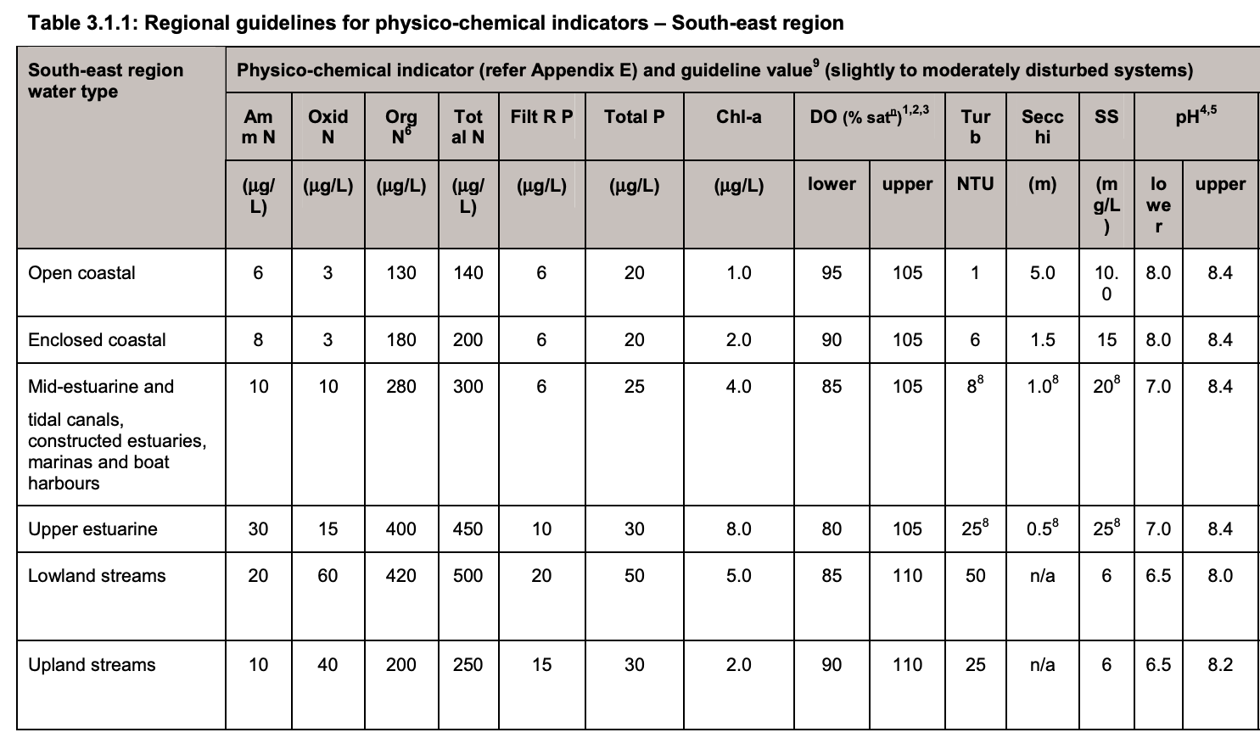
Qld water quality guidelines
(this is an example of the cut-off values for a waterbody in regional SE Qld that is moderately disturbed)
Qld water quality guidelines (des.qld.gov.au)
Note: DIN is oxidized N (Oxid N) + ammonia (Amm N) combined.
Filterable reactive P (FiltR P) includes DIP, whereby the DIP filters through a 0.45µm filter and is reactive. It’s not called DIP here because it may also include some organic P that is <0.45µm and reactive too.
Notes:
Image/info: https://environment.des.qld.gov.au/__data/assets/pdf_file/0020/95150/water-quality-guidelines.pdf
Info on FiltR P: https://hess.copernicus.org/articles/6/113/2002/hess-6-113-2002.pdf. …. Separation of ‘dissolved’ and ‘particulate’ P phases is based mainly on filtration using 0.45 µm (mainly) or 0.7 µm membrane filters. Analytical determination of P in natural waters is based on the phosphomolybdic acid methodology, as modified by Murphy and Riley (1962). The following determinations are made routinely: (i) Soluble Reactive Phosphorus (SRP), a measure of monomeric inorganic phosphorus (orthophosphate) in solution. Other terms commonly used within the literature to describe this fraction include: ‘Dissolved Reactive Phosphorus (DRP)’, Dissolved Inorganic Phosphorus (DIP)’,
‘Filterable Reactive Phosphorus (FRP)’ and ‘Reactive Phosphorus for a filtered sample to a defined filter size ….
Info: https://www.nalms.org/secchidipin/monitoring-methods/phosphorus/ that read …At one time SRP was called “dissolved inorganic phosphorus.” This terminology was changed to “soluble reactive phosphorus” (Rigler 1964; Strickland and Parsons 1965) to reflect a more realistic interpretation of what forms of phosphorus were found in this fraction. The terms “soluble” and “reactive” were chosen instead because this form of filtered phosphorus was neither necessarily dissolved nor necessarily inorganic. The term “reactive” is used to indicate that the phosphorus in the SRP fraction is not solely inorganic phosphorus, but could include any form of phosphorus, including some organic forms, that react with the reagents. Some organic forms apparently do hydrolyze and react under the conditions of this test, while some forms of inorganic phosphorus (polyphosphates), in fact, do not react. There is a continuing debate as to what extent SRP represents solely the ortho form of phosphorus or is biologically available (Nürnberg and Peters 1984). The actual composition of SRP probably varies with the nature of the water body.
The “soluble” fraction does not necessarily contain only dissolved phosphorus forms: the phosphorus containing material in the soluble fraction is dependent on the porosity and characteristics of the filter used. Typically, a 0.45 micron cellulose (Millipore) filter is used as a standard. This filter excludes most particulates, but colloidal phosphorus may be present in the filtered fraction.

Slide 24
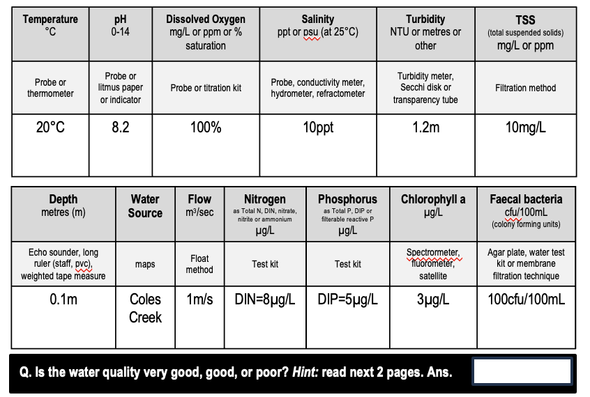
Is the water quality…
Very good
Good
Poor
???

Slide 25
Very good

Slide 26

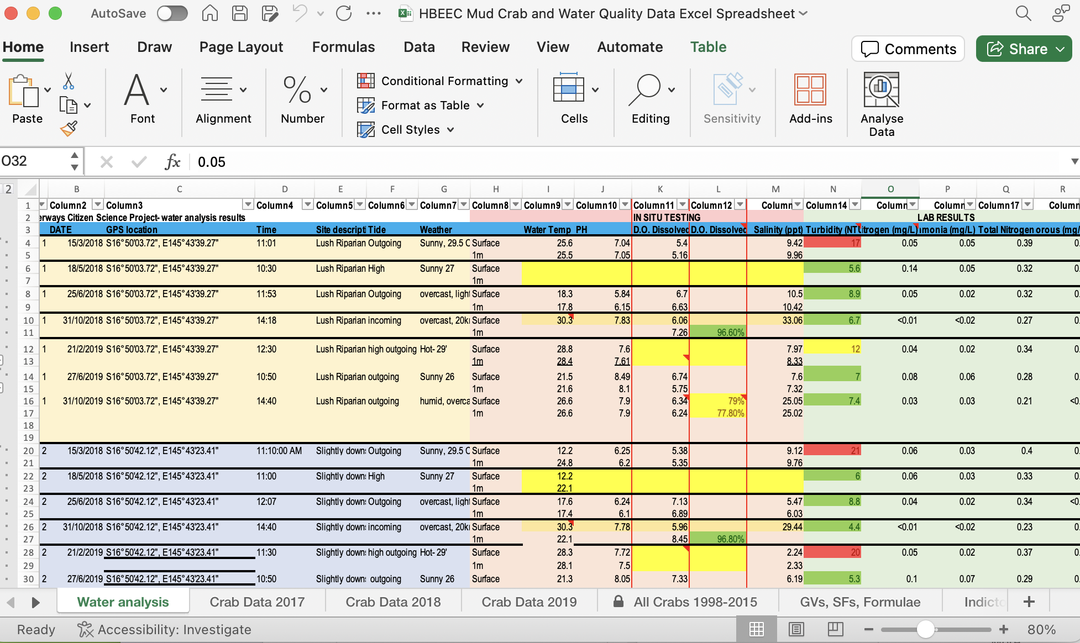
Download the workbook and spreadsheet below from marineeducation.com.au to practice interpreting data from biotic and abiotic tests on a water sample to determine water quality
(teacher shared resources tab)

Slide 27
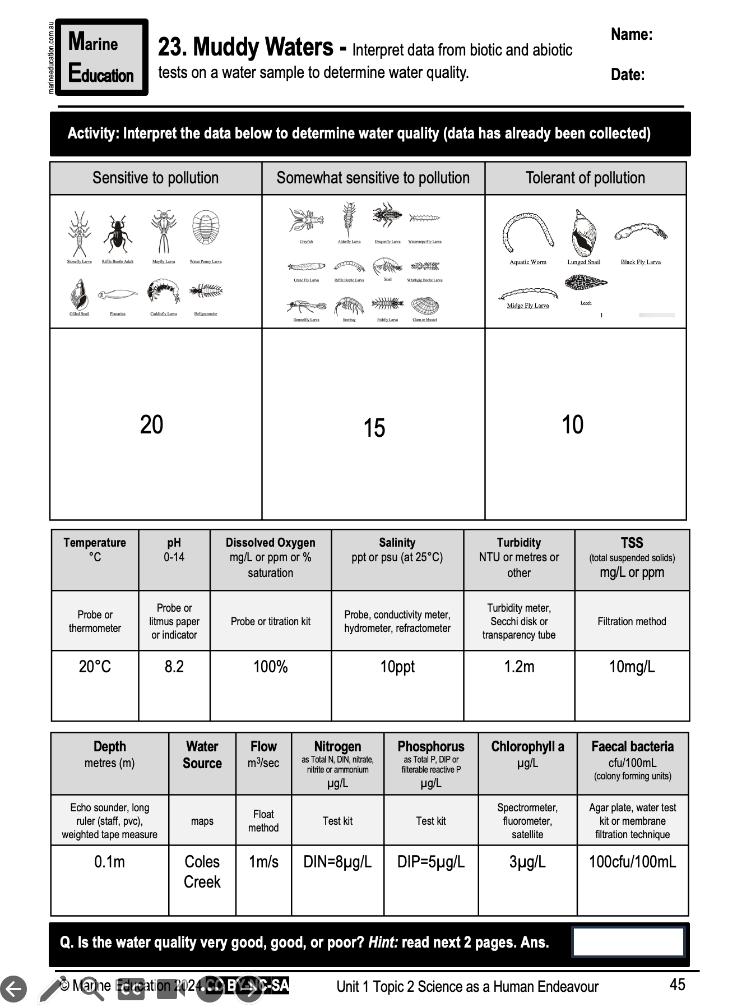
Learning Intention:
Interpret data from biotic and abiotic tests on a water sample to determine water quality.
Success Criteria:
Complete Marine Education Workbook titled, ’23. Muddy Waters’
Notes:
Image:

