Slide 1
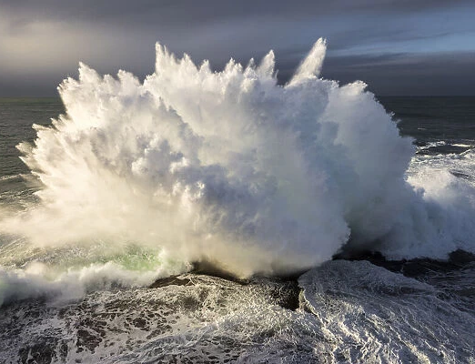
Learning Intention:
Describe the role of adaptation in enhancing an organism’s survival in a specific marine environment.
Success Criteria:
Complete Marine Education worksheet ‘25. Life or Death’
Notes:
Image: https://www.mediastorehouse.com.au/discover-images-by-awl/waves-crashing-rocks-north-curl-curl-rockpool-24271807.html

Slide 2
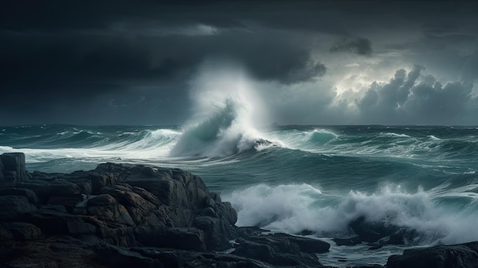
Life is not always easy…
Notes:
Image: https://www.freepik.com/premium-ai-image/wave-breaking-rocky-shore-with-storm-background_68020433.htm

Slide 3
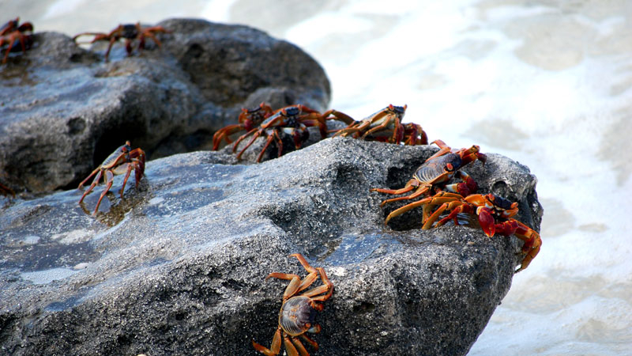
It can have its challenges
Notes:
Image: https://www.reefconservation.mu/gallery/discover-the-marine-environment/rocky-shores/

Slide 4
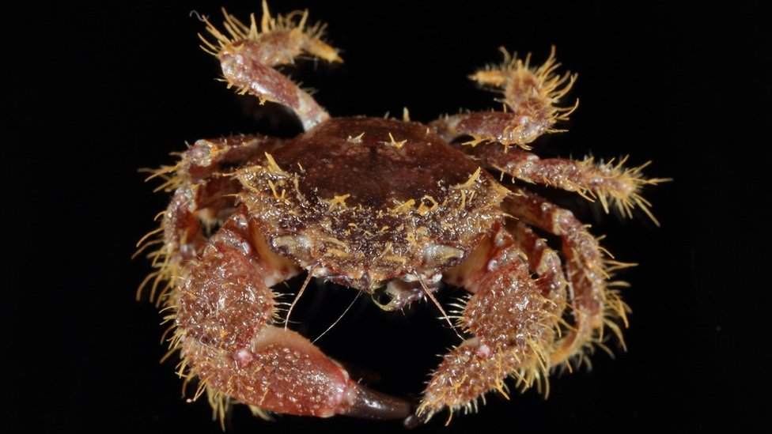
Organisms have adaptations that increase their chance of survival

Slide 5
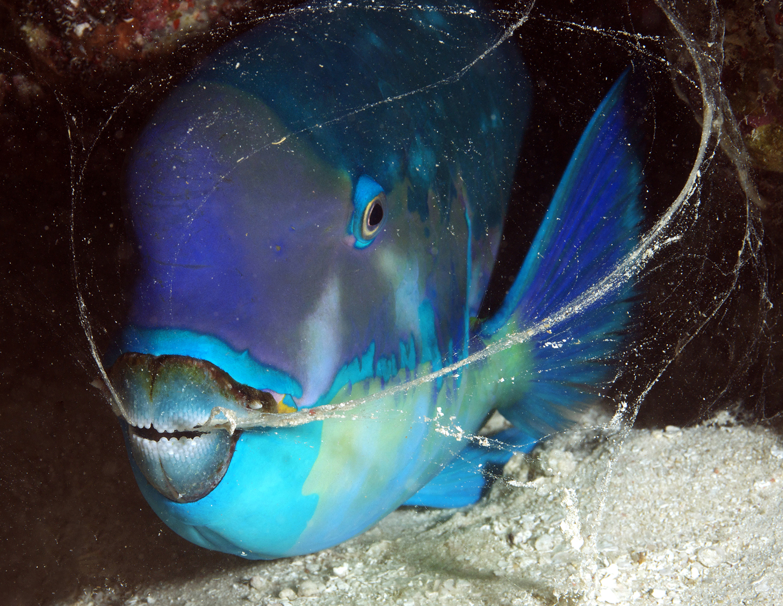
For example, the ‘snot bubble’ of a parrotfish to hide its smell from
night-time predators…
Notes:
Image: https://twitter.com/theoceanagency/status/1233074318097039360

Slide 6
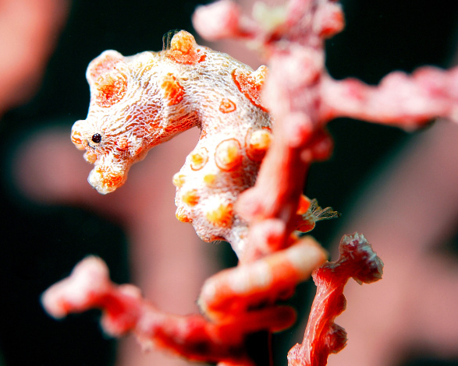
…or camouflauge
Notes:
Image: https://scubadiverlife.com/top-eight-underwater-masters-camouflage/

Slide 7
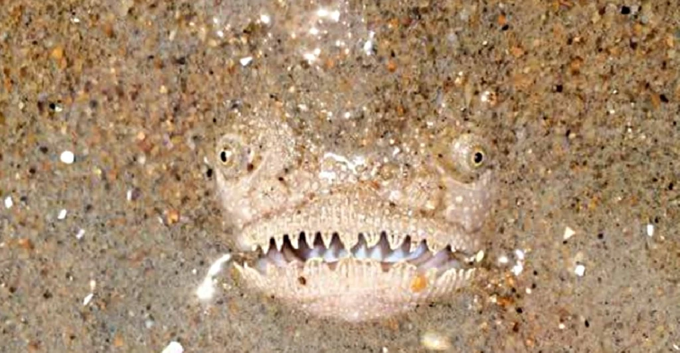
…and hiding
Notes:
Image: https://www.atlantis-bali-diving.com/sea-creatures-most-amazing-camouflage/
The stargazer, also known as king of camouflage, can be found living worldwide in deep waters as well as shallow waters. Being able to bury themselves very rapidly in the sand, leaving only their eyes and mouth uncovered, the are very good in ambushing their predators. Besides this they have a lure they use to attract prey within striking distance, they feed on soft organisms such as fish, cuttlefish and octopus.

Slide 8
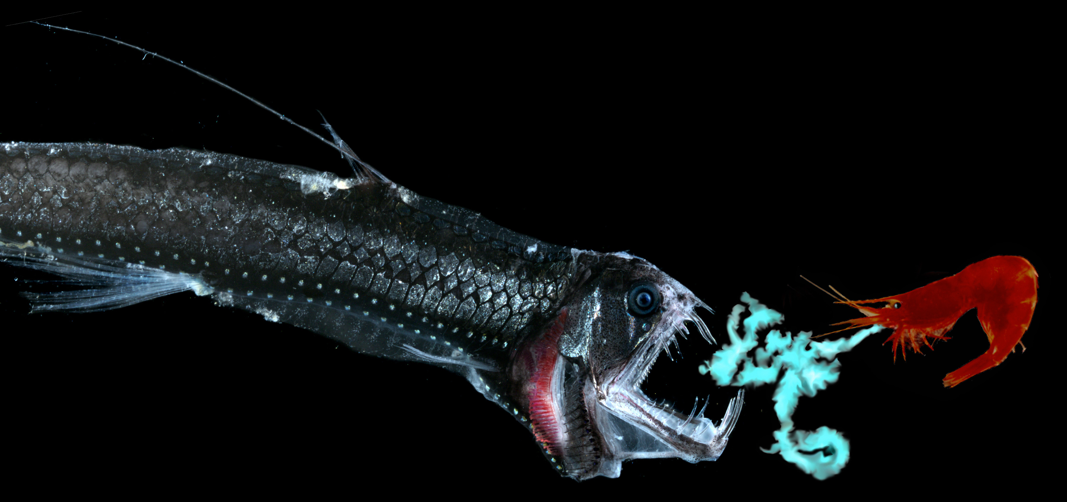
bioluminescence
for communicating, hunting and defending
Notes:
Image: https://e360.yale.edu/features/a-scientist-reveals-the-bioluminescent-magic-of-the-deep-sea-world
A deep-sea shrimp spews bioluminescent chemicals at its predator, a viperfish. EDITH WIDDER

Slide 9
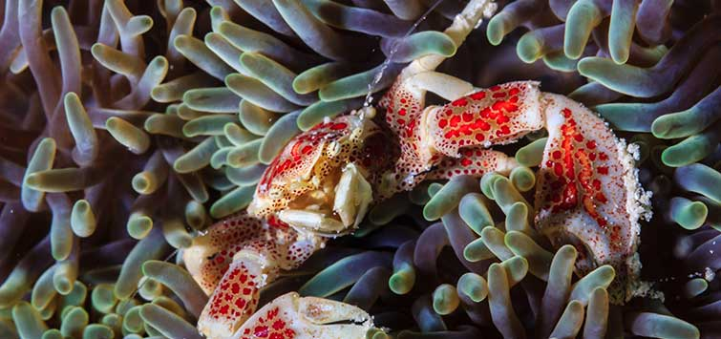
Symbiosis
Notes:
Image: https://www.tfhmagazine.com/articles/saltwater/a-look-at-symbioses-in-the-marine-aquarium

Slide 10
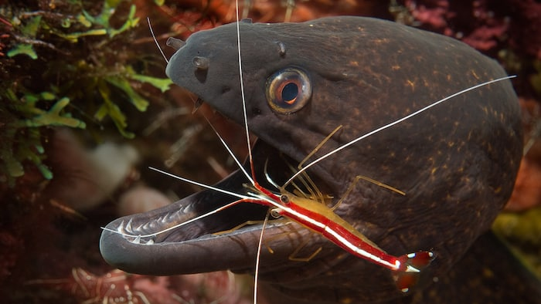
Mutualism
Cleaner shrimp servicing a moray eel
Notes:
Image: https://twofishdivers.com/blog/marine-symbiosis/

Slide 11
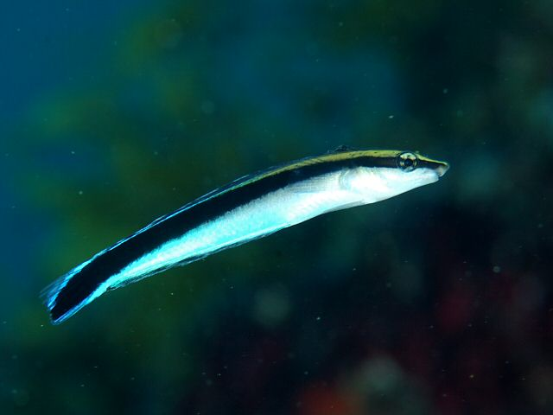
Mimicry
(pretending to be something else)
False cleaner wrasse

Slide 12
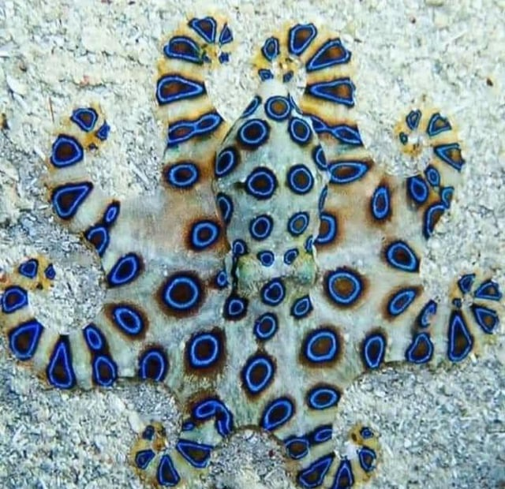
Aposematic colouration
(warning colours to signal they’re dangerous)
Notes:
Image: https://www.reddit.com/r/NatureIsFuckingLit/comments/jzcznc/blueringed_octopus_very_pretty_but_very_deadly/

Slide 13
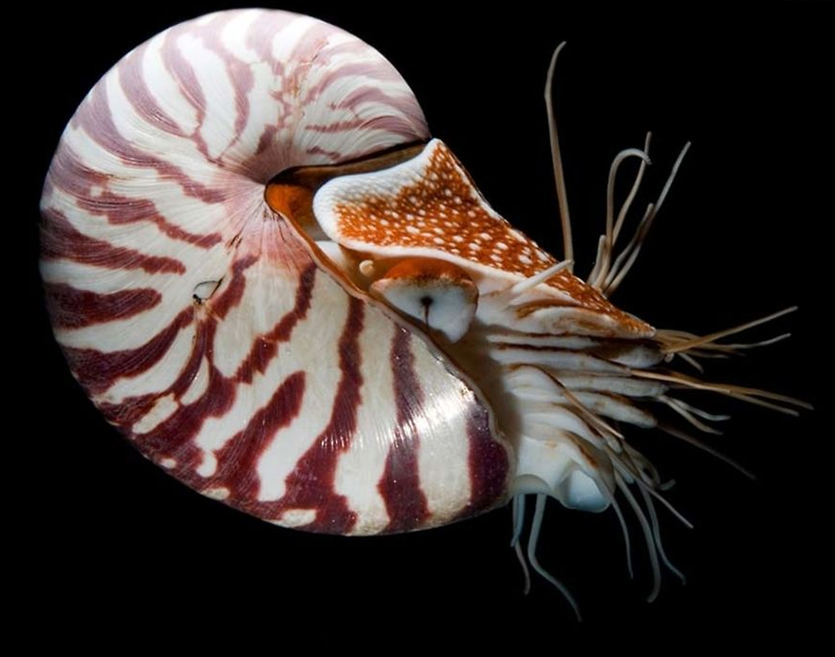
Duirnal vertical migration
(animals migrating to shallow waters at night-time in the cover of darkness)
nautilus

Slide 14
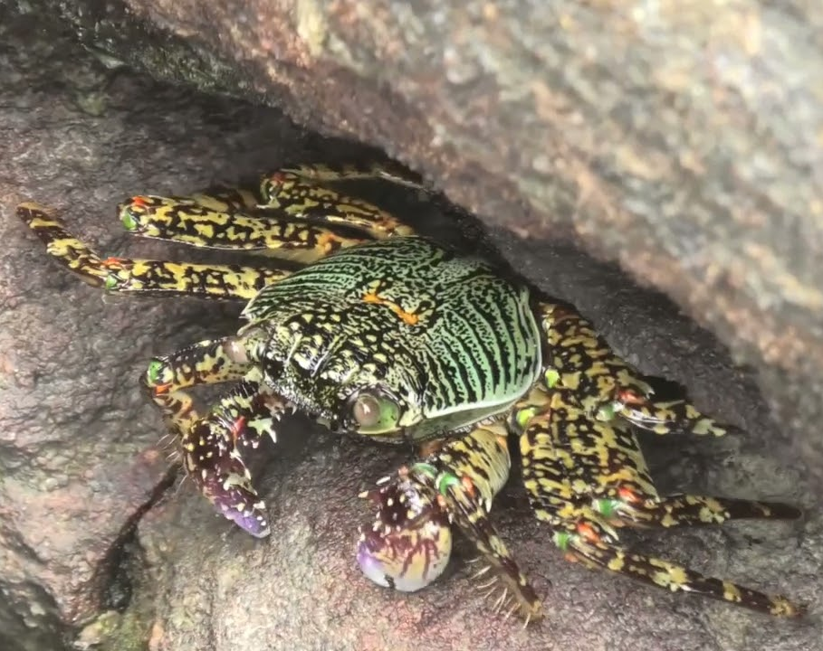
All these adaptations are designed to enhance survival rate
Tropical rock crab
Notes:
Image: https://www.rosmaninhoazevedo.com/?s=tropical-rock-crab-front-this-very-little-pale-lined-ee-787zm0HB

Slide 15
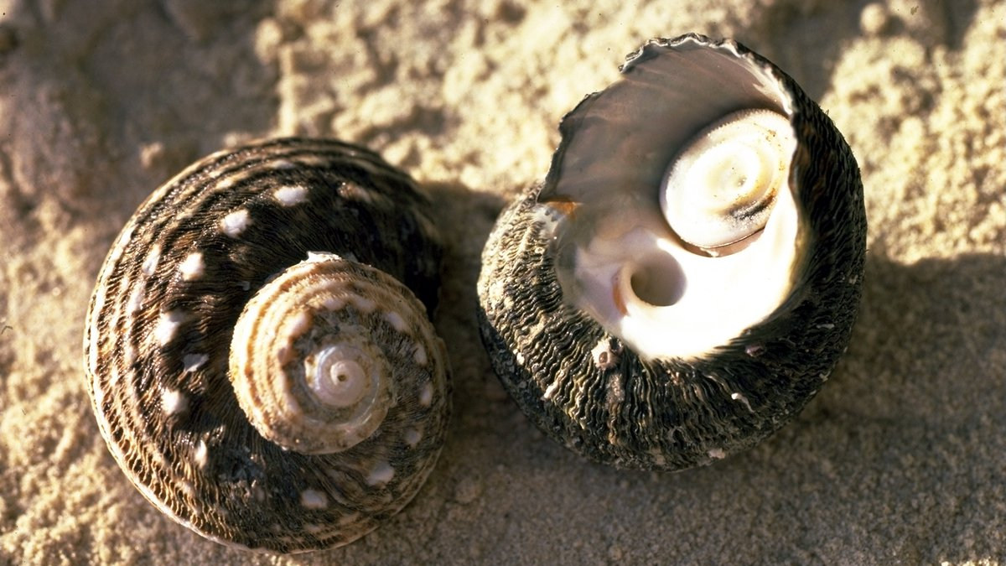
Activity: Describe the role of the operculum (‘cat’s eye’ or ‘trap door’) in enhancing a turban snail’s survival on a rocky shore
Blocks out predators and traps in moisture
Notes:
Image: https://australian.museum/learn/animals/molluscs/turban-snail/

Slide 16
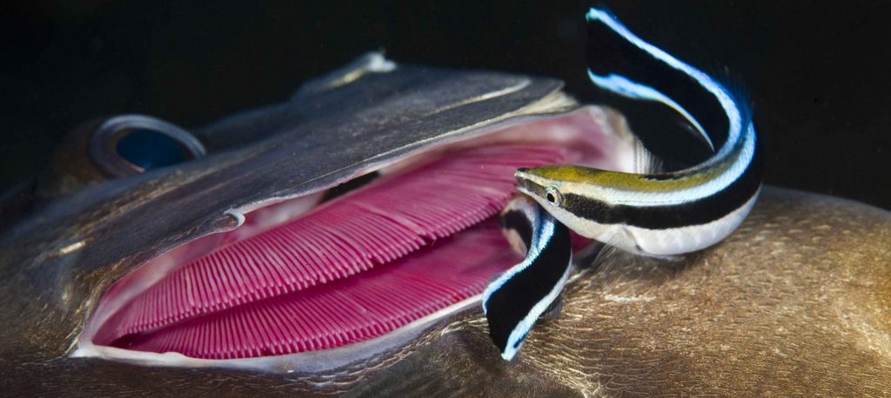
Activity: Describe the role of cleaning stations in enhancing the
survival of fish on coral reefs
Removes potential parasites
Notes:
Image: https://marinewaters.fish.wa.gov.au/resource/cleaning-station/

Slide 17
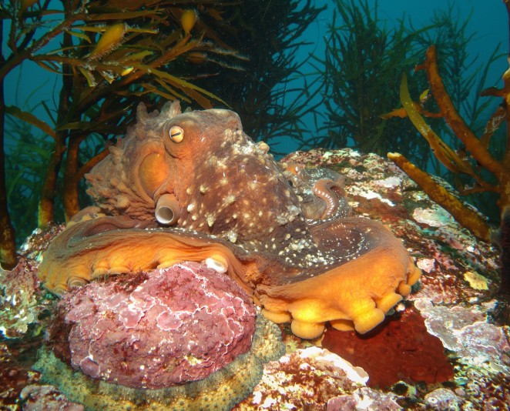
Hide from predators and prey
Activity: Describe the role of camouflage in enhancing the
survival of an octopus in a kelp forest
Hiding from predators (and potential prey)
Notes:
Image: https://www.climatechangenews.com/2016/10/14/the-creatures-of-tasmanias-disappearing-kelp-forests-in-pictures-2/

Slide 18
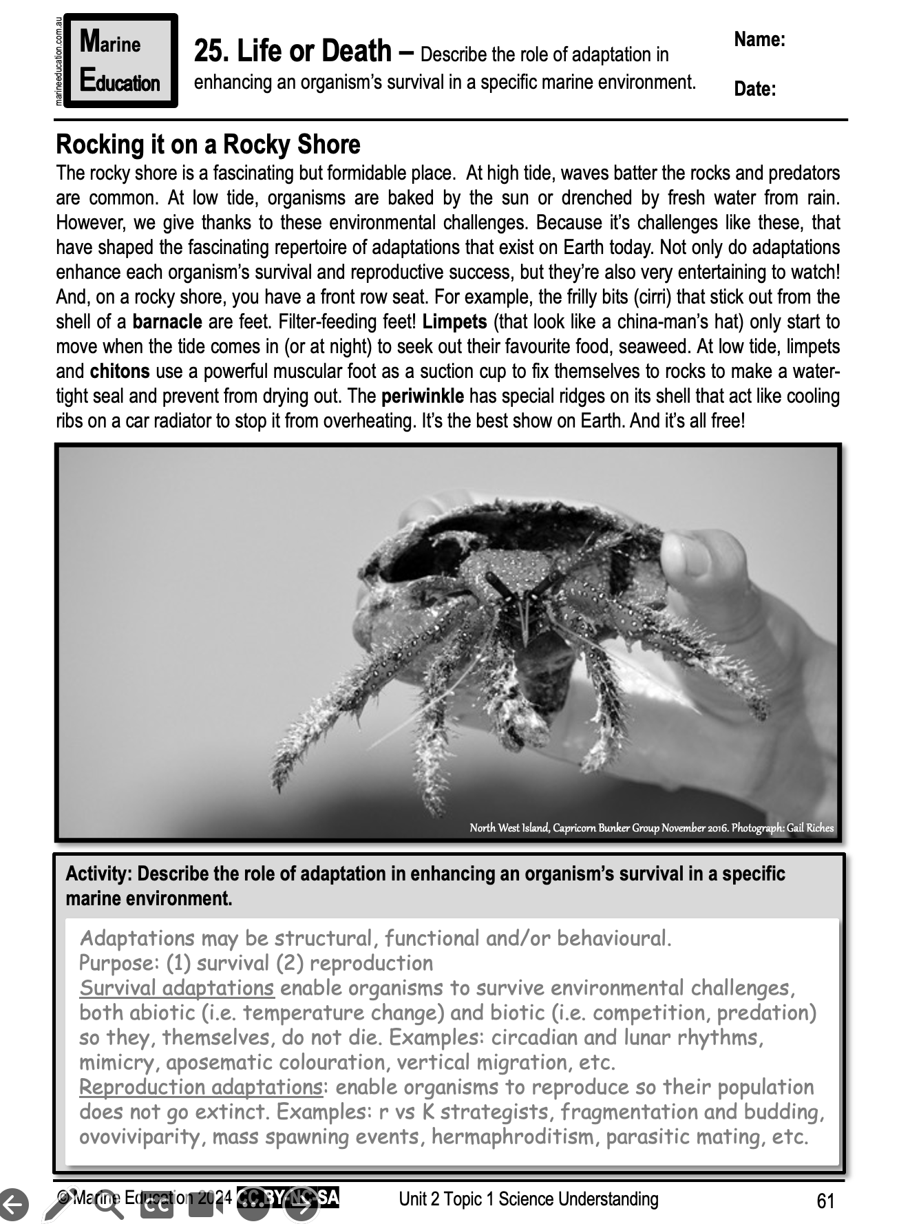
Learning Intention:
Describe the role of adaptation in enhancing an organism’s survival in a specific marine environment.
Success Criteria:
Complete Marine Education worksheet ‘25. Life or Death’
Notes:
Image: https://www.mediastorehouse.com.au/discover-images-by-awl/waves-crashing-rocks-north-curl-curl-rockpool-24271807.html

