Slide 1
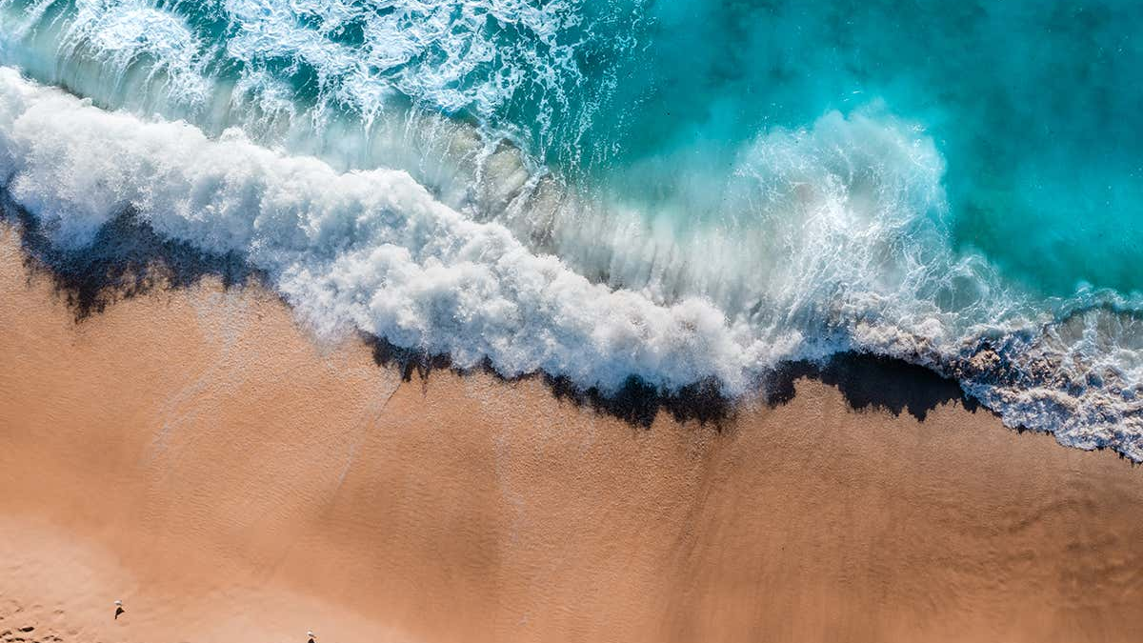
Learning Intention:
Describe the concepts of sand budget and longshore drift
Success Criteria:
Complete Marine Education worksheet ‘3. Shifty sand’
Notes:
https://www.youtube.com/watch?app=desktop&v=loRr97fOWdg

Slide 2
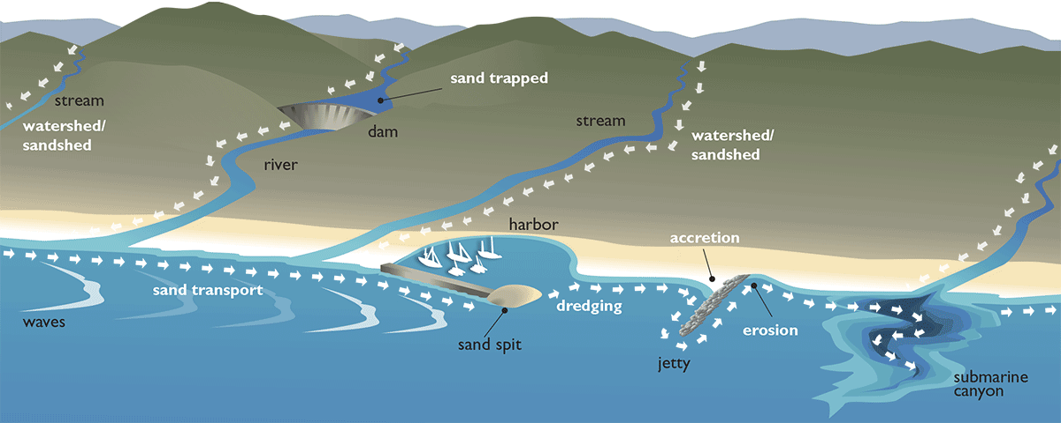

Slide 3
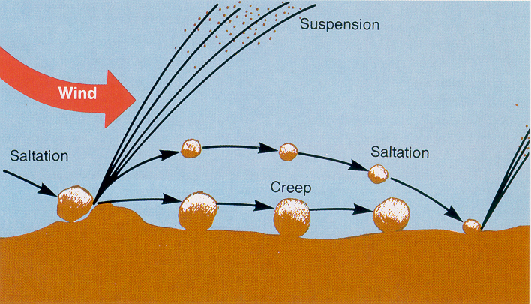
A similar thing occurs in water!

Slide 4
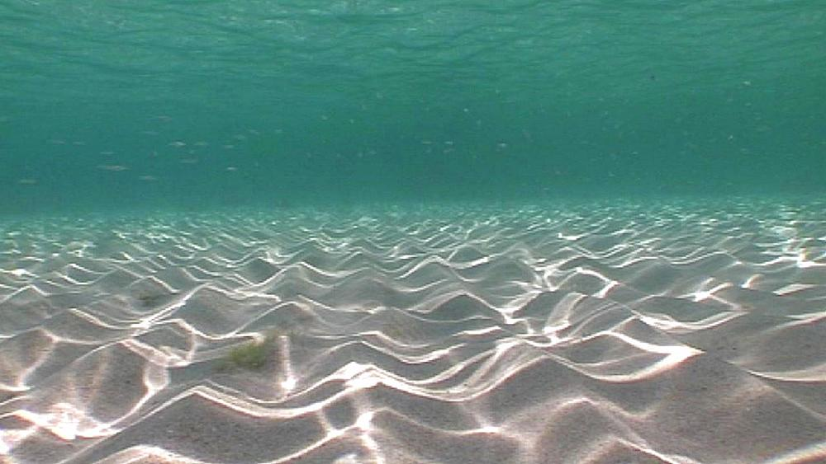

Slide 5
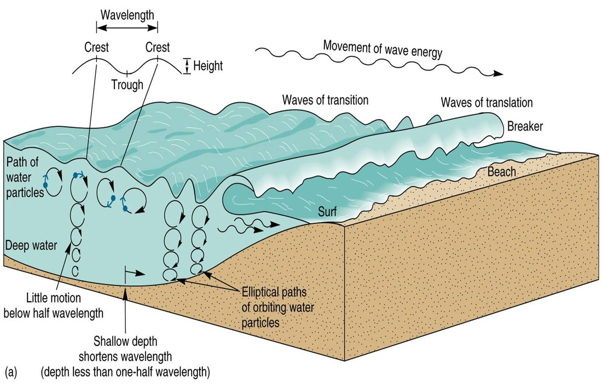
Notes:
https://www.thegeographeronline.net/coasts.html

Slide 6
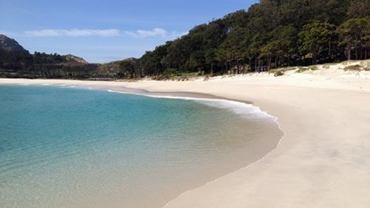
Constructive waves make beaches (calm)
Strong swash
Sand builds (accretion)
Weak backwash

Slide 7
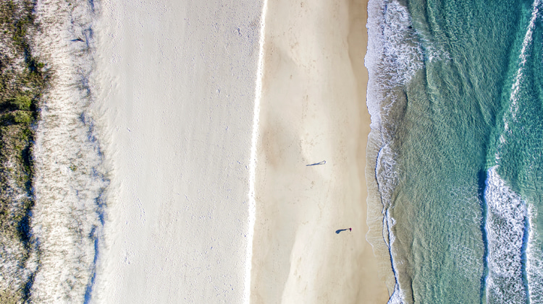

Slide 8
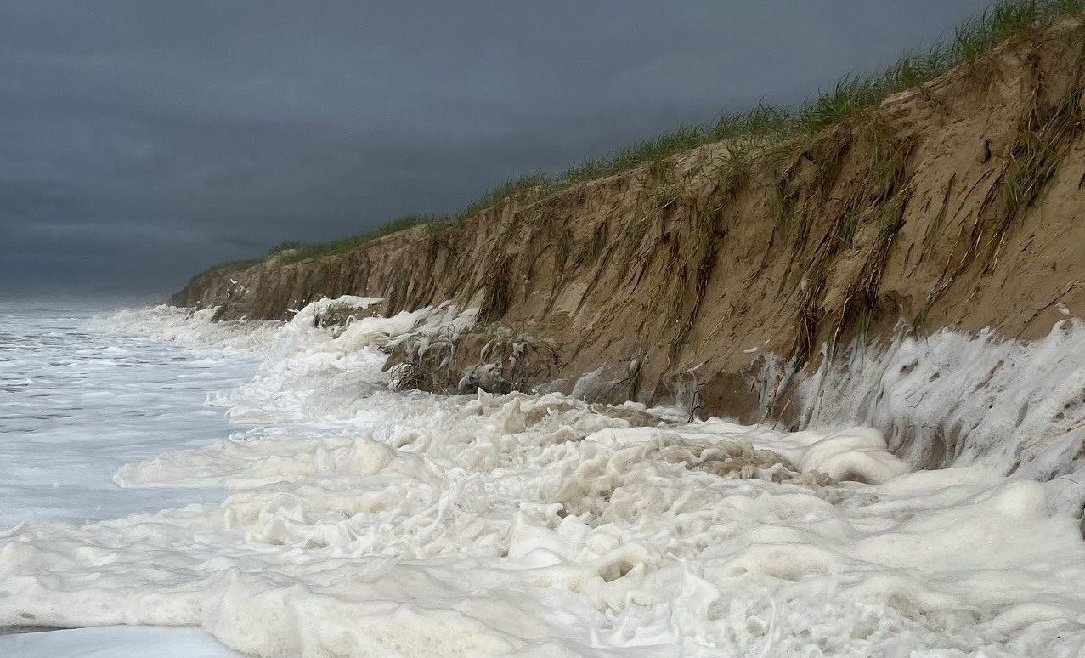
Destructive waves destroy beaches (rough)
Strong swash
STRONGER backwash
Sand erodes (erosion)

Slide 9
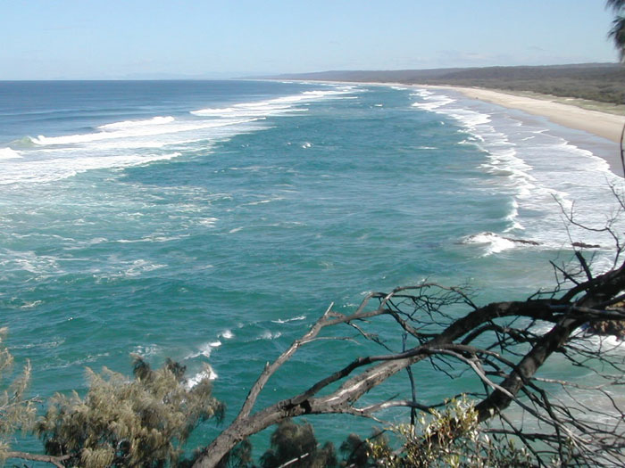
But the sand doesn’t travel far….
usually only about
100-500m offshore
where the new sand bar makes a new surf break!

Slide 10
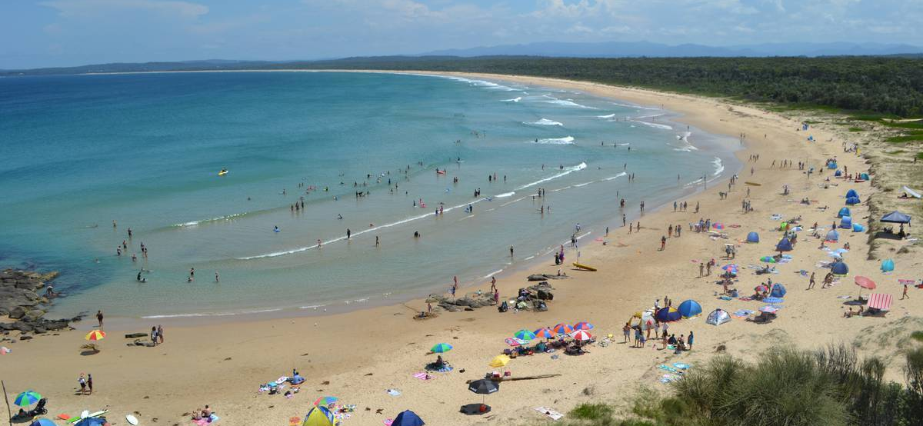
When seas calm down (e.g. winter)
constructive waves return the sand to the beach ☺

Slide 11
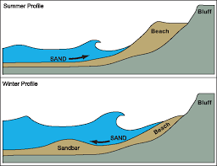
Constructive waves (calm)
Destructive waves (rough)

Slide 12



Sand Budget
The volume of sand entering
and leaving a beach

Slide 13
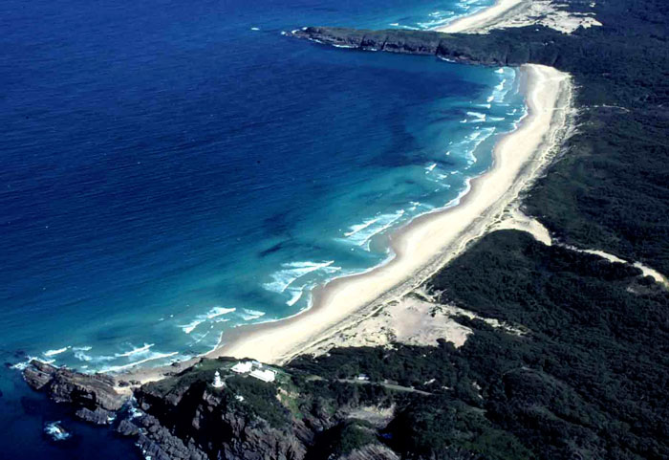
Sand also creeps up the coast via longshore drift

Slide 14
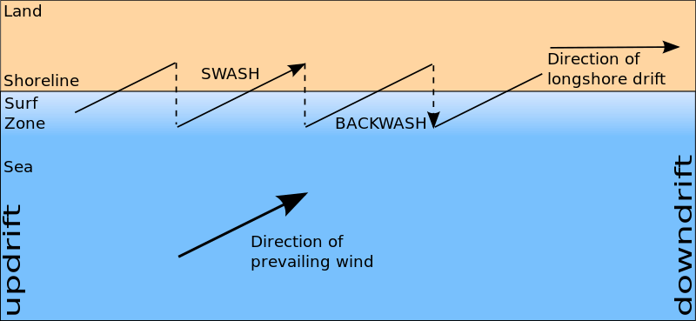
Longshore Drift
A process that slowly transports sand along a coastline, in the general direction of the prevailing wind and waves.
Notes:
https://commons.wikimedia.org/wiki/File:Longshore_drift.svg

Slide 15
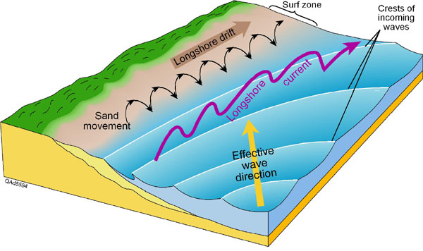

Slide 16
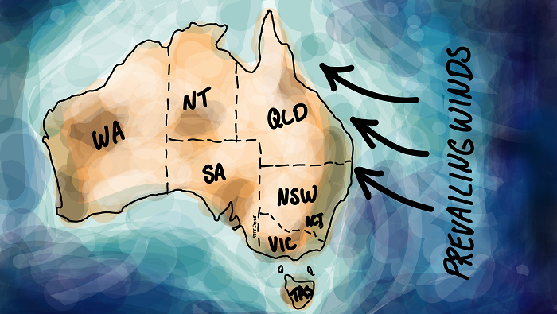

Slide 17
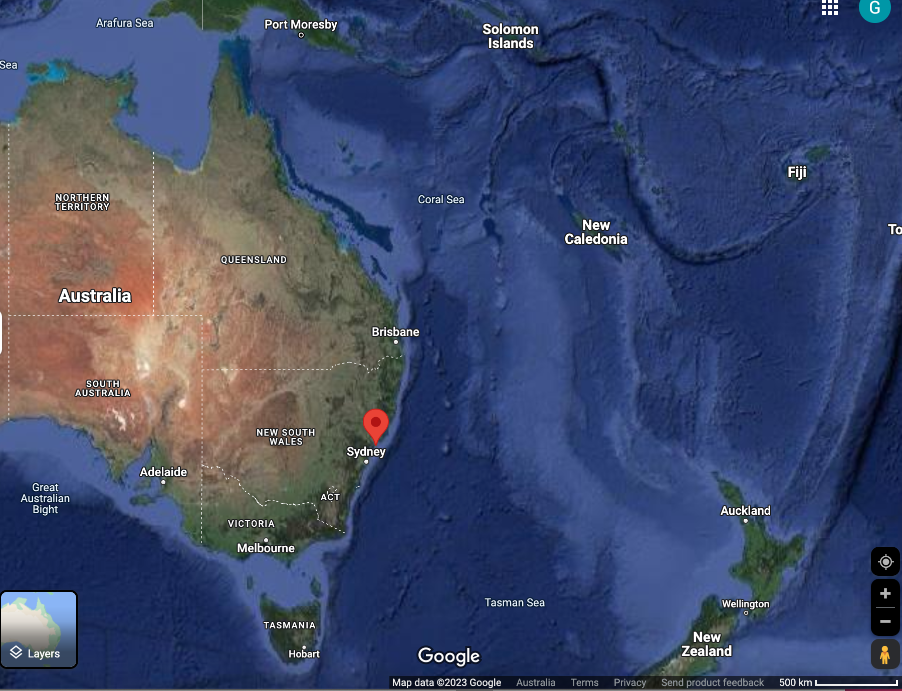
Starting in NSW
(initially a very long time ago
when sea levels were much lower)

Slide 18
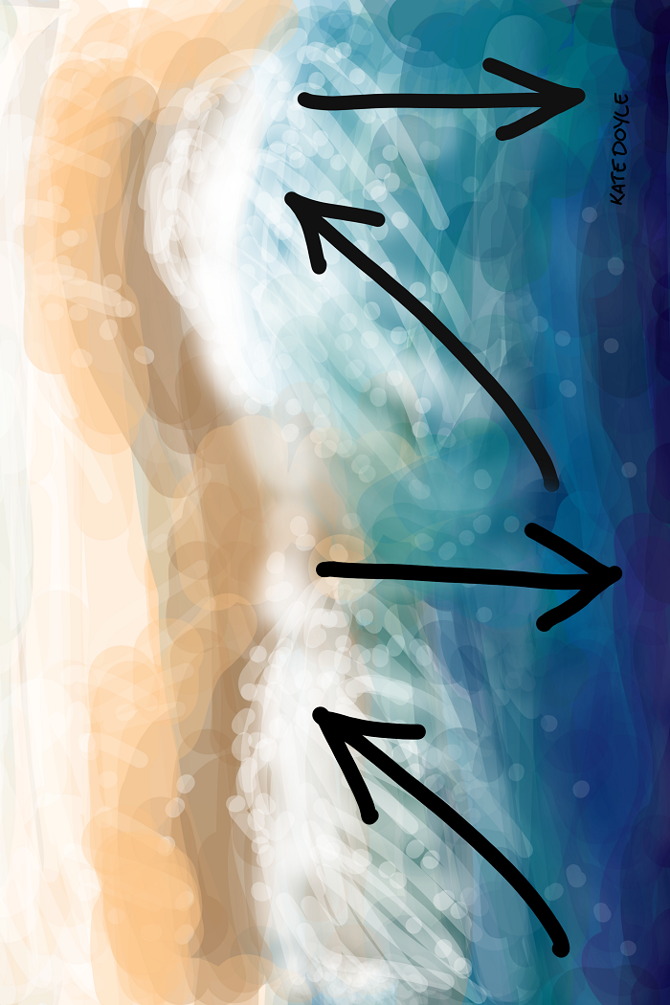
The tiny sand particles travelled down river and out to sea.
Wind-driven currents swept them northbound in a zig-zag motion with the swash and backwash, called longshore drift.

Slide 19
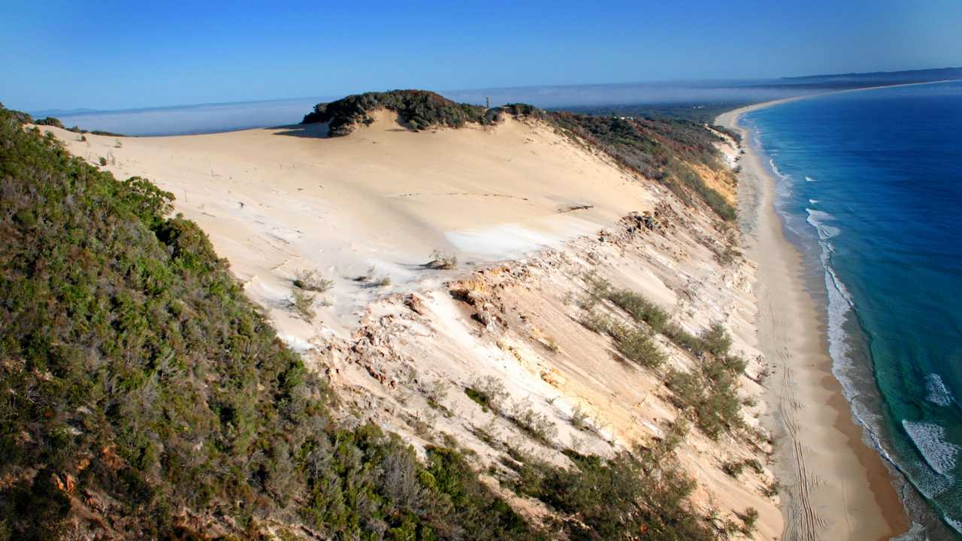
Building some mammoth sand islands in the process… (Moreton, Stradbroke and Fraser Island)

Slide 20
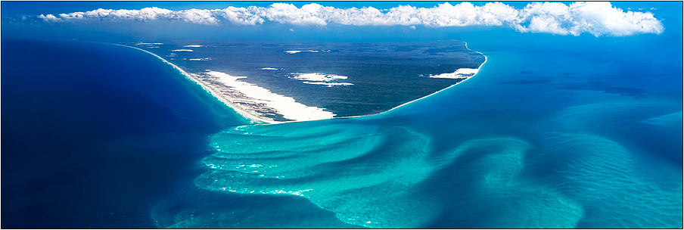
Some of it ending up here…
Break-sea spit
North of K’gari (Fraser Island)

Slide 21
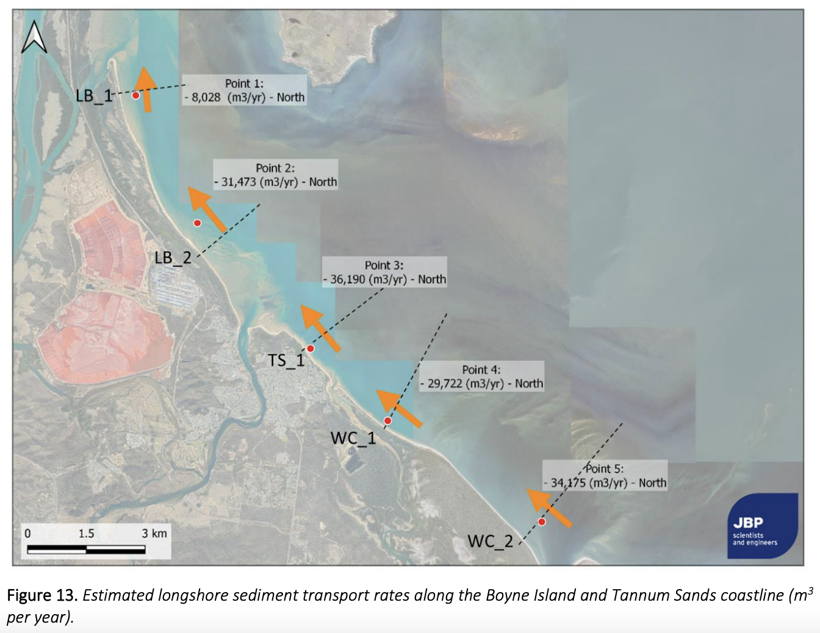
Whilst the rest of the sand continues its journey north
Notes:
Image: https://www.gladstone.qld.gov.au/coasts-coastal-vegetation

Slide 22
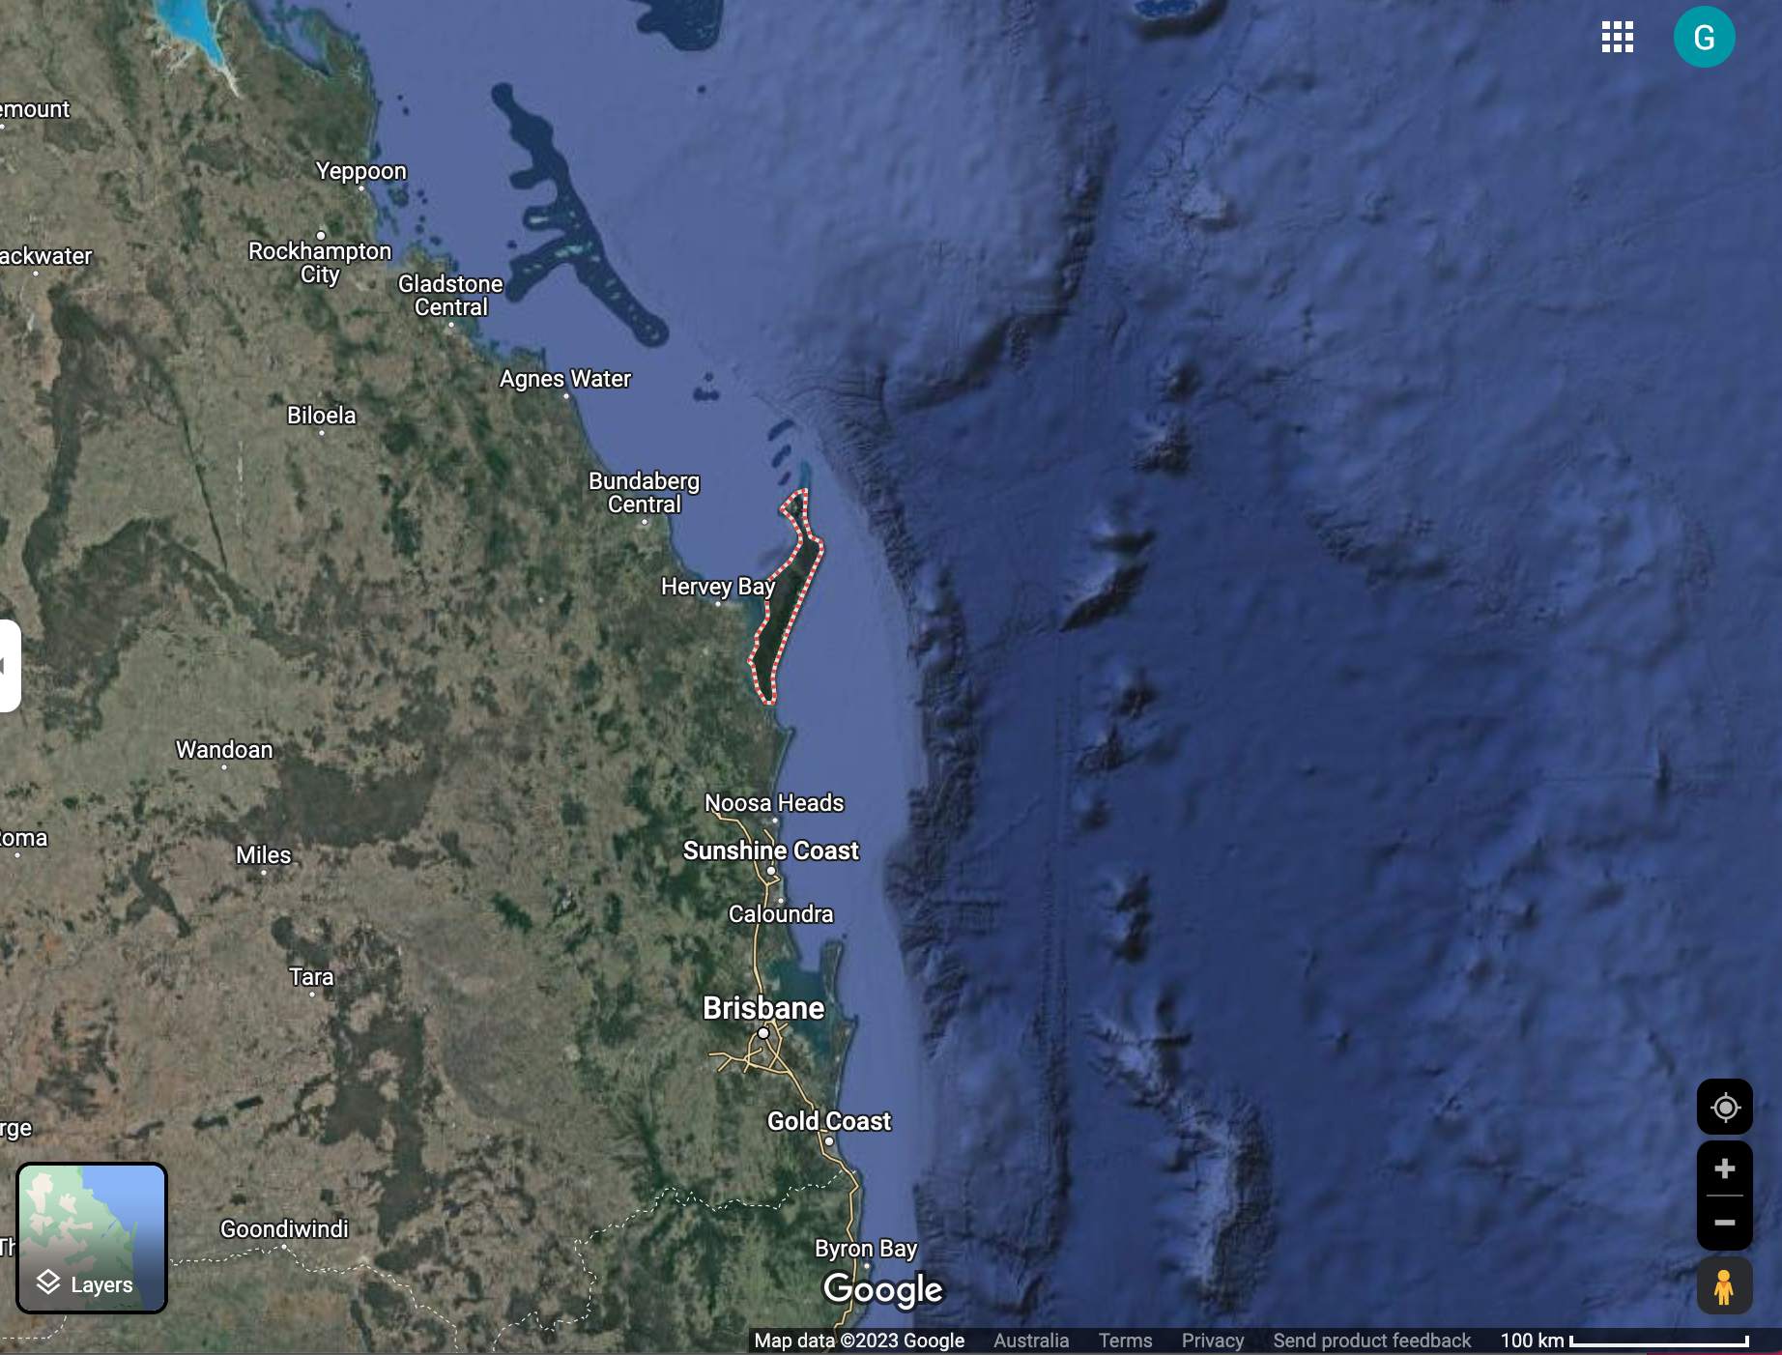
Longshore drift: A process that slowly transports sand along a coastline, in the general direction of the prevailing wind and waves.
Sand Budget:
The volume of sand entering
and leaving a beach.

Slide 23
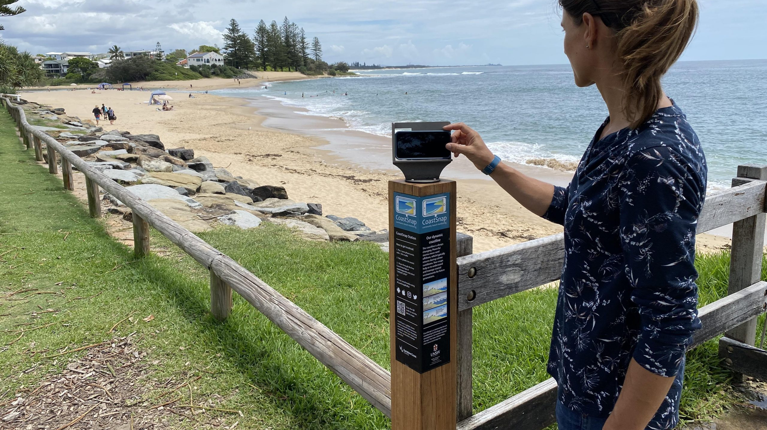

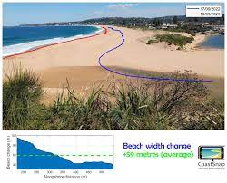

Slide 24
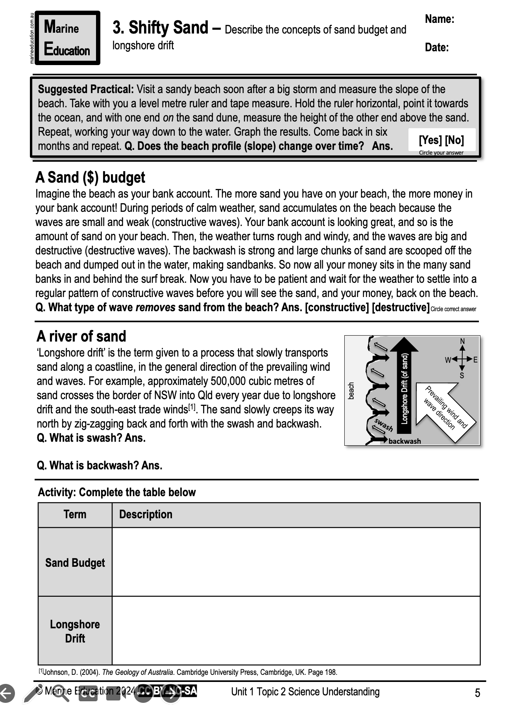
Learning Intention:
Describe the concepts of sand budget and longshore drift
Success Criteria:
Complete Marine Education worksheet ‘3. Shifty sand’
Notes:
https://www.youtube.com/watch?app=desktop&v=loRr97fOWdg

