Slide 1
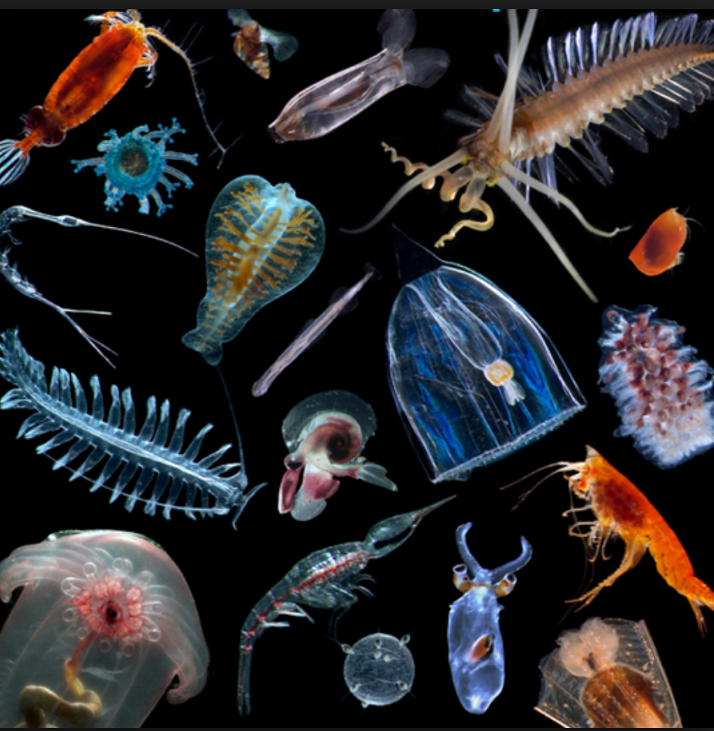
Learning Intention:
Describe the processes of the following cycles: water, carbon and oxygen.
Success Criteria:
Complete Marine Education worksheet ‘3. To reCYCLE’
Notes:
Image: https://www.aquaticlivefood.com.au/10-things-to-know-about-plankton/

Slide 2
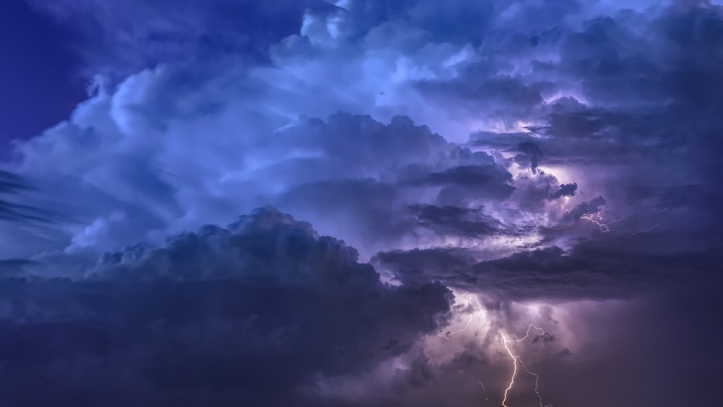
The Water Cycle

Slide 3
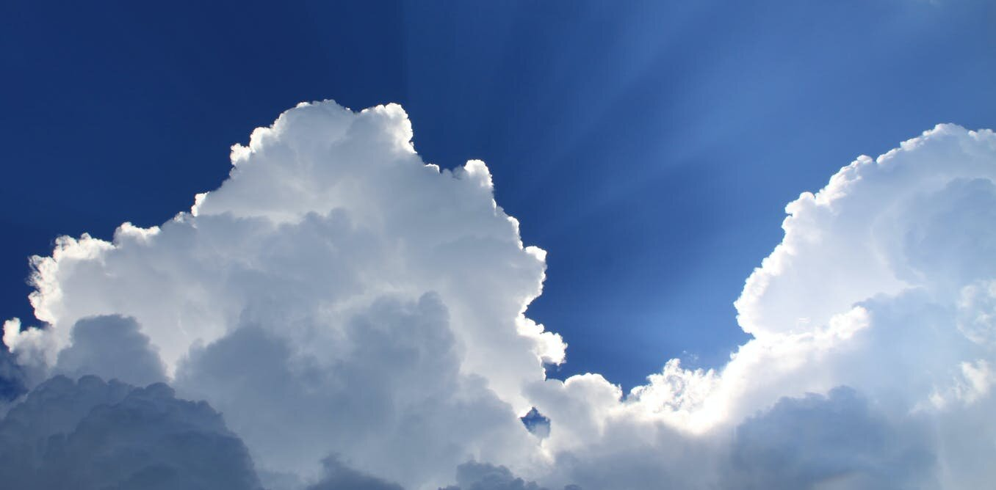
Water in the atmosphere

Slide 4
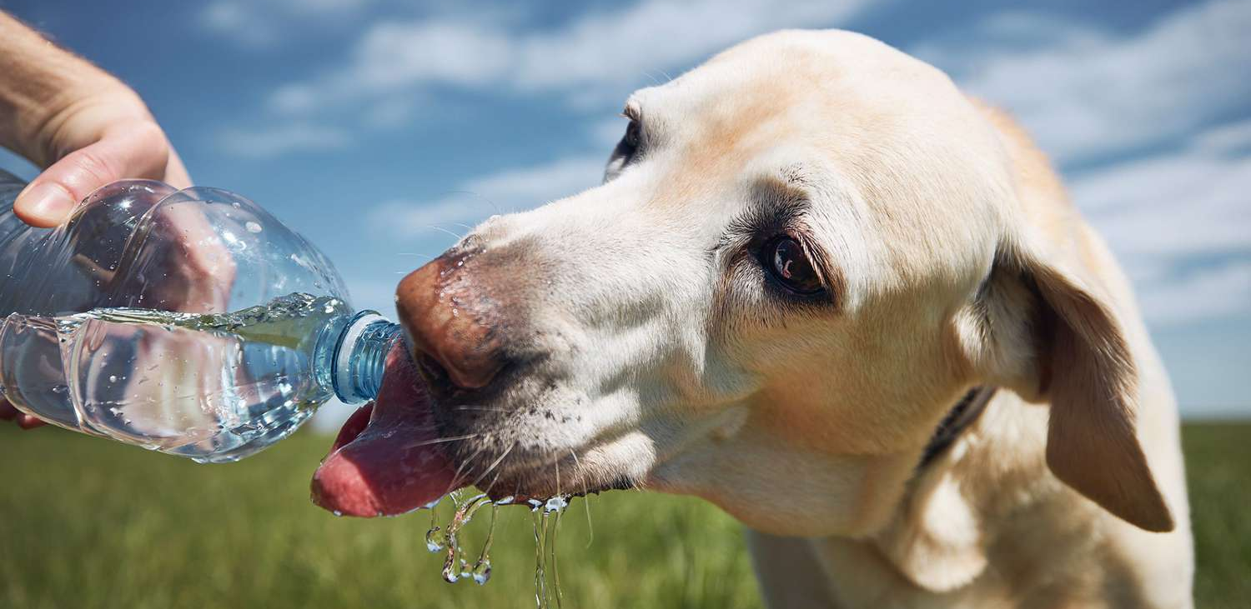
Water in the biosphere

Slide 5
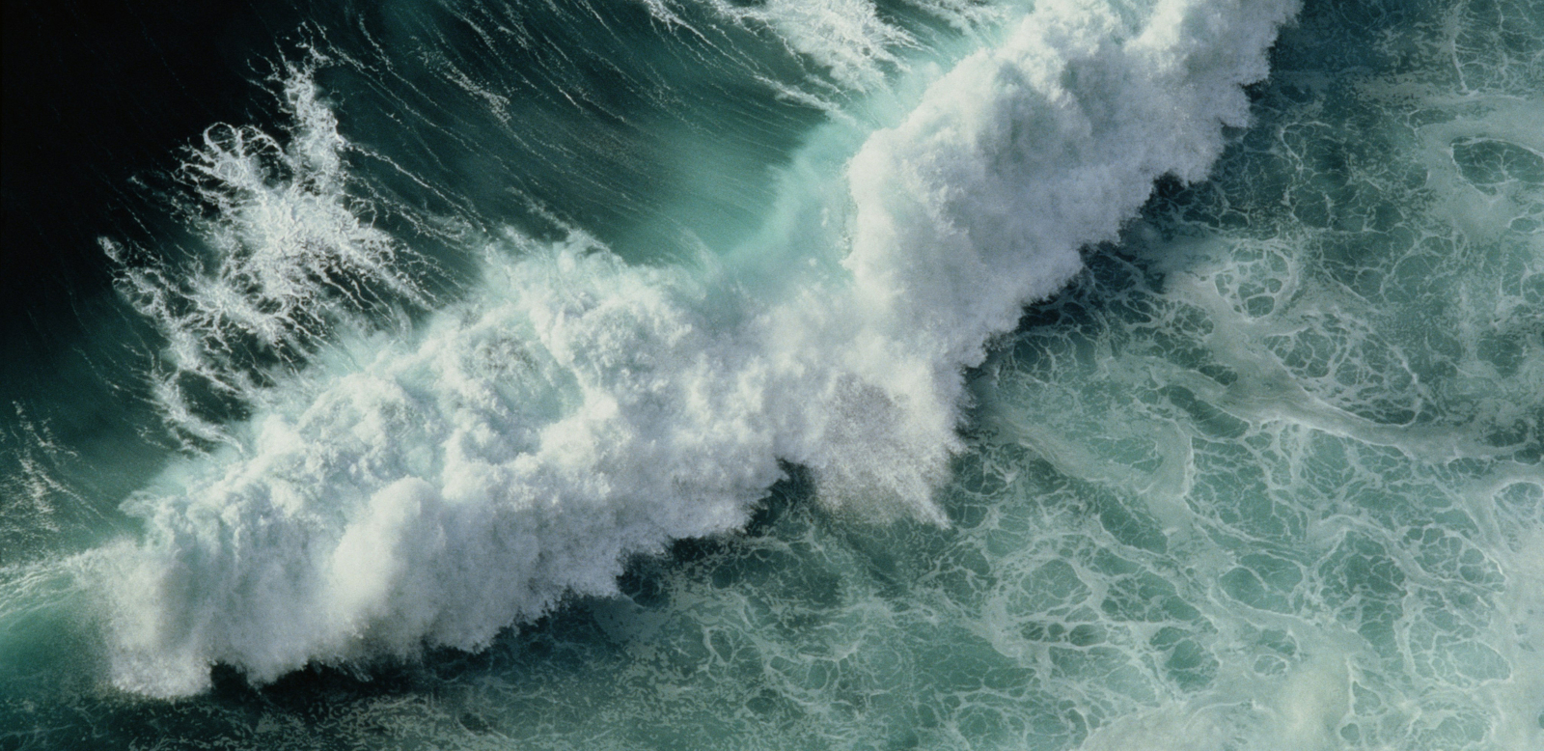
Water in the hydrosphere

Slide 6
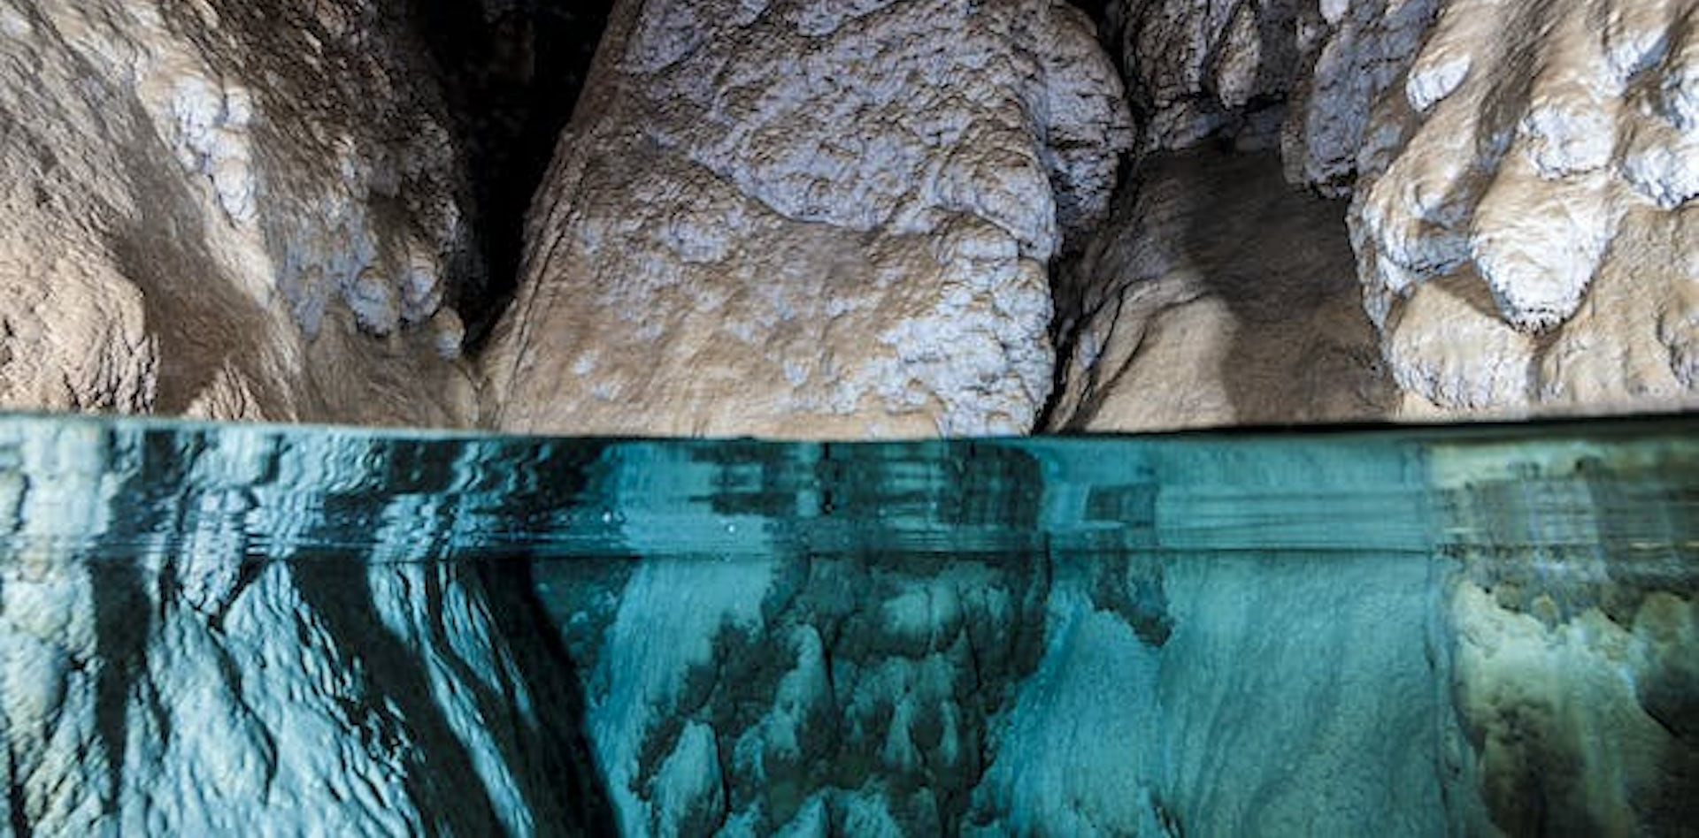
Water in the lithosphere (e.g. groundwater)

Slide 7
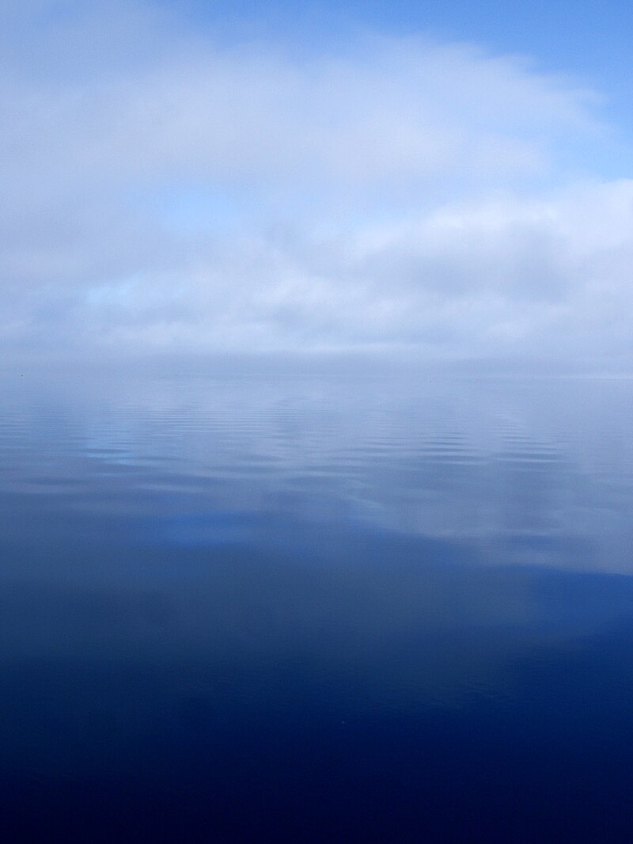
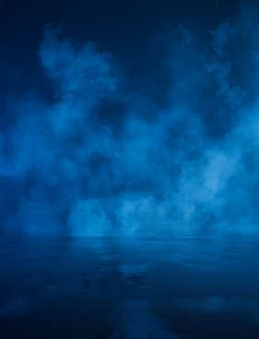
Evaporation
(liquid to gas)

Slide 8
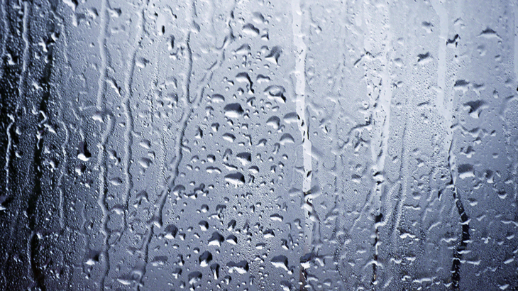
Condensation
(gas to liquid)

Slide 9
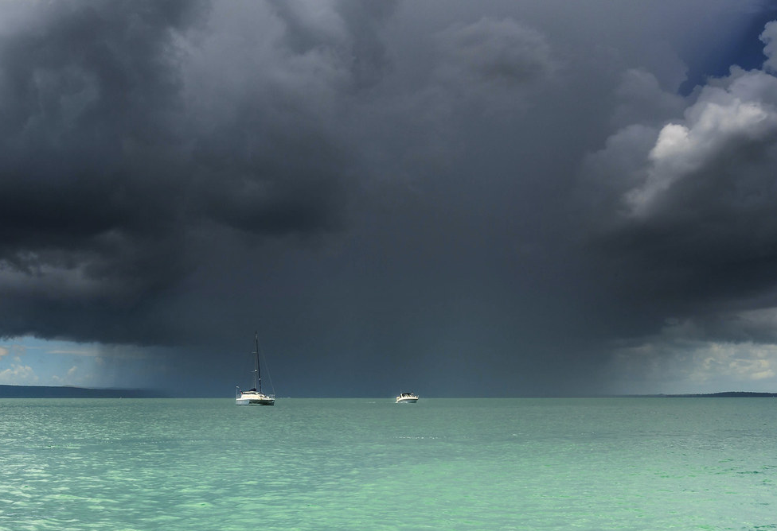
Precipitation
(rain, snow, hail)

Slide 10
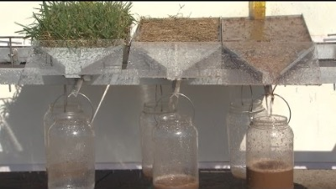
Infiltration
(water on ground enters soil)
https://www.youtube.com/watch?app=desktop&v=ZohI2YR7wQ4
Notes:
https://www.youtube.com/watch?app=desktop&v=ZohI2YR7wQ4

Slide 11
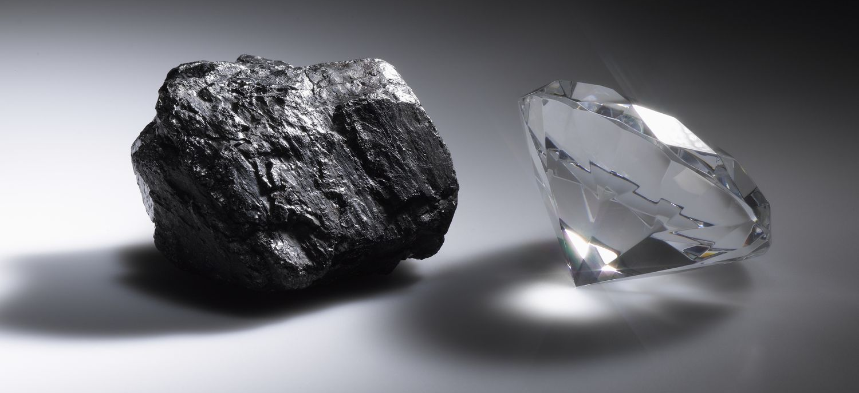
The Carbon Cycle

Slide 12
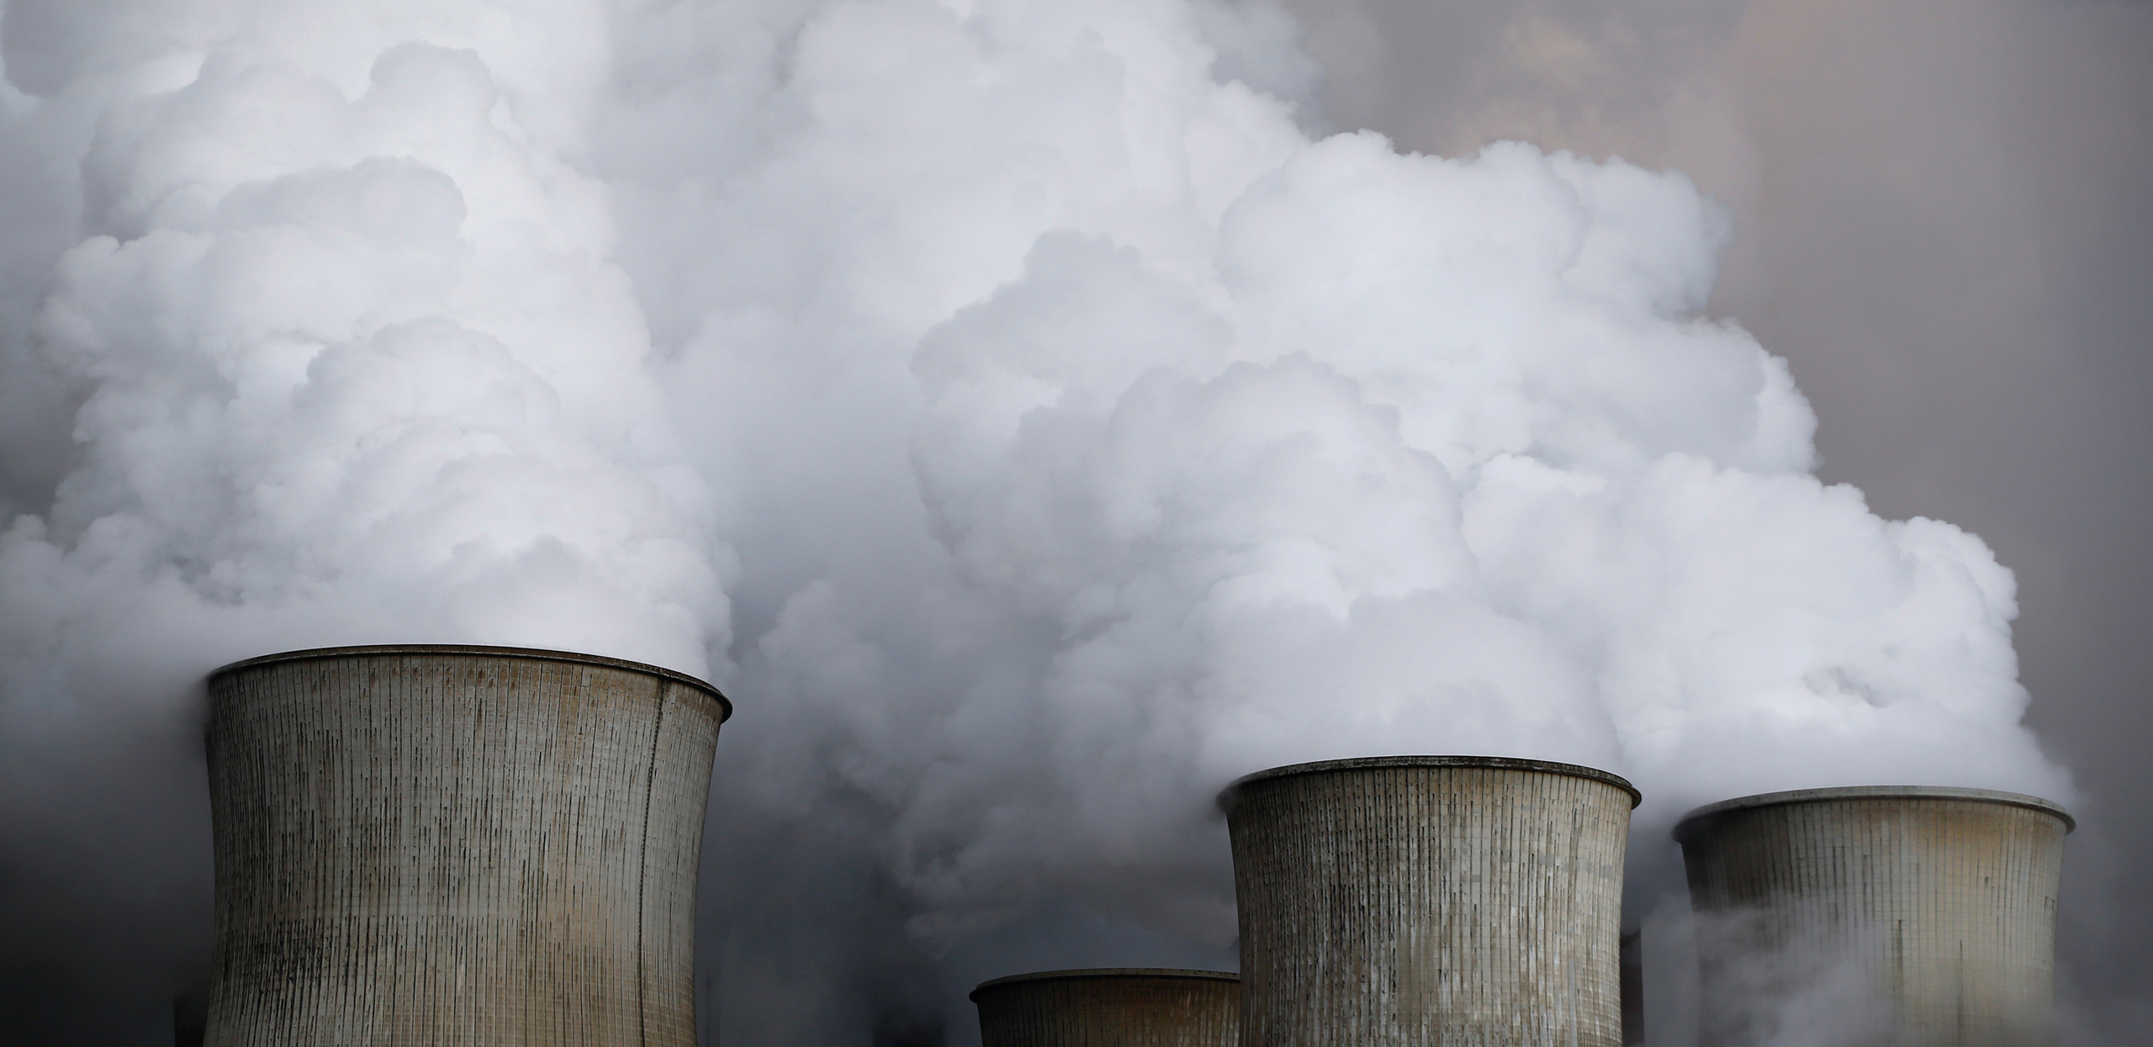
Carbon in the atmosphere

Slide 13
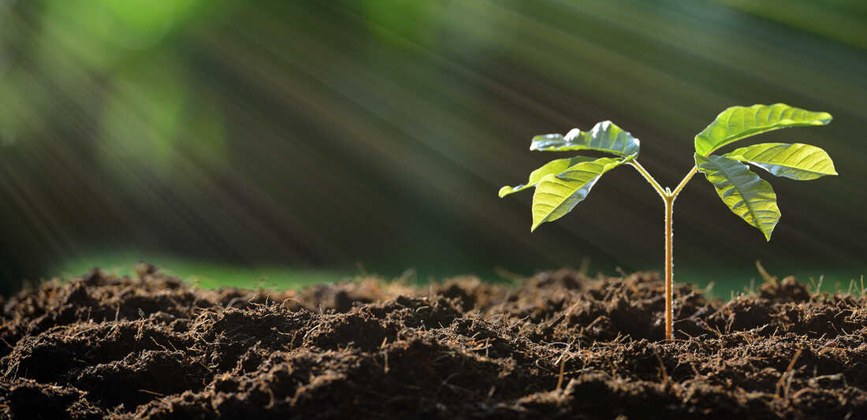
Carbon in the biosphere

Slide 14
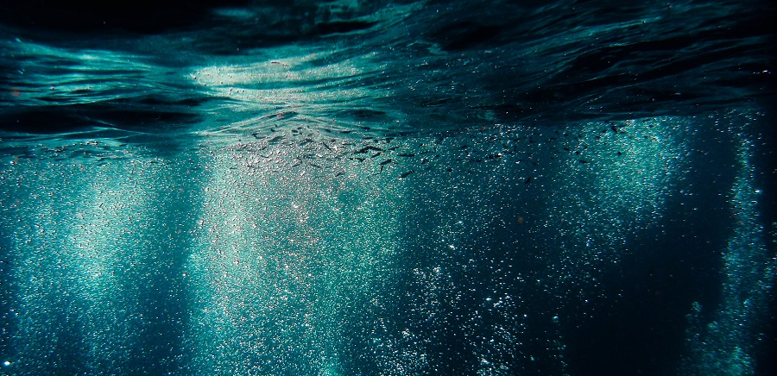
Carbon (dissolved) in the hydrosphere

Slide 15
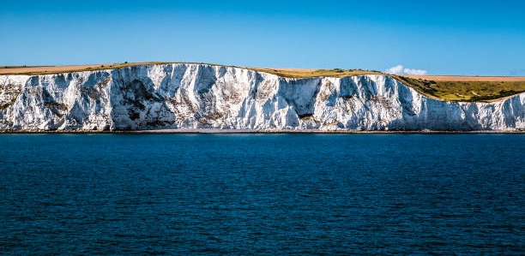
Carbon in the lithosphere
Limestone cliffs

Slide 16
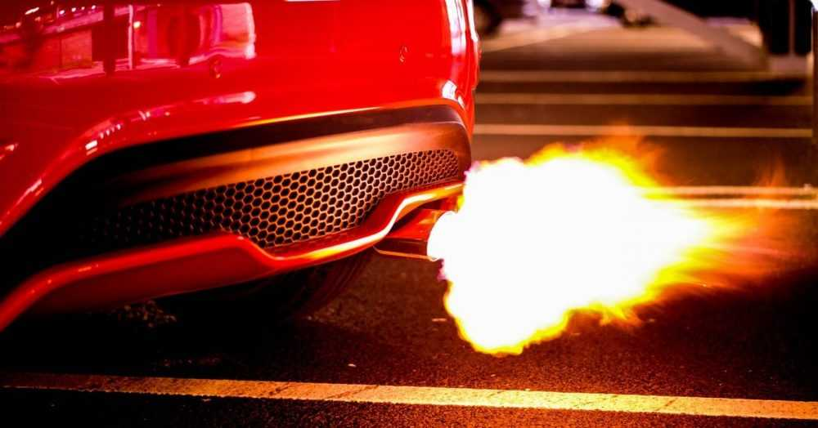
Combustion

Slide 17
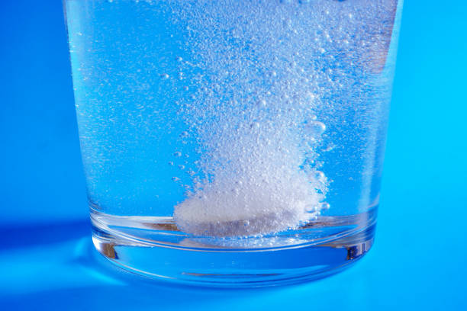
Dissolution
(dissolving)

Slide 18
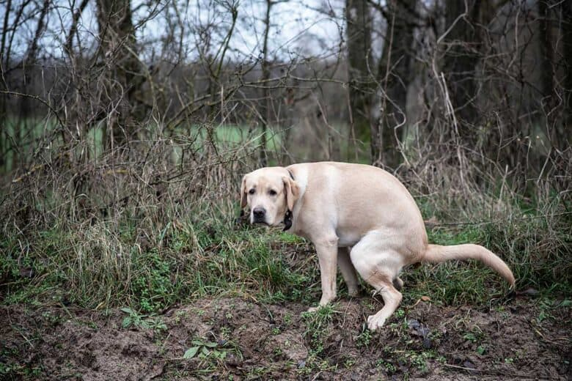
Excretion

Slide 19
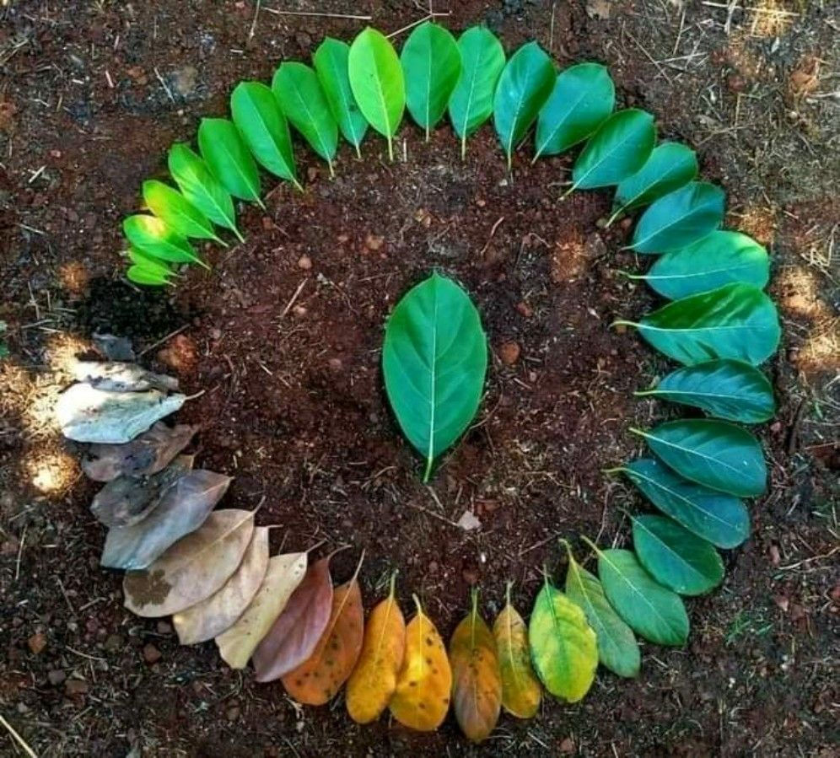
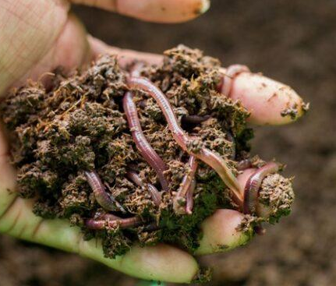
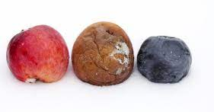
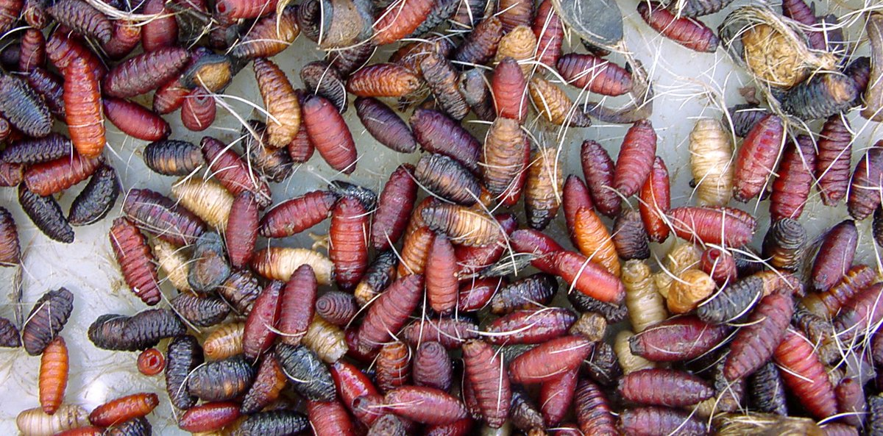
Decomposition

Slide 20
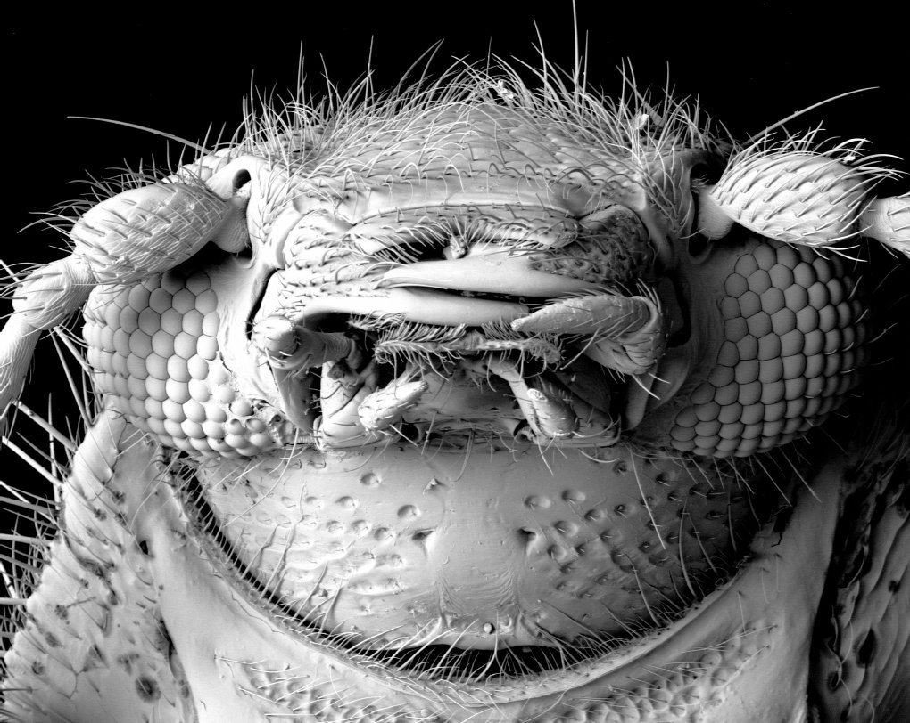
Decomposition
Corpse eating beetle
Notes:
Image: https://australian.museum/learn/science/decomposition-corpse-fauna/

Slide 21
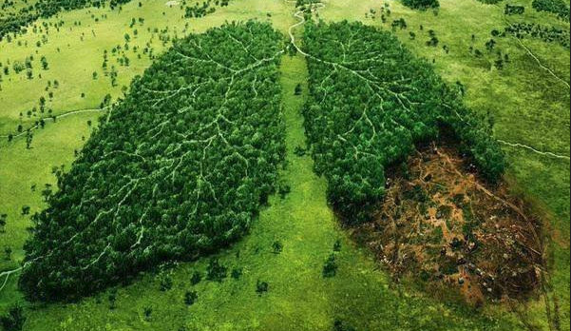
The Oxygen Cycle

Slide 22
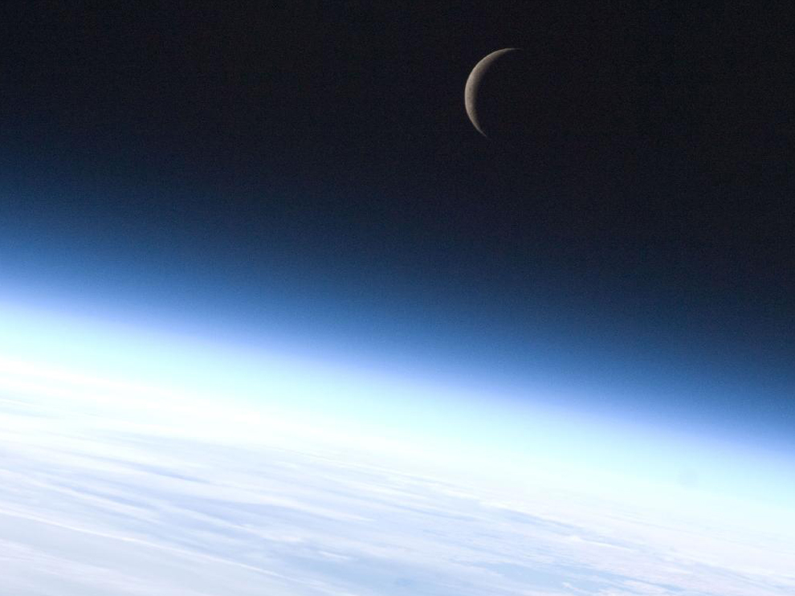
Oxygen in the atmosphere

Slide 23
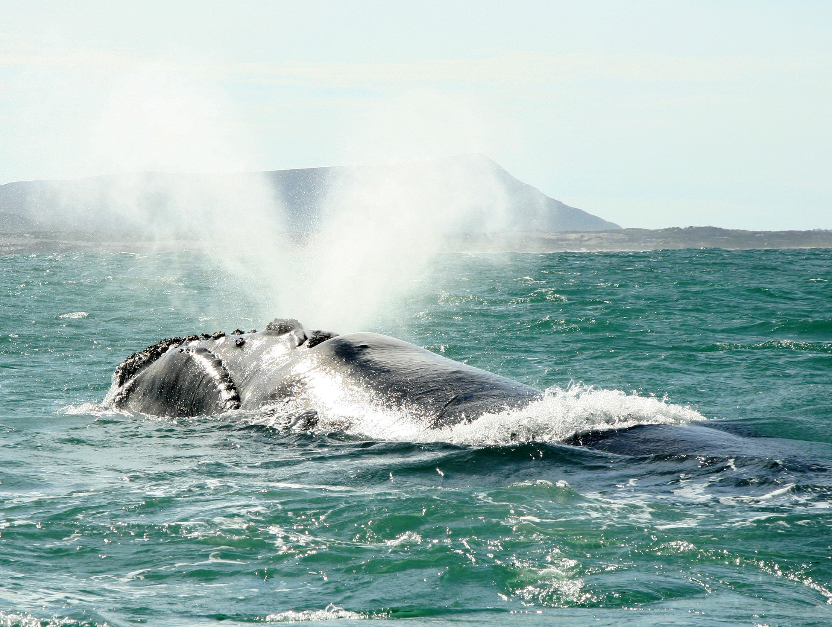
Oxygen in the biosphere

Slide 24
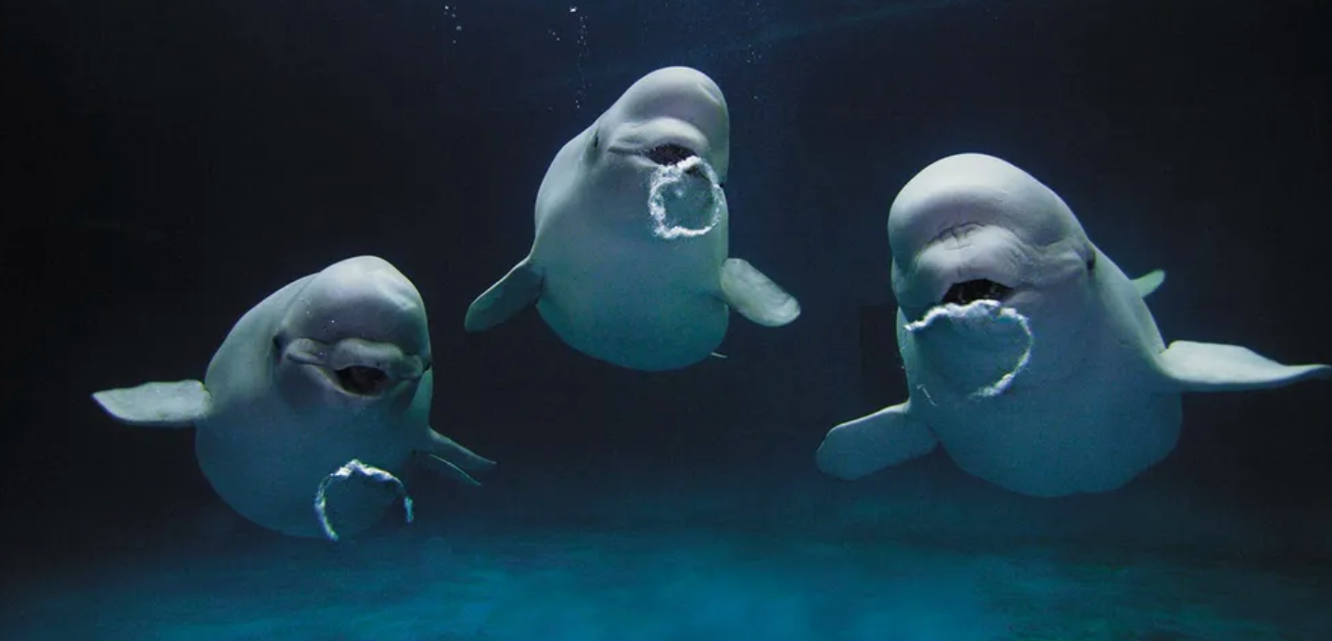
Oxygen (dissolved) in the hydrosphere

Slide 25
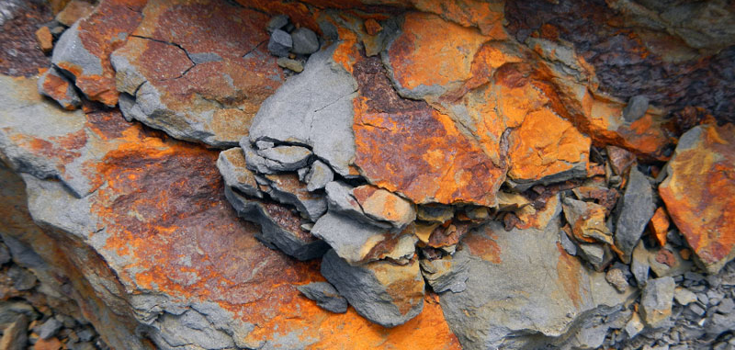
Oxygen in the lithosphere

Slide 26
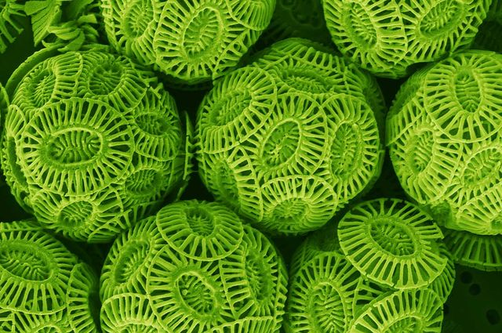
Photosynthesis
Phytoplankton

Slide 27
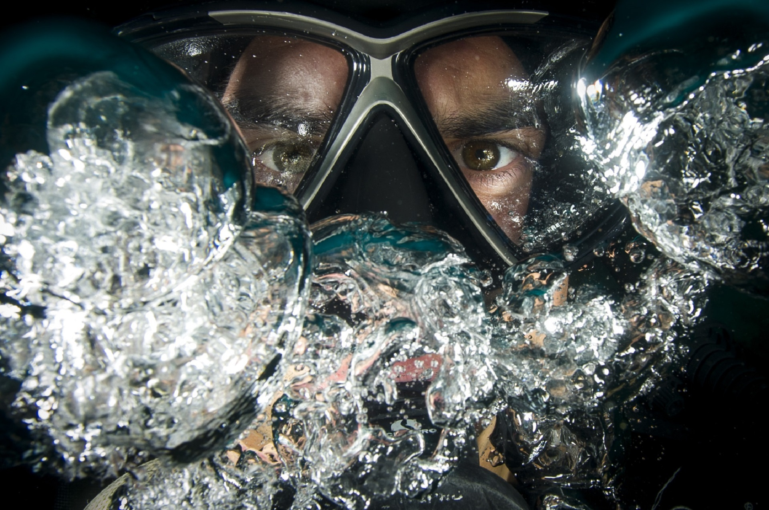
Respiration

Slide 28
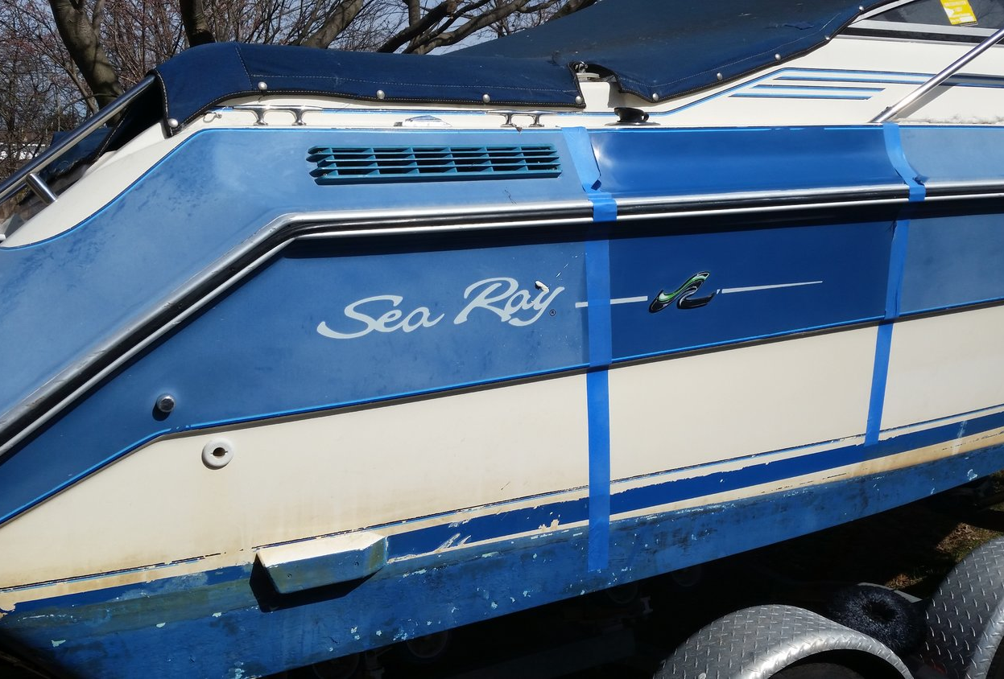
Oxidation
(a chemical change in the presence of oxygen)

Slide 29
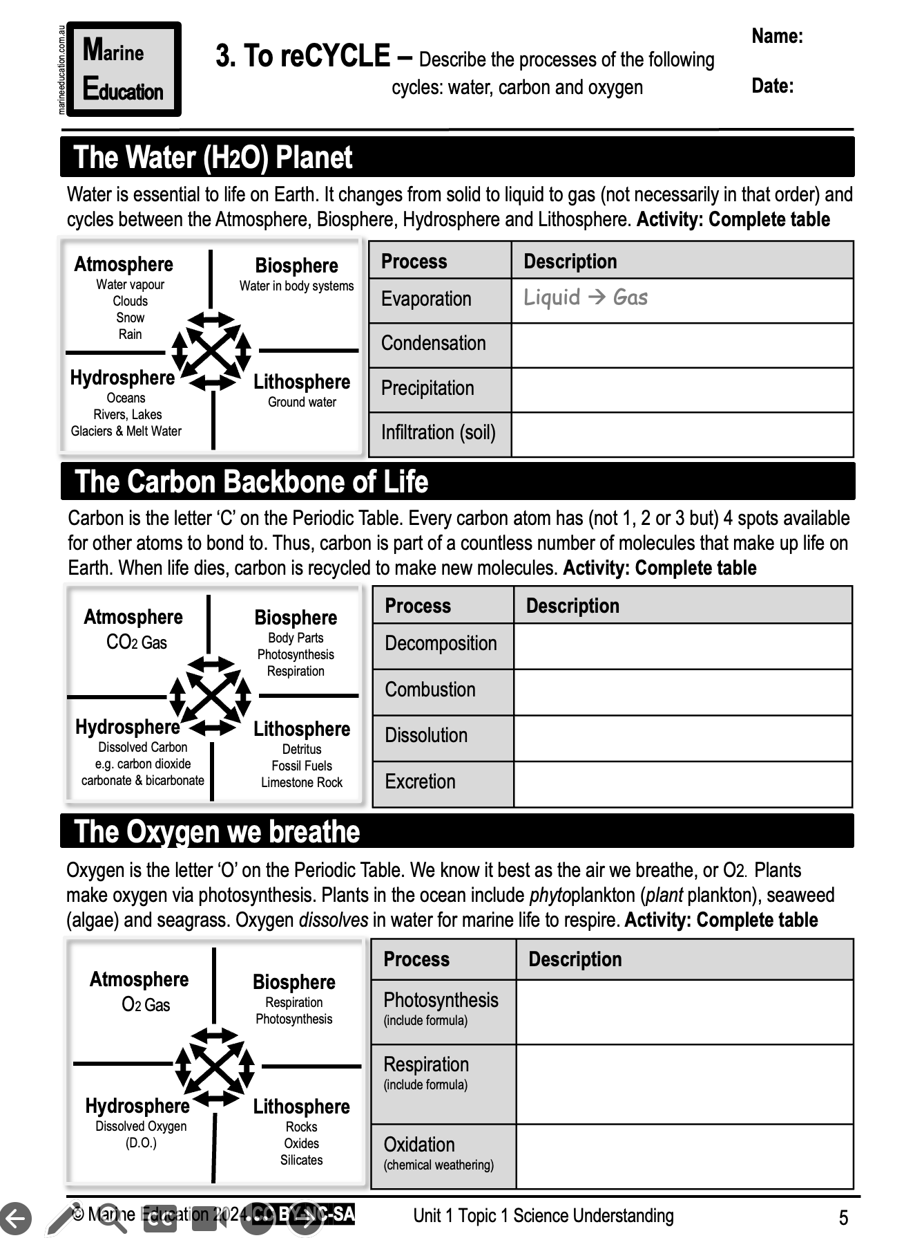
Learning Intention:
Describe the processes of the following cycles: water, carbon and oxygen.
Success Criteria:
Complete Marine Education worksheet ‘3. To reCYCLE’

