Slide 1
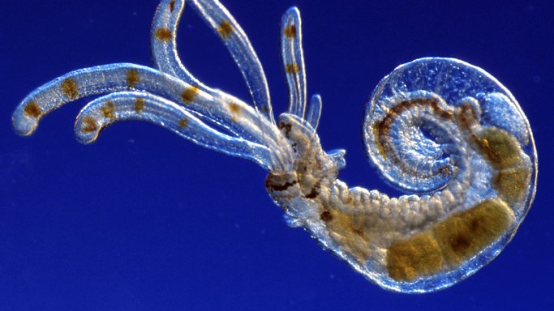
Terebellid worm larvae
Learning Intention:
Describe the implications of connectivity to marine ecosystems, e.g. estuaries, mangroves, seagrass beds.
Success Criteria:
Complete Marine Education worksheet ‘’4. Connect….ivity’
Notes:
Image: https://australian.museum/learn/animals/plankton/zooplankton/

Slide 2
Connectivity is the web of links, relationships and connections
that result from the
movement of individuals
(i.e. dispersal of eggs, larvae, juveniles and migration of adults)
and materials
(i.e. nutrients)
between spatially separated populations.
Notes:
Source:: AIMS
More info: https://reefresilience.org/management-strategies/marine-protected-areas-2/resilient-mpa-design/connectivity/

Slide 3
Connectivity is also the process by which local marine populations recruit larvae from distant sources via the currents that connect one part of the ocean with another.
It is essential for maintaining the genetic diversity and resilience of these populations.
Notes:
Source:: AIMS
More info: https://reefresilience.org/management-strategies/marine-protected-areas-2/resilient-mpa-design/connectivity/

Slide 4
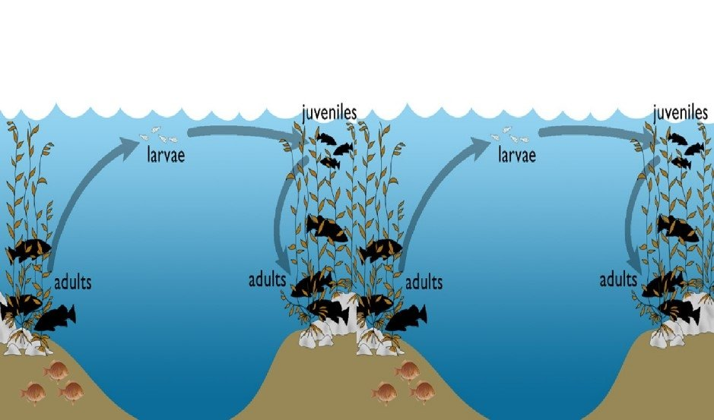

Slide 5
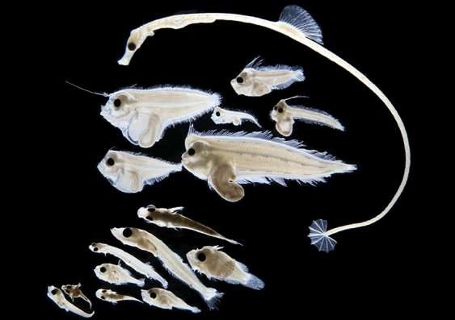
Notes:
Image: https://phys.org/news/2018-10-larval-fish-database-effects-climate.html

Slide 6
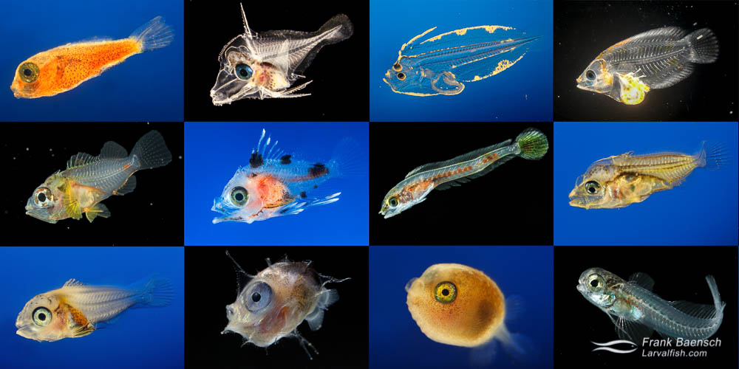
Notes:
Image: https://www.frankbaensch.com/marine-aquarium-fish-culture/my-research/larval-fish-project/

Slide 7
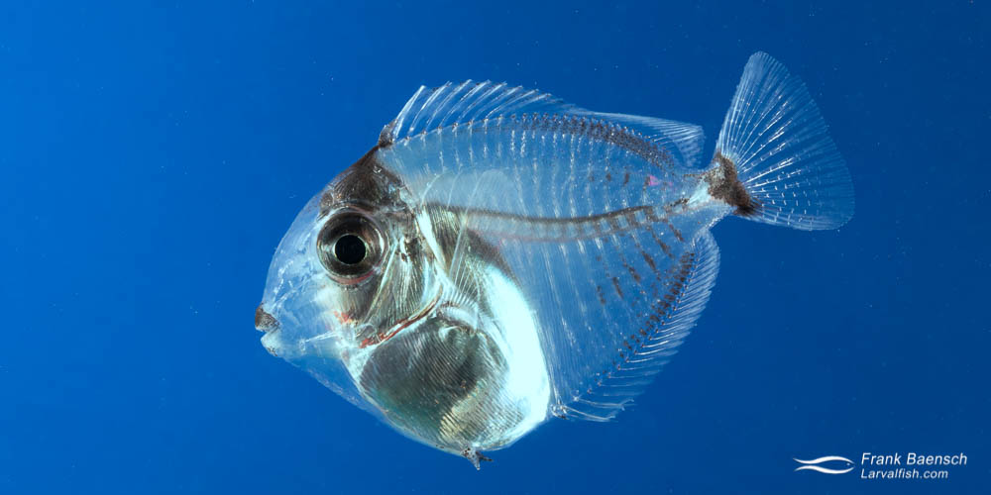
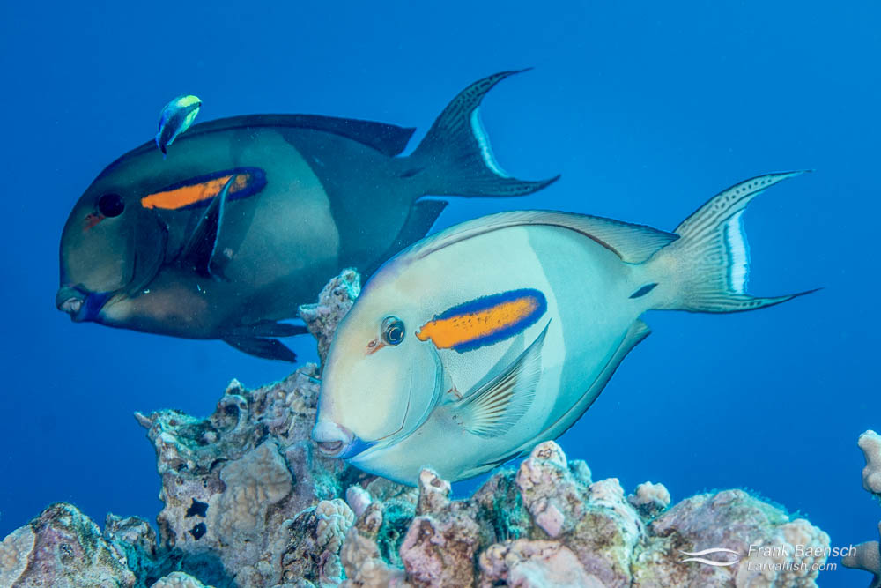
Orange band Surgeonfish larvae (Acanthurus olivaceus) drift for 130 days
Notes:
Image: https://www.frankbaensch.com/marine-aquarium-fish-culture/my-research/larval-fish-project/

Slide 8
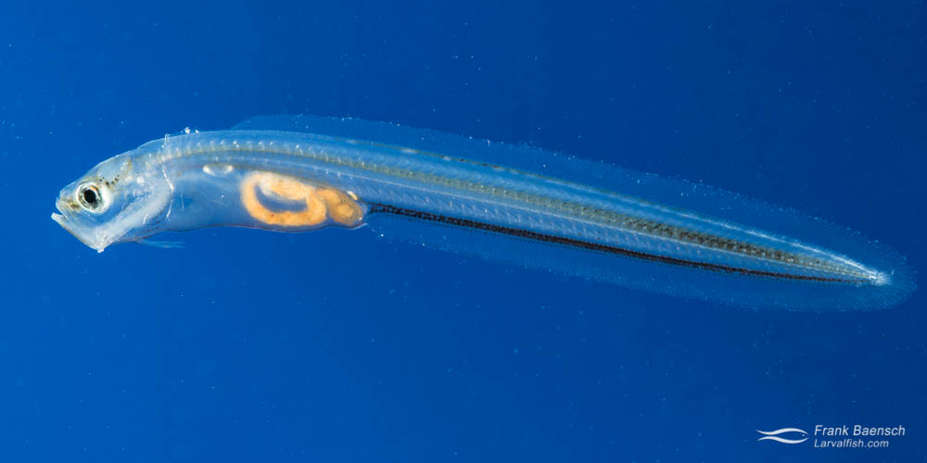
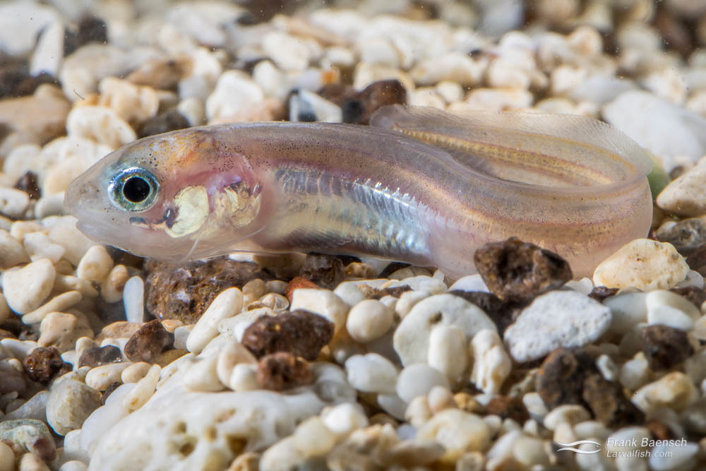
Blackedge cusk larvae (Ophidion muraenolepis) drift for 34 days
Notes:
Image: https://www.frankbaensch.com/marine-aquarium-fish-culture/my-research/blackedge-cusk-eel-culture/

Slide 9
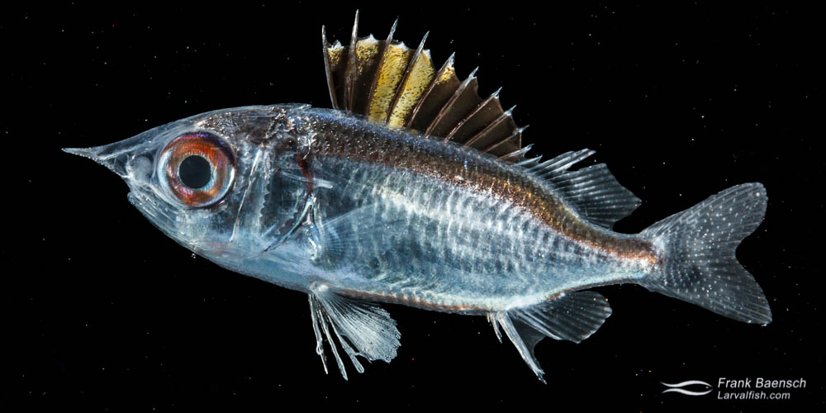
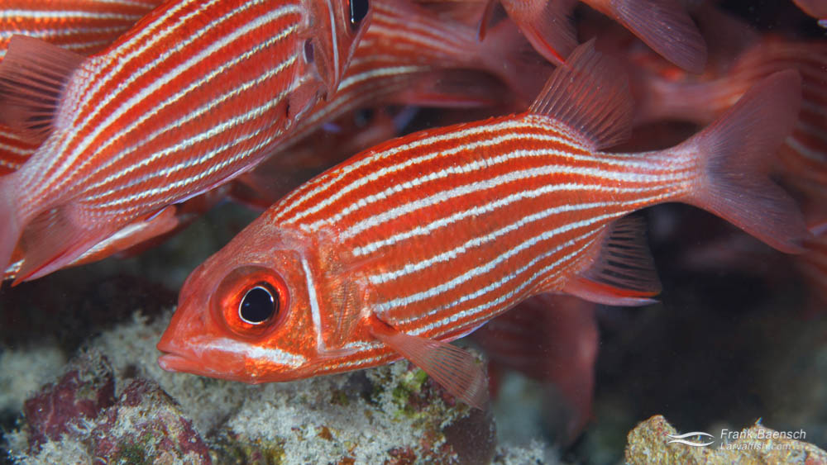
Squirrelfish larvae (Sargocentron xantherythrum) drift for 50 days

Slide 10
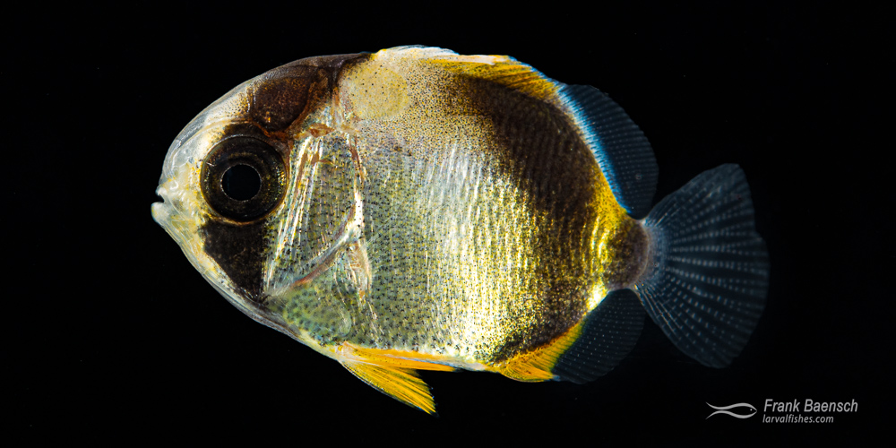
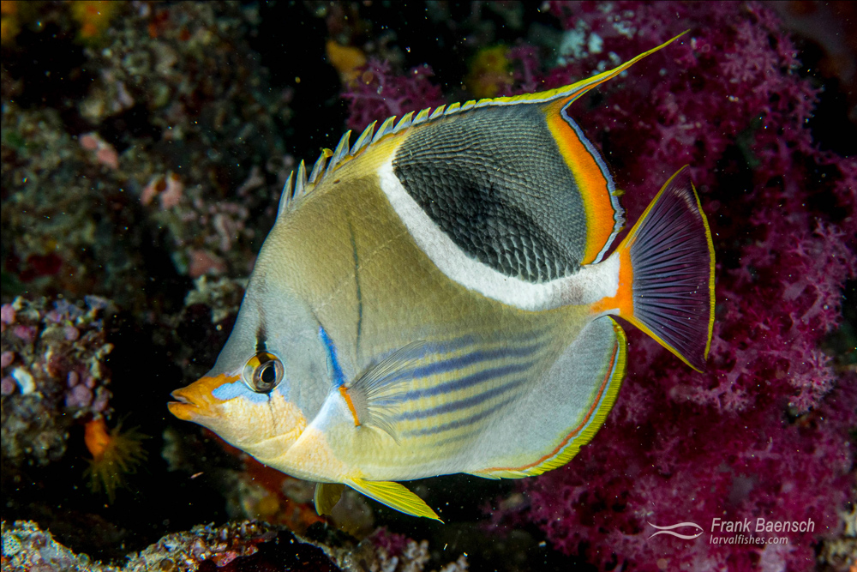
Saddleback butterflyfish (Chaetodon ephippium) drift for 68 days
Notes:
Image:https://www.frankbaensch.com/marine-aquarium-fish-culture/my-research/saddled-butterflyfish-culture/

Slide 11
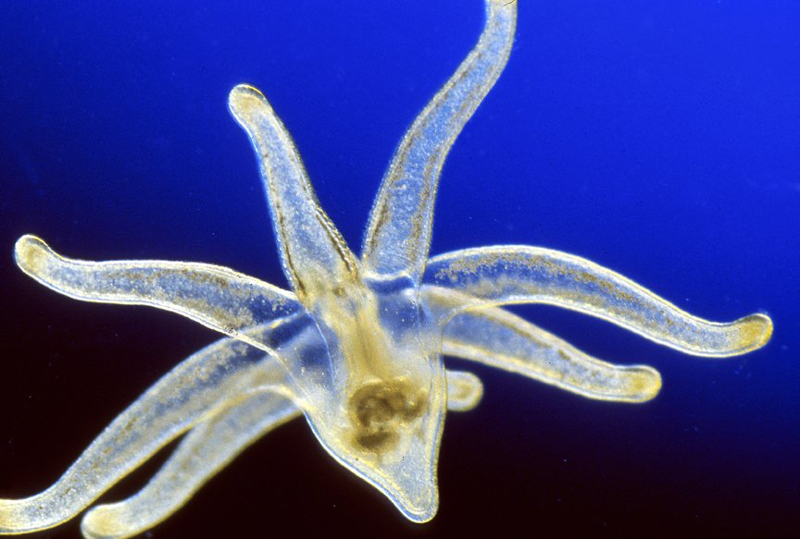
Tube anemone larvae
Notes:
Image: https://australian.museum/learn/animals/plankton/meroplankton/

Slide 12
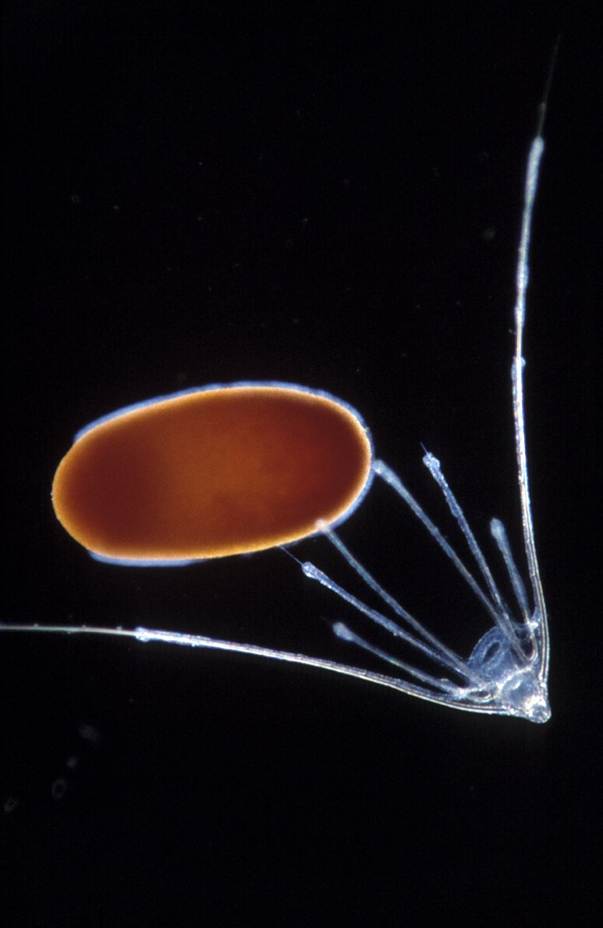
Brittle Star and Coral larvae

Slide 13
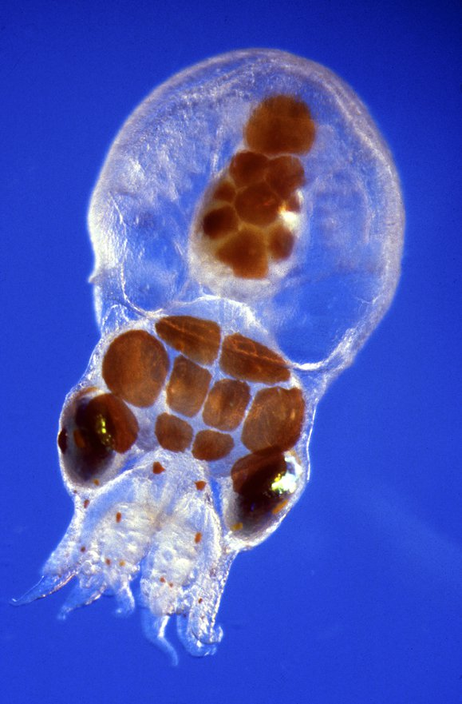
Octopus larvae
Notes:
Image: https://australian.museum/learn/animals/plankton/meroplankton/

Slide 14
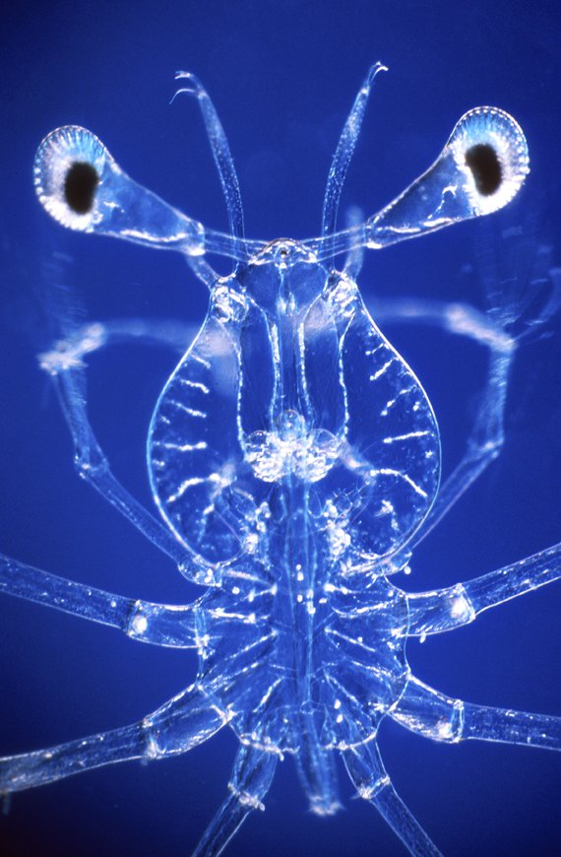
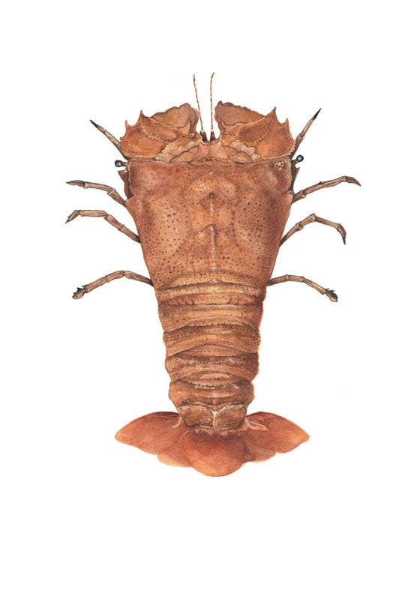
Slipper Lobster larvae
adult

Slide 15
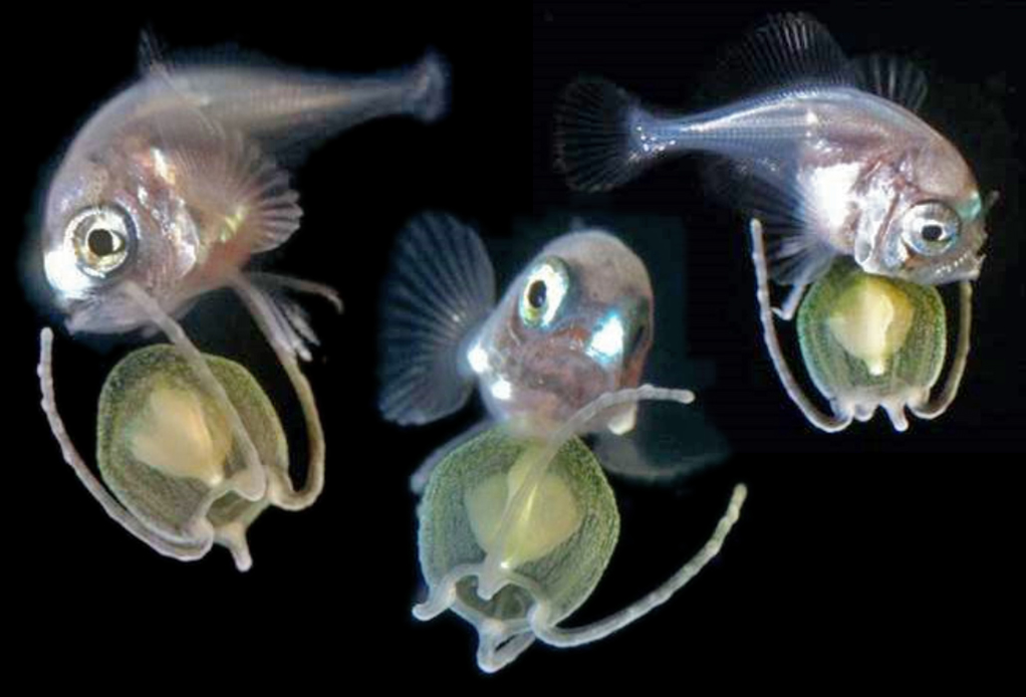
A Pacific pomfret (Brama orcini) larva (pictured from 3 angles) in the ocean, riding a jellyfish.
Notes:
Image: https://www.sciencenews.org/article/underwater-photos-deep-sea-fish-larvae-capture-new-views-detail

Slide 16
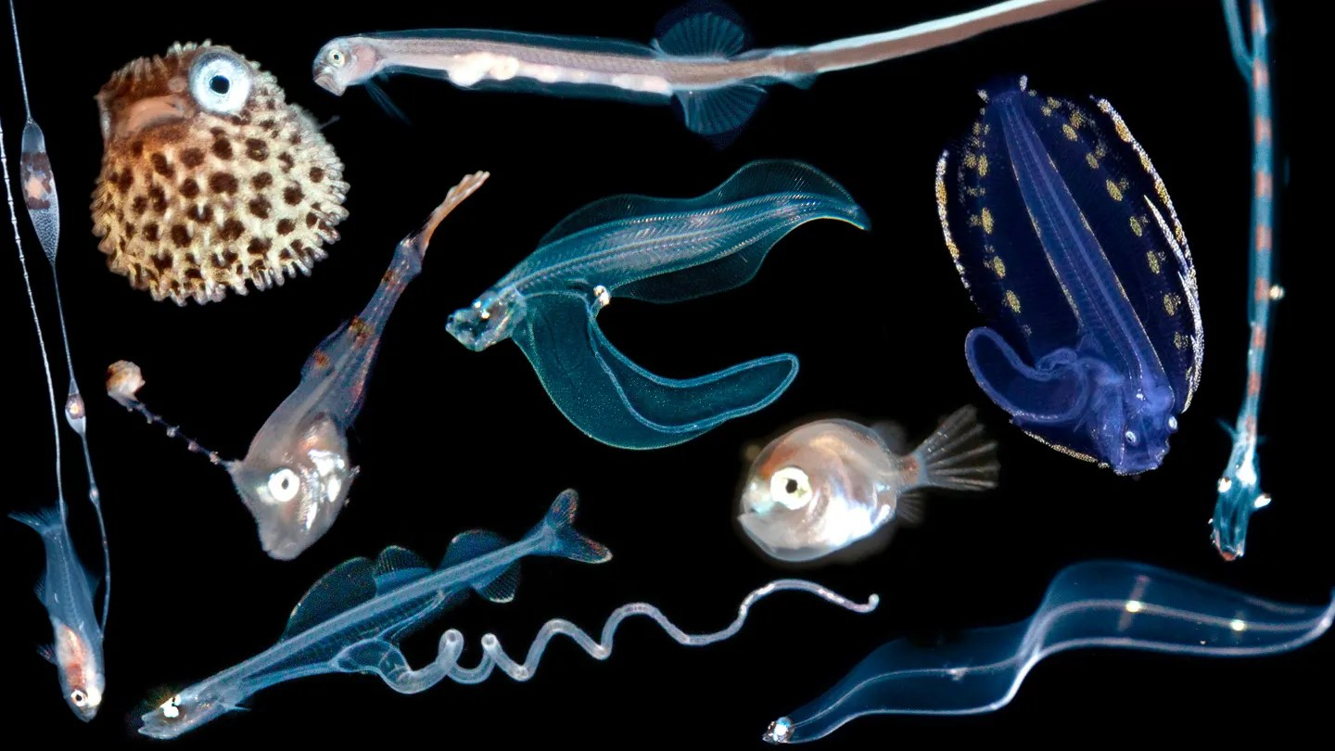
Notes:
Image: https://www.sciencenews.org/article/underwater-photos-deep-sea-fish-larvae-capture-new-views-detail

Slide 17
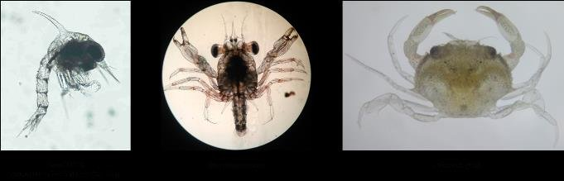
Larvae development of mud crab from Zoea to crablet stages
Notes:
Image: https://www.researchgate.net/figure/Larvae-development-of-mud-crab-from-Zoea-to-Crablet-stages_fig1_349156246

Slide 18
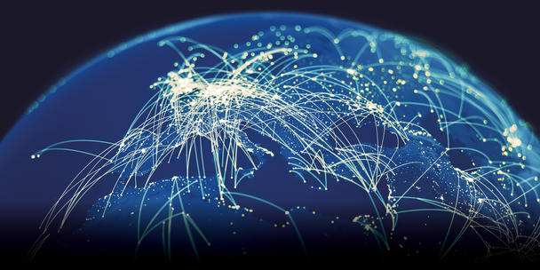
Connectivity

Slide 19
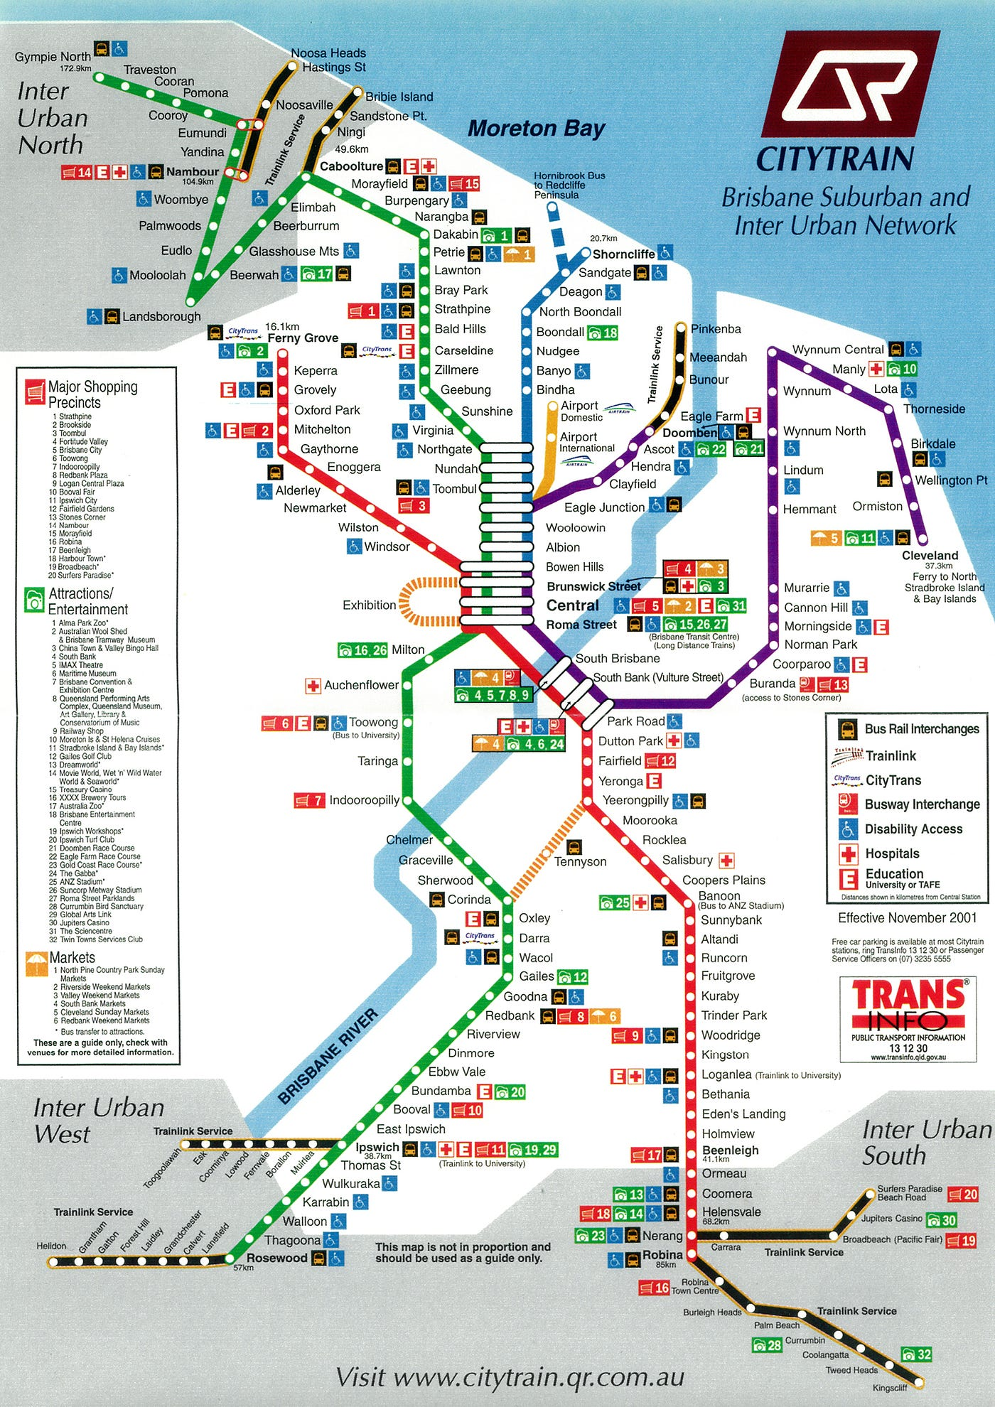
Think of connectivity as a
network of
train stations.

Slide 20
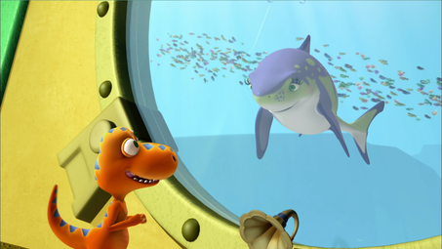
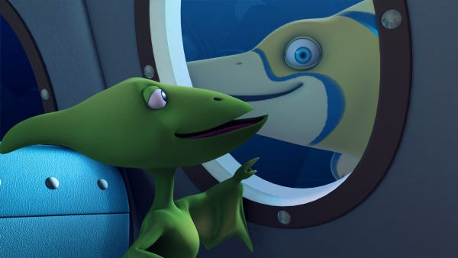
The water currents are the trains.
The larvae are the travellers.
The ecosystems are the stations.
The environmental managers are security.

Slide 21
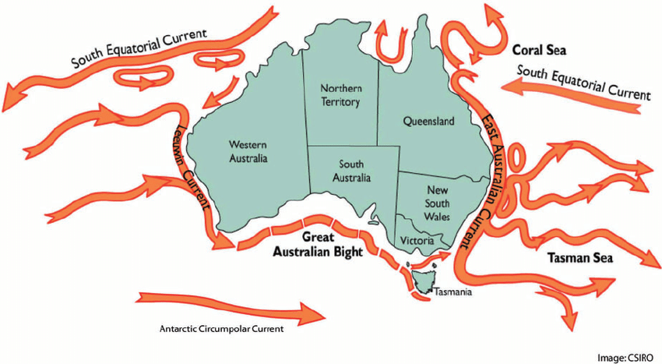
The ‘trains’
Notes:
Image: https://www.researchgate.net/figure/Oceanic-and-coastal-currents-of-Australia_fig1_230666486

Slide 22
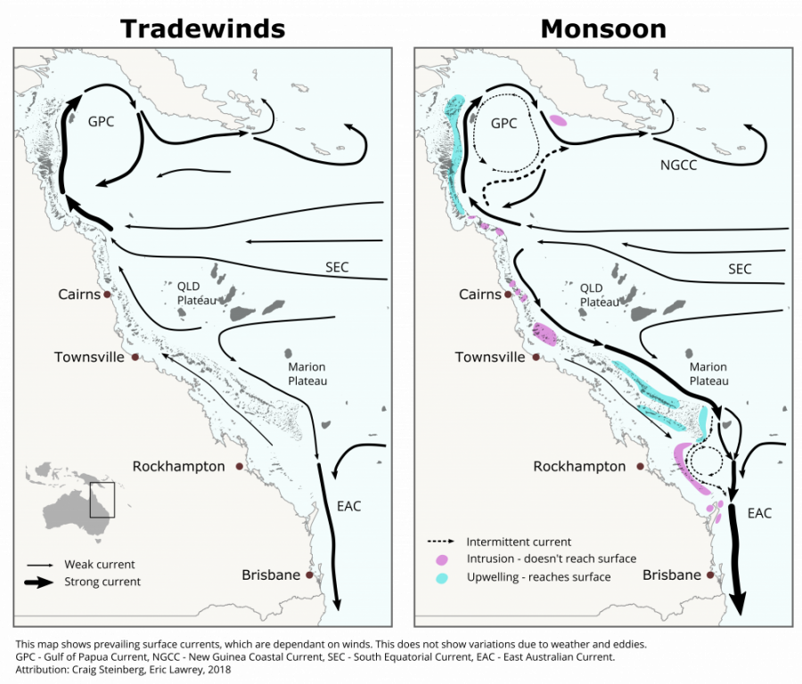
Trade winds
Monsoon season
Timetables change

Slide 23
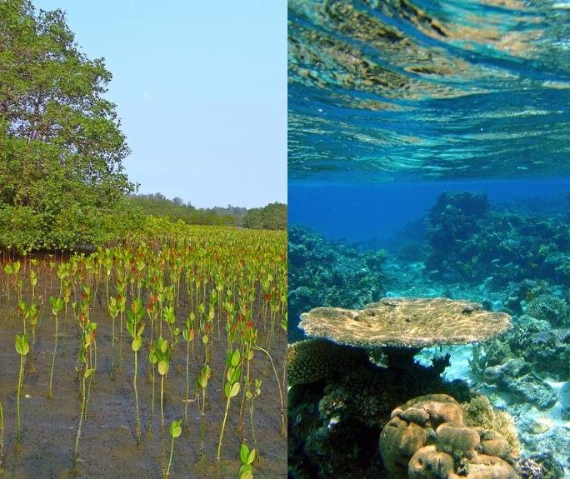
The ecosystems are the ‘stations’

Slide 24
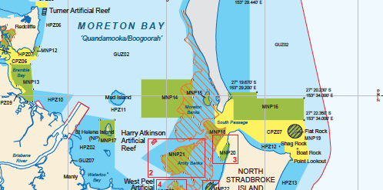
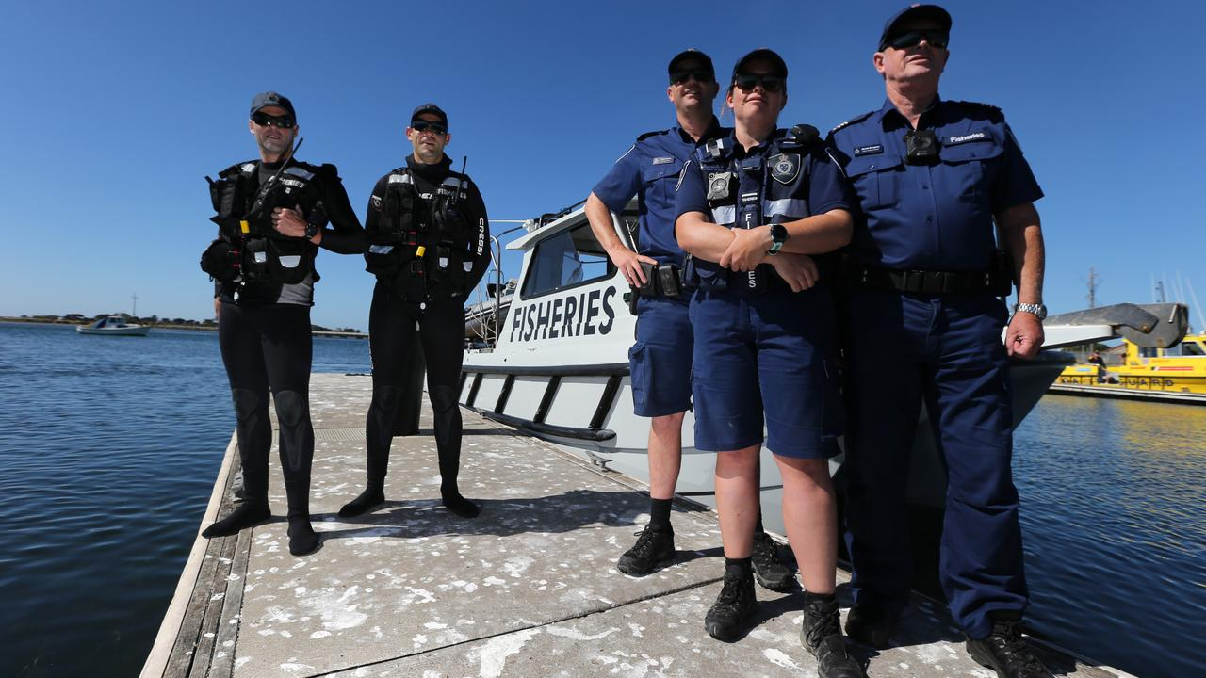
The environmental managers are security

Slide 25
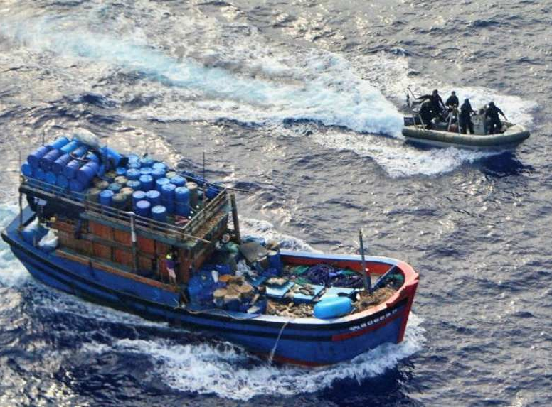
so passengers can reach their destinations safely

Slide 26
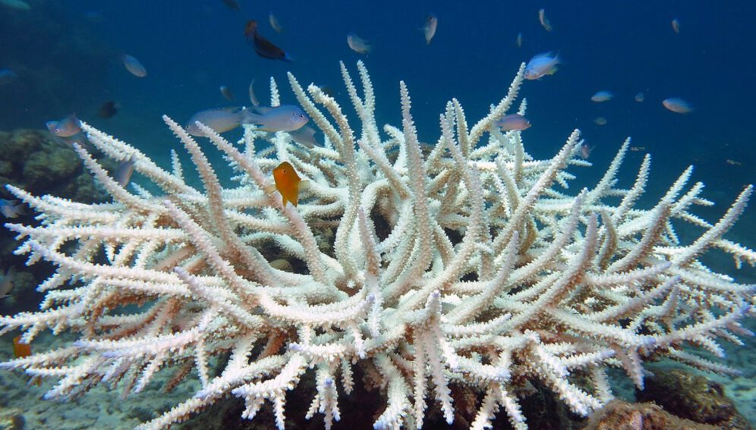
To help save (re-seed) a dying reef

Slide 27
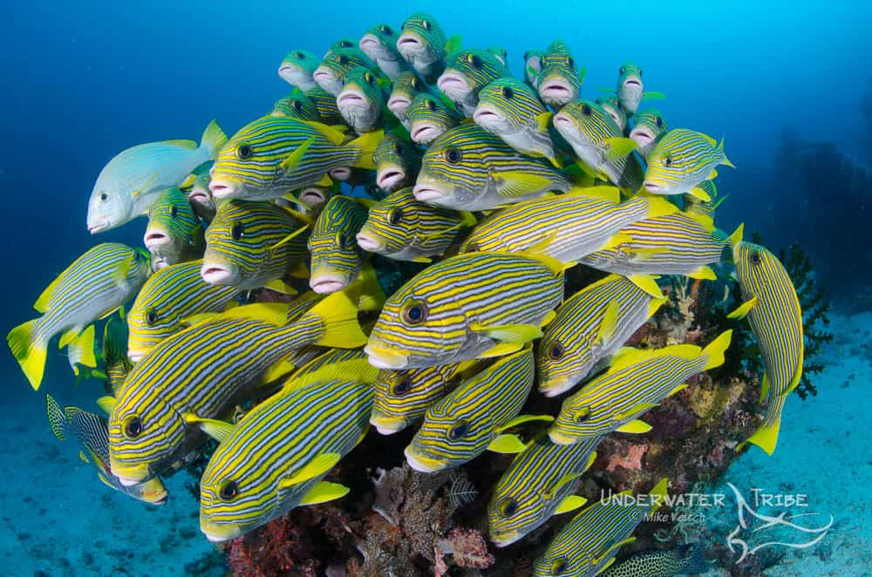
and maintain healthy ones
Notes:
Image: https://www.underwatertribe.com/tutorial/how-to-shoot-schooling-fish/

Slide 28
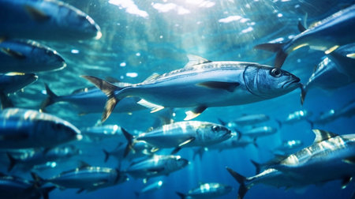
Notes:
Image: https://www.123rf.com/stock-photo/pelagic_fish.html

Slide 29
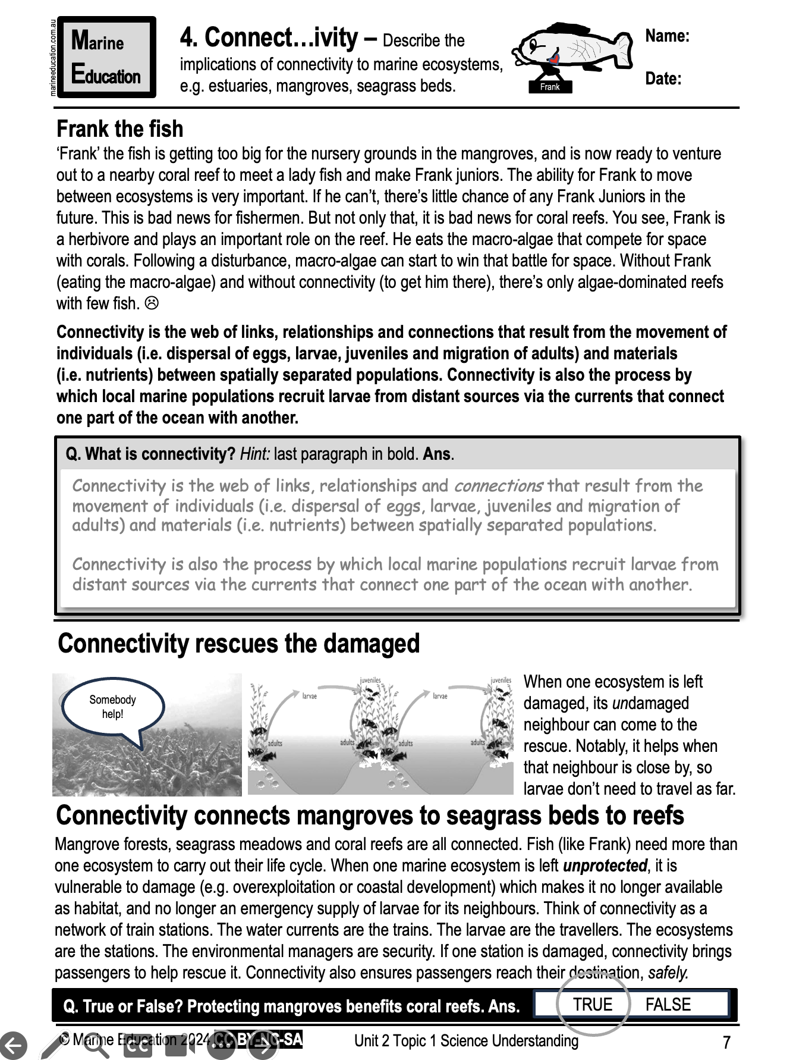
Terebellid worm larvae
Learning Intention:
Describe the implications of connectivity to marine ecosystems, e.g. estuaries, mangroves, seagrass beds.
Success Criteria:
Complete Marine Education worksheet ‘’4. Connect….ivity’
Notes:
Image: https://australian.museum/learn/animals/plankton/zooplankton/

