Slide 1
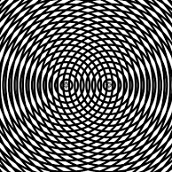
Learning Intention:
Contrast refraction, reflection and diffraction
Success Criteria:
Complete Marine Education worksheet ‘4. Wave wrap’
Notes:
https://www.youtube.com/watch?app=desktop&v=loRr97fOWdg

Slide 2
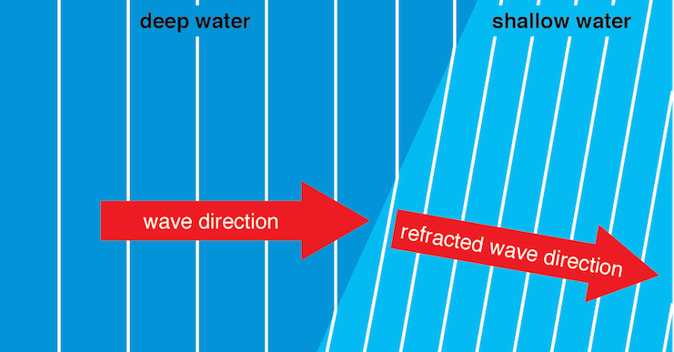
Refraction
The wave changes direction after passing from one medium to another
(i.e. deep to shallow water)

Slide 3
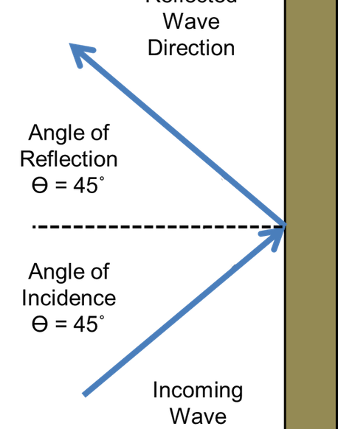
Reflection
The wave changes direction after bouncing off a barrier

Slide 4
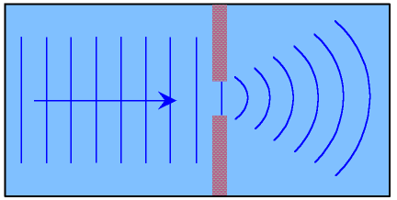
Diffraction
The wave changes direction after passing through an opening or around a barrier

Slide 5
Guess the wave interference pattern…
Is it reflection, refraction or diffraction?

Slide 6
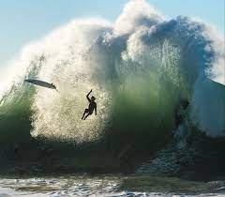
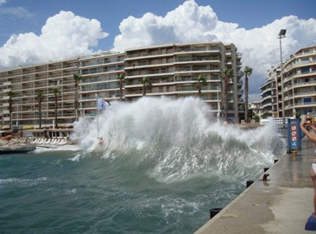
Is it reflection, refraction or diffraction?

Slide 7
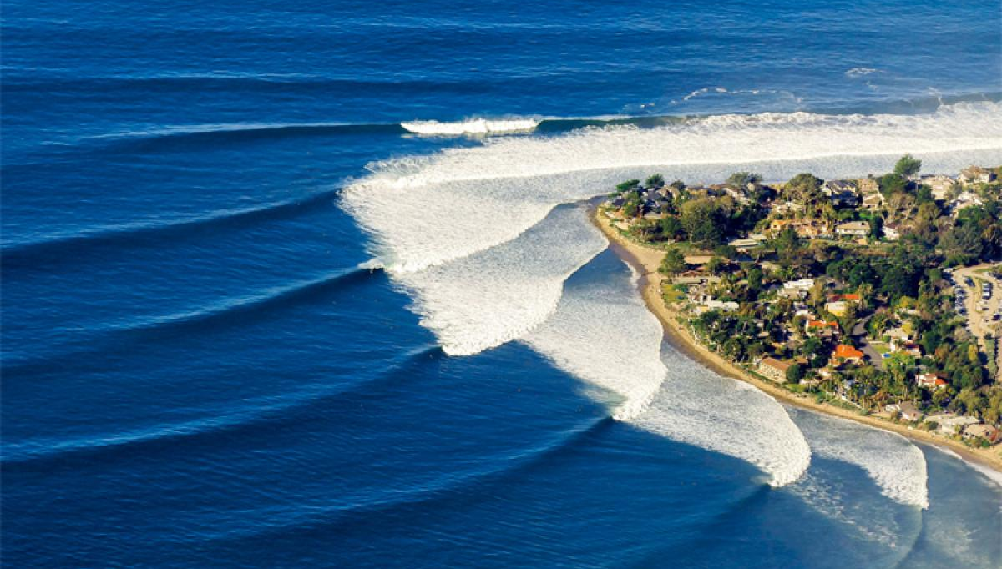
Is it reflection, refraction or diffraction?

Slide 8
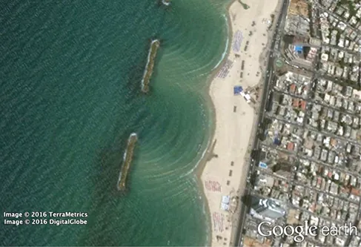
Is it reflection, refraction or diffraction?

Slide 9
How did you go?

Slide 10
Reflection
Diffraction
Refraction

Slide 11
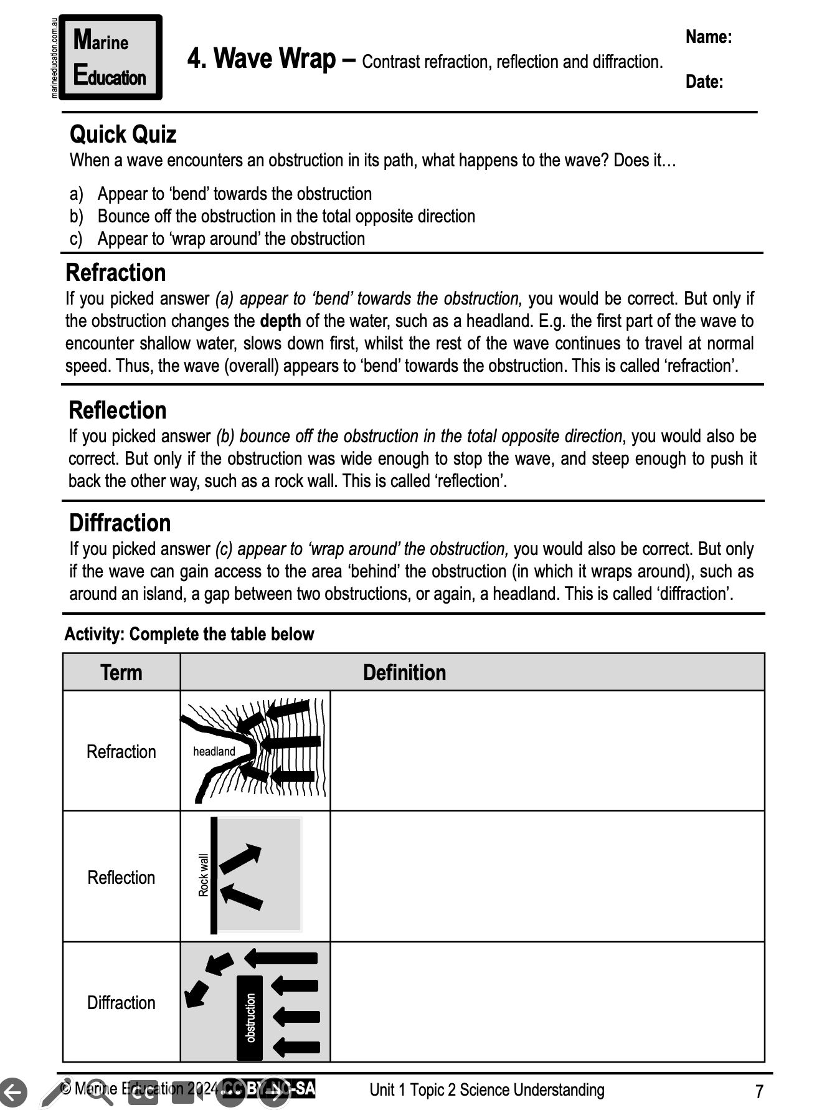
Learning Intention:
Contrast refraction, reflection and diffraction
Success Criteria:
Complete Marine Education worksheet ‘4. Wave wrap’
Notes:
https://www.youtube.com/watch?app=desktop&v=loRr97fOWdg

