Slide 1
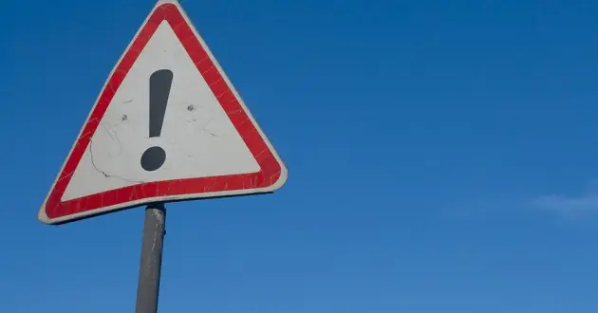
Learning Intention:
Identify factors that lead to a loss of diversity, e.g. natural hazard, loss/fragmentation of habitat, pollution, exploitation, introduction of new species, disease.
Success Criteria:
Complete Marine Education worksheet ‘5. Security Breach’
Notes:
Image: https://australian.museum/learn/animals/plankton/zooplankton/

Slide 2
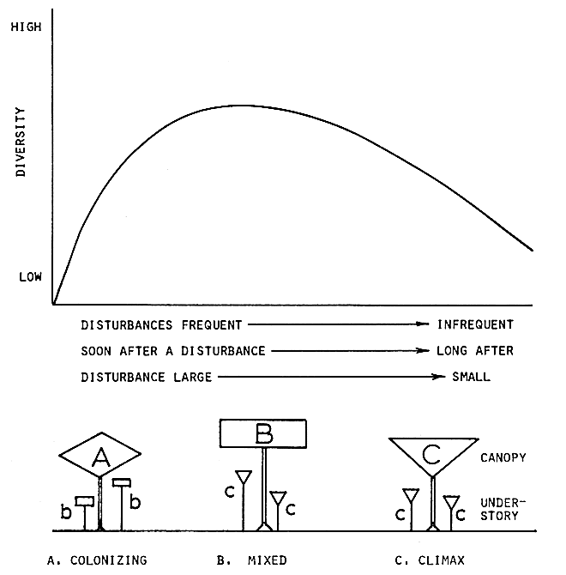
Intermediate Disturbance Hypothesis
Question:
When is biodiversity highest?
Notes:
Image: From Connell, J. H. (1978). Diversity in Tropical Rain Forests and Coral Reefs. Science, New Series, Vol. 199. No. 4335. DOI: DOI: 10.1126/science.199.4335.1302. Reprinted with permission from AAAS.

Slide 3
Intermediate Disturbance Hypothesis
Answer:
when there is only an ‘intermediate’ level of damage
(enough to make space for other species)
Notes:
Image: From Connell, J. H. (1978). Diversity in Tropical Rain Forests and Coral Reefs. Science, New Series, Vol. 199. No. 4335. DOI: DOI: 10.1126/science.199.4335.1302. Reprinted with permission from AAAS.

Slide 4
Intermediate Disturbance Hypothesis
Loss of diversity occurs when the damage is too
frequent or severe
as well as when disturbances are few and far between
(allowing one species to dominate)
Notes:
Image: From Connell, J. H. (1978). Diversity in Tropical Rain Forests and Coral Reefs. Science, New Series, Vol. 199. No. 4335. DOI: DOI: 10.1126/science.199.4335.1302. Reprinted with permission from AAAS.

Slide 5
For example,
frequent or severe
natural hazards

Slide 6
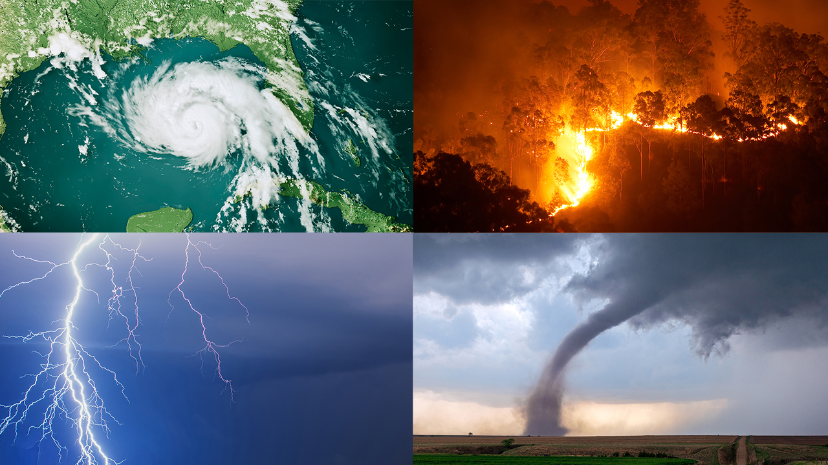

Slide 7
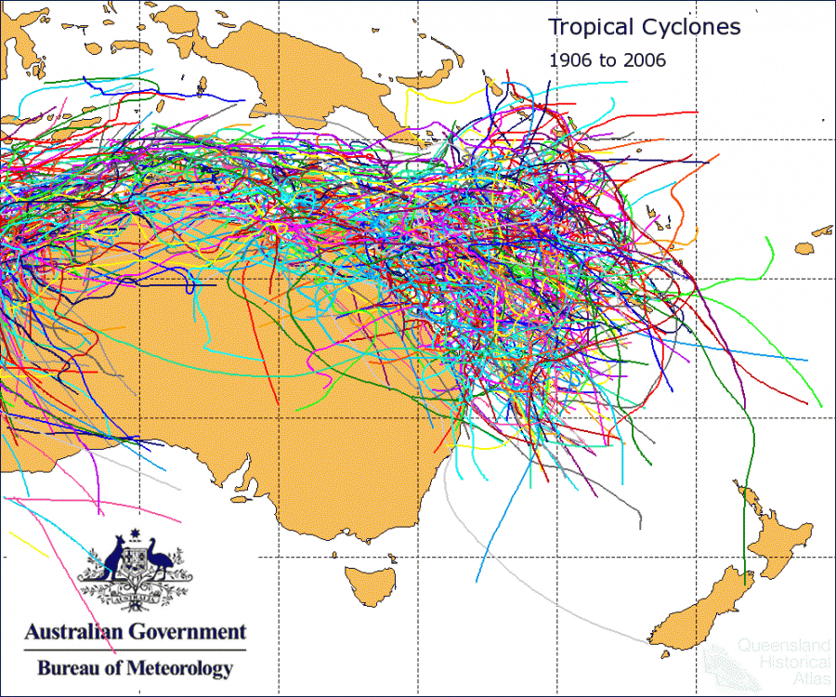
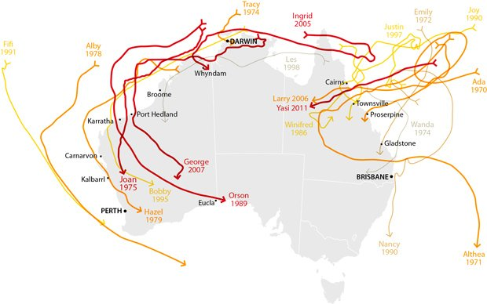
Cyclones
100 years of cyclones
The worst ones
Notes:
Image (left): https://www.qhatlas.com.au/content/tropical-cyclones
Image (right): https://www.australiangeographic.com.au/topics/science-environment/2011/08/cyclone-tracking-australias-worst-storms/

Slide 8
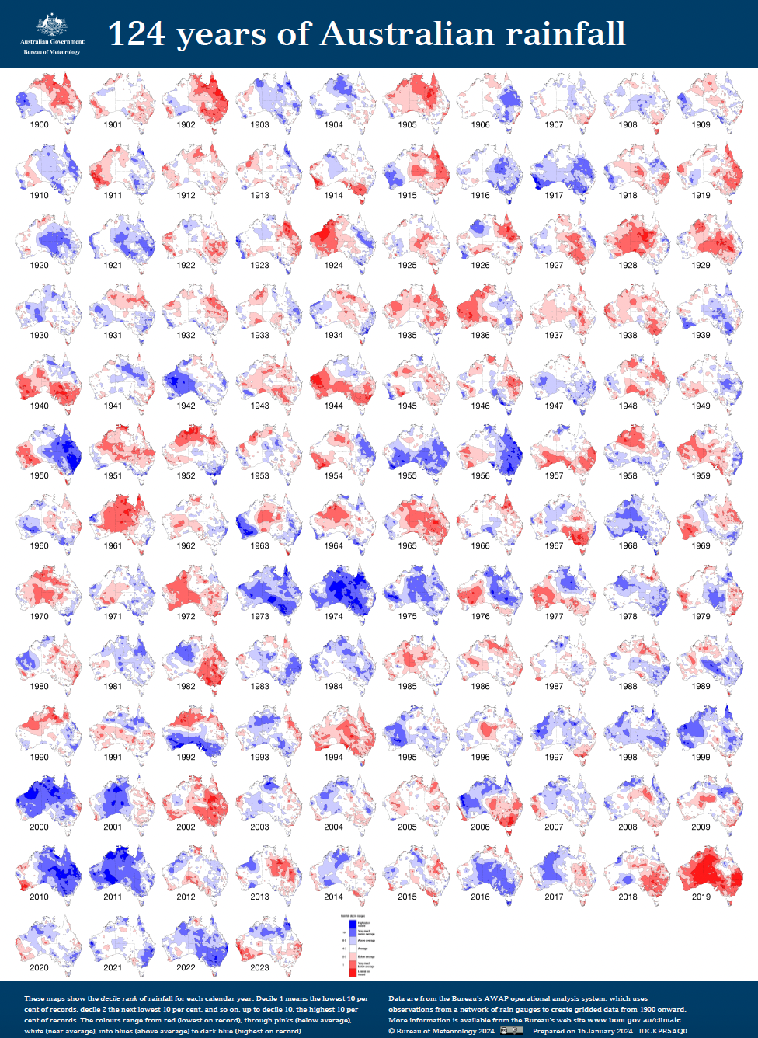
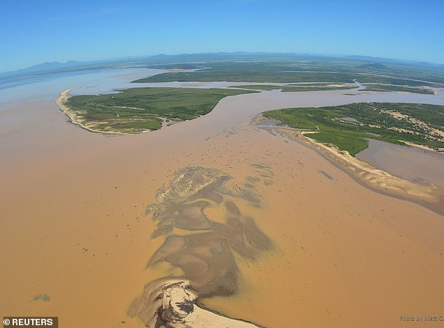
Floods
Notes:
Poster: BOM
Image: https://www.dailymail.co.uk/news/article-6708755/Incredible-photos-massive-plumes-polluted-water-pose-threat-Great-Barrier-Reef.html

Slide 9
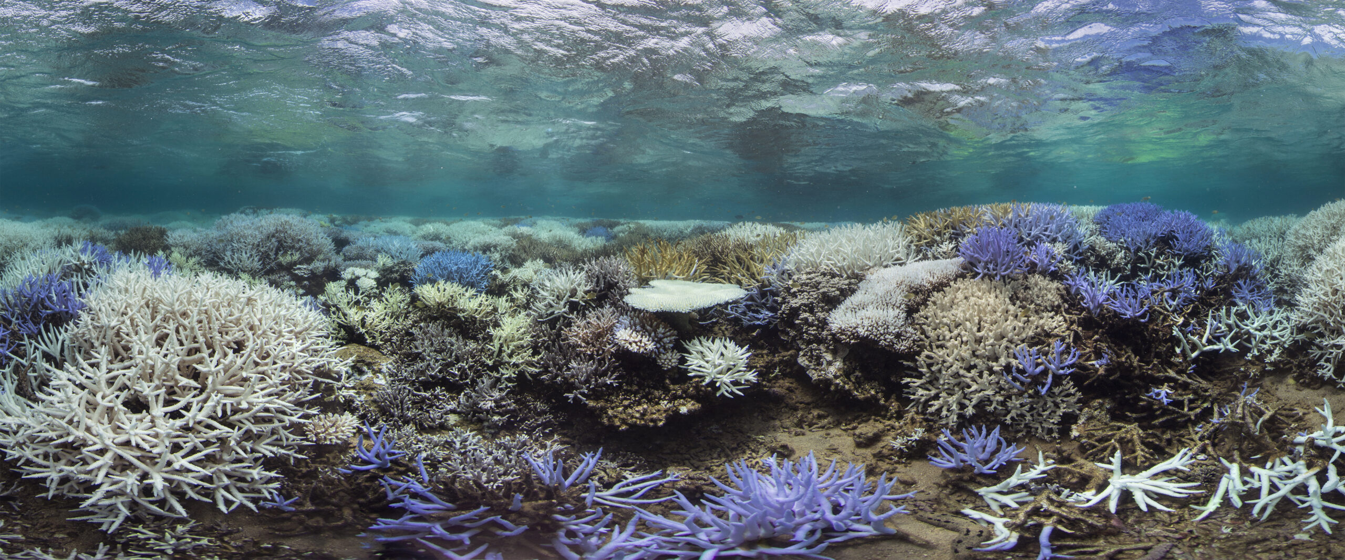
Heat Waves

Slide 10
For example,
frequent or severe
loss/fragmentation of habitat

Slide 11
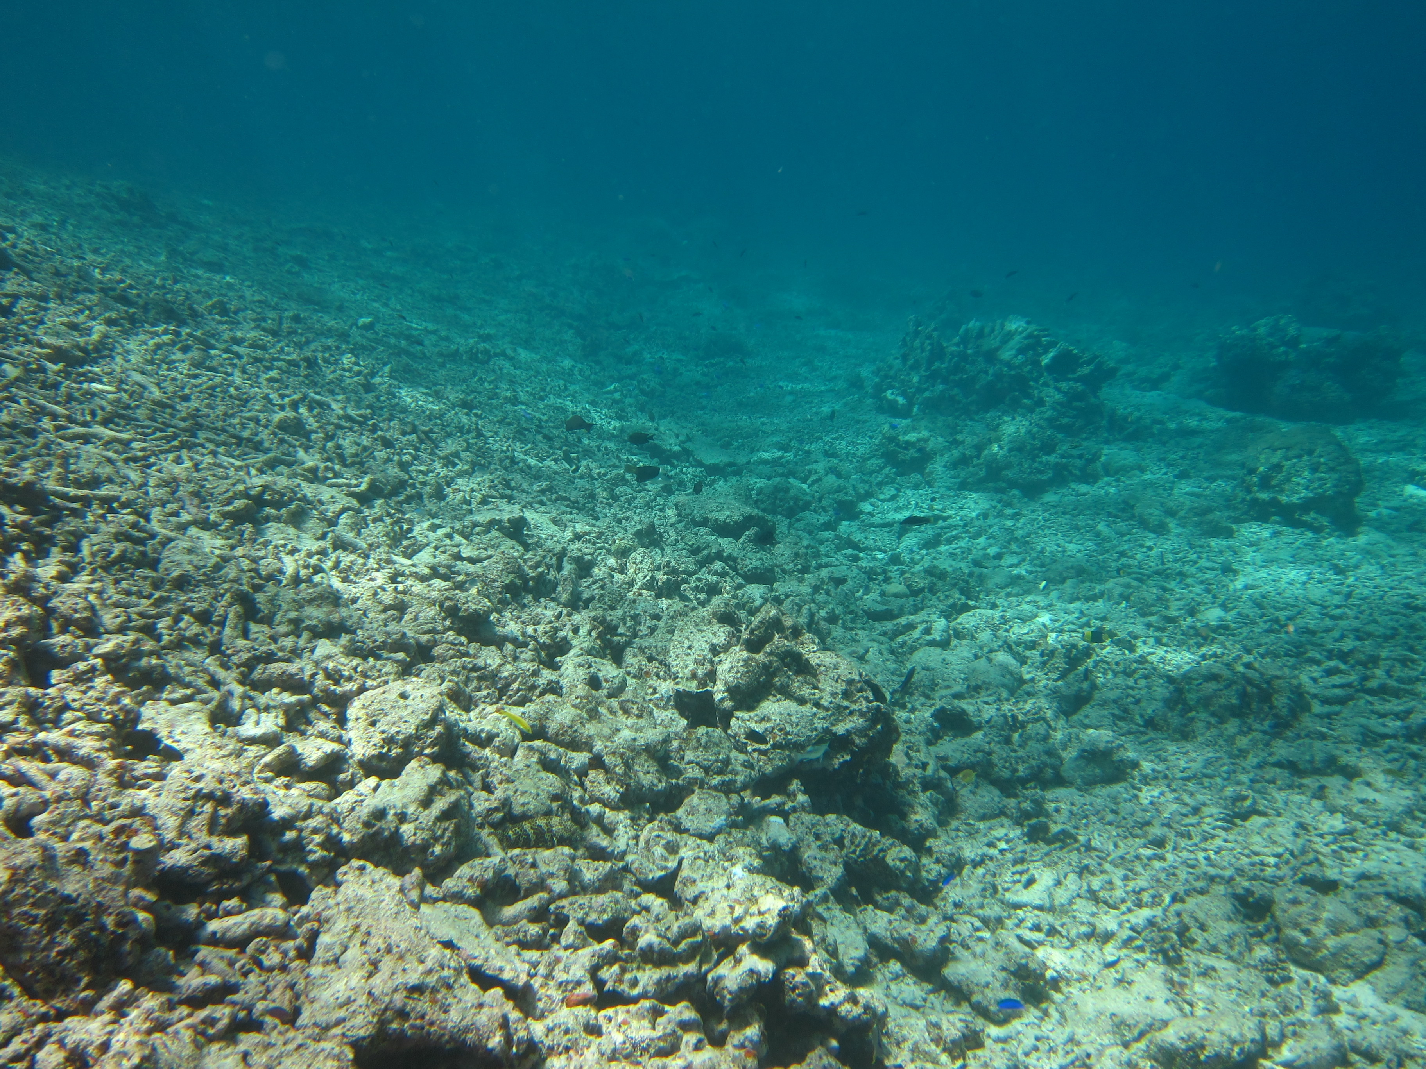
Coral rubble
(result of category 5 Tropical Cyclone Hamish in 2009)
Notes:
Image: https://eatlas.org.au/media/568

Slide 12
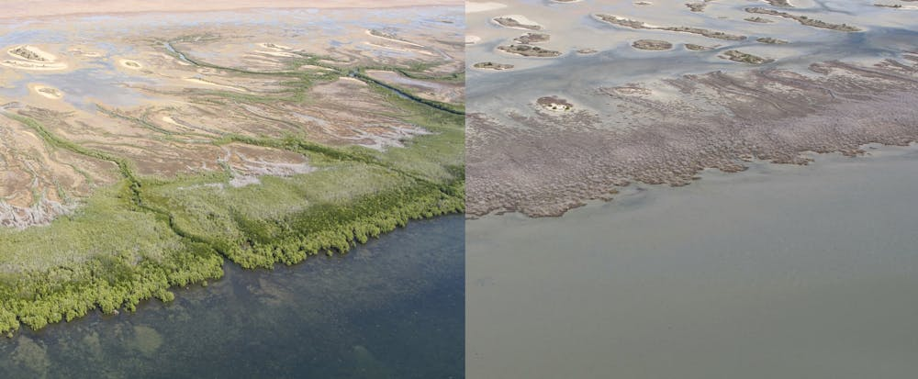
Massive Mangrove Forest Die-back in the Gulf 2015-16
Notes:
Image: https://theconversation.com/extreme-weather-likely-behind-worst-recorded-mangrove-dieback-in-northern-australia-71880

Slide 13
For example,
frequent or severe
pollution

Slide 14
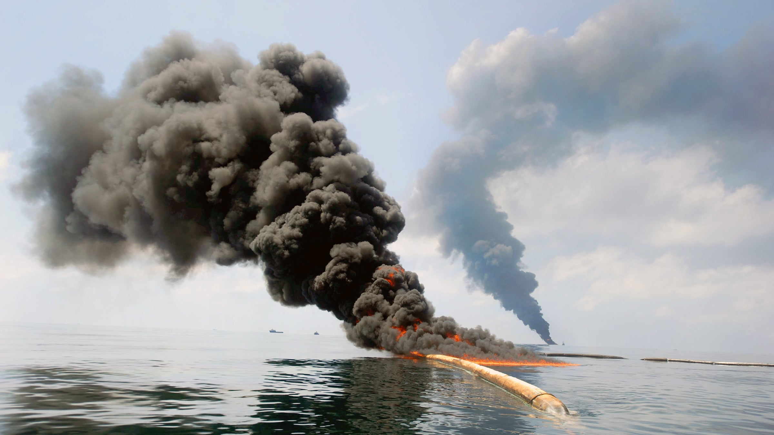
BP Deepwater Horizon Oil Spill Disaster, Gulf of Mexico, 2010
Notes:
Image: https://www.outsideonline.com/outdoor-adventure/gulf-oil-spill-left-gigantic-ring-seafloor/

Slide 15
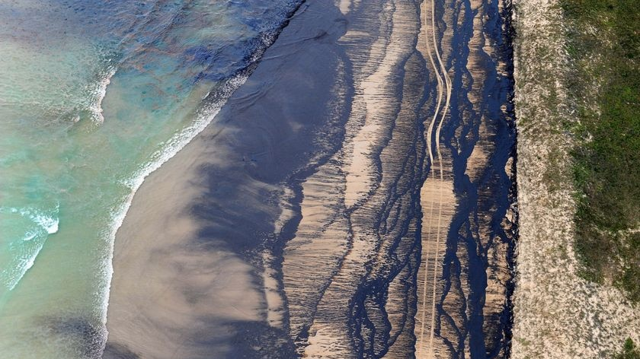
60km of SE Qld coastline was covered in oil, which came from the Pacific Adventurer after it was damaged by rough seas from cyclone Hamish.
Notes:
Image: https://www.abc.net.au/news/2009-03-13/oil-spill-qld-beaches-declared-disaster-zones/1617238Sixty kilometres of coastline is covered in the slick, which came from the Pacific Adventurer after it was damaged earlier this week in rough seas whipped up by cyclone Hamish.

Slide 16
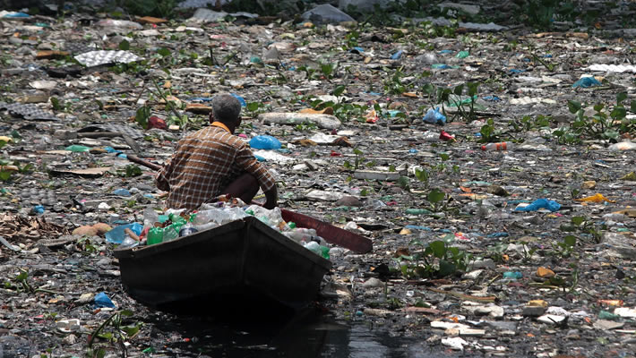
Notes:
Image: https://greentumble.com/top-10-most-polluted-rivers-in-the-world

Slide 17
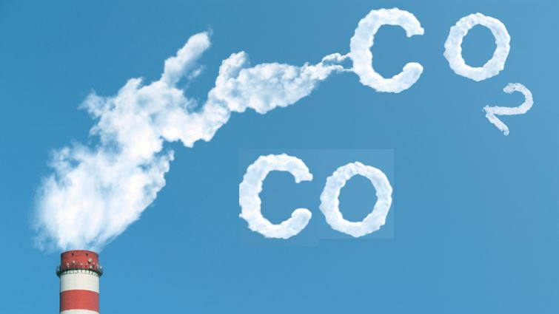

Slide 18
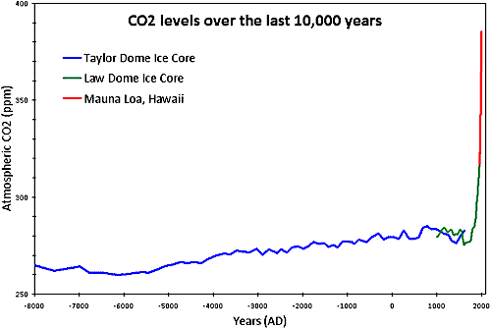

Slide 19
For example,
frequent or severe
exploitation

Slide 20
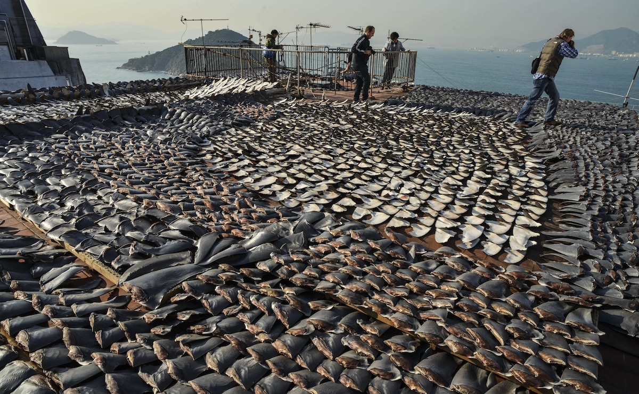
Shark fins, Hong Kong
Notes:
Image: https://www.ecowatch.com/overfishing-facts-ecowatch.html

Slide 21
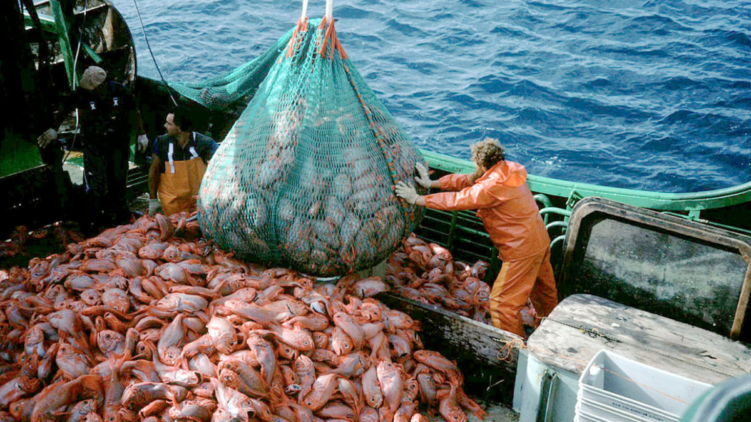
Deep Sea Fish Orange Roughy
Notes:
Image: https://www.fishforward.eu/en/topics/facts-figures/

Slide 22
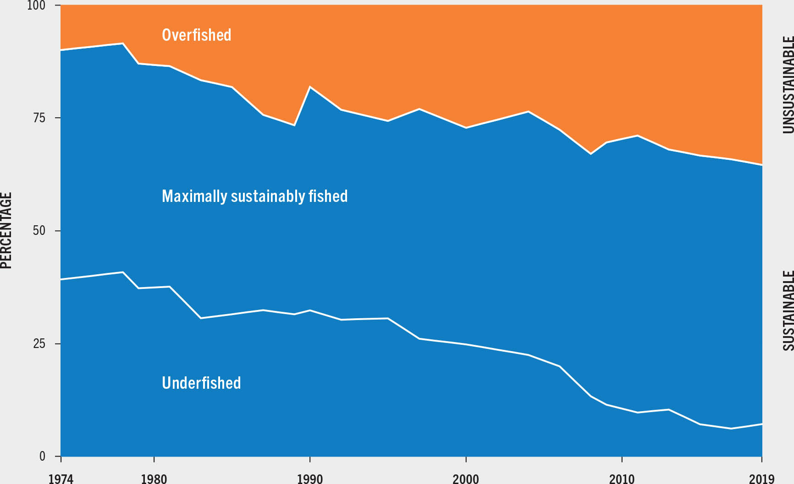
Notes:
Image: https://www.fao.org/3/cc0461en/online/sofia/2022/status-of-fishery-resources.html

Slide 23
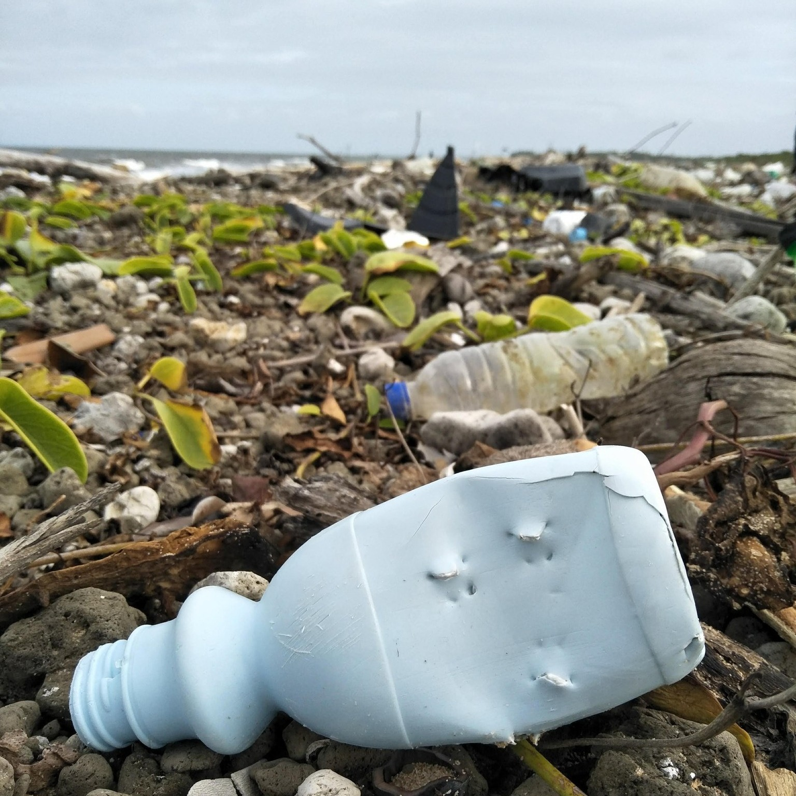
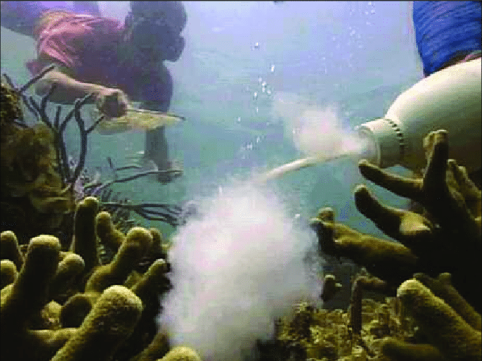
Cyanide fishing
KKK Bottles found by Tangaroa Blue
Notes:
Image (left) : Tangaroa Blue facebook page post - https://www.facebook.com/photo/?fbid=5029558630433749&set=pcb.5029552603767685
Image (right): https://www.researchgate.net/figure/A-fisherman-squirts-cyanide-solution-on-corals-while-another-waits-for-stunned-fish-to_fig2_238791896 - A fisherman squirts cyanide solution on corals while another waits for stunned fish to come out. Photo by Ferdinand Cruz of East Asia Seas Initiatives.

Slide 24
For example,
frequent or severe
introduction of new species

Slide 25
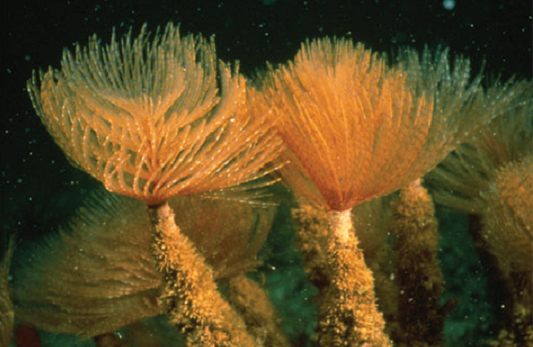
The European fan worm (Sabella spallanzanii)
Notes:
Image: https://www.dpi.nsw.gov.au/dpi/bfs/aquatic-biosecurity/aquatic-pests-and-diseases/marine-pests

Slide 26
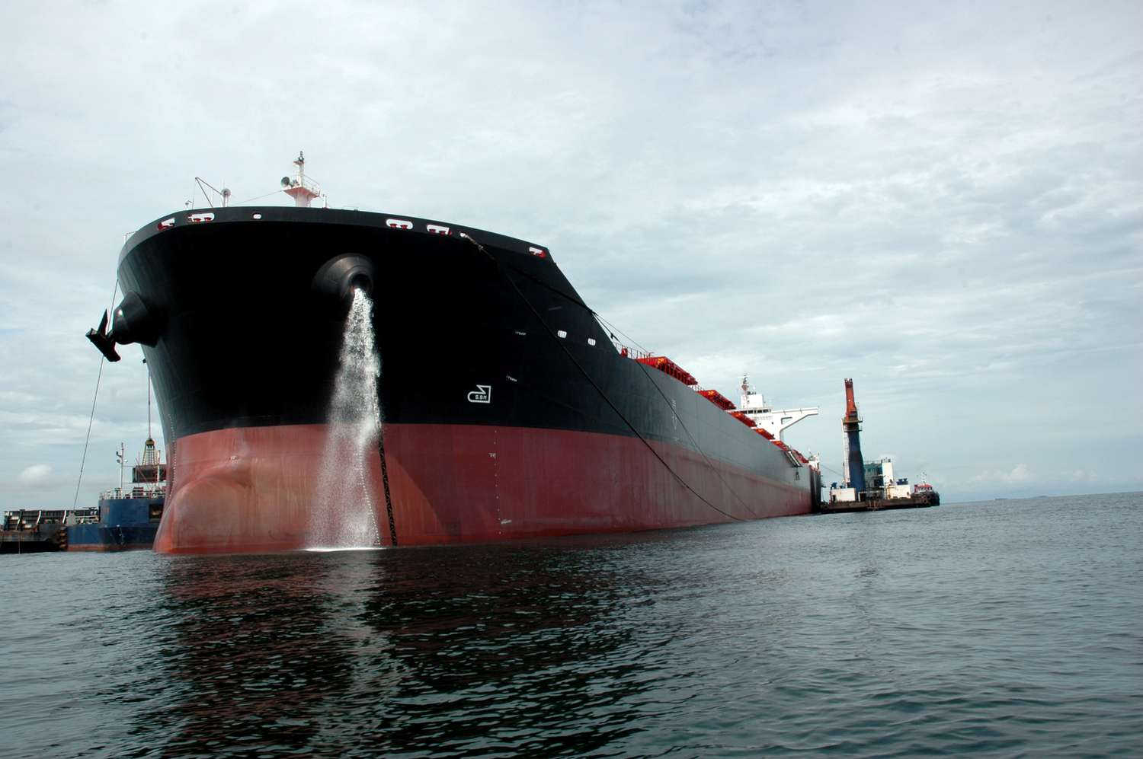
“Hitchhikers” in ship ballast
water
Notes:
Image: https://www.treehugger.com/what-is-ballast-water-5179976

Slide 27
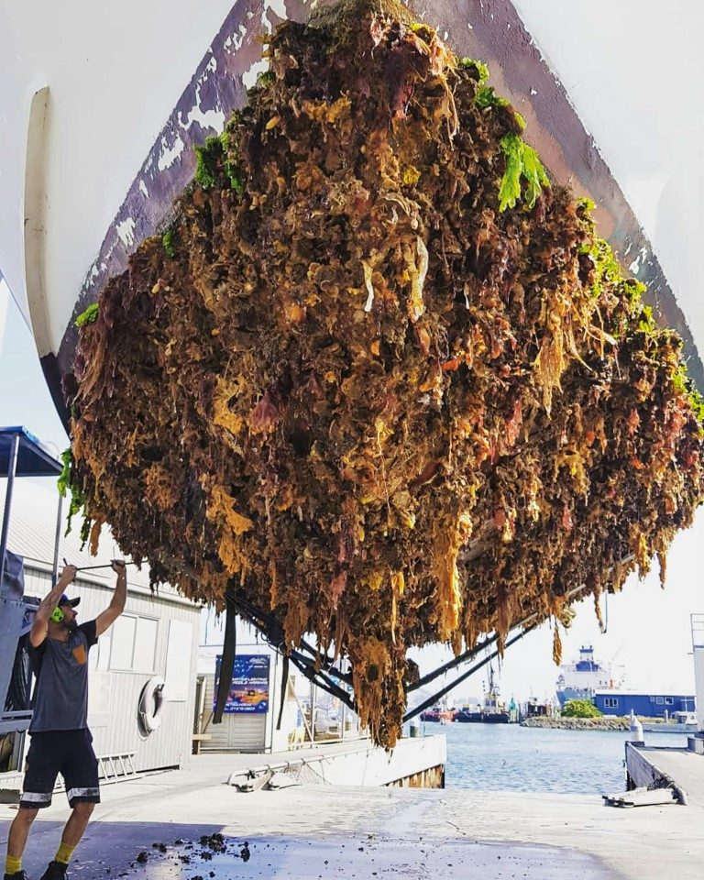
“hitchhikers” on boat hulls
Notes:
Image: https://boatingnz.co.nz/haulout/

Slide 28
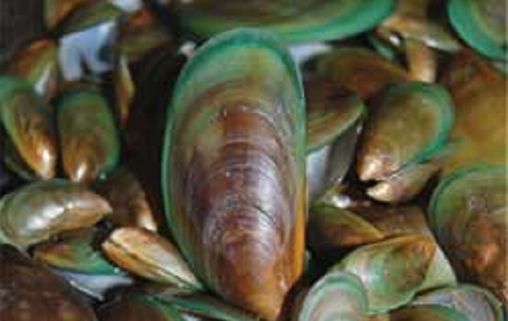
Asian Green Mussel ((Perna viridis)
Notes:
Info: https://www.marinepests.gov.au/pests/map
Image: https://www.dpi.nsw.gov.au/dpi/bfs/aquatic-biosecurity/aquatic-pests-and-diseases/marine-pests/bivalve-molluscs/asian-green-mussel

Slide 29
For example,
frequent or severe
disease

Slide 30
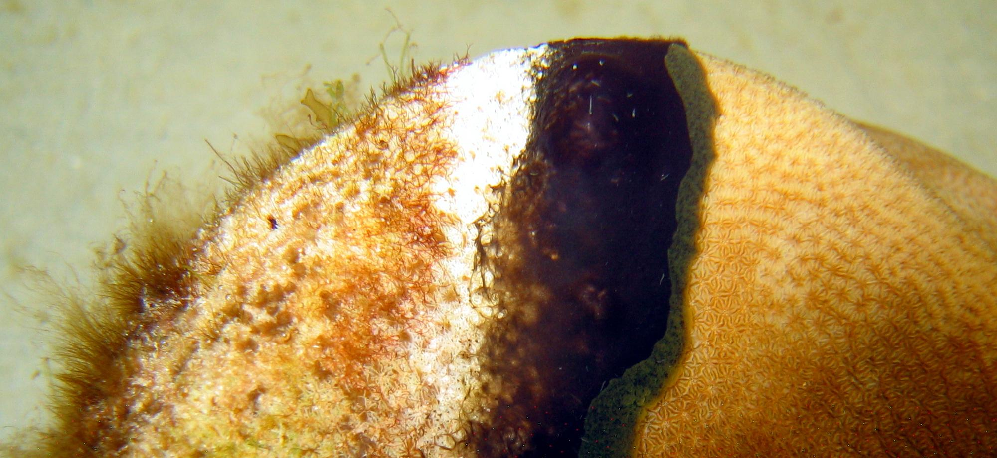
Coral diseases
Notes:
Image: https://www.aims.gov.au/docs/research/biodiversity-ecology/threats/coral-disease.html

Slide 31
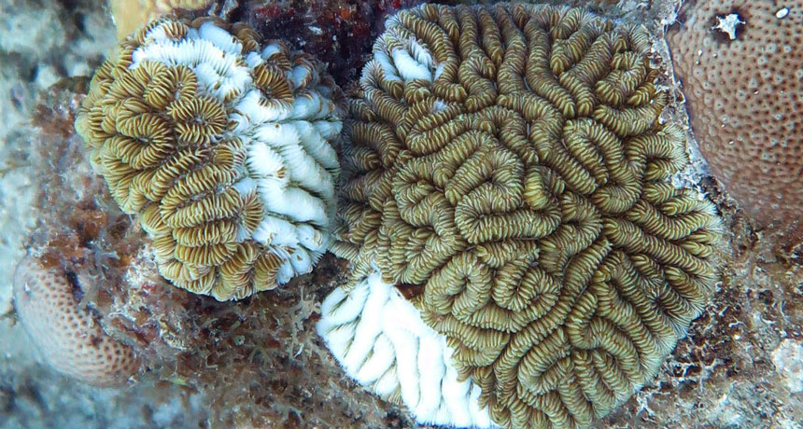
Notes:
Image: https://www.snexplores.org/article/mystery-disease-killing-caribbean-corals

Slide 32
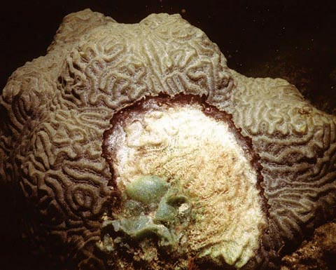

Slide 33
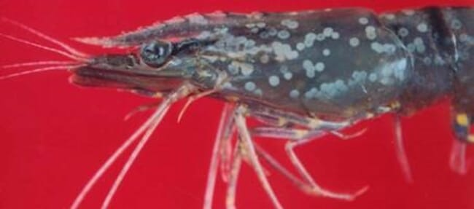
White spot disease
(caused by white spot syndrome virus or WSSV)
Notes:
Image: https://thefishsite.com/disease-guide/white-spot-syndrome-virus

Slide 34
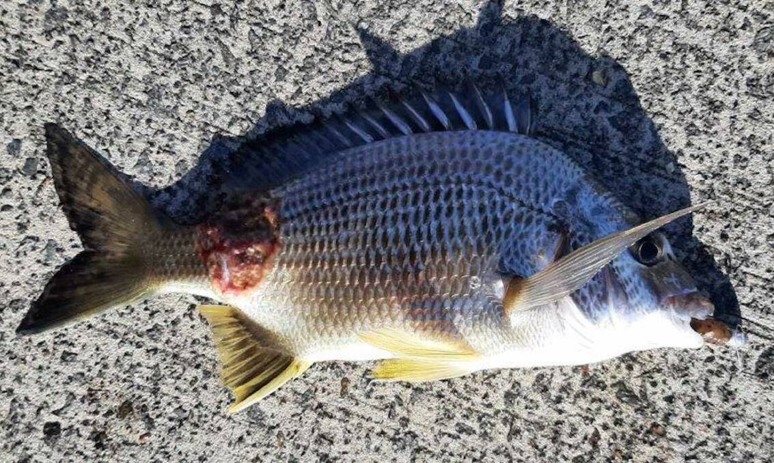
Red spot disease
Notes:
Image: https://www.newcastleherald.com.au/story/7559921/red-spot-disease-looms-over-myall-lakes/

Slide 35
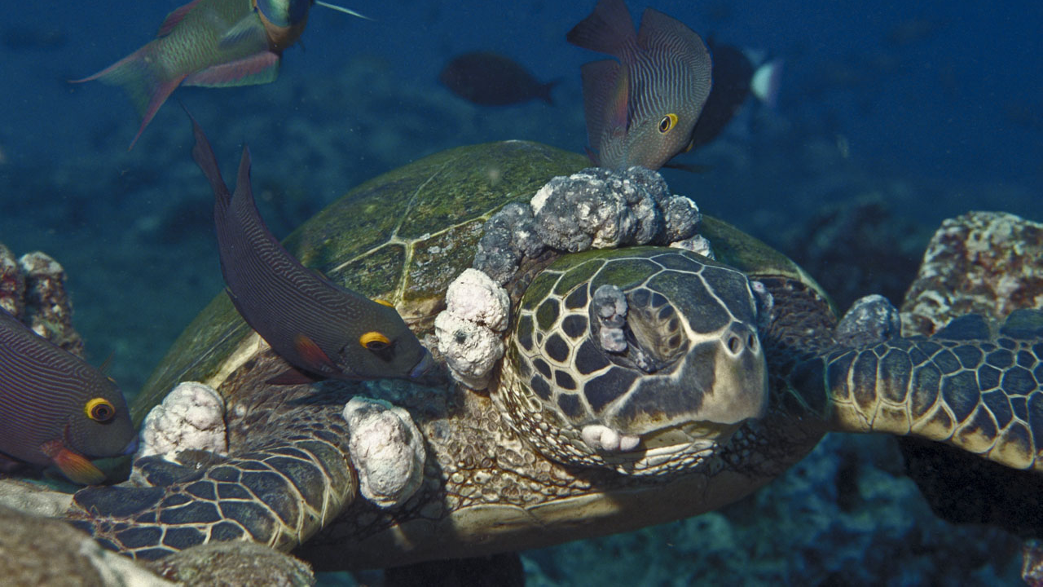
Turtle fibropapillomatosis (FP)
(caused by herpes virus)
Notes:
Image: https://en.wikipedia.org/wiki/Turtle_fibropapillomatosis

Slide 36
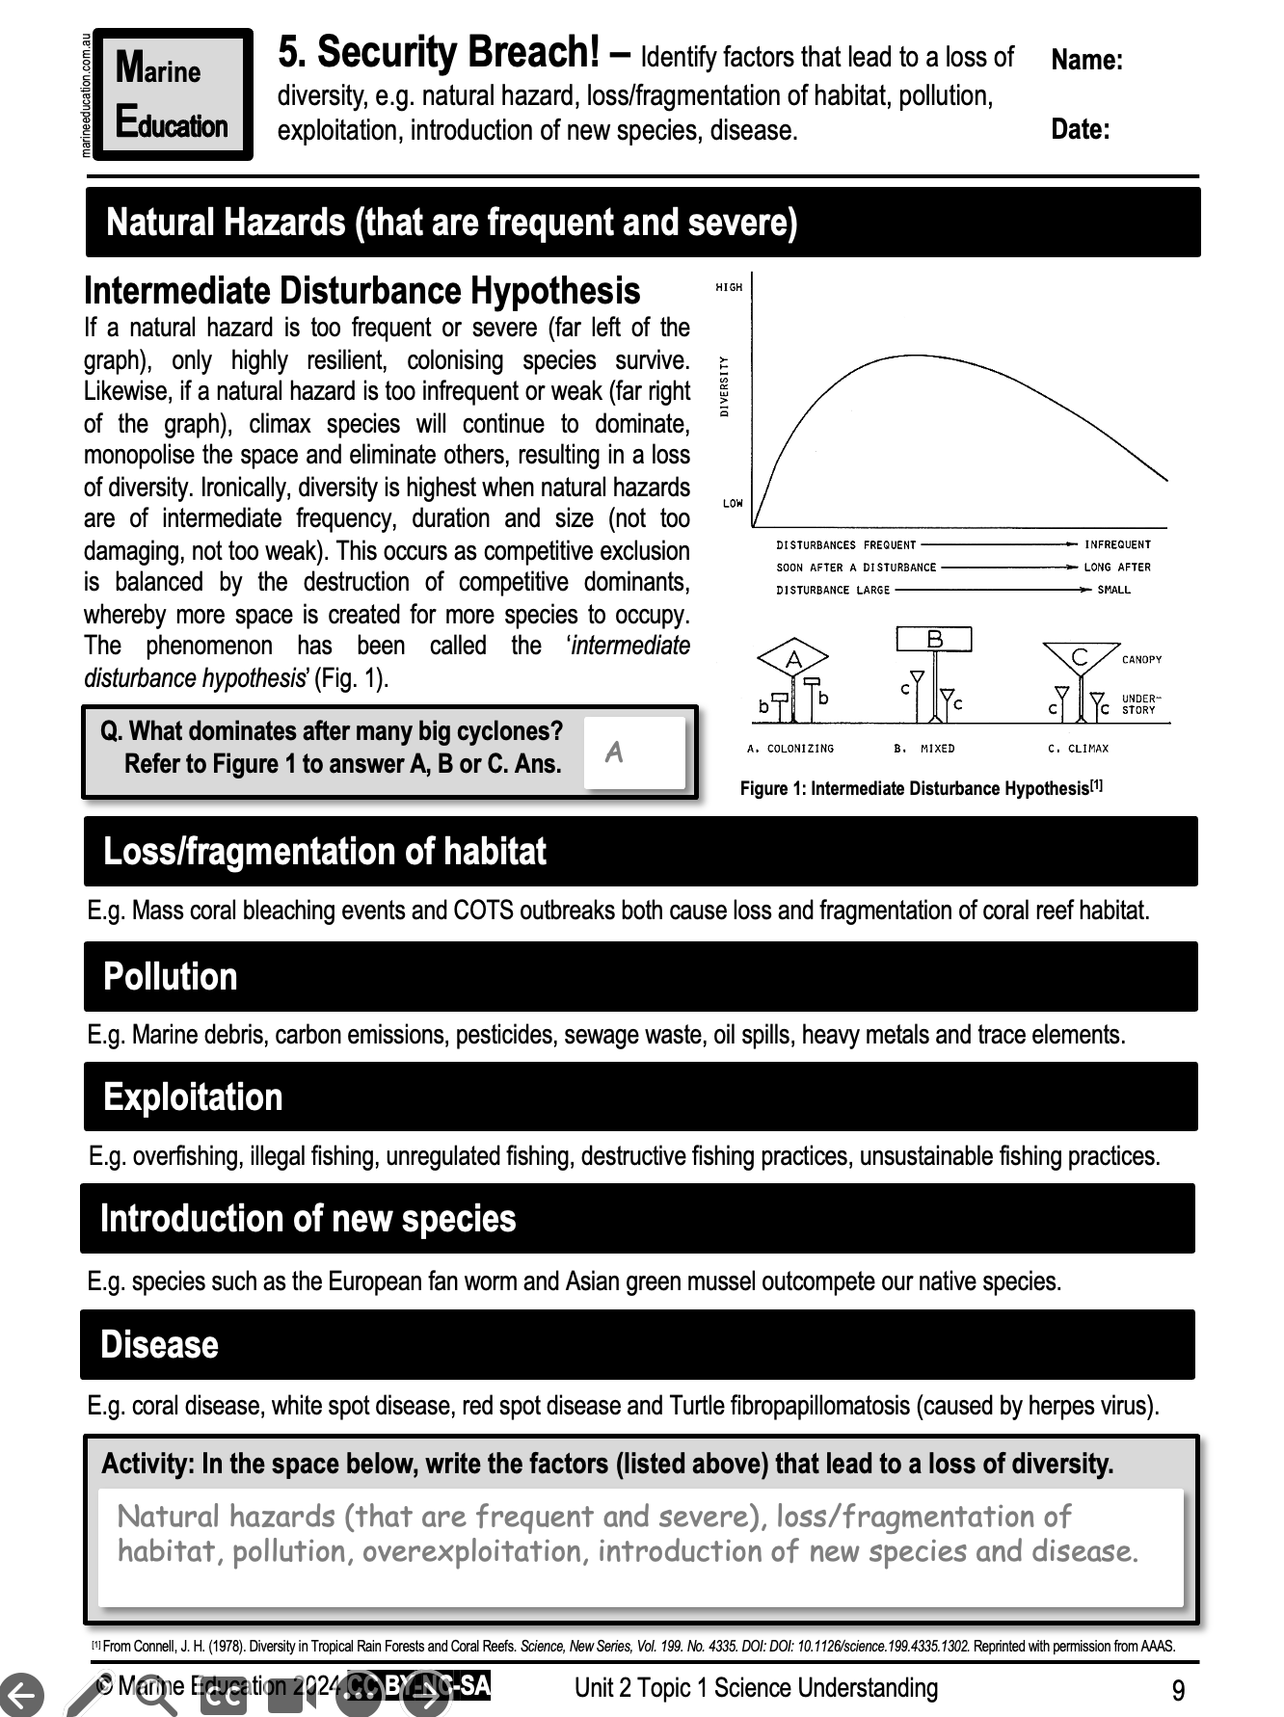
Learning Intention:
Identify factors that lead to a loss of diversity, e.g. natural hazard, loss/fragmentation of habitat, pollution, exploitation, introduction of new species, disease.
Success Criteria:
Complete Marine Education worksheet ‘5. Security Breach’
Notes:
Image: https://australian.museum/learn/animals/plankton/zooplankton/

