Slide 1
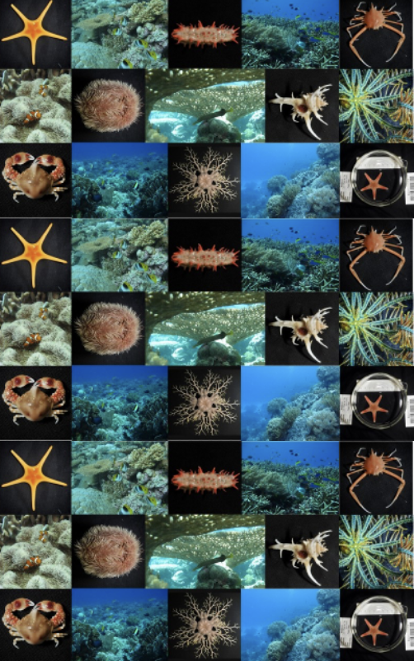
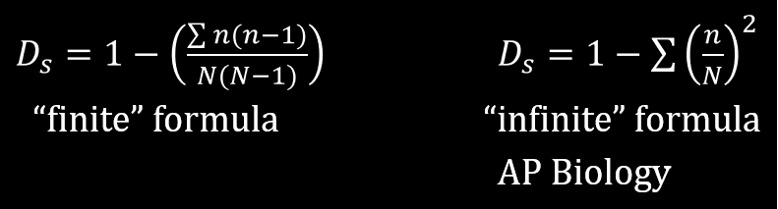
Learning Intention:
Calculate the biodiversity of a marine ecosystem using….
Simpson’s Diversity Index (SDI)
where
N = total number of organisms of all species and
n = number of organisms of one species.
Success Criteria:
Complete Marine Education worksheet
‘6. Homer’s Index’
Notes:
Image: https://eatlas.org.au/nwa/celebrate-biodiversity-Australias-north-west-marine-region

Slide 2
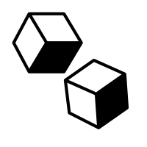
Simpson’s Diversity Index (SDI)
Indices | Formula | Interpretation | Explanation
Simpsons Diversity Index (SDI) | 1- ∑ n(n-1) N(N-1) | 0 – 1 0 = no diversity 1 = infinite diversity | The probability that 2 randomly selected individuals will be 2 different species (or categories). 100% chance = infinite diversity

Slide 3
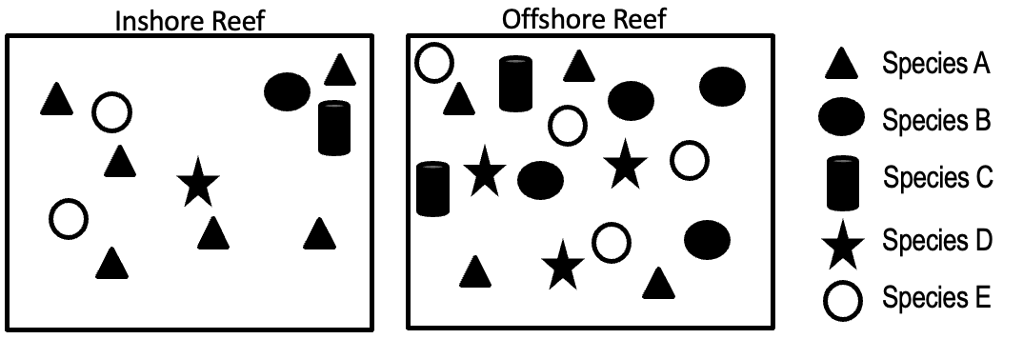
randomly placed quadrats
For this activity, we will compare the SDI of an inshore reef with the SDI of an
offshore reef.
vs.

Slide 4
INSHORE REEF
IDENTIFY | COUNT | STATS
Name | n | n(n -1)
Species A | 6 | 30
Species B | 1 | 0
Species C | 1 | 0
Species D | 1 | 0
Species E | 2 | 2
Total | N | ∑n(n-1)
Simpsons Diversity Index Calculations | N(N-1)= | SDI =
Count the number of triangles
6x5=
Count the number of black circles
1x0=
Count the number of cylinders
1x0=
Count the number of stars
1x0=
Count the number of white circles
2x1=

Slide 5
INSHORE REEF
IDENTIFY | COUNT | STATS
Name | n | n(n -1)
Species A | 6 | 30
Species B | 1 | 0
Species C | 1 | 0
Species D | 1 | 0
Species E | 2 | 2
Total | 11 | 32
Simpsons Diversity Index Calculations | N(N-1)= | SDI =
Add them up
Add them up

Slide 6
INSHORE REEF
IDENTIFY | COUNT | STATS
Name | n | n(n -1)
Species A | 6 | 30
Species B | 1 | 0
Species C | 1 | 0
Species D | 1 | 0
Species E | 2 | 2
Total | N 11 | ∑n(n-1) 32
Simpsons Diversity Index Calculations | N(N-1)= 110 | SDI =
11x10=

Slide 7
INSHORE REEF
IDENTIFY | COUNT | STATS
Name | n | n(n -1)
Species A | 6 | 30
Species B | 1 | 0
Species C | 1 | 0
Species D | 1 | 0
Species E | 2 | 2
Total | N 11 | ∑n(n-1) 32
Simpsons Diversity Index Calculations | N(N-1)= 110 | SDI = 0.709
1-[32/110)=

Slide 8
Your turn!
OFFSHORE REEF
IDENTIFY | COUNT | STATS
Name | n | n(n -1)
Total | N | ∑n(n-1)
Simpsons Diversity Index Calculations | N(N-1)= | SDI =

Slide 9
OFFSHORE REEF
IDENTIFY | COUNT | STATS
Name | n | n(n -1)
Species A | 4 | 12
Species B | 4 | 12
Species C | 2 | 2
Species D | 3 | 6
Species E | 4 | 12
Total | N 17 | ∑n(n-1) 44
Simpsons Diversity Index Calculations | N(N-1)= 272 | SDI = 0.838
Count the number of triangles
4x3=
Count the number of black circles
4x3=
Count the number of cylinders
2x1=
Count the number of stars
3x2=
Count the number of white circles
4x3=
Add them up
17x16=
1-[44/272)=

Slide 10
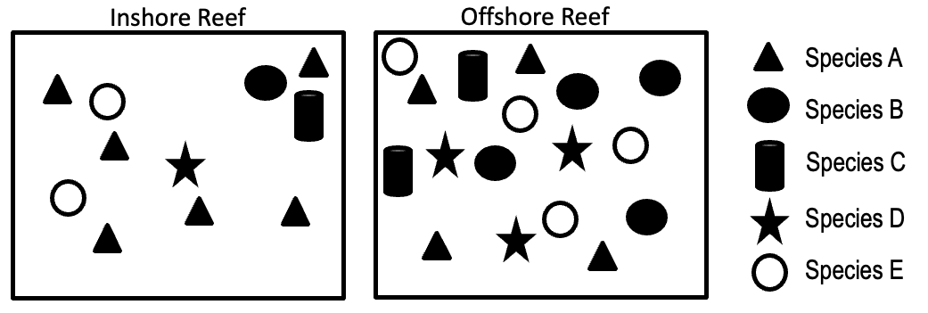
The offshore reef has a higher SDI (0.838) than the inshore reef (0.709).
This means the species diversity is slightly higher at the offshore reef.
SDI=0.709
SDI=0.838

Slide 11
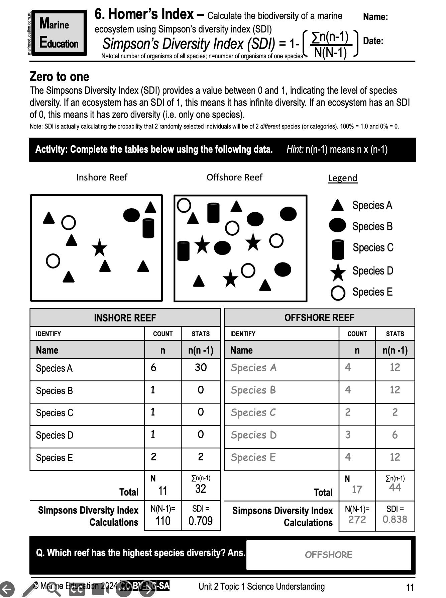
Learning Intention:
Calculate the biodiversity of a marine ecosystem using….
Simpson’s Diversity Index (SDI)
where
N = total number of organisms of all species and
n = number of organisms of one species.
Success Criteria:
Complete Marine Education worksheet
‘6. Homer’s Index’
Notes:
Image: https://eatlas.org.au/nwa/celebrate-biodiversity-Australias-north-west-marine-region

