Slide 1
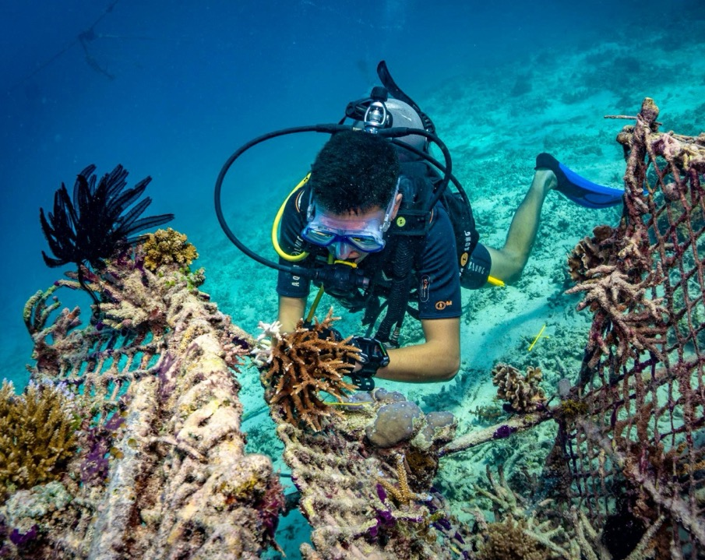
Learning Intention:
Apply the terms ecosystem resilience, disturbance and recovery as indicators of ‘health’ of marine environments to a chosen case study.
Success Criteria:
Complete Marine Education worksheet
‘6. Marine Diagnosis’
Notes:
Image: https://www.volunteerworld.com/se/volunteer-program/biorock-coral-reef-restoration-in-indonesia-gili-trawangan

Slide 2
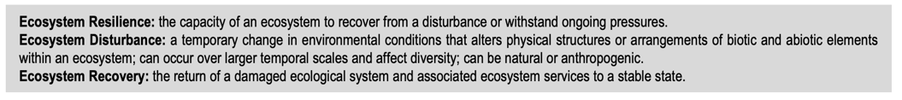
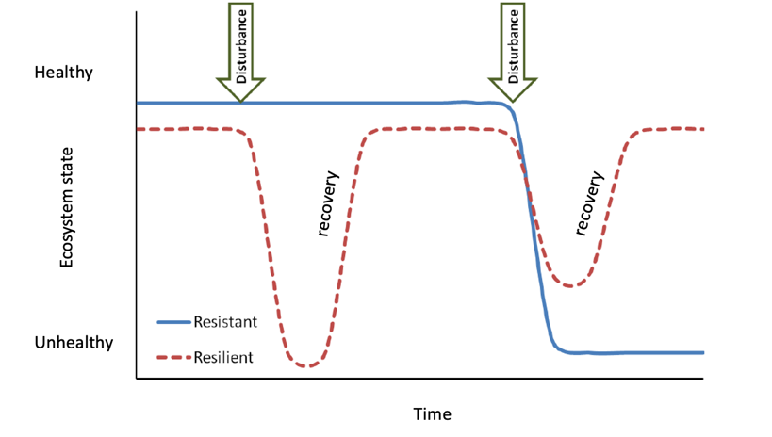
To recap, in your Marine Education workbook, it reads….
For example:
Notes:
Image; https://www.researchgate.net/figure/Graphical-depiction-of-resistance-versus-resilience-in-response-to-functional-service_fig1_261797595

Slide 3
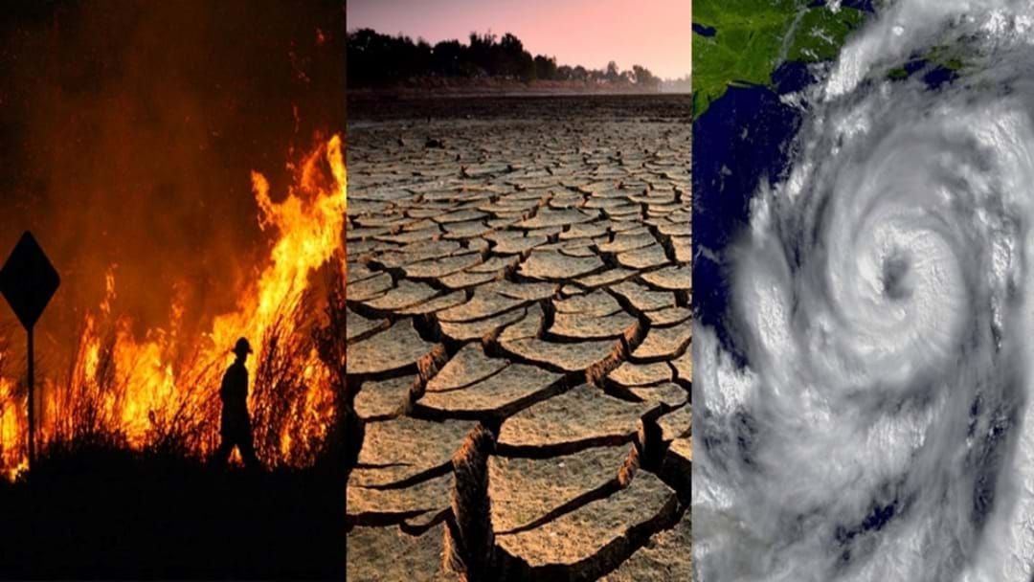
Disturbances
Notes:
Image: https://www.hit.com.au/story/climate-report-queensland-bears-the-brunt-of-natural-disasters-210830

Slide 4
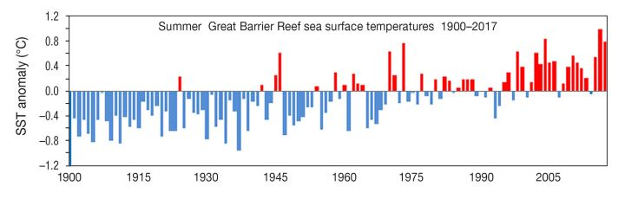
Disturbances
E.g. more mass bleaching events
Notes:
Image: https://climatefeedback.org/claimreview/sea-temperatures-around-the-great-barrier-reef-have-increased-over-the-last-150-years-contrary-to-claim-at-wattsupwiththat/ sourced from the Bureau of Meteorology

Slide 5
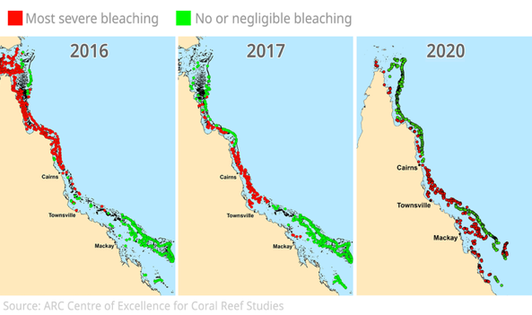
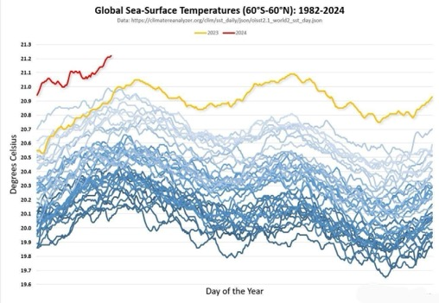
Case study: the most recent Great Barrier Reef mass bleaching events
2024
2023
…..(update)
Notes:
Image (left): https://reefbites.com/2020/04/22/coral-bleaching-in-2020-the-great-barrier-reef-and-beyond/
Image (right): https://www.reddit.com/r/dataisbeautiful/comments/1bddj0o/oc_global_sea_surface_temperatures_19842024/

Slide 6
Add pictures/news articles/journal articles of the most recent mass bleaching event/s here

Slide 7
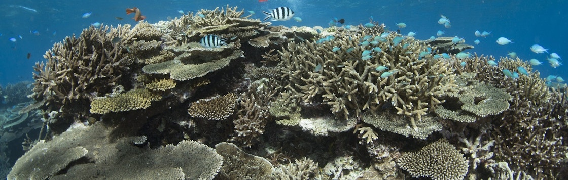
A coral reef is resilient and quickly recovers from disturbances if it has:
High functional diversity
Heat resistant ‘super’ corals

Slide 8
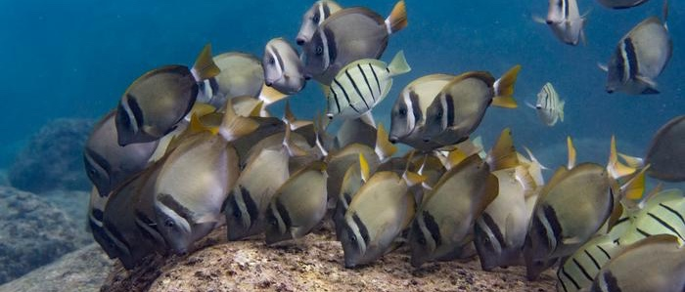
High functional diversity
(high number of species performing the same function – e.g. grazing)
Notes:
Image: https://www.eurekalert.org/multimedia/1007403

Slide 9
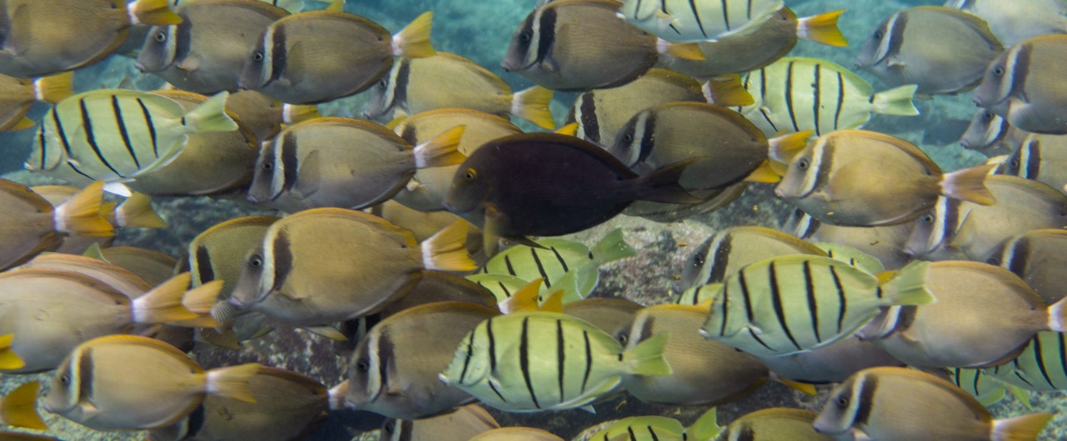
If one dies, another can take its place
Called functional redundancy
Notes:
Image: https://dlnr.hawaii.gov/holomua/herbivoremanagement/participate-in-the-process/

Slide 10
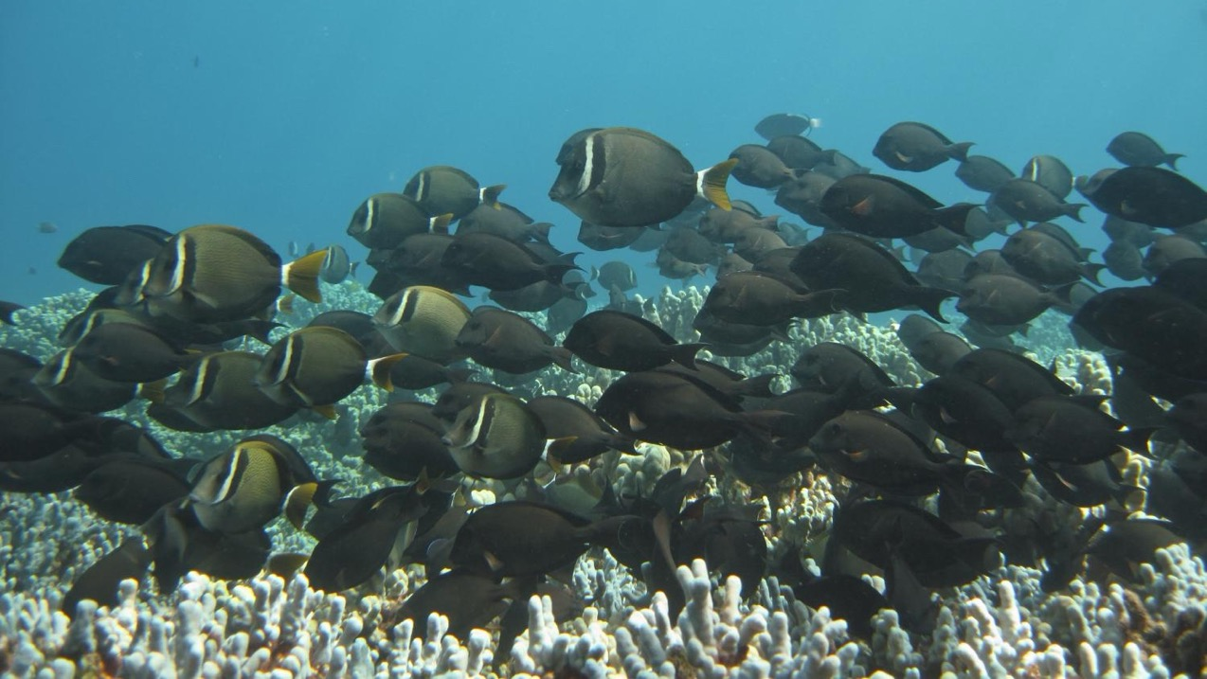
Thus, reef productivity and performance is maintained
Notes:
Image; https://phys.org/news/2016-12-reef-fish-grazing-behaviors-coral.html

Slide 11
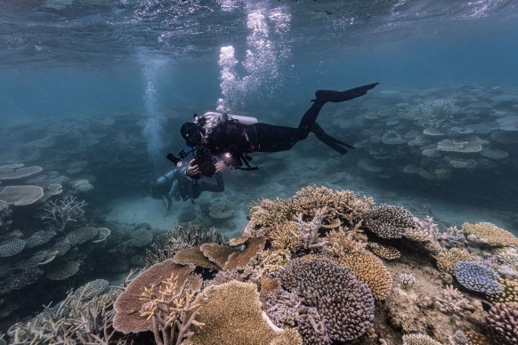
…and the reef can make a speedy recovery
Lizard Island 2022
Notes:
Image: https://www.smh.com.au/environment/sustainability/on-a-remote-australian-island-a-small-patch-of-reef-is-as-good-as-scientists-have-ever-seen-it-20220826-p5bcyb.html

Slide 12
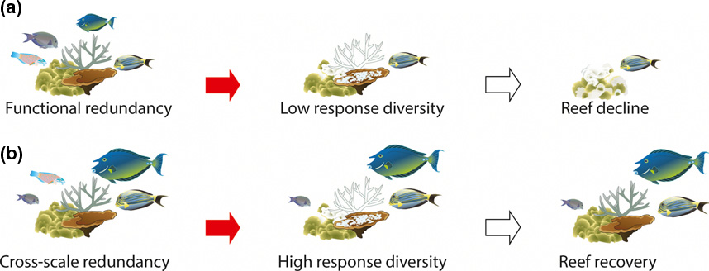
High functional redundancy → Reef recovery
LOW Functional diversity and LOW Functional redundancy
HIGH Functional diversity and HIGH Functional redundancy
Image adapted from: Nash, K.L., Graham, N.A., Jennings, S., Wilson, S.K., & Bellwood, D.R. (2016). Herbivore cross‐scale redundancy supports response diversity and promotes coral reef resilience. Journal of Applied Ecology, 53, 646-655.
Notes:
Image: Nash, K.L., Graham, N.A., Jennings, S., Wilson, S.K., & Bellwood, D.R. (2016). Herbivore cross‐scale redundancy supports response diversity and promotes coral reef resilience. Journal of Applied Ecology, 53, 646-655.

Slide 13
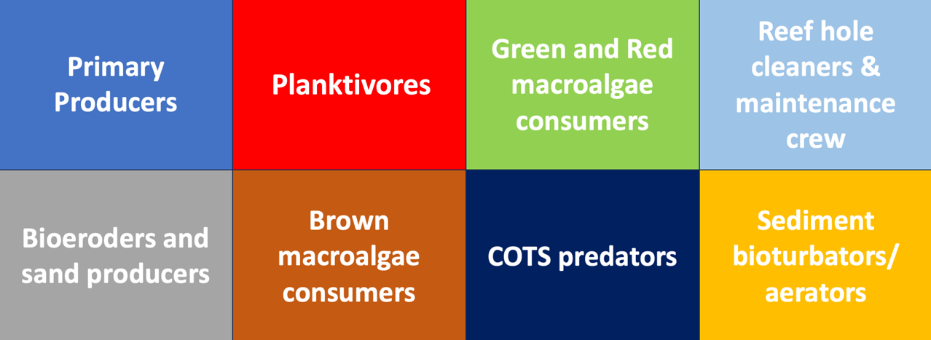
Examples of key functional groups (role descriptions)
with redundant members

Slide 14
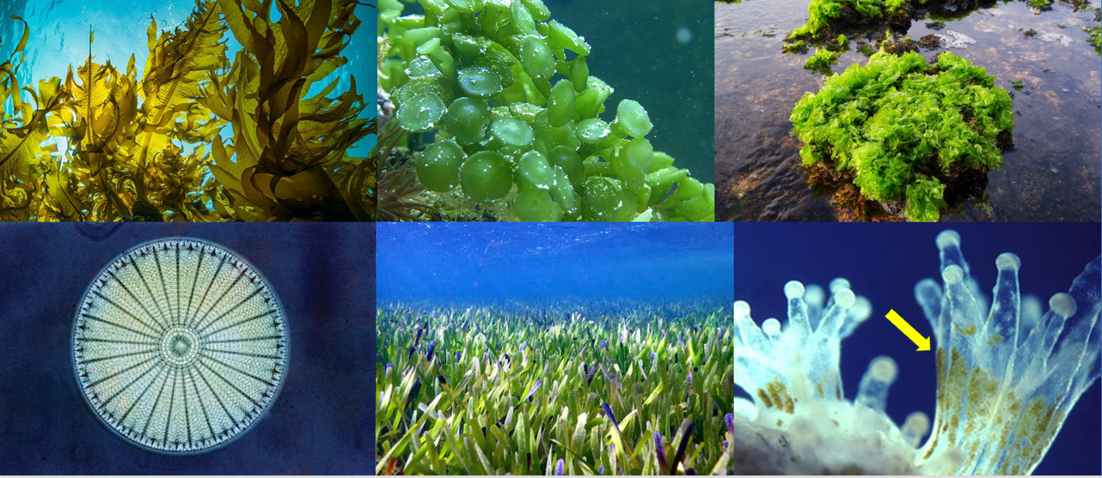
Primary Producers
carry out photosynthesis

Slide 15
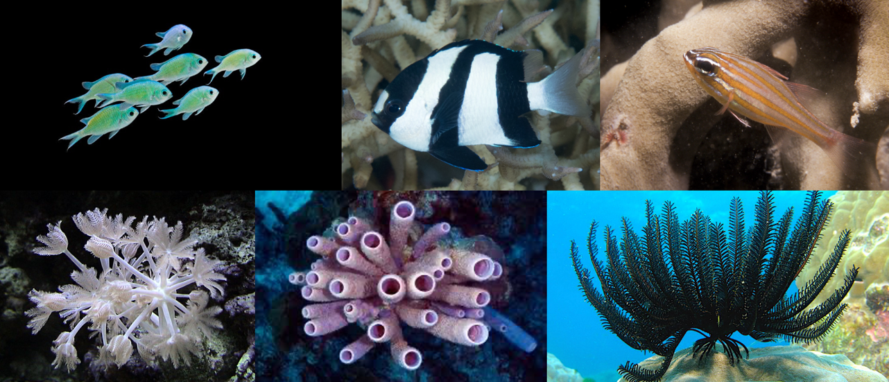
Planktivores
Feed on plankton - capture and retain nutrients from the ocean

Slide 16
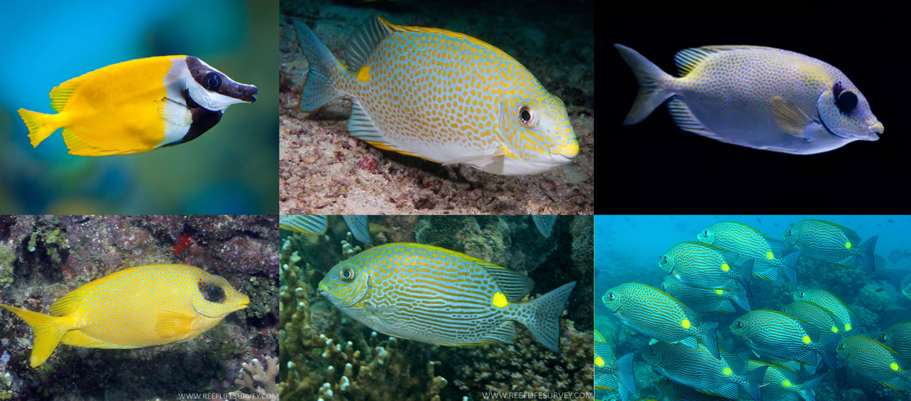
Green and Red Macroalgae consumers
Pictured below are the rabbitfish (there are more to this group)

Slide 17
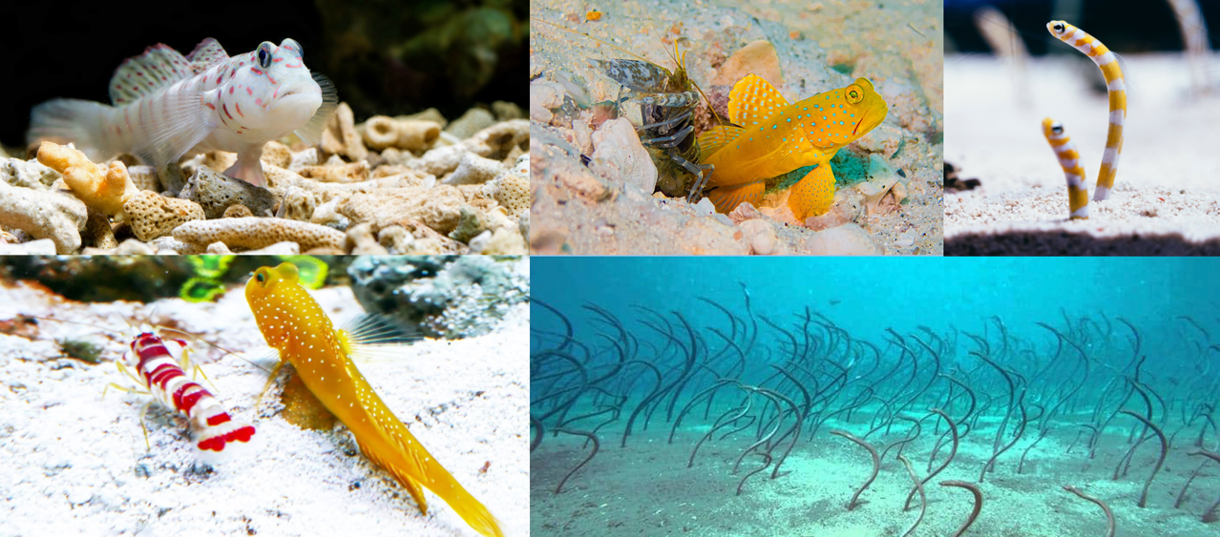
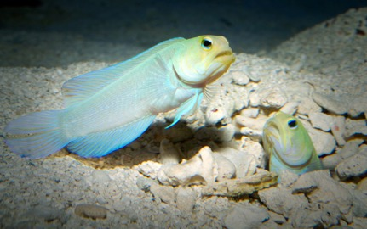
Reef hole cleaners and maintenance crew
vital for maintaining reef holes as microhabitats

Slide 18
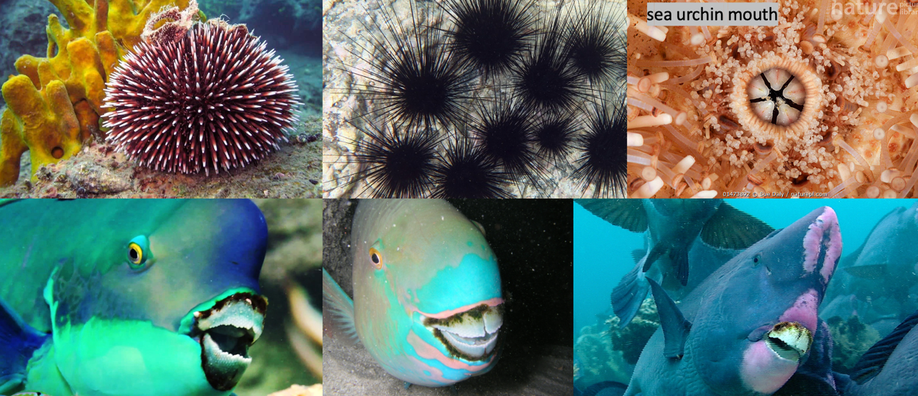
Reef rock bioeroders (excavators) and sand producers
graze on dead corals and coralline algae, then excrete sand, which makes more sand!

Slide 19
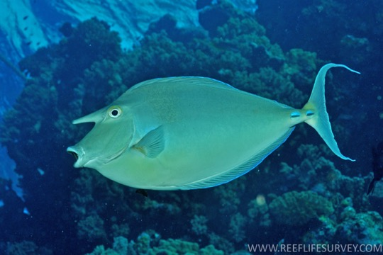
Brown macroalgae consumers
Not many do this important job. Low functional redundancy.
Blue spine unicornfish

Slide 20
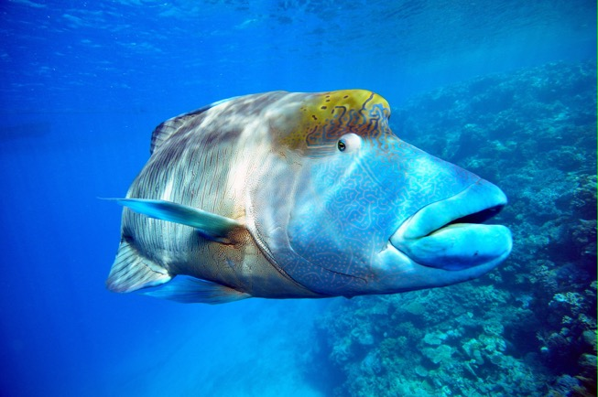
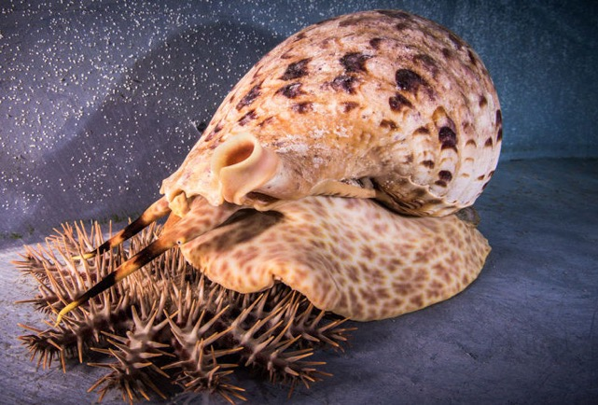
COTS predators
Not many do this important job. Low functional redundancy.

Slide 21
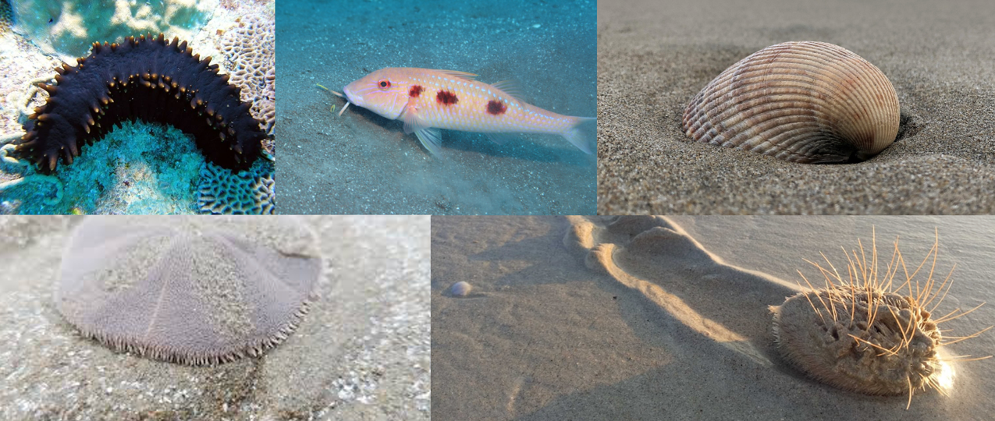
Sediment bioturbators/aerators

Slide 22
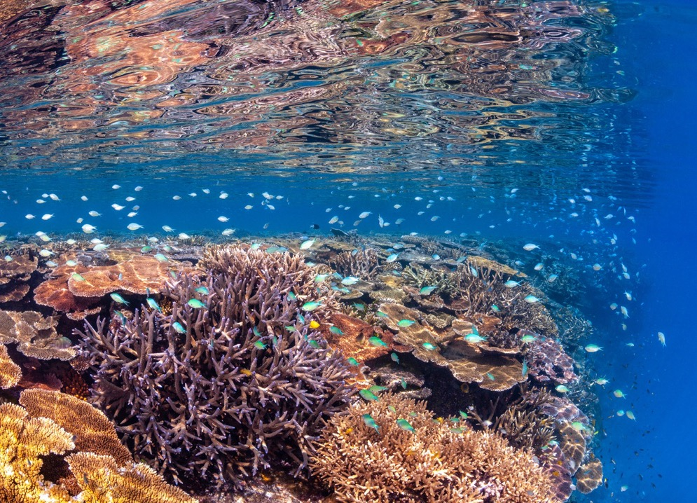
Corals are important because they create habitat
for the functional groups
Notes:
Image: https://communities.springernature.com/posts/does-more-coral-necessarily-equate-to-more-fish

Slide 23
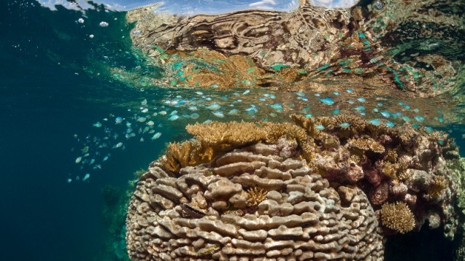
In return, functional groups like ‘grazers’ keep the habitat nice and healthy
Notes:
Image: https://news.climate.columbia.edu/2015/08/17/can-we-save-coral-reefs/

Slide 24
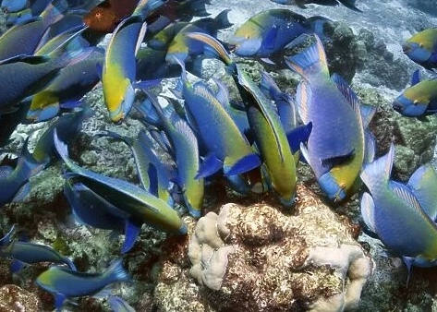
E.g. Grazers have the job of eating algae
that compete with coral for space
(grazers are the lawn-mowers of the sea)
Notes:
Image: https://www.mediastorehouse.com.au/science-photo-library/parrotfish-feeding-reef-c014-2918-9211735.html

Slide 25
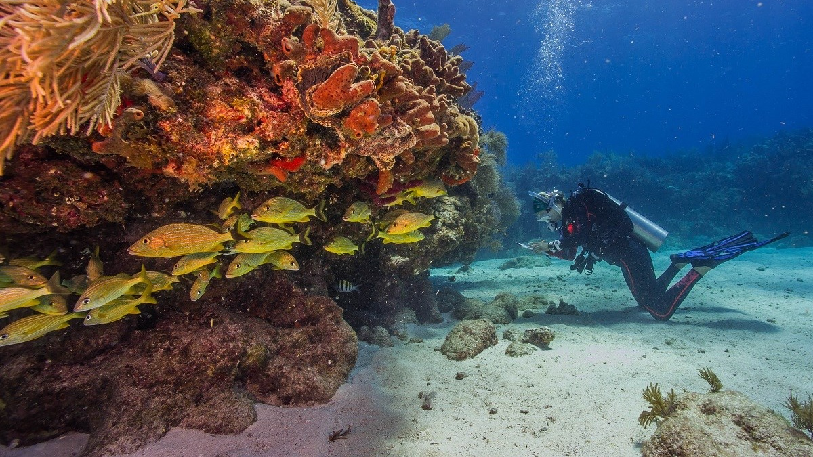
Corals provide the habitat
Notes:
Image: https://floridascoralreef.org/the-reef/facts-and-history

Slide 26
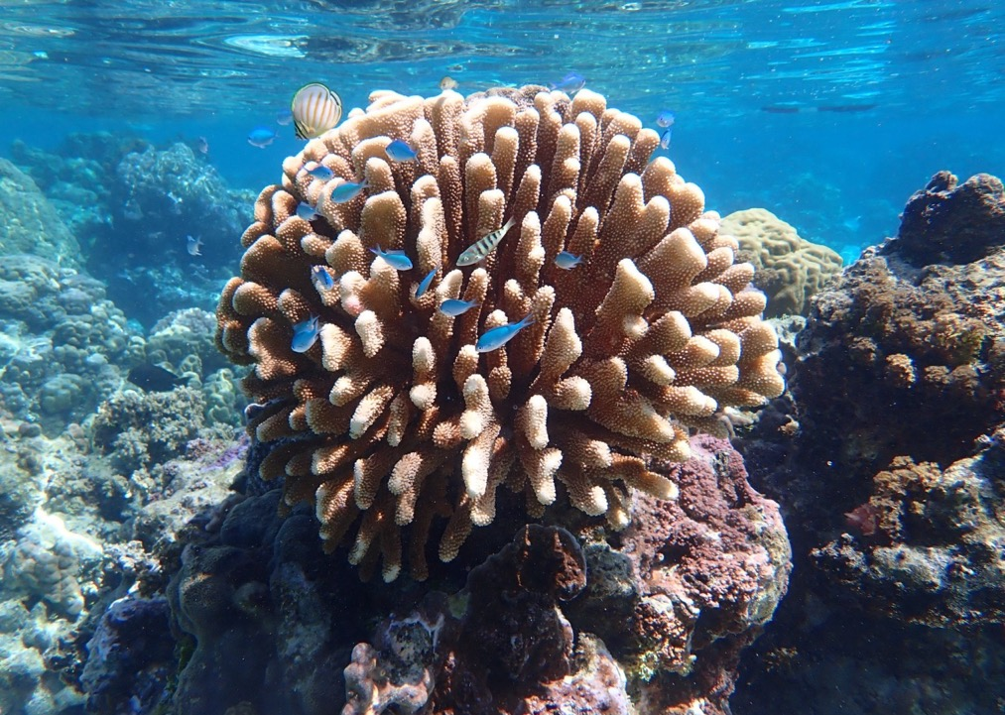
Functional groups keep it healthy
Notes:
Image: https://www.newsweek.com/fish-poo-vital-coral-survival-1794525

Slide 27
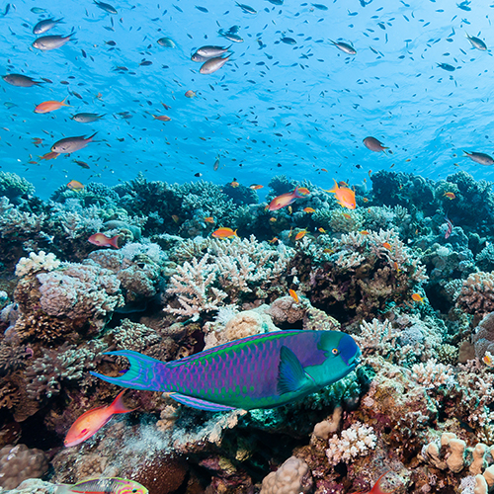
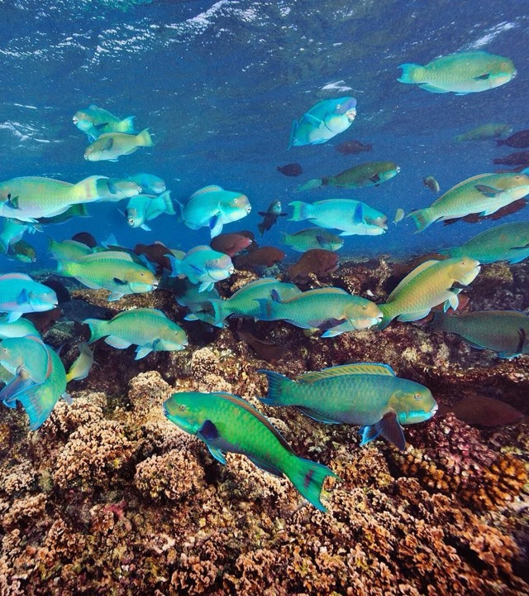
Notes:
Image (left): https://hoteliermaldives.com/parrotfish-play-pivotal-role-coral-reef-island-building/
Image (right): https://new77.ecole-peg.ch/?w=facts-about-parrotfish-coral-reefs-ee-G513bnhG

Slide 28
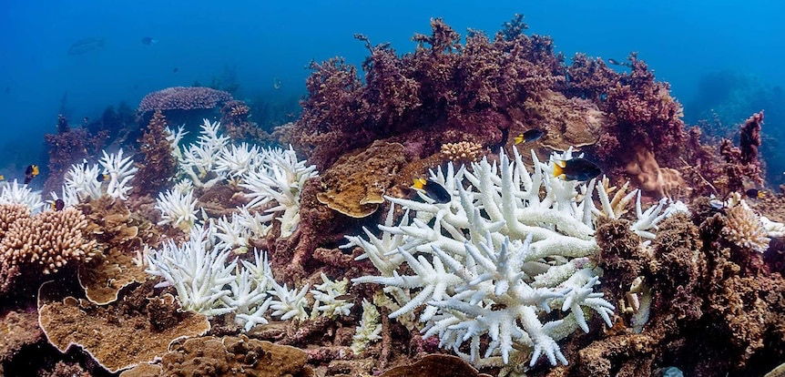
But, not all corals are doing so well in these heat waves.
Notes:
Image: https://www.abc.net.au/btn/classroom/coral-bleaching/13811232

Slide 29
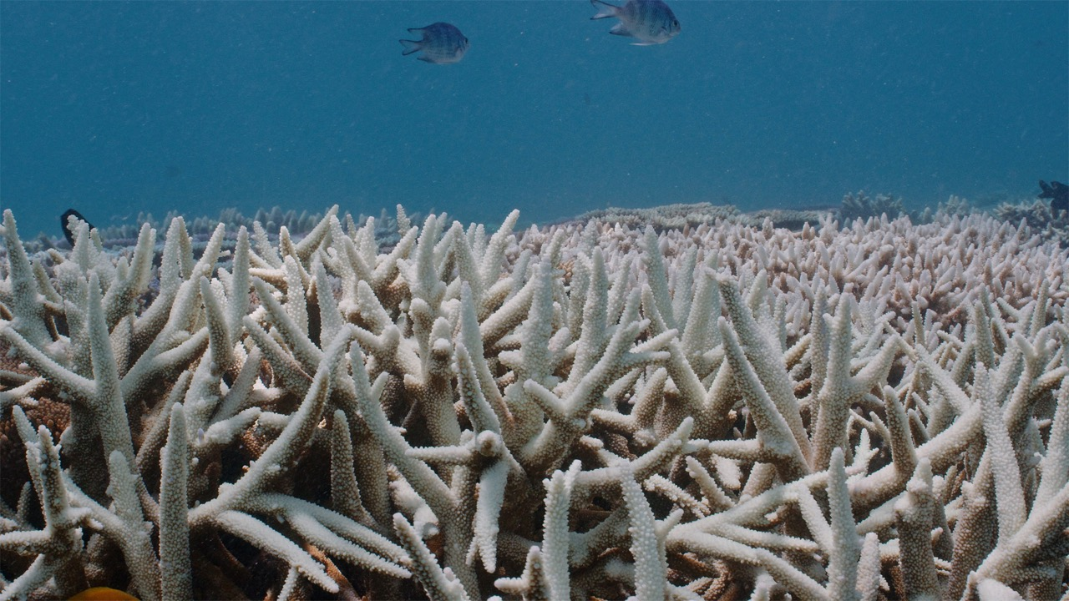
Notes:
Image: https://news.mongabay.com/2022/03/the-great-barrier-reef-is-bleaching-once-again-and-over-a-larger-area/

Slide 30
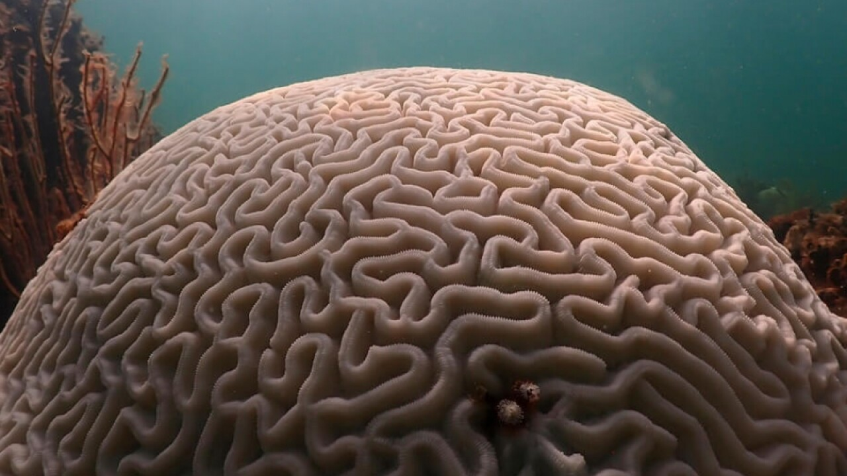
Even the toughest corals are now struggling
Notes:
Image: https://www.wptv.com/what-can-florida-s-dying-corals-tell-us-about-the-shifting-climate

Slide 31
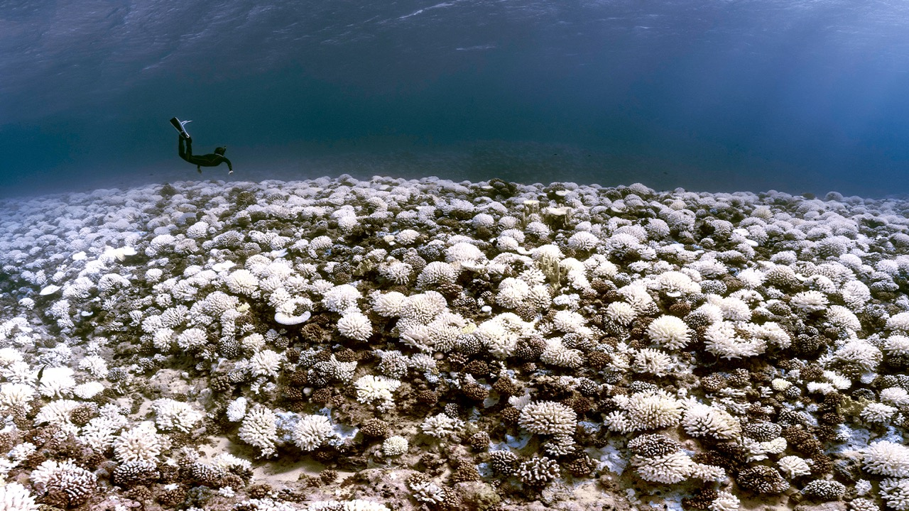
Notes:
Image; https://grist.org/science/world-4th-coral-bleaching-event-official-climate/

Slide 32
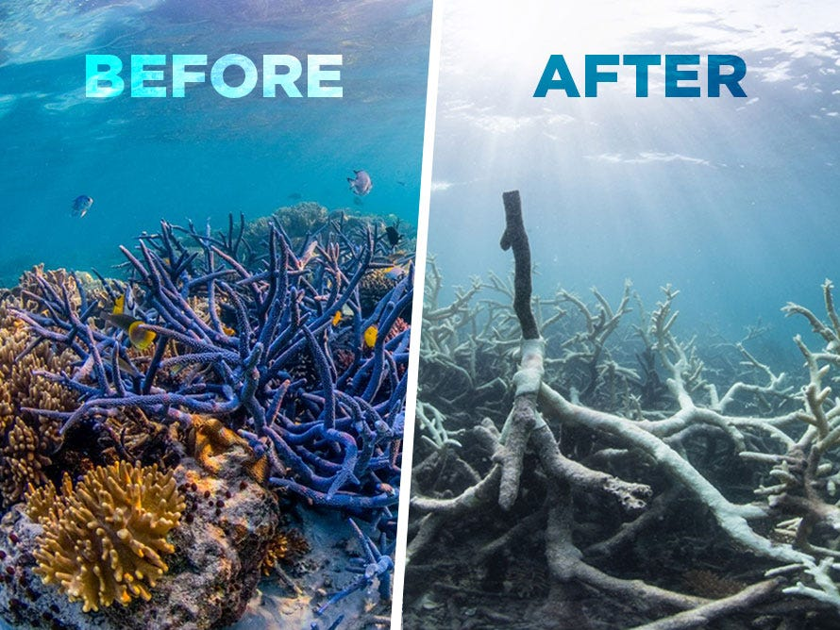
Functional groups have left.
The ‘employees’ are gone and jobs are not getting done.
Notes:
Image; https://medium.com/@TheEcoAdventure/great-barrier-reef-is-dying-643e91f08772

Slide 33
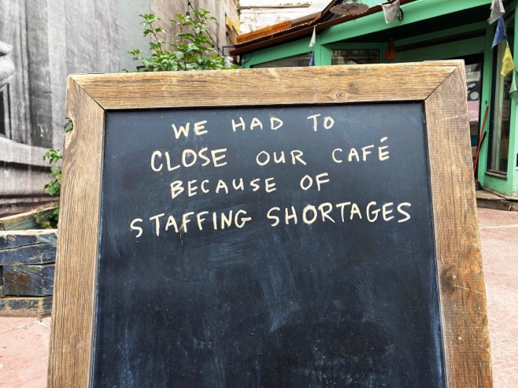
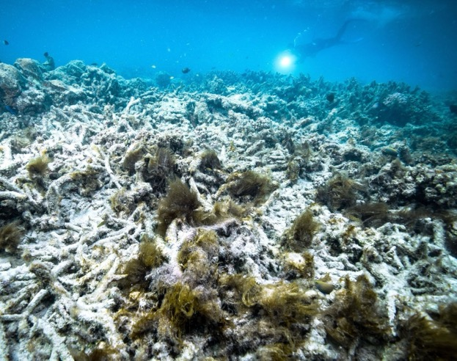
What happens to a workplace (ecosystem) that hasn’t got enough staff (marine life) doing their jobs?
Notes:
Image (left): https://www.employmentplus.com.au/news/seven-ways-to-ease-the-burden-of-staffing-shortages
Image (right): https://www.nytimes.com/2020/04/06/world/australia/great-barrier-reefs-bleaching-dying.html

Slide 34
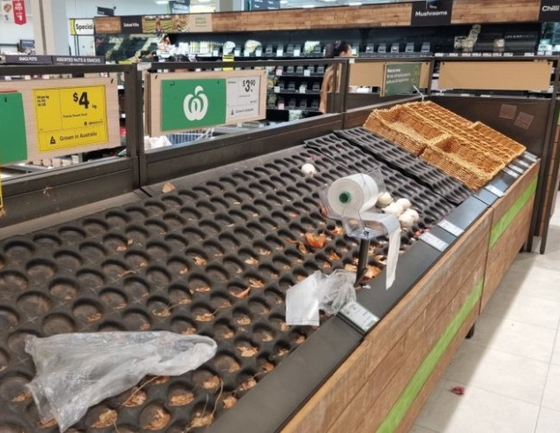
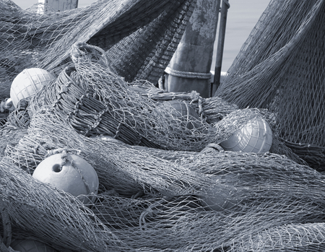
Ecosystems go Bankrupt
No fish caught
Notes:
Image (left): https://www.smh.com.au/politics/queensland/woolies-blames-terrible-it-problem-for-empty-shelves-in-brisbane-20240513-p5jd9f.html
Image (right): https://www.123rf.com/stock-photo/fishing_net_old.html

Slide 35
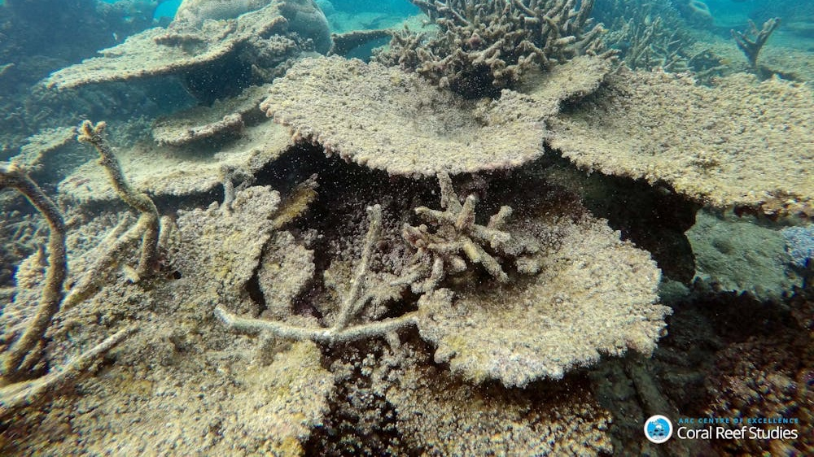
CLOSED for business
Notes:
Image: https://theconversation.com/how-much-coral-has-died-in-the-great-barrier-reefs-worst-bleaching-event-69494
Dead table corals killed by bleaching in the north, November 2016. Greg Torda, ARC Centre of Excellence for Coral Reef Studies.,

Slide 36
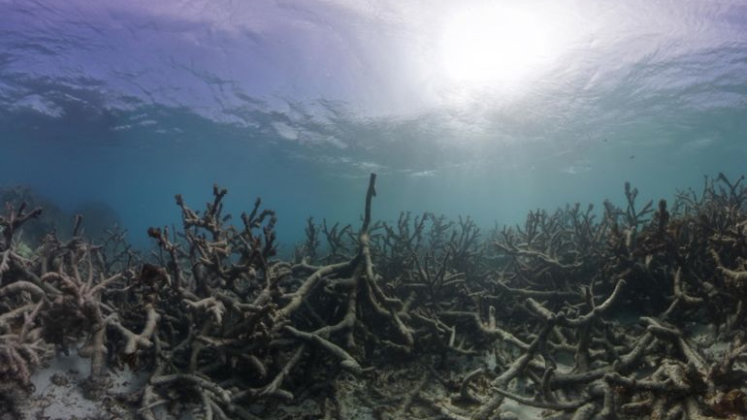
reefs become too WEAK to recover
Notes:
Image; https://www.aljazeera.com/features/2018/1/29/why-are-coral-reefs-important-and-why-are-they-dying

Slide 37
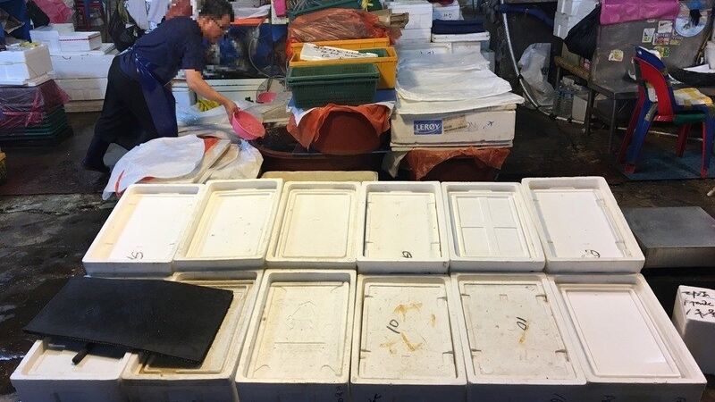
Notes:
Image: https://english.hani.co.kr/arti/english_edition/e_national/855957

Slide 38
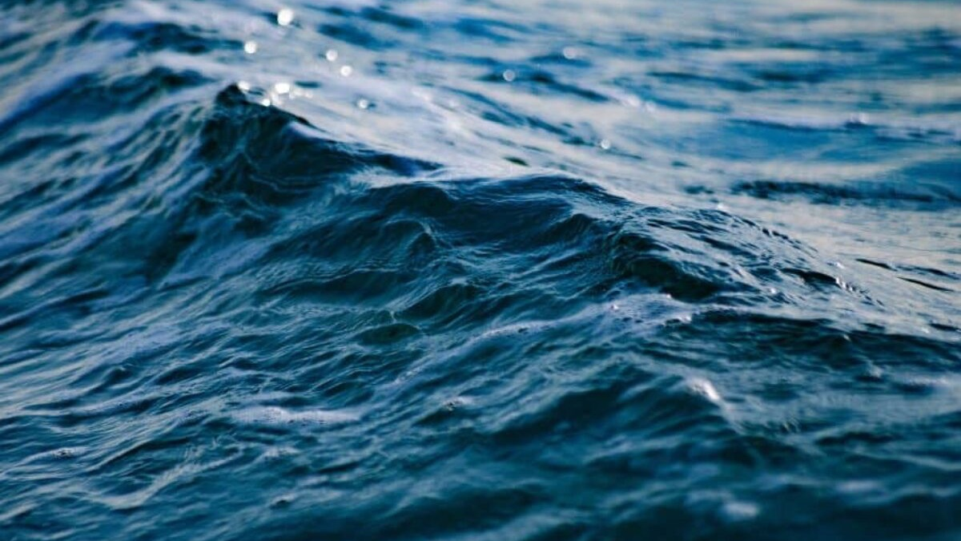
But, most of the time, the damage bill goes largely unseen
(hidden underwater)
Notes:
Image: https://earth.org/the-consequences-of-rising-sea-surface-temperatures-on-wildlife-and-coastal-communities/

Slide 39
Insert the latest data for the Great Barrier Reef
E.g. AIMS Long Term Monitoring Data graphs

Slide 40
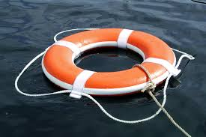
If we act now, we can throw the reef a lifeline….

Slide 41
A coral reef is resilient and quickly recovers from disturbances if it has:
High functional biodiversity
Heat resistant ‘super’ corals

Slide 42
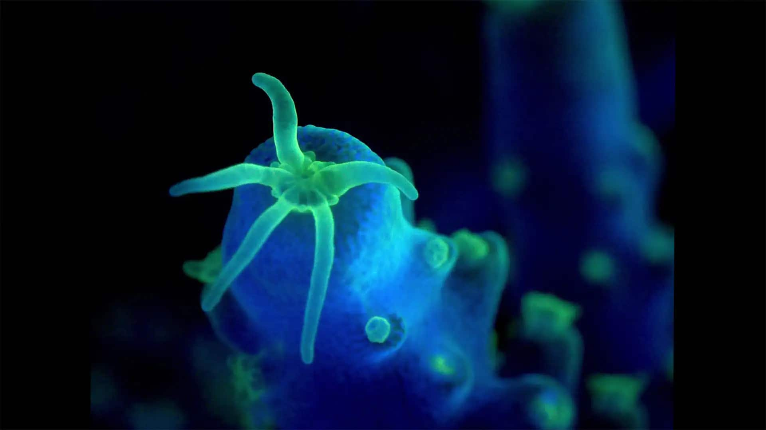
Heat resistant ’super’ corals
are corals that have adapted to already elevated temperatures (due to where they live)
Notes:
Image: https://www.cbc.ca/natureofthings/features/saving-the-worlds-coral-reefs-by-speeding-up-evolution

Slide 43
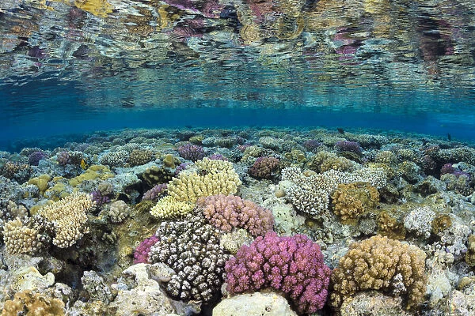
Heat resistant ‘super’ corals
are usually found in warm, wide shallow reef flats and warm, closed shallow lagoons
Notes:
Image: https://www.vifmall.com/?ggcid=1743491

Slide 44
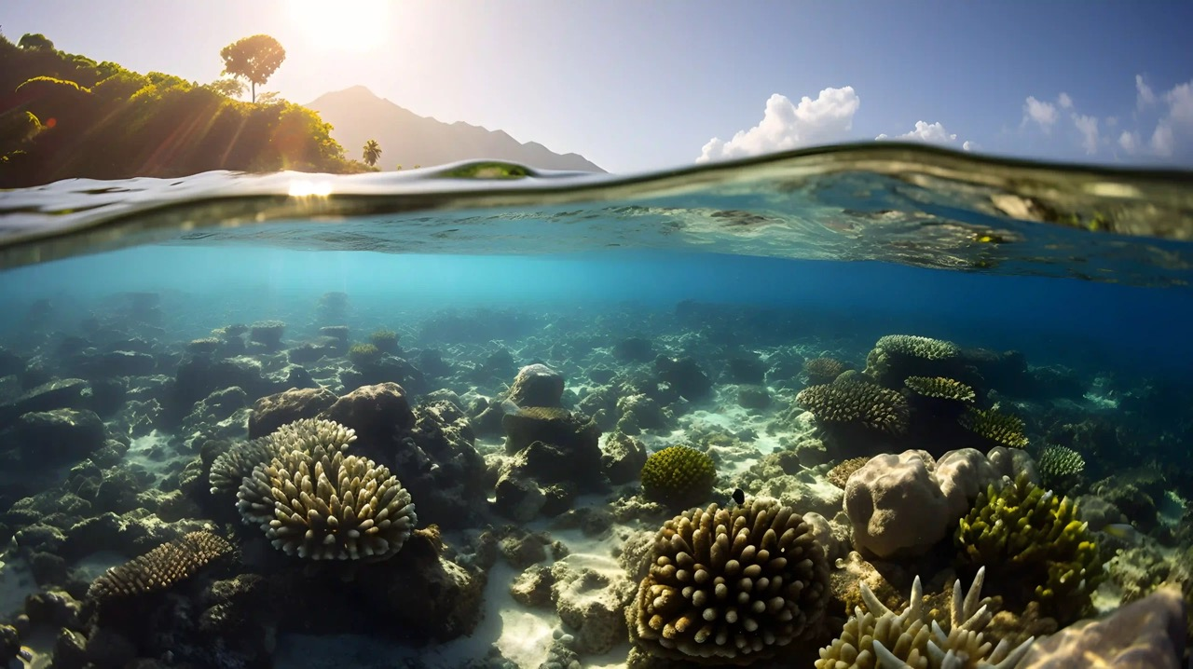
Notes:
Image: https://www.aquaread.com/blog/global-warming-impacts-of-rising-sea-temperature/

Slide 45
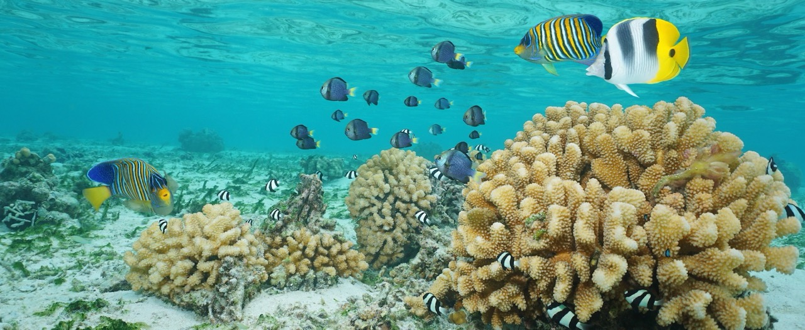
Heat resistant ‘super’ corals
like all corals, provide habitat for functional groups to live
Notes:
Image: https://grist.org/climate/rumors-of-this-corals-survival-were-greatly-exaggerated/

Slide 46
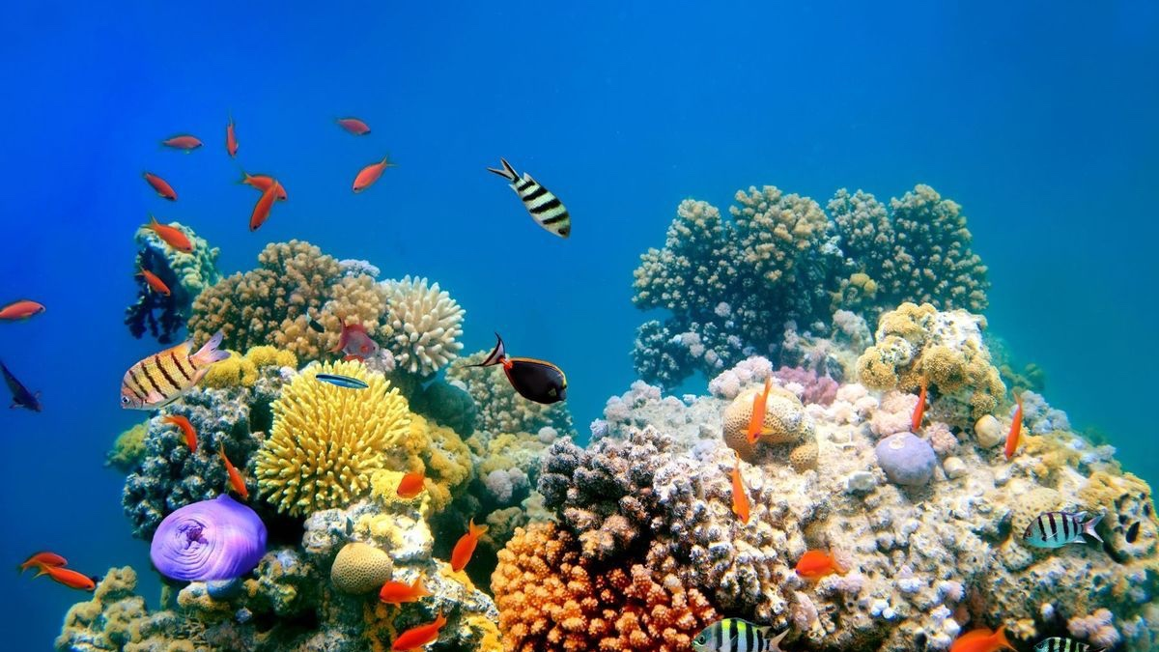
Thus, promoting high functional diversity
and, therefore, high functional redundancy
Notes:
Image: https://www.the-scientist.com/deepwater-coral-reefs-unlikely-to-welcome-shallow-water-animals--64531

Slide 47

But even ‘super’ corals have a bleaching threshold temperature.
Notes:
Image: https://www.smh.com.au/politics/federal/mass-coral-bleaching-on-great-barrier-reef-sparks-fear-of-global-event-20240308-p5fauh.html

Slide 48

Bleached and dead coral around Lizard Island on the Great Barrier Reef [David Gray/AFP]
Notes:
Image: https://www.aljazeera.com/news/2024/4/17/australias-great-barrier-reef-suffers-worst-bleaching-on-record
Bleached and dead coral around Lizard Island on the Great Barrier Reef [David Gray/AFP]

Slide 49

Thus,
‘super’ corals
need to be moved to
gene bank nurseries in cooler waters NOW
to withstand future bleaching events and be preserved.
Notes:
Image: https://www.nemo.eco/coral-hub/corals-for-conservation

Slide 50

Notes:
Image: https://www.nemo.eco/coral-hub/corals-for-conservation

Slide 51

Notes:
Image; https://www.nemo.eco/coral-hub/corals-for-conservation

Slide 52

Notes:
Image: https://www.nemo.eco/coral-hub/corals-for-conservation

Slide 53

Notes:
Image: https://www.nemo.eco/coral-hub/corals-for-conservation

Slide 54


Gene bank nurseries have already been set up in Fiji and other places around the world (not so much on the GBR)
Notes:
Images: https://www.nemo.eco/coral-hub/corals-for-conservation

Slide 55

Case Study
(Fiji)
https://www.youtube.com/watch?v=KuOWxwnFZnk

Slide 56

We urgently need gene bank nurseries on the Great Barrier Reef
Activity: search Google Earth to locate ‘hot pocket’ reefs where super corals may be found on the GBR, as well as potential gene bank nursery sites.
What to look for (Source: Corals4Conservation):
“hot pocket” reefs are often dominated by shallow waters less than one meter deep at low tide.
“hot pocket” reefs are regularly exposed to extremely hot waters at low tide and may also the air during extreme low tides and thus impacted by heavy rainfall and drying by the sun and wind.
Follow the general principle that nearshore reefs are warmer than cooler offshore waters.
Wide reef flats accumulate hot water during low tide more than narrow reef flats do.
Large reefs with extensive shallow areas will be warmer than small reefs with less shallow water.
Leeward (protected) sides of islands and reef flats sheltered from waves and winds will be warmer than their windward sides.
Gene bank nurseries should be located behind a narrow reef flat, which breaks the waves and protects the nursery, but it needs to be able to do so from all sides (not just the prevailing wind side).
Gene bank nurseries should be at least 1-2 meters deeper than the reef flat and situated close-up against the reef, where fish can gain access to clean the nursery corals (and not be afraid to swim there).
GBRMPA permitting process requires fragmentation to occur in the same reef complex and same gene pool.

Slide 57

For example:
Potential hot-pocket coral populations are circled in pink as potential collecting sites.
Potential gene bank nurseries are circled in blue.

Slide 58




Permits
In Fiji, you only need permission from traditional owners to start a nursery.
In Australia, you need a permit from the government
(for them to assess the risks involved with the activity)
For more information, watch video “Permitting advice for coral restoration projects in the GBR”: https://www.youtube.com/watch?v=GNOii47yX2M

Slide 59

Learning Intention:
Apply the terms ecosystem resilience, disturbance and recovery as indicators of ‘health’ of marine environments to a chosen case study.
Success Criteria:
Complete Marine Education worksheet
‘6. Marine Diagnosis’
Notes:
Image: https://www.volunteerworld.com/se/volunteer-program/biorock-coral-reef-restoration-in-indonesia-gili-trawangan

