Slide 1
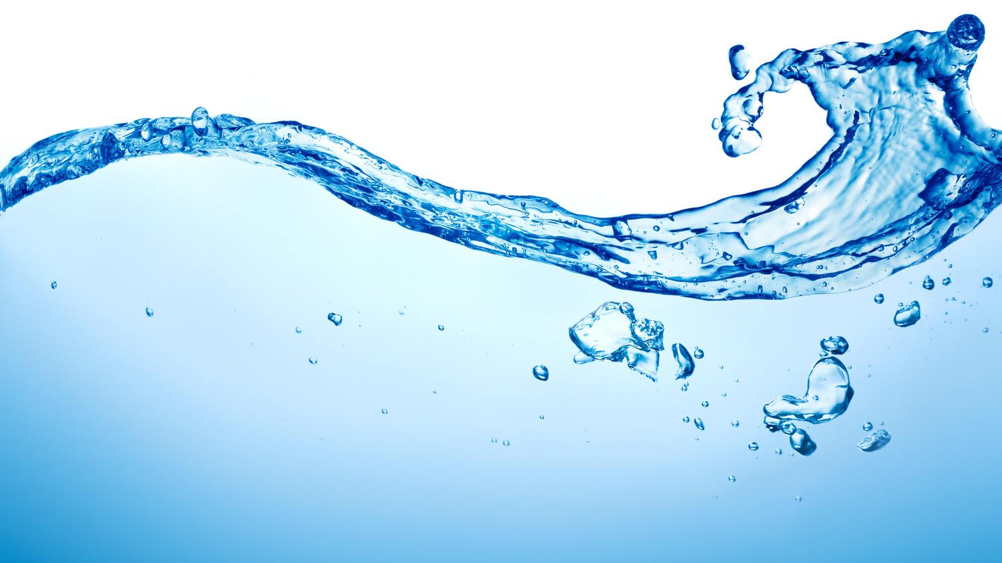
Learning Intention:
Describe the physical and chemical properties of water, including structure, hydrogen bonding, polarity, action as a solvent, heat capacity and density
Success Criteria:
Complete Marine Education worksheet ‘6. Wacky Water’
Notes:
https://cinergee.com.au/blog/the-amazing-effects-of-water-on-our-body/

Slide 2
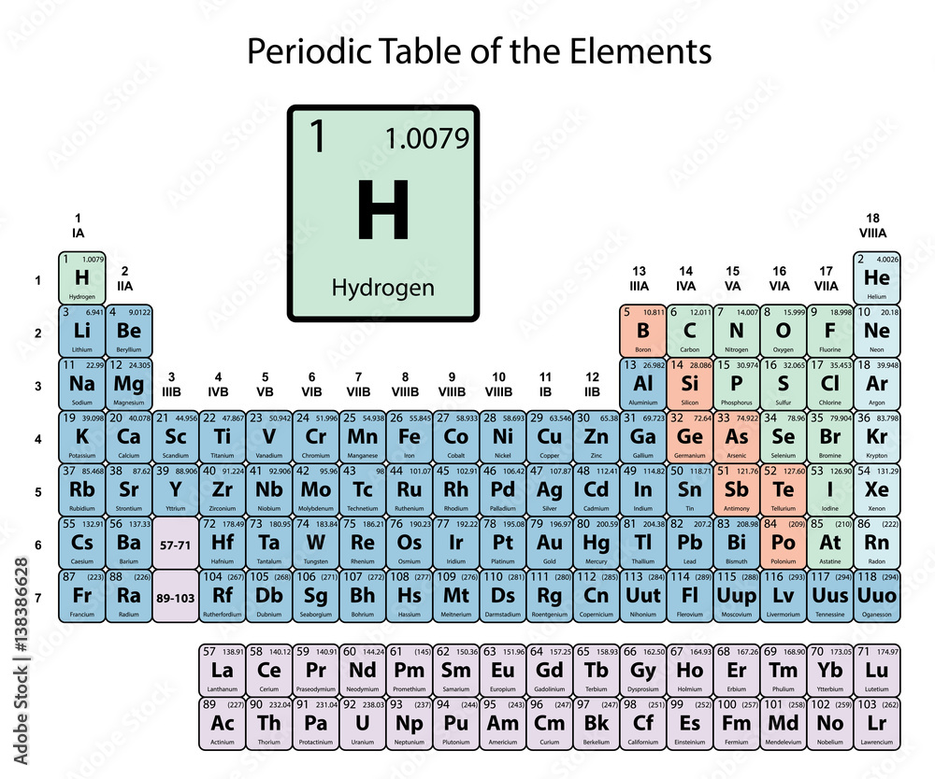
Hydrogen atom

Slide 3
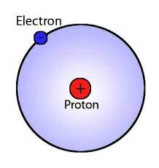
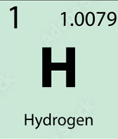
Hydrogen atom
Notes:
http://www.mysearch.org.uk/website1/html/211.Bohr.html

Slide 4
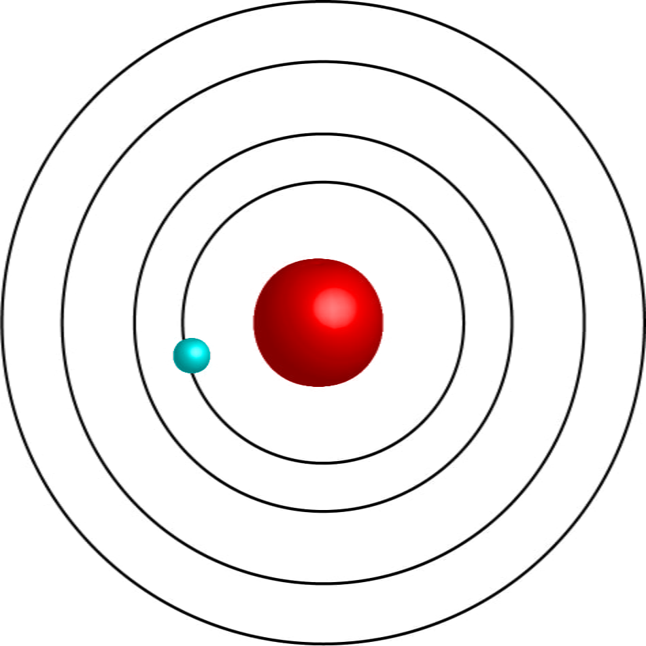
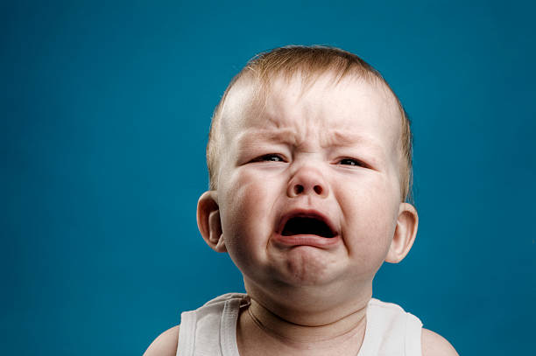
electron
proton
A full inner shell has 2 electrons (happy atom).
Hydrogen only has 1 ☹.
Notes:
https://chemistrytalk.org/bohr-atomic-model/

Slide 5
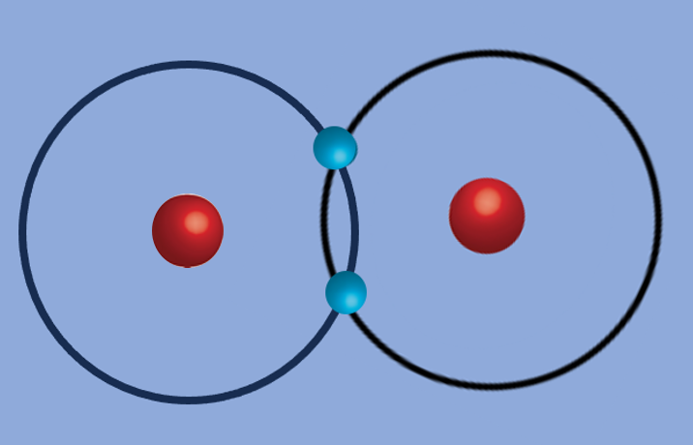

H₂ molecule
Joined together, they both have a full inner shell ☺

Slide 6
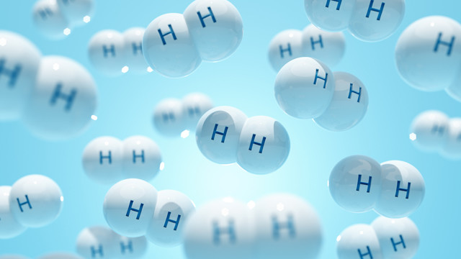
Notes:
https://www.bizneworleans.com/states-companies-compete-for-billions-to-make-hydrogen/

Slide 7
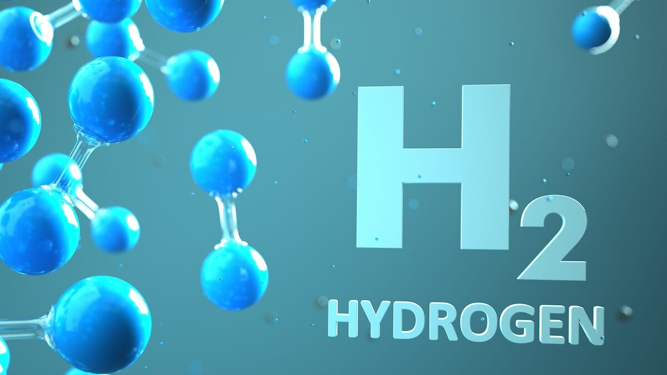

Slide 8
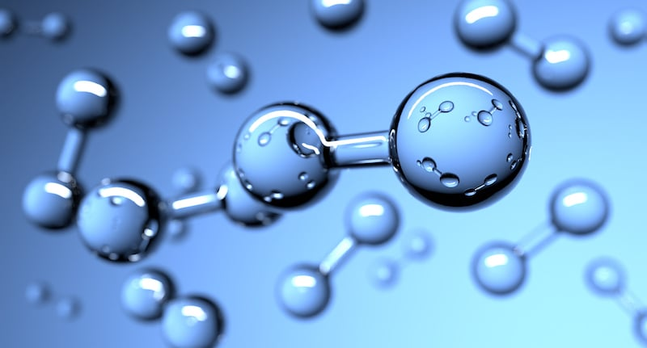

Slide 9
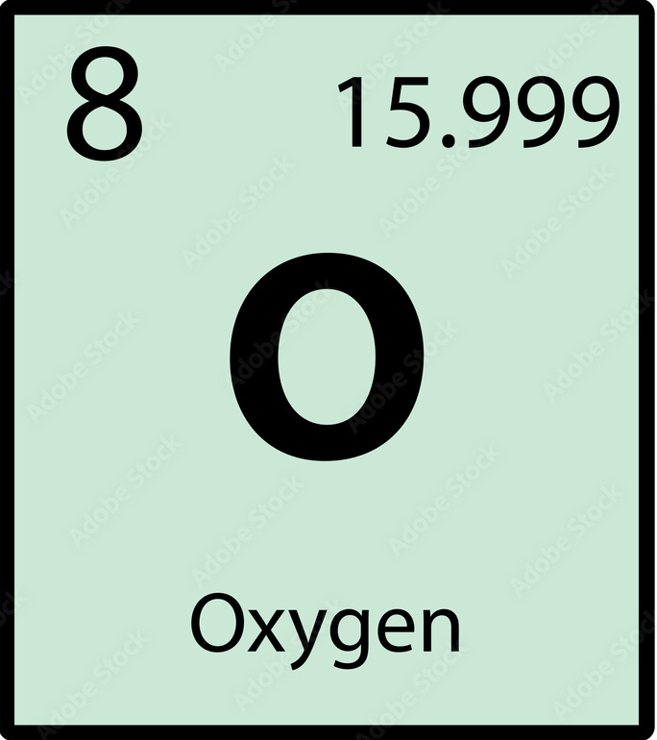
Oxygen atom

Slide 10
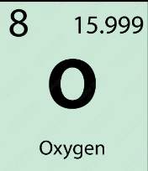
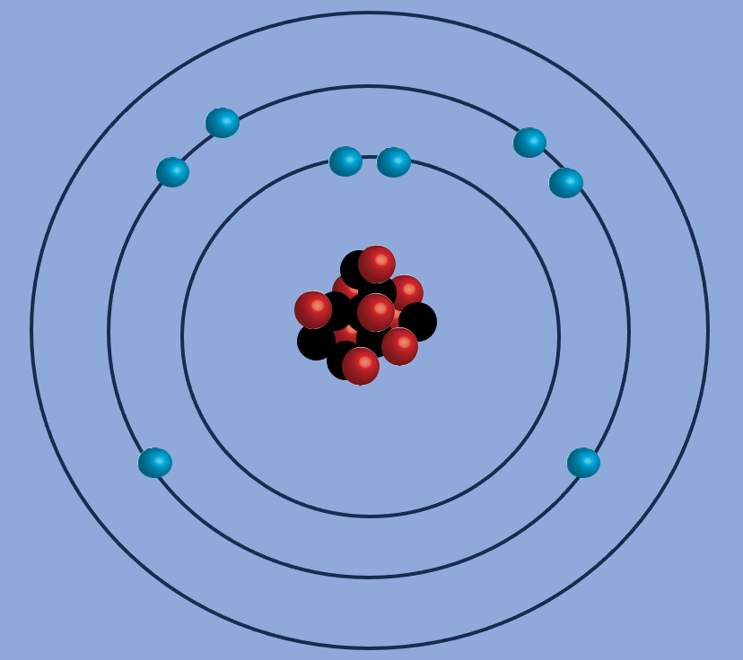
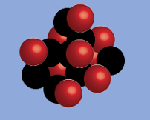
electron
proton
neutron
Oxygen atom
Notes:
http://www.mysearch.org.uk/website1/html/211.Bohr.html

Slide 11
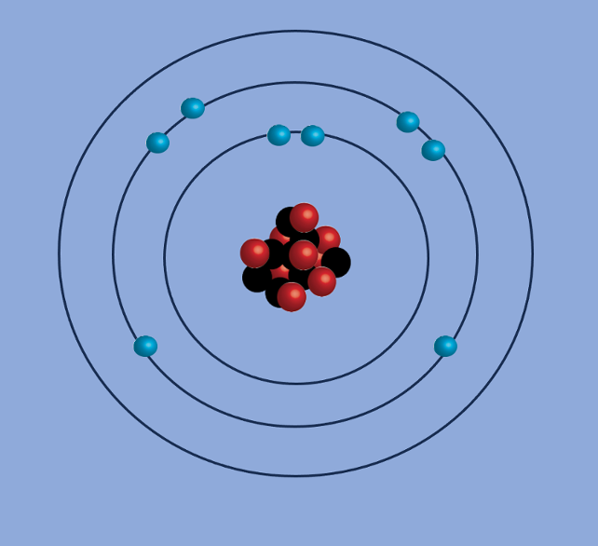
A full outer shell has 8 electrons (happy atom).
Oxygen only has 6 ☹.
Notes:
https://chemistrytalk.org/bohr-atomic-model/

Slide 12
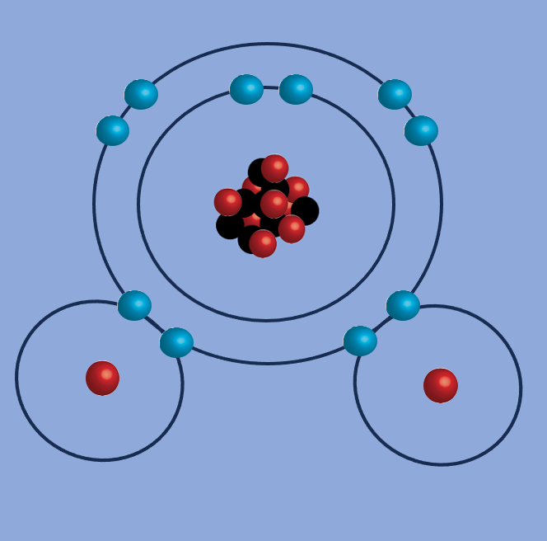

Hydrogen (x2) joined with oxygen (x1) and they all have full shells ☺
Notes:
https://socratic.org/questions/what-is-the-molecular-structure-of-h-2o

Slide 13
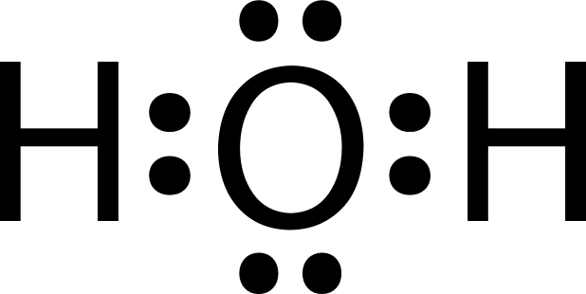

Slide 14
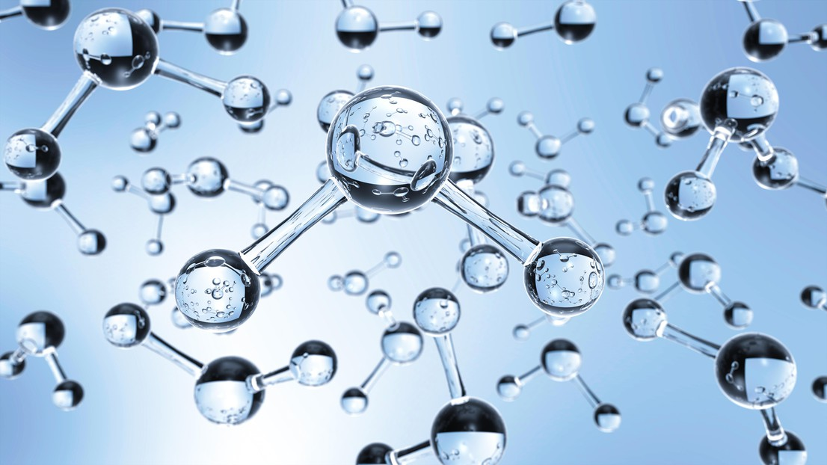
Notes:
https://actu.epfl.ch/news/liquid-flow-is-influenced-by-a-quantum-effect-in-3/

Slide 15


Mickey Mouse ears

Slide 16
Electrons are negatively charged
protons are positively charged

Slide 17
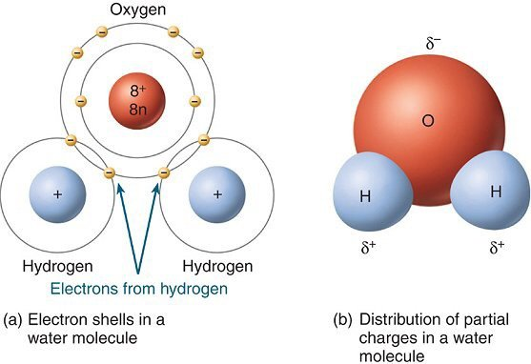
+
This is the POSITVE end of the water molecule
(due to both hydrogen atoms being close together on top)
-
This is the NEGATIVE end of the water molecule

Slide 18
+
pole
“Dipole” (two pole) structure
-
pole

Slide 19
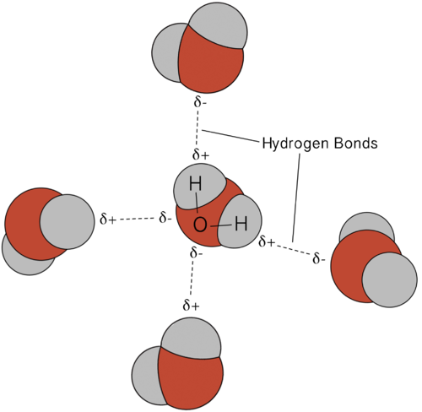
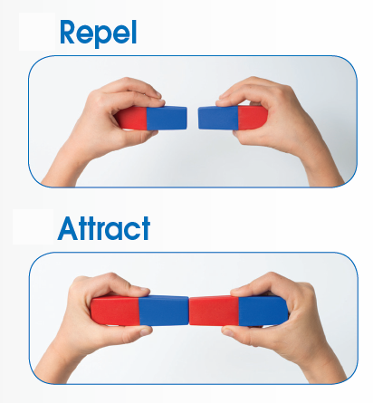
Opposites attract

Slide 20
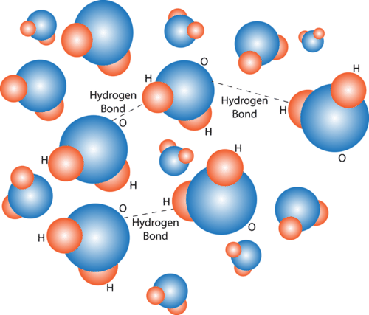
Hydrogen bonds
Notes:
https://www.ck12.org/biology/structure-and-properties-of-water/lesson/biochemical-properties-of-water-advanced-bio-adv/

Slide 21
One of water’s special properties is its tremendous solvent power – it’s ability to dissolve stuff. The dipole structure of the H2O molecule accounts for its unsurpassed properties as a solvent, attracting (not only other H2O molecules but also) other positively or negatively charged atoms, called ions, such as SALT ions Sodium (+) and Chloride (-) ions.
That’s why sea water tastes so salty!

Slide 22
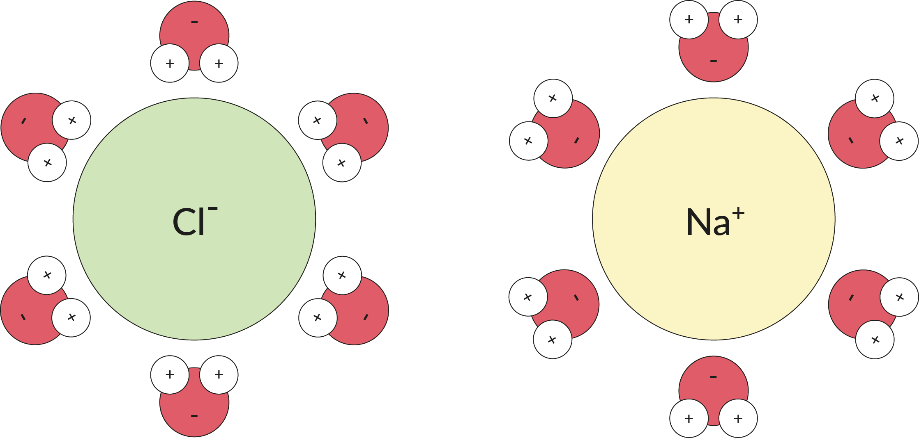
Notes:
https://www.ozmo.io/how-to-describe-the-structure-of-the-water-molecule-kids/

Slide 23
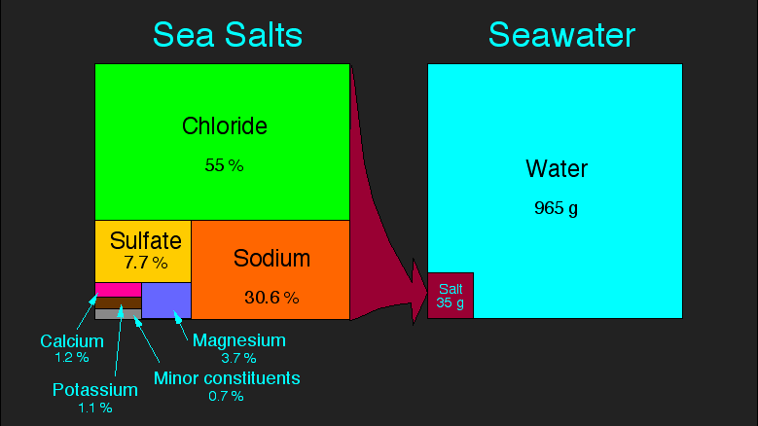
1kg
Notes:
https://uk.m.wikipedia.org/wiki/%D0%A4%D0%B0%D0%B9%D0%BB:Sea_salt-e_hg.png

Slide 24
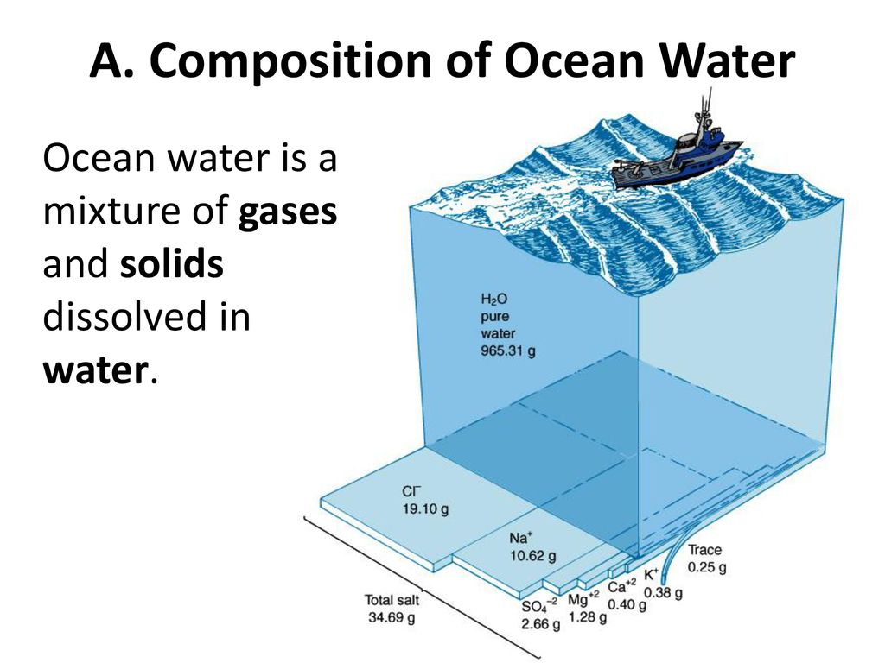
Notes:
https://slideplayer.com/slide/13751592/

Slide 25
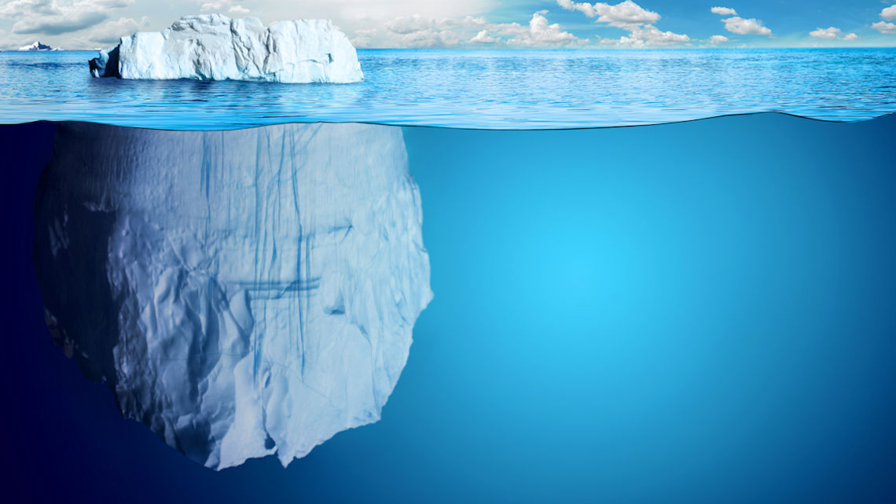
Ice is less dense than water. This means it floats.
Notes:
https://alearningfamily.com/main/iceberg-more-than-the-eye-can-see/

Slide 26
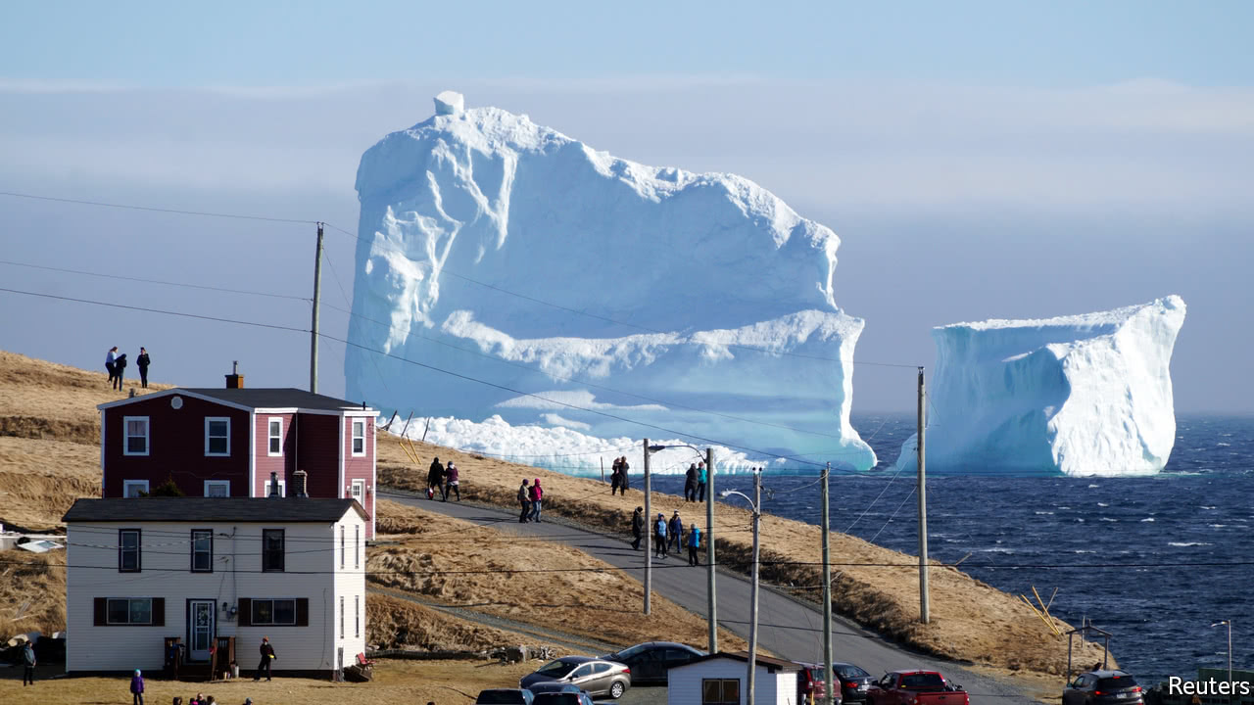
Notes:
https://www.economist.com/the-economist-explains/2017/06/26/why-newfoundland-has-so-many-icebergs-this-year

Slide 27
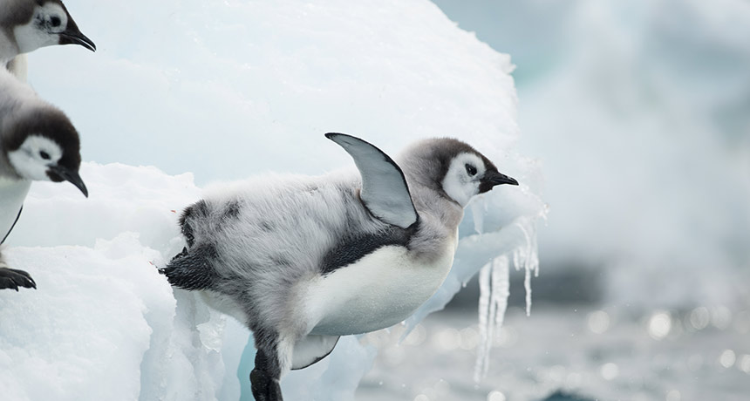
Notes:
https://www.sciencenews.org/article/young-emperor-penguins-brave-icy-winter-waters-their-first-year
JUMP RIGHT IN Although on their own at five months old and not yet knowing how to swim, dive or hunt, young emperor penguins quickly learn skills needed to survive Antarctica’s ice-strewn waters.
VINCENT MUNIER

Slide 28
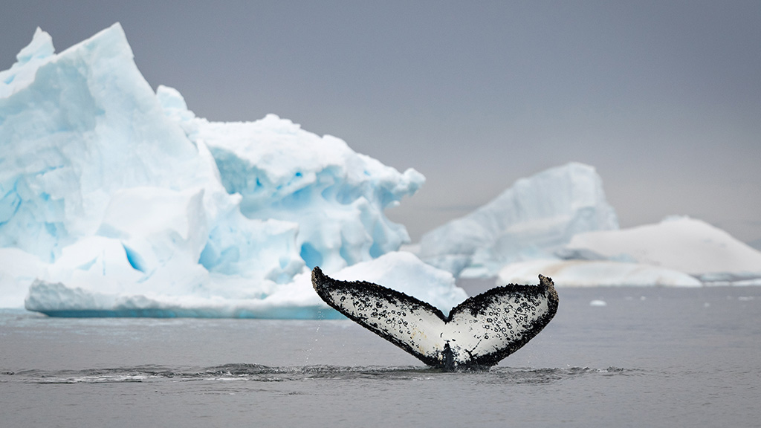
Notes:
https://www.abercrombiekent.com/blog/reasons-to-go/wildlife-bucket-list-8-whales-and-seals-to-see-in-antarctica

Slide 29
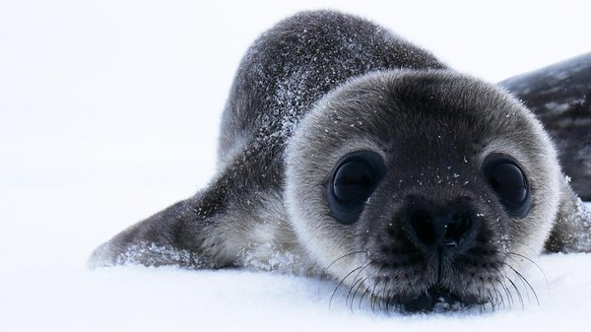
Notes:
https://www.pbs.org/wgbh/nova/video/antarctic-extremes-weddell-seals/

Slide 30
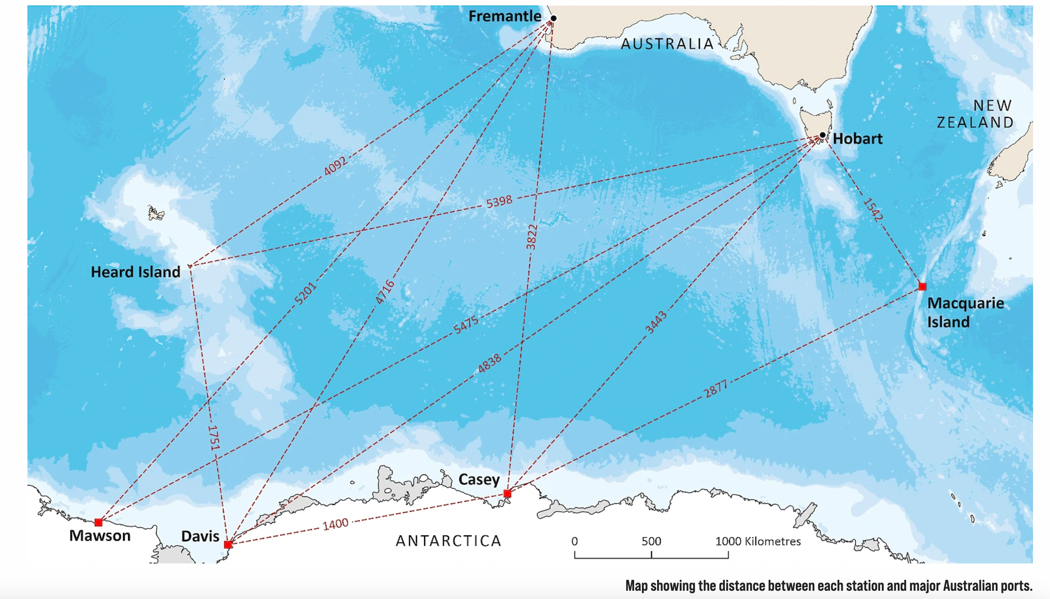
Notes:
https://www.antarctica.gov.au/antarctic-operations/stations/

Slide 31
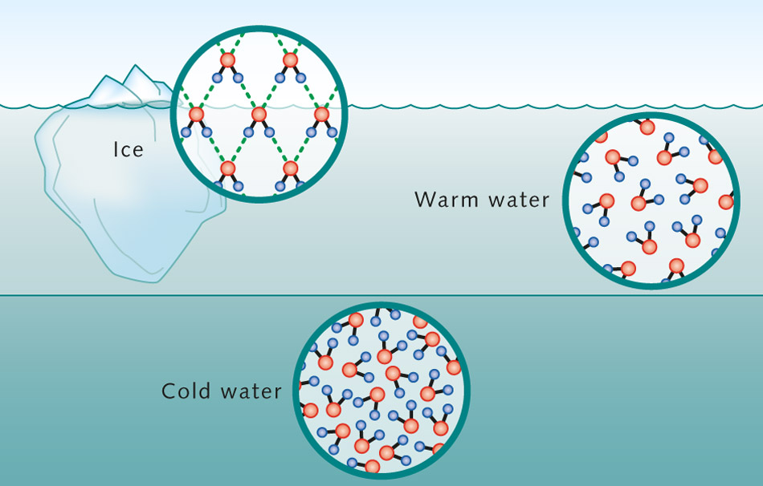
Ice floats on water
Cold water sinks (more dense)
Notes:
https://worldoceanreview.com/en/wor-1/climate-system/great-ocean-currents/water-a-unique-molecule/

Slide 32
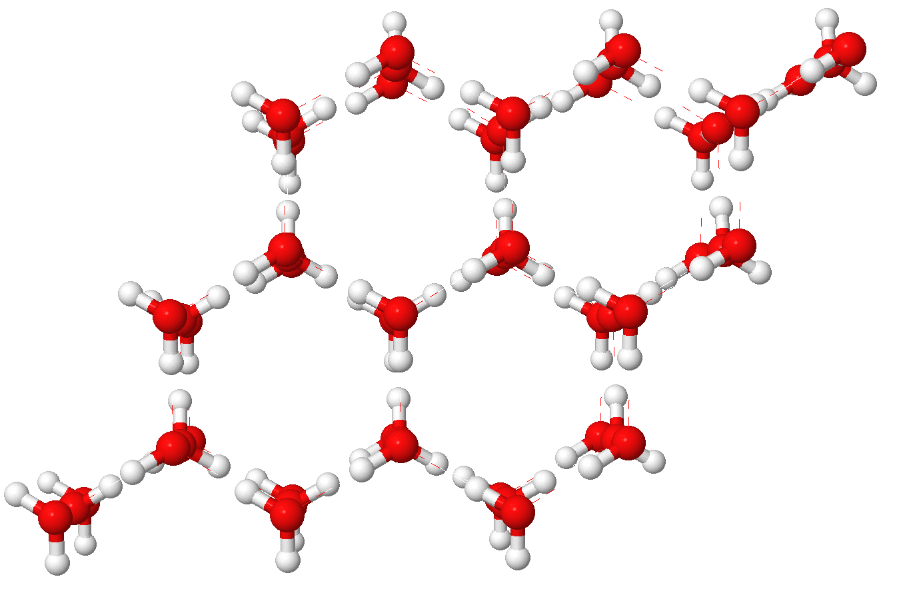
Ice

Slide 33
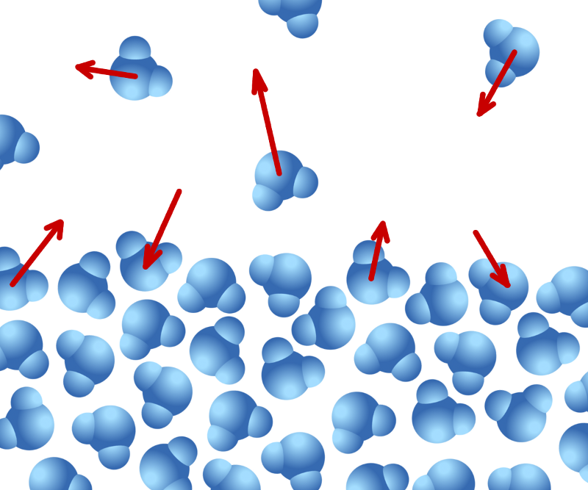
Evaporation
(hydrogen bonds break)

Slide 34

Notes:
https://www.livescience.com/planet-earth/plants/tropical-rainforests-could-get-too-hot-for-photosynthesis-and-die-if-climate-crisis-continues-scientists-warn

Slide 35
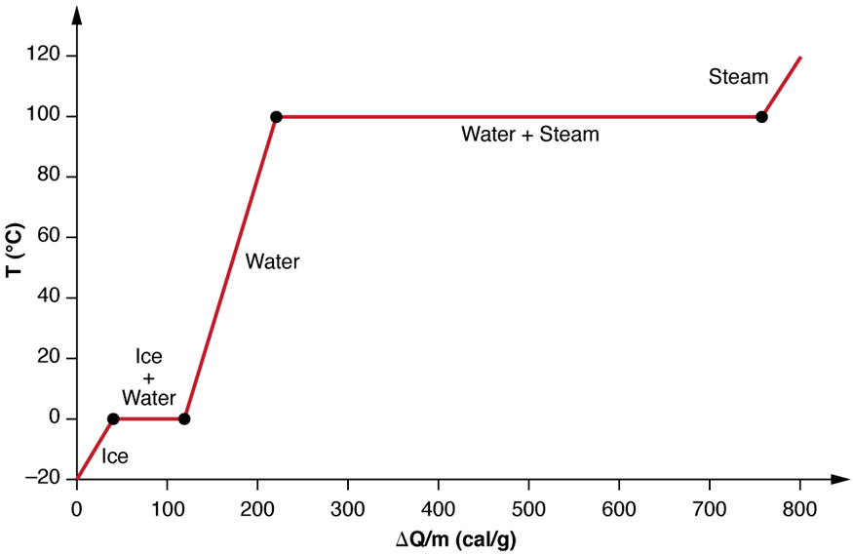
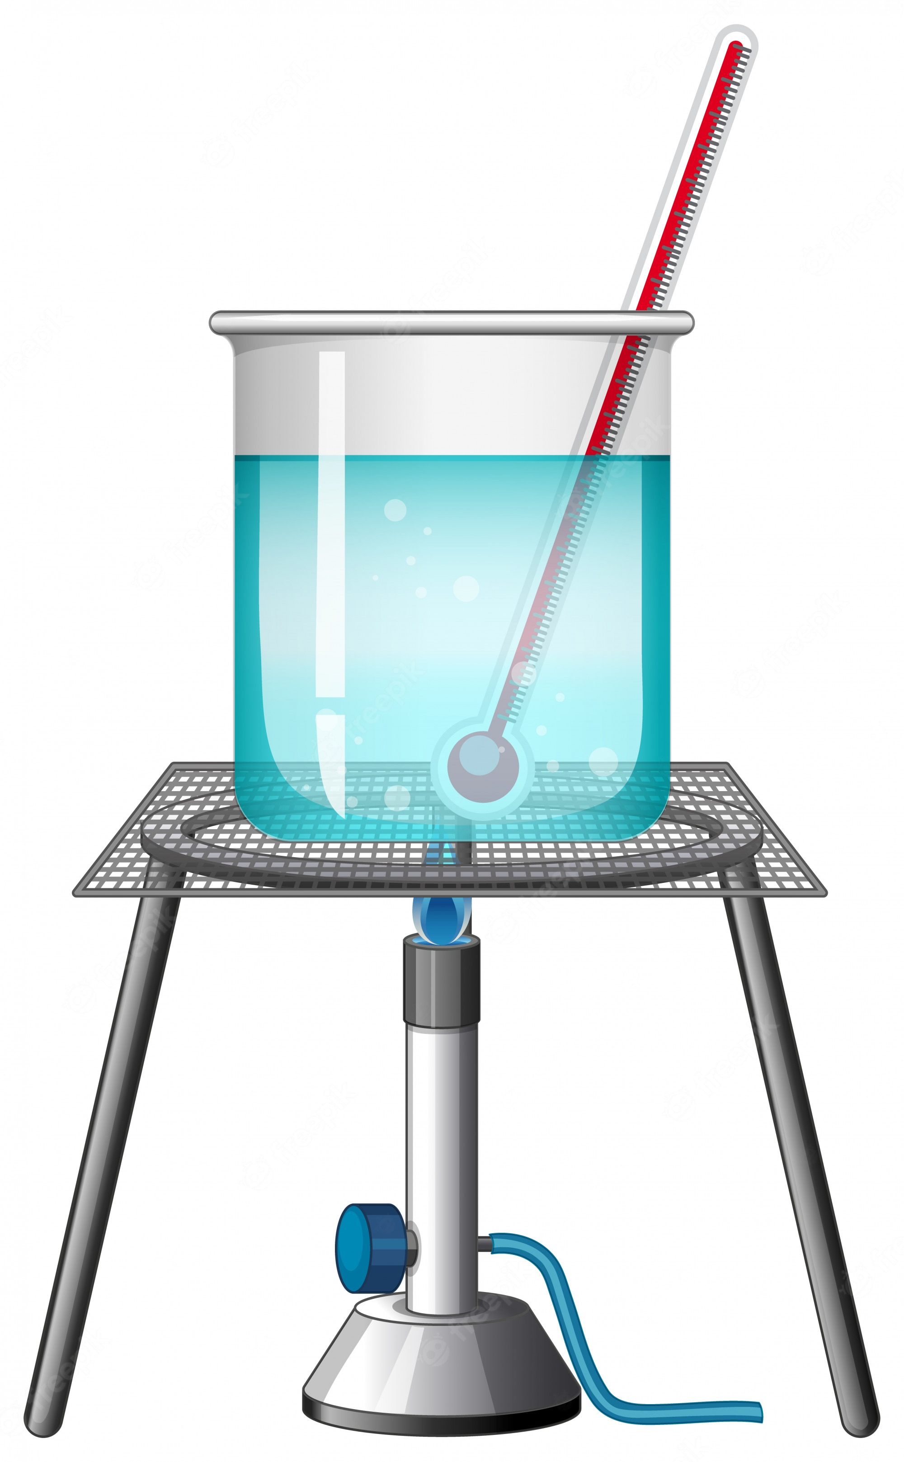
Temperature (℃)
Notice how the temperature stays the same when ice melts and water turns to steam. This is because the heat energy is being used to break the hydrogen bonds instead of raise the temperature.
Energy △Q/m (cal/g)
Notes:
The reason why is because the energy is being used to break the hydrogen bonds instead of raise the temperature.

Slide 36
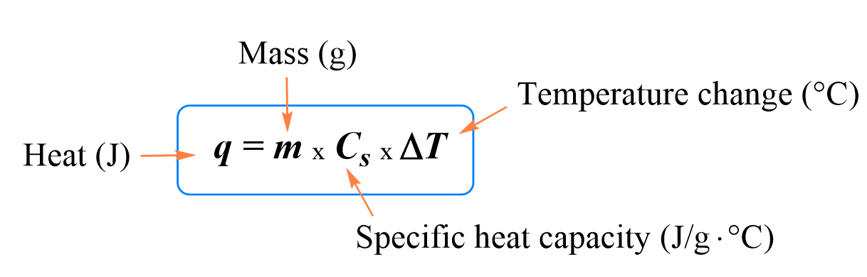
Specific Heat Capacity
Heat (cal.)
The amount of heat (energy) required to raise the temperature of 1kg by 1℃

Slide 37
The Specific Heat Capacity of liquid water is 1.0 cal/(g. ℃) at 1atm.
1kg
1 ℃
Heat (cal.)
1.0 cal/(g. ℃)
This implies that it takes 1 calorie of energy to raise 1 gram of water by 1 degree Celsius.

Slide 38
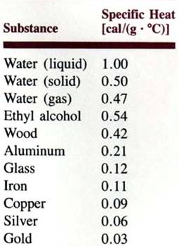
The specific heat capacity of liquid water is HIGH compared to many other substances
This means the ocean is slow to heat up or cool down.

Slide 39
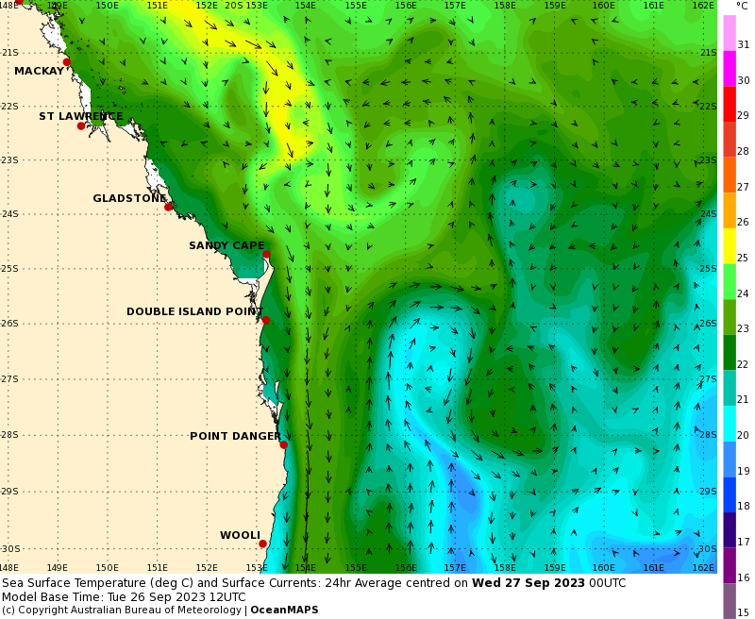
Warm water currents and cold water currents rarely mix.
Instead they each travel
as individual water masses with clear boundaries.
Notes:
http://www.bom.gov.au/oceanography/forecasts/idyoc300.shtml?region=SEQLD&forecast=SSTCur

Slide 40

Water stays cool on warm winter days

Slide 41
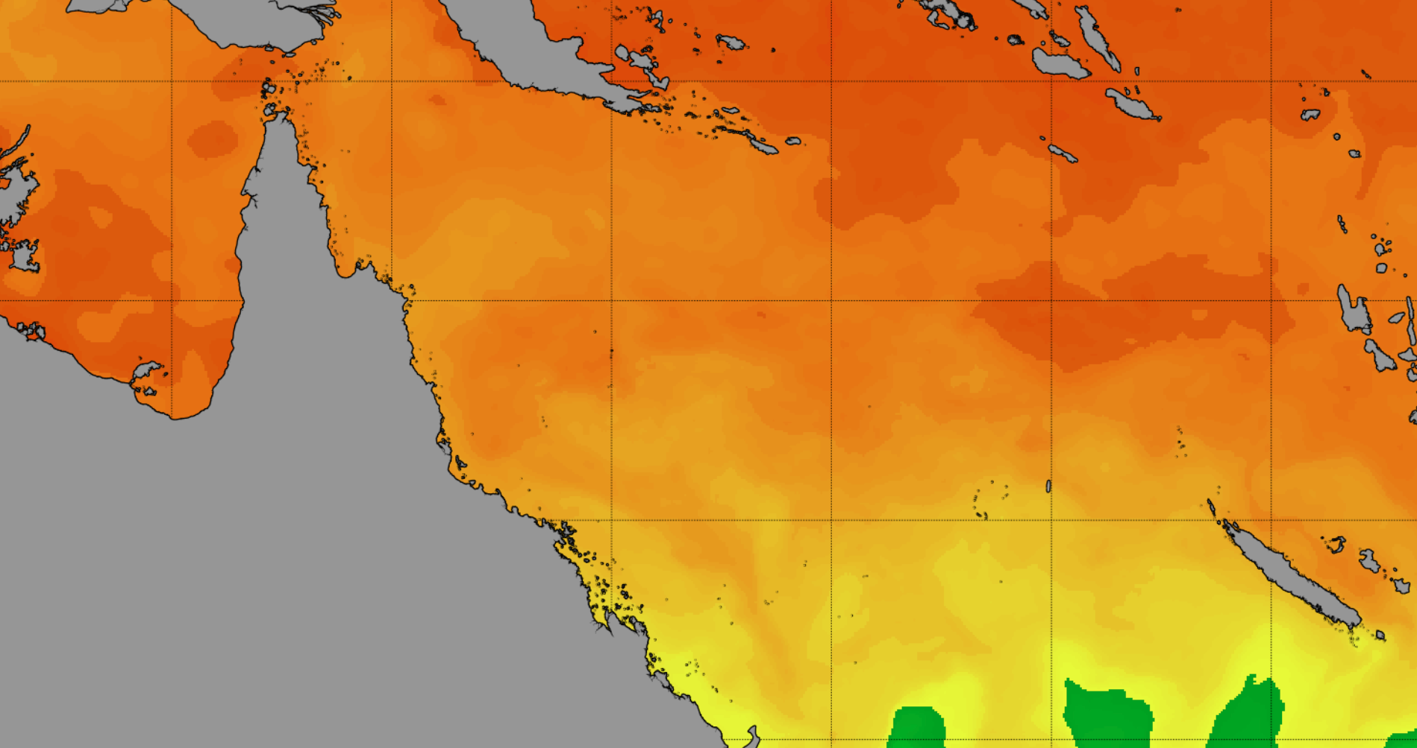
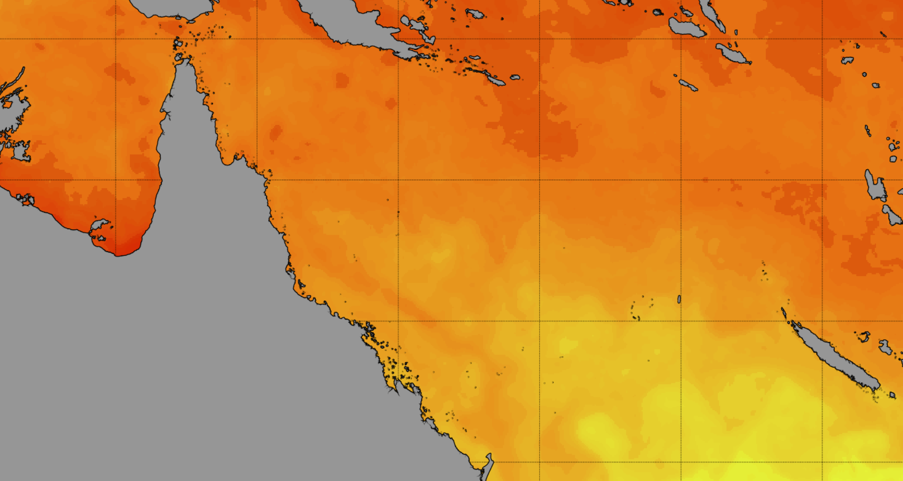
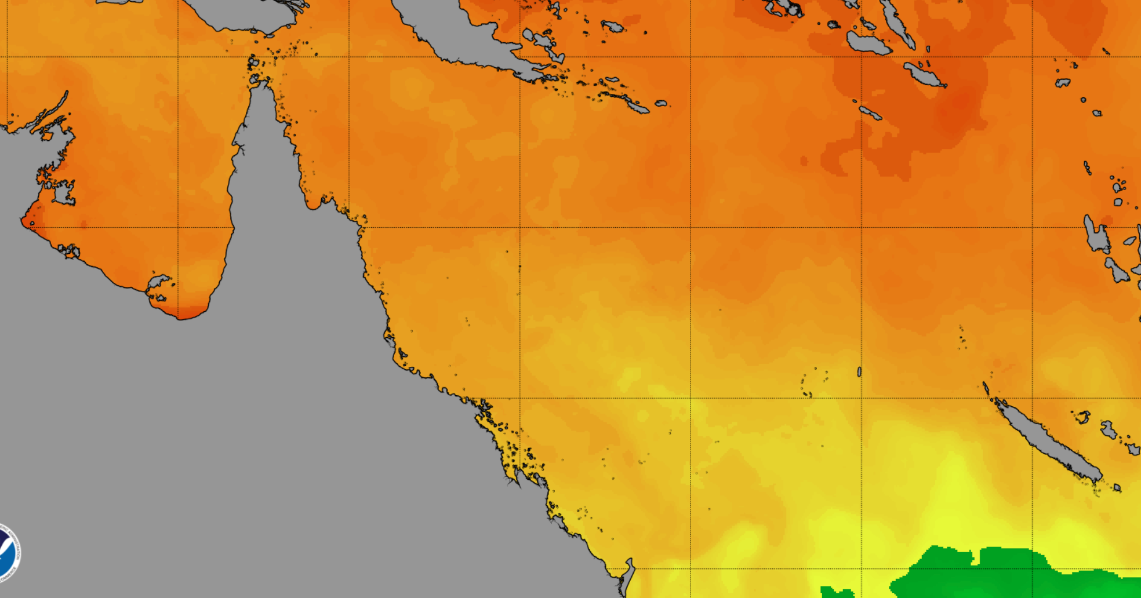
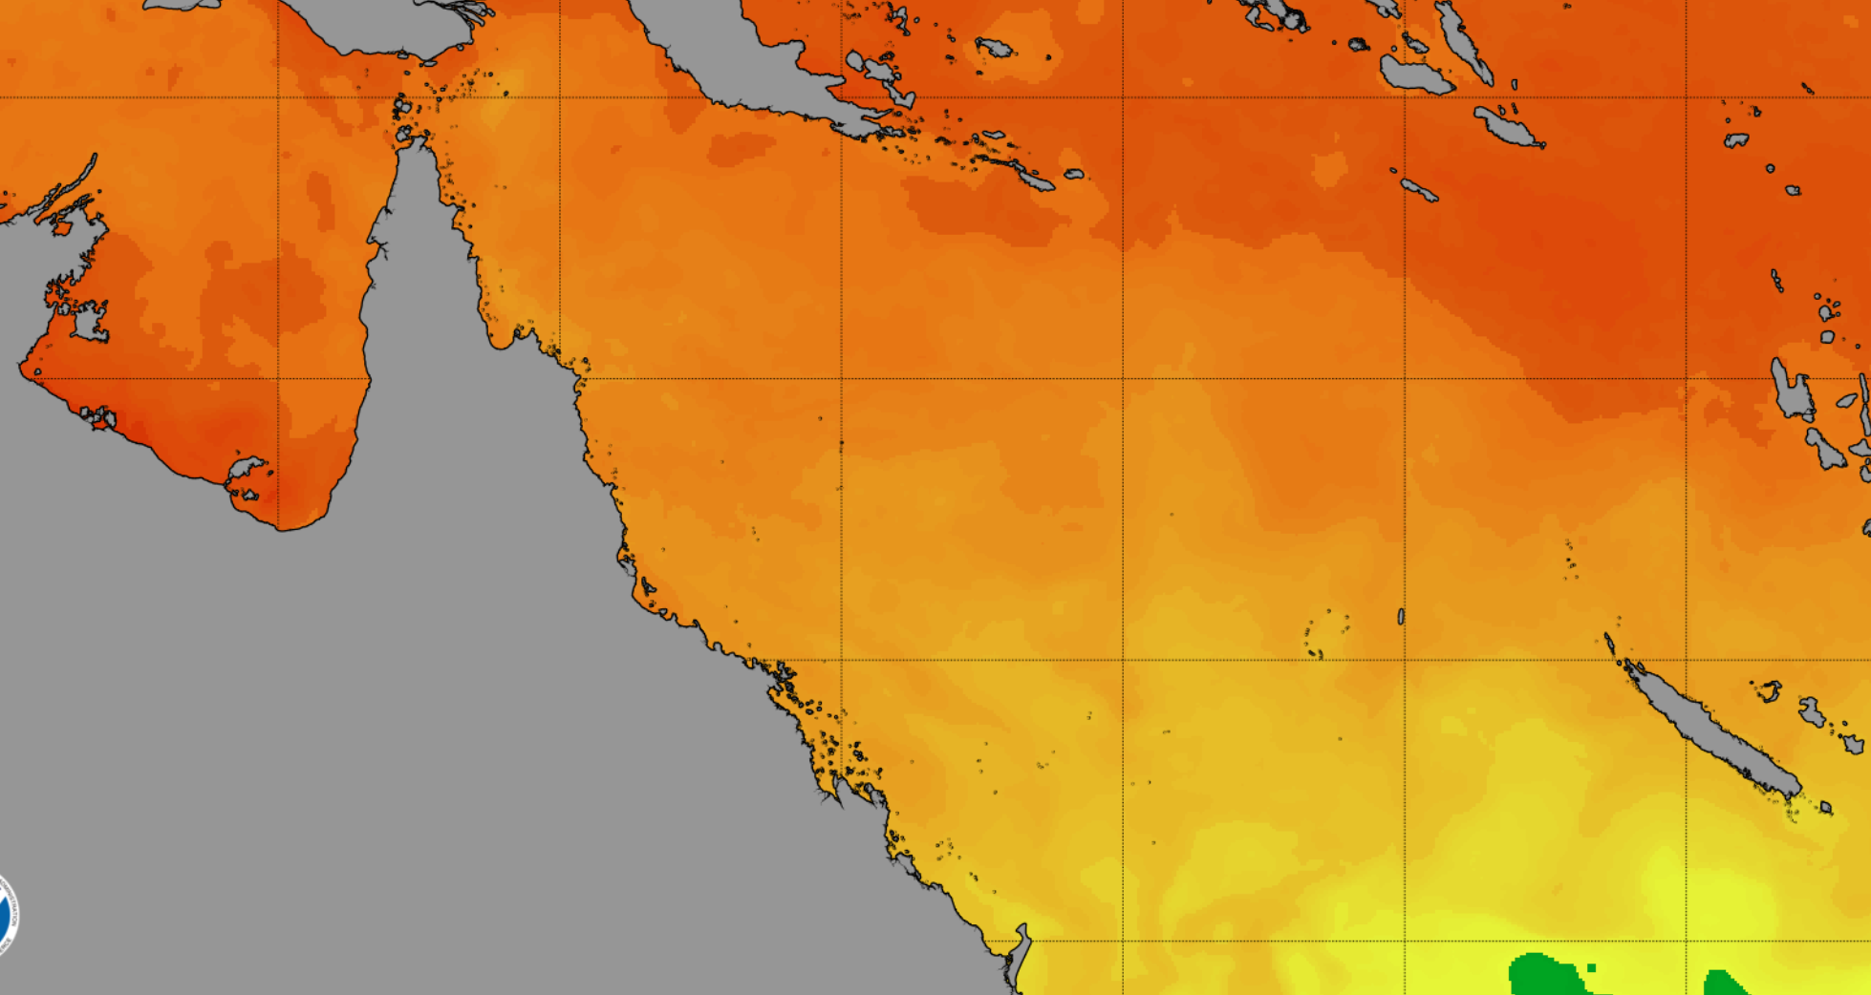
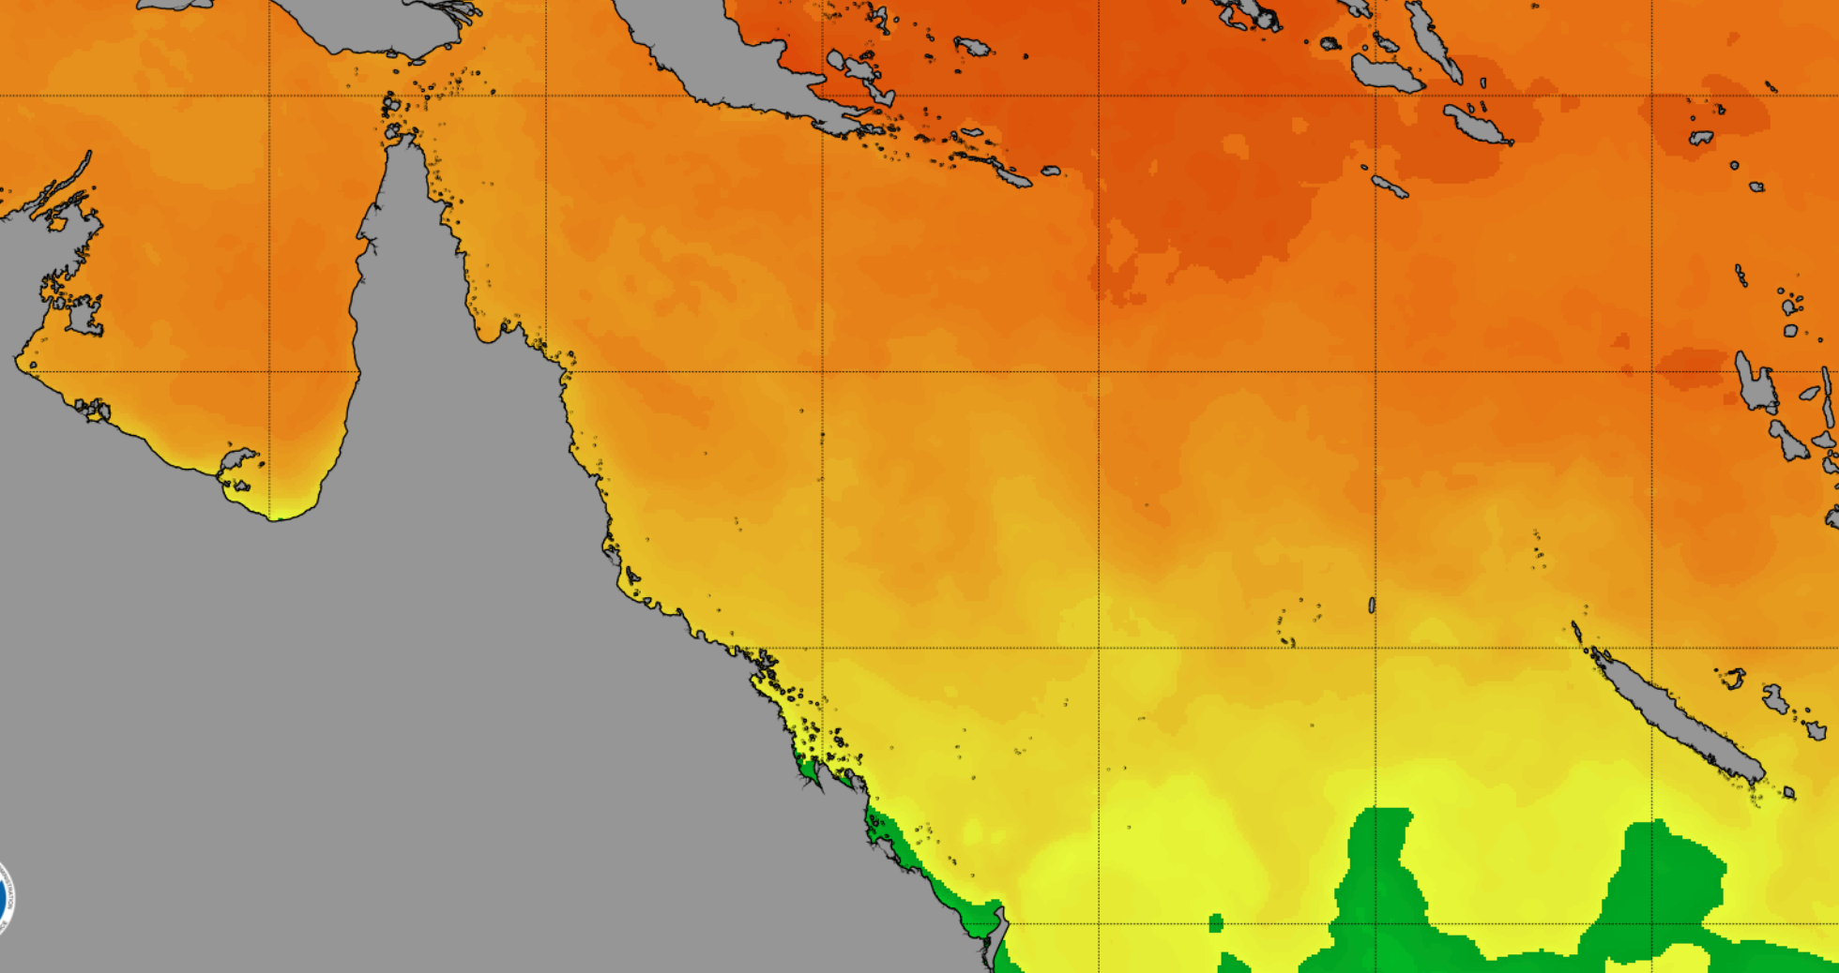
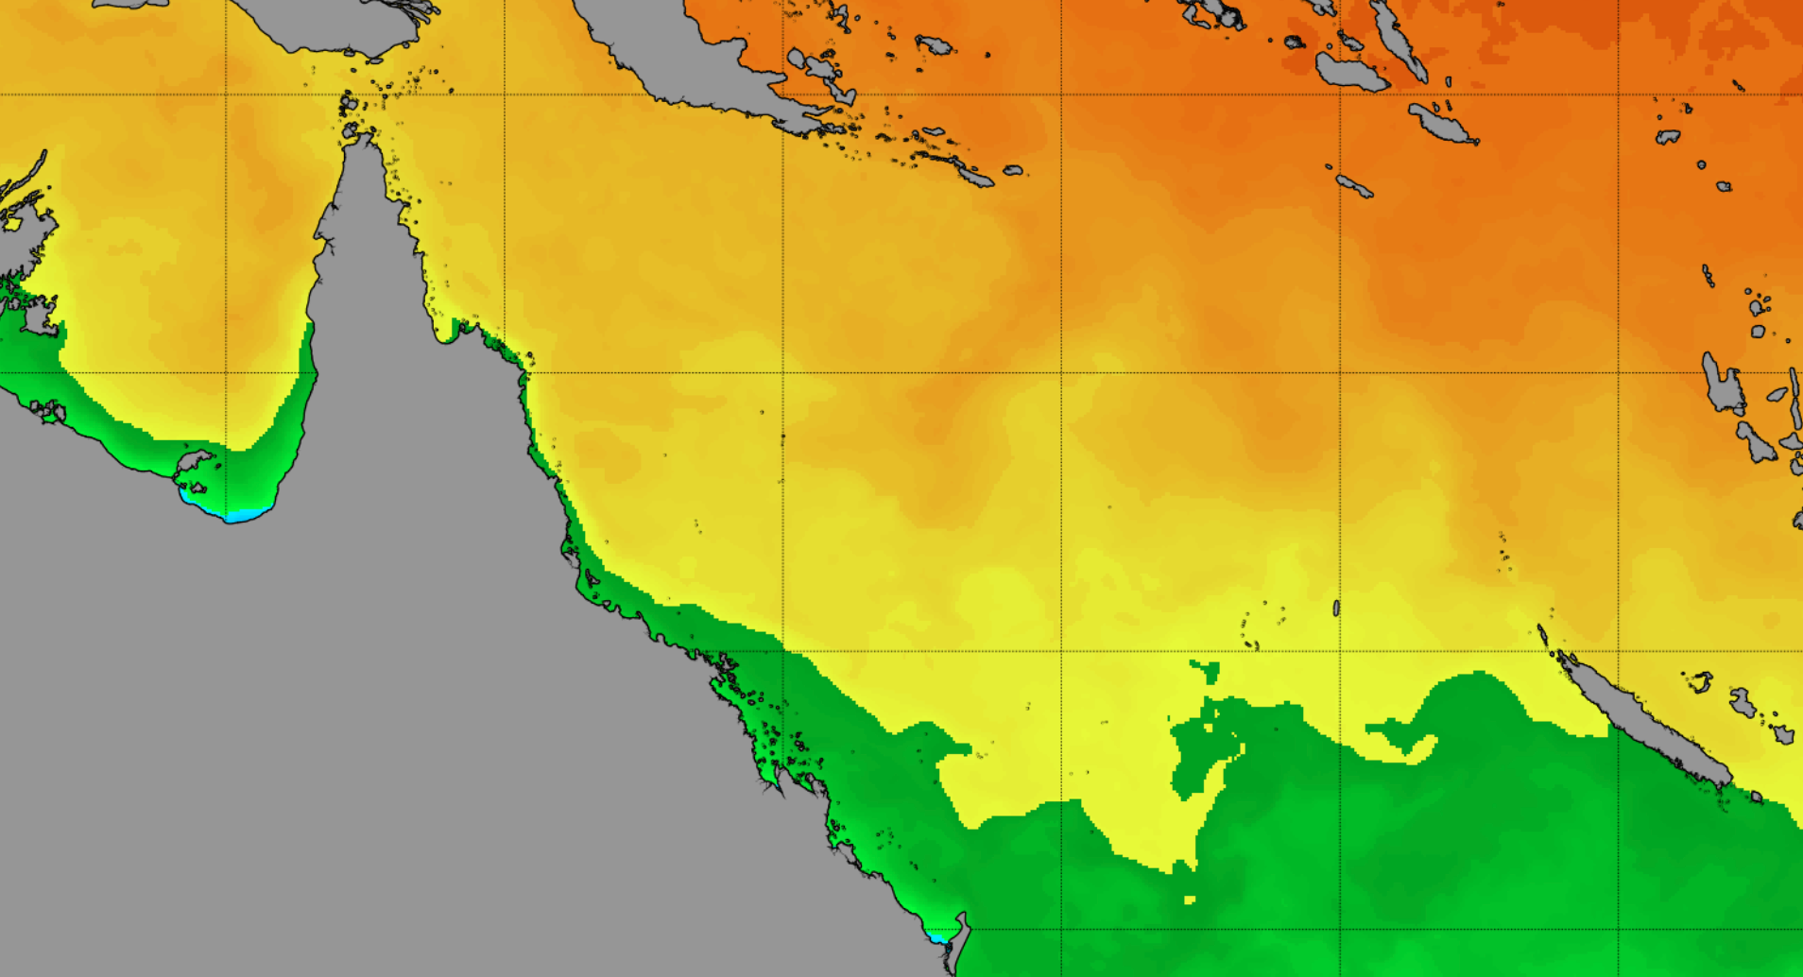
Water stays warm on cool Autumn days
Jan 1st 2023
Feb 1st 2023
March 1st 2023
April 1st 2023
May 1st 2023
June 1st 2023
The ocean’s high heat capacity means ocean temperatures stay warm well into Autumn.

Slide 42
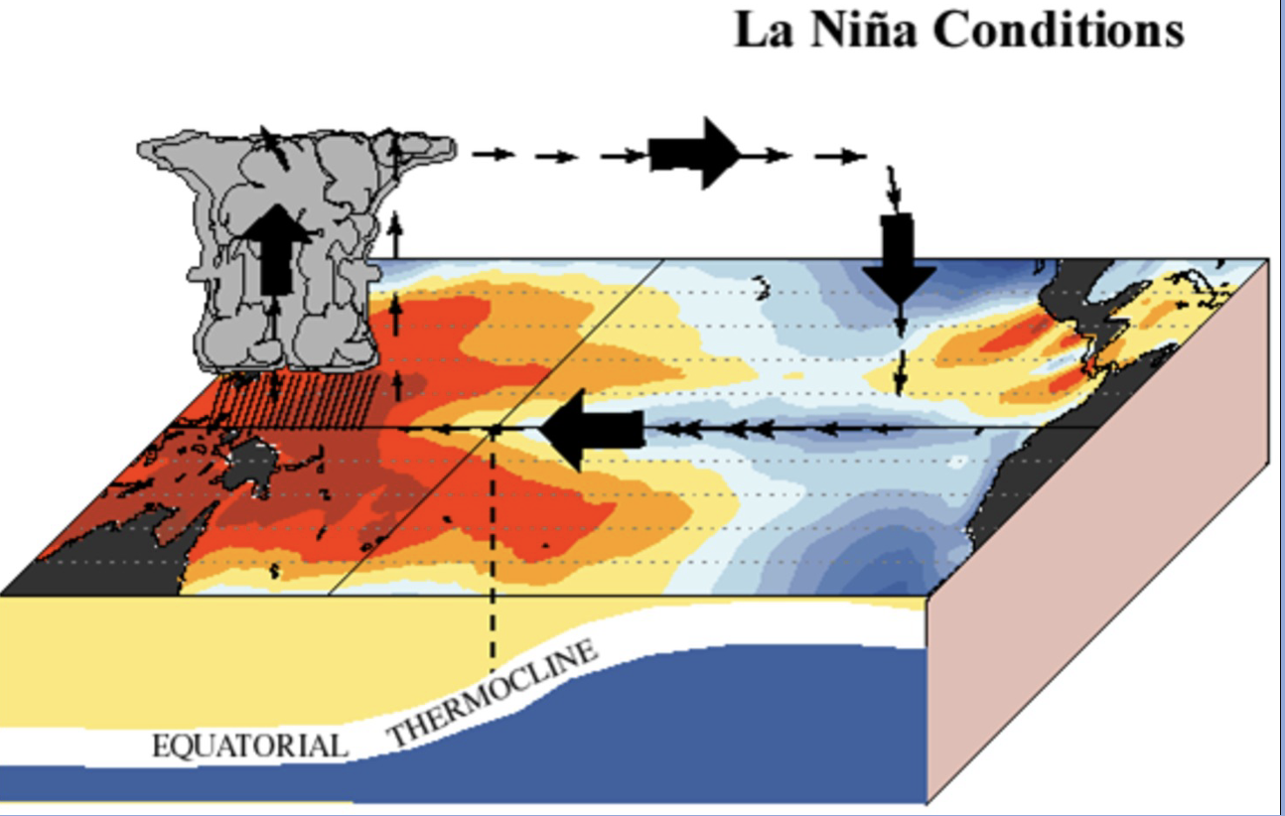
Sea surface temperatures influence climate as much as climate influences sea surface temperatures
Notes:
Image: https://blog.csiro.au/explainer-el-nino-and-la-nina/

Slide 43

Because of the ocean’s high heat capacity, the nights do not get cold on tropical islands.
This is because the ocean does not cool down at night like it does on land.

Slide 44
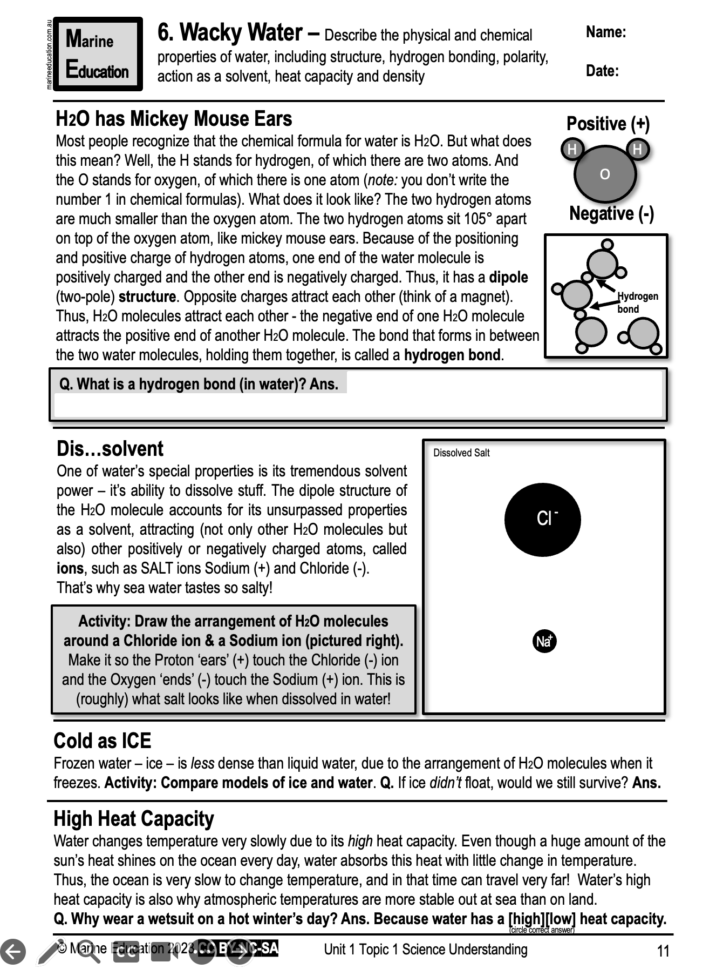
Learning Intention:
Describe the physical and chemical properties of water, including structure, hydrogen bonding, polarity, action as a solvent, heat capacity and density
Success Criteria:
Complete Marine Education worksheet ‘6. Wacky Water’
Notes:
https://cinergee.com.au/blog/the-amazing-effects-of-water-on-our-body/

