Slide 1
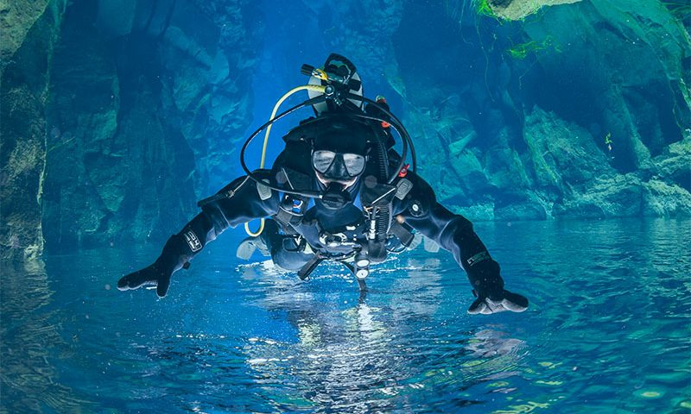
Learning Intention:
Describe the concept of ocean layers, including thermocline, halocline and pycnocline
Success Criteria:
Complete Marine Education worksheet ‘’7. All sorts of clines’
Image: Cave diver hovering above a pycnocline
Notes:
https://www.dresseldivers.com/blog/differences-halocline-thermocline/

Slide 2
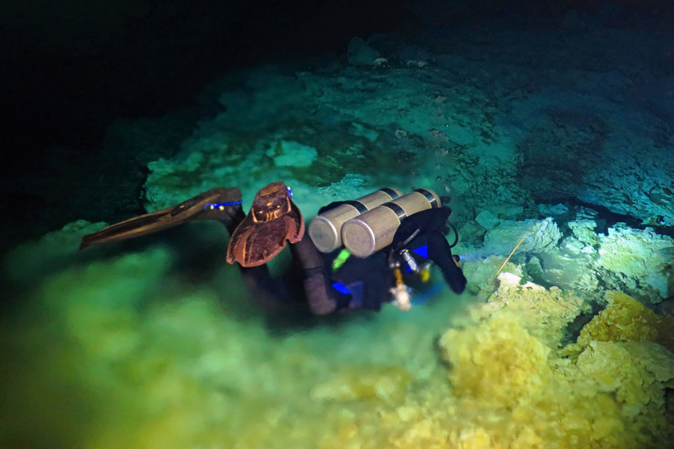
cline = layer

Slide 3
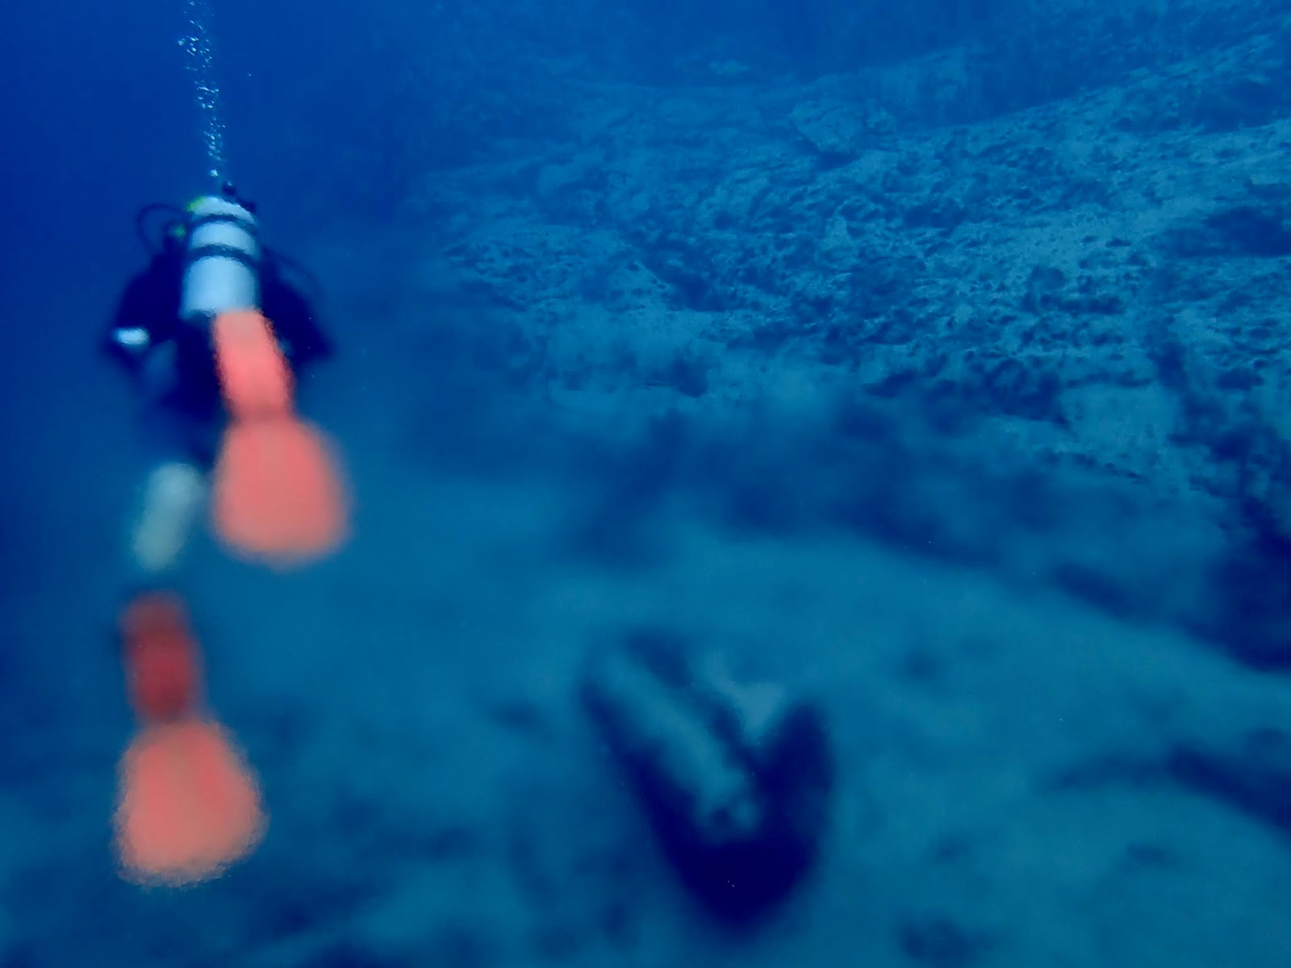
thermocline
Notes:
http://svfieldtrip.blogspot.com/2020/07/barracuda-lake-coron-island-philippines.html

Slide 4
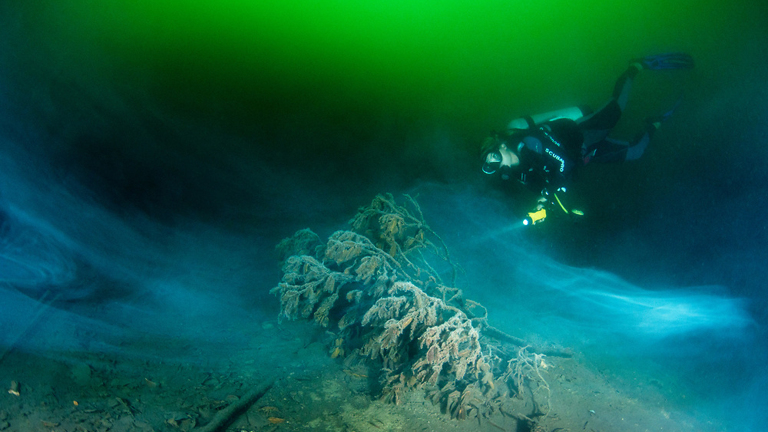
Notes:
https://www.shanegross.com/image/I000084v9PETvhYw

Slide 5
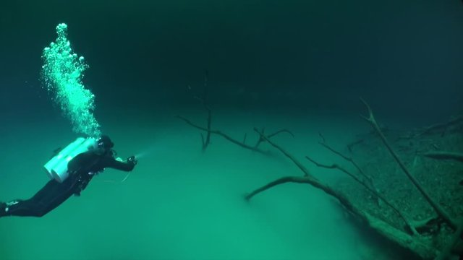
halocline
Notes:
https://stock.adobe.com/search?k=halocline

Slide 6
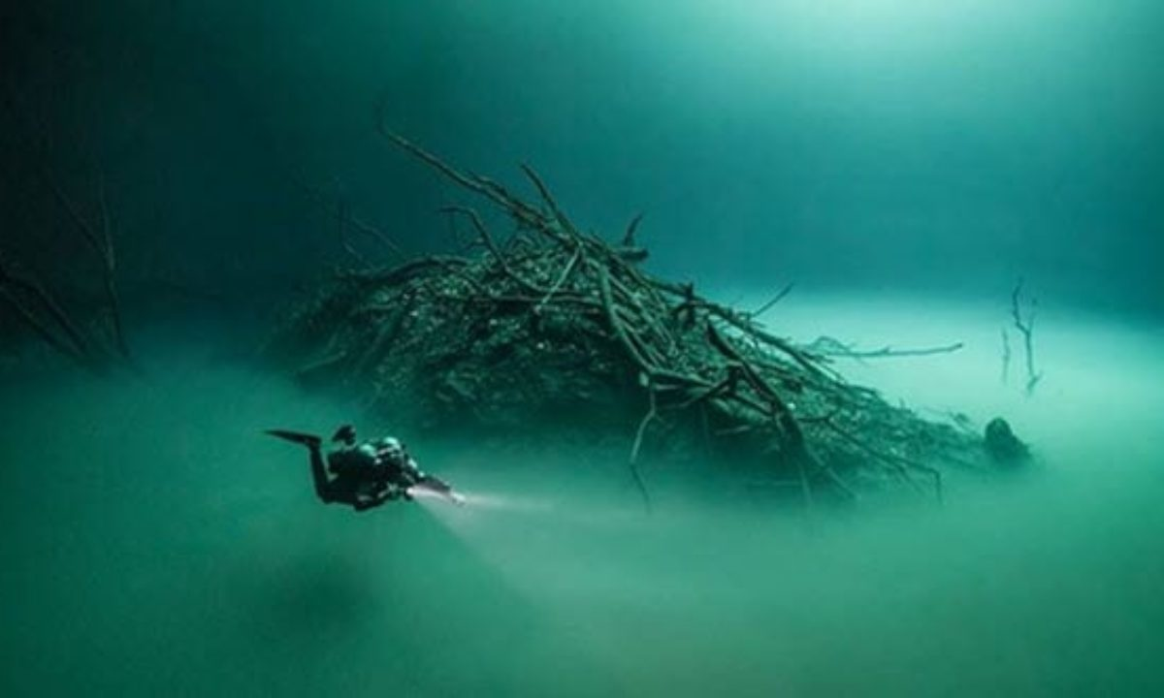

Slide 7
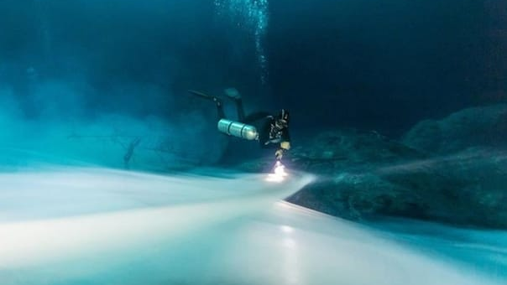

Slide 8
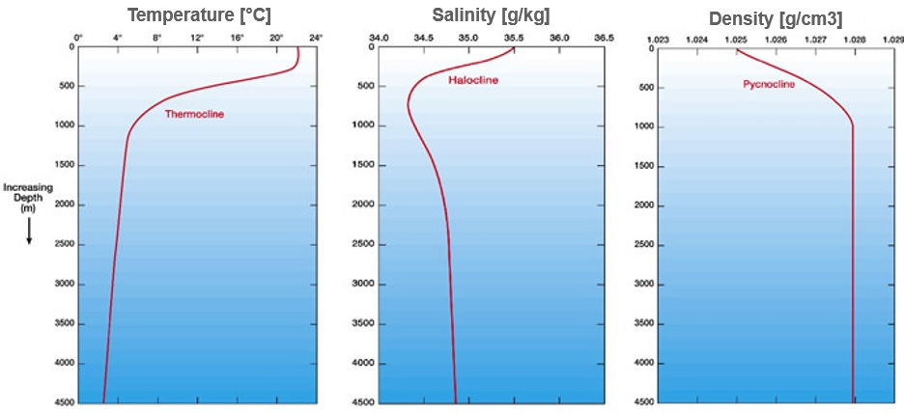
A thermocline is a rapid change in temperature between two layers of water

Slide 9
A halocline is a rapid change in salinity (dissolved salt content) between two layers of water

Slide 10
A pycnocline is a rapid change in density (caused by a permanent thermocline and/or halocline).

Slide 11
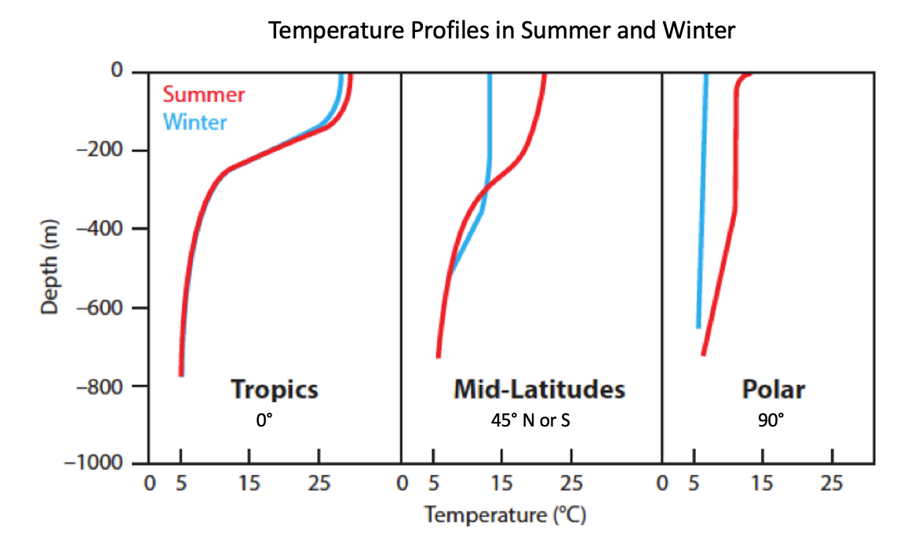
The amount of direct sunlight
(affecting temperature)
and the amount of rain
(effecting salinity)
vary with latitude and
season.

Slide 12
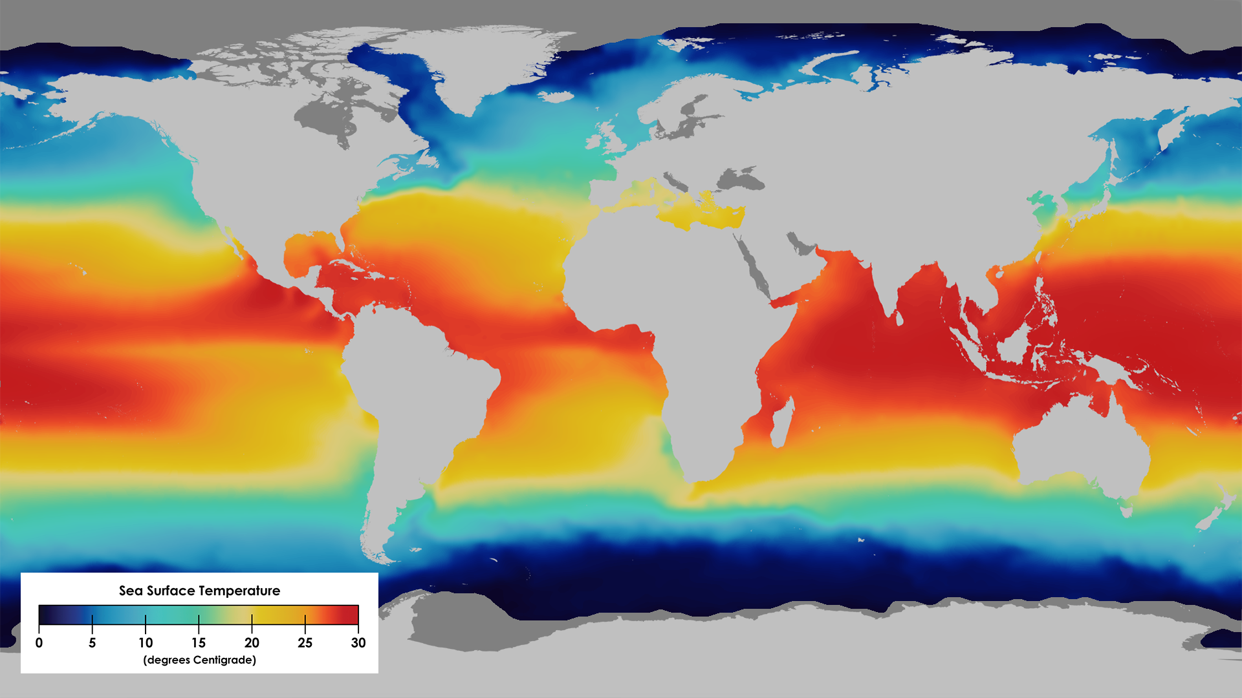
Notes:
https://www.pbslearningmedia.org/resource/buac17-912-sci-ess-seasurftsd/sea-surface-temperature-salinity-and-density/

Slide 13
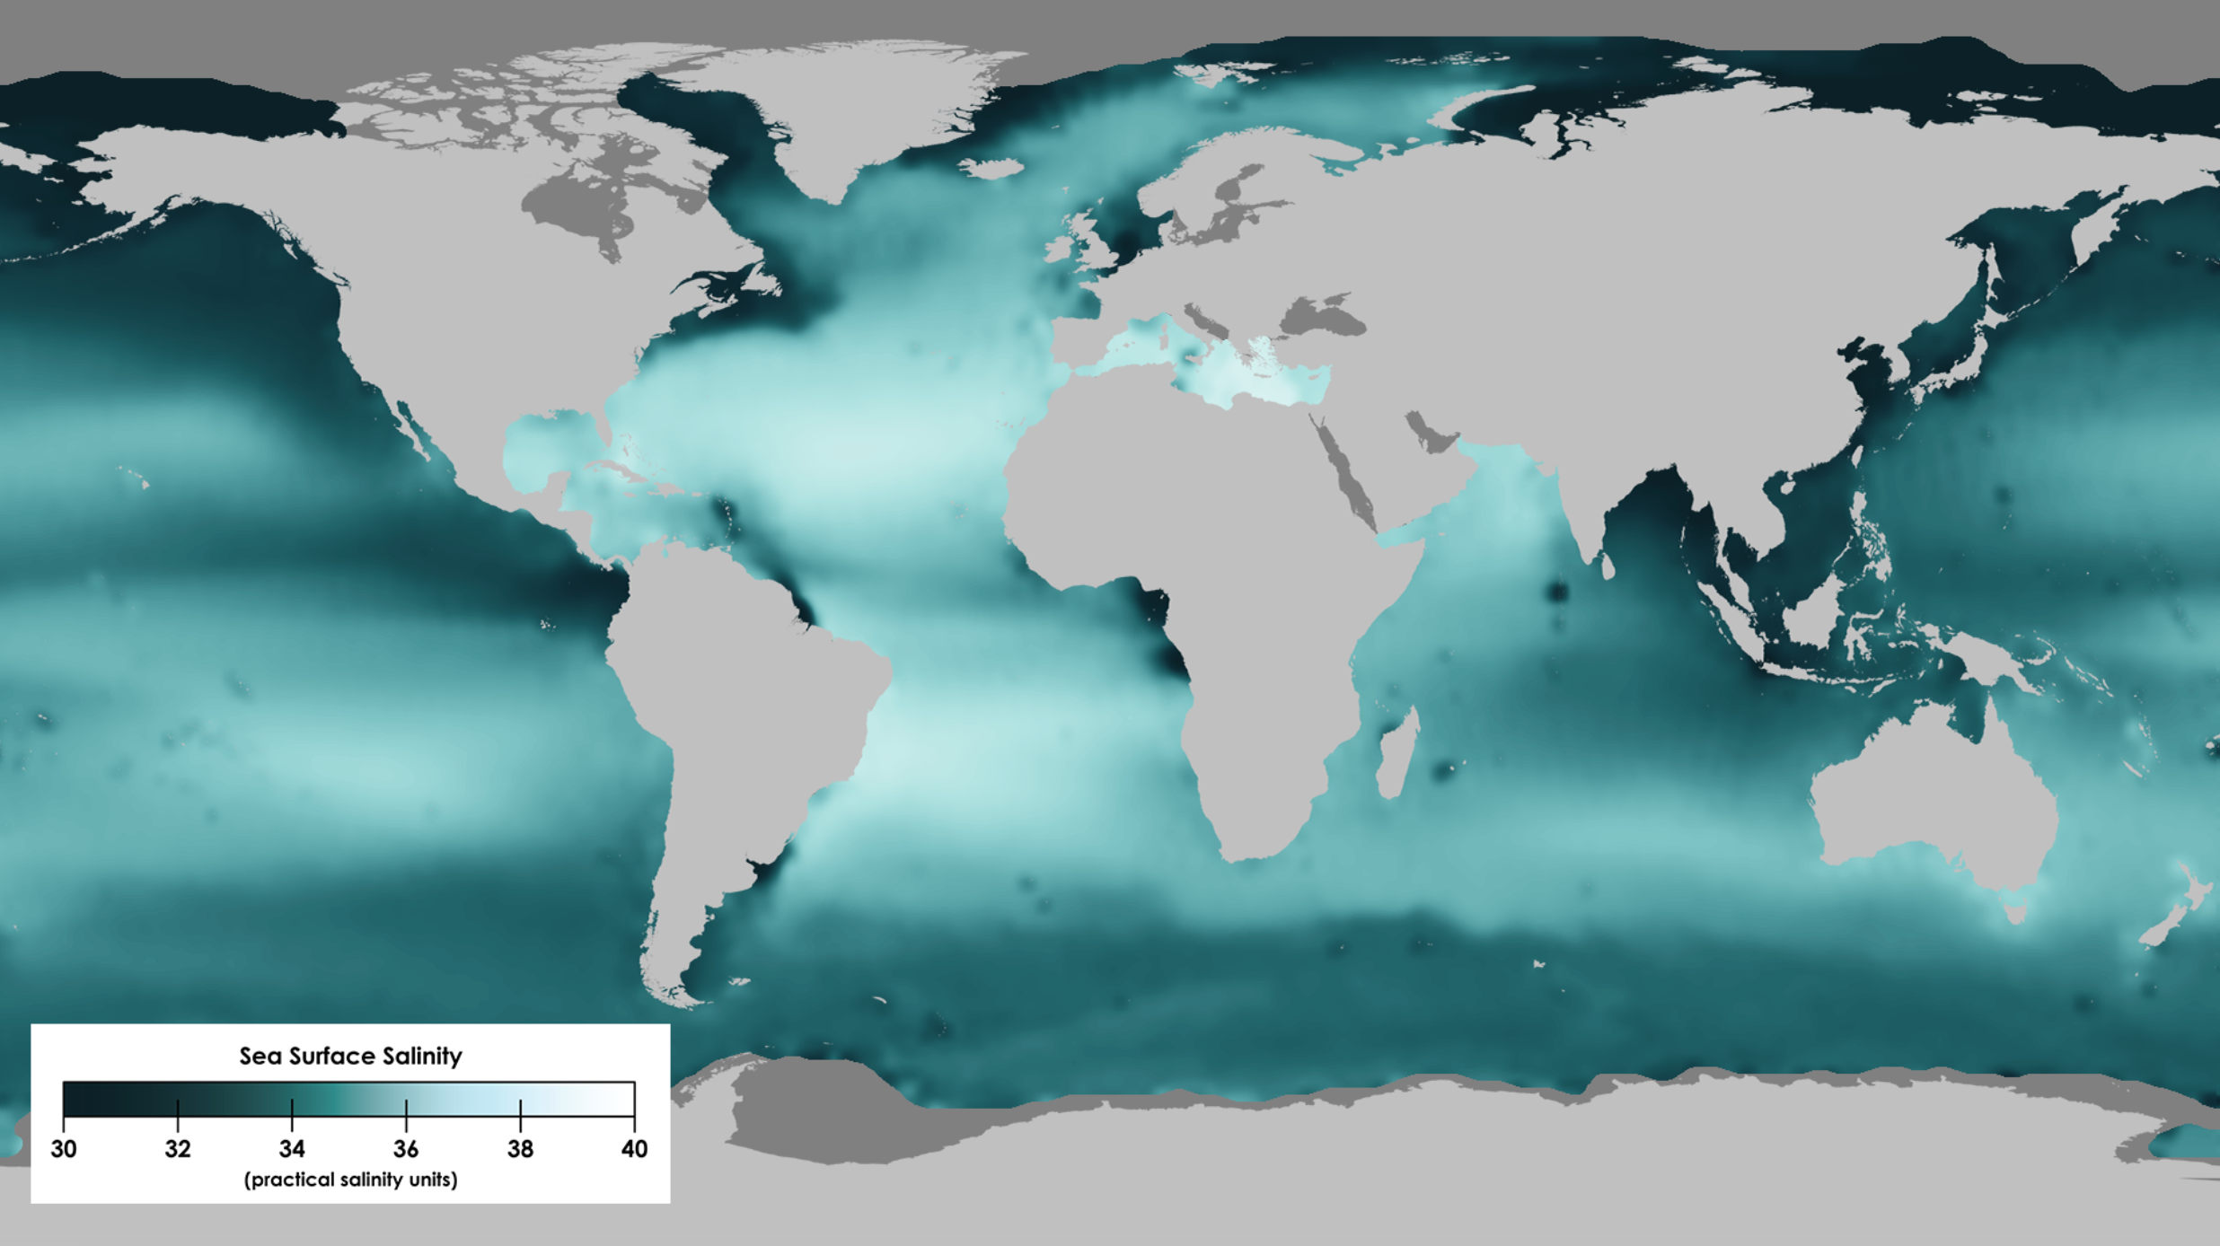

Slide 14
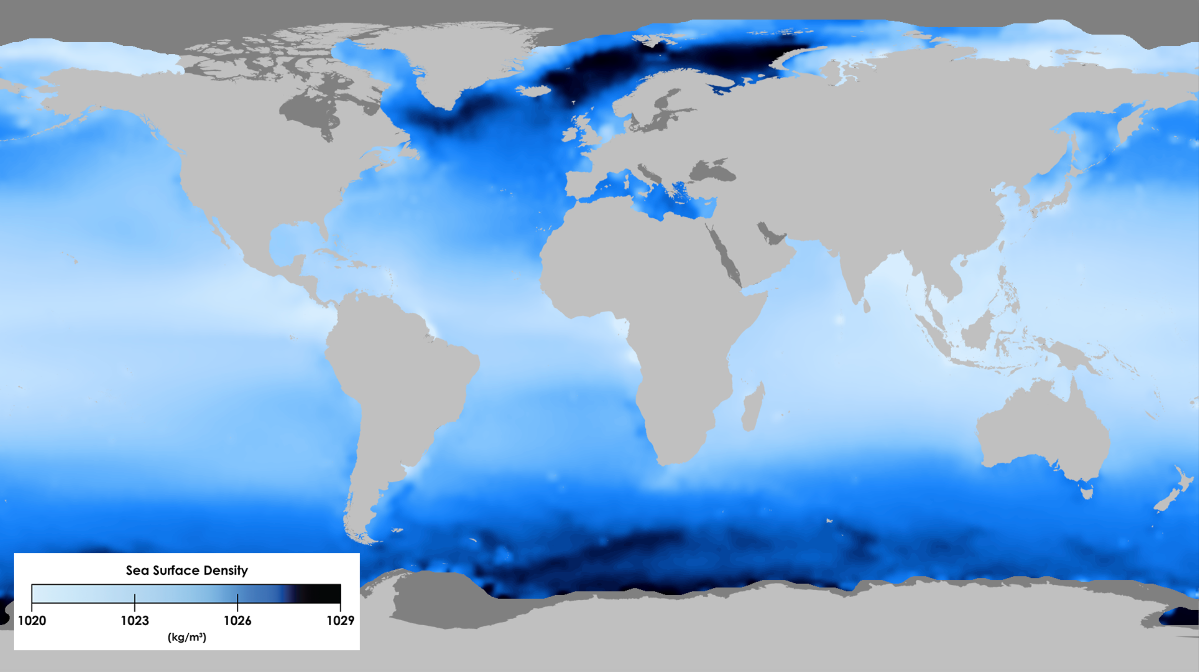

Slide 15
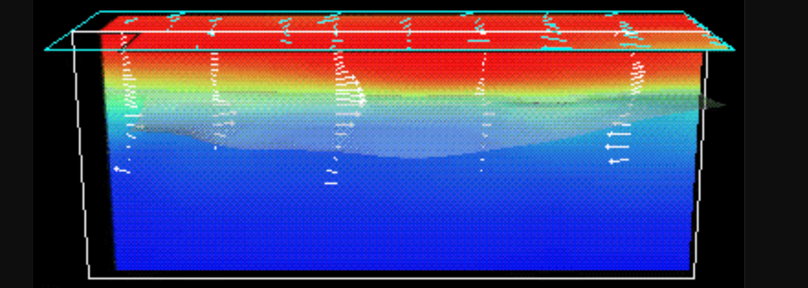
El Nino
South America
Australia
Notes:
http://www.atmo.arizona.edu/students/courselinks/spring16/atmo170a1s4/1S1P_stuff/el_nino/el_nino.html

Slide 16
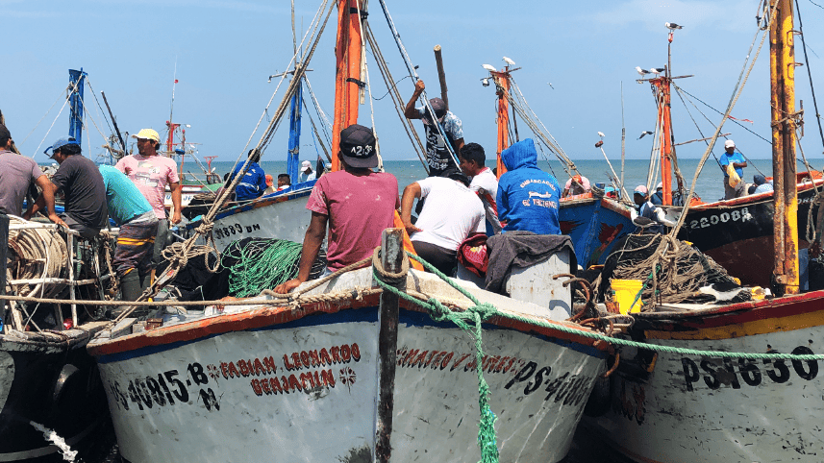
Peru’s anchovy fishery
Notes:
http://tmpsantafe.org/wp-content/uploads/2017/01/EarthComm_5-8c.pdf

Slide 17
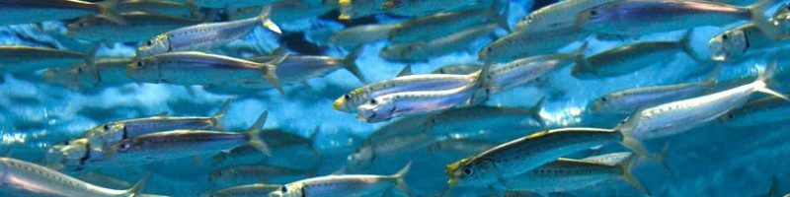
Upwellings bring nutrients to anchovy fishery off Peru
El Nino thermocline STOPS that.

Slide 18
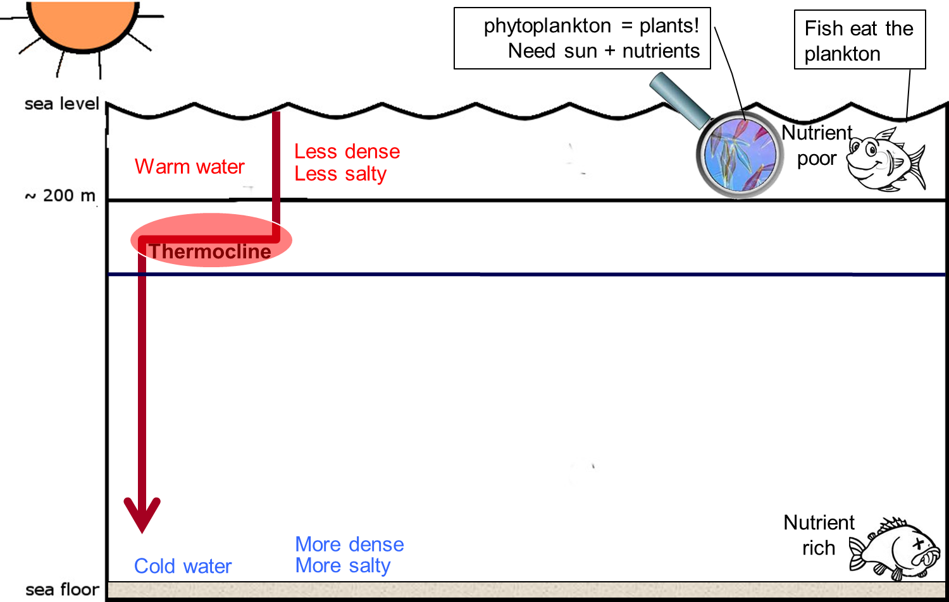
Notes:
http://geophile.net/Lessons/seawater/seawater_08.html

Slide 19
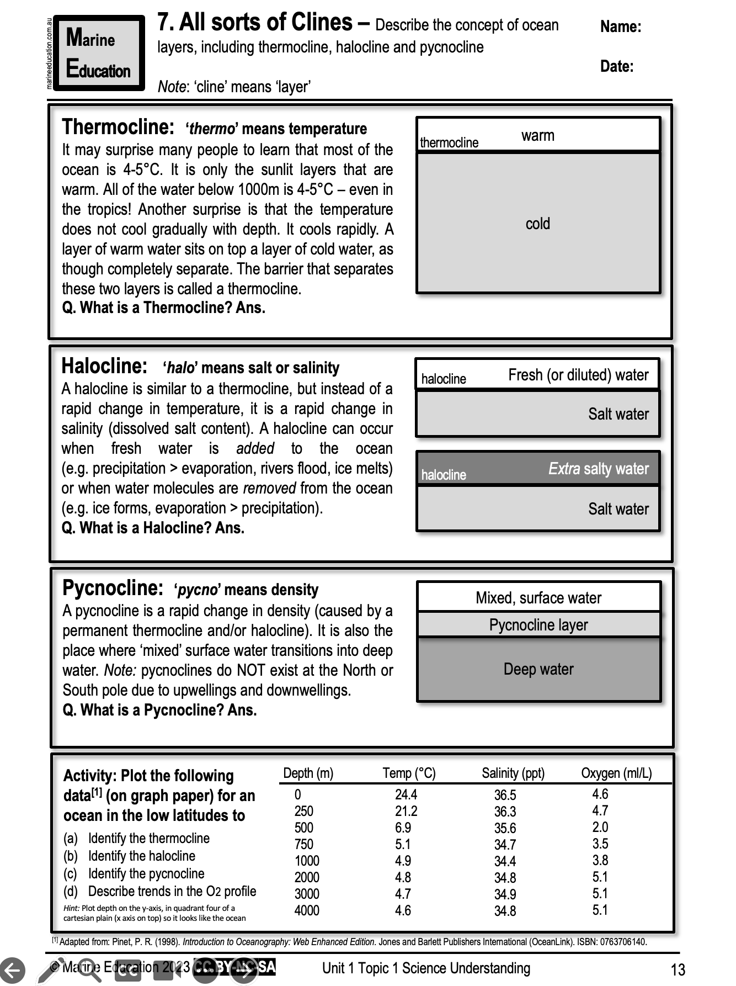
Learning Intention:
Describe the concept of ocean layers, including thermocline, halocline and pycnocline
Success Criteria:
Complete Marine Education worksheet ‘’7. All sorts of clines’
Notes:
https://www.dresseldivers.com/blog/differences-halocline-thermocline/

