Slide 1
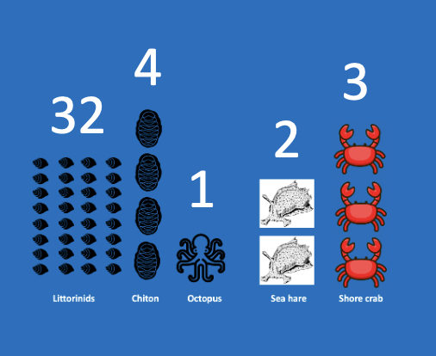
Learning Intention:
Interpret data to determine the biodiversity of a marine ecosystem using diversity indices.
Success Criteria:
Complete Marine Education worksheet ‘7. Formula Feast

Slide 2



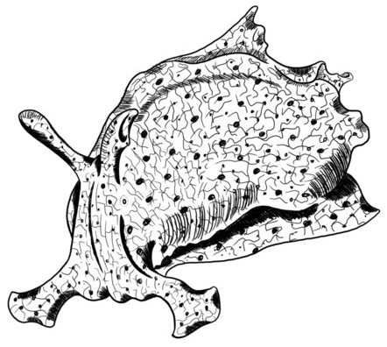

Rocky Shore SDI?
Littorinids
Chiton
Octopus
Sea hare
Shore crab

Slide 3
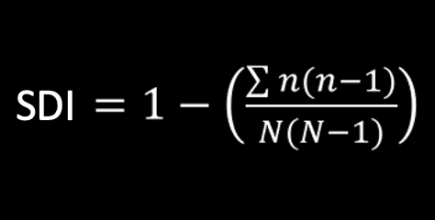
Name | COUNT (n) | n(n-1)
Littorinids | 32
Chitons | 4
Octopus | 1
Sea hare | 2
Shore crab | 3
TOTAL | N= | ∑n(n-1) =
 | N(N-1)= | SDI =

Slide 4
Name | COUNT (n) | n(n-1)
Littorinids | 32 | 992
Chitons | 4 | 12
Octopus | 1 | 0
Sea hare | 2 | 2
Shore crab | 3 | 6
TOTAL | N= | ∑n(n-1) =
 | N(N-1)= | SDI =
32x31=
4x5=
1x0=
2x1=
3x2=

Slide 5
Name | COUNT (n) | n(n-1)
Littorinids | 32 | 992
Chitons | 4 | 12
Octopus | 1 | 0
Sea hare | 2 | 2
Shore crab | 3 | 6
TOTAL | N= 42 | ∑n(n-1) = 1012
 | N(N-1)= | SDI =
32x31=
4x5=
1x0=
2x1=
3x2=
Add them up

Slide 6
Name | COUNT (n) | n(n-1)
Littorinids | 32 | 992
Chitons | 4 | 12
Octopus | 1 | 0
Sea hare | 2 | 2
Shore crab | 3 | 6
TOTAL | N= 42 | ∑n(n-1) = 1012
 | N(N-1)= 1722 | SDI =
32x31=
4x5=
1x0=
2x1=
3x2=
Add them up
42(41)

Slide 7
Name | COUNT (n) | n(n-1)
Littorinids | 32 | 992
Chitons | 4 | 12
Octopus | 1 | 0
Sea hare | 2 | 2
Shore crab | 3 | 6
TOTAL | N= 42 | ∑n(n-1) = 1012
 | N(N-1)= 1722 | SDI = 0.41
32x31=
4x5=
1x0=
2x1=
3x2=
Add them up
42(41)
1-[1012/1722)=

Slide 8
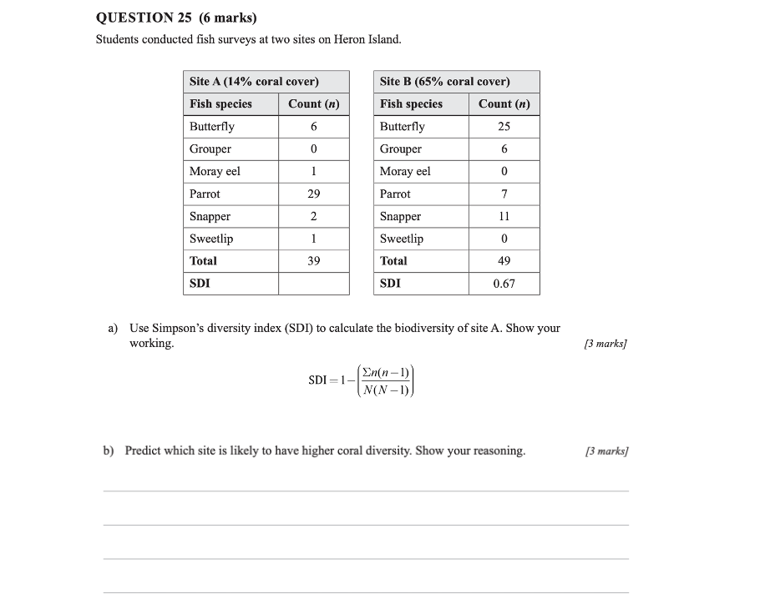
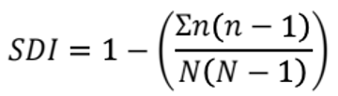
SDI of Site A?

Slide 9
Name | COUNT (n) | n(n-1)
Butterfly fish | 6
Grouper | 0
Moray Eel | 1
Parrot fish | 29
Snapper | 2
Sweetlip | 1
TOTAL | N= | ∑n(n-1) =
 | N(N-1)= | SDI =

Slide 10
Name | COUNT (n) | n(n-1)
Butterfly fish | 6 | 30
Grouper | 0 | 0
Moray Eel | 1 | 0
Parrot fish | 29 | 812
Snapper | 2 | 2
Sweetlip | 1 | 0
TOTAL | N= | ∑n(n-1) =
 | N(N-1)= | SDI =
6x5=
0x0=
1x0=
29x28=
2x1=
1x0=

Slide 11
Name | COUNT (n) | n(n-1)
Butterfly fish | 6 | 30
Grouper | 0 | 0
Moray Eel | 1 | 0
Parrot fish | 29 | 812
Snapper | 2 | 2
Sweetlip | 1 | 0
TOTAL | N= 39 | ∑n(n-1) = 844
 | N(N-1)= | SDI =
6x5=
0x0=
1x0=
29x28=
2x1=
1x0=
Add them up

Slide 12
Name | COUNT (n) | n(n-1)
Butterfly fish | 6 | 30
Grouper | 0 | 0
Moray Eel | 1 | 0
Parrot fish | 29 | 812
Snapper | 2 | 2
Sweetlip | 1 | 0
TOTAL | N= 39 | ∑n(n-1) = 844
 | N(N-1)= 1482 | SDI =
6x5=
0x0=
1x0=
29x28=
2x1=
1x0=
Add them up
39(38)

Slide 13
Name | COUNT (n) | n(n-1)
Butterfly fish | 6 | 30
Grouper | 0 | 0
Moray Eel | 1 | 0
Parrot fish | 29 | 812
Snapper | 2 | 2
Sweetlip | 1 | 0
TOTAL | N= 39 | ∑n(n-1) = 844
 | N(N-1)= 1482 | SDI = 0.43
6x5=
0x0=
1x0=
29x28=
2x1=
1x0=
Add them up
39(38)
1-[844/1482)=

Slide 14
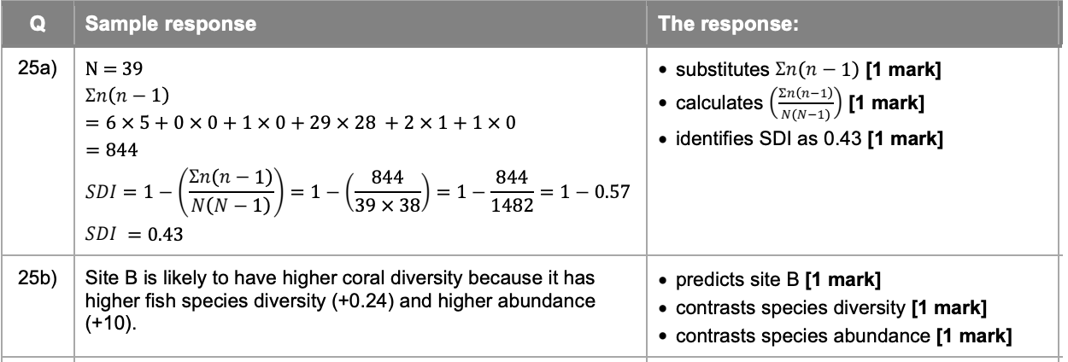
An example for the exam marker to use as context
How your response will be marked
How did you go?

Slide 15

Name | COUNT (n) | n(n-1)
Butterfly fish | 6 | 30
Grouper | 0 | 0
Moray Eel | 1 | 0
Parrot fish | 29 | 812
Snapper | 2 | 2
Sweetlip | 1 | 0
TOTAL | N= 39 | ∑n(n-1) = 844
 | N(N-1)= 1482 | SDI = 0.43
One mark

Slide 16
Name | COUNT (n) | n(n-1)
Butterfly fish | 6 | 30
Grouper | 0 | 0
Moray Eel | 1 | 0
Parrot fish | 29 | 812
Snapper | 2 | 2
Sweetlip | 1 | 0
TOTAL | N= 39 | ∑n(n-1) = 844
 | N(N-1)= 1482 | SDI = 0.43
One mark

Slide 17
Name | COUNT (n) | n(n-1)
Butterfly fish | 6 | 30
Grouper | 0 | 0
Moray Eel | 1 | 0
Parrot fish | 29 | 812
Snapper | 2 | 2
Sweetlip | 1 | 0
TOTAL | N= 39 | ∑n(n-1) = 844
 | N(N-1)= 1482 | SDI = 0.43
One mark

Slide 18
0.43

Slide 19
0.43
Site B
0.67 (SDI Site B) -0.43 (SDI Site A) = 0.24
49 (Site B Total) – 39 (Site A total) = 10

Slide 20
An example for the exam marker to use as context
How your response will be marked
How did you go?

Slide 21
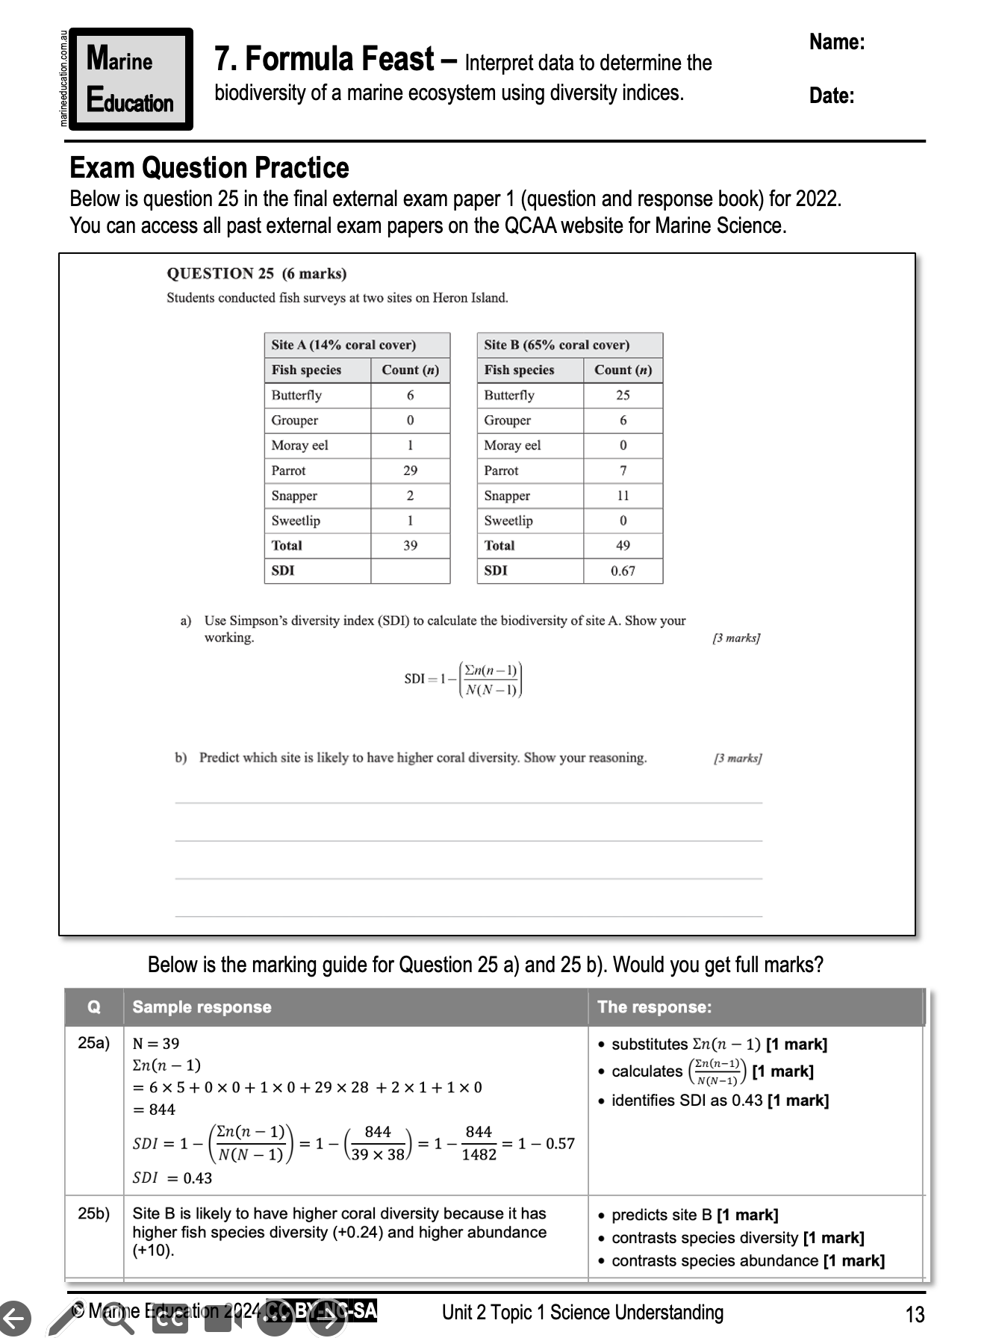
Learning Intention:
Interpret data to determine the biodiversity of a marine ecosystem using diversity indices.
Success Criteria:
Complete Marine Education worksheet ‘7. Formula Feast’

