Slide 1
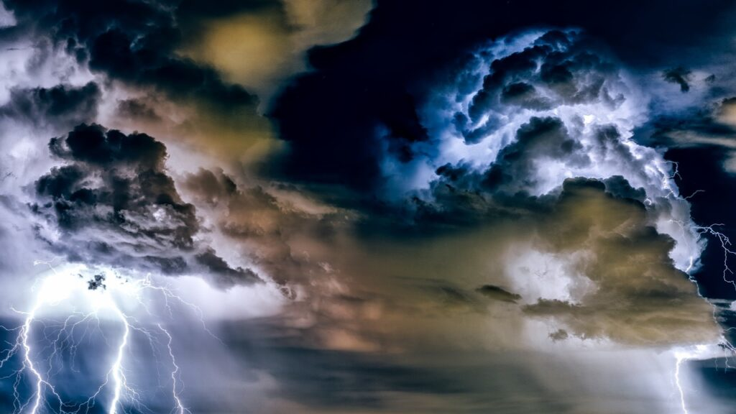
Learning Intention:
Explain how weather patterns and climate (e.g. temperature, wind speed and direction, rainfall, breezes, barometric pressure) are driven by atmosphere/ocean interactions.
Success Criteria:
Complete Marine Education worksheet ‘7. Well, blow me down”
Notes:
https://www.youtube.com/watch?app=desktop&v=loRr97fOWdg

Slide 2
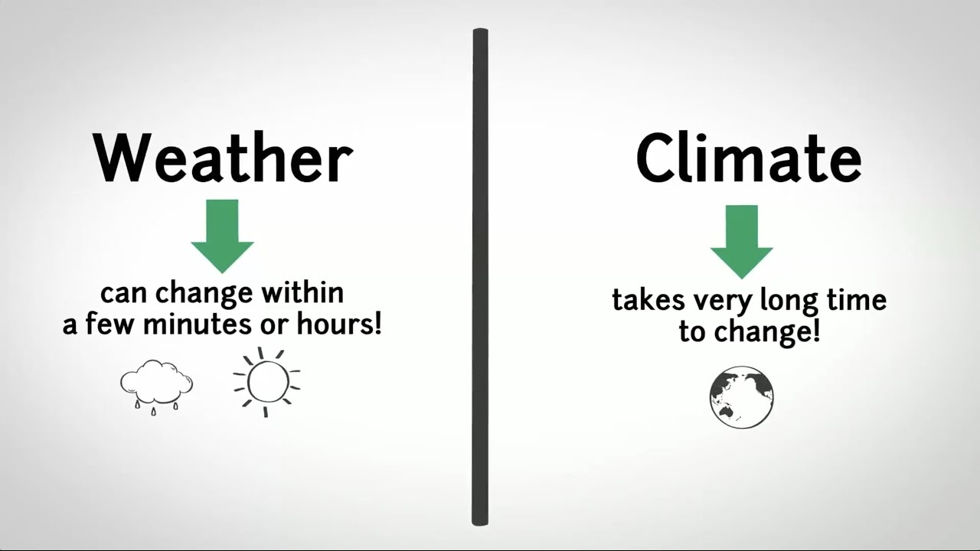

Slide 3

Weather

Slide 4
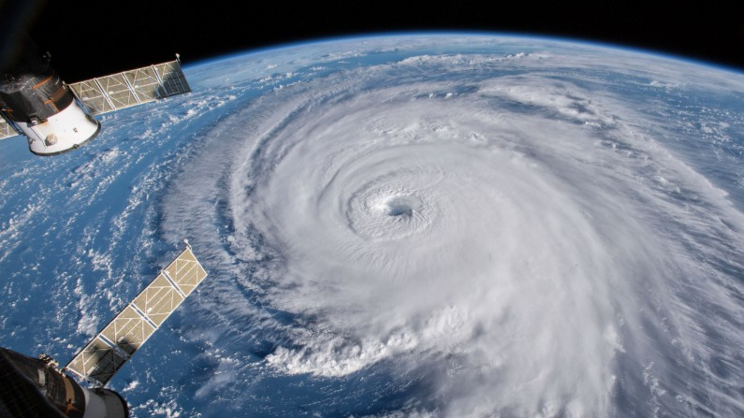
LOW barometric pressure system (warm air is rising)
cyclone

Slide 5
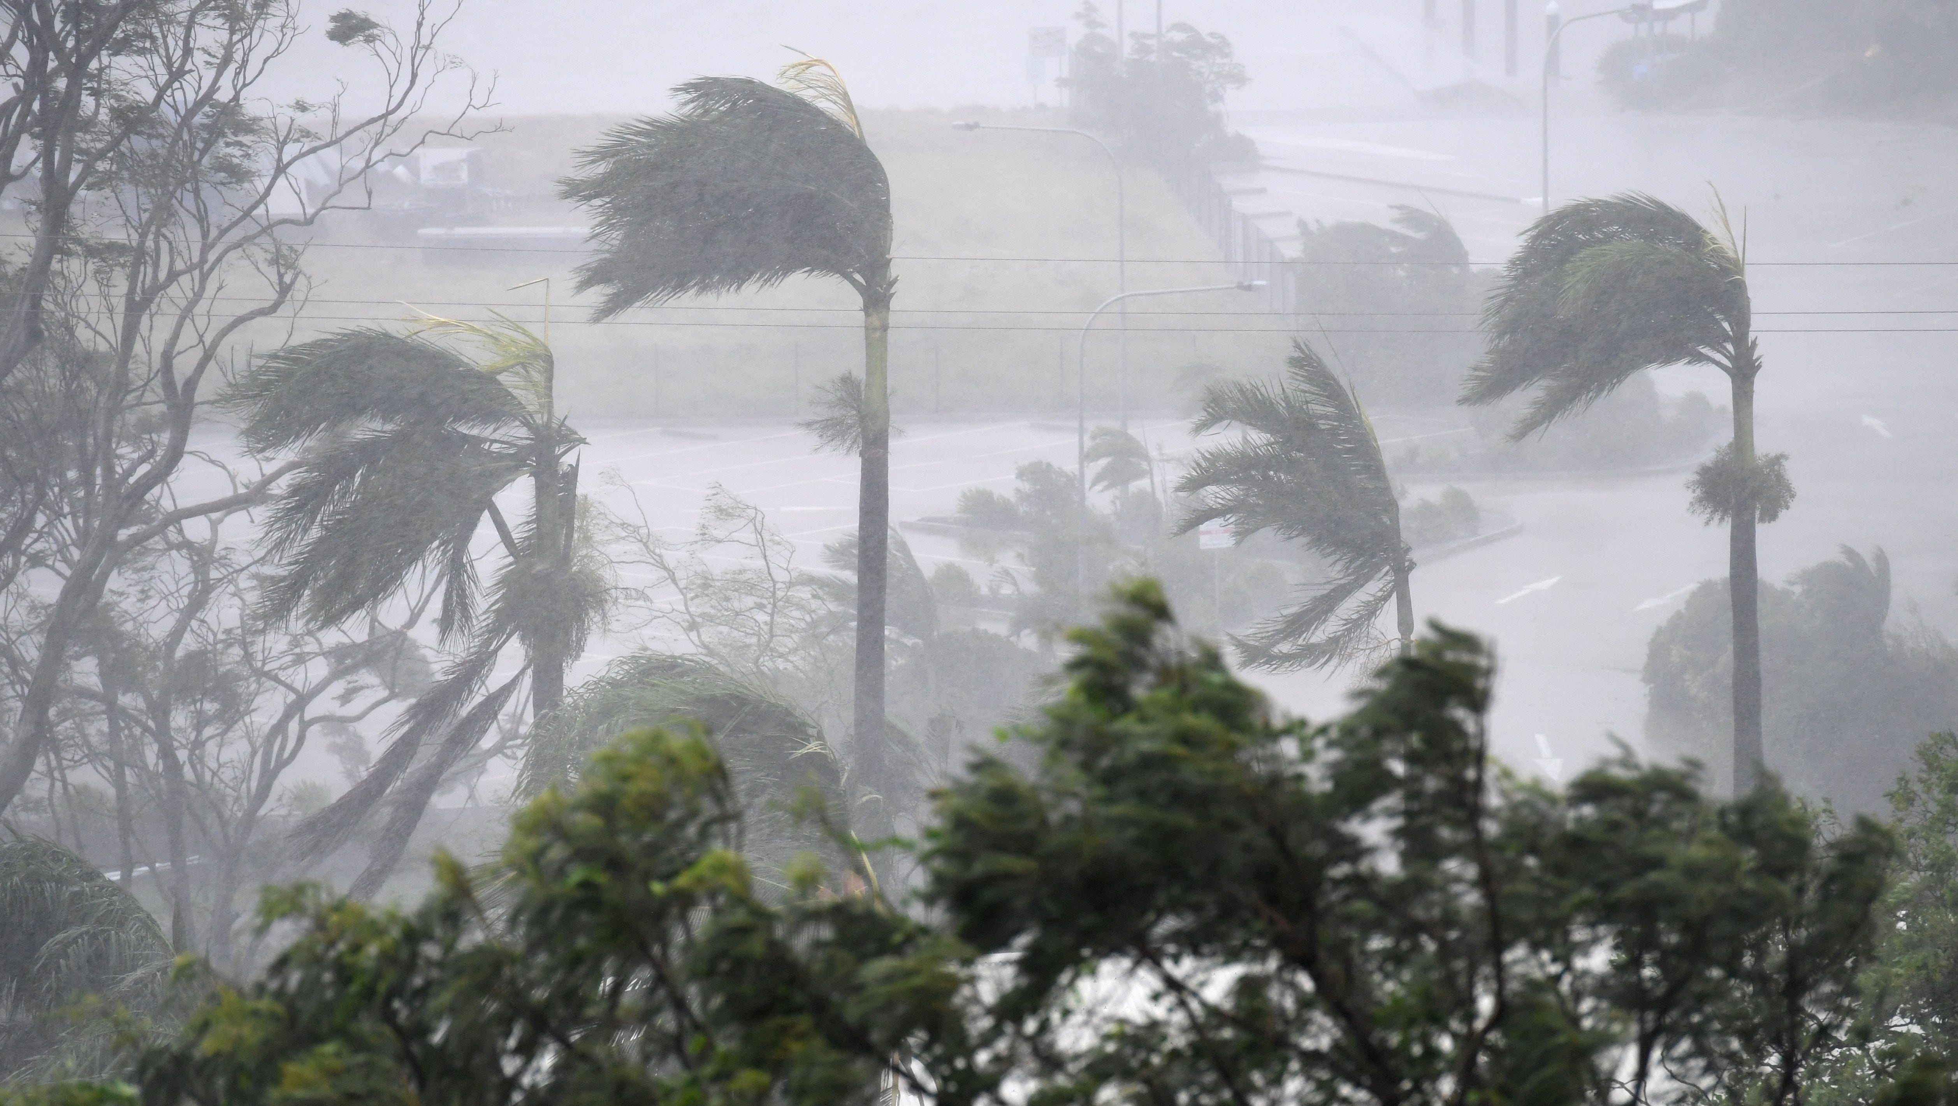
LOW pressure

Slide 6
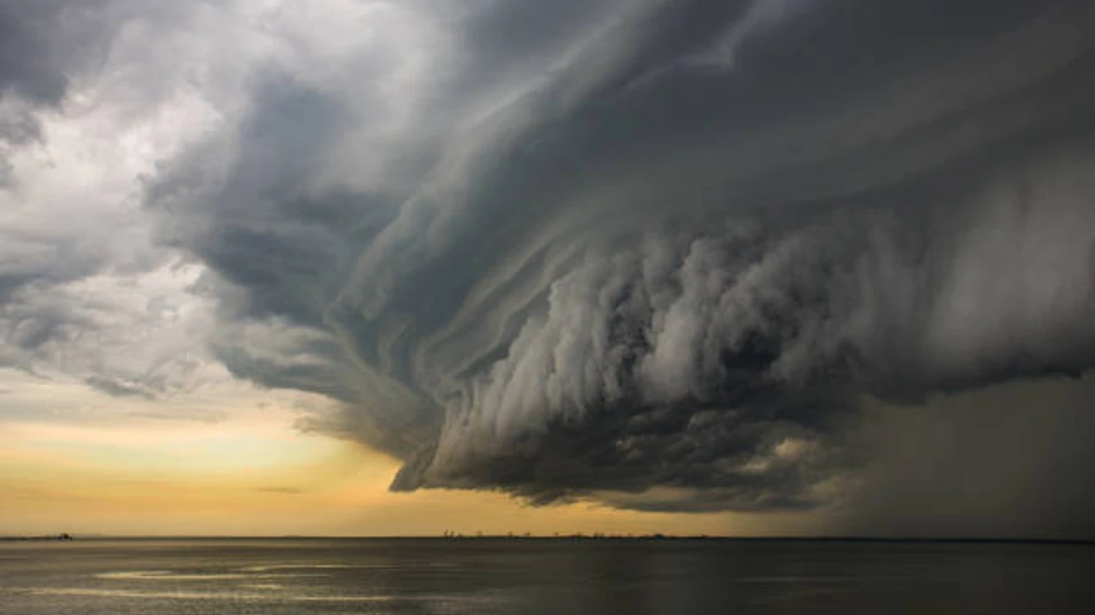
LOW pressure

Slide 7
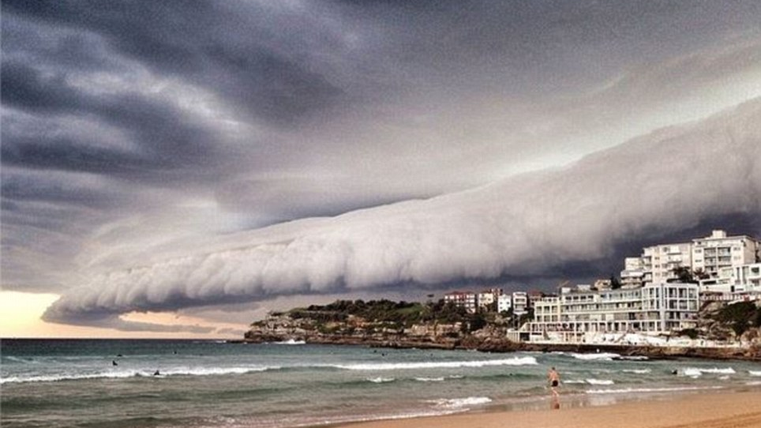
LOW pressure

Slide 8
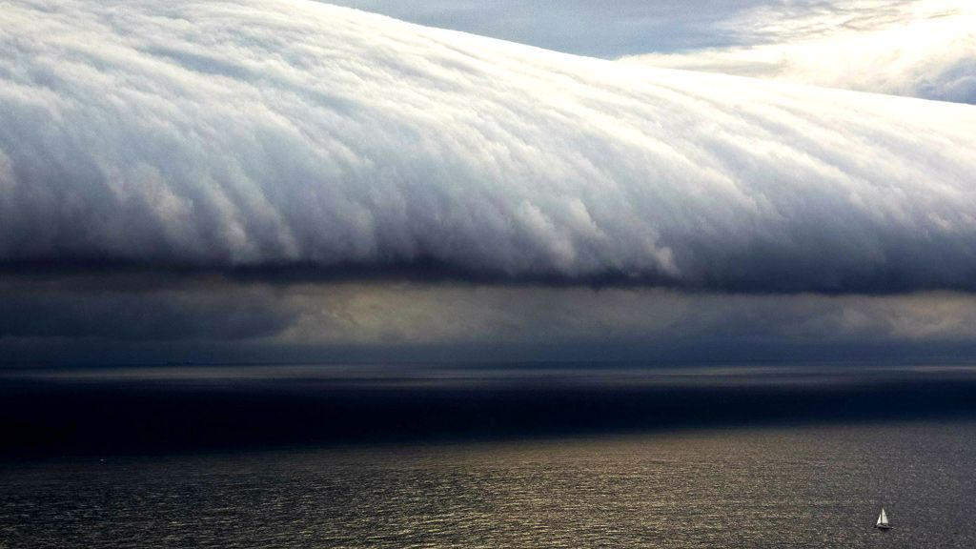
LOW pressure

Slide 9
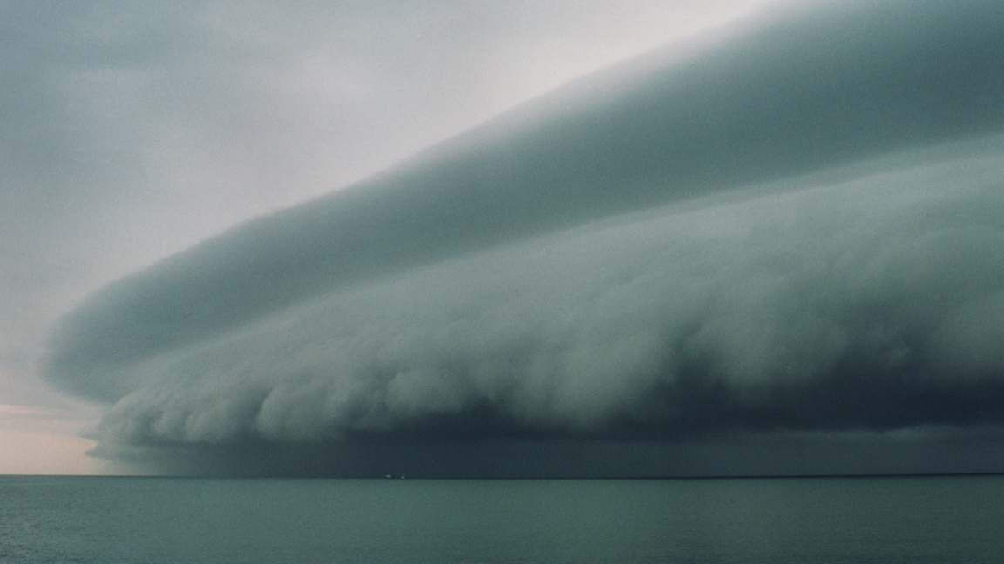
LOW pressure

Slide 10
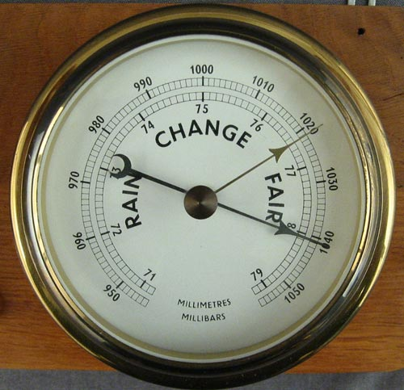
Barometer

Slide 11

HIGH pressure

Slide 12

HIGH pressure

Slide 13

HIGH barometric pressure system (cool air is sinking)

Slide 14
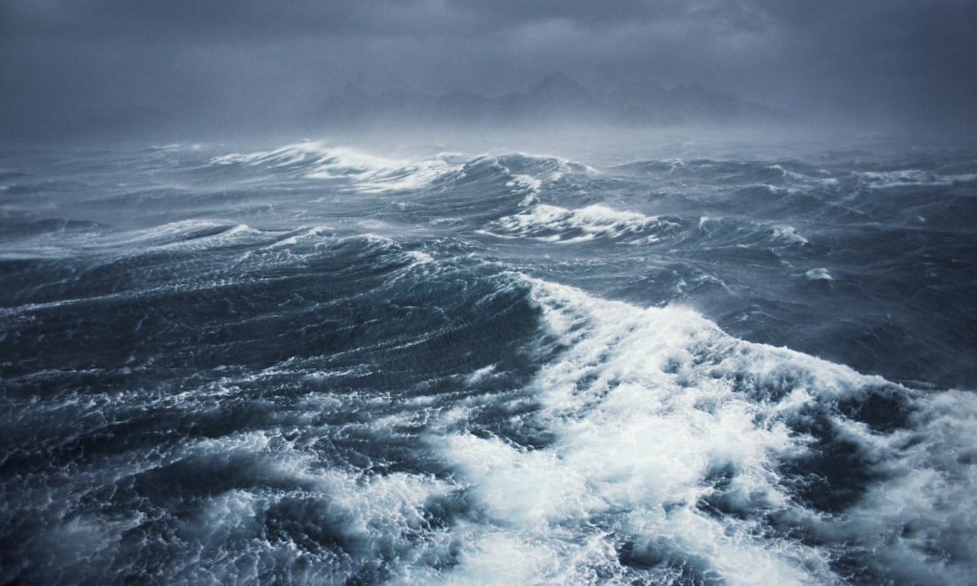
Wind = air moving from high pressure to low pressure

Slide 15
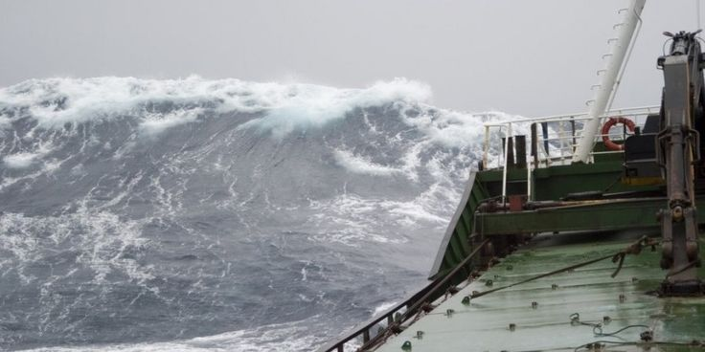
The closer the pressure systems are to each other, the stronger the wind

Slide 16
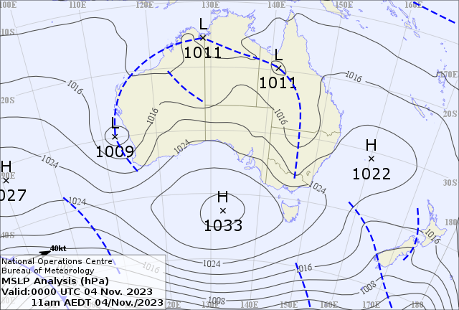
The closer the isobars
(lines on weather map joining areas of equal pressure)
the stronger the WIND

Slide 17

warm
SINKS
RISES

Slide 18
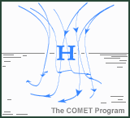




Slide 19
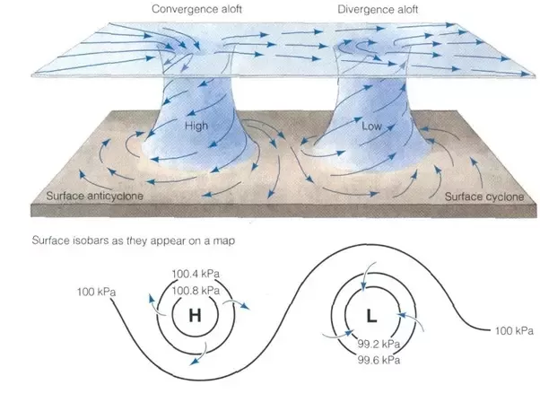
Spiraling
(and thus wind direction) is due to the Coriolis effect
Notes:
https://www.quora.com/Why-do-high-pressure-areas-have-good-weather

Slide 20
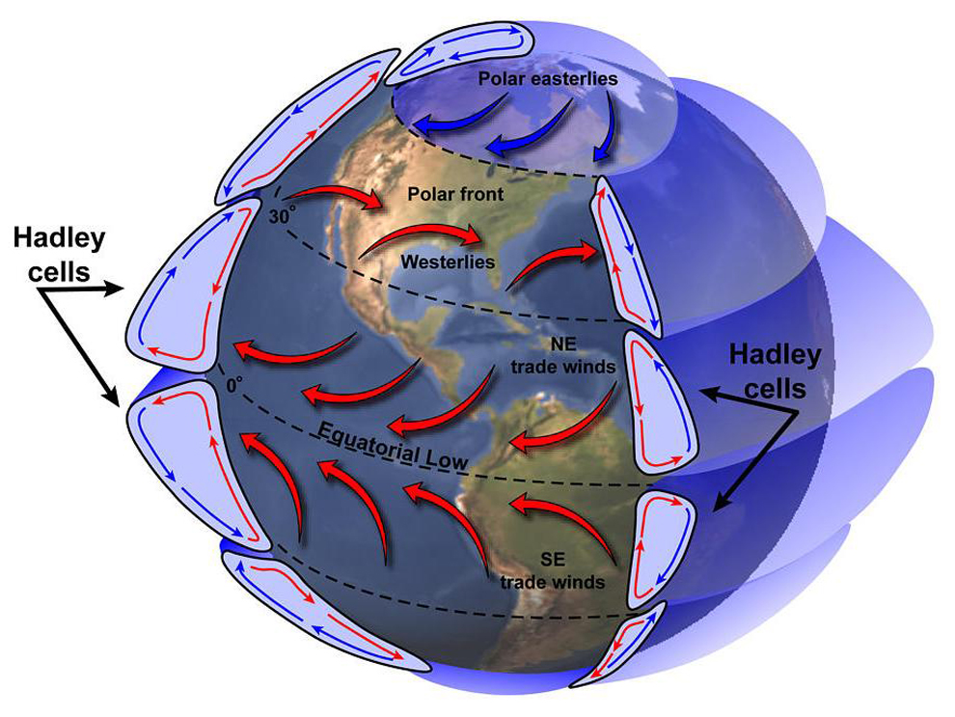

Slide 21
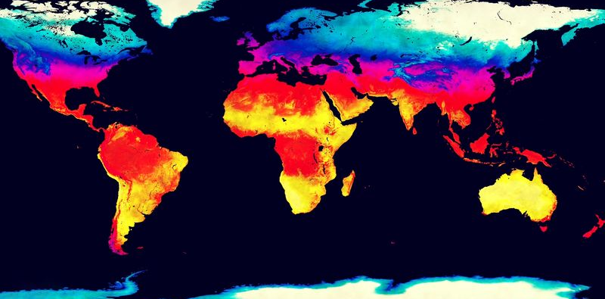
Climate

Slide 22
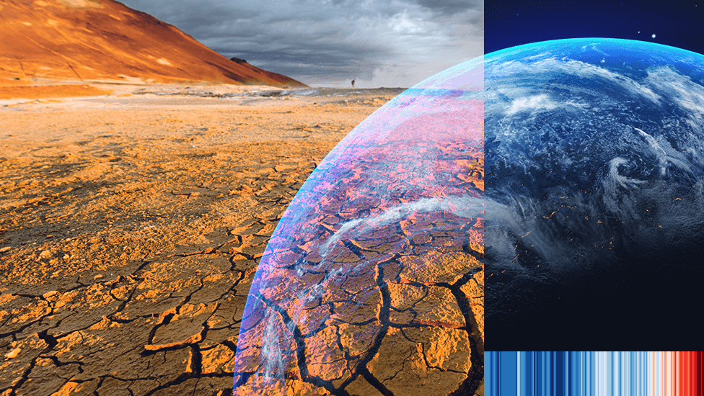

Slide 23
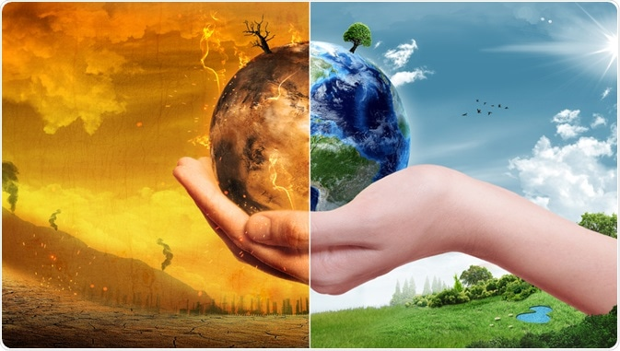

Slide 24
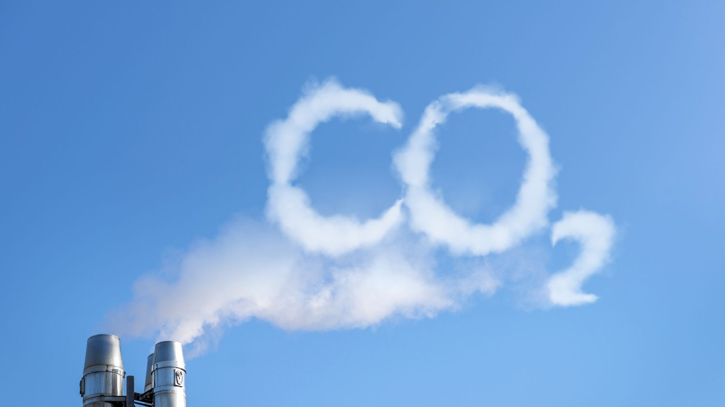

Slide 25


Slide 26
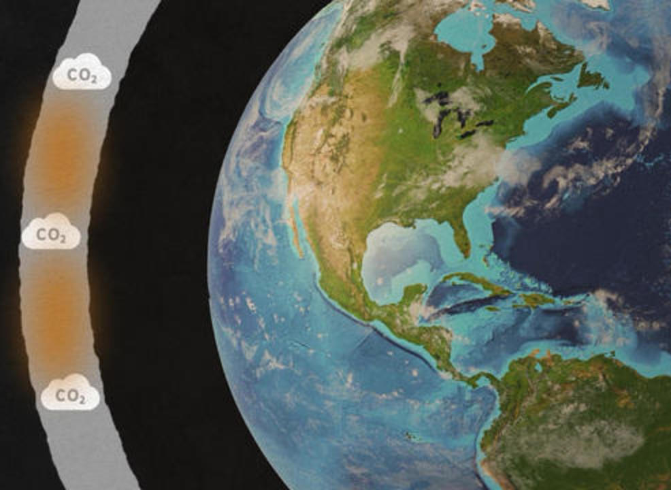
CO₂
acts like Earth’s blanket
(or the glass windows in a greenhouse) trapping in heat

Slide 27
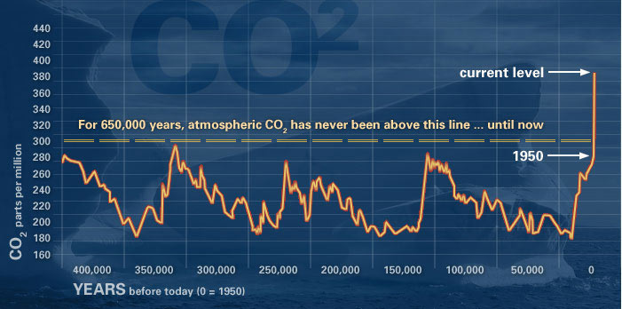
CO₂ concentrations rise

Slide 28
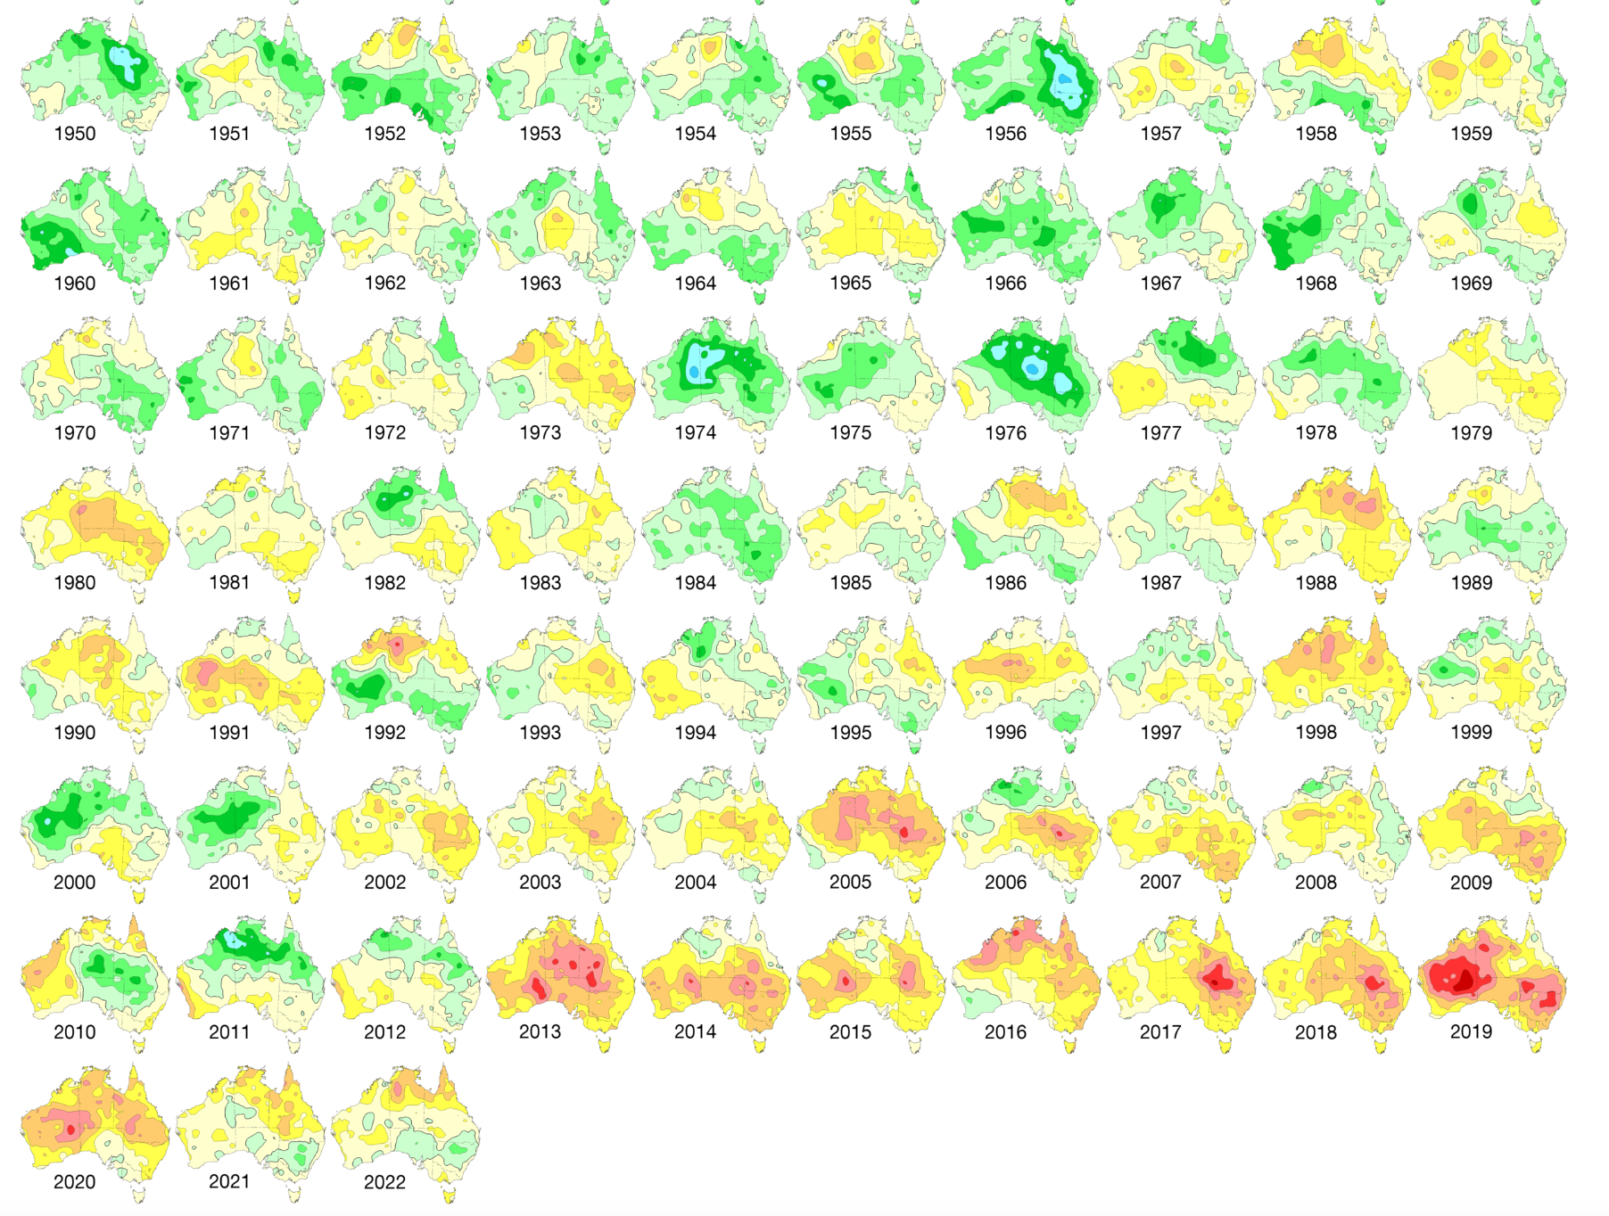
so temperatures rise
Notes:
Bom.gov.au

Slide 29
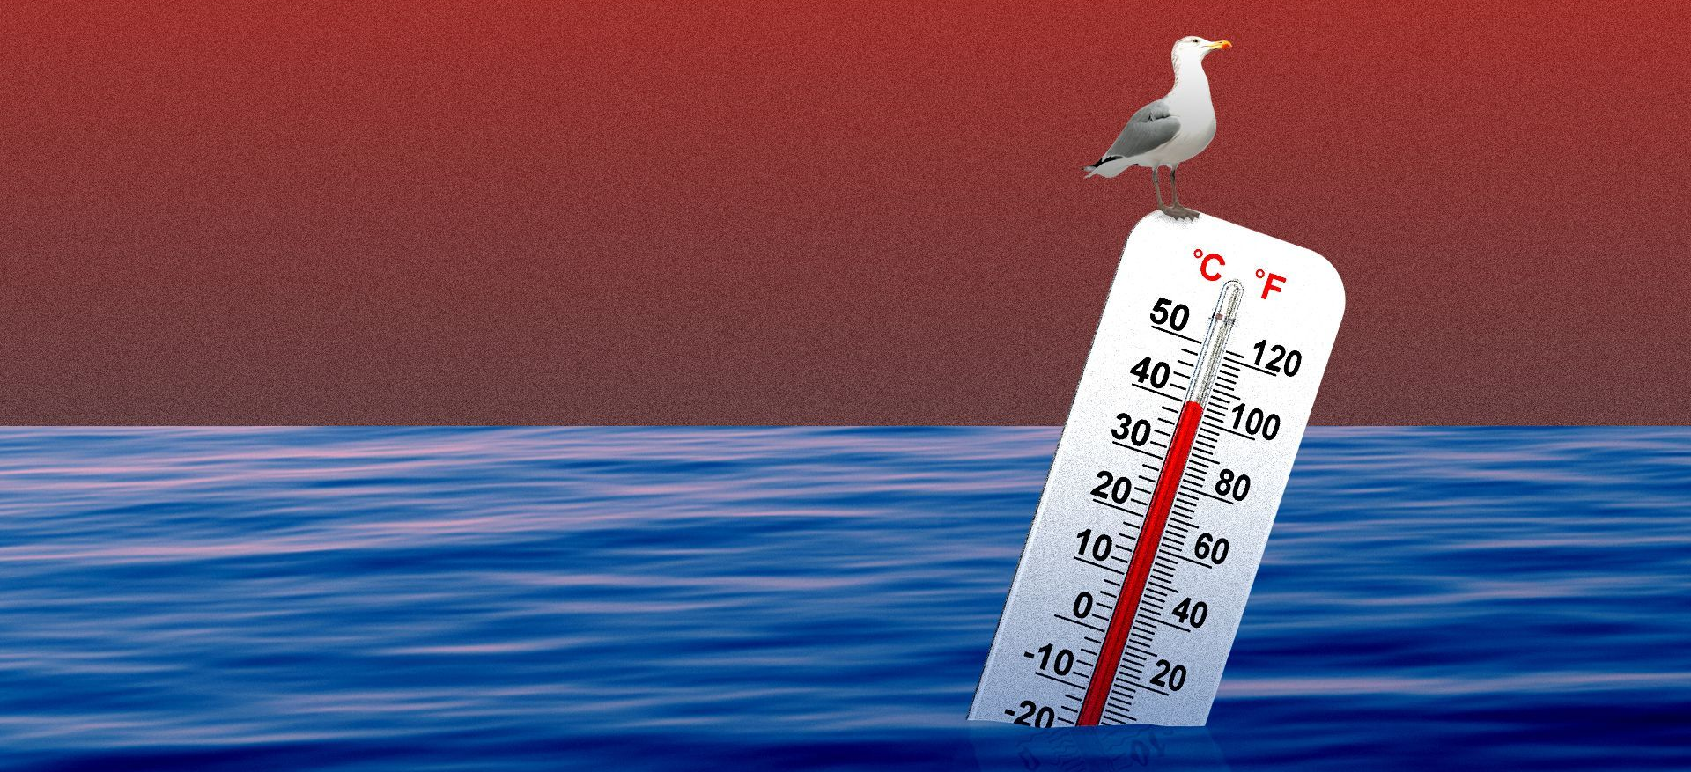
The oceans act as Earth’s enormous heat sponge

Slide 30
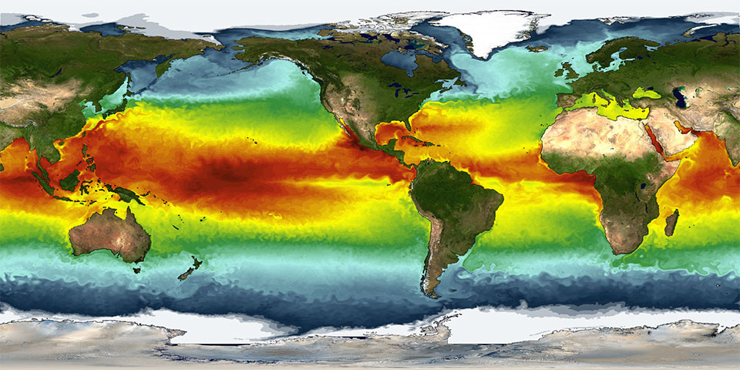
sea surface temperatures rise

Slide 31
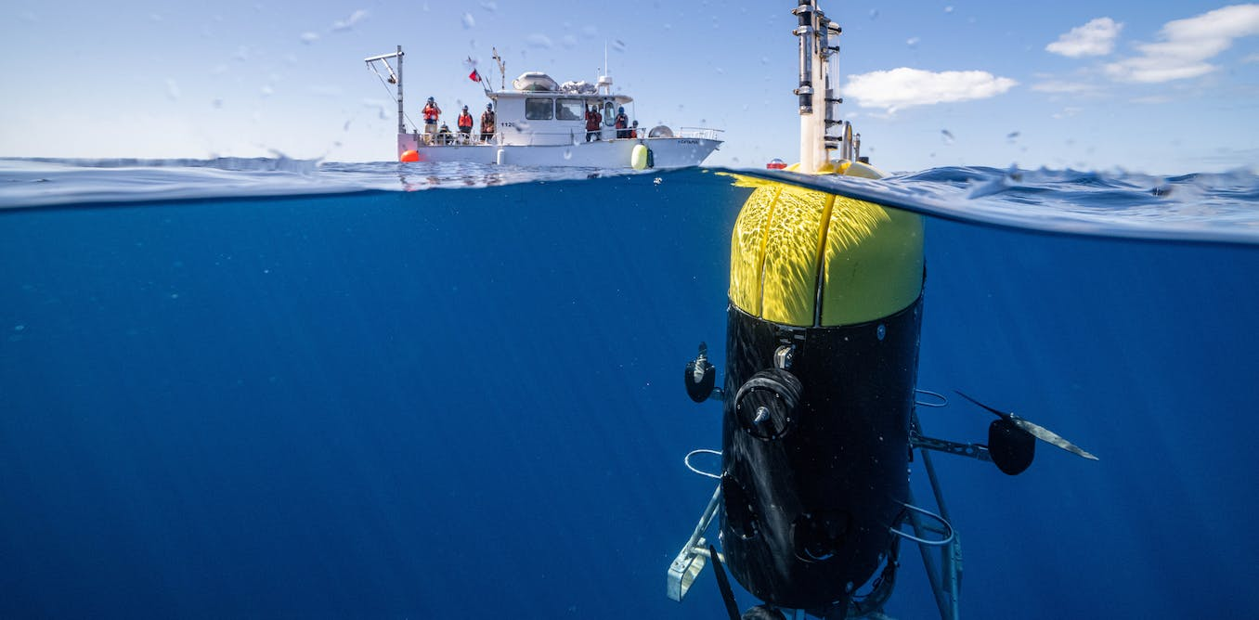
The air directly above the ocean warms

Slide 32
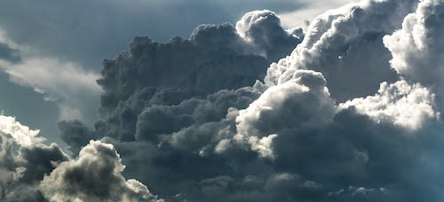
Energy is transferred from the ocean to the atmosphere as heat (making the atmosphere more unstable)

Slide 33
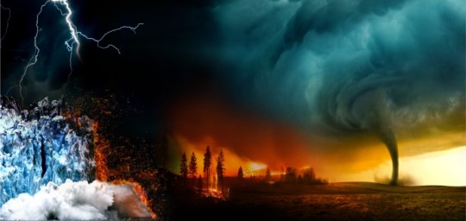
Weather events become more extreme & more frequent

Slide 34
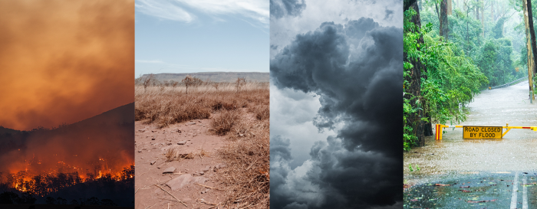
as the climates changes with increasing CO₂ emissions.

Slide 35
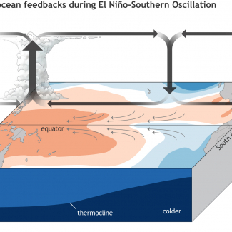
Hence, weather patterns and climate are driven by atmosphere/ocean interactions

Slide 36

These atmosphere/ocean interactions can be observed on a much smaller scale as land & sea breezes (onshore & offshore breezes)
Why it’s often calmer early in the morning than in the afternoon….

Slide 37
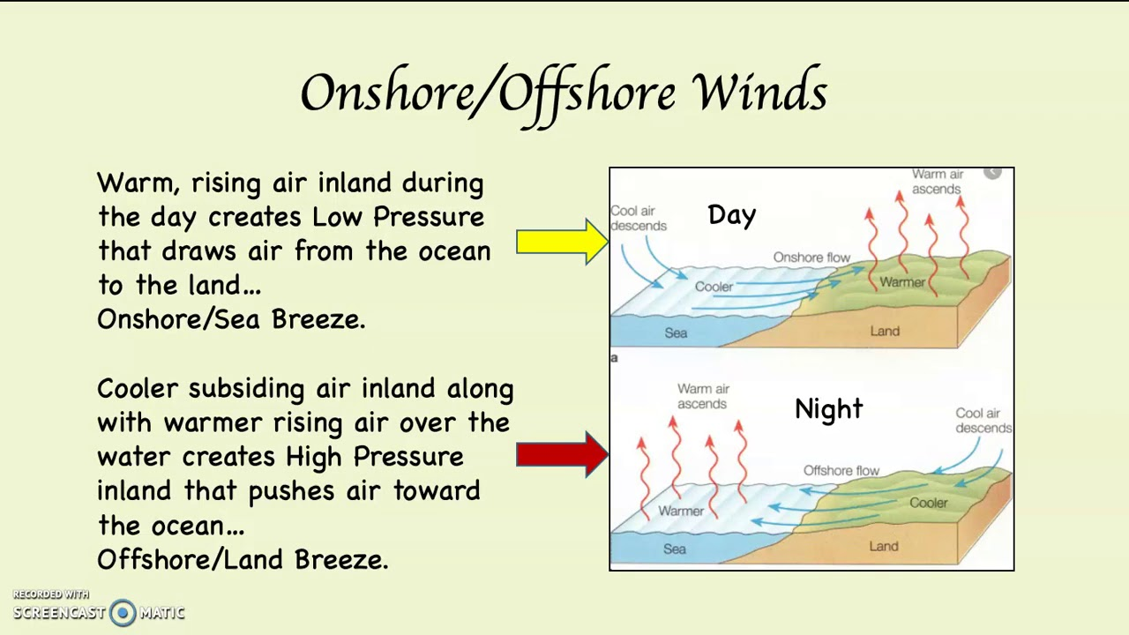

Slide 38
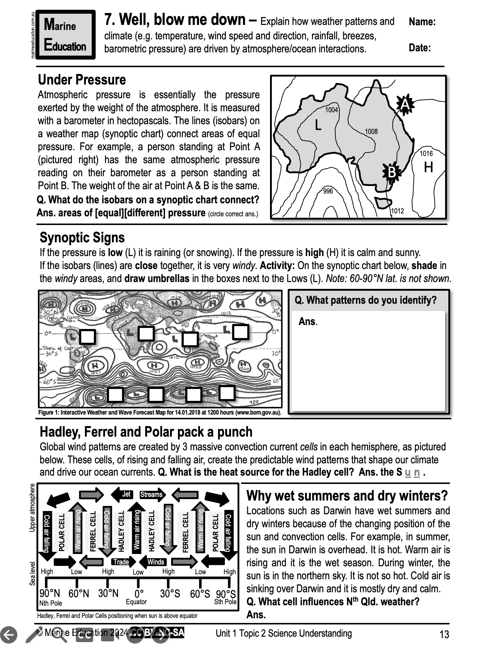
Learning Intention:
Explain how weather patterns and climate (e.g. temperature, wind speed and direction, rainfall, breezes, barometric pressure) are driven by atmosphere/ocean interactions.
Success Criteria:
Complete Marine Education worksheet ‘7. Well, blow me down”
Notes:
https://www.youtube.com/watch?app=desktop&v=loRr97fOWdg

