Slide 1
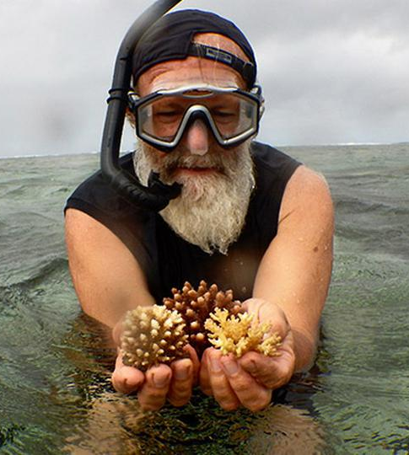
Learning Intention:
Describe the concepts of ecosystem disturbance, resilience and recovery.
Success Criteria:
Complete Marine Education worksheet ‘8. Environmental Medical’
Notes:
Image: https://corals4conservation.org/ Dr. Austin Bowden-Kerby

Slide 2
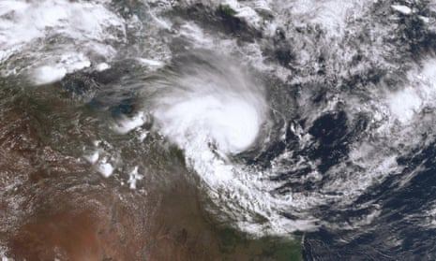
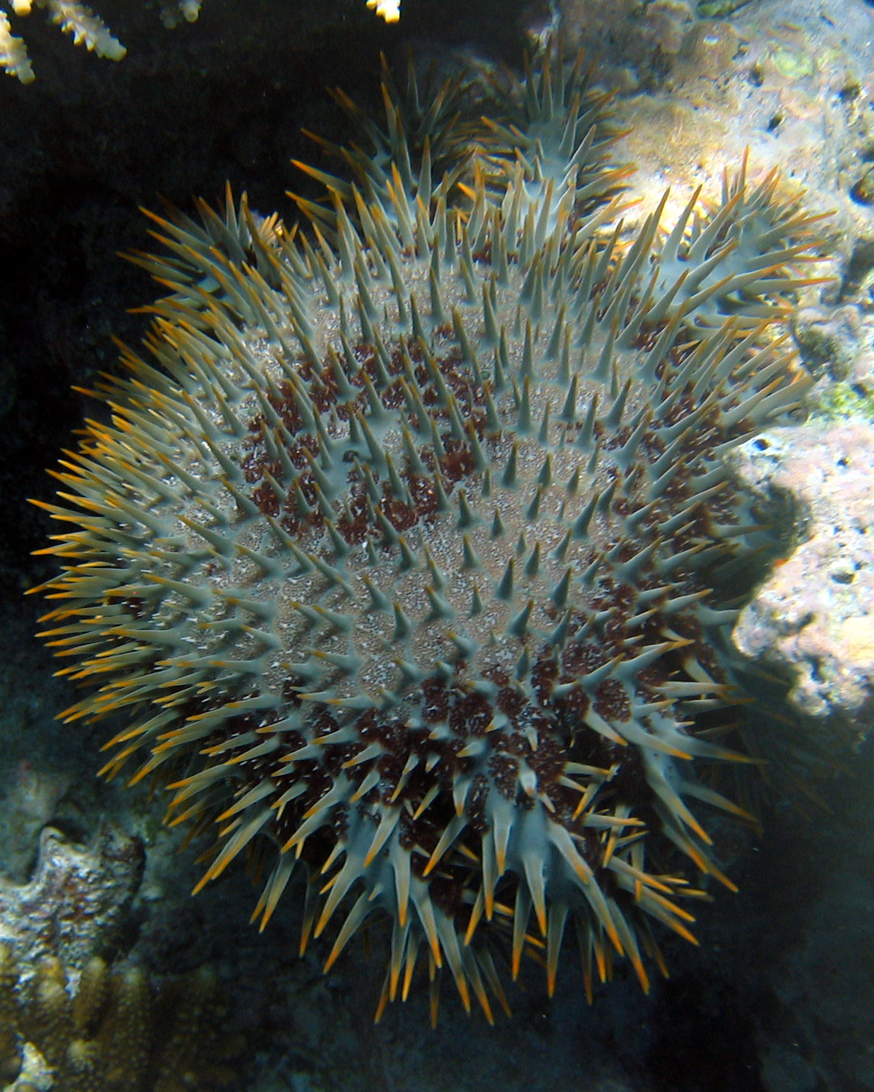
Disturbance is an event of intense environmental stress, forcing change upon an ecosystem (e.g. virus)

Slide 3
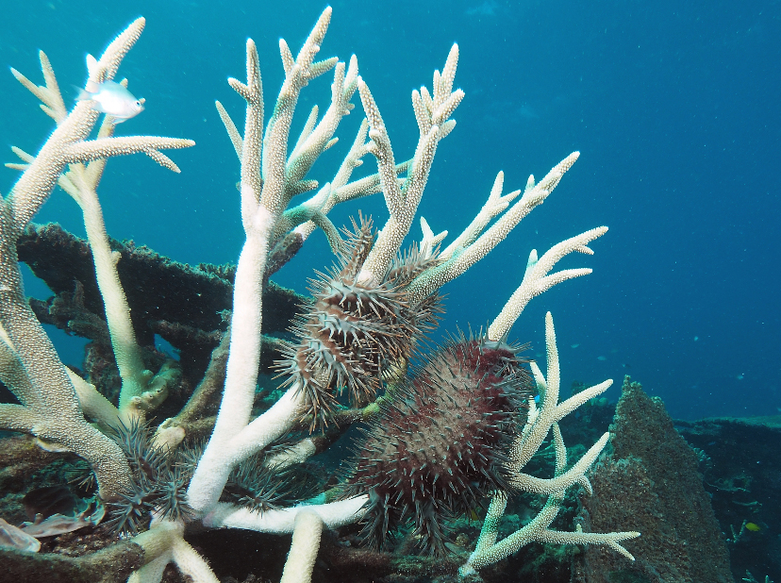
Crown of Thorns Starfish
COTS
(eat coral)
Notes:
Image; https://www.csiro.au/en/research/natural-environment/oceans/CoTS

Slide 4
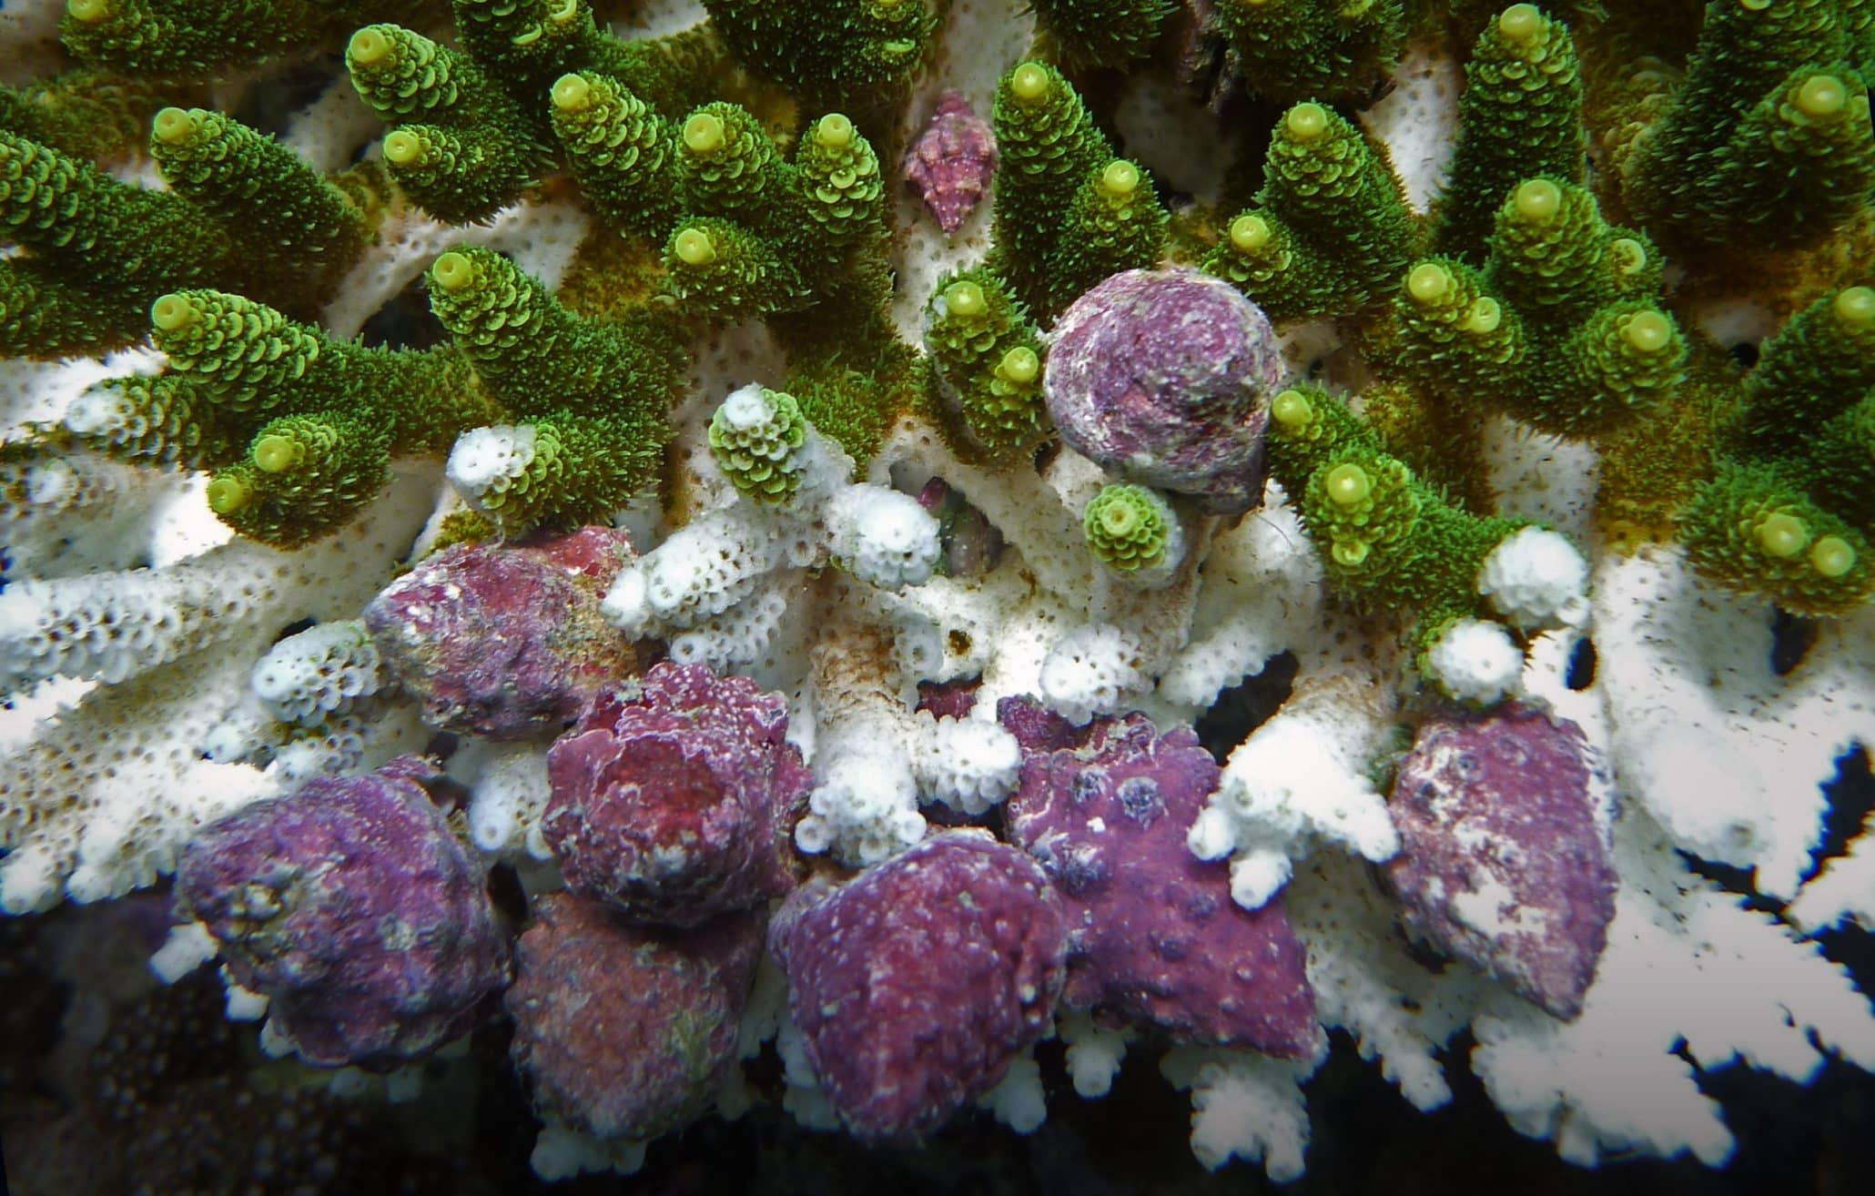
Drupella snails
(eat coral)

Slide 5
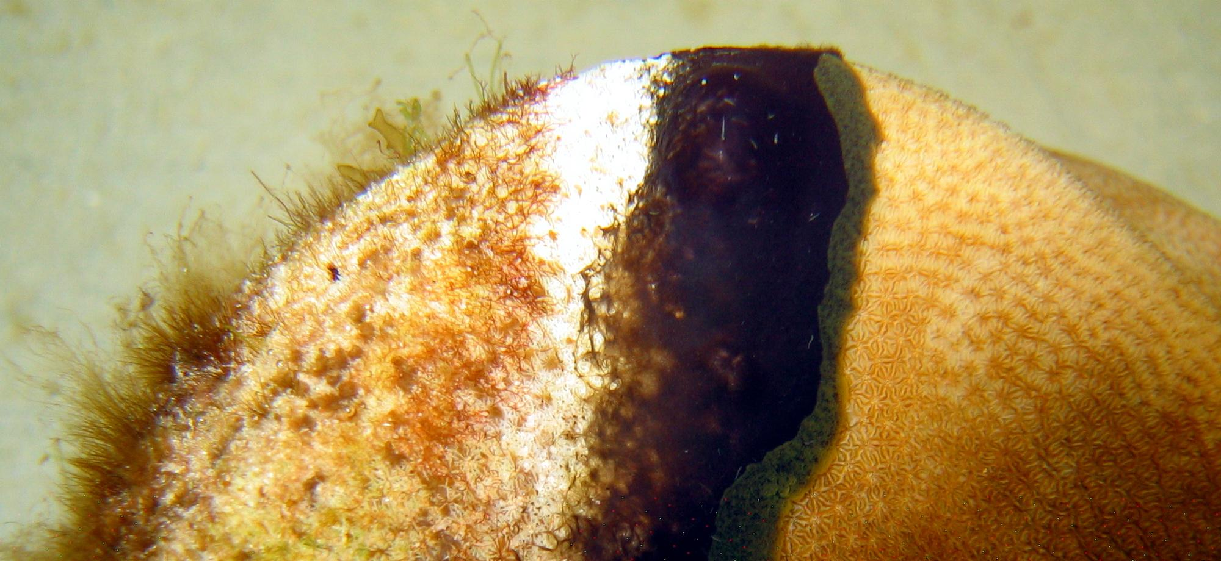
Coral disease
Notes:
Image: https://www.aims.gov.au/docs/research/biodiversity-ecology/threats/coral-disease.html

Slide 6
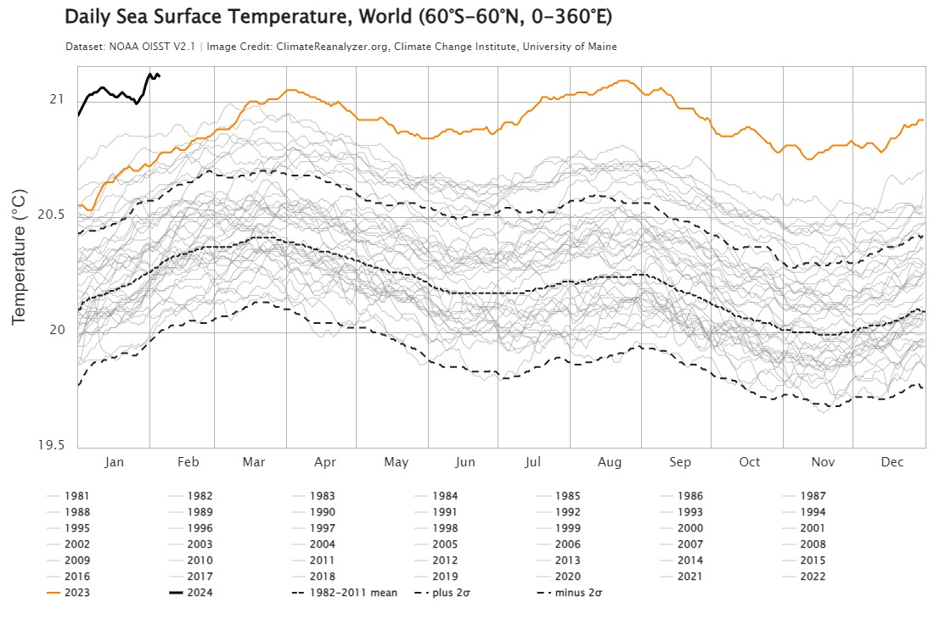
Mass bleaching events
(due to high temperatures)

Slide 7
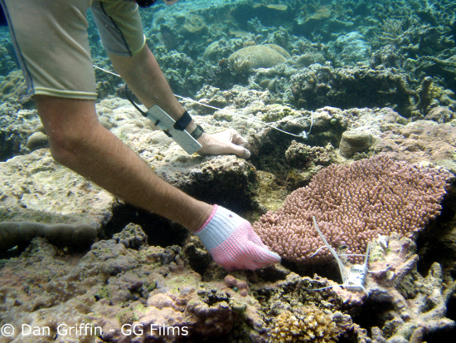
Resistance is the capacity to withstand a disturbance (e.g. to not get sick in the first place)
Heat resistant corals
with heat resistant zooxanthellae
do not bleach as fast as other corals
Notes:
Image; https://www.edgeofexistence.org/blog/coral-resistance-to-bleaching-a-genetic-basis/

Slide 8
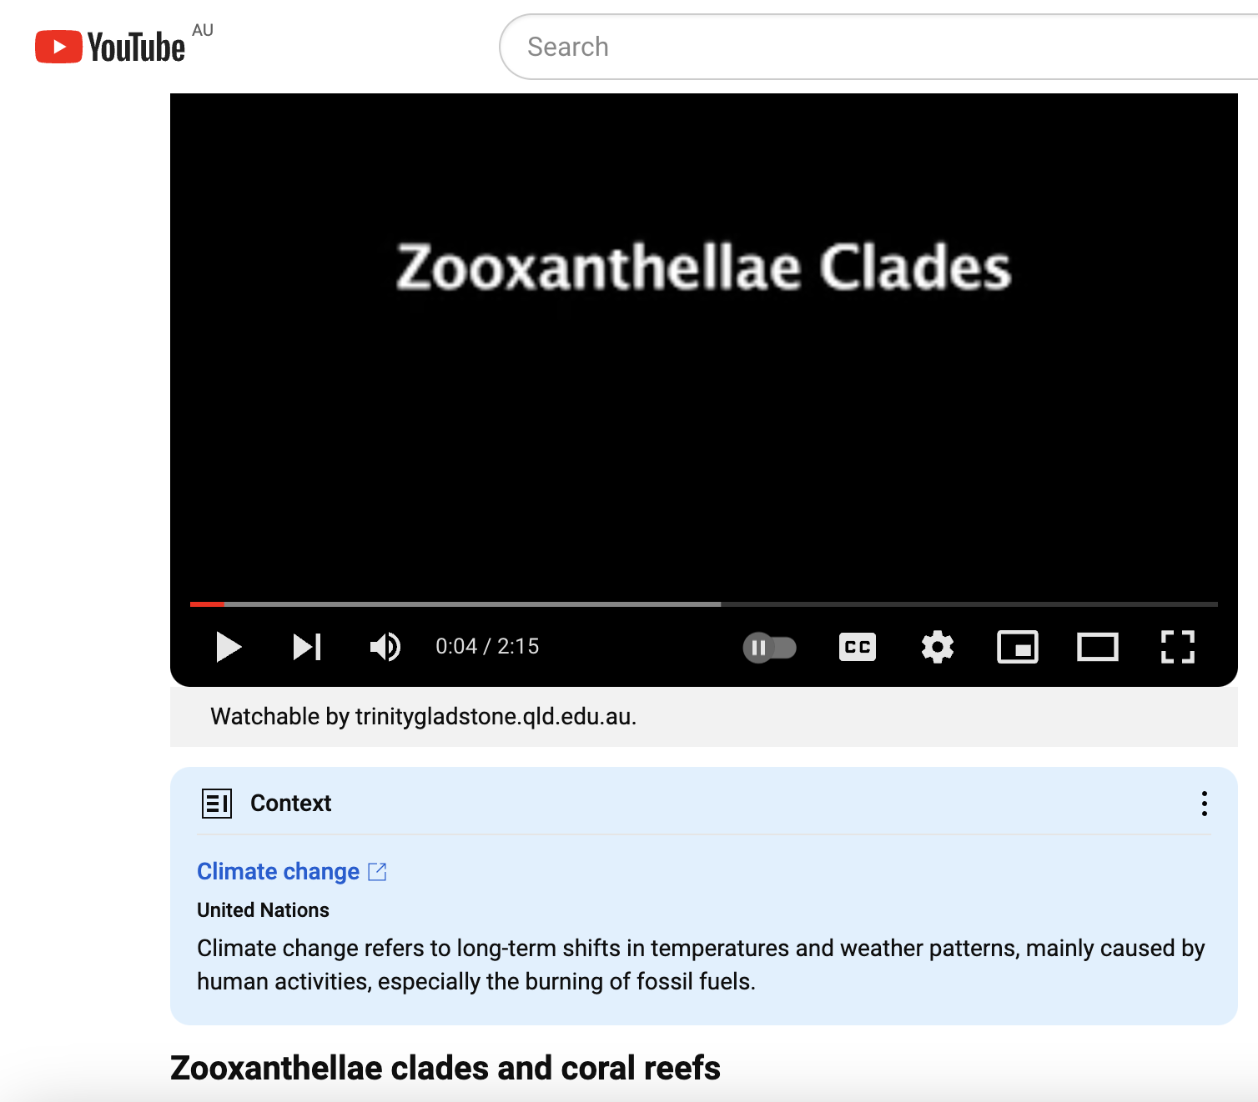
https://www.youtube.com/watch?v=IKaJ-uzy_UE

Slide 9
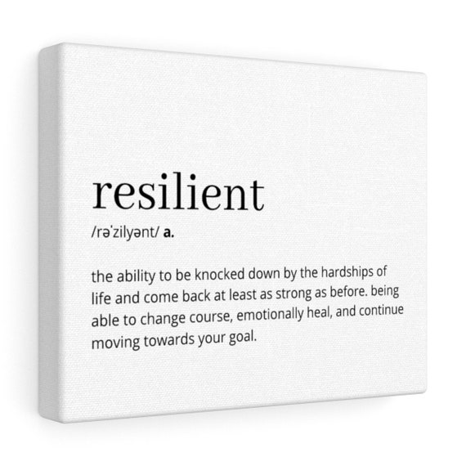
Resilience is the capacity to recover from a disturbance or withstand ongoing pressures (e.g. immunity)
Getting back up after being knocked down
https://reefresilience.org/news/

Slide 10
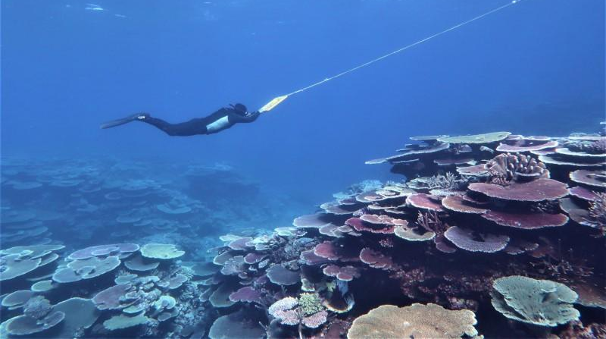
Recovery refers to the return of a damaged ecological system and associated ecosystem services to a stable state (i.e. an identifiable abundance and composition of species) (e.g. getting better again).

Slide 11
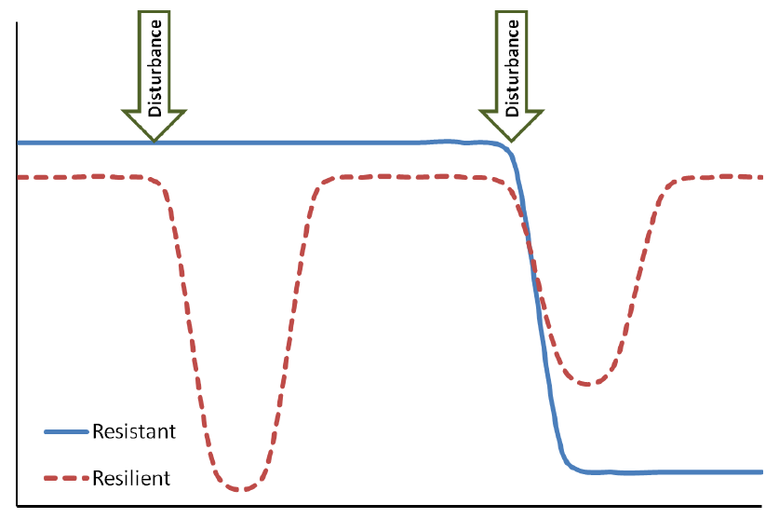
Disturbance, Resistance, Resilience and Recovery
Healthy
Ecosystem state
recovery
recovery
Unhealthy
Time
Notes:
Image; https://www.researchgate.net/figure/Graphical-depiction-of-resistance-versus-resilience-in-response-to-functional-service_fig1_261797595

Slide 12
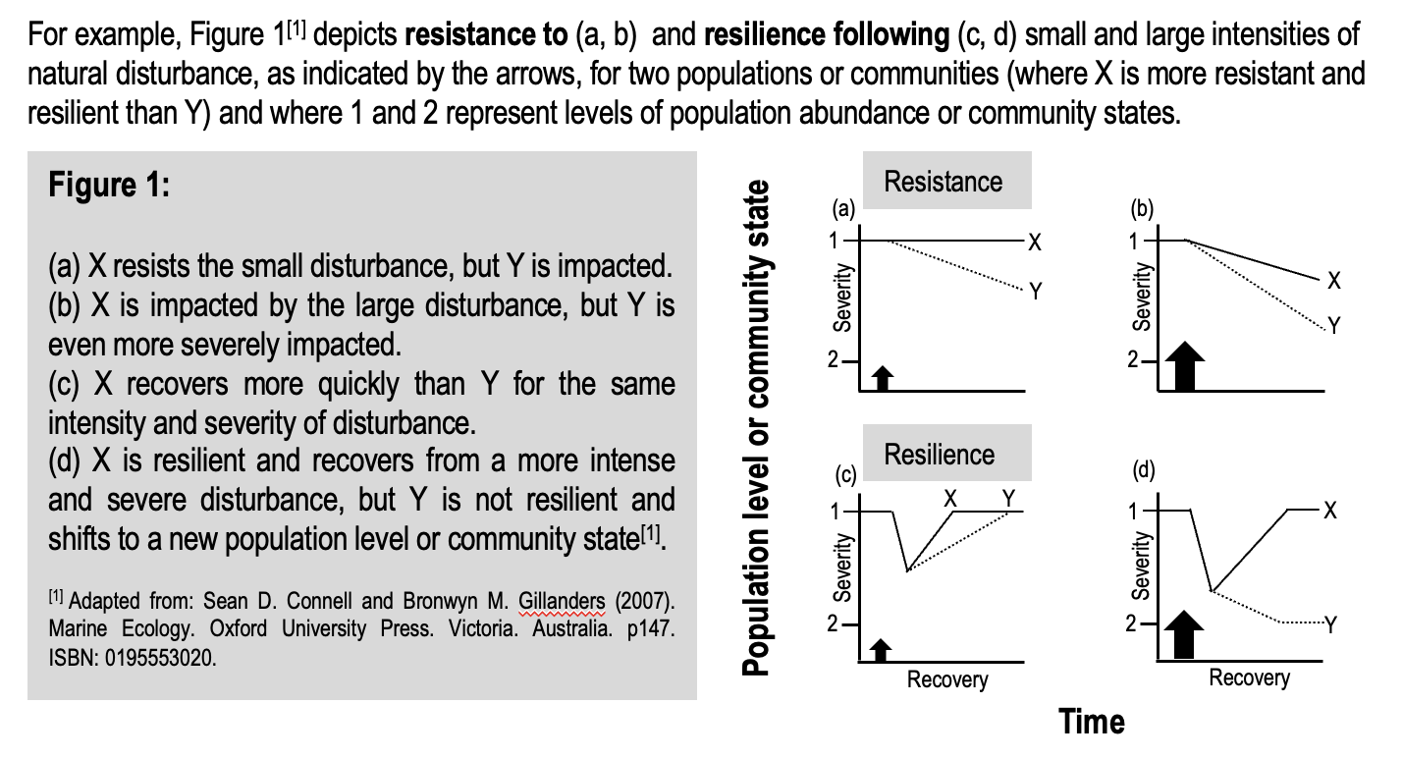

Slide 13
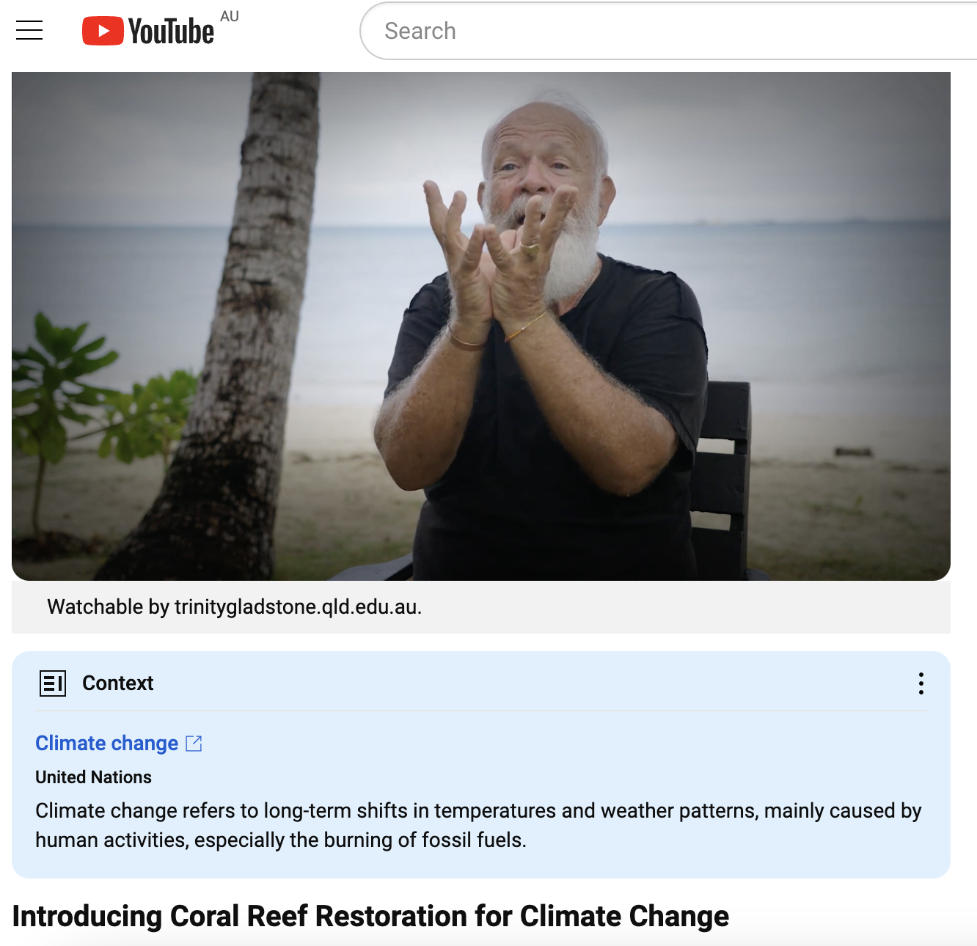
How to make a coral nursery
https://www.youtube.com/watch?v=9VbWV23JBxY
Notes:
Image: https://corals4conservation.org/ Dr. Austin Bowden-Kerby

Slide 14
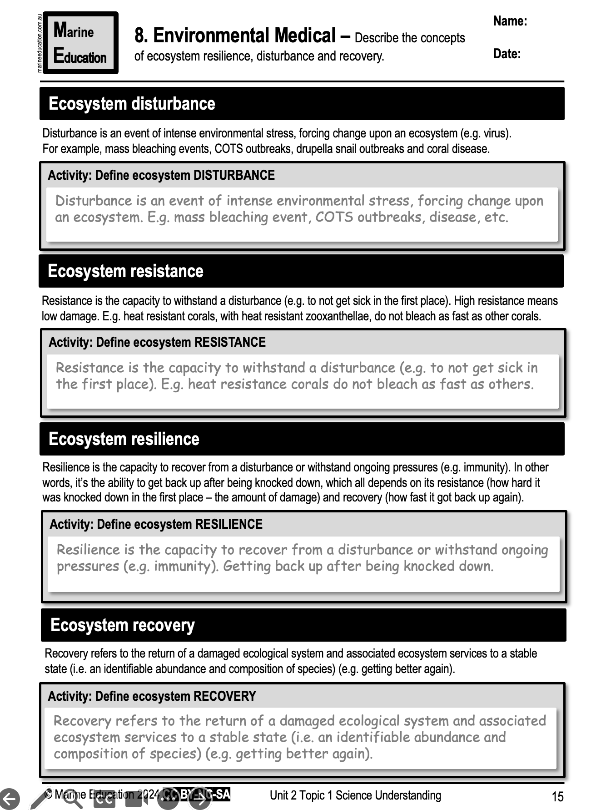
Learning Intention:
Describe the concepts of ecosystem resilience, disturbance and recovery.
Success Criteria:
Complete Marine Education worksheet ‘8. Environmental Medical’

