Slide 1
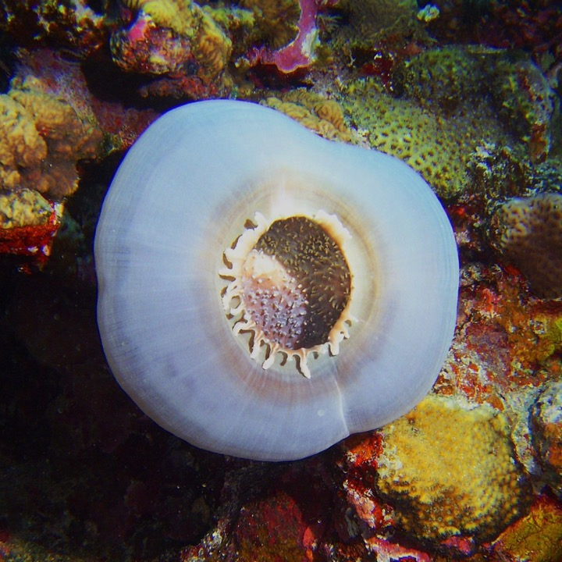
Learning Intention:
Describe criteria used to inform decisions regarding the design of protected marine areas.
Success Criteria:
Complete Marine Education worksheet ‘8. How to draw lines and make pretty shapes’
Corallimorpharian anemone in Huon marine park
Notes:
Image:https://parksaustralia.gov.au/marine/parks/south-east/huon/
Corallimorpharian anemone in Huon marine park

Slide 2
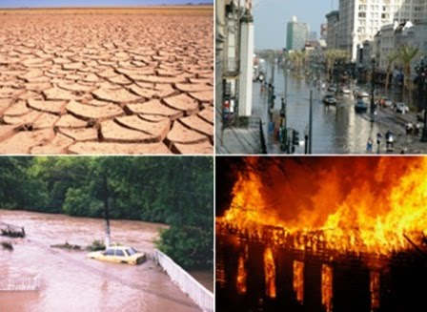
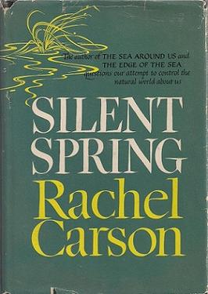
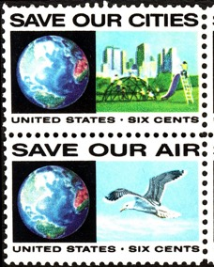
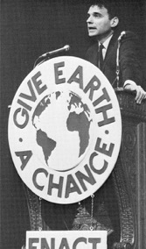
1970
Scientists highlight the urgent but complex problems bearing on our very survival

Slide 3

The people heard their message
20 million people attended events on the first Earth Day in 1970 which brought environmentalism to the forefront of political discourse in the United States

Slide 4
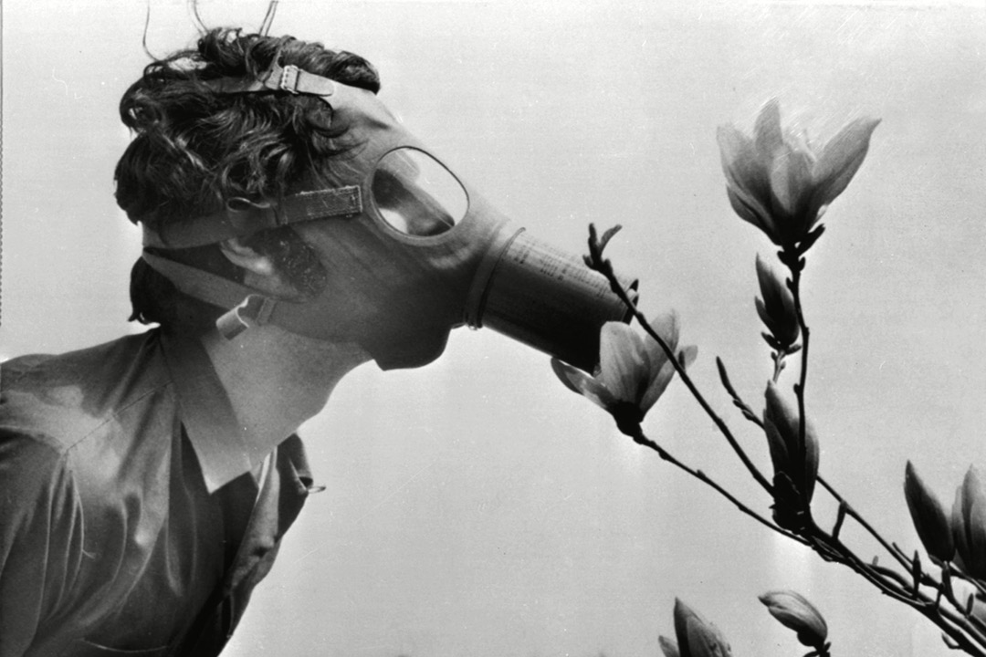
First Earth Day
April 22nd 1970
Notes:
Image: https://www.rollingstone.com/culture/culture-pictures/earth-day-1970-gallery-pictures-new-york-philadelphia-boston-california-987057/earth-day-philadelphia-philadelphia-usa/

Slide 5
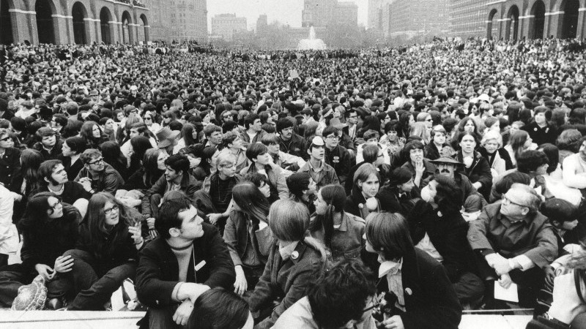
Notes:
Image: https://www.rollingstone.com/culture/culture-pictures/earth-day-1970-gallery-pictures-new-york-philadelphia-boston-california-987057/earth-day-philadelphia-philadelphia-usa/

Slide 6
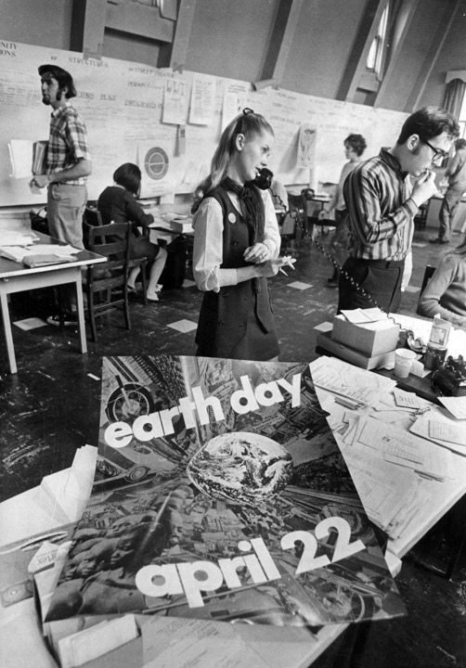
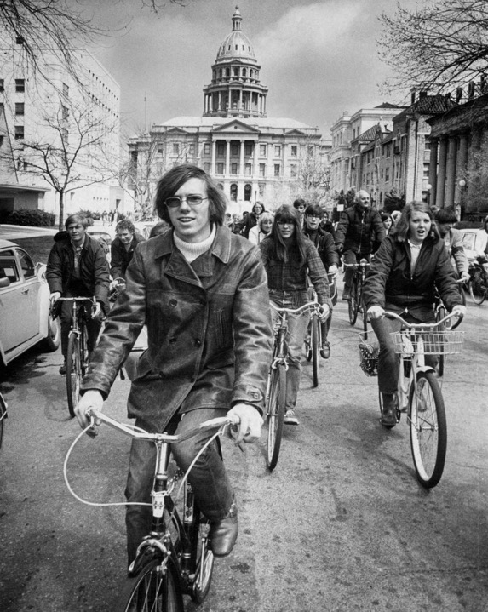
Notes:
Image: https://www.rollingstone.com/culture/culture-pictures/earth-day-1970-gallery-pictures-new-york-philadelphia-boston-california-987057/apr-22-1970-peter-cohen-of-the-university-of-colorado-leads-260-cyclists-from-capitol-of-teach-in/

Slide 7
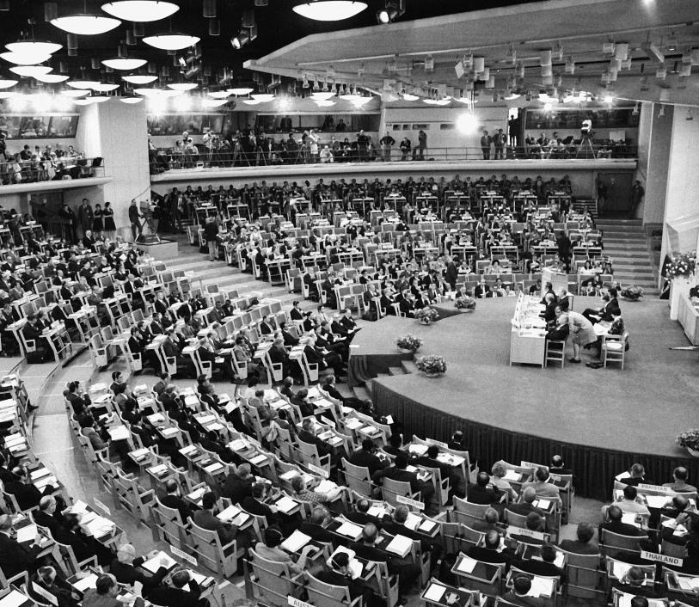
Governments responded
1972
The first UN world conference on the environment in Stockholm.
Notes:
Image: Grieger, Andreas. “Only One Earth: Stockholm and the Beginning of Modern Environmental Diplomacy.” Environment & Society Portal, Arcadia (2012), no. 10. Rachel Carson Center for Environment and Society. https://doi.org/10.5282/rcc/3867.

Slide 8
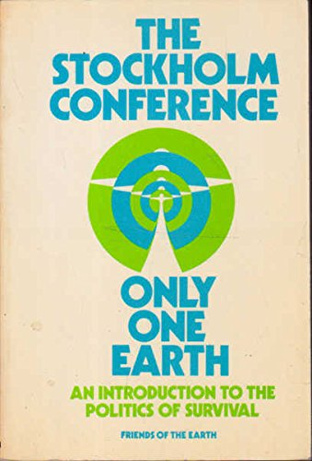
The theme for the conference was
Only One Earth
Notes:
Image: https://www.abebooks.com/9780856440069/Stockholm-Conference-earth-introduction-politics-085644006X/plp

Slide 9
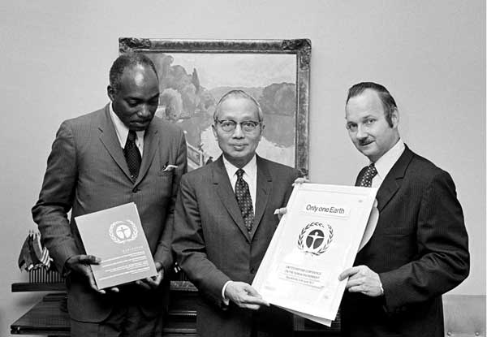
The conference created the first document in international LAW to recognise the
right to a healthy environment.
Countries went home and added the environment to their own laws.
Notes:
Image and info: https://dics.co/current-affairs/stockholm-conference-upsc

Slide 10
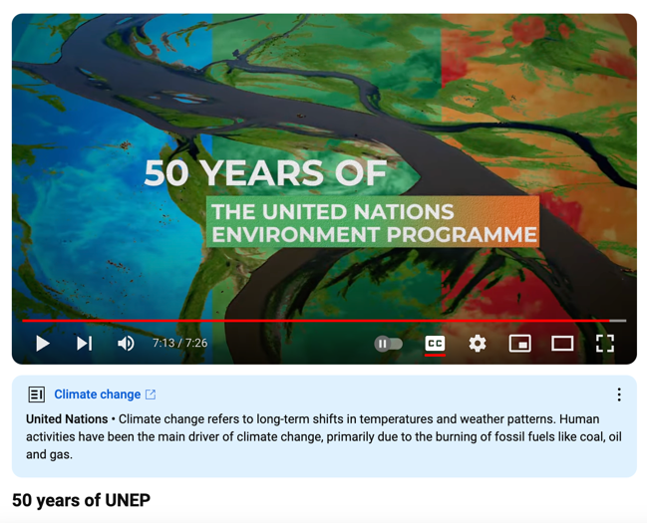
At the conference UNEP
was established
(to help them do this)
to unite the world in saving our planet.
https://www.youtube.com/watch?v=zuXWT4Bnyro
Notes:
Info: https://www.unep.org/who-we-are/about-us

Slide 11
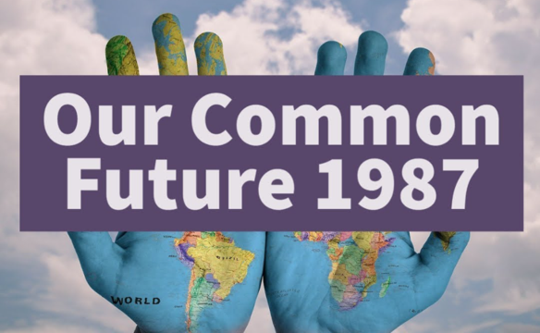

1987
Ecological Sustainable Development (ESD)
was officially defined as:
“the ability to make development sustainable to ensure that it meets the needs of the present without compromising the ability of future generations to meet their own needs”
Our Common Future (Brundtland Report)
Notes:
Image (top): https://environmentalsciences.quora.com/Our-Common-Future-The-Brundtland-Report-1987-https-thegreenpolitics-com-our-common-future-the-brundtland-report-19
Image (bottom): https://issuu.com/preethid2770/docs/brundtland_report.pptx

Slide 12

The definition put a focus on how we leave the planet for future generations
Notes:
Image; https://depositphotos.com/photos/future-generations.html

Slide 13
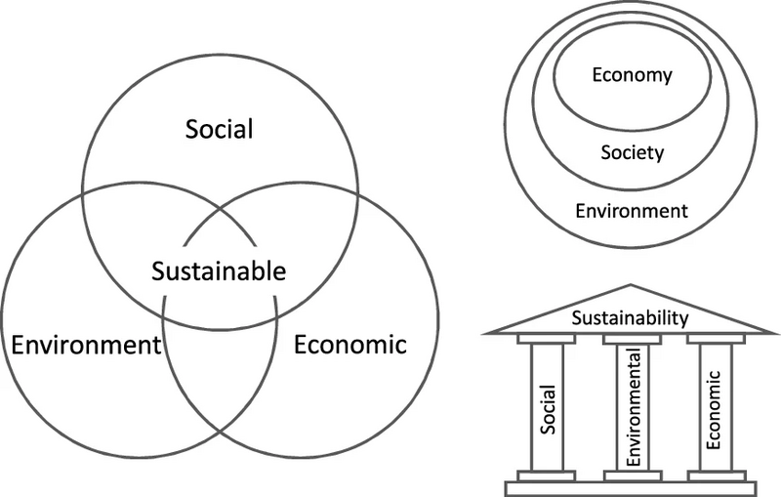
Visual representations of the principles of Ecological Sustainable Development (ESD)
Notes:
Image: https://en.wikipedia.org/wiki/Sustainability

Slide 14


ESD is now a key principle enshrined in many international agreements and declarations (LAWS)
In Australia,
ESD has been included in over 60 pieces of Australian legislation.

Slide 15
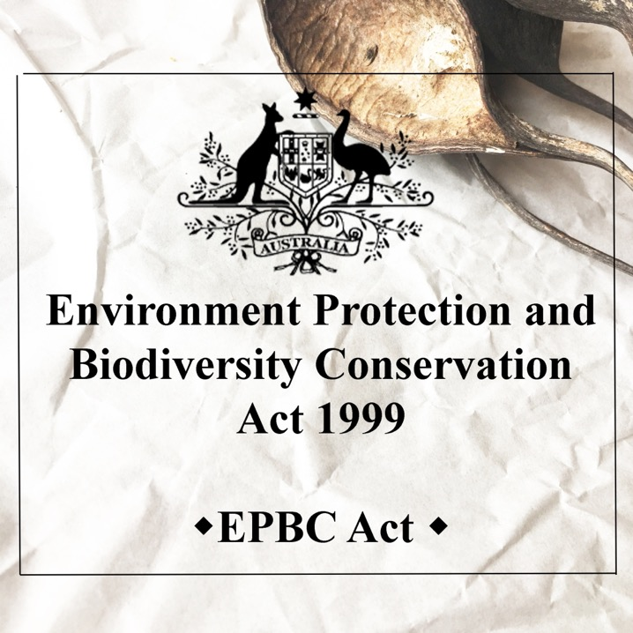
Including the National Strategy for Ecologically Sustainable Development (1992), the National Strategy for the Conservation of Australia’s Biological Diversity (1996) and in Section 3A of the Environment Protection and Biodiversity Conservation Act 1999
often quoted as the
EPBC Act
(also where the precautionary principle is found)
Notes:
Image: https://sellaismk.shop/product_details/18145299.html

Slide 16
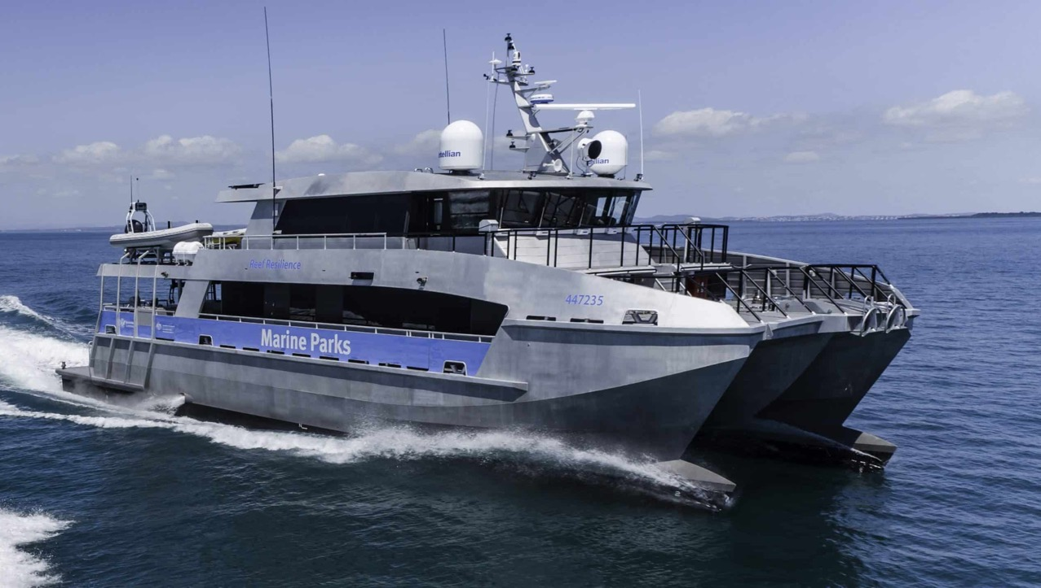
It was widely accepted that MPAs promote ESD

Slide 17
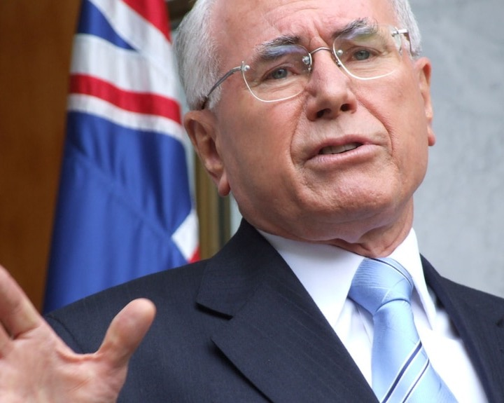
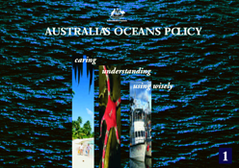
1998
The Oceans Policy
is launched by the Howard government
Notes:
Info: https://library.dbca.wa.gov.au/static/FullTextFiles/018882.pdf

Slide 18
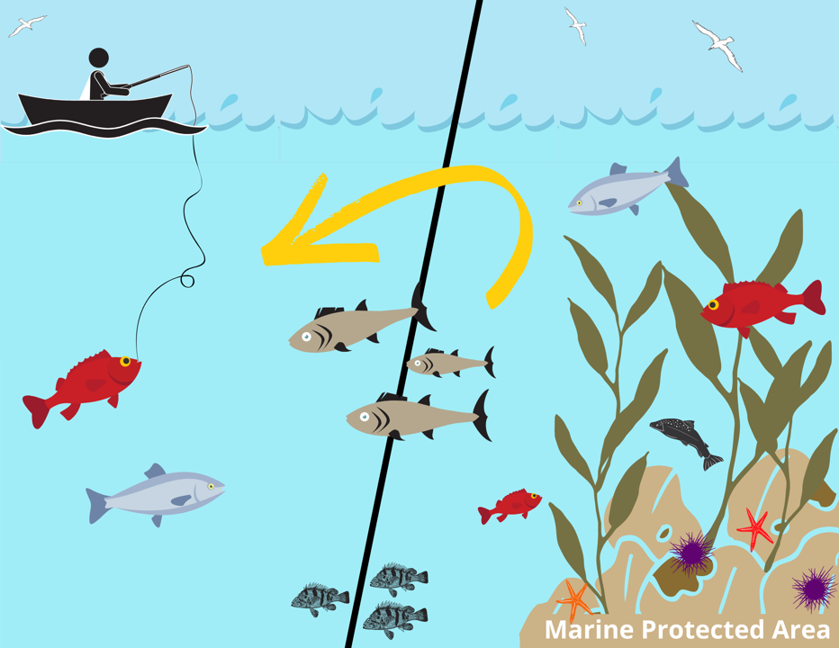
The Oceans Policy called for MORE marine parks to protect biodiversity
Sold to voters by highlighting the “spill over effect”
Notes:
Image: https://california.surfrider.org/blog/the-spillover-effect-and-more-in-marine-protected-area-news

Slide 19
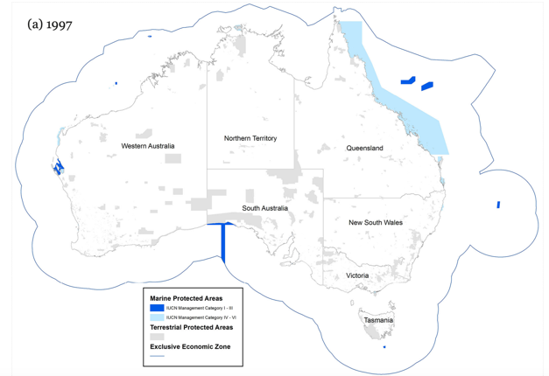
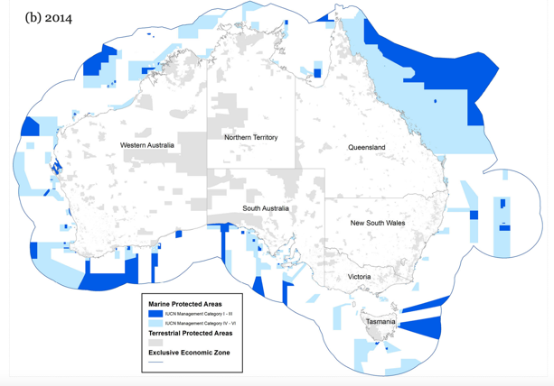
Thus, in 1998 the National Representative System of Marine Protected Areas (NRSMPA) was born…
1997
2014
Notes:
Image: https://parksjournal.com/wp-content/uploads/2021/03/PARKS-24.2-Fitzsimons-and-Wescott-10.2305-IUCN.CH_.2018.PARKS%E2%80%9024%E2%80%902JAF.en_.pdf
Fitzsimons, James; Wescott, G (2018). Large-scale expansion of marine protected area networks: lessons from Australia. Deakin University. Journal contribution. https://hdl.handle.net/10536/DRO/DU:30116587

Slide 20
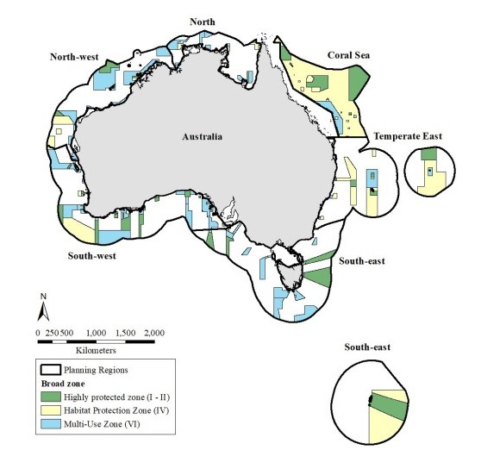
2018
The primary goal of NRSMPA is to establish and manage
a comprehensive, adequate and representative
(CAR) system of marine protected areas.
Notes:
Image: https://conservationplanning.org/2020/11/representation-does-not-necessarily-reduce-threats-to-biodiversity-australias-commonwealth-marine-protected-area-system-20122018/

Slide 21
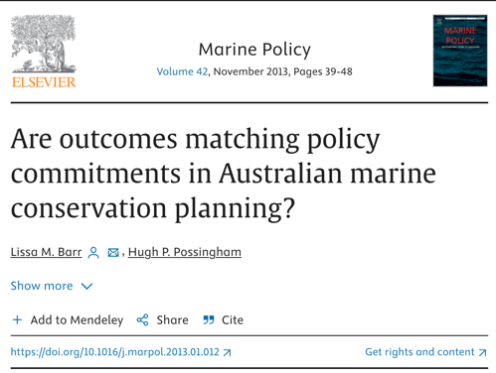
CAR means that MPAs should include the full range of marine ecosystems.
“Protecting the full range of ecosystems off the coasts of Australia is a fundamental requirement….or else habitats with distinct biology may be lost”
Cressey, D. Australia’s plans for sea havens ‘flawed’. Nature 495, 155 (2013). https://doi.org/10.1038/495155a
Notes:
Paper: Lissa M. Barr, Hugh P. Possingham (2013). Are outcomes matching policy commitments in Australian marine conservation planning?Marine Policy,
Volume 42. Pages 39-48,
Quote: Cressey, D. Australia’s plans for sea havens ‘flawed’. Nature 495, 155 (2013). https://doi.org/10.1038/495155a

Slide 22
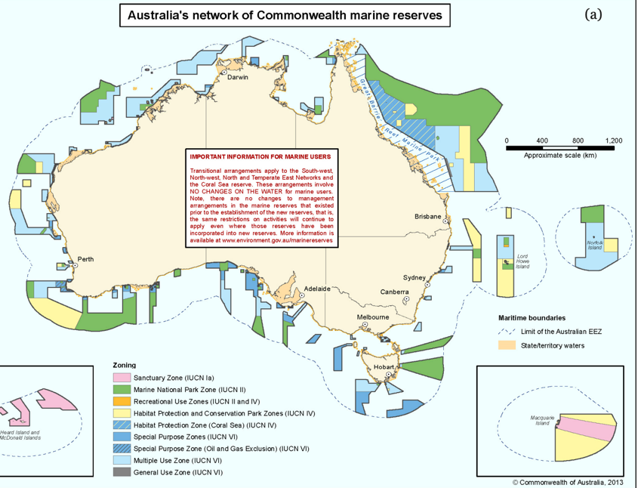
Is this comprehensive, adequate and representative enough?
Are there enough ‘no-take’ green zones and ‘no-go’ pink zones?

Slide 23

MPAs can be called different names
(e.g. no-take fisheries reserves or locally managed marine areas)
or divided into different zones
(e.g. no-take green zone or no-go’ pink zone)
so they can be multi-use MPAs,
to be shared.
Notes:
Image: https://en.wikipedia.org/wiki/Australian_marine_parks

Slide 24
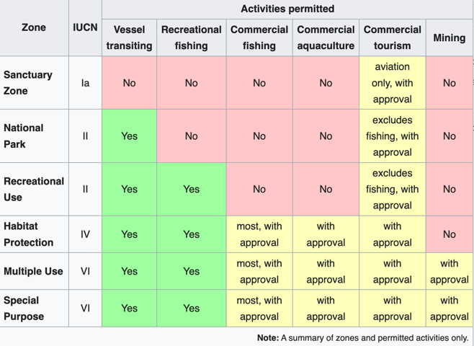
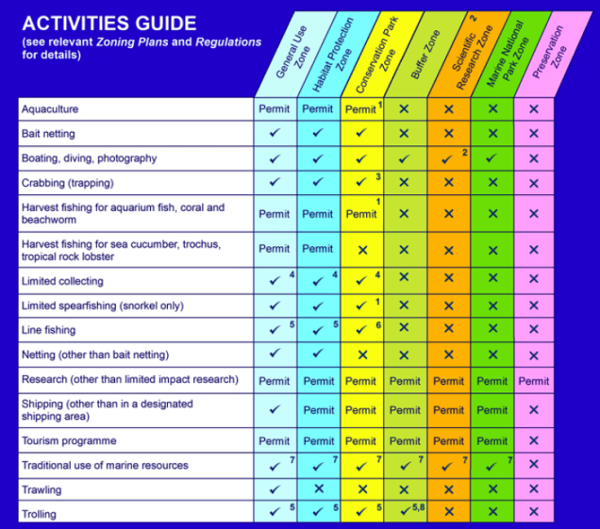
Zones of Australian Marine Parks
Zones of GBRMPA

Slide 25
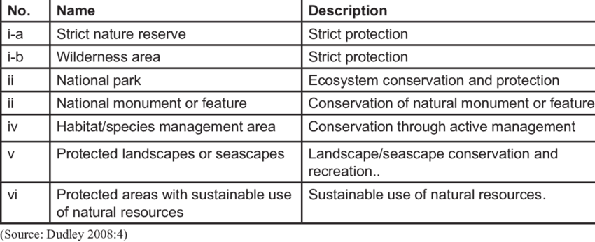
IUCN protected area categories and definitions
ZONE
Level of protection
Notes:
Image: Bwalya, Bridget. (2018). Strategies for wildlife management in Africa: Actors, successes and failures. Accessed: https://www.researchgate.net/figure/IUCN-protected-area-categories-and-definitions_tbl1_338684271

Slide 26
They’re designed with zones (with different rules) so that MPAs can be multi-use parks, to be shared.
Notes:
Image: https://en.wikipedia.org/wiki/Australian_marine_parks

Slide 27
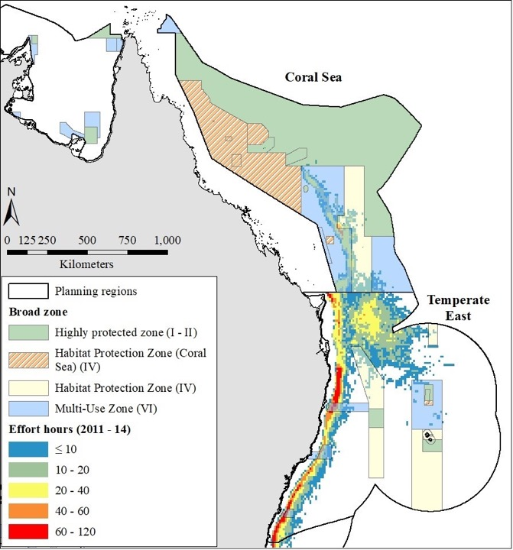
Cockerell et al., 2012
Are our MPAs comprehensive, adequate and representative enough?
Do they protect the full range of ecosystems?
(Note: Red is where most longline boats fish)
Notes:
Image: https://conservationplanning.org/2020/11/representation-does-not-necessarily-reduce-threats-to-biodiversity-australias-commonwealth-marine-protected-area-system-20122018/
Paper: Brayden Cockerell, Robert L. Pressey, Alana Grech, Jorge G. Álvarez-Romero, Trevor Ward, Rodolphe Devillers, (2020). Representation does not necessarily reduce threats to biodiversity: Australia's Commonwealth marine protected area system, 2012–2018. Biological Conservation,. Volume 252,
. 108813. ISSN 0006-3207,

Slide 28
In Part 2, you will be taken on a trip around Australia to see what’s protected and what isn’t, so you can make your own judgement….

