Slide 1
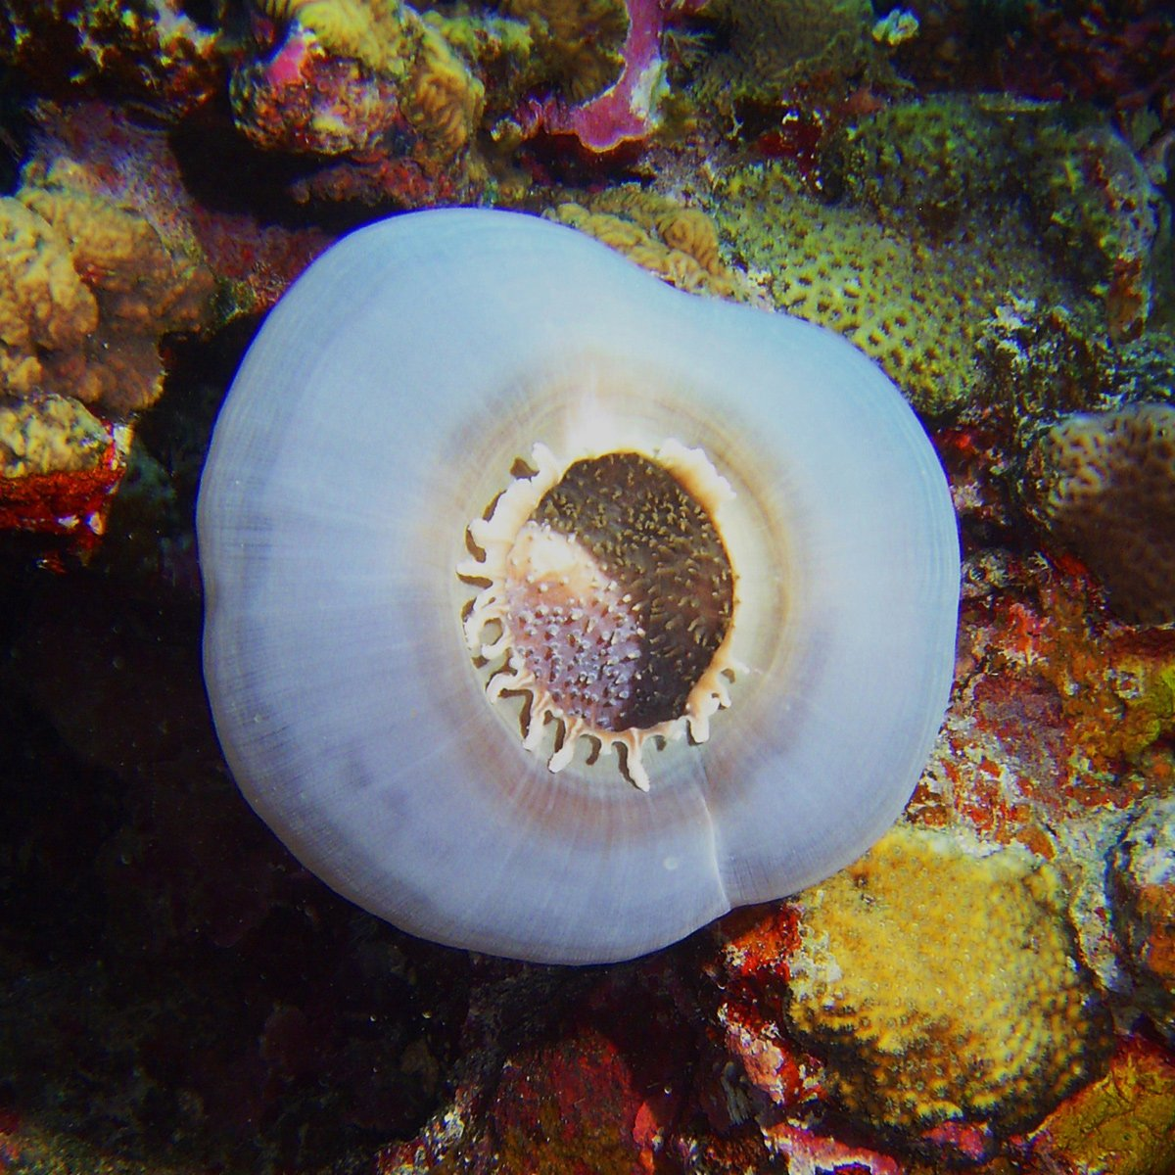
Learning Intention:
Describe criteria used to inform decisions regarding the design of protected marine areas.
Success Criteria:
Complete Marine Education worksheet ‘8. How to draw lines and make pretty shapes’
Corallimorpharian anemone in Huon marine park
Notes:
Image:https://parksaustralia.gov.au/marine/parks/south-east/huon/
Corallimorpharian anemone in Huon marine park

Slide 2
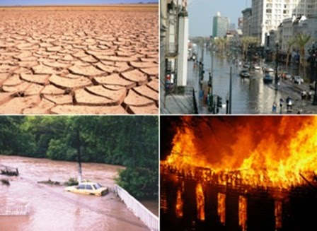
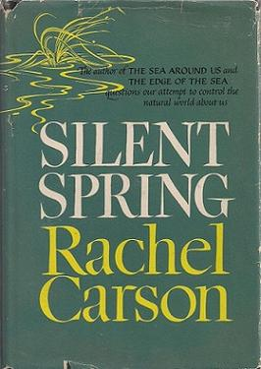
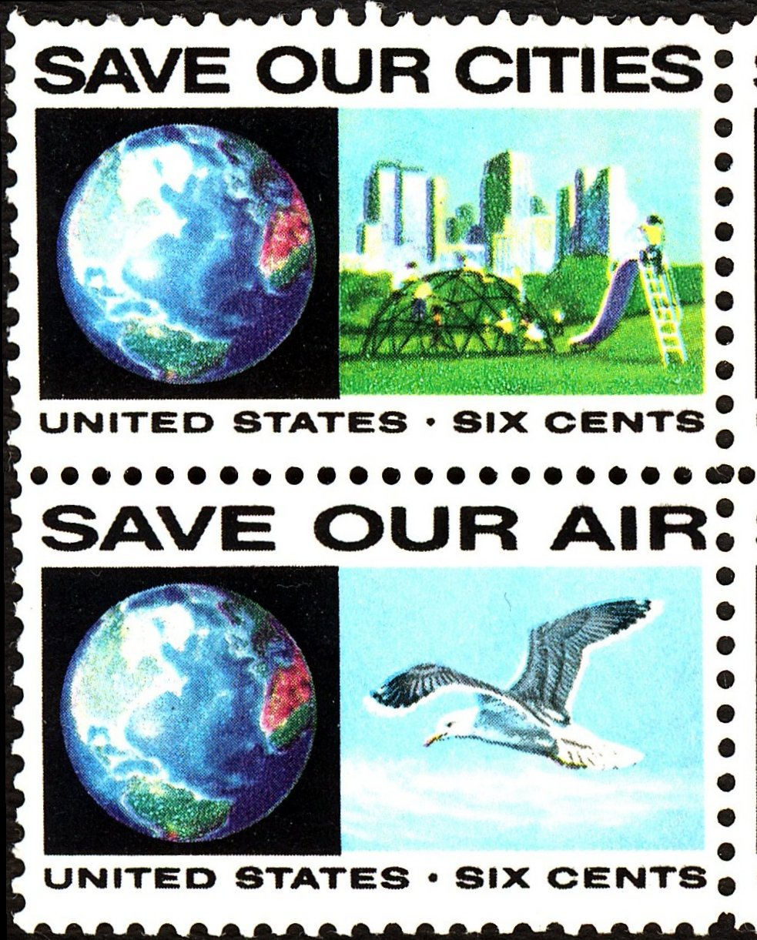
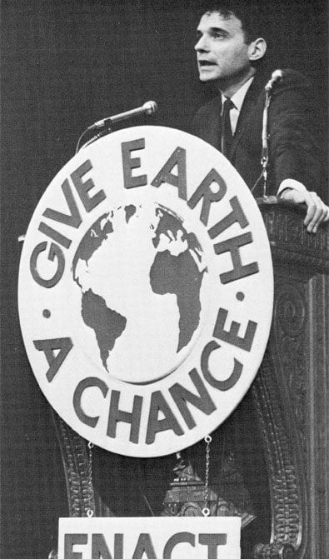
1970
Scientists highlight the urgent but complex problems bearing on our very survival

Slide 3

The people heard their message
20 million people attended events on the first Earth Day in 1970 which brought environmentalism to the forefront of political discourse in the United States

Slide 4
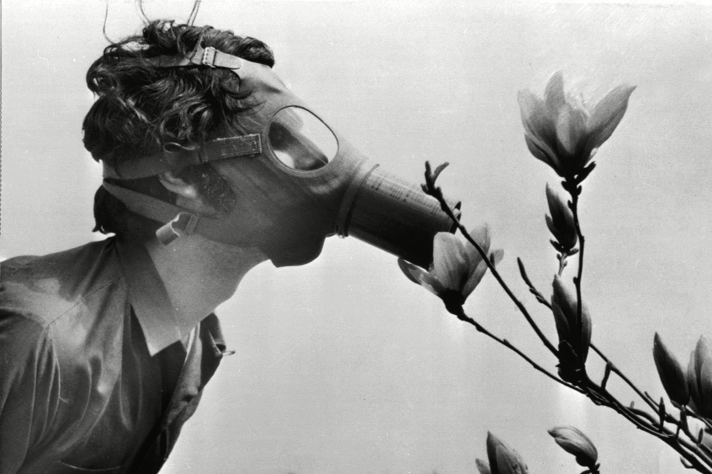
First Earth Day
April 22nd 1970
Notes:
Image: https://www.rollingstone.com/culture/culture-pictures/earth-day-1970-gallery-pictures-new-york-philadelphia-boston-california-987057/earth-day-philadelphia-philadelphia-usa/

Slide 5
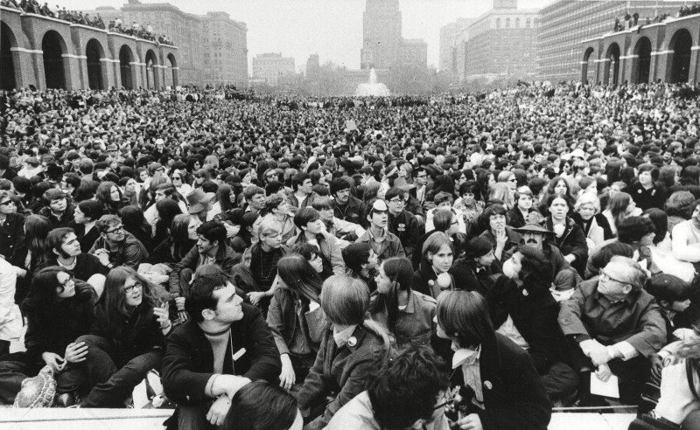
Notes:
Image: https://www.rollingstone.com/culture/culture-pictures/earth-day-1970-gallery-pictures-new-york-philadelphia-boston-california-987057/earth-day-philadelphia-philadelphia-usa/

Slide 6
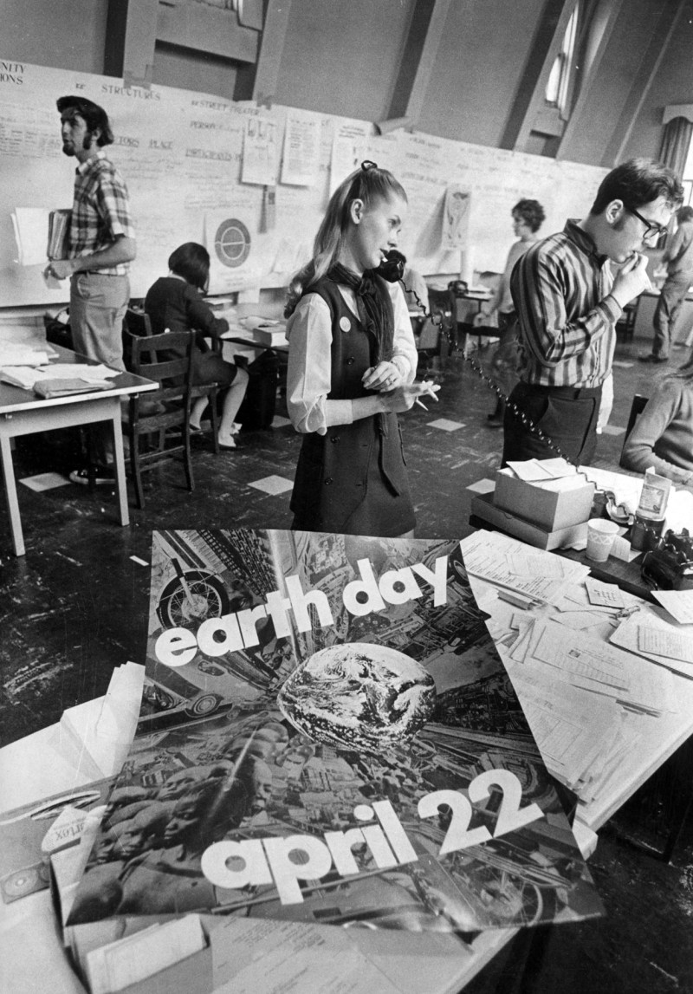
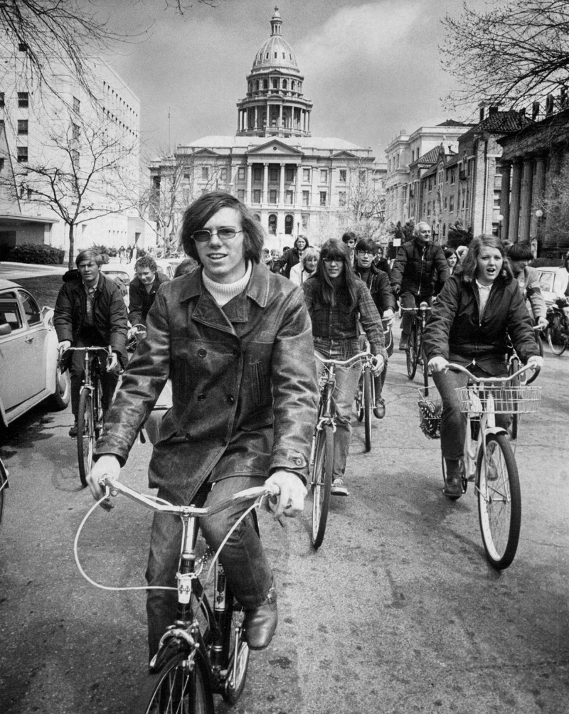
Notes:
Image: https://www.rollingstone.com/culture/culture-pictures/earth-day-1970-gallery-pictures-new-york-philadelphia-boston-california-987057/apr-22-1970-peter-cohen-of-the-university-of-colorado-leads-260-cyclists-from-capitol-of-teach-in/

Slide 7
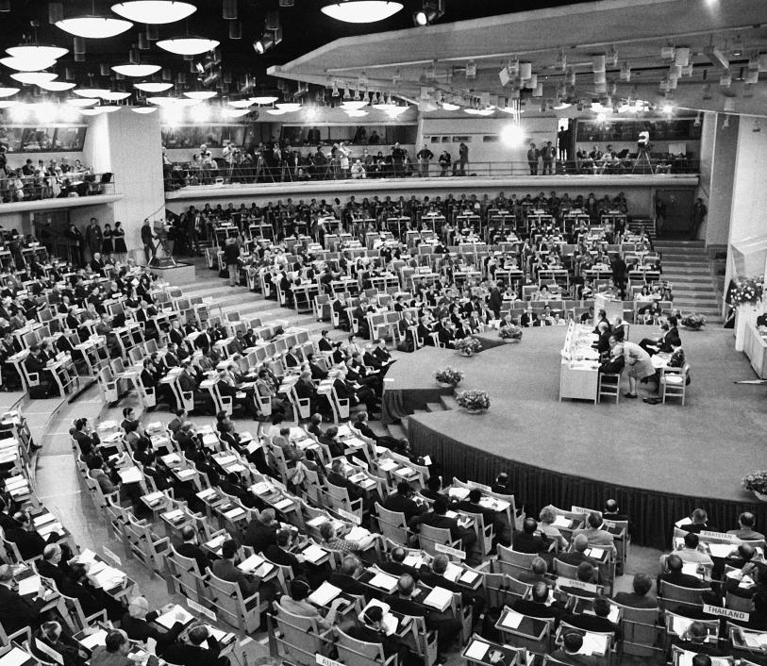
Governments responded
1972
The first UN world conference on the environment in Stockholm.
Notes:
Image: Grieger, Andreas. “Only One Earth: Stockholm and the Beginning of Modern Environmental Diplomacy.” Environment & Society Portal, Arcadia (2012), no. 10. Rachel Carson Center for Environment and Society. https://doi.org/10.5282/rcc/3867.

Slide 8
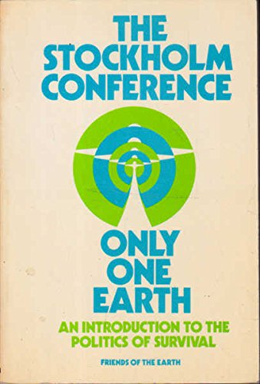
The theme for the conference was
Only One Earth
Notes:
Image: https://www.abebooks.com/9780856440069/Stockholm-Conference-earth-introduction-politics-085644006X/plp

Slide 9
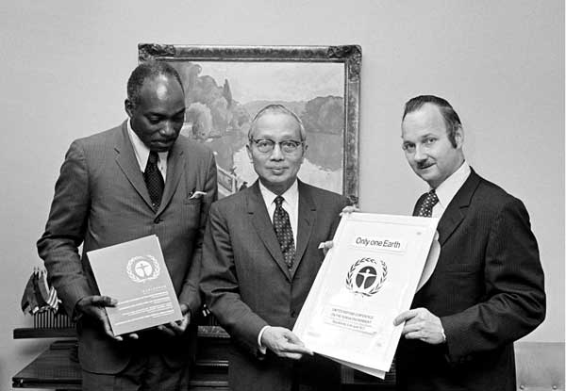
The conference created the first document in international LAW to recognise the
right to a healthy environment.
Countries went home and added the environment to their own laws.
Notes:
Image and info: https://dics.co/current-affairs/stockholm-conference-upsc

Slide 10
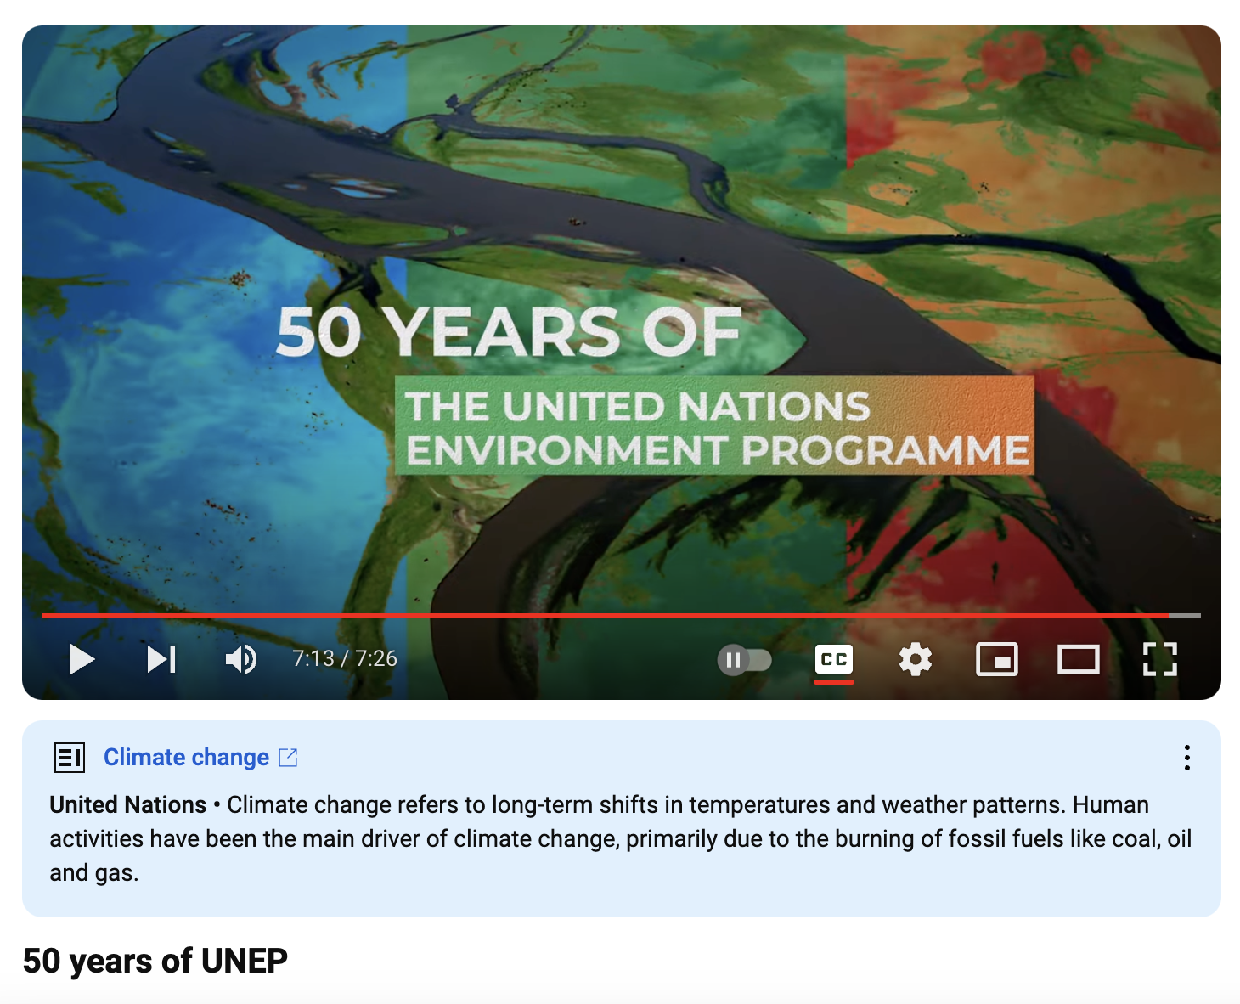
At the conference UNEP
was established
(to help them do this)
to unite the world in saving our planet.
https://www.youtube.com/watch?v=zuXWT4Bnyro
Notes:
Info: https://www.unep.org/who-we-are/about-us

Slide 11


1987
Ecological Sustainable Development (ESD)
was officially defined as:
“the ability to make development sustainable to ensure that it meets the needs of the present without compromising the ability of future generations to meet their own needs”
Our Common Future (Brundtland Report)
Notes:
Image (top): https://environmentalsciences.quora.com/Our-Common-Future-The-Brundtland-Report-1987-https-thegreenpolitics-com-our-common-future-the-brundtland-report-19
Image (bottom): https://issuu.com/preethid2770/docs/brundtland_report.pptx

Slide 12

The definition put a focus on how we leave the planet for future generations
Notes:
Image; https://depositphotos.com/photos/future-generations.html

Slide 13
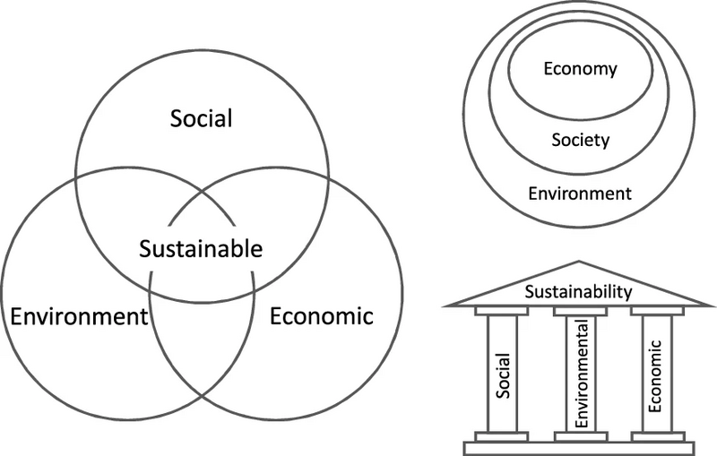
Visual representations of the principles of Ecological Sustainable Development (ESD)
Notes:
Image: https://en.wikipedia.org/wiki/Sustainability

Slide 14


ESD is now a key principle enshrined in many international agreements and declarations (LAWS)
In Australia,
ESD has been included in over 60 pieces of Australian legislation.

Slide 15
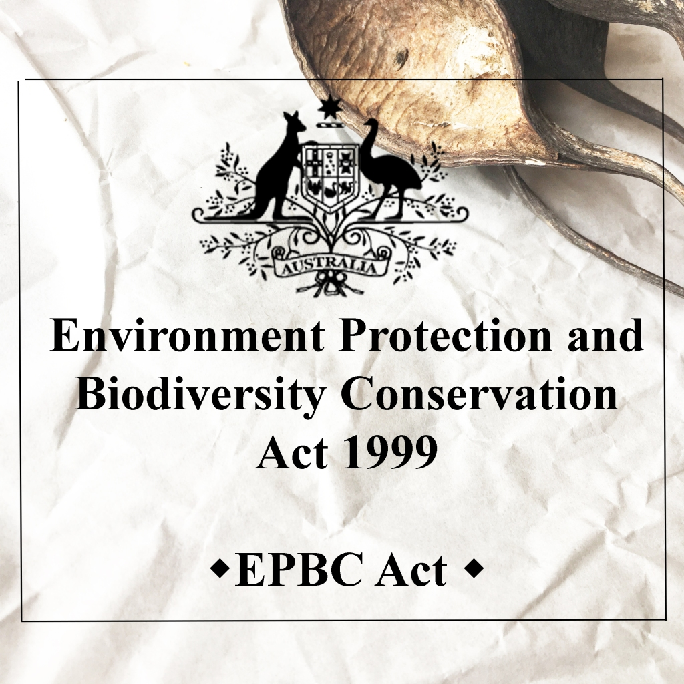
Including the National Strategy for Ecologically Sustainable Development (1992), the National Strategy for the Conservation of Australia’s Biological Diversity (1996) and in Section 3A of the Environment Protection and Biodiversity Conservation Act 1999
often quoted as the
EPBC Act
(also where the precautionary principle is found)
Notes:
Image: https://sellaismk.shop/product_details/18145299.html

Slide 16
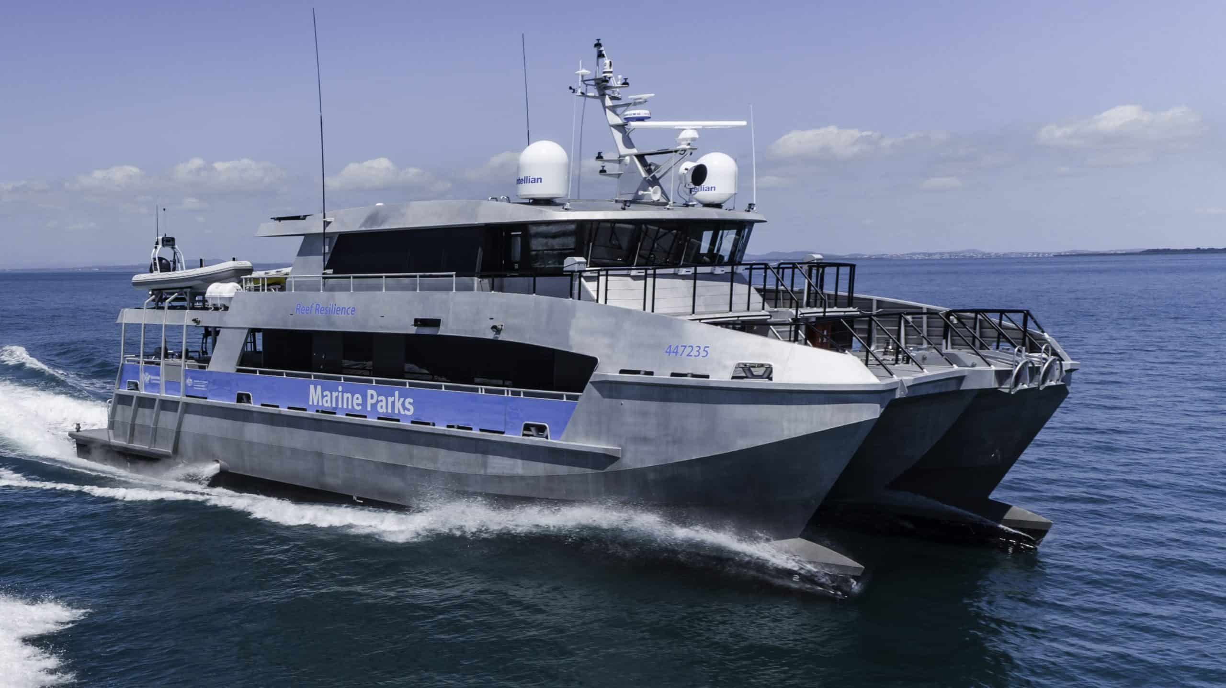
It was widely accepted that MPAs promote ESD

Slide 17
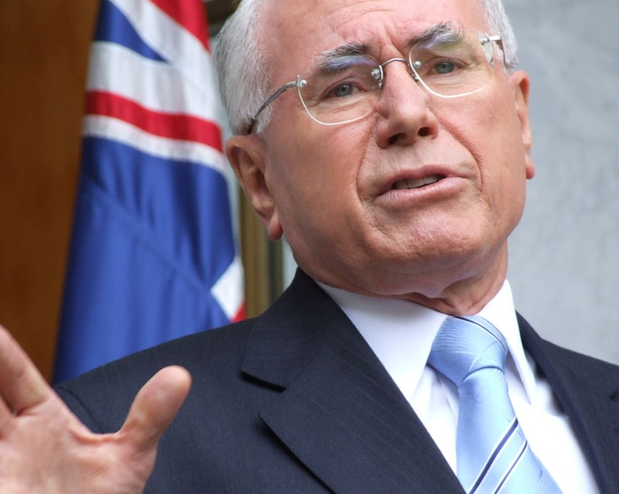
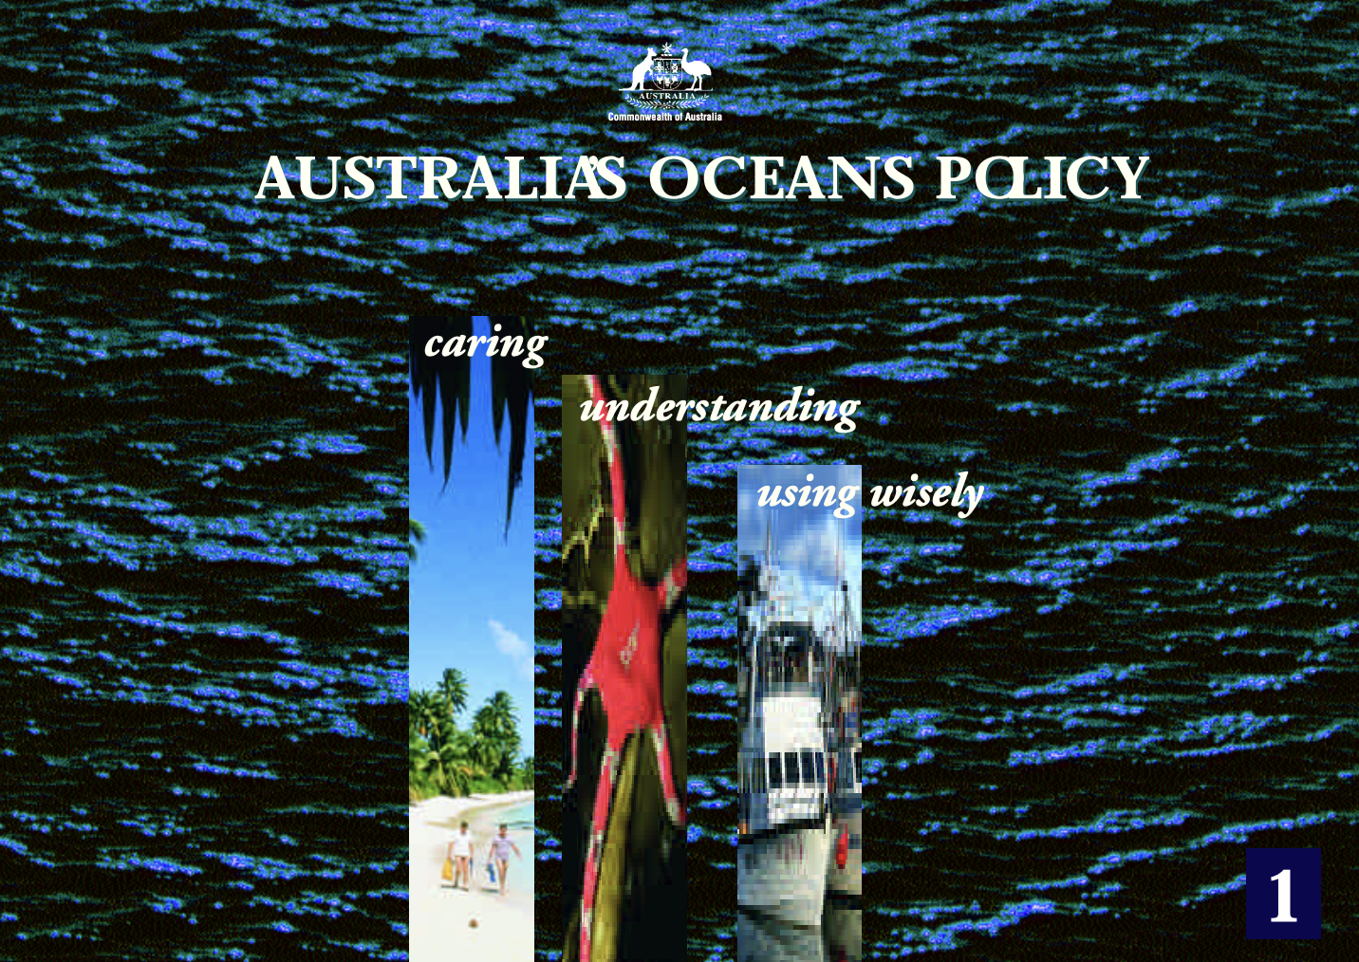
1998
The Oceans Policy
is launched by the Howard government
Notes:
Info: https://library.dbca.wa.gov.au/static/FullTextFiles/018882.pdf

Slide 18
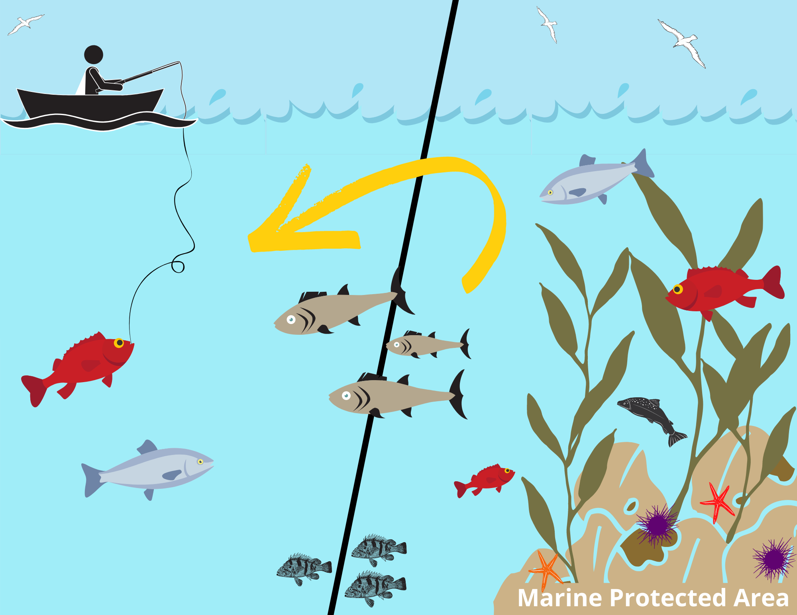
The Oceans Policy called for MORE marine parks to protect biodiversity
Sold to voters by highlighting the “spill over effect”
Notes:
Image: https://california.surfrider.org/blog/the-spillover-effect-and-more-in-marine-protected-area-news

Slide 19
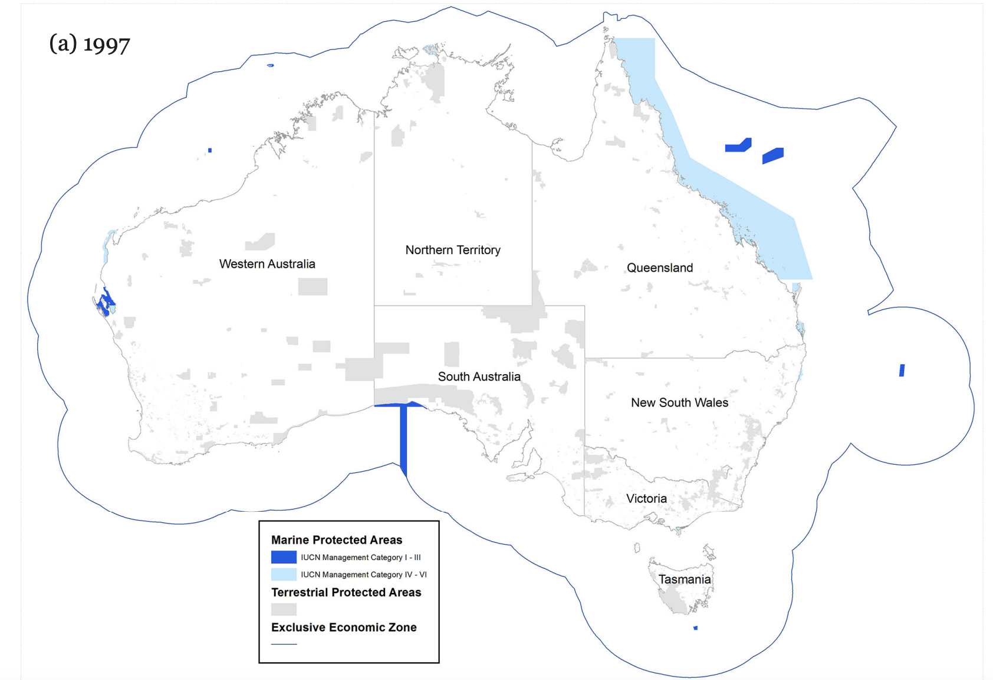
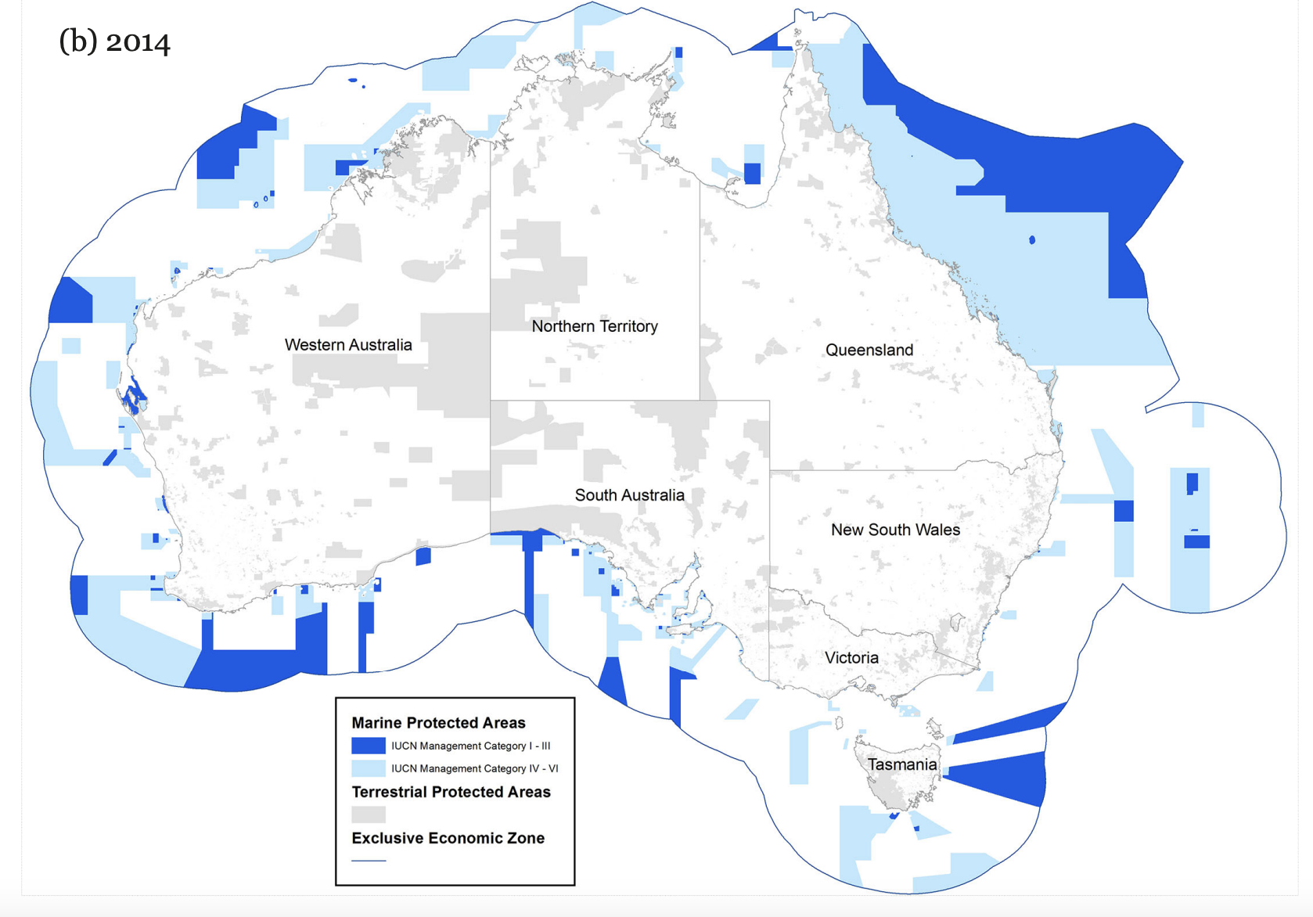
Thus, in 1998 the National Representative System of Marine Protected Areas (NRSMPA) was born…
1997
2014
Notes:
Image: https://parksjournal.com/wp-content/uploads/2021/03/PARKS-24.2-Fitzsimons-and-Wescott-10.2305-IUCN.CH_.2018.PARKS%E2%80%9024%E2%80%902JAF.en_.pdf
Fitzsimons, James; Wescott, G (2018). Large-scale expansion of marine protected area networks: lessons from Australia. Deakin University. Journal contribution. https://hdl.handle.net/10536/DRO/DU:30116587

Slide 20
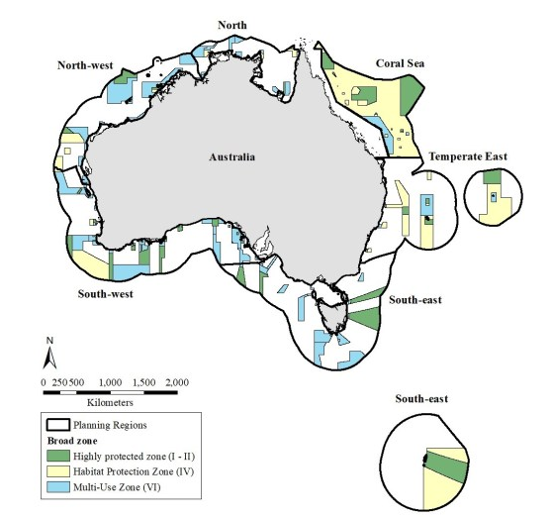
2018
The primary goal of NRSMPA is to establish and manage
a comprehensive, adequate and representative
(CAR) system of marine protected areas.
Notes:
Image: https://conservationplanning.org/2020/11/representation-does-not-necessarily-reduce-threats-to-biodiversity-australias-commonwealth-marine-protected-area-system-20122018/

Slide 21
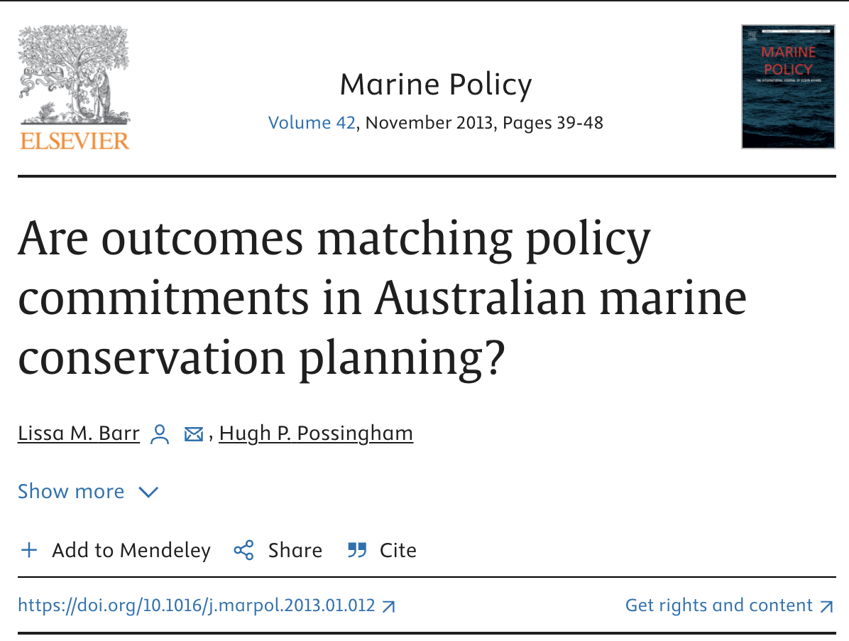
CAR means that MPAs should include the full range of marine ecosystems.
“Protecting the full range of ecosystems off the coasts of Australia is a fundamental requirement….or else habitats with distinct biology may be lost”
Cressey, D. Australia’s plans for sea havens ‘flawed’. Nature 495, 155 (2013). https://doi.org/10.1038/495155a
Notes:
Paper: Lissa M. Barr, Hugh P. Possingham (2013). Are outcomes matching policy commitments in Australian marine conservation planning?Marine Policy,
Volume 42. Pages 39-48,
Quote: Cressey, D. Australia’s plans for sea havens ‘flawed’. Nature 495, 155 (2013). https://doi.org/10.1038/495155a

Slide 22
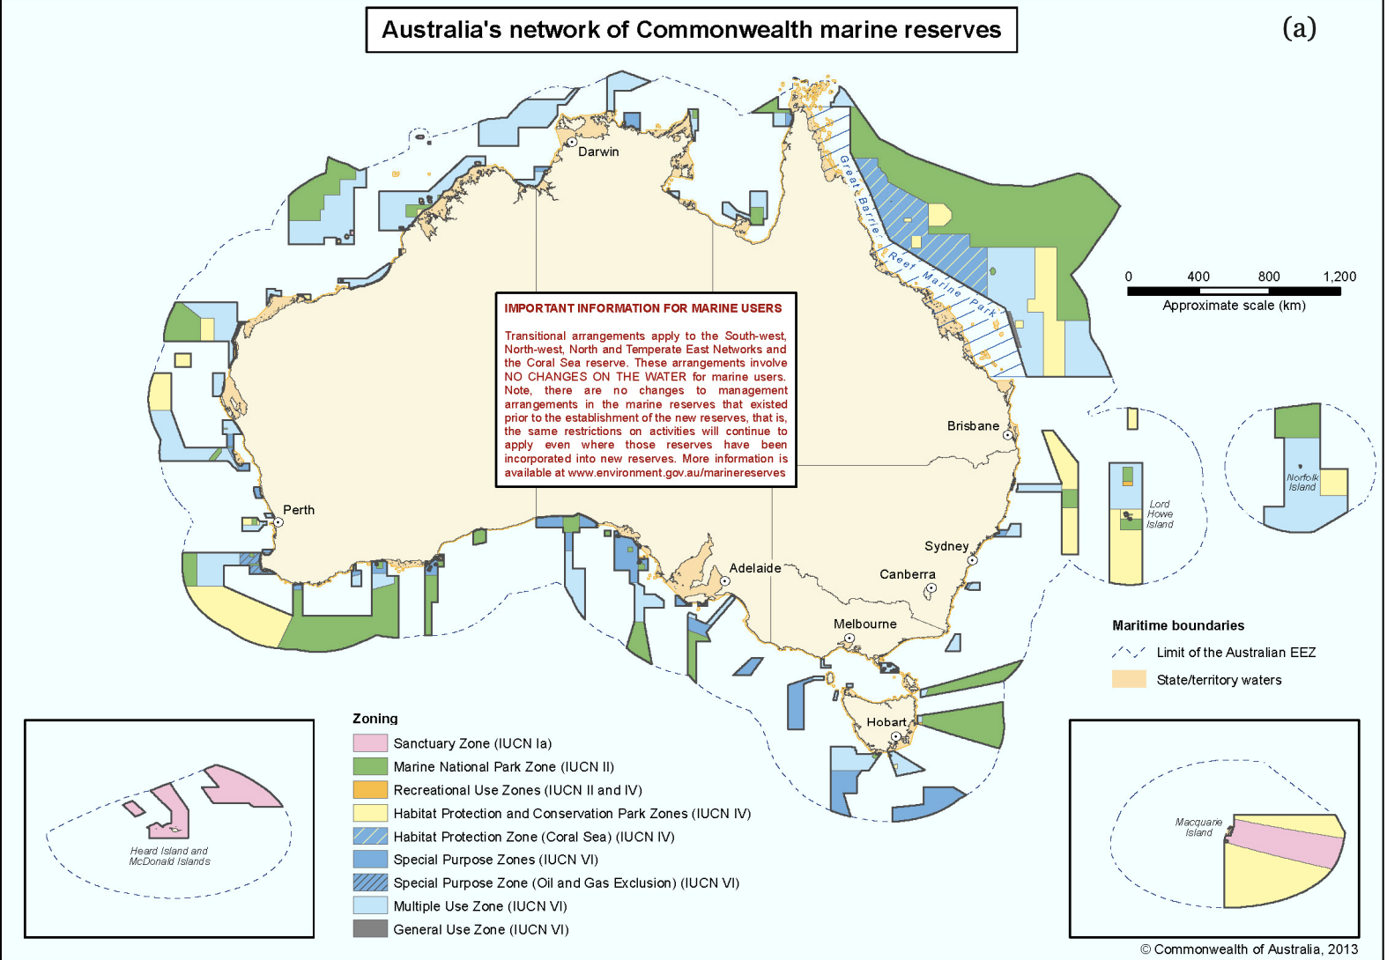
Is this comprehensive, adequate and representative enough?
Are there enough ‘no-take’ green zones and ‘no-go’ pink zones?

Slide 23
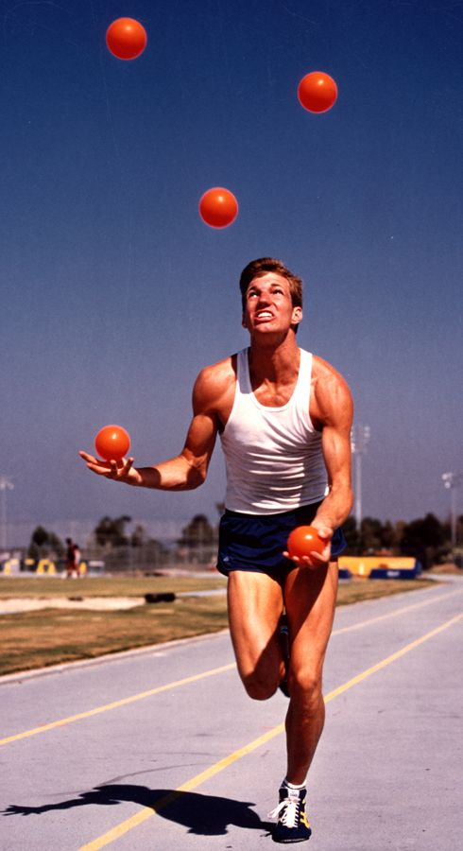
MPAs can be called different names
(e.g. no-take fisheries reserves or locally managed marine areas)
or be divided into different zones
(e.g. no-take green zone or no-go’ pink zone)
so they can be multi-use MPAs,
to be shared.
Notes:
Image: https://en.wikipedia.org/wiki/Australian_marine_parks

Slide 24
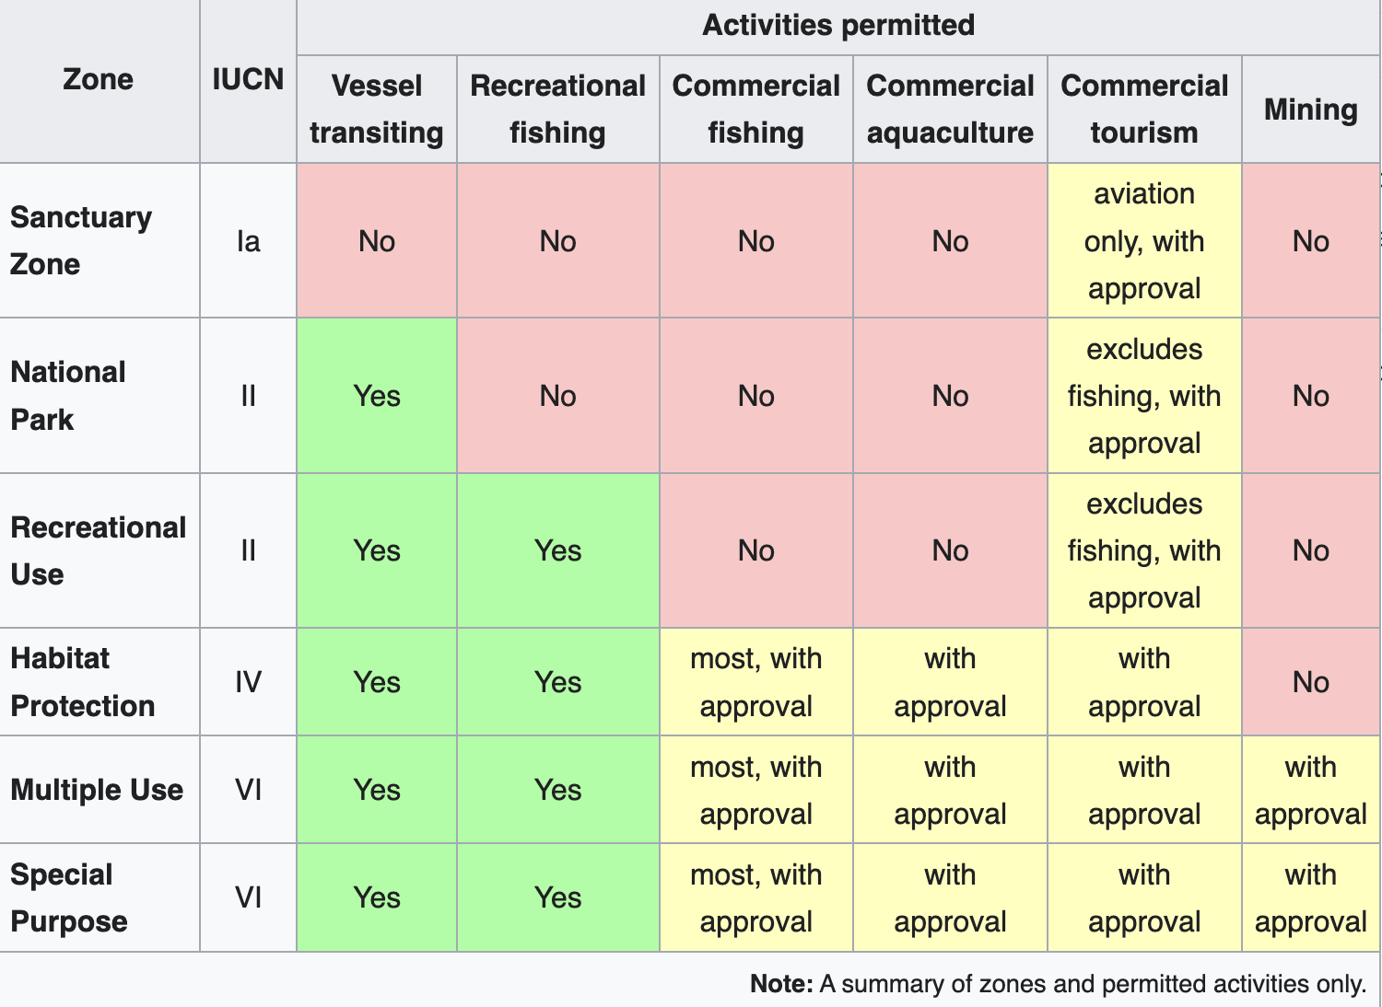
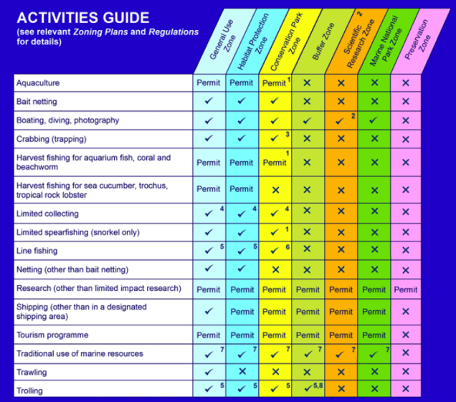
Zones of Australian Marine Parks
Zones of GBRMPA

Slide 25
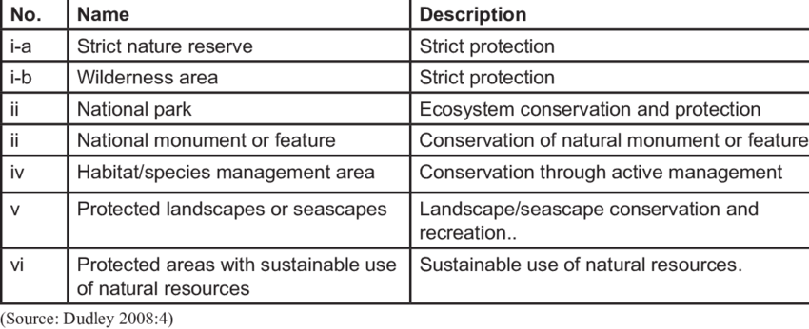
IUCN protected area categories and definitions
Level of protection
Notes:
Image: Bwalya, Bridget. (2018). Strategies for wildlife management in Africa: Actors, successes and failures. Accessed: https://www.researchgate.net/figure/IUCN-protected-area-categories-and-definitions_tbl1_338684271

Slide 26
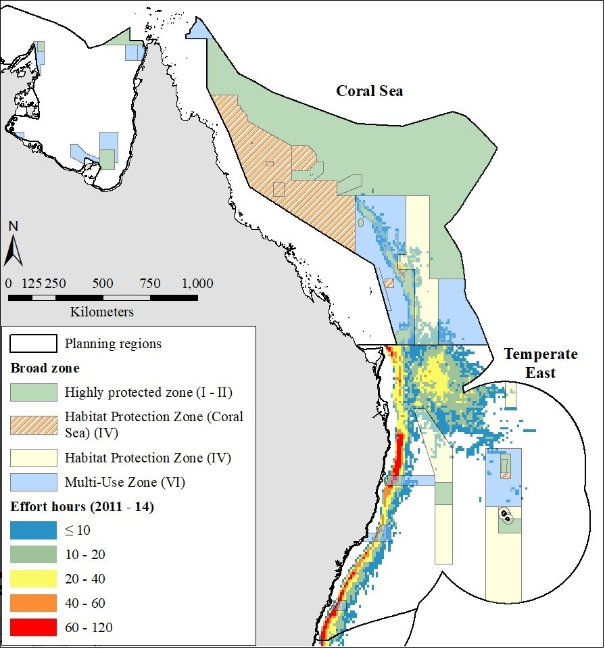
Cockerell et al., 2012
Are our MPAs comprehensive, adequate and representative enough?
Do they protect the full range of ecosystems?
(Note: Red is where most longline boats fish)
Notes:
Image: https://conservationplanning.org/2020/11/representation-does-not-necessarily-reduce-threats-to-biodiversity-australias-commonwealth-marine-protected-area-system-20122018/
Paper: Brayden Cockerell, Robert L. Pressey, Alana Grech, Jorge G. Álvarez-Romero, Trevor Ward, Rodolphe Devillers, (2020). Representation does not necessarily reduce threats to biodiversity: Australia's Commonwealth marine protected area system, 2012–2018. Biological Conservation,. Volume 252,
. 108813. ISSN 0006-3207,

Slide 27
Let’s take a trip around Australia to see what’s protected and what isn’t, so you can make your own judgement.

Slide 28
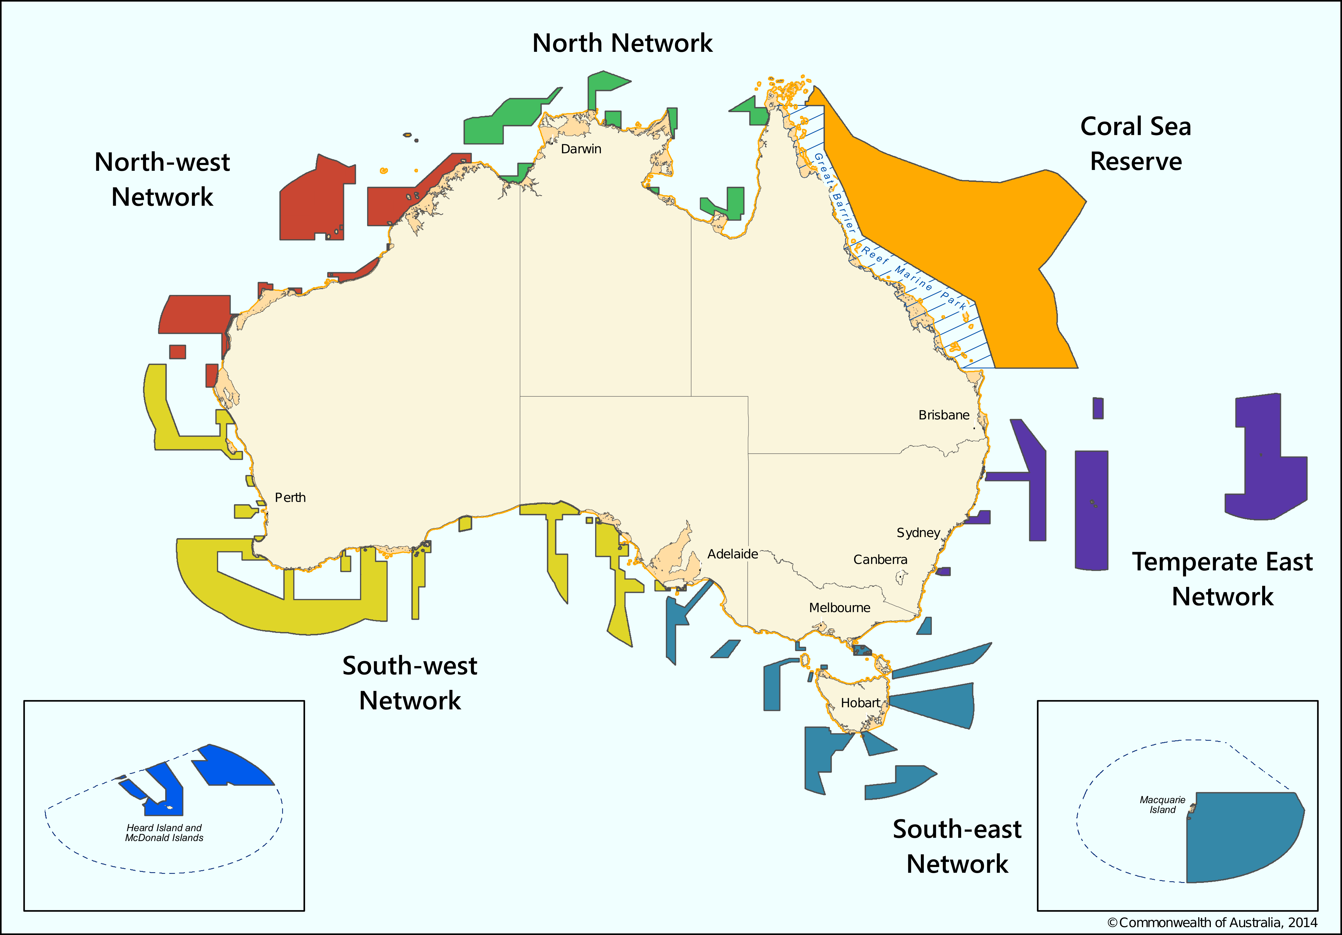
MPAs
in Australia
3 - 200 nautical miles offshore

Slide 29


The Australian Government manages all Commonwealth MPAs 3-200nm offshore
(who grouped them into ‘networks’ as per the NRSMPA)

Slide 30
Temperate East Network
Established 2012
includes 3 seamount chains
Starts at Bundaberg
Finishes in NSW
8 MPAs
Notes:
Info: https://www.dcceew.gov.au/sites/default/files/env/pages/2b8154b0-dce9-4c9e-bffd-cfb1db8fab65/files/te-cmr-network-mgt-plan-information-only-has-no-legal-effect.pdf

Slide 31
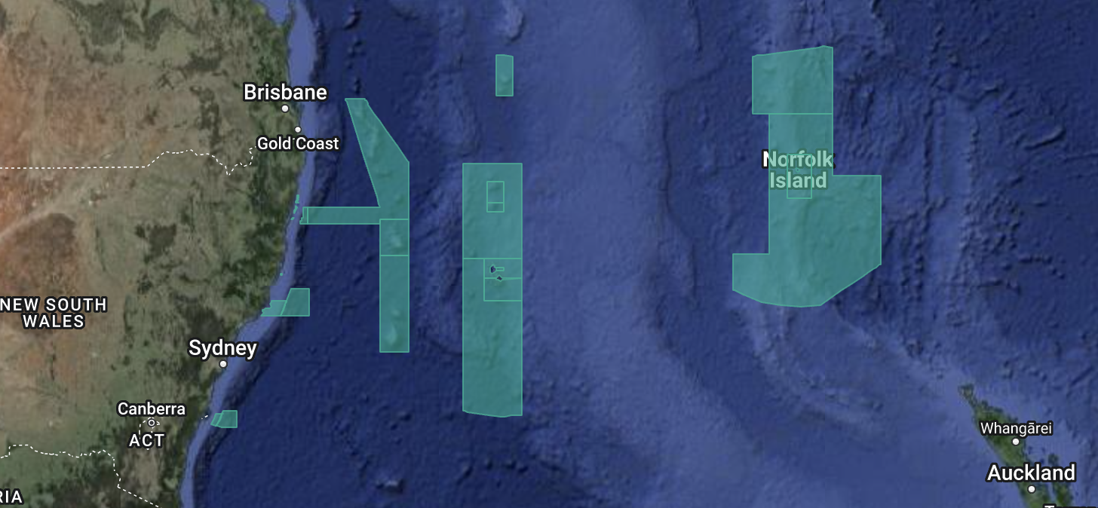
Temperate East Network
Notes:
Image: https://parksaustralia.gov.au/marine/

Slide 32
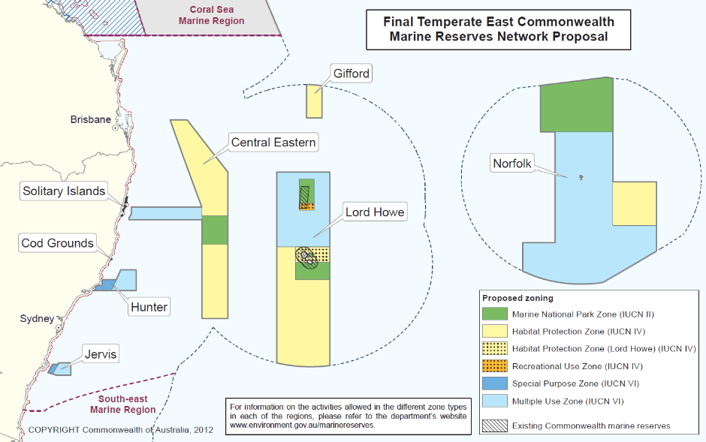
Notes:
Image: https://www.abc.net.au/news/2012-06-14/australian-marine-reserves-maps/4069666

Slide 33
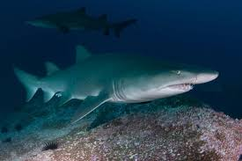
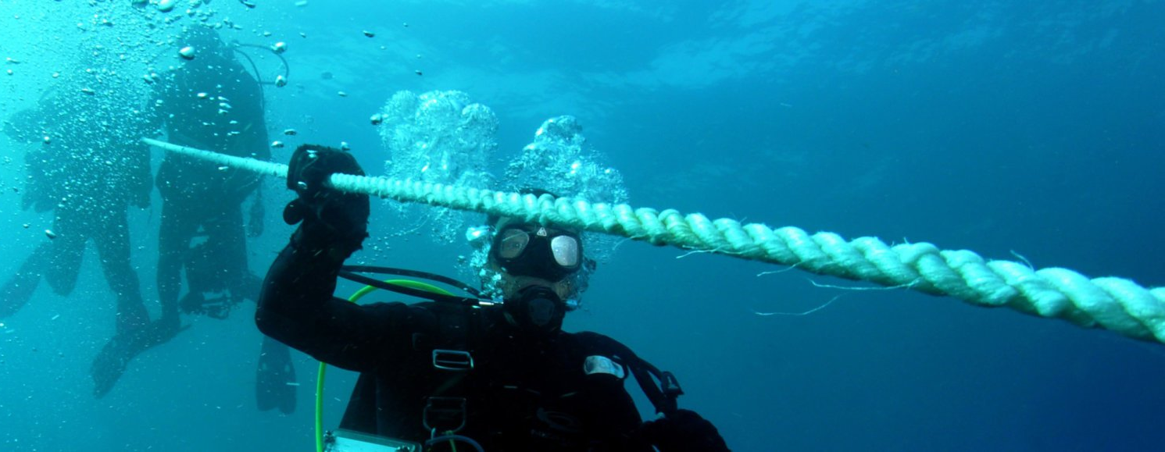
E.g. Cod Grounds
Notes:
Images: https://parksaustralia.gov.au/marine/parks/temperate-east/cod-grounds/

Slide 34
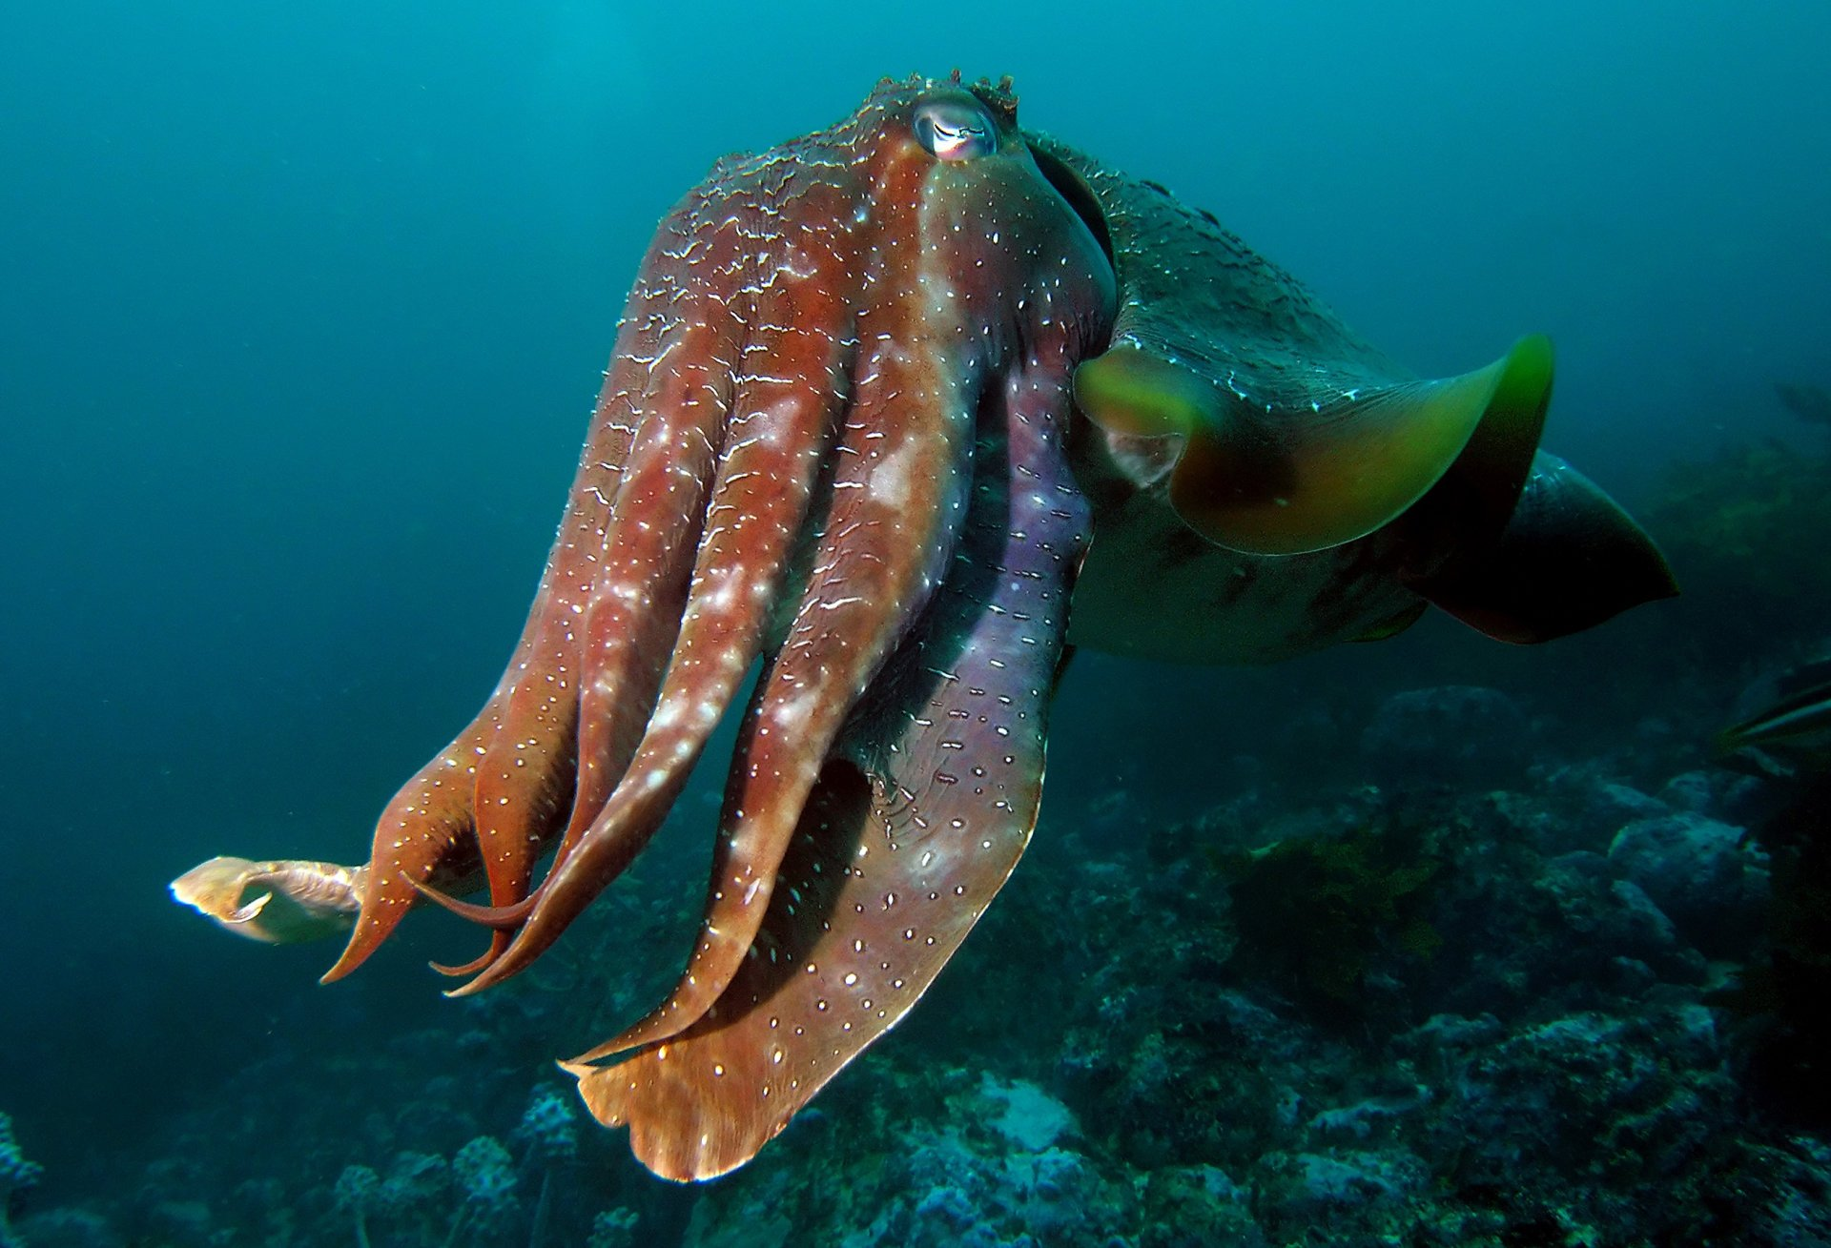
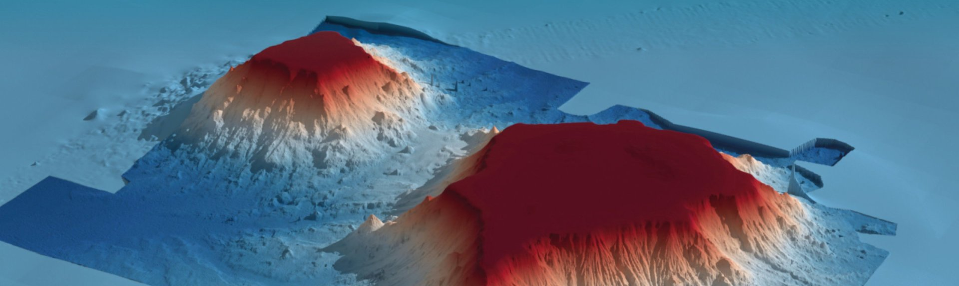
E.g. Gifford Marine Park
Gifford Marine Park protects a 2000m high flat-topped undersea volcano called Gifford Tablemount
Notes:
Images: https://parksaustralia.gov.au/marine/parks/temperate-east/gifford/
Gifford Marine Park protects a 2000 metre high flat-topped undersea volcano called Gifford Tablemount

Slide 35
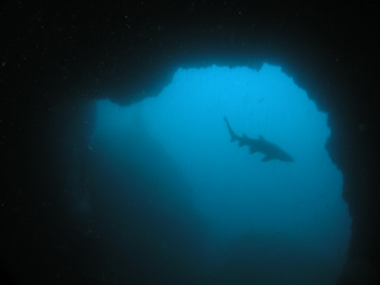
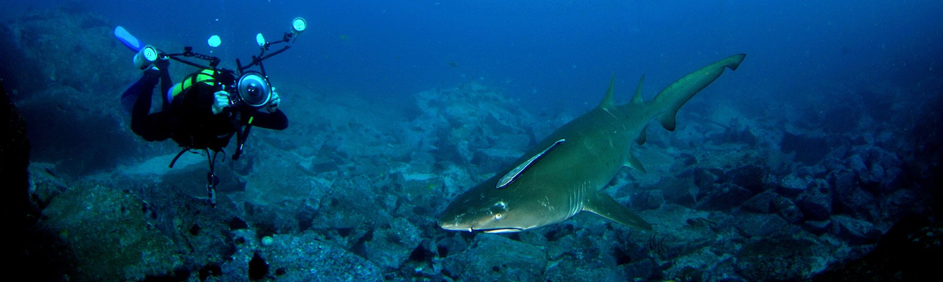
E.g. Solitary Islands Marine Park (including Pimpernel Rock pictured right)
Notes:
Image: https://parksaustralia.gov.au/marine/parks/temperate-east/solitary-islands/
Image (pimpernel rock): https://www.michaelmcfadyenscuba.info/viewpage.php?page_id=189

Slide 36
South East Network
Established 2007
22 different benthic ecosystems
NSW. Vic. Tas. SA.
10m to 6000m
14 MPAs
Notes:
Info: https://parksaustralia.gov.au/marine/files/south-east/Updates/SE-Network-Evaluation-Summary.pdf
Info: https://parksaustralia.gov.au/marine/files/south-east/AMP---SE-SOK-Summary_SE-Network.pdf

Slide 37
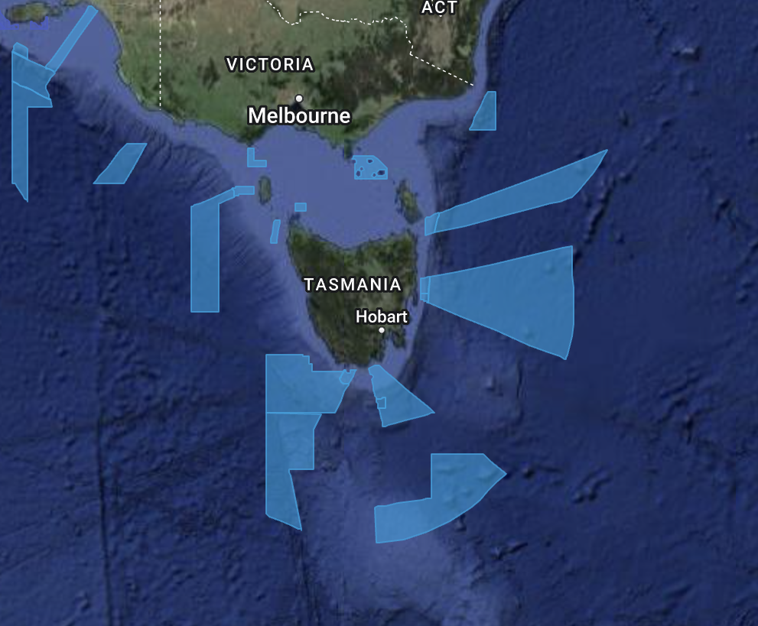
South East Network
Notes:
Image: https://parksaustralia.gov.au/marine/

Slide 38
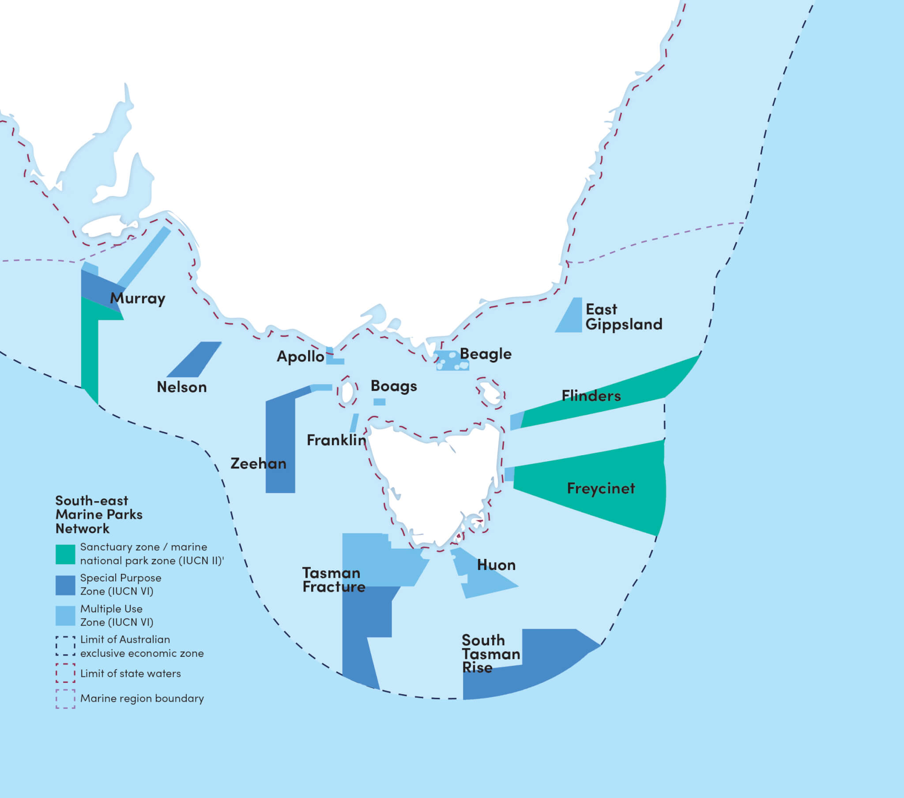
South East Network
Notes:
Image: https://www.marineconservation.org.au/south-east-marine-parks/

Slide 39
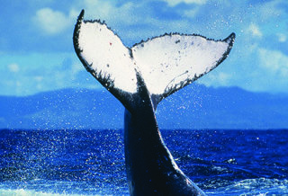
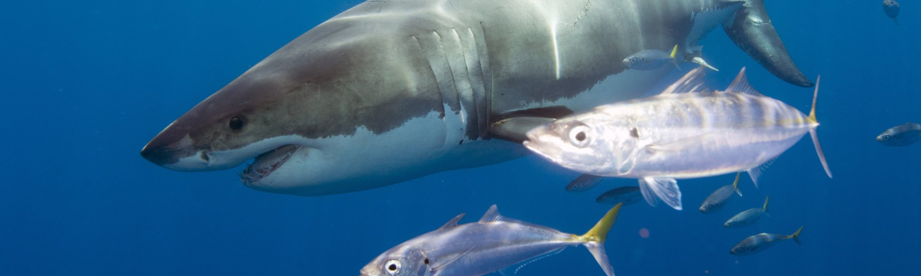
E.g. Nelson Marine Park
Notes:
Image (shark): https://parksaustralia.gov.au/marine/parks/south-east/nelson/

Slide 40
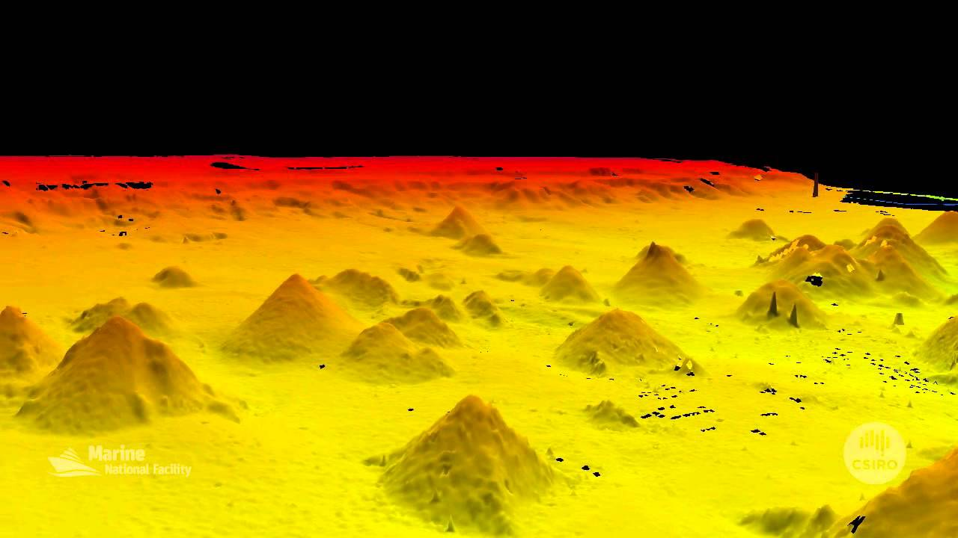
E.g. Huan Marine Park
(Australia’s largest cluster of seamounts)
Notes:
Image: https://atlas.parksaustralia.gov.au/amps?featureId=AMP_SE_HUO

Slide 41
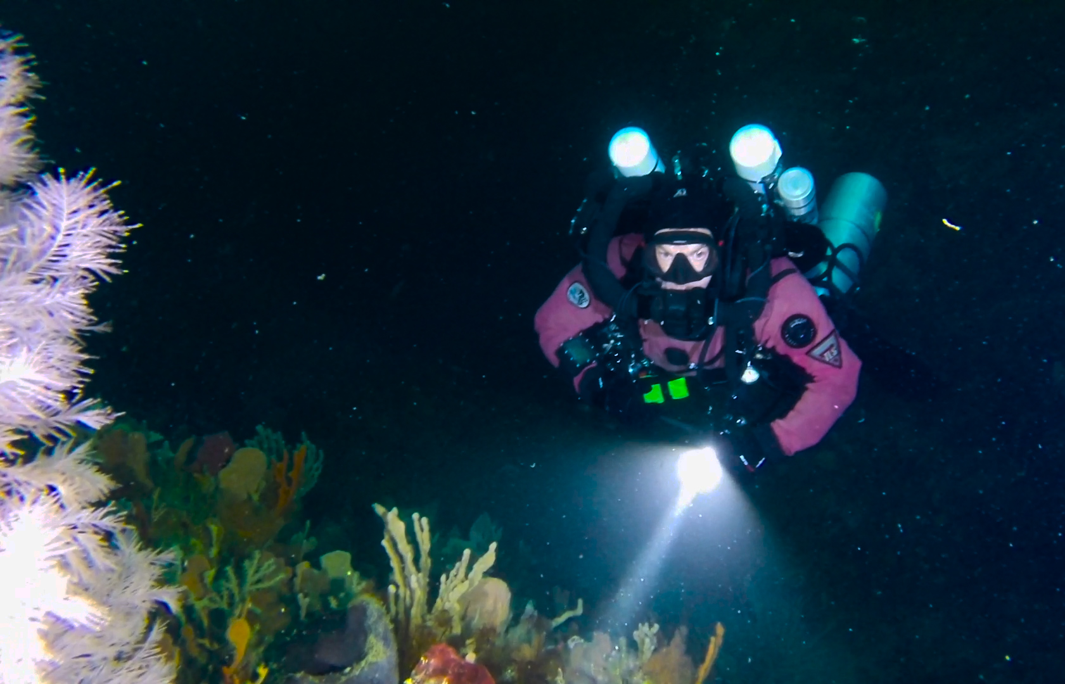
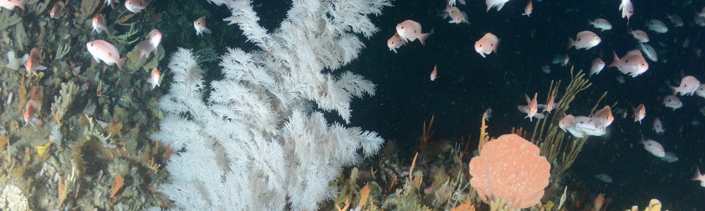
E.g. Freycinet Marine Park
“Black coral”
Notes:
Image: https://atlas.parksaustralia.gov.au/amps/research/black-corals-in-the-freycinet-marine-park
Image (top right): https://www.imas.utas.edu.au/news/news-items/citizen-scientists-film-black-corals-at-spectacular-unexplored-reef-off-tasmanias-east-coast

Slide 42
Macquarie Island Marine Park
Part of the South East Network
World Heritage Listed
Rangers belong to Tasmania Parks and Wildlife
Research Station there
Royal penguins (endemic)

Slide 43
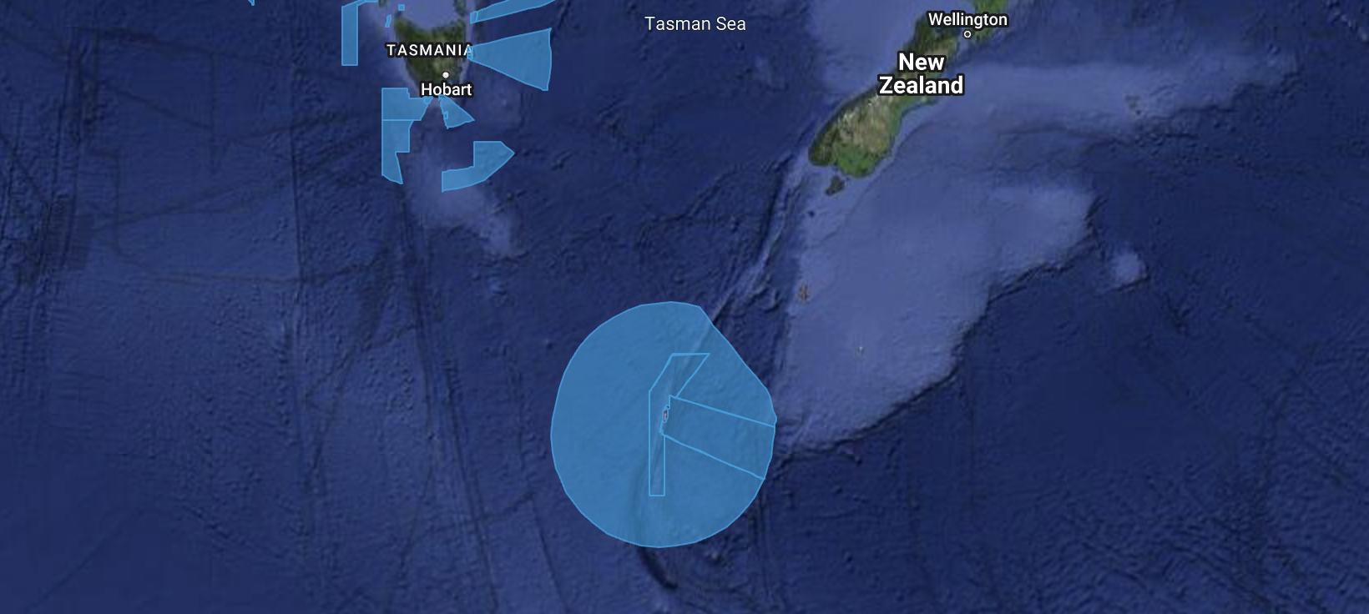
Macquarie Island Marine Park
Notes:
Image: https://parksaustralia.gov.au/marine/

Slide 44
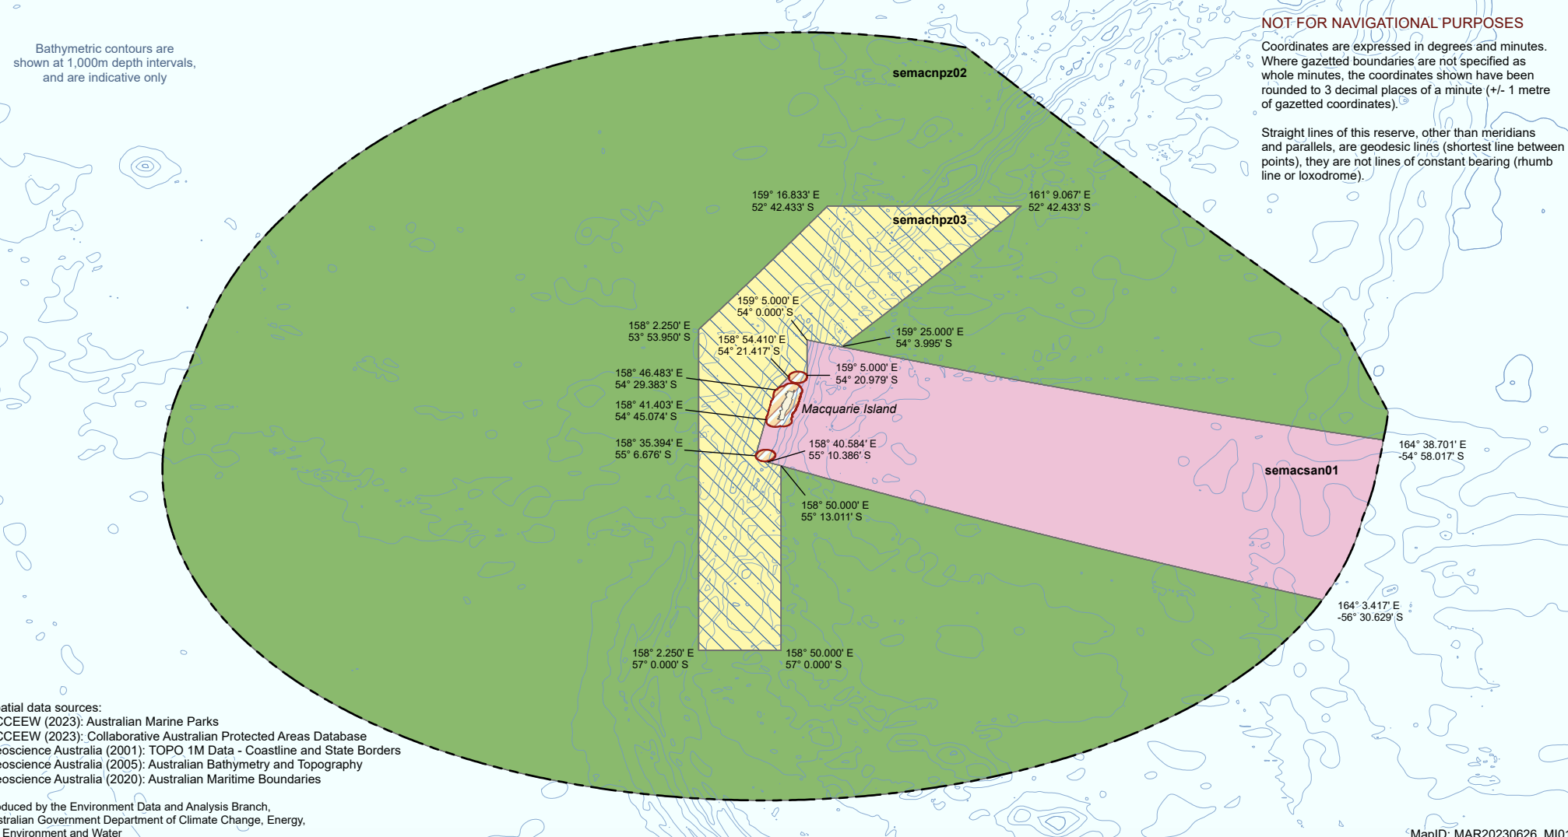
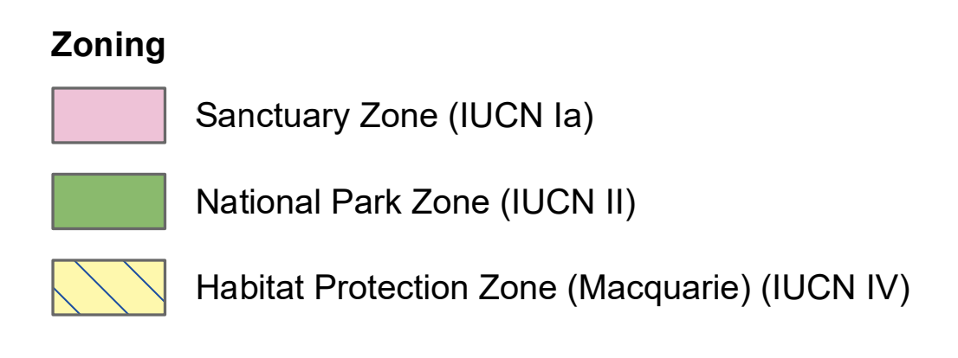
Macquarie Island Marine Park
Notes:
Image: https://parksaustralia.gov.au/marine/files/Final_Mac_Island_MP_zoning_bathy_contours_1000m.pdf

Slide 45
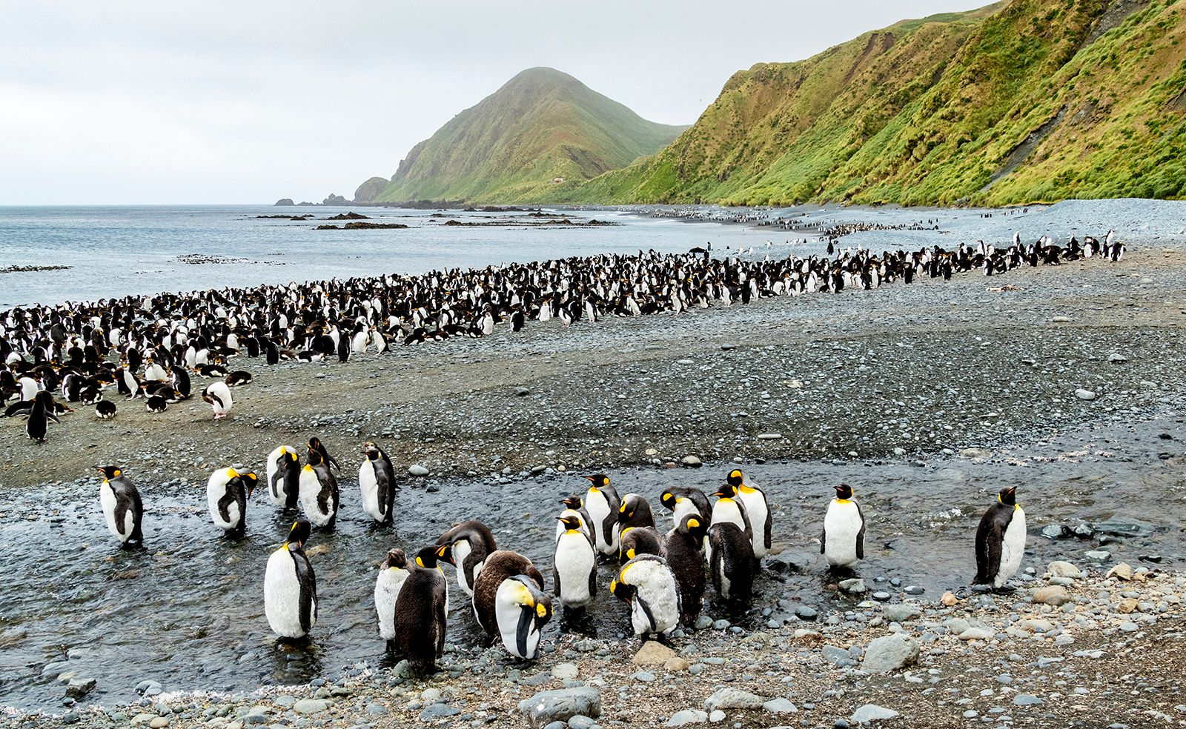
Macquarie Island
Notes:
Image: https://www.britannica.com/place/Macquarie-Island

Slide 46
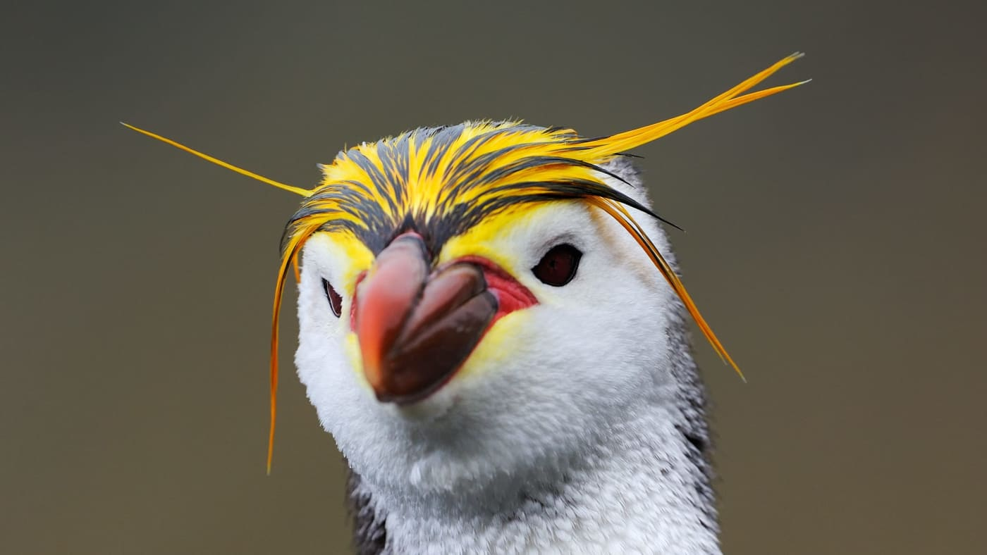
Royal Penguins (Eudyptes schlegeli) are endemic to Macquarie Island
Notes:
Image: https://wwf.org.au/blogs/coming-together-to-protect-the-royal-penguin/

Slide 47

King Penguins and Elephant Seals on Macquarie Island
Notes:
Image: https://www.antarctica.gov.au/antarctic-operations/stations/macquarie-island/macquarie-is-science/
The large population of wildlife on Macquarie Island, including these elephant seals and king penguins, ensures that biological science is an important part of scientific research on the island. Photo: Kerry Steinberner

Slide 48

Macquarie Island Research station
(half way point to Antarctica)
Notes:
Image: https://www.antarctica.gov.au/antarctic-operations/stations/macquarie-island/macquarie-is-science/

Slide 49

Elephant seals like boating too Photo: Kerry Steinberner
Notes:
Image: https://www.antarctica.gov.au/antarctic-operations/stations/macquarie-island/location/
Elephant seals like boating too Photo: Kerry Steinberner

Slide 50

Notes:
Image: https://parksjournal.com/wp-content/uploads/2021/03/PARKS-24.2-Fitzsimons-and-Wescott-10.2305-IUCN.CH_.2018.PARKS%E2%80%9024%E2%80%902JAF.en_.pdf

Slide 51
Heard Island and MacDonald Islands
Established 2002
One of the most remote places on Earth
Australia’s only 2 active volcanoes
2 weeks to get there by boat
1 MPA
Notes:
Info: https://www.antarctica.gov.au/antarctic-operations/stations/other-locations/heard-island/protection-and-management/marine-reserve/

Slide 52

Heard Island and MacDonald Islands
Notes:
Image: https://parksaustralia.gov.au/marine/

Slide 53

No-one lives there
Notes:
Image: https://www.abc.net.au/news/2019-01-25/heard-island-australias-mysterious-land-of-fire-and-ice/10713860

Slide 54

No take
Notes:
Image: Brooks, Cassandra & Epstein, Graham & Ban, Natalie. (2019). Managing Marine Protected Areas in Remote Areas: The Case of the Subantarctic Heard and McDonald Islands. Frontiers in Marine Science. 6. 10.3389/fmars.2019.00631.

Slide 55

Heard Island and MacDonald Islands
Notes:
Image: https://www.antarctica.gov.au/antarctic-operations/stations/other-locations/heard-island/

Slide 56

Notes:
Image (seals): https://www.antarctica.gov.au/antarctic-operations/stations/other-locations/heard-island/

Slide 57

80% is snow/ice
Notes:
Image: https://www.abc.net.au/news/2019-01-25/heard-island-australias-mysterious-land-of-fire-and-ice/10713860

Slide 58
South West Network
includes the Great Australian Bight
Established 2018
SA and WA
Endangered southern right whales
14 MPAs

Slide 59

South West Network
Notes:
Image: https://parksaustralia.gov.au/marine/

Slide 60

Notes:
Image: https://www.abc.net.au/news/2012-06-14/australian-marine-reserves-maps/4069666

Slide 61


E.g. Bremer (Bay) Marine Park
Bremer Bay Orca watching tours
Photo by David Govoni
Notes:
Image (orcas): https://parksaustralia.gov.au/marine/parks/south-west/
Image (top right): https://www.viator.com/en-AU/tours/Western-Australia/Bremer-Bay-Orca-Experience/d126-10984P10

Slide 62


Southern Right Whale watching
Notes:
Image: https://whalewatchwesternaustralia.com/species/southern-right-whale/

Slide 63

E.g. Abrolhos (Islands) Marine Park
Notes:
Image: https://www.chargetheglobe.com/the-ultimate-guide-to-the-abrolhos-islands/

Slide 64

E.g. Jurien (Bay) Marine Park
Notes:
Image: https://exploreparks.dbca.wa.gov.au/park/jurien-bay-marine-park

Slide 65

$255 to swim with seals in Jurien Bay
Notes:
Image: https://saltyswims.com.au/jurien-bay-marine-park-experience/

Slide 66
North West Network
Established 2018
Whale Sharks
Shark Bay
Ningaloo Reef
13 MPAs

Slide 67

North West Network
Notes:
Image: https://parksaustralia.gov.au/marine/

Slide 68

Notes:
Image: https://www.abc.net.au/news/2012-06-14/australian-marine-reserves-maps/4069666

Slide 69

E.g. Ningaloo Marine Park
Notes:
Image: https://www.instyleadventures.com.au/news/experience-the-ningaloo-reef/

Slide 70


Slide 71


Camping Osprey Bay, Cape Range National Park/Ningaloo Reef WA
Notes:
Image: Cape Range National Park (camping) https://unisonconsulting.com.sg/kfyo.php?cname=osprey+bay&cid=160

Slide 72

E.g. Shark Bay Marine Park
(Hamelin Pool stromatolites – ancient rock)
Notes:
Image: https://www.gorv.com.au/travel-guide-shark-bay-wa/
Hamelin Pool stromatolites.

Slide 73

E.g. Roebuck (Bay) Marine Park

Slide 74

Notes:
Image: https://www.viewbug.com/photo/91007309

Slide 75
Christmas & Cocos (Keeling) Islands
”Indian Ocean Territories Marine Parks”
Christmas Island Red crab migration
Established 2022
Coral atolls
Christmas Island detention centre
2 MPAs

Slide 76

Australia
Notes:
Image: https://parksaustralia.gov.au/marine/

Slide 77

Notes:
Image: https://parksaustralia.gov.au/marine/pub/maps/christmas-island-marine-park-map-zoning-2022.pdf

Slide 78


Slide 79

Cocos (Keeling) Islands
Notes:
Image: https://earthobservatory.nasa.gov/images/76791/cocos-keeling-islands

Slide 80

Cocos (Keeling) Islands

Slide 81

https://www.youtube.com/watch?v=PLWSOjykTfQ&t=52s
Notes:
https://www.youtube.com/watch?v=PLWSOjykTfQ&t=52s

Slide 82

Christmas Island Red Crab migration

Slide 83

Christmas Island Detention Centre
Notes:
Image: https://www.theaustralian.com.au/subscribe/news/1/?sourceCode=TAWEB_WRE170_a_GGL&dest=https%3A%2F%2Fwww.theaustralian.com.au%2Fnation%2Fpolitics%2Fkillers-and-rapists-set-free-to-roam-on-christmas-island%2Fnews-story%2Fcc20d1e949a8f0885d73f4e6fdbcf720&memtype=anonymous&mode=premium&v21=GROUPA-Segment-1-NOSCORE&V21spcbehaviour=append

Slide 84
North Network
Established 2018
Shallow waters
Shallow continental shelf
NT and Qld
8 MPAs

Slide 85

North Network
Notes:
Image: https://parksaustralia.gov.au/marine/

Slide 86

Notes:
Image: https://www.abc.net.au/news/2012-06-14/australian-marine-reserves-maps/4069666

Slide 87

E.g. Oceanic Shoals Marine Park
https://www.youtube.com/watch?v=wPwmZ2AMeT0&t=12s

Slide 88

Notes:
Image: https://www.nespmarine.edu.au/tags/bruvs

Slide 89
Coral Sea Reserve
Established
Out past the GBR
2200 km long
1 MPA with many regional zoning plans
1300 km wide

Slide 90

Coral Sea Reserve
Notes:
Image: https://parksaustralia.gov.au/marine/

Slide 91

Coral Sea Reserve
Notes:
Image: https://www.abc.net.au/news/2012-06-14/australian-marine-reserves-maps/4069666

Slide 92

Notes:
Image: https://parksaustralia.gov.au/marine/files/scientific-publications/JamesCookUniversityCSMP-Coral-Reef-Health-Survey-2023.pdf

Slide 93

E.g. Willis Island
(weather station)
Notes:
Image: https://dxnews.com/forum/forum/dxing/45789-vk9wx-willis-island

Slide 94

E.g. Osprey Reef
(Spirit of Freedom Liveaboard)
Notes:
Image: https://greatbarrierreefliveaboards.com/tours/great-barrier-reef/spirit-of-freedom-4-night-liveaboard/

Slide 95
Great Barrier Reef Marine Park
Established
1975
World Heritage Listed
2300 km long
1 MPA with many regional zoning plans
60-250km wide

Slide 96

Marine jurisdiction boundaries
Notes:
Image: Outlook report 2019 https://elibrary.gbrmpa.gov.au/jspui/handle/11017/3474

Slide 97

© WWF / Jürgen FREUND
Notes:
Image: https://wwf.panda.org/wwf_news/?163783/AUSTRALIA---Great-Barrier-Reef-Marine-Park-Zoning-Plan
Image © WWF / Jürgen FREUND

Slide 98

Notes:
Image; https://www2.gbrmpa.gov.au/learn/fascinating-facts-about-great-barrier-reef

Slide 99


MPAs
Qld
0 - 3 nautical miles offshore
Notes:
Image: https://www.qld.gov.au/environment/coasts-waterways/marine-parks/about#gallery-66610

Slide 100
Great Sandy Marine Park
Starts south of Bundaberg
Established 2006
0-3 nm
Finishes north of Sunshine Coast
Notes:
Info: https://parks.desi.qld.gov.au/parks/great-sandy-marine

Slide 101

Great Sandy Marine Park

Slide 102

Great Sandy Marine Park
(update)
Notes:
Image; https://www.qld.gov.au/__data/assets/pdf_file/0012/401115/gsmp-dris.pdf

Slide 103

E.g. K’gari (Fraser) Island
Notes:
Image: https://www.escape.com.au/destinations/australia/queensland/8-reasons-to-head-to-the-fraser-coast-right-now/news-story/ad4399d8838f0304f73d8fa9d374c4d0
White sand beaches are just the beginning of what Fraser Island has to offer. Picture: Fraser Coast Tourism

Slide 104

E.g. Wolf Rock (Rainbow Beach)

Slide 105

E.g. Wolf Rock (Rainbow Beach)
Grey Nurse Shark
Notes:
Image: https://diveinaustralia.com.au/?product=wolf-rock

Slide 106
Moreton Bay Marine Park
Established 1993
Starts south of Sunshine Coast
0-3 nm
Finishes Gold Coast
Notes:
Info: https://parks.desi.qld.gov.au/parks/moreton-bay

Slide 107

Moreton Bay Marine Park

Slide 108

Moreton Bay Marine Park
Notes:
Image: https://moretonbayfoundation.org/moreton-bay-zones.html
https://moretonbayfoundation.org/moreton-bay/maps/interactive-moreton-bay-zone-map/

Slide 109

E.g. Moreton Island
Notes:
Image: https://www.tangalooma.com/moreton-island/moreton-bay-marine-park

Slide 110

Tangalooma Wrecks
Notes:
Image: https://www.viator.com/en-AU/tours/Moreton-Bay-Region/Eco-Cruise-Boom-netting-snorkeling-and-swimming-Moreton-Island/d50992-105025P1

Slide 111

E.g. Stradbroke Island
Notes:
Image: https://www.sealink.com.au/north-stradbroke-island/things-to-do/north-stradbroke-island-wildlife/

Slide 112

E.g. Flinders Reef
Tip of Moreton Island
Notes:
Image: https://sv-anui.com/2023/01/20/flinders-reef-and-other-wanderings/

Slide 113
So, who decides where the MPAs go, how big or small they are, and what levels of protection they offer?

Slide 114


Governance refers to who makes all the decisions and how those decisions are made.
Notes:
Image: https://www.nca.gov.au/attractions/parliament-house

Slide 115
Below is a list of Criteria used to inform decisions regarding the design of MPAs.
Activity: Find a location or ecosystem that is NOT protected (or, not protected enough).
Determine if it should be protected, based on the following criteria.
Explain WHY or WHY NOT.

Slide 116

Naturalness
Is it untouched?
Notes:
Info: Kenchington, R. & Kelleher, G. (1992). Guidelines for Establishing Marine Protected Areas. A Marine Conservation and Development Report. IUCN. Gland, Switzerland. Vii + 79 pp. P15-16. ISBN: 2831701058.

Slide 117

Biogeographic importance
Does it contain any unique or unusual geological features?
Notes:
Info: Kenchington, R. & Kelleher, G. (1992). Guidelines for Establishing Marine Protected Areas. A Marine Conservation and Development Report. IUCN. Gland, Switzerland. Vii + 79 pp. P15-16. ISBN: 2831701058.

Slide 118

Ecological importance
Does it provide habitat for any rare or endangered species?
Is it a breeding or rest area?
Notes:
Info: Kenchington, R. & Kelleher, G. (1992). Guidelines for Establishing Marine Protected Areas. A Marine Conservation and Development Report. IUCN. Gland, Switzerland. Vii + 79 pp. P15-16. ISBN: 2831701058.

Slide 119

Economic importance
Does (or can) it make money if protected?
Notes:
Info: Kenchington, R. & Kelleher, G. (1992). Guidelines for Establishing Marine Protected Areas. A Marine Conservation and Development Report. IUCN. Gland, Switzerland. Vii + 79 pp. P15-16. ISBN: 2831701058.

Slide 120

Social importance
Do people go there because of its heritage, historical, cultural, traditional, aesthetic, educational or recreational qualities?
Notes:
Info: Kenchington, R. & Kelleher, G. (1992). Guidelines for Establishing Marine Protected Areas. A Marine Conservation and Development Report. IUCN. Gland, Switzerland. Vii + 79 pp. P15-16. ISBN: 2831701058.

Slide 121

Scientific importance
Do scientists need it protected for research or monitoring?
Notes:
Info: Kenchington, R. & Kelleher, G. (1992). Guidelines for Establishing Marine Protected Areas. A Marine Conservation and Development Report. IUCN. Gland, Switzerland. Vii + 79 pp. P15-16. ISBN: 2831701058.

Slide 122

International or National significance
Is it worthy of being listed as a national or international heritage site or subject to an international or national conservation agreement?
Notes:
Info: Kenchington, R. & Kelleher, G. (1992). Guidelines for Establishing Marine Protected Areas. A Marine Conservation and Development Report. IUCN. Gland, Switzerland. Vii + 79 pp. P15-16. ISBN: 2831701058.

Slide 123

Practicality/feasibility
How easy is it to manage?
Notes:
Info: Kenchington, R. & Kelleher, G. (1992). Guidelines for Establishing Marine Protected Areas. A Marine Conservation and Development Report. IUCN. Gland, Switzerland. Vii + 79 pp. P15-16. ISBN: 2831701058.

Slide 124

Notes:
Image: https://nit.com.au/03-08-2022/3590/wa-marine-parks-creation-hailed-as-benchmark-for-indigenous-co-design

Slide 125

MPAs
around the world
(as of 2022)
Notes:
Image: https://en.wikipedia.org/wiki/Marine_protected_area#/media/File:Global_Marine_Protected_Areas_as_of_Nov_2022.png

Slide 126

Learning Intention:
Describe criteria used to inform decisions regarding the design of protected marine areas.
Success Criteria:
Complete Marine Education worksheet ‘8. How to draw lines and make pretty shapes’
Corallimorpharian anemone in Huon marine park
Notes:
Image:https://parksaustralia.gov.au/marine/parks/south-east/huon/
Corallimorpharian anemone in Huon marine park

