Slide 1
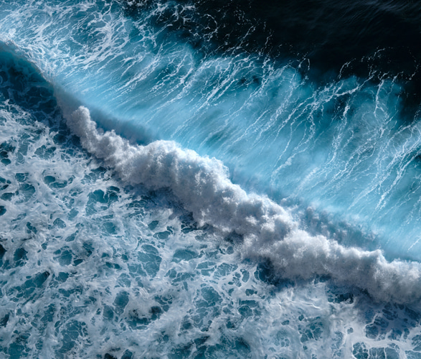
Learning Intention:
Describe the processes of wave formation, e.g. fetch, relationship of wave height and type to water depth and wave celerity.
Success Criteria:
Complete Marine Education worksheet
‘8. Surf’s Up”

Slide 2
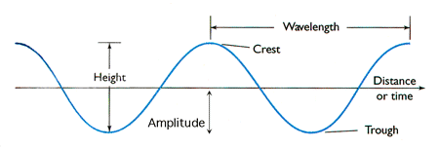
Wave characteristics
λ

Slide 3
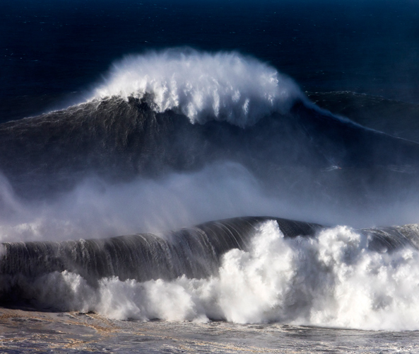
Wind-driven waves grow in size depending on 3 factors:
Wind…
Strength
Duration
Fetch

Slide 4
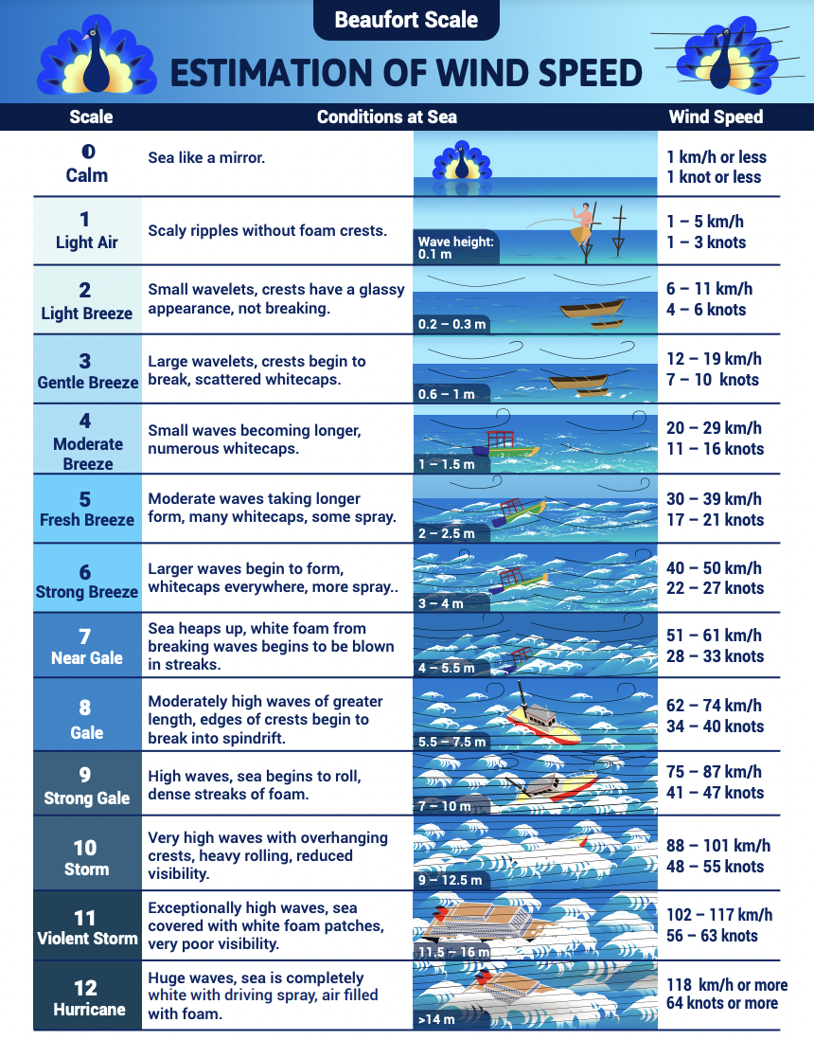
Beaufort Scale
Strength of wind
Notes:
Image: https://app.adpc.net/resources/beaufort-scale-on-conditions-at-sea/

Slide 5
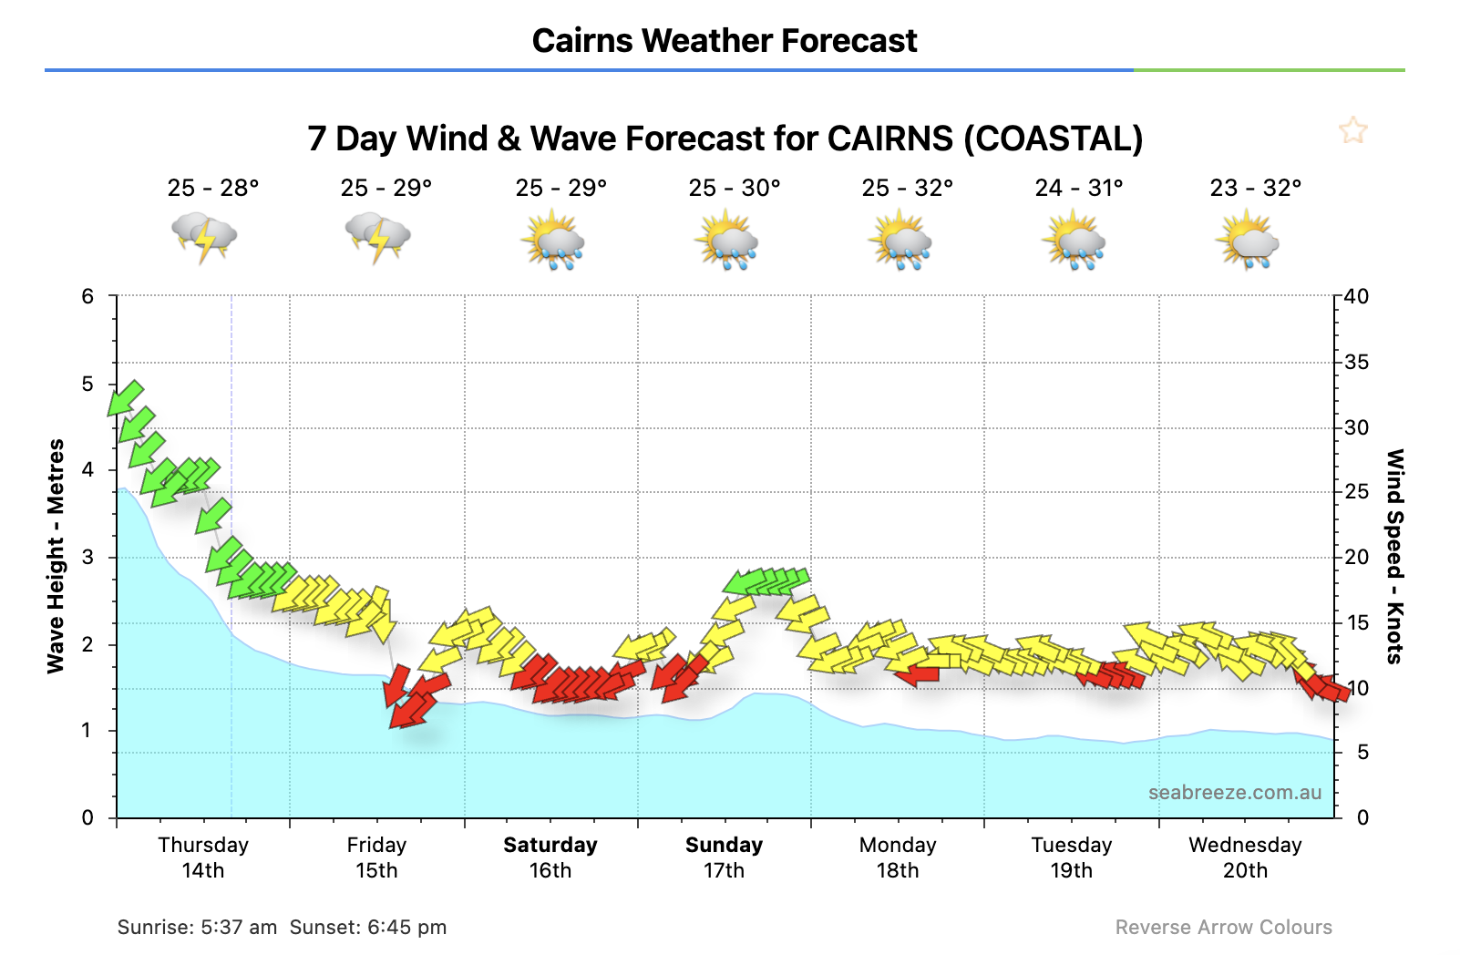
Duration of wind

Slide 6
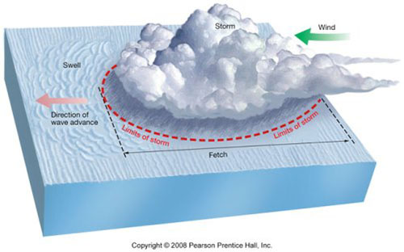
Fetch of wind
Fetch is the distance over the water that the wind can blow uninterrupted
Notes:
Image: https://www.eoas.ubc.ca/courses/atsc113/sailing/met_concepts/08-met-waves/8a-wave-formation/index.html

Slide 7
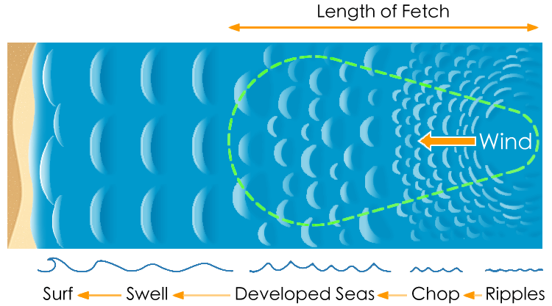

Slide 8
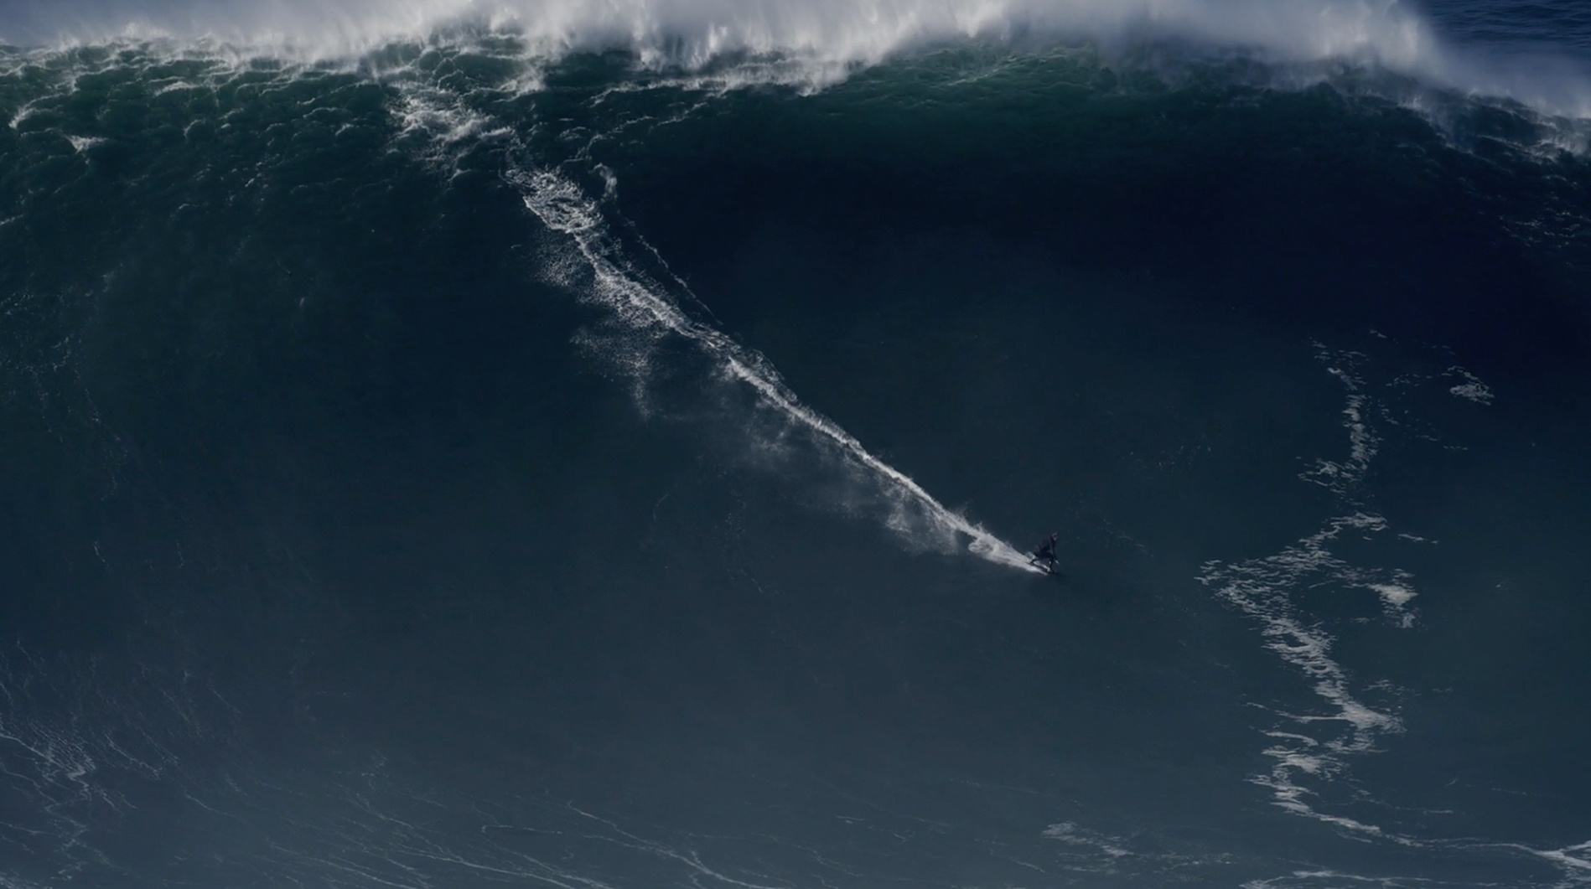
Biggest wave ever surfed?

Slide 9
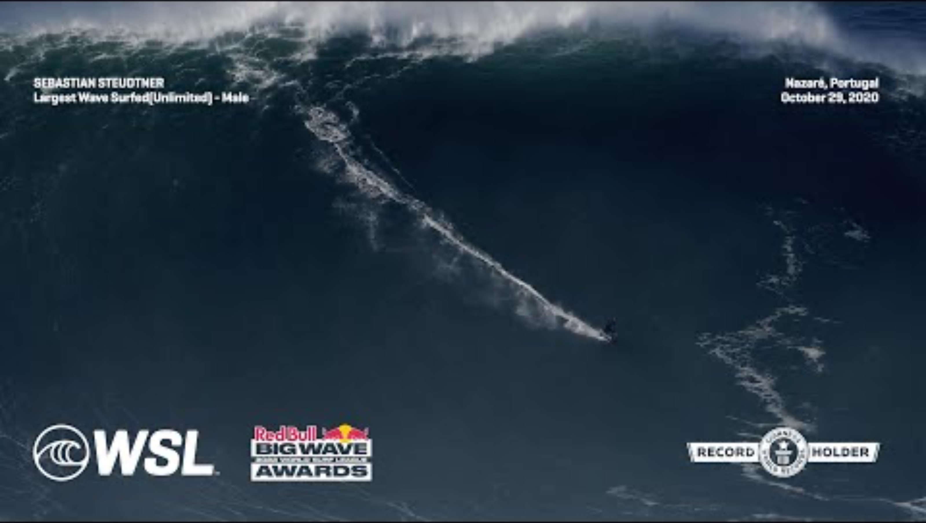
https://www.youtube.com/watch?v=CIXbZPHLv2o
Notes:
https://www.youtube.com/watch?v=CIXbZPHLv2o

Slide 10
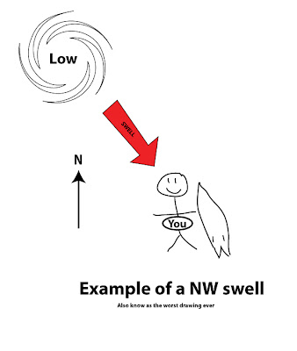
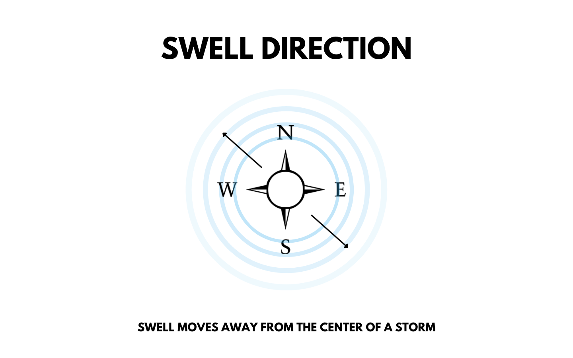
Swell’s rolling in

Slide 11
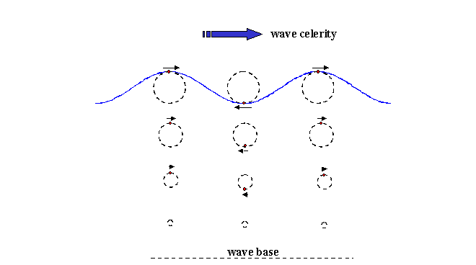
Wave celerity (wavelength / time)
Wave celerity is the speed of the wave.
Physicists use the word ‘celerity’ instead of ‘speed’, to remind themselves that it’s the energy
(not the mass) of the wave that is in motion.
Notes:
Image: https://www.eoas.ubc.ca/courses/atsc113/sailing/met_concepts/08-met-waves/8a-wave-formation/index.html

Slide 12
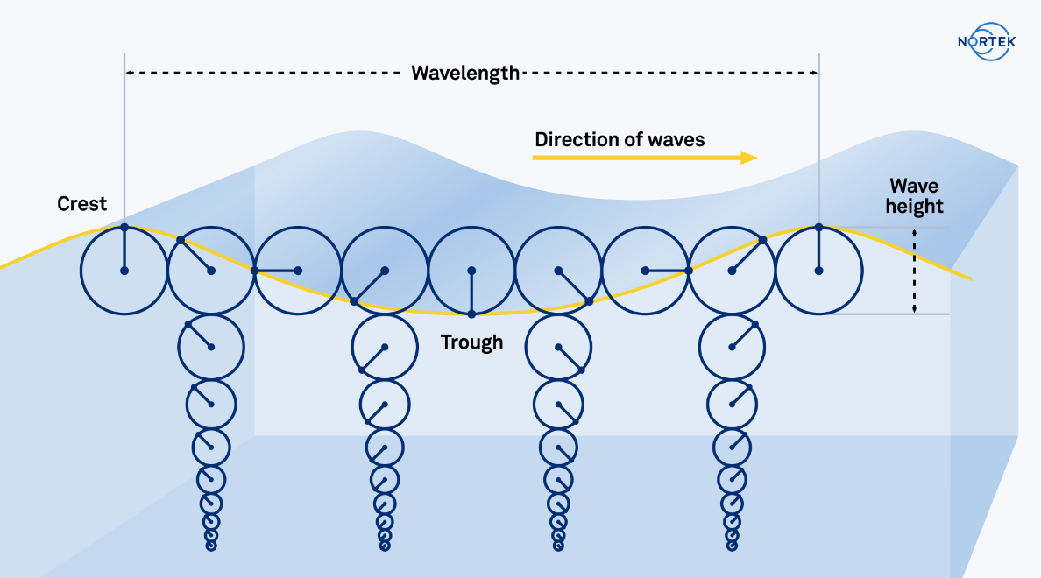
The Orbitals

Slide 13
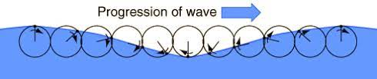
The Orbitals

Slide 14
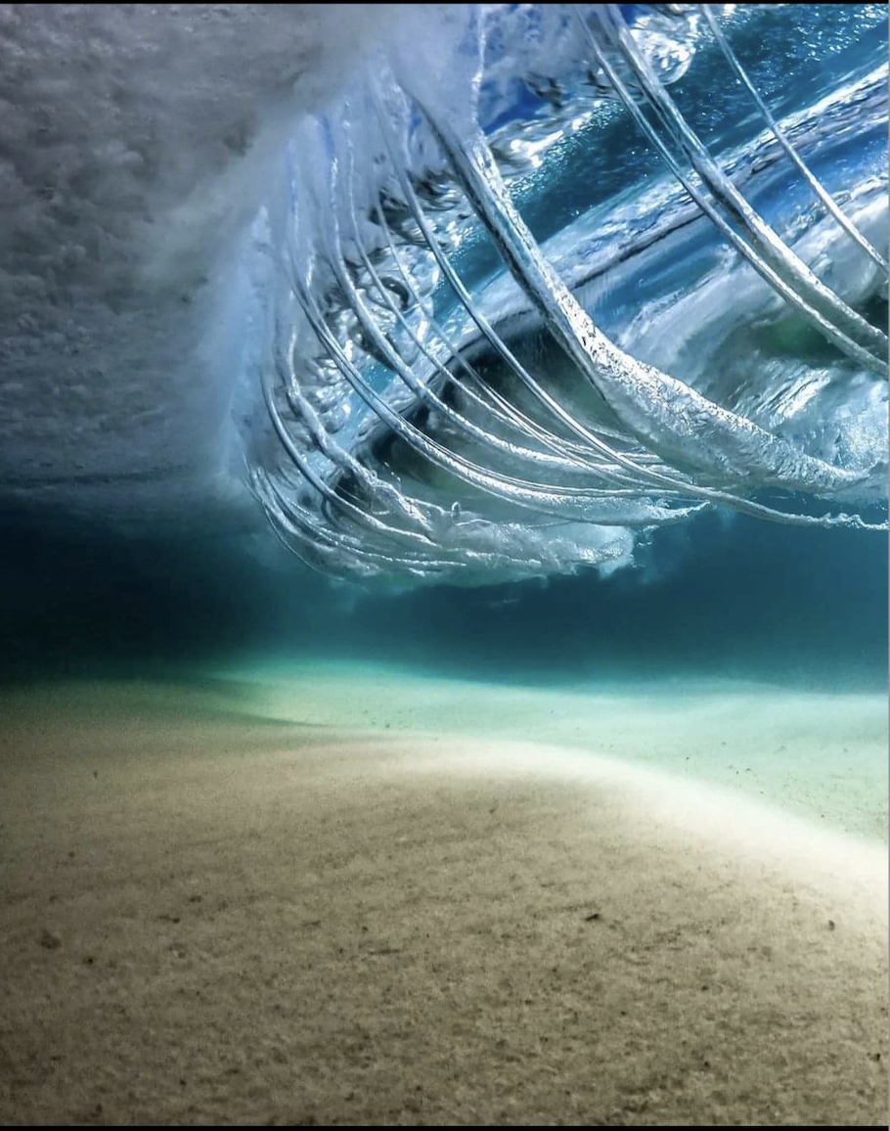
Duck dive under a wave and it pushes you towards the back of the wave due to the direction of the orbitals!

Slide 15
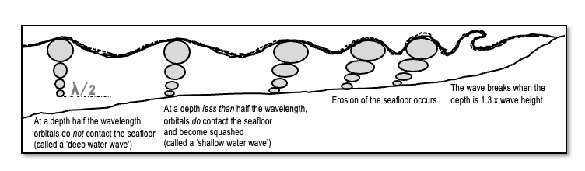
Waves break when depth is 1.3 x wave height

Slide 16
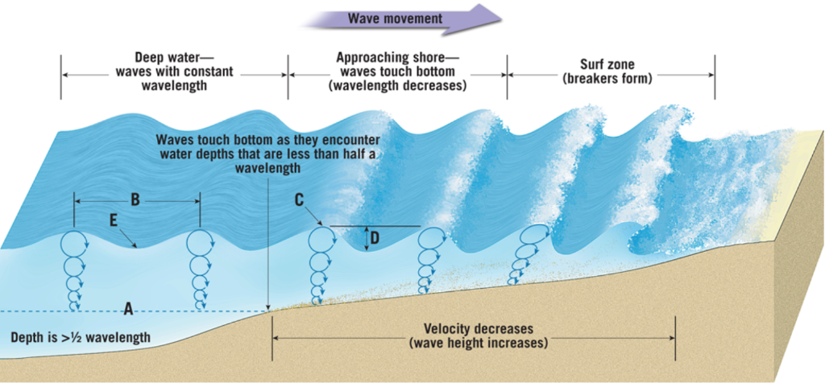
Wave break

Slide 17
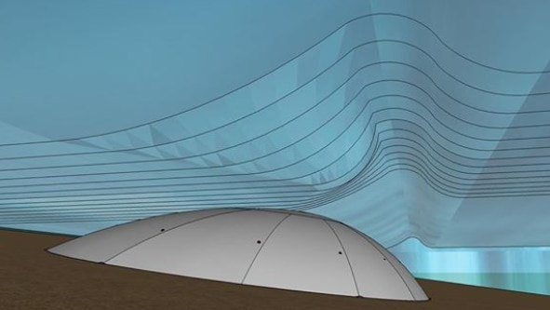
Artificial reefs
“'World-first' inflatable surf reef to be installed at beach in Western Australia” …2 months later…. “Ripped seam puts world's first inflatable surf reef on hold”
Notes:
Image: https://www.abc.net.au/news/2019-06-13/world-first-artificial-surf-reef-to-be-installed-at-bunbury/11204280
News headline: https://www.surfertoday.com/surfing/ripped-seam-puts-worlds-first-inflatable-surf-reef-on-hold

Slide 18
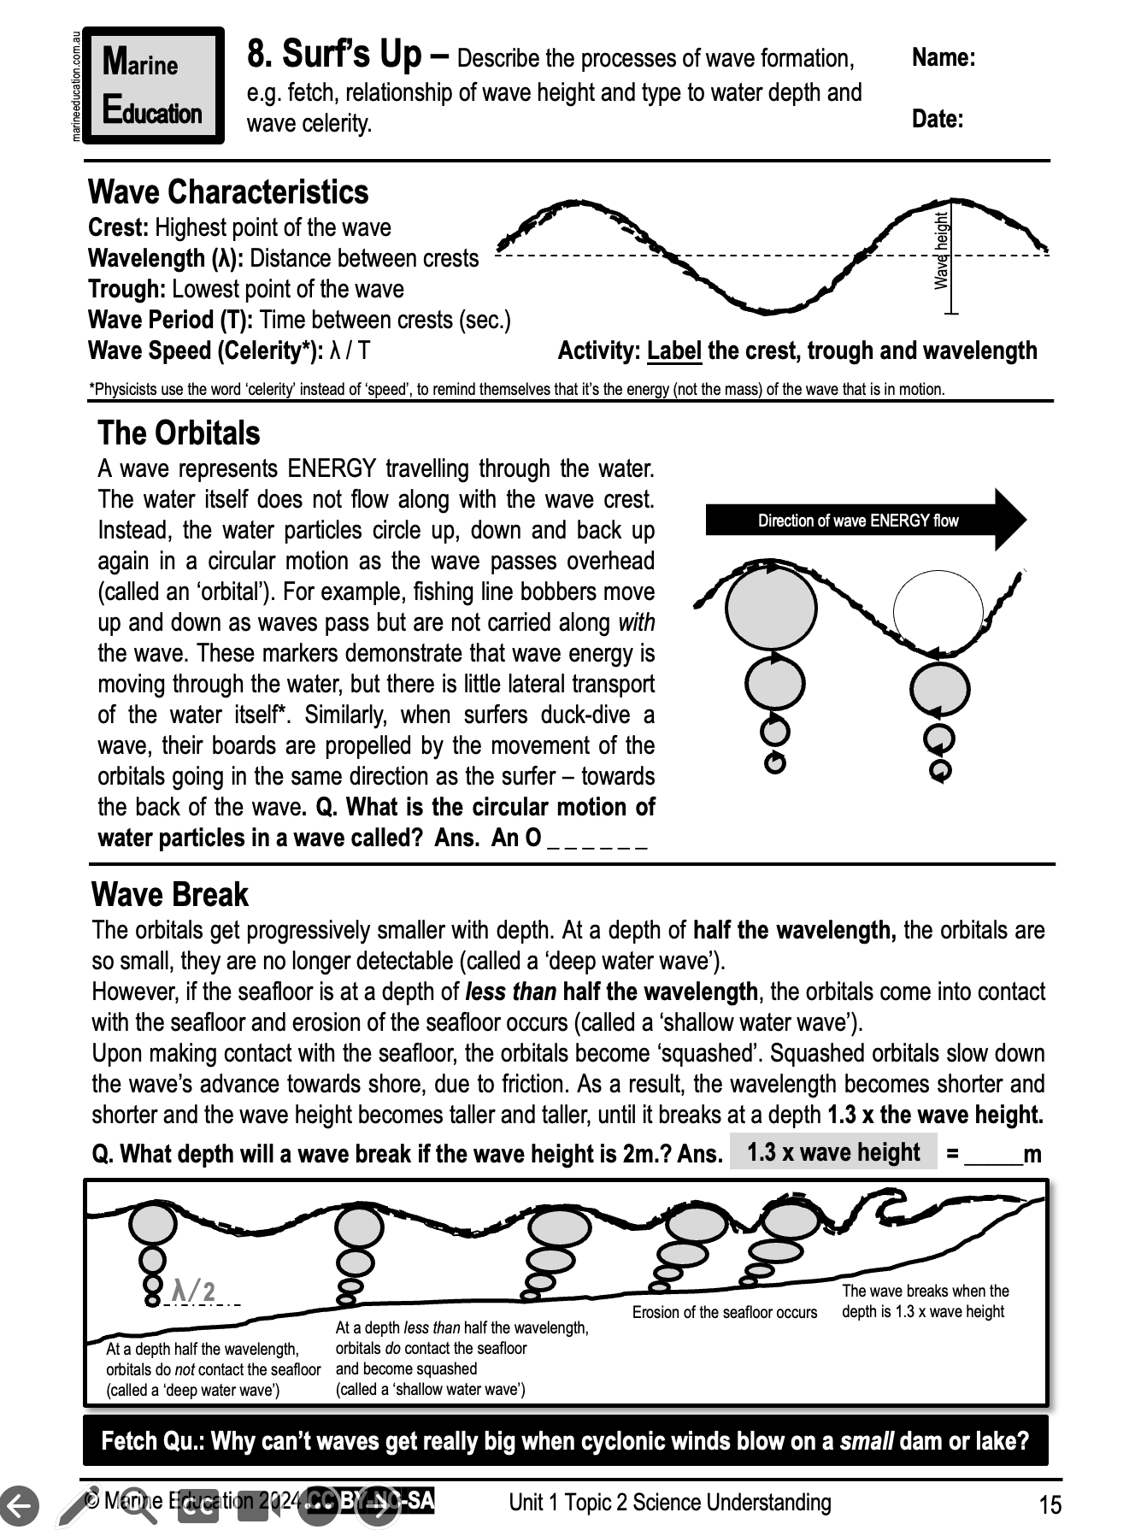
Learning Intention:
Describe the processes of wave formation (e.g. fetch, relationship of wave height and type to water depth and wave celerity).
Success Criteria:
Complete Marine Education worksheet
‘8. Surf’s Up”

