Slide 1
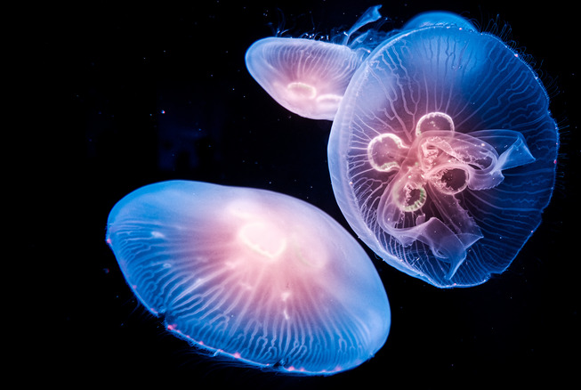
Learning Intention:
Describe how thermoclines and nutrients produce the oxygen minimum within the open ocean
Success Criteria:
Complete Marine Education worksheet ‘8. The Shadow Zone’
Notes:
https://www.grunge.com/462263/the-real-life-twilight-zone-explained/

Slide 2
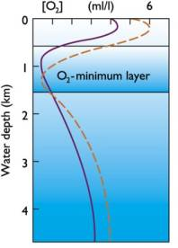
Oxygen minimum zones (OMZs) are regions of the global ocean that have low dissolved oxygen concentrations at depths between 200-1000 m due to a permanent thermocline slowing down the falling motion of any dead organic matter from above.
Notes:
https://www.nature.com/articles/s41467-022-35083-x

Slide 3
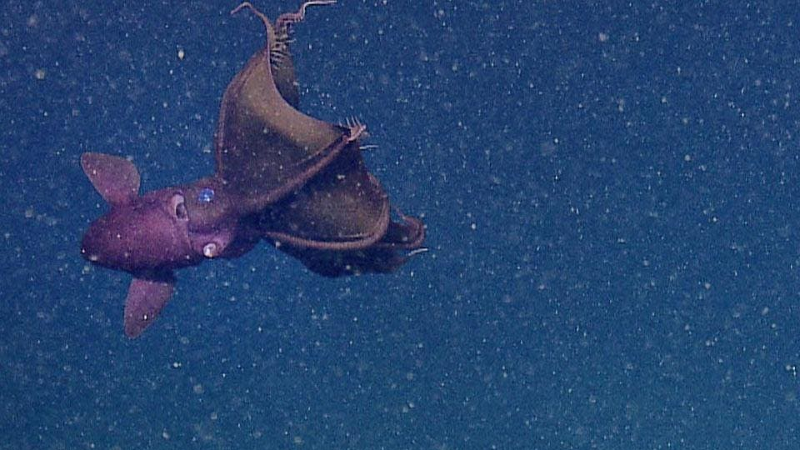
Nutrients falling down as ‘marine snow’ accumulate at the oxygen minimum zone.
The thermocline acts as a barrier.
Anything sinking must slow down, like cars coming into a traffic jam.
Notes:
https://www.nature.com/articles/s41467-022-35083-x

Slide 4
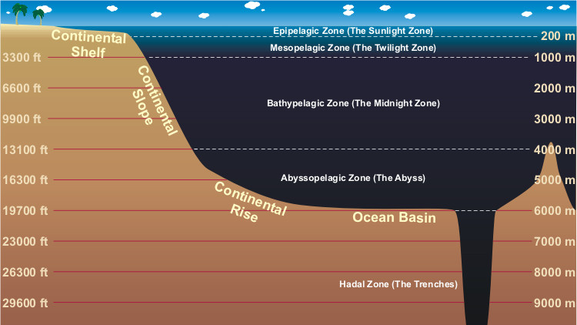

Slide 5
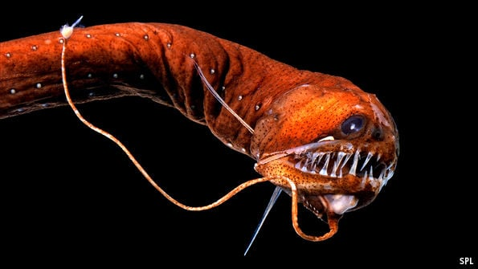
200-1000m is the Mesopelagic Zone.
Also called the Twilight Zone.

Slide 6
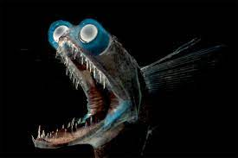

Slide 7
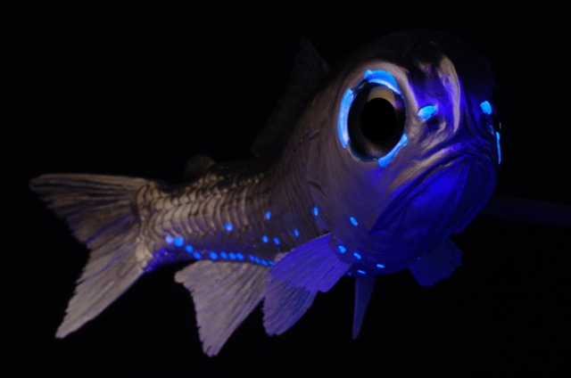
Notes:
https://vlr.eng.br/pinocho-cuento/facts-about-mesopelagic-fish-%E2%80%93-summer-ww-28430065

Slide 8
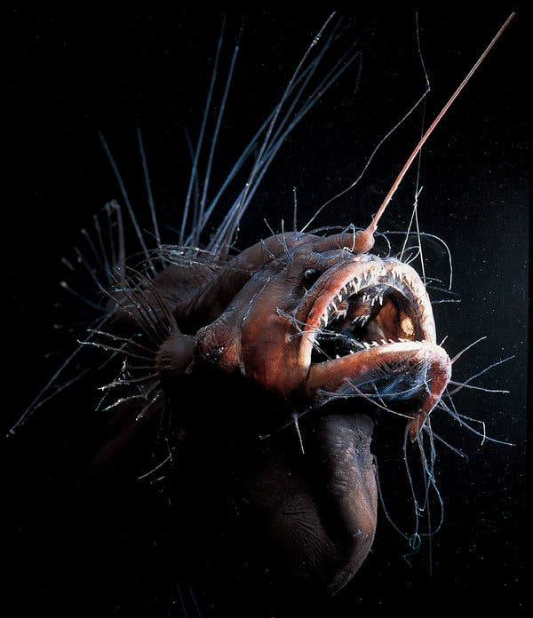

Slide 9
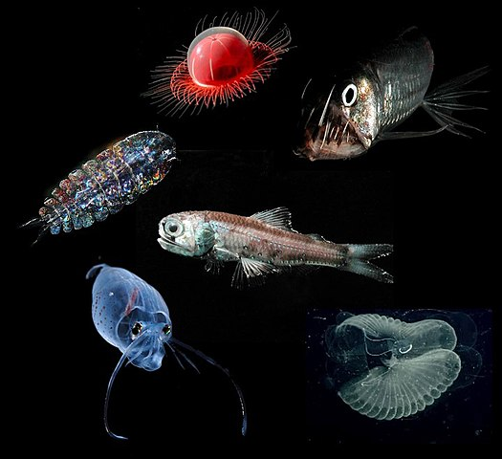
These animals all need to breathe.

Slide 10
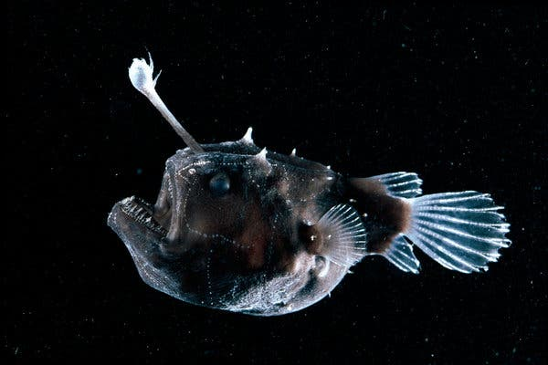
But it’s too deep for photosynthesis to replace the oxygen that is used up in respiration.

Slide 11
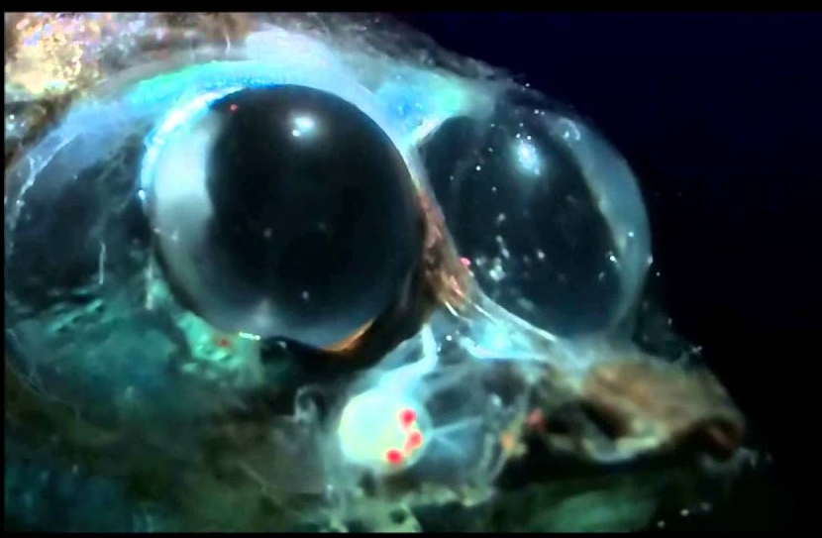
…so the oxygen levels deplete.

Slide 12
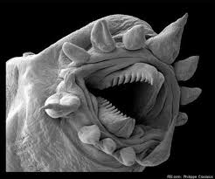
Decomposition uses oxygen too…
Notes:
https://news.yahoo.com/incredible-technology-explore-microscopic-world-134527812.html

Slide 13
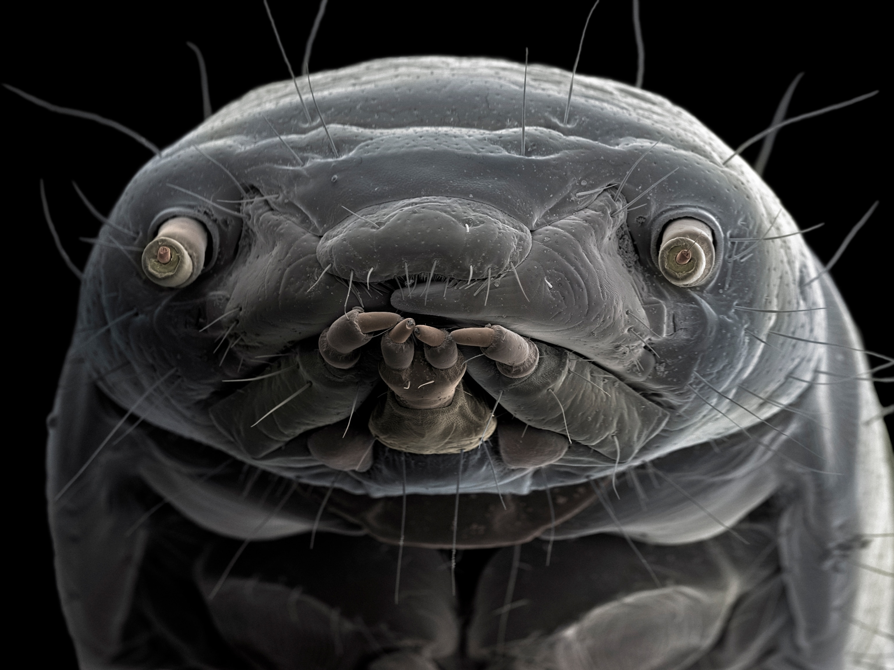
Mealworm
And so, the oxygen minimum zone has the lowest oxygen levels in the ocean, hence the name.
Notes:
https://www.nationalgeographic.com/science/article/hidden-world-microscopic-life-revealed-extraordinary-pictures

Slide 14
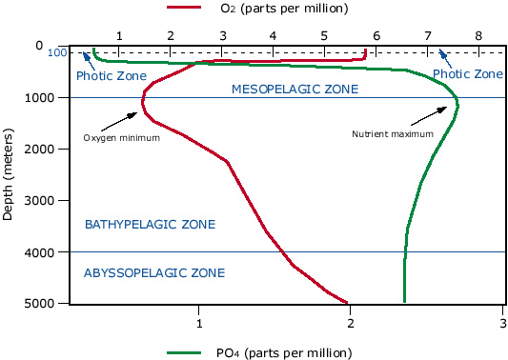
Below the oxygen minimum zone, oxygen levels increase again (from thermohaline circulation or THC). You will learn about THC next lesson.
For this lesson, and for this graph, only focus on the 1000m mark.
Oxygen in red.
Nutrients in green.
More nutrients
= more decomposition
= less oxygen.
(nutrients)

Slide 15
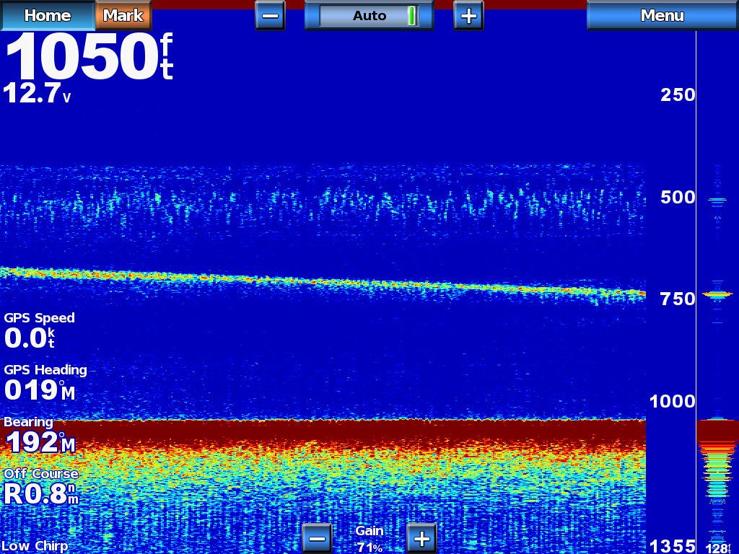
Thermocline on a sounder/fish finder

Slide 16
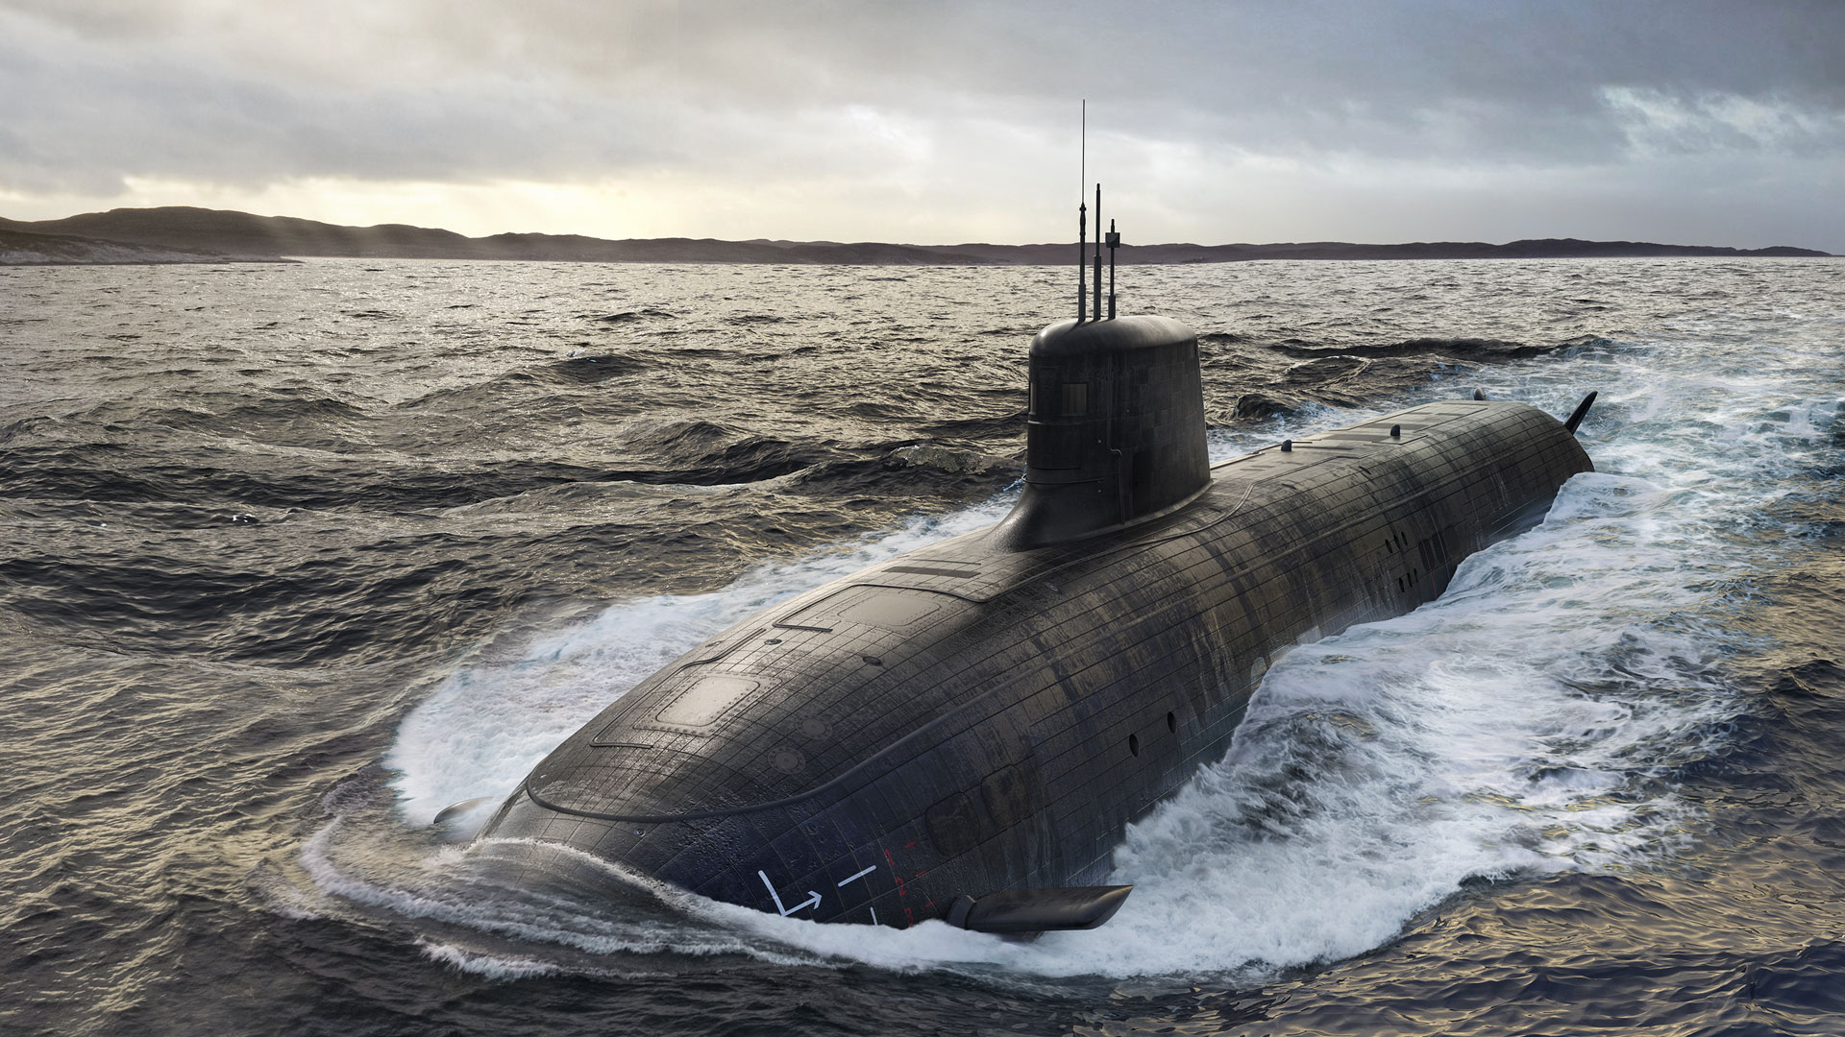
Fun Facts

Slide 17
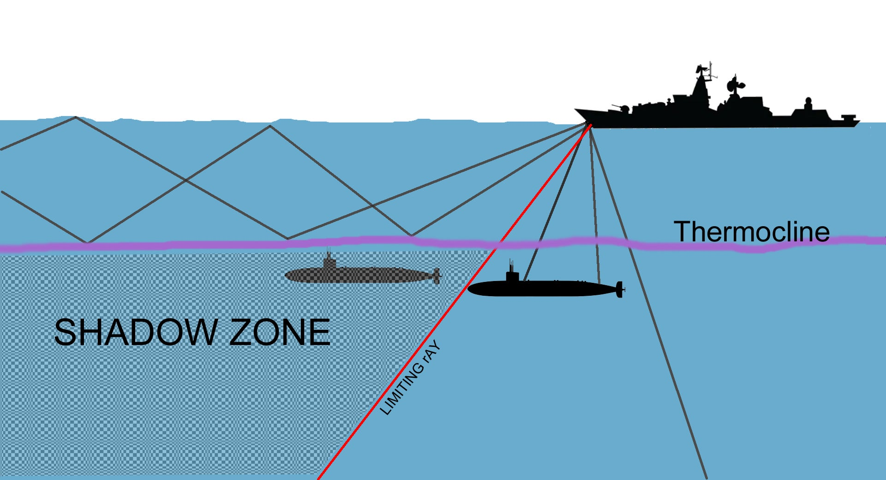
At the base of the mixed layer where the thermocline begins, sound refracts upwards and downwards creating a ‘shadow zone’ where, in the 1960s, submarines would hide with almost complete immunity.
Notes:
https://www.thedrive.com/the-war-zone/40286/the-hunt-for-a-soviet-submarine-desperately-trying-to-sneak-through-the-strait-of-gibraltar

Slide 18
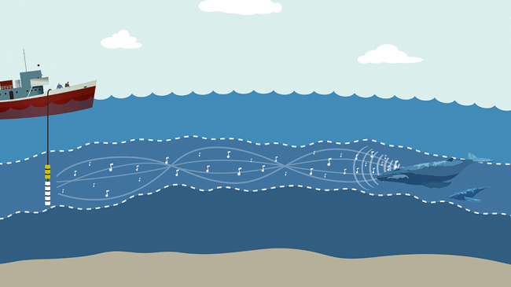
A sound wave omitted within a thermocline (e.g. from a whale) is trapped by the thermocline and travels thousands of kilometers without the signal losing significant energy.
Baleen whales appear to take advantage of this sound channel to broadcast songs for great distances.
Notes:
https://oceanservice.noaa.gov/facts/sofar.html

Slide 19
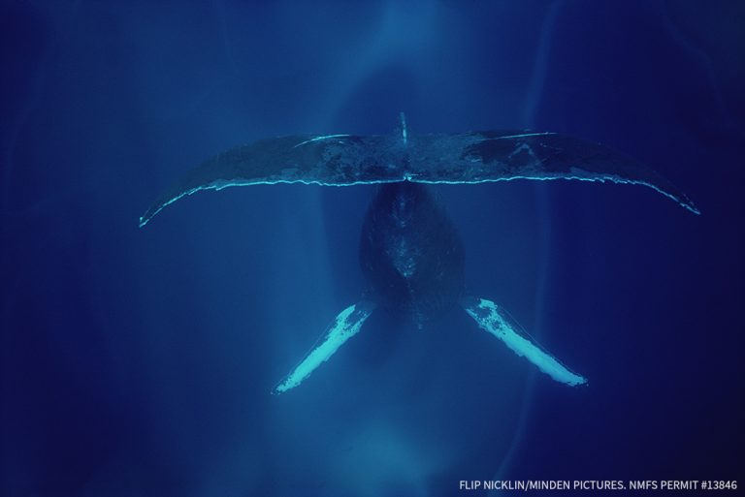
Notes:
https://mauioceancenter.com/in-search-of-humpback-whale-songs/

Slide 20
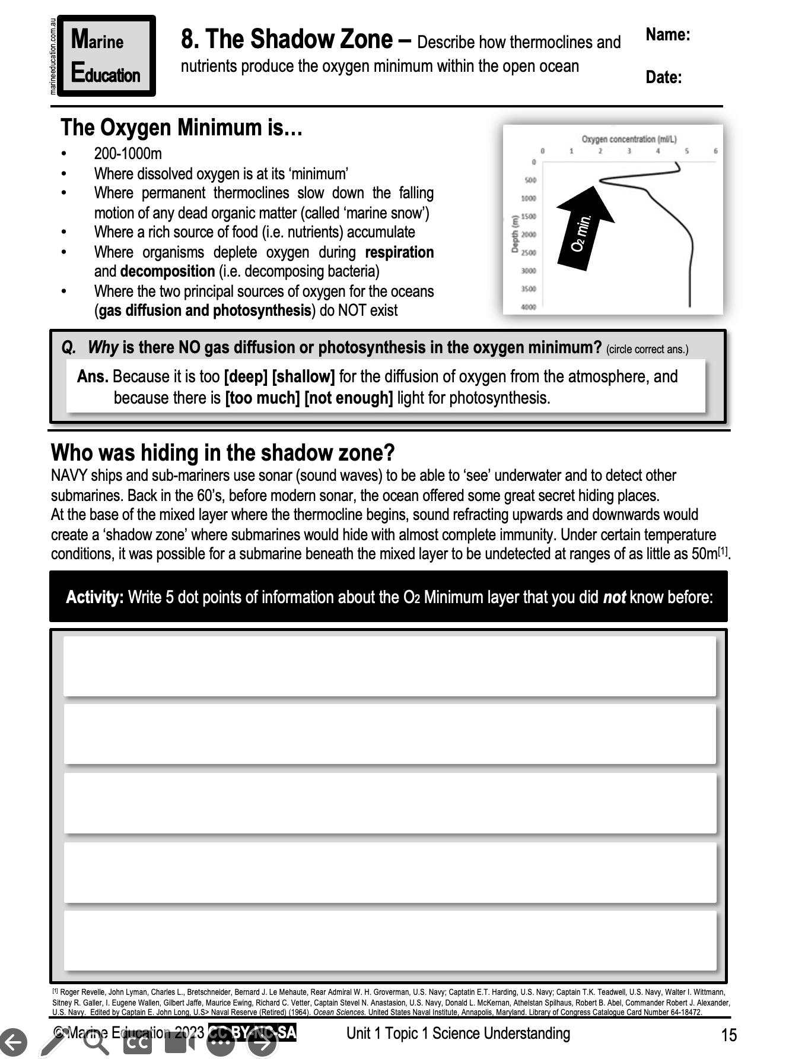
Learning Intention:
Describe how thermoclines and nutrients produce the oxygen minimum within the open ocean
Success Criteria:
Complete Marine Education worksheet ‘8. The Shadow Zone’

