Slide 1
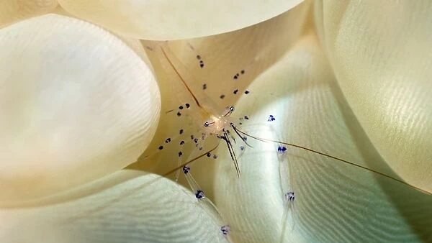
Learning Intention:
Identify biotic components of marine ecosystems, i.e. trophic levels, food chains, food webs, interactions and population dynamics.
Success Criteria:
Complete Marine Education worksheet ‘9. Bio….ta’

Slide 2
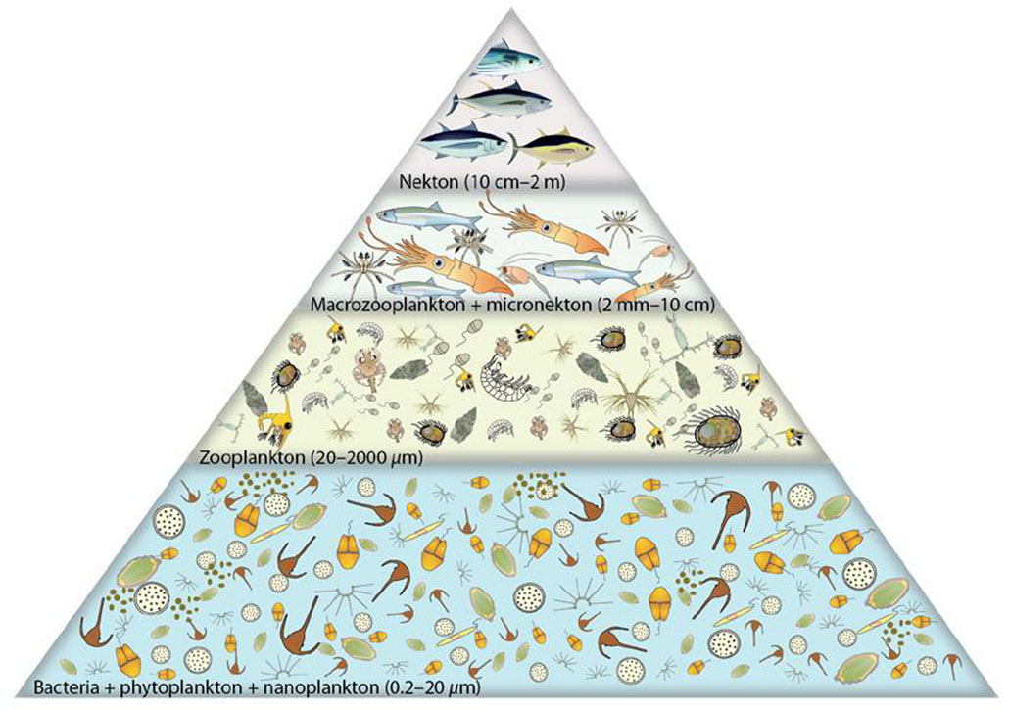
4th
3rd
Trophic Levels
Primary producers always start at trophic level 1
2nd
1st
Notes:
Image: https://pirca.org/2016/04/22/generalized-trophic-pyramid-for-the-tropical-pacific-ocean/

Slide 3
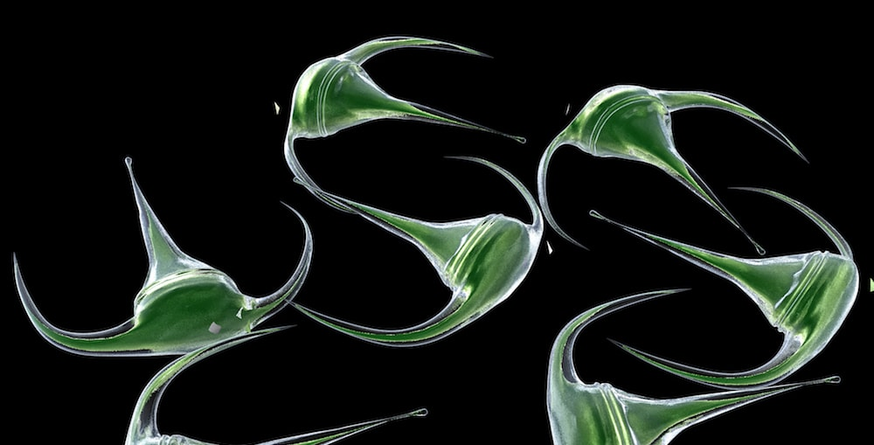
1st Trophic Level: Primary Producers
dinoflagellates
Notes:
Image: https://www.algaebarn.com/blog/phytoplankton/using-live-microalgae-to-control-nuisance-dinoflagellates/

Slide 4
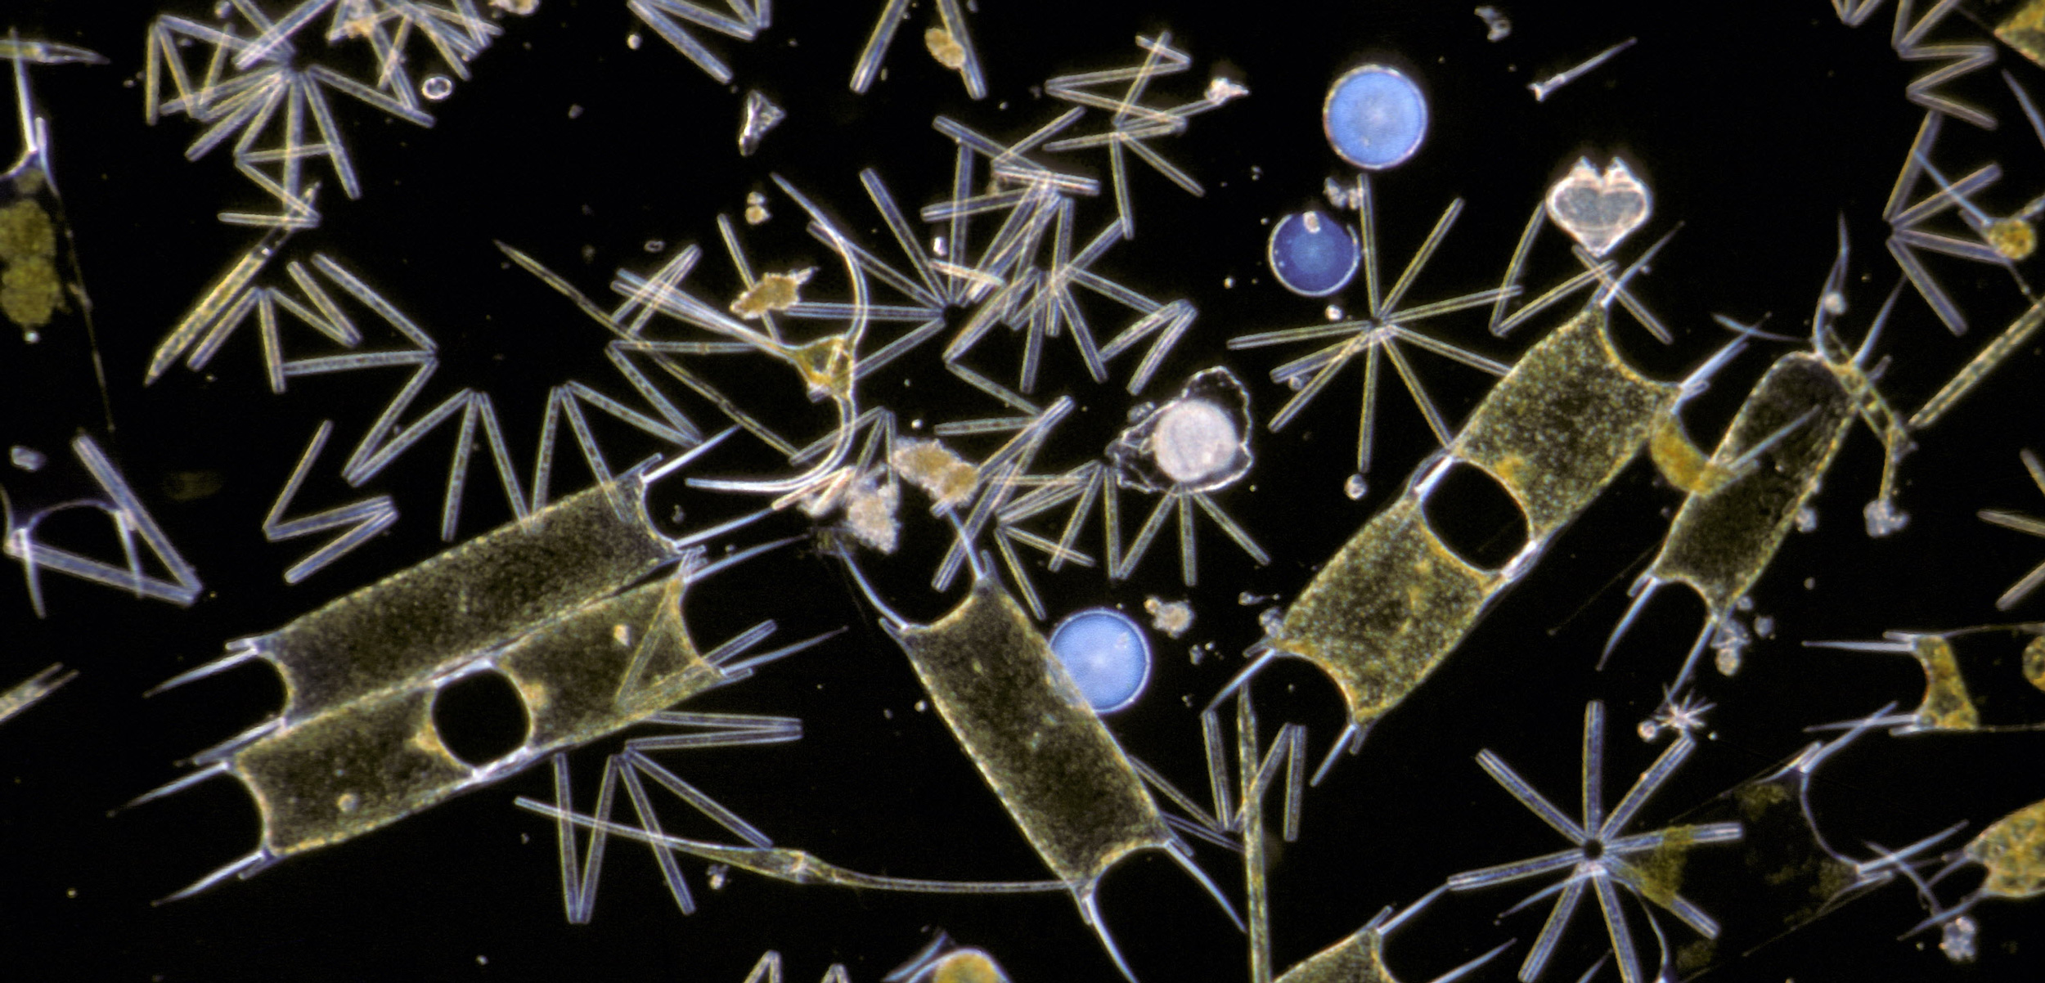
e. g. phytoplankton
Notes:
Image: https://hakaimagazine.com/news/why-are-there-so-many-kinds-of-phytoplankton/

Slide 5
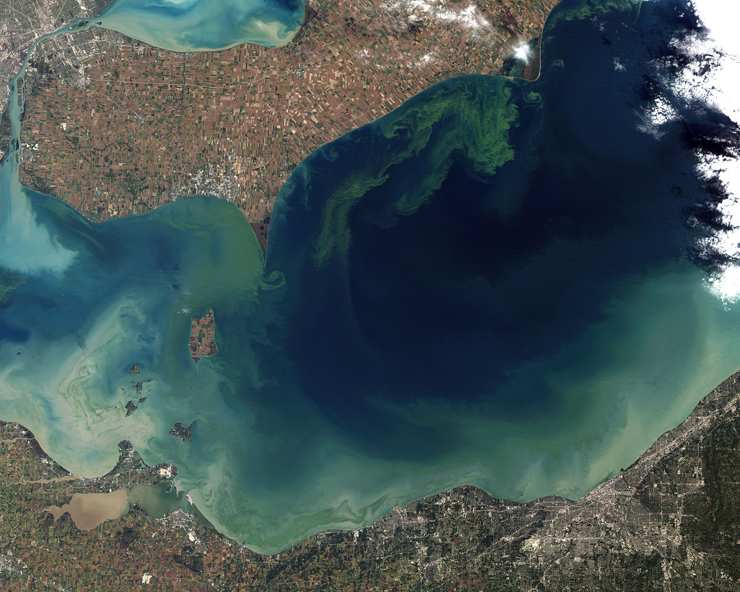
algae

Slide 6
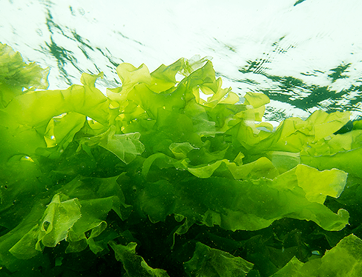
Ulva sp. (sea lettuce)
seaweed
Notes:
Image: https://nordicseafarm.com/project/ulvafarm/

Slide 7
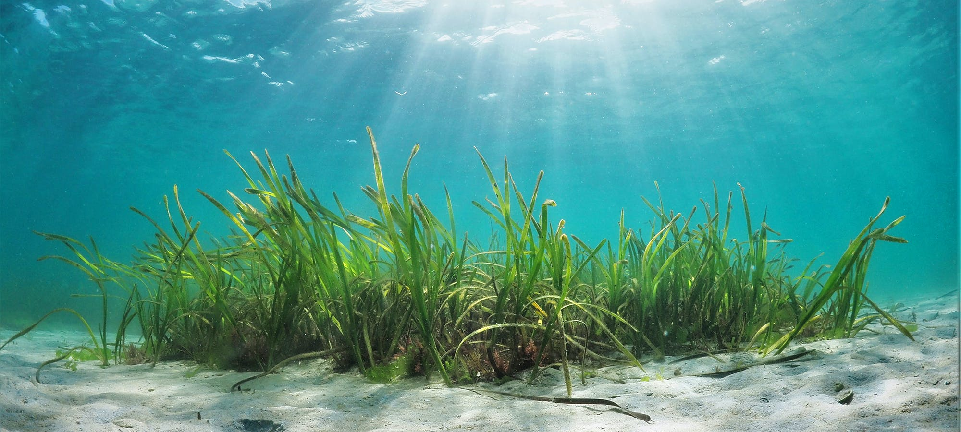
seagrass

Slide 8
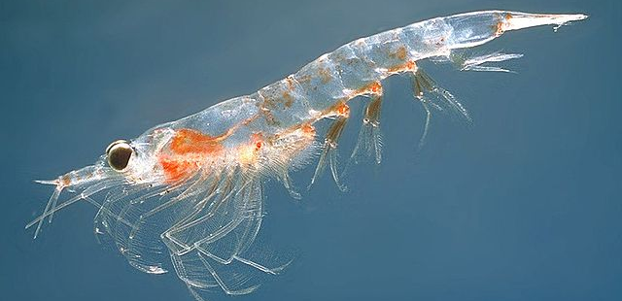
2nd Trophic Level: Primary Consumers
krill
Notes:
Image: https://hakaimagazine.com/news/why-are-there-so-many-kinds-of-phytoplankton/

Slide 9
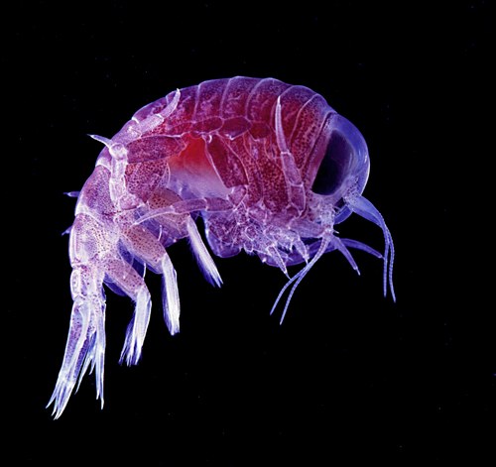
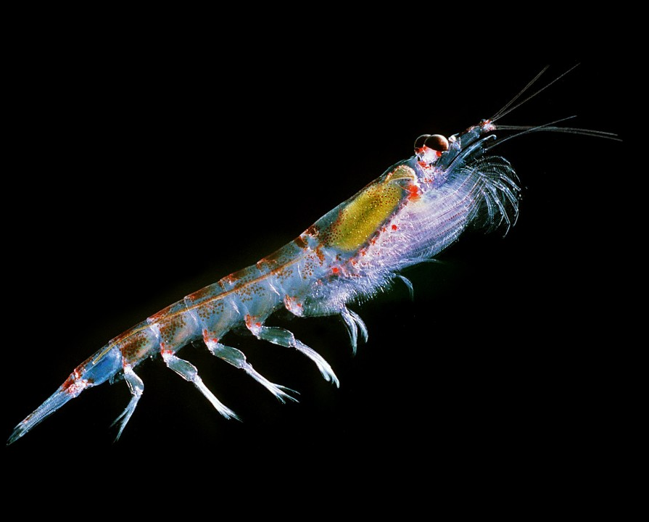
e.g. zooplankton
Notes:
Image: https://qknowbooks.gitbooks.io/featured_books_and_articles-marine-realm/content/zooplankton.html

Slide 10
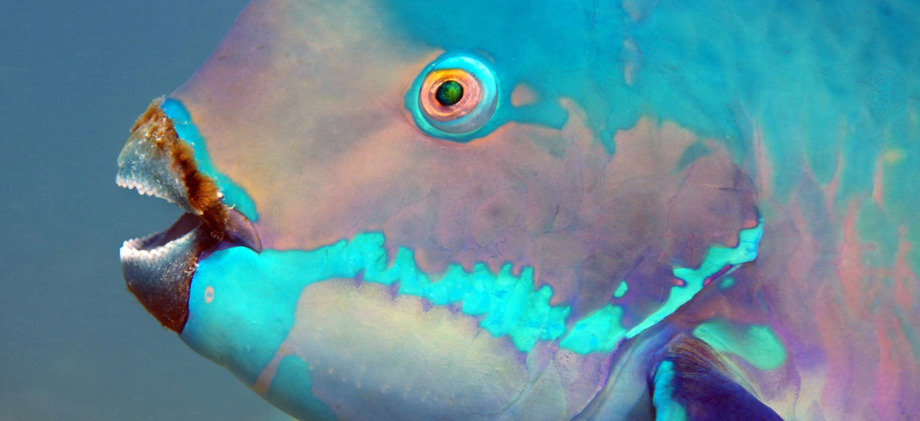
herbivores
parrotfish
Notes:
Image: https://www.barrierreef.org/news/blog/five-fascinating-facts-about-parrotfish

Slide 11
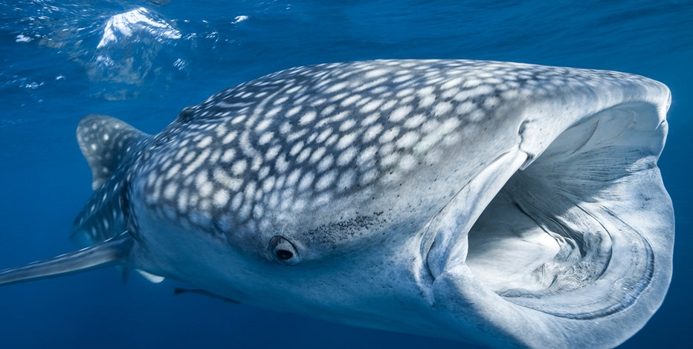
omnivores
Whale Shark
Notes:
Image: https://www.fox13news.com/news/national-whale-shark-day-celebrates-largest-fish-in-the-world

Slide 12
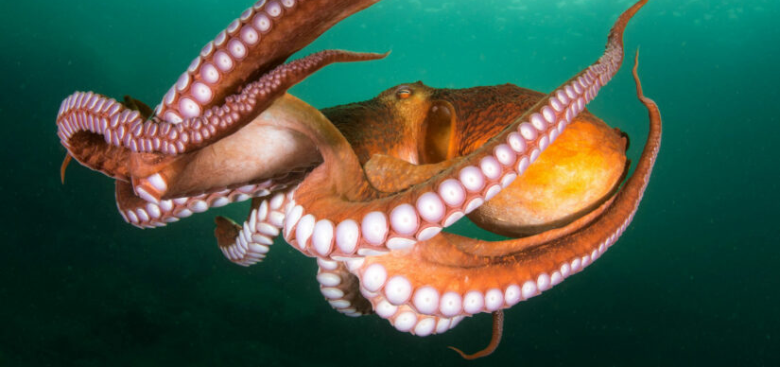
3rd Trophic Level: Secondary Consumers

Slide 13
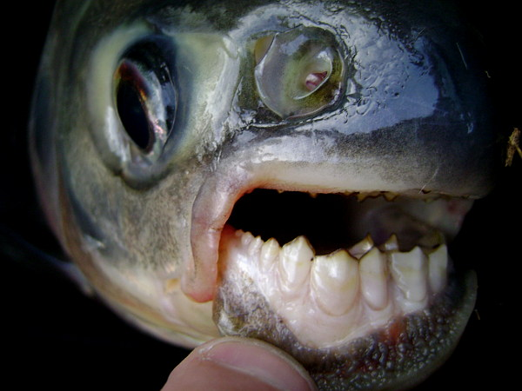
omnivores
Pacu

Slide 14
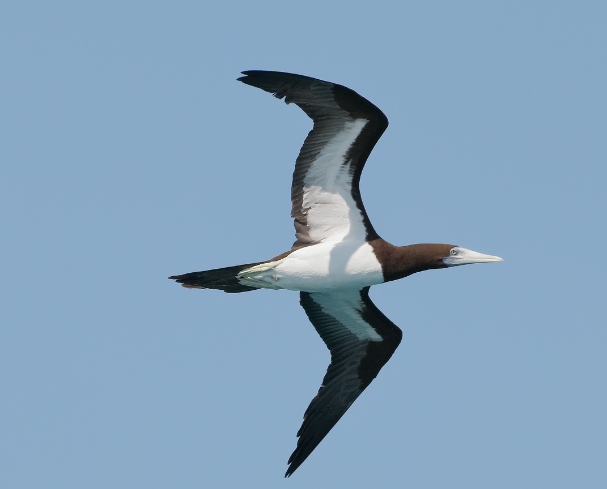
carnivores
Booby Bird
Notes:
Image:

Slide 15
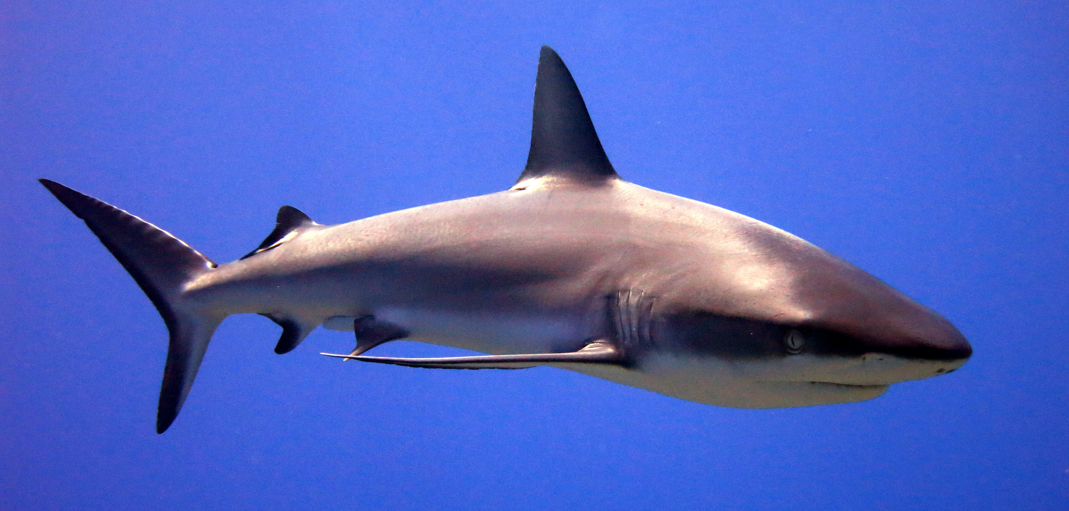
4th Trophic Level: Tertiary Consumers
Grey Reef Shark
Notes:
Image: Wikapedia

Slide 16


Slide 17
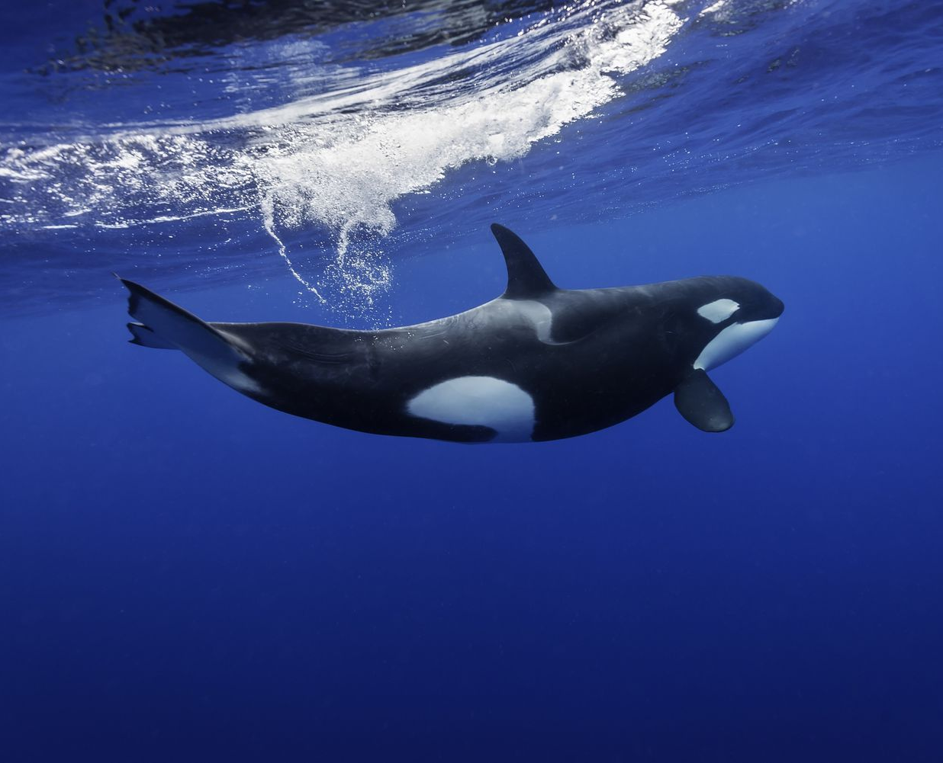
carnivores
Orca (killer whale)

Slide 18
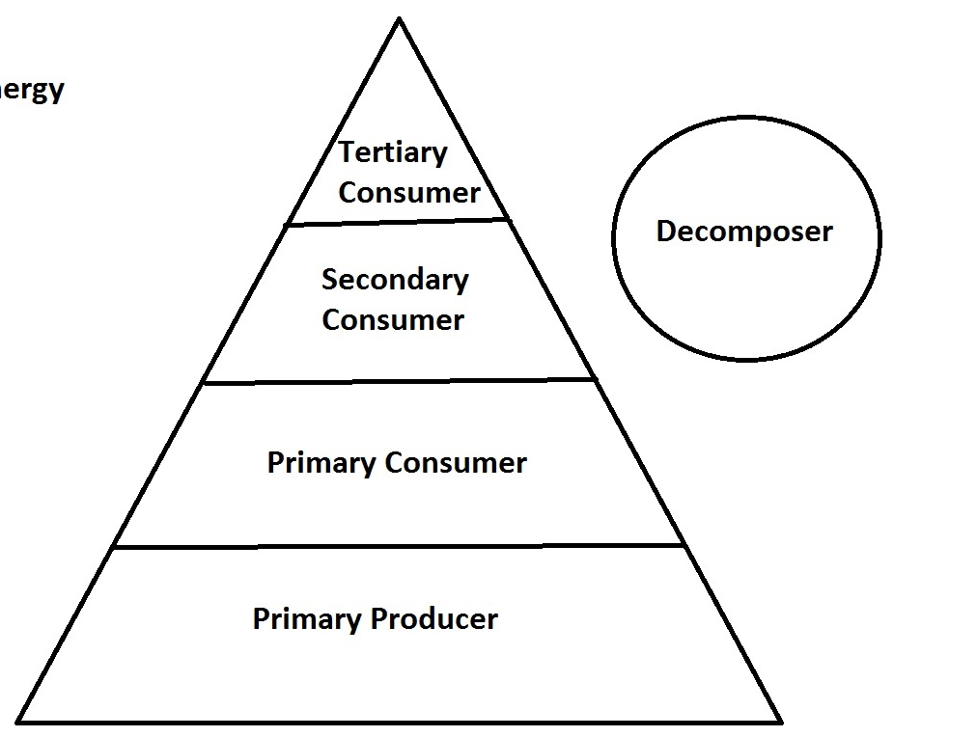

Slide 19
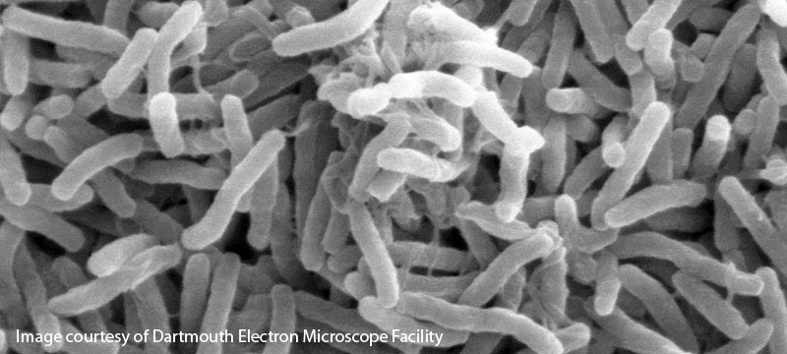
Decomposers
Notes:
Image:

Slide 20
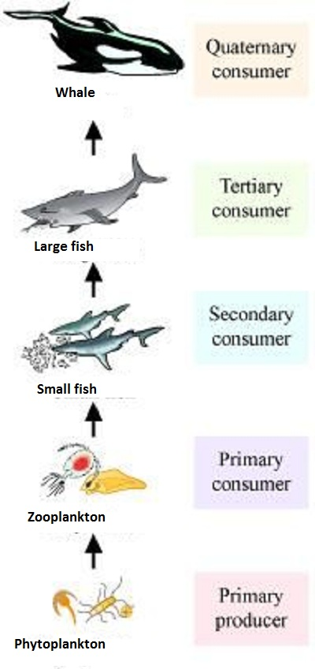
Food Chain (one direction)

Slide 21
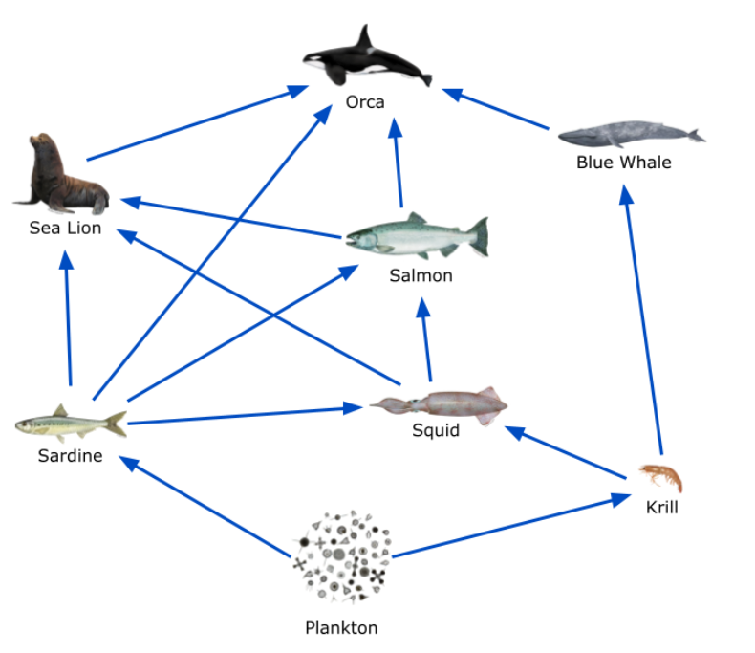
Food WEB
(multi direction)

Slide 22
Biotic Interactions

Slide 23
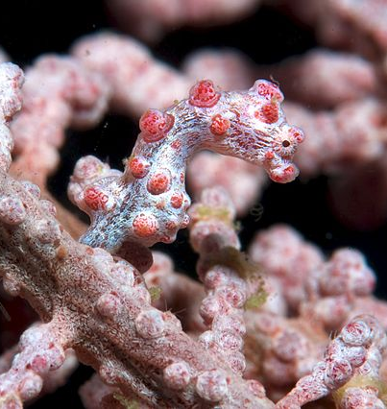
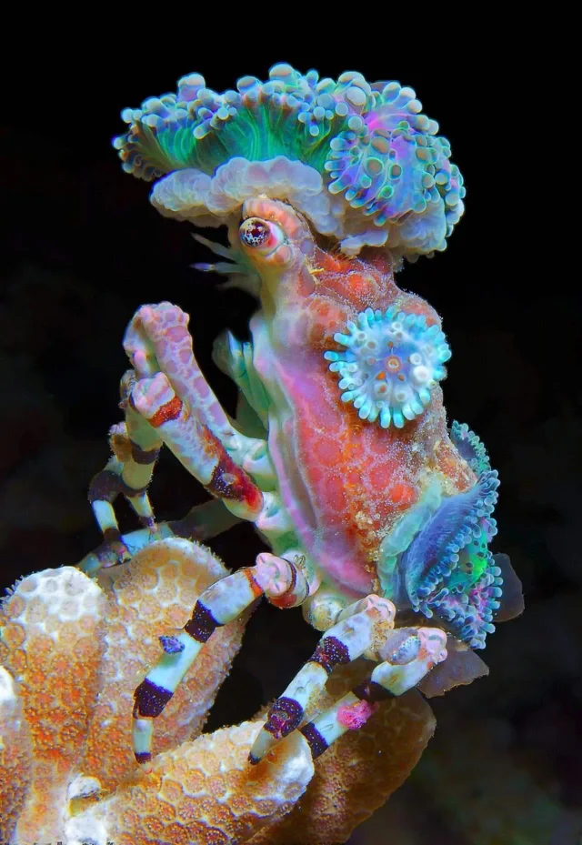
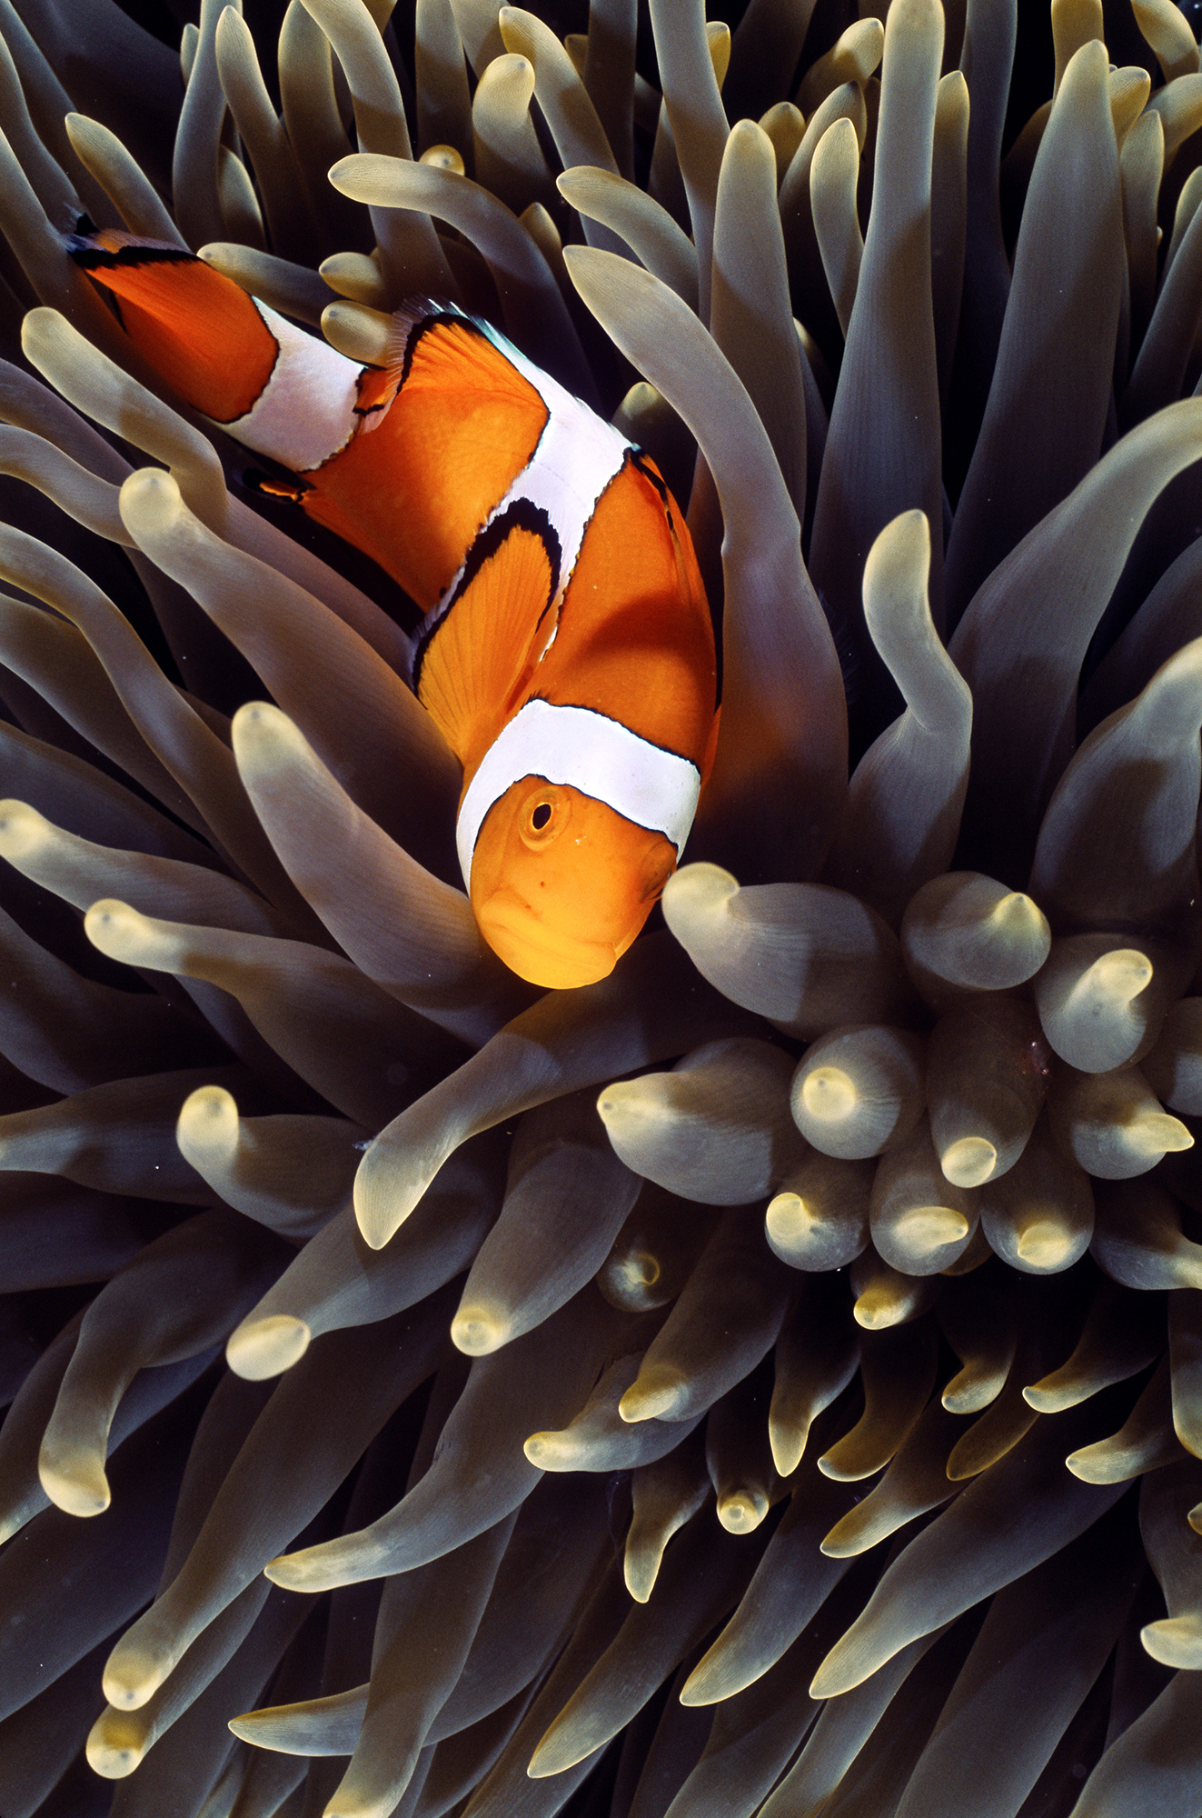
Symbiosis (2 different species living together)

Slide 24
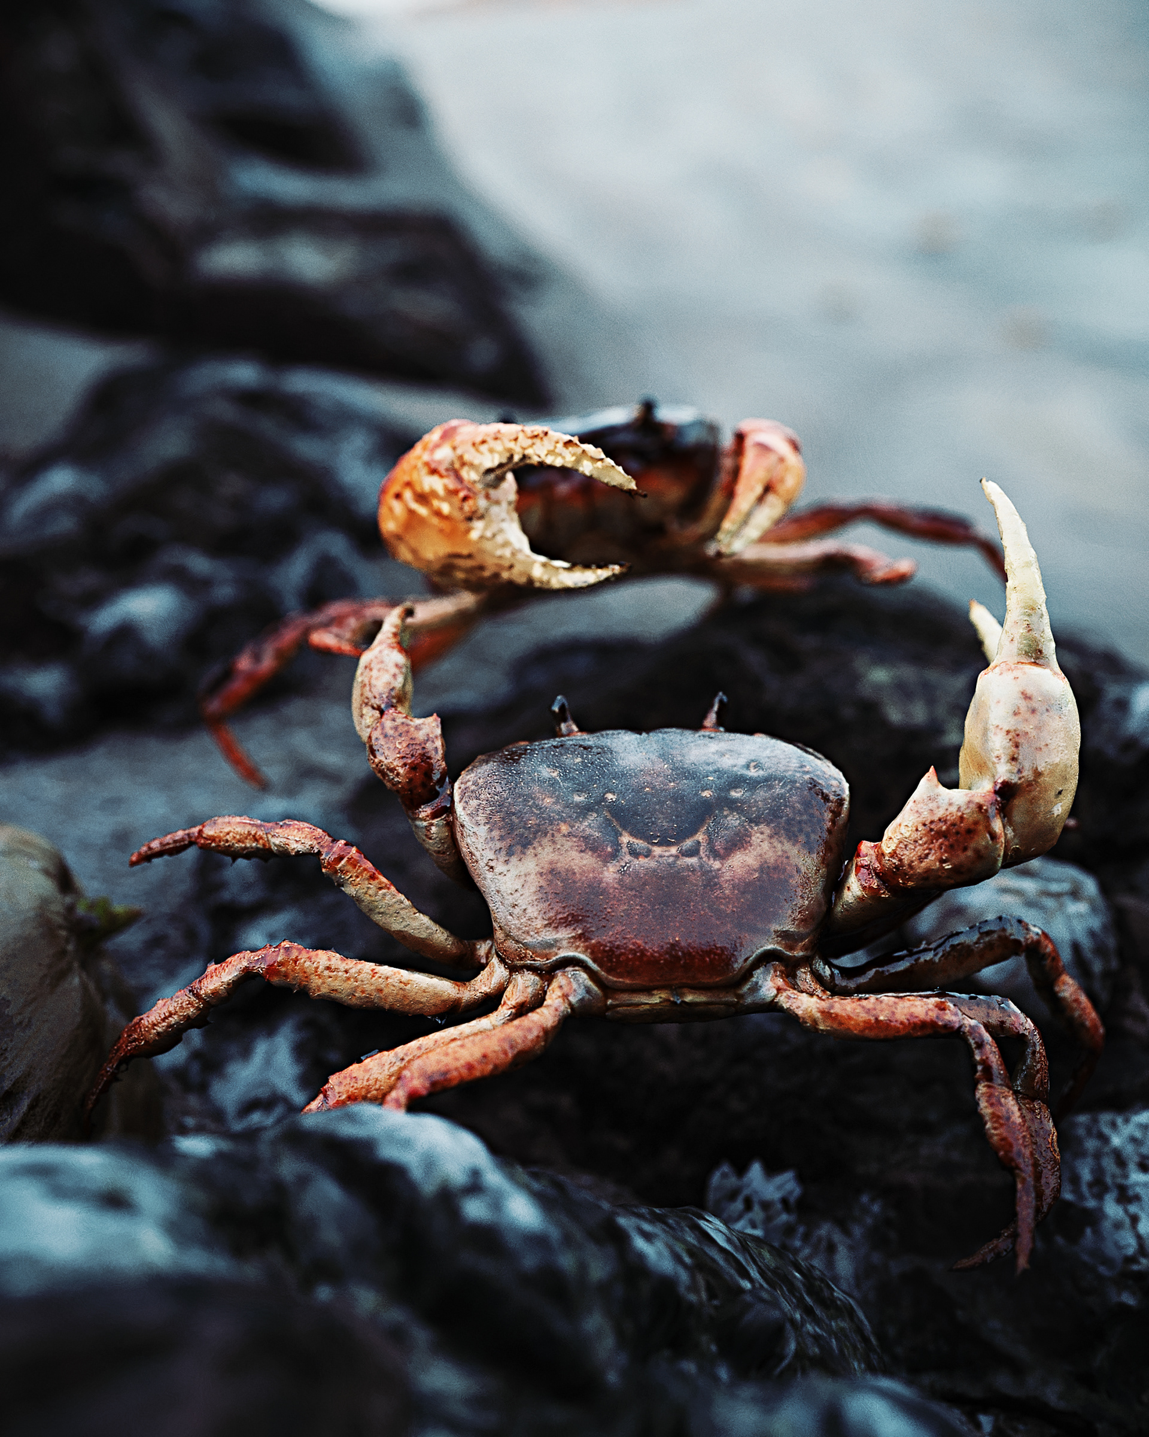
competition

Slide 25
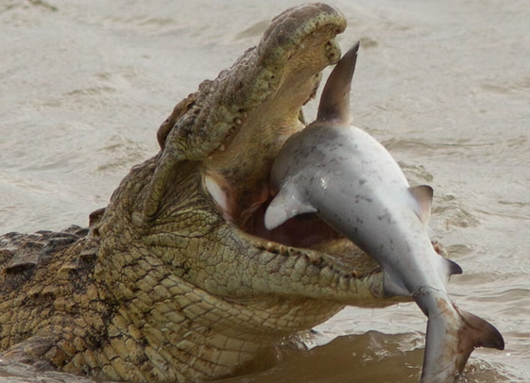
predation
Notes:
Image: https://www.independent.co.uk/news/world/australasia/crocodile-eats-shark-south-africa-b1823043.html

Slide 26
Population dynamics
changes to the size of a population over time

Slide 27
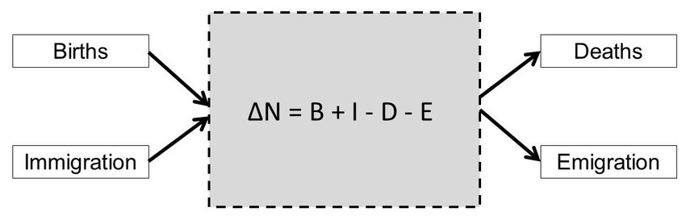
△N = (𝐵 + 𝐼) − (𝐷 + 𝐸)
where:
△N = the rate of change of a population
B = birth rate
D = death rate
I = immigration
E = emigration.

Slide 28
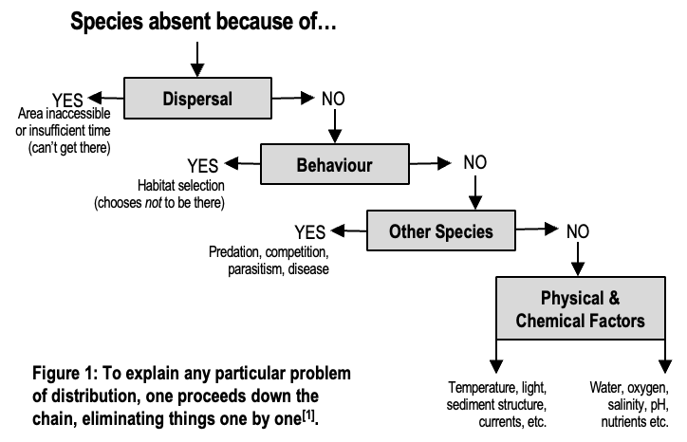
Distribution (where species are found)
Adapted from: Krebs, C. J. (1972). Ecology: The experimental analysis of distribution and abundance. Harper & Row, Publishers, Inc., New York. Library of Congress Catalog Card Number: 70-184931.

Slide 29
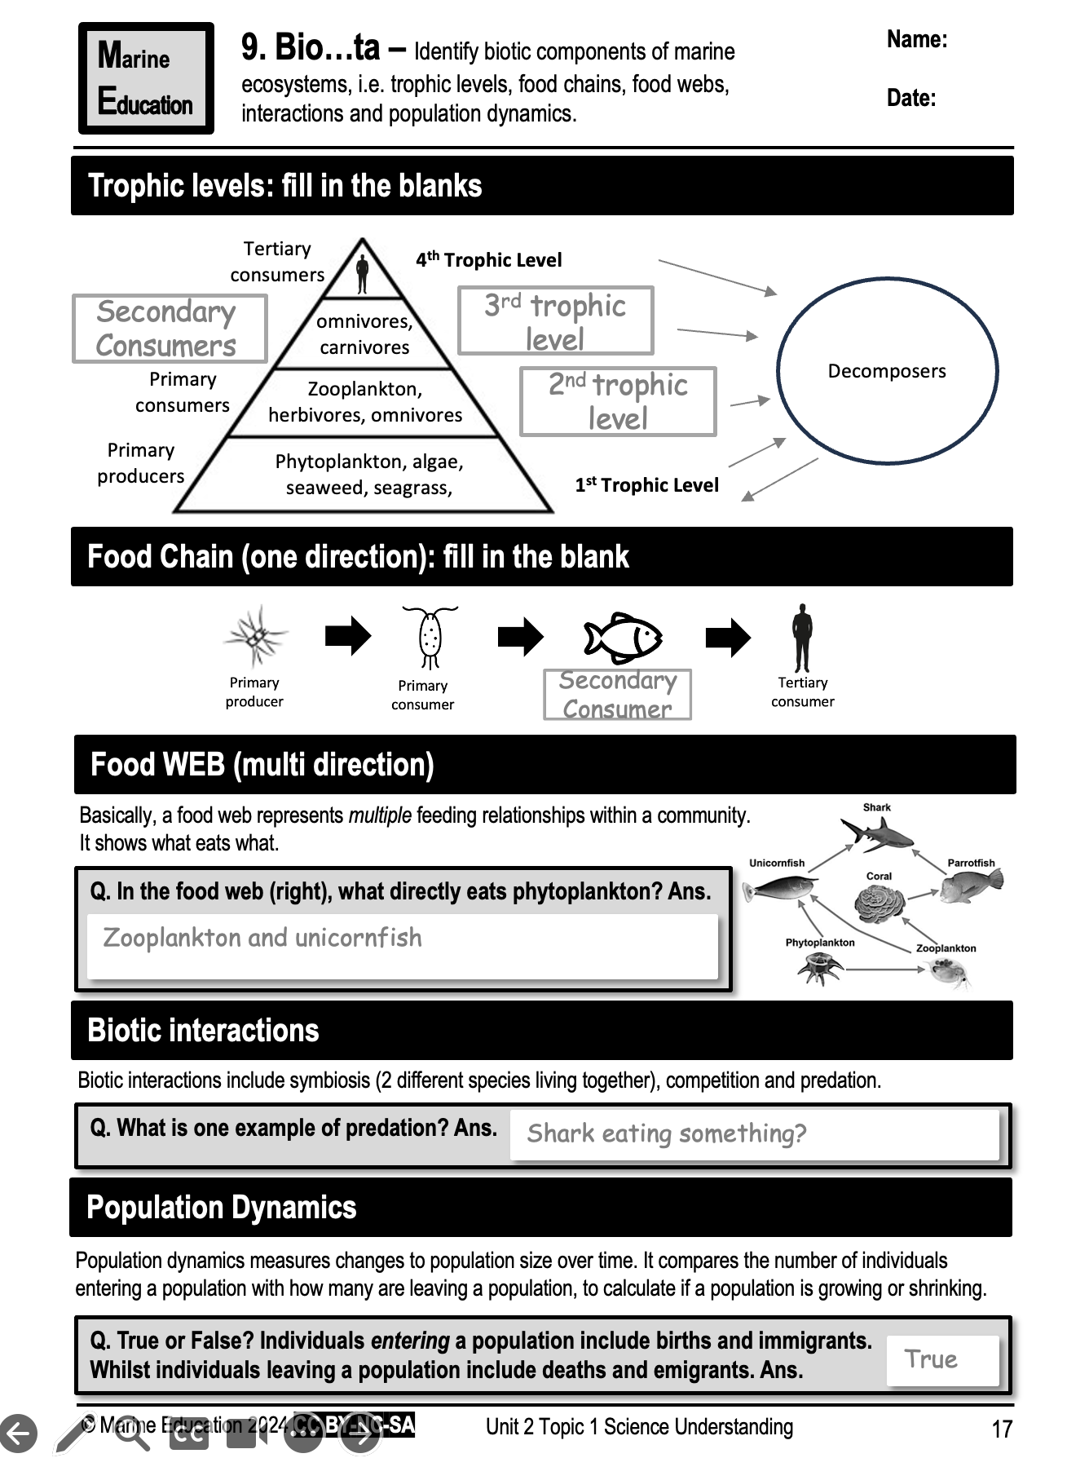
Learning Intention:
Identify biotic components of marine ecosystems, i.e. trophic levels, food chains, food webs, interactions and population dynamics.
Success Criteria:
Complete Marine Education worksheet ‘9. Bio….ta’

