Slide 1
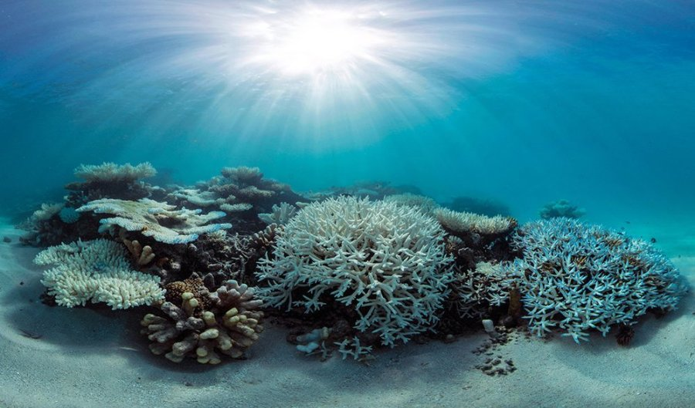
Learning Intention:
Compare the strategies and techniques used for marine environmental planning and management with reference to a specific case study.
Success Criteria:
Complete Marine Education worksheet ‘Marine Park or Paper Park?’
Notes:
Image: https://www.australiangeographic.com.au/news/2017/02/only-10-per-cent-of-reefs-to-survive-past-2050/

Slide 2
Marine Protected Area (MPA) Case Studies

Slide 3
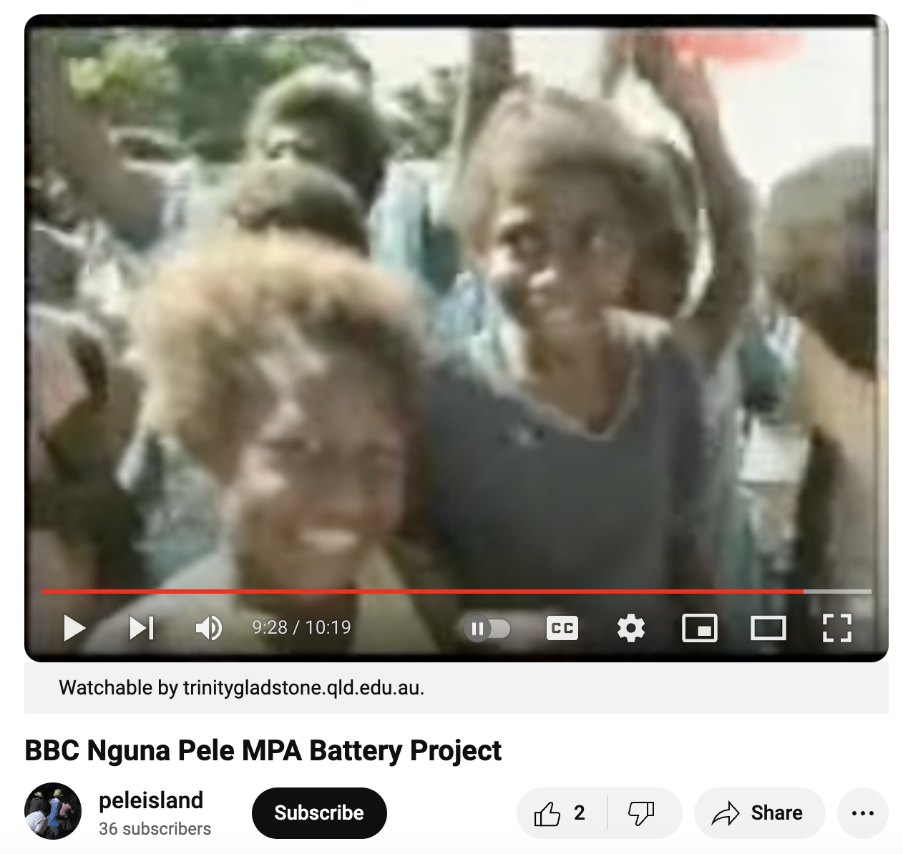
Vanuatu
Village chief closes areas of reef to enhance biodiversity.
Solar panels installed to reduce battery waste on reef.
https://www.youtube.com/watch?v=X_UtQOlqhuc

Slide 4
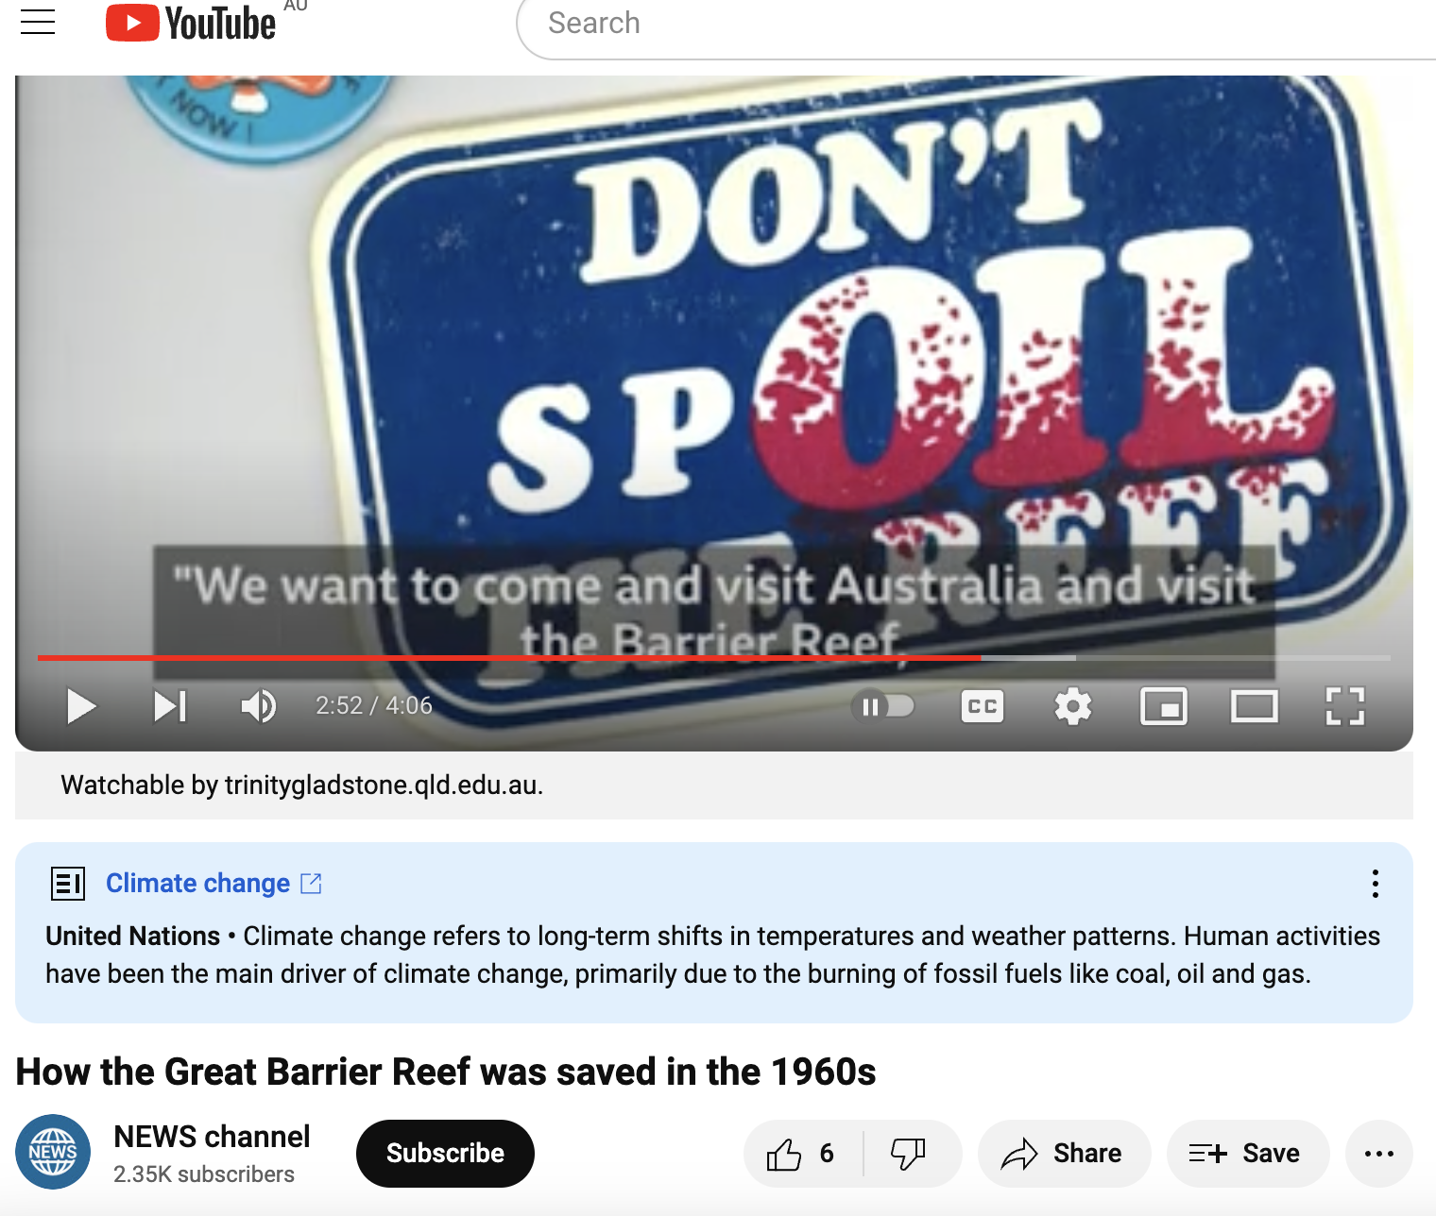
Great Barrier Reef Marine Park
Before it was protected, the Great Barrier Reef was going to be mined for limestone.
https://www.youtube.com/watch?v=4clmApAPZtk
https://www.bbc.com/reel/video/p07qbg4k/how-the-great-barrier-reef-was-saved-in-the-1960s

Slide 5
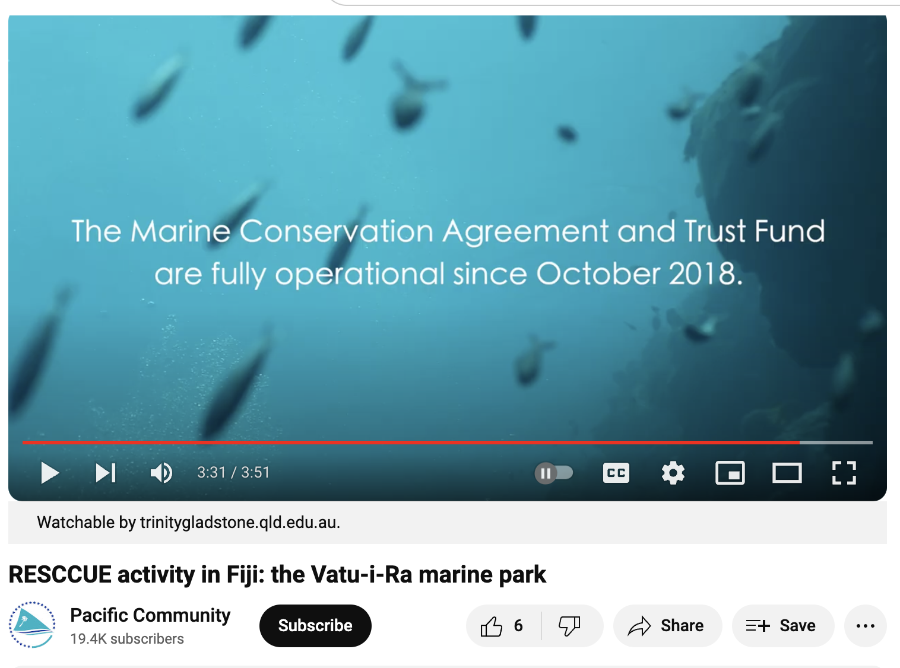
Fiji
Money from tourist divers funds closure of the reef to fishing
https://www.youtube.com/watch?v=XVI3TQy2778

Slide 6
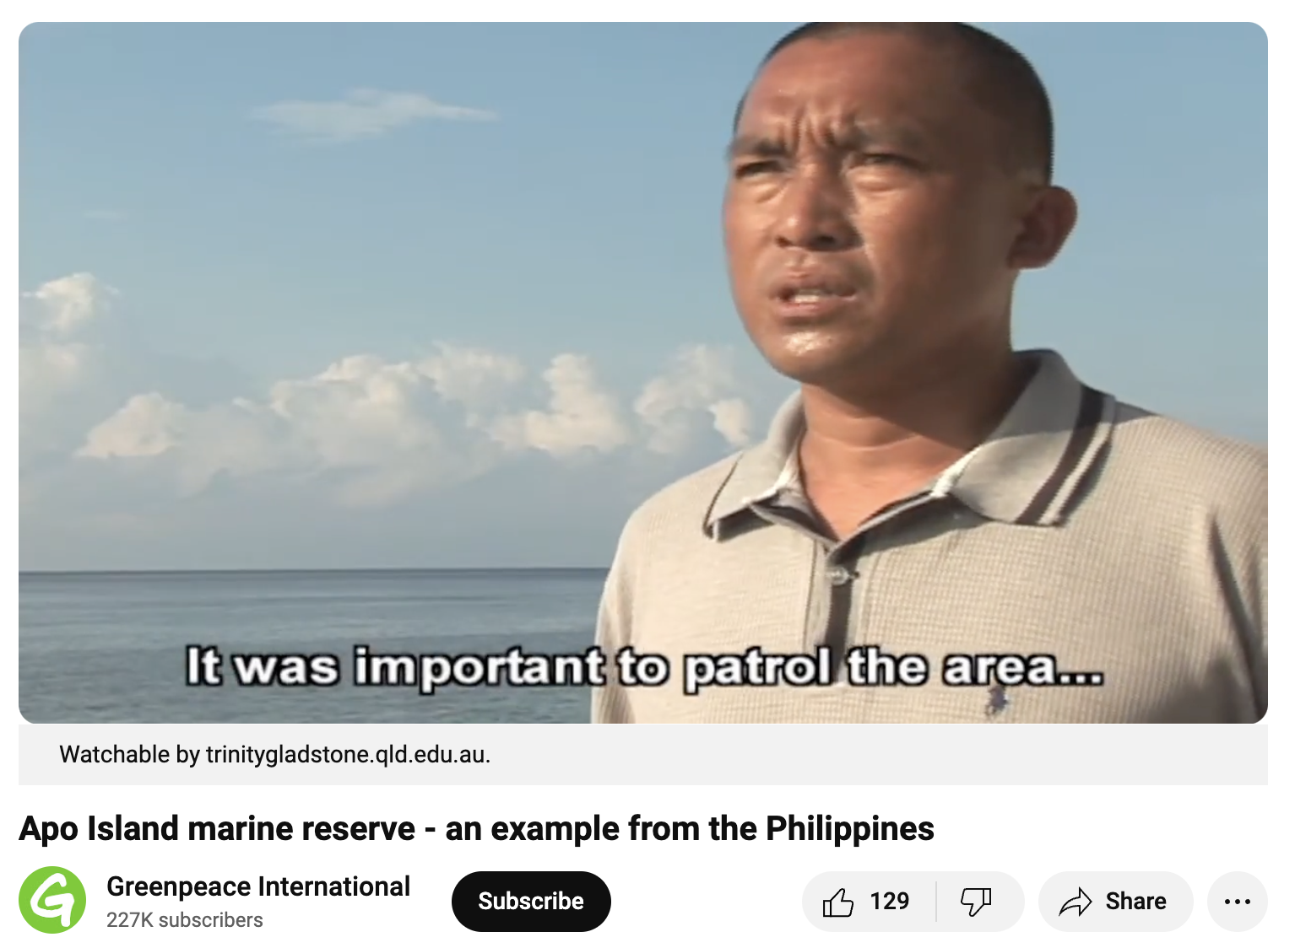
Apo Island Phillipines
An MPA success story, within a country that has many ‘paper parks’
https://www.youtube.com/watch?v=MCtxxdEaa6k

Slide 7
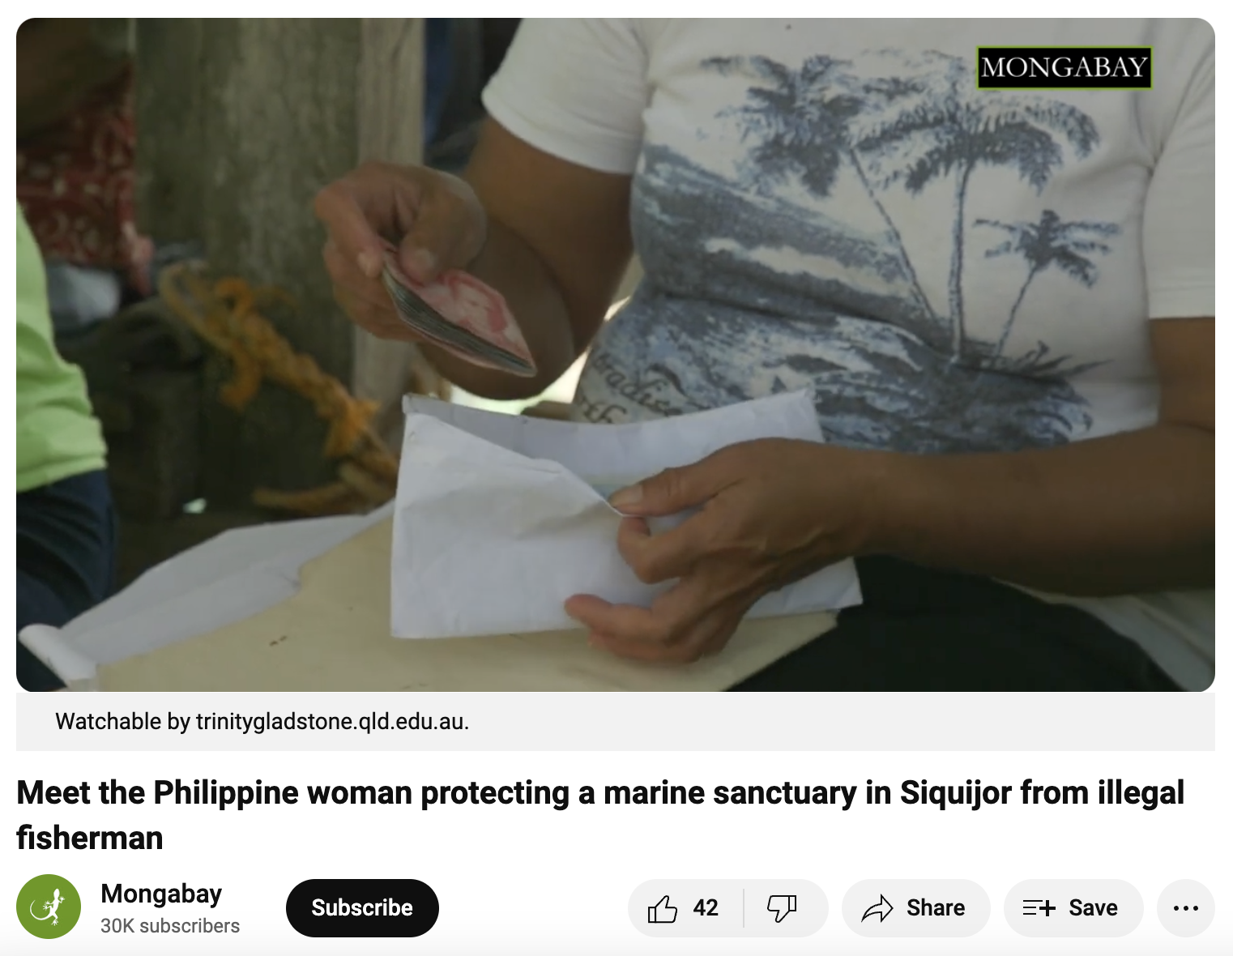
Siquijor Phillipines
Village women take matters into their own hands, paddling out in the dark of night on kayaks to defend their sanctuary from
illegal fishers
https://www.youtube.com/watch?v=kyh1cMxAu_Y&t=21s

Slide 8
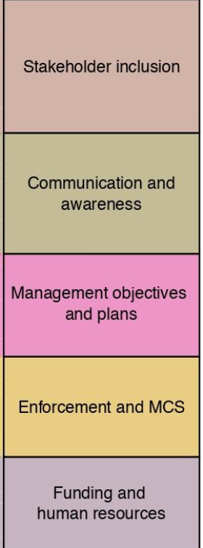
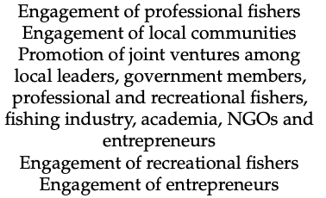
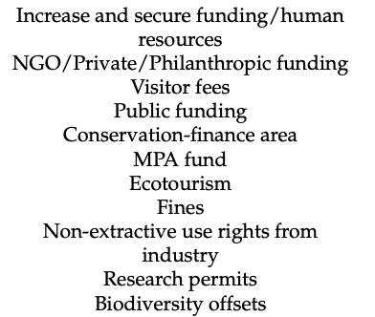
Top 5 MPA success criteria
Involve the fishers
Communicate in language fishers understand
Have clear objectives
Enforce the rules
Find a way to fund it
Adapted from Di Clintio et al., 2003
Notes:
Paper: Di Cintio, Antonio & Niccolini, Federico & Scipioni, Sara & Bulleri, Fabio. (2023). Avoiding “Paper Parks”: A Global Literature Review on Socioeconomic Factors Underpinning the Effectiveness of Marine Protected Areas. Sustainability. 15. 4464. 10.3390/su15054464.

Slide 9
Endangered Species Case Studies

Slide 10
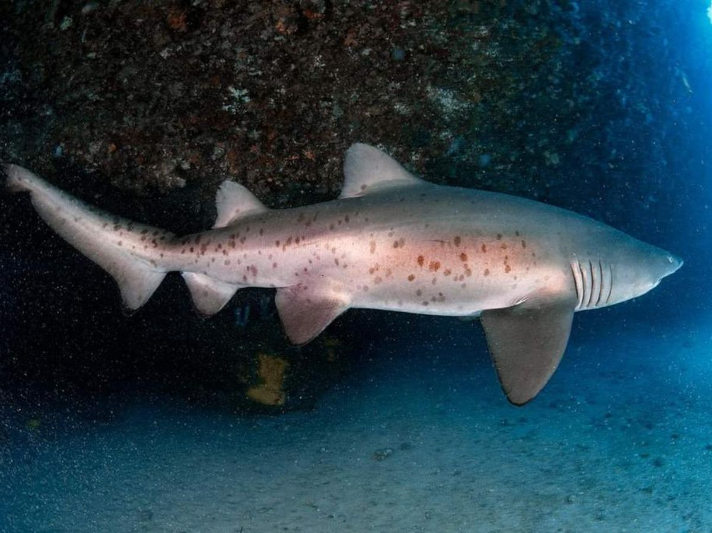
Grey Nurse Sharks
have been protected since the 1970s before they were hunted almost to extinction. As numbers now start to increase, critical habitat sites have sharks on them again. But, these sites need to be protected too. The Grey Nurse Shark is still critically endangered.

Slide 11
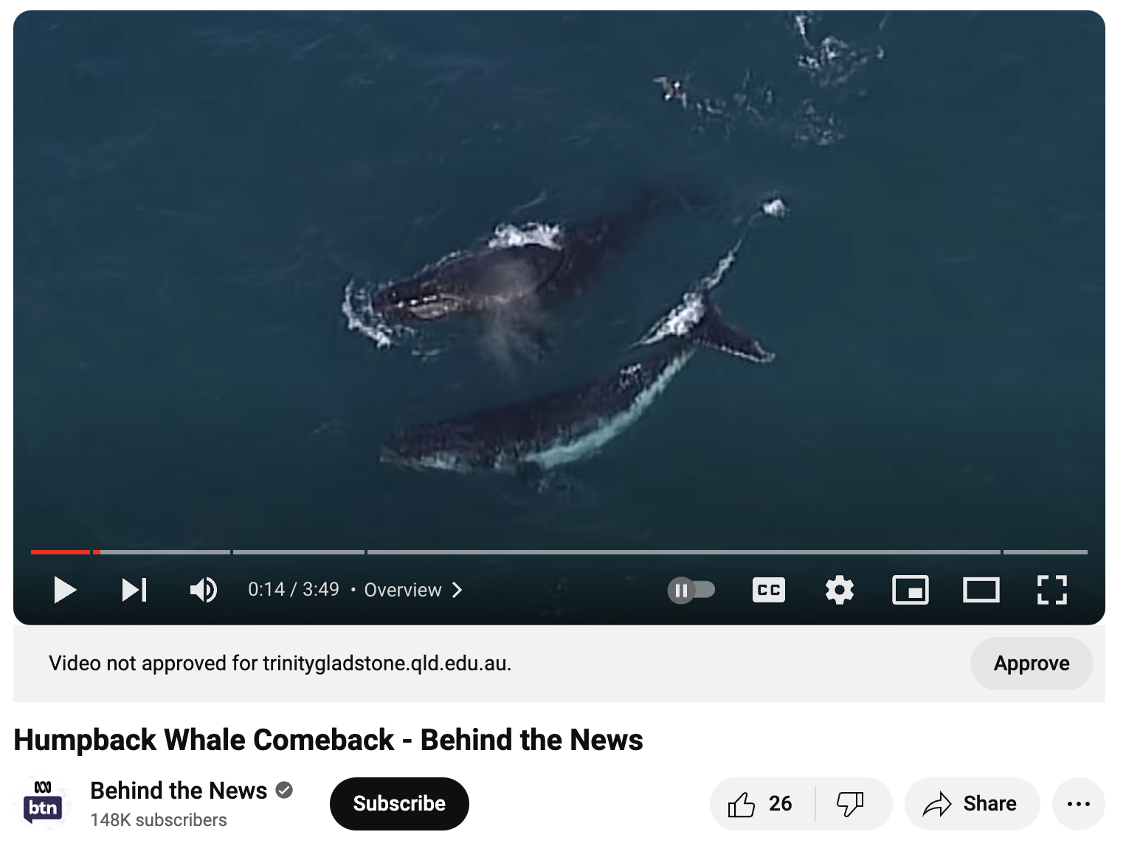
Humpback Whales
are making a come-back from the whaling days. But now, they’re under threat from different pressures
https://www.youtube.com/watch?v=tsiwP1XB7Gc

Slide 12
Plague, disease and introduced species
Case Studies

Slide 13
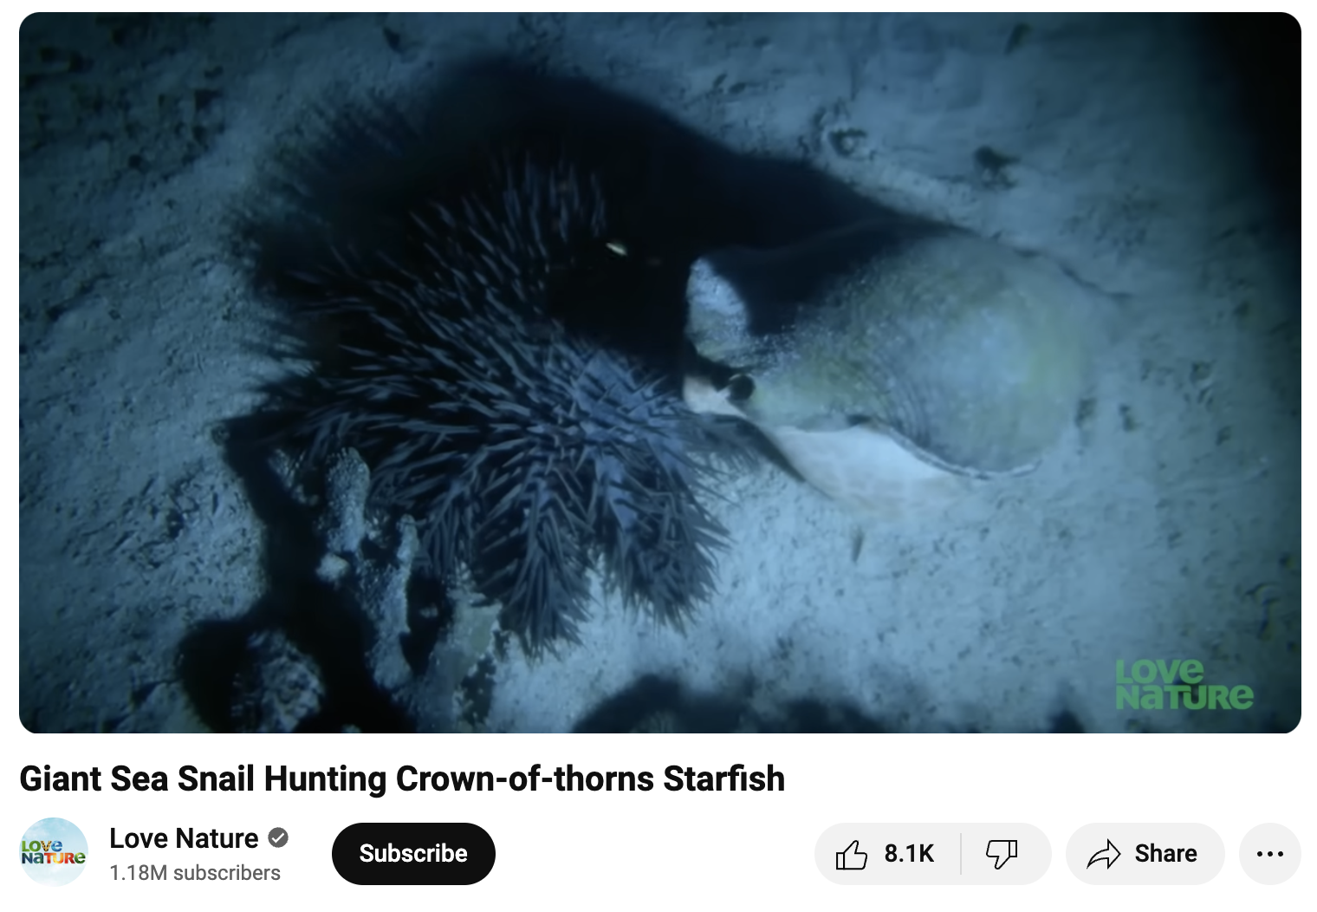
COTS
Giant Triton Shells eat Crown of Thorns Starfish (COTS). But Giant Triton Shells were overfished and never recovered. Now, GBRMPA spends millions on COTS control programs.
https://www.youtube.com/watch?v=lBAyyoZOUl0

Slide 14
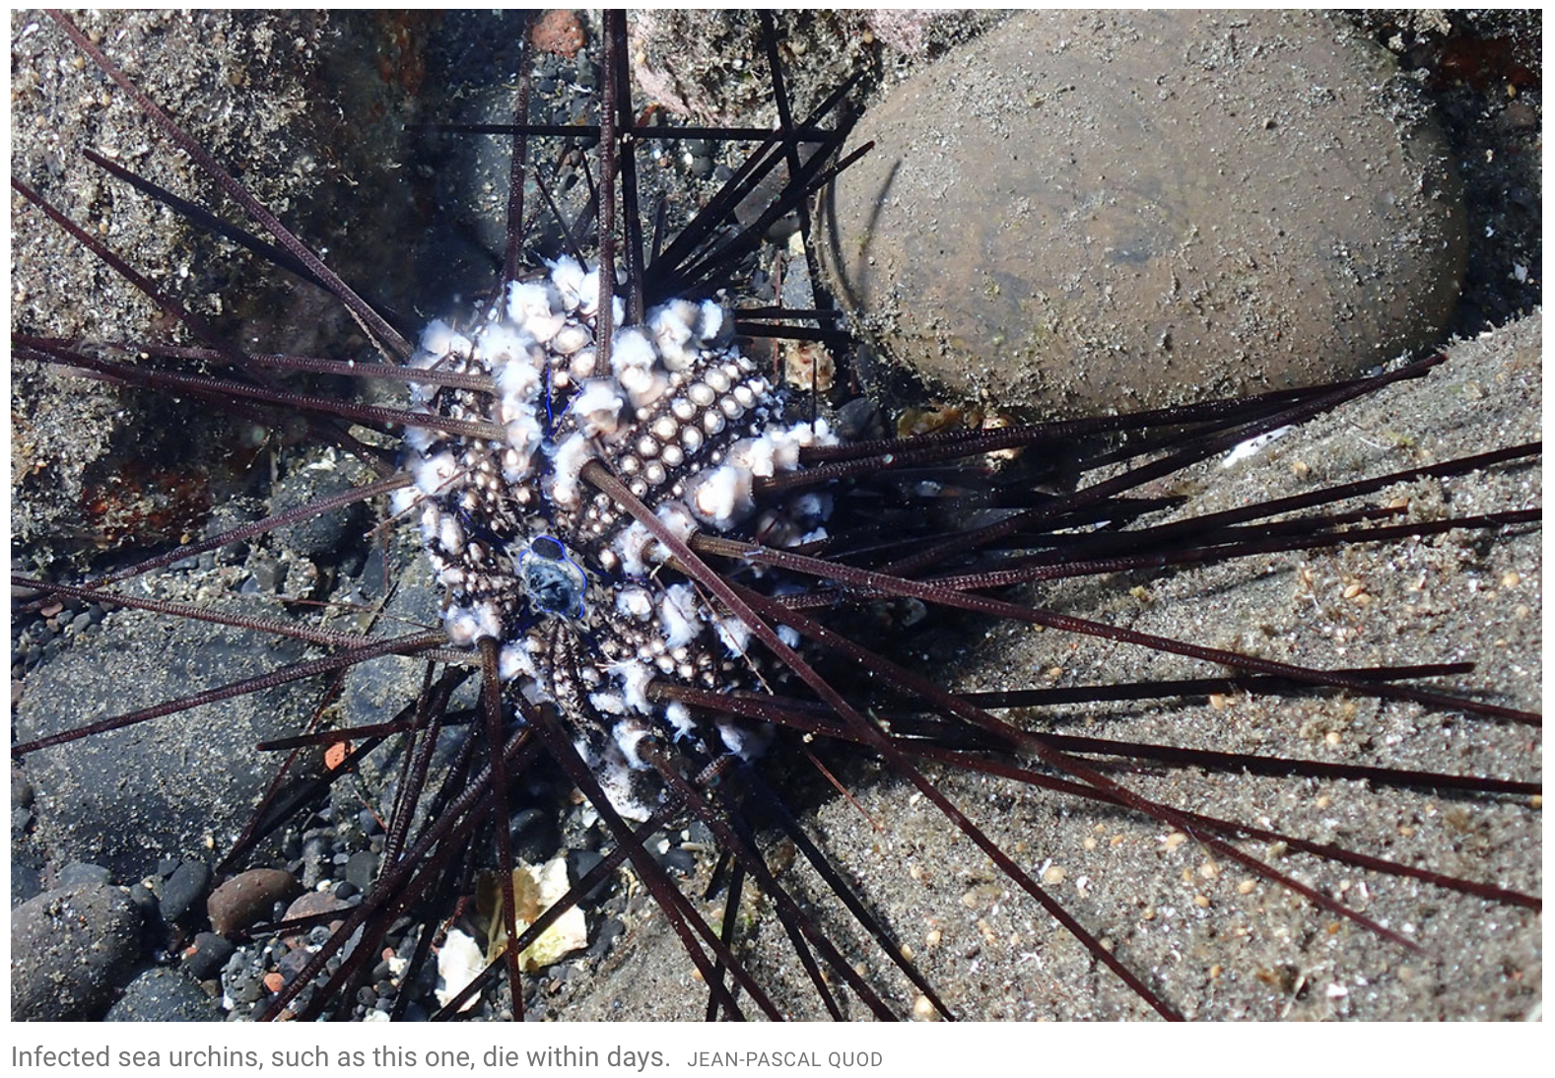
Pathogen
killing sea urchins
A deadly wave of pathogen has spread from the Caribbean to the Red Sea and is feared could reach as far as the GBR
Notes:
Image and info: https://www.science.org/content/article/mysterious-sea-urchin-plague-spreading-through-world-s-oceans

Slide 15
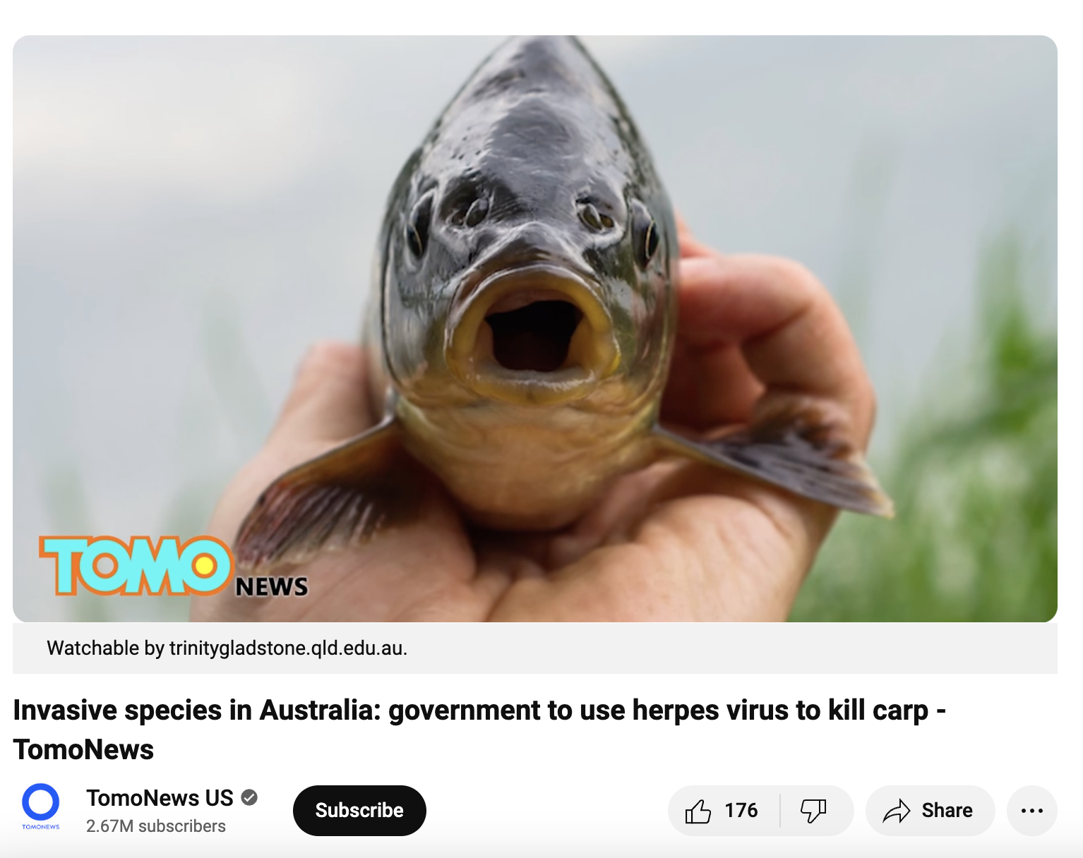
Carp
On 1 May 2016, the Australian Government announced $15.2 million in funding to investigate the feasibility of the cyprinid herpesvirus 3 (carp virus) as a biological control agent for carp – an introduced and invasive species.

Slide 16
Overfishing Case Studies

Slide 17
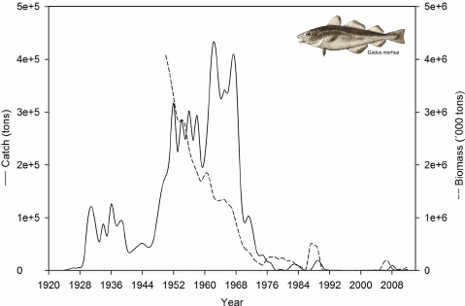
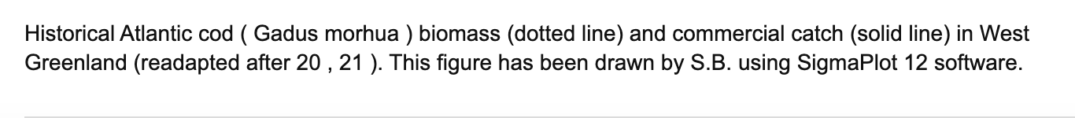
Atlantic Cod
The devastating collapse of the once iconic Northern Atlantic cod fishery in the 1980s remains one of the most globally recognized cases of overfishing.
Notes:
Image: Bonanomi, Sara & Pellisier, Loic & Therkildsen, Nina & Hedeholm, Rasmus & Retzel, Anja & Meldrup, Dorte & Olsen, Steffen & Nielsen, Anders & Pampoulie, Christophe & Hemmer-Hansen, Jakob & Wisz, Mary & Grønkjær, Peter & Nielsen, Einar. (2015). Archived DNA reveals fisheries and climate induced collapse of a major fishery. Scientific Reports. 5. 15395.

Slide 18
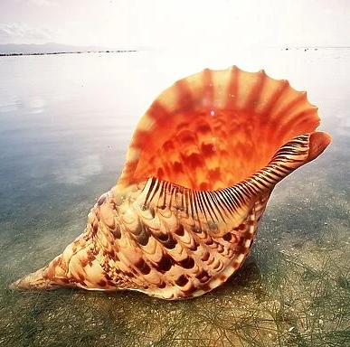
Giant Triton Shell
Although the giant triton is a protected species in Australia, it can be legally traded around the rest of the world.
Notes:
Image: https://www.mediastorehouse.com.au/ardea-wildlife-pets-environment/fish/giant-triton-shell-beach-645269.html

Slide 19
Climate Change Mitigation
Case Studies

Slide 20
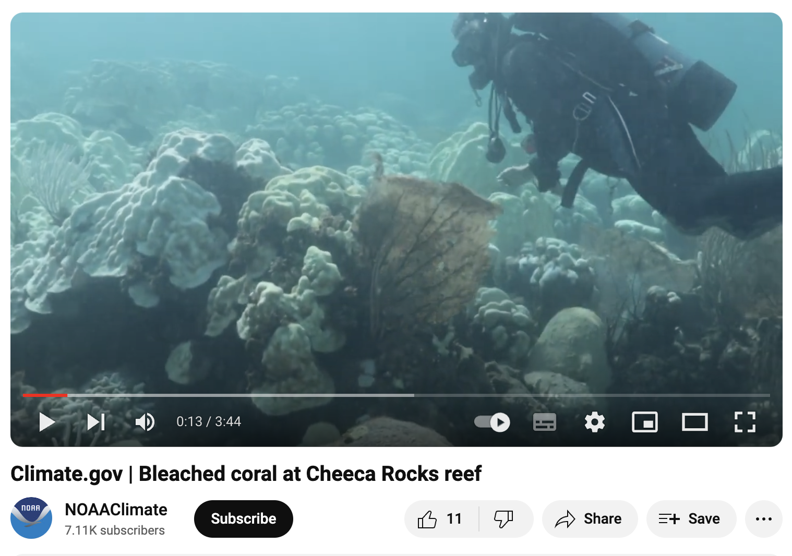
Florida
After the 2023 heatwave, approximately 75% of all Florida genotypes now only survive in land-based facilities. Most not of reproductive size.
https://www.youtube.com/watch?v=BDzkvT3_I-E
Notes:
Info: Andrew Baker, University of Miami (2024). Keynote speaker, Coral Reef Symposium Cairns. Changing paradigms in the restoration of Florida’s reefs: novel interventions, transnational obstacles, and the urgent need to share genetic resources to maximize coral survival.

Slide 21
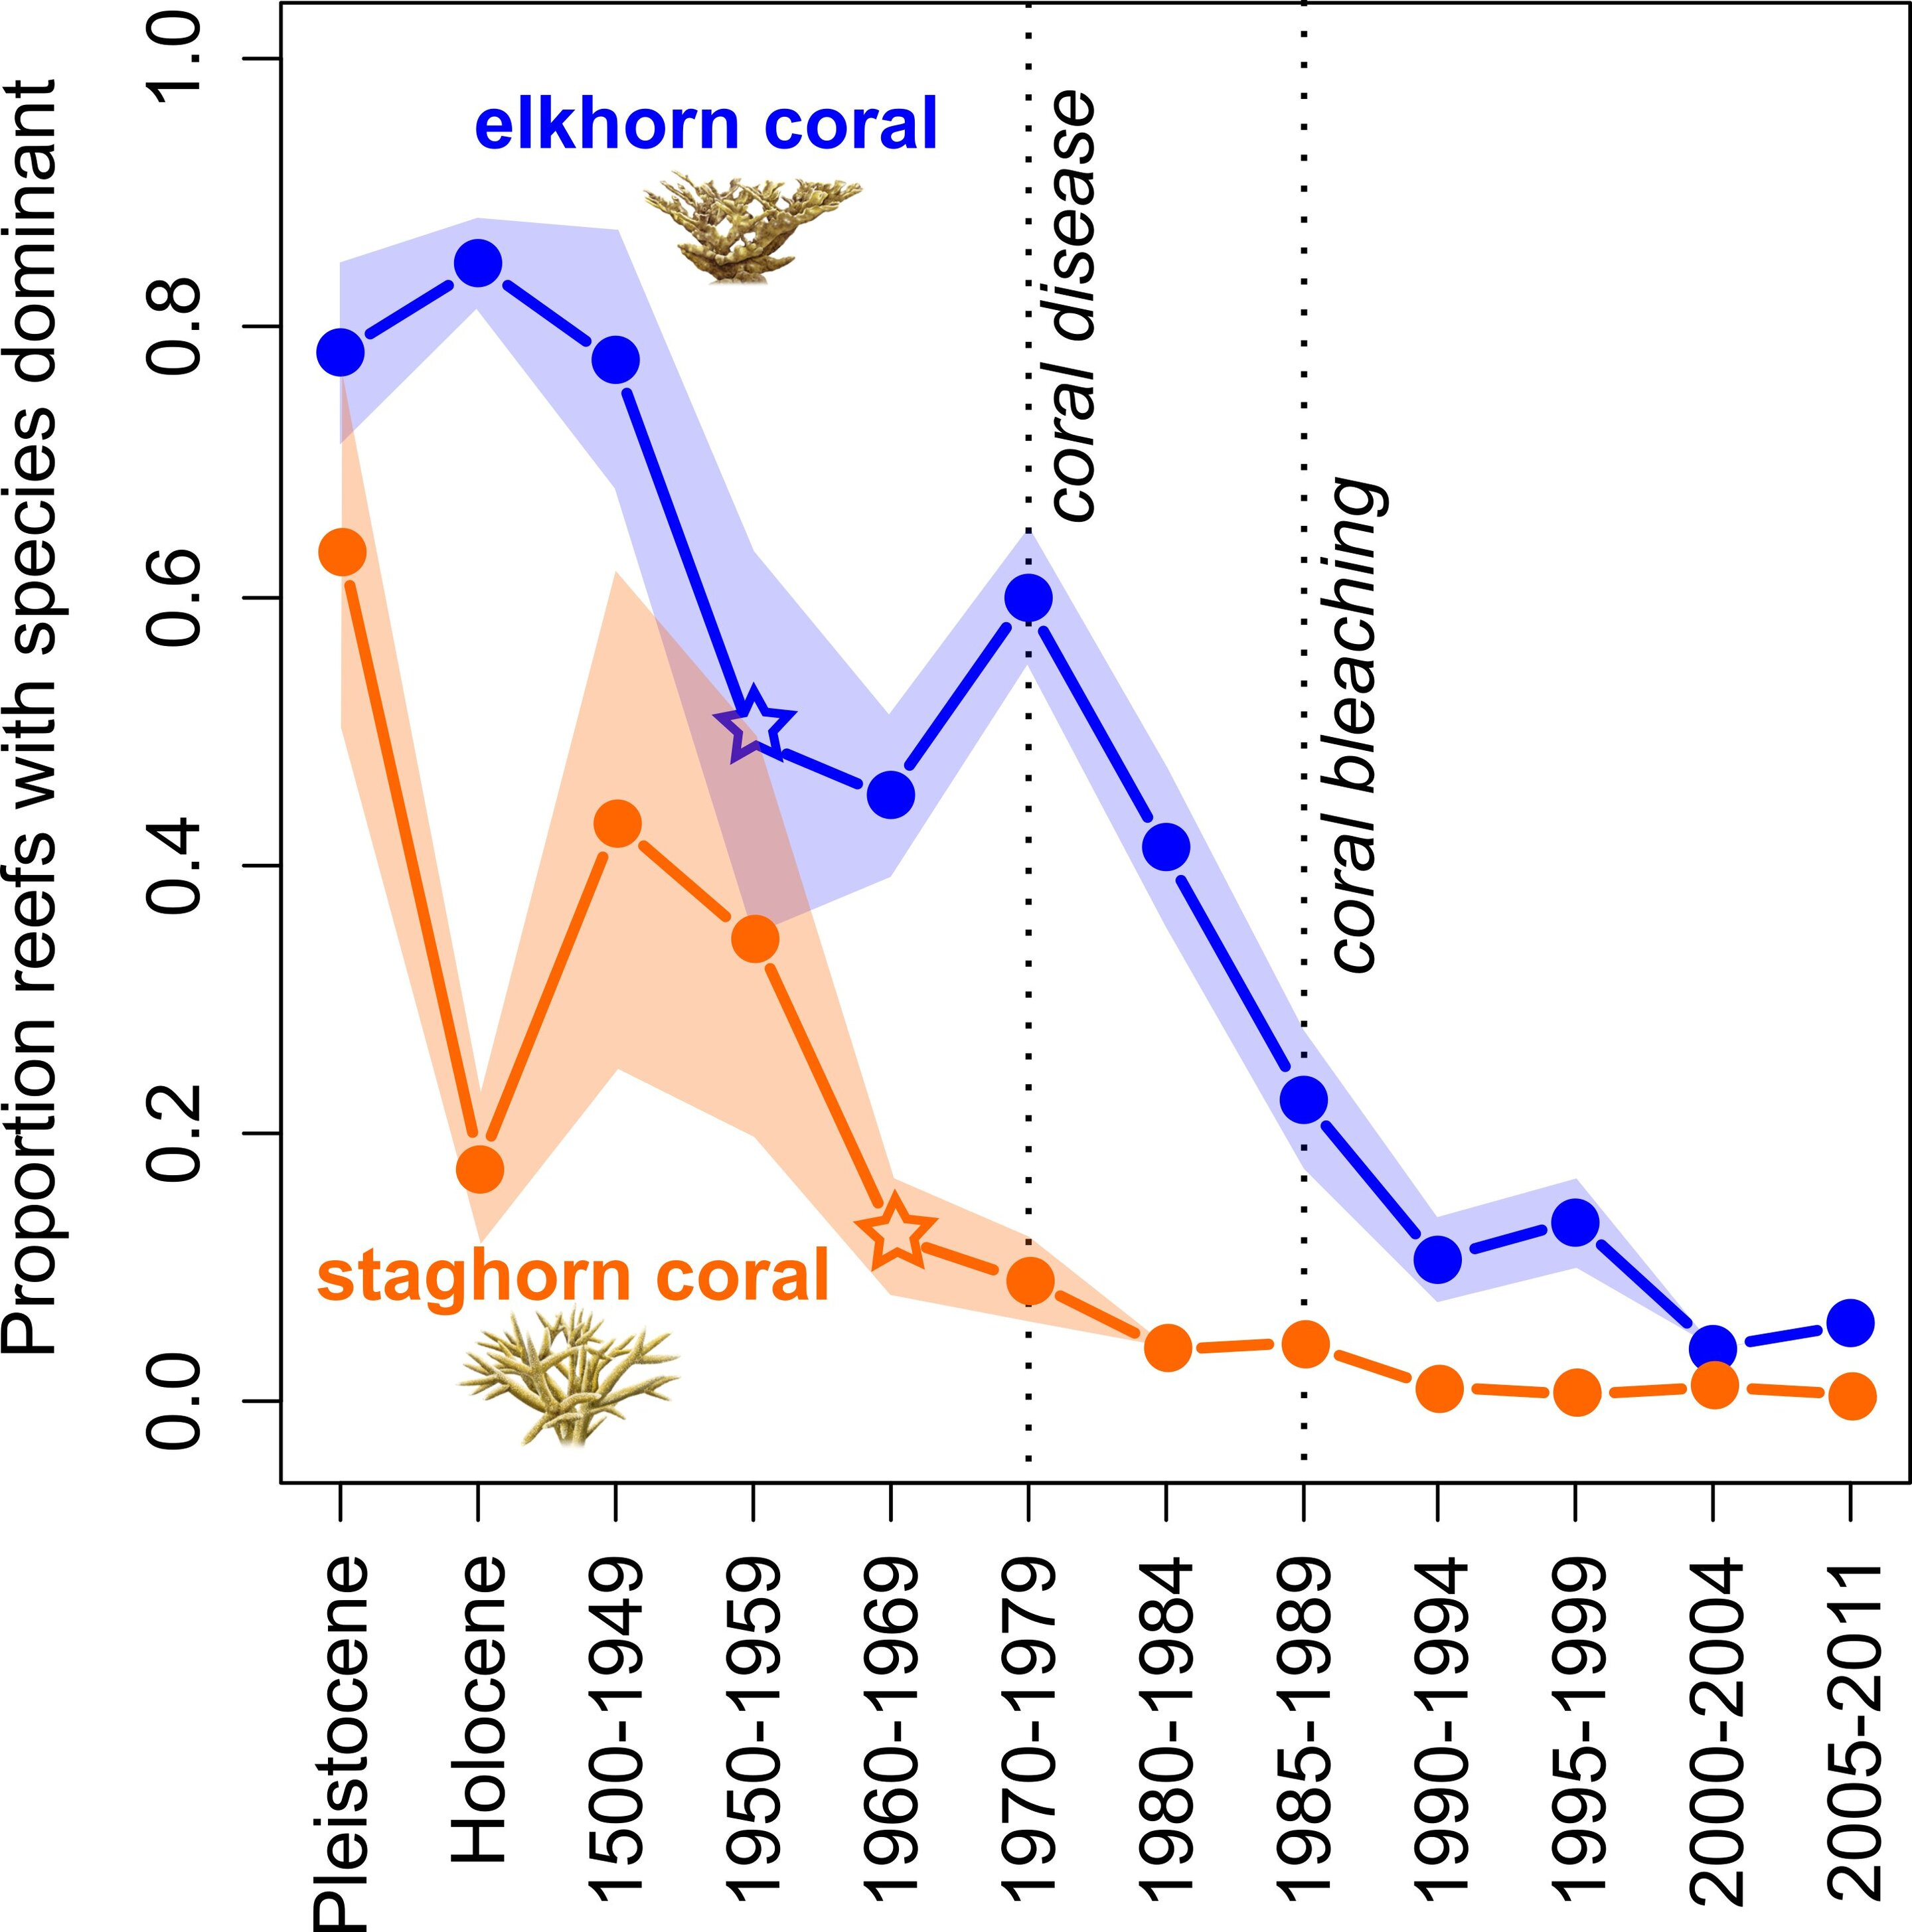
Caribbean
The decline of Caribbean reefs began in the 1950s, before the current climate change crisis and before other reefs around the world experienced similar declines.
Credit: Catie Kramer, Arizona State University
Notes:
Image: https://phys.org/news/2020-04-caribbean-coral-reef-decline-began.html#google_vignette

Slide 22
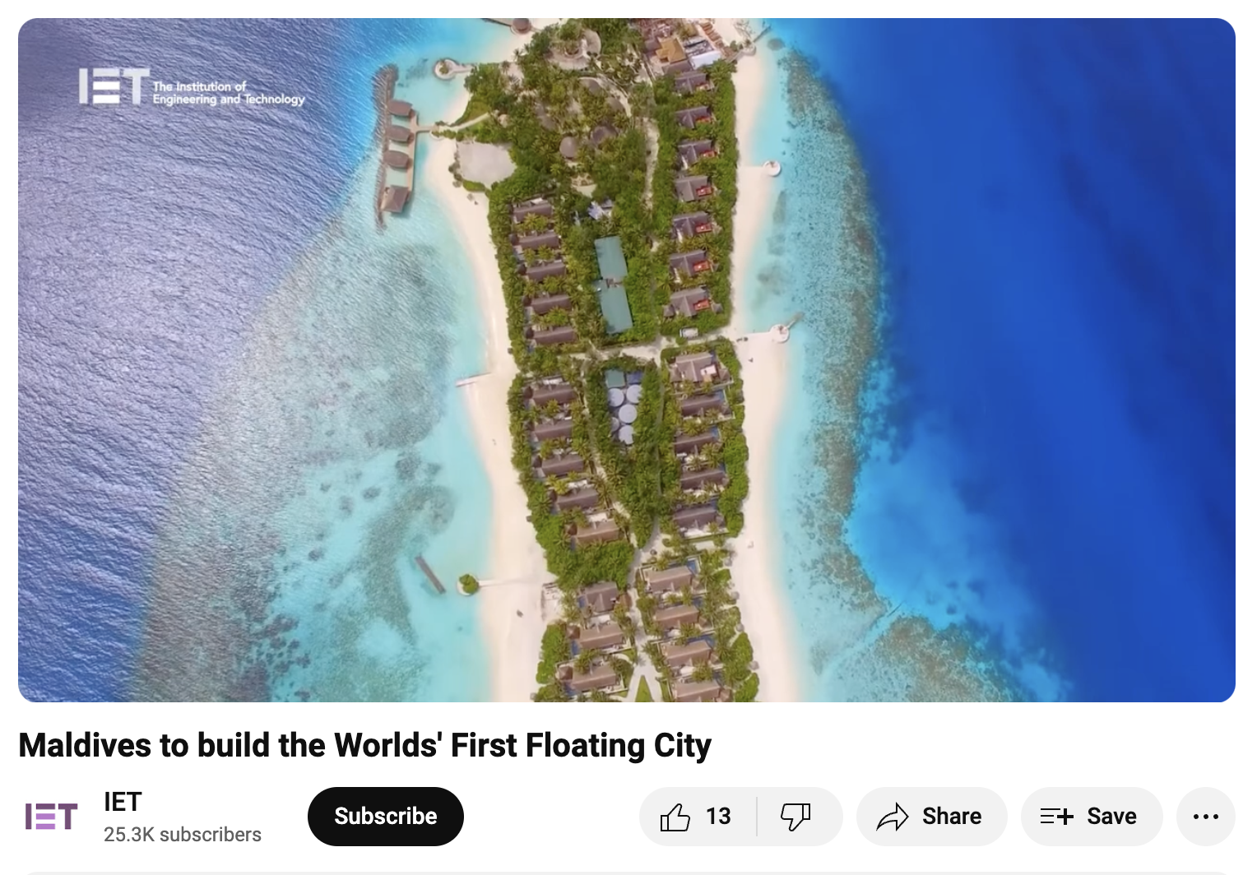
Maldives
With rising sea levels, the Maldives will soon be underwater.
So, in response, the government is building floating cities.
https://www.youtube.com/watch?v=jxm3KYbAPw4

Slide 23
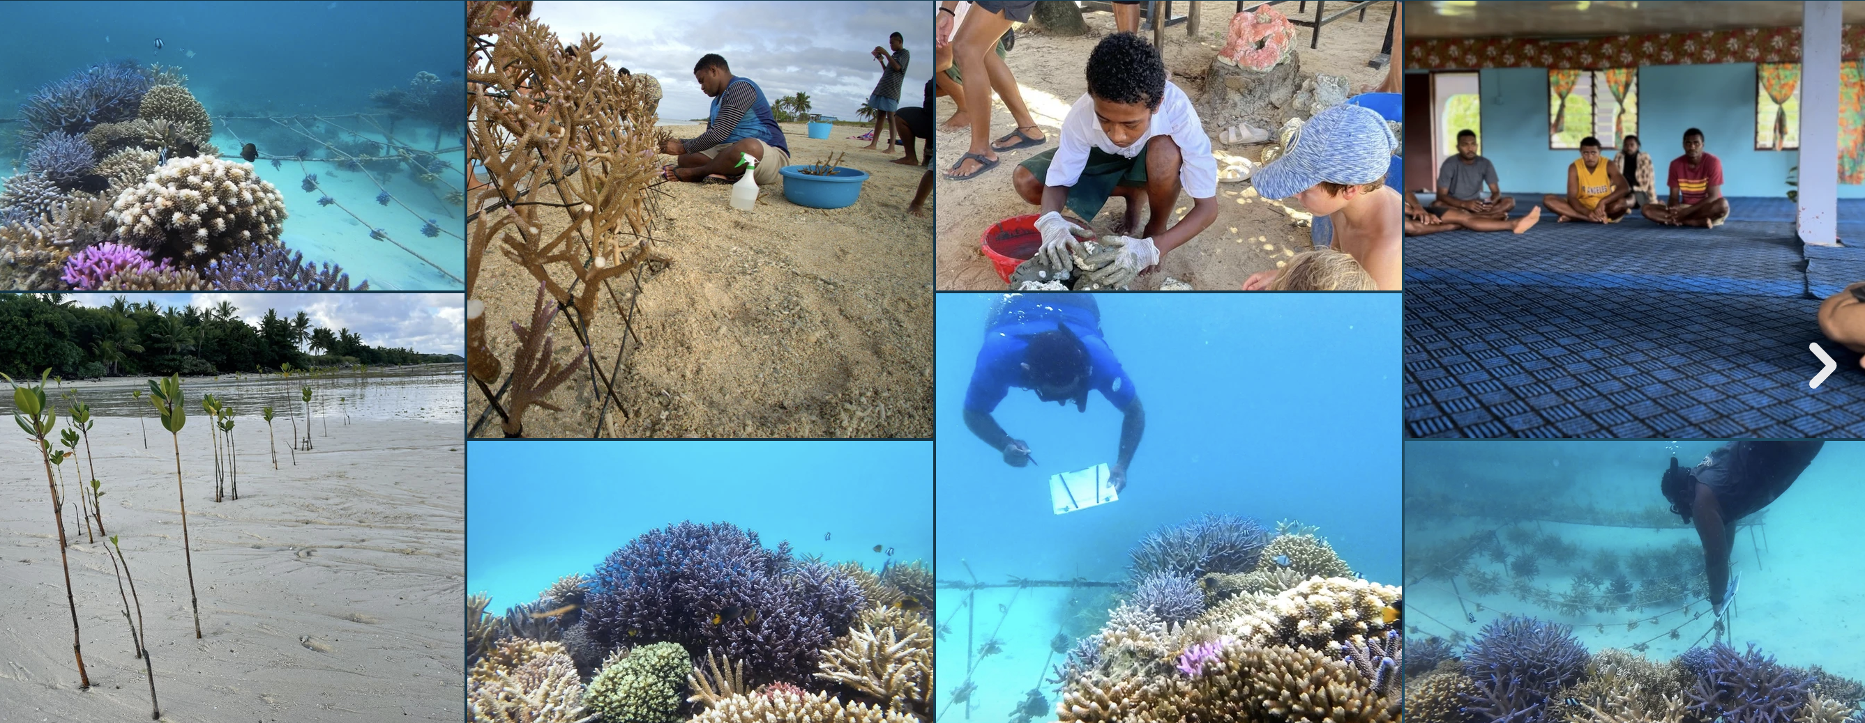
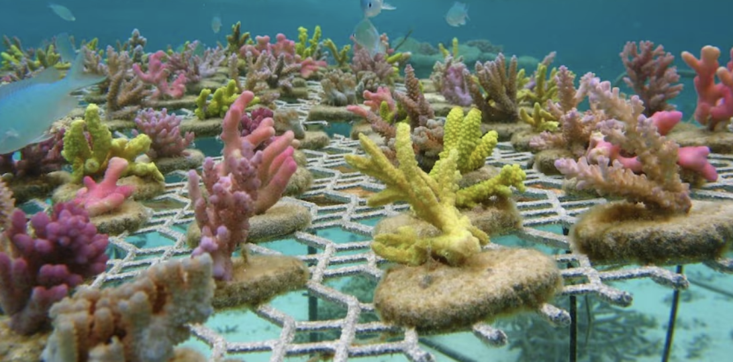
Fiji
Corals for Conservation garden ‘super corals’ in cold water nurseries to save their genotypes from future mass bleaching events
Notes:
Image (top): https://www.corals4conservation.org/
Image (bottom):

Slide 24
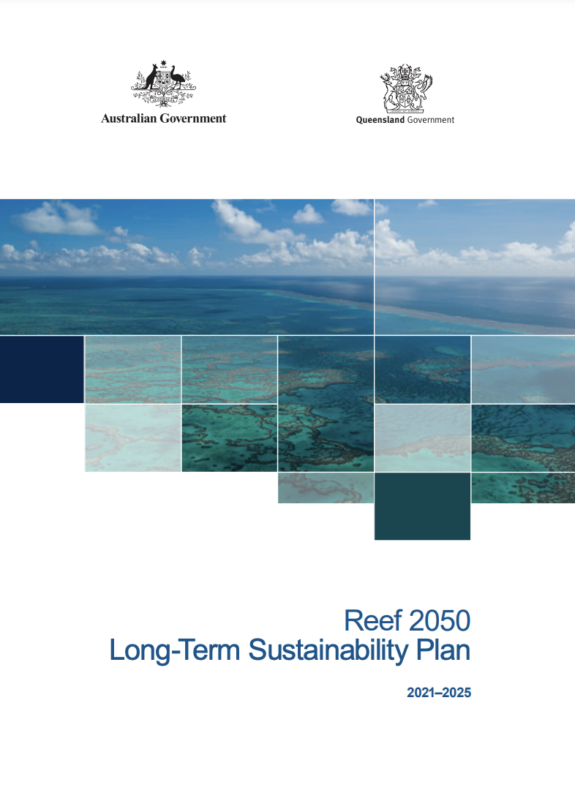
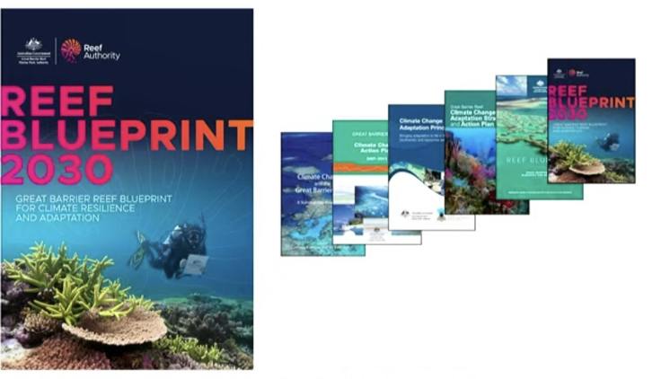
GBR
The Reef 2050 Long Term Sustainability Plan
>$3 billion (over 10yrs) to help control COTS outbreaks, improve water quality, double the on-ground joint field management program,
address plastic pollution and rehabilitate island, coastal and reef habitats.
Notes:
Images and Plans: https://www.dcceew.gov.au/parks-heritage/great-barrier-reef/publications/reef-2050-long-term-sustainability-plan-2021-25

Slide 25
Case Study: Great Barrier Reef Marine Park
Strategy/Technique 1: Zoning and Spatial Management
  Description: The Great Barrier Reef Marine Park Authority implemented a zoning system that categorizes different areas of the reef for varying levels of protection and use. This includes no-take zones, recreational use zones, and multiple-use zones.
  Effectiveness: Zoning has helped to reduce fishing pressure, protect critical habitats, and facilitate ecotourism activities, contributing to the overall conservation of biodiversity within the marine park.
Strategy/Technique 2: Integrated Coastal Management (ICM)
  Description: ICM approaches involve multiple stakeholders (government, industries, communities) working together to manage land and marine activities to minimize environmental impacts and promote sustainable development.
  Effectiveness: Integrated Coastal Management in the Great Barrier Reef region has facilitated collaborative decision-making, improved monitoring and enforcement of regulations, and enhanced resilience against climate change impacts such as coral bleaching events.

Slide 26
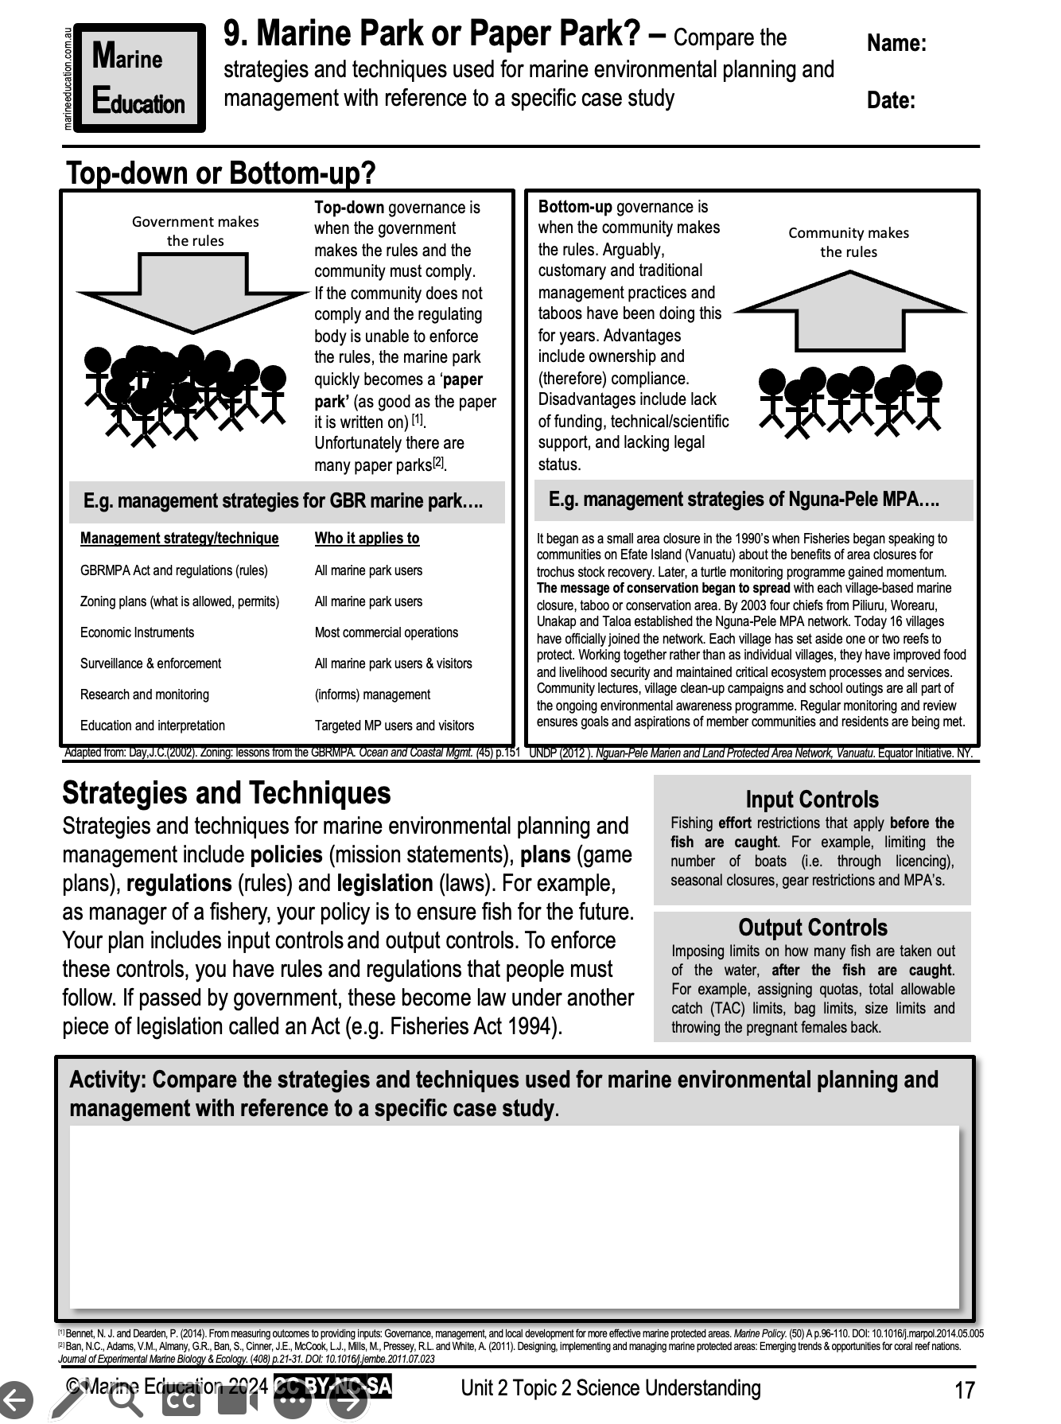
Learning Intention:
Compare the strategies and techniques used for marine environmental planning and management with reference to a specific case study.
Success Criteria:
Complete Marine Education worksheet ‘Marine Park or Paper Park?’
Notes:
Image: https://www.australiangeographic.com.au/news/2017/02/only-10-per-cent-of-reefs-to-survive-past-2050/

